Slide 1
Mid-Atlantic Bight Research

Slide 2
Christopher Filosa Robert Forney Oliver Ho Amy Leonard Packy Looney Danielle Neidich

Slide 3
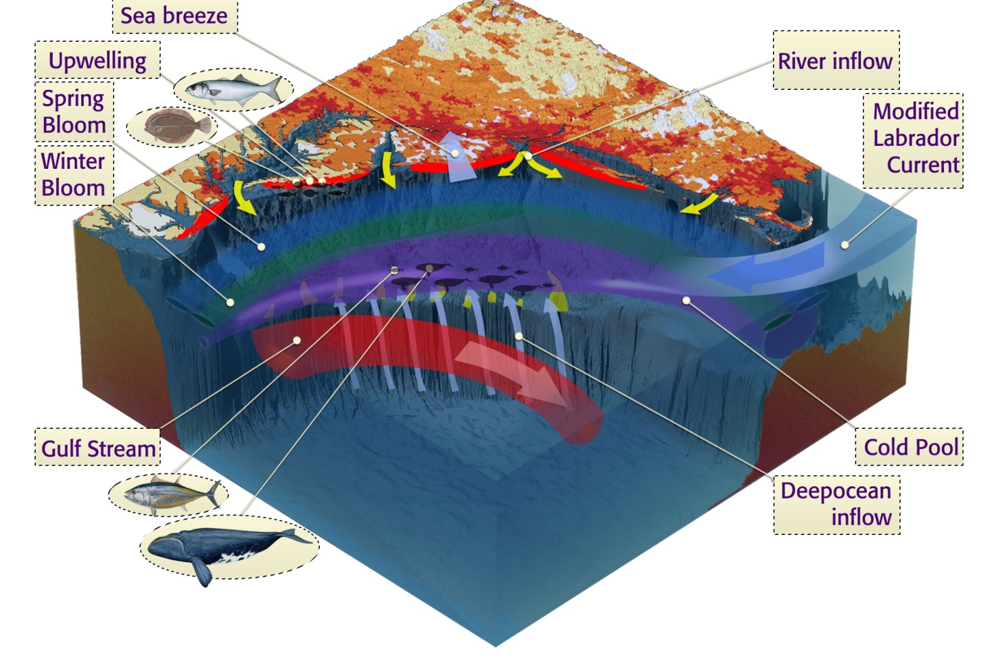
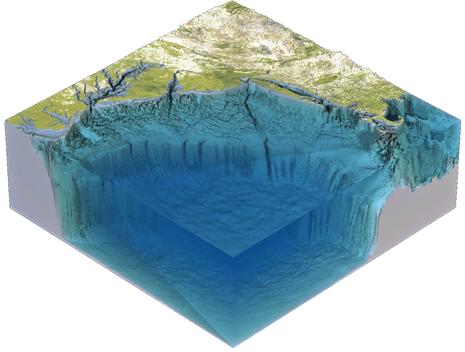
Mid-Atlantic
Bight

Slide 4
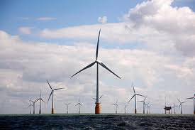
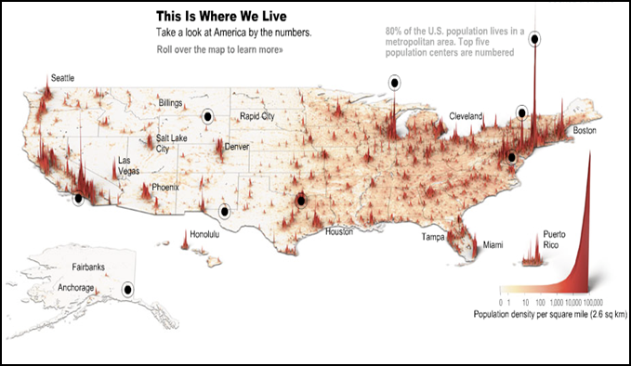
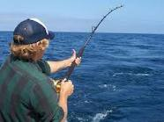
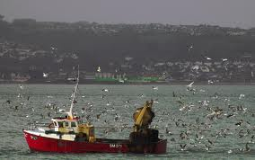
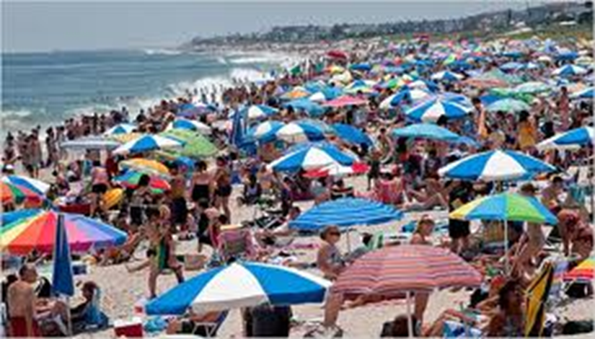
Importance
of the MAB

Slide 5
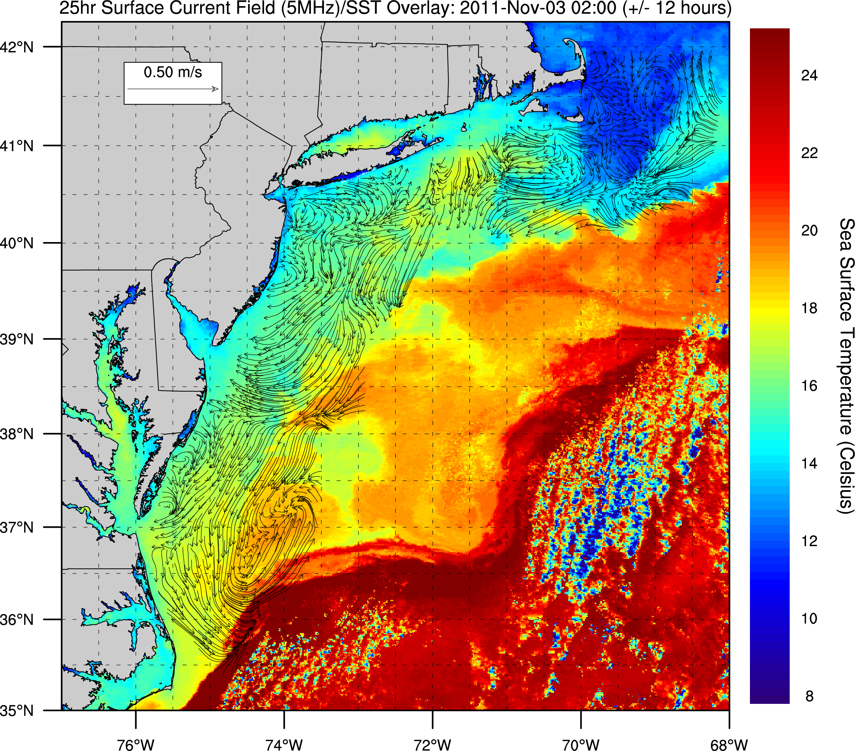
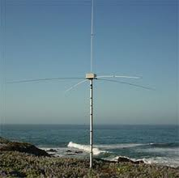
CODAR

Slide 6
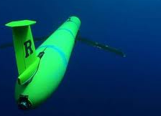
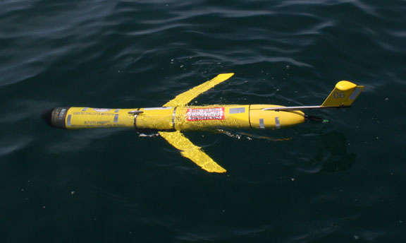
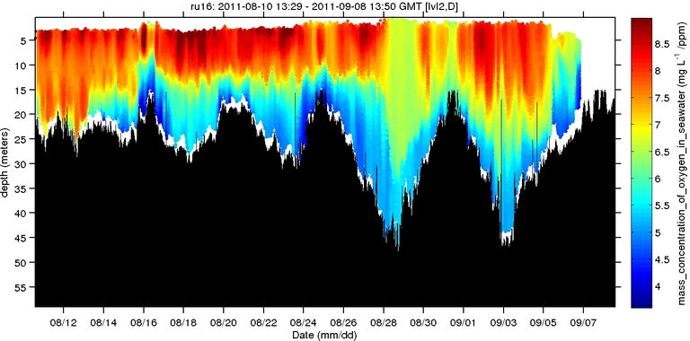
Gliders

Slide 7
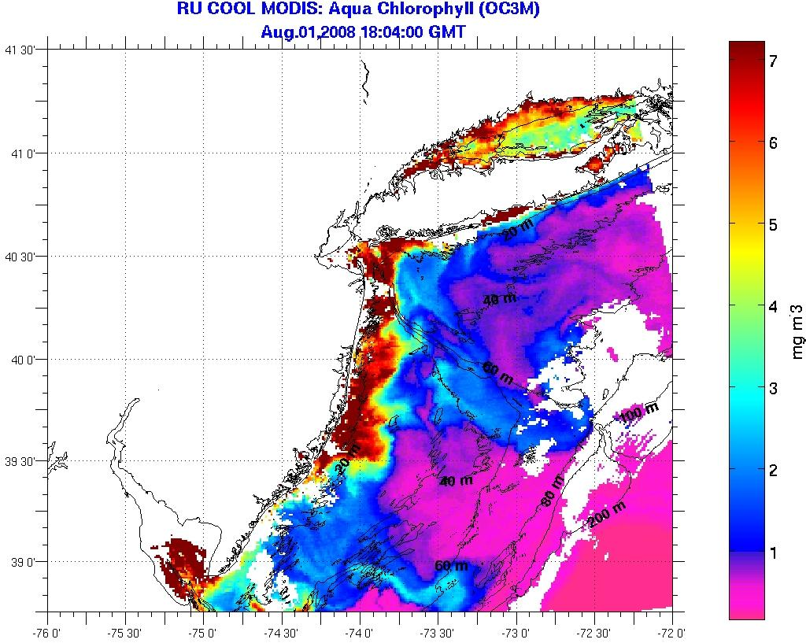
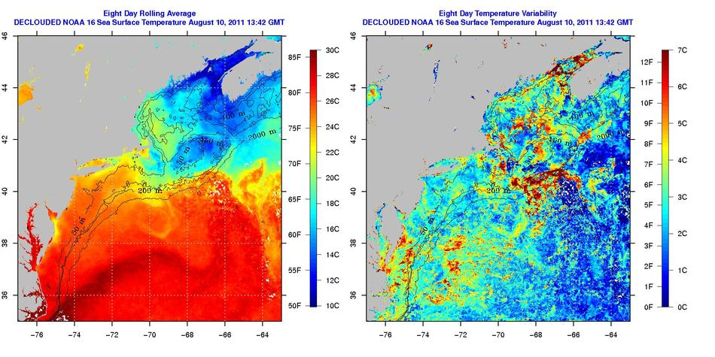
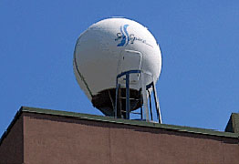
Satellite

Slide 8
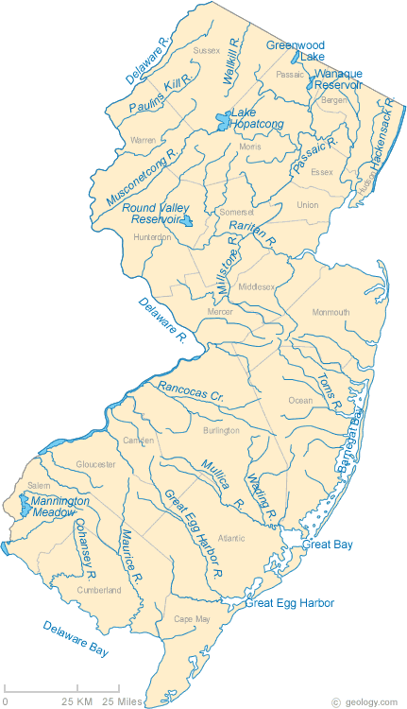
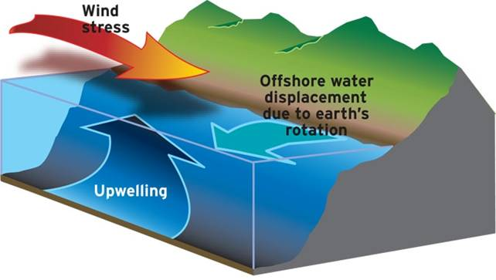
What fuels a bloom?
Runoff
Upwelling

Slide 9
The Biological Pump

Slide 10
Phytoplankton Bloom or Bust!
A look at physical properties of the
Mid-Atlantic Bight during phytoplankton blooms in the summers of 2010 and 2011
Regina Guazzo
Veronica Connor
Kristen Holenstein
Robert Jackson
Stephanie Silva
Eric Sinsky

Slide 11
Methodology
High Chlorophyll Concentrations via Satellite
Surface Currents measured with CODAR
Gliders sampling in phytoplankton blooms
Gliders measuring chlorophyll, oxygen concentration, salinity, temperature
Originally were studying 5 years
Due to presentation time constraints, focused our presentation on 2010 and 2011

Slide 12
2011
8/11/2011 – 8/26/2011
“Massive algae bloom off New Jersey coast not expected to move in near future” –The Star-Ledger Aug 19, 2011

Slide 13
True Color Satellite Image
August 17, 2011

Slide 14
Chlorophyll Concentration
August 22, 2011

Slide 15
CODAR/SST
August 19 – 26, 2011

Slide 16
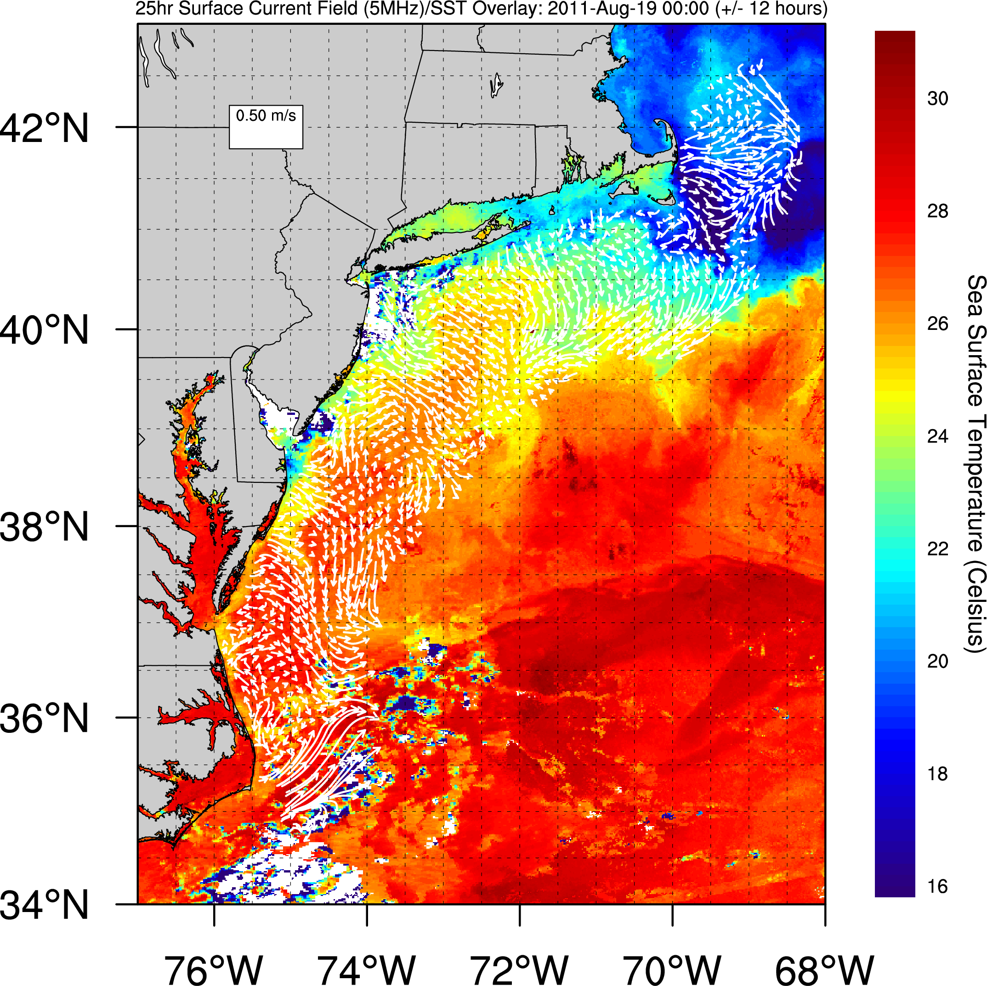

Slide 17
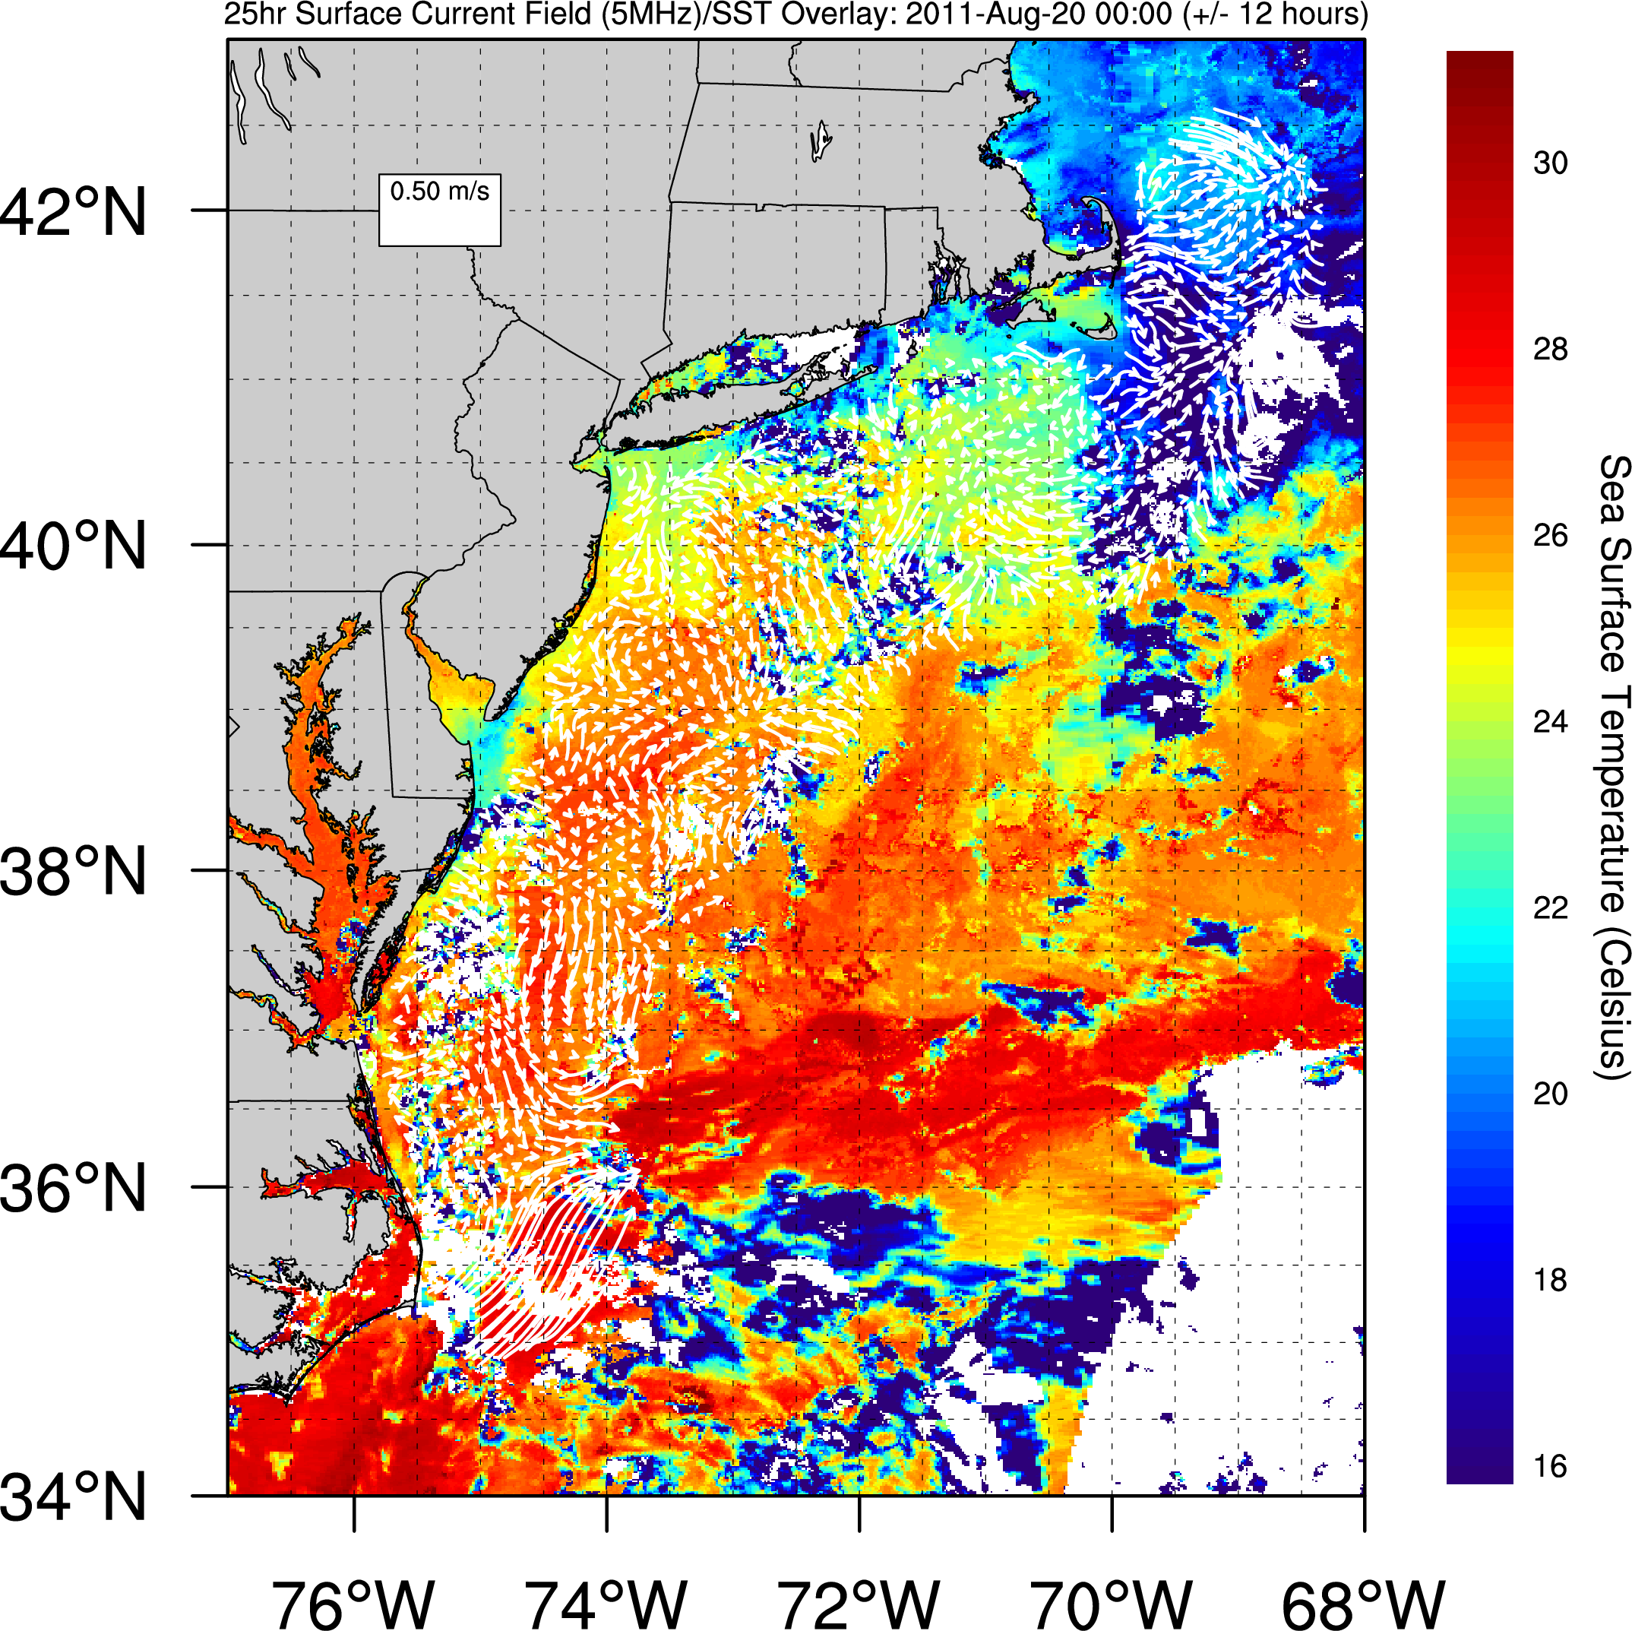

Slide 18
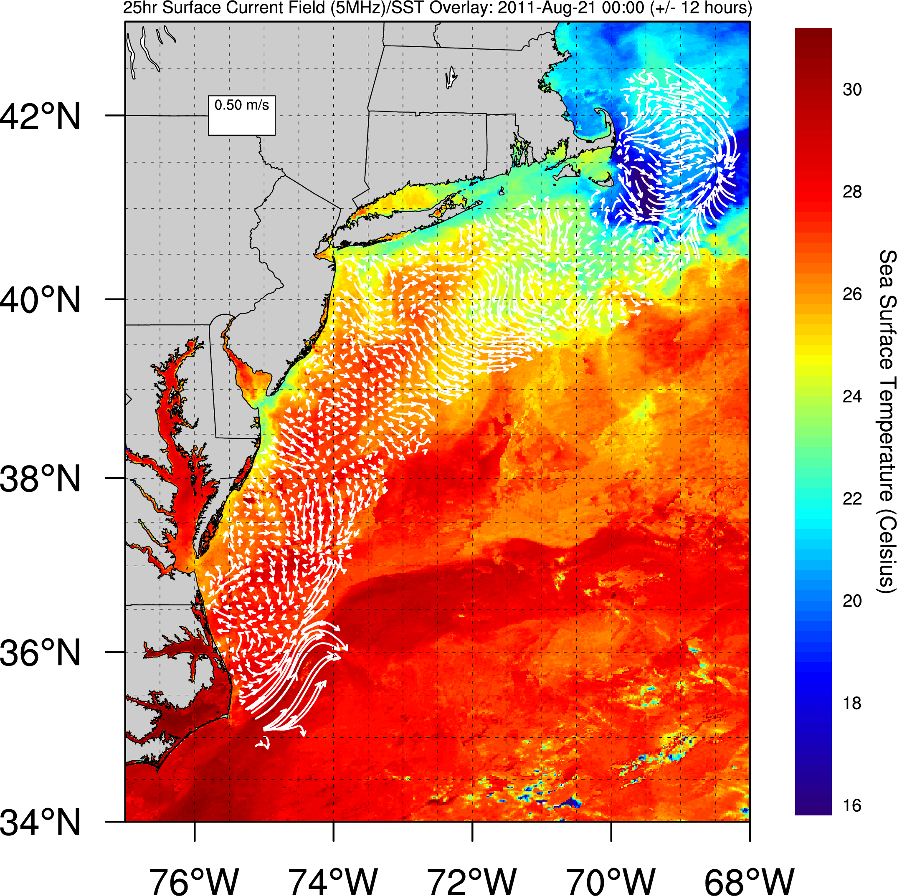

Slide 19
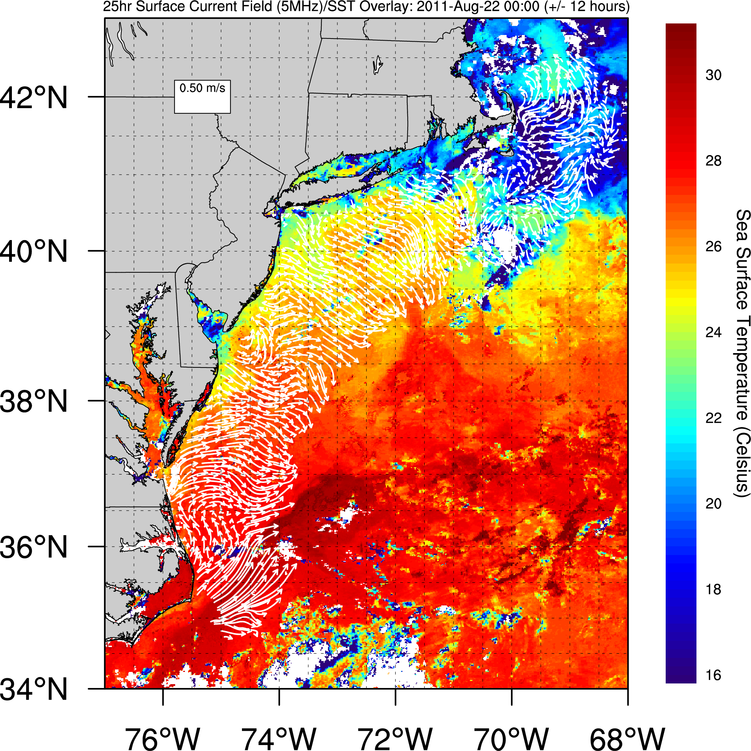

Slide 20
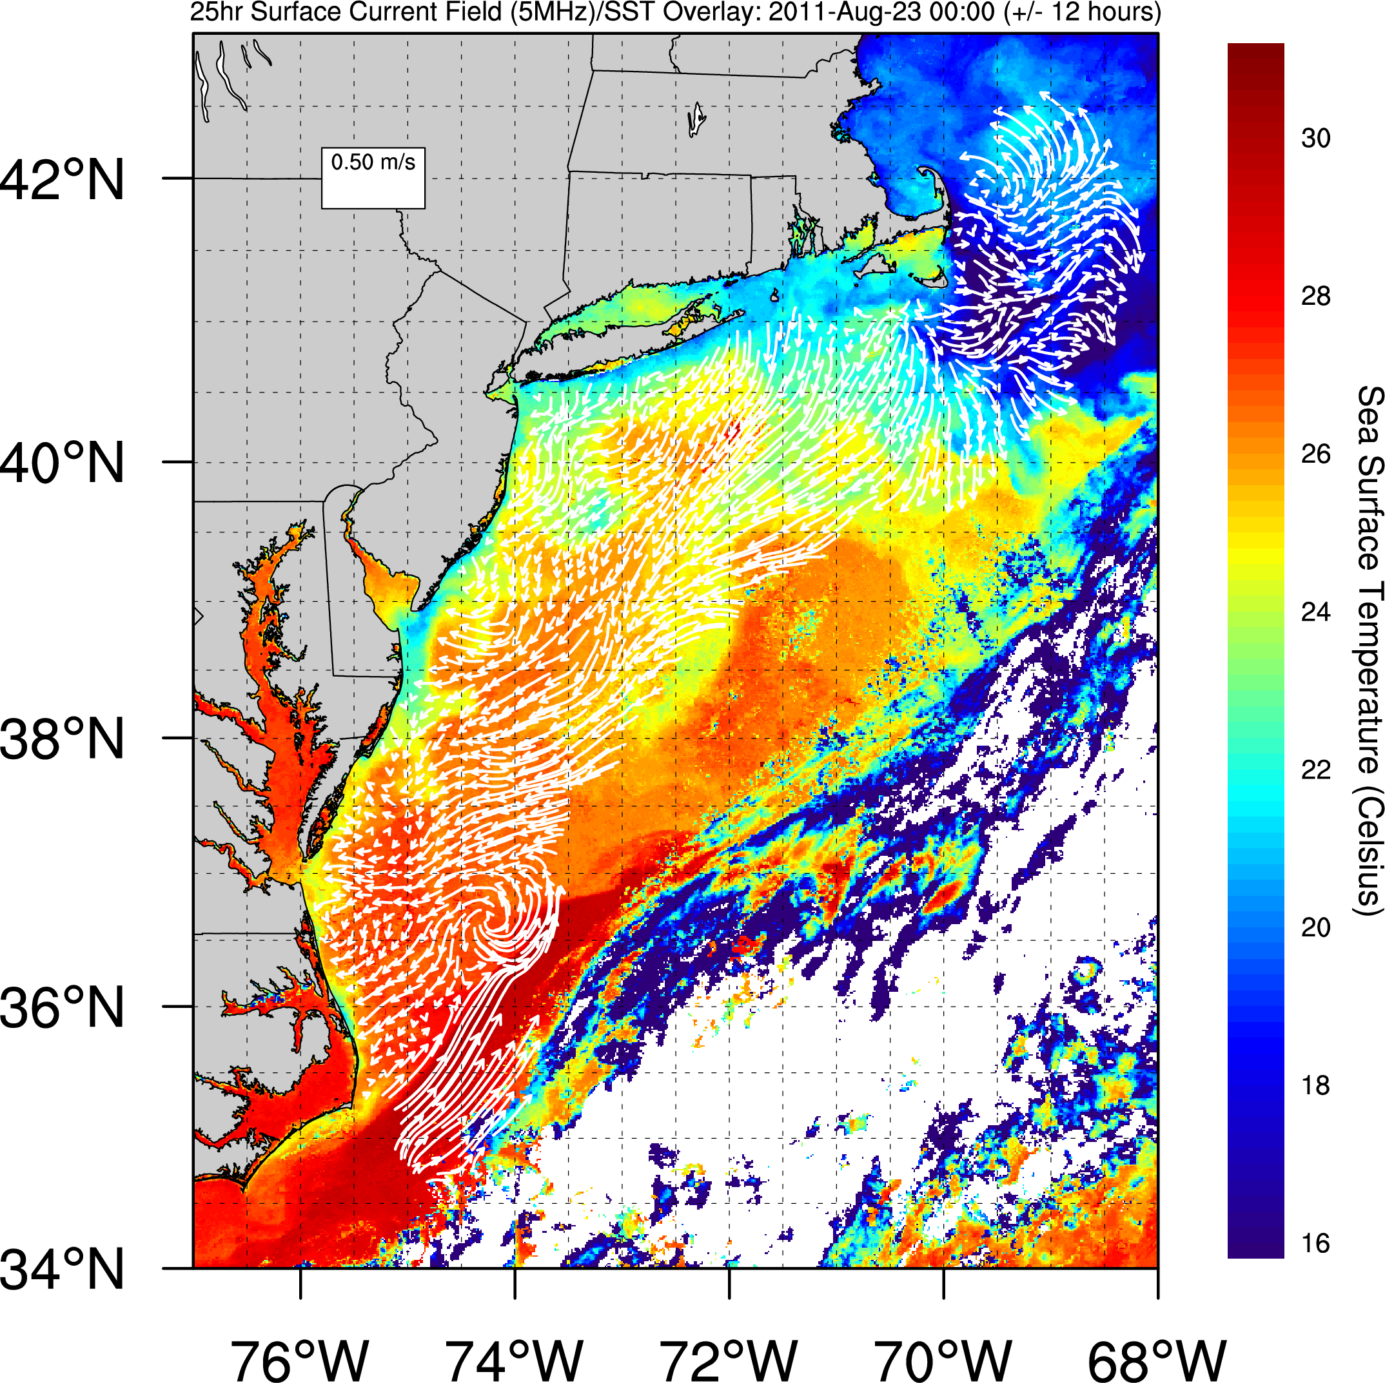

Slide 21
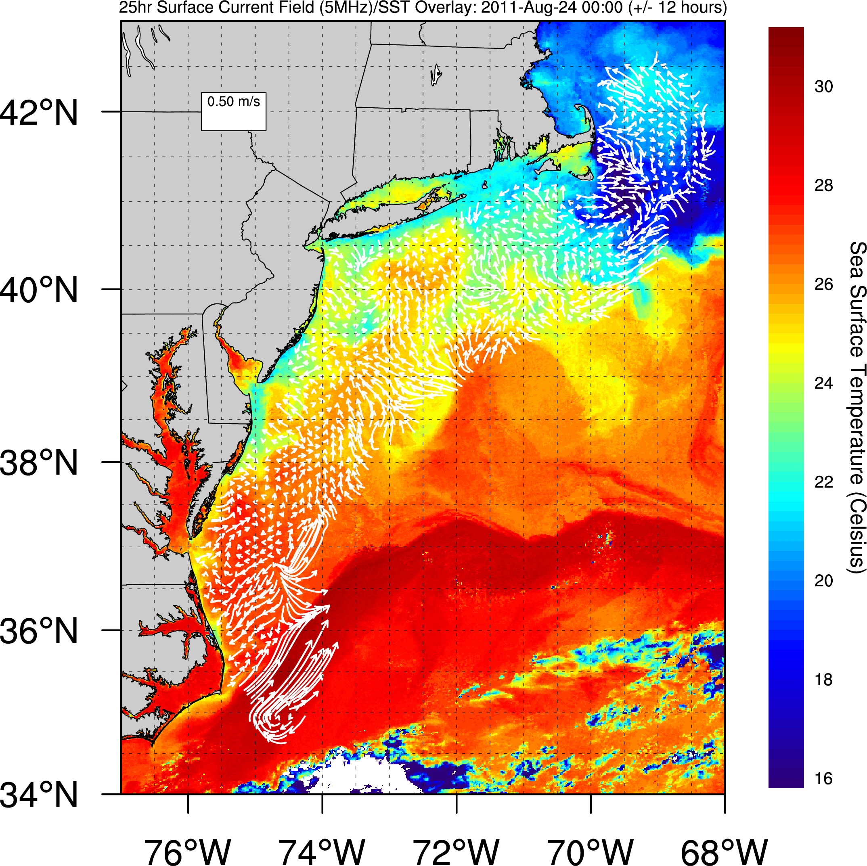

Slide 22
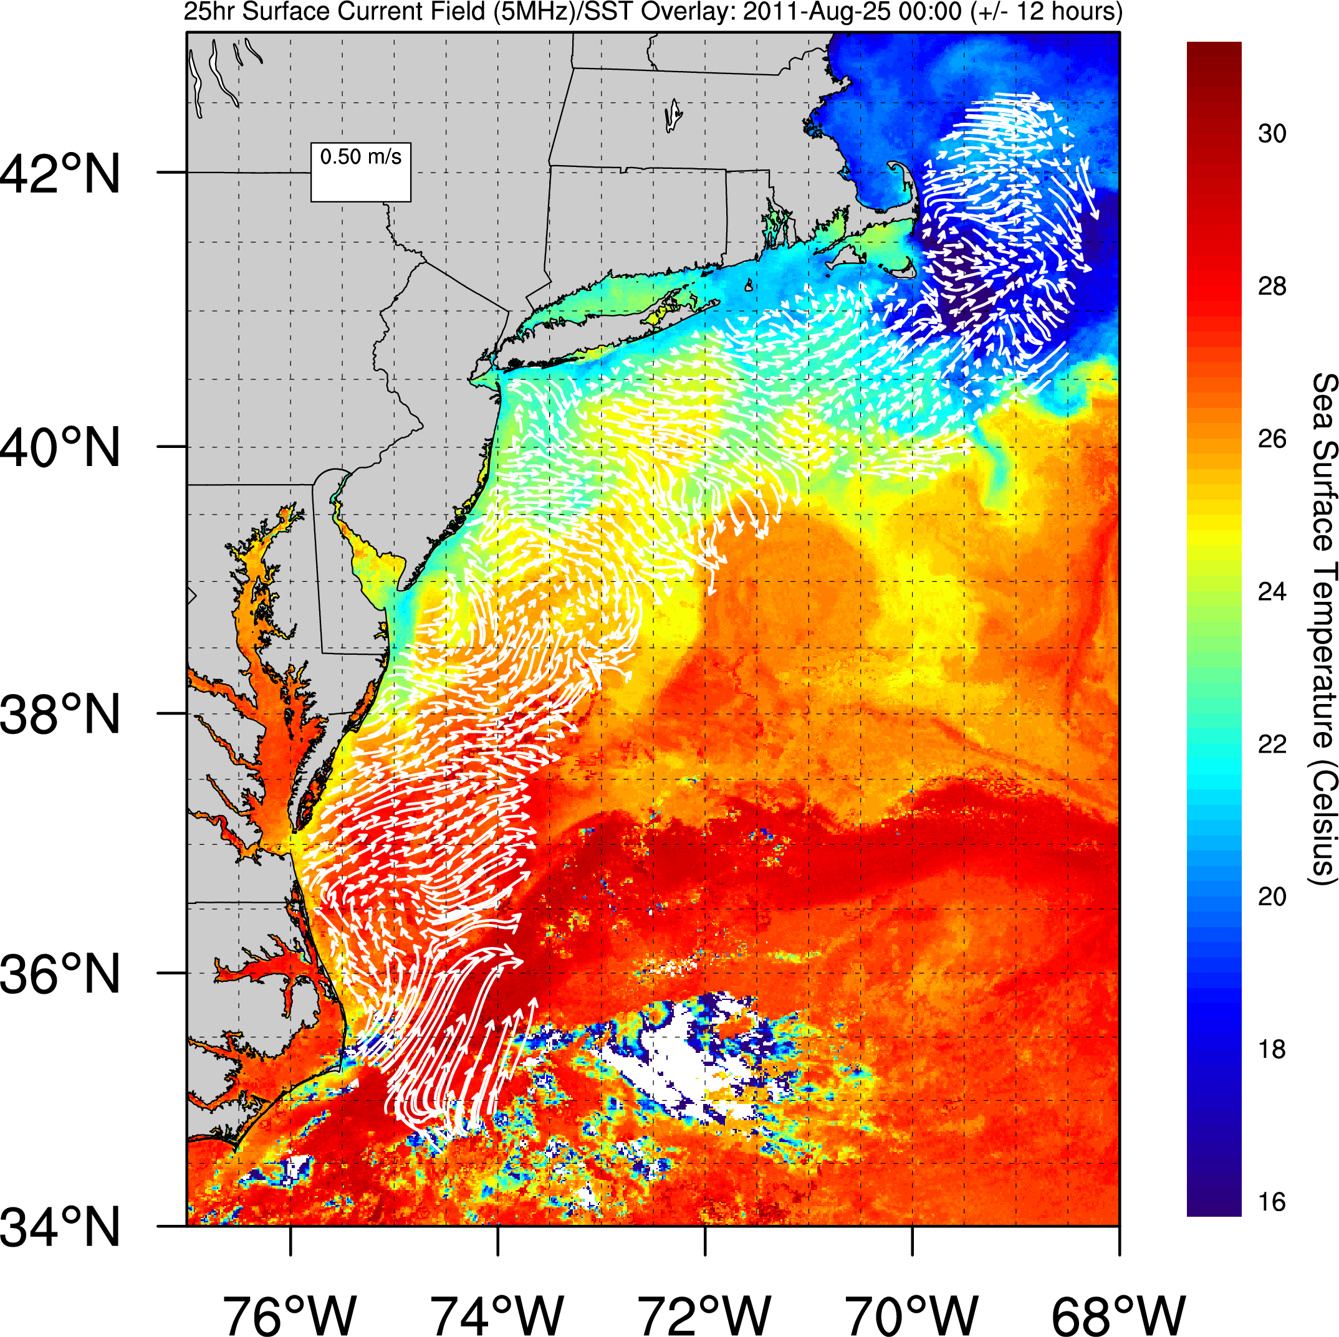

Slide 23
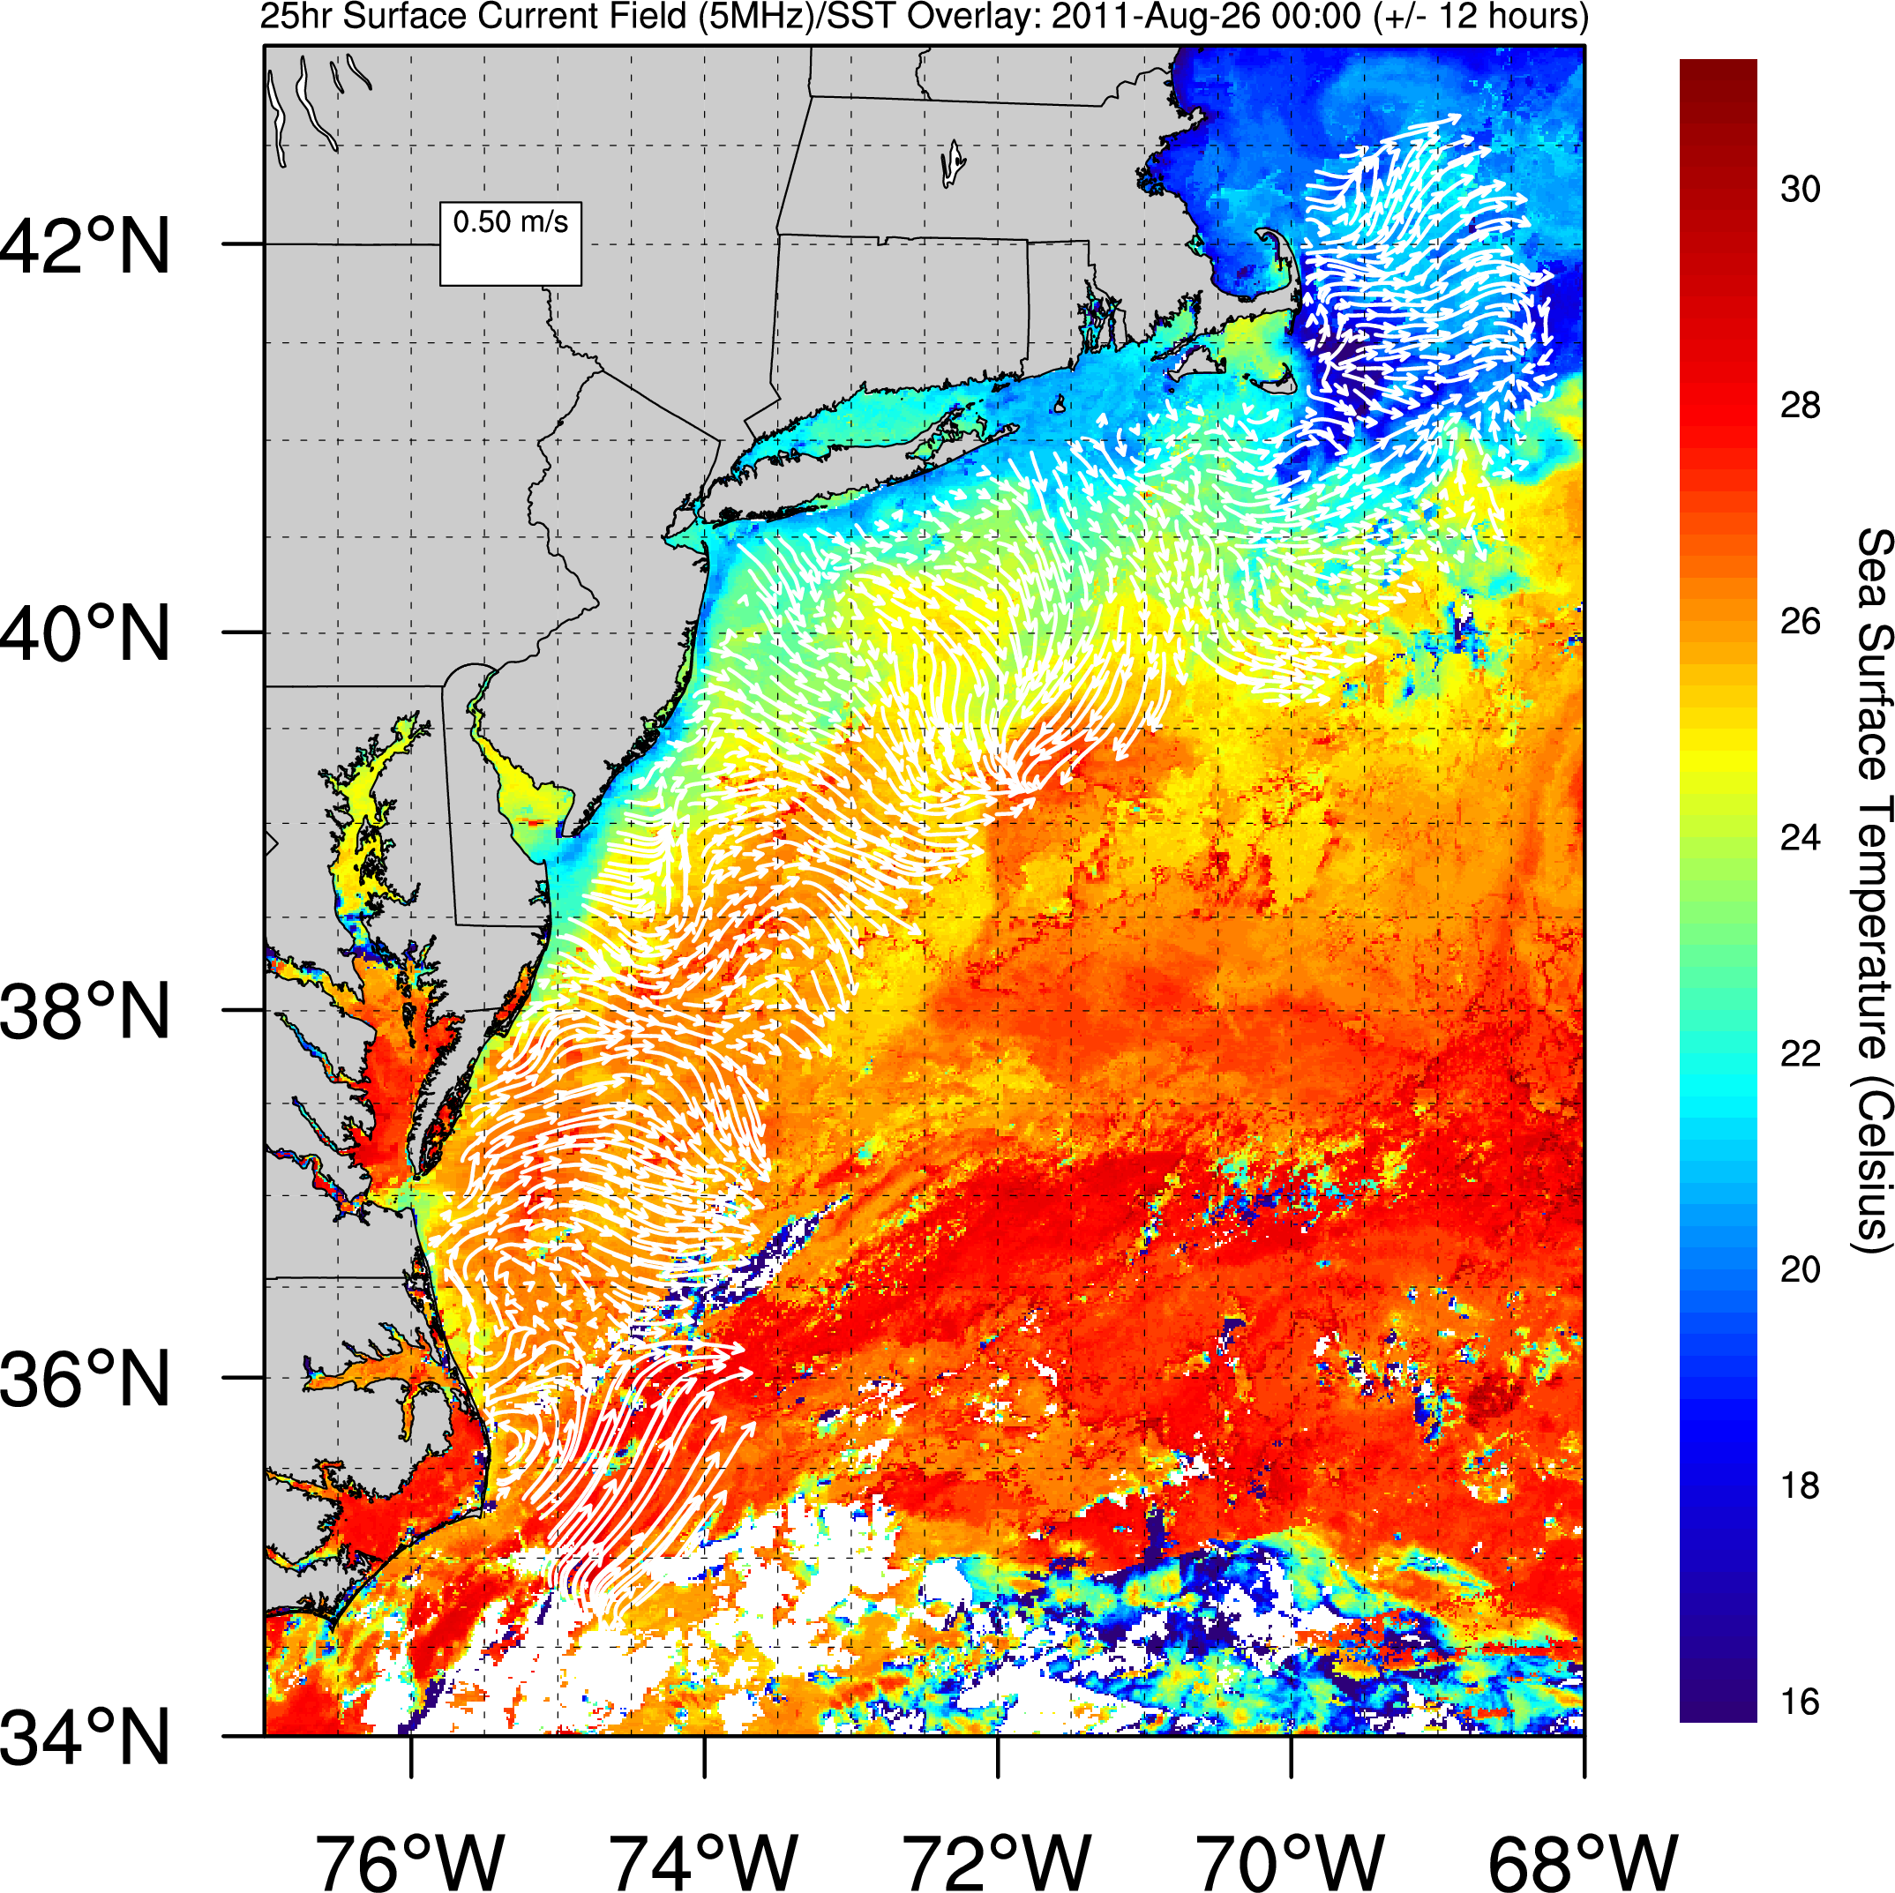

Slide 24
CODAR/SST summary
Aug 19
Aug 20
Aug 21
Aug 22
Aug 23
Aug 24
Aug 25
Aug 26

Slide 25
Temperature
RU 16 – August 2011
Depth (meters)
Temperature (°C)
Date

Slide 26
Salinity
RU 16 – August 2011
Depth (meters)
Salinity (PSU)
Date

Slide 27
Chlorophyll Transect
Depth (meters)
Chlorophyll Concentration
(μm/L)
Date

Slide 28
Dissolved Oxygen
RU 16 – August 2011
Depth (meters)
Oxygen Concentration (mg/L)
Date

Slide 29
2010
8/19/2010 – 8/30/2010

Slide 30
Chlorophyll Concentration
August 30, 2010

Slide 31
CODAR/SST
August 20– 30, 2010

Slide 32
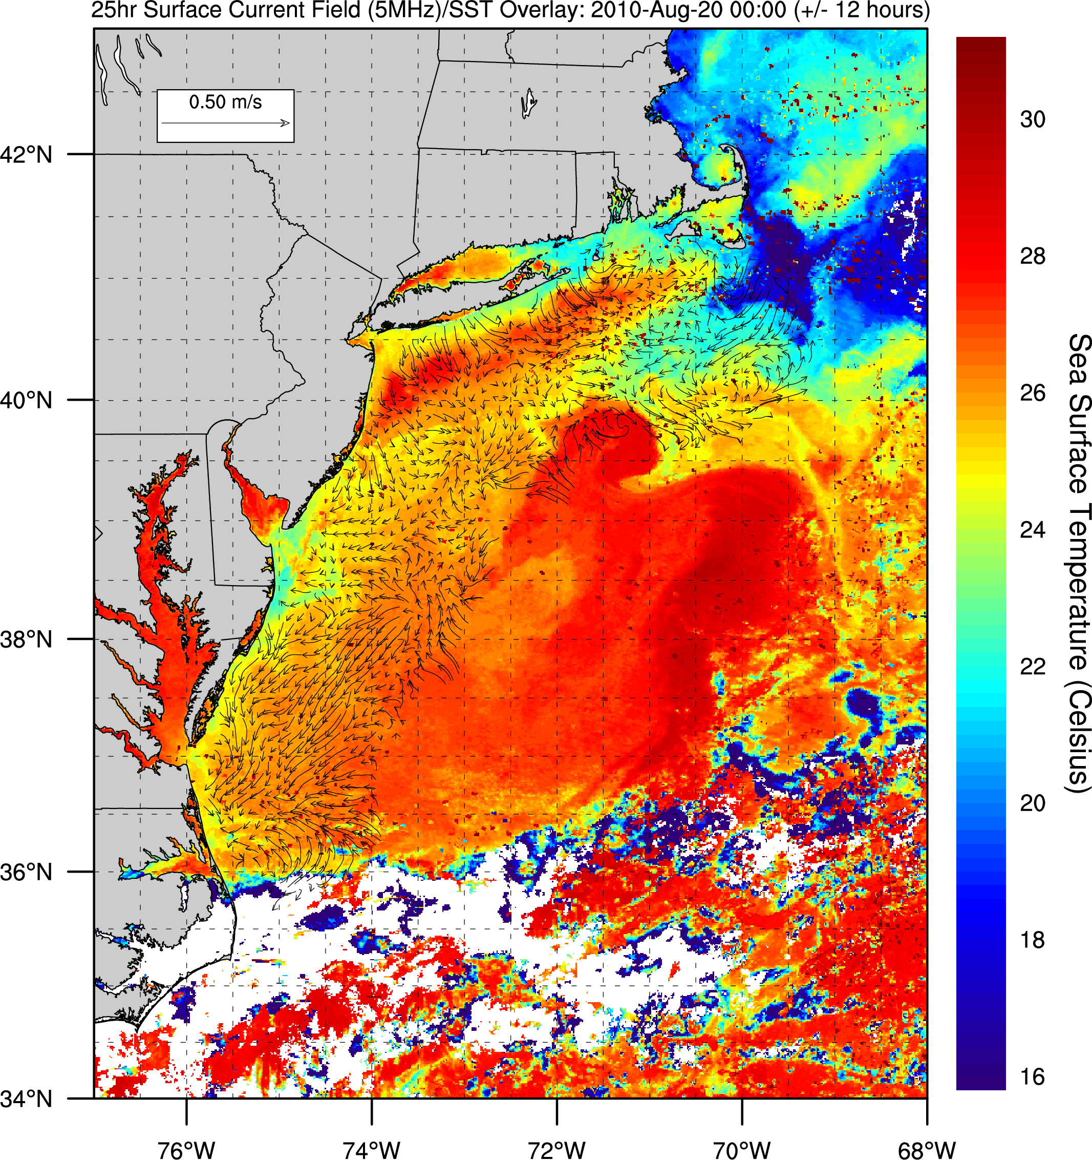

Slide 33
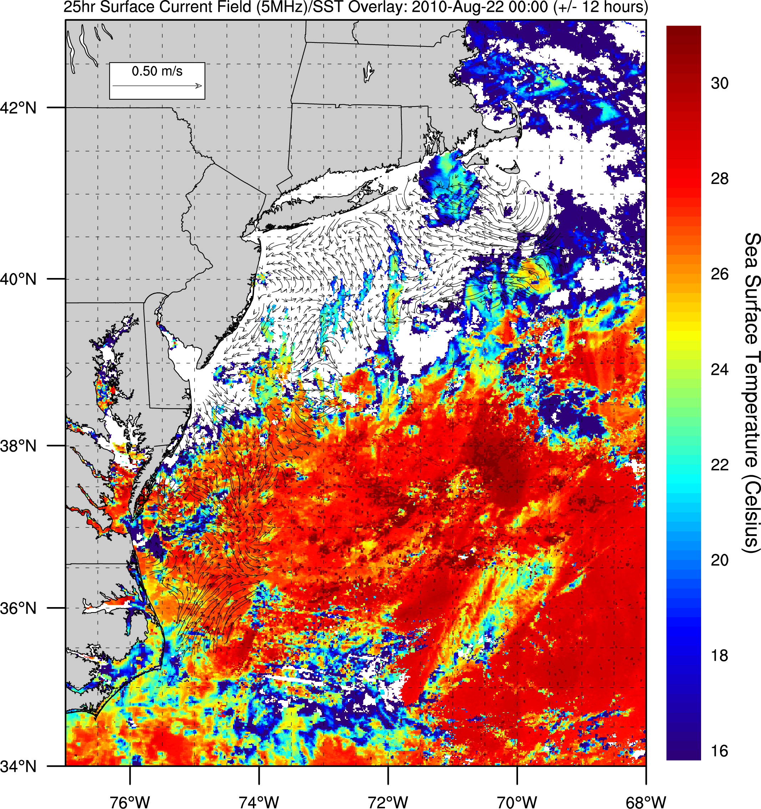

Slide 34
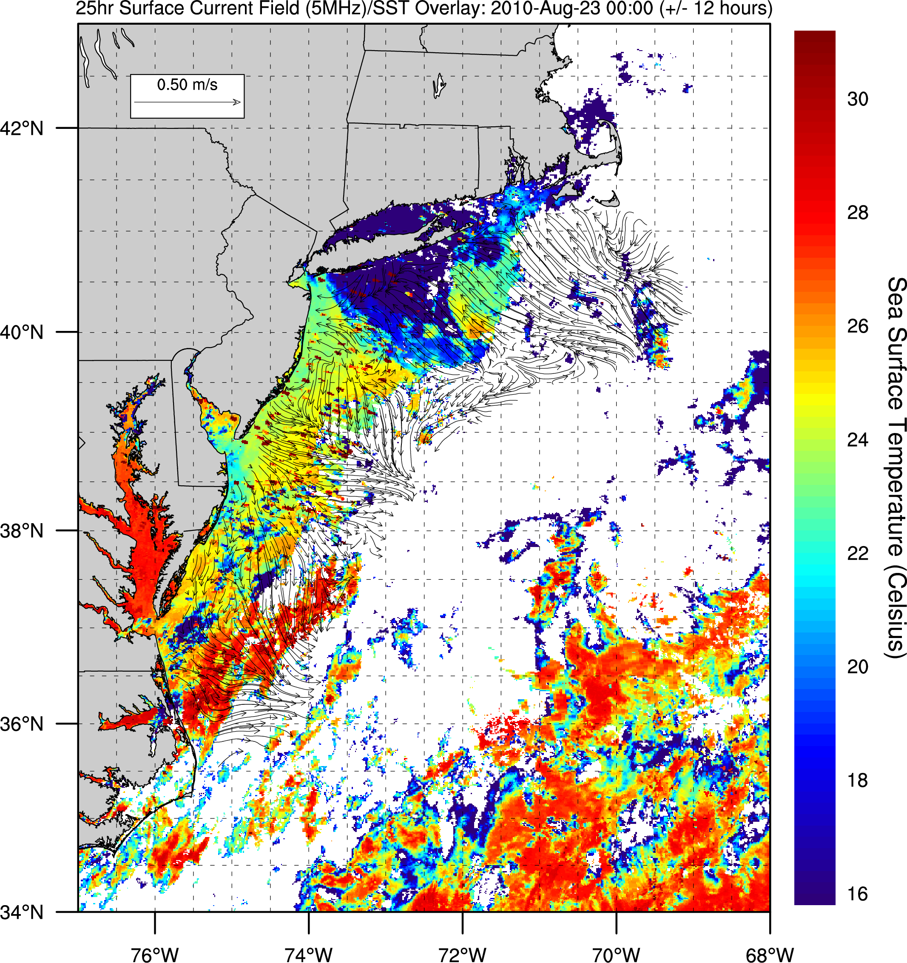

Slide 35
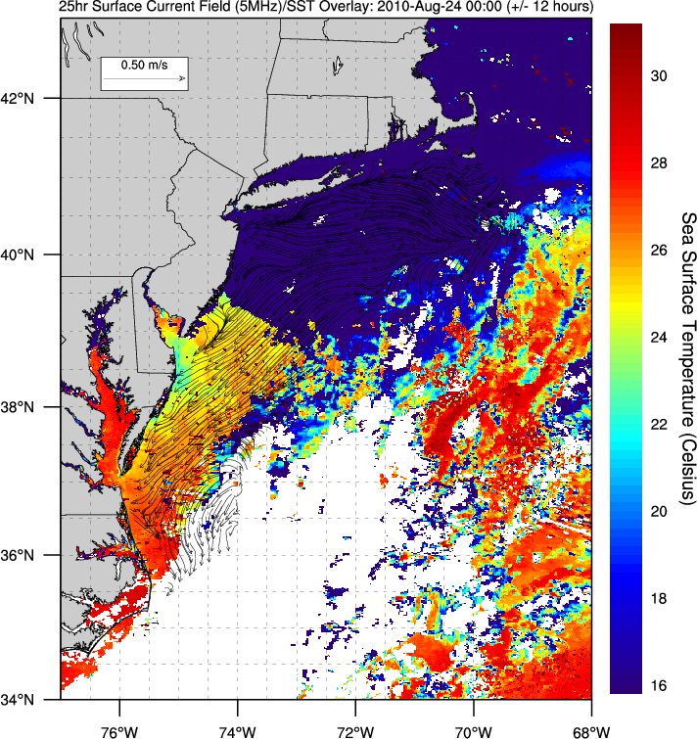

Slide 36
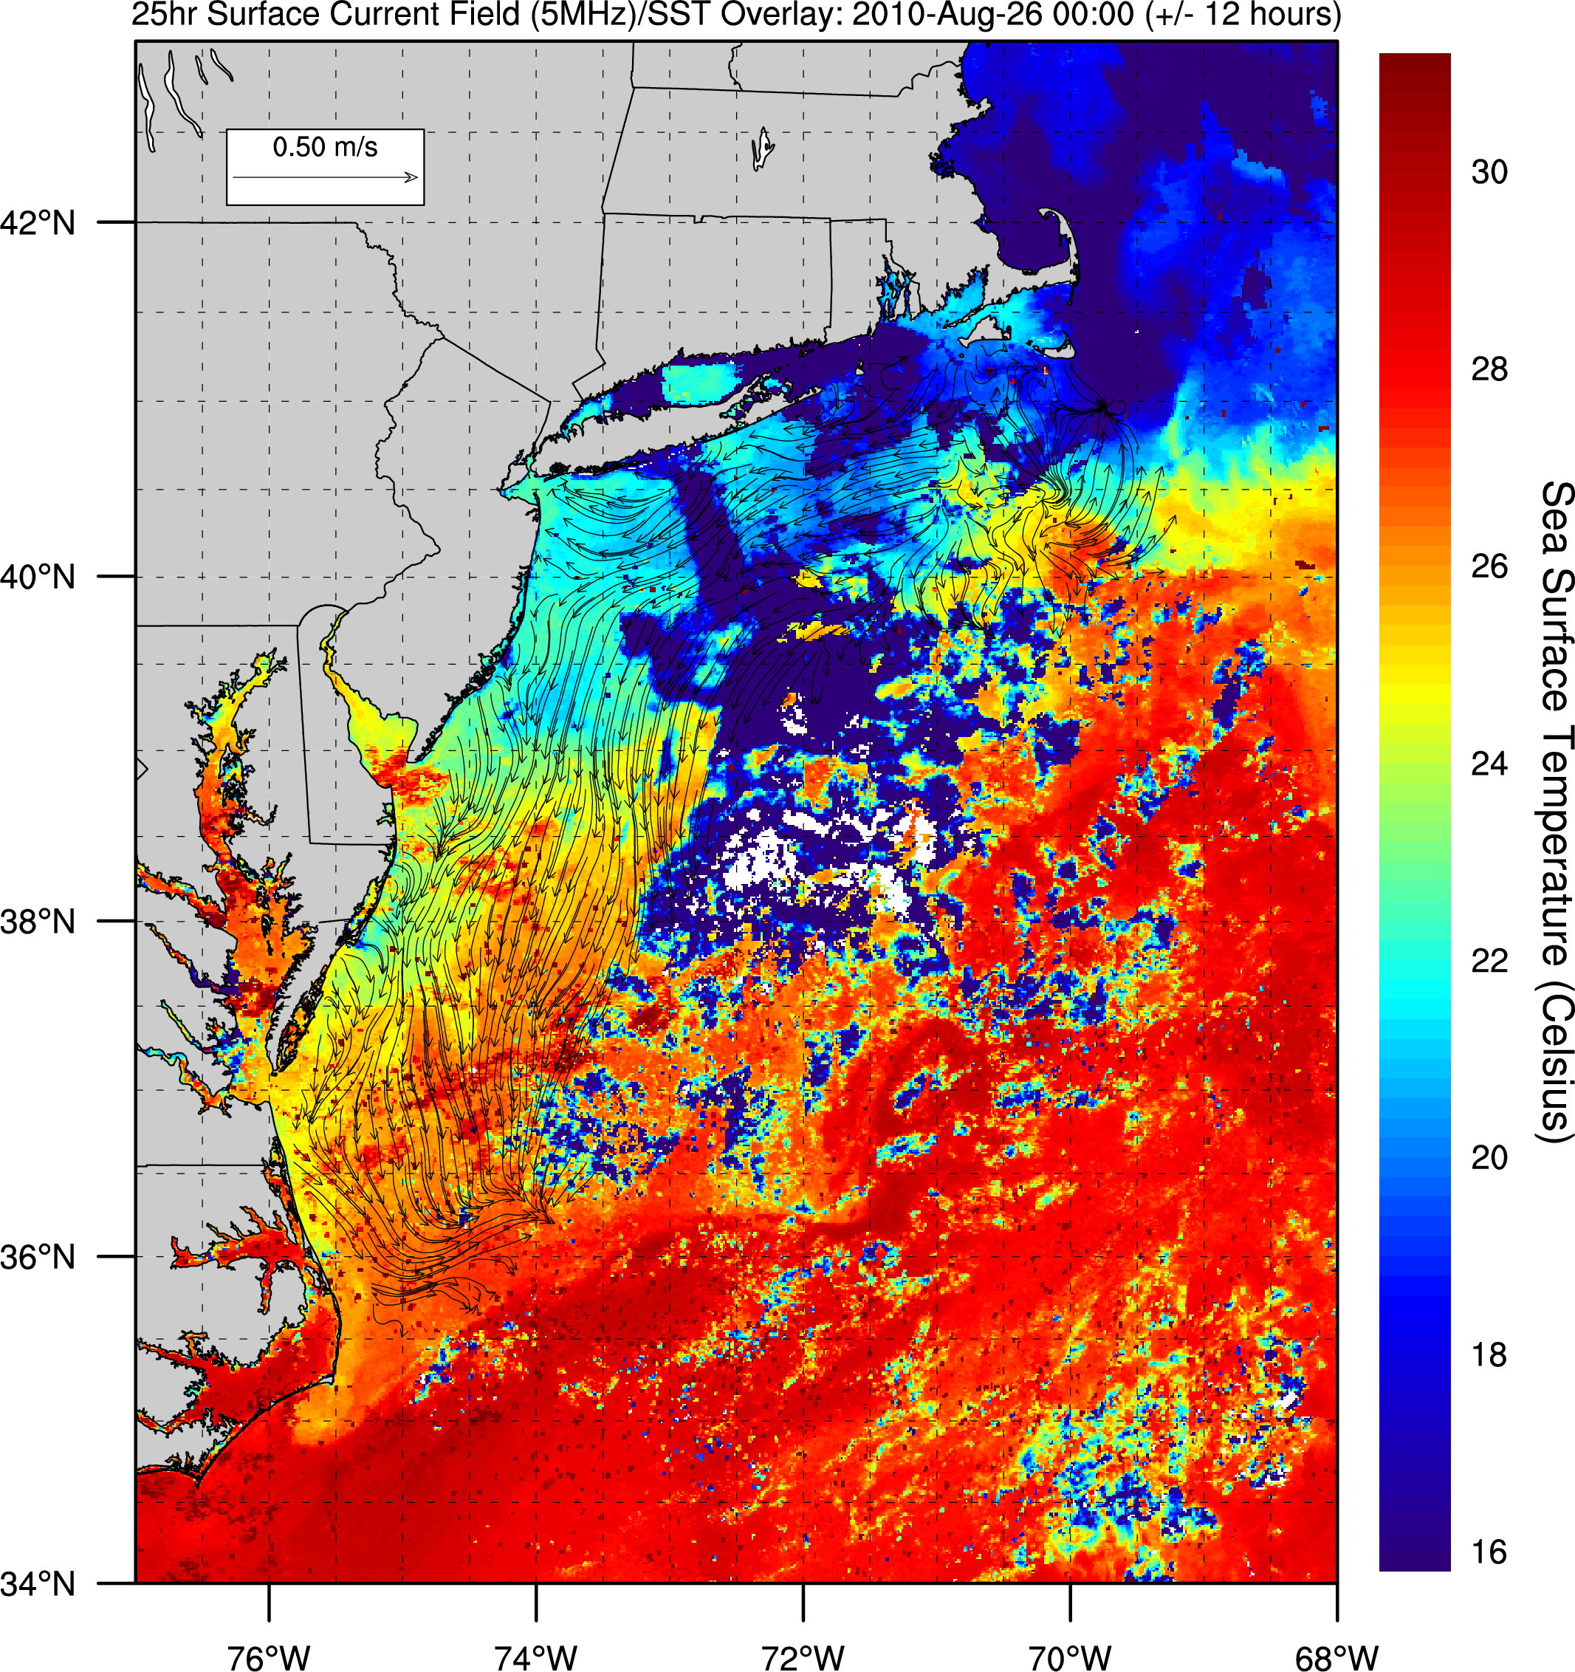

Slide 37
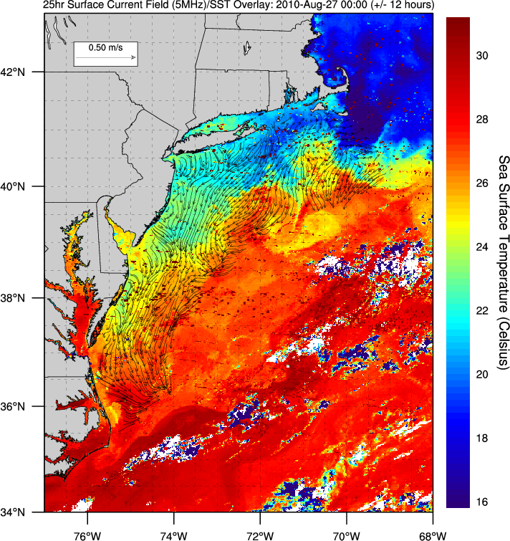

Slide 38
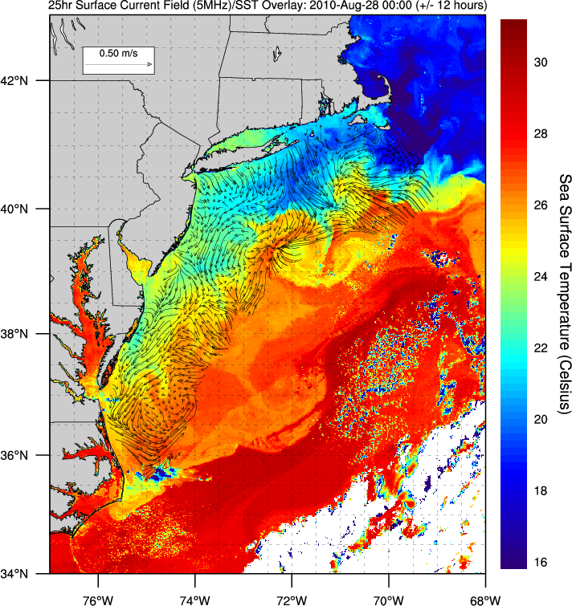

Slide 39
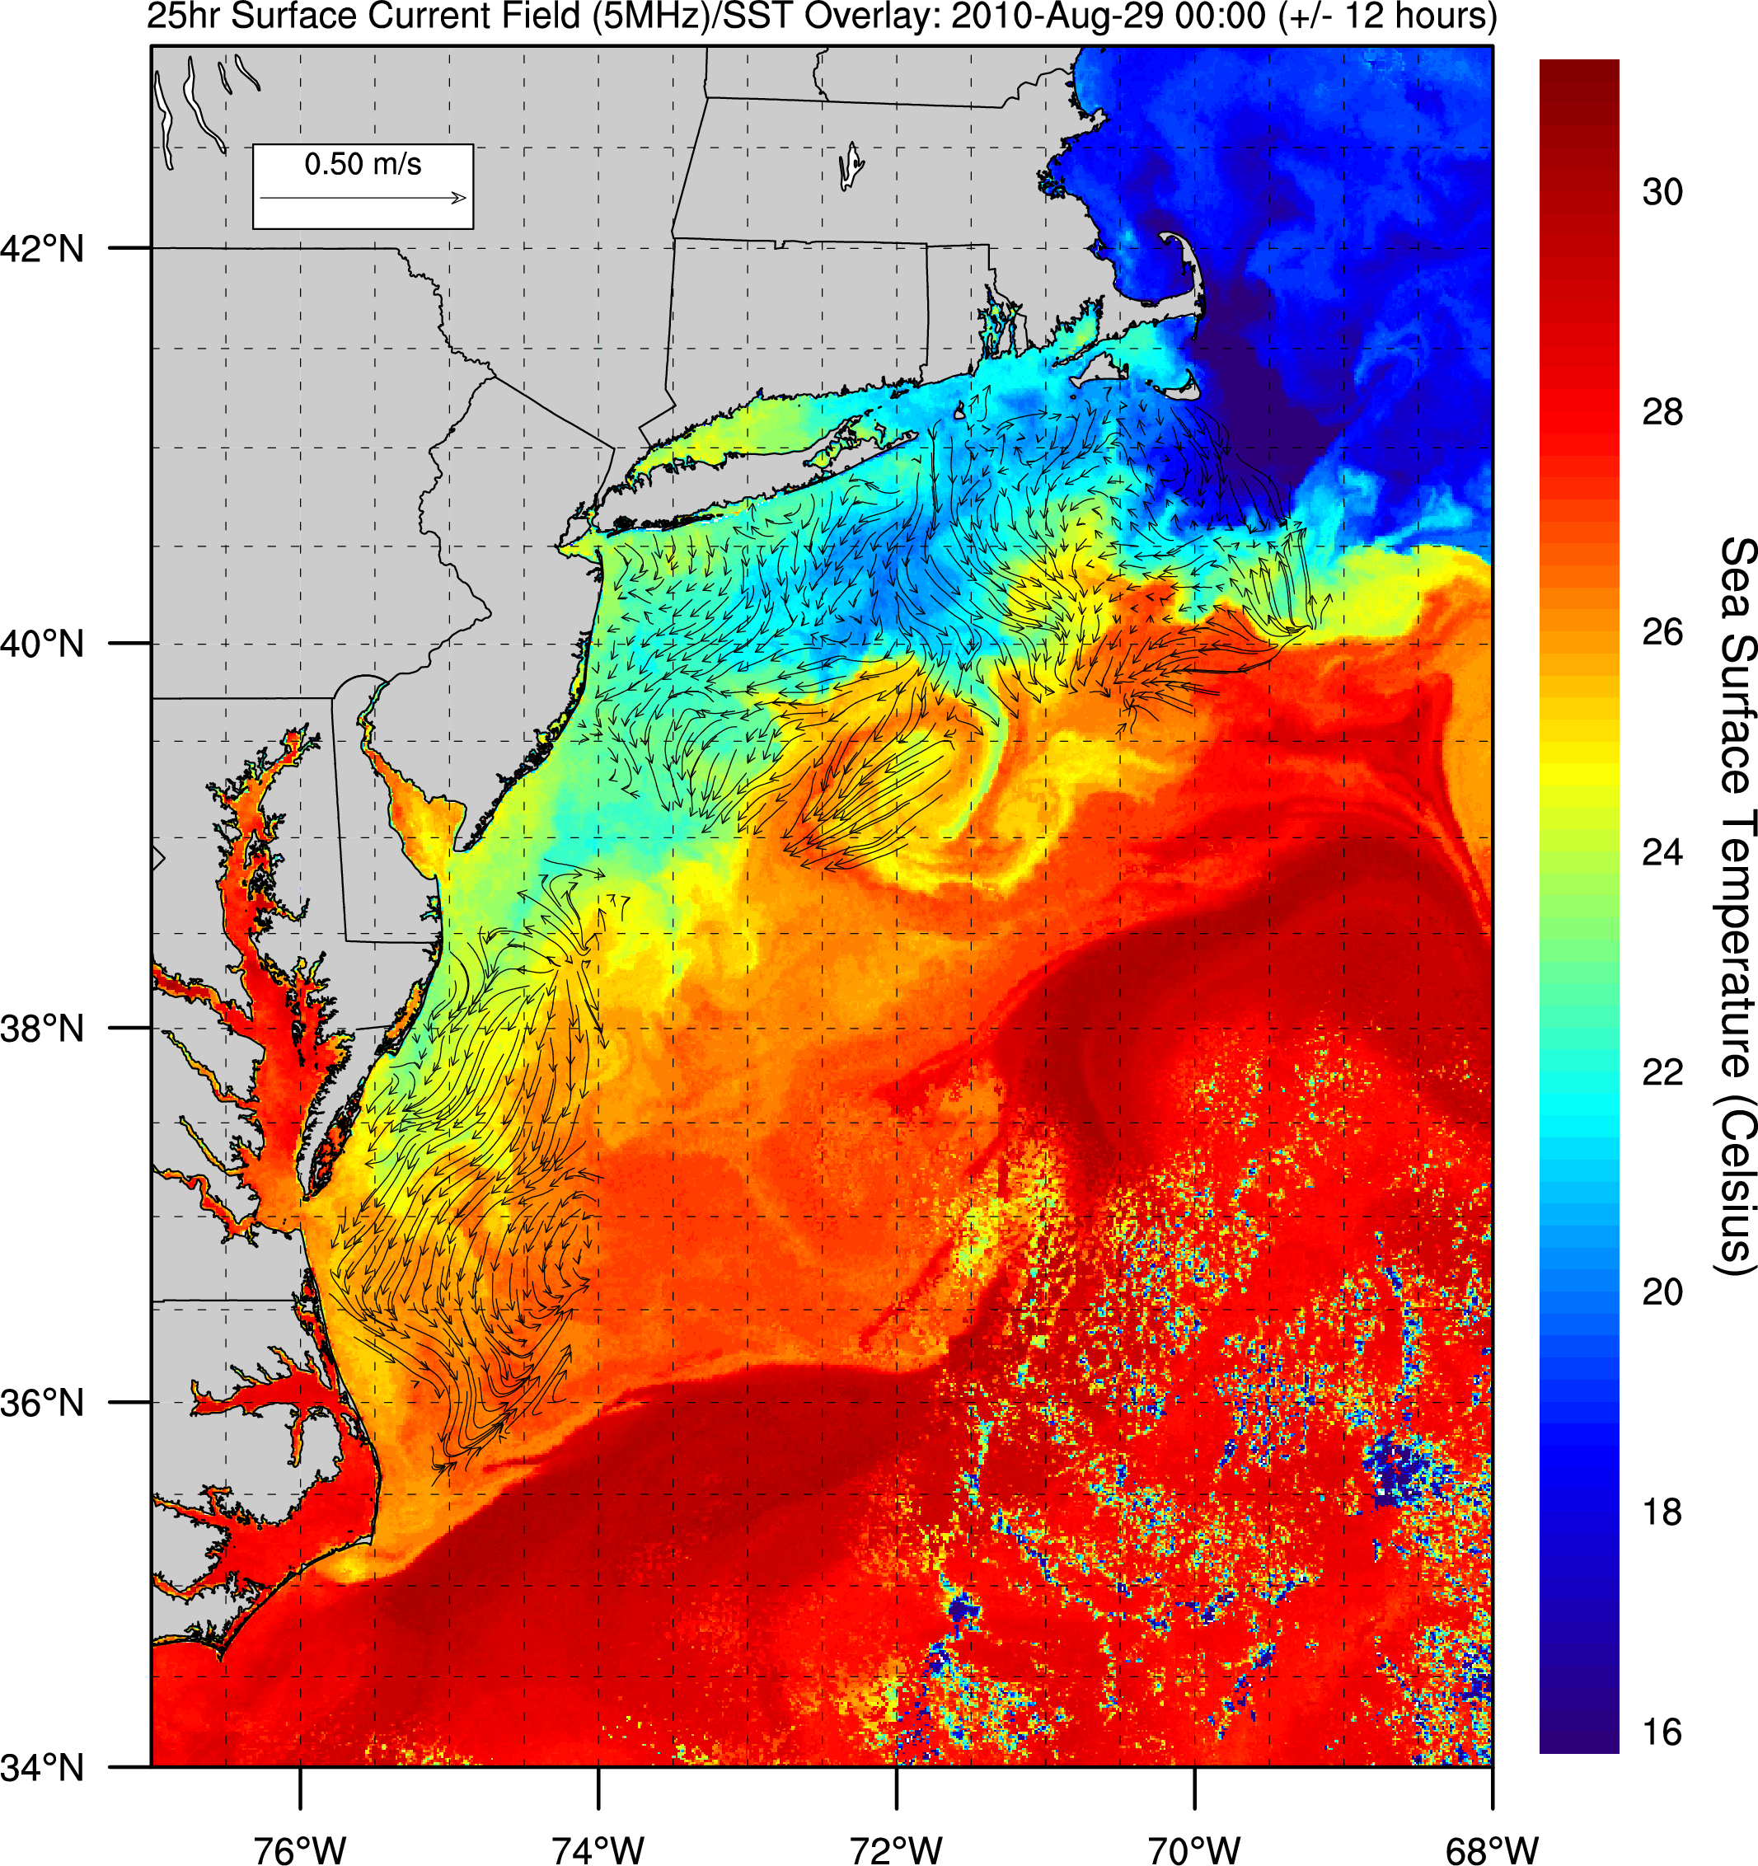

Slide 40
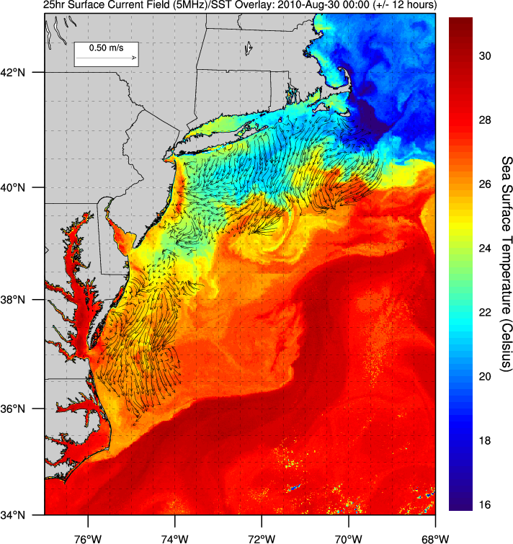

Slide 41
CODAR/SST summary
Aug 20
Aug 22
Aug 23
Aug 24
Aug 26
Aug 27
Aug 28
Aug 29
Aug 30

Slide 42
Temperature
RU 16 – August 2010
Depth (meters)
Temperature (°C)
Date

Slide 43
Salinity
RU 16 – August 2010
Depth (meters)
Salinity (PSU)
Date

Slide 44
Chlorophyll Transect
RU 16 – August 2010
Depth (meters)
Chlorophyll Concentration
(μm/L)
Date

Slide 45
Dissolved Oxygen
RU 16 – August 2010
Depth (meters)
Oxygen Concentration (mg/L)
Date

Slide 46
Total Precipitation
(only including dates until peak of bloom)
2010 – 2.769 cm
2011 – 13.284 cm
Average Precipitation for August – 10.973 cm
Source: wunderground.com

Slide 47
Why was there such a big bloom in 2011?
Upwelling and runoff inputting nutrients
Currents spreading out phytoplankton
Shallow mixed layer (10-15 meters)
Highly stratified waters
Phytoplankton concentrated at bottom of mixed layer (balance sunlight with nutrients)
Optimal conditions for species of phytoplankton

Slide 48
Fisheries?
Fish need oxygen in the water to breathe
Phytoplankton blooms affect oxygen concentrations
Jason’s Group will talk about specific species of fish that are most affected by low oxygen

Slide 49
BIOLOGY GROUP
Jason, Eden, Kara, Michelle,
Leah, Stephanie, Ricky

Slide 50
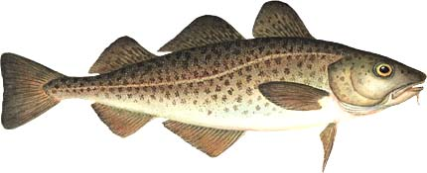
Gadus morhua: Atlantic Cod
Location: North Atlantic Ocean; Greenland to North Carolina, off the coast of Iceland, and along the coasts of Europe
Commercial Value: Cod are important to the international market, stock is currently at risk from overfishing
Size: reach sizes of 25 pounds and 40 to 42 inches in length
Nutrition: smaller bottom dwelling cod feed mainly upon small crustaceans such as shrimp and amphipods. Adults will eat almost anything
Population Size: stock is reported to have decreased by 96% since the 1850s.
Reproduction: mature around 5 years. A 40 inch female may lay about 3 million eggs, and a 50 inch female up to 9 million eggs in one spawning season. 200 feet of water.
Oxygen Tolerance: 4.3 kPa - point where cod can no longer regulate O2 consumption
Future: Moratoriums were declared on some remaining stocks, meaning they can’t be fished

Slide 51
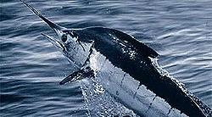
Scientific Name: Makaira nigricans
Common Name: The Atlantic Blue Marlin
Location: Atlantic ocean
Commercial Value : Medium Value due to particular value in Japanese delicacy's, Hawaiian roadside food vendors, and High rarity in recreational game fishing.
Range: Inhabits waters warmer than 24°C;
Its latitudinal range changes seasonally and extends from about
latitude 45°N to Latitude 35°S.
Size: They can reach 90-130 lbs.
Nutrition: They feed on mackerel, tuna and squid, hunt at day and alone
Reproduction: they release 7 million eggs but very few reach sexual maturity
Population size and trend: Significant decline almost 90% since 1960’s
Oxygen Level Tolerance : Blue marlin can only survive in less then 2 ppm of oxygen
Ecosystem Role: They are apex predators that eat
Future of Blue Marlin in the Mid-Atlantic Bight:
If oxygen levels don’t increase the species will die off due to disrupted migration and reproduction patterns

Slide 52
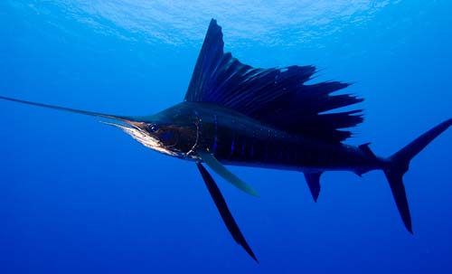
Scientific Name: Istiophorus albicans
Common Name: Sailfish
Location: Atlantic Ocean, (Mid Atlantic Byte)
Commercial Value: Low Value, tough meat; Highly prized recreational fish
Range: Lat-Long (along what coast): between 40N and 40S; Gulf of Mexico, Atlantic coast, western Africa; 21-28 degrees celsius
Depth: 937 feet (286 meters)
Size: 3.15-3.40m and 100kg
Nutrition: small pelagic fishes particularly mackerels, tunas, jacks, halfbeaks, and needlefish
Reproduction: External fertilization, after eggs are laid 36 hours later they hatch, 2 centimeters to 6-8 feet in one year
Population size and trend: Only 60% of its maximum yield
Oxygen Level Tolerance: Studies have not been done
Ecosystem Role: Apex predators could reduce genetic diversity
Future of Fish in the Mid-Atlantic Bight
If oxygen levels don’t increase the species will die off due to disrupted migration and reproduction patterns

Slide 53
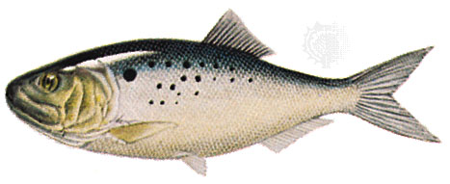
Brevoortia tyrannus
Atlantic Menhaden
Location: New Jersey to the Carolinas
Commerical Value: bait, many oil needs, fishmeal
Depth: Surface
Size: 15 inches, weight varies
Nutrition: Plankton, zooplankton
Reproduction: eggs hatch in open ocean, larvae move to estuaries, after a year, move to the ocean
Population size and trend: most abundant in waters
Oxygen Level Tolerance: no higher then 1.1 mgL-1 DO at 28C
Ecosystem Role: Forage fish, filter feeder
Future of Fish in the Mid-Atlantic Bight:
Managed by the Atlantic States Marine Fisheries Commission (ASMFC)
If overfished: fecundity reference point, Fishing mortality target
Notes:
53

Slide 54
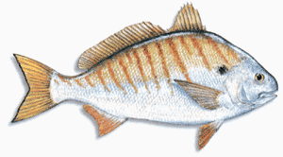
Leiostomus xanthurus
Spot Fish
Location: North Carolina coast
Commercial Value: commercial/recreational fishing
Depth: near bottom
Size: 6-10 inches, max 14 inches, up to 1 lb
Nutrition: Bottom feeders: worms, small crustaceans, mollusks
Reproduction: Spawn in off coast waters, juveniles move to Bay for some months
Population size and trend: Abundant schools
Oxygen Level Tolerance: 2 mgL-1, no lower then 1.5 mgL-1
Ecosystem Role: Food source
Future of Fish in the Mid-Atlantic Bight:
Not overfished at the moment, but being watched over just in case.

Slide 55
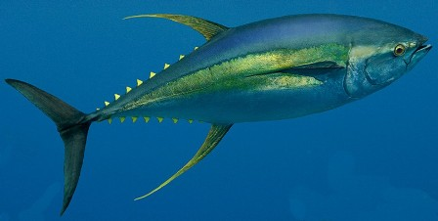
Scientific Name: Thunnus albacares
Common Name: Yellow Fin Tina
Location: Pelagic waters of Tropical and Subtropical oceans worldwide
Commercial Value : Tuna are a very commercial fish because it is one of the most popular fish to eat and it is a favorite among recreational fisherman
Range: Lat-Long (along what coast): Atlantic Coast, Pacific Coast
Depth : depths less than 100 meters
Size: Maximum length of 6 feet and weighs up to 400 pounds
Nutrition: flying fish, mackerel, crustaceans, and squid
Reproduction: Spawning takes place at sea in the spring and summer, and most fish are capable of reproduction at the age of 2 or 3 years
Population size and trend: yellow fin tuna populations are falling
Oxygen Level Tolerance : need an abundant amount of oxygen supply
Future of Fish in the Mid-Atlantic Bight
-International Commission for the Conservation of Atlantic Tunas has adopted new yellow fin management standards that reduce the catch of small yellow fin off of West Africa and bring other fishing nations closer to U.S. standards to try and raise yellow fin tuna populations
-2007 tuna are considered an endangered species (http://www.nytimes.com/2007/01/22/ health/22iht-tuna.4291357.html)

Slide 56
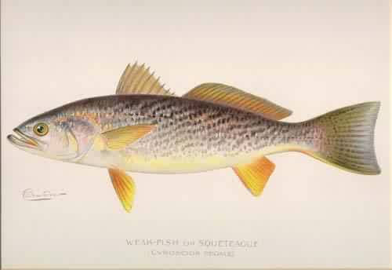
Scientific Name: Cynoscion regalis
Common Name: Weakfish
Your Fishy
Commercial Value :
Fished for commercial and recreational purposes
Range:
Eastern United states and Canada; Can be found from Nova Scotia, Canada to Florida
Weakfish migrate up and down the coast in accordance to the seasonality in ocean water temperatures
Depth:
These fish are normally surface dwellers
Info:
Size: Weakfish can reach up to 1 meter in length
Weight: The average weight of weakfish is usually less than 12 pounds. Any fish heavier than that is considered to be rare
Nutrition:
In general though weakfish feed on an variety of crabs, shrimp, mollusks, squid and small fish
Reproduction:
May through October; Batch fecundity and spawning frequency varies annually
Young fish swim down to the lower part of the Bay from late summer to fall making their way to salty water by winter
Population size and trend: Weakfish are on a massive decline; populations have dropped, they were
recently banned from being fished off the coasts of Maine to Florida in 1995
Oxygen Level Tolerance :
In general weakfish have a relatively high tolerance to low oxygen levels, particularly if they have become accustomed to it
Certain functionality such as swimming and overall activity have shown to be lower in hypoxic conditions
Ecosystem Role:
In the Chesapeake Bay, weakfish are top carnivores; feed along the edge of various habitats such as the eel-grass habitat and channel, rock and oyster reef habitats
The weakfish are a main prey fish for certain carnivorous fish, such as the striped bass
Have a significant impact on small fish populations such as menhaden, anchovies and mummichog
Future of Fish in the Mid-Atlantic Bight
it has been determined that the weakfish will still decline but due to inefficiency of replenish the populations and not due to hypoxia

Slide 57
Orange Roughy
Scientific Name:
(Hoplostethus atlantics)
Location:
It is found in 3 to 9 °C (37 to 48 °F) deep waters of the Western Pacific Ocean
Orange roughly are located near features such as seamounts, plateaus and canyons, especially during spawning and feeding.
Population Size:
Down to less than 30% of their original numbers
Belongs to the slime-head family.
Commercial Value:
Overfishing

Slide 58
Orange Roughy
Size/Info On How Hypoxia Affects It:
The organic flux from surface water accumulates in the area and results in episodic hypoxia at the sediment surface.
Orange roughy are bottom dwellers they are extremely susceptible to hypoxia and its affects.
They are slow moving therefore have a more challenging time traveling out of the hypoxic regions into safer waters.
Reproduction/Nutrition:
Orange roughy are oceanodromous
They travel several hundred kilometers between spawning and feeding areas each year
Once hatched the young fish descend deeper as they mature
Orange Roughy shed sperm and eggs at the same time. The time between fertilization and hatching is thought to be 10 to 20 days.

Slide 59
Orange Roughy
What is their Future?:
The Marine Conservation Society has categorized orange roughy as vulnerable to exploitation.
Extremely susceptible to overfishing
Human consumption of orange roughy has risen drastically due to increased supply through new deep-sea trawling techniques.
Very slow recovery rate because of long life span
Due to habitat damage of commercial trawling: Coral reef habitat dwindling
Problems: overfishing, high by-catch, and poor management; or farming methods have serious environmental impacts.
Their conservation concern is very high

Slide 60
Fluke
Scientific Name:
Paralichthys dentatus
Location:
Fluke is a marine flatfish that is found in the Atlantic Ocean off the East coast of the United States and Canada.
It is especially abundant in waters from North Carolina to Massachusetts.
Population Size:
Is a member of the left-eyed flounder family
There are typically 5 to 14 (eye-like) spots on the body.
They can change the color and pattern of their dark side to match the surrounding bottom
Capable of rapidly burrowing into muddy or sandy bottoms.
Commercial Value:
Trawling.
Recreational fishing is typically done while drifting in a boat or casting.
It is considered an excellent food fish with firm, mild tasting white meat.

Slide 61
Fluke
Size/info on How Hypoxia Affects it:
Summer flounders ordinarily grow to a maximum weight of 15 pounds or so, and to a length of 3 feet.
Fluke spend most of their lives on bottom
They prefer sandy bottom, or mud, where they are often seen.
Fluke often lurk in eel grass, or among the piling of docks
Unlike the Orange Roughy the Fluke can get away from the bottom trowels in which they dwell.
Reproduction/Nutrition:
Feeding largely on smaller fish of various sorts, on squids, crabs, shrimps, and other crustaceans; on small shelled mollusks; on worms, and on sand dollars.
It is very fierce and active in pursuit of prey, often following schools of small fish right up to the surface.

Slide 62
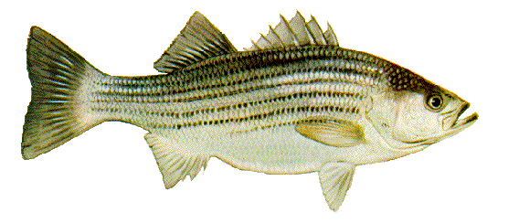
Morone Saxatilis
Striped Bass
Location: They populate in Chesapeake Bay-called Rock fish there
Commercial value: top recreational fish
Range: http://www.striperspace.com/largefallmap.html
http://www.striperspace.com/largespringmap.html
-prefer water temperatures between 55-68 degrees °F
Size: females are bigger than males (15inches-50 inches)
Nutrition: will eat anything- bunker, clams
Declining Species: March/April reports that Mycobacteriosis (a wasting disease) is causing mortality rate to increase; but also poaching in federal waters, where it is prohibited to fish them
-HYPOXIA: mid 1990’s it enhanced population; recent years it counterbalanced– mixed with abundance of this fish= overconsumption of prey
-during summer months dissolved oxygen levels range from 3-6 mg/L
-Through recent research dissolved oxygen concentrations are often below minimum tolerance levels.

Slide 63
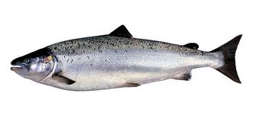
Salmo Salar
Atlantic Salmon
Location: migrate from freshwater rivers to oceans from stages of life and can also find more in Pacific Salmon’s territory
Commercial Value: Fishing is now prohibited; protected by Endangered Species Act
Range: Gulf of Maine -- Dead zones in Atlantic—caused over fishing (now prohibited) – migration to Pacific http://www.fishwatch.gov/seafood_profiles/species/salmon/species_pages/atlantic_salmon.htm
Size: can grow to length of a human arm
Nutrition: their diet depends on location -- they offer as fertilizers to plants, animals, and algae to food for brown bears
HYPOXIA: -experiment with eggs showed that feeding was reduced from oxygen shortage
-the eggs are deposited in riverbeds—most affected at this state
-NOAA suggests that changing spring wind patterns and warmer water temperatures—causes predators to change migration= eliminating Atlantic Salmon

Slide 64
Mid Atlantic Bight Policy
Kathrine Bianchini, Erin Holswade, Colin Gibbons, John Huggstickler, Melissa Regan, Krishna Atkuru

Slide 65
Concept Map

Slide 66
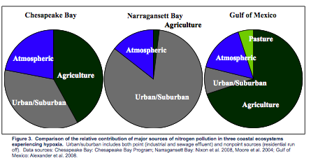
Management Plans and Policy Surrounding Mid-Atlantic Hypoxia
Legislations
Harmful Algal Bloom and Hypoxia Research
And Control Act
Coastal Zone Management Act
Water Resources Development Act
Clean Water Act
Food, Conservation, and Energy Act of 2008
Energy Independence and Security Act of 2007
Notes:
Most hypoxia is associated on the global scale with either areas of high population density or developed watersheds that export larges quantities of nutrients and organic matter. Since the creation of the Clean Water Act in 1970 point source pollution (i.e. waste disposals) have dramatically decreased, yet the amount of hypoxic zones has continued to increase since the 1960s. This is due to nonpoint pollution sources. Agricultural fertilizers are the leading nonpoint source of nutrient pollution, with other sources coming from atmospheric deposition from burning fossil fuels and nitrogen fixation in legume crops. (Primary sources in watersheds)
66

Slide 67
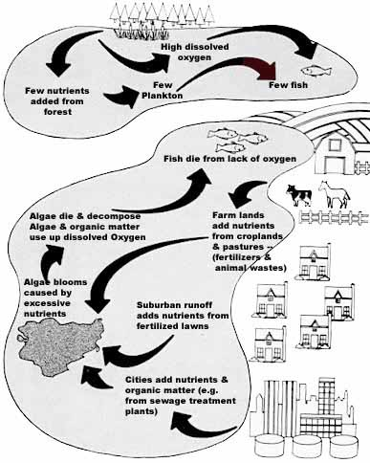
Agencies Involved in Management
United States Department of Agriculture (USDA)
National Oceanic and Atmospheric Administration (NOAA)
Environmental Protection Agency (EPA)
United States Geological Survey (USGS)
http://www.oneplan.org/Water/Runoff.asp
Notes:
67

Slide 68
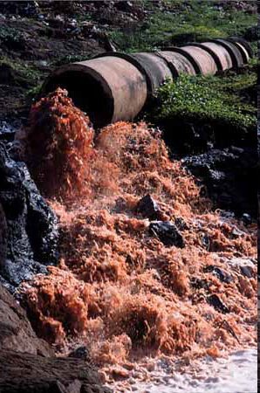
Clean Water Act
Requires anyone who wants to discharge pollutants to first obtain an NPDES permit or the discharge will be considered illegal.
Makes it unlawful to discharge any pollutant from a point source into navigable waters.
Exact language used in the act: “It is the national goal that the discharge of pollutants into the navigable waters be eliminated…” (EPA).
“Navigable waters” used eighty-eight times throughout the CWA.
http://radio-weblogs.com/0101170/images/water/effluent.jpg

Slide 69
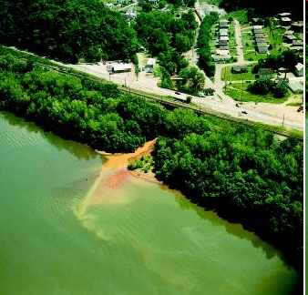
Clean Water Restoration Act
Amends the Clean Water Act: replaces the term “navigable waters” with “waters of the United States.”
Focuses on the issue of what can/cannot be deemed “navigable” and emphasizes the significance of bodies of water that may not be connected to larger water systems (open congress)
Controversial: too broad of a regulation?
http://www.waterencyclopedia.com/images/wsci_03_img0431.jpg

Slide 70
What Should We Do?
More logical to add words to clarify and strengthen regulation than it is to omit them!
Acknowledge that there are different bodies of water and water systems in every state.
http://ecowatch.org/wp-content/uploads/2012/03/w10.jpg

Slide 71
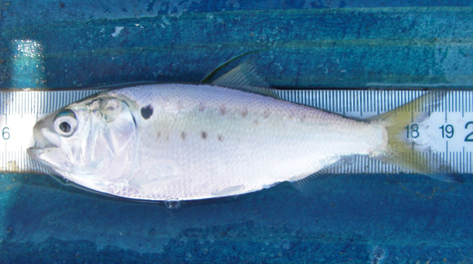
Atlantic Menhaden
Massive hypoxia die out in the Delaware Bay
Dangerous levels of low oxygen
Caused a lot of fishing restrictions.
Largely overlooked until the last few years
Regulated by over 15 states
Scientists suggest that population needs to quadruple
http://www.vims.edu/research/units/projects/menhaden/about/index.php

Slide 72
Menhaden Policy
Debate over the strictness of regulations
Population plummeted 88% in the last 25 years
10% of what historic high was
Almost 550 million tons are caught a year
Omega Protein has a monopoly on the industry

Slide 73
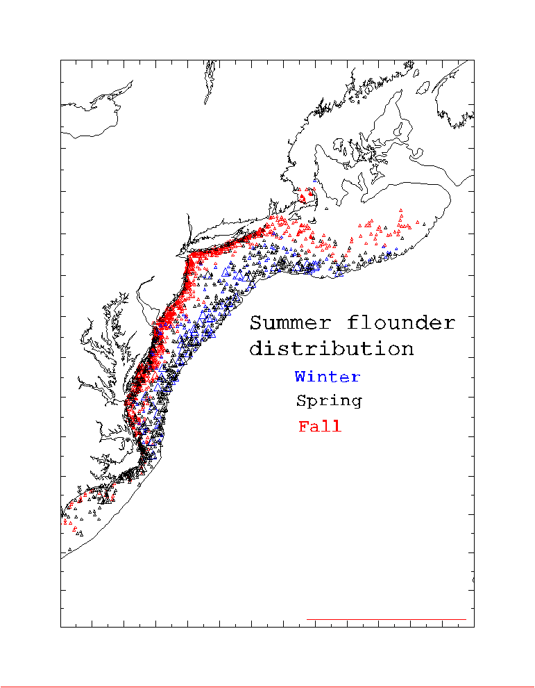
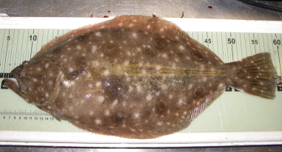
Summer Flounder
Estuaries are used as important nursery habitats
Adult fish return to these shallow water estuarine areas
Hypoxia effects natural estuarine habitat
http://cae2k.com/photosviewer-0/summer-flounder.html
http://www.nefsc.noaa.gov/sos/spsyn/fldrs/summer/animation/spring/index.html

Slide 74
Summer Flounder Policy
Season from May 5th - September 28th
5 bag limit
New Regulations on catch size limits are very controversial
The fluke move to deeper water when hypoxic events happen
This decreases the population around the estuaries and causes less fish to be caught

Slide 75
Weakfish
Weakfish have to move from the area when it becomes hypoxic
Bottom feeders- when they move the fish have to move as well to find more to eat
If they cant find more to eat- die!
http://www.dnr.state.md.us/fisheries/fishfacts/art/weakfish.jpg
http://www.odu.edu/sci/cqfe/Research/Chesapeake%20Bay/Weakfish/Weakfish.htm

Slide 76
Regulations
In 1995 Federal waters between Maine and Florida were closed for fisheries to help rebuild population
Current regulations include:
12-inch minimum catch size
By catch limit of 150 pounds for commercial fishing boats
1 fish per angler per day until the population rebuilds.

Slide 77
Hypoxia/Catch Shares
Hypoxia reduces healthy fish levels.
Catch shares reduce fish supply and consolidate fish production.
Prices will increase for consumers.
Menhaden TAC slashed by 37%(ASFMC)
20 ground fish stocks

Slide 78
Background /Policy
Magnuson-Stevens Fishery Conservation and Management Act
Overfishing
The Magnuson-Stevens Fishery Conservation and Management Reauthorization Act of 200611(ACL LAP)
15 fisheries/six regional management councils
NOAA catch share policy November 4 2010 Obama Administration
Total Allowable Catch /Annual Limit/LAP
Allocation formula based on catch history
Commoditized catch shares Transferable
www.noaa.gov

Slide 79
Economic effects
Transfer small boats to large boats/corporate consolidation.(55 out of active 247 boats accounted for 61% percent of revenue in New England (Washington examiner).
Loss of Individual Fishermen jobs(only 37% of boats survived transition where catch shares were implemented)(Food& watch magazine).
Boats in water went from 500 to 253(Ileana Ros-lehtinen).
Preserve fish stocks
Support catch shares letter signed.
http://www.flickr.com/photos/tracy_olson/61056391/

Slide 80
Acknowledgements
Josh Kohut
Oscar Schofield awesome professors!
Scott Glenn
John Kerfoot – gave us plots of data for gliders and CODAR

Slide 81
Thank You!
Christopher Filosa
Regina Guazzo
Jason Werrell
Katherine Bianchini
and Team

