Slide 1
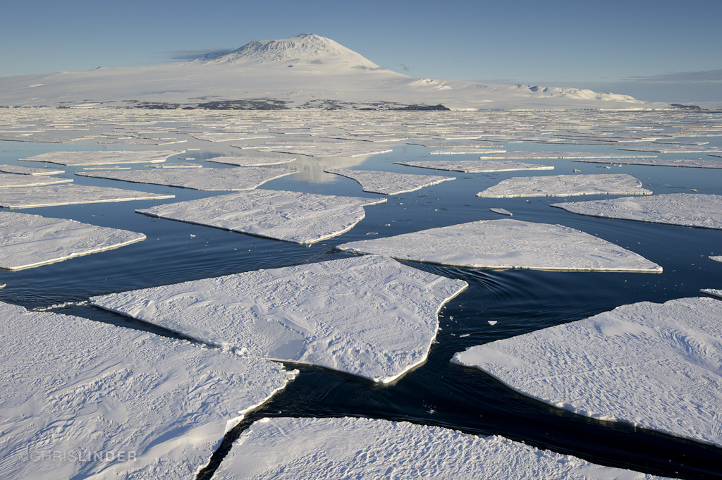


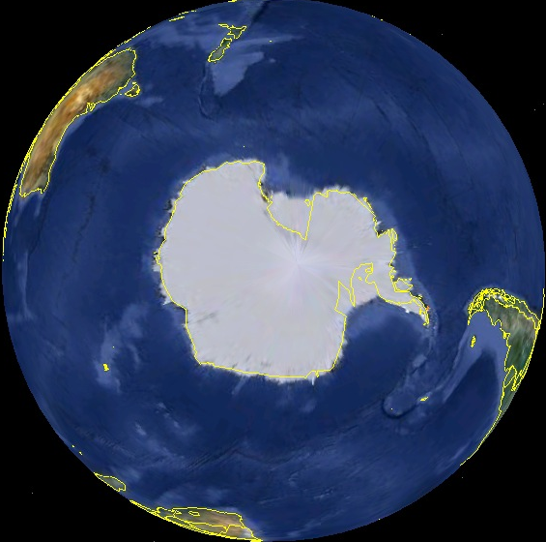
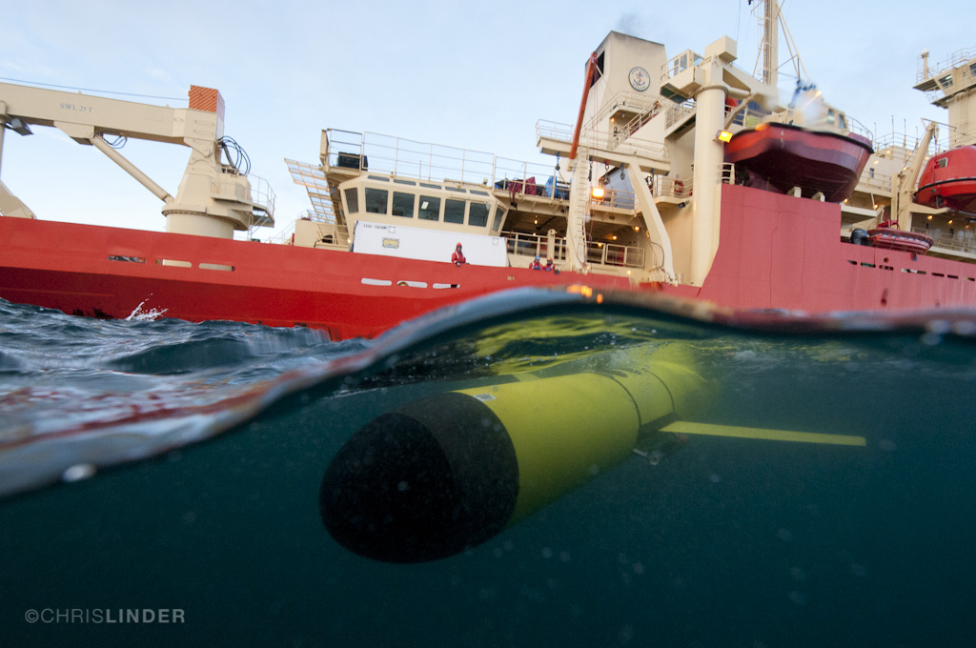
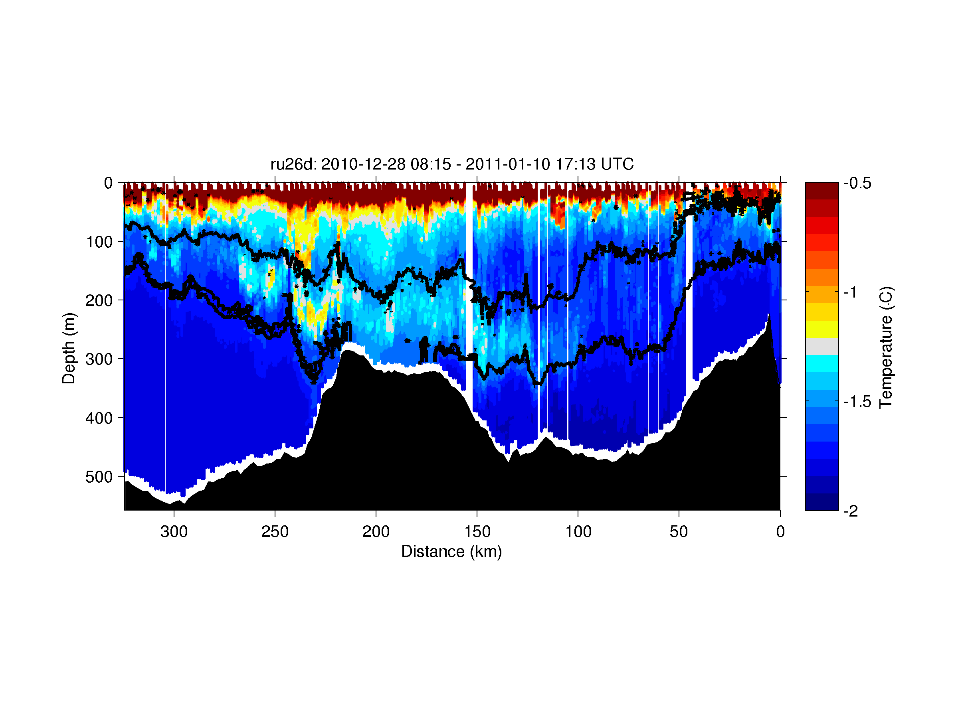
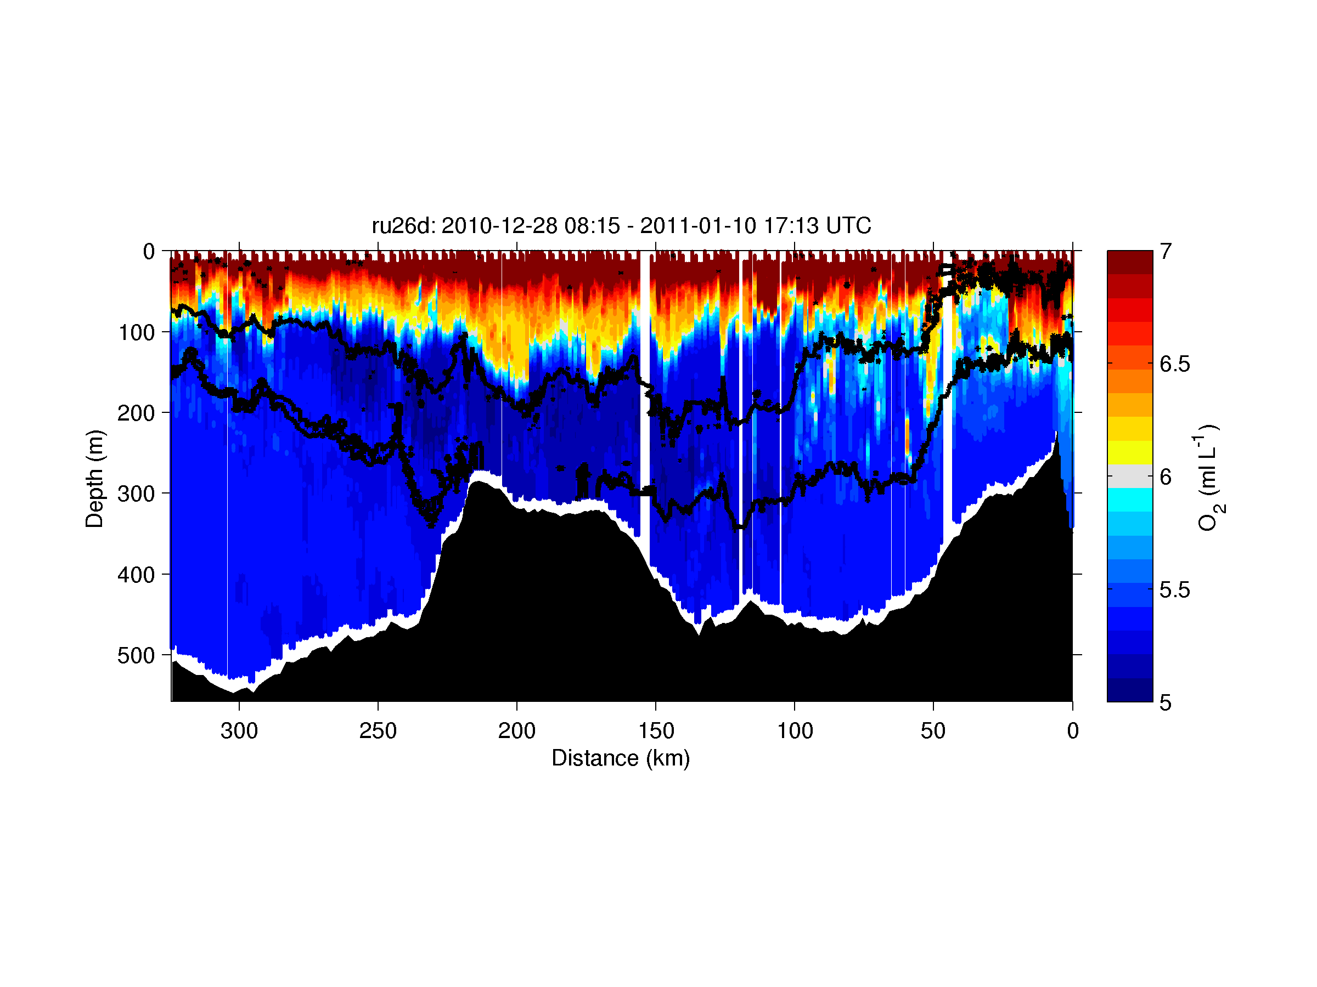
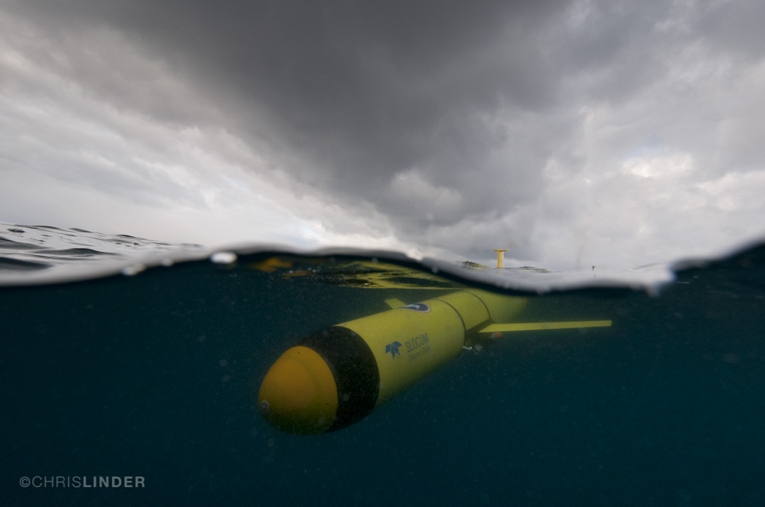
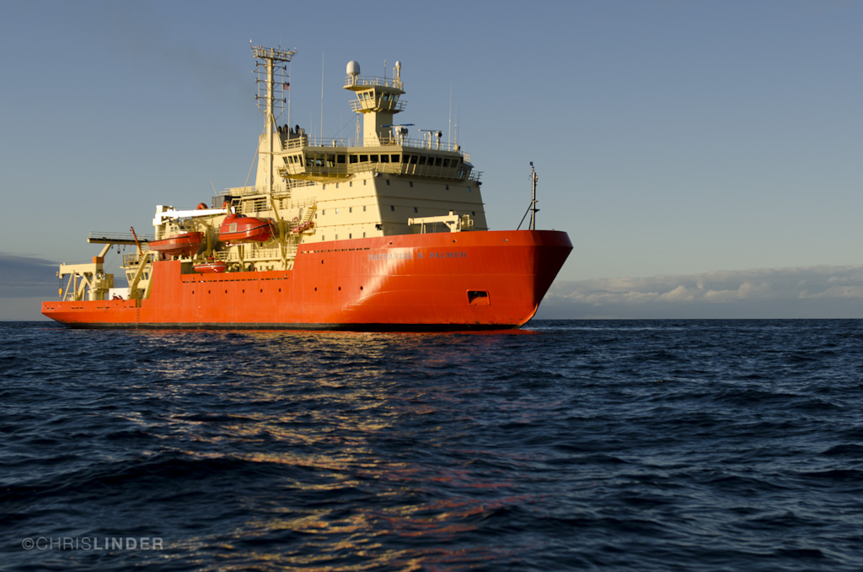
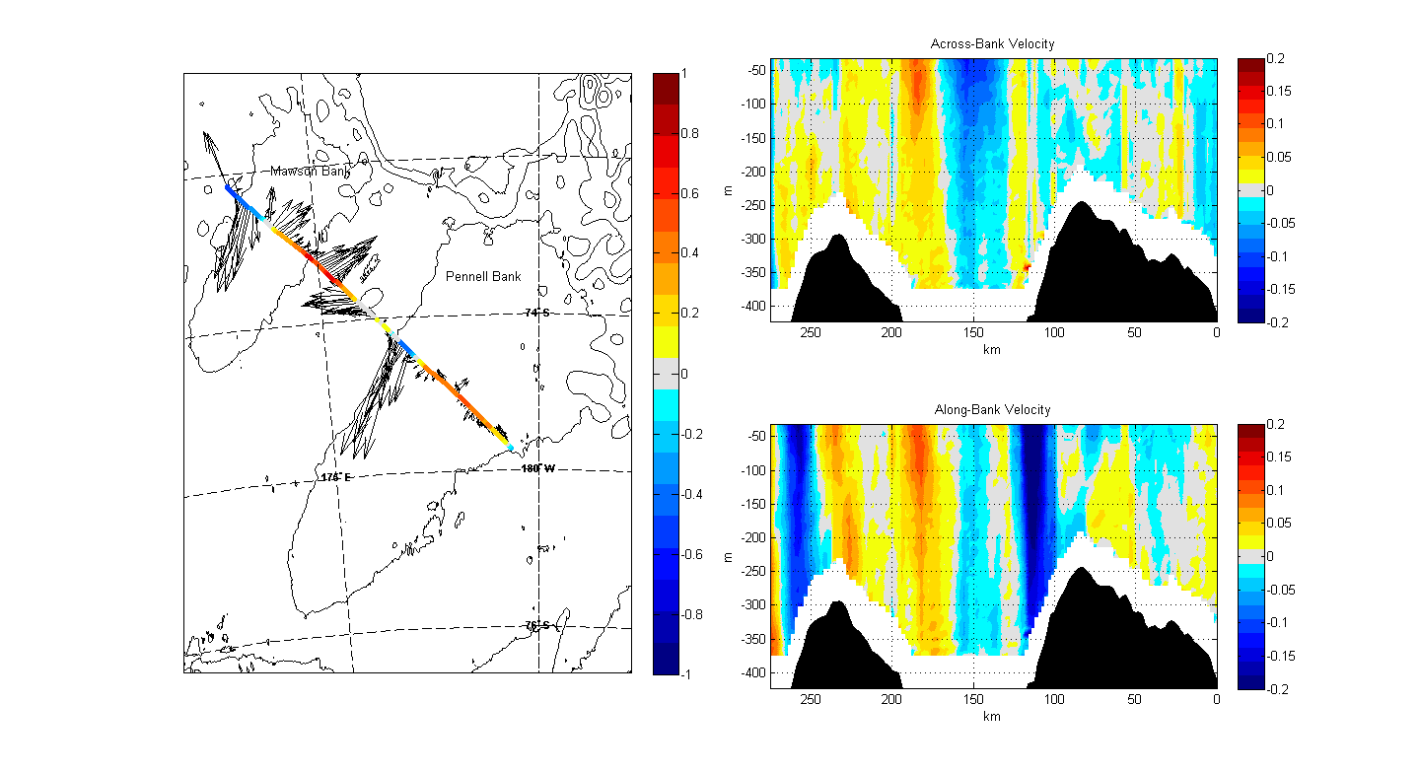
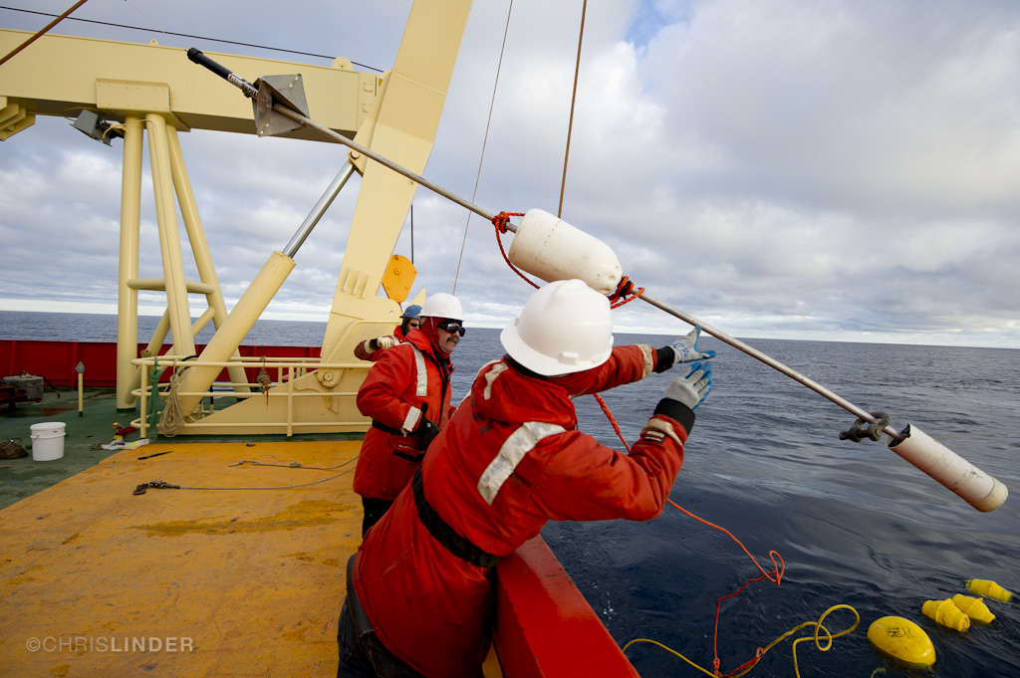
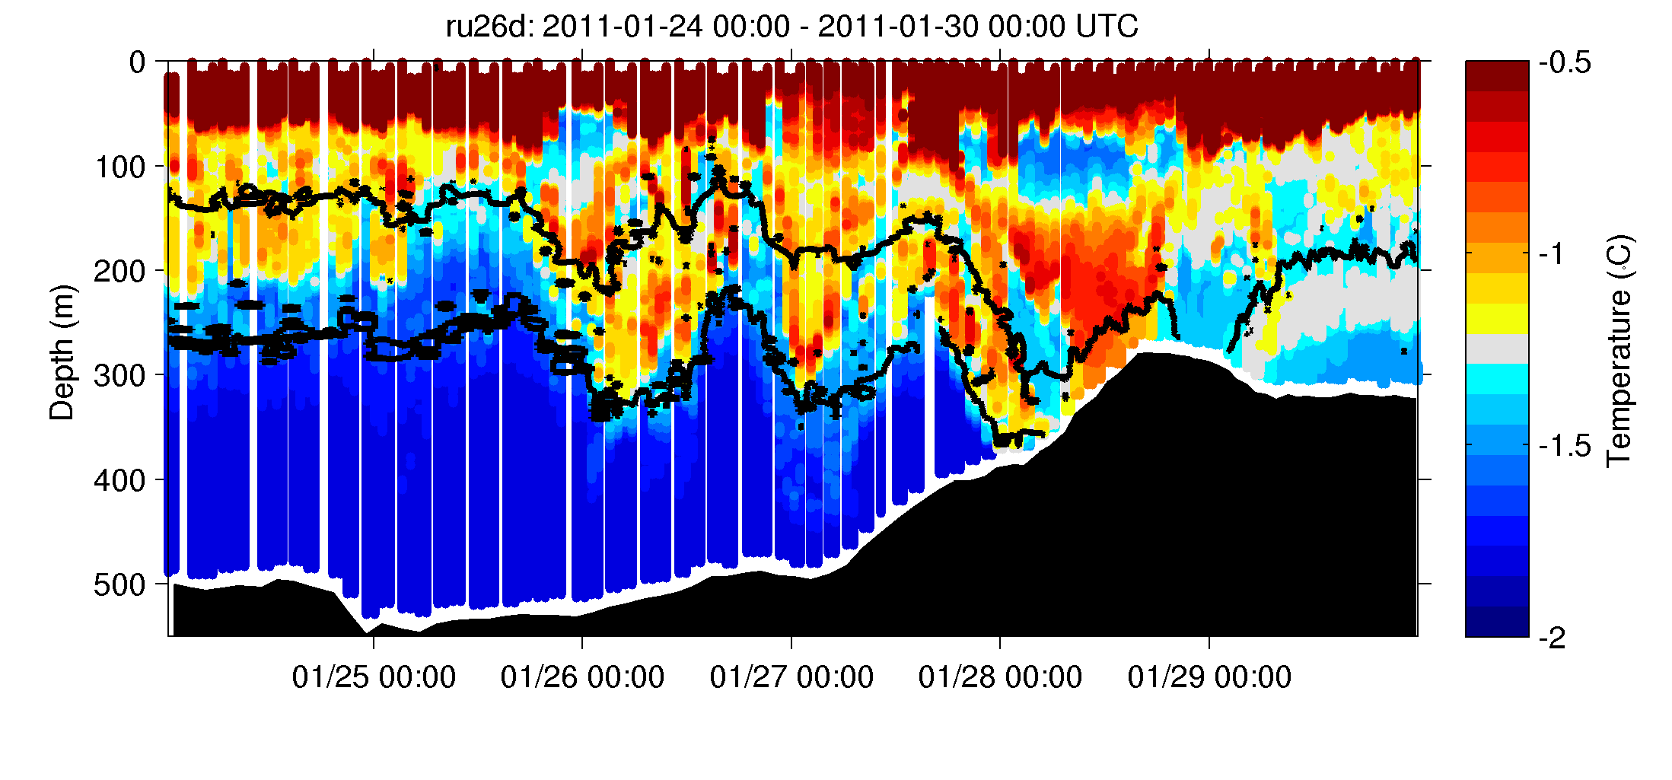
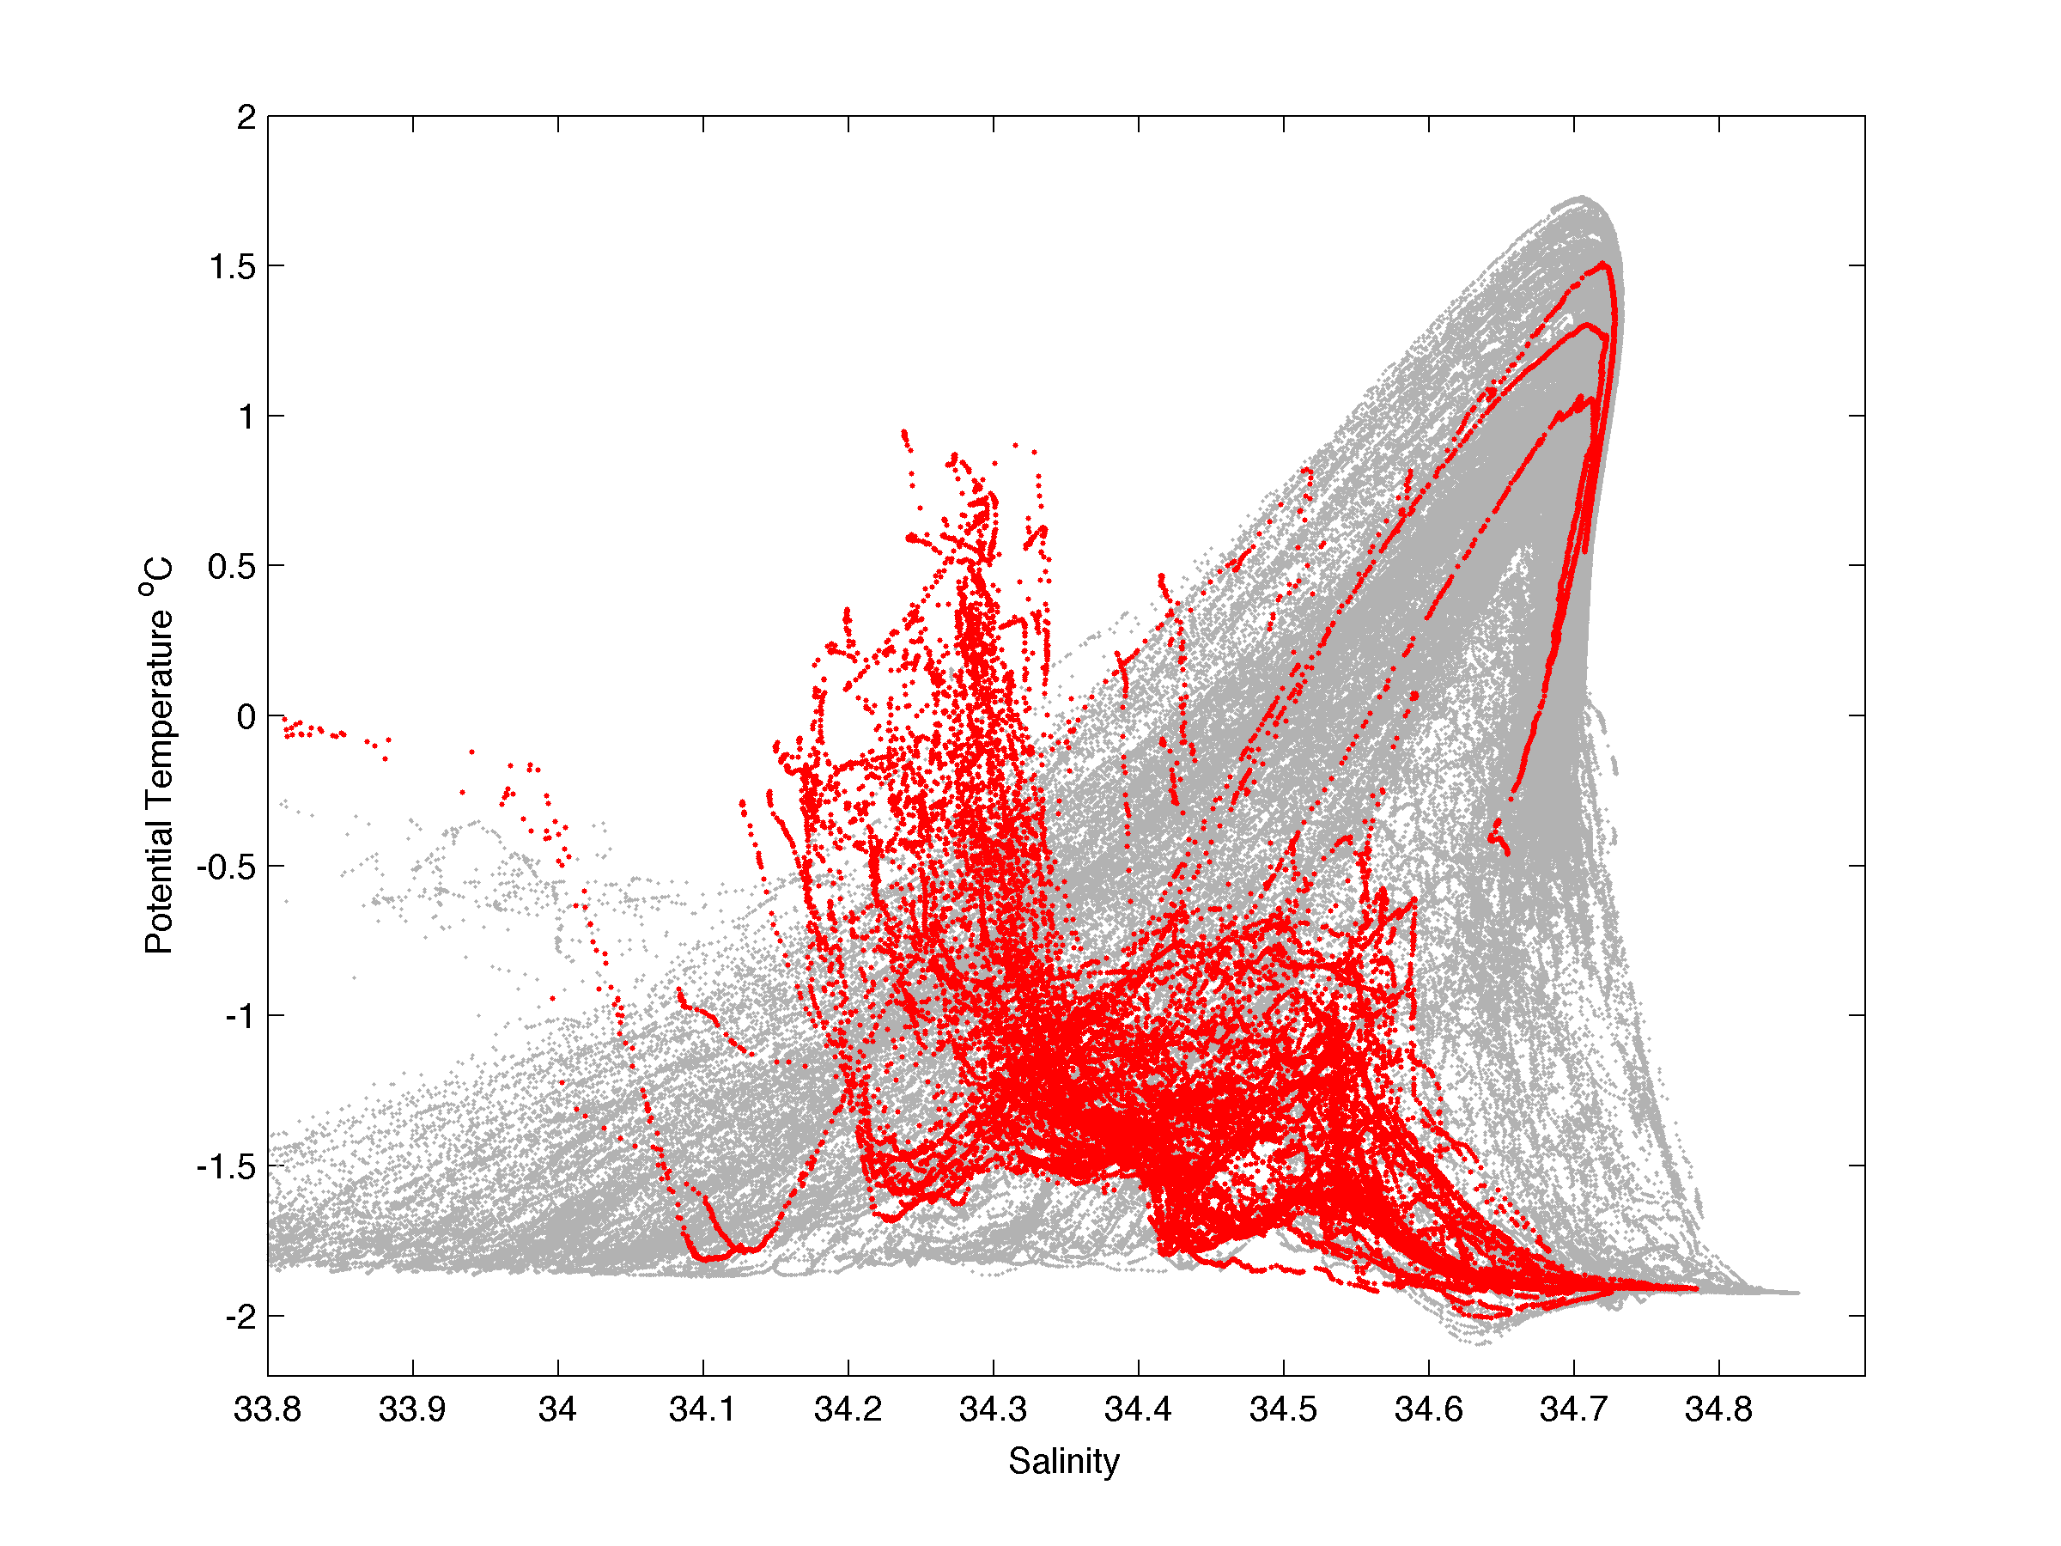
Small scale variability of the cross shelf flow over the outer shelf of the Ross Sea
B2025
Josh Kohut¹, Elias Hunter¹, and Bruce Huber²
¹Institute of Marine and Coastal Sciences, Rutgers University ²Lamont Doherty Earth Observatory, Columbia University
The Ross Sea
Glider Section: Hydrography
Ship Sections: Velocity
Mooring Deployment
The shelves of Antarctica’s continental seas are critical water mass transformation centers with impacts felt both locally and globally. The water masses that undergo these transformations have origins in the deep ocean and on the shelf itself. Here we focus on the intrusion of warm Circumpolar Deep Water (CDW) from the interior of the Southern Ocean onto the shelf. The warmer CDW mixes with shelf water to form Modified Circumpolar Deep Water (MCDW).
A single glider section across the bank and trough topography of the Ross Sea shows the scale and possible dynamics driving the distribution of MCDW in the Ross Sea. Neutral density contours characterizing MCDW are shown in black.
Profiles of water velocity were obtained from the hull mounted 150 KHz ADCP. Depth averaged and depth dependent data were detided using the predicted barotropic tide derived from Ross Sea sub-region of the the Oregon Tidal Prediction System (Erofeeva et al., 2005).
The temporal variability of the flow moving south along the western slope of Pennell Bank was sampled with a 13 day mooring deployment. Time series of the temperature, salinity, and velocity were sampled at a mean depth of 225 m, within the MCDW core observed in the ship and glider sections.
Depth Averaged
The velocity data show the strong diurnal tide that transitioned from spring to neap over the duration of the deployment.
The temperature data at 225 m is highly variable over scales of 10s of minutes to hours.
The salinity is also highly variable, predominately at the diurnal band.
Depth average velocity between ship cross-sections is variable over the shallows of the banks.
The most consistent feature across all the individual sections is the southward flow along the western slopes of the banks.
While there is some variability in the strength and width of this flow, there is a consistent transport of cooler surface water from the shelf break toward the interior of the Ross Shelf.
Surface Temperature (°C)
In this study we use an extensive multiplatform observation array to characterize the southward flow of MCDW from the shelf break to the interior of the Ross Sea Shelf.
JT
PB
RB
Deep Glider AUV
Dec 10, 2010 - Feb 4, 2011
Time (MMDD)
The pressure data (not shown) indicates a fluctuation in the sensor depth of 10-30 m correlated with the tide. While significant, this sensor motion does not appear to account for all the variability in the diurnal band.
JT
PB
RB
MCDW Transport
RVIB Nathaniel B. Palmer
Jan 19, 2011 - Feb 12, 2011
MB
JT
PB
Given the observations of MCDW along the western slope of Pennell Bank we estimate a mean volume transport over the sample period.
Estimated Transport = 100 m x 20,000 m x 0.12 m/s = 2.4x10⁵ m³/s
0.24 Sv
The subsurface temperature maximum and dissolved oxygen minimum map the location of MCDW relative to the topography of the bank.
MCDW is concentrated over the 400 meter isobath of the western slope of Pennell Bank
Warm water within the MCDW neutral density band is seen all the way across Pennell Bank.
Distance (km)
Depth Dependent
Mooring
Jan 27, 2011 - Feb 9, 2011
Across-Bank Velocity (m/s)
Based on the observations, this transport varies significantly in both space and time. For example the glider section below shows the large vertical displacement of the MCDW layer as the glider approaches Pennell Bank from the west. These oscillations are predominately in the diurnal band.
Ship Sections: Hydrography
The NBP completed eight transects across Pennell Bank, Joides Trough, and Mawson Bank including nine stations sampled multiple times along the line. Neutral density contours characterizing MCDW are shown in black.
Depth (m)
MB = Mawson Bank JT = Joides Trough PB = Pennell Bank RB = Ross Bank
Water Mass Distribution
MB
JT
PB
Following Orsi and Wiederwohl (2009) we classify the observed water masses into these general categories:
Bottom Water (neutral density > 28.27)
MCDW/CDW (28.00 < neutral density < 28.27)
Surface Water (neutral density < 28.00)
Temperature (°C)
Distance (km)
Along-Bank Velocity (m/s)
JT
PB
MB
JT
PB
0125 0126 0127 0128 0129
Salinity (psu)
Time (MMDD)
Turn in transect near mooring location
Depth (m)
Summary
The mean volume transport of MCDW is approximately 0.24 Sv centered over the western slope of Pennell Bank at a depth between 200 m and 300 m.
The transport is seen to vary significantly over small spatial and temporal scales.
The MCDW core near the mooring site intersects the bottom while further to the south the glider shows a shallower MCDW core that reaches up and over Pennell Bank.
Both model and observation strategies must resolve these scales to accurately characterize the volume transport of MCDW from the shelf break to the shelf interior.
NBP Data 2003 - Present
SEAFARERS
28.00
MB
JT
PB
MB
JT
PB
28.27
Dissolved Oxygen (ml/L)
Distance (km)
MB
JT
PB
The across bank flow tends to be up slope over the western edge of each bank. The largest shears are seen over the eastern edge of Mawson Bank and Joides Trough.
The along-bank flow is most intense over the edges of the banks with flow toward the south along the western edge and toward the north along the eastern edge.
The southward flow coincident with the MCDW core seen in the hydrographic section is surface intensified with a mean velocity of about 0.3 m/s reducing to 0.12 m/s at the depth of the MCDW peak (200-300 m).
Distance (km)
The mean cross section based on all the casts taken across these stations shows the significant variation in water column properties across the complicated topography.
At mid-depth the most striking feature is the concentrated slug of warmer, lower dissolved oxygen, MCDW centered over the 400 m isobath of the western slope of Pennell Bank.
The neutral density bands indicate that this core intersects the bottom and may not reach the low oxygen water over Pennell Bank.
Acknowledgments: This work was supported by the NSF Office of Polar Programs. We would like to thank to the entire Raytheon Polar Services team for their help with the glider sea ice deployment and all work completed on board the NBP. We look forward to working with our SEAFARERS Co-Investigators to see how these dynamics impact chemical and biological process across the Ross Shelf.
Erofeeva, S. Y., Laurie Padman, Gary Egbert, 2005: Assimilation of Ship-Mounted ADCP Data for Barotropic Tides: Application to the Ross Sea. J. Atmos. Oceanic Technol., 22, 721–734.
Orsi, A. H. and C. L. Wiederwohl, 2009: A recount of Ross Sea waters. Deep Sea Research Part II: Topical Studies in Oceanography 56 (13-14): 778-795.

