Slide 1
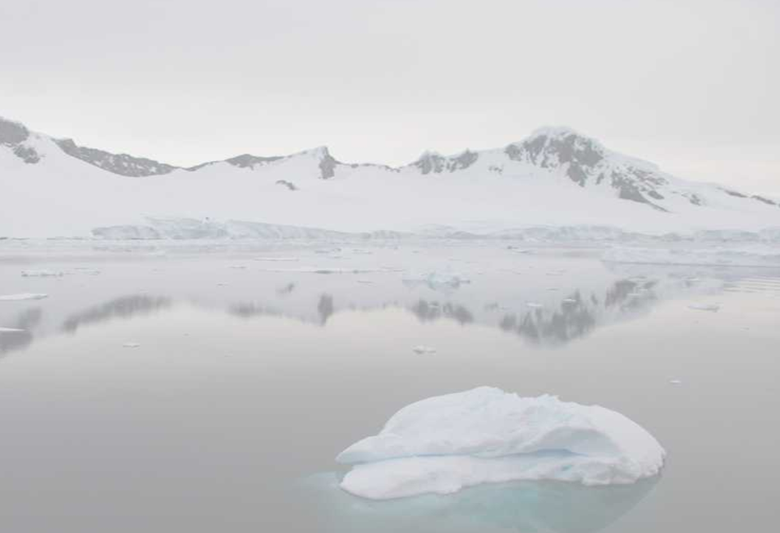






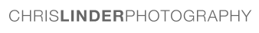
AUV RESEARCH AND EDUCATION IN THE ROSS SEA: SCIENTISTS SHARE RESEARCH EXPERIENCE WITH MIDDLE SCHOOL TEACHERS AND STUDENTS
Josh Kohut, Sage Lichtenwalner, and Janice McDonnell Chris Parsons
Rutgers University Word Craft
Harold Clark, Kate Florio, and Katie Gardner Chris Linder
Liberty Science Center Chris Linder Photography
Hugh Powell
Cornell University

Slide 2





Our Team
25 Teachers
28 Scientists
1,000 Students
COSEE-Networked Ocean World (NOW)

Slide 3
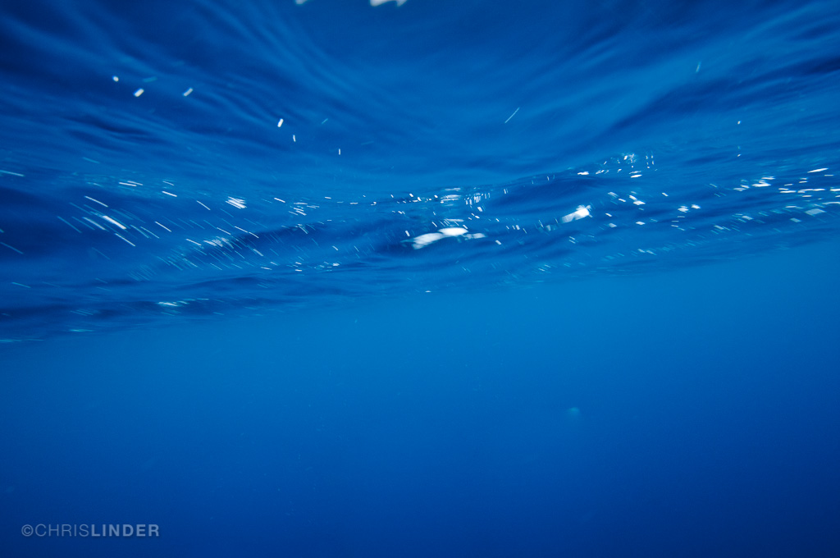
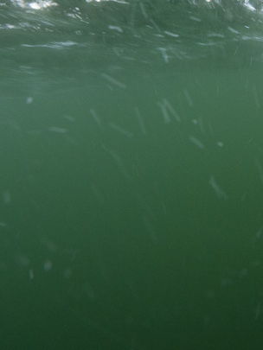
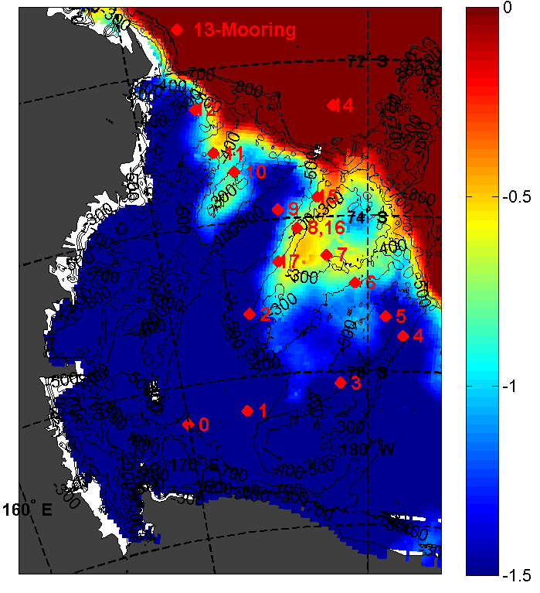
Modified Circumpolar Deep Water and the Ross Sea Ecosystem
Ross Sea Climatology
Ross Sea Forecasts
Temperature – 250m
Orsi and Weiderwahl.
Dinninman et al.

Slide 4
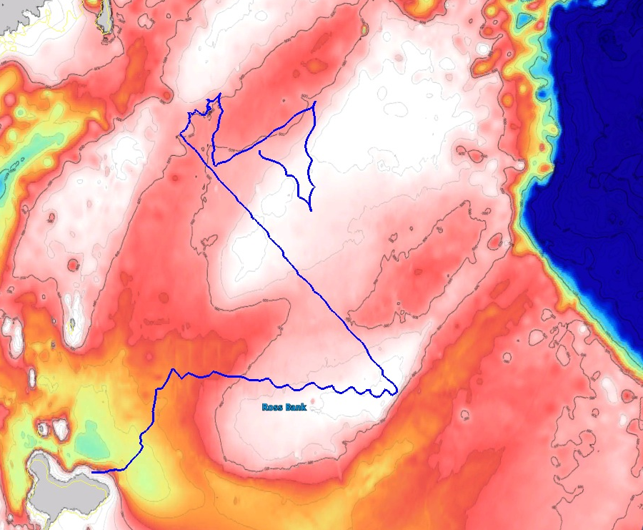
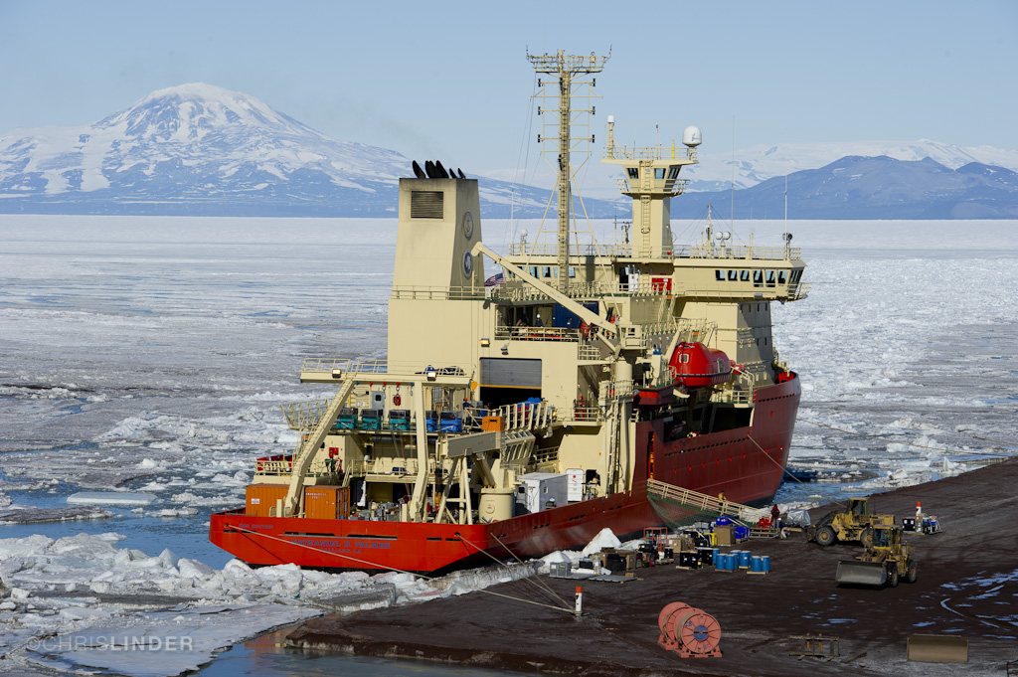
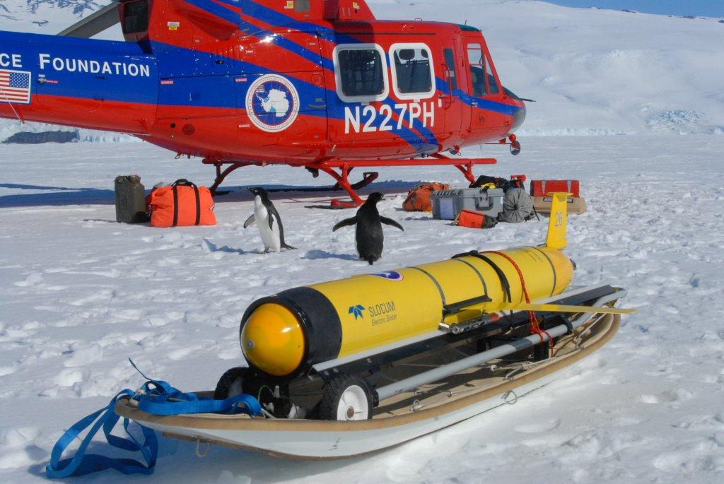
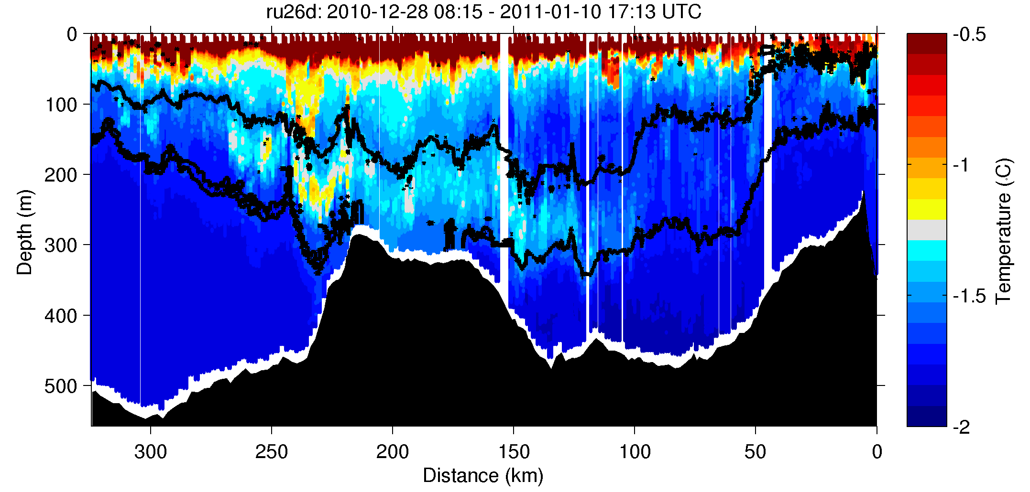
Deep Glider Mapping of Ross Sea Water Masses Poster B2025 Today!
Cross bank section identifies peak MCDW

Slide 5
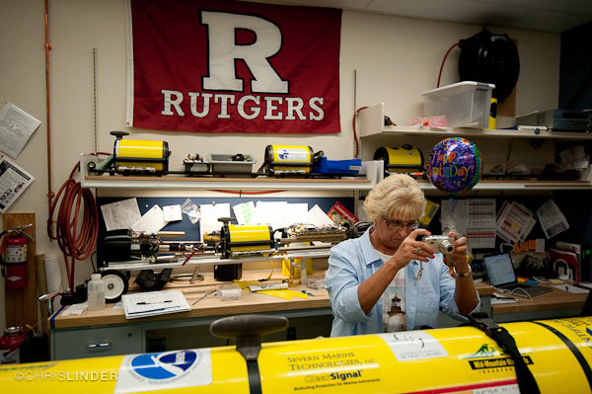
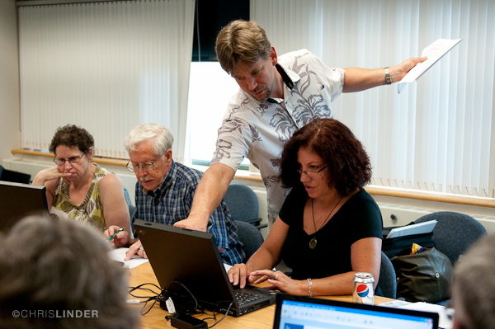
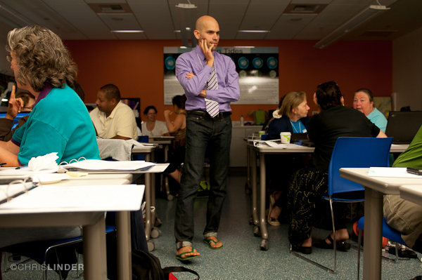
Technology
The Ross Sea Connection
Summer Teacher Institute (Poster Today: B0696)
- 25 teachers
- Grades 6-9
Evaluation (Stay tuned, coming up next!)
- Guided the design of our approach
- Effectiveness of the program through surveys
and interviews
Daily Journals
- 30 entries
- 350 Comments
Live Audiocasts from the Ship (9)
- 17 schools
- 9 scientists and 1 captain
Science
Tools

Slide 6
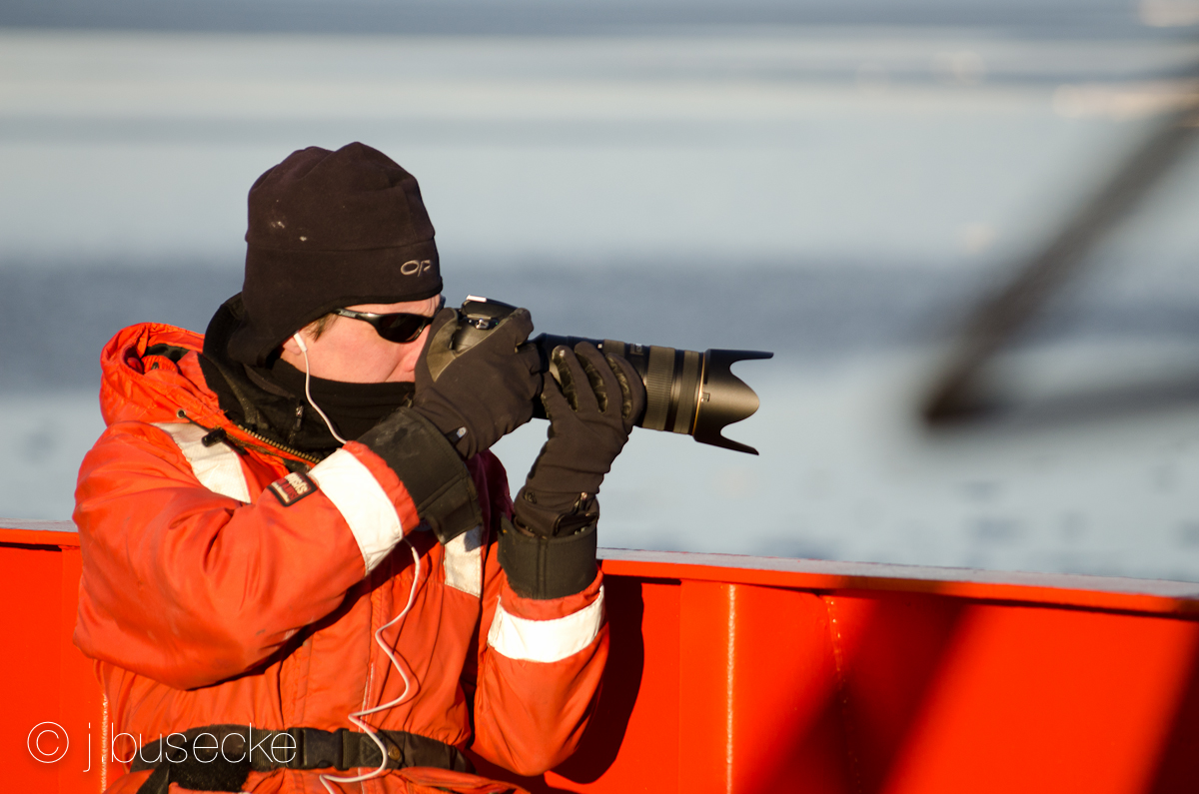
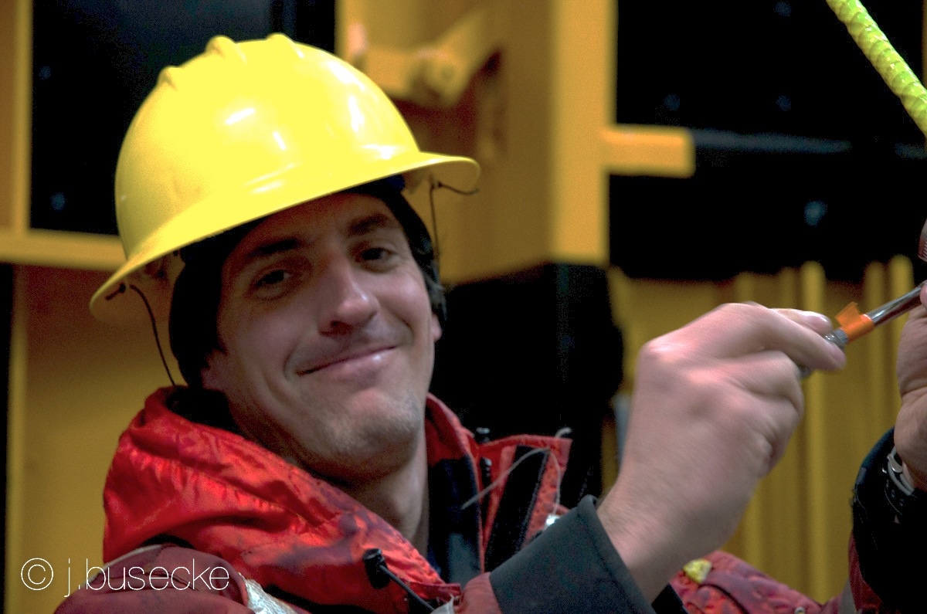
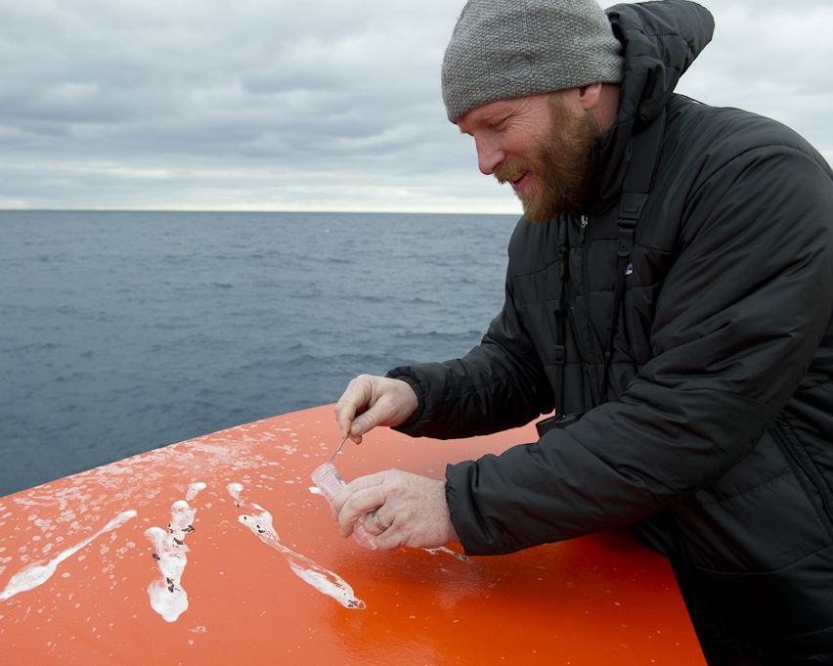
The Field Team
Chris Linder
Chris Linder Photography
Photographer and Facilitator
Physical Oceanographer
Over 50,000 photos taken
Hugh Powell
Cornell University
Science Writer and Storyteller
Ornithologist
30 blog entries and 120
responses to comments

Slide 7
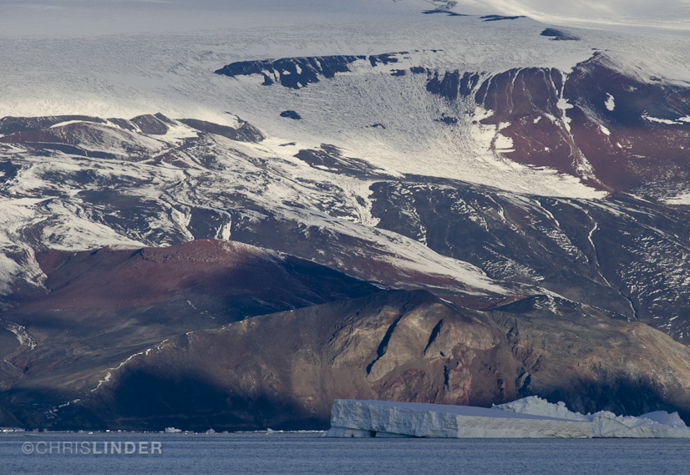
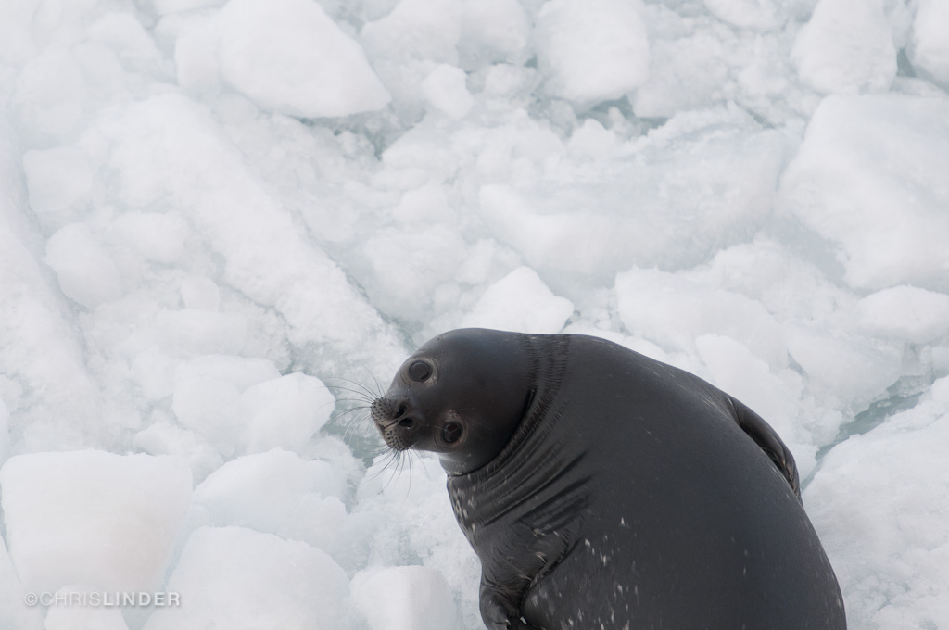
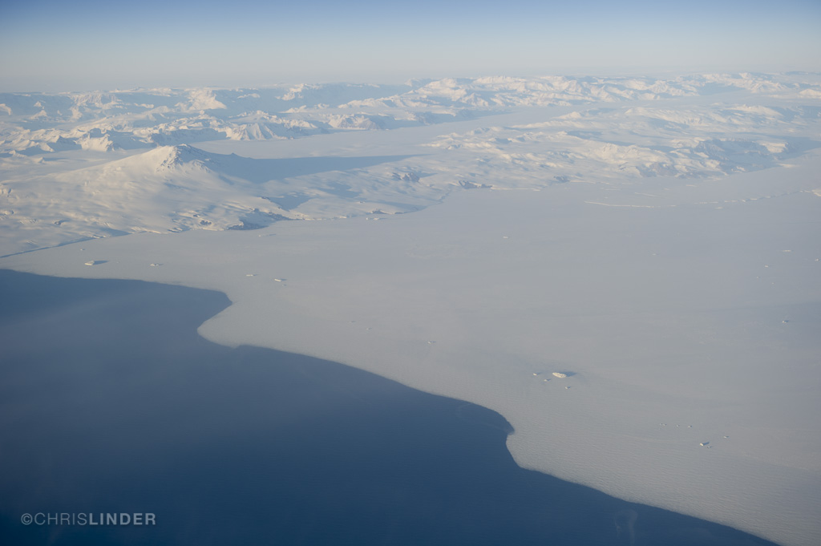
The Ross Sea

Slide 8
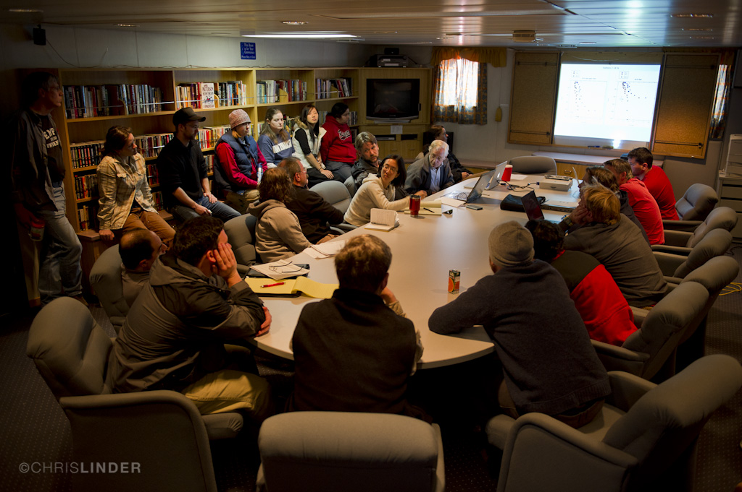
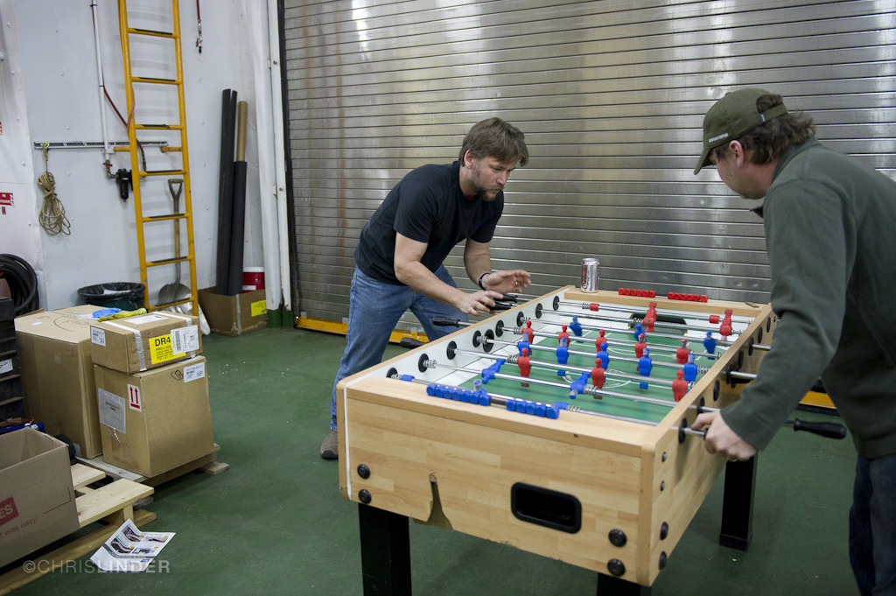
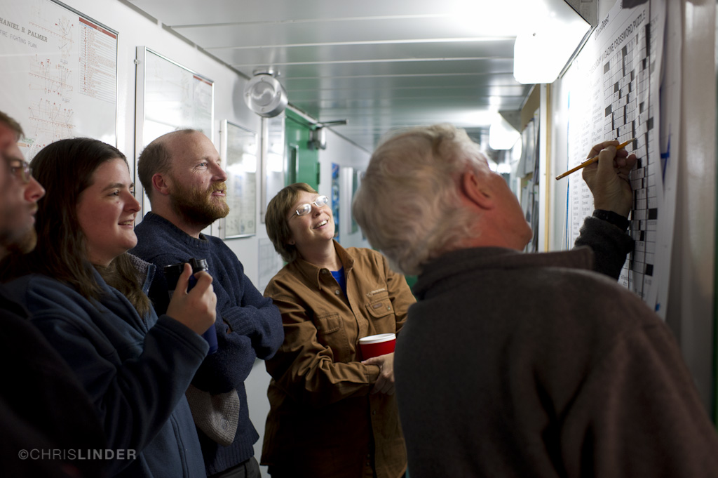
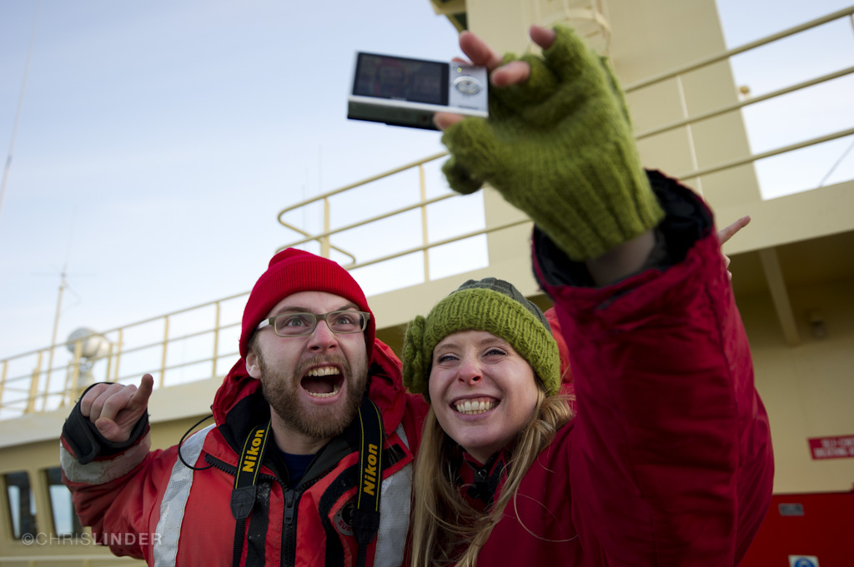
Life on Board

Slide 9
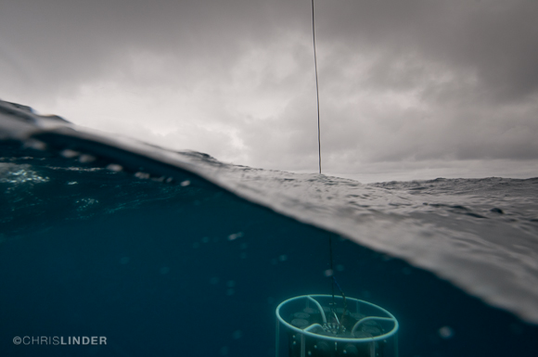
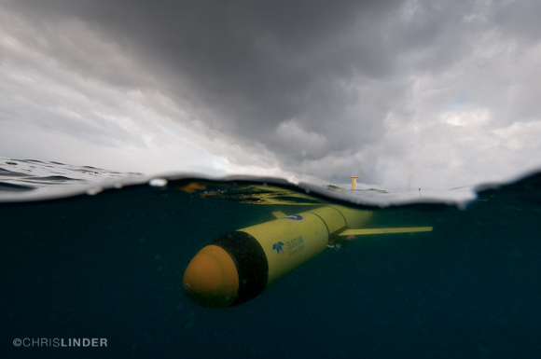
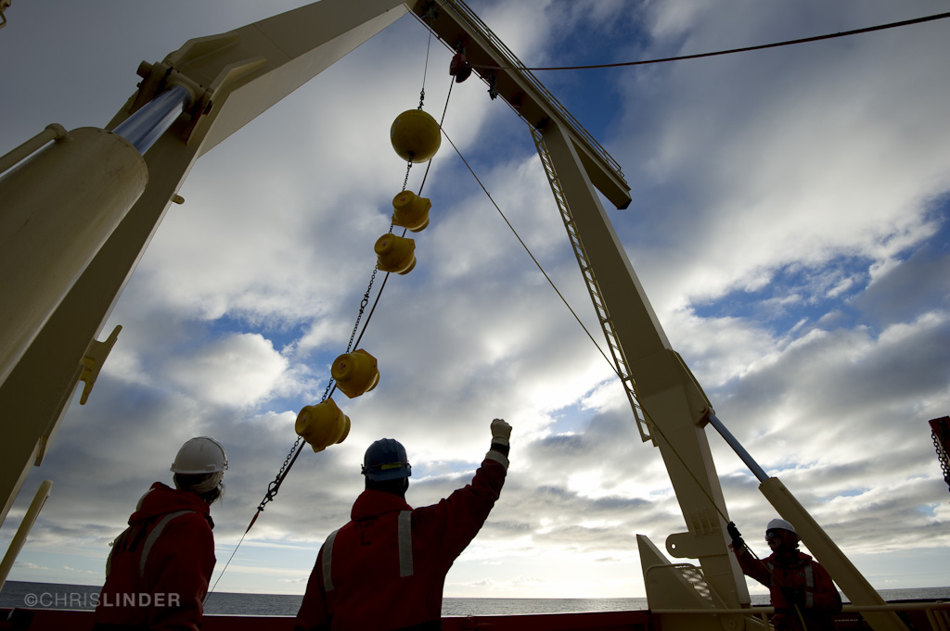
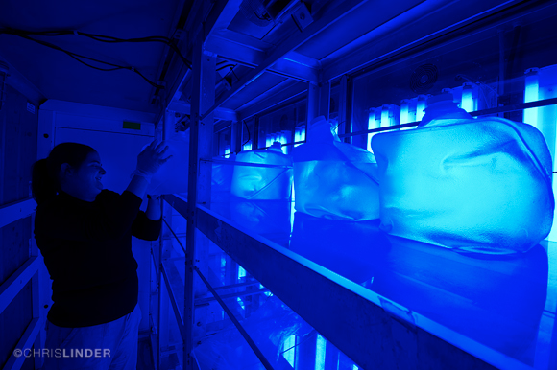
The Technology

Slide 10
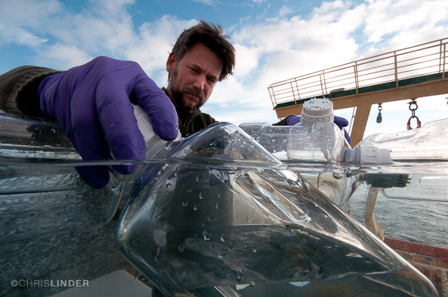
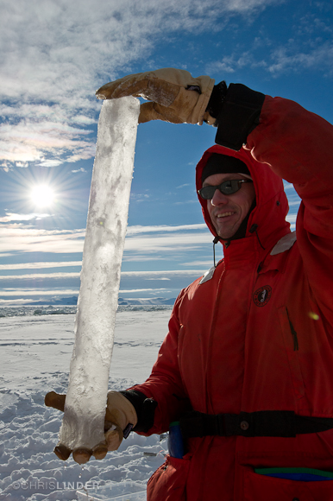
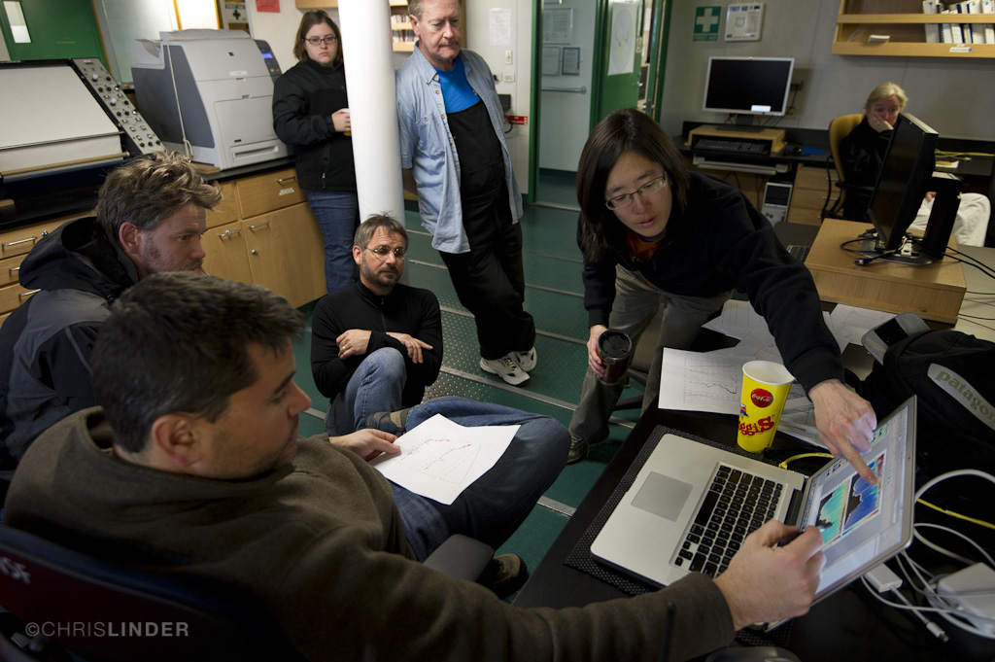
The Process of Science

Slide 11

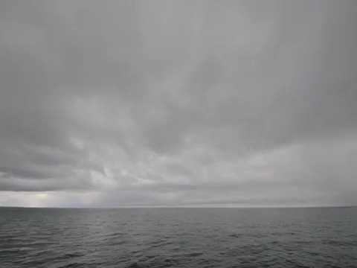
Videos
- Mooring Time Lapse
- Ship Time lapse
- Engine Room Time Lapse
- CTD Cam
Download them all at:
http://coseenow.net/ross-sea/

Slide 12
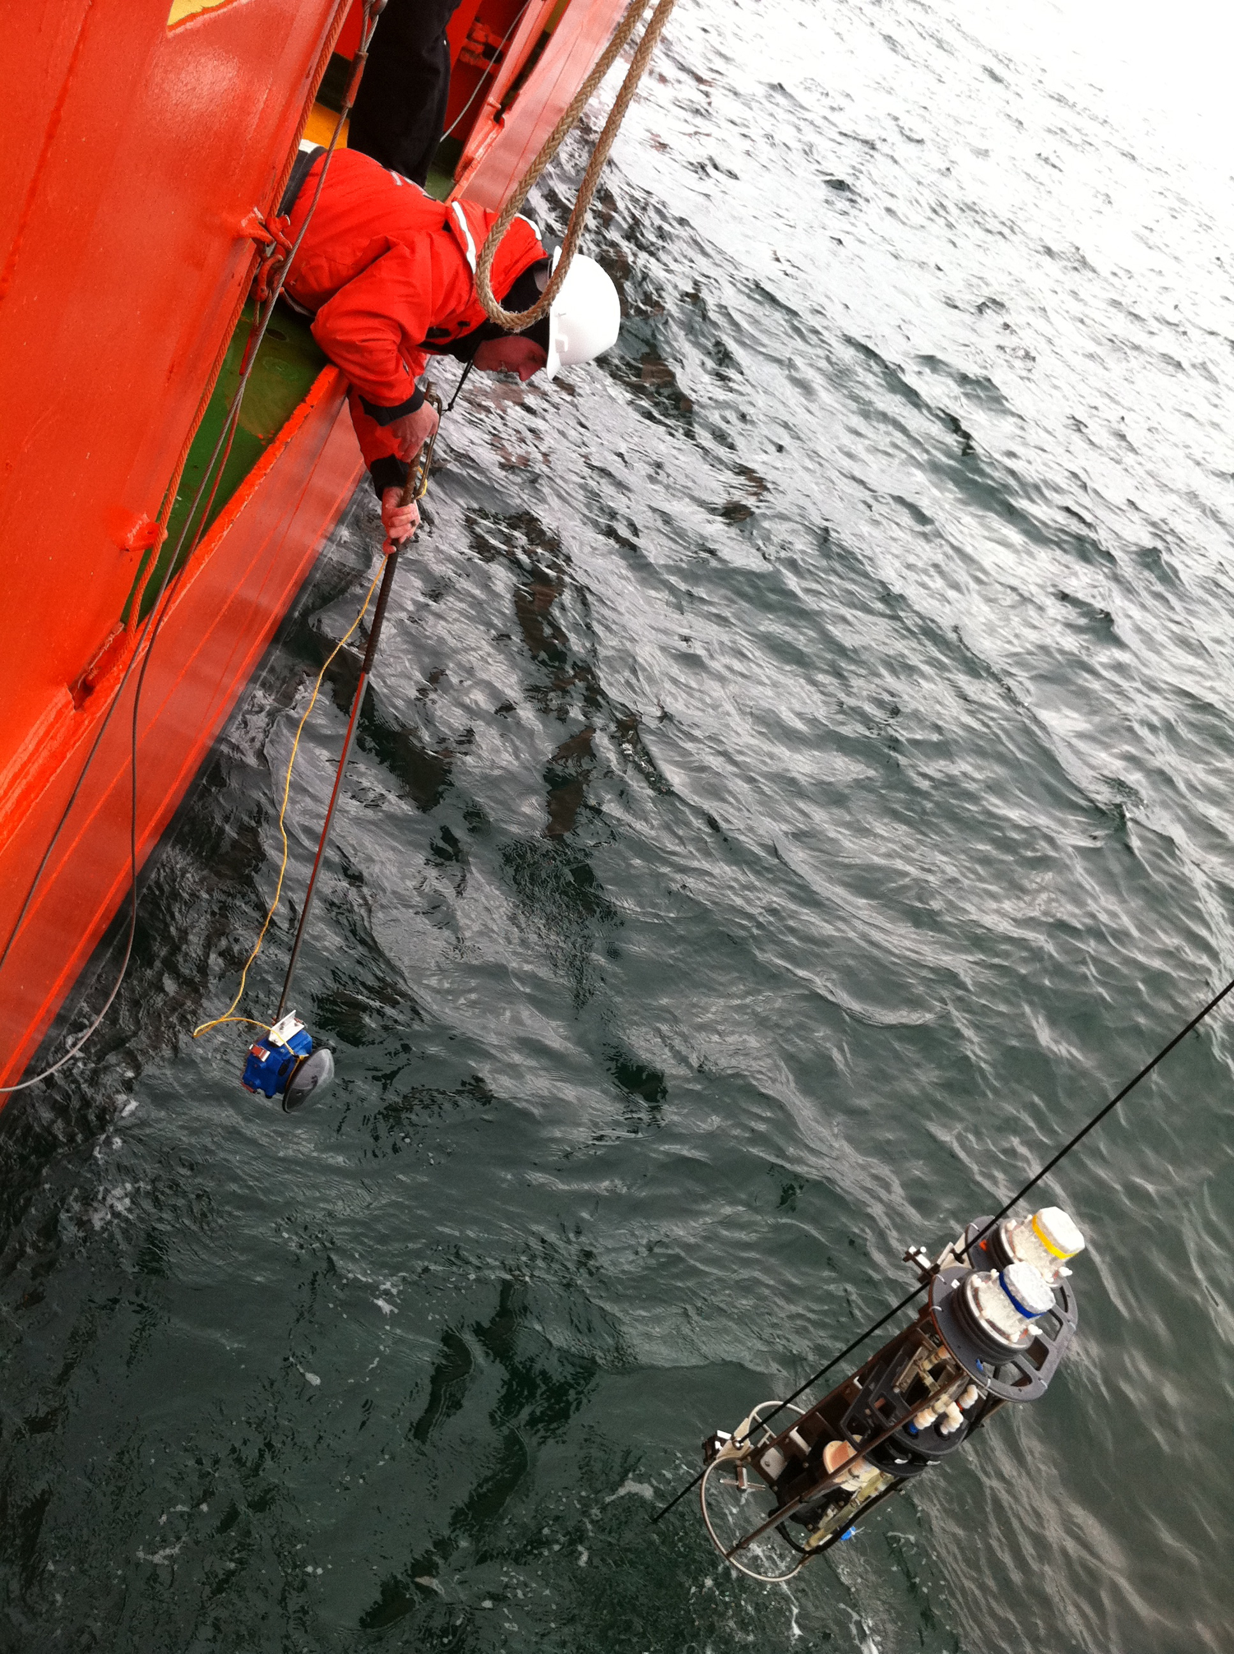
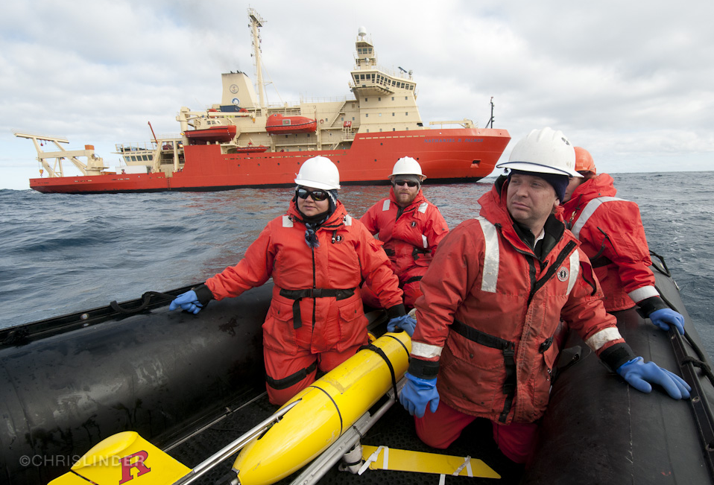
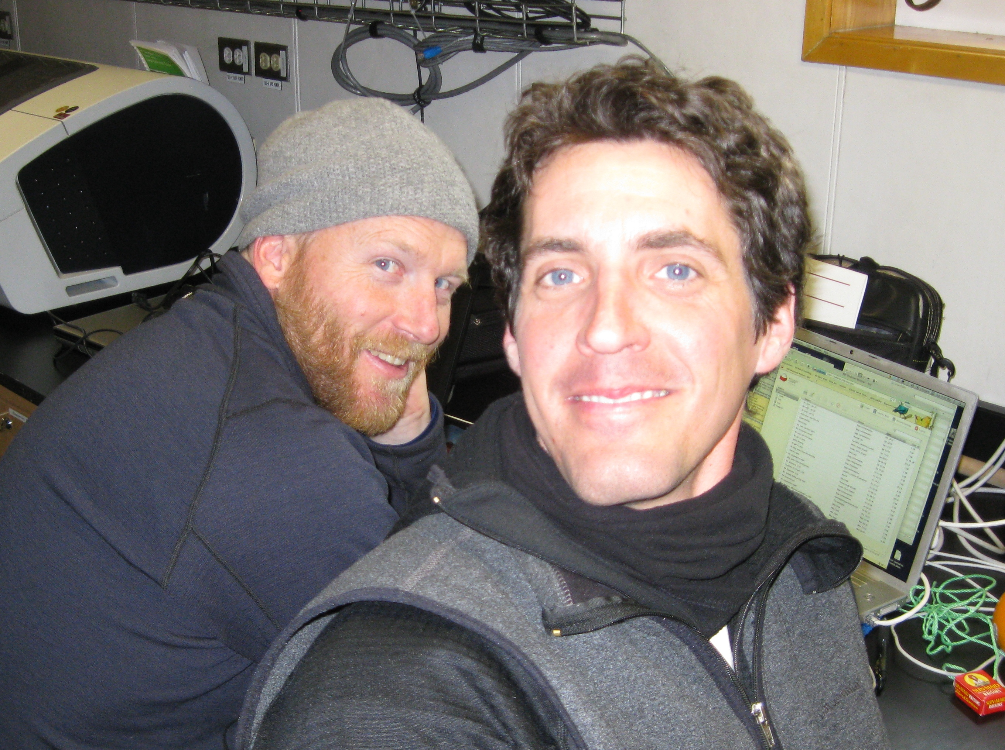
A day in their life aboard the NBP
10:00am - 11:30am : Wake up.
11:30am - 3:00 am : Full immersion in the science.
- Working with the scientists
- Documenting through thousands of photos
3:00am - 5:00am : Photo selection and Storyboard.
5:00am - 7:00am : Write the blog and send.

Slide 13
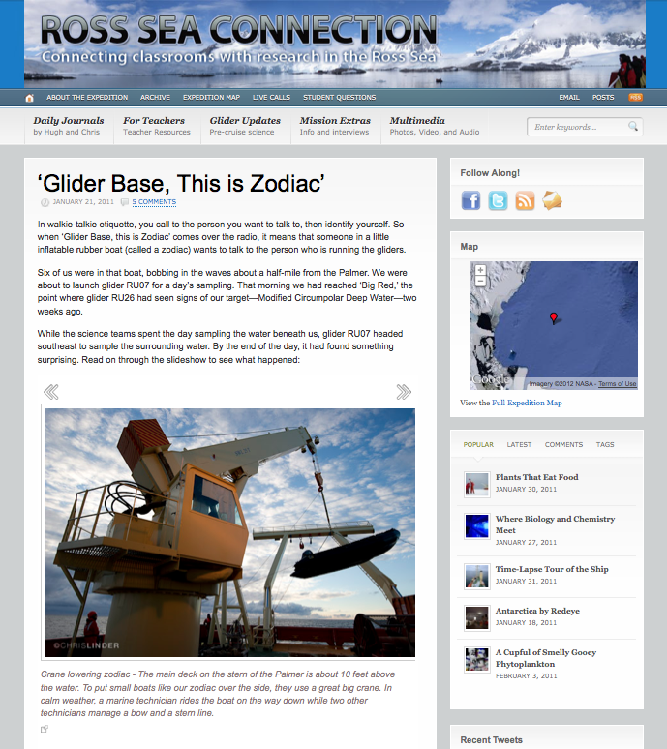
Daily Journals
Anatomy of the Daily Journal:
1) Introduction to the topic
2) Photos tell the story
3) Comments with response from
the ship
30 Entries Including:
‘Breaking Ice with Skuas, Seals, Penguins, and Whales’
‘Feeding Time on the Palmer’
‘Out Comes the Science Equipment’
‘How Scientists Look for the Truth’

Slide 14
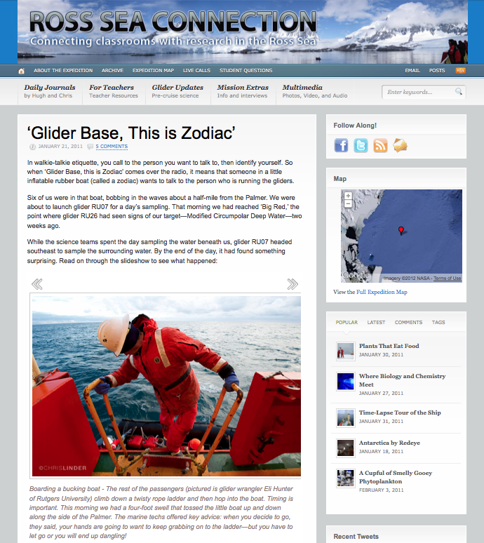
Daily Journals
Anatomy of the Daily Journal:
1) Introduction to the topic
2) Photos tell the story
3) Comments with response from
the ship
30 Entries Including:
‘Breaking Ice with Skuas, Seals, Penguins, and Whales’
‘Feeding Time on the Palmer’
‘Out Comes the Science Equipment’
‘How Scientists Look for the Truth’

Slide 15
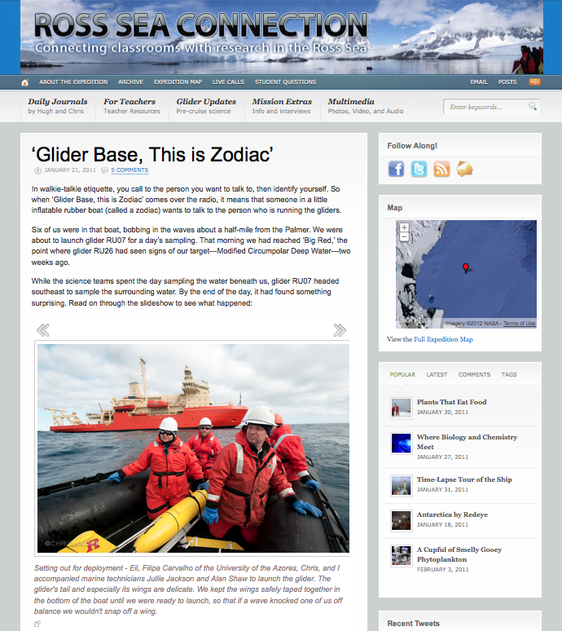
Daily Journals
Anatomy of the Daily Journal:
1) Introduction to the topic
2) Photos tell the story
3) Comments with response from
the ship
30 Entries Including:
‘Breaking Ice with Skuas, Seals, Penguins, and Whales’
‘Feeding Time on the Palmer’
‘Out Comes the Science Equipment’
‘How Scientists Look for the Truth’

Slide 16
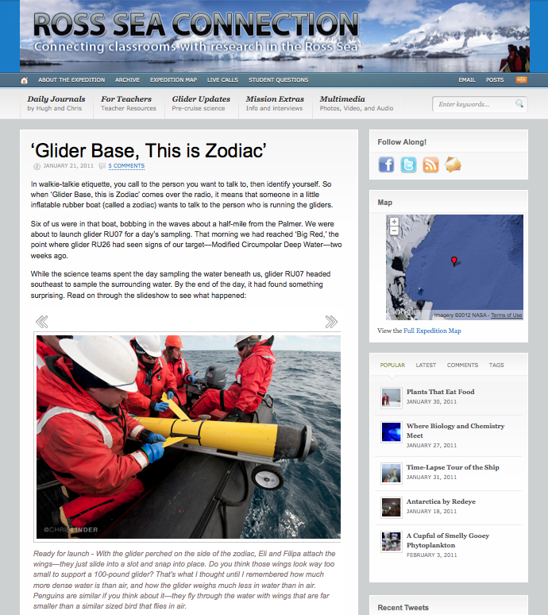
Daily Journals
Anatomy of the Daily Journal:
1) Introduction to the topic
2) Photos tell the story
3) Comments with response from
the ship
30 Entries Including:
‘Breaking Ice with Skuas, Seals, Penguins, and Whales’
‘Feeding Time on the Palmer’
‘Out Comes the Science Equipment’
‘How Scientists Look for the Truth’

Slide 17
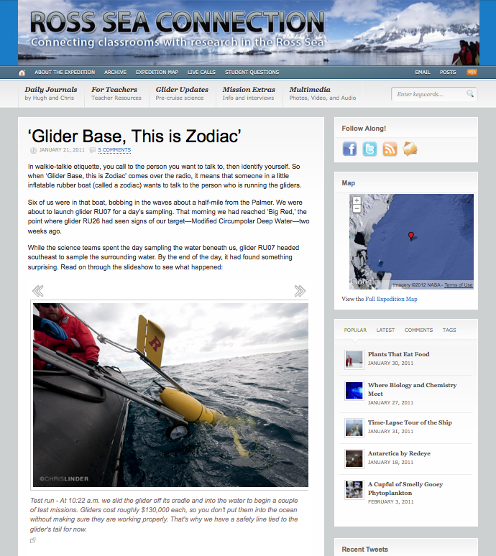
Daily Journals
Anatomy of the Daily Journal:
1) Introduction to the topic
2) Photos tell the story
3) Comments with response from
the ship
30 Entries Including:
‘Breaking Ice with Skuas, Seals, Penguins, and Whales’
‘Feeding Time on the Palmer’
‘Out Comes the Science Equipment’
‘How Scientists Look for the Truth’

Slide 18
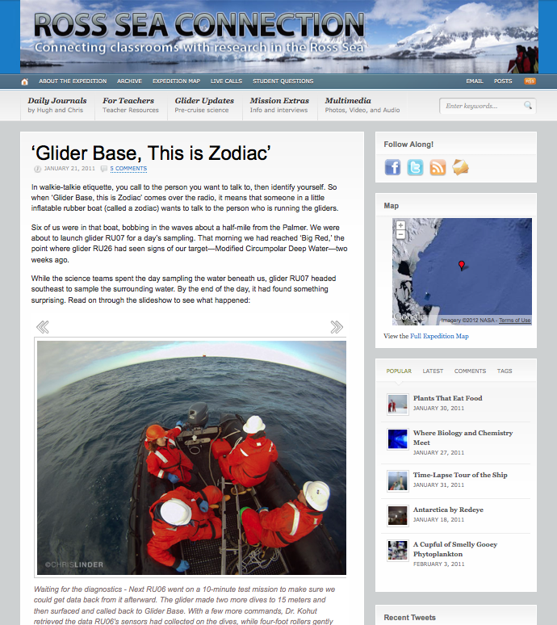
Daily Journals
Anatomy of the Daily Journal:
1) Introduction to the topic
2) Photos tell the story
3) Comments with response from
the ship
30 Entries Including:
‘Breaking Ice with Skuas, Seals, Penguins, and Whales’
‘Feeding Time on the Palmer’
‘Out Comes the Science Equipment’
‘How Scientists Look for the Truth’

Slide 19
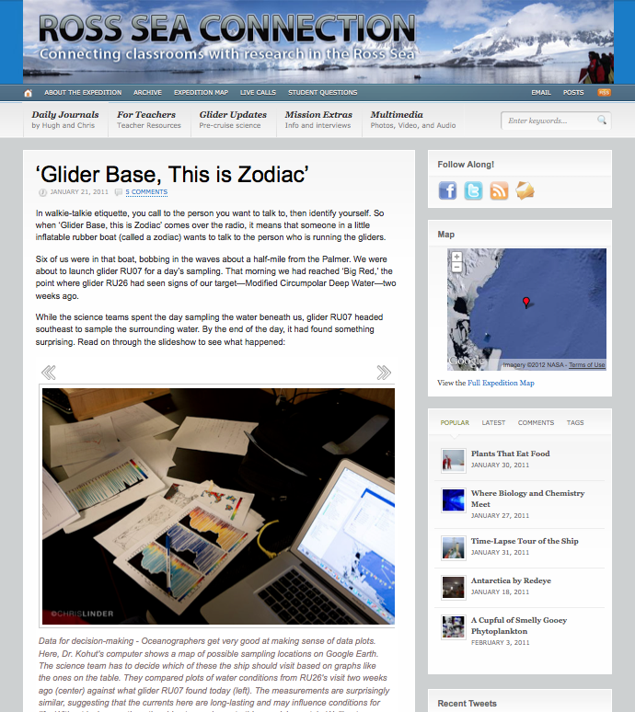
Daily Journals
Anatomy of the Daily Journal:
1) Introduction to the topic
2) Photos tell the story
3) Comments with response from
the ship
30 Entries Including:
‘Breaking Ice with Skuas, Seals, Penguins, and Whales’
‘Feeding Time on the Palmer’
‘Out Comes the Science Equipment’
‘How Scientists Look for the Truth’

Slide 20
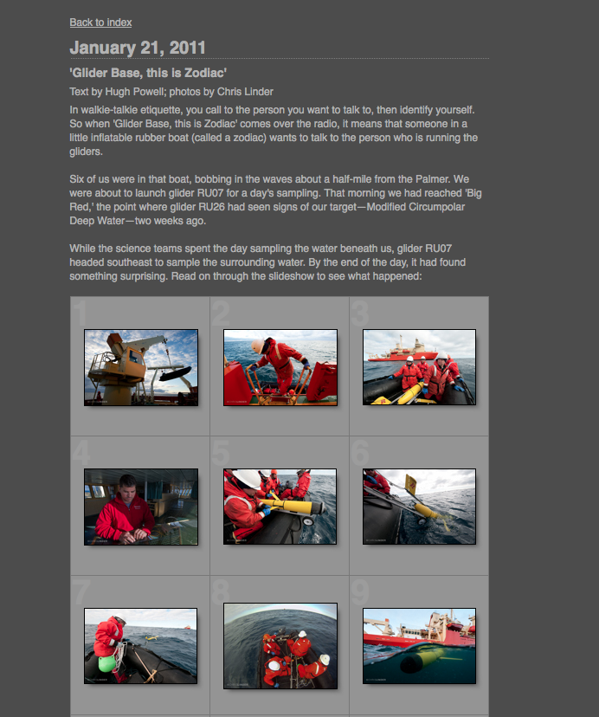
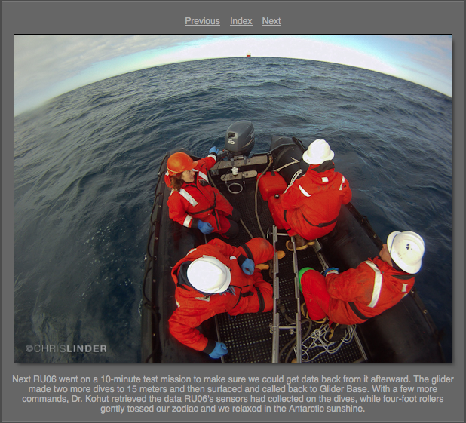
Daily Journals:
Scientist’s Perspective
‘Reading the mirror blog on the ship kept a lot of us informed as to what was going on…
- Scientist Comment
‘… I sent the link to friends and family, they loved reading it and following along, and to colleagues, and they also followed along and enjoyed looking at it.’
- Scientist Comment

Slide 21
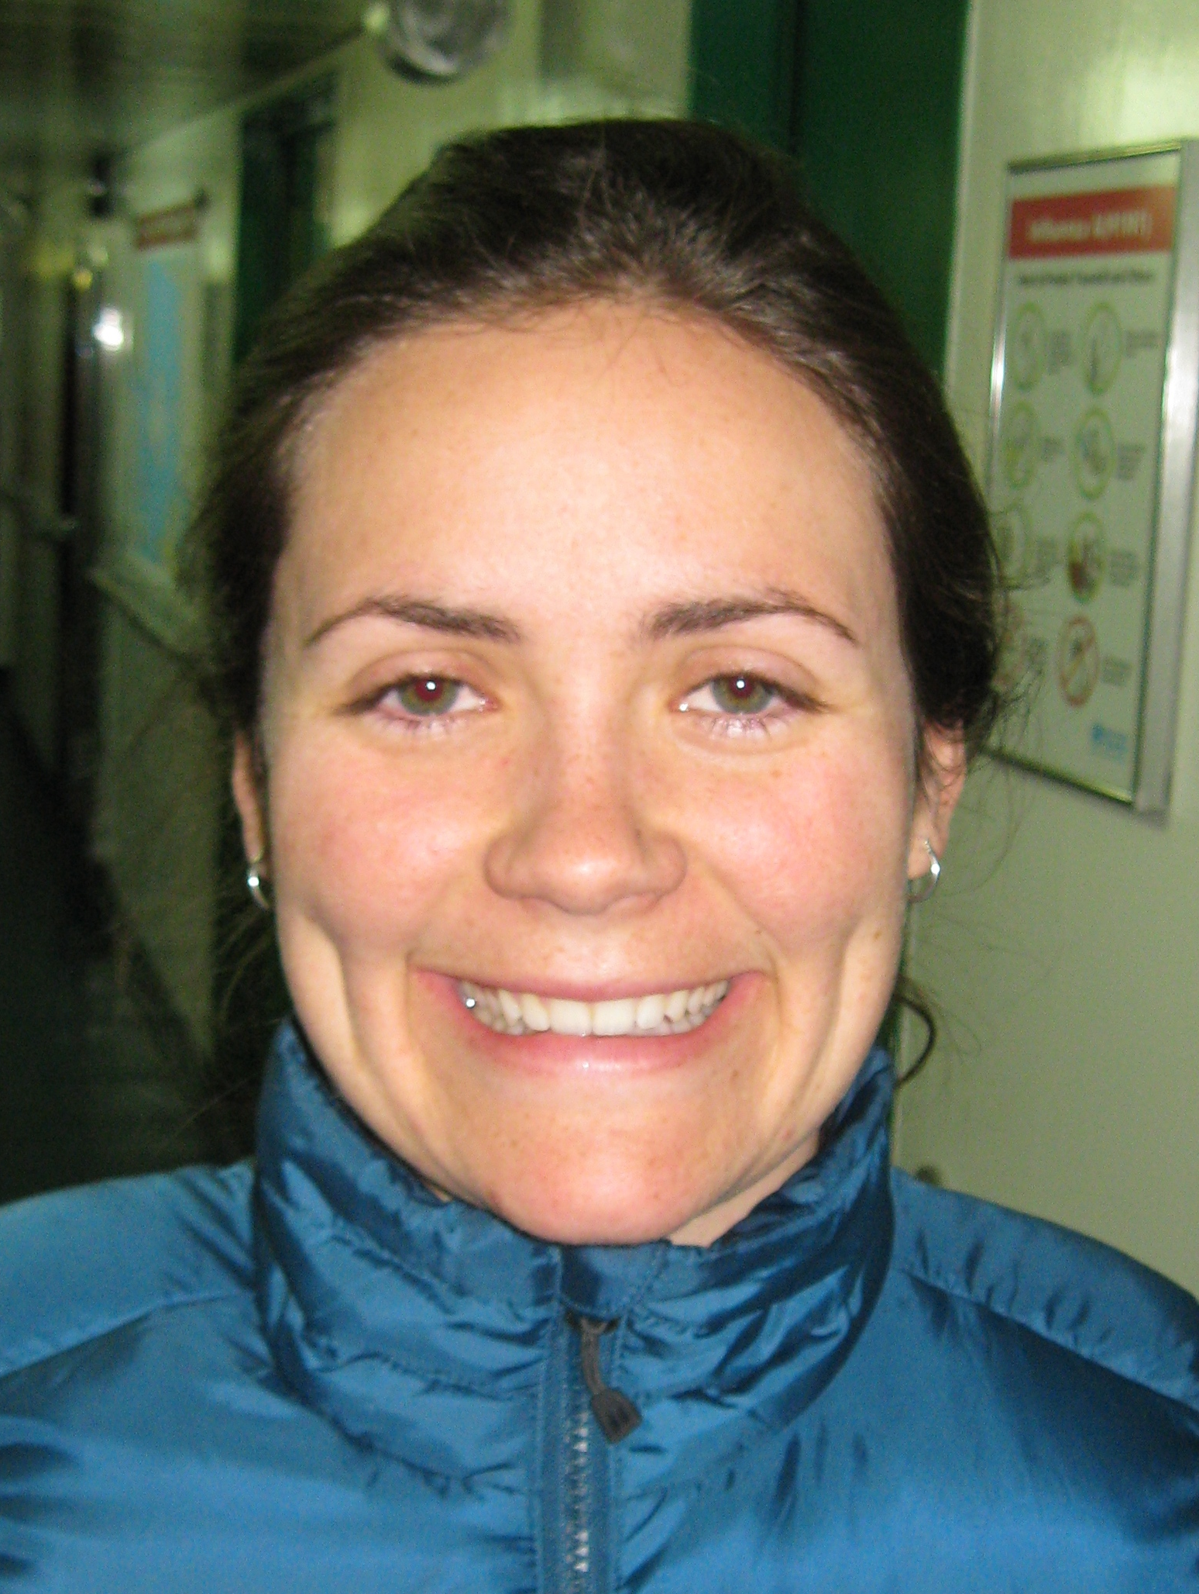
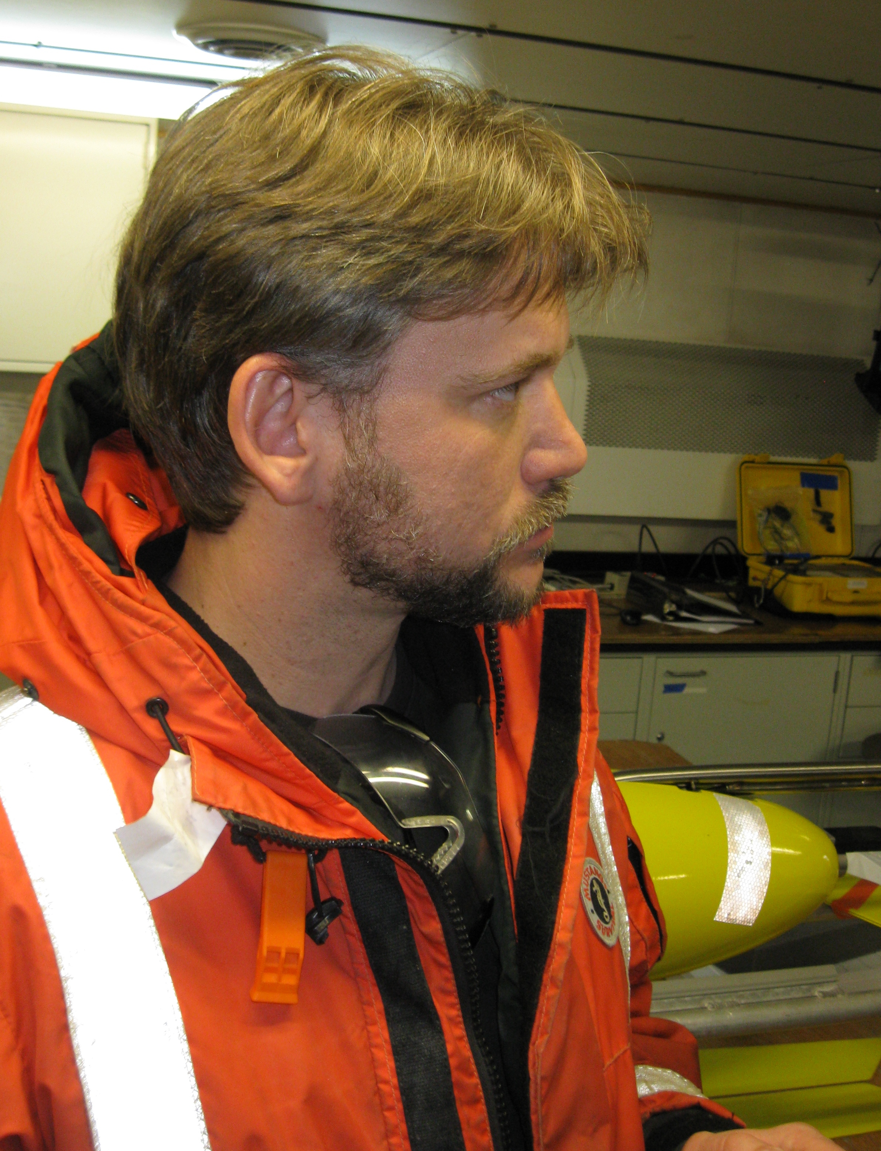

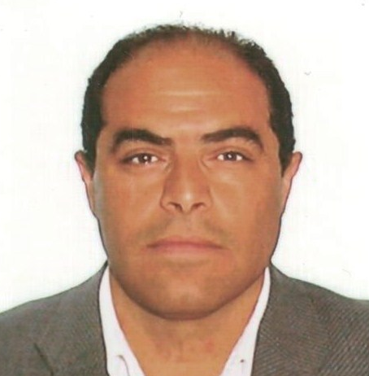
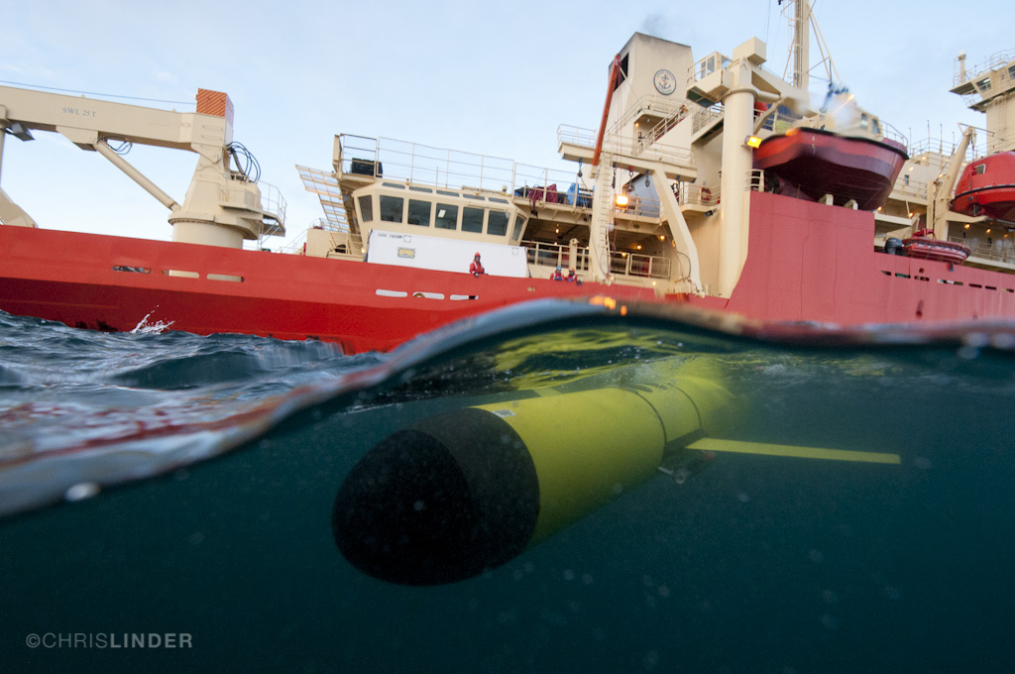
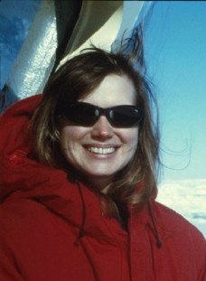
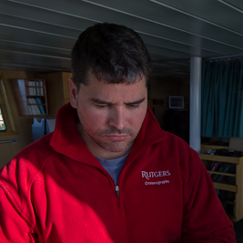
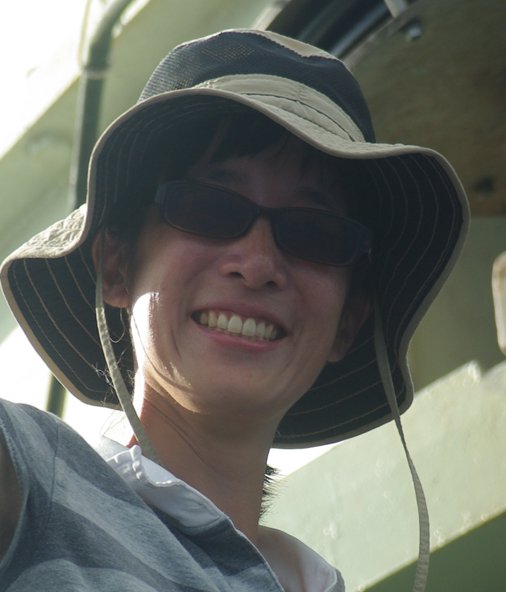
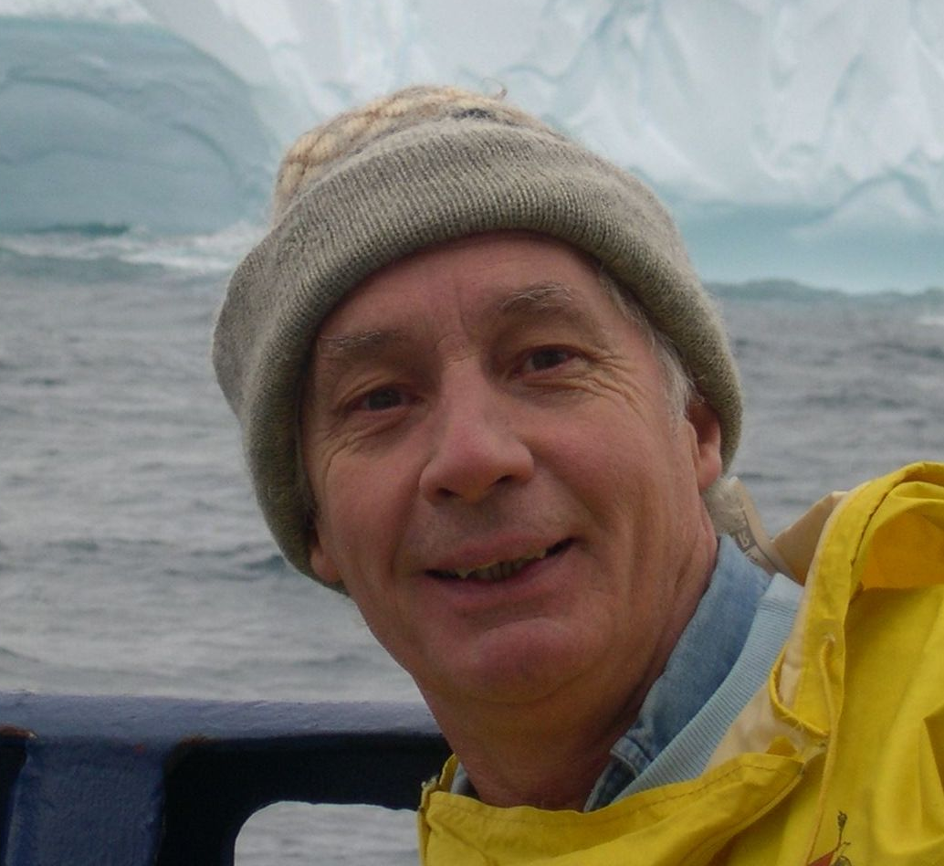



Live Audiocasts
- 9 Calls
- 1 to 2 scientists on each
- 1 to 3 schools on each
9 Scientists and 1 Captain
17 Schools and over 1,000 Students
http://coseenow.net/ross-sea/

Slide 22

Live Audiocasts
- 9 Calls
- 1 to 2 scientists on each
- 1 to 3 schools on each
9 Scientists and 1 Captain
17 Schools and over 1,000 Students
http://coseenow.net/ross-sea/
Dr. Josh Kohut
Rutgers University

Slide 23

Live Audiocasts
- 9 Calls
- 1 to 2 scientists on each
- 1 to 3 schools on each
9 Scientists and 1 Captain
17 Schools and over 1,000 Students
http://coseenow.net/ross-sea/

Slide 24




Live Audiocasts
- 9 Calls
- 1 to 2 scientists on each
- 1 to 3 schools on each
9 Scientists and 1 Captain
17 Schools and over 1,000 Students
http://coseenow.net/ross-sea/

Slide 25


Live Audiocasts: Scientist’s Perspective
Students
Scientists
‘When the scientists responded positively to their questions, they got really excited. They talked about that and told other people…’
- Ross Sea Teacher Comment
‘They think scientists are cool, …
They weren’t bored.’
- Ross Sea Teacher Comment
‘… I think you should do your Ph.D. on that question because it’s an area that we don’t know much about. Very good question.’
- Scientist Response to Student Question
We targeted 5 scientists to participate.
We got 9 scientists and 1 captain.

Slide 26

Summary
Scientist’s Perspective
I was quite impressed with this whole broader impacts project. It certainly was more extensive than anything I’ve ever participated in.
- Scientist Comment
It was great. I enjoyed it and was happy to see such a professional approach to this. If we do not do something about raising the level of science literacy in the US we are doomed!
- Scientist Comment
Just a big thank you to all those involved to make it so easy to be part of this great program. I am very interested to learn what impact we had and how we might improve it in the future.
- Scientist Comment
http://coseenow.net/ross-sea/

