Slide 1
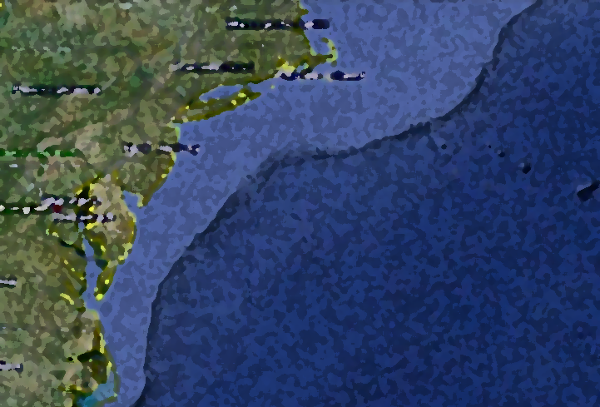










Inter-Annual Variability of the Cold Pool in the Mid-Atlantic Bight
Christopher M. Filosa

Slide 2
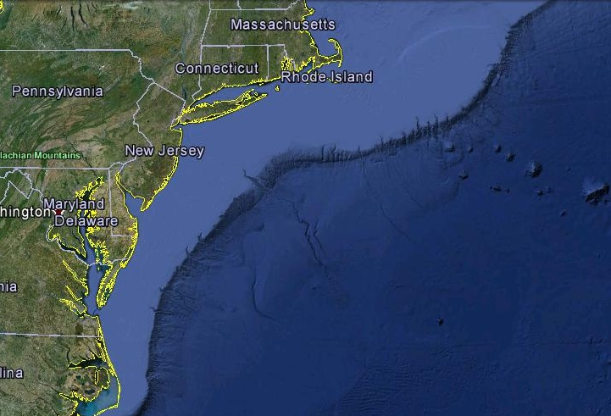
Mid-Atlantic
Bight

Slide 3
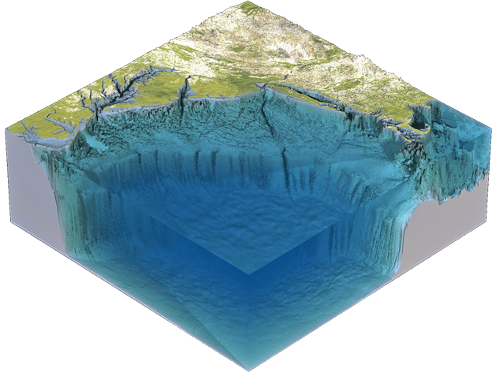
Mid-Atlantic
Bight
River Inputs
Eline

Slide 4
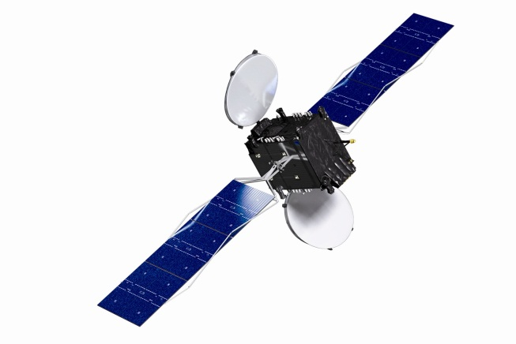
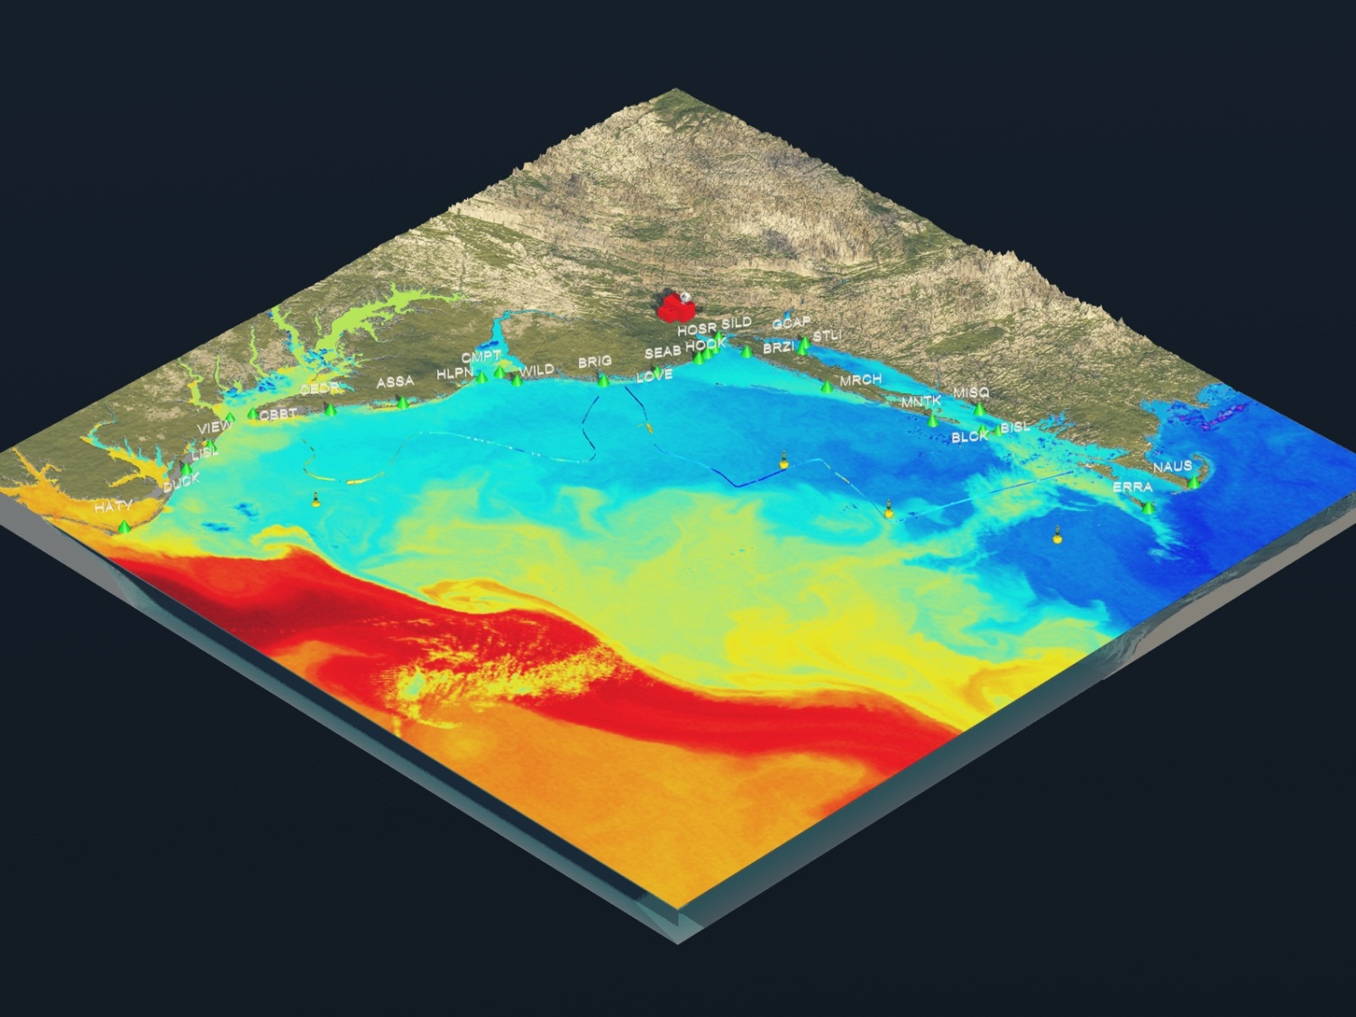
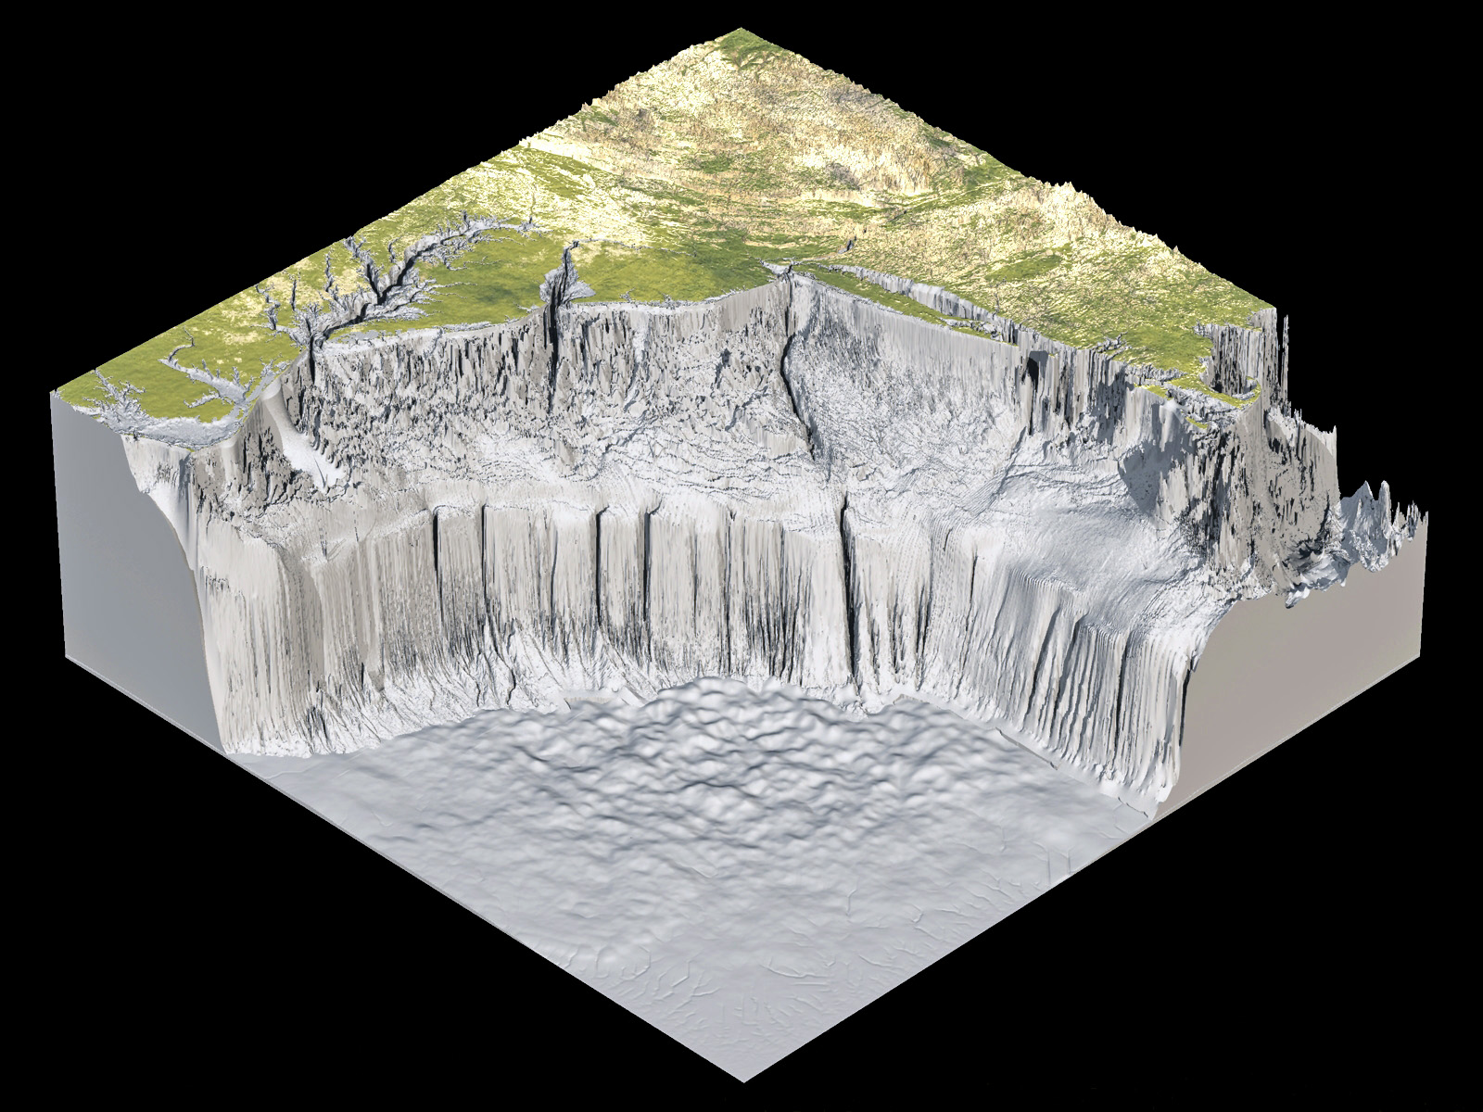
Mid-Atlantic
Bight

Slide 5
Mid-Atlantic
Bight
100m
(300ft)
4000m
(13000ft)

Slide 6
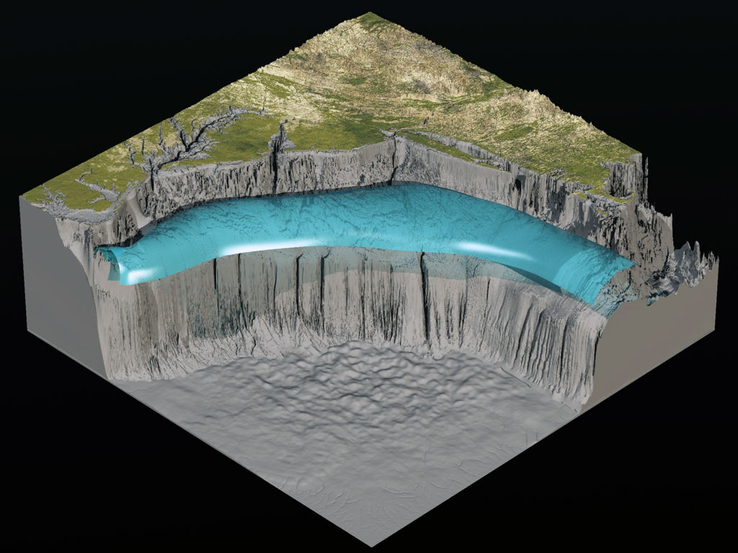
Cold Pool

Slide 7
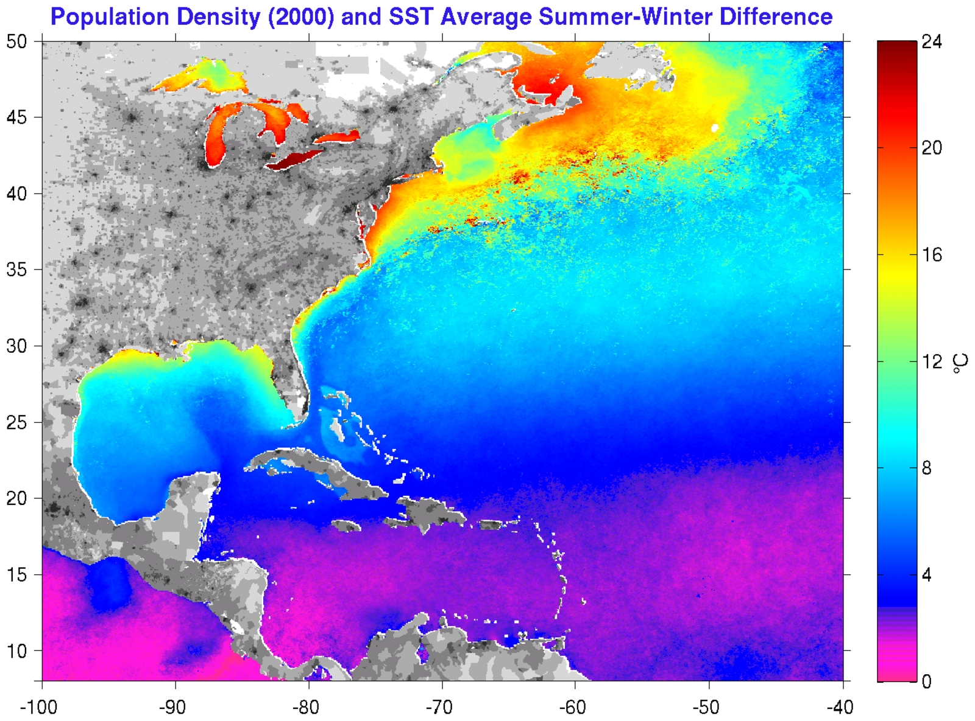
Temperature Range

Slide 8

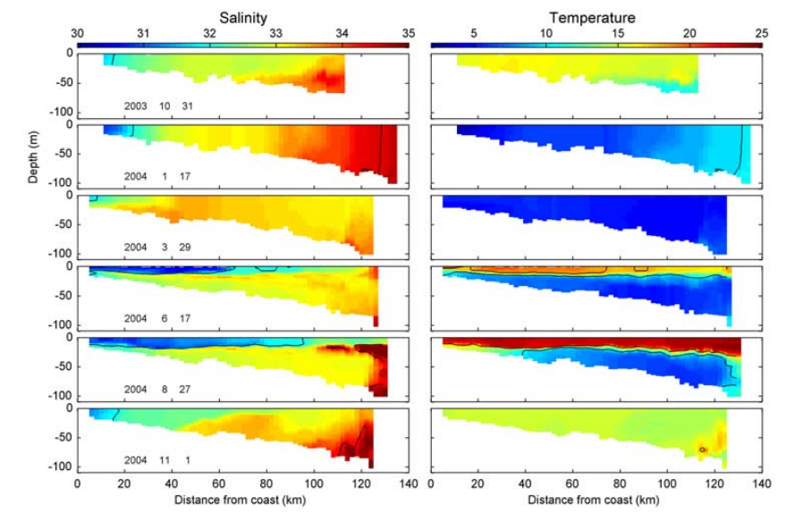
Year in the Life of the Cold Pool
Salinity
Temperature
Winter
Summer
0km 50km 120 km 0km 50km 120km
(Castelao 2008)

Slide 9
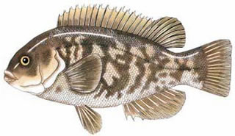
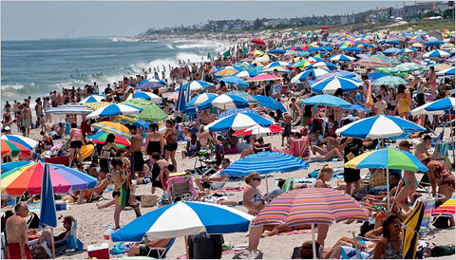
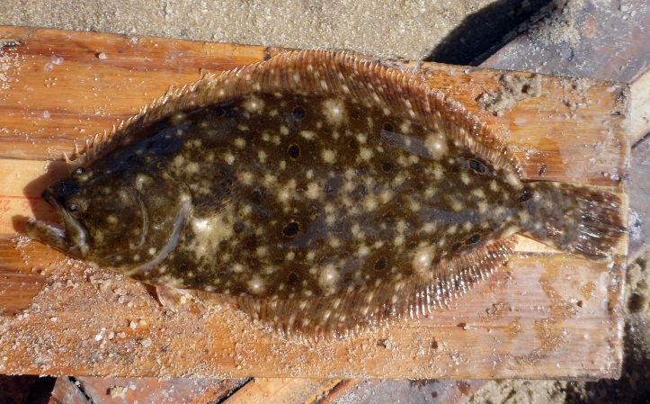
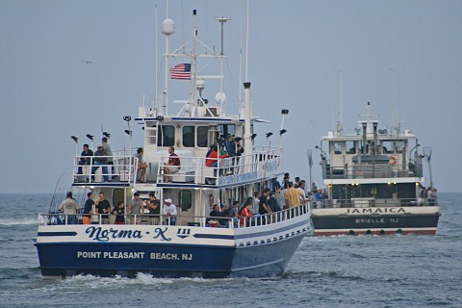
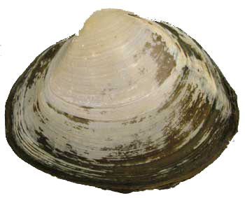
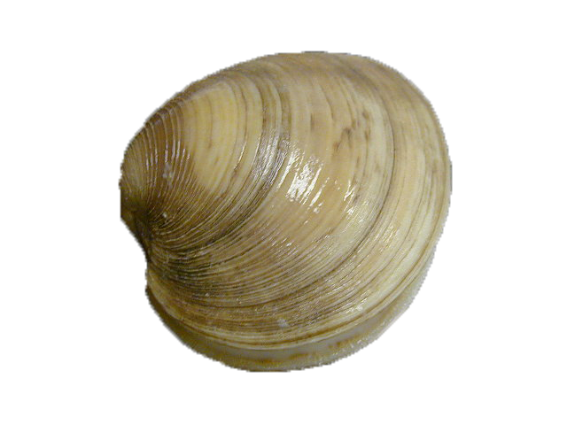
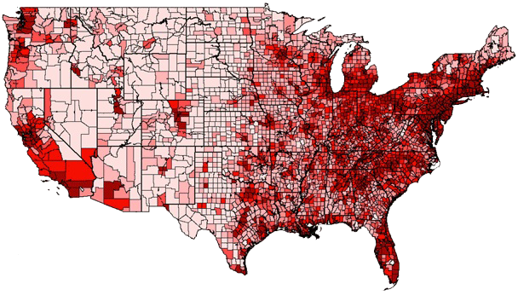
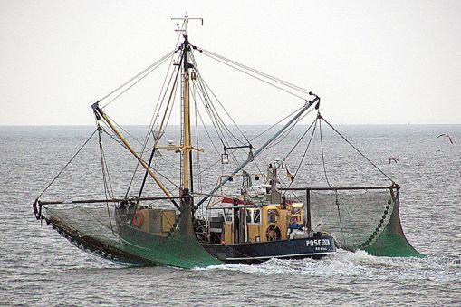
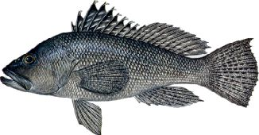
Importance of the
Cold Pool

Slide 10
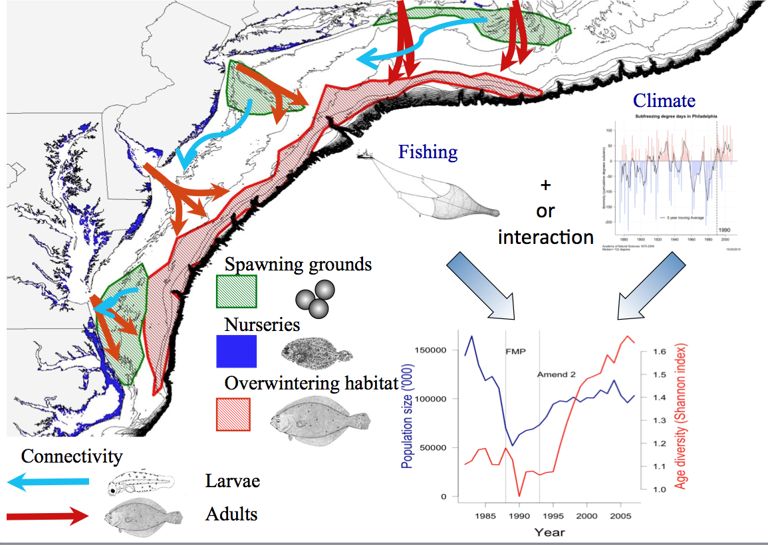
Summer Flounder
0
(Manderson, NOAA, 2010)

Slide 11
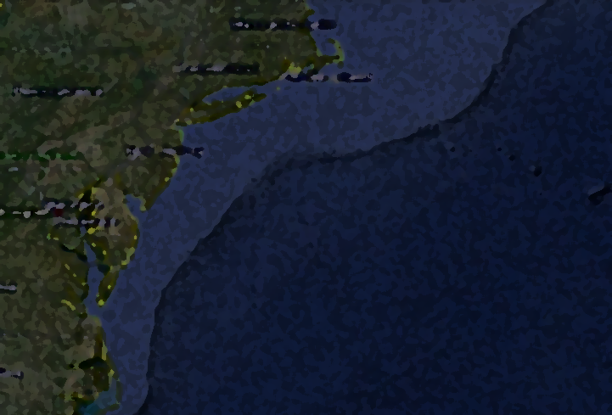
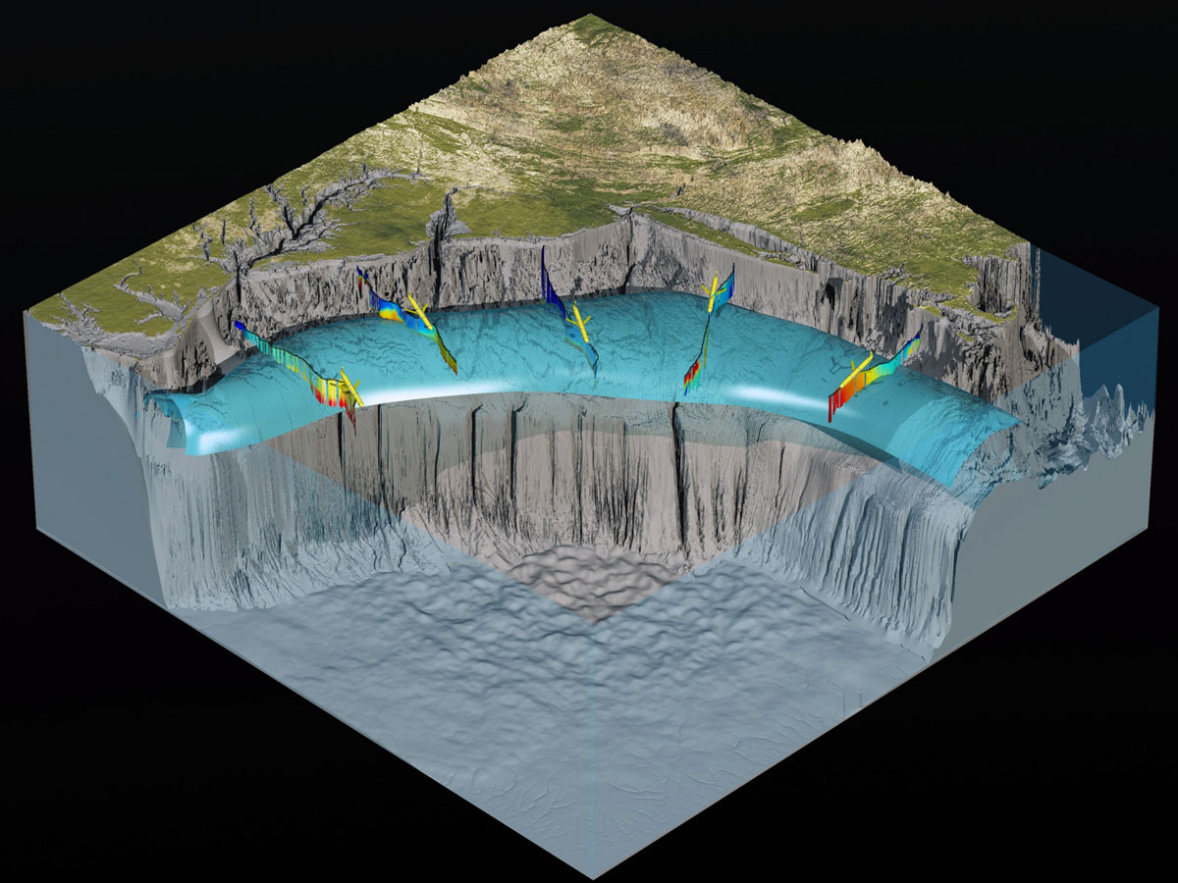
Objective
To see how the cold pool is changing over time
  in high resolution
Temperature
Salinity
Area
Location

Slide 12
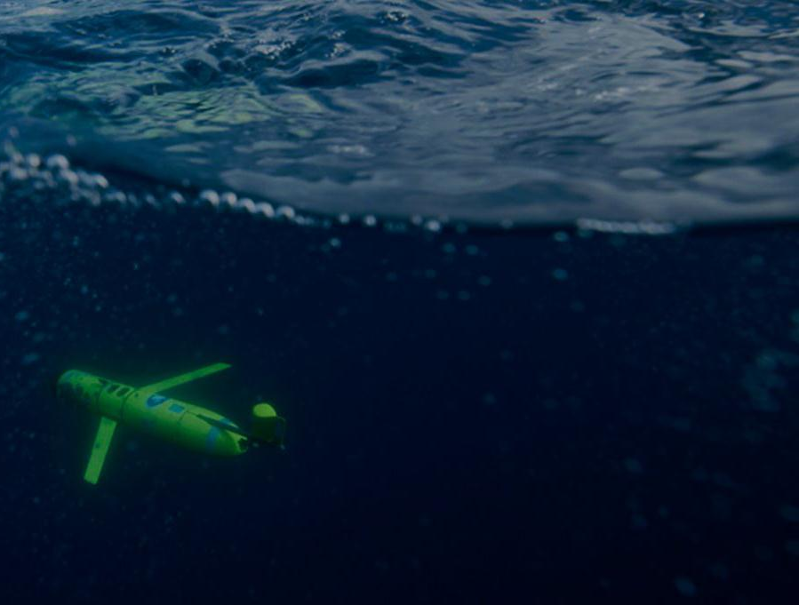
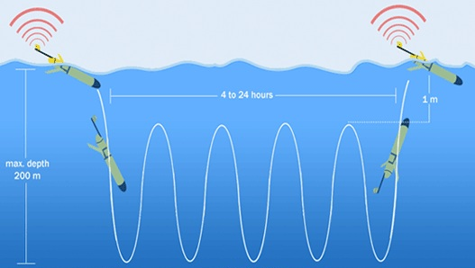
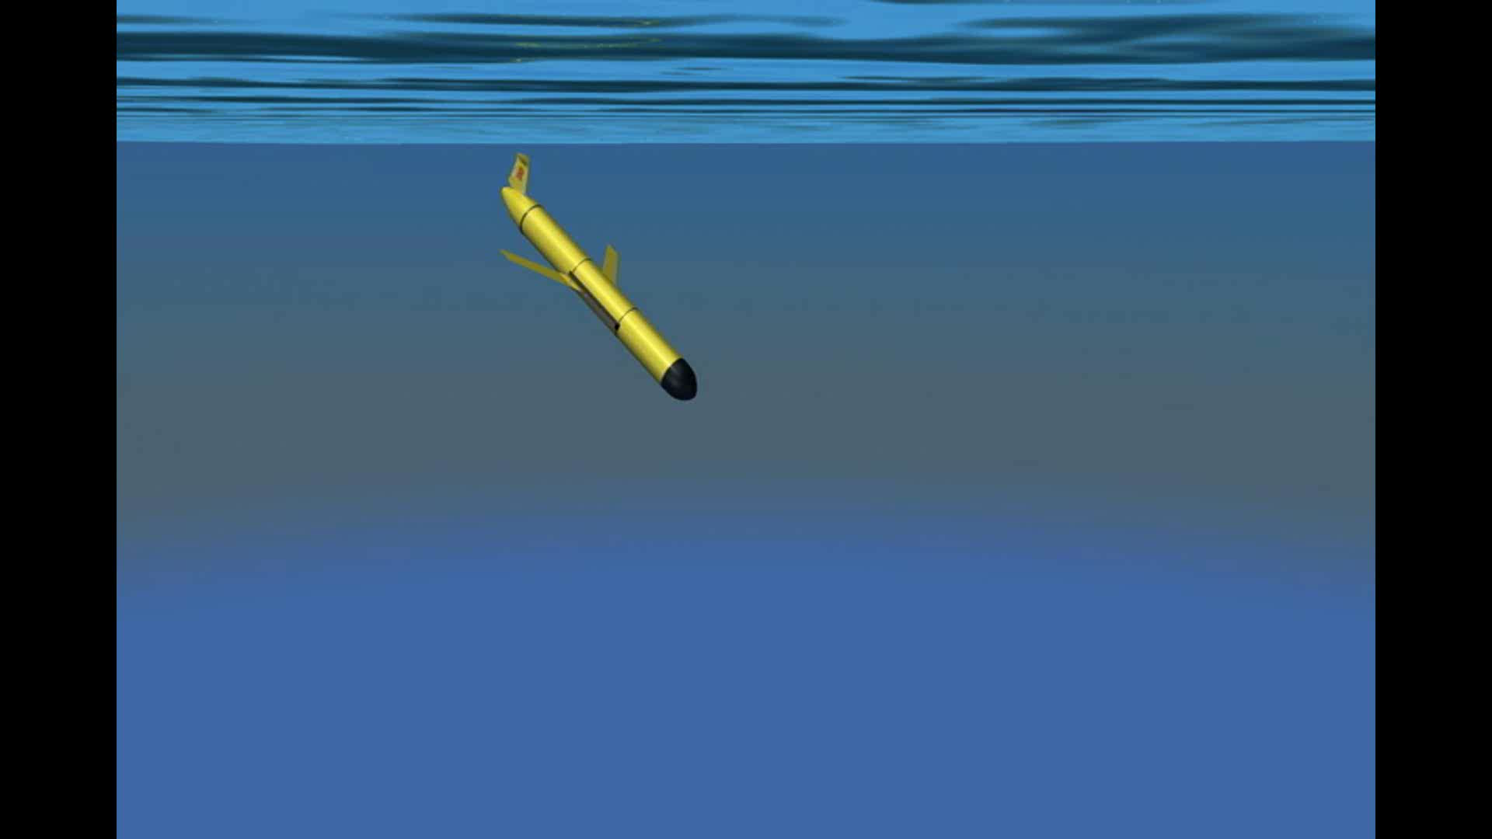
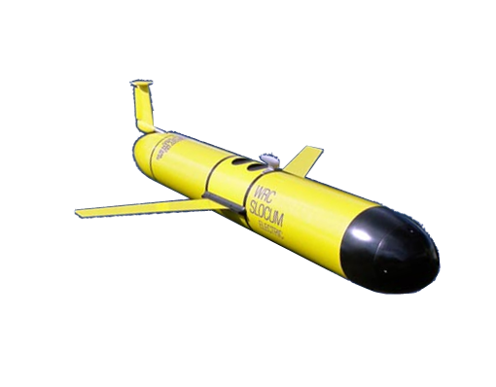
Slocum Glider
Buoyancy driven
Travels underwater in a wave pattern
Uses a CTD sensor to sample the ocean

Slide 13

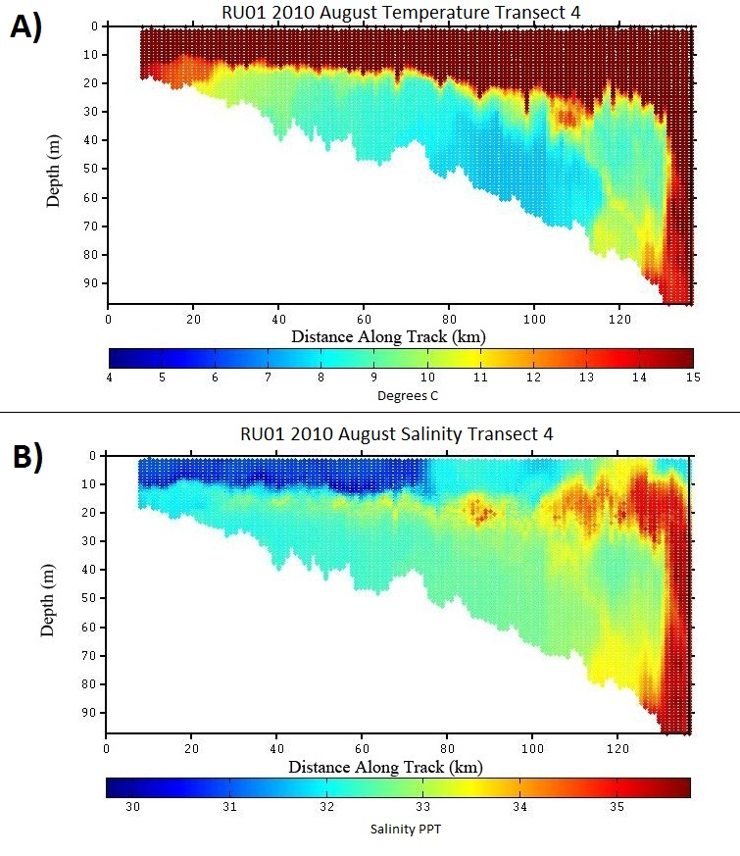
Sample Glider Transect
Depth
(m)
0
50
100
Temperature
0km 60km 120km
4ºC 10ºC 15ºC
0
50
100
Salinity
Depth
(m)
0km 60km 120km
30ppt 33ppt 36ppt

Slide 14
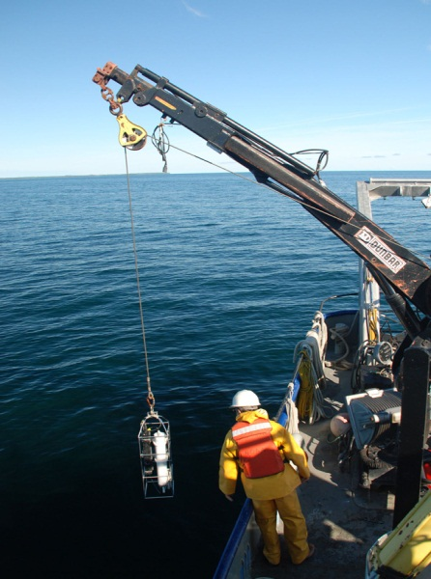
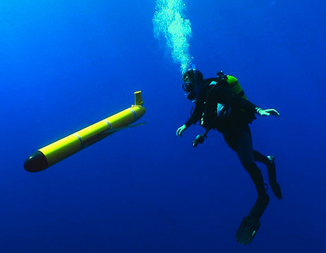
Measuring the Cold Pool
Difficult to measure because it is subsurface and highly variable in time and space
Traditional
NEW
Expensive to charter a boat
Scientists have to go out to sea
Large data gaps
  distance between measurements
  (~10km resolution)
  Time between measurements
  (months to years)
Less expensive method of sampling
Robot is at sea
Cohesive sampling
(100m resolution)

Slide 15
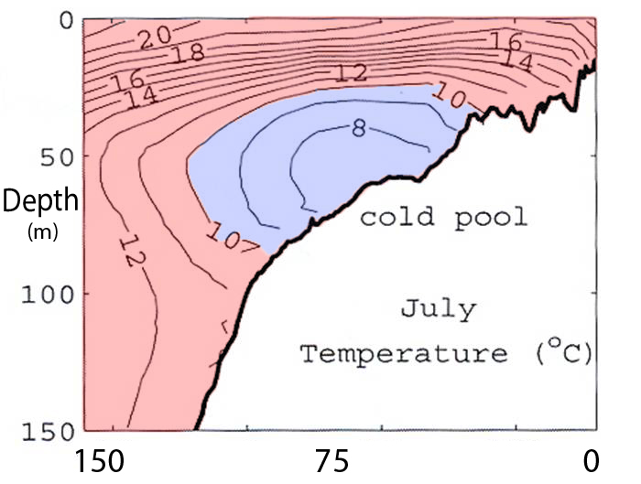
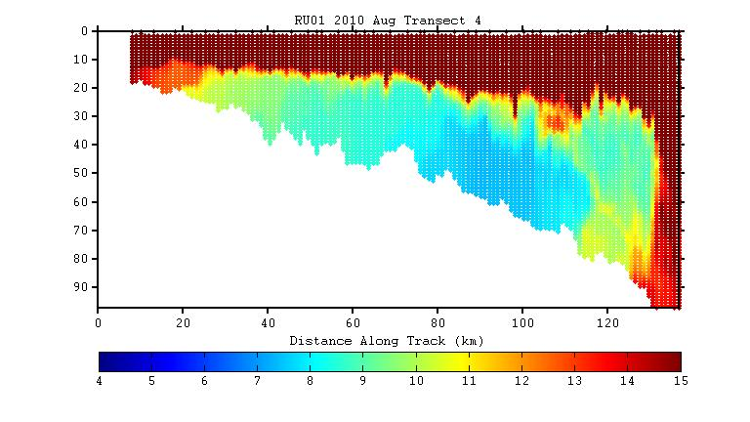
Measuring the Cold Pool
Difficult to measure because it is subsurface and highly variable in time and space
OLD
NEW
0
50
100
Sea Floor
(Castelao 2008)

Slide 16
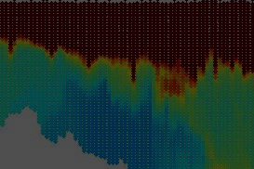
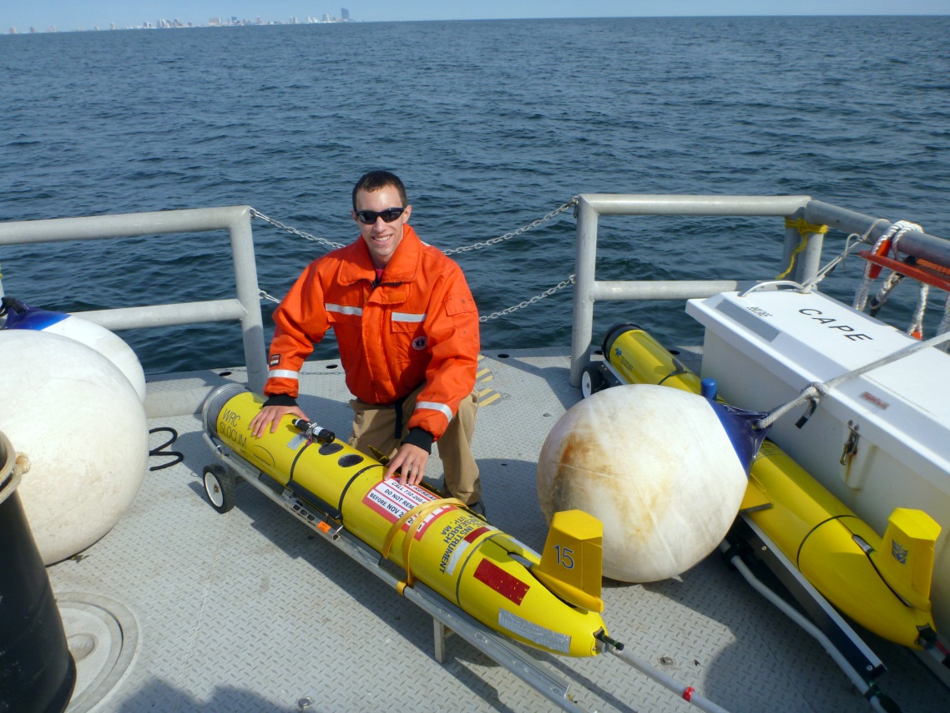
Available Data
Glider Data:
5 years from 2007 through 2011
Focus in June through October
26 transects
7 different gliders

Slide 17
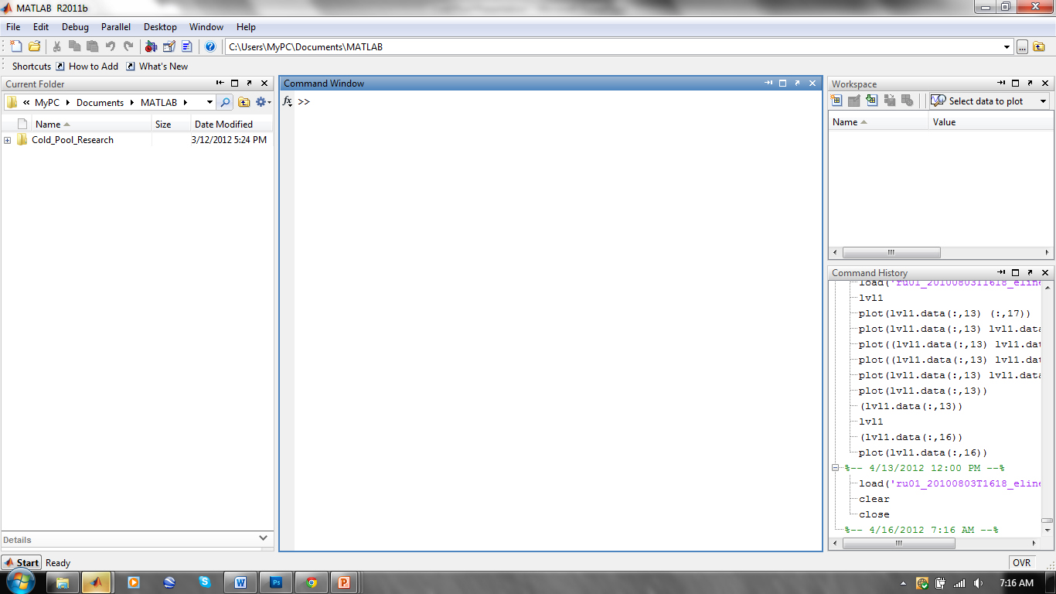
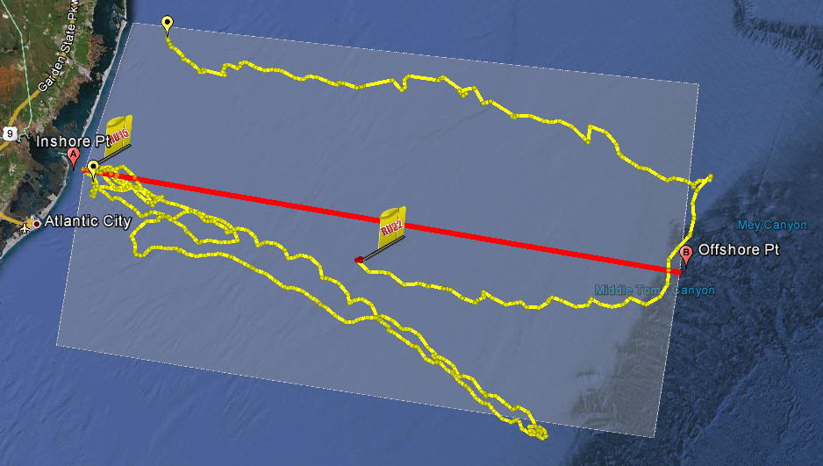
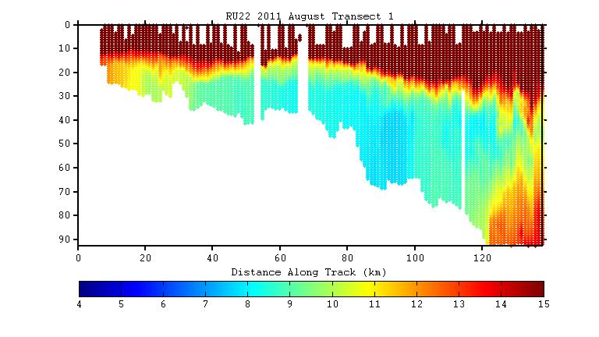
Data
Transformation
Gather all of the glider data
Collapse the data onto a single line
Find whole transects
Grab data from the transects
Use metrics to plot data

Slide 18
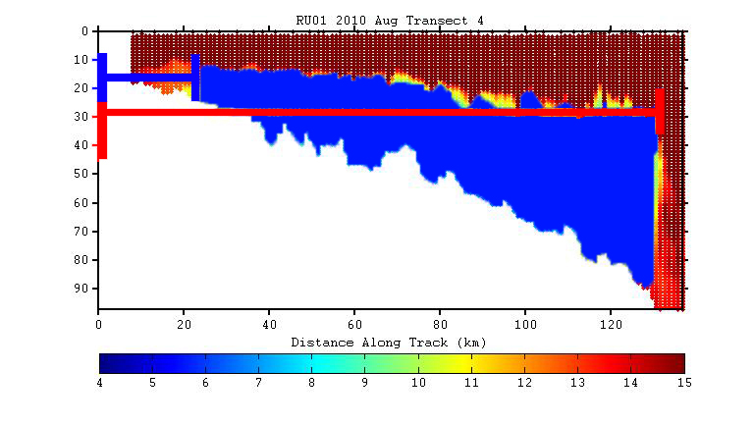
Cold Pool Metrics
Location
Area
Average Temperature
Average Salinity
4 different metrics

Slide 19
Location

Slide 20
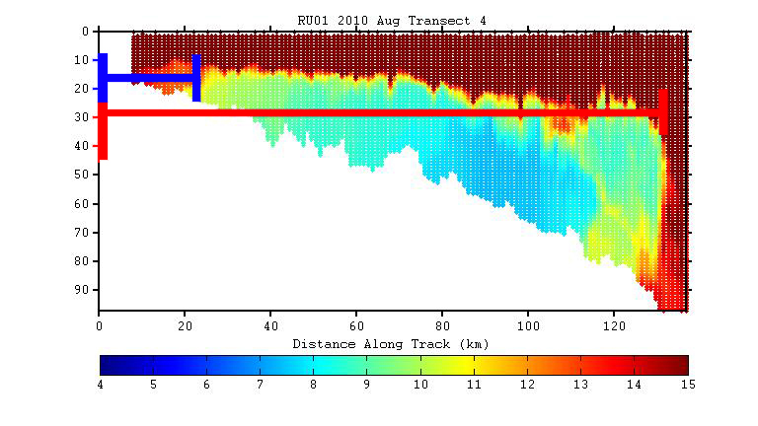
Location
Inshore
Distance
Offshore
Distance

Slide 21
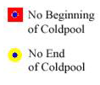

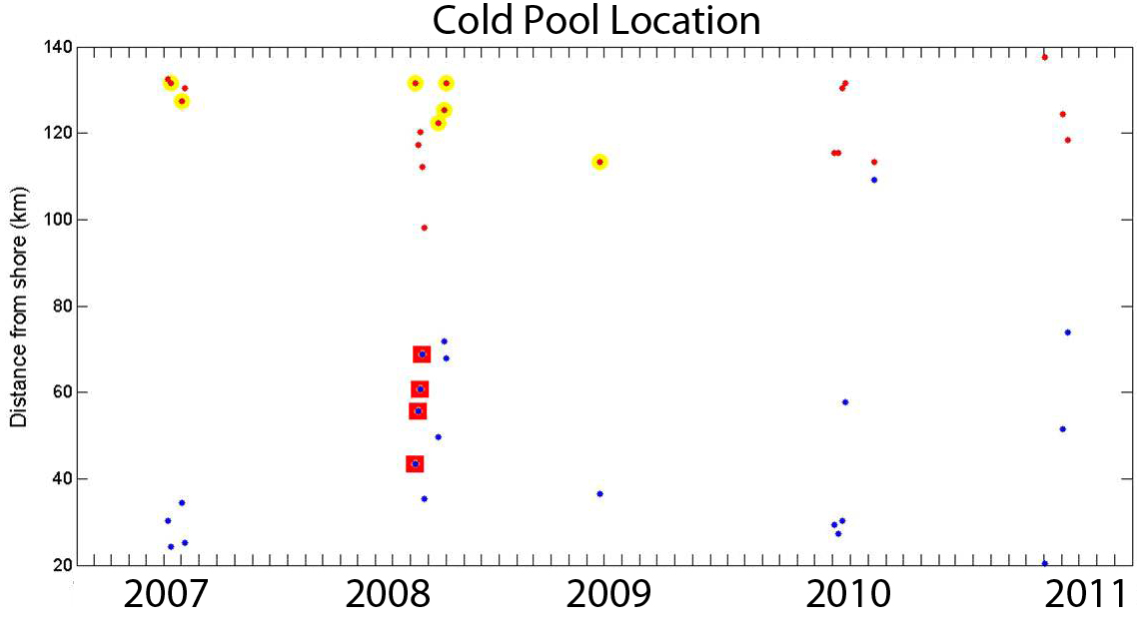
Results: Location
140
20

Slide 22
Area

Slide 23
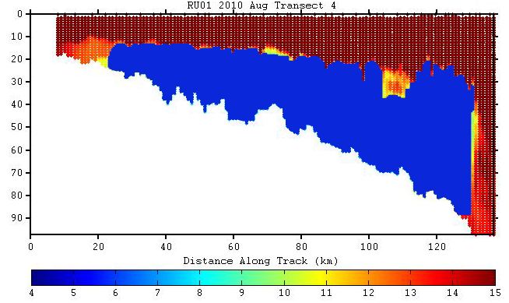
Area

Slide 24

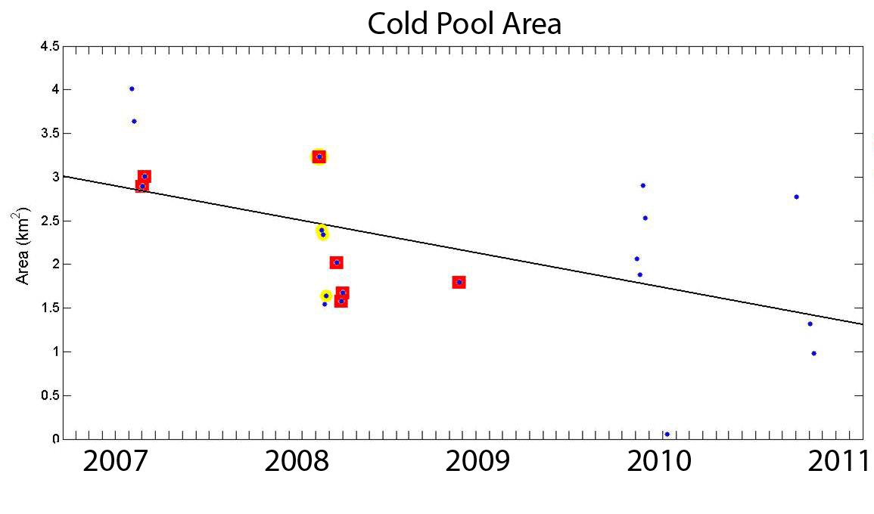
Results: Area
4.5
R²=.3
Area Shrinking .34km² /year
0

Slide 25
Average Temperature

Slide 26
Average Temperature

Slide 27

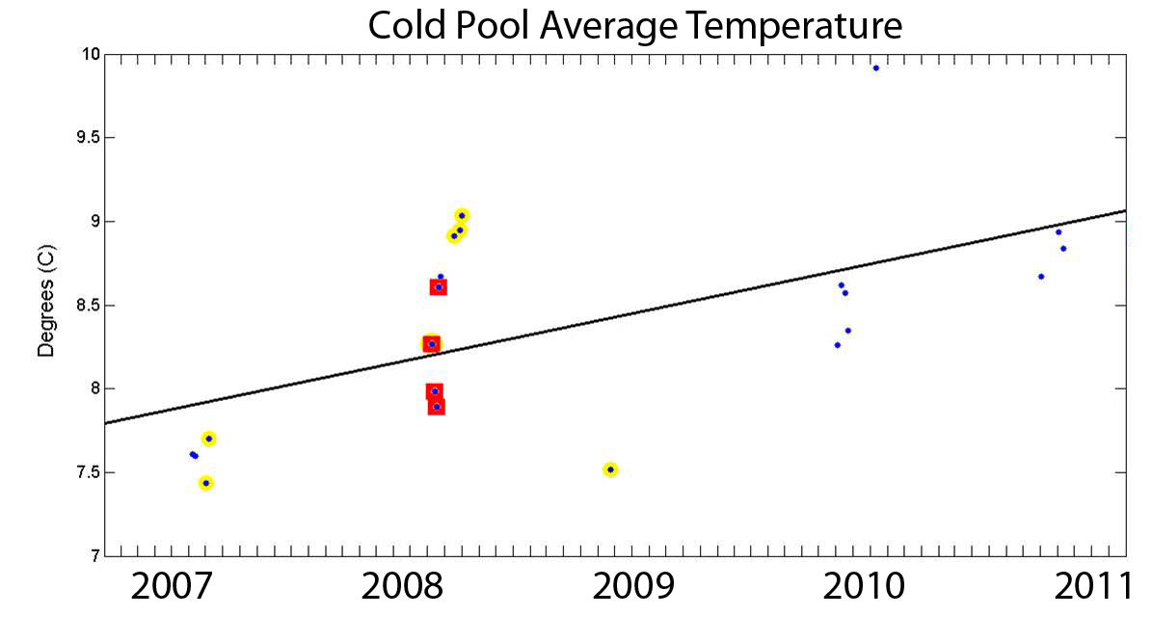
Results: Temperature
10
R²=.35
Temp Increasing by .25ºC/Year
7

Slide 28
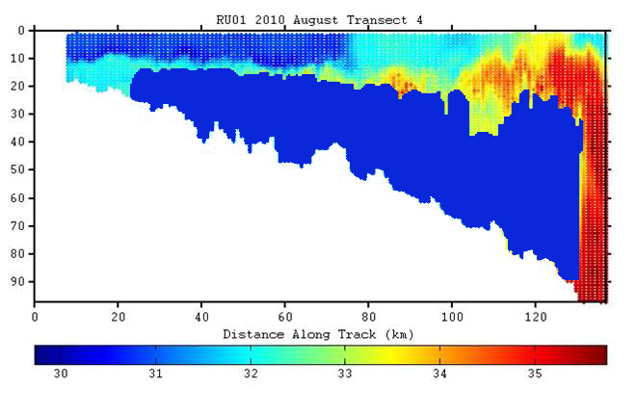
Average Salinity

Slide 29
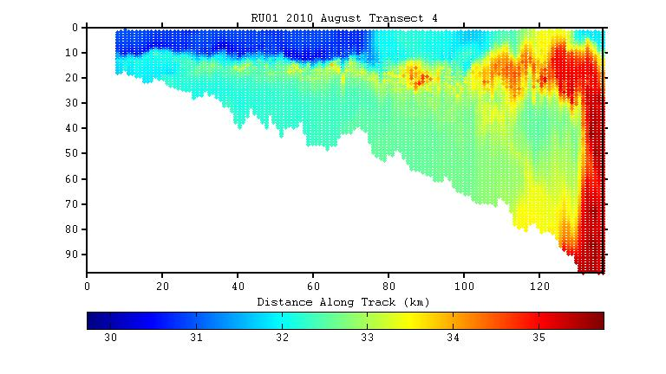
Average Salinity

Slide 30
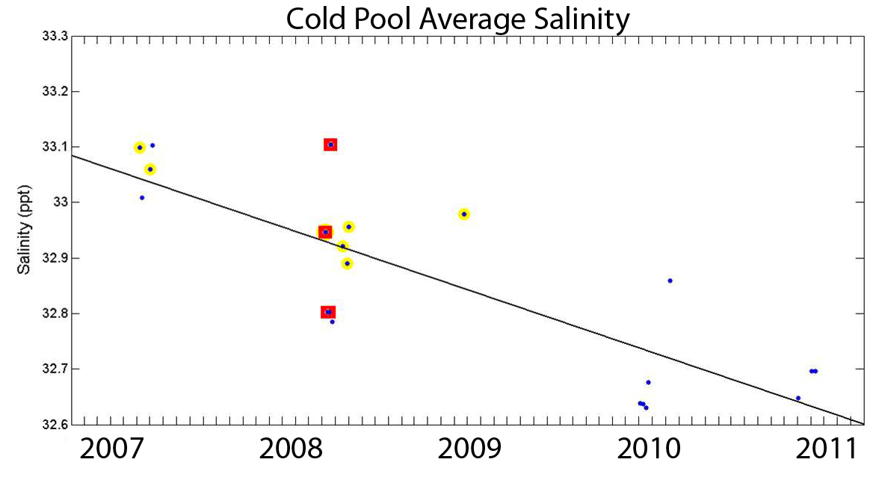
Results: Salinity
33.3
R²=.7
Freshening by .1ppt / year
32.6

Slide 31
Conclusion
The Cold Pool
Highly variable in location throughout the year
  distance from shore
  depth
Area
  Decreasing by .34km² / year
  R² =.30
Temperature
  Warming by .25ºC / year warming , freshening
  R² =.35 getting smaller
Salinity
  Freshening by .1ppt / year
  R² =.70

Slide 32
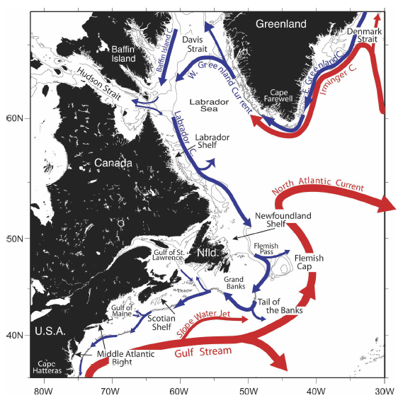
Future Work
What is causing these trends?
  Local or Remote?
Fratantoni, 2007

Slide 33
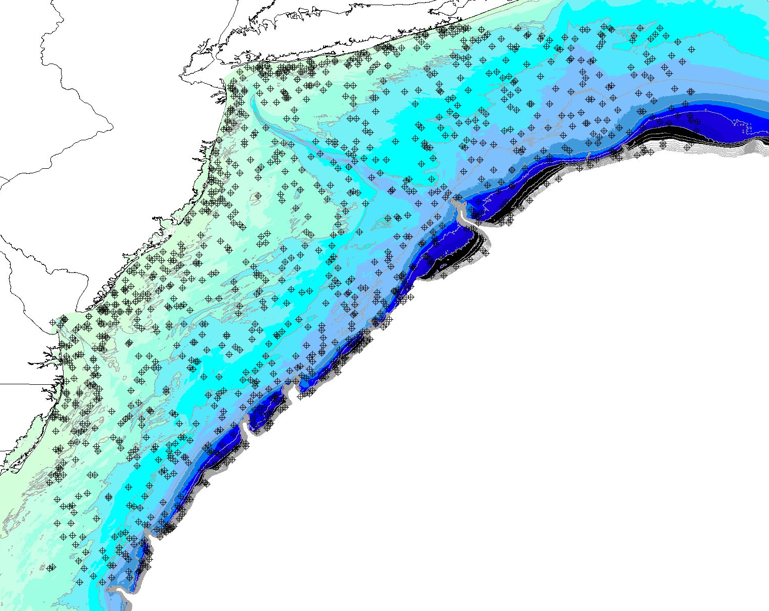
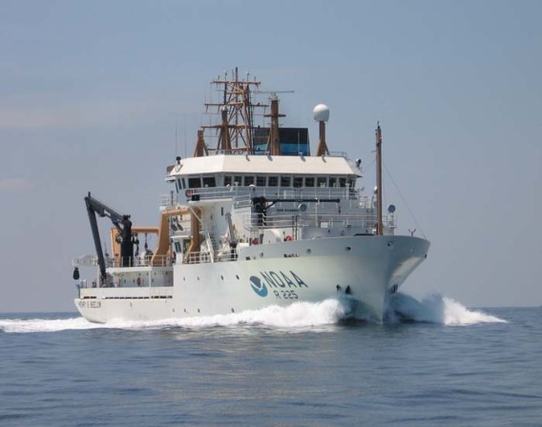
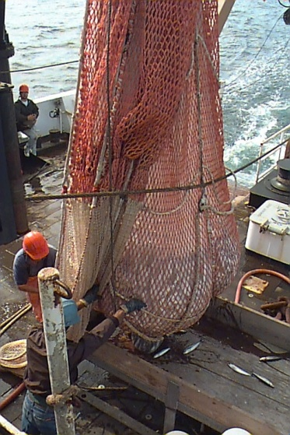
Future Work
What are the ecosystem impacts?
  Compare cold pool data to NOAA fisheries trawl data
  (NOAA 2007)
NEFSC bottom trawls
Fall and Spring Surveys
65 Species (≥15 cm)

Slide 34
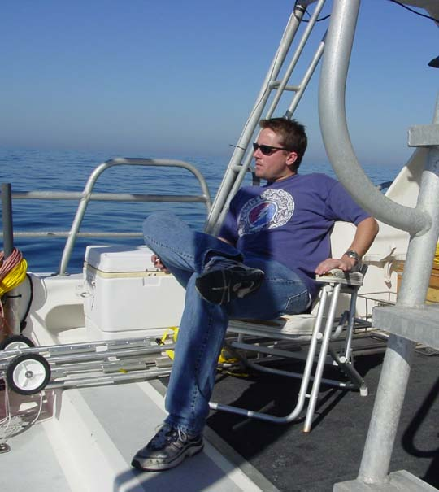




Acknowledgements
Dr. Josh Kohut
Dr. Scott Glenn
Dr. Grace Saba
John Kerfoot
Glider Team

Slide 35

QUESTIONS

