Slide 1
Validation of an ultra high frequency radar (River sonde) for current mapping in the urbanized Hudson River estuary
2010 summer research institute at DHS
-National Center for Secure and Resilient Marine Commerce-
Dakota Goldinger
Danielle Holden
Omar Lopez
Lenny Llauger
Shankar Nilakantan
Angelica Sogor

Slide 2
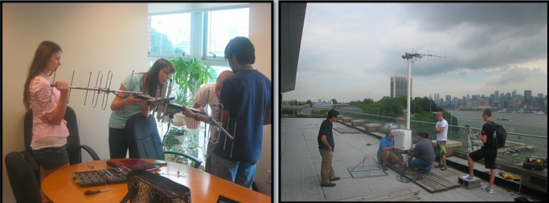
Overview
What is River Sonde?
How River Sonde was used at Stevens Institute of Technology, summer 2010
Results: Did the River Sonde accurately measure river currents?
Applications of River Sonde

Slide 3
What is River Sonde?
An Ultra High Frequency Radar: 450 MHz propagated
3 antennas, uses Doppler Shift to measure river surface properties.
Signal waves are emitted from the radar’s transmitter. After signal waves bounce off surface gravity water waves, a receiver processes the data.
Surface current velocities
Wind Direction
Waves
Significant Wave Height
Wave Period
Peak Wave Direction

Slide 4
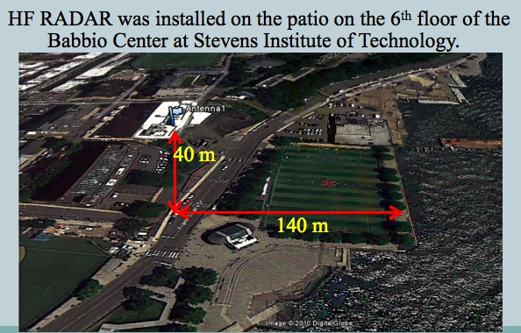
DHS Summer Research Institute
Purpose: To determine whether the River Sonde accurately measured currents.

Slide 5
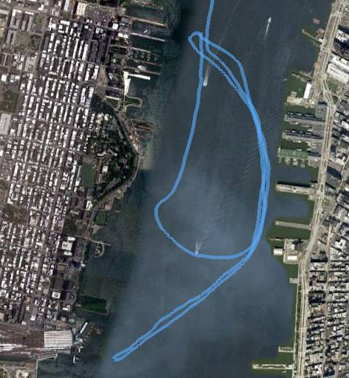
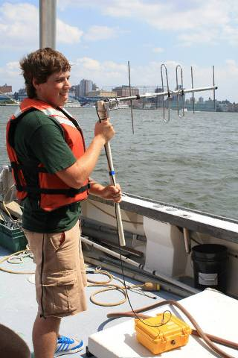
Antenna Pattern Measurement - Calibration
Babbio Center

Slide 6
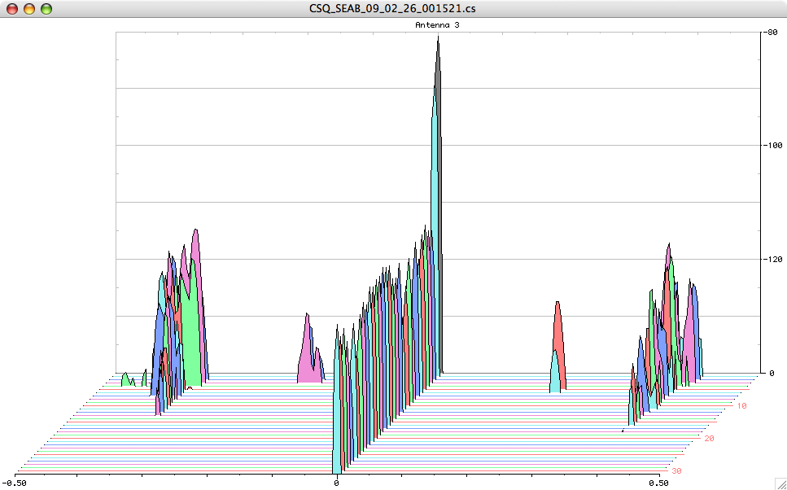
How we used the River Sonde
Fixed Objects & Direct Signals
Negative direction = away from radar
Positive direction = towards radar
Bragg Waves
Bragg Waves
“Noise”
“Noise”
Boat
Range
Doppler Frequency
Notes:
First order peaks are called “channels”: these are Bragg Wave
Bragg Wave: an ocean surface wave which has a wavelength equal to the radar electromagnetic wavelength onto the ocean surface

Slide 7
Comparing River Sonde
Compared with two existing river observation and prediction systems:
NYHOPS buoy
Wind speeds (knots) versus number of EM waves received after bouncing off river surface
NOAA tidal model and gauges
Tidal heights vs. current velocities and intensity

Slide 8
Radial vector map from 1 Riversonde
BABBIO

Slide 9
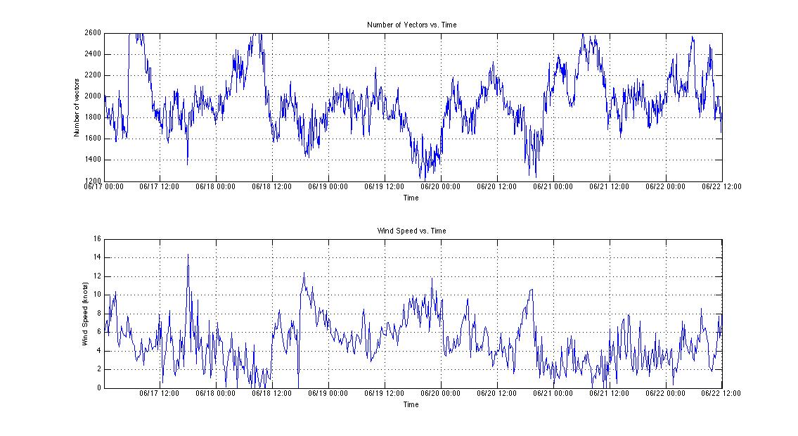
Compared with a NYHOPS buoy
1. measures surface currents, water level, wind direction/speed, etc.
2. provided tidal measurements
3. used two stations in Manhattan waters for validation:
Pier 40 and Castle Point
Vectors
Wind Velocity

Slide 10
NOAA Comparison
Down river
G
G
G
G
G
G
G
G
G
G
G
G
Gg
G
Up river

Slide 11
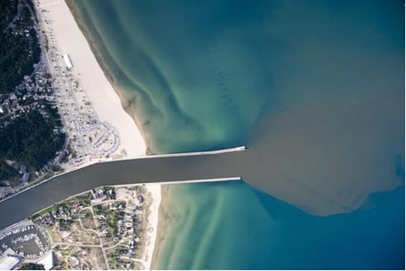
Applications of River Sonde in New York Harbor Estuary
200 miles of PCB contaminated areas in Hudson River
Construction
Storm events
River Sonde network can track and predict WWTPs outflow plumes
Any plumes
Strong salinity front and high tidal flow from the lower Hudson estuary upstream are trackable

Slide 12
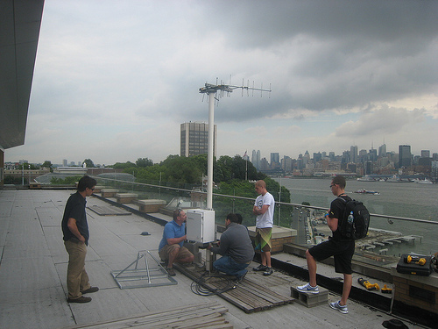
Summary
Student internship deployed and operated the first River Sonde on the east coast during the summer of 2010
We compared currents from the River Sonde to models and other measurements with good results.
Applications for improved transport monitoring in the Hudson River are now being investigated

