Slide 1
West Antarctic Peninsula
Glider Operations (and the Progression of a Scientific Project)
Collin Dobson, Amanda Jones, Tejas Shah, Amelia Snow, Cynthia Taylor

Slide 2
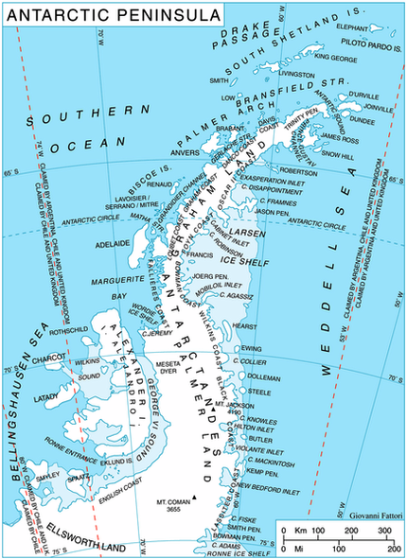
West Antarctic Peninsula:
The subject of our study
• Northern most part of Mainland Antarctica
• Susceptible to climate change—experiencing
rapid warming (alters sea ice dynamic/
ecosystem interaction) Effects glaciers!
• Phytoplankton affected –surface chlorophyll
decreased 12 % !
• Rise of half degree Celsius each decade
• We examined time frame 2007-2011

Slide 3

Palmer Long Term Ecological Research Project (LTER)
    Construction of the U.S. Antarctic station was completed in 1968, replacing 'Old Palmer' that was established in 1965.
    Palmer LTER established in 1990.
    Marine ecology of the Southern Ocean focused on:
      physical forcing (atmospheric, oceanic and sea ice) of the ecosystem with emphasis on the ecological consequences of sea-ice variability
      biological processes with emphasis on microbial, primary production and the life-history parameters of secondary producers (krill) and apex predators (penguins)
      physical/optical/chemical/biological modeling that links ecosystem processes to environmental variables.

Slide 4
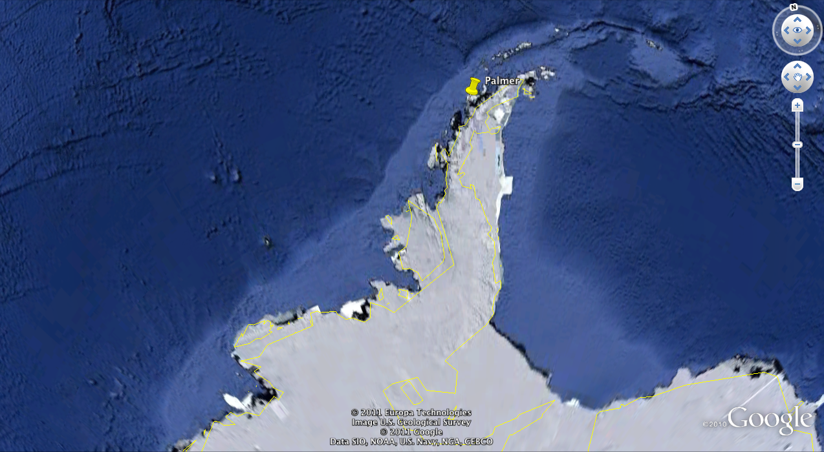
Goal: To understand the Antarctic ecosystem using a series of data sets to determine how the climate is changing and its affects on the West Antarctic Peninsula
Notes:
When given gliders ops for Antarctic we established our goal for the semester to be: to understand the Antarctic ecosystem using a series of data sets to determine how the climate is changing and its affects on the West Antarctic Peninsula

Slide 5
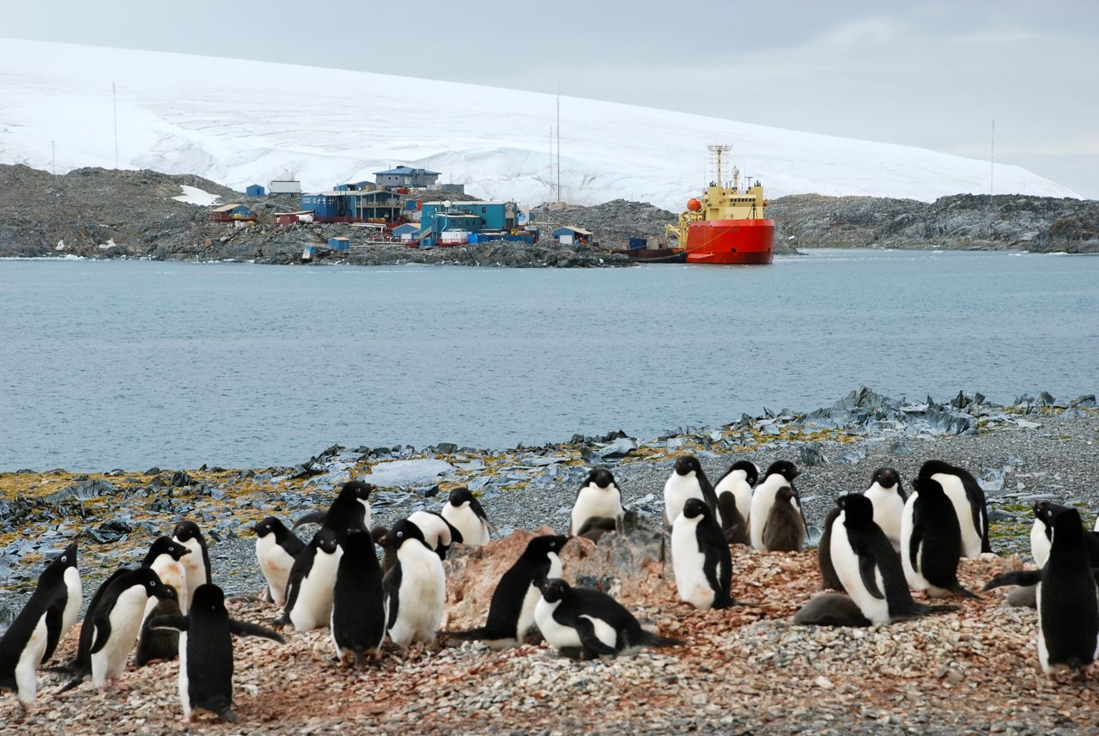
Attempt #1:
Palmer 2001-2011
  Station B &E
  Temperature, Salinity, Density
  Gliders 2007-2011
    Temperature, Salinity, Density
    3D Temperature transect through canyon
Notes:
Our major area of interest was looking at temperature specifically the thermocline. In order to do this we wanted to use varying data sources to illustrate temperature change over time in the WAP especially near Palmer Station. To look at the area around Palmer more closely we had planned to use data from station B & E at Palmer to look at temperature, salinity, and density from 2001-2011. We were then going to compare this data with glider data from 2007-2011 (the years we have had gliders as part of the LTER project). We also wanted to plot 3D temperature transects for gliders throughout the canyon

Slide 6
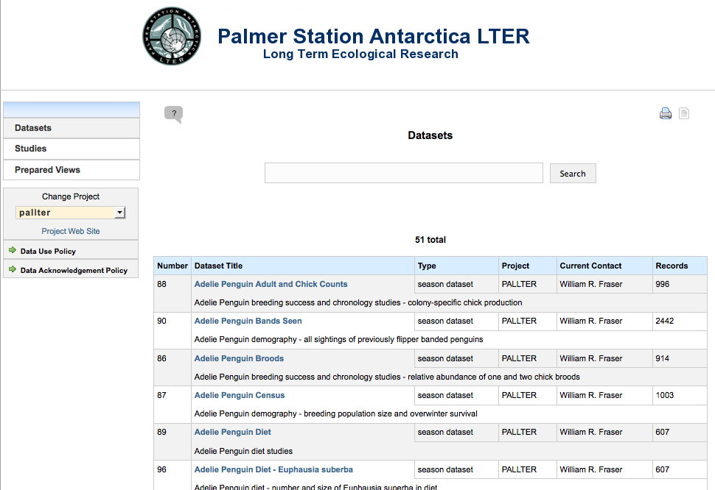
Problems: Station B & E where art thou?
Notes:
In order to look at Palmer Station data we needed to use Datazoo, provided on the LTER website. When we first pulled up Datazoo there were no files on the server. We emailed to fix this problem. Data was put online but we learned that data was not quality controlled and not depth averaged so this could not be used.

Slide 7
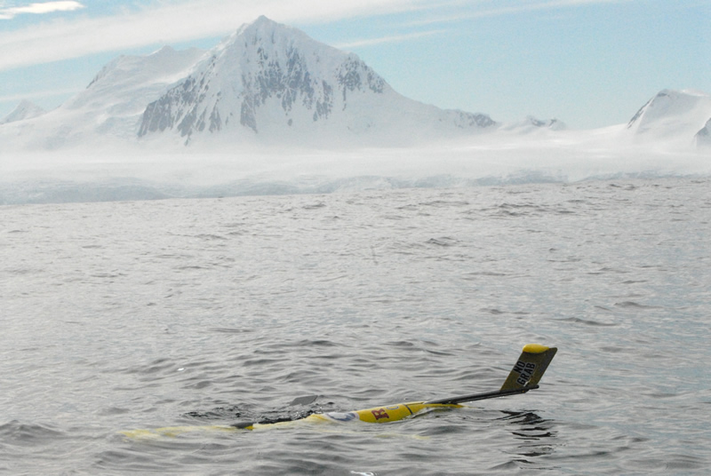
Attempt #2:
No more DataZoo
  Gliders 2007-2011
    9 gliders
    4 year long-term
    Temperature, Salinity, Density
    Excel line graphs
    Glider tracks in
    Google Earth
    3D Temperature transect through canyon
Notes:
With no useable data on the DataZoo we revamped our project to just look at glider data. We were able to determine that there were 9 glider deployments in the 4 years of glider ops at Palmer. We had planned to plot temperature, salinity, and density using excel. We also were going to plot glider tracks in Google Earth and also the 3D temperature transect through the canyon.

Slide 8
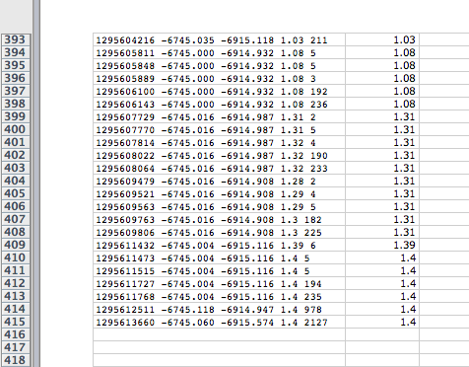
Problems: Excel…
Excel not a sufficient way to analyze data
Not feasible to pull out data points
Notes:
Once again we hit a small problem. It was hard to transfer the glider data into excel and once into excel each temperature had to be pulled out in order to be graphed and there were over 400 lines of data per glider. Even if we had taken the time to do this, the plot made in excel really was not helpful at telling a story. The above plot is temperature vs. time but as you can see it is hard to even tell what this plot means.

Slide 9
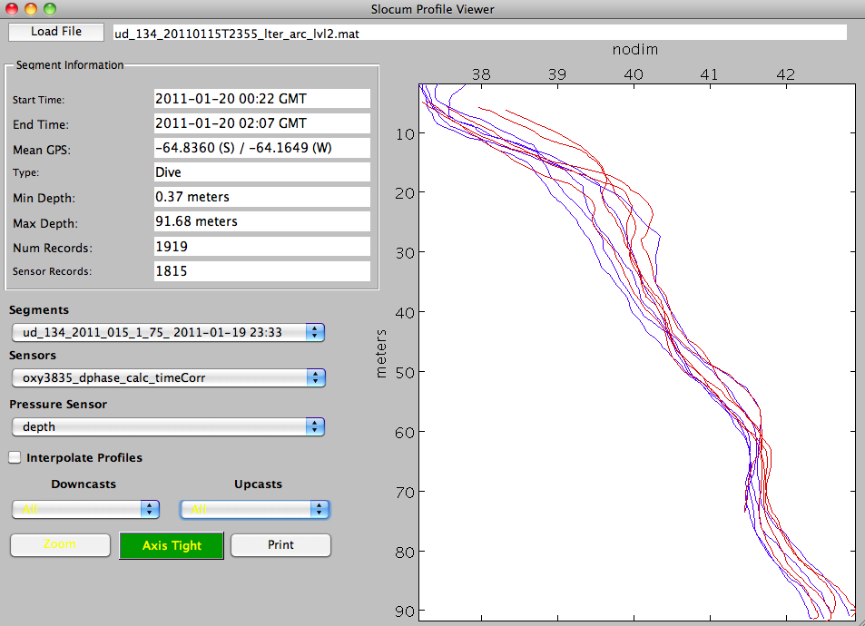
Attempt #3:
Matlab Gui
  2007-2011 Gliders
  9 gliders
    8RU + 1UDel
  Temperature, Salinity, Density profiles
    Animation
    3D Temperature transect through the canyon
Notes:
Realizing we needed a different way to analyze our data we decided to use the gui created by John Kerfoot. Our plan was to use the 9 gliders deployed in the WAP from 2007 with 8 being Rutgers gldiers and 1 a Udel glider. We had hoped to plot temperature, salinity, and density for these gliders and animate our plots to show how each of these data sets was changing over the last four years.

Slide 10
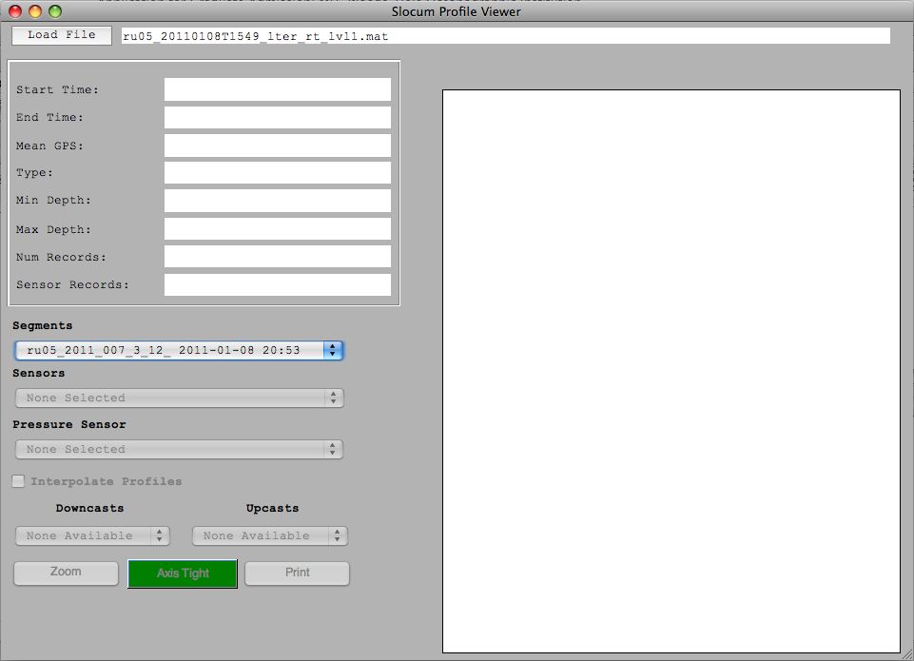
Problems: Where is all of our data?
    Only 5 gliders with data
    Only level1 data
      Not compatible with new gui
      Error in old gui
Notes:
Once again we had some problems. When speaking with Tina and John we found out that there were only 5 gliders with data on boardwalk and this data was only level 1. This seemed to be an issue by not being compatible with the new gui. When trying to use the old gui through Matlab we were hit with lots of red error messages, never a good thing to see in Matlab.

Slide 11
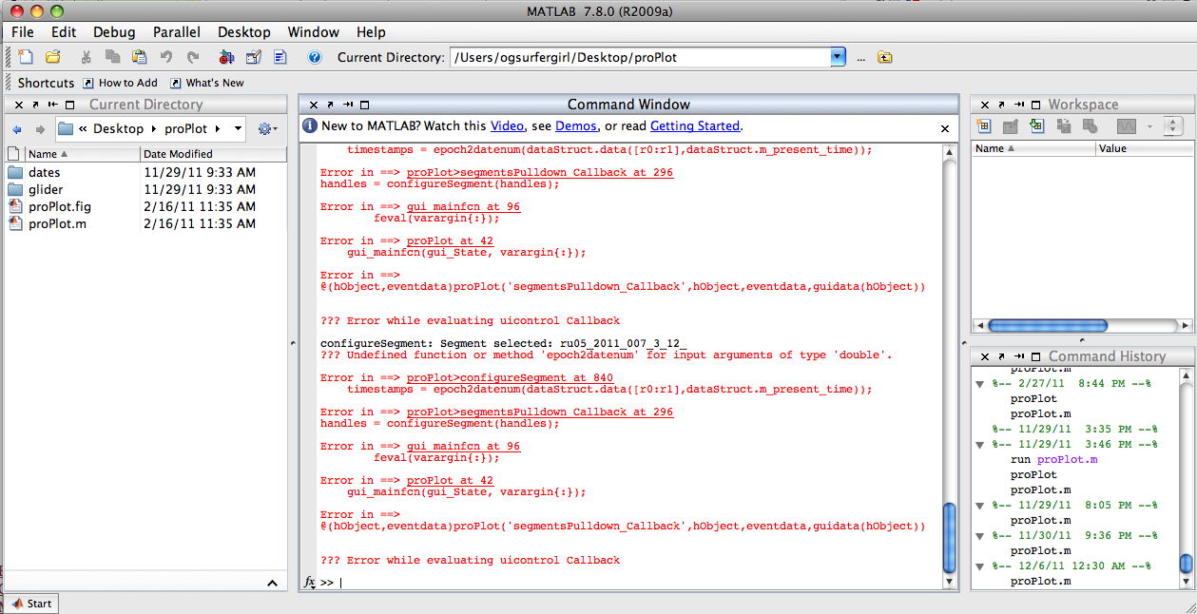
Overall Problems
    Trouble with Matlab
    Data not easily accessible
    Data not in right format
    Techs busy
    DataZoo
      10 years missing
Notes:
So to sum up all of our problems: we had a lot of trouble with Matlab, our glider data was not easily accessible and once found was not in a compatible format. We also had issues with progressing in a timely manner because a lot of our questions depended on Tina and John having time, being very busy themselves. Another issues was the Datazoo and that though the data is accessible it has not been converted into a user friendly format.

Slide 12
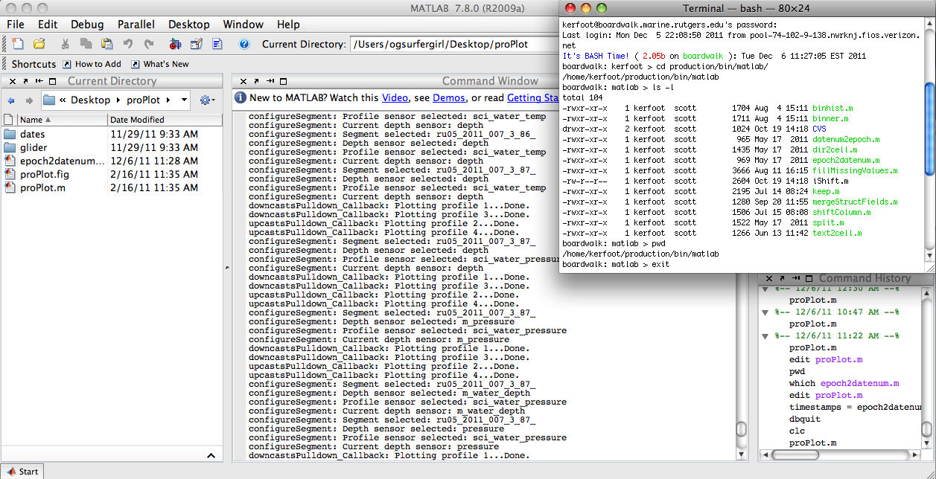
Last and Hopefully Final Attempt
    UD_134 Plots
    3D Temperature transect through canyon
    Glider tracks in Google Earth
    Possible Matlab code
Notes:
So after all this we needed to make a definitive plan for what we knew we would be able to accomplish with what was left of the semester. We had been able to get UD_134 data to load in the new gui so we had been able to make temperature, salinity and density plots for this glider. We also planned to produce the 3D temperature transect, plot glider tracks in Google Earth and possibly get a Matlab code to plot the data or get the gui to work.

Slide 13
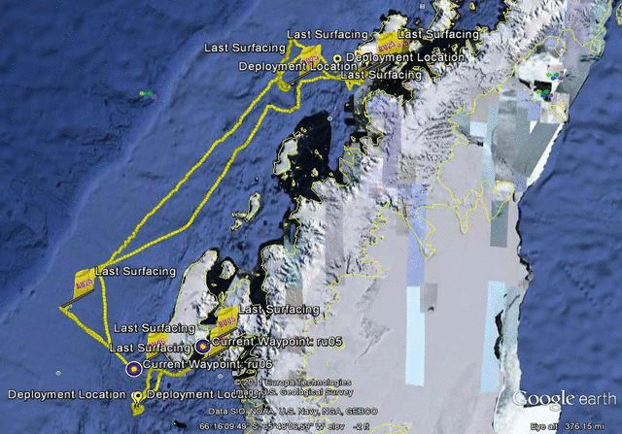
Google Earth

Slide 14
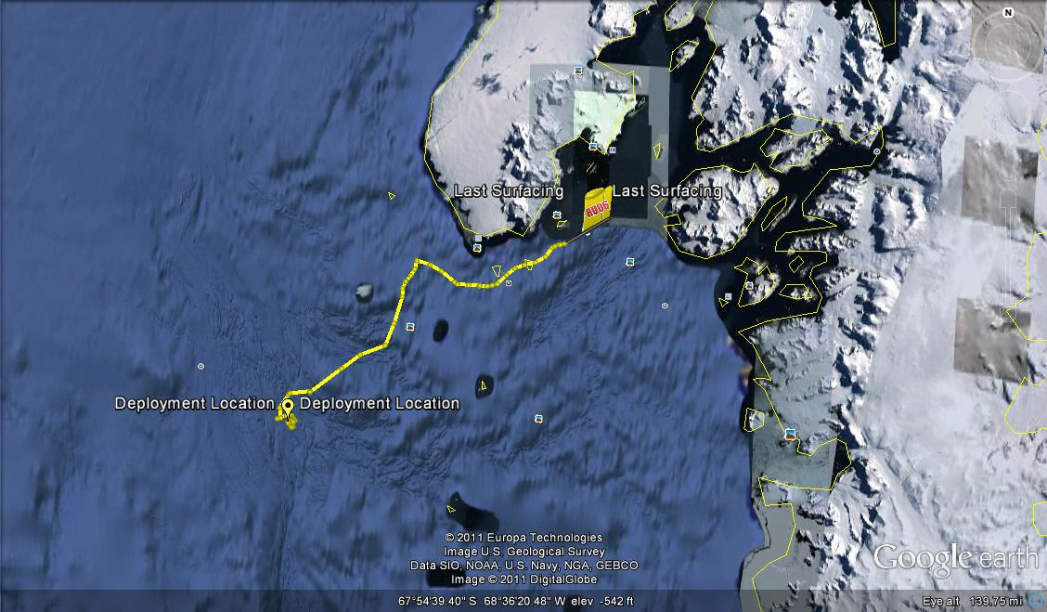
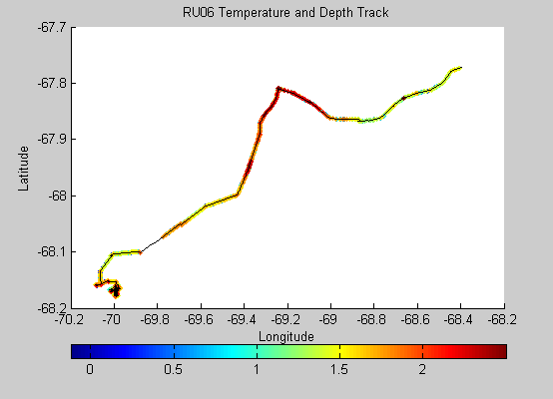
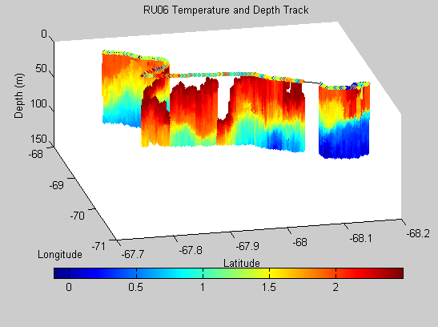
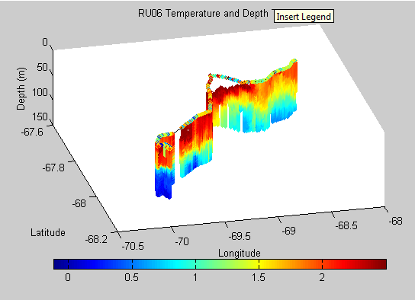
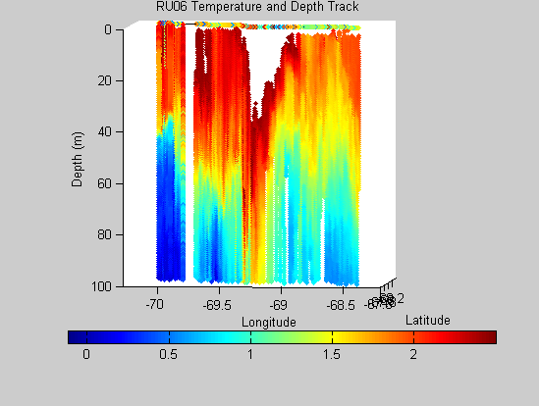
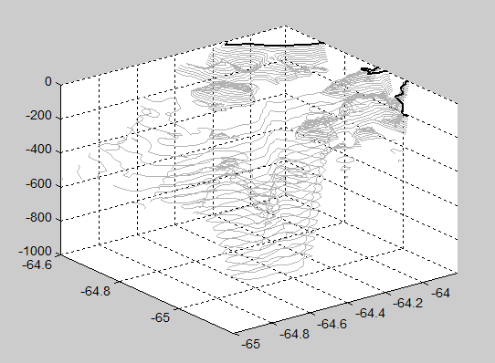
3D Temperature Transect

Slide 15
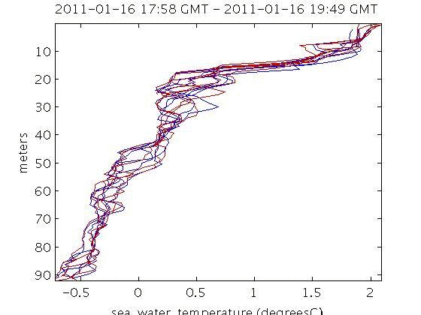
UD_134 Temperature

Slide 16
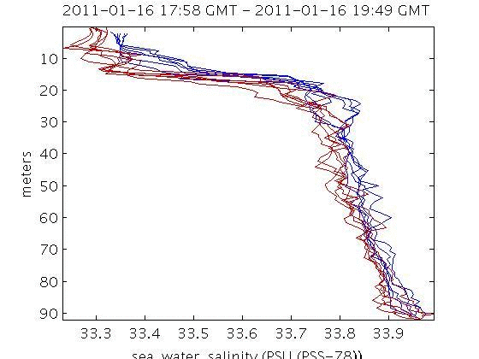
UD_134 Salinity

Slide 17
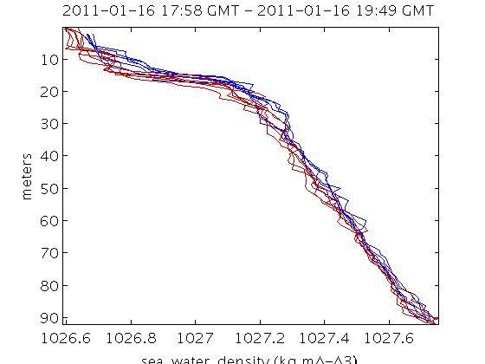
UD_134 Density

Slide 18
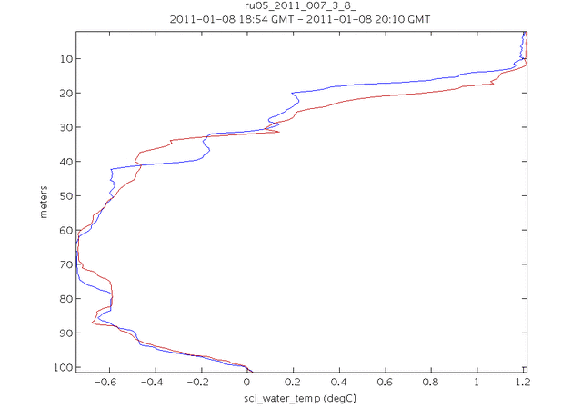
RU05 Temperature

Slide 19
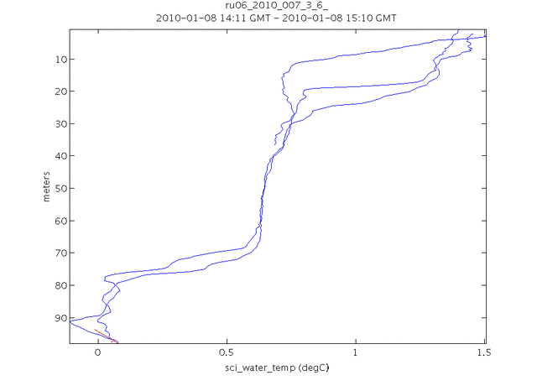
RU06 Temperature

Slide 20
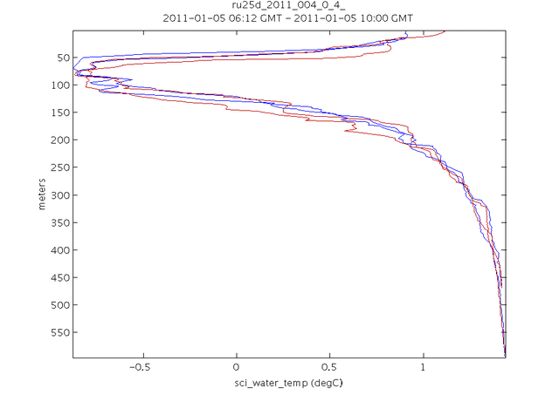
RU25d Temperature

Slide 21
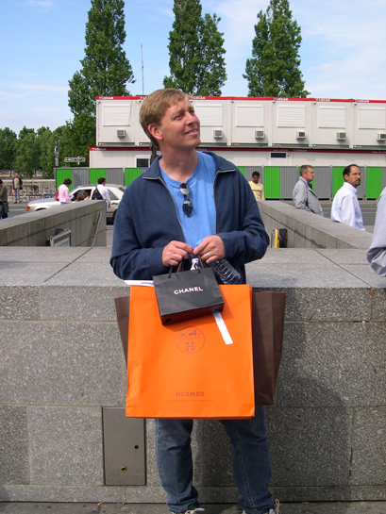
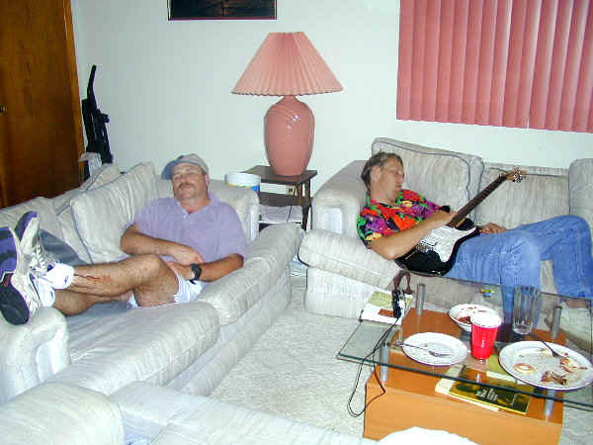
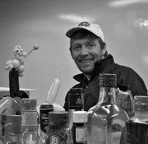
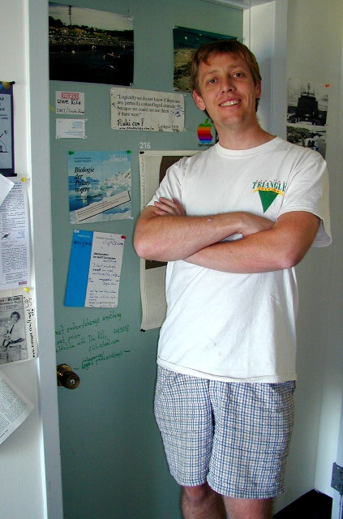
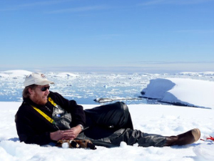
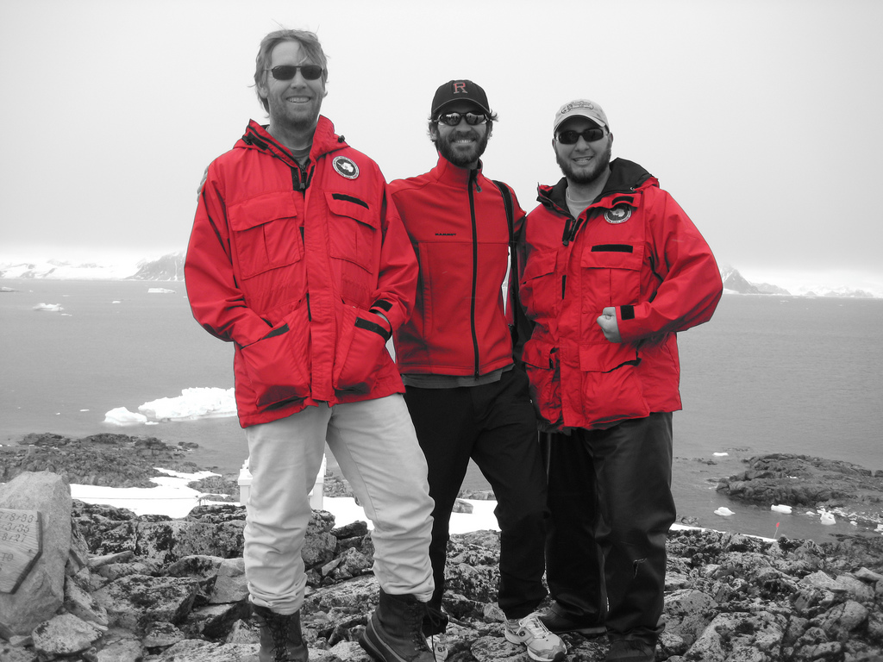
Lessons Learned
    SCIENCE ISN’T ALWAYS FUN
    Hard to do a project in 15 weeks if playing where in the world is Oscar Schofield?
Notes:
So what did we learn from this project…science isn’t always fun. It was a stressful semester with a lot of problems and we did not get to accomplish everything we had hoped. Also it is hard to design a project and implement it in 15 weeks when playing where in the world is Oscar Schofield?

Slide 22
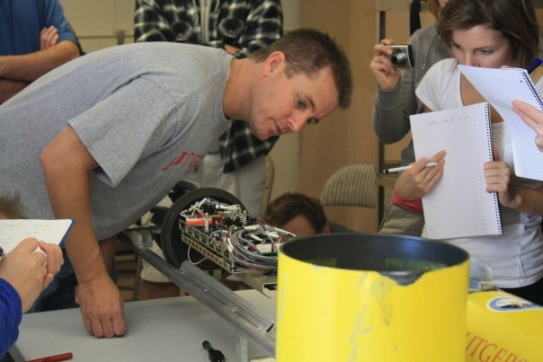
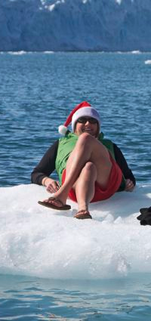
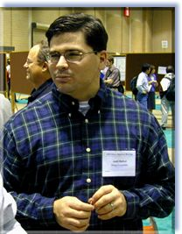
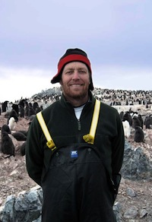
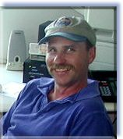
Acknowledgements
    John Kerfoot
    Scotscar Kohut
    Tina
Notes:
We’d like to thank Tina for helping us find our data and teaching Collin how to plot in 3D, John for being awesome and dealing with our near tears with Matlab and the gui, and Scotscar Kohut for their guidance.

