Slide 1
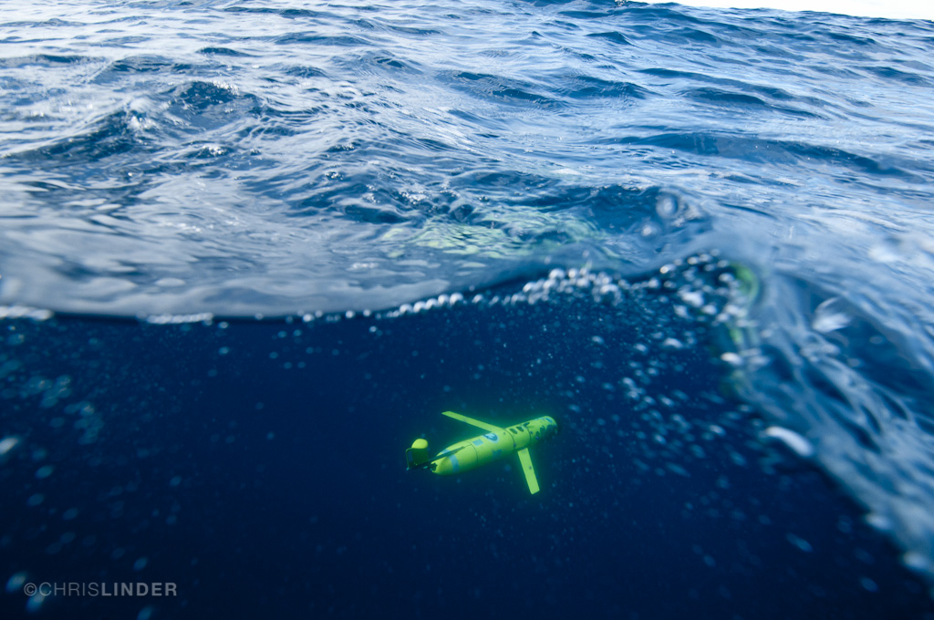




GLIDER MEASUREMNETS OF
PHYTOPLANKTON PHYSIOLOGY
IN PALMER DEEP
Notes:
1

Slide 2
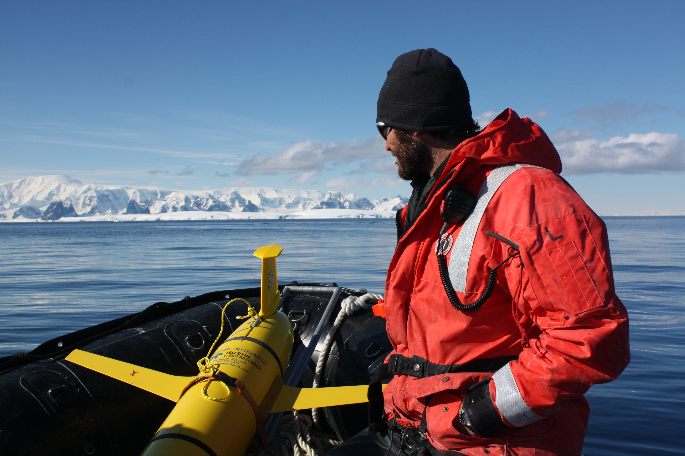
What can a physiology approach tell us about the Palmer deep populations?

Slide 3
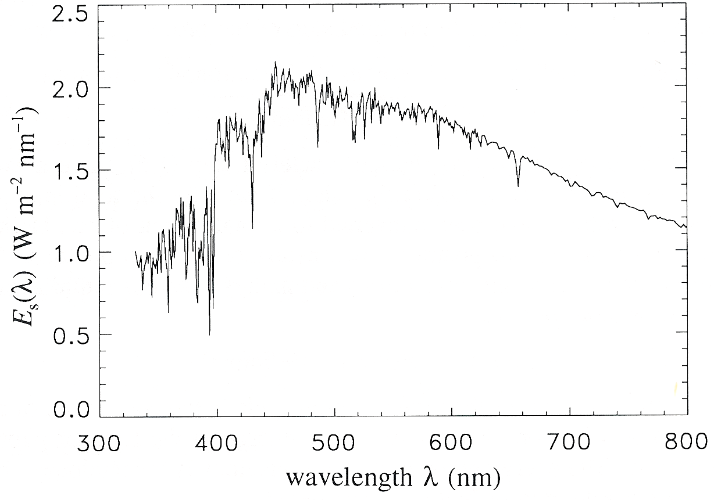

Photosynthesis = PAR * a_{ph} * φ
Scalar visible irradiance
Quantum efficiency of ……..
Absorption
High
Spectrally averaged absorption
Fluorescence
or charge
separation
Irradiance
0.00
0.00
0.20
0.40
0.60
0.80
1.00
oxygen
20.00
Energy that is into the cell
Varies cell pigmentation, light history,
and size
)
40.00
m
(
carbon fixation
h
t
p
e
60.00
D
80.00
~ 1%
Low
100.00
growth
Energy into the ocean
Varies with depth according to the IOPs
IOPs with radiative transfer eqns describe the AOPS
Efficiency of converting energy into
End product (electrons, oxygen, carbon)
Varies with end product and physiology

Slide 4
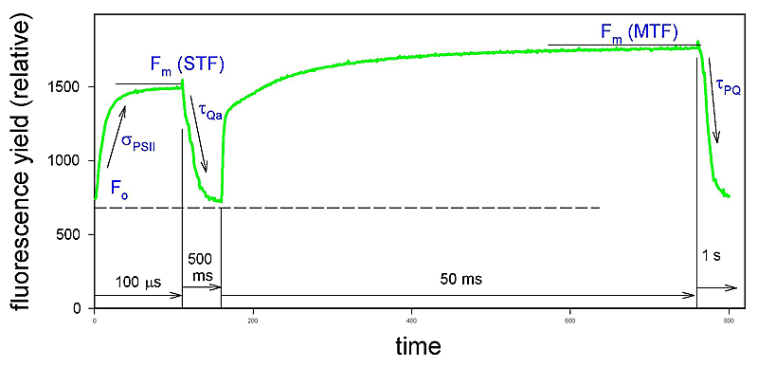

Slide 5
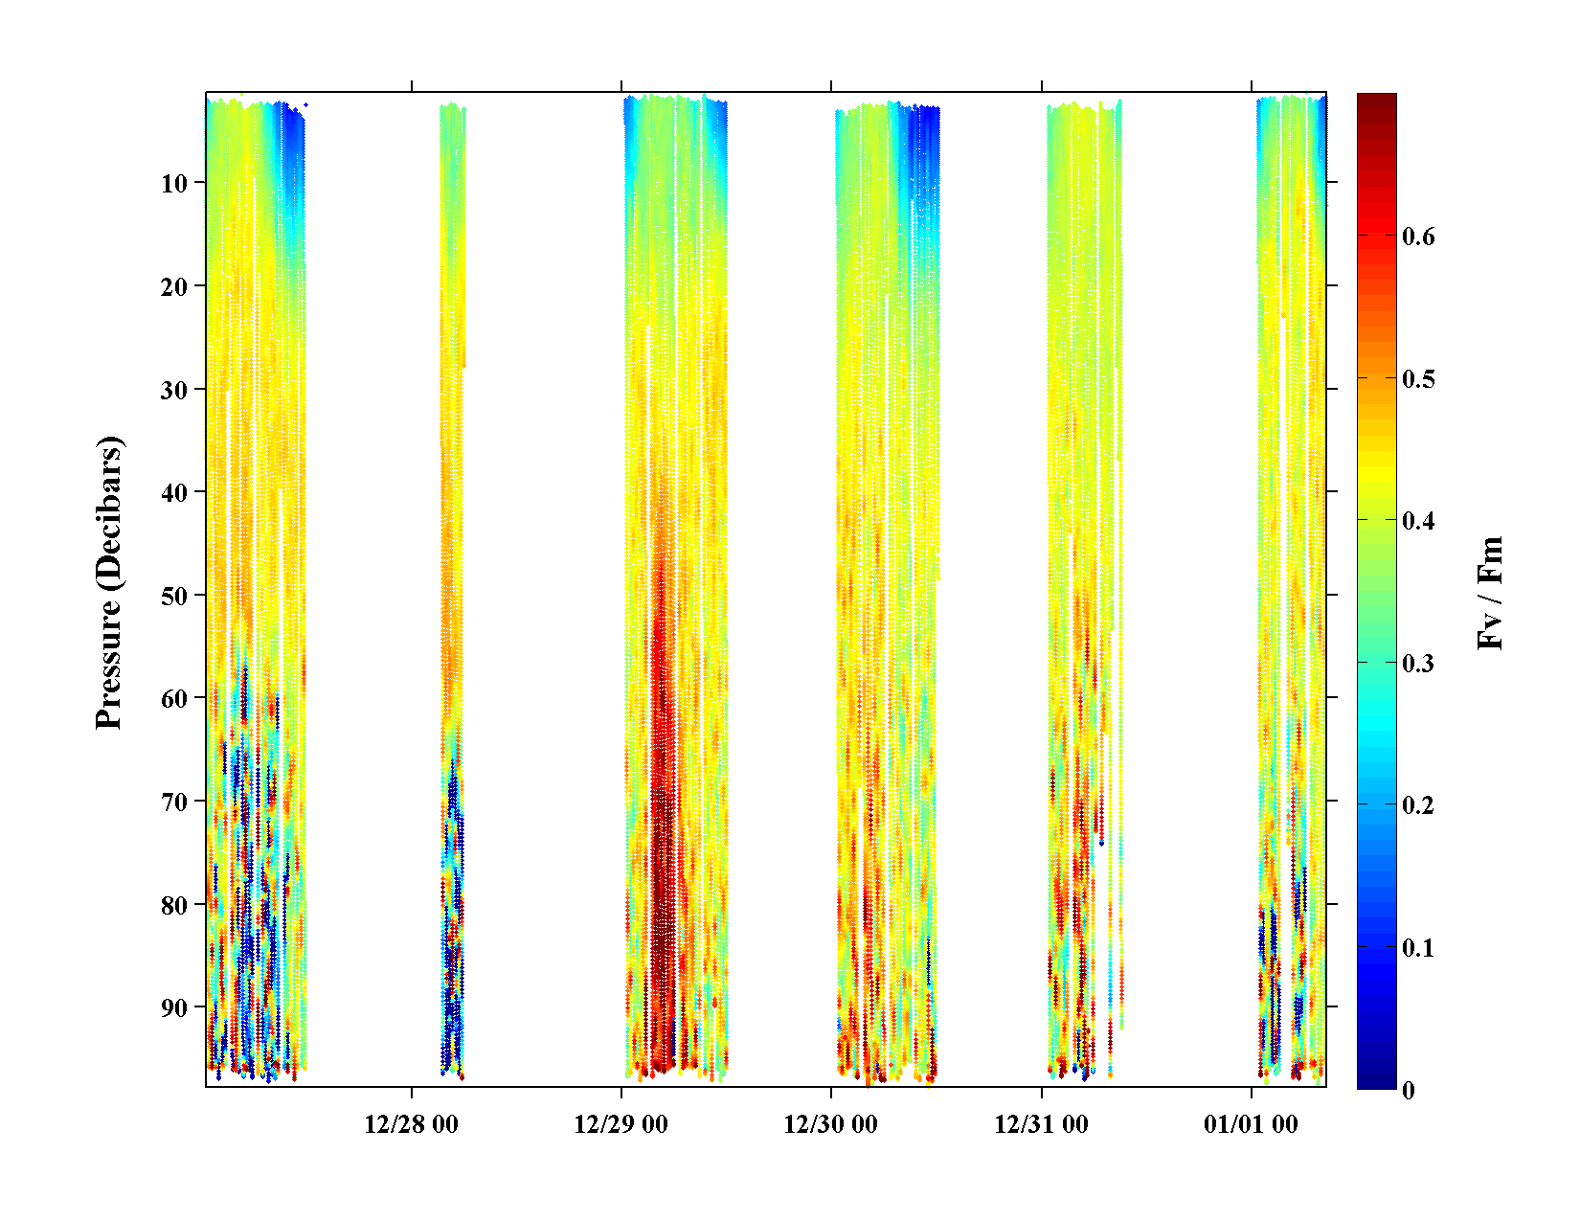
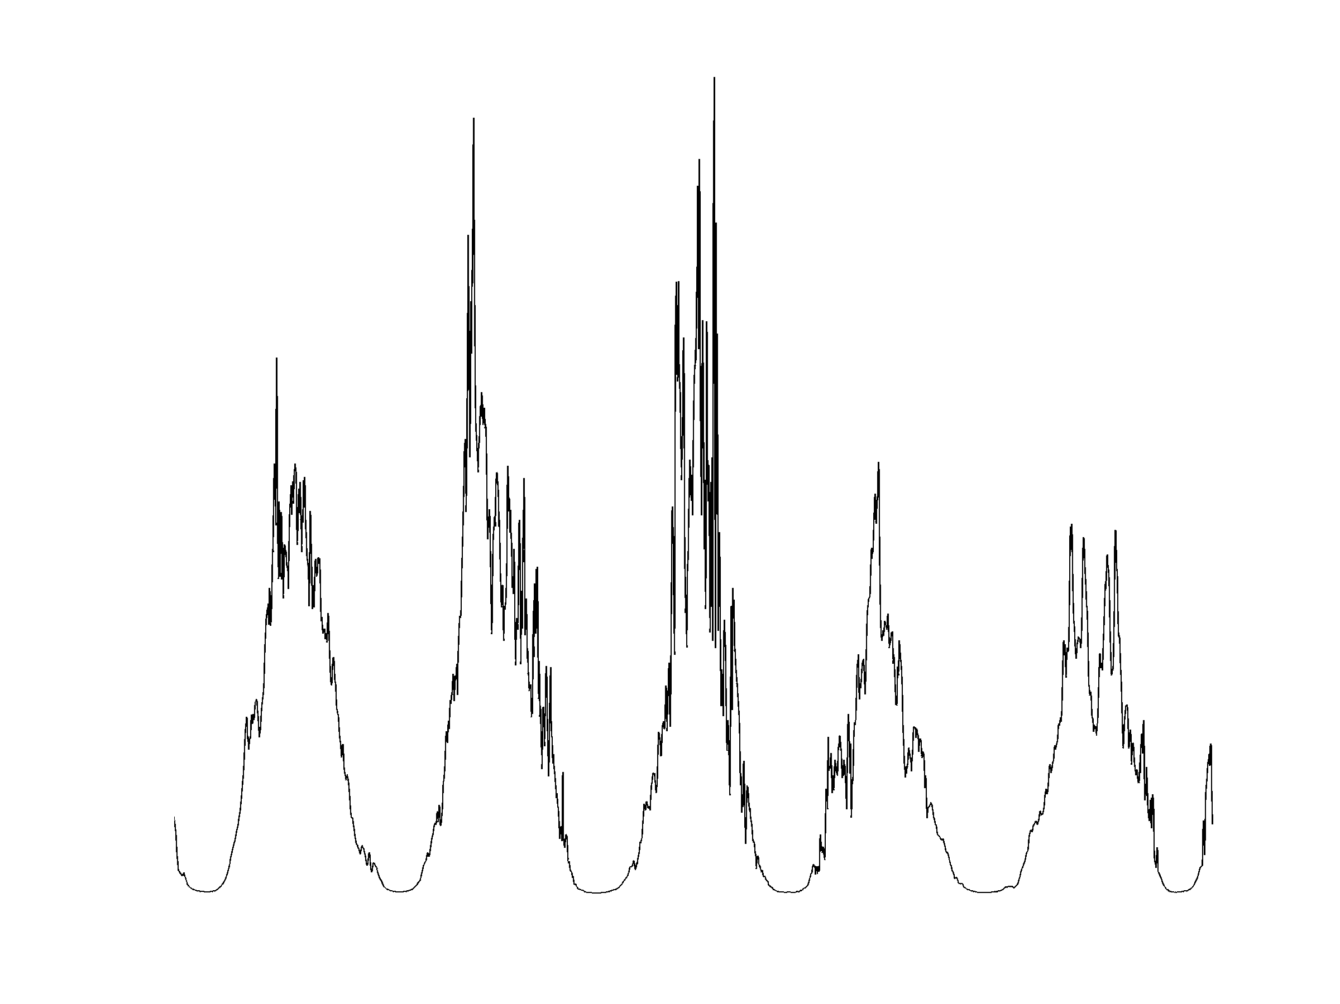

Slide 6
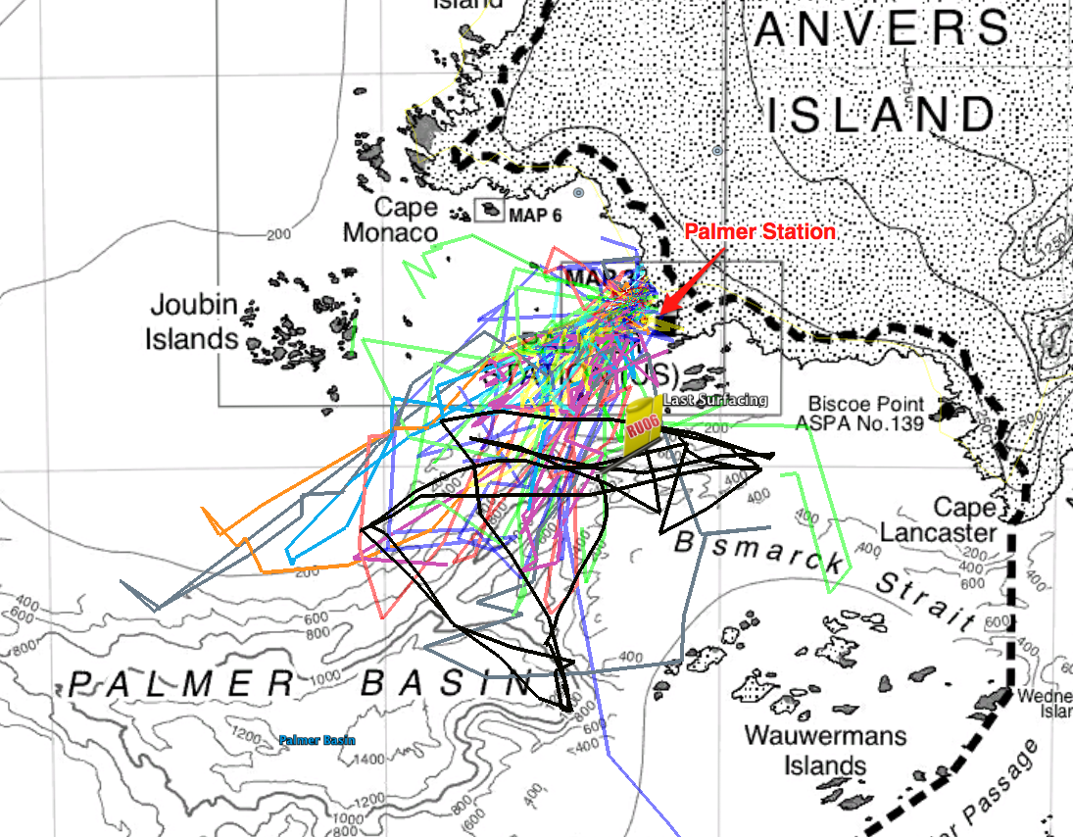
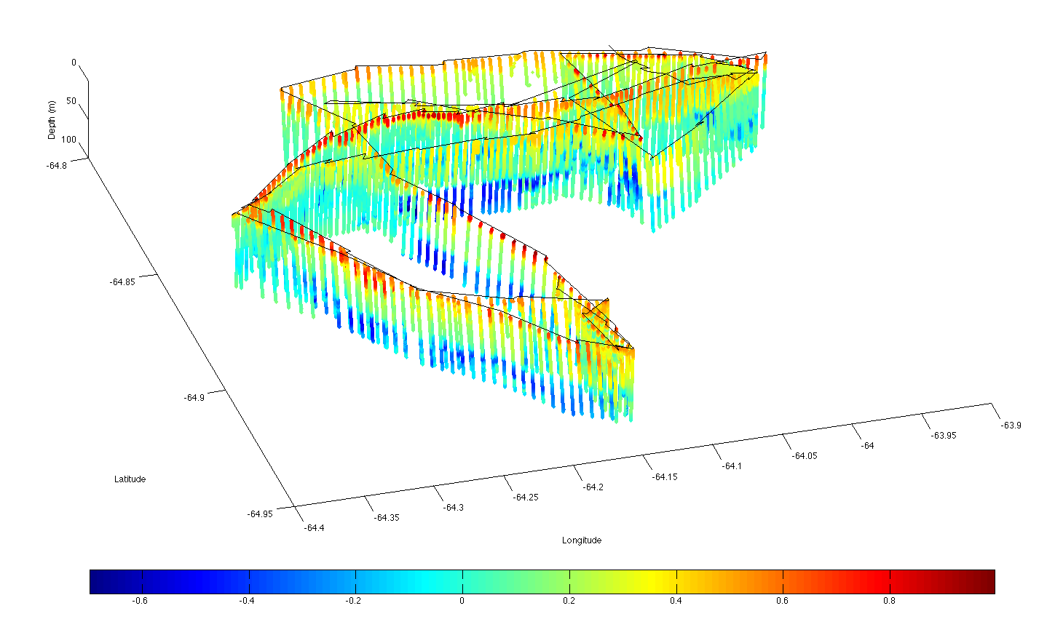
0
Depth (m)
100
-64.8
Latitude
Deep Canyon
-63.9
-64.95
Longitude
-64.4
-0.6
-0.4
Temperature (Celsius)
0.8
1.0

Slide 7
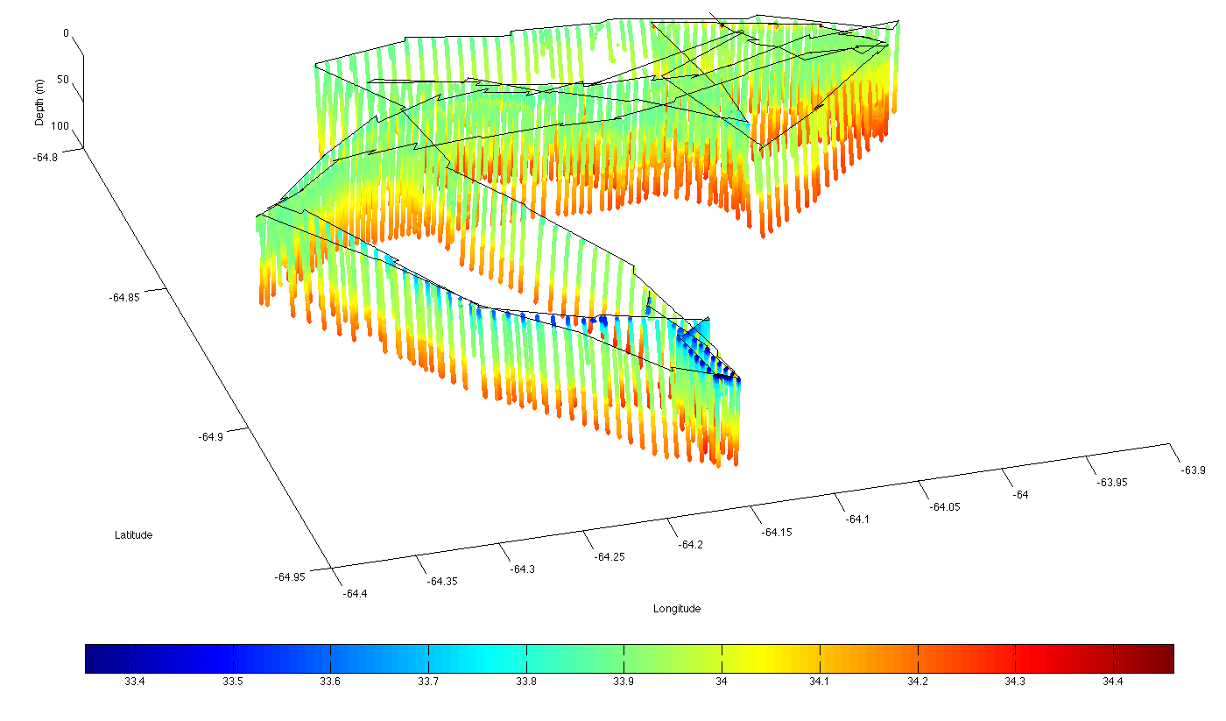
0
Depth (m)
100
-64.8
Latitude
Deep Canyon
-63.9
-64.95
Longitude
-64.4
33.4
33.6
Salinity
34.2
34.4

Slide 8
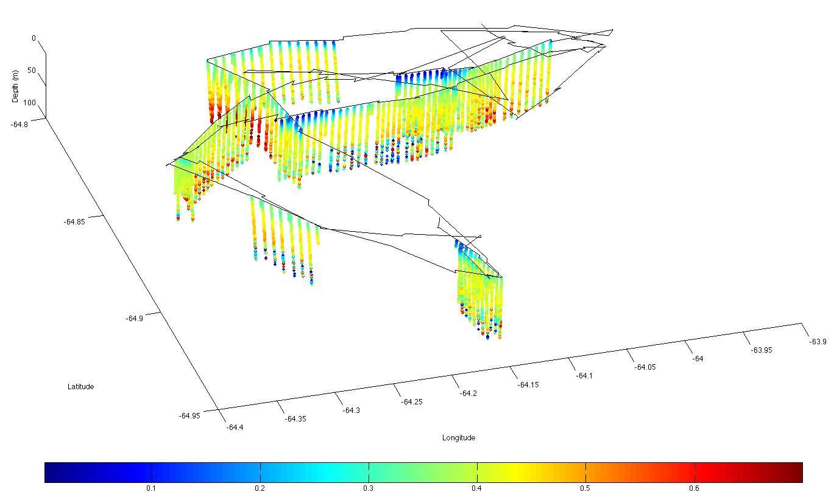
0
Depth (m)
100
-64.8
Latitude
Deep Canyon
-63.9
-64.95
Longitude
-64.4
0
0.1
Maximum quantum yield (Fv/Fm)
0.6
0.7

Slide 9
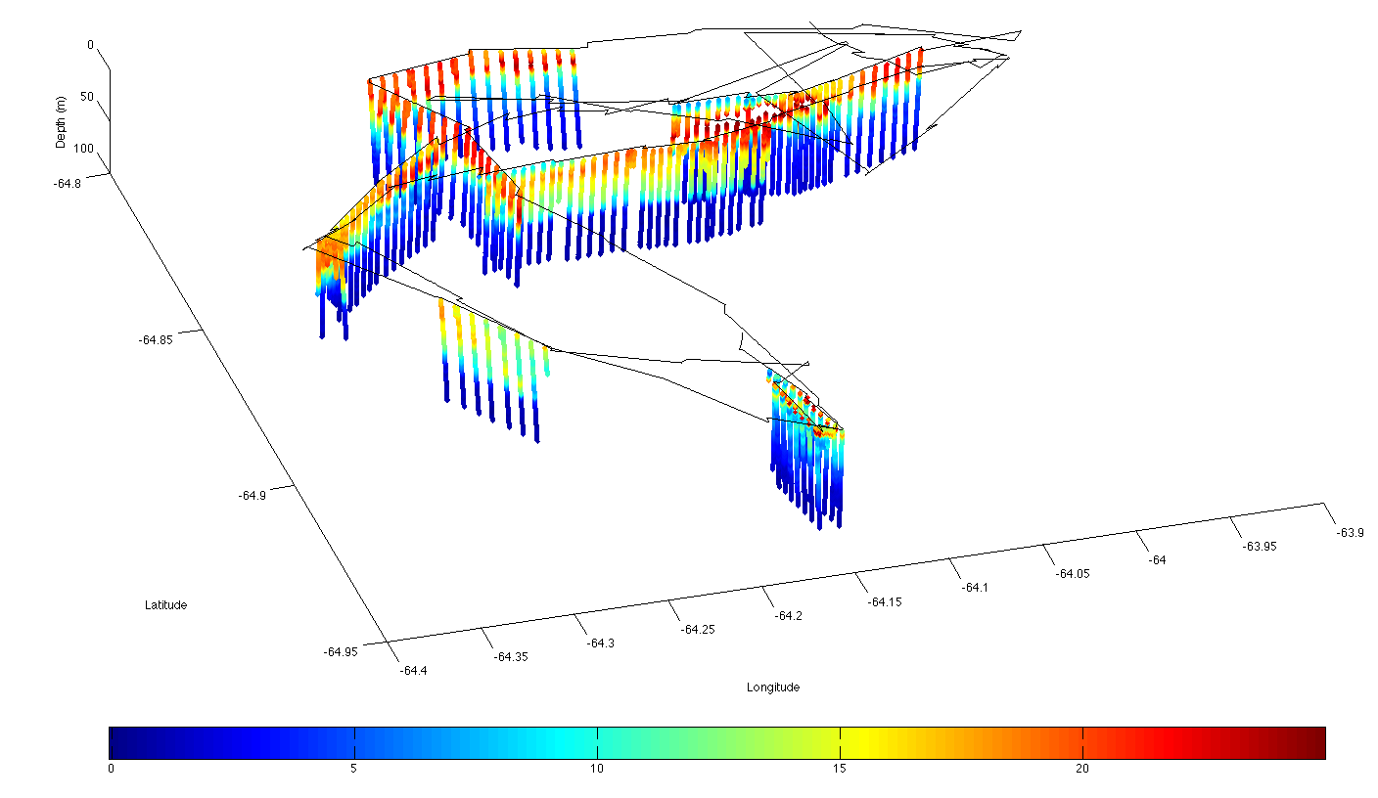
0
Depth (m)
100
-64.8
Latitude
Deep Canyon
-63.9
-64.95
Longitude
-64.4
0
5
Fluorescence-zero (volts)
20
25

Slide 10
Other useful indices
FLUORESCENCE INDUCTION
Integrated area is
reflection of the absorption
cross-section
Photons
Low
light
cells
High
light
cells
Fluorescence rise
Photo-acclimation
Time
Flash is on
RC2

Slide 11
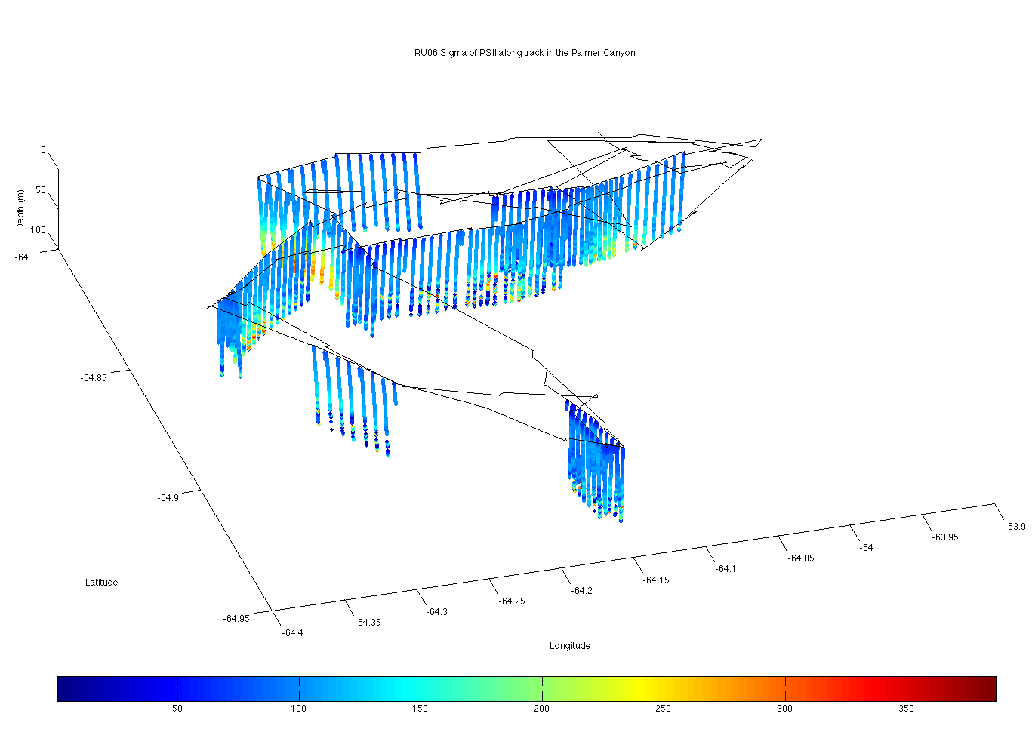
0
Depth (m)
100
-64.8
Latitude
-63.9
-64.95
Longitude
-64.4
50
Sigma PSII
350

Slide 12
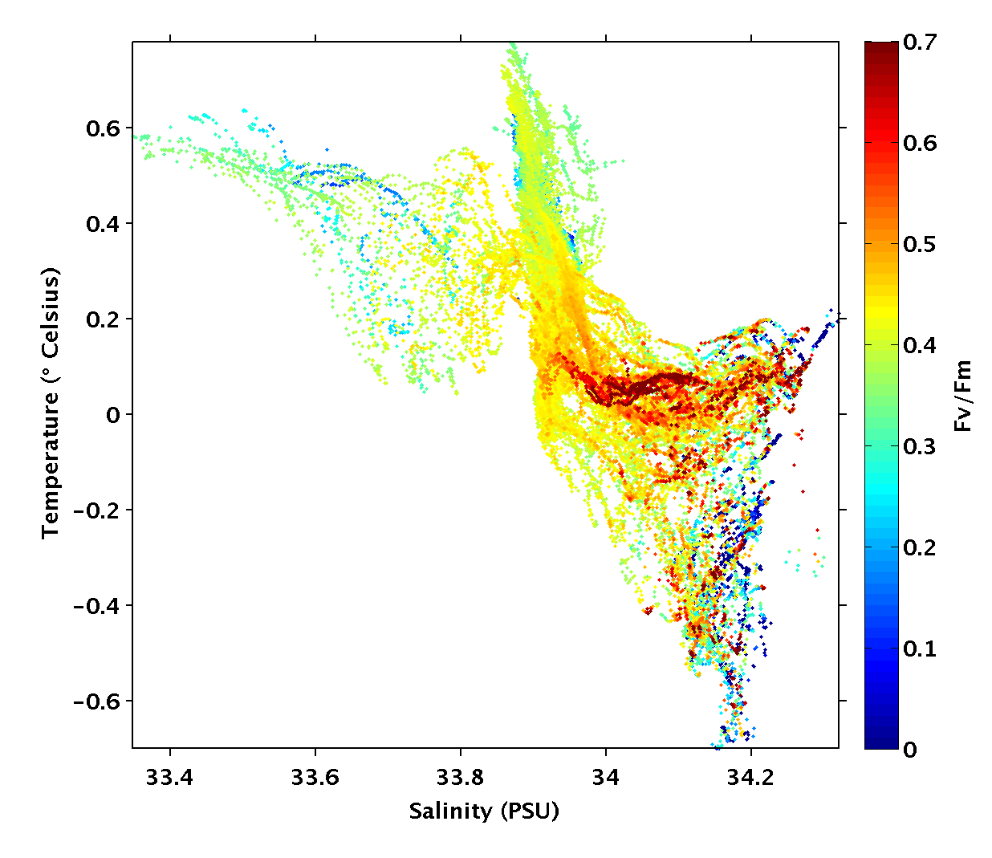

Slide 13
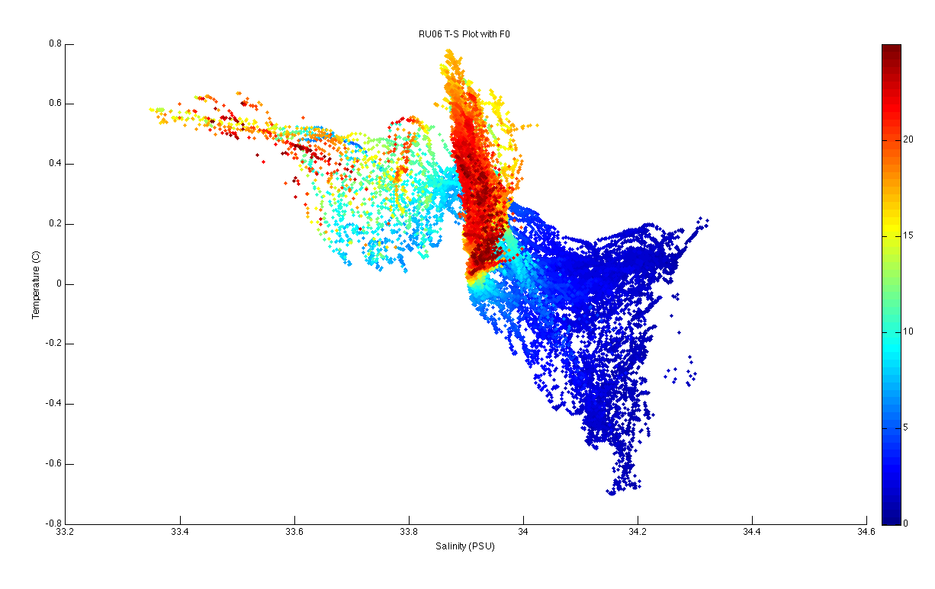

Slide 14
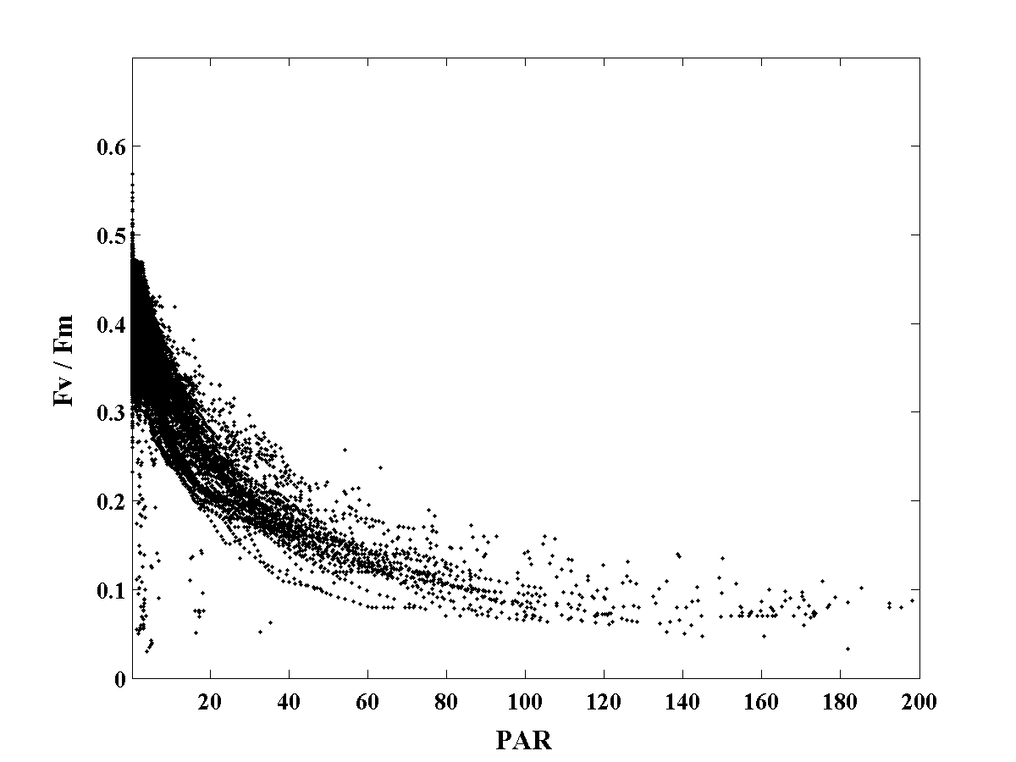
Fl
¹⁴C
Based on Moline et al. 1998

Slide 15
Rough seas
Antarctic
1
Arabian Sea (SW Monsoon)
2
Arabian Sea (Inter Monsoon)
3
Arabian Sea (NE Monsoon)
4
Antarctic (Bransfield-Bellingshausen water)
5
Antarctic (Bransfield-Weddell water)
6
Antarctic (Ice-Edge water)
7
Antarctic (Weddell-Scotia Confluence waters)
8
Antarctic (Bellingshausen Cold water)
9
Antarctic (Bellingshausen Warm water)
10
Antarctic (Transitional Weddell Water)
11
Antarctic (Palmer Station)
12
Canary Islands (Fall)
13
NE Atlantic Subtropical Gyre (Fall)
14
NW Atlantic Subtropical Gyre (Fall)
φ_{max} (mol C mol photons absorbed⁻¹)
15
Gulf Stream (Fall)
16
NW Atlantic Continental Shelf (Fall)
17
Canary Islands (Spring)
18
NE Atlantic Subtropical Gyre (Spring)
19
NW Atlantic Subtropical Gyre (Spring)
20
Gulf Stream (Spring)
21
NW Atlantic Continental Shelf (Spring)
22
Southern California Bight
23
New Jersey Coastal Region
Oligotrohic
seas
E_{k(PAR)} (μmol photons m⁻² s⁻¹)

Slide 16
CONCLUSIONS
There is spatial variability in the biomass and the physiology
Healthiest phytoplankton are found at the edge of the canyon associated with the warmer bottom temperatures
Populations appear to dark light adapted
Photosystem II saturates earlier than carbon fixation

