Slide 1
Conditions Around the
Azores/Canaries
By: Conor O’mara, Heather Coulson, Mario Garcia & Oliver Ho

Slide 2
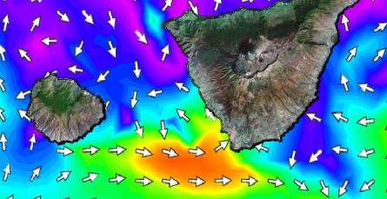
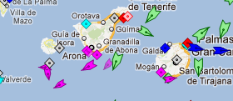
What do we plot?
Wind Speed
Current Speed
Sea Surface Height
Ship Traffic
WHY?
When deciding what to plot for our specific topic, we decided to take into consideration aspects that affect a glider or in this case, Silbo’s journey to the Canaries and we came to the conclusion that it would be most important to plot data on wind speed, current speed, sea surface height and ship traffic.

Slide 3
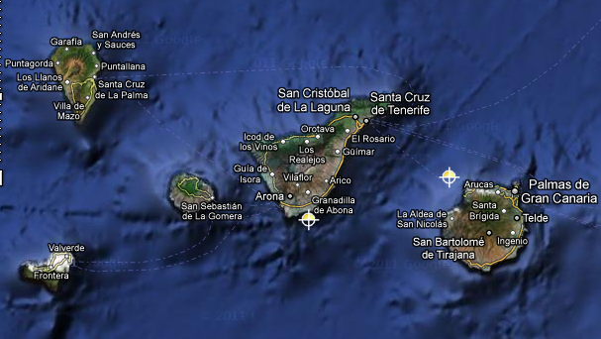
Canary Islands
Blue Circle: Possible area for glider recovery
Red Circle: Tenerife Sur Buoy
La Gomera
Tenerife

Slide 5
Why is wind speed important?
It effects the ocean
*Provides energy on the ocean surface*
Causes ripples and waves*
Effects the size of those ripples and waves*
Which could ultimately take a toll on the glider*

Slide 6
Current Speed
Light Blue = 6:30 am
Blue = 1:30 pm
Green = 10:30 pm

Slide 7
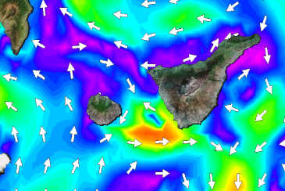
Why Current Speed?
Easy Formula:
Current Speed = Time = Battery Life
Slow moving currents = more time to reach destination = more use of battery life
Fast moving currents = less time to reach destination = less use of battery life
Since the gliders have no propeller, they depend of ocean currents to glide their way through the ocean, therefore the glider is a the mercy of the currents and that is why we decided to monitor currents because they are what determine Silbo’s ability to reach its goal.

Slide 8
Sea Surface Height
cm
This chart graphs the sea surface height based on the according time of day on each date, off the coast of La Gomera

Slide 9
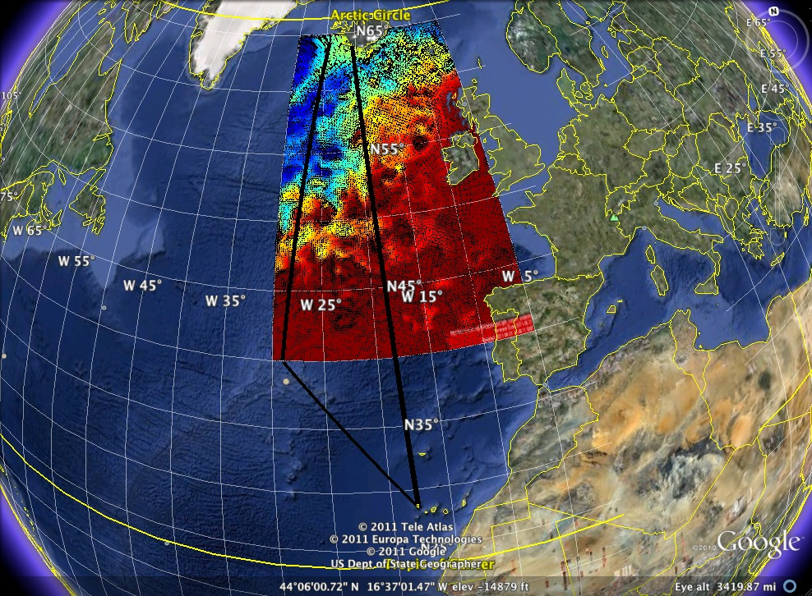
Important for the Mission
Sea surface height can possibly affect our window of recovery. If SSH is too intense (meaning high), chances of recovery are lowered because we don't want to risk crew members and/or equipment going out in 10m or so waters. Ideally we’d prefer SSH to be low or manageable, as opposed to a high SSH where it would be dangerous to recover.

Slide 10
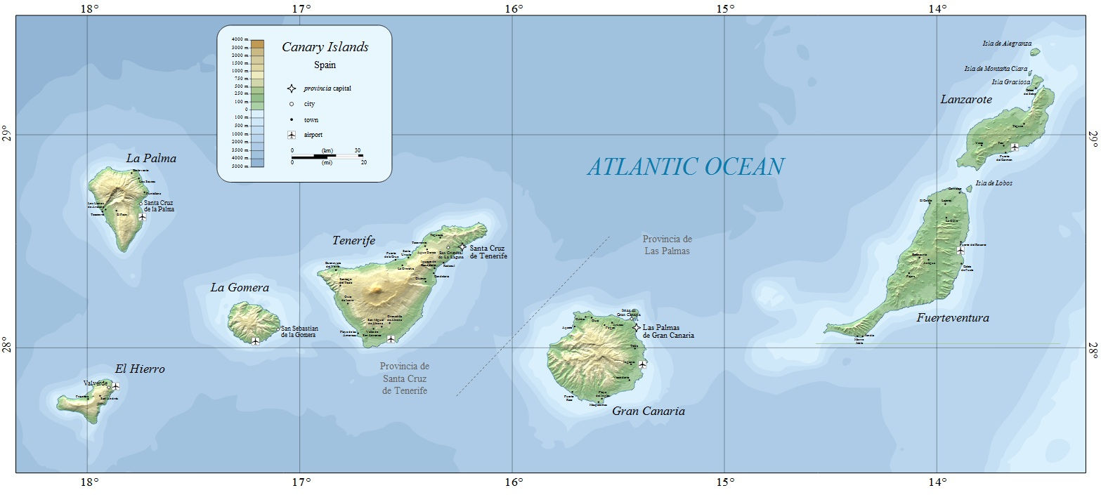
Shipping at the Finish Line
Silbo would approach the Canary Islands from the North or Northwest. The ideal recovery site would be in an area with little to no commercial activity, yet still high in depth to reduce the risk of running aground.
The island’s exports are bananas, sugarcane, tomatoes, oranges, dates, and tobacco to Europe and the Americas. Shipping traffic will affect Silbo’s recovery; the number of ships correlate with danger. More activity results in a greater probability of collision and mission failure.
The types of ships recorded include passenger, cargo, sailing ships, pilot vessels and tugboats. Tourism is a big part of the economy with about 12 million tourists a year interested in everything from its four national parks to witnessing Canarian wrestling. Ferry boat rides between islands which can take from a one to two and a half hours, can reach speeds of up to 30 knots (~35mph). Any sort of collision could lead to Silbo spiraling down to an abrupt end to the mission.
Measurements of four out of the seven islands that comprise the Canary Islands were used in the making of these figures.

Slide 12
Conclusion
Overall we wanted to plot data that was relevant and useful in Silbo’s journey to the Canaries which is why we decided to plot:
Wind Speed
Current Speed
Sea Surface Height
Ship Traffic
We would like to thank Enrique and his colleague for taking their time in helping us and allowing us to use their data.
http://www.puertos.es/en/oceanografia_y_meteorologia/redes_de_medida/index.html
ftp://cain.puertos.es/incoming/IBI-ROOS/DATA/PuertosDelEstado/Buoys/
GRACIAS!!!

