Slide 1
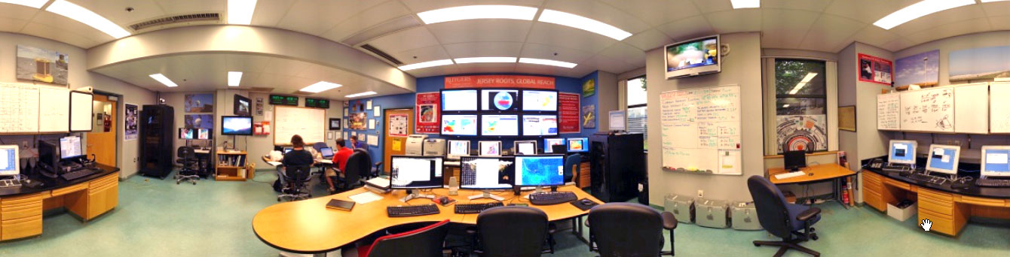
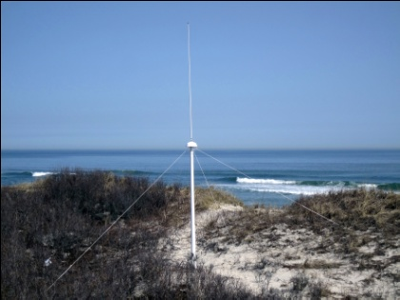
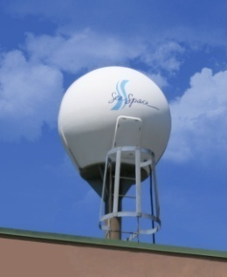
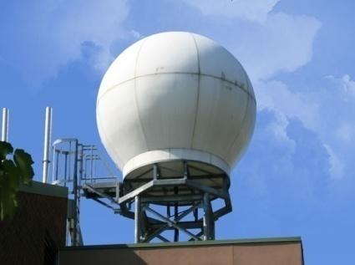
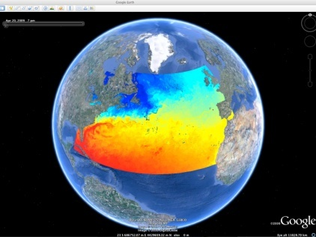
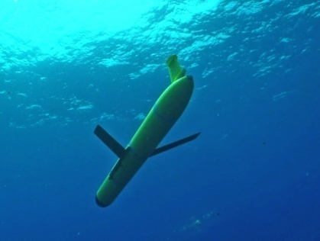












Southern Operations: Gliders On Ice
Rutgers University - Coastal Ocean Observation Lab
CODAR Network
L-Band & X-Band Satellite Receivers
3-D Nowcasts
& Forecasts
Glider Fleet
Jersey Roots, Global Reach
Notes:
1

Slide 2
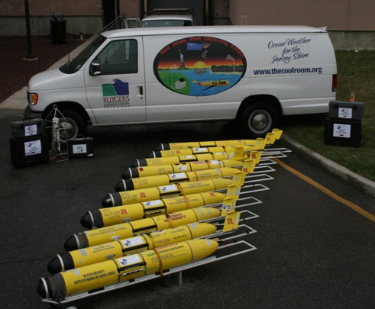
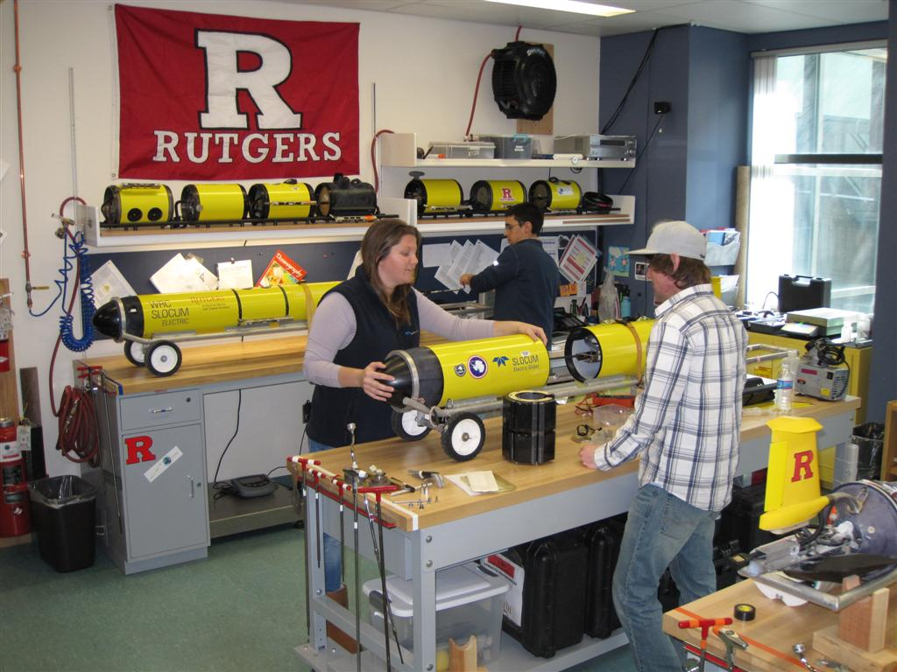
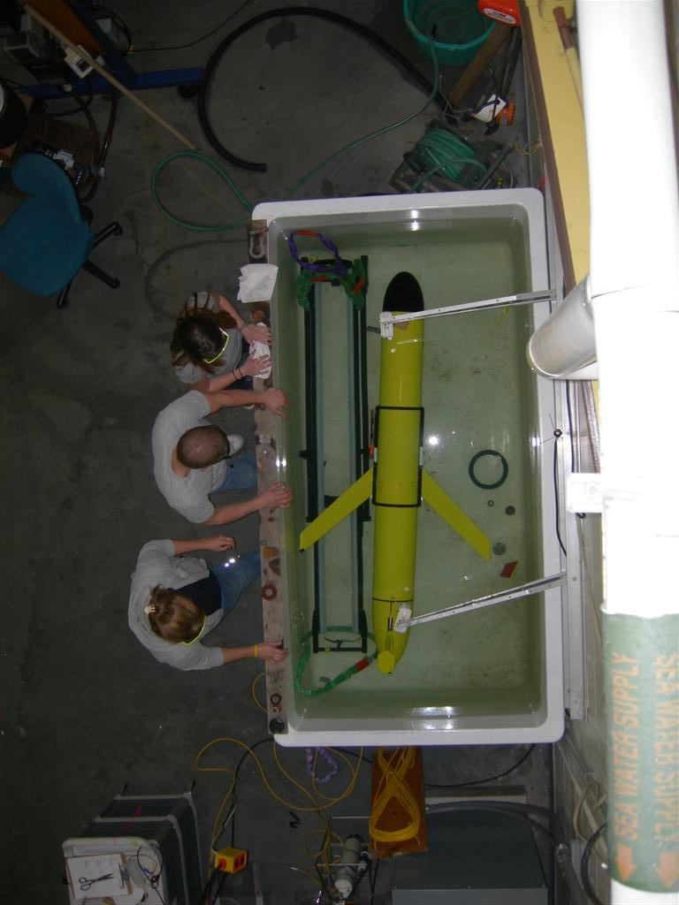
Rutgers Glider Facilities
1 Teledyne Webb Slocum Shallow Glider (30m)
19 Teledyne Webb Slocum Coastal Gliders (200m)
2 Teledyne Webb Slocum Deep Gliders (1000m)

Slide 3
Rutgers Glider Facilities
1 Teledyne Webb Slocum Shallow Glider (30m)
19 Teledyne Webb Slocum Coastal Gliders (200m)
2 Teledyne Webb Slocum Deep Gliders (1000m)
Sea-Bird CTD (un-pumped)
Sea-Bird CTD (pumped)
TRDI ADCP
OSU Turbulence Chi-pod
URI Bioprobe
Wetlabs pucks (5 configurations)
Hobi Labs hydroscat-2
Sony camera
Mote Marine Lab breve buster
RU/Satlantic FIRe
Satlantic radiometer
Aanderraa optode
Vemco fish reciever
Wetlabs SAM
Wetlabs BAM
Licor PAR

Slide 4
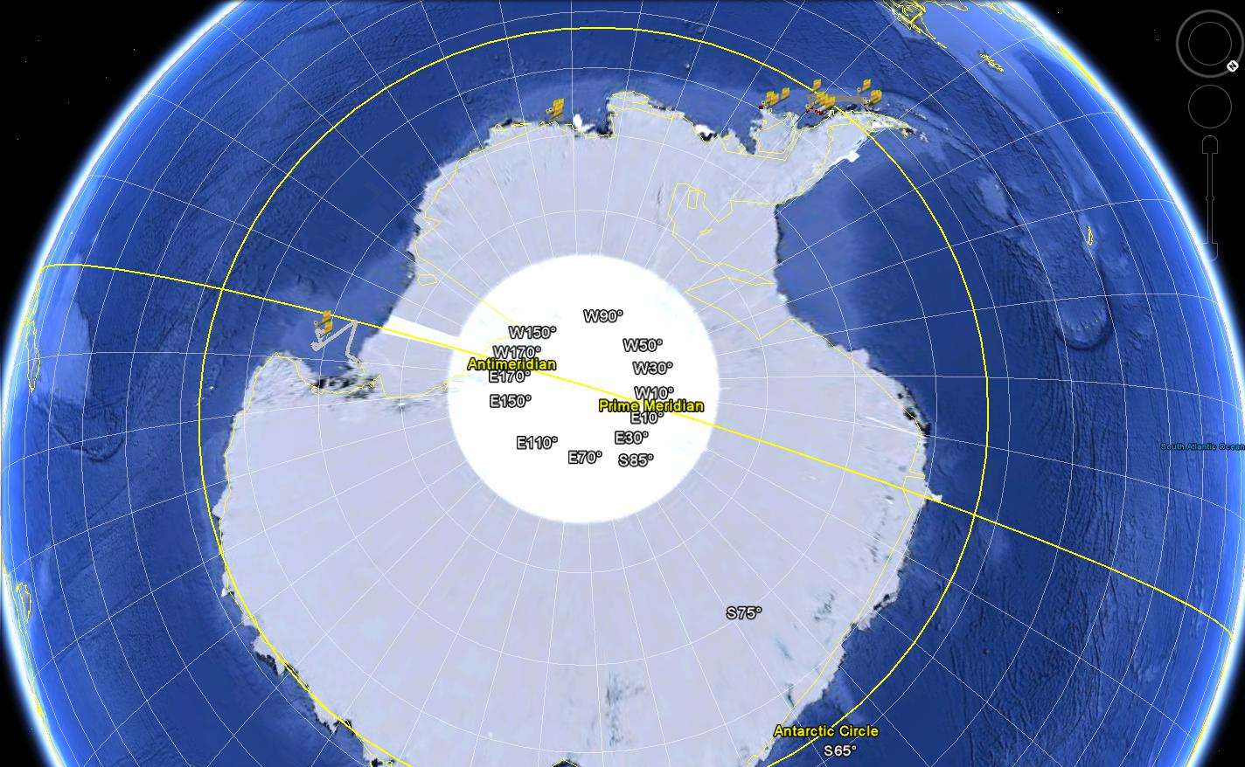
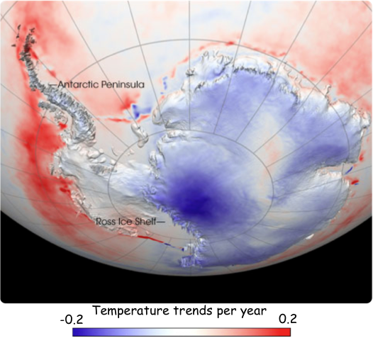
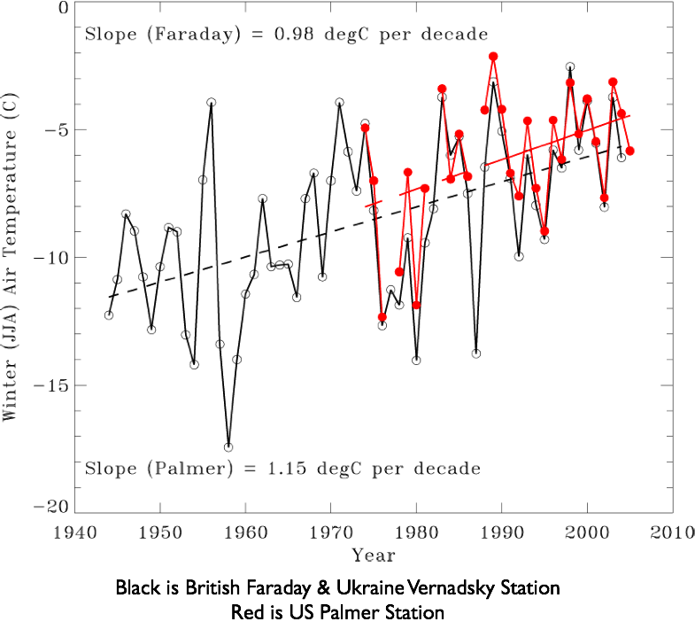
RU-COOL Glider Fleet: Antarctic Deployments: 2007 – 2011
- Number of Deployments: 22
- In-water days: 251
- Distance flown: 5,009 km

Slide 5
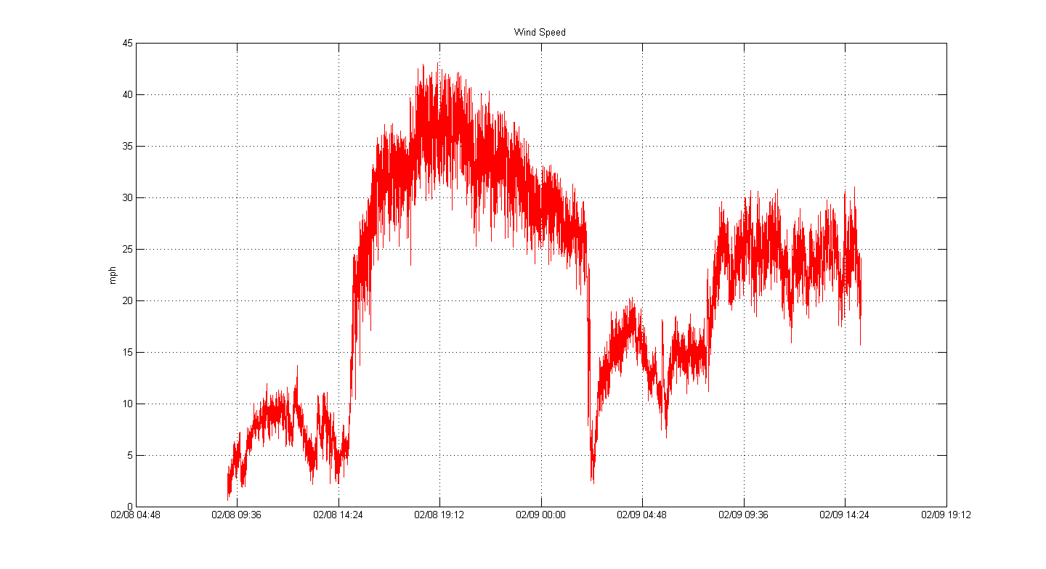
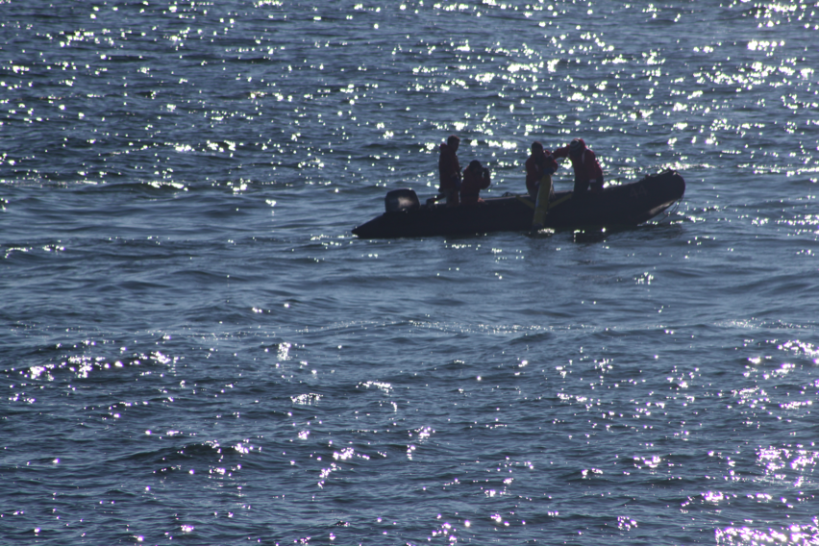
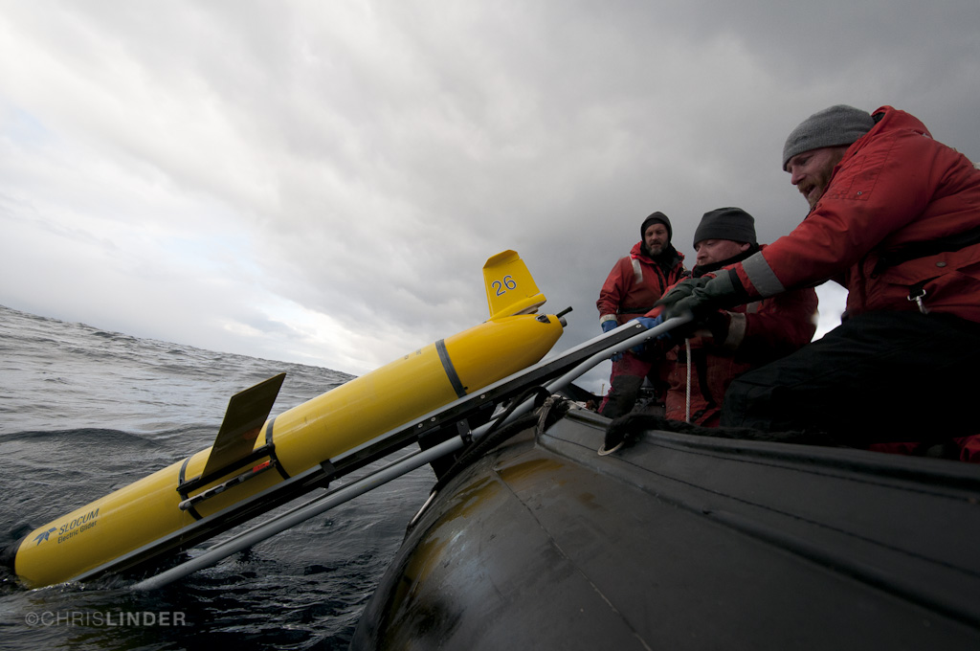
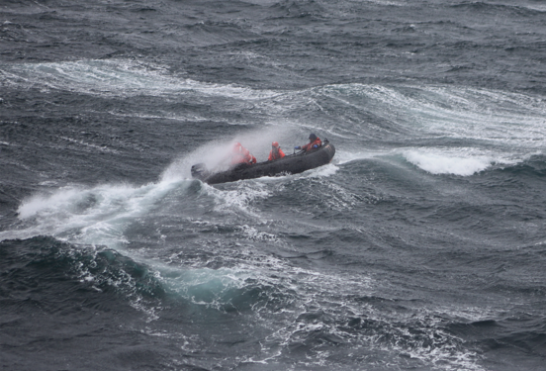
24 Hour Winds (knots)
40
31
22
13
4

Slide 6
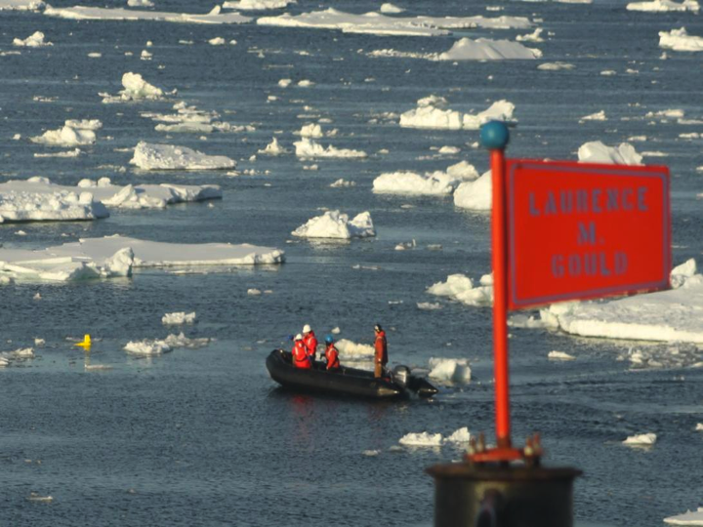

Slide 7
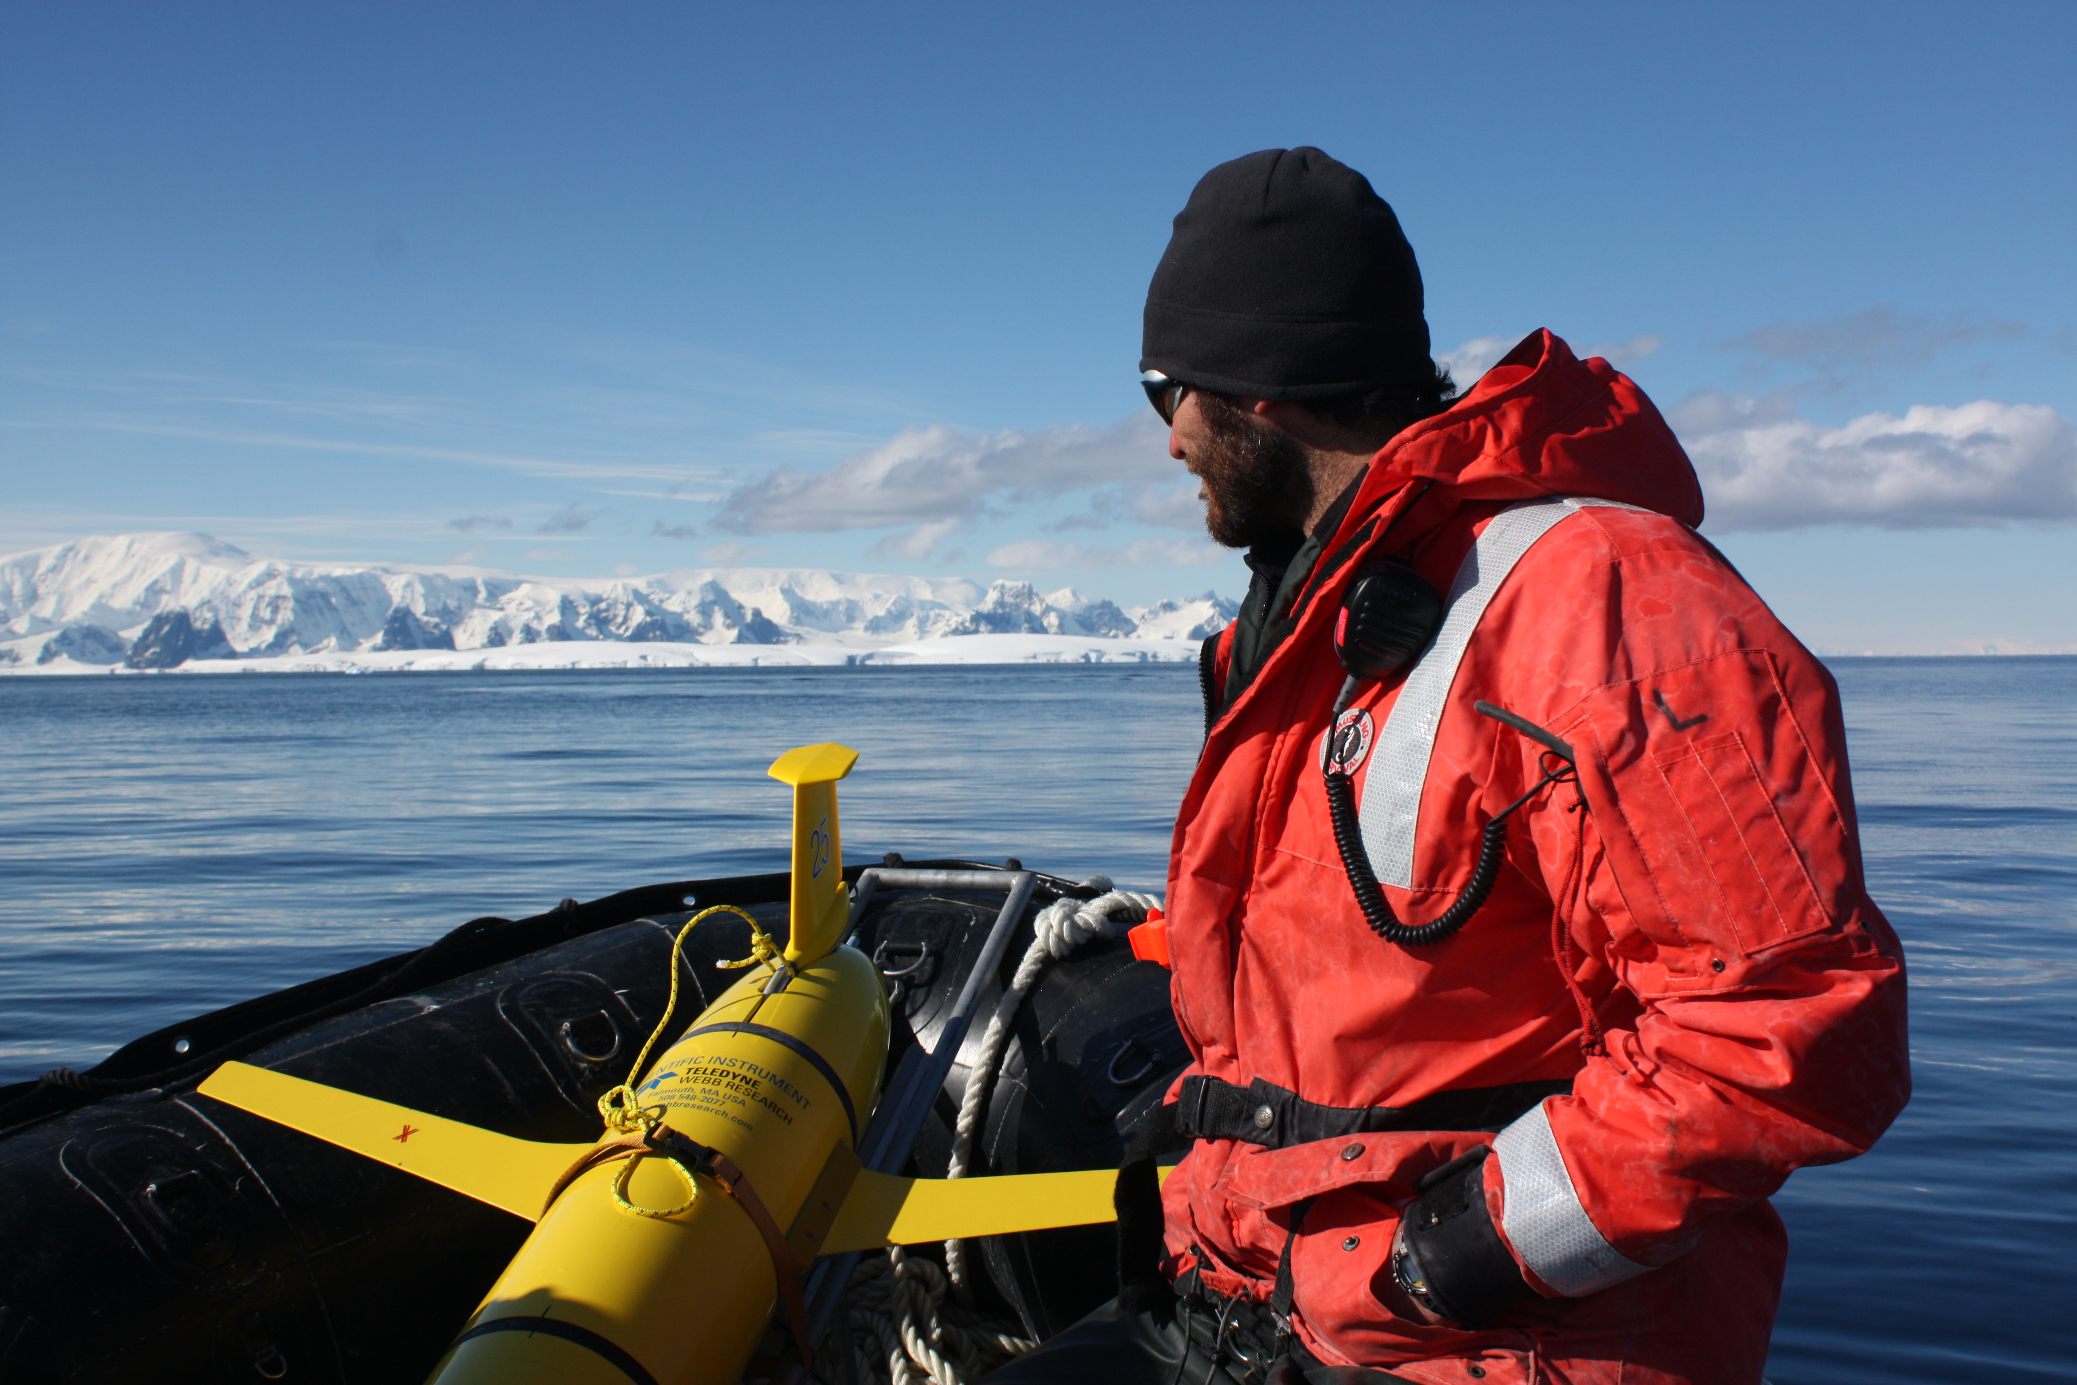
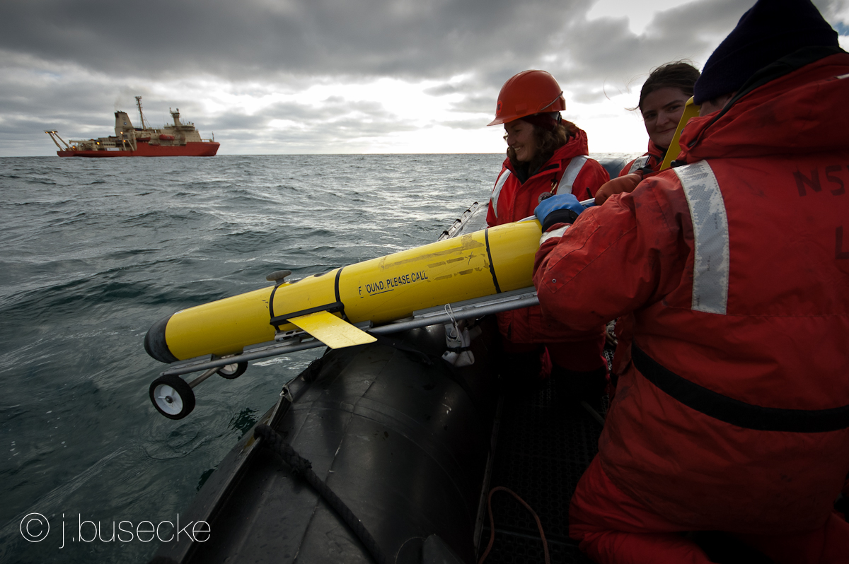
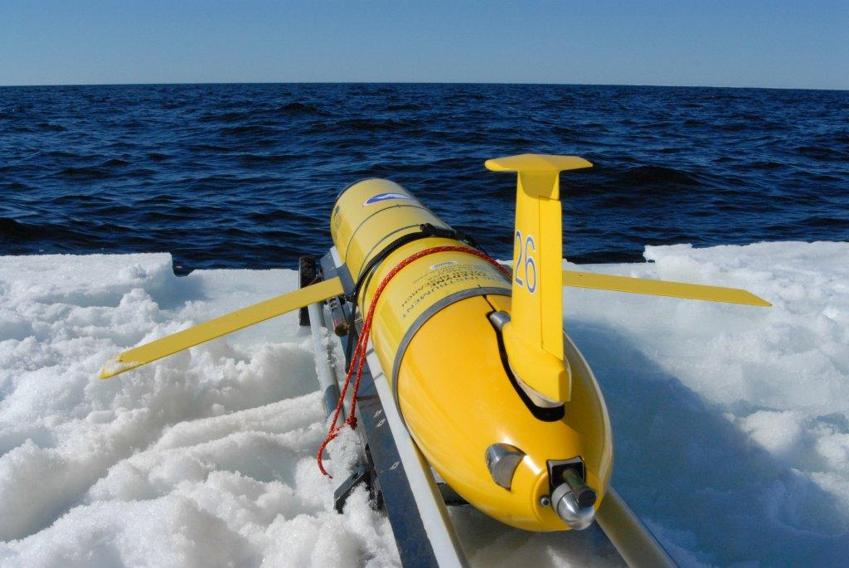
Glider deployments
in a unique ecosystem

Slide 8
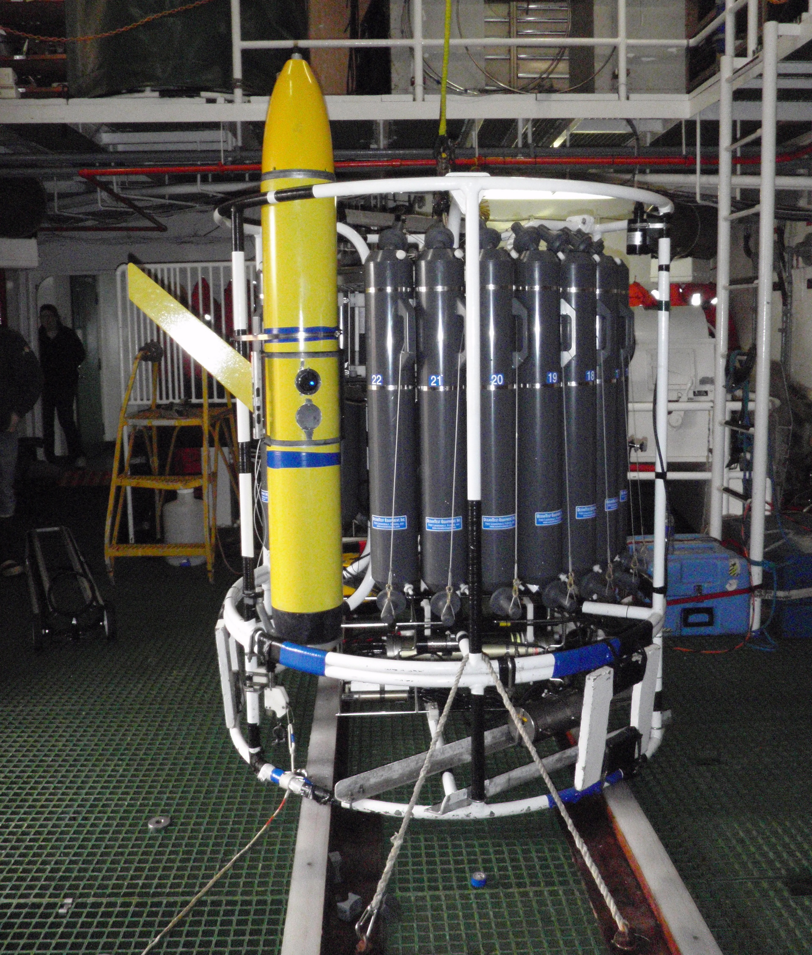
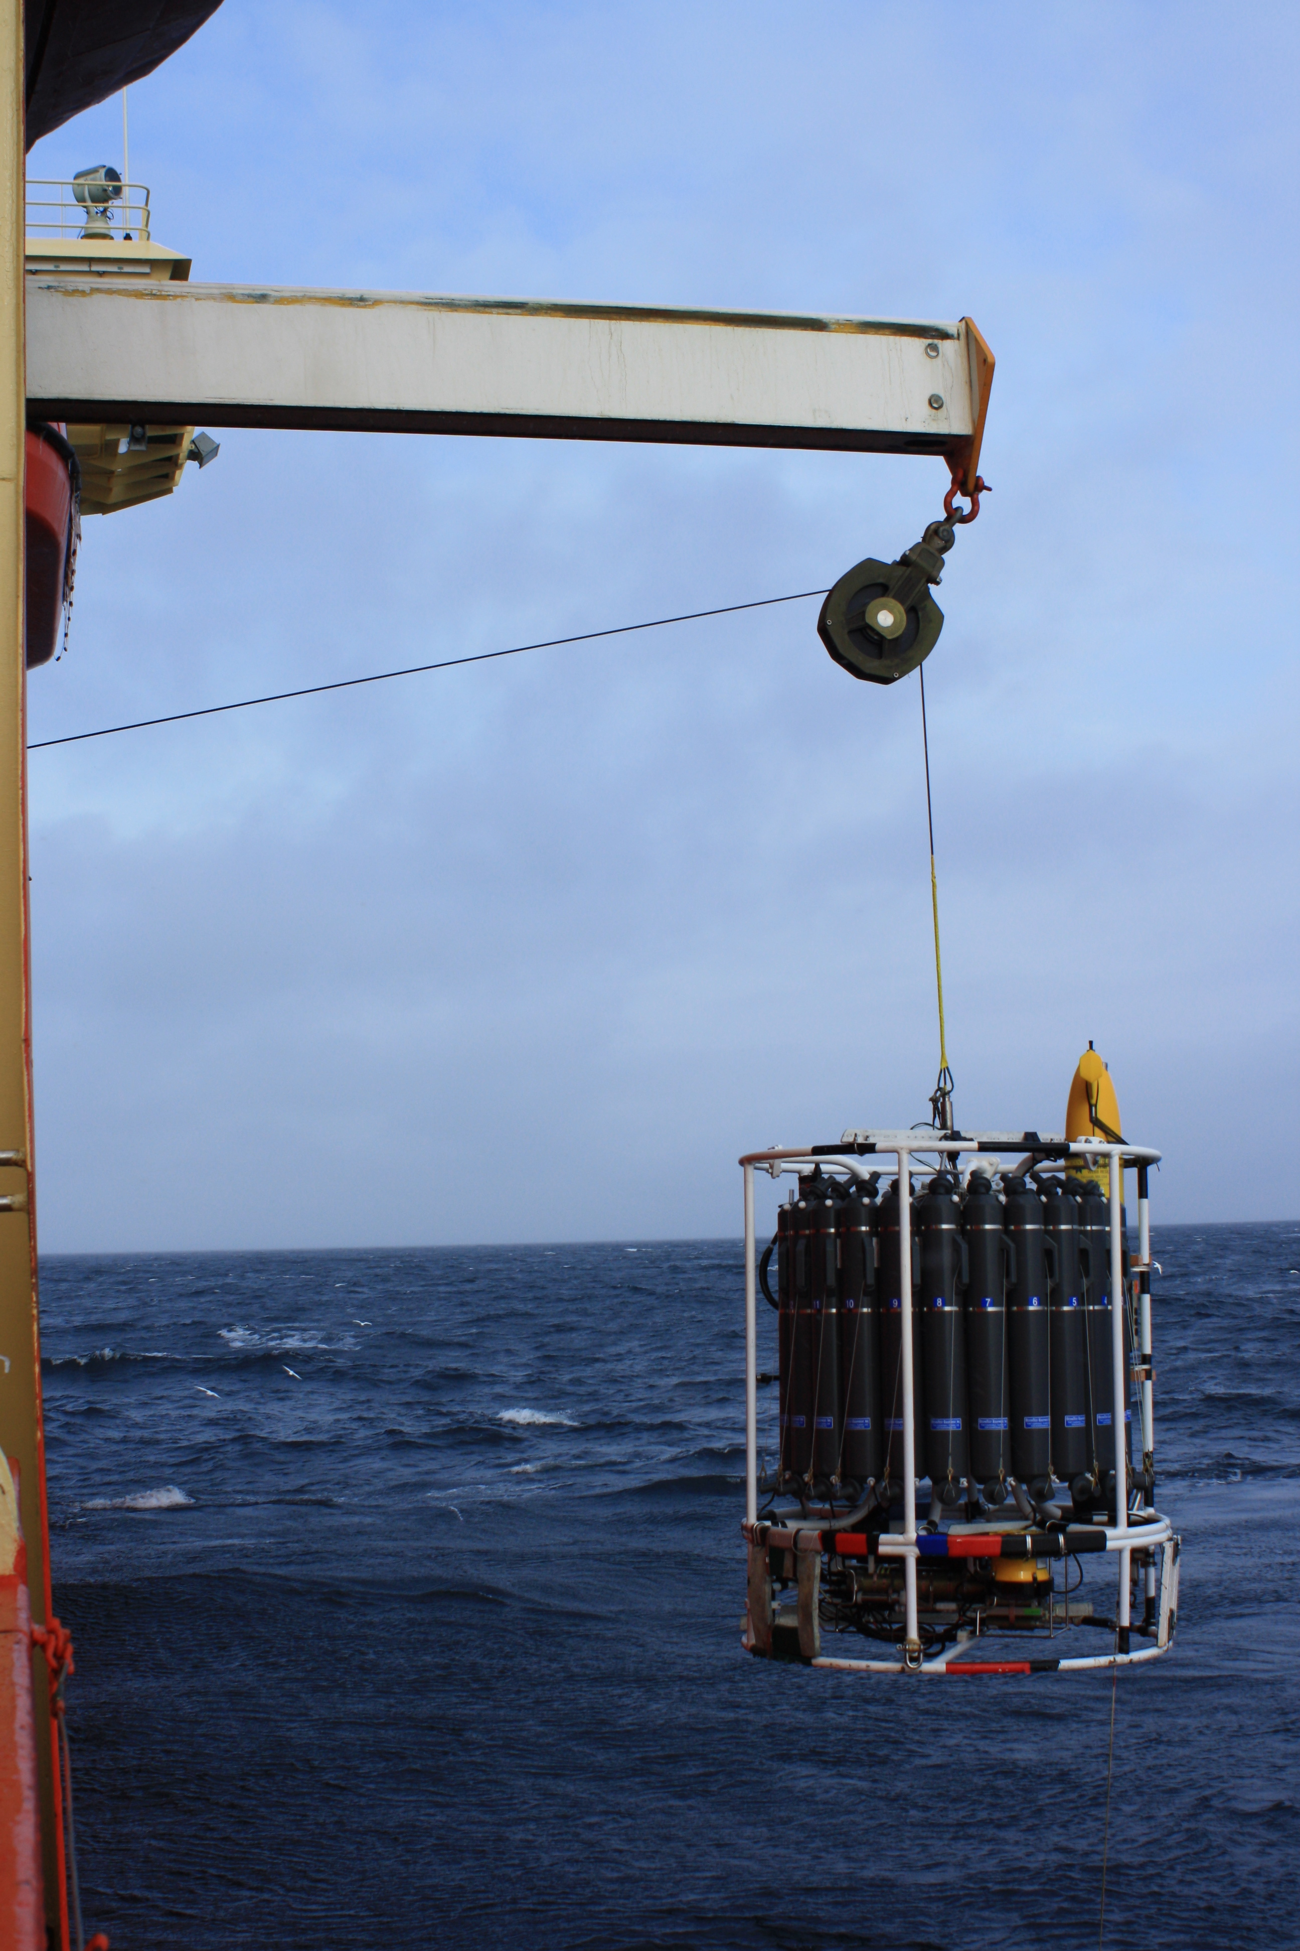
LADCP
Sea Bird CTD – pumped
Sea Bird CTD – not pumped
Wetlabs – EcoTriplet
Aanderraa DO
Sea Bird DO
Wetlabs – AC-9
20 bottle sampler (12 L each)

Slide 9
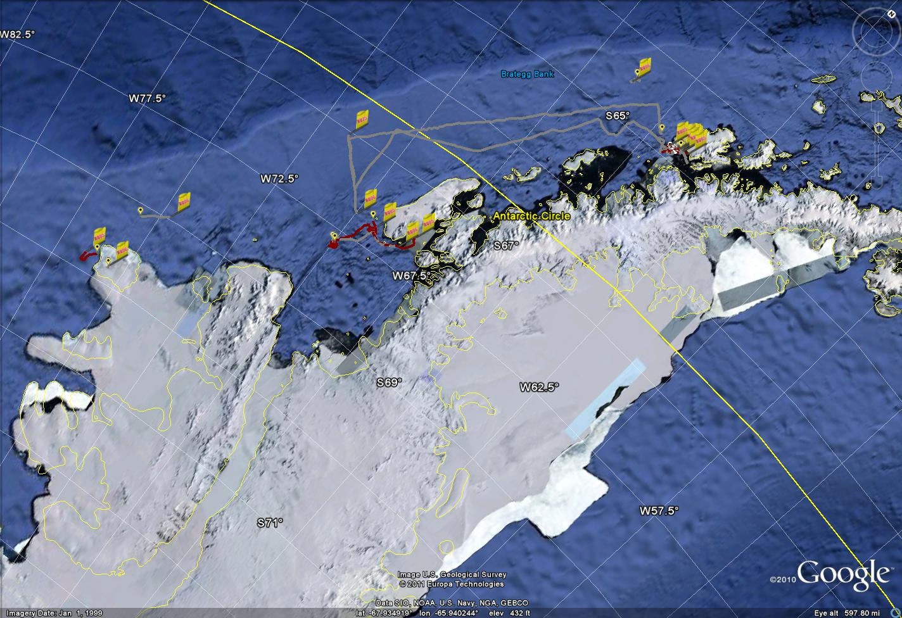
RU-COOL Palmer Peninsula Glider Deployments: 2007 - 2011
PALmer Long-Term Ecological Research
PAL-LTER

Slide 10
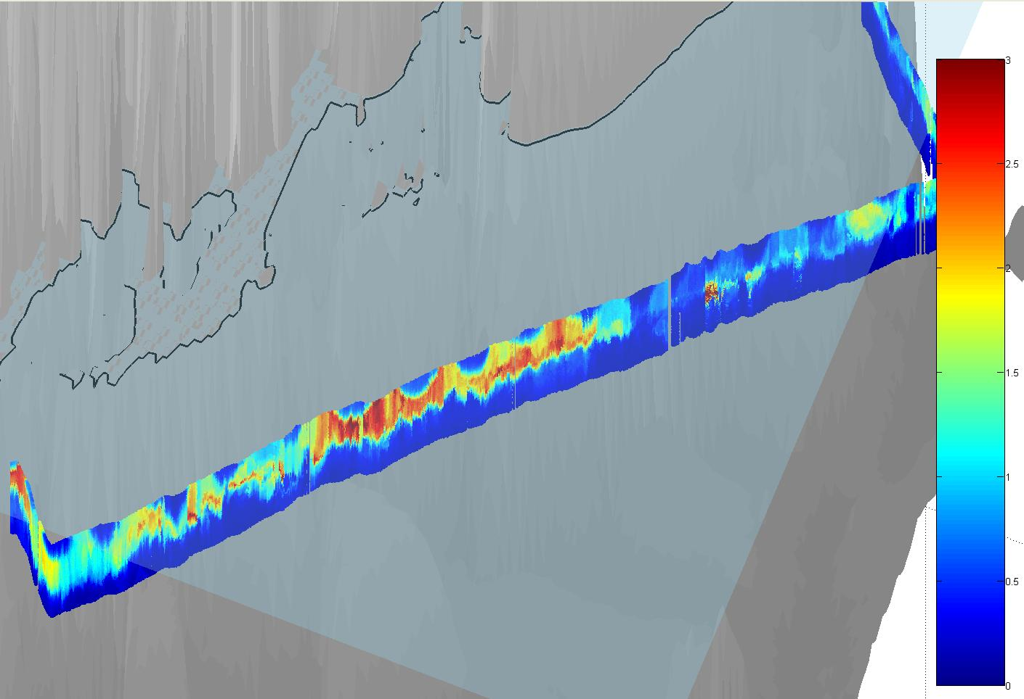
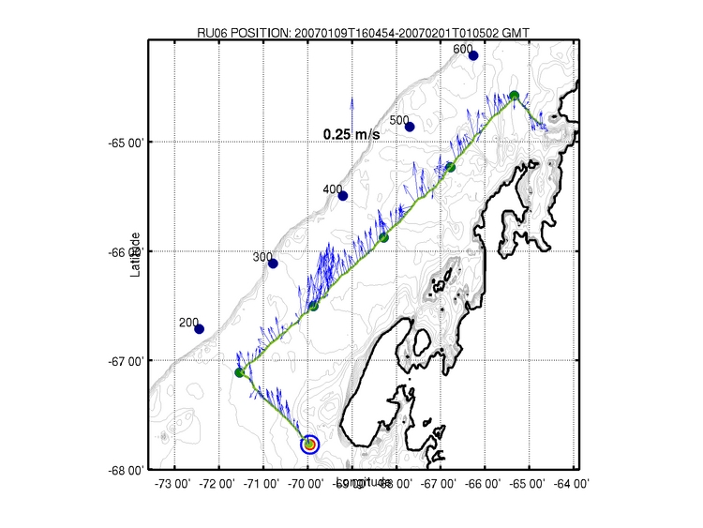
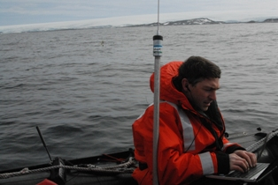
Gliders in Antarctica: January 2007
3
1.5
Chlorophyll a fluorescence (μg/L)
100 meters
0

Slide 11
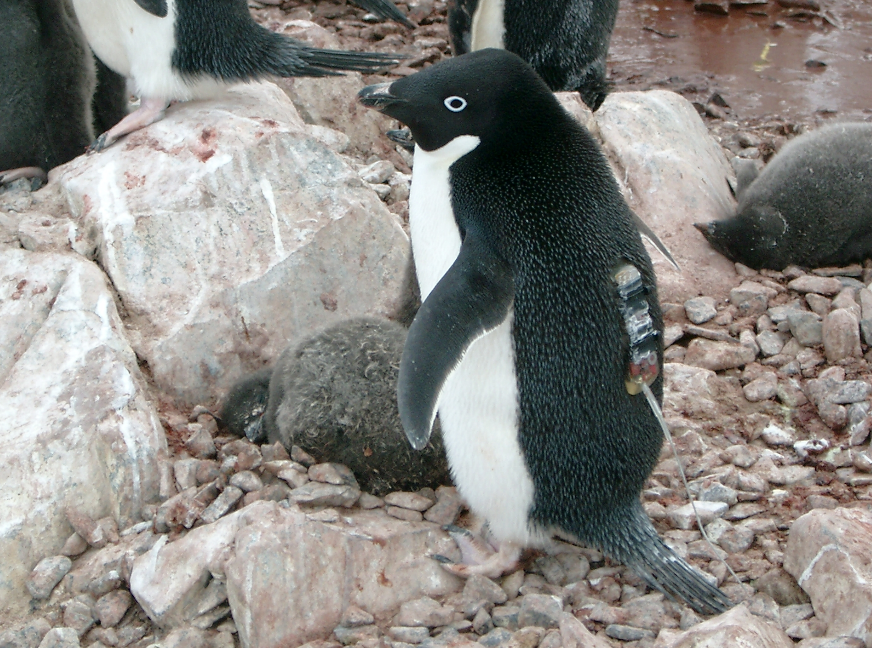
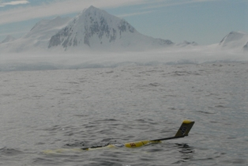
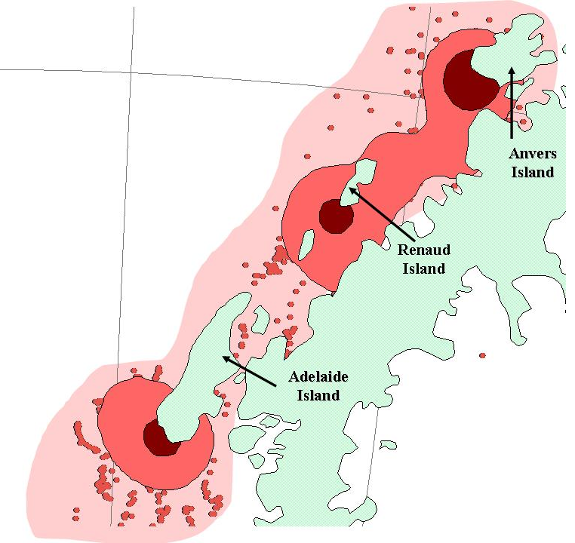
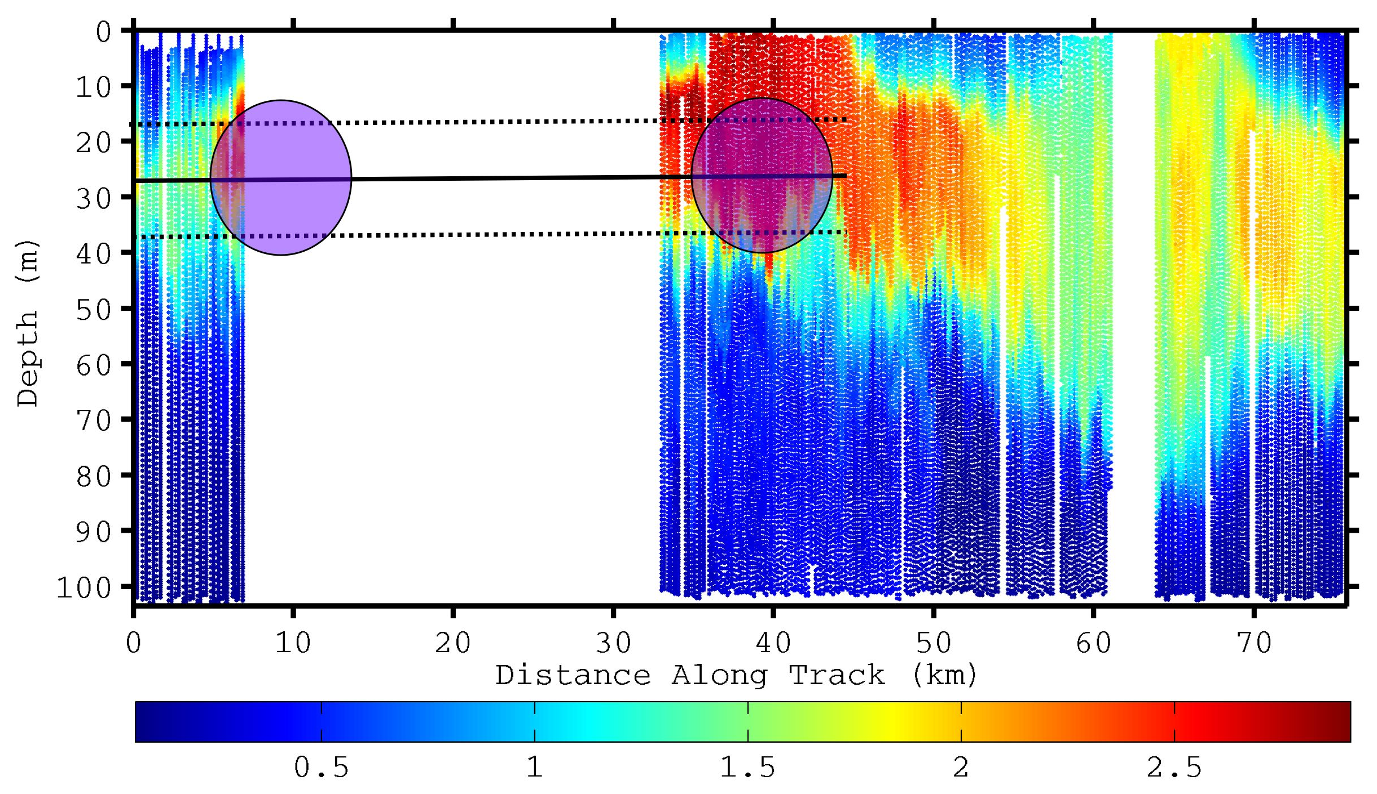
Adaptive Sampling of Penguin Habitats
Penguin
Foraging
locations
Kahl et al., 2010
Chlorophyll (μg/L)

Slide 12
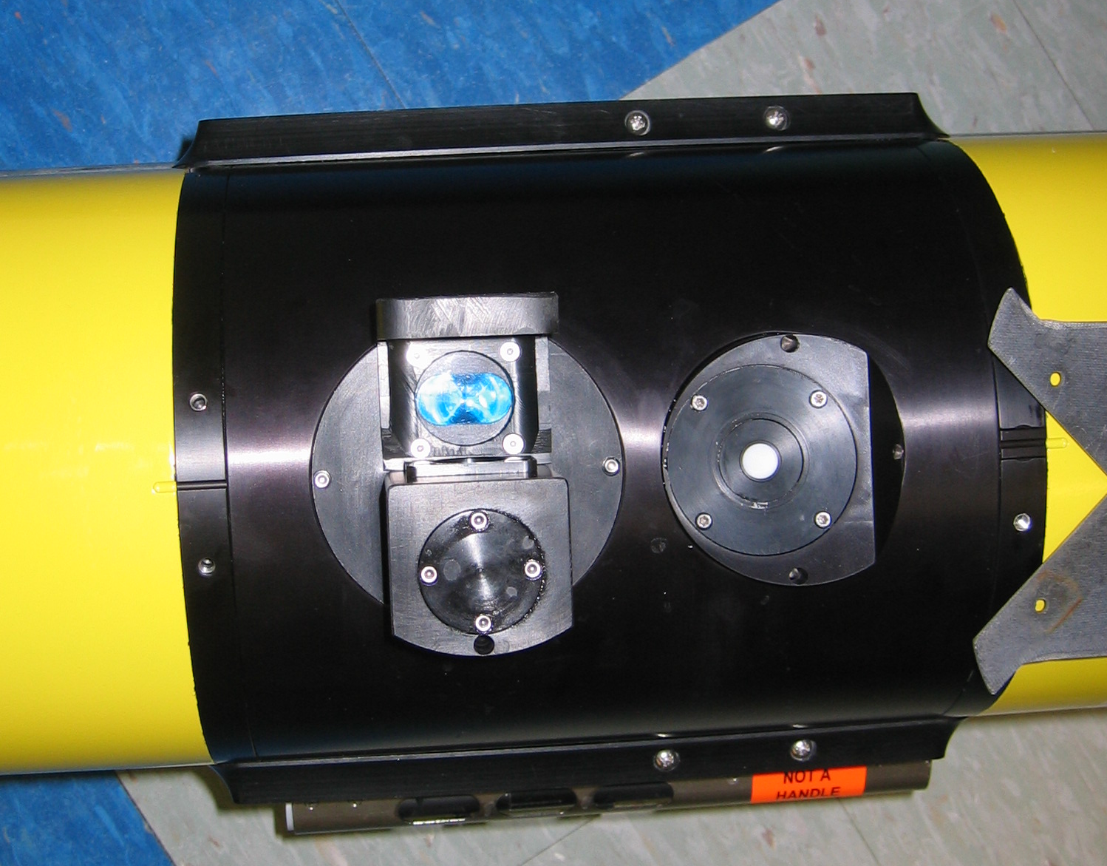
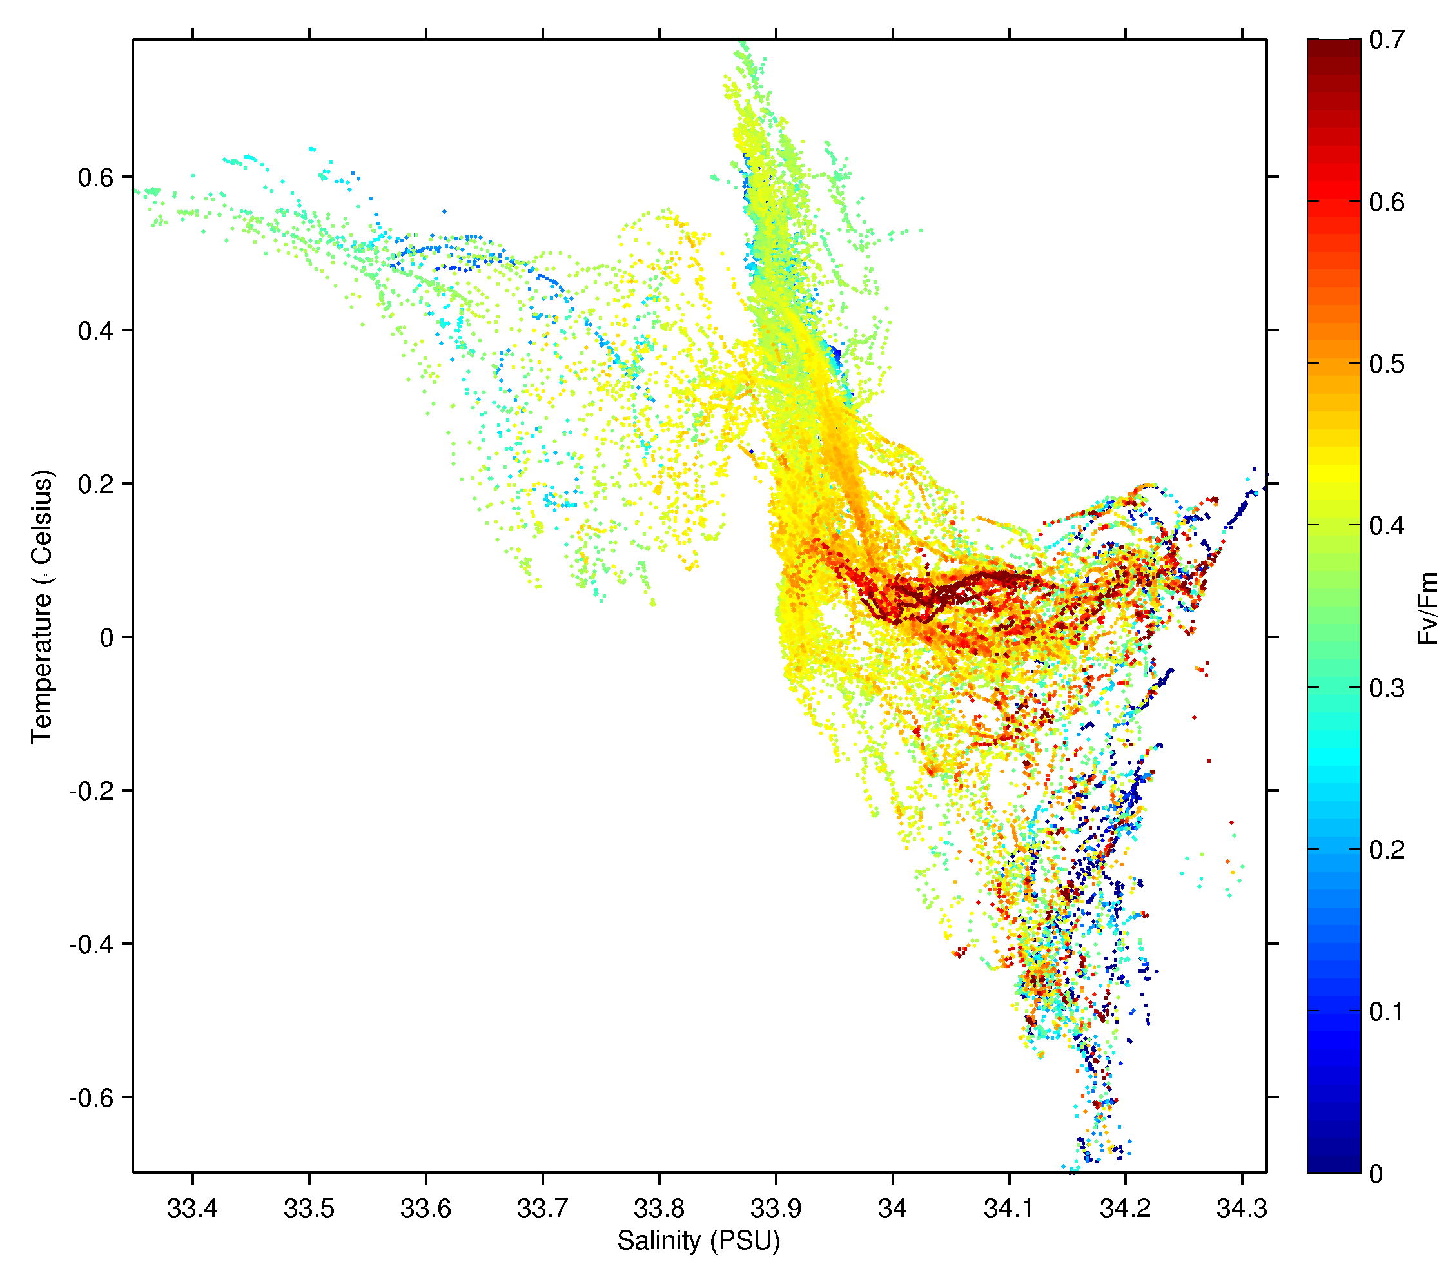
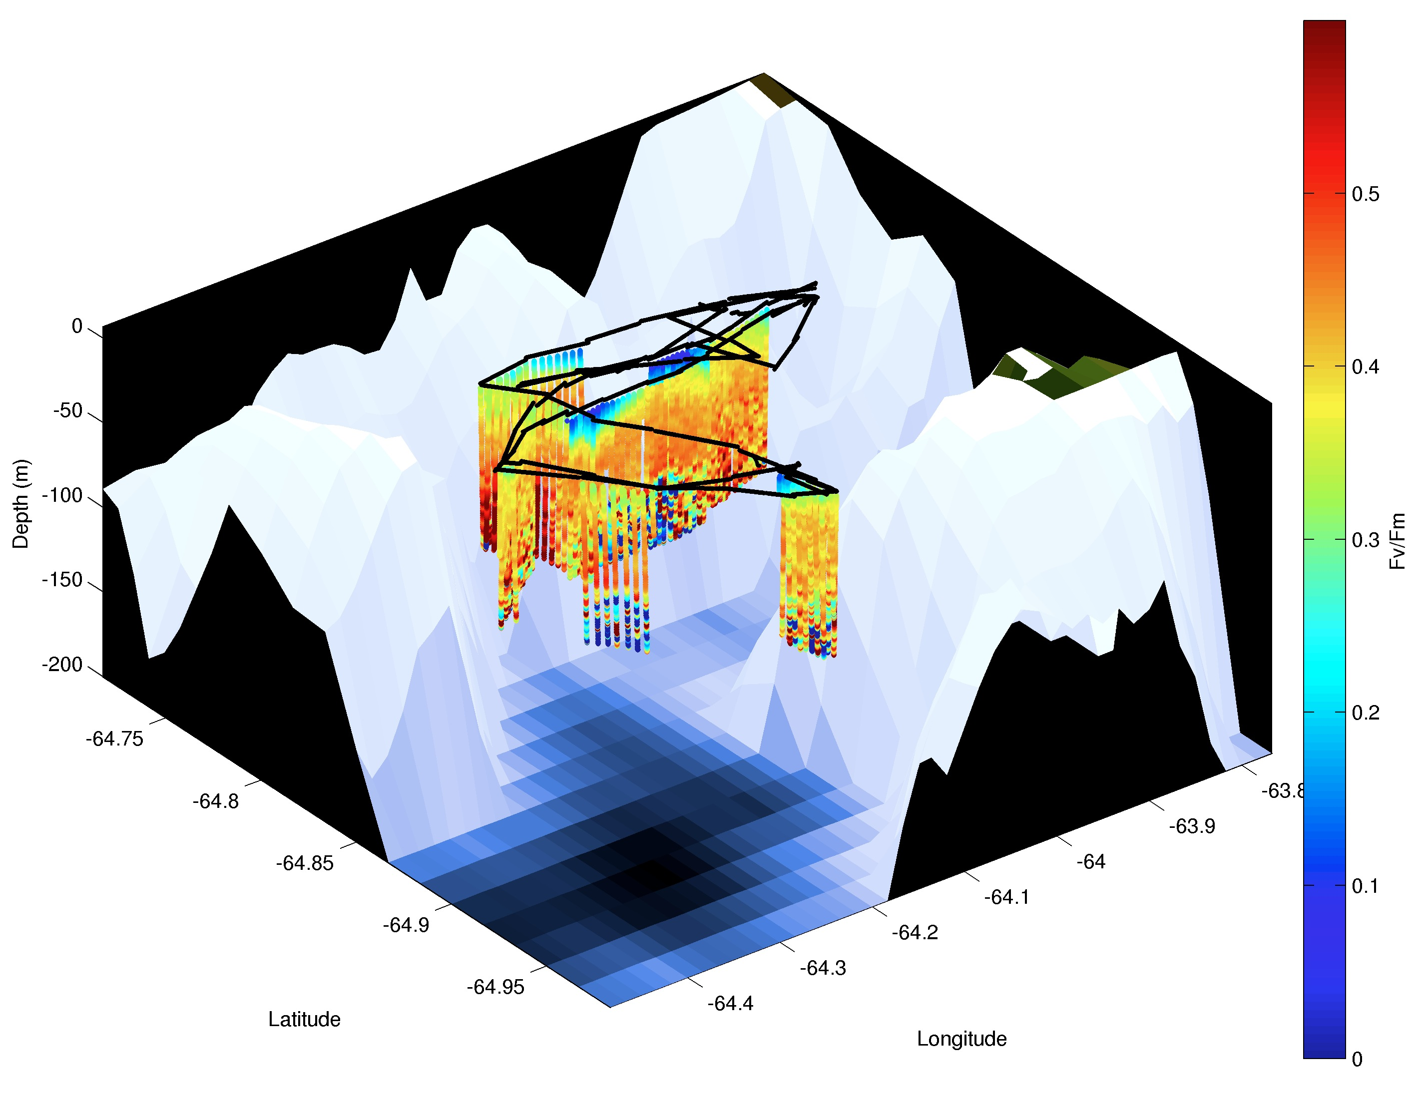
Mapping Phytoplankton Physiology
Rutgers /Satlantic FIRe Sensor

Slide 13
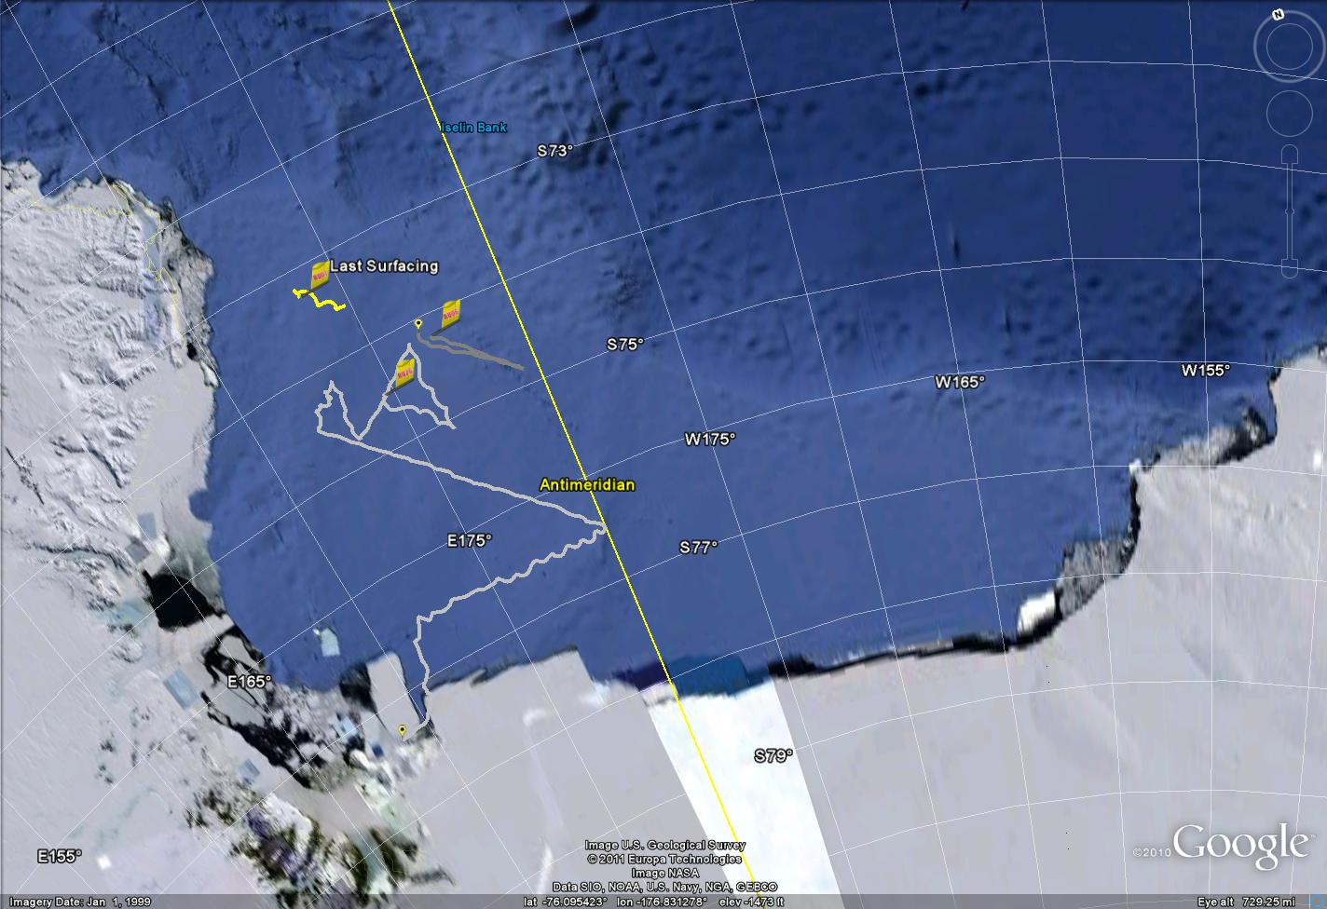
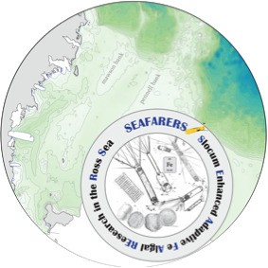
RU-COOL Ross Sea Slocum Glider Deployments: 2011
Slocum Enhanced Adaptive Fe Algal REsearch in the Ross Sea
SEAFARERS

Slide 14
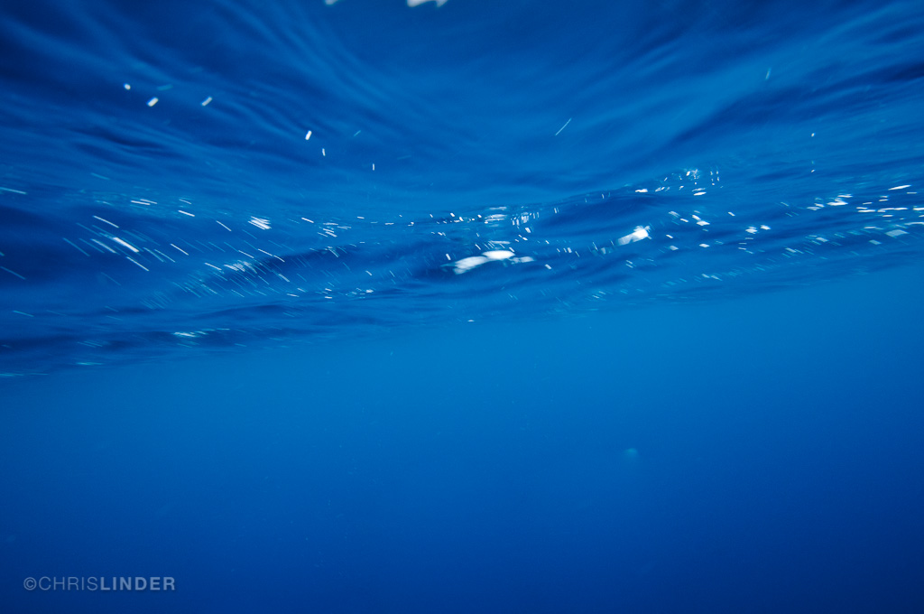
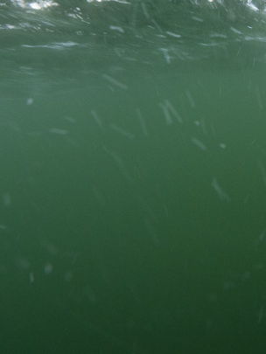
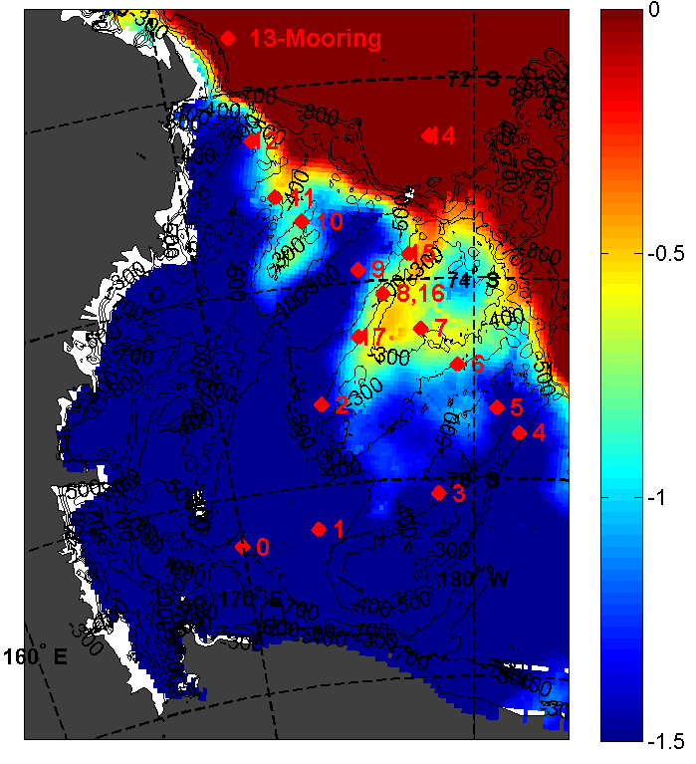
Modified Circumpolar Deep Water and the Ross Sea Ecosystem
Ross Sea Climatology
Ross Sea Forecasts
Temperature – 250m
Orsi et al.
Dinninman et al.

Slide 15
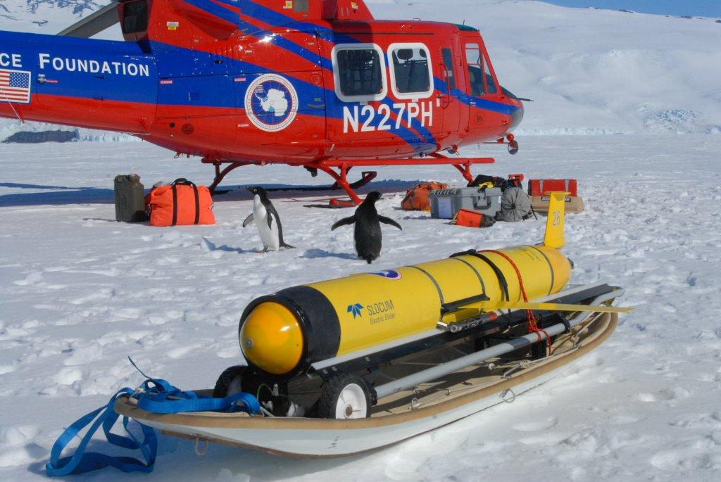
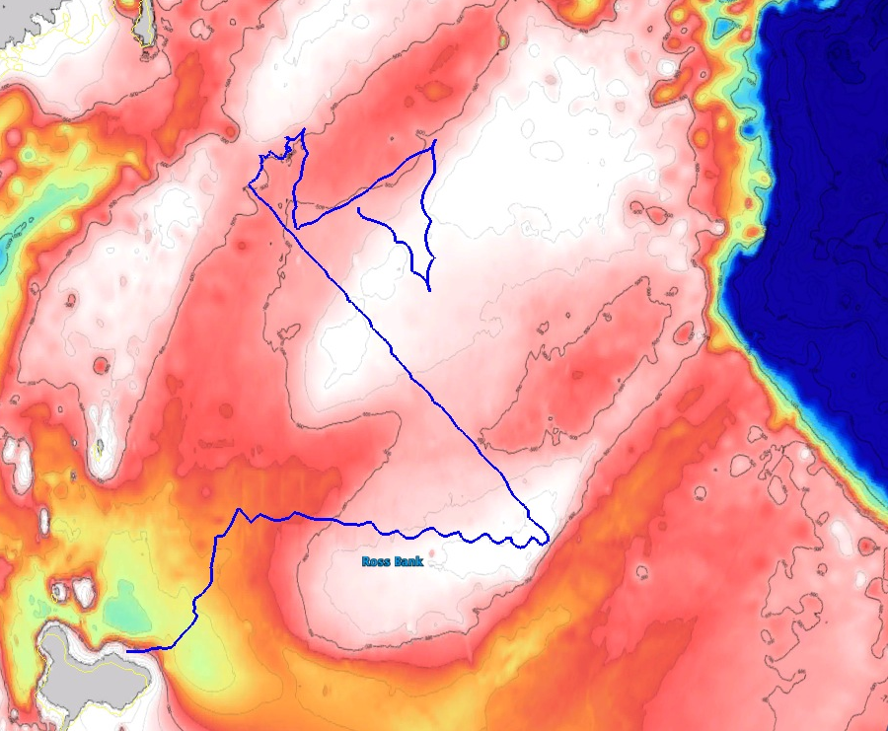
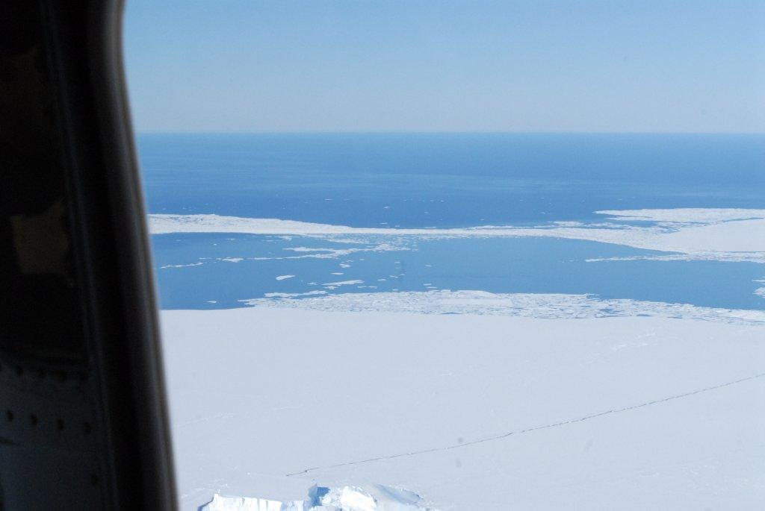
Deep Glider Mapping of Ross Sea Water Masses
December 2010-February 2011
RU26D
- Lithium Primary
- 1000m Pump
- CTD
- Optode
- Triplet Puck
~300 km

Slide 16
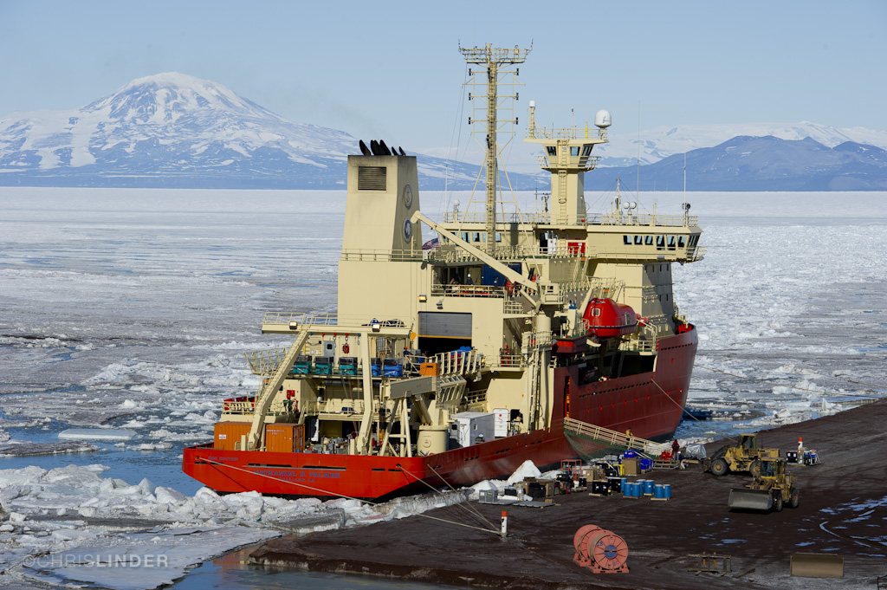
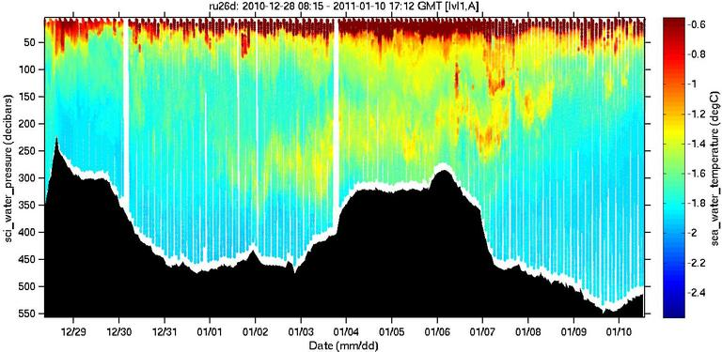
Deep Glider Mapping of Ross Sea Water Masses
Cross bank section identifies peak MCDW

Slide 17
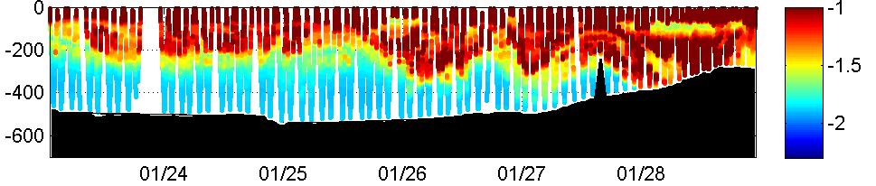
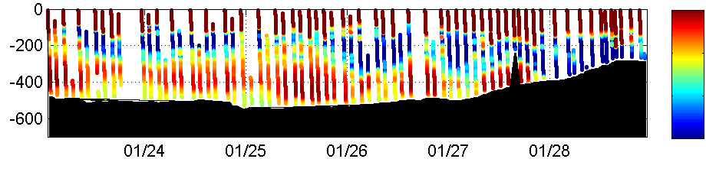
Small Scale Water Mass Variations (Time and Space)
Temperature (°C)
7.7
7.5
7.3
7.1
Dissolved Oxygen (mL/L)

Slide 18
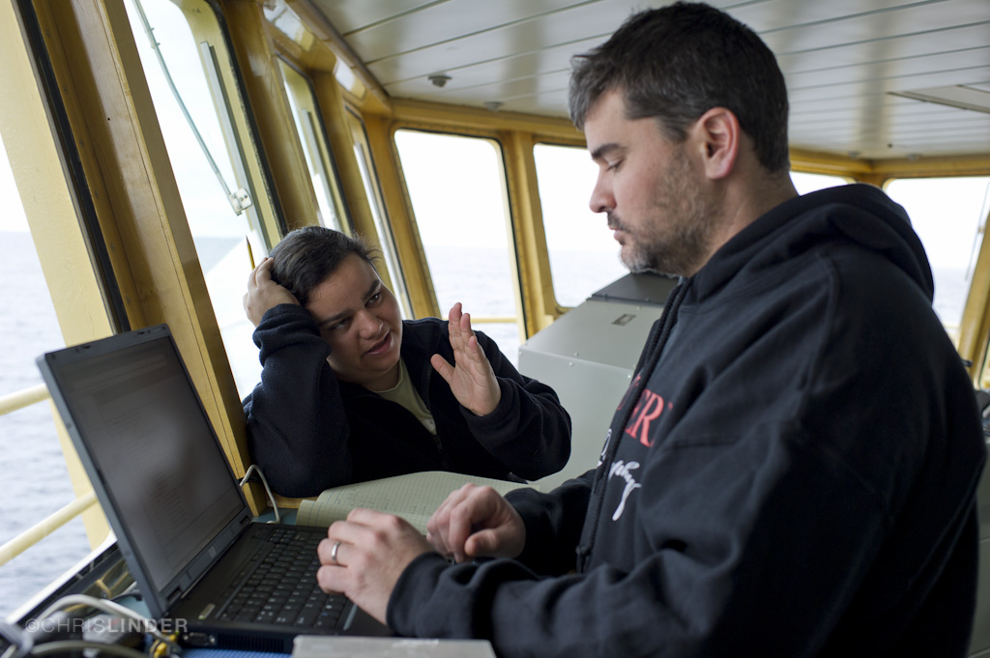
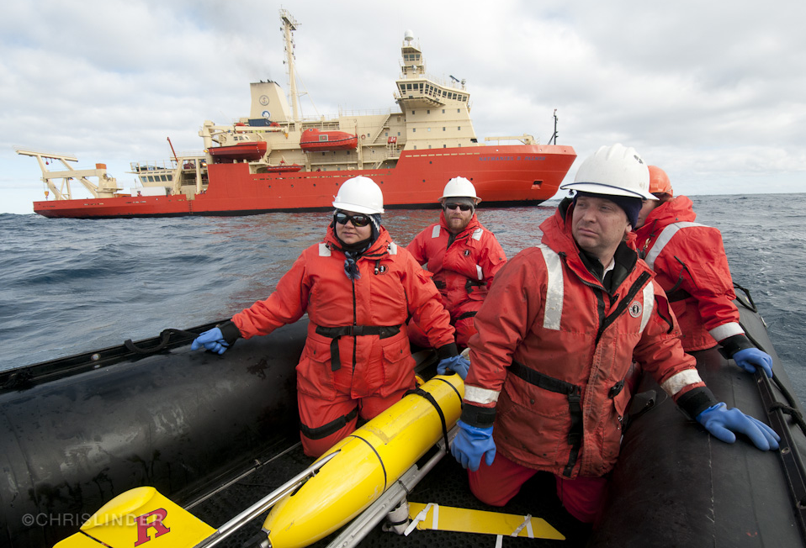
Line of Sight Glider Missions
RVIB Nathaniel B. Palmer

Slide 19
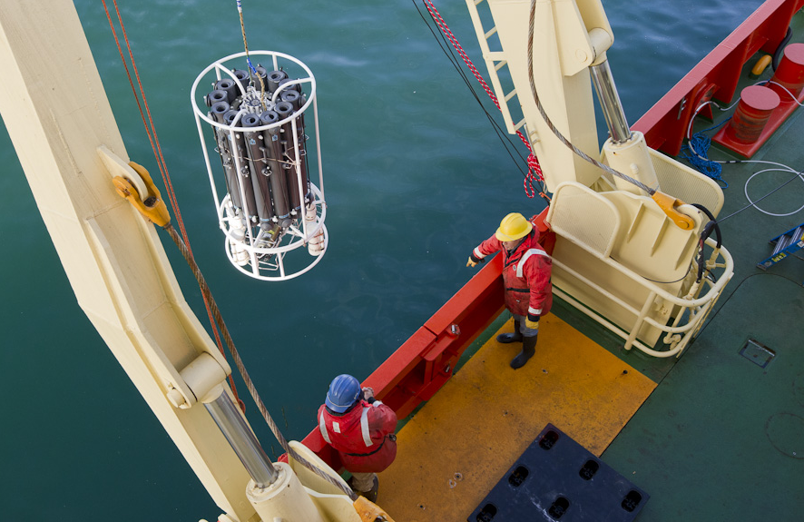
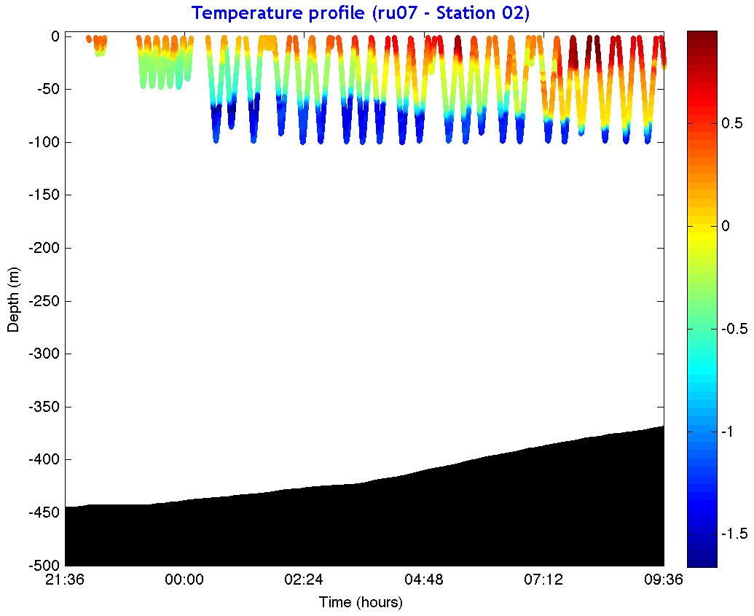
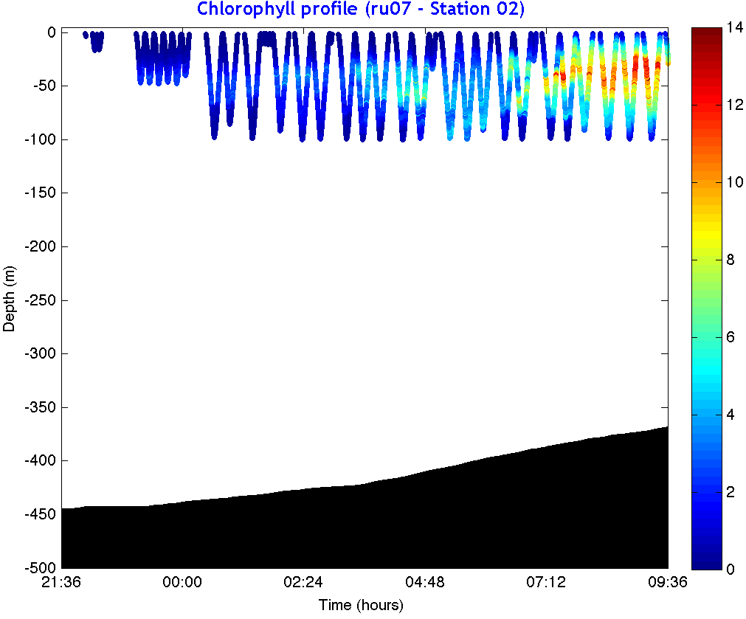
Small Scale Water Mass Variations
Relative to ship sampling
12 km
12 km
Temperature
Chlorophyll

Slide 20

Shallow Gliders Cover the Banks
RU07
- Alkaline
- 100 m pump
- CTD
- 2 Triplet Pucks
Mawson Bank
RU06
- Alkaline
- 100 m pump
- CTD
- 2 Triplet Pucks
Pennell Bank

Slide 21




Mawson Bank
Pennell Bank
Deeper Shallower
Deeper Shallower

Slide 22



We were not alone on the ship
Students follow along back on campus

Slide 23

We were not alone on the ship
Students follow along back on campus

Slide 24


The Ross Sea Connection
Many beyond the science team
participate in the science
Daily Blog Entries
- Science
- Technology
Materials for teachers
9 live phone calls from
the ship to the
classrooms
Over the 28-day cruise…
- 11,000 Visitors
- 340 Comments

Slide 25

Summary
Gliders are well suited for required flexible sampling requirements of the Antarctic coastal seas.
Gliders provide a unique view of important coupled process over small time and space scales allowing us to view the polar seas as we have never been able to before.
Polar ecosystems are more accessible to broad audiences through glider missions shared through the internet.

