Slide 1
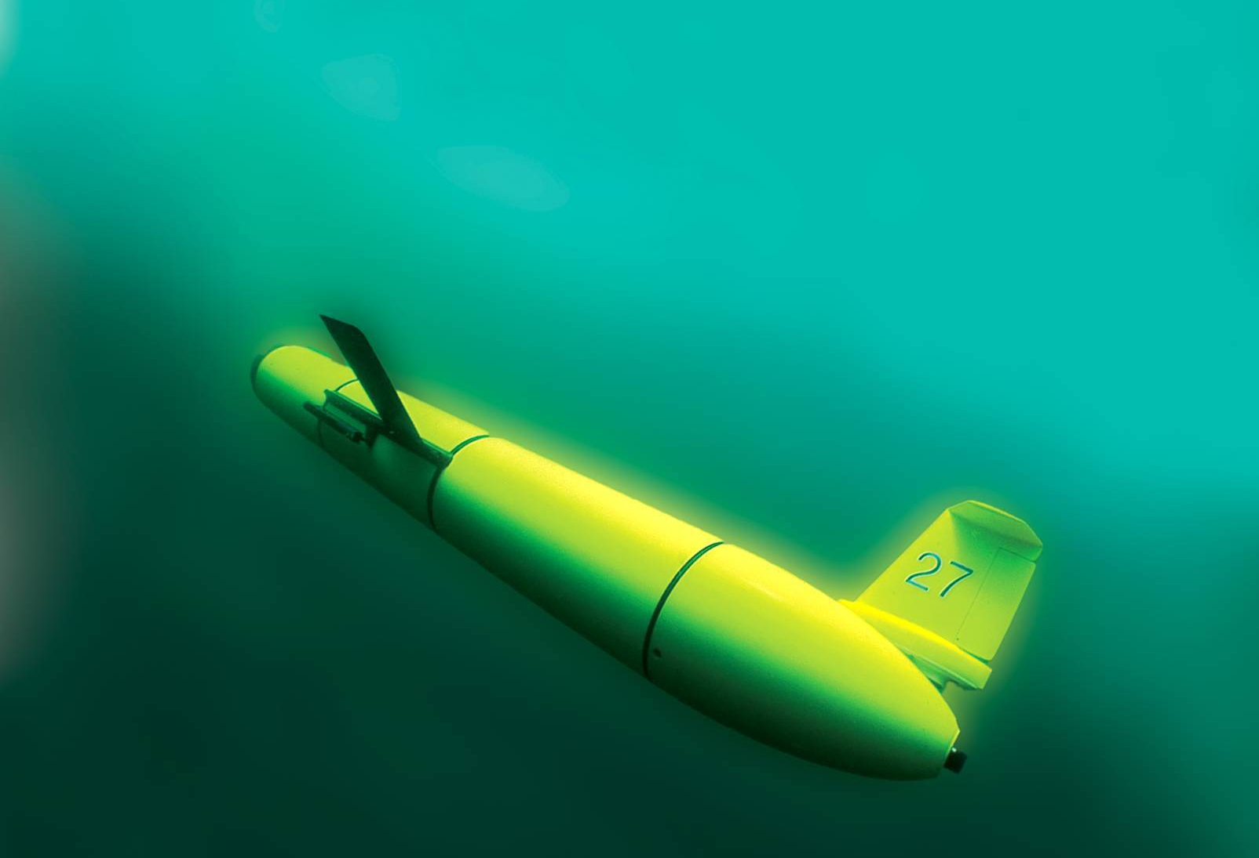
The Historic Flight of RU27:
The Scarlet Knight
The First Underwater Robot
to Cross the Atlantic
Scott Glenn
Coastal Ocean Observation Lab
Institute of Marine and Coastal Sciences
School of Environmental and Biological Sciences
Rutgers, The State University of New Jersey
http://rucool.marine.rutgers.edu/

Slide 2
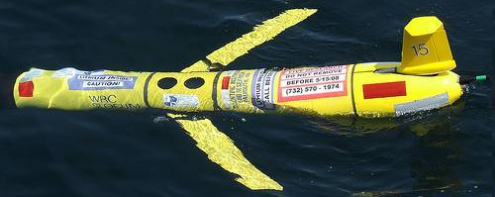
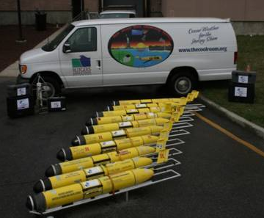
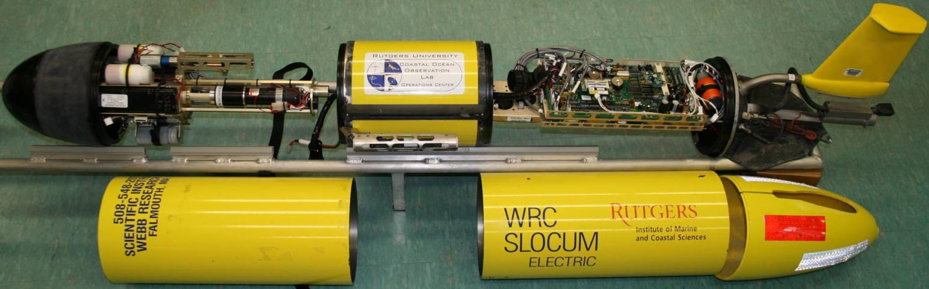
What is a Robotic Underwater Glider?
Antenna
(Iridium, Freewave, GPS & Argos)
Science Payload Bay
Control Board
Buoyancy Pump
Air Bladder
Tailfin &
Rudder
CHIP
Altimeter
CTD
Fore Hull
Aft Hull
Cowling

Slide 3
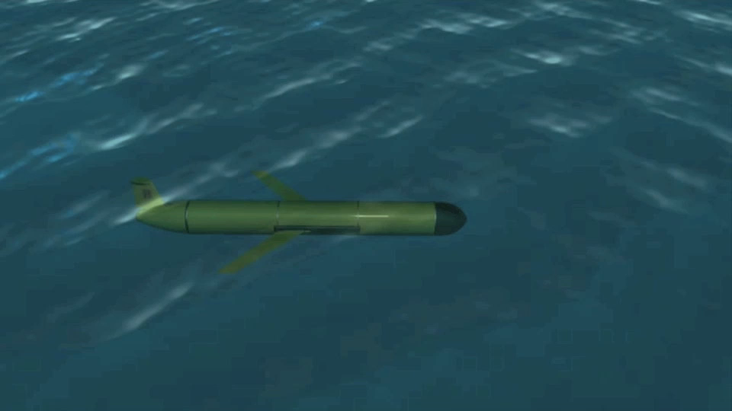
Glider Diving Behavior
Buoyancy Pump pulls water in, Batteries are pushed forward

Slide 4
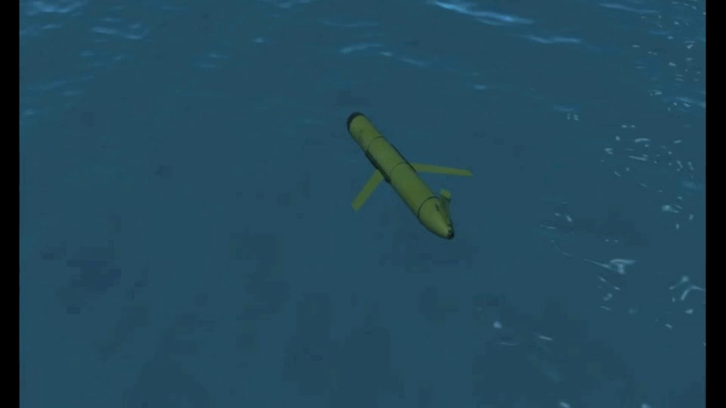
Glider Underwater Navigation
Rudder used to steer a compass heading

Slide 5
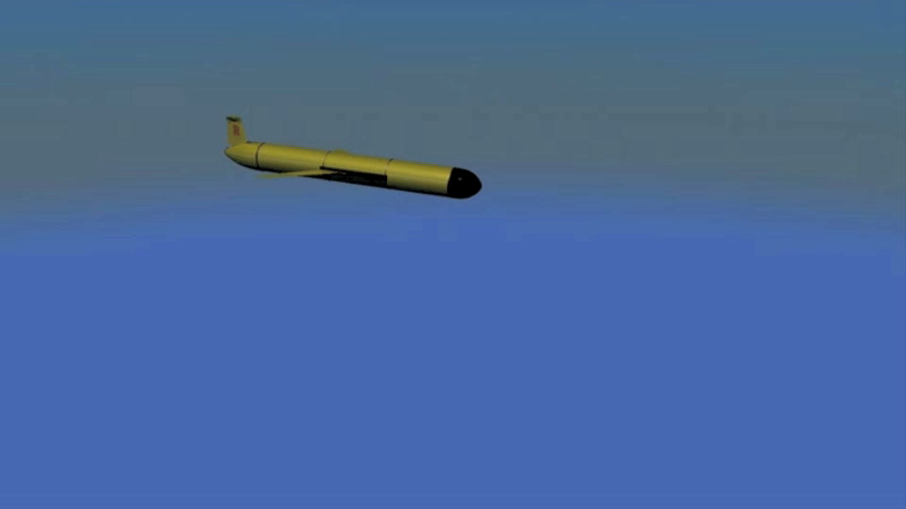
Glider Climbing Behavior
Buoyancy Pump pushes water out, Batteries are pulled back

Slide 6
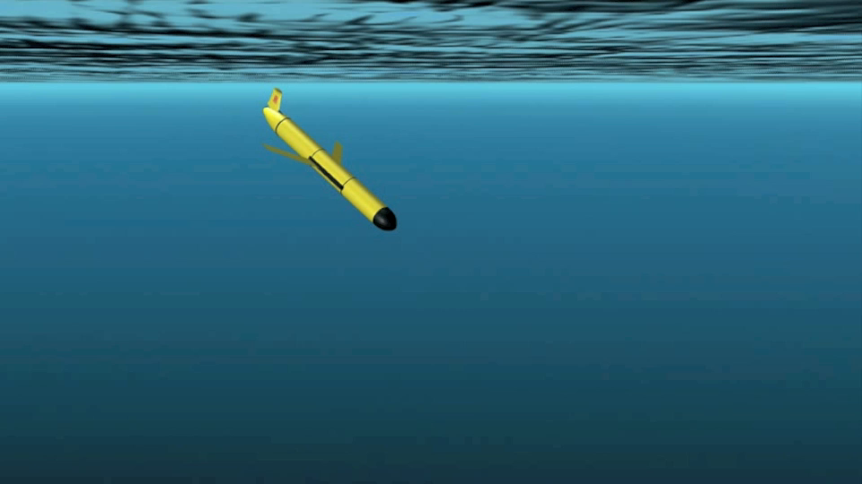
Glider Flight Path & Communications
Alternating Dives & Climbs, Surfacing to Phone Home

Slide 7
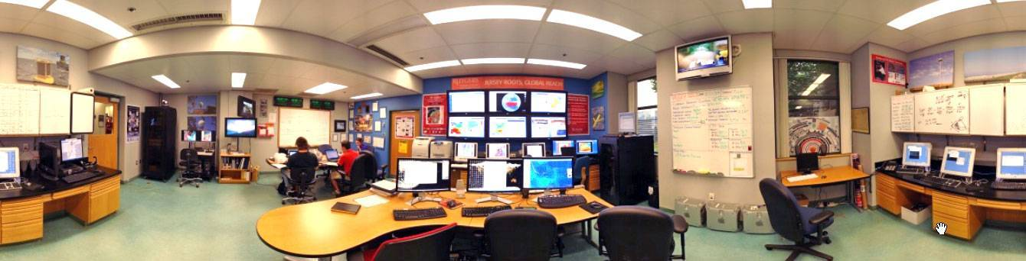
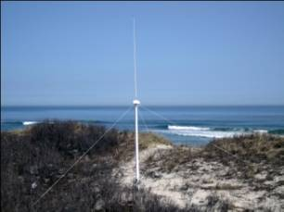
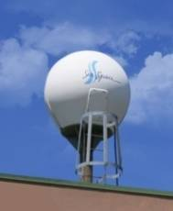
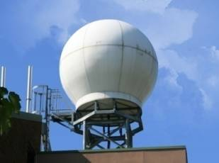
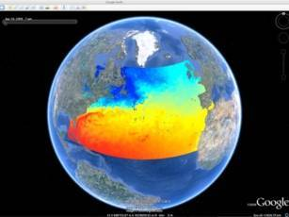
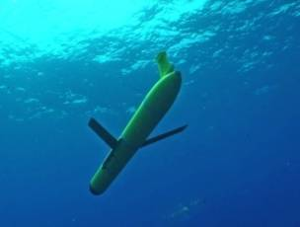
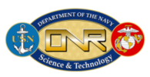











Rutgers University - Coastal Ocean Observation Lab
On-Campus Observatory Research & Education Center
CODAR Network
L-Band & X-Band Satellite Receivers
3-D Nowcasts
& Forecasts
Glider Fleet
Notes:
7

Slide 8


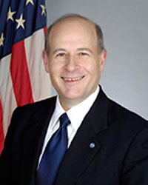
Trans-Atlantic Glider Challenge – May 24, 2006 –
UNESCO E.U./U.S. Baltic Sea Conference in Lithuania
Dr. Rick Spinrad
Assistant Administrator
NOAA
Office of Oceanic and Atmospheric Research
“I have something you need to do for the good of your country.”
“Take one of your gliders, modify it, and fly it across the Atlantic, inspiring students along the way.”

Slide 9
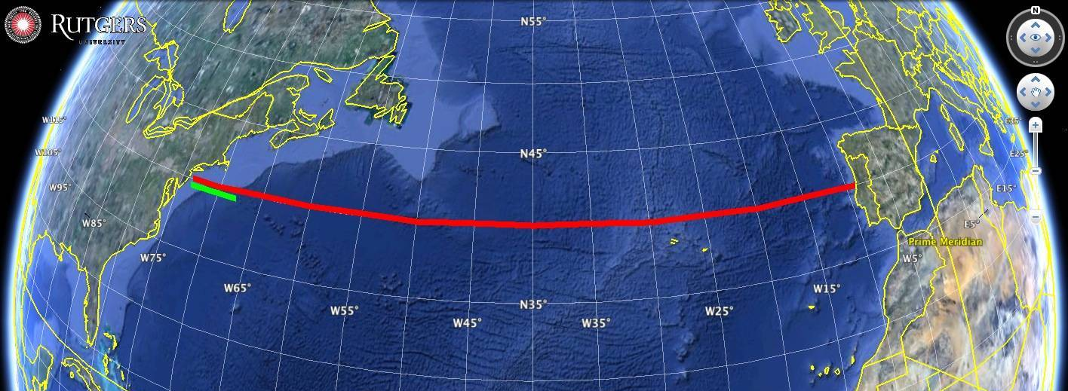
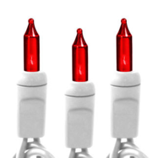
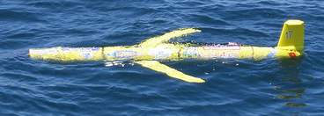
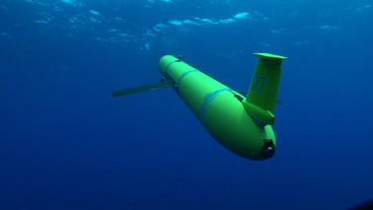
Technology Challenges for a Trans-Atlantic Glider Mission
East-West
Distance Across:
5,500 km
Longest Mission
in 2006: 500 km
Increase Duration
Ruggedize for Storms
Corrosion & Biofouling
Global Roadmap
Federal Research Agency Response:
Too Risky
for Research
Rutgers
Alumni
Support
RU15 – NJ to Halifax - 2008
RU17 – NJ to Azores - 2008
RU27 – NJ to Spain - 2009
RU15
RU17
RU27

Slide 10
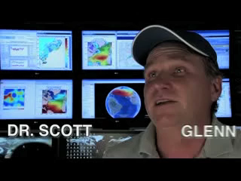

Slide 11
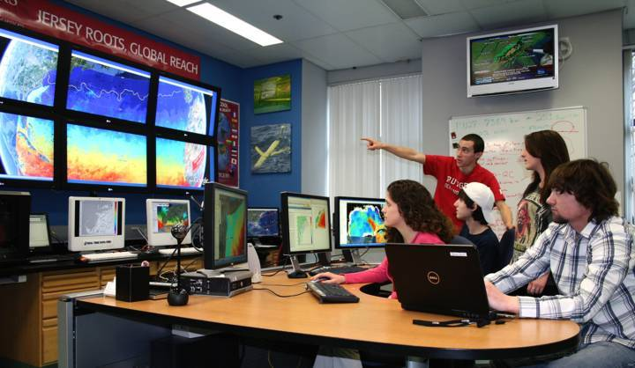
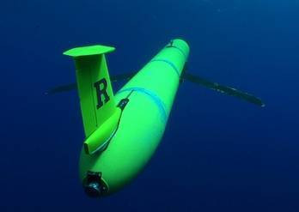
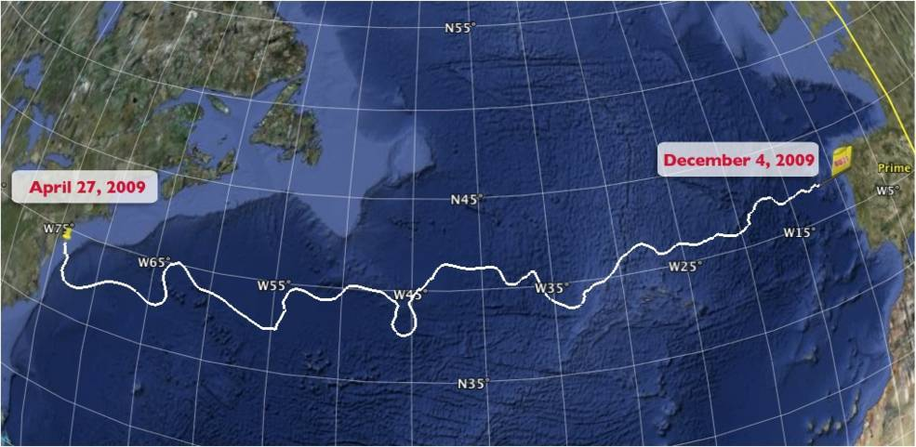
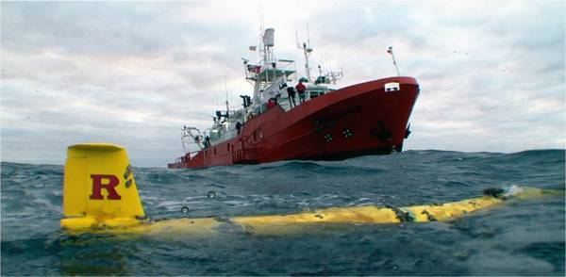
Scarlet Knight’s Mission Summary
Scarlet
Knight passes the Azores
Rutgers students
in the COOLroom
Preparing for recovery off
Galicia, Spain
221 days at sea, covering a world record 7,400 km.

Slide 12
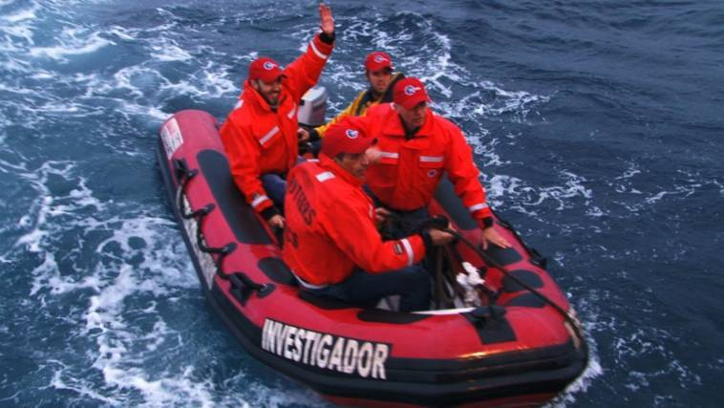
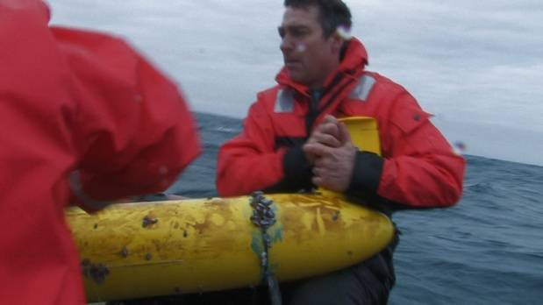
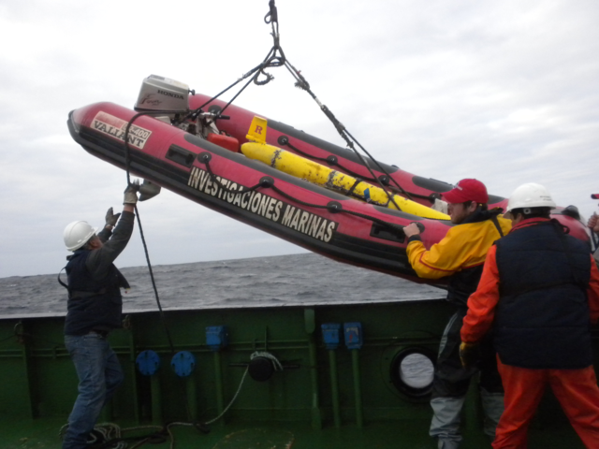
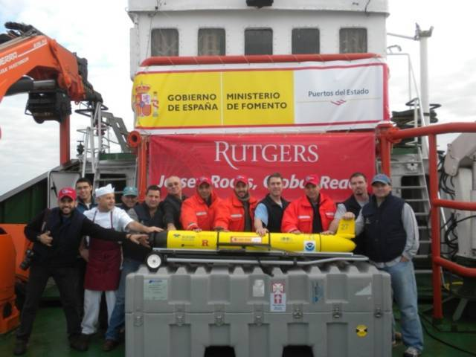
Scarlet Knight’s Recovery off of Baiona, Spain

Slide 13
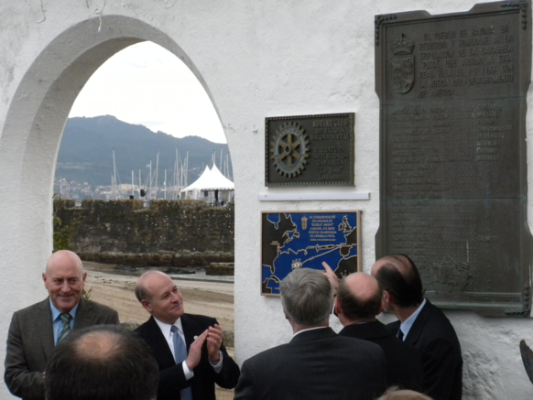
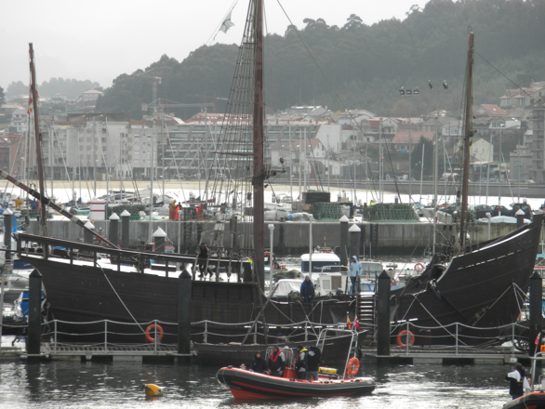
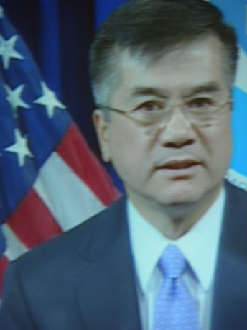
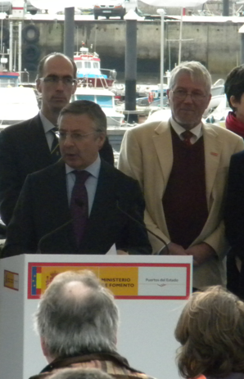
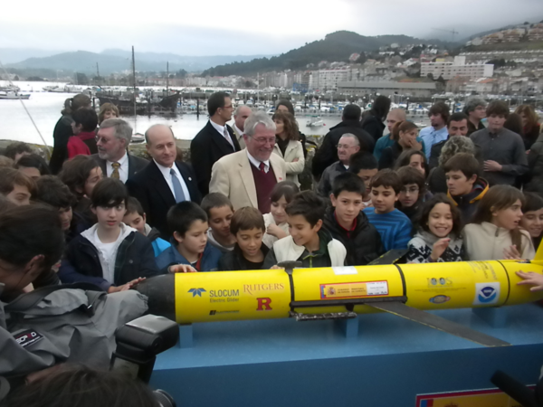
Scarlet Knight’s Landfall in Baiona, Spain
Same port that Columbus’ Pinta made landfall in 1493

Slide 14
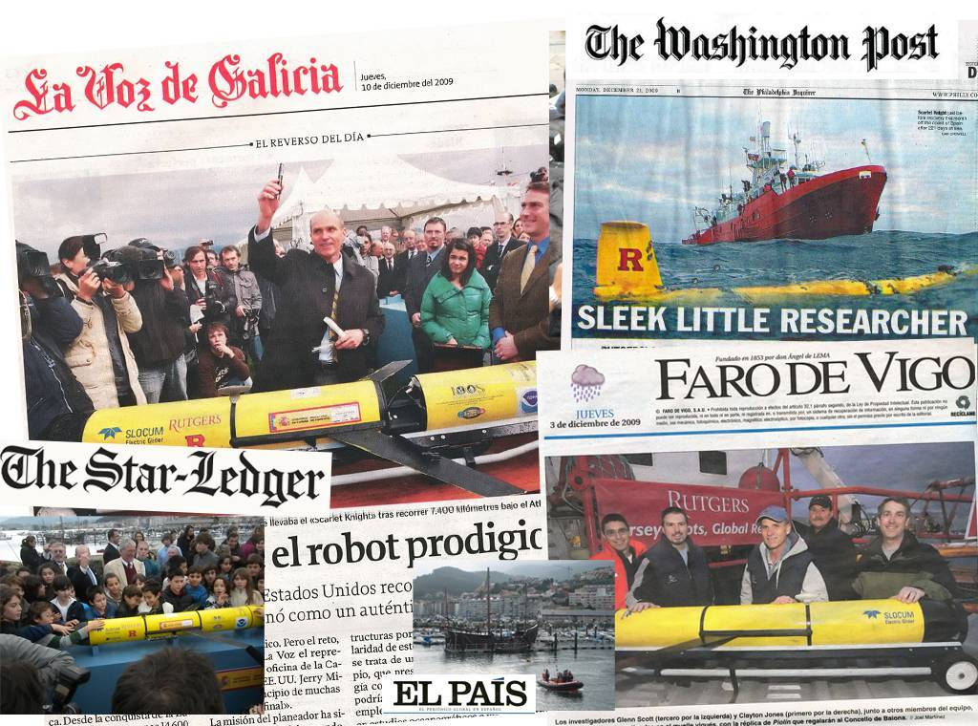
Scarlet Knight - The first underwater robot to cross an ocean:
A hero’s Welcome, December 9, 2009

Slide 15
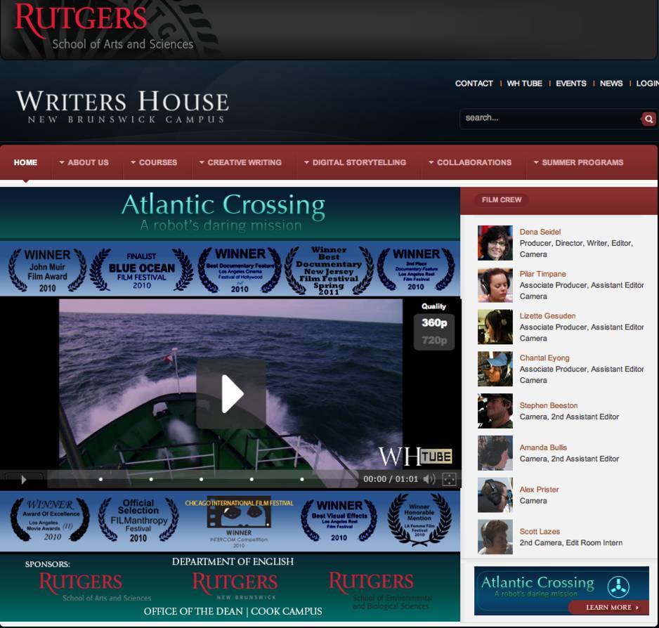
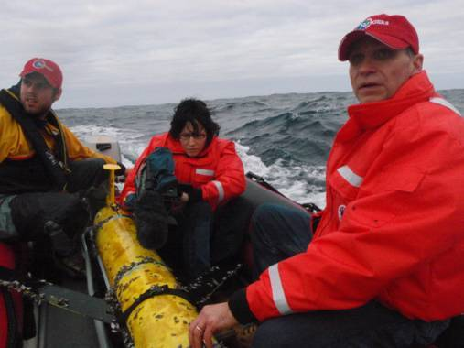
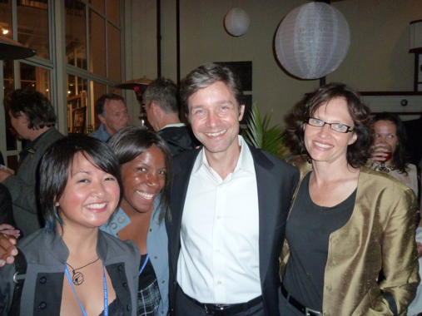
Atlantic Crossing: A Robot’s Daring Mission
An Award-Winning Feature-Length Documentary by Rutgers Filmmaker Dena Seidel
Filming the recovery of RU27
offshore Baiona, Spain
Dena, Fabien Cousteau & Rutgers Students
at the Blue Ocean Film Festival

Slide 16
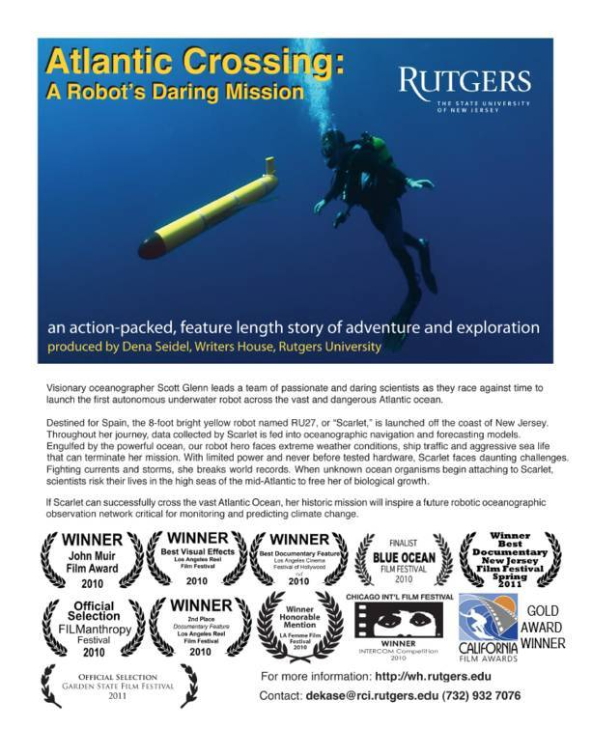
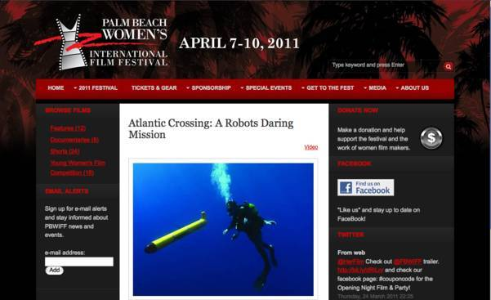

Atlantic Crossing: A Robot’s Daring Mission
An Award-Winning Feature-Length Documentary by Rutgers Filmmaker Dena Seidel
Palm Beach Women’s International Film Festival
April 7-10, 2011 www.pbwiff.com
57 minute TV version distributed
Nationwide to all 350 PBS Stations
on April 29, 2011
Downtown Boca Film Festival
April 9-17, 2011 www.dbff.us

Slide 17
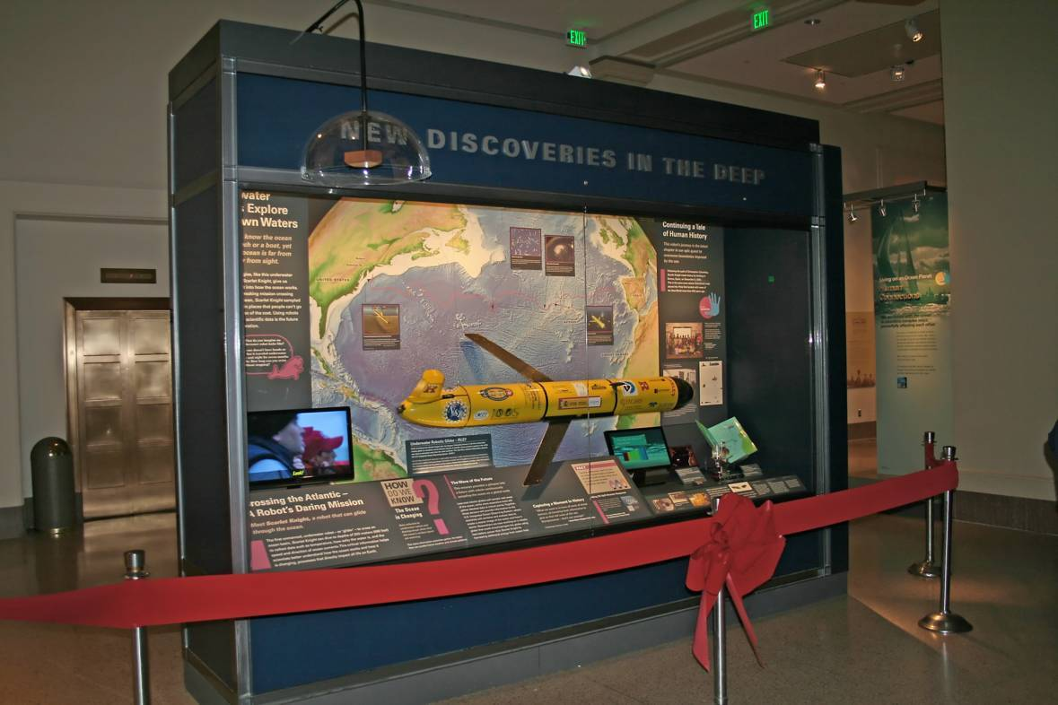
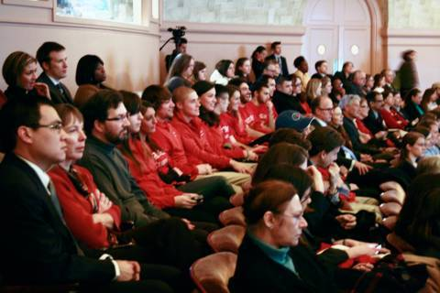
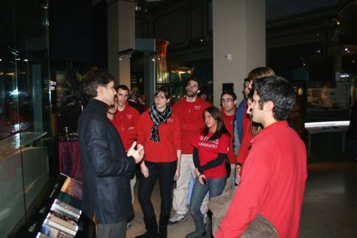
The Scarlet Knight enters the Smithsonian: Dec. 9th, 2010
National Museum of Natural History, Ocean Hall, Washington, DC

Slide 18
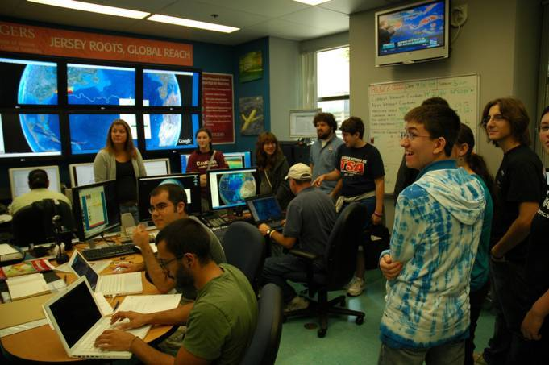
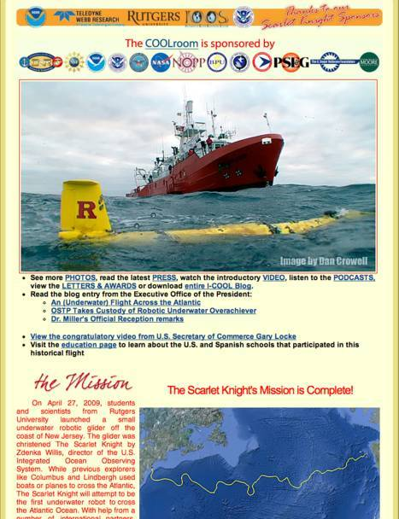
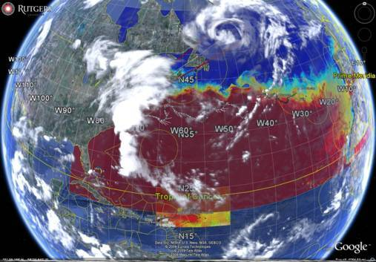
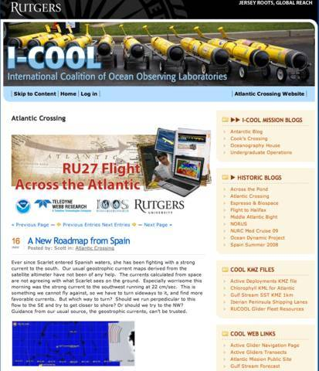
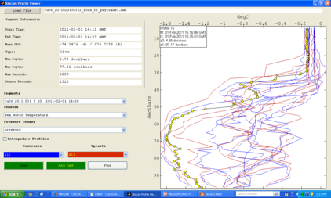
Trans-Atlantic Education
Social networking tools developed to enable collaboration between scientists and students in the U.S., Canada, Spain and Portugal on the RU15, RU17, and RU27 long-duration glider missions.
Interactive Data Interface
Google Earth, Glider GUI
Briefing Blog
Web Portal

Slide 19
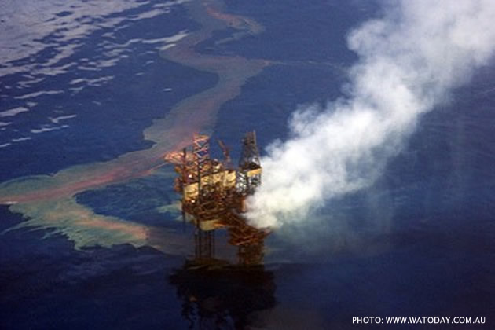
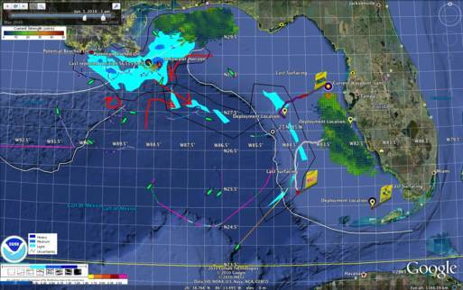



Rutgers Response to the Deepwater Horizon Oil Spill
Same social networking tools used to coordinate the U.S. National response to the Gulf Oil Spill.
Interactive Data Interface
Google Earth, Glider GUI
Web Portal
Briefing Blog

Slide 20

Deepwater Horizon Oil Spill Response: West Florida Shelf Approaches
10 Gliders Coordinated. 127 Briefs Posted. Several used to brief the White House.
Impacts: (1) We did not get in the way. (2) We reduced the burden.
(3) We informed the Unified Command.

Slide 21




Global Glider Challenge – The Challenger Mission
December 9, 2009 – Baiona, Spain
Rick Spinrad to
Bob Goodman:
Build and Coordinate a Global Glider Fleet to complete the first robotic revisit of the HMS Challenger’s Circumnavigation,
and inspire students along the way.
HMS Challenger Voyage
First Scientific Circumnavigation
1872-1876
111,000 km =
(15 gliders x 7,400 km/glider)
Bob Goodman to
Rick Spinrad:
We accept
your challenge.

Slide 22



Challenger Mission – Next Steps – Test Flights
Rutgers Plan for the Challenger Mission:
International Education Program for Sustained
at-Sea Robotic Global Omni-Presence
U.S. National Science Foundation’s
Ocean Observing
Initiative:
Education Program for
Sustained at-Sea
Tele-Presence
2011
Spain’s Plataforma Oceanica de Canarias:
Education Program for
Sustained
at-Sea
Human-
Presence

