Slide 1
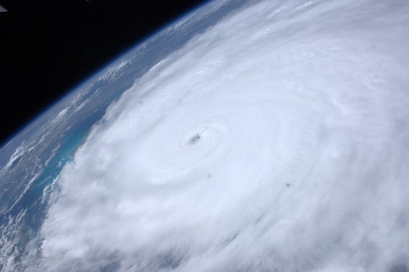
Hurricane Irene
Jason Werrell, John Huffstickler, Lisa Schardien, Kara Millaci, Nicole Del Monaco, Tom Osbourne

Slide 2
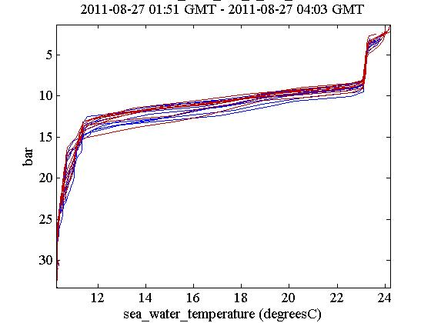
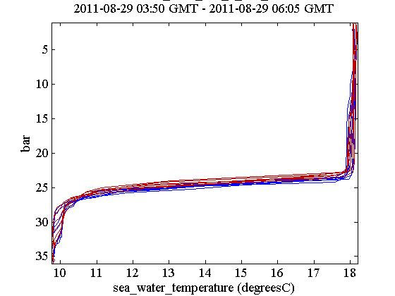
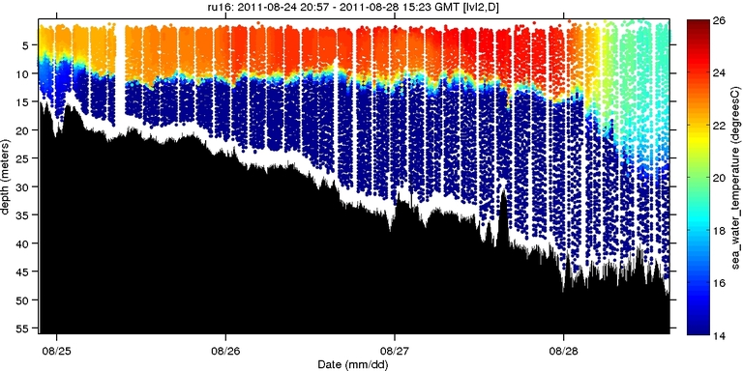
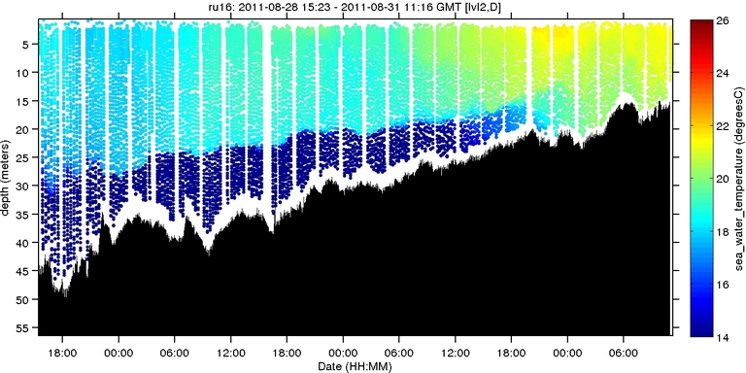
Temperature
Temperature decreased by 6C at the surface and 2C at the thermocline
Notes:
Before the storm, the sea surface temperature was 24 C, with the thermocline at about 15m and 12 C. After the storm, the temperature was 18 C at the surface and 10 C at the thermocline of about 27m.
The depth change of the thermocline shows that the hurricane mixed the upper water column. Temperature decreased by 6 C at the surface and 2 C at the thermocline. Many things are affected by temperature changes, such as biology, weather, density, and dissolved oxygen.

Slide 3
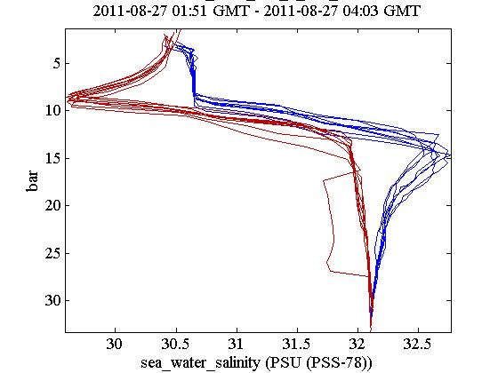
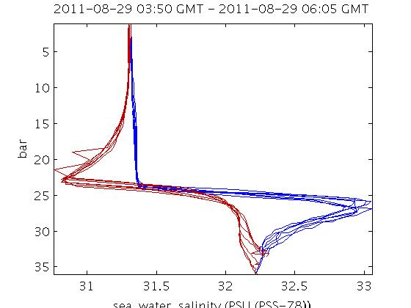
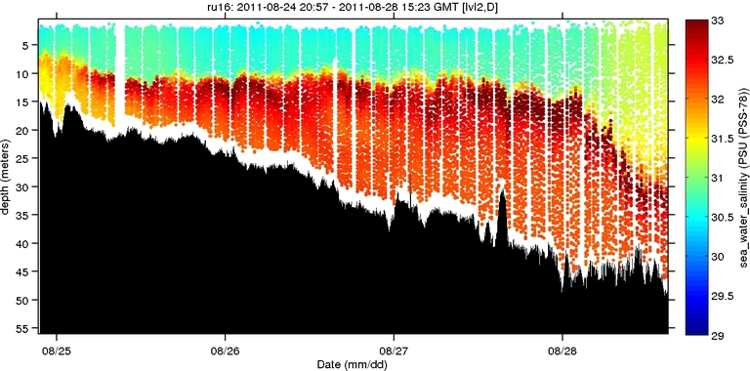
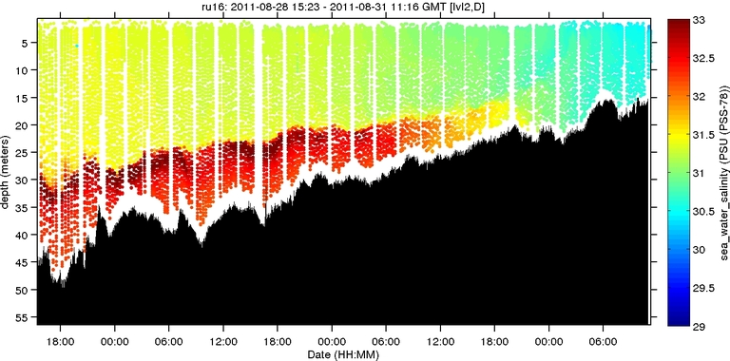
Salinity
Salinity at the surface increased from 30.5 to 31.4 PSU; stayed 32PSU at thermocline
Notes:
Salinity at the surface changed from 30.5 to 31.4 PSU. These values increase slightly with depth, and the salinity at the thermocline is 32 PSU both before and after Irene. Salinity changes affect conductivity, biology, and density.

Slide 4
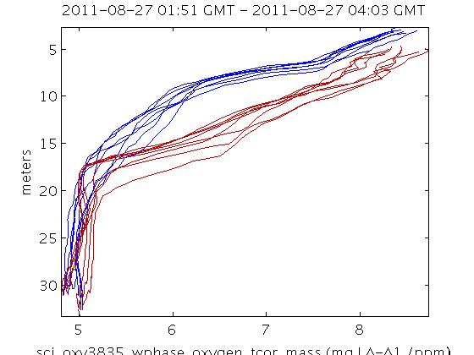
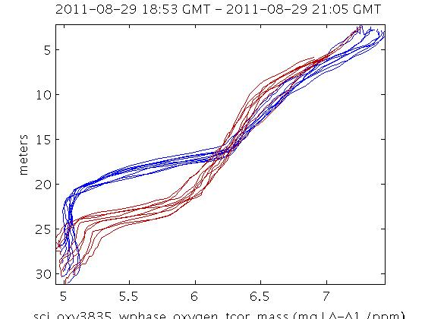
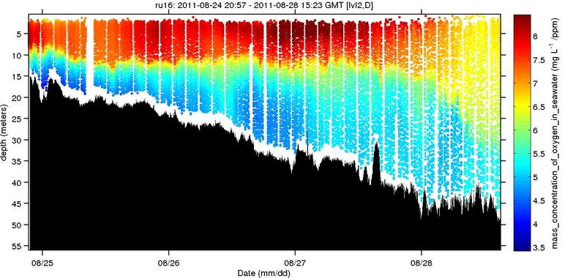
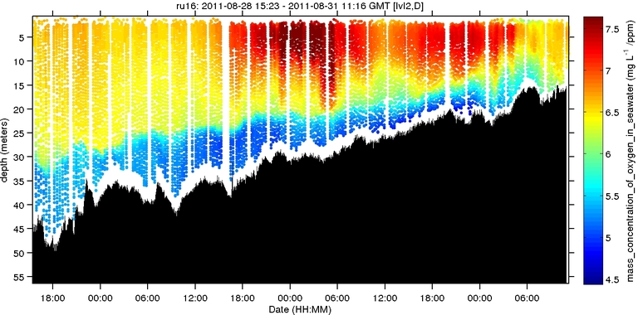
Dissolved Oxygen
DO at the surface was at 8.5 before the storm and 7.5 after; 5 at both thermoclines
Notes:
DO at the surface was at about 8.5 before the storm and 7.5 after. At the start of the thermocline DO is about 7 before the storm, and 6.25 afterwards. DO is 5 at both thermoclines, even though they occur at different depths. Mixing is responsible for getting more oxygen down to deeper water after the storm, but the values are lower at the surface. Organisms need enough oxygen to survive, 4-5 or higher for most fish.

Slide 5
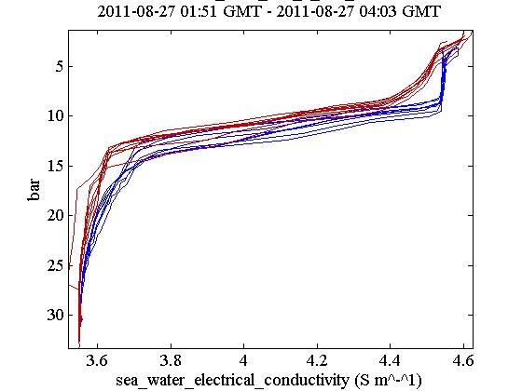
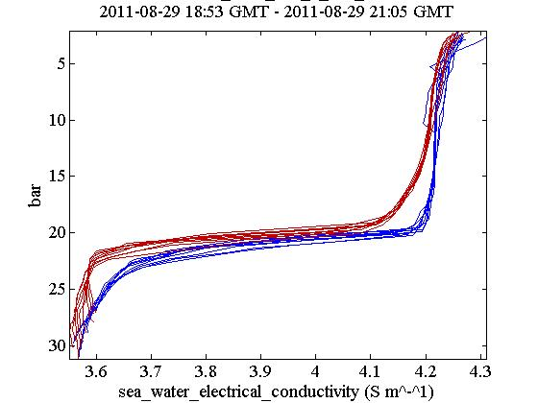
Conductivity
There was a decrease in conductivity at the surface from 4.5 to 4.25, and at the thermocline from 3.7 to 3.6, even though salinity increased (30.5 to 31.4 PSU)
Notes:
Seawater Conductivity measures the amount of dissolved salts in the water in ionic form. Irene increased the salinity from 30.5 to 31.4 PSU, but this shows a decrease in conductivity at the surface from 4.5 to 4.25, and at the thermocline from 3.7 to 3.6.

Slide 6
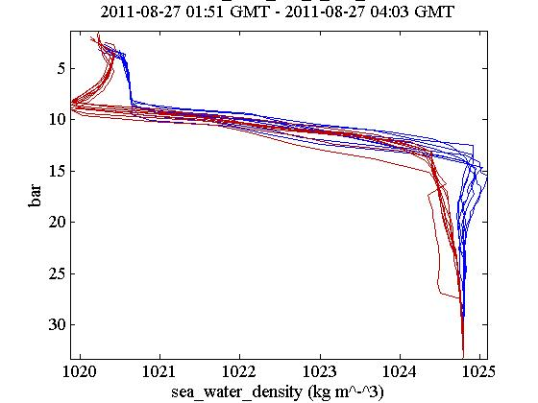
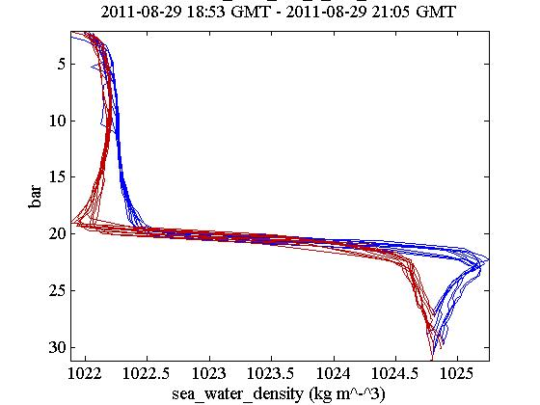
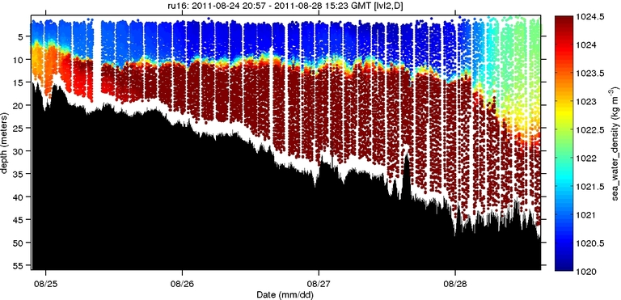
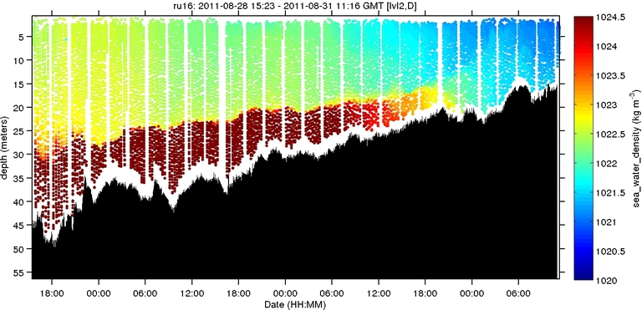
Density
Density increased by 2 kg m^-3 at the surface; stayed same at thermocline
Notes:
Seawater density depends on temperature and dissolved materials. Heavy water sinks to the bottom. The water became slightly denser at the surface after the storm by 2 kg m^-3 . Density was about the same at the thermocline both before and after Irene.

Slide 7
Heat Change
Heat
Time
Took surface temperature every few hours
Subtracted it from thermocline temp. (10C)
Multiplied each value by specific heat of water (4.1855 J/g*k)

