Slide 1
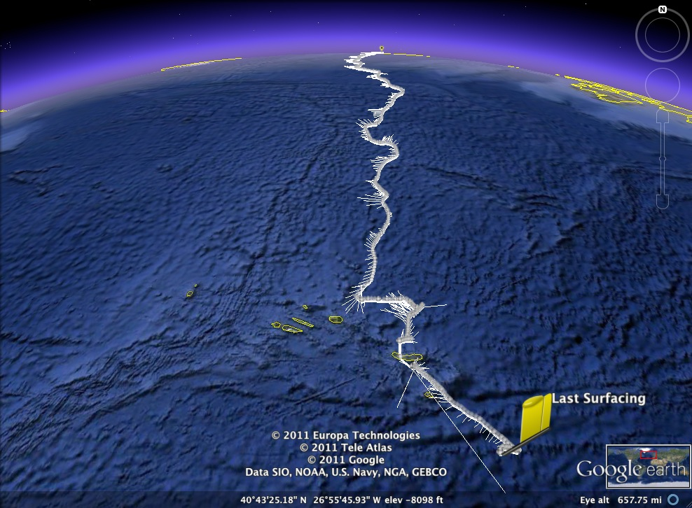
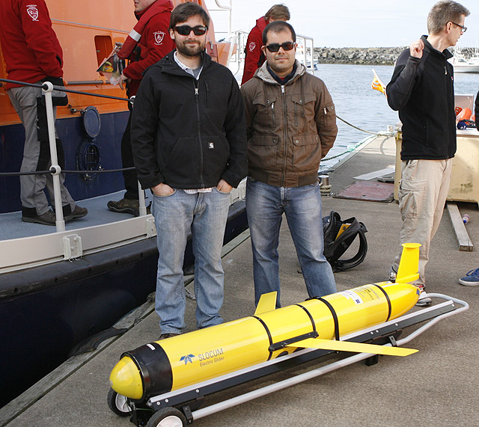
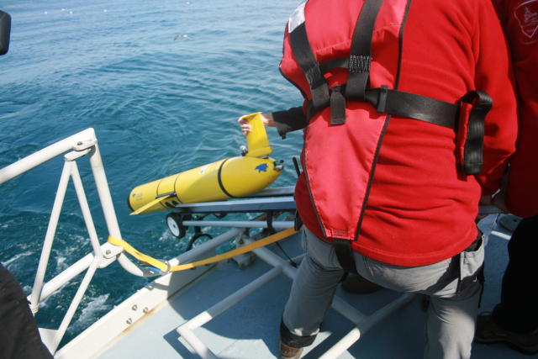
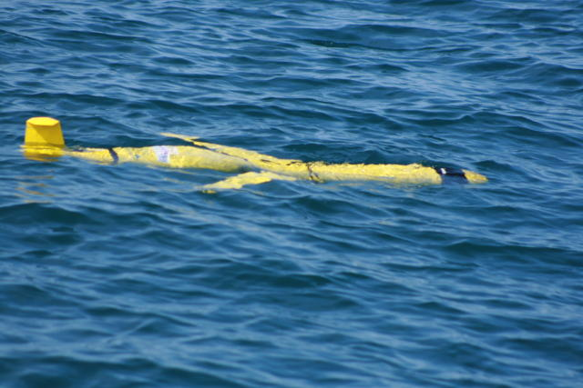
The Challenger Mission
Leg 1: Reykjavik, Iceland to The Azores
Jess Castoro, Chris Puskas, Eva Pena, Holly Broadus & Nilsen Strandskov

Slide 2
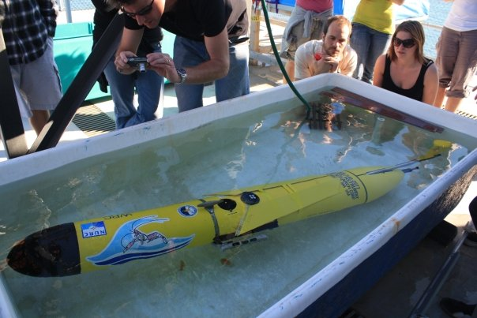
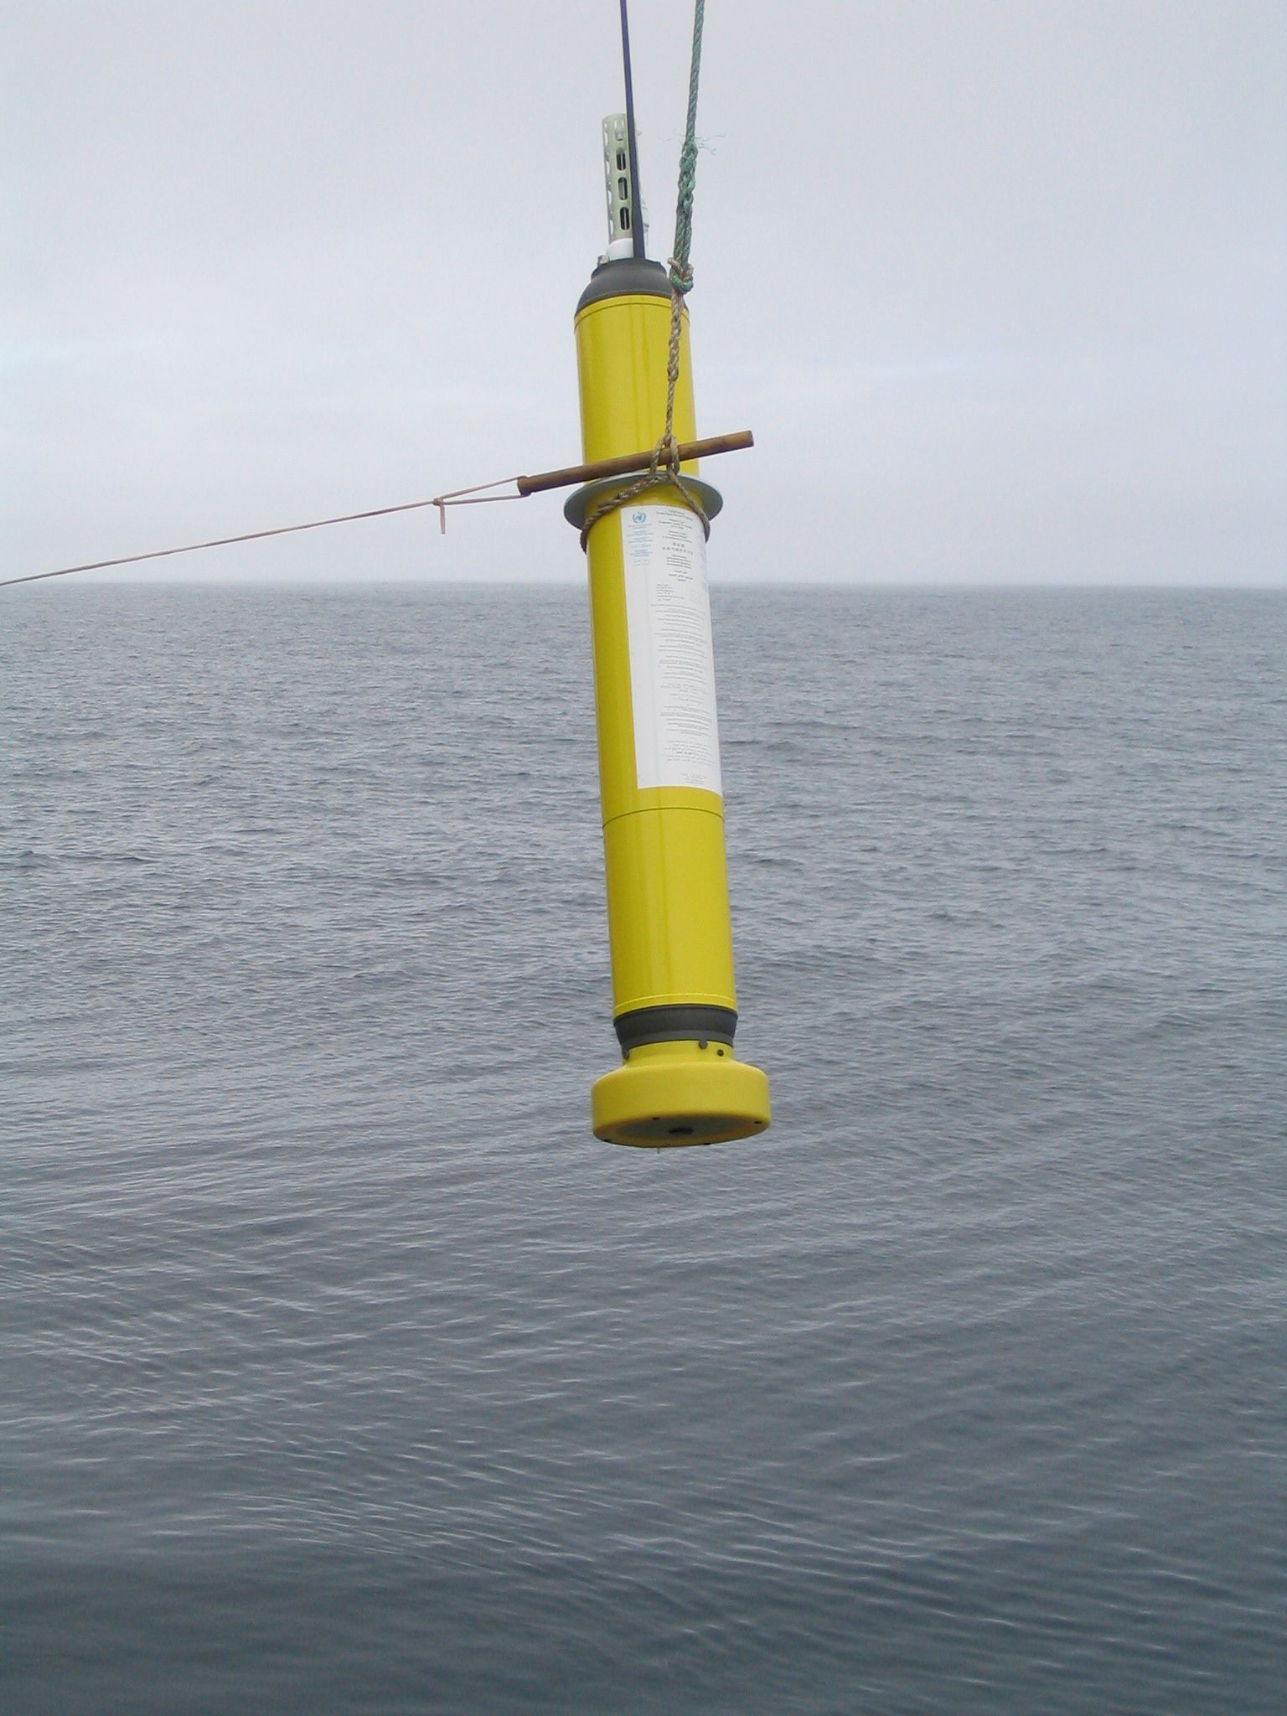
Materials:
The CTD (Conductivity, Temperature & Depth) mounted on the Slocum Glider has taken measurements of temperature on every downcast along the track from Iceland to the position on October 5th
Argo Drifter positioned off of Iceland close to June 23rd and near Silbo’s position on October 5th

Slide 3
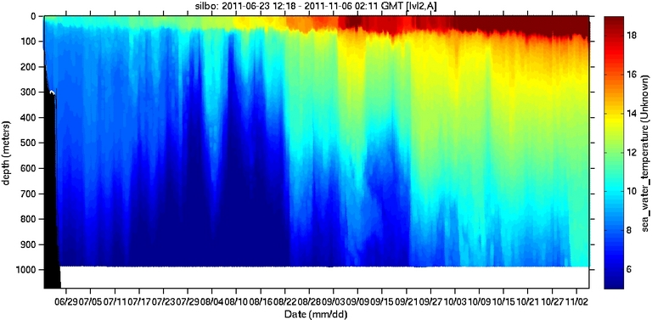
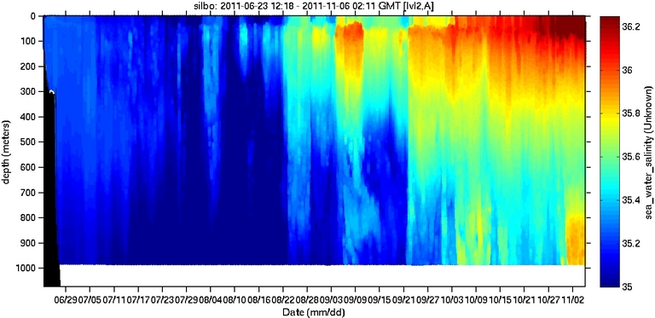
Temperature
Salinity
Are the temperature and salinity changes regional or temporal?

Slide 4
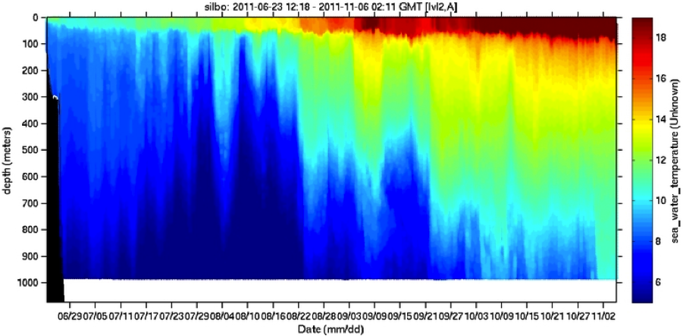
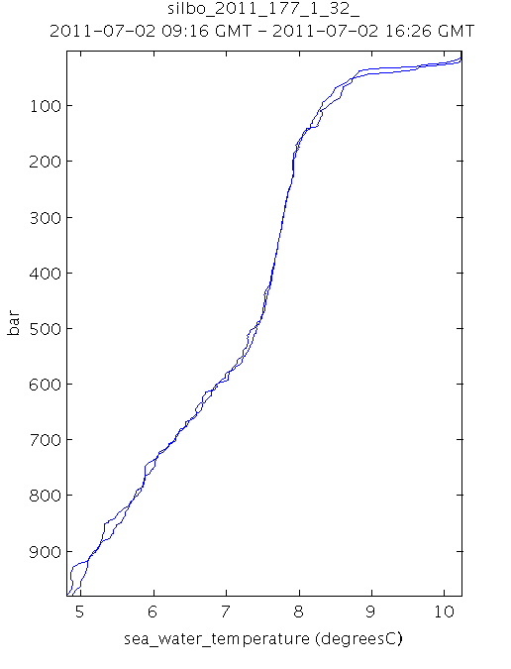
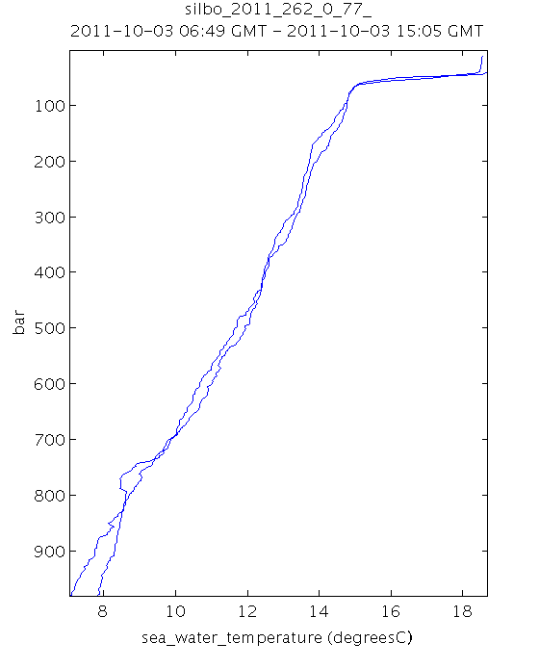
Temperature Collected by Silbo
Notes:
Surface ~10˚ C 1000m ~ 5˚ C to Surface ~18˚C 1000m 8˚C

Slide 5
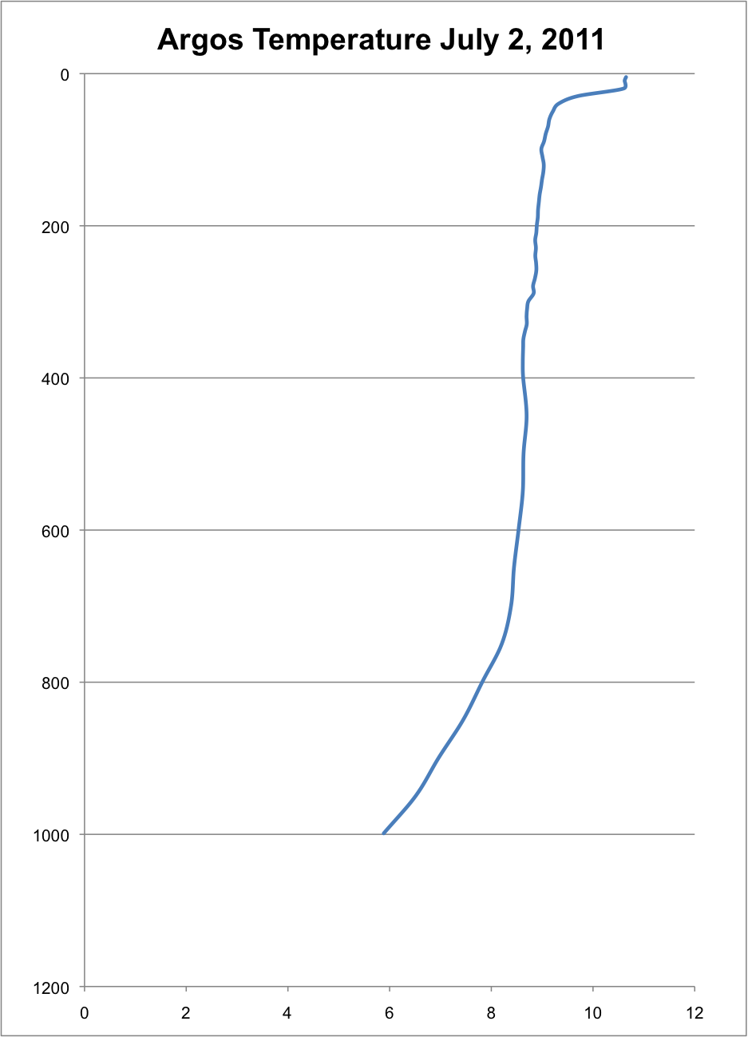
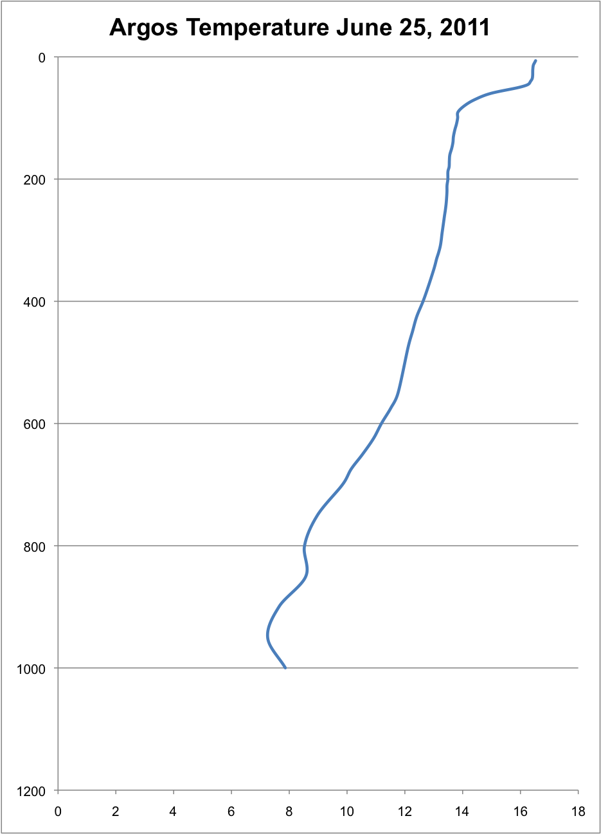
Temperature Comparison from the First Week:
Argos Drifter off of Iceland
Argos Drifter at Silbo’s Location in October
meters
meters
˚C
˚C
Notes:
10˚C-6˚C vs 16˚C-7˚C

Slide 6
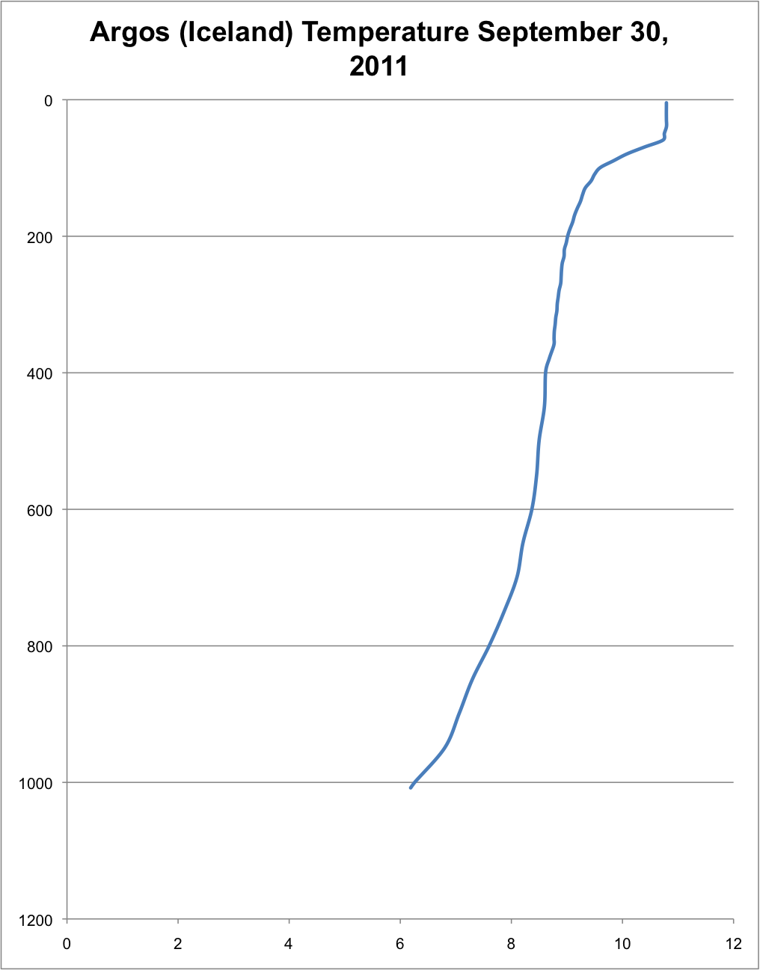
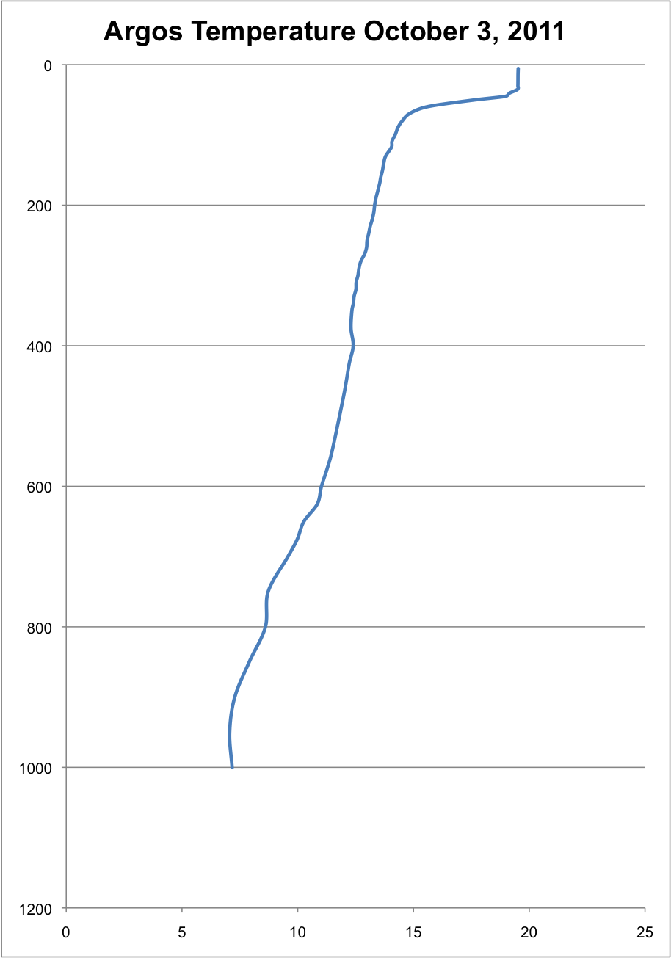
Temperature Comparison for the week of October 3rd
Argos Drifter off of Iceland
Argos Drifter at Silbo’s Location in October
meters
meters
˚C
˚C
Notes:
11˚C- 6˚C vs 19˚C-7˚C

Slide 7
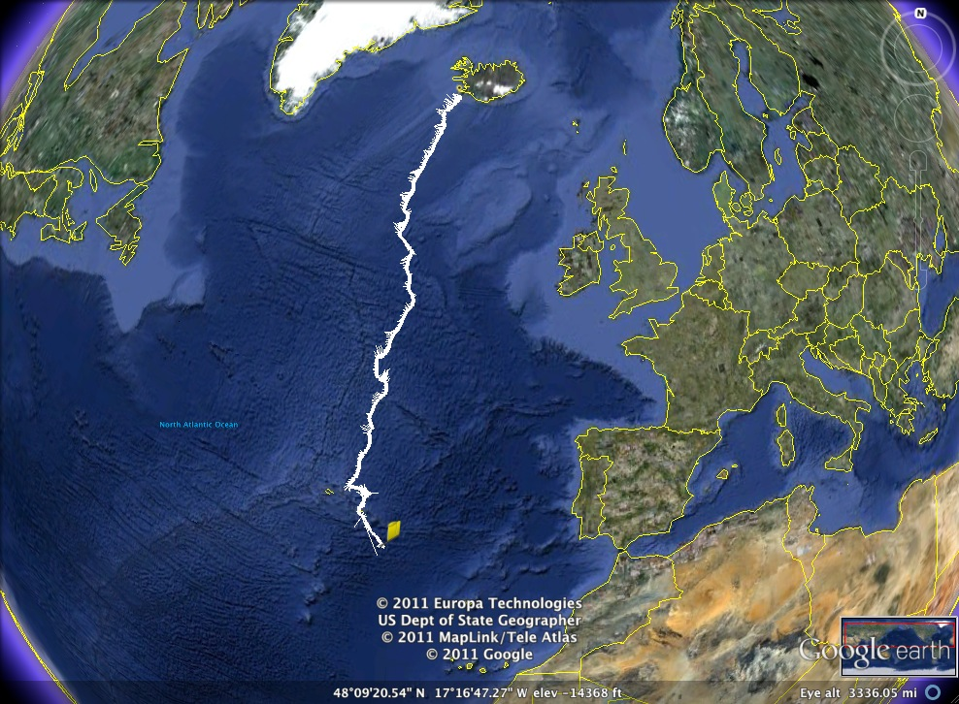
Silbo saw a change from the surface being ~10˚C and at depth being 5˚C by Iceland to a range of 18˚C to ~7˚C at his position on October 3rd
The Argos drifter off of Iceland measured a depth range from 10.6-5.8˚C in July to 10.8-6.2 at the end of October
The Argos drifter near Silbo’s position in October measured 16.5-7.8˚C at the end of June compared to 19.5-7.2˚C
July 2
Oct 3

Slide 8
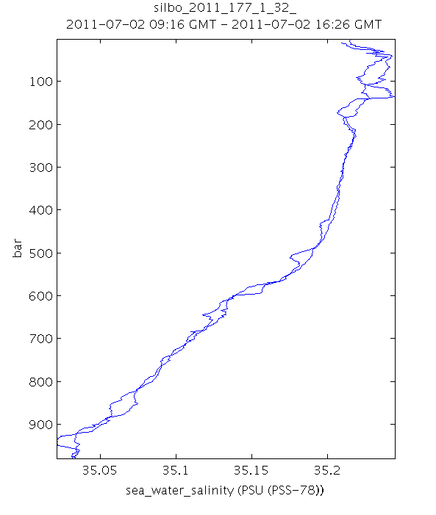
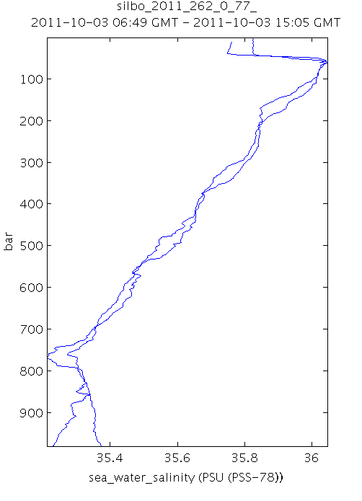
Salinity Collected by Silbo

Slide 9
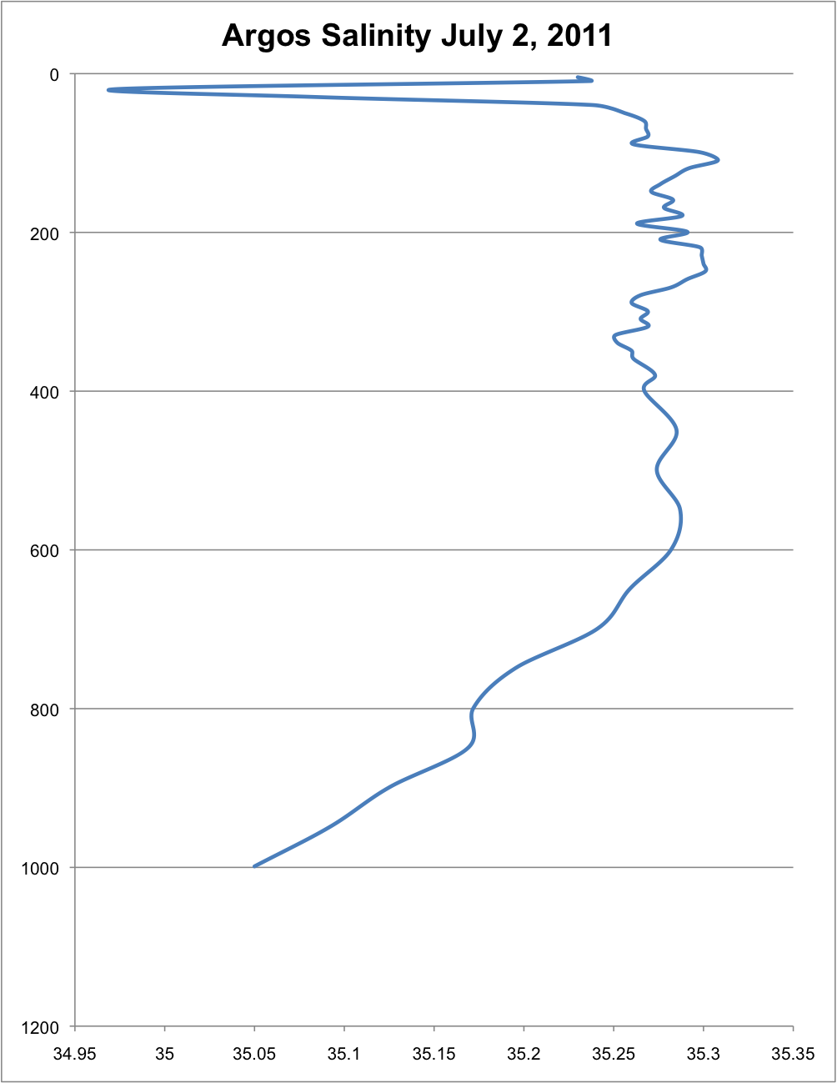
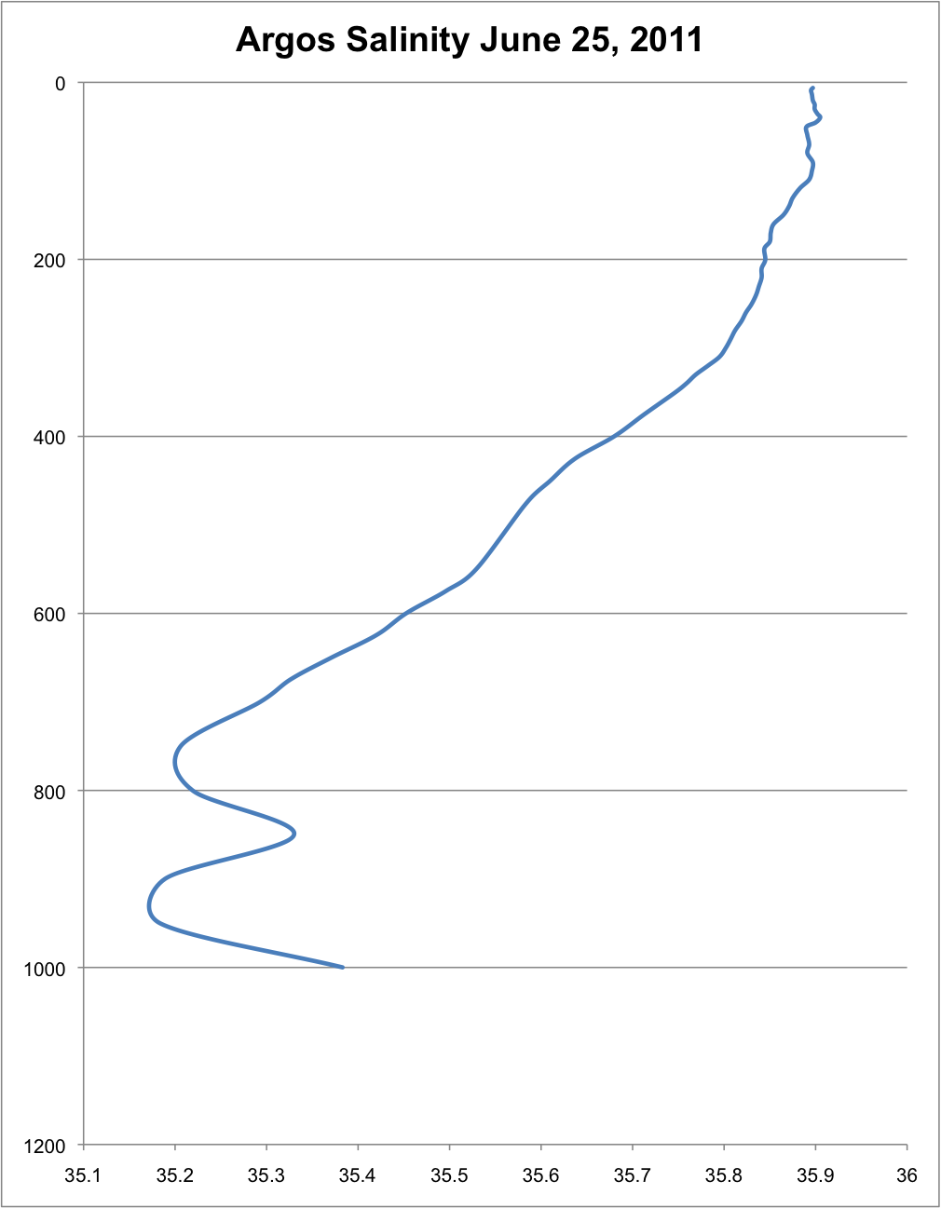
Salinity Comparison from the First Week:
Argos Drifter at Silbo’s Location in October
Argos Drifter off of Iceland
meters
meters
psu
psu

Slide 10
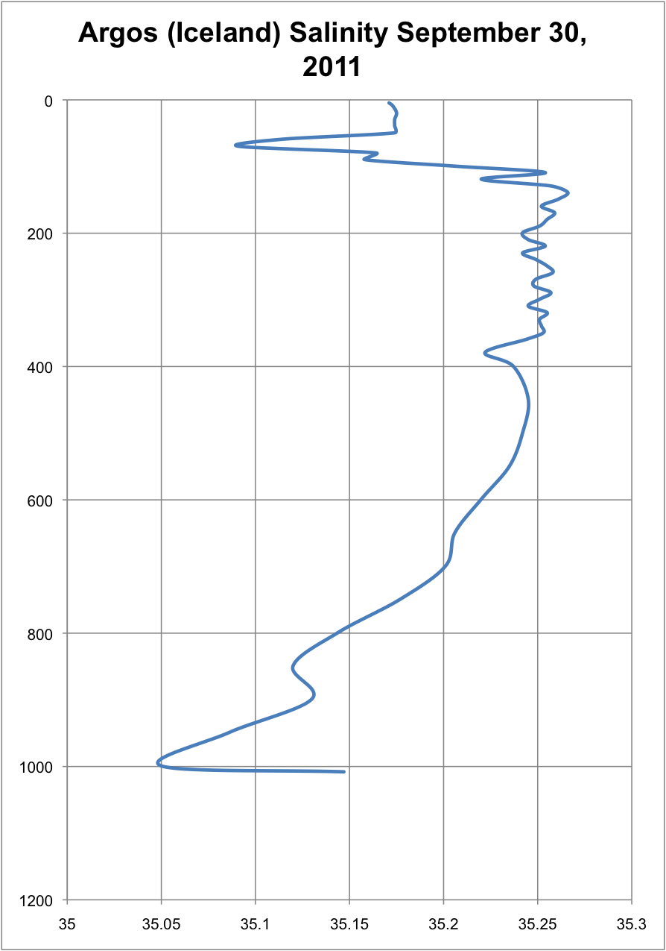
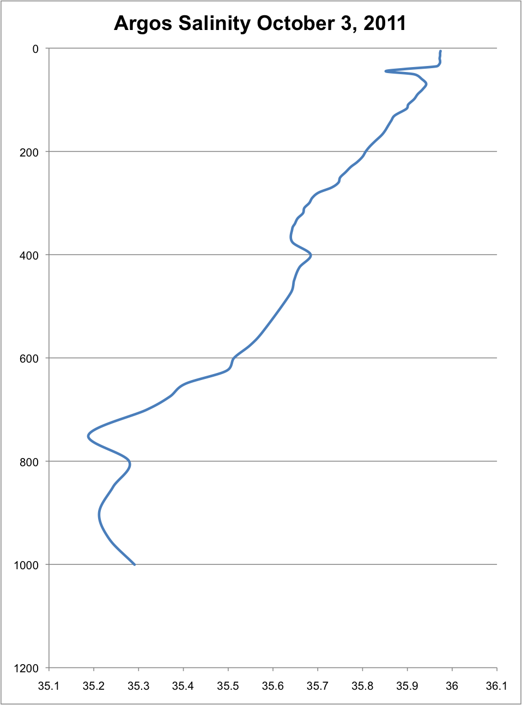
Salinity Comparison from the Week of October 3rd :
Argos Drifter off of Iceland
Argos Drifter at Silbo’s Location in October
meters
meters
psu
psu

Slide 11
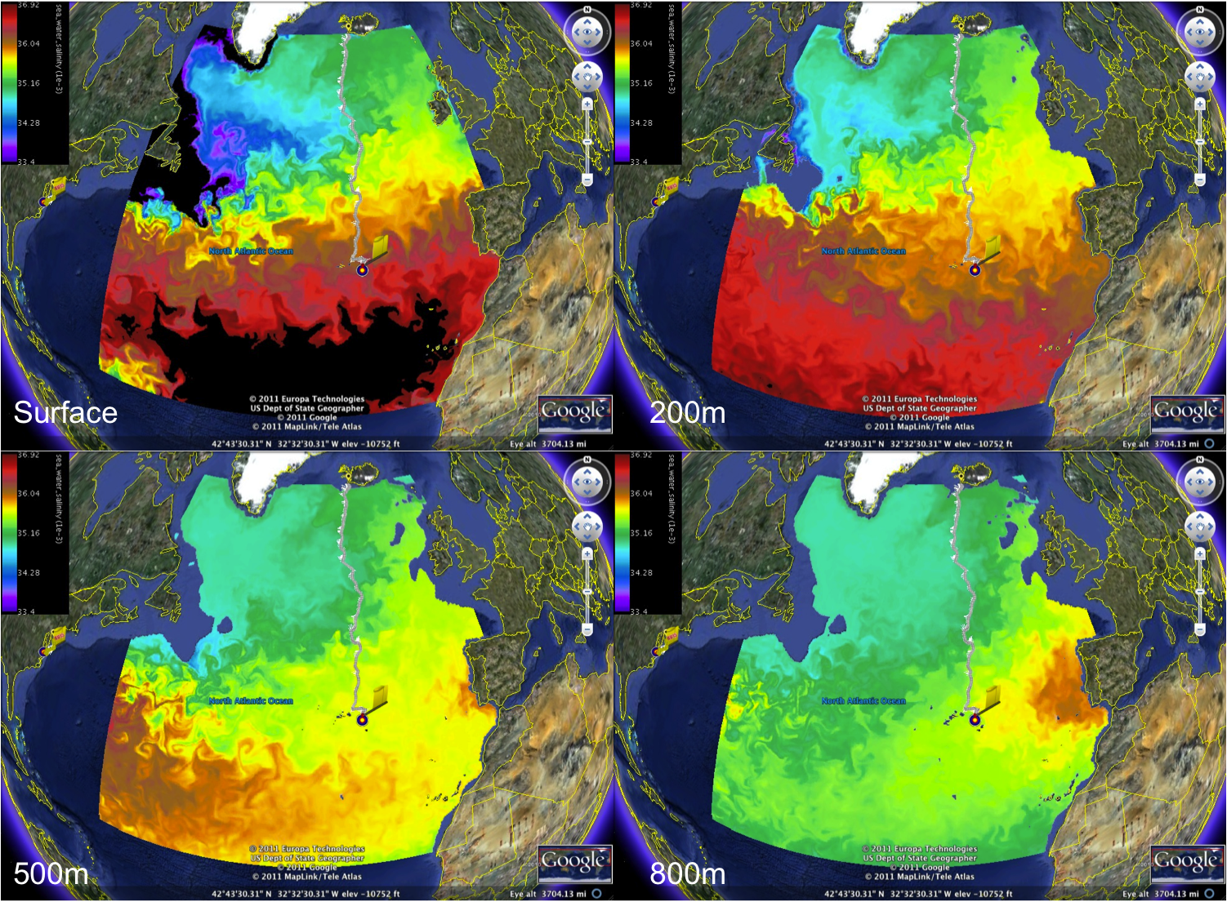
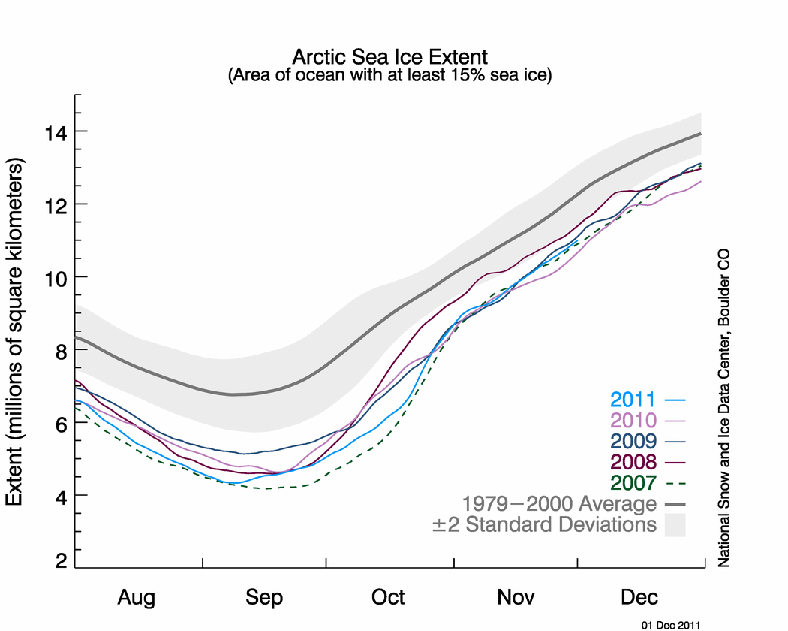
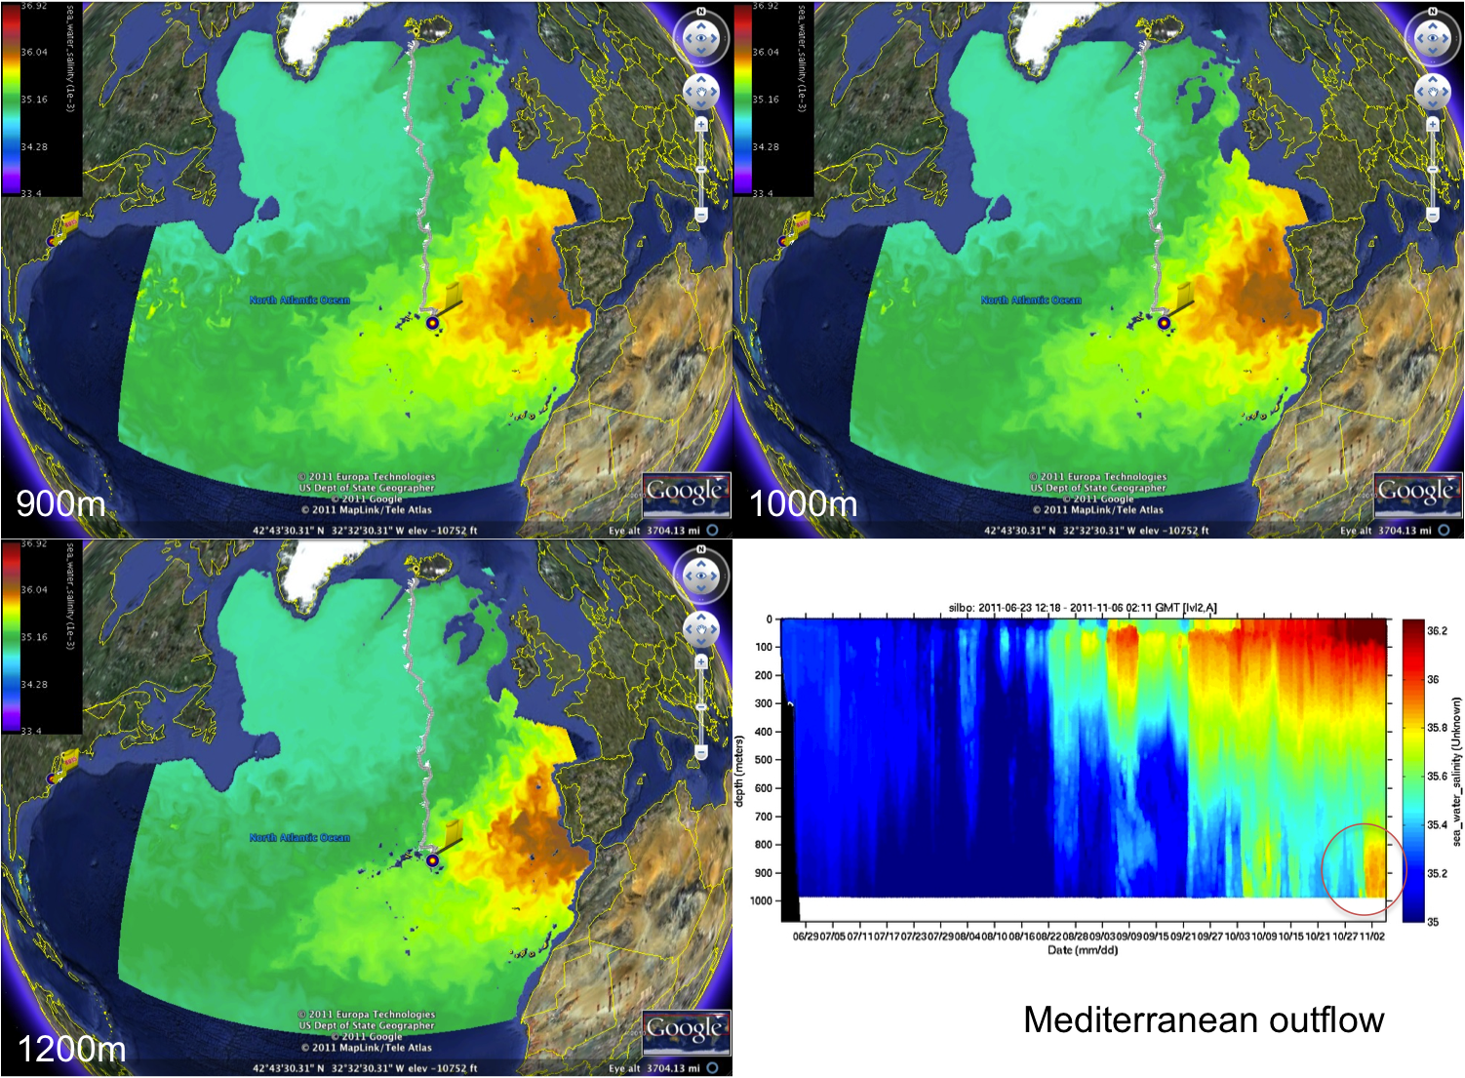

Slide 12
In Conclusion:
Temperature:
The temperature up near Iceland changed very little over the time we analyzed, while the temperature for the position near October 3rd underwent a much larger change. It seems the temperature difference may have been both regional and temporal.
Salinity:
Concentration differences seem to be regional and potentially due to peak fresh water flux from height of ice melt and the outer reaches of the Mediterranean Outflow.

