Slide 1
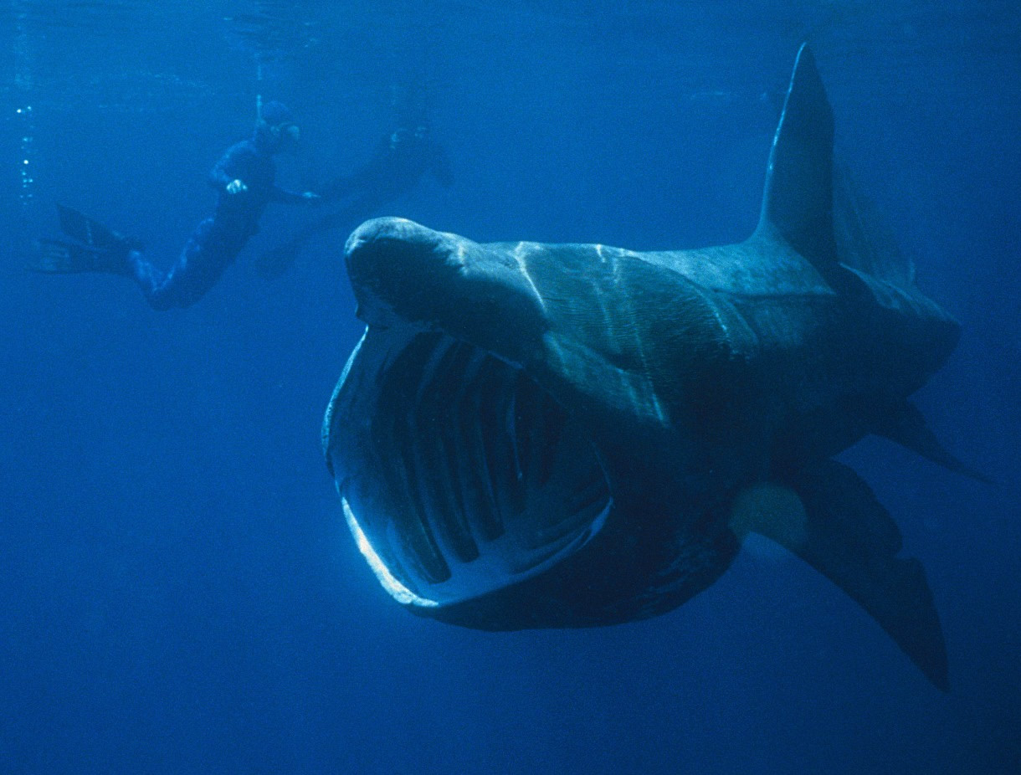












C-MORE 2: Observing life, measuring the phytoplankton
Oscar Schofield (RU COOL)
Picture by Chris Gotschalk
Notes:
1

Slide 2
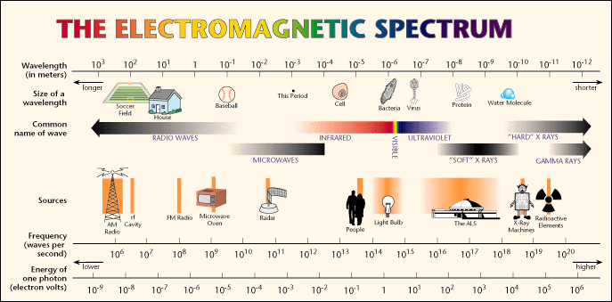
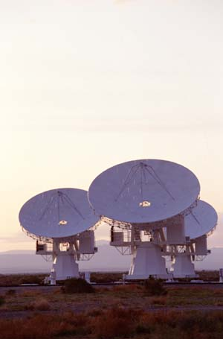
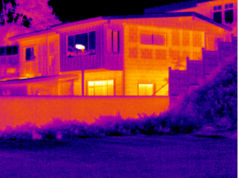
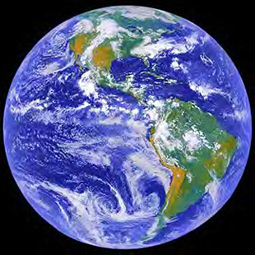
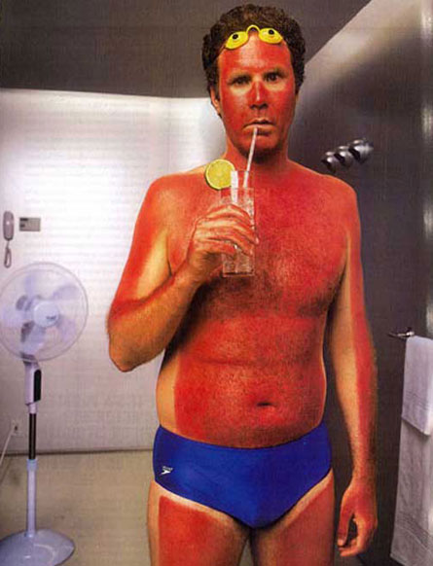
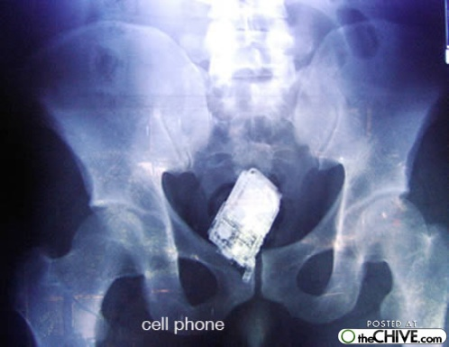

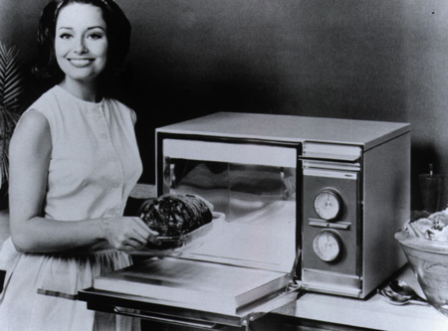
Phytoplankton growth and nutrient assimilation is tied to ambient light levels.
Enough energy to excite
(vibrate a molecule)
Enough energy make something new
(rearrange a molecule)
Enough energy move electrons

Slide 3
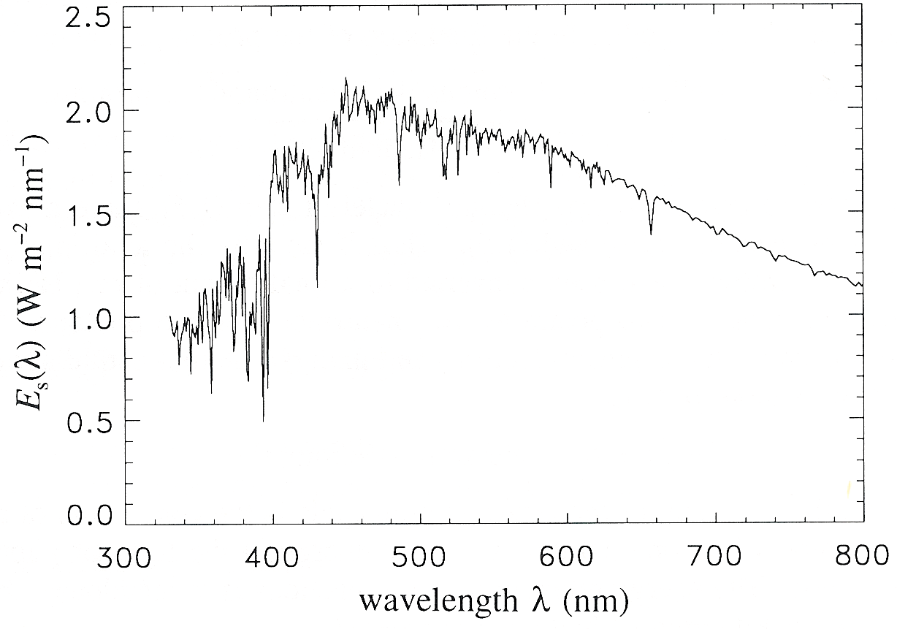
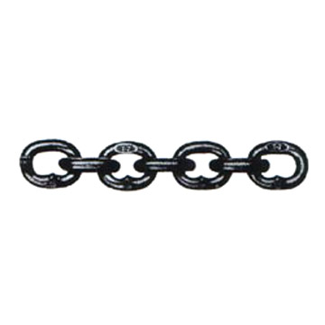
Photosynthesis = PAR * a_{ph} * φ
Scalar visible irradiance
Quantum efficiency of ……..
Absorption
High
Spectrally averaged absorption
Fluorescence
or charge
separation
Irradiance
0.00
0.00
0.20
0.40
0.60
0.80
1.00
oxygen
20.00
Energy that is into the cell
Varies cell pigmentation, light history,
and size
)
40.00
m
(
carbon fixation
h
t
p
e
60.00
D
80.00
~ 1%
Low
100.00
growth
Energy into the ocean
Varies with depth according to the IOPs
IOPs with radiative transfer eqns describe the AOPS
Efficiency of converting energy into
End product (electrons, oxygen, carbon)
Varies with end product and physiology

Slide 4
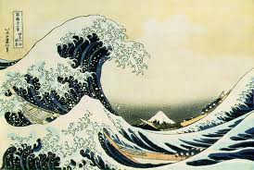
“Every day, the ocean changes colour – or rather, it passes though a variety of hues between the morning, noon and night of a single day. The subtle shapes of clouds, the glittering light of the sun, and the shifts in atmospheric pressure tint the sea with deep tones, cheerful tomes, plaintive tones that would cause any painter to pause in wonder.”
from The Samurai by Shusaku Endo (1980)

Slide 5
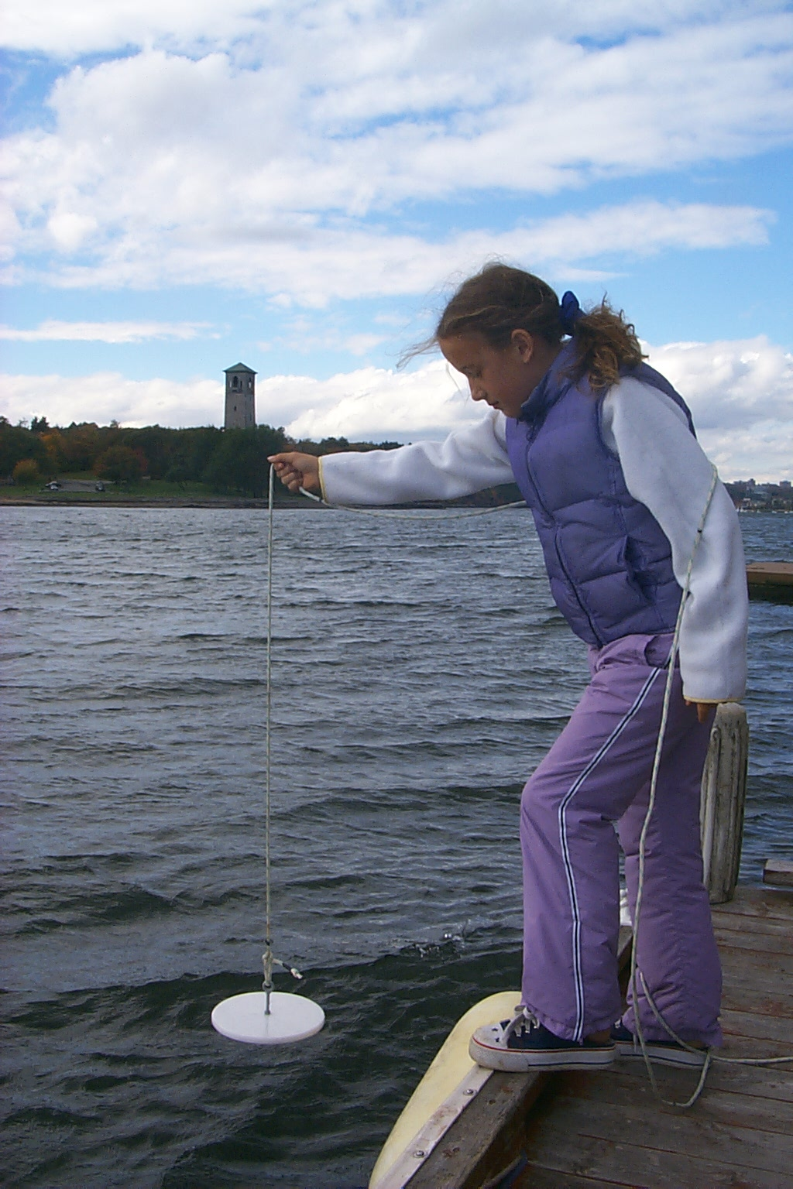
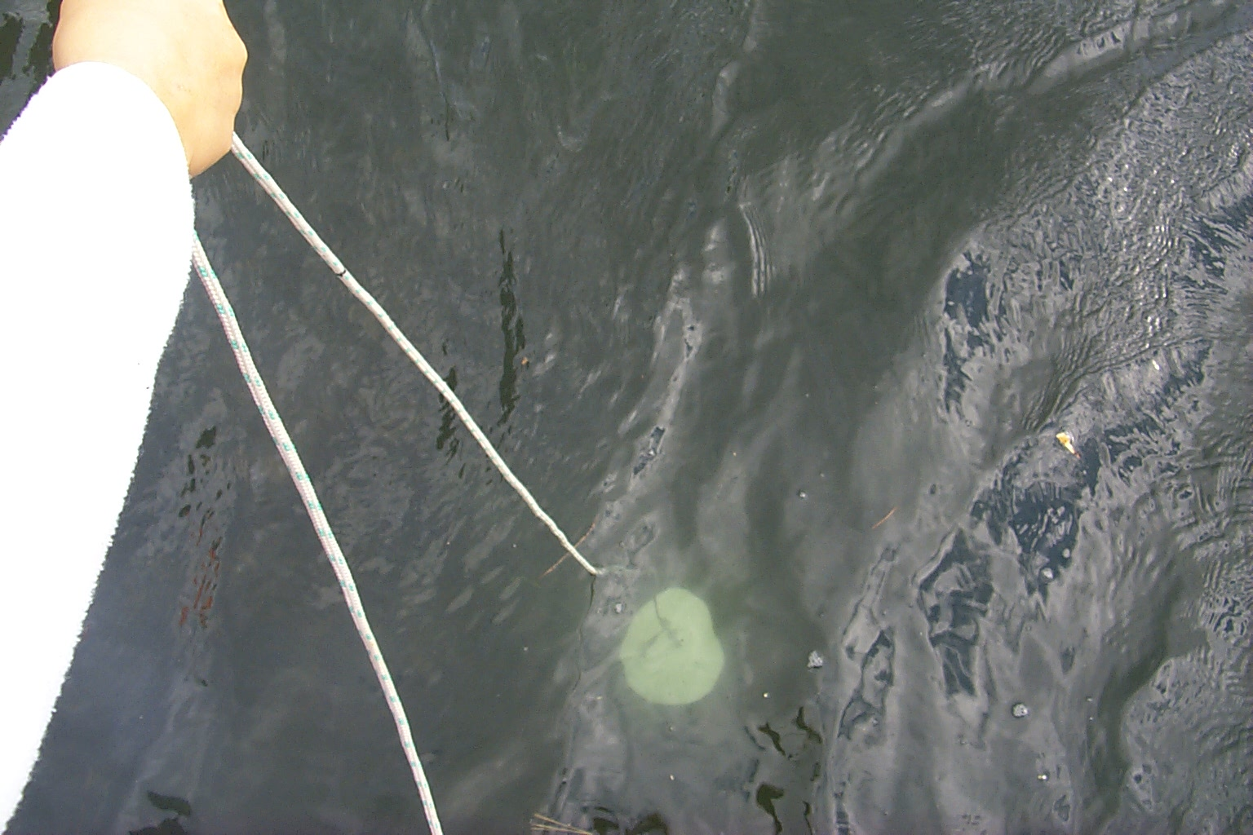
“Eyeball Optics”
The Secchi Disk:
First systematic usage reported in 1866, but observed and remarked upon much earlier.
Early experiments carried out by Commander Cialdi, head of the Papal Navy, and Professor Secchi onboard the SS L’Immacolata Concezione (Cialdi, 1866).
Used operationally for establishing aids to navigation over shallow water.
Thanks to Marlon Lewis

Slide 6

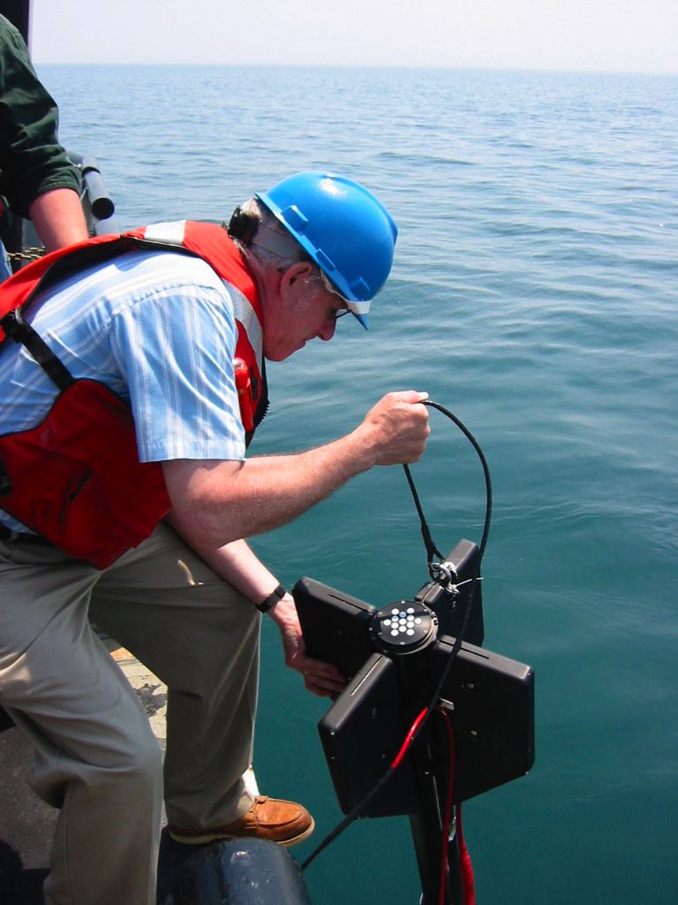
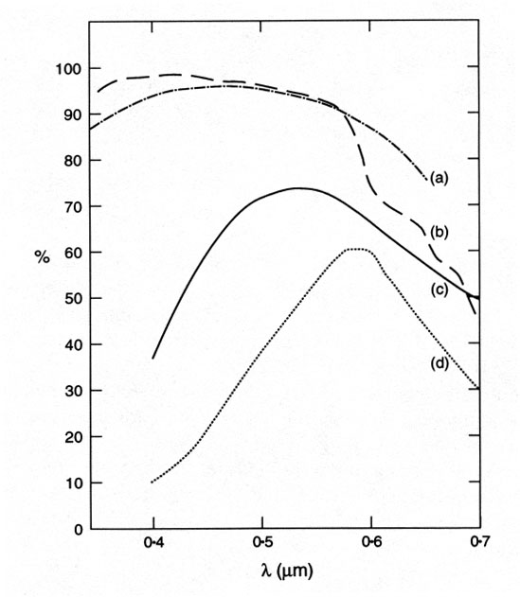
Measuring the light into the system
From John T. O. Kirk’s billabongs

Slide 7
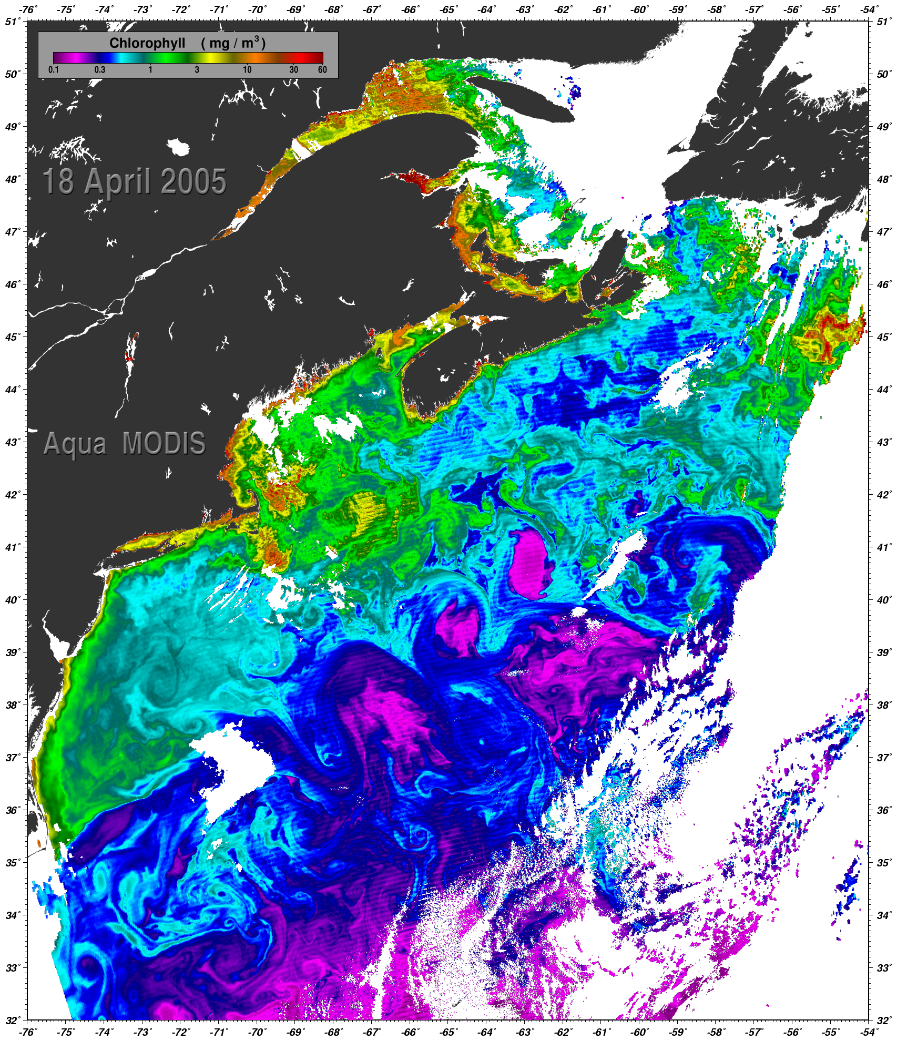
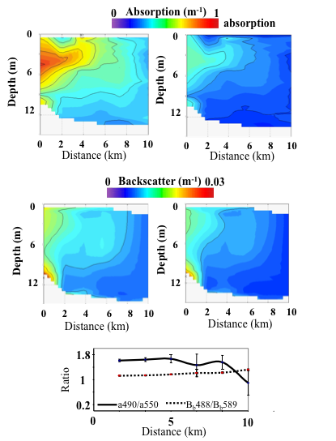
Reflectance(λ) = G* b_{b}(λ)/{b_{b}(λ) +a(λ)}

Slide 8
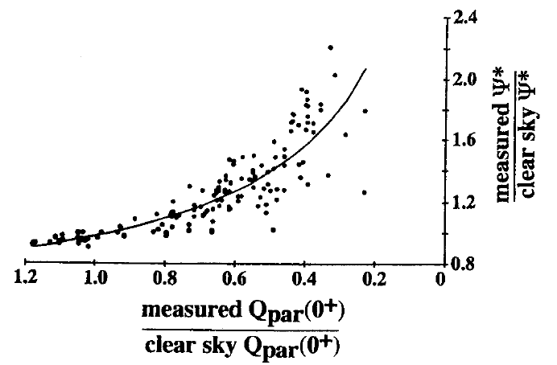
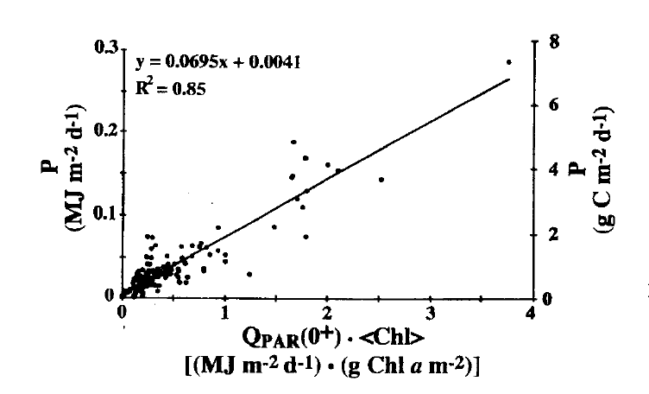
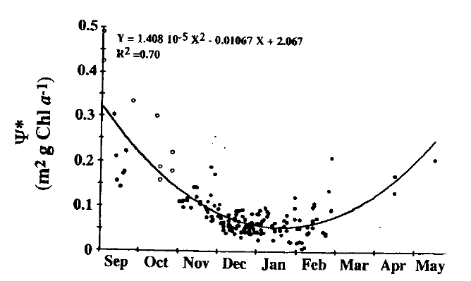
What are some of the classical DIMS?
Local
weather
Ψ∗ = P/(Qpar(0+)<Chl>)
Morel and Platt show Ψ* variability
Of 50% around a value of at specific
chl values
seasonal
Diatoms Ψ 0.114 + 0.051
Cryptophytes Ψ 0.053 + 0.011
Claustre et al.

Slide 9
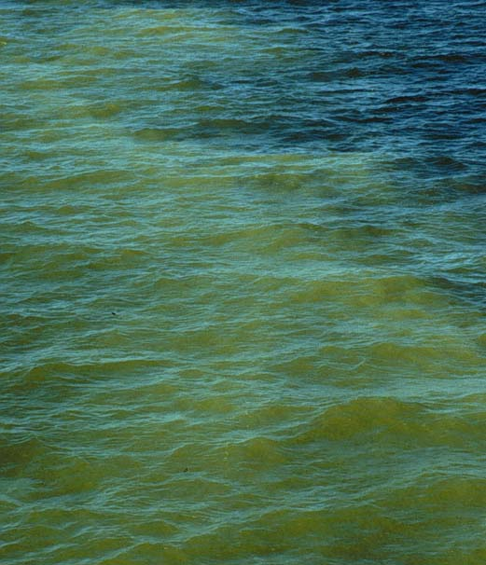
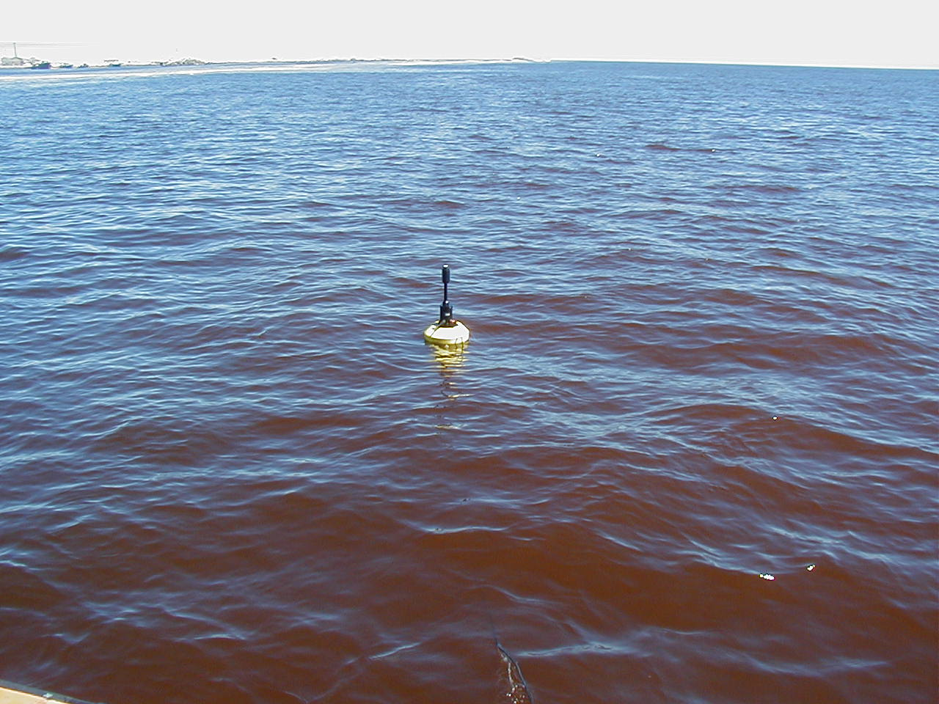
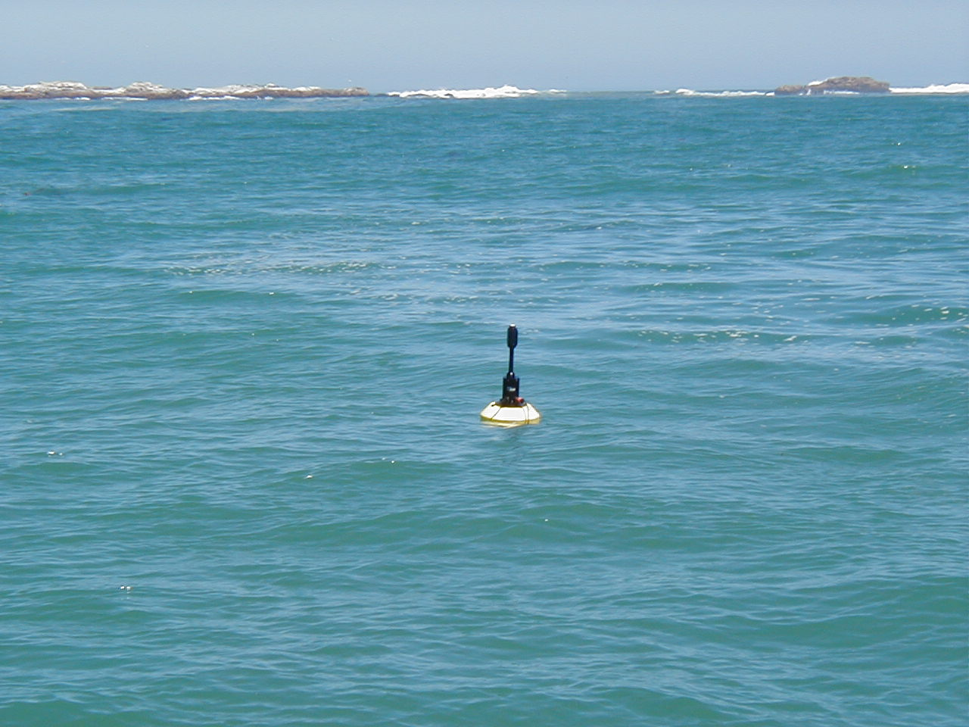
Penetration of light is determined by the material in the water
which is determined by the overall inherent optical properties (IOPs)
Absorption (a) color
Photos by S. Etheridge

Slide 10
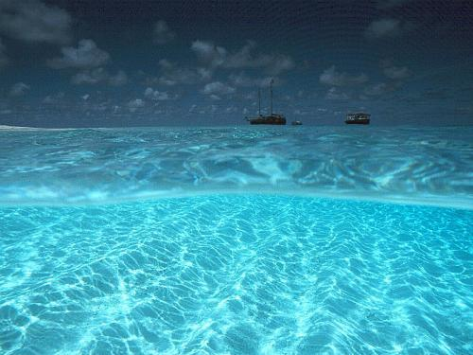
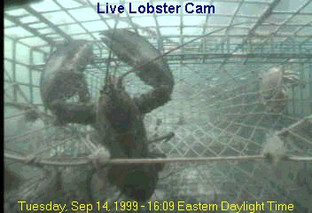
Scattering (b) clarity
a + b = c
c = attenuation
From Collin Roesler

Slide 11

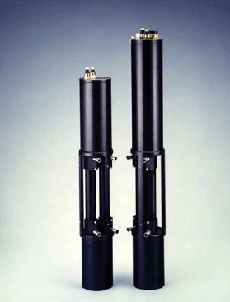
WetLabs
detector
detector
Absorption (a)
Attenuation (b)

Slide 12
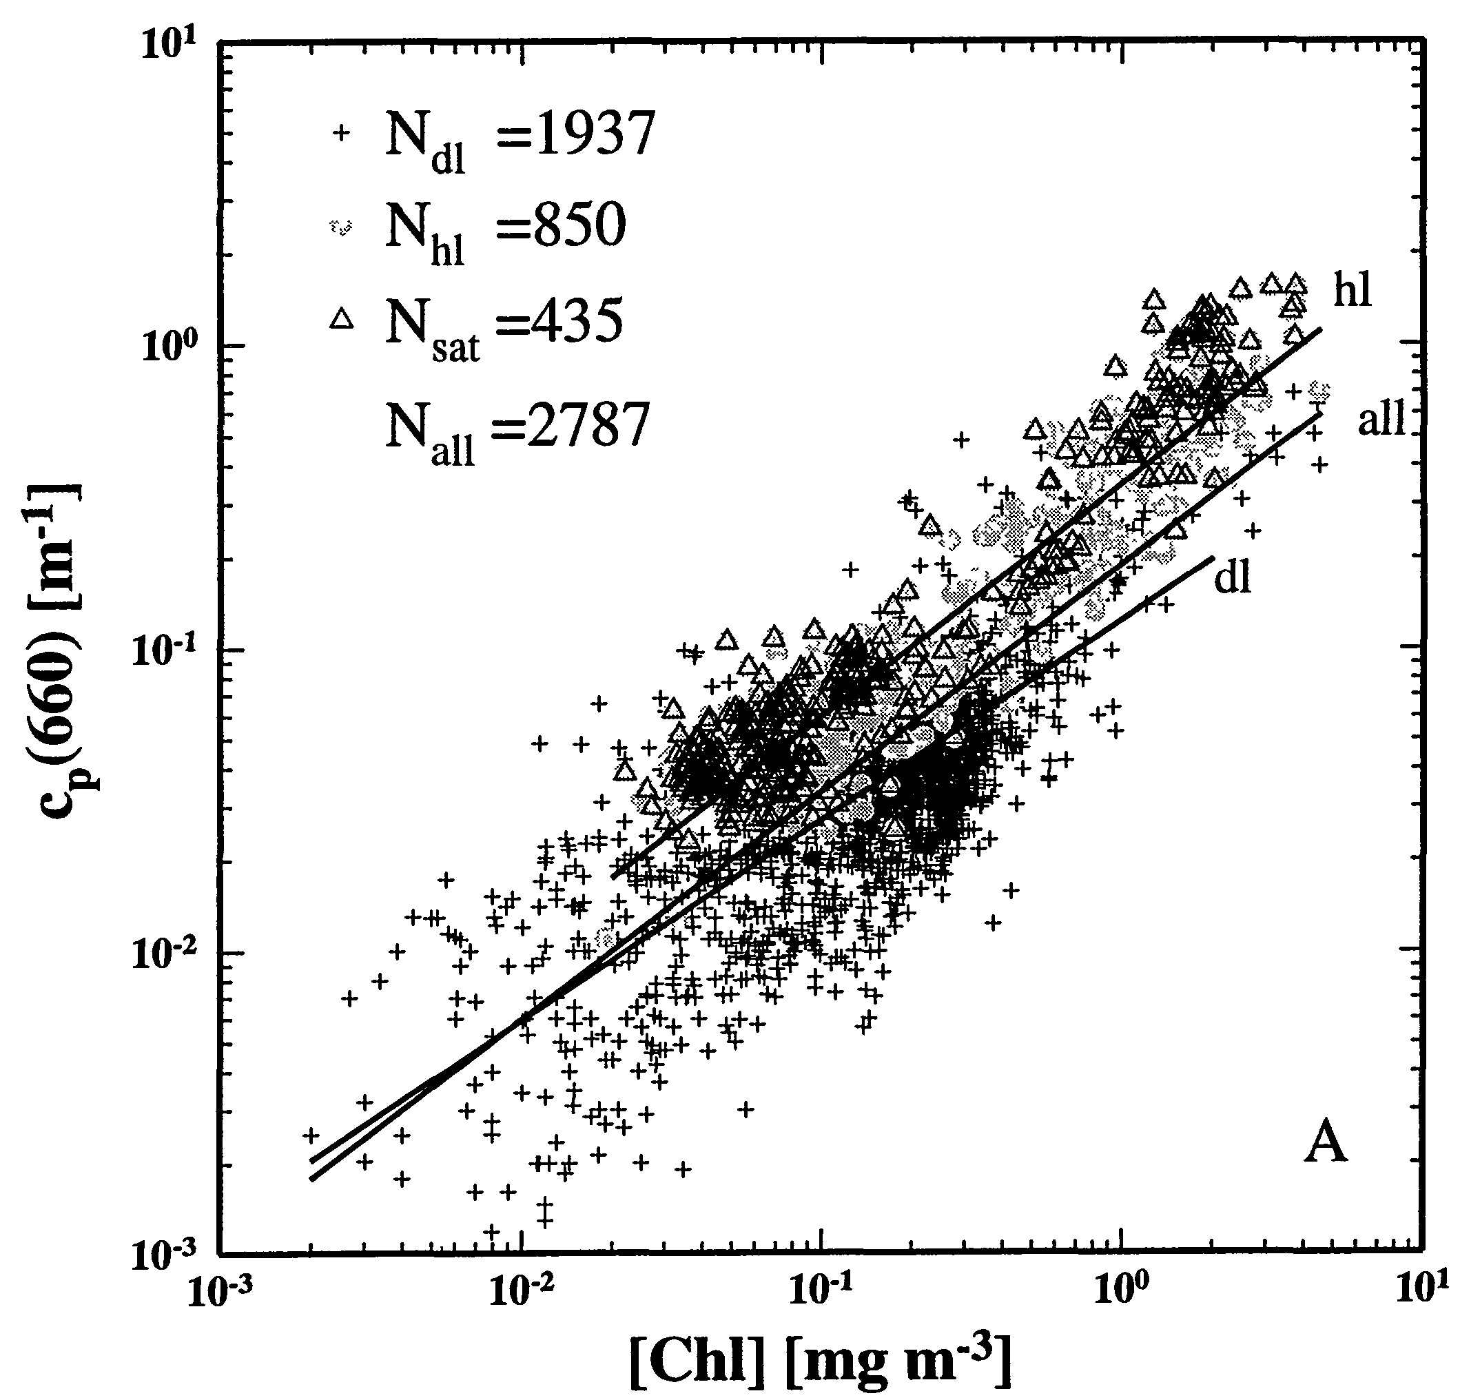
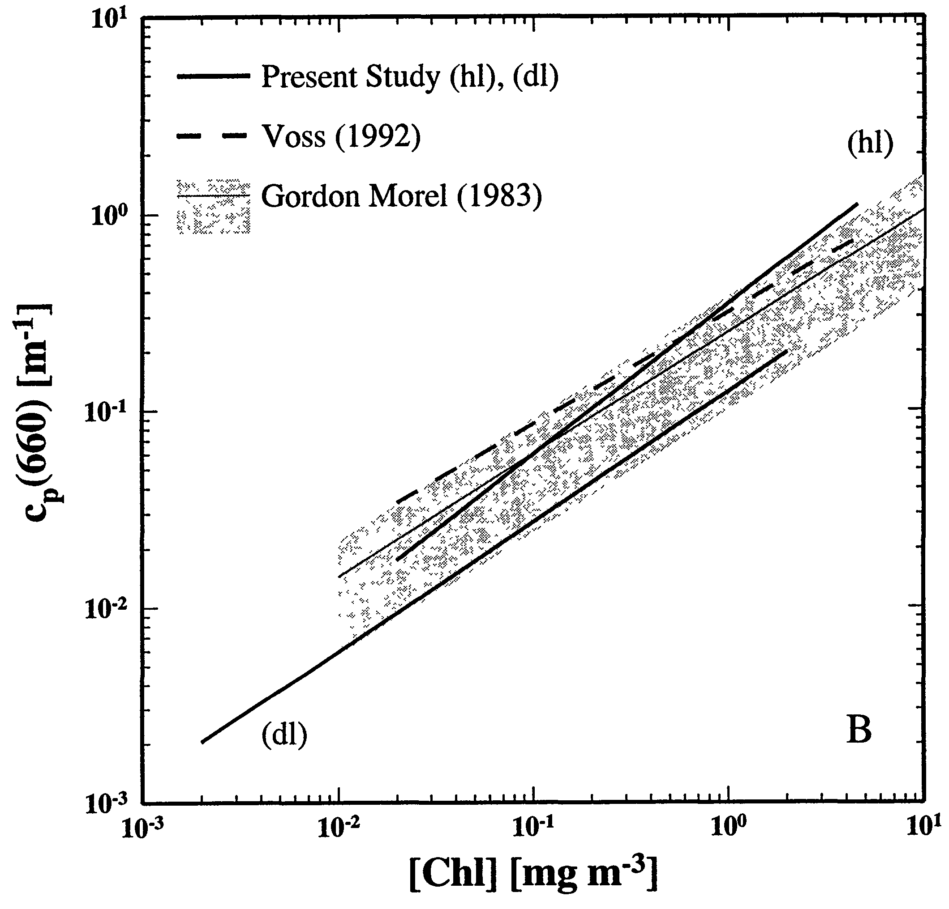
Scattering – Case I waters
c_{p}(660) ≈ b_{p}(660)
        Positively correlated
        Non-linear, B ≈ 0.7
        High unexplained variance
Loisel and Morel 1998

Slide 13
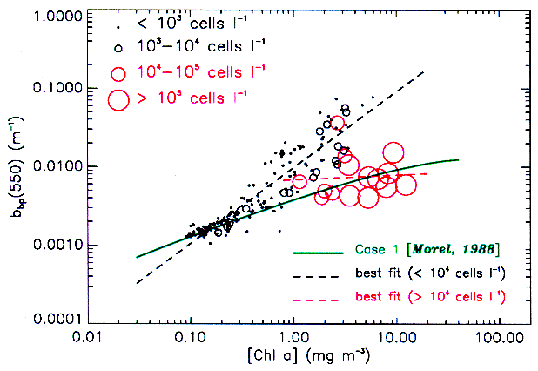
Particle backscattering
West Florida Shelf
Karenia brevis
bloom
Cannizzaro et al. 2002

Slide 14
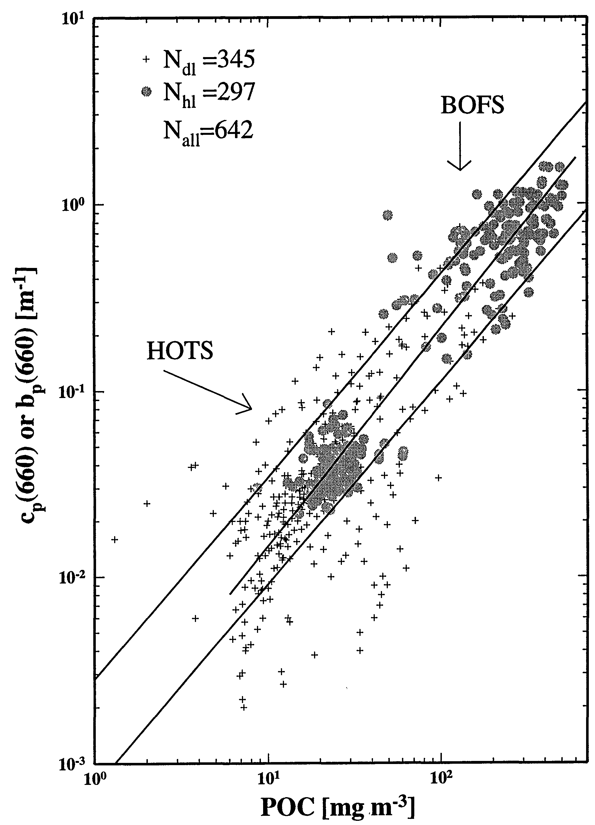
POC – Scattering (Case I waters)
Subtropical Pacific, North Atlantic
B ≈ 1
Contrast with non-linear dependence on Chl
→ POC-Chl variations are important
Loisel and Morel 1998

Slide 15
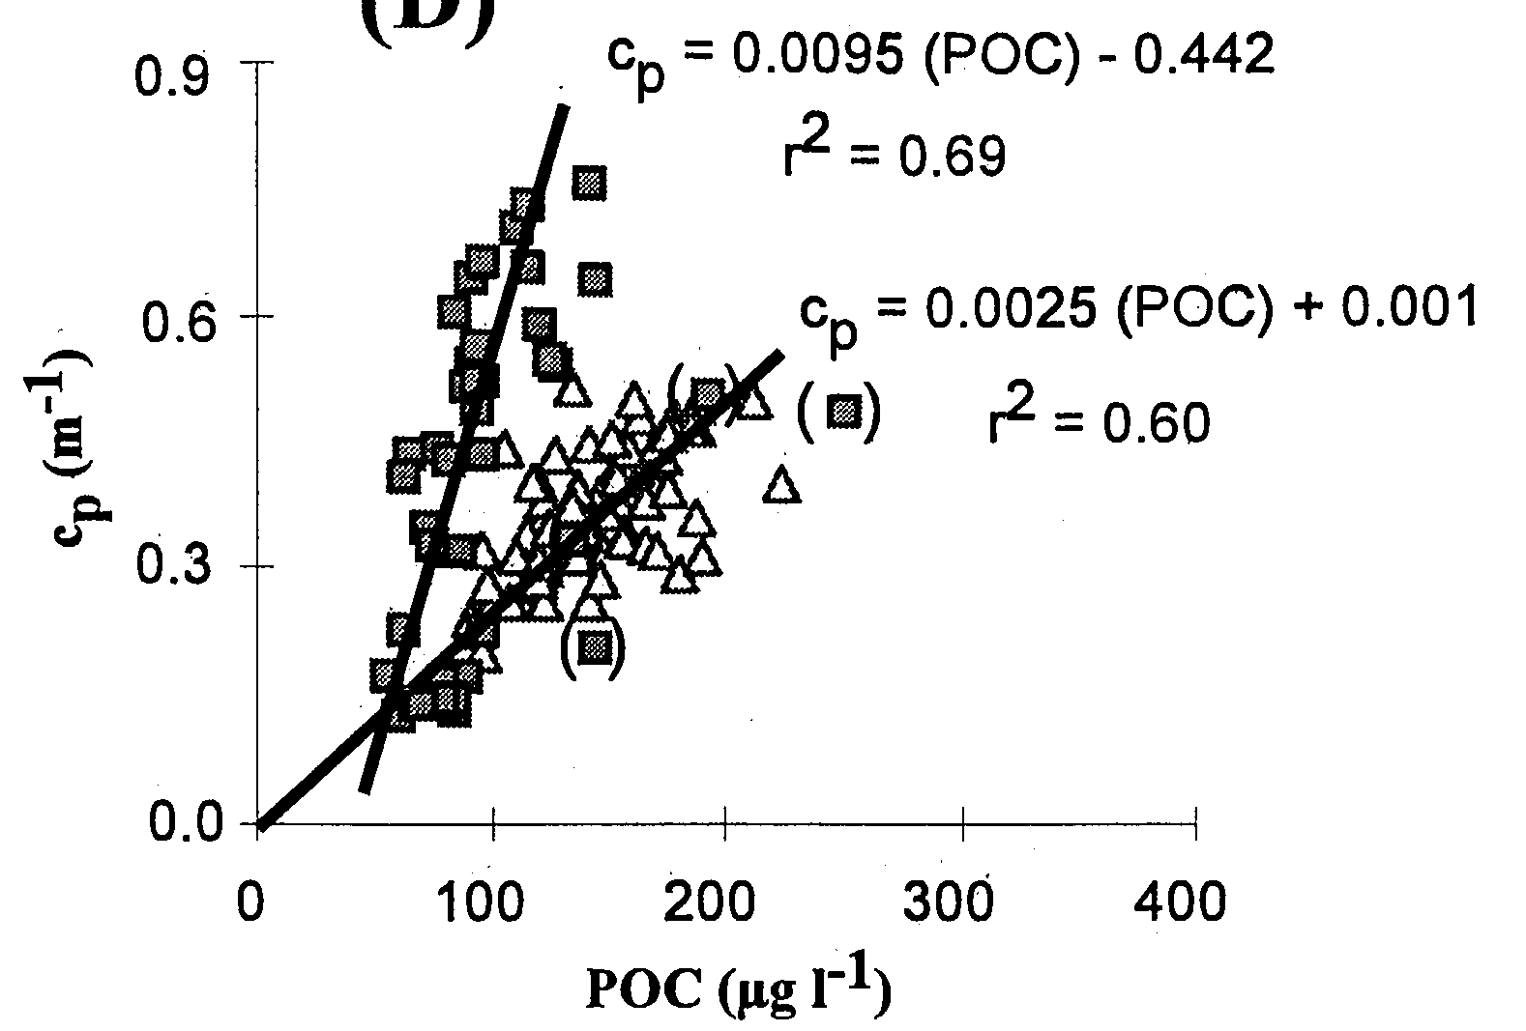
POC-Scattering
New England Continental Shelf
Bottom layer
c_{p}(660)
Surface layer
Gardner et al. 2001
→ Under specific conditions, the c_{p} – POC relationship varies

Slide 16
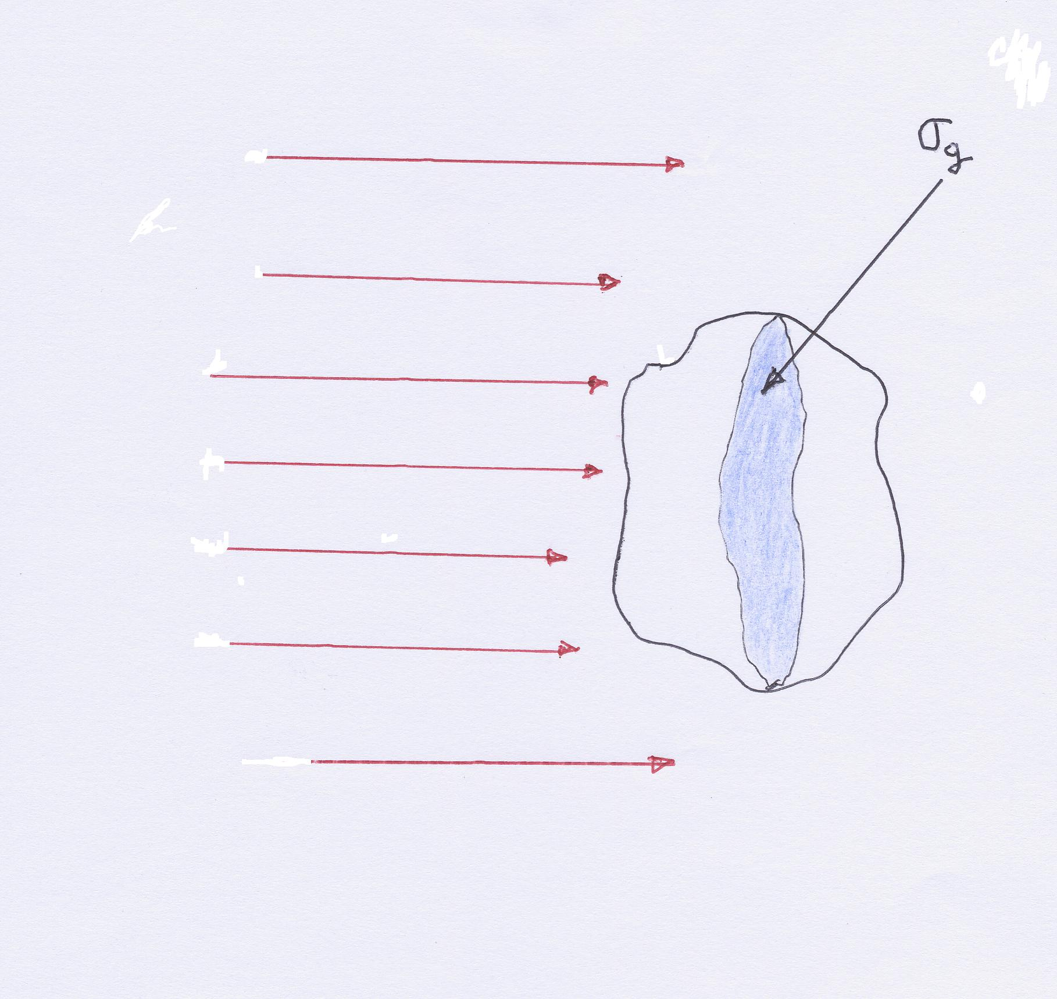
From beautiful work of Morel, Bricaud, and Kirk
E.m. radiation propagating as plane waves; σ_{g} geometric cross section (its « shadow »)
EFFICIENCY FACTORS
Energy absorbed within…
Energy scattered out by..
Divided by
Energy impinging on σ_{g}
_{Qa and Qb, respectively}

Slide 17
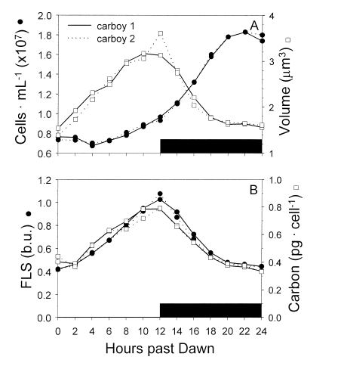
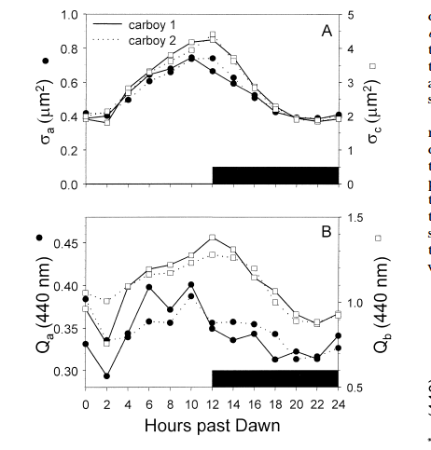
Durand et al. 2002

Slide 18
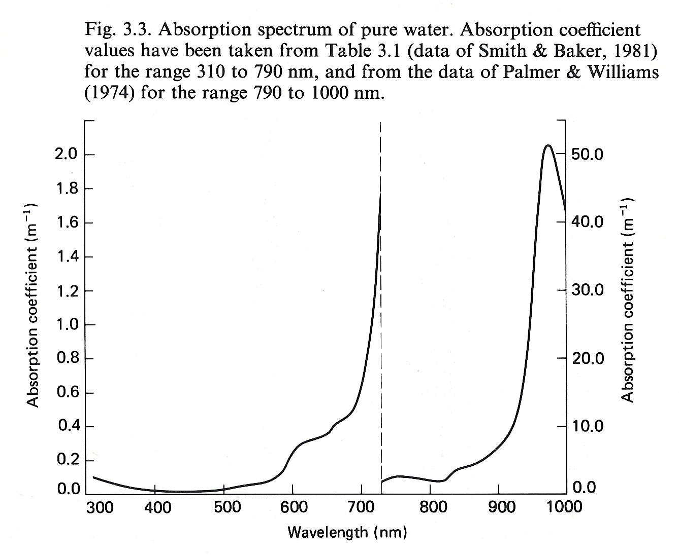
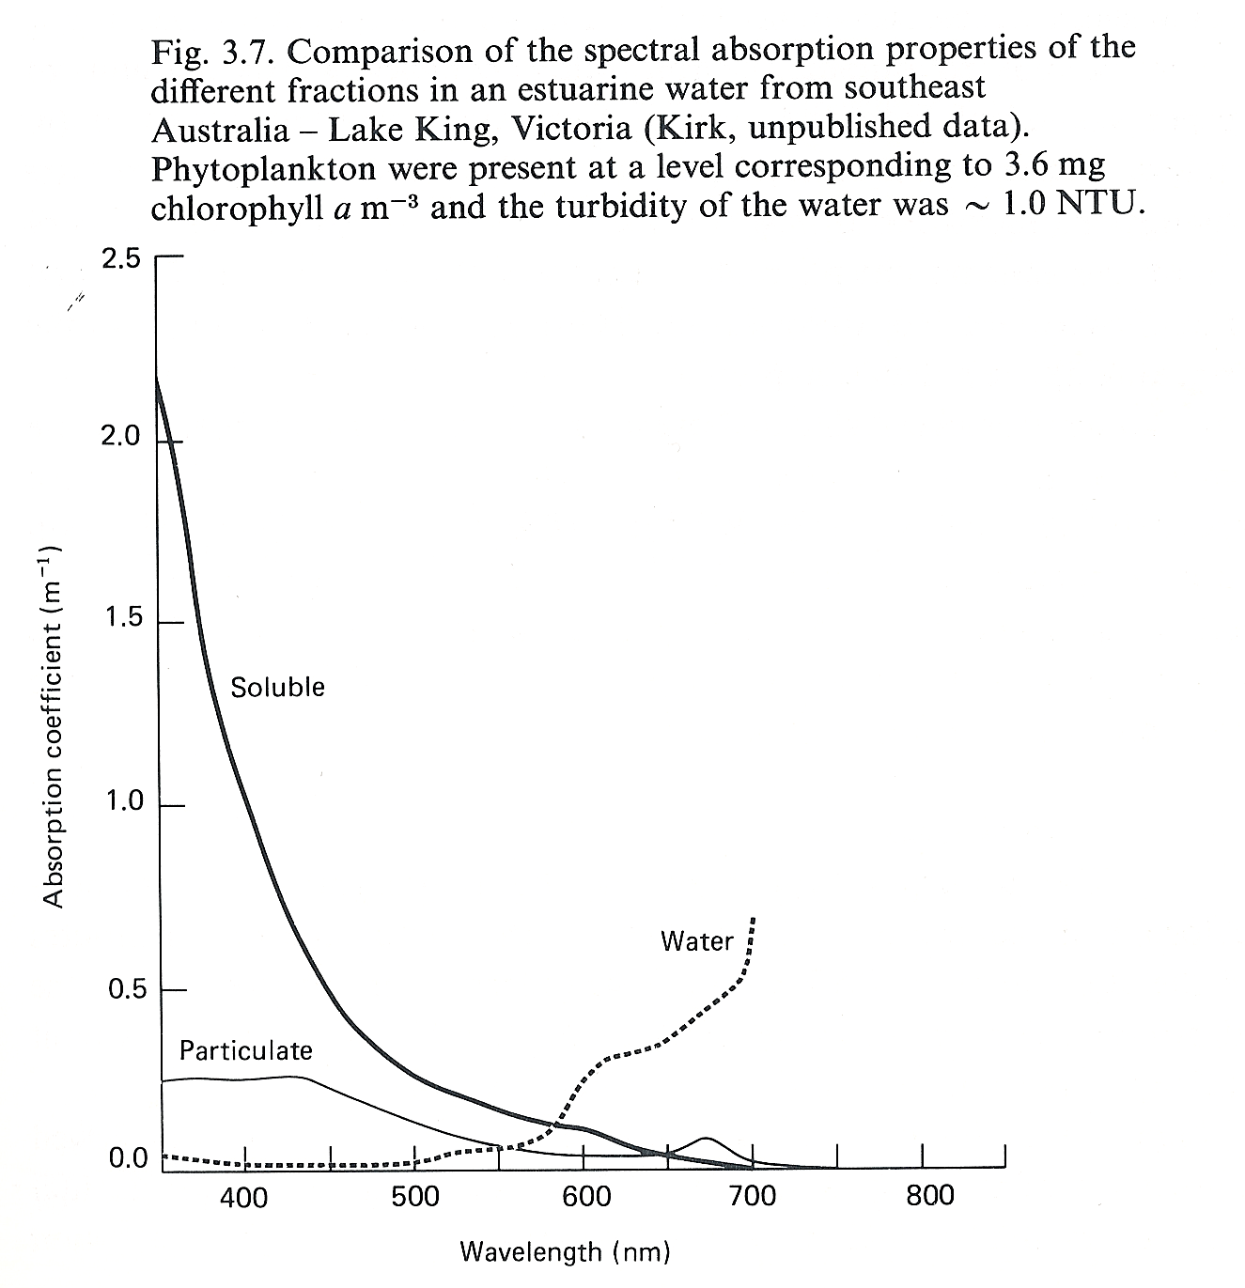

Slide 19
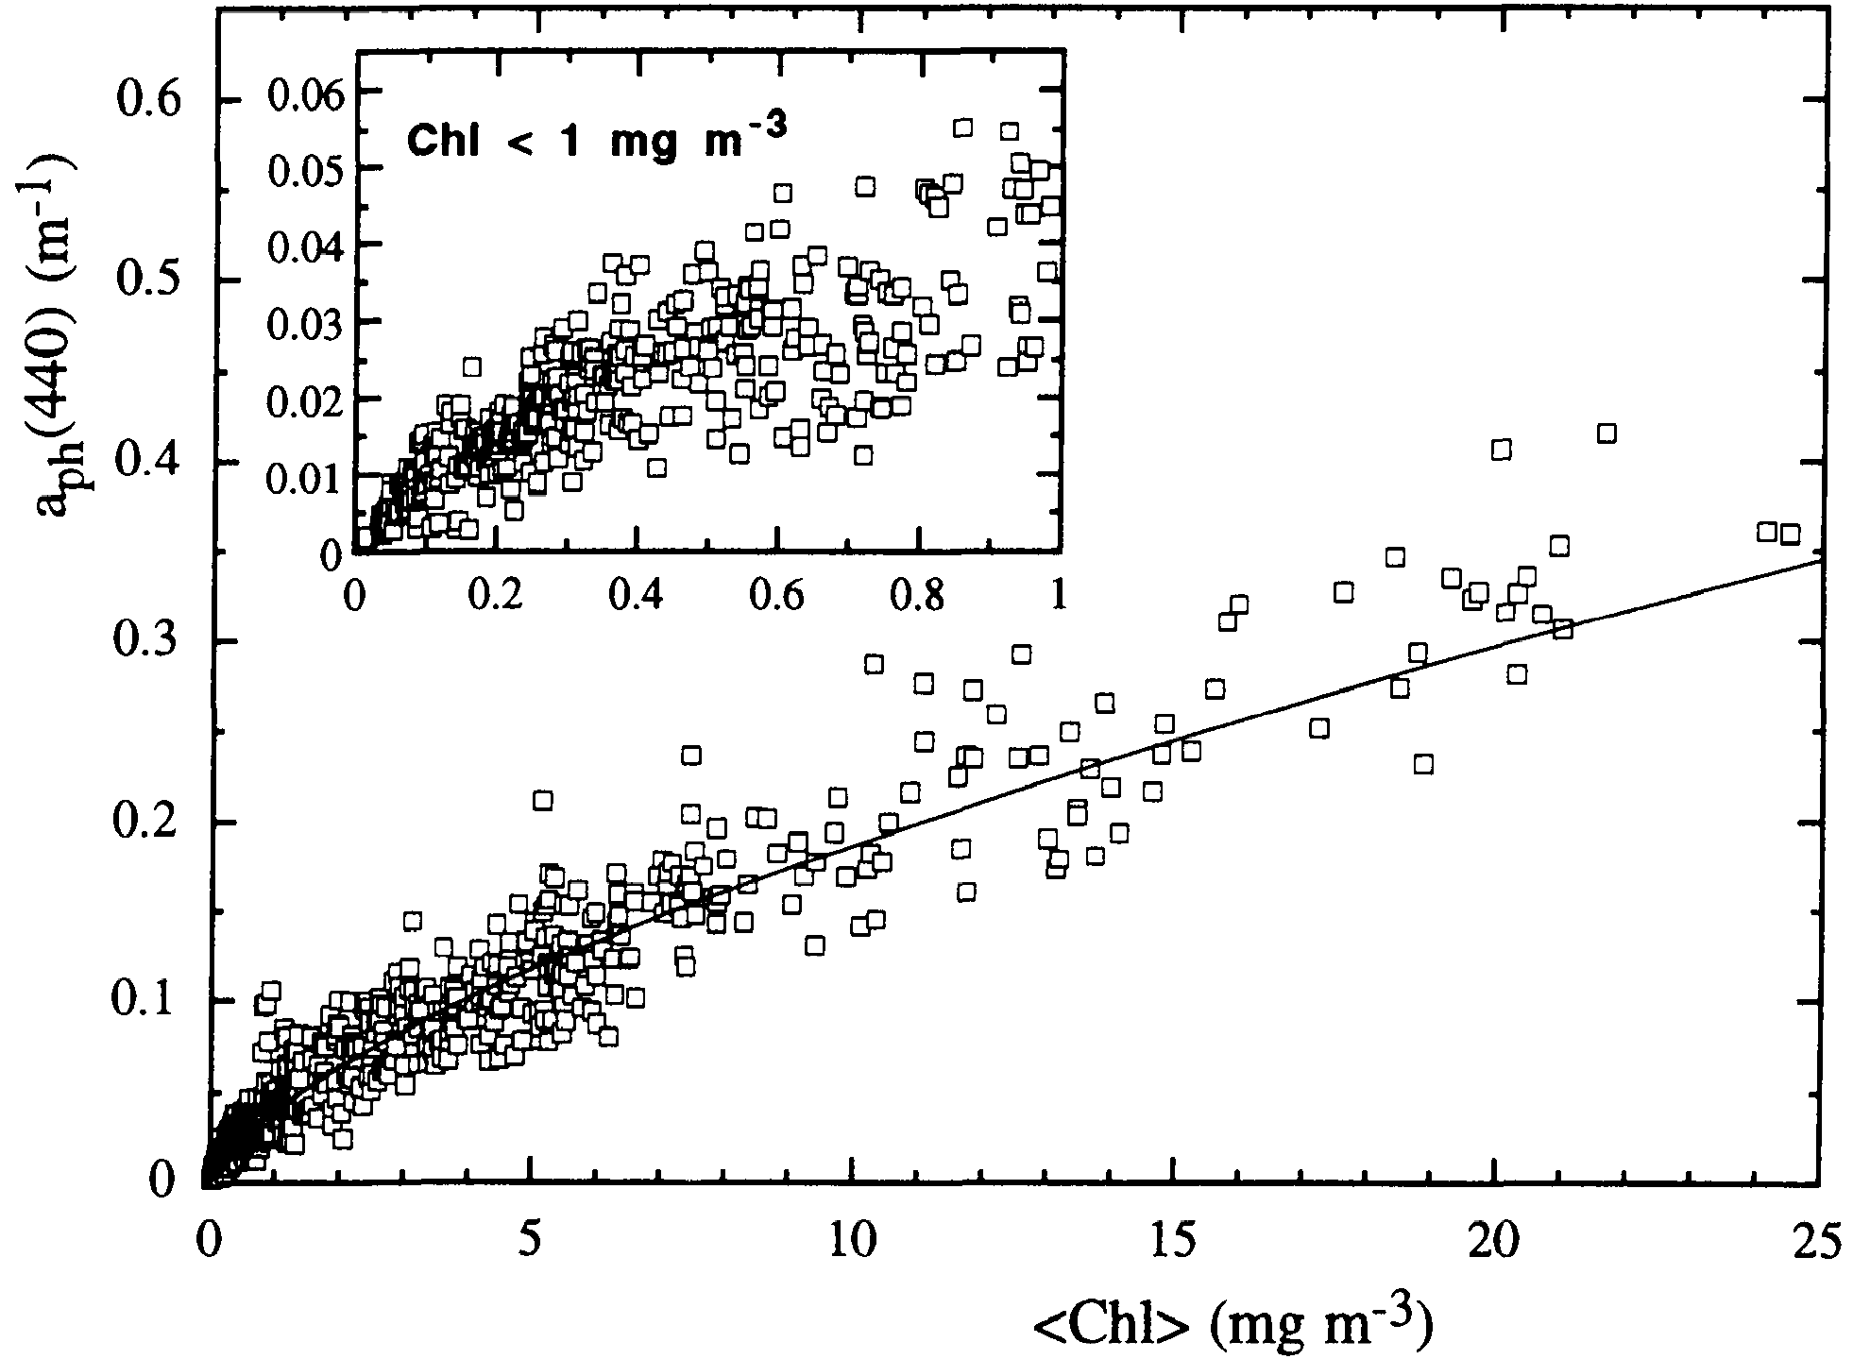
Positively correlated
Chl: 0.02 – 25 mg m⁻³
(eutrophic, mesotrophic, and oligotrophic waters)
➔ Non-linear dependence
Bricaud et al. 1995
Thanks to Heidi Sosik

Slide 20
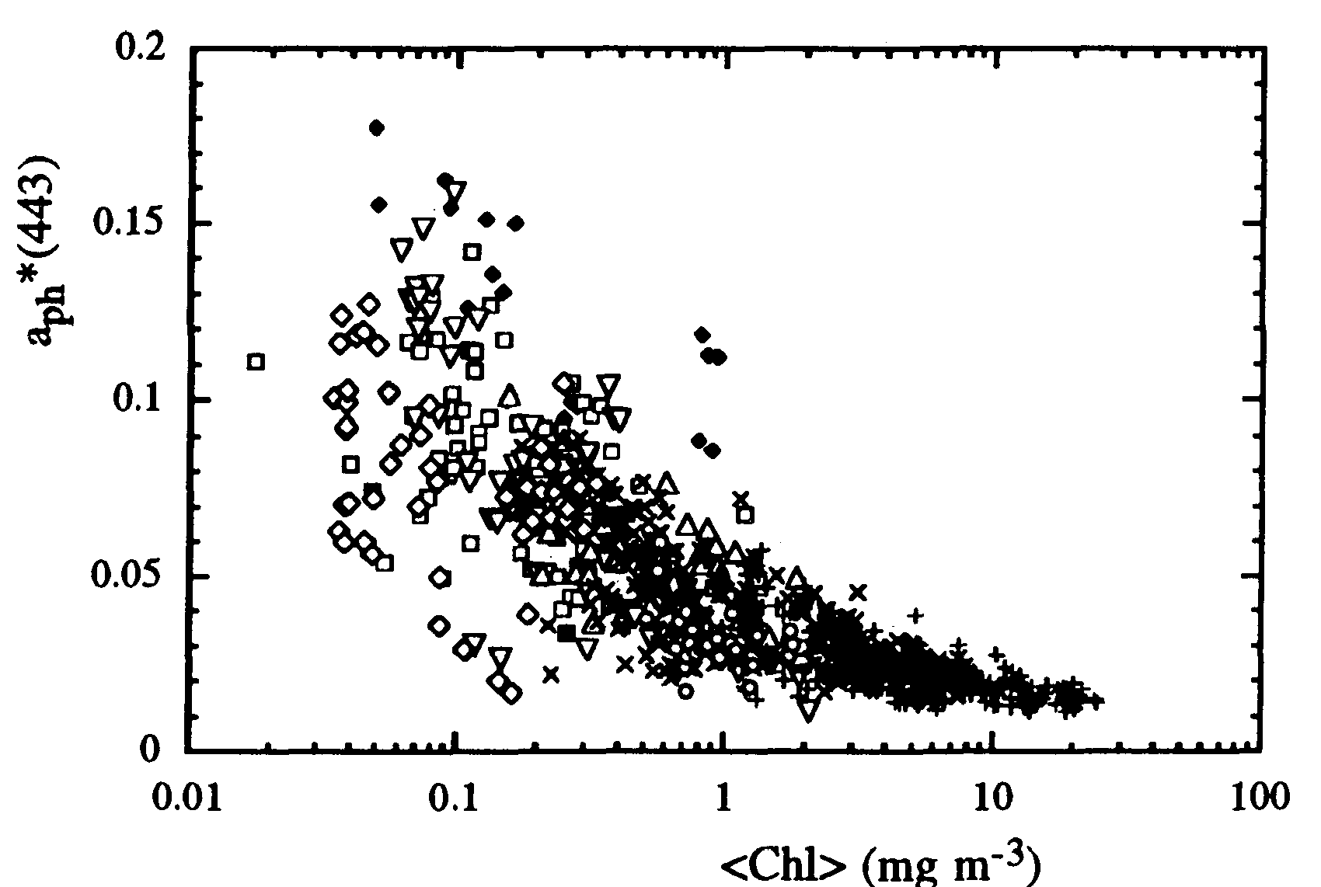
Chl-specific phytoplankton absorption
Second-order variability in a_{ph}(λ)
Negatively correlated
A(λ) and B(λ)
statistically determined
→ This reflects effects of changing growth conditions and community structure with trophic status
Note: unexplained variability

Slide 21
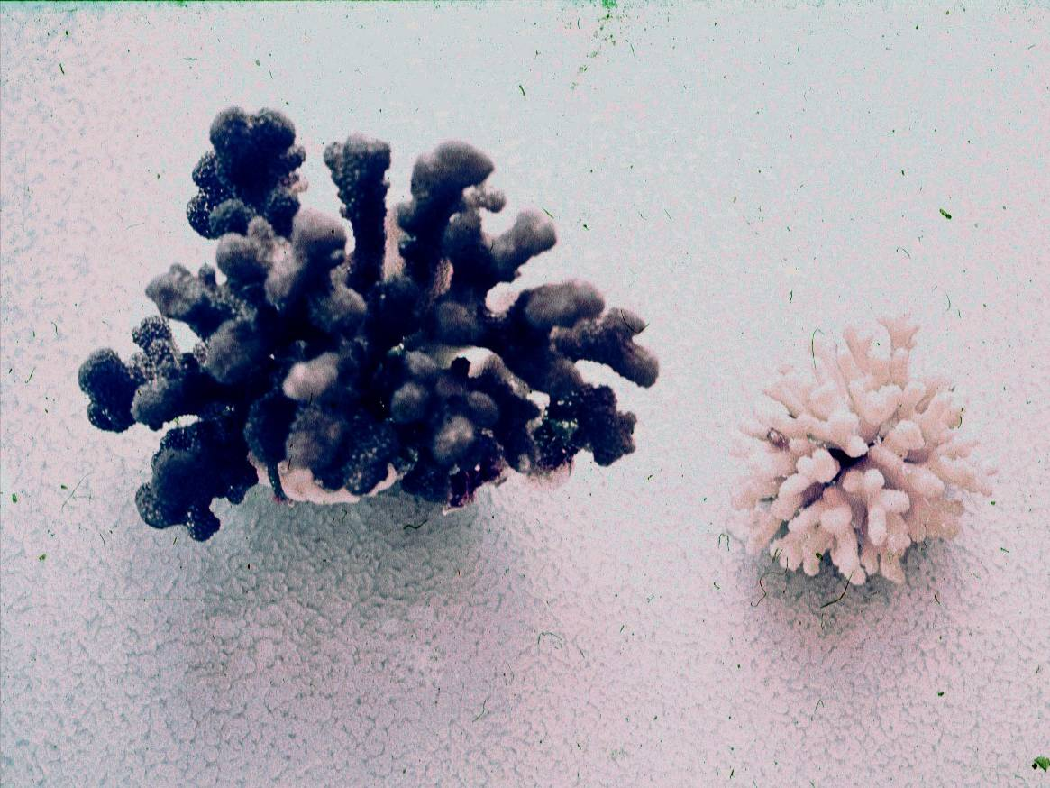
High light
Low light

Slide 22
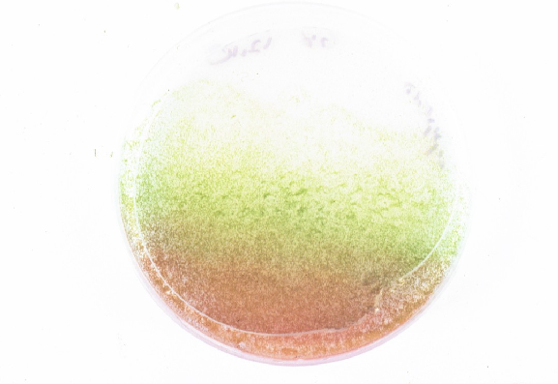
Photosynthetic
pigments
Low light
Photo-protective
pigments
High light
chlorophyte alga Haematococcus pluvialis

Slide 23
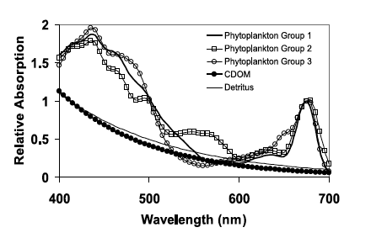

Slide 24
2000
1500
surface
μmol photons (m⁻² s⁻¹)
1m
1000
2m
5m
500
13m
A
C
0
Calendar Day
Wavelength (nm)
Depth (m)
Depth (m)
B
D
Calendar Day
Calendar Day
Oliver et al. 2004
μmol photons m⁻² s⁻¹
(m⁻¹)

Slide 25
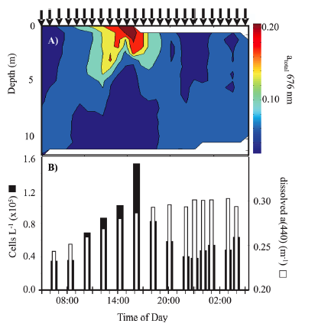
Vertical migration of
Karenia brevis

Slide 26
Individual pigments can be measured on discrete samples biochemically
0.08
chl a
chl b
0.06
chl c
PSC
0.04
PPC
absorption coefficient (m² mg⁻¹)
0.02
0.0
400
450
500
550
600
650
700
wavelength (nm)
From Bidigare

Slide 27
chl c
phycobilins
chl b
chl b
chl a
carotenoids
chl a
chl a-chl c-carotenoids
1.25
chl a-chl b-carotenoids
20
chl a-phycobilins
1.0
15
0.75
Relative Absorption
Spectral Irradiance ( μW cm⁻² nm⁻¹)
10
0.50
5
0.25
0
0
400
450
500
550
600
650
700
Wavelength (nm)

Slide 28
10
0
B)
1
Chl a
1
25
Chl b
Sun stimulated
fluorescence
20
PSC
Chl c
0.1
90
40
Spectral irradiance (μWcm⁻²s⁻¹)
Depth (m)
0.01
60
0.001
0.0001
A)
80
0.00001
Decreasing efficiency
Increasing efficiency
100
400
500
600
700
0
1
2
3
Wavelength (nm)
Relative pigment-specific
spectrally weighted absorption

Slide 29
Heat
Absorbed photon
Charge stabilization &
photosynthesis
Fluorescence

Slide 30
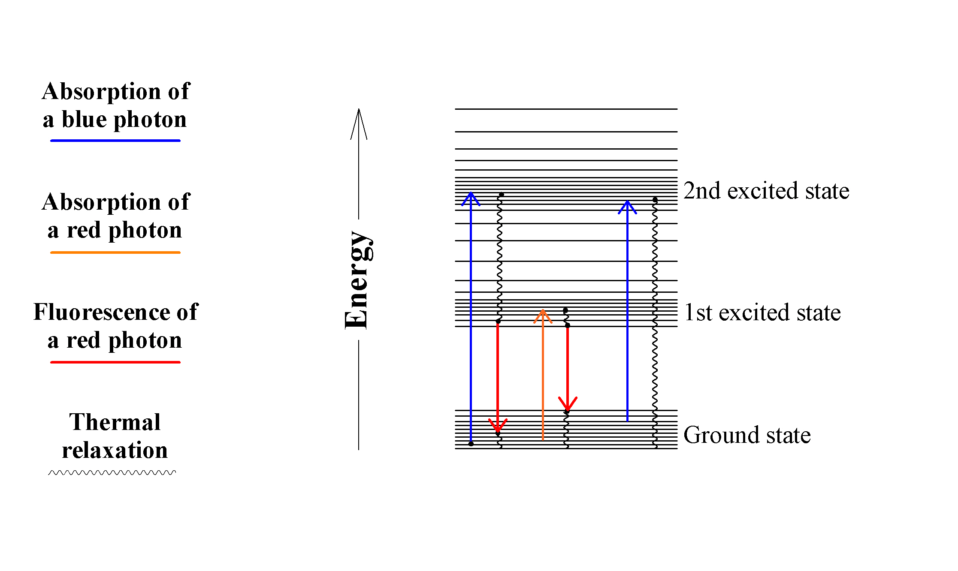
Chlorophyll a - Fate of photons absorbed by an isolated molecule
Diagram of energy states in chlorophyll and possible transitions

Slide 31
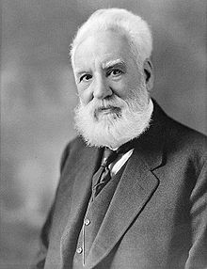
Light Absorption
Heating
Thermal Expansion
Alexander Graham Bell developed “spectrophone”, essentially an ordinary spectroscope equipped with a hearing tube instead of an eyepiece listening to light induced changes in the thermal sound.
Pressure
Wave
Photoacoustic
signal

Slide 32
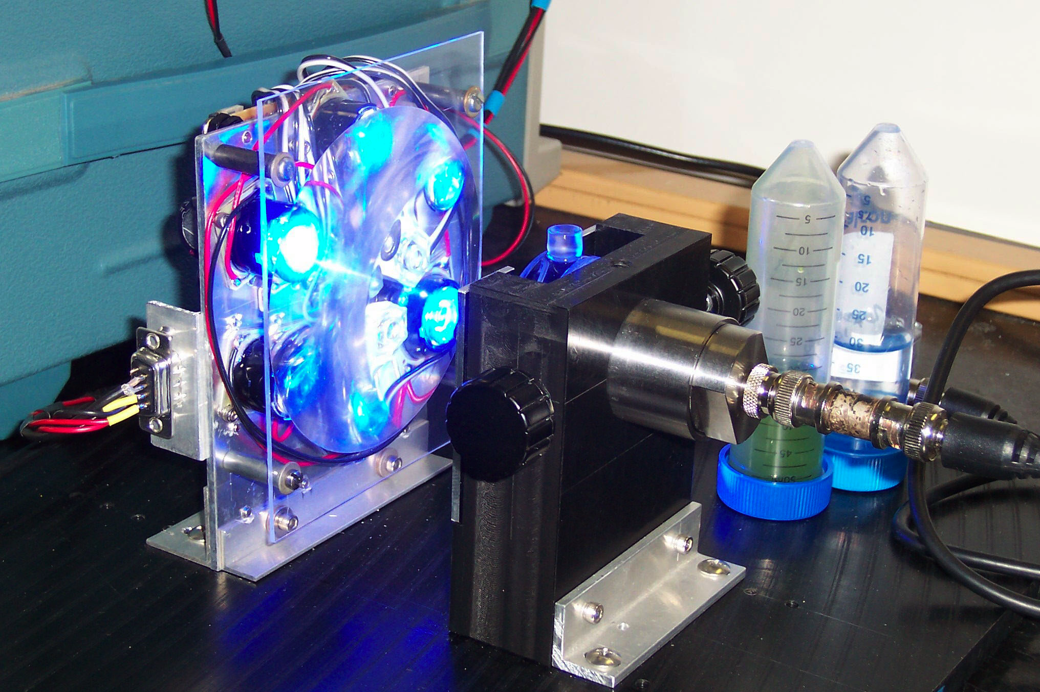
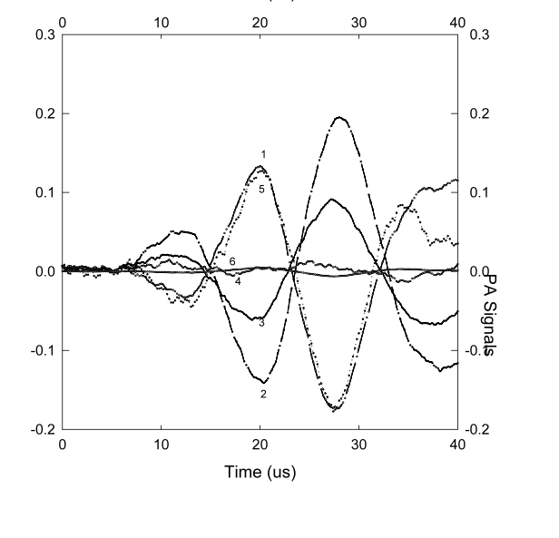
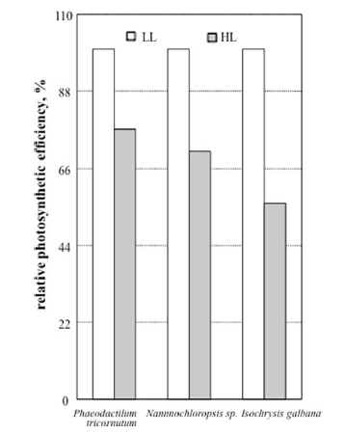
Strong light flash
Weak light flash

Slide 33
φmax
Quantum yield
Light

Slide 34
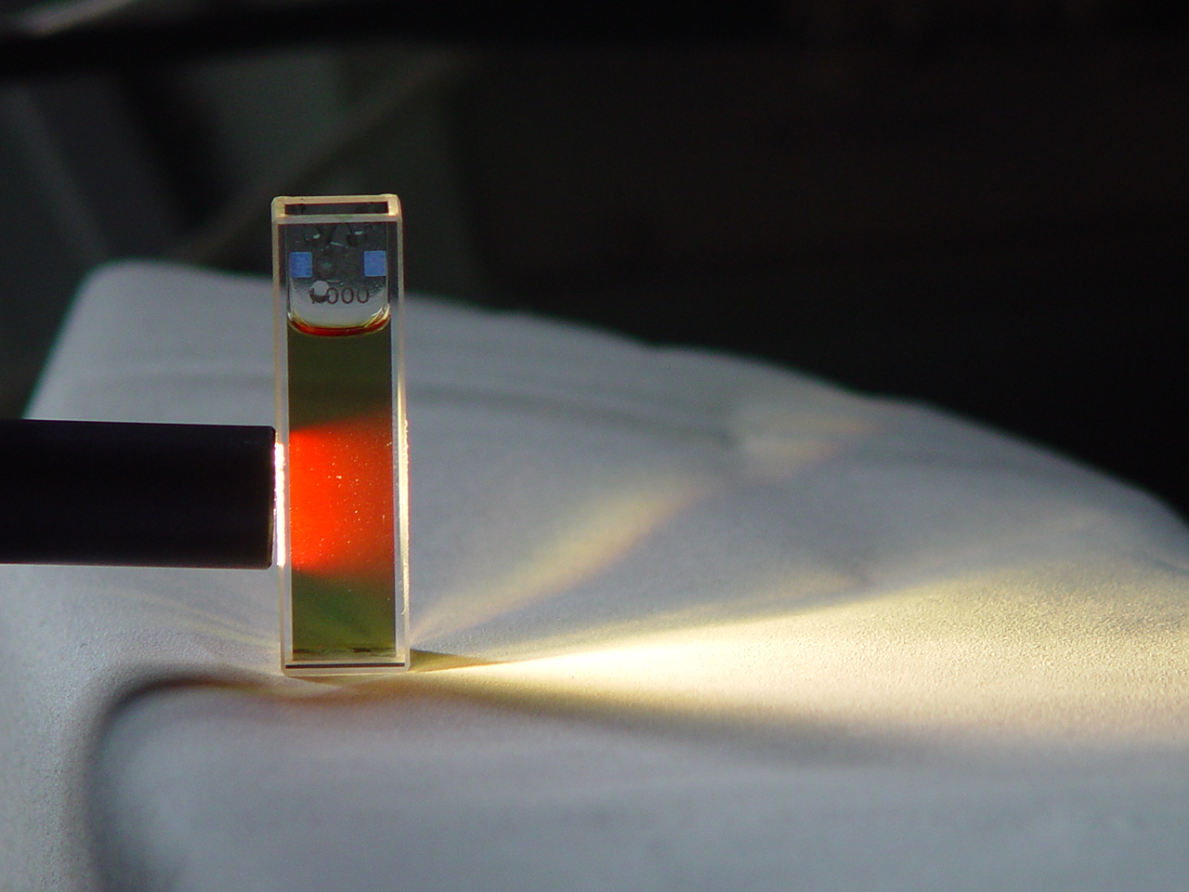
Fluorescence

Slide 35
Stress
(light, nutrients)
Chlorophyll fluorescence
An ideal world
Chlorophyll concentration

Slide 36
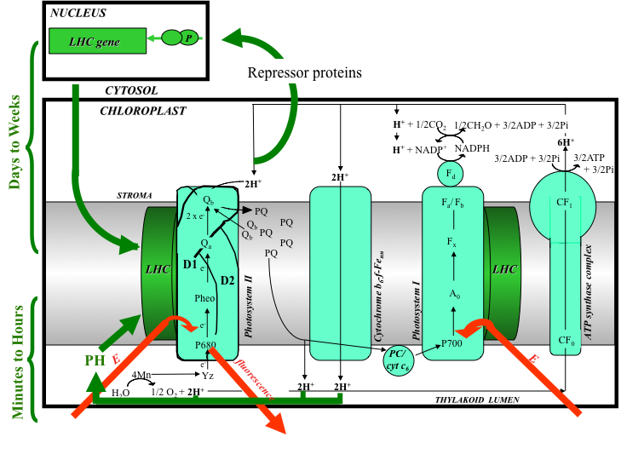

Slide 37
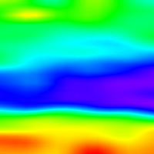

0
0
monospecific
G. breve
community
5
5
10
10
Depth (m)
Depth (m)
15
15
mixed
chromophyte
community
20
20
CDOM
Chl a
8:00
12:00
18:00
22:00
8:00
12:00
18:00
22:00
Local DaylightTime
Local DaylightTime

Slide 38
Fluorescence: The Basics
F_{m}
F_{m’}
Fluorescence intensity
F_{t}
F₀
Saturating flash
time

Slide 39
Other useful indices
FLUORESCENCE INDUCTION
Integrated area is
reflection of the absorption
cross-section
Photons
Low
light
cells
High
light
cells
Fluorescence rise
Photo-acclimation
Time
Flash is on
RC2

Slide 40
Other useful indices
FLOURESCENCE DECAY CONSTANTS
Light
Flash
Turned
Off
Fluorescence
Fluorescence decay constants
Time
PQ
D2
Qb
Qa
D1
Local time of day
Pheo
RC

Slide 41
0.1
10
0.8
φ_{max}
0.08
8
0.7
0.06
6
Carbon Quantum Yield
(mol C mol photons absorbed⁻¹)
P_{max}
Fv/Fm
0.6
Productivity (mg C mg Chl a⁻² h⁻¹)
Environmental
stress
0.04
4
α
0.02
0.5
2
I_{k}
0
0
0.4
0.1
1
10
100
1000
Irradiance (μmol photons m⁻² s⁻¹)

Slide 42
Is a cell a puddle or lake?
From Jassby and Platt 1976

Slide 43
Predicting oxygen evolution from fluorescence
(model assuming FII = 0.5)
6
5
1:1 line
4
measured oxygen evolution
3
2
1
R²=0.92, P<<0.0001
0
0
1
2
3
4
5
6
fluorescence-based predictions of oxygen evolution

Slide 44
Photosynthesis a chain of cascading reactions:
Each step sets the upper limit efficiency for each following step down the line
Φm_{psii} (0.65) > φm₀₂ (on the order 0.125)>φm_{co2} (on the order 0.07)
For each use of energy go to one process, it is the expense of
another reaction, this impacts the overall efficiency
Nutrient source φm_{co2}
Ammonium 0.09
Nitrate 0.07
Simplest expression for photosynthesis is
P = φ * a_{ph} * PAR

Slide 45

While chlorophyll specific absorption varies 3-4 fold
quantum yields vary by an order of magnitude
Even in 1980’s was treated as a constant
From Babin et al.

Slide 46
From Behrenfeld et al.

Slide 47
The conversion efficiency can varies between end products
Light-limited
photosynthesis
12
10
8
Light-saturated photosynthesis
Ratio of Oxygen to Carbon Quantum Yields
6
4
2
0
0
0.5
1
1.5
2
2.5
3
3.5
4
4.5
5
Absorbed Quanta by phytoplankton

Slide 48

These instruments can be carried on remote platforms

Slide 49
Physiological response
Environmental Stress
PAR
UVA + PAR
UVB + UVA + PAR
0.75
1600
0.6
800
Visible light downregulation
EPS
1200
600
0.50
0.4
UVB
damage
PAR (μmol m⁻² s⁻¹)
800
Fv/Fm
PAR (μmol m⁻² s⁻¹)
400
0.25
0.2
Fv/Fm
400
200
I_{k}>PAR
I_{k}>PAR
0.00
0
0
0
5:00
9:00
13:00
17:00
21:00
6:00
10:00
14:00
18:00
Local Daylight Time
Local Daylight Time

Slide 50
Rough seas
1
Arabian Sea (SW Monsoon)
2
Arabian Sea (Inter Monsoon)
3
Arabian Sea (NE Monsoon)
4
Antarctic (Bransfield-Bellingshausen water)
5
Antarctic (Bransfield-Weddell water)
6
Antarctic (Ice-Edge water)
7
Antarctic (Weddell-Scotia Confluence waters)
8
Antarctic (Bellingshausen Cold water)
9
Antarctic (Bellingshausen Warm water)
10
Antarctic (Transitional Weddell Water)
11
Antarctic (Palmer Station)
12
Canary Islands (Fall)
13
NE Atlantic Subtropical Gyre (Fall)
14
NW Atlantic Subtropical Gyre (Fall)
φ_{max} (mol C mol photons absorbed⁻¹)
15
Gulf Stream (Fall)
16
NW Atlantic Continental Shelf (Fall)
17
Canary Islands (Spring)
18
NE Atlantic Subtropical Gyre (Spring)
19
NW Atlantic Subtropical Gyre (Spring)
20
Gulf Stream (Spring)
21
NW Atlantic Continental Shelf (Spring)
22
Southern California Bight
23
New Jersey Coastal Region
Oligotrohic
seas
E_{k(PAR)} (μmol photons m⁻² s⁻¹)

Slide 51

High light
Low light
β-carotene globules
thylakoids

Slide 52


NUTRIENT LIMITATIONS
Iron-Ex

Slide 53
V=Vmax*S/(Ks+S)
Austin Powers Fat Bastard System
Vmax
Nutrient Uptake (V)
Miss Manner System
Ks (usually at Vmax/2)
Nutrient concentration (can be nitrogen, phosphorus)

Slide 54


Diatoms
High Vm
High Ks
Coccolithophores
Low Vm
Low Ks
High or fluctuating nutrients
High mixing, upwelling
Low average irradiance, light fluctuations
High turbulence
Chronically oligotrophic
Stratified conditions
High average irradiance
Low turbulence

Slide 56
light
E_{k}
depth
Chlorophyll

