Slide 1
Project Scope Description
Construction Plenary, Day 1
Anthony Ferlaino
OOI Project Manager

Slide 2
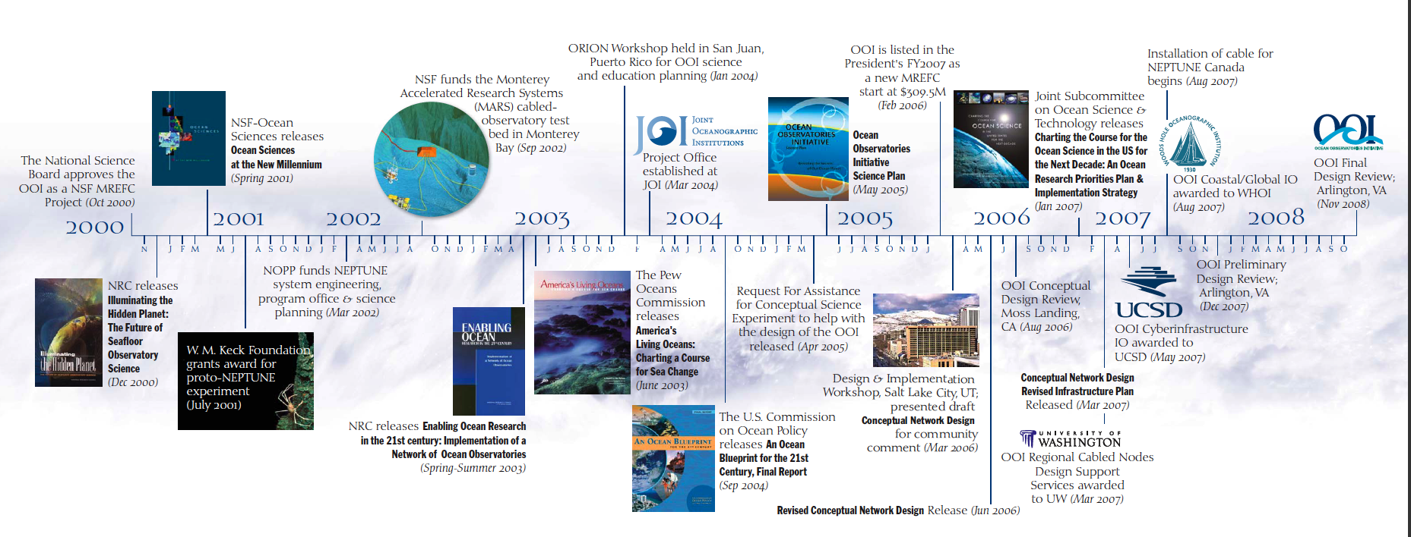
OOI Science Requirements Community Defined
Overarching Science Themes
Forcing and exchanges at the boundaries
    Ocean-atmosphere exchange
    Fluid-rock interactions
Dynamics of the boundary regimes
    Coastal ocean dynamics and ecosystems
    The subseafloor biosphere
    Plate-scale, ocean geodynamics
Dynamics and variability of the ocean volume
    Climate variability
    Ocean circulation
    Turbulent mixing and biophysical interactions
    Ecosystems
Across the boundaries and in the interior
    Carbon cycling, ocean acidification, ecosystem health

Slide 3
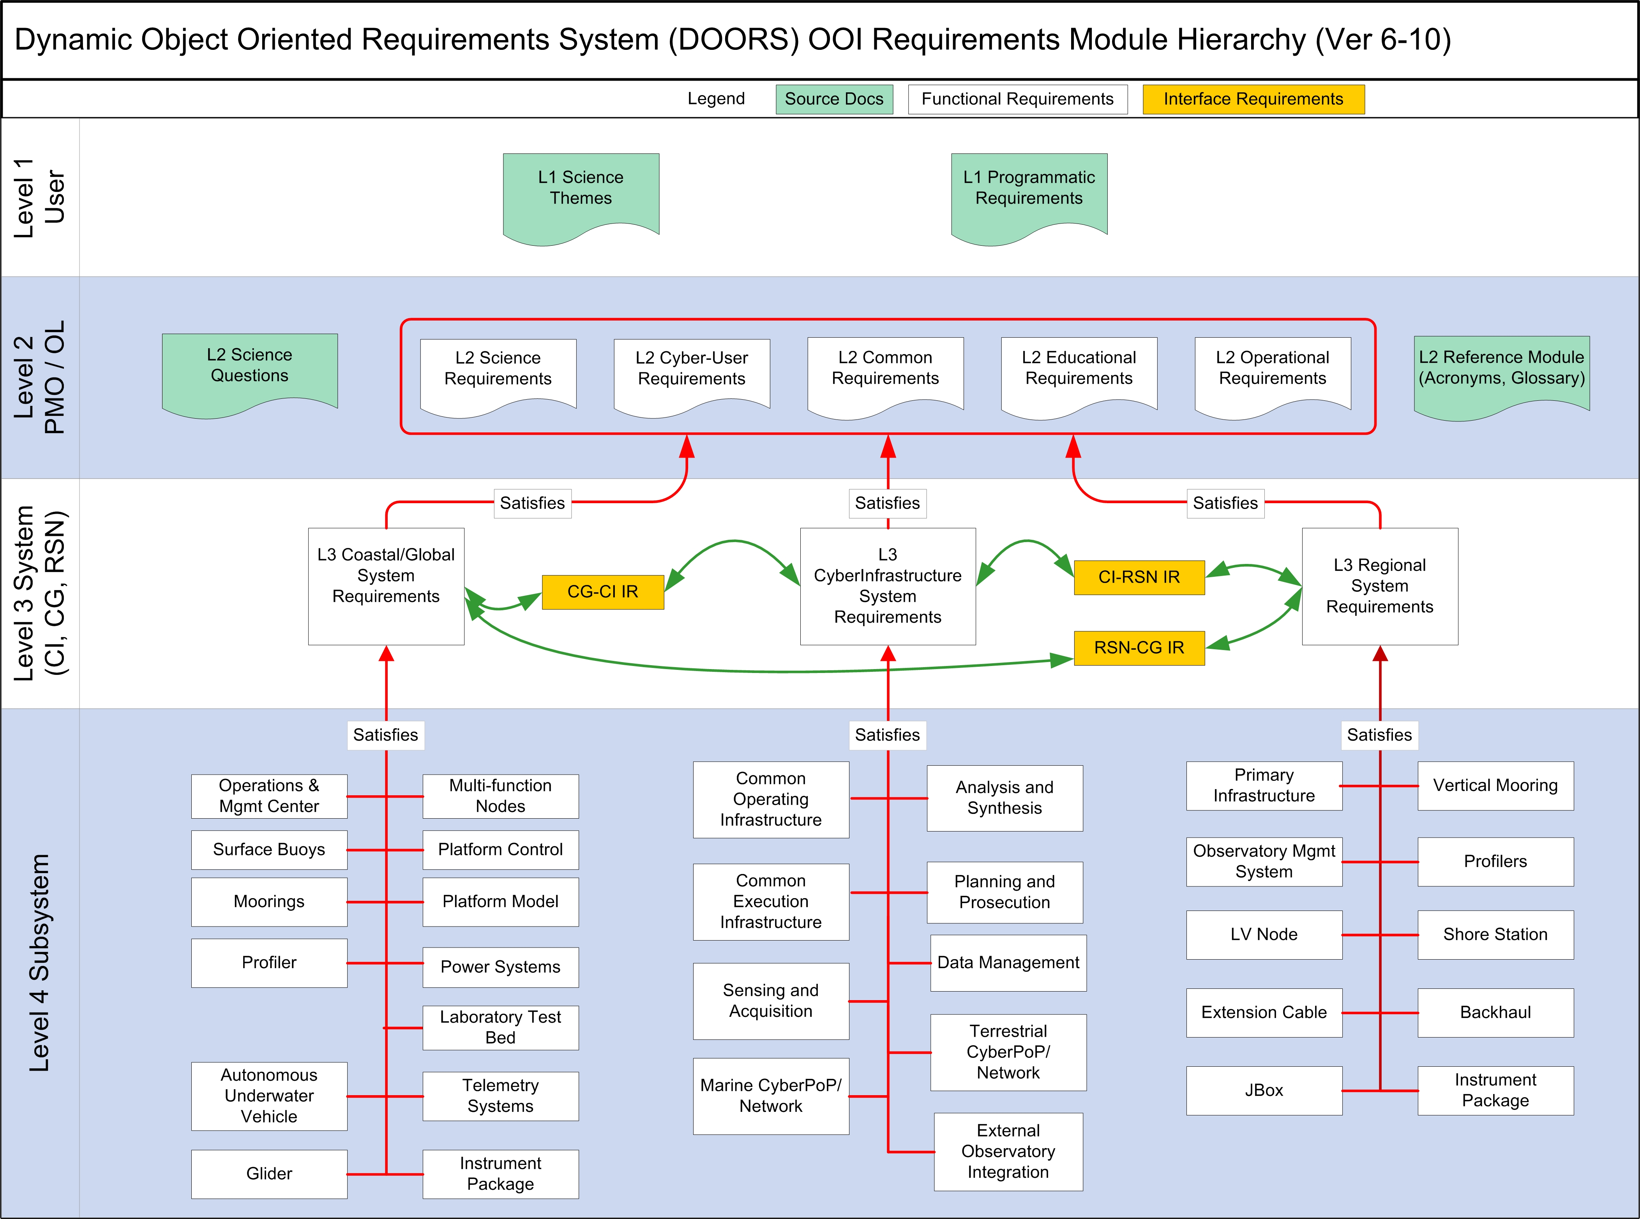
OOI requirements are controlled in DOORS

Slide 4
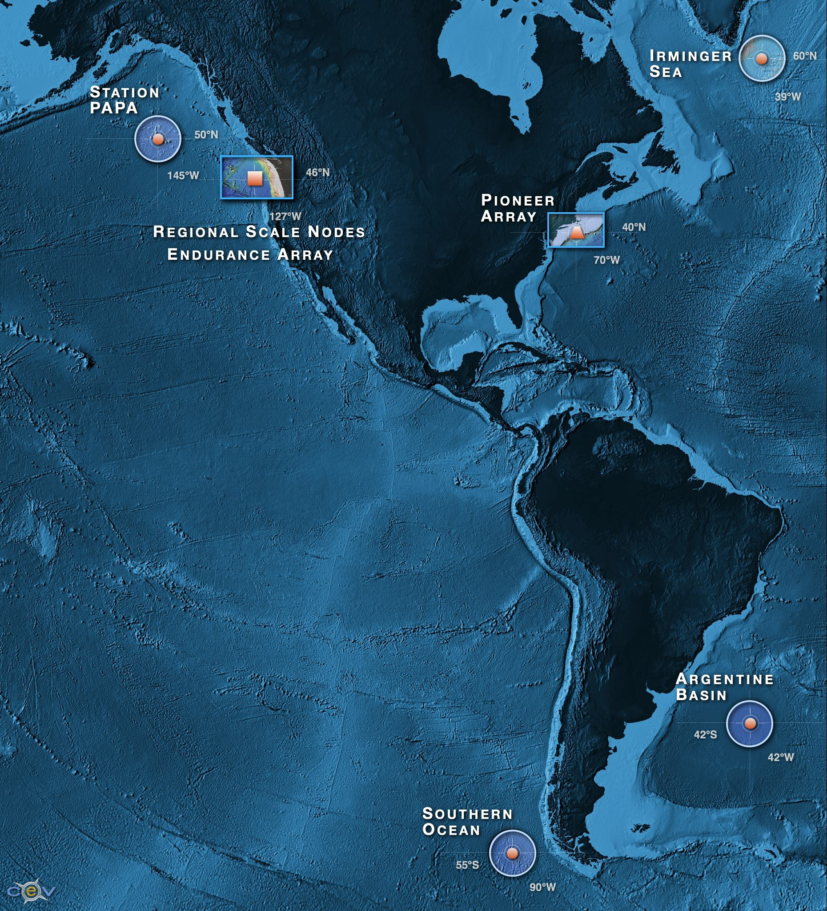
OOI Science Requires Resolution of High Frequency Forcing (minutes-hours)
In Distant and/or Extreme Environments for Sustained Periods (years-decades)
Four Global high latitude sites
Station Papa
Irminger Sea
Argentine Basin
Southern Ocean
Two Coastal Arrays
Endurance Array
Pioneer Array
Cabled Array
Meso-scale,
Plate Scale network
The locations and type of infrastructure drive engineering design, deployment, and maintenance profiles

Slide 5
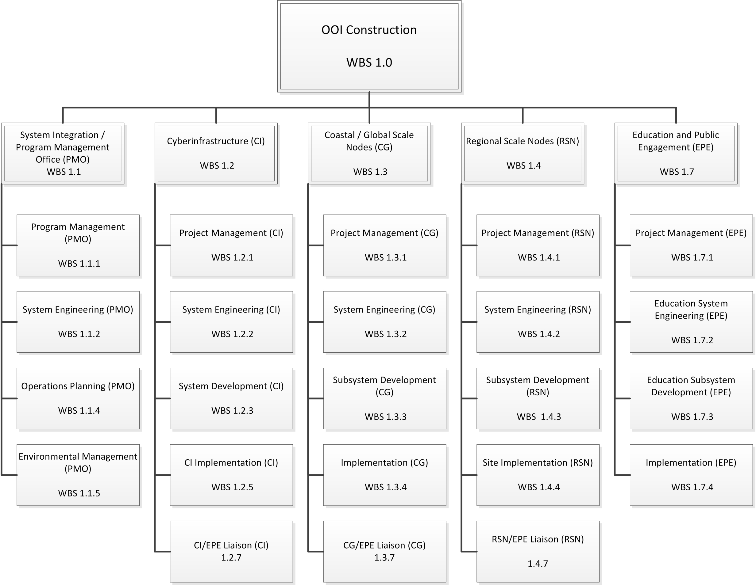
Top Level Work Breakdown Structure

Slide 6
Cyberinfrastructure WBS
System Development
Sensing and Acquisition
Analysis and Synthesis
Planning and Prosecution
Data Management
Common Operation Infrastructure
Common Execution Infrastructure
System Integration and Test
External Observatory Integration
User Experience
Implementation
Marine Network Integration
Cyber POP Activation

Slide 7
Coastal/Global WBS
System Development
Buoy Design Development
Mooring Development
Benthic Package Development
Vehicle Development
Development Integration and Test
Operations and Maintenance Center Design and Development
Instrument Development
Preparation for Production
Implementation
Global Sites
Coastal Endurance Array
Coastal Pioneer Array
Operations Maintenance Center

Slide 8
Regional Scale Nodes WBS
Sub-System Development
Observatory Management System
LV Nodes Dev
Extension Cables inc Terminations Dev
Vertical Mooring Development
Winch and Profilers Dev
J-Boxes Dev
National Security System Dev
Core Instruments Packages Dev
Logistics Depot Equipment Dev
Site Implementation
Pacific City Oregon Shore Station Installation
Submarine Cable System Subcontract all segments
Site 1 Hydrate Ridge Site Assembly / Installation / Test
Site 3 Axial Site Assembly / Installation / Test
Contract Oversight for Primary Infrastructure

Slide 9
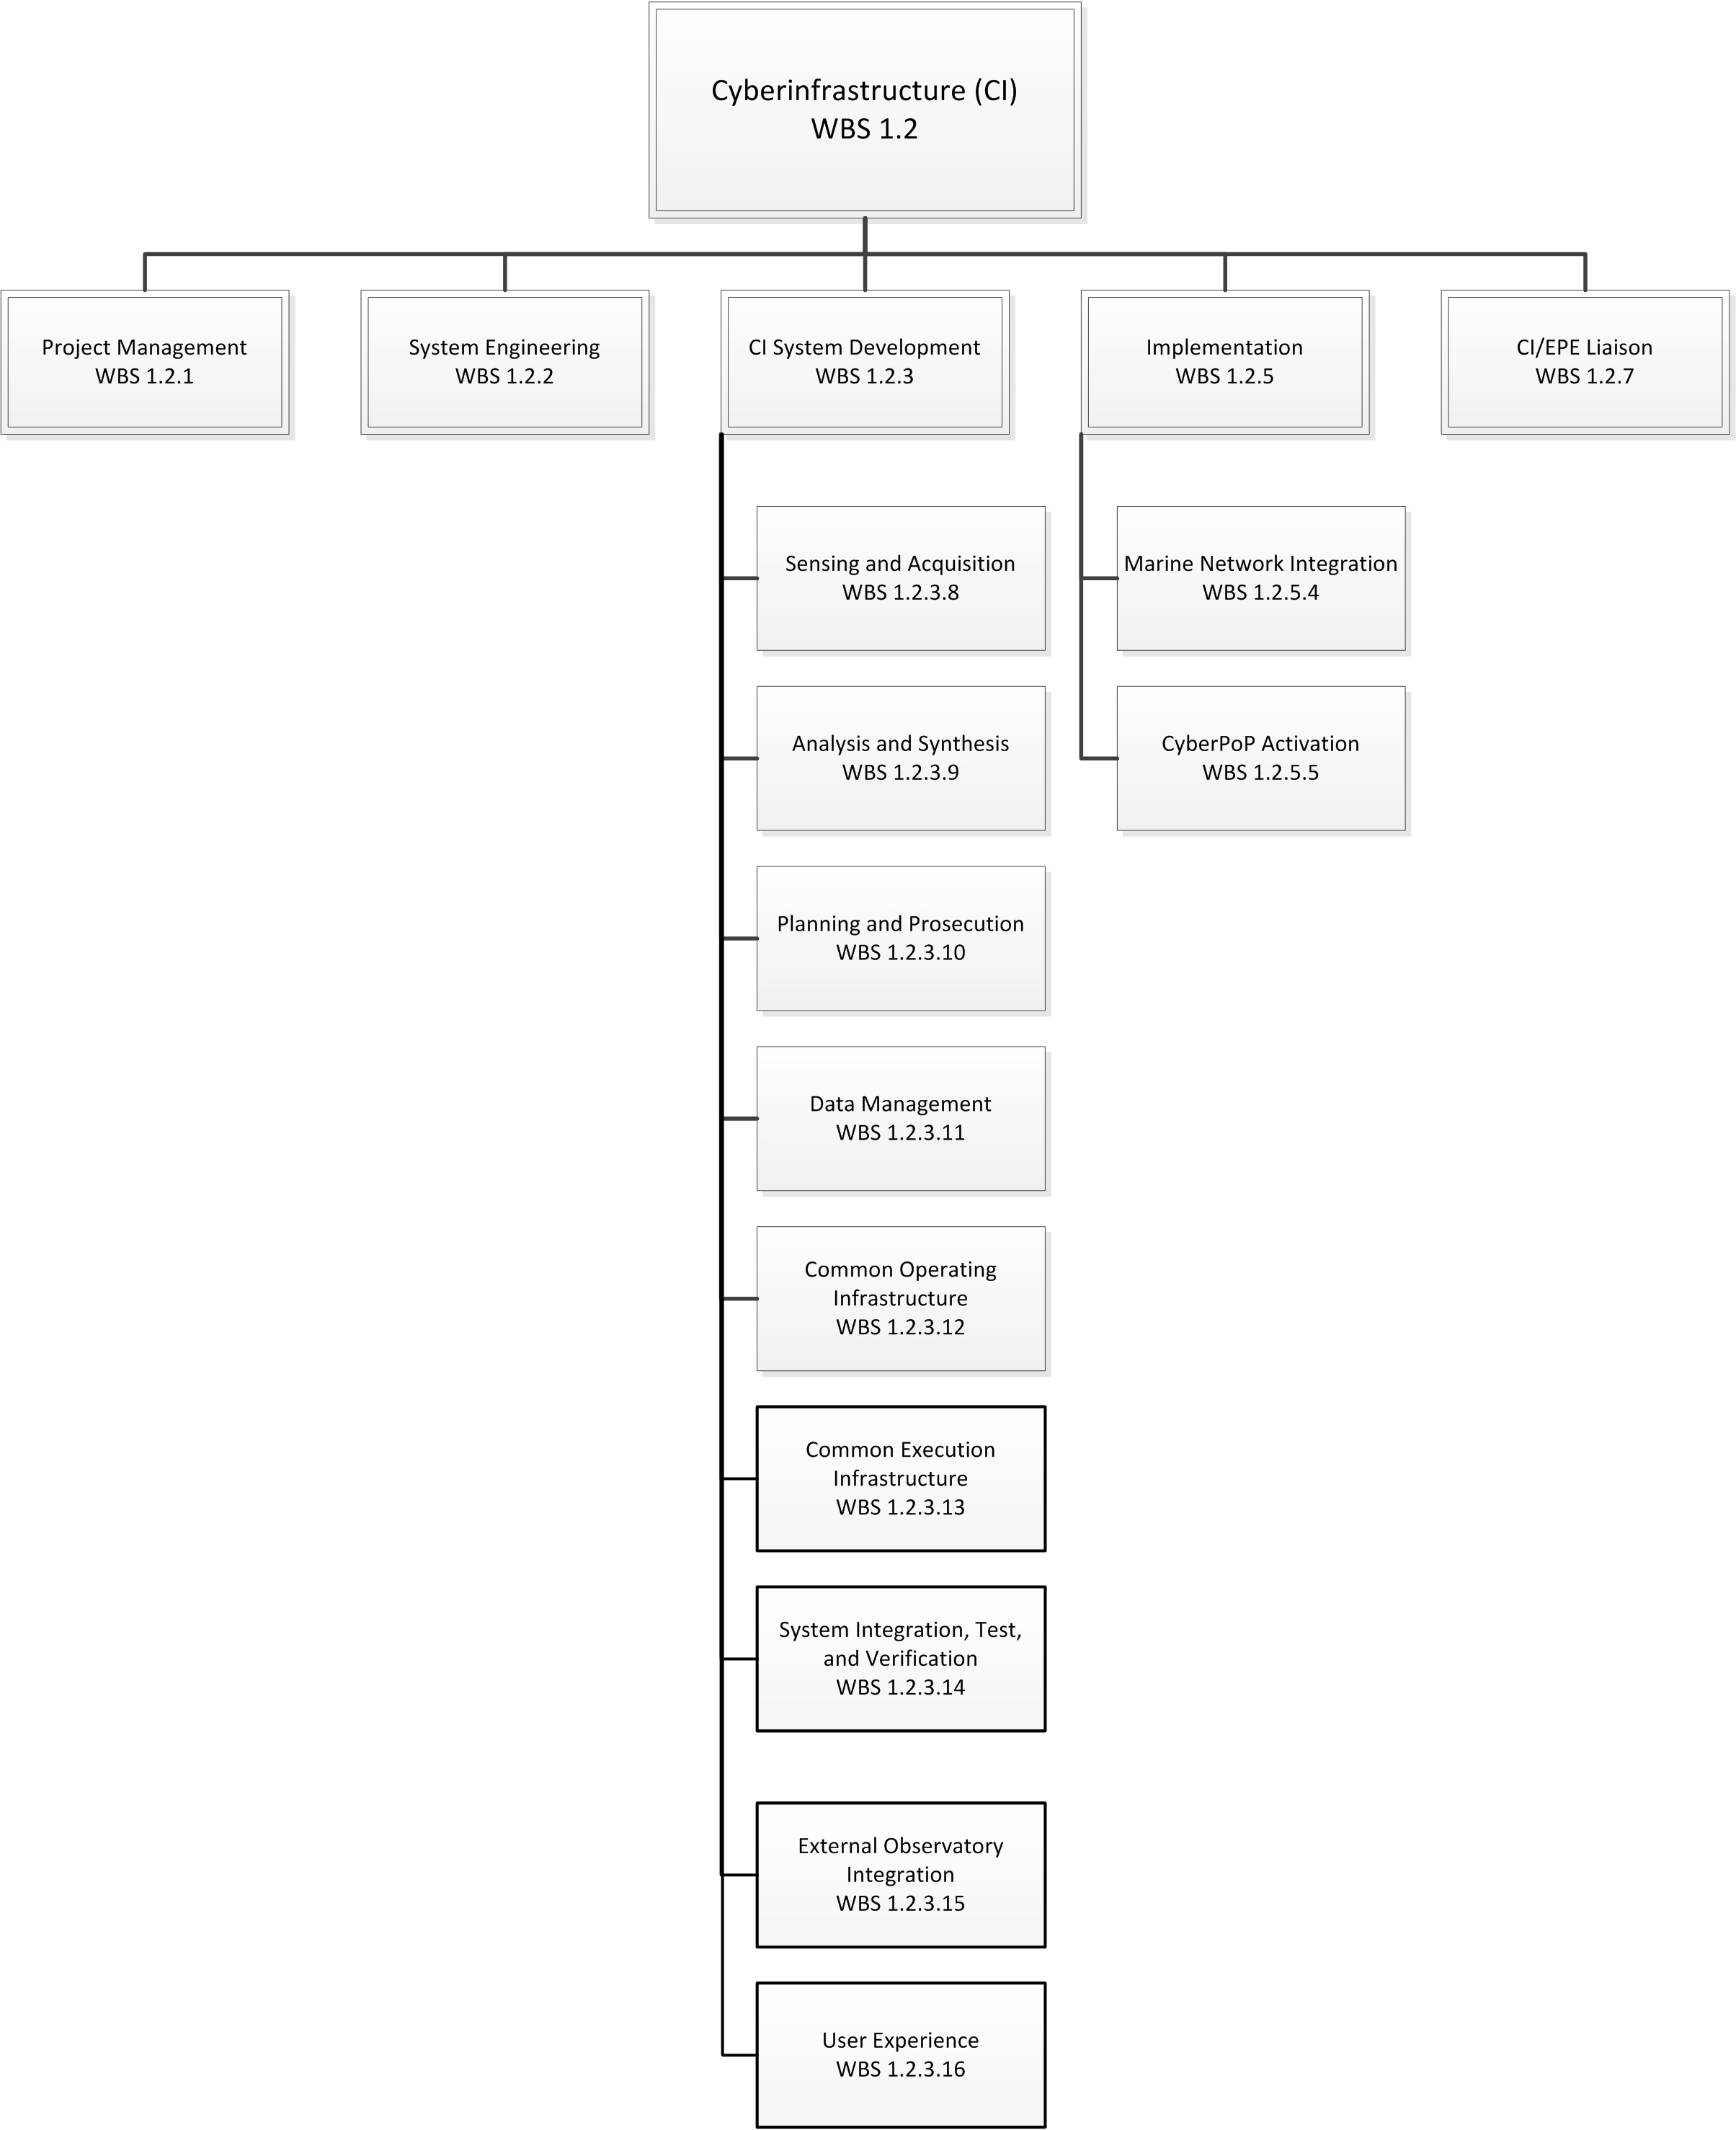
WBS 1.2 Cyberinfrastructure

Slide 10
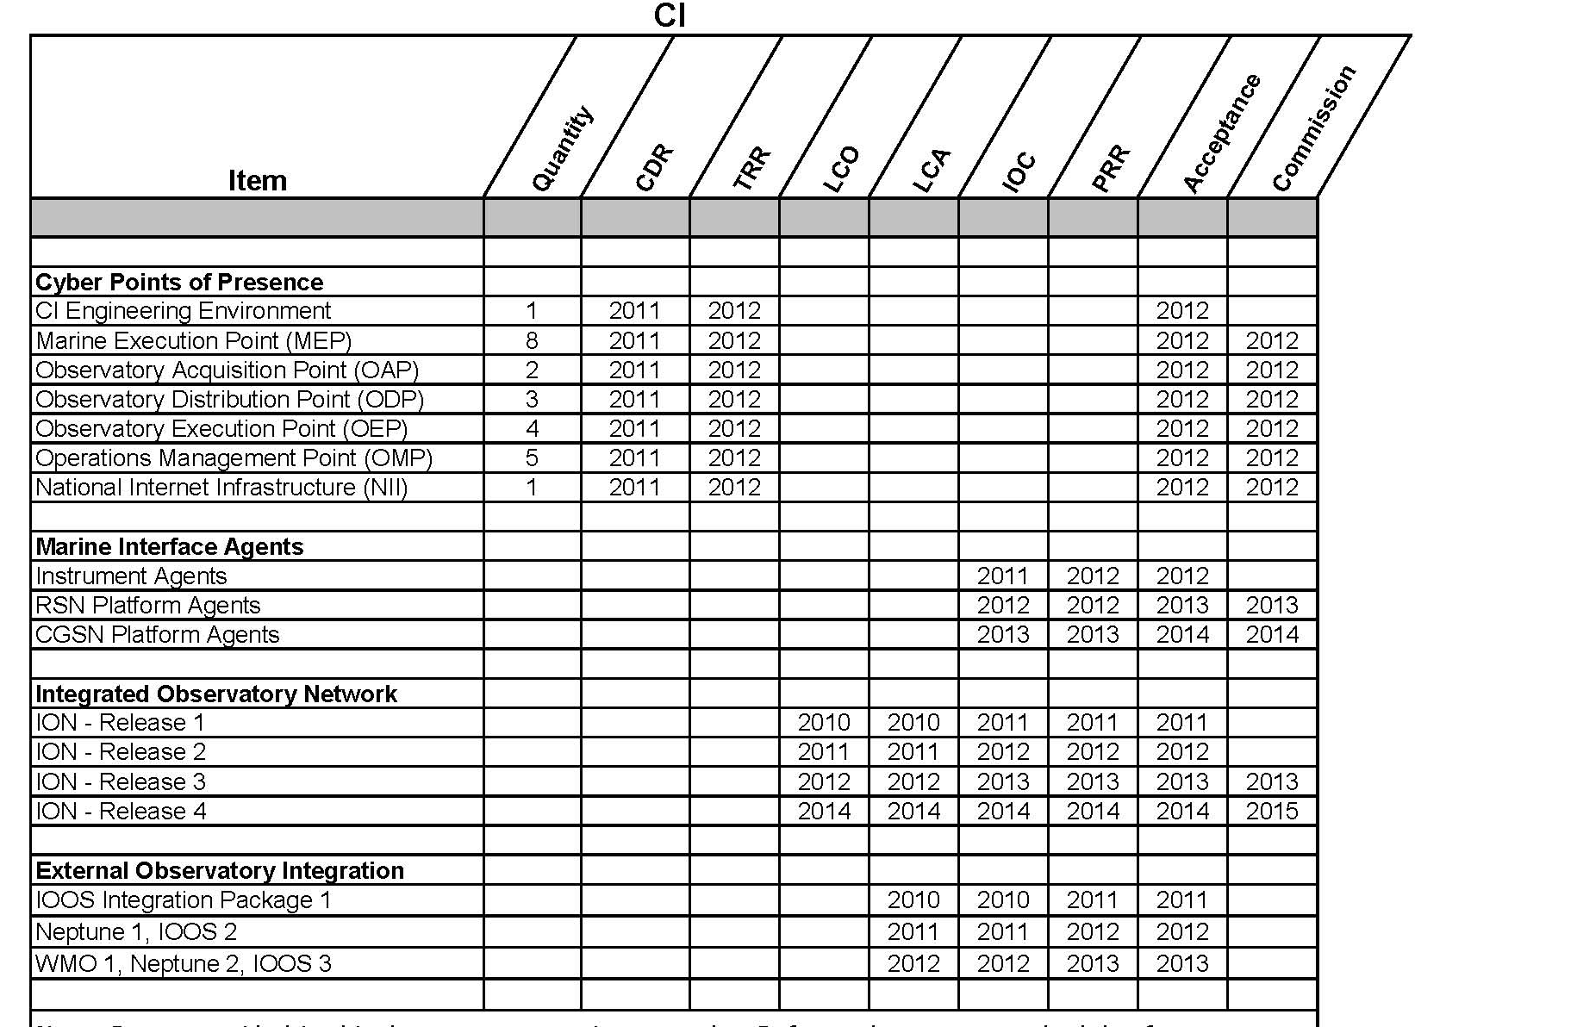
Cyberinfrastructure Design Configuration Items

Slide 11
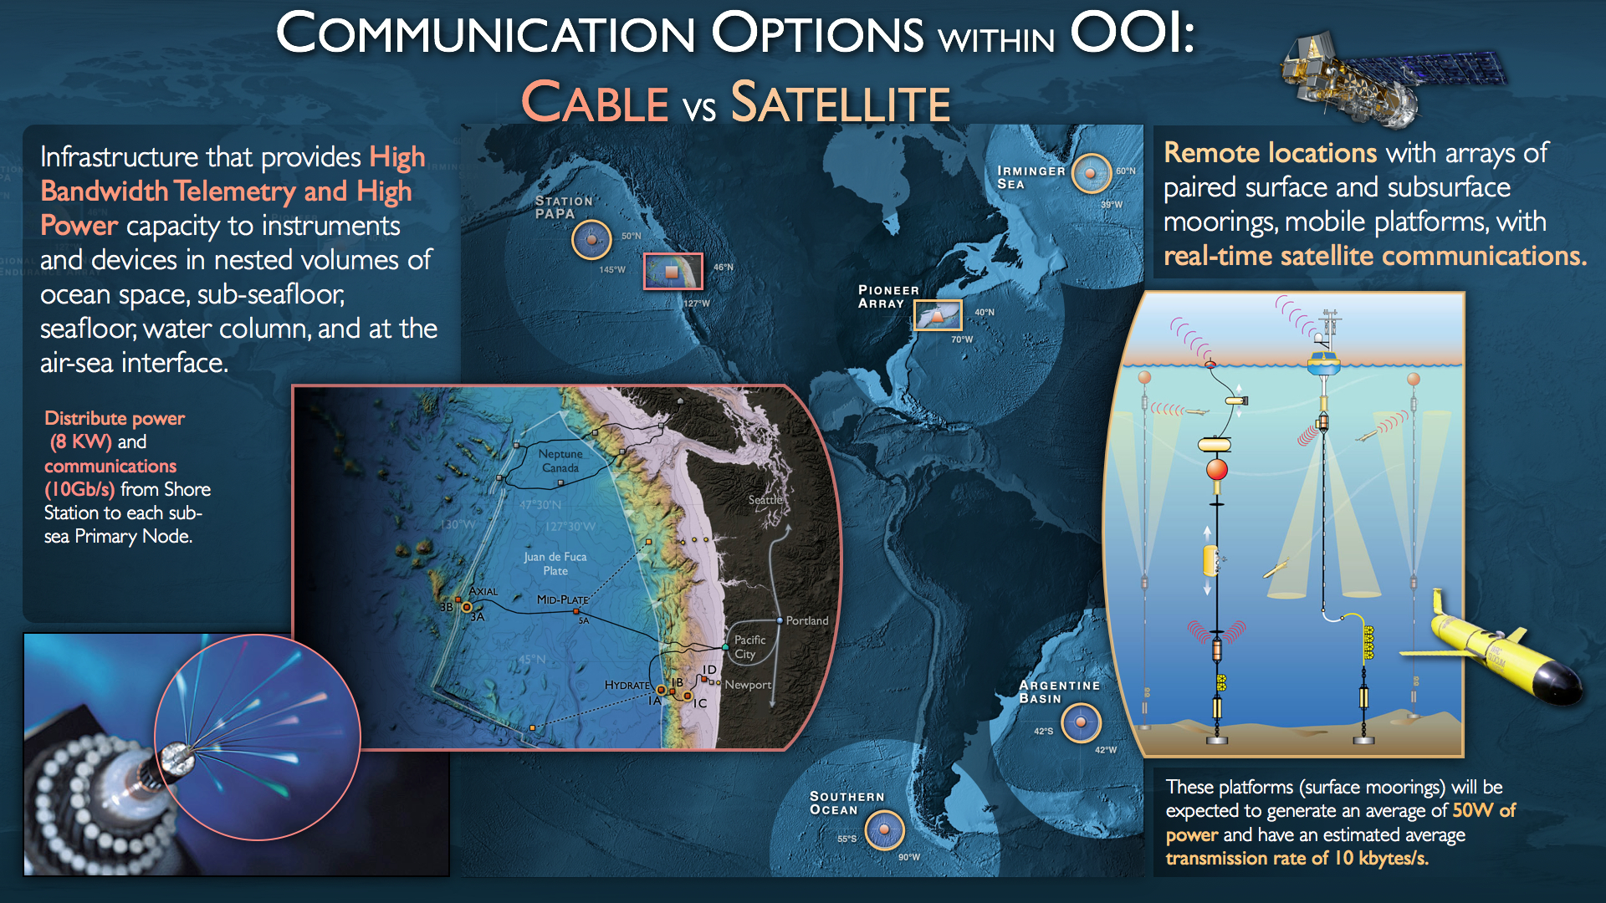
OOI engineering strategy based on multiple modes of communication

Slide 12
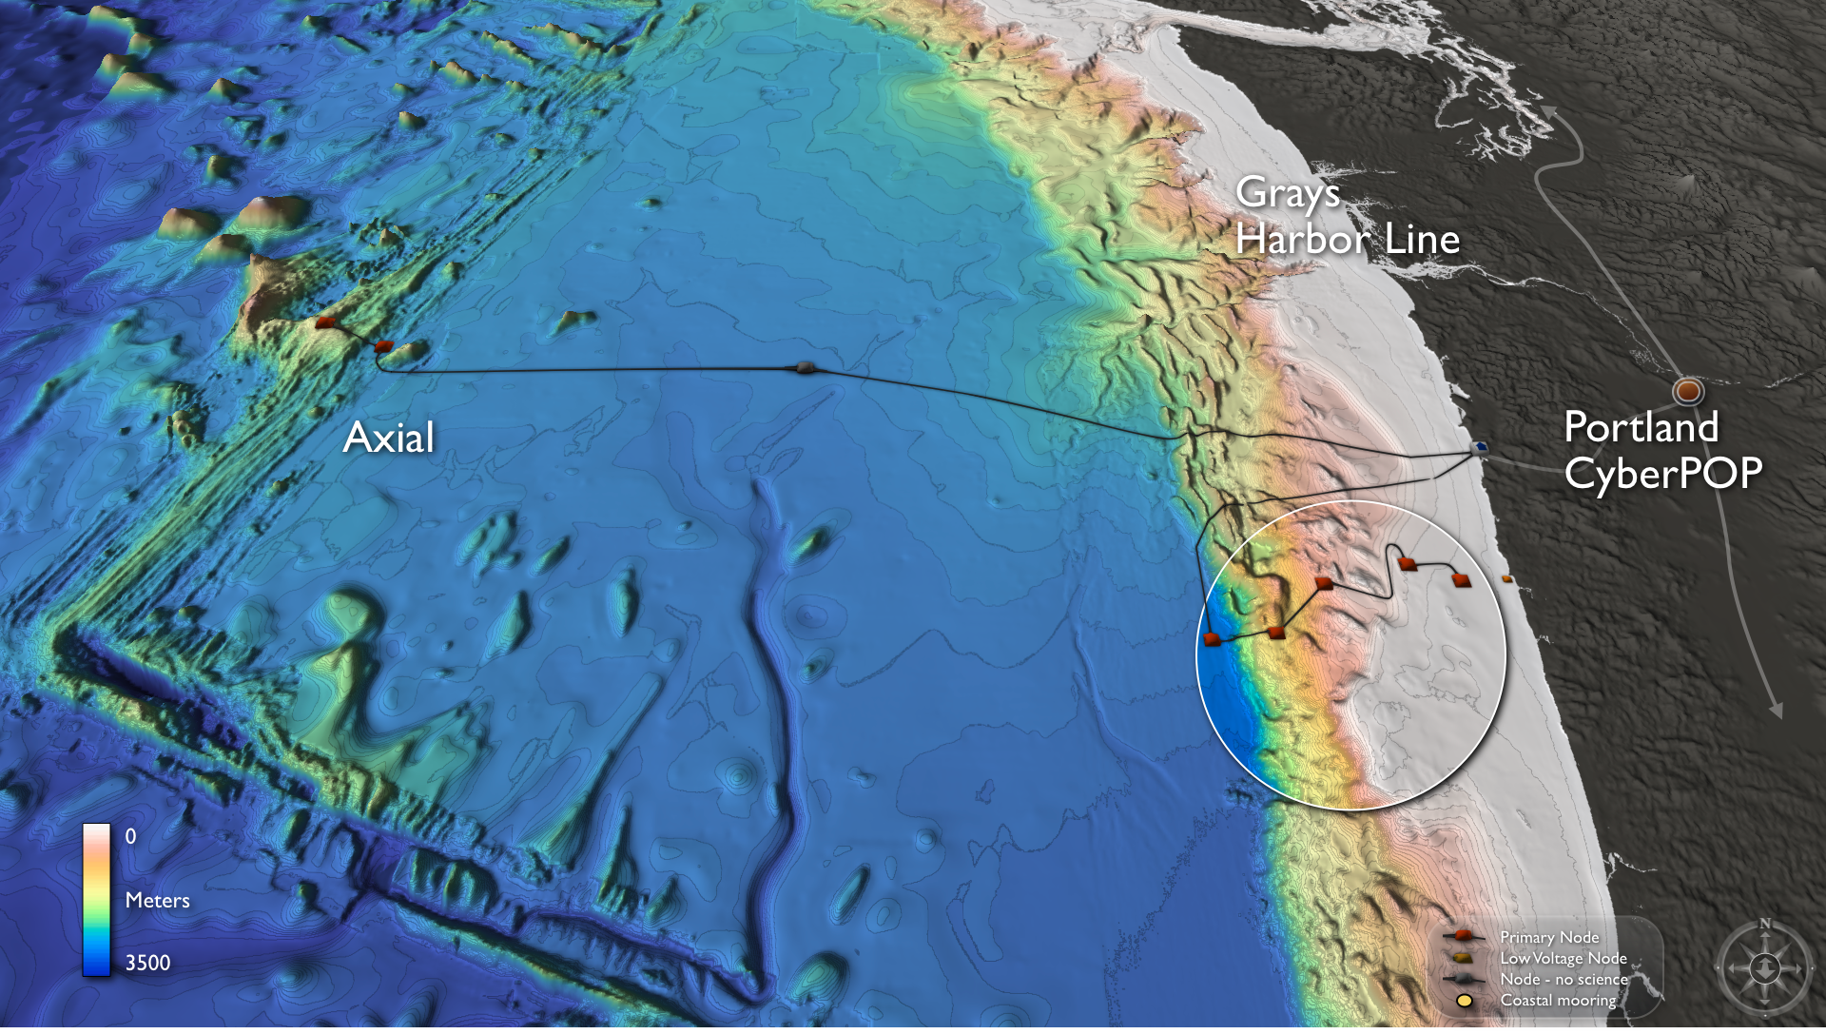
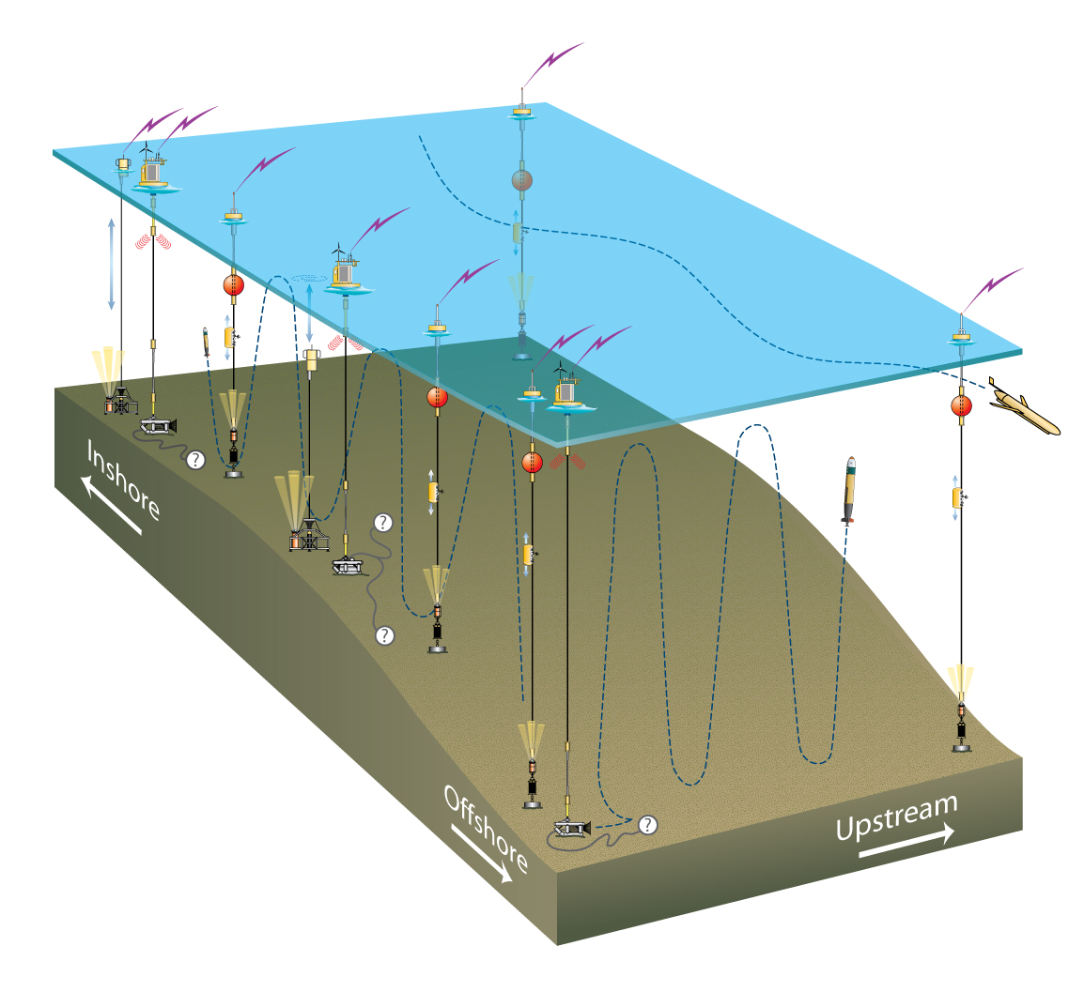
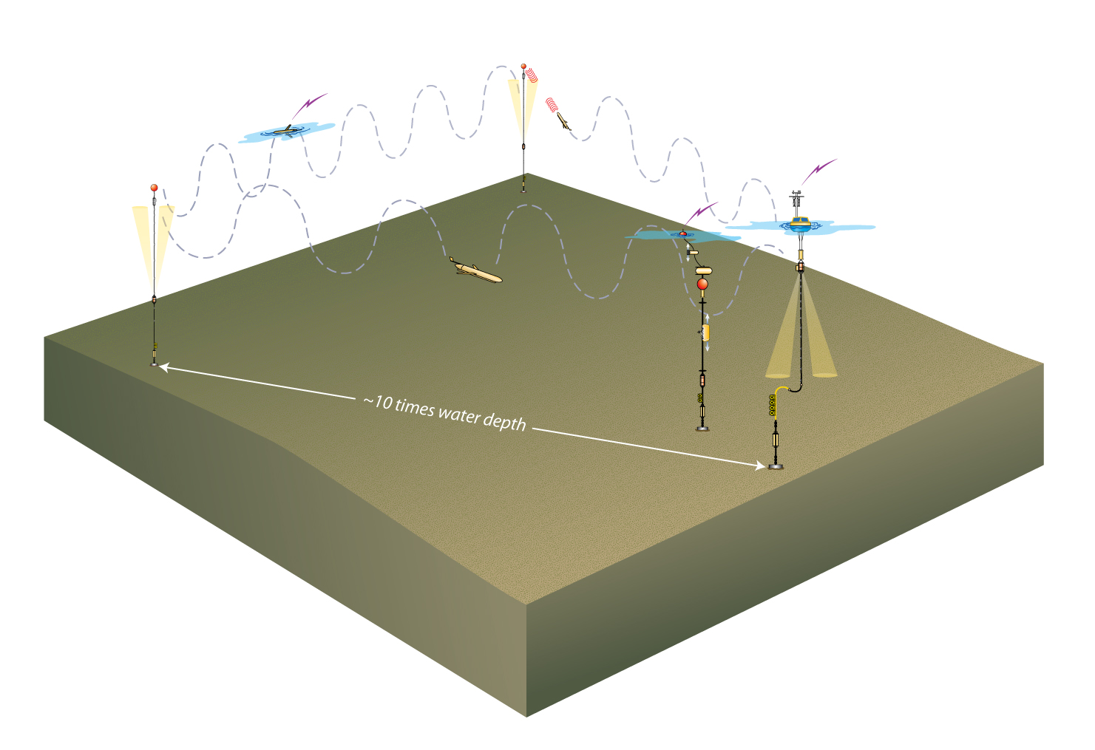
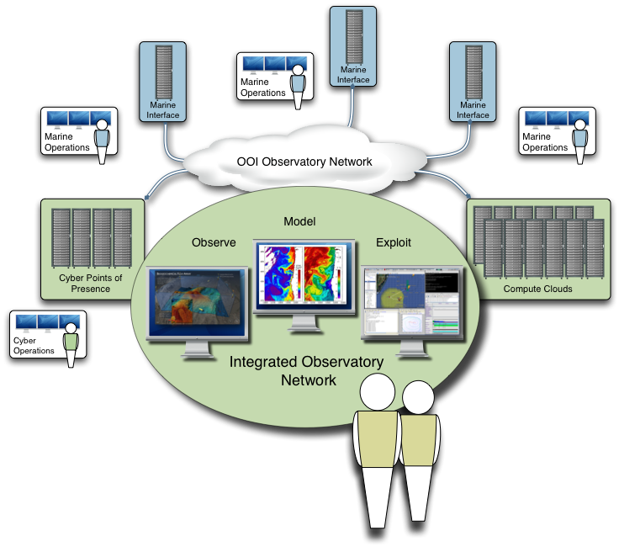
OOI Integrated Observatory
Observatory Requirements:
Provide one integrated observatory interface to all users inside and outside the OOI. Enable the users to investigate observations, manage the observatory and its assets and collaborate with each other in teams.
Engineering Drivers:
A geographically distributed system of systems with observatories at multiple scales and operational authority. OOI-wide need for data distribution, storage, processing and command and control.

Slide 13
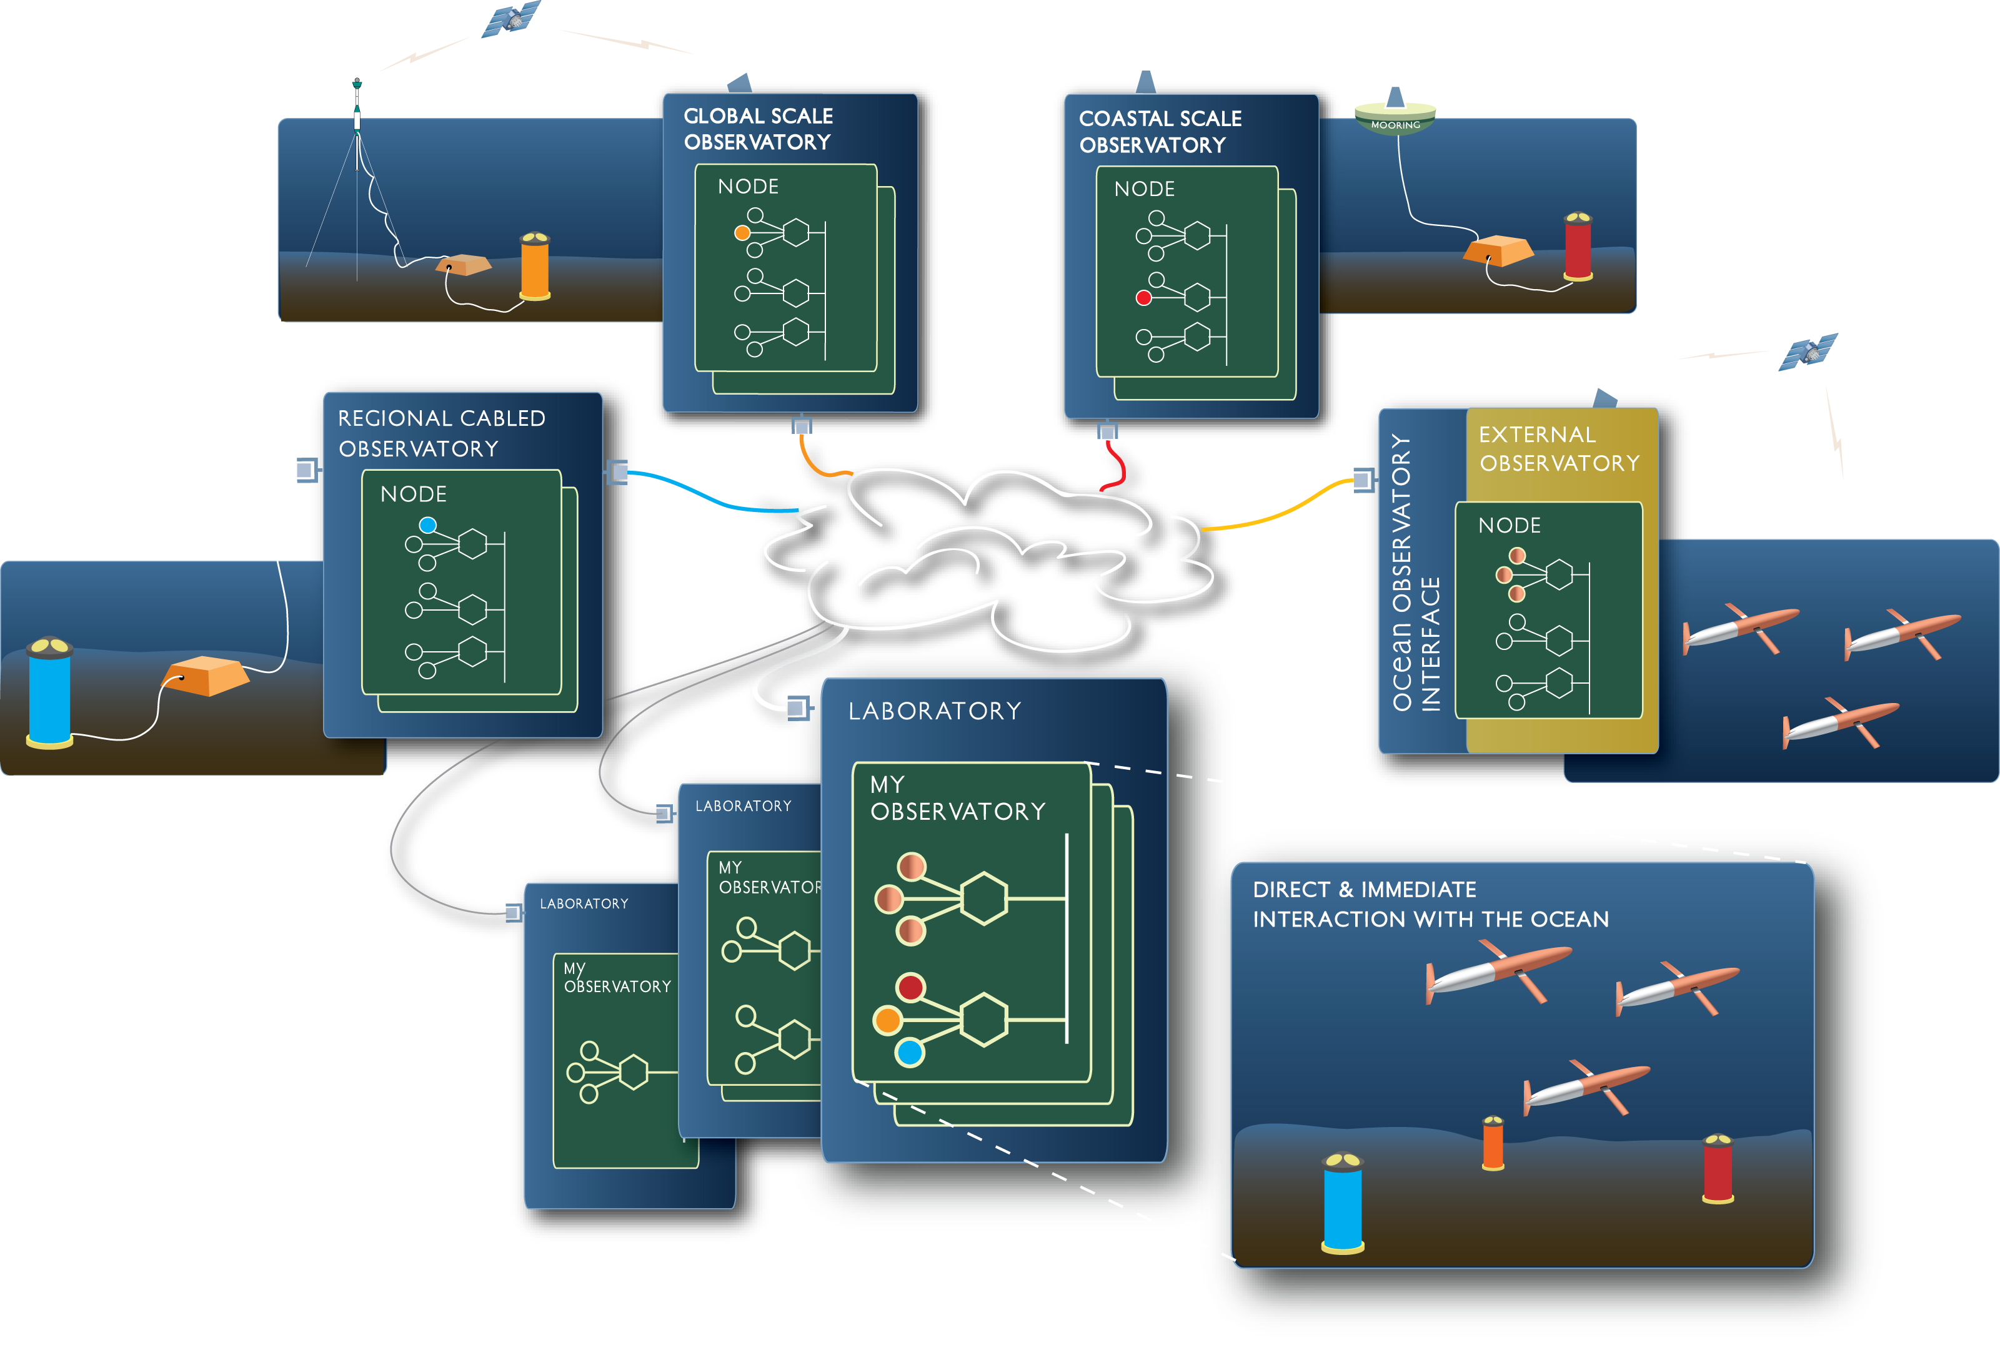
Virtual Observatories
Observatory Requirements:
Enable communities of users to work with the instruments and observatory assets they need from across all OOI sites in a uniform observatory environment. Support multiple “virtual” observatories in parallel.
Observatory
Interface
Engineering Drivers:
Multiple heterogeneous communities of users accessing shared observatory assets across the OOI. Enable access to observatory assets based on user authorization level and observatory policy.

Slide 14
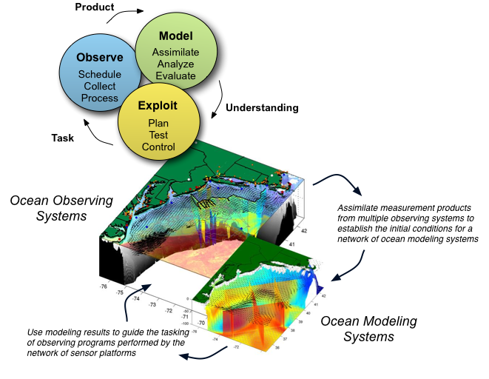
Event Detection and Response
Observatory Requirements:
Support closed loop scientific activities. Enable interactive and event-driven control of the observatory assets based on interactive and real-time observations and analyses.
Engineering Drivers:
Workflows accessing real-time measurements, external data sources, real-time processing, QA and event-detection, complex numerical models leading to control of mobile and stationary observatory assets.

Slide 15
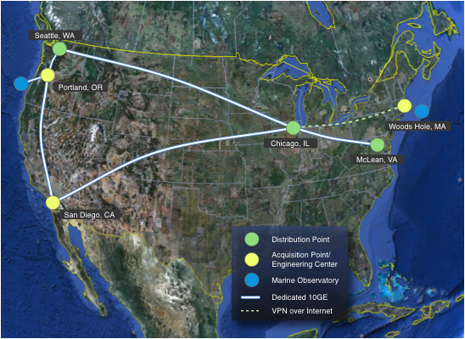
Deployment Topology
Observatory Requirements:
Provide observatory assets to support measurements of scientific processes. Provide computational and network assets to enable real-time, secure access and processing for the observatory users
Engineering Drivers:
Proximity to observatory assets, geographic redundancy. High-bandwidth, low latency access to national and international network peering points. Access to commercial and academic compute clouds

Slide 16
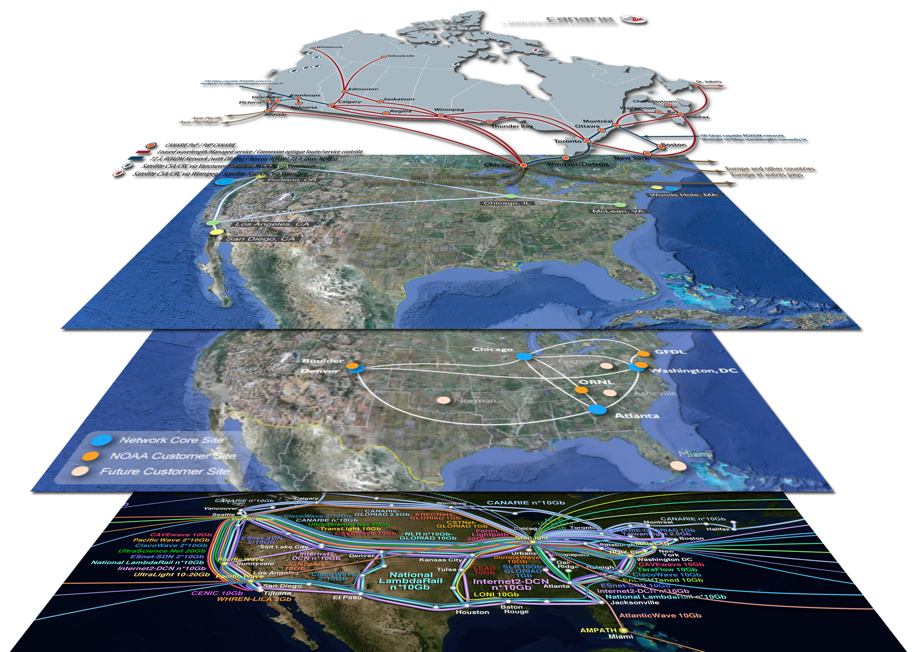
External Observatory Integration
NEPTUNE
Canada
Engineering Driver:
The topology used by the OOI program is easily integrated into national and international cyber-networks. This will facilitate collaboration for developing the international ocean observing network
NFS OOI
Network
NOAA N-Wave
Network
Global Lambda
Integrated Facility

Slide 17
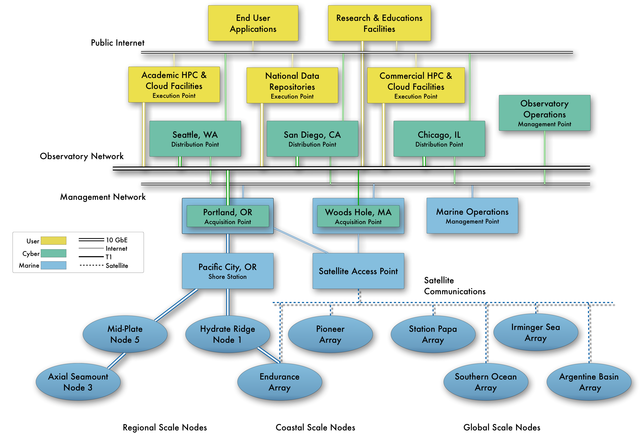
Network Deployment
Engineering Driver:
The physical network links the marine operators, external users, and educators to the ocean assets deployed throughout the world’s oceans.

Slide 18
OOI Cyberinfrastructure Year 2 Milestones
Release 1: Data Distribution Network
  Life Cycle Architecture Review: August 2010
  Initial Operating Capability Review: May 2011
Life Cycle Architecture Review for Instrument Agents and External Observatory Integration: Dec 2010
Completed purchase and installation of San Diego Engineering Center (CyberPoP Buildout): Jan 2011

Slide 19
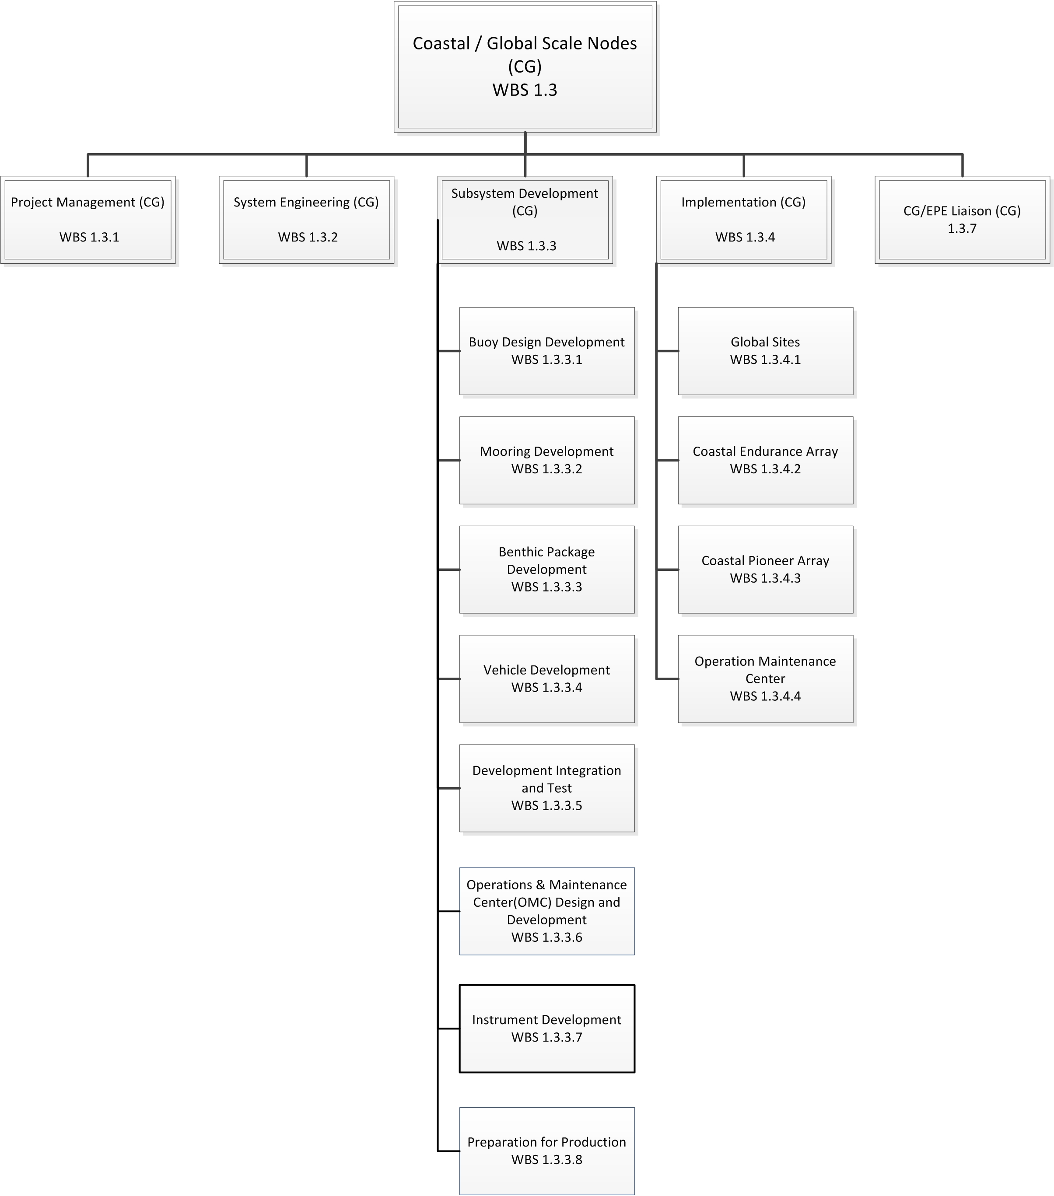
WBS 1.3 Coastal / Global Scale Nodes

Slide 20
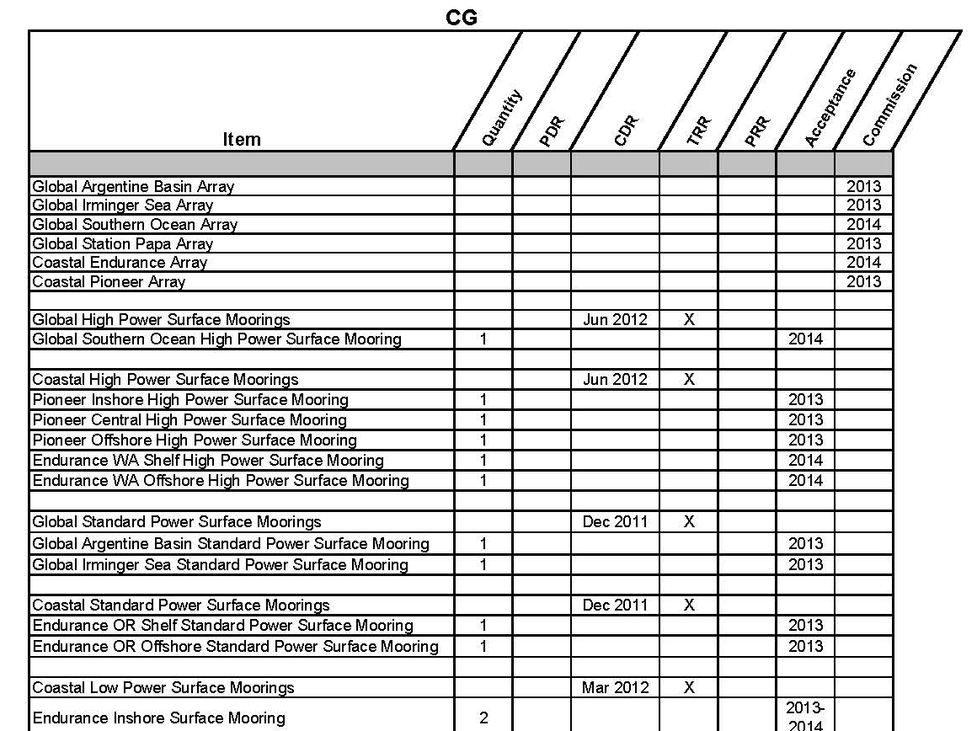
Coastal / Global Design Configuration Items

Slide 21
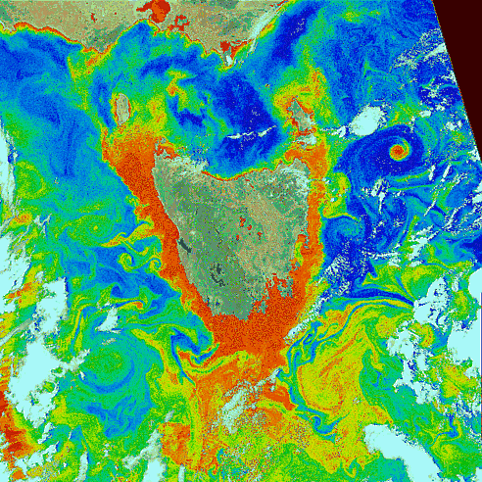
Global Scale Nodes
A engineering driver to sample
mesoscale space to resolve eddys
Observing Requirements: Simultaneous observations resolving at least daily time scales and multiple spatial scales, data from air-sea interface to sea floor, collects data for up to a year, multidisciplinary sensor suites, real-time data, adaptability
Engineering Drivers:
Remote locations, need to operate for months to a year without maintenance, power capacity for the community to add sensors, remote control of sampling, survive high waves and wind
NASA ocean color image of the
ocean around Tasmania

Slide 22
Global Scale Nodes
Subsurface
flanking
moorings
Observation Need: Adaptive spatial data sampling
of water column that can be sustained for a year
Gliders
• Paired surface and profiler moorings cover full water column
• 3 gliders to observe evolution of ocean properties on sections
• 2 gliders to track/survey features, also commandable as spares
• 2 subsurface moorings with fixed depth sensors complete triangular moored array
• telemetry via gliders
Paired surface and
profiler mooring

Slide 23
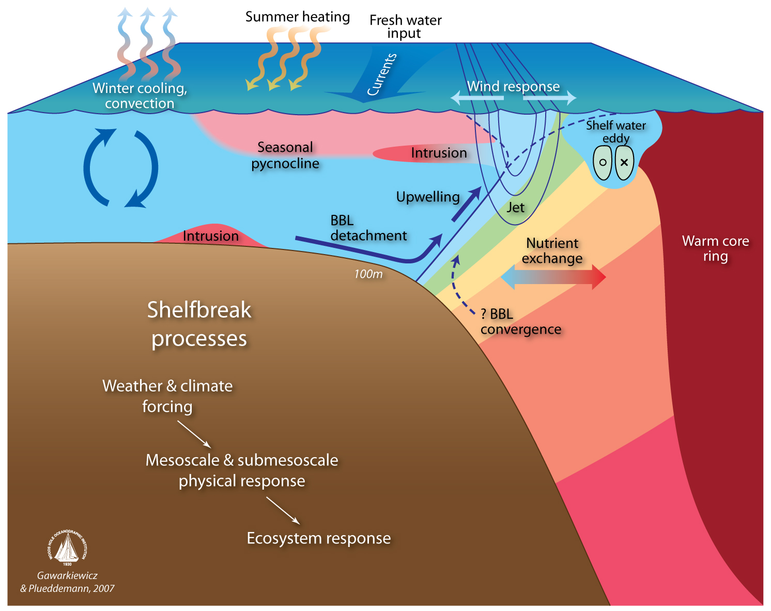
Coastal Node: Pioneer Array
How exchanges between a broad shelf with the a deep ocean that is bounded by an energetic western boundary system structure physics, chemistry, and biology of continental shelves
Observing Requirements: Nested simultaneous observations resolving short time scales and multiple spatial scales, data from air-sea interface to sea floor, multidisciplinary sensor suites, real-time data, high resolution adaptive sampling
Engineering Drivers:
High turbulence resulting in high frequency heterogeneity in space/time, high rates of bio-fouling, human presence, rapid response cabailities

Slide 24
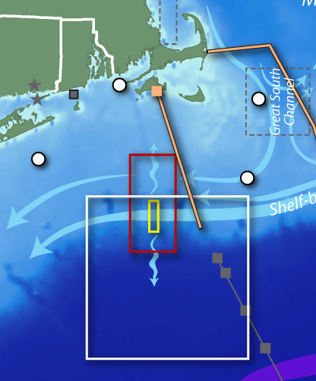
Coastal Node: Pioneer Array
Engineering Design: Multi-element, multi-scale, fixed and mobile assets, relocatable, reconfigurable to resolve processes Network consists of surface profiling floats, subsurface floats, coastal gliders, and docking AUVs

Slide 25
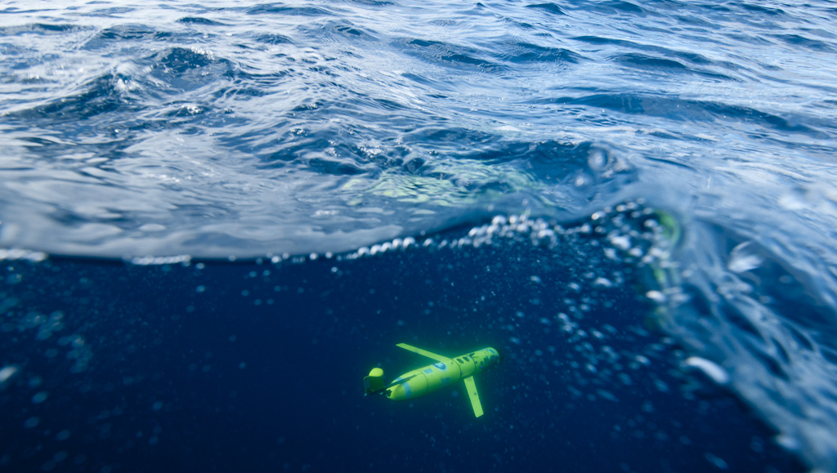
Coastal Nodes: Successful procurement of mobile gliders
March 15, 2011
Teledyne Webb is competitively awarded the contract for coastal Slocum gliders. Engineering drivers for the glider decision was based on the proven ability to navigate shallow waters, ease of battery exchange, capable of carrying multiple sensors

Slide 26
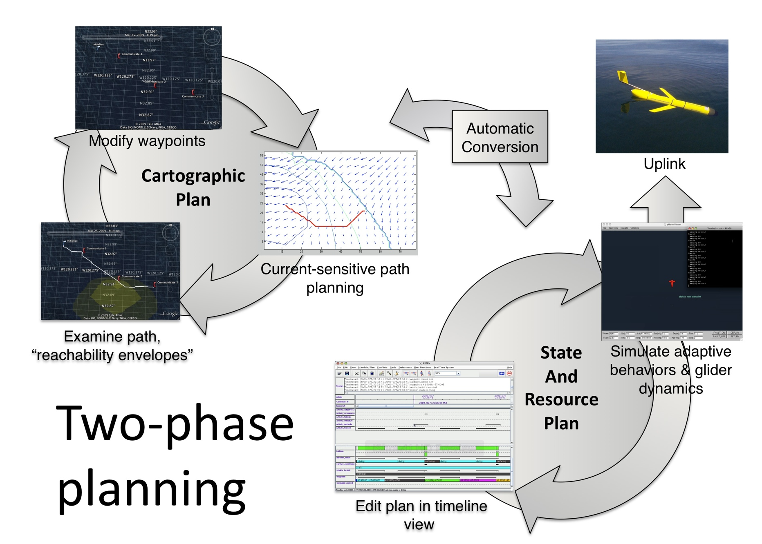
Coastal Nodes: Successful command/control test of coastal mobile gliders
Engineering Drivers:
Fleets of mobile platforms will require automated control. CI software has been tested which allows the efficient operation of a multi-vehicle fleet. The software allowed multiple vehicle sampling to be optimized and coordinated with detailed satellite sampling of surface conditions

Slide 27
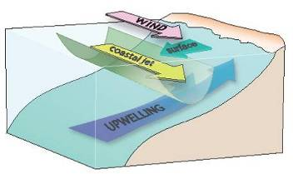
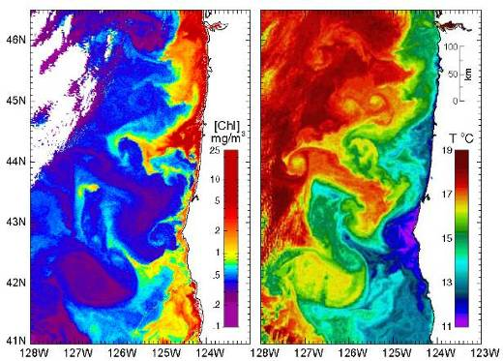
Coastal Node: Endurance Array
An engineering driver to resolve how coastal jets
structure ecosystems and coastal chemistry
Observing Requirements: Simultaneous observations resolving short time scales and multiple spatial scales, data from air-sea interface to sea floor, collects data for up to a year, multidisciplinary sensor suites, real-time data, adaptability
temperature
Engineering Drivers:
High turbulence resulting in high frequency heterogeneity in space/time, high rates of bio-fouling, human presence
phytoplankton

Slide 28
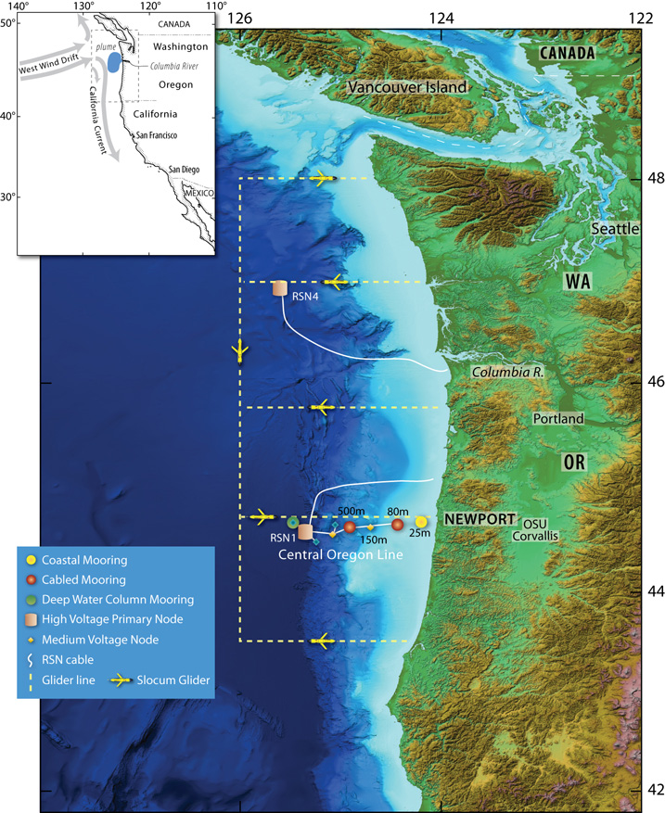
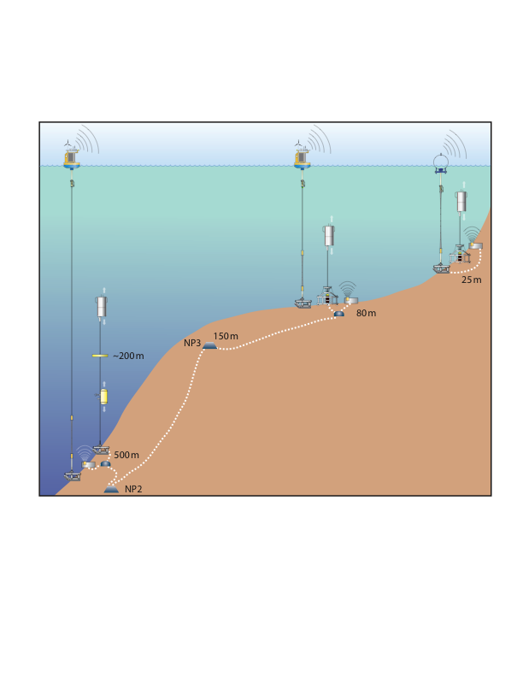
Coastal Node: Endurance Array
Engineering Design: Multi-element, multi-scale cabled, high power and bandwidth Fixed and mobile assets deployed for long term sustained time series. Network consists of surface profiling floats, subsurface floats, coastal gliders, and subsurface electro-optical cable.
60 km
500 km
500 m
25 m
125 km

Slide 29
Coastal and Global Scale Nodes Year 2 Design Milestones
At Sea Test 2 (AST2) Telemetry and Platform Controller Hardware and Software PDR: April 2011
AST2 Benthic Anchor Recovery Frame (BARF) PDR: April 2011
Benthic Experiment Package (BEP) Part 2 PDR: January 2011
AST2 Coastal Surface Mooring PDR: January 2011
AST2 Global Hybrid Profiler (GHP) PDR: January 2011
Power Systems Controller (PSC) PDR: December 2010
Benthic Experiment Package (BEP) Part1 PDR: November 2010
Surface Buoy PDR: October 2010

Slide 30
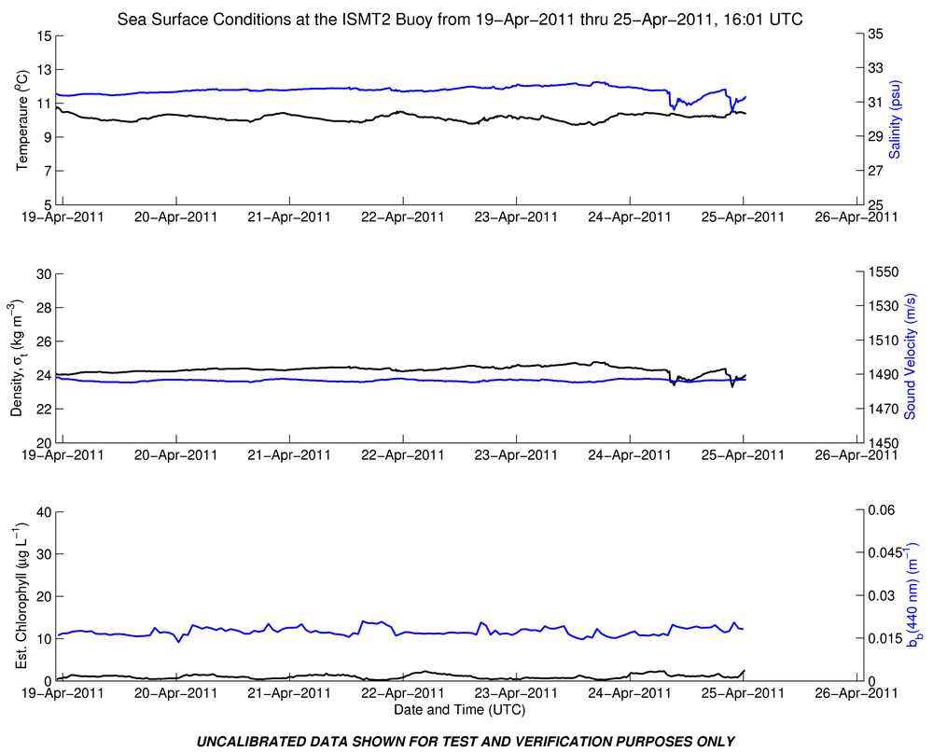
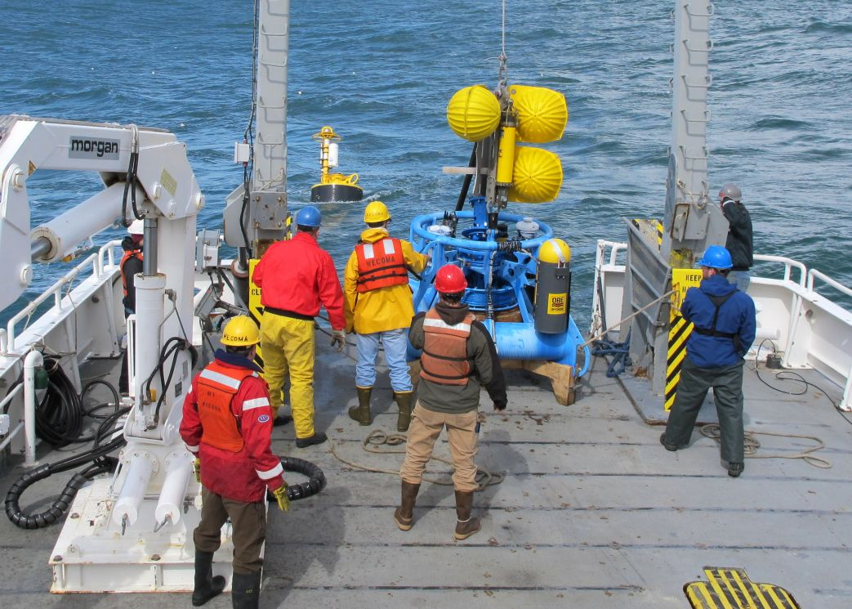
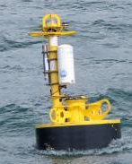
ISMT2 Test Mooring Deployment
OOI deployed a test mooring from the RV Wecoma on March 19, 2011. The surface moorings have provided real-time data to shore.

Slide 31
ISMT2 Reviews
In Shore Mooring Test 2 (ISMT2) TRR: March 16, 2011
In Shore Mooring Test 2 (ISMT2) CDR: January 11, 2011

Slide 32
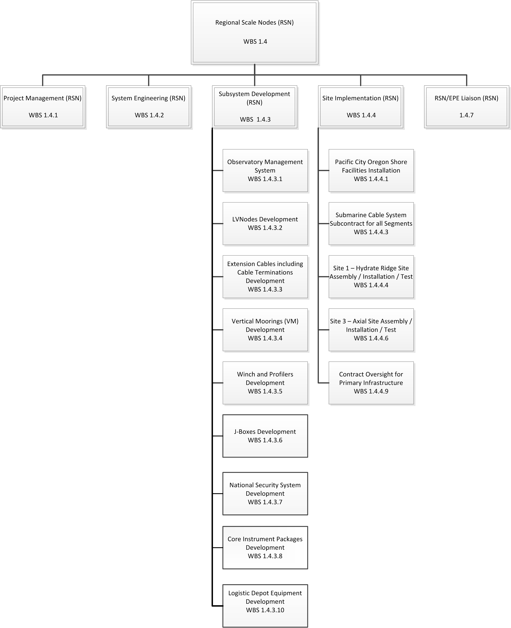
WBS 1.4 Regional Scale Nodes

Slide 33
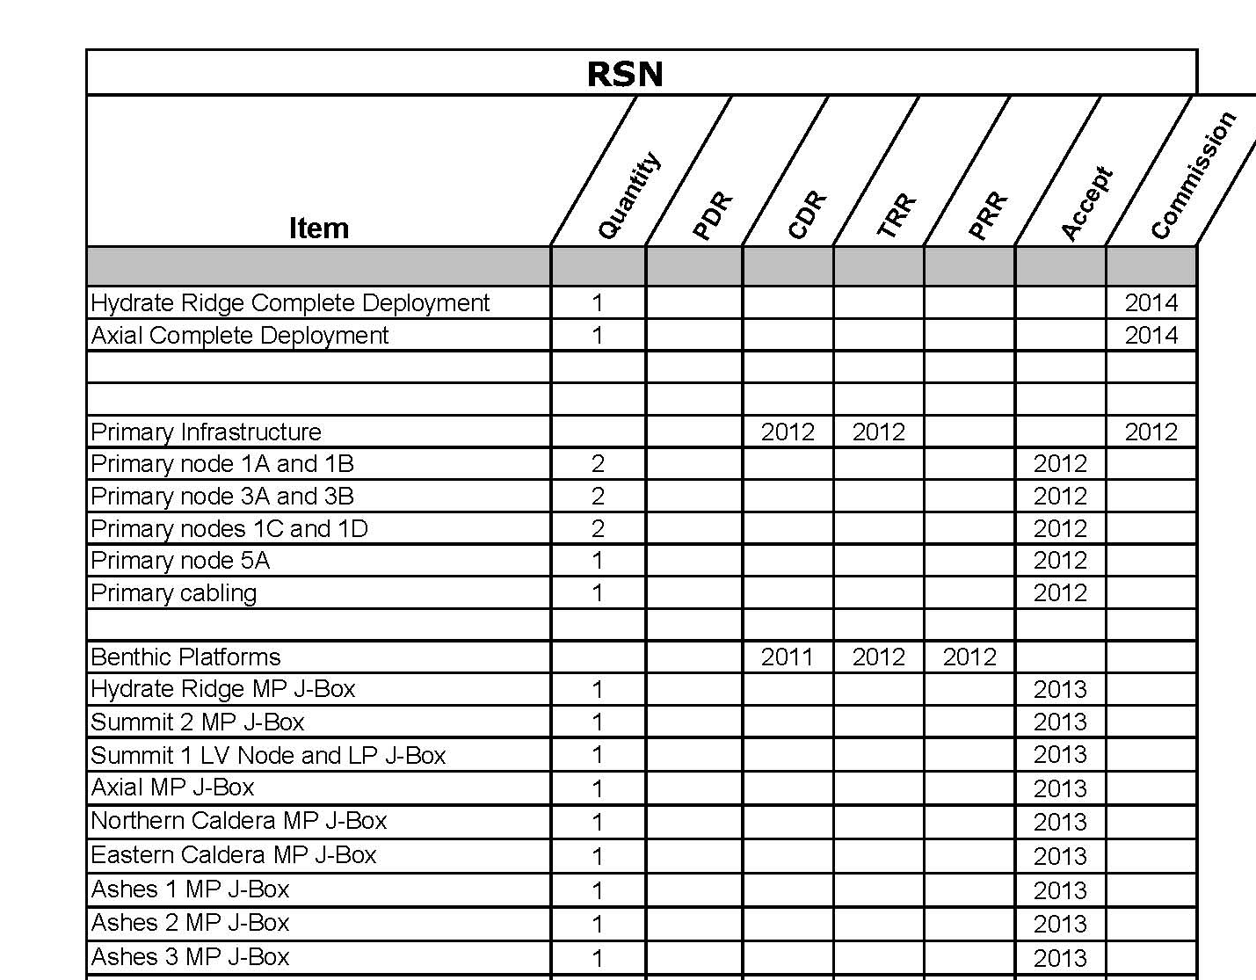
Regional Scale Nodes Design Configuration Items

Slide 34
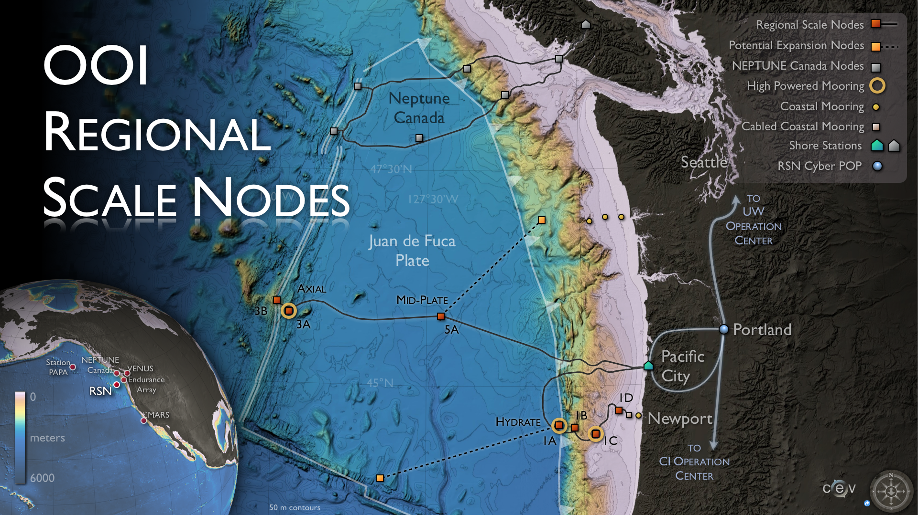
Regional Cabled Network
An 800 km Electro-optical Backbone Provides Scientists with Multiple Subsea Power and Communications Nodes. Each node provides 8 kW and 10 Gb/s.
.

Slide 35
Regional Cabled Network
An engineering driver is to sample the lithosphere, methane hydrate, and overlying water column
Observing Requirements: High frequency physical, chemical, and biological data below, within the methane hydrate, and the overlying water column.
• Engineering Drivers: High
H power and bandwidth required to support seismic, chemical, and geophysical and water column measurements. Sensors require high frequency information to resolve rapid responses
Seafloor Photomosaic of an
Experimental Site – in
Hydrate Ridge Area

Slide 36
Regional Cabled Network

Slide 37
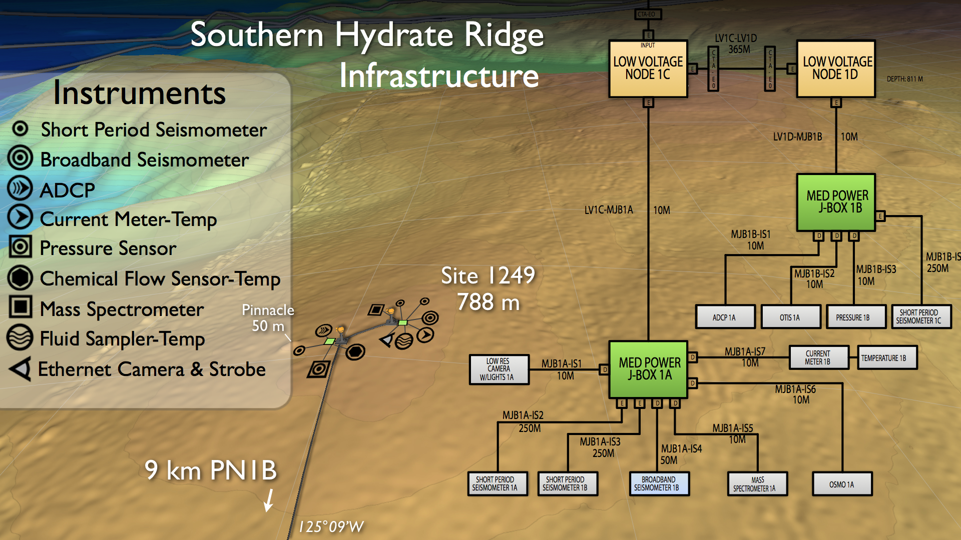
Regional Cabled Network

Slide 38
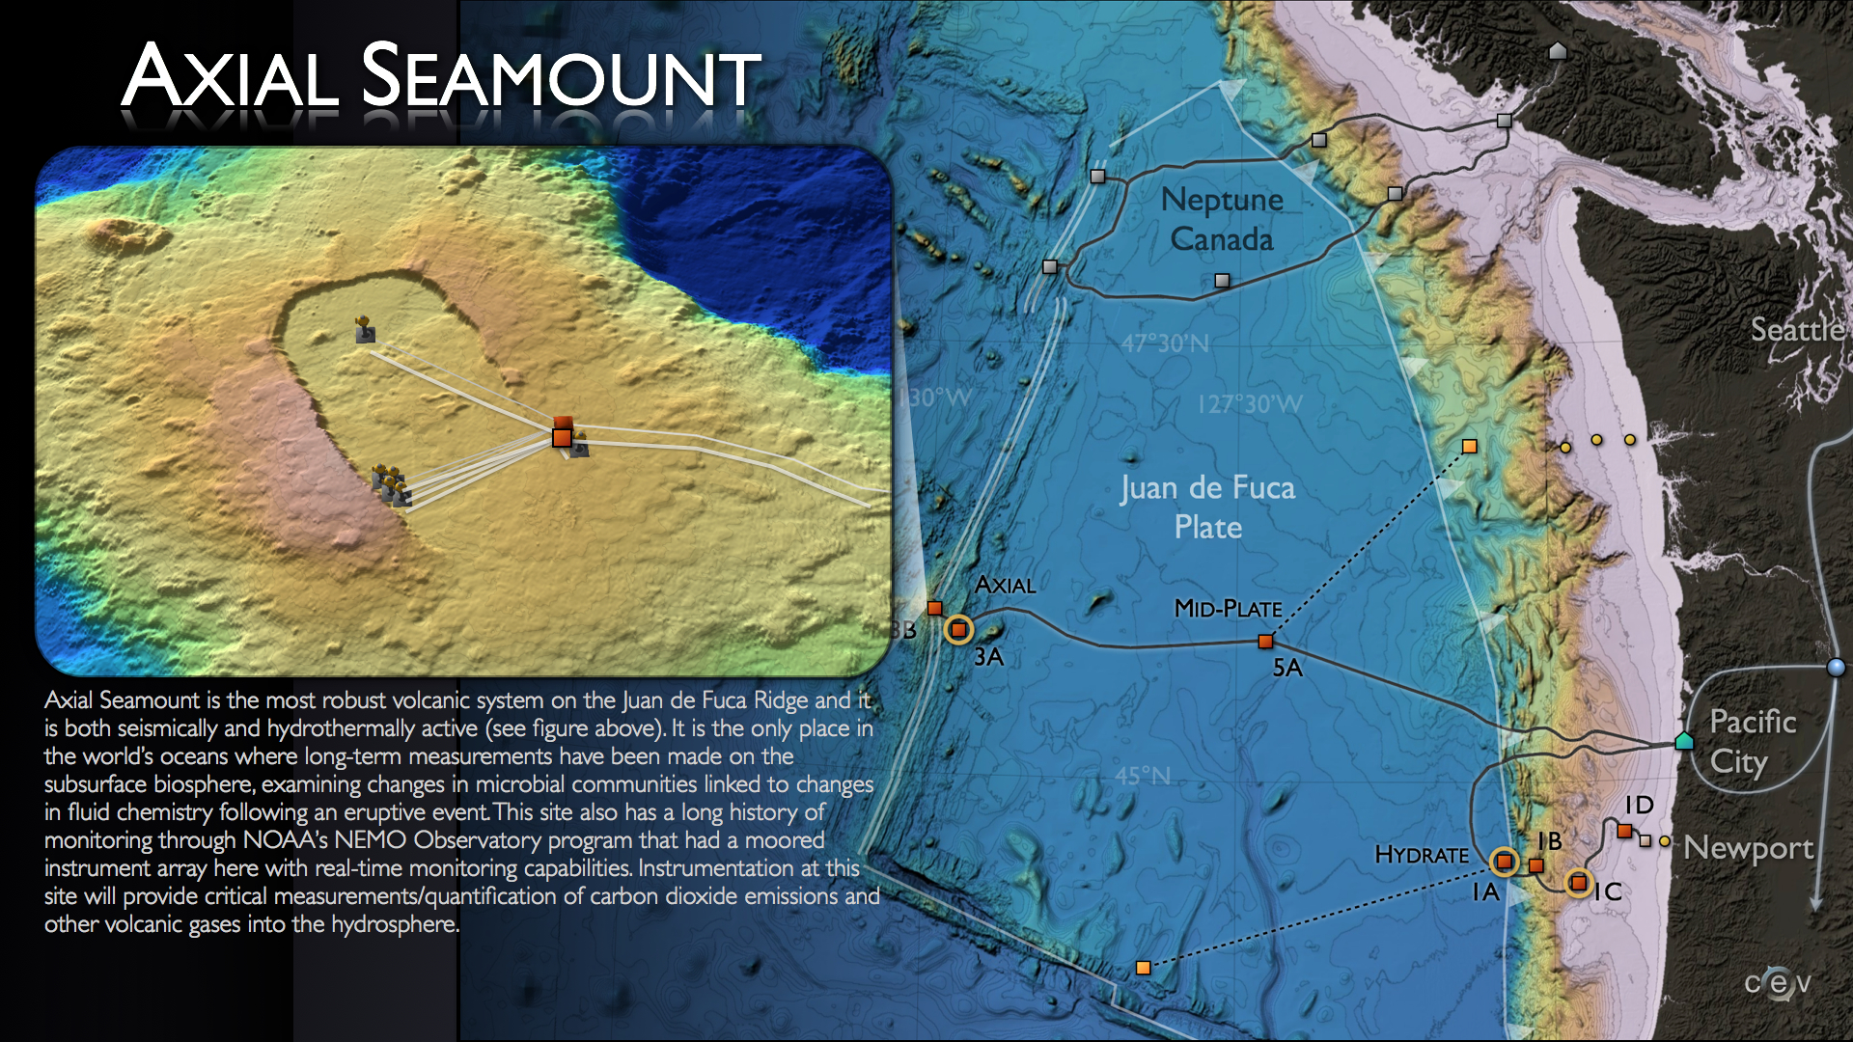
The Most Robust Volcanic System on JDF Ridge

Slide 39
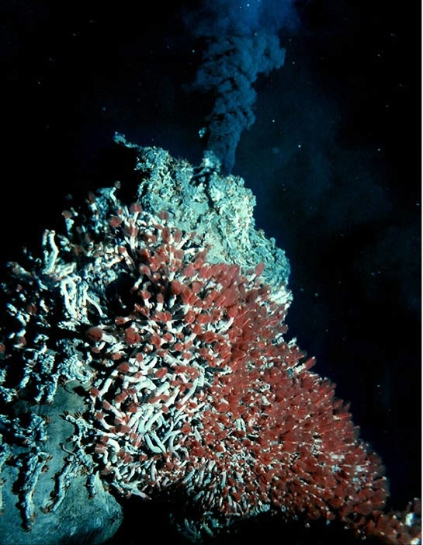
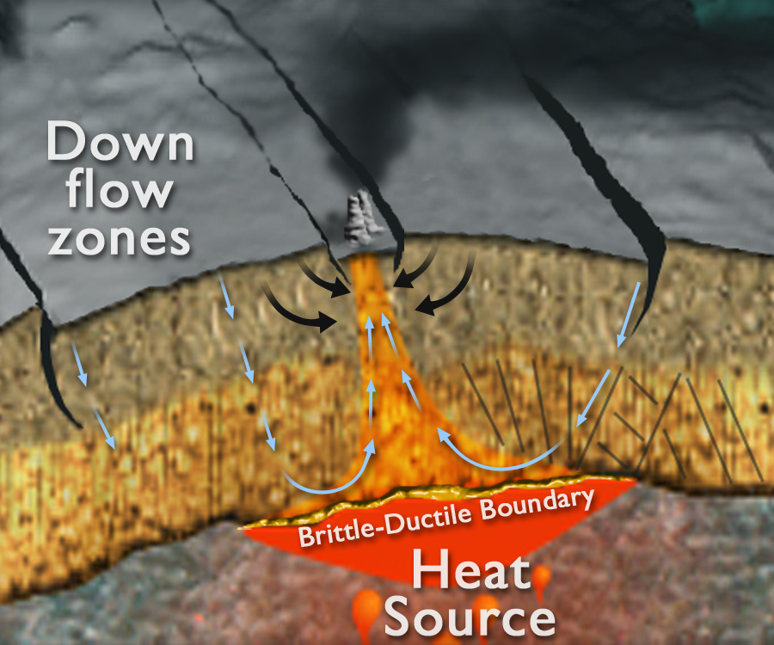
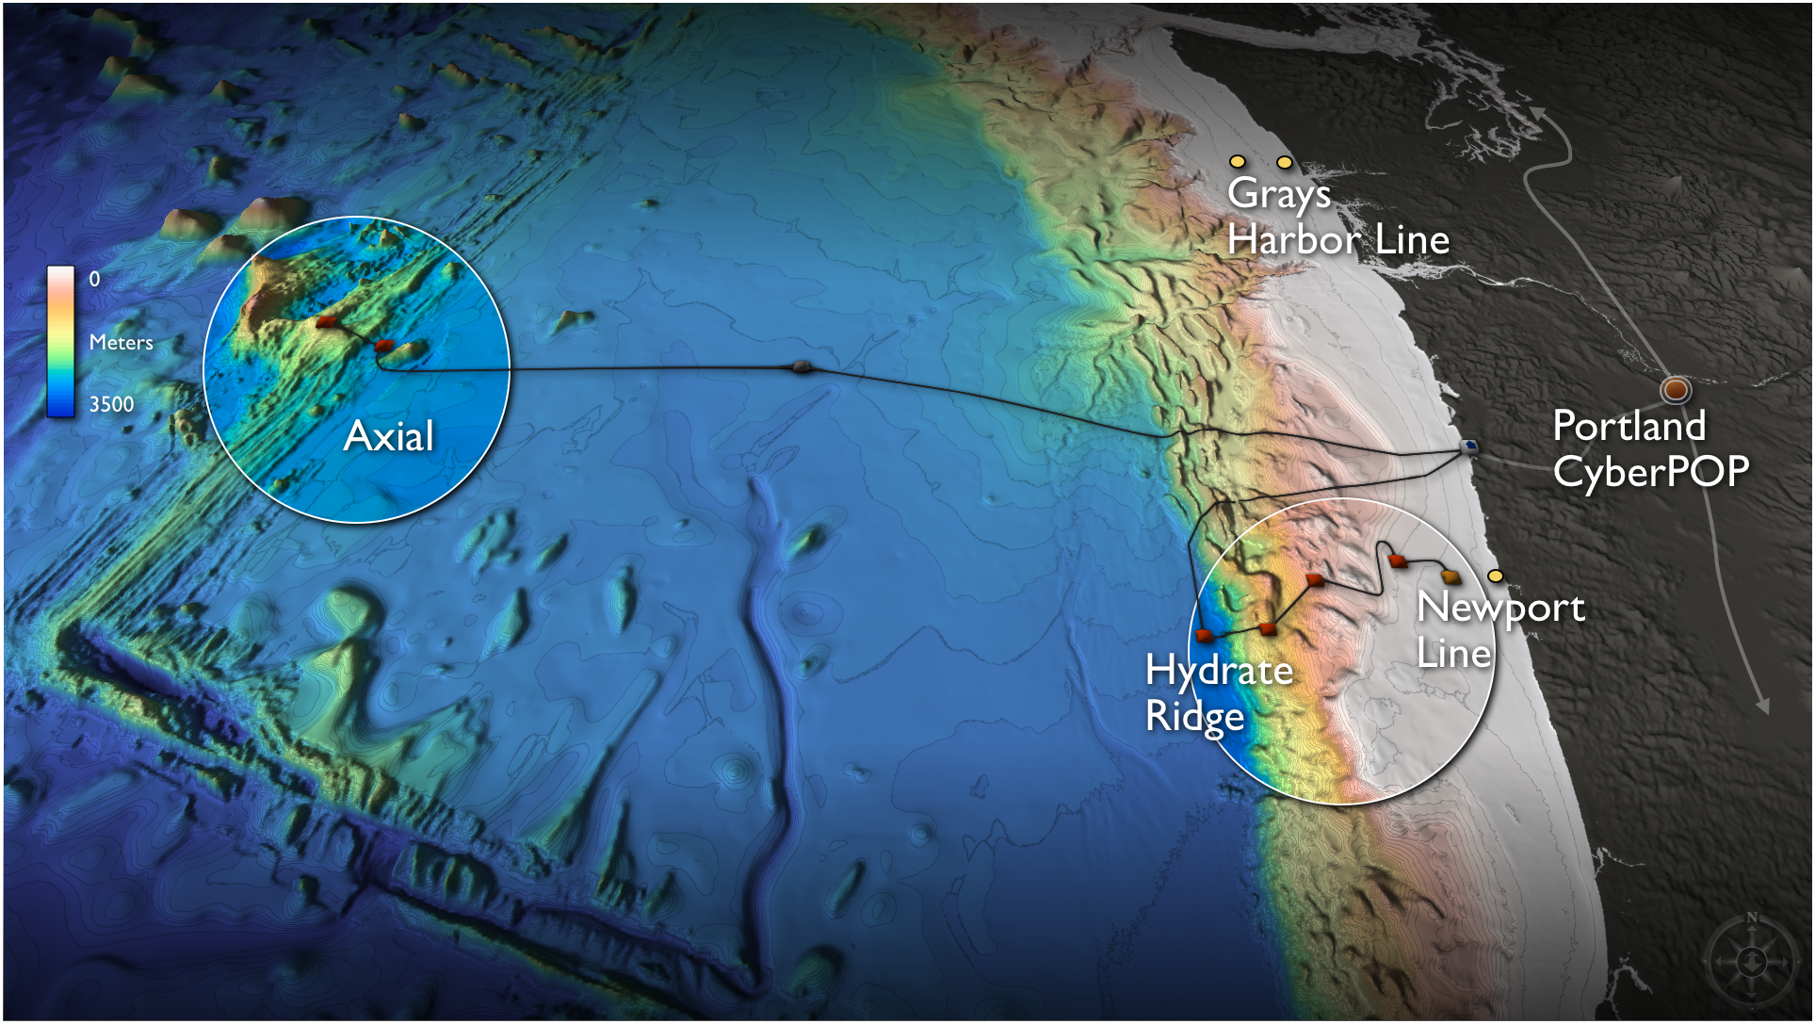
Regional Cabled Network
A engineering driver is to understand the linkages between sub-seafloor microbial communities, hot springs, volcanic activity, and the overlying ocean
Observing Requirements: High frequency physical, chemical, geophysical, and biological data at an active volcano linked to the overlying water column.
Engineering Drivers:
High power and bandwidth required to support seismic, chemical, and geophysical measurements including high definition video The sensors require high frequency information to resolve rapid responses to episodic events, like volcanic eruptions.

Slide 40
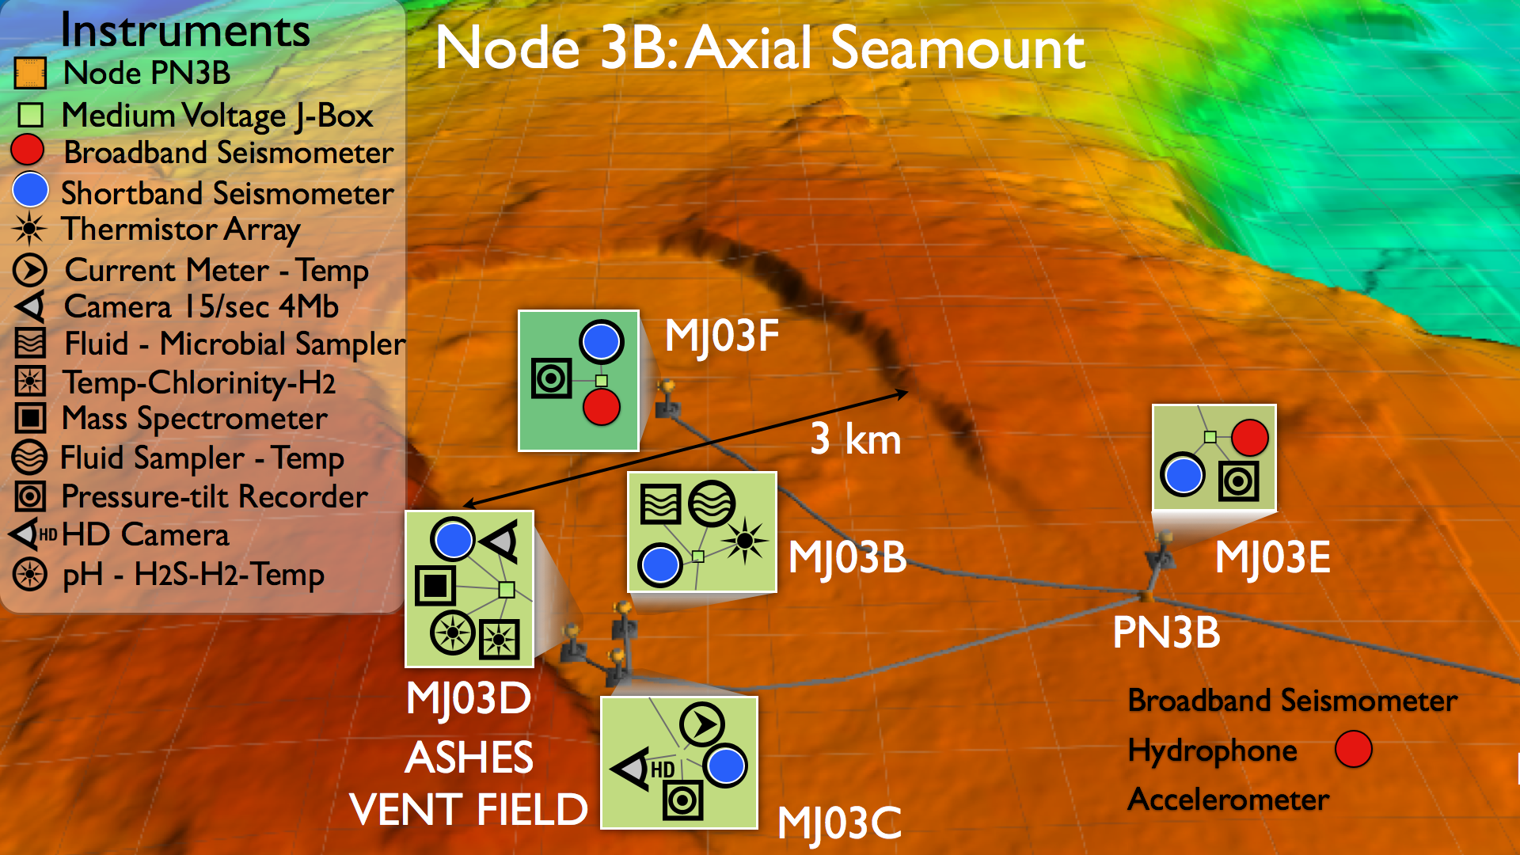
Engineering/Instrumentation Overview of a Pre-Eruptive Volcano

Slide 41
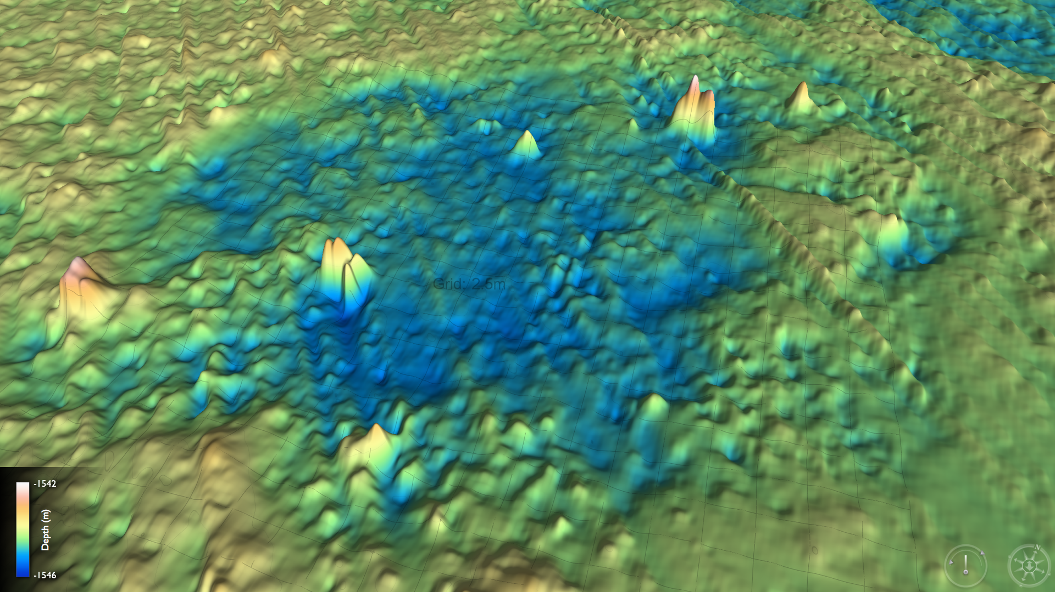
Life in Extreme Environments
High Resolution Mapping Reveals Experimental Sites: INFERNO Sulfide Deposit
4 m
INFERNO
40

Slide 42
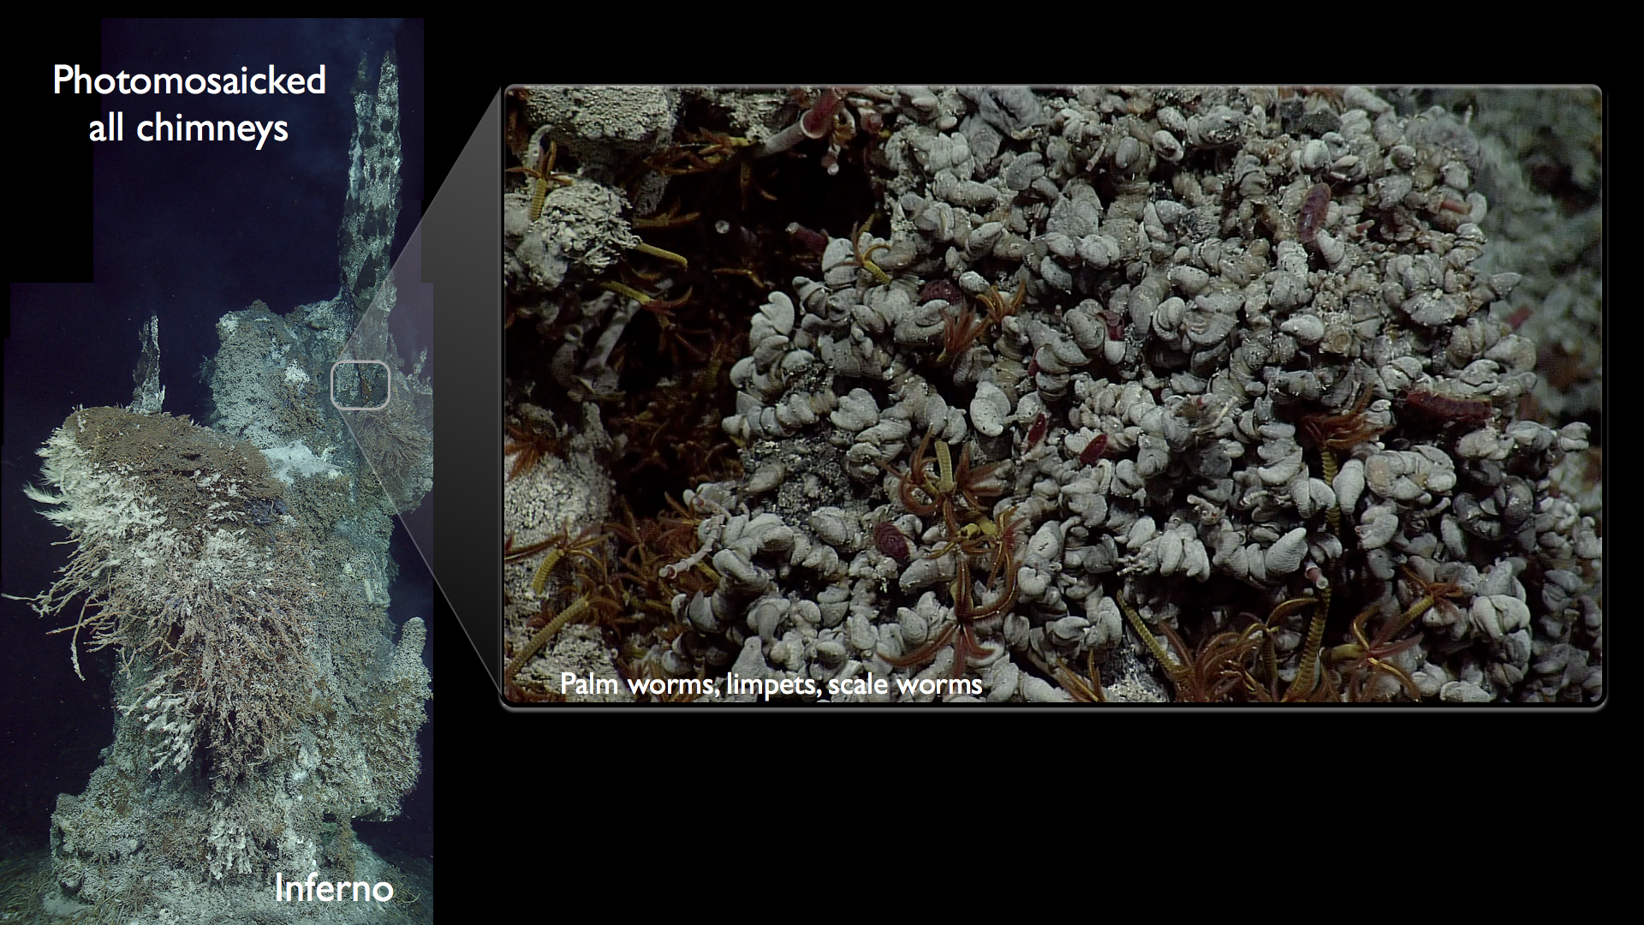
Life in Extreme Environments
High Resolution Imaging of INFERNO allows experiments at mm scale
4 m
Inferno
Sensors at the 300°C vent “INFERNO” will provide HD imagery, seismicity, tides, seafloor inflation, and fluid chemistry
41

Slide 43
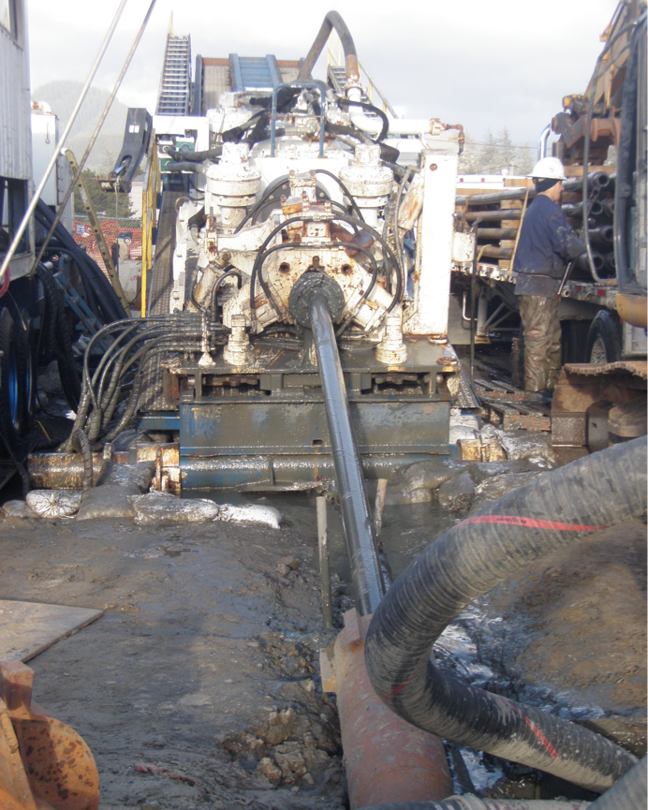
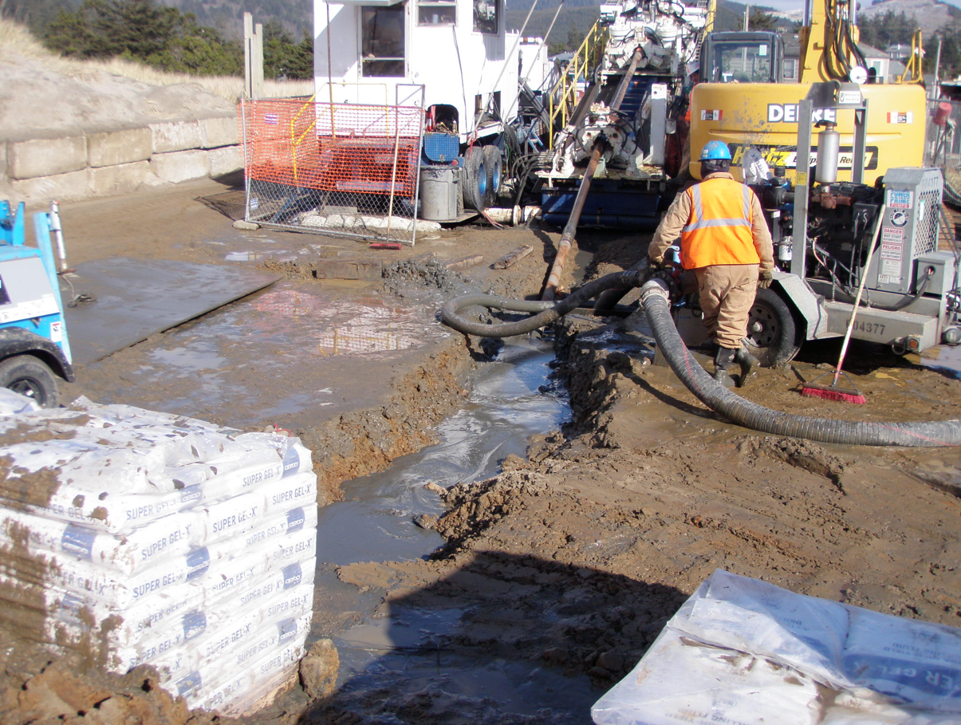
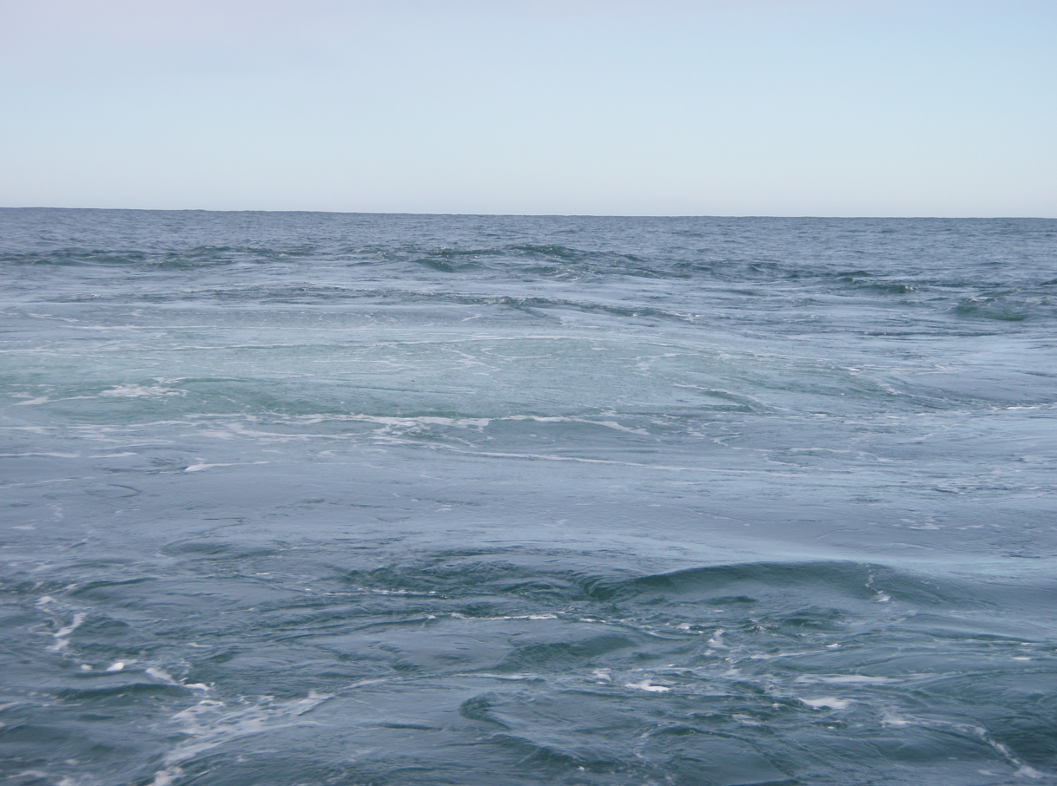
Environmentally Sound Horizontal Directional Drilling Beneath Dunes – Completed Feb-March 2011

Slide 44
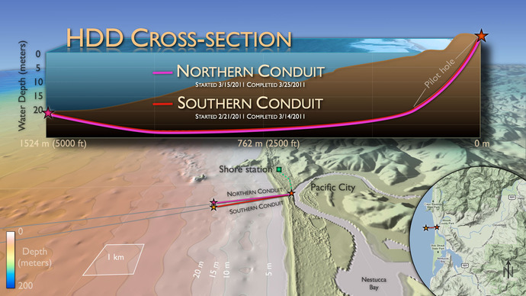
Cross-Shore Drill Holes Emerge in 20 meters of Water –
Cables to be pulled ashore in JULY, 2011

Slide 45
Regional Cabled Network Year 2 Key Agreements
Station Lease & Terrestrial Conduit Agreement completed : May 2010
Oregon Fishermen’s Cable Committee (OFCC) membership by Ocean Leadership: Dec 2010
Cable Maintenance Agreement (North America Zone), negotiation initiated: Jan 2011
Backhaul Capacity Lease completed: Feb. 2011
Cyber POP Lease completed: Feb 2011
Construction Permits in place: Feb 2011

Slide 46
Regional Cabled Network Year 2 Milestones
Cable Route Survey Completed & Agreed: Jan 2011
Terrestrial Conduit Acceptance Completed: Aug 2010
Ocean ground – Deep Anode Completed: Oct 2010
Shore Station Readiness for Equipment: Feb 2011
Fore-Dune Grading and Horizontal Directional Drilling Completed: March 2011

Slide 47
Regional Cabled Network Year 2 Design Milestones
Primary Infrastructure System CDR: April 2011 (L3-Maripro)
Vertical Mooring and Profilers PDR: March 2011 (UW)
Network Management System (NMS) CDR: April 2011 (L3-Maripro)
Line Monitoring Equipment (LME) & Terminal Element Management System (TEMS) CDR: March 2011 (Tyco)
Primary Node Controller (PNC) CDR: August 2010 (Texcel)
Medium Voltage Power Converter (MVPC) CDR: February 2011 (DTI)
MVPC Power Demo: February 2011 (DTI)
Optical Test Bed Demo: February 2011 (Tyco)
Simulator CDR: November 2010 (L3-Maripro)
Power Feed Equipment (PFE) Part 2 CDR & MVPC/Cooling System PDR: October 2010 (DTI)
Ethernet Switch CDR: October 2010 (Curtiss Wright)

Slide 48
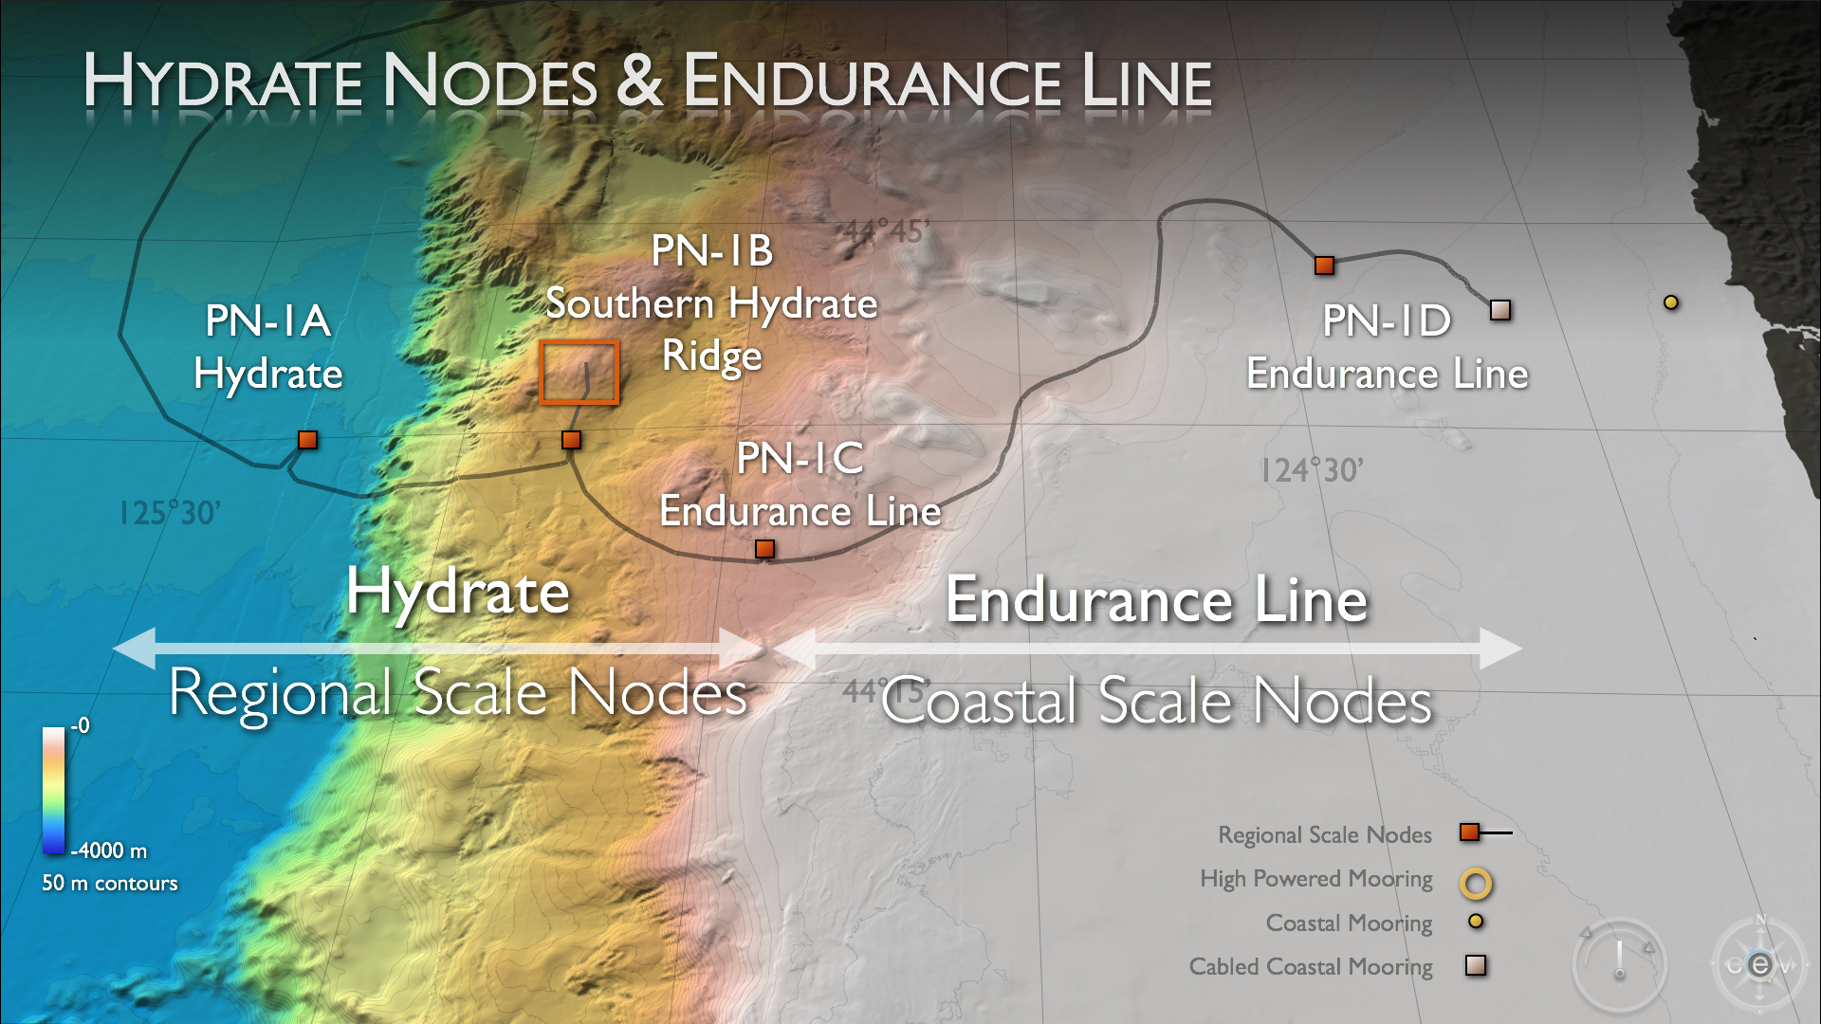
RCN Supporting Coastal Endurance Array
Engineering driver to support multiple high power water column profilers and allow for expansion of the Community Science. Presence of the deep sea cable provides capacity to enable considerable growth

Slide 49
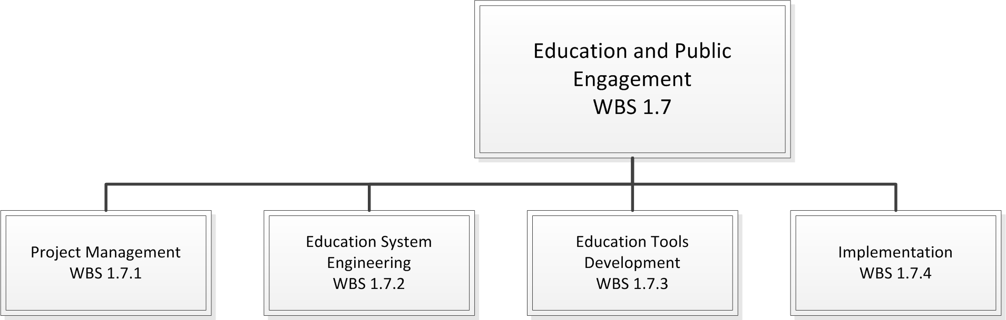
WBS 1.7 Education and Public Engagement
Competitive Contract Award March 1, 2011

Slide 50
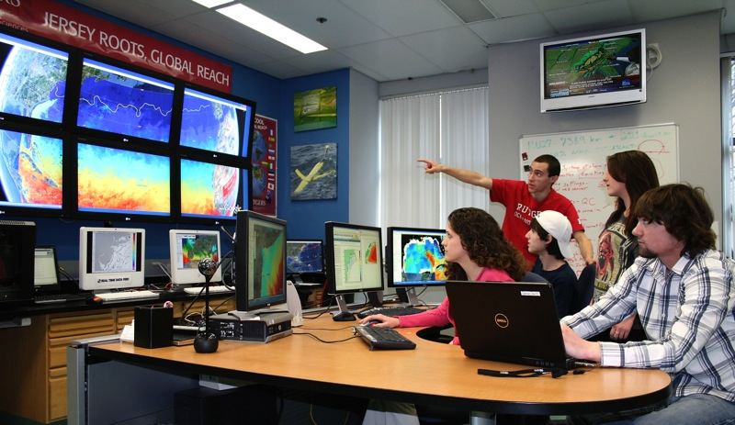
OOI Developing the infrastructure to enable education and public engagement (EPE)
OOI is constructing a series of software tools and a web-based social network to engage a wide range of education users spanning from faculty, graduate and undergraduate students, informal science educators and the general public.
The software will be designed to provide
scientists and educators a suite of tools
that will enable them to enhance their
undergraduate education and engage
the general public using real-time and
streaming data provided by the OOI.

Slide 51
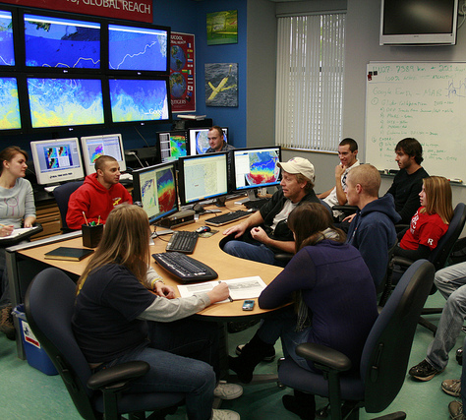
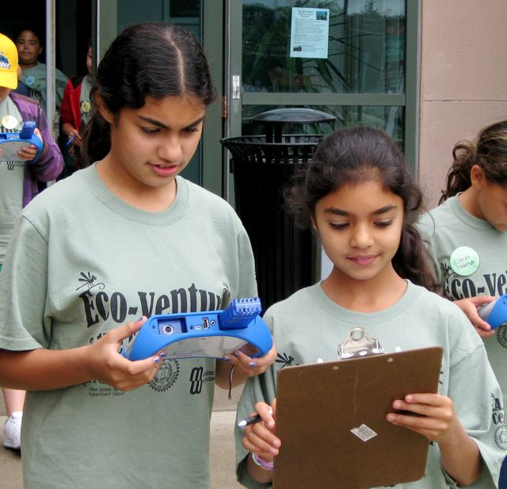
Target Audiences for the EPE
Undergraduate Educators
Example: Educators
using real-time observatory data in an undergraduate research course
Free Choice Content Developers Example: OOI Project Educator Janice McDonnell focusing on real-time data use in an after-school 4-H club program

