Slide 1
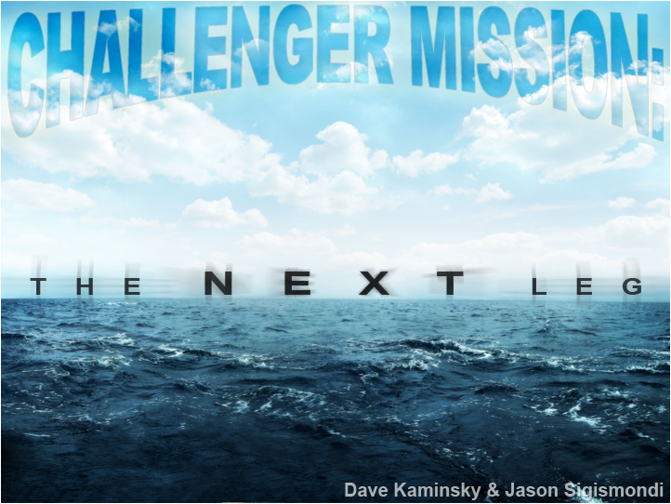
Notes:
Doing something a bit different than all the other groups. Looking into the future, so no glider data…had to find other forms of data to work with.

Slide 2
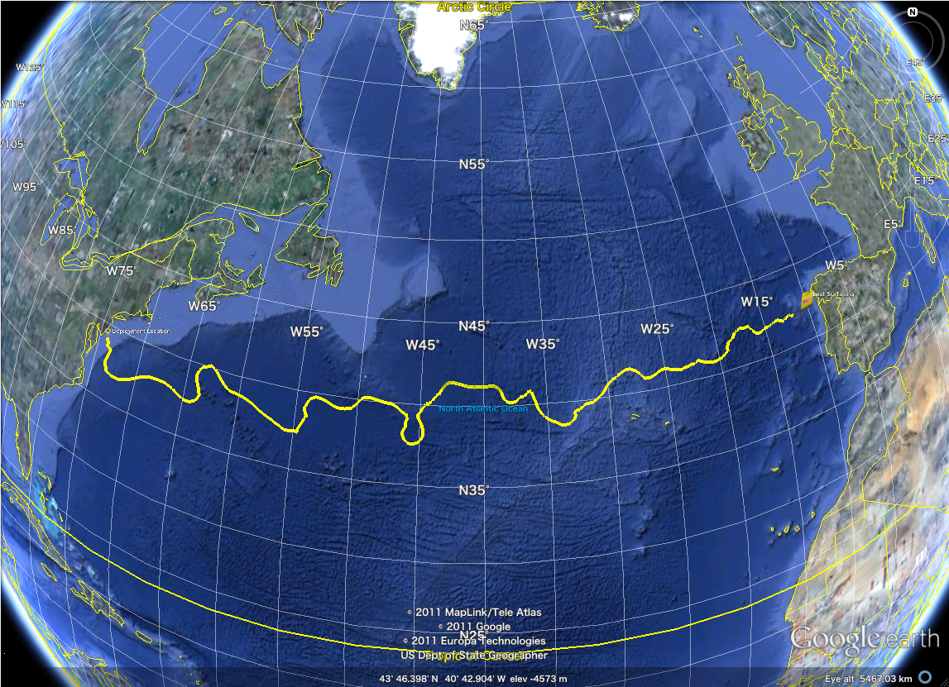
40°N

Slide 3

25°W
40°N

Slide 4
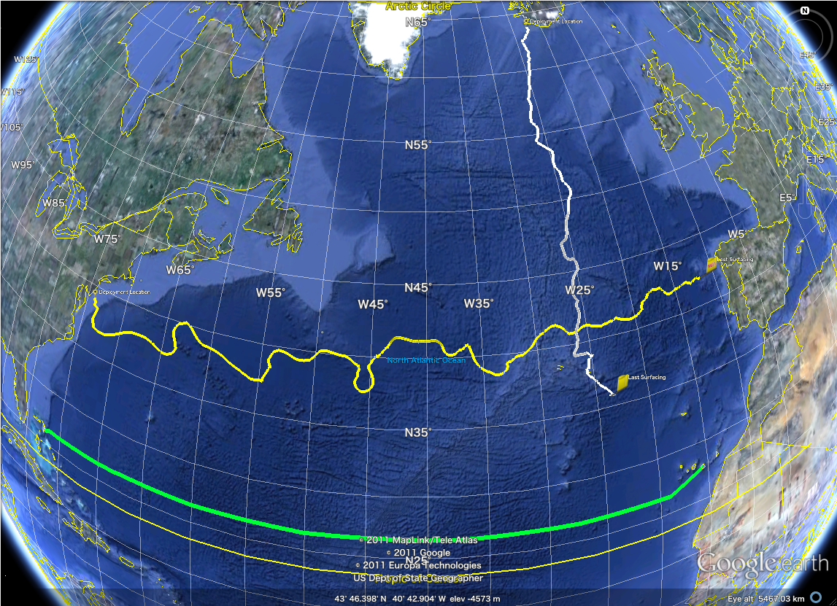
25°W
40°N
26.5°N

Slide 5
25°W
HEAT TRANSPORT!!!
40°N
26.5°N

Slide 6
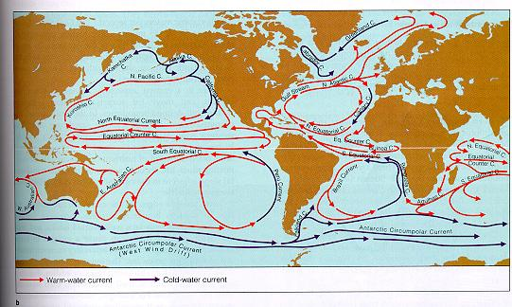

Slide 7
North Atlantic Gyre

Slide 8
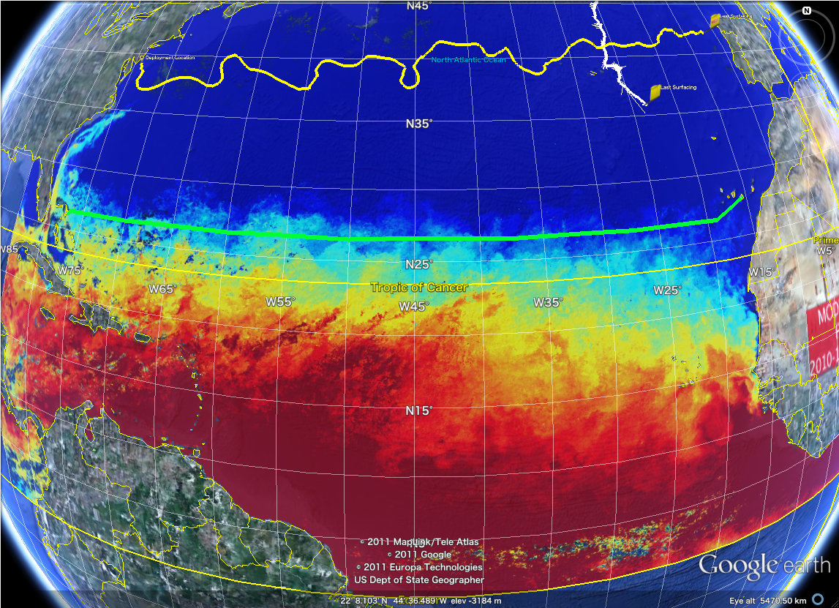

Slide 10
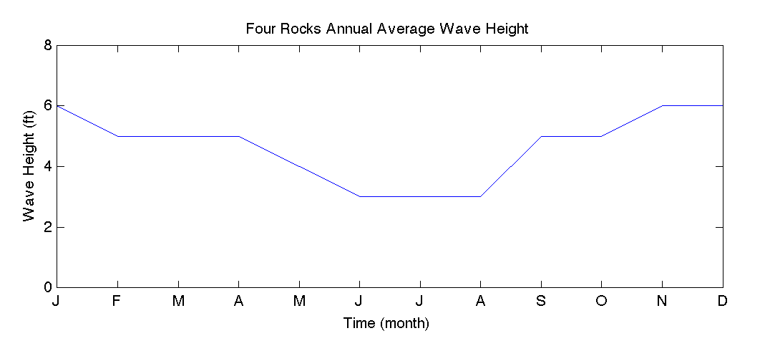
Notes:
JASON

Slide 11
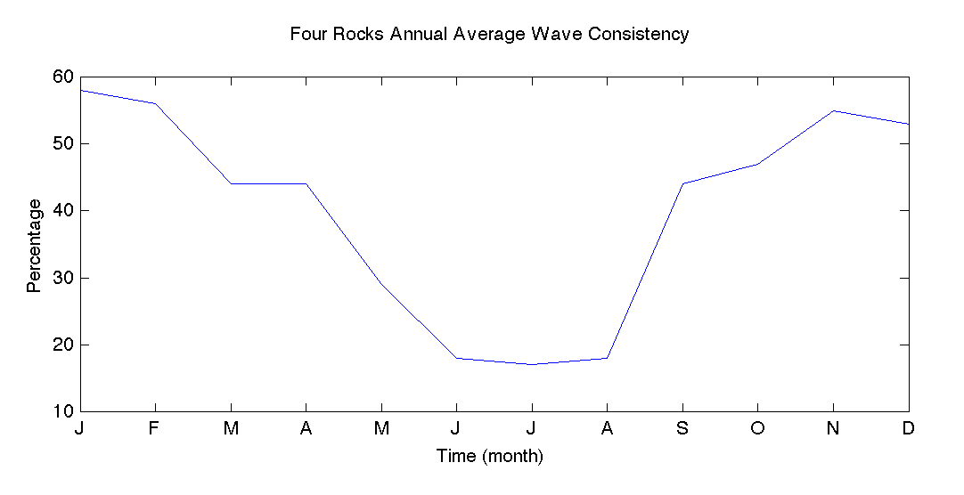
Notes:
JASON

Slide 12
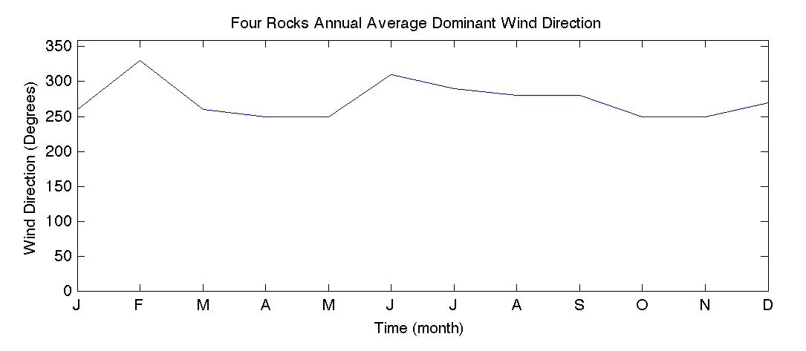
Notes:
JASON

Slide 13
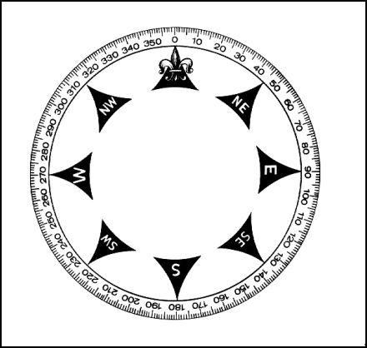
Notes:
JASON

Slide 14
Notes:
JASON

Slide 15
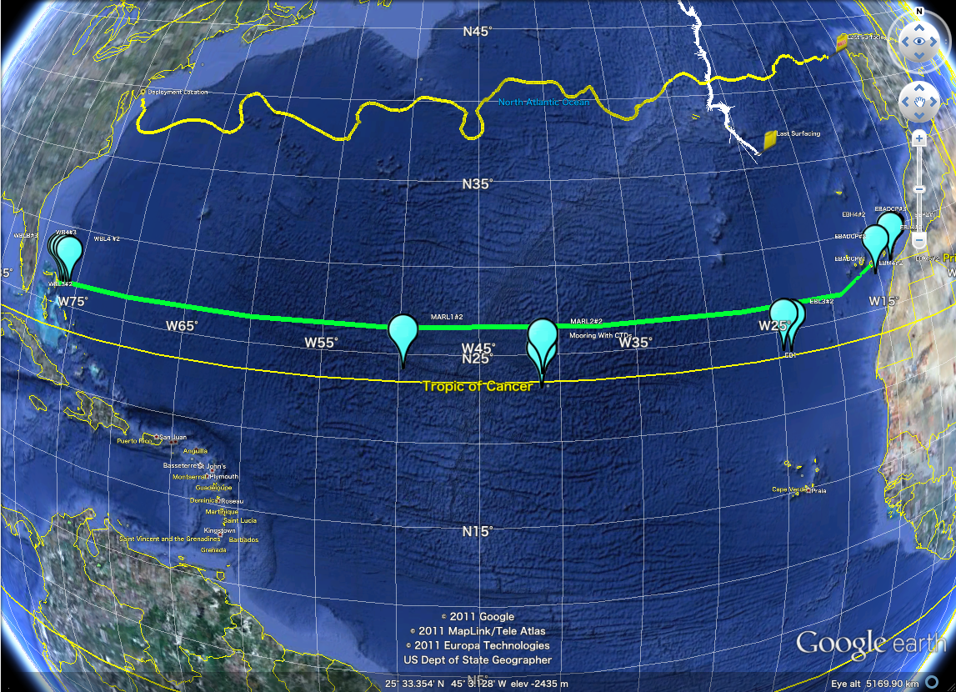
Notes:
h

Slide 16
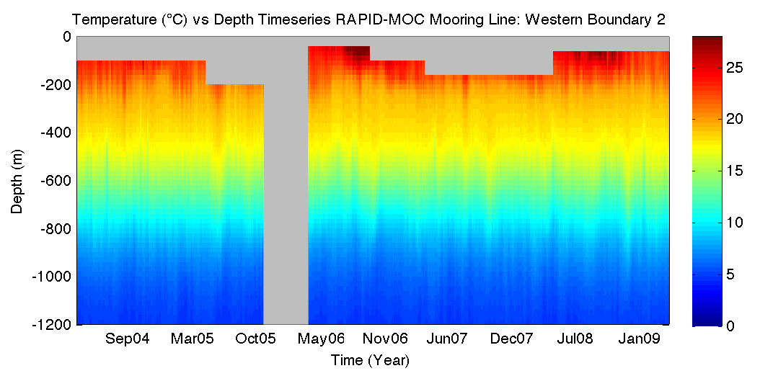
Notes:
Plots look similar to glider data you’ve seen, but its actually very different. ::describe difference b/w glider plots and there mooring plots::
Grey spots are no data points. Bad data/no data that I extracted
Temp scales same

Slide 17
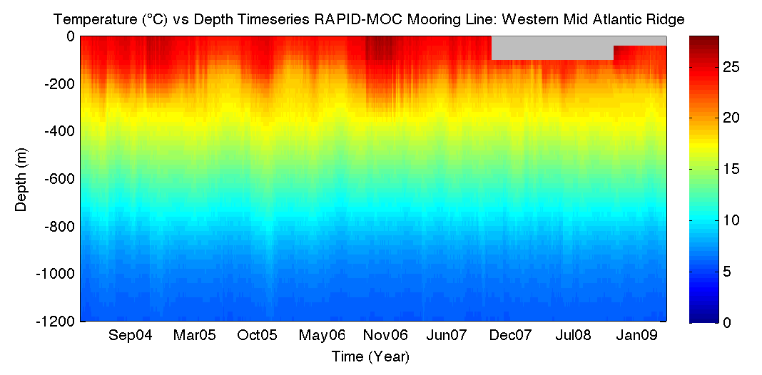

Slide 18
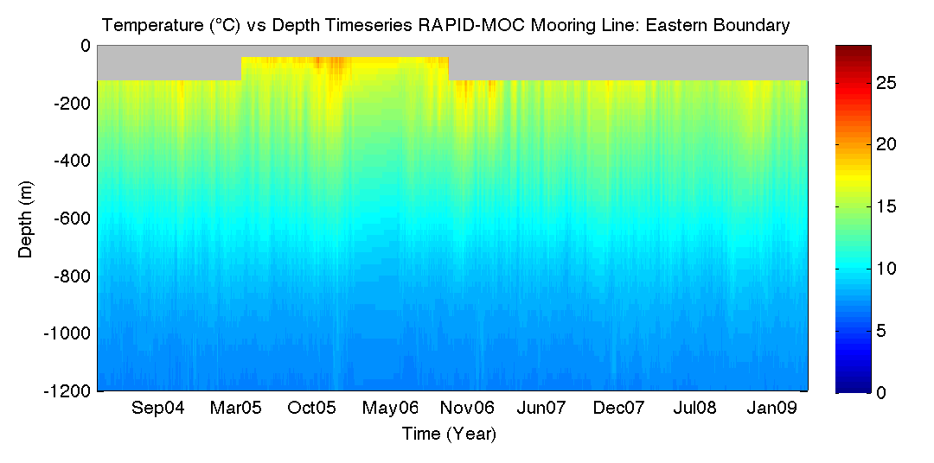

Slide 20
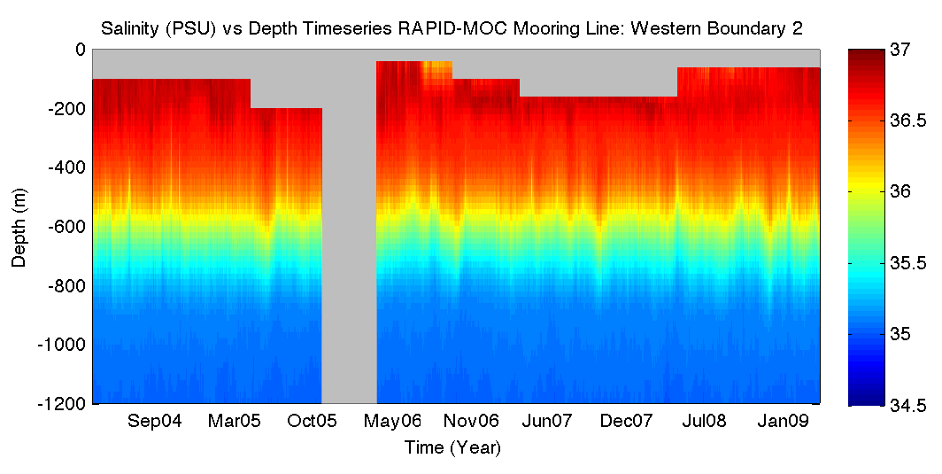
Notes:
Salinity scales different

Slide 21
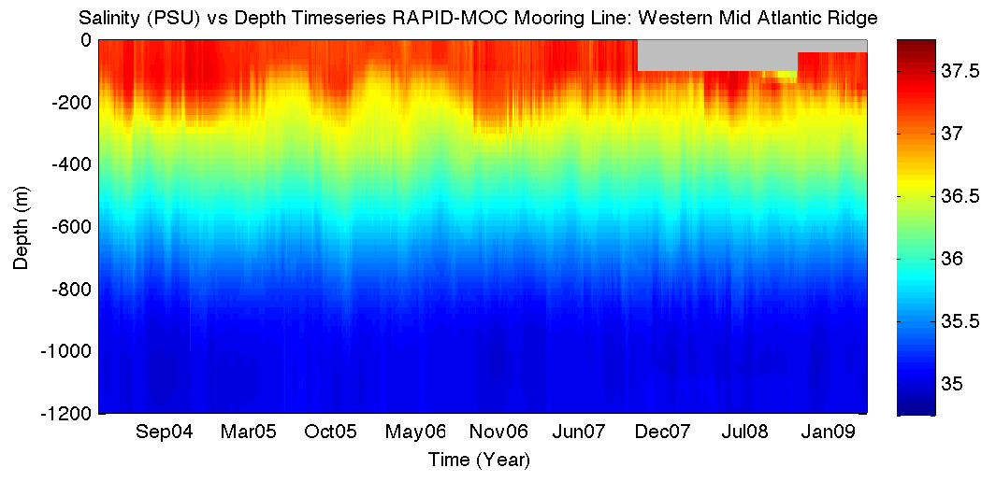

Slide 22
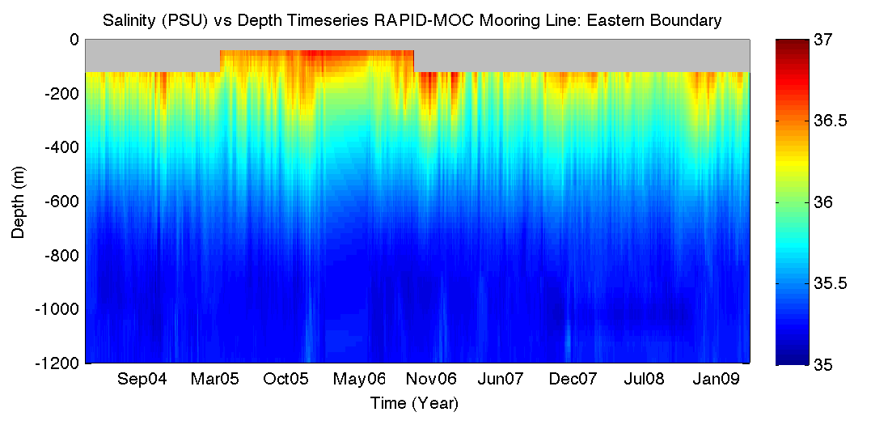

Slide 24
Four Rocks Wave & Wind:
Wave Height
  Most favorable: June-August (3 ft)
  Next best option: February-April, September-October (4-5 ft)
  Least favorable: November-January (6 ft)
    Average range is only 3-6 ft, all within reasonable range for deployment
Dominant Winds:
  Primarily originating from SSE-ENE (blowing towards WSW-NNW)
    No dominant winds are favorable (blowing the opposite way intended direction of travel for glider)
Notes:
JASON

Slide 25
Calculating minimum density for ballasting:
Using conservative numbers for minimum density:
Minimum Temperature 5°C
Max Temperature: 28°C
Minimum Salinity: 34 PSU
Maximum Salinity: 37 PSU

Slide 26
Calculating minimum density for ballasting:
Using conservative numbers for minimum density:
Minimum Temperature 5°C
Max Temperature: 28°C
Minimum Salinity: 34 PSU
Maximum Salinity: 37 PSU
Calculated Density: 1021.672

Slide 27
Calculating minimum density for ballasting:
FUTURE CONSIDERATIONS:
  Wave and wind data are monthly averages
    Need to take into account daily forecasts
  Limited mooring surface data & some no data points
    Freshwater lenses?
    More conservative???...always better to not be able to sink (CAN fix) rather than not be able to surface (potentially CANNOT fix)!...but don’t want to be stuck on the surface either.

Slide 28

Thank you!
Special thanks to:
-Natural Environment Research Council RAPID program
-National Oceanography Centre Southampton
-University of Miami
-Rosenstiel School of Marine and Atmospheric Science
-Atlantic Oceanographic and Meteorological Laboratory
-Spanish Institute of Oceanography
-Max Planck Institute for Meteorology
Data from the RAPID-WATCH MOC monitoring project are funded by the Natural Environment Research Council and are freely available from www.noc.soton.ac.uk/rapidmoc.
-Magic Seaweed Wind & Swell
-Scott Glenn, Oscar Schofield, Josh Kohut, Dave Aragon, Shannon Harrison
Notes:
Any questions?

