Slide 1
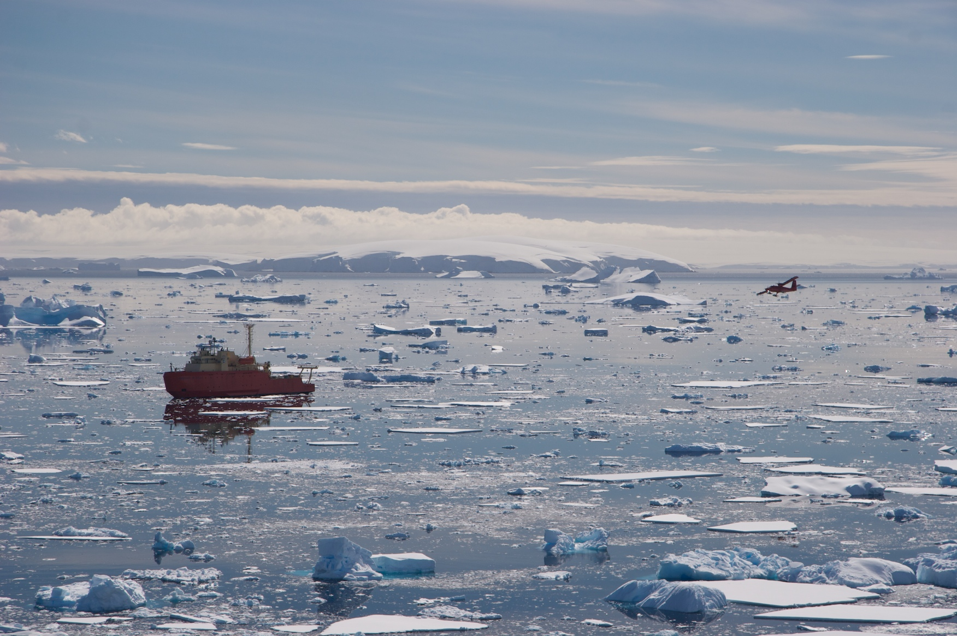

Bathymetric structuring of biological hotspots in the West Antarctic Peninsula
Schofield, O., Ducklow, H., Arrott, M., Kahl, A., Martinson, D., Steinberg, D. K., Fraser, B., Gorman, K.
Acknowledgements: National Science Foundation’s Office of Polar Programs & LTER program, Gordon and Betty Moore Foundation, NASA Biodiversity Program

Slide 2
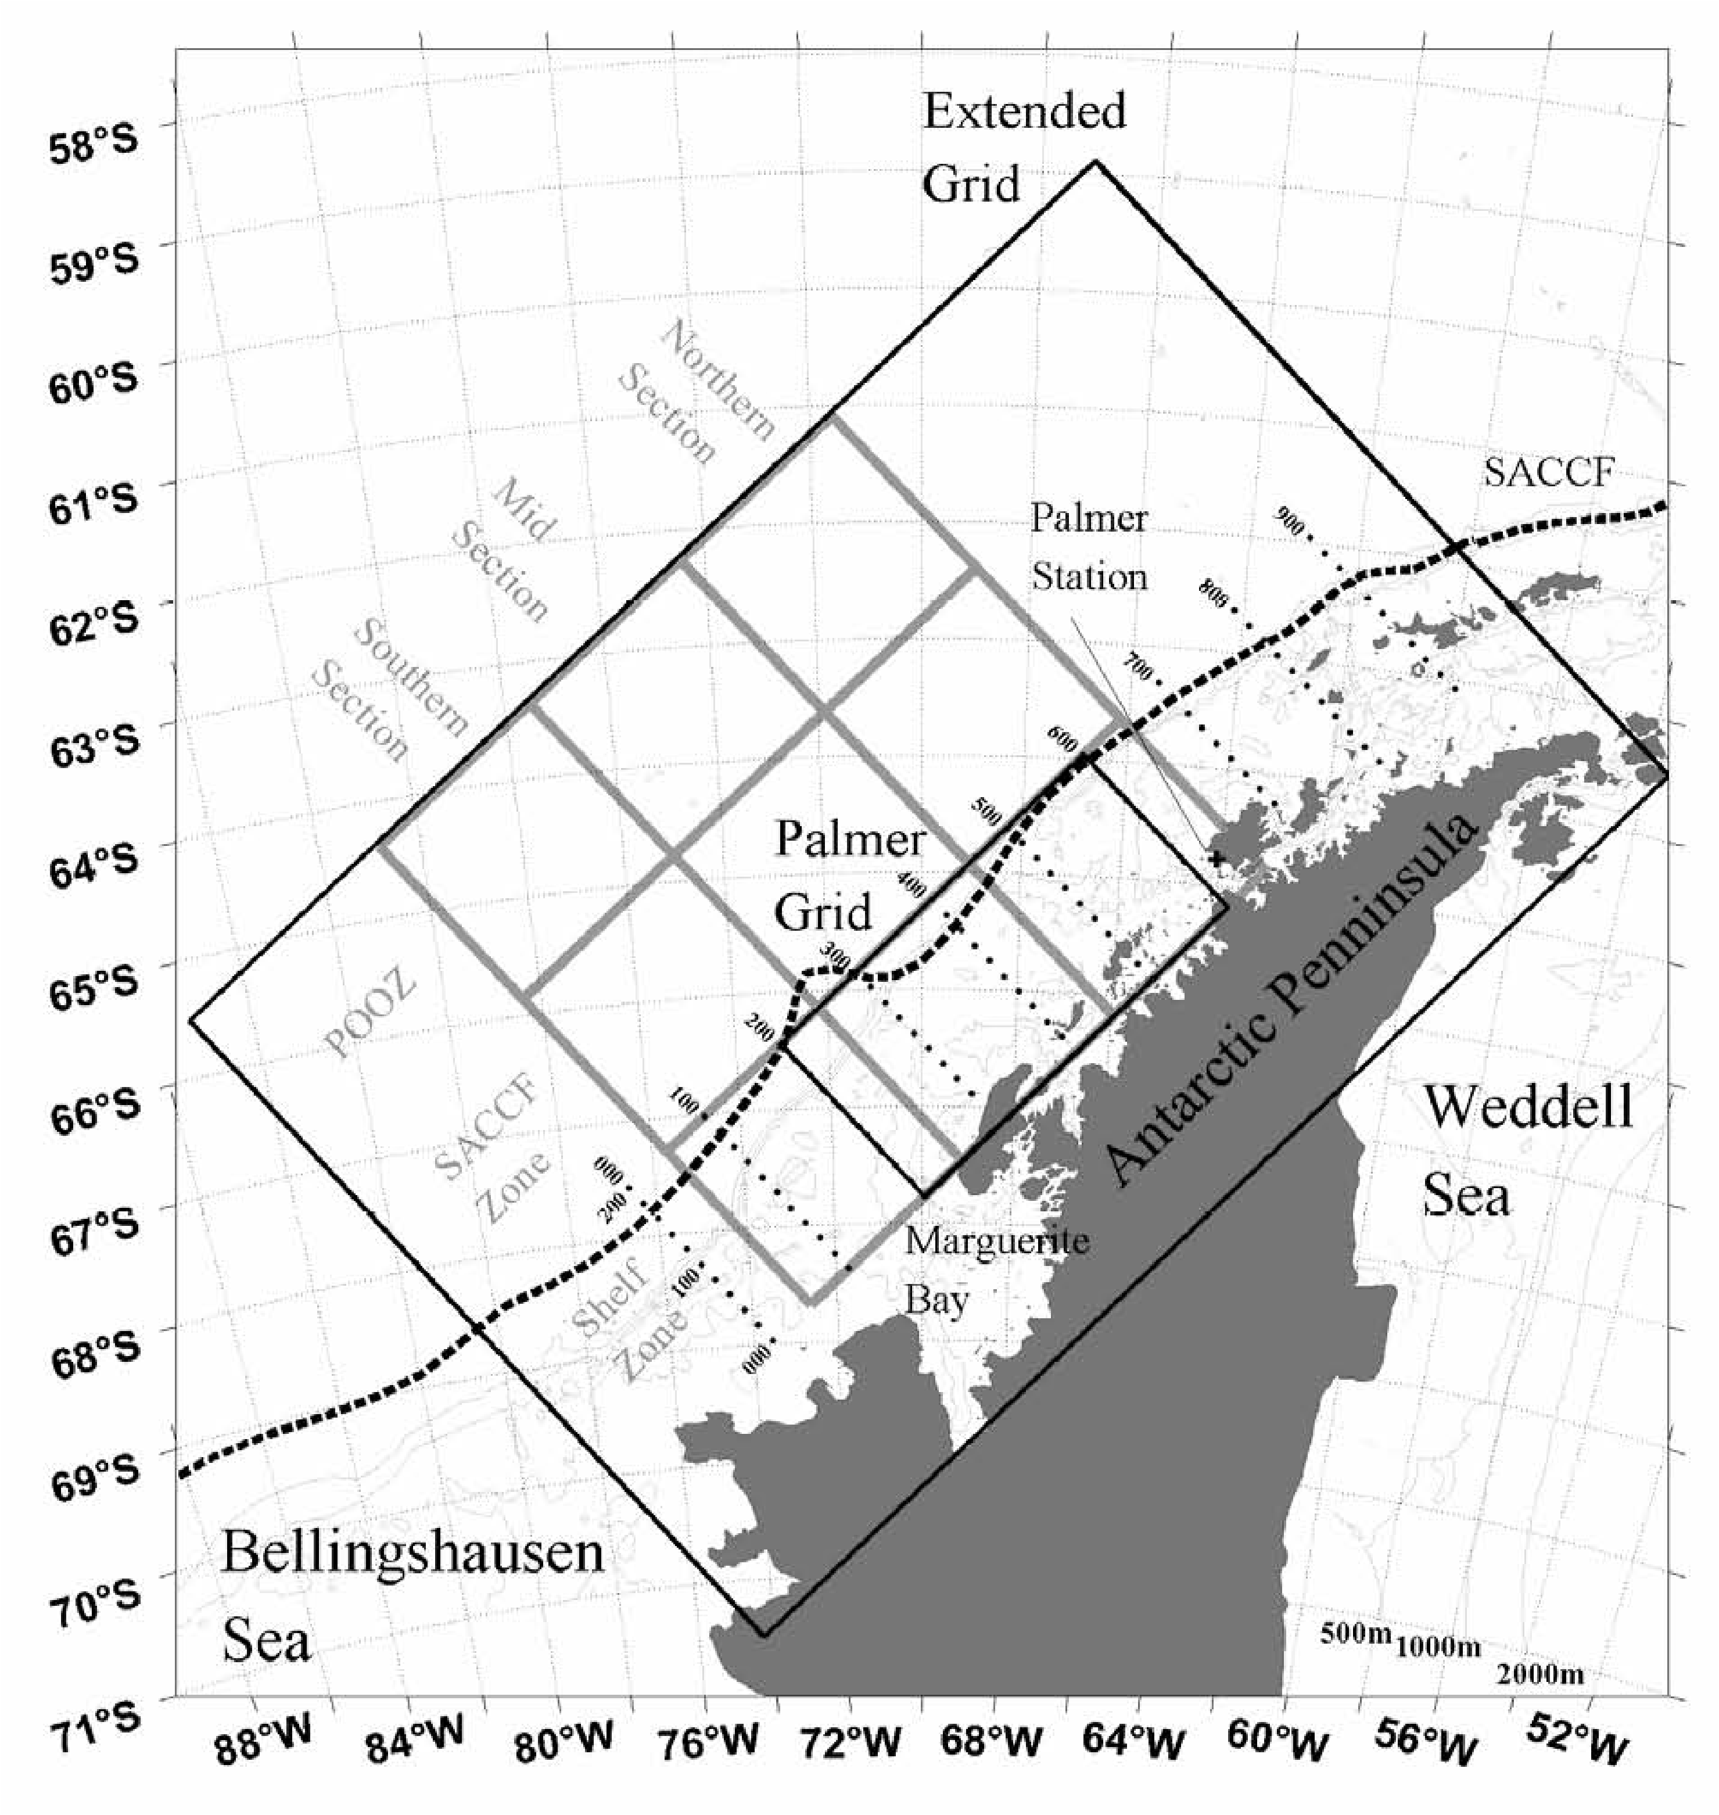
Outline for today
A) What regulates biological hot spots along the West Antarctic Peninsula?
B) Why is there urgency in documenting these submescale hot-spots?
C) How will new technology galvanize the path forward?
D) What have the technologies found?
E) Where are we going?
Acknowledgements to the Palmer troops and the COOL room in the trenches: Elizabeth Leonardis, Michael Garzio, Megan Cermino, Brian Gaas, Tina Haskins, David Aragon, John Kerfoot, Chip Haldeman, Hugh Roarty, Courtney Kohut

Slide 3
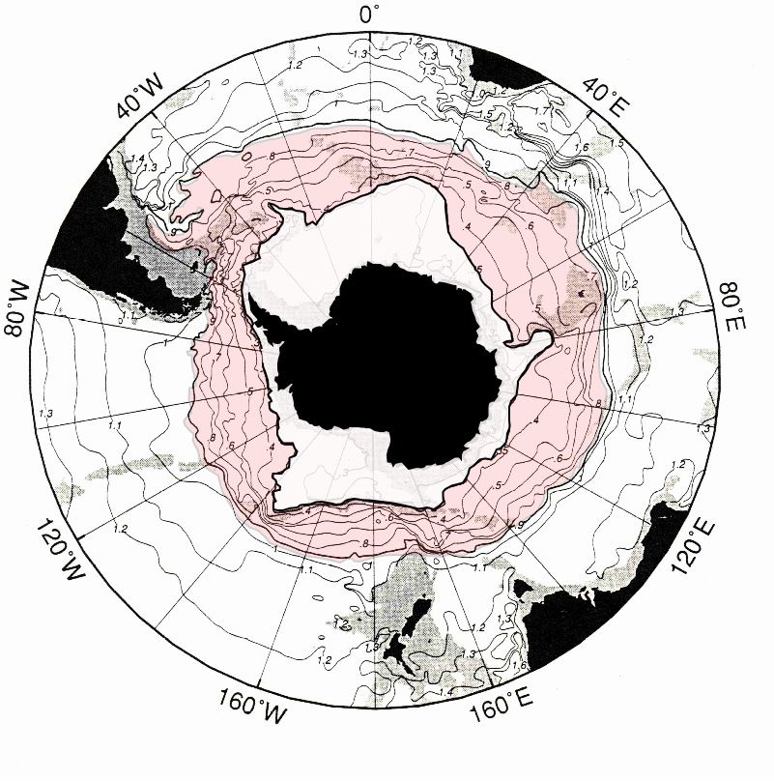
The West Antarctic Peninsula is the located close to the Antarctic Circumpolar Current compared to the rest of the continent. This current is source of heat to this region as the warm is a balmy 4 degrees warm.

Slide 4
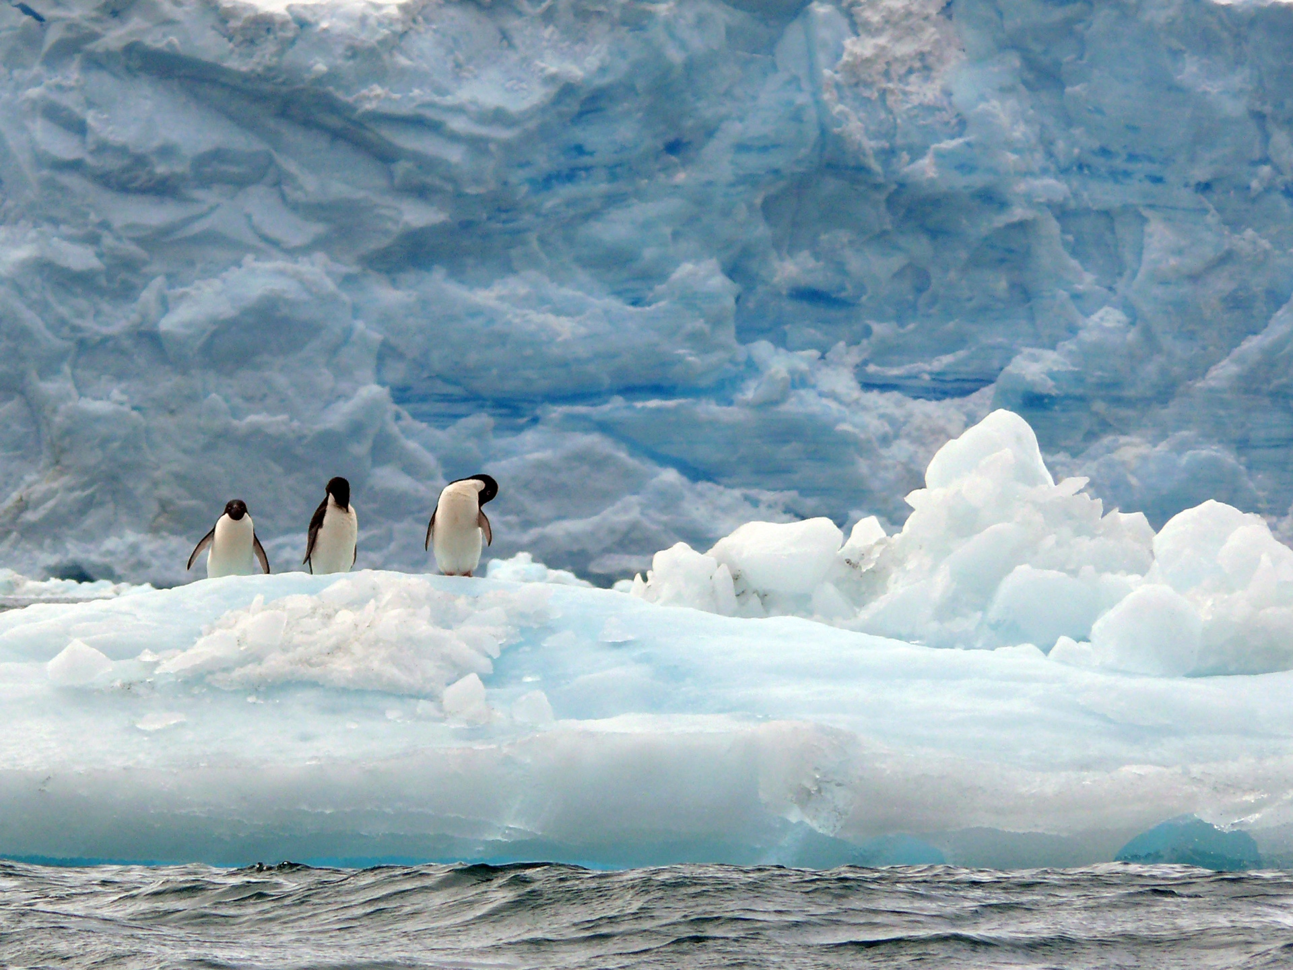
What regulates biological hot spots along the West Antarctic Peninsula?
Who is our candidate species to define the hot spot?
Adélie penguin
(Pygoscelis adeliae)

Slide 5
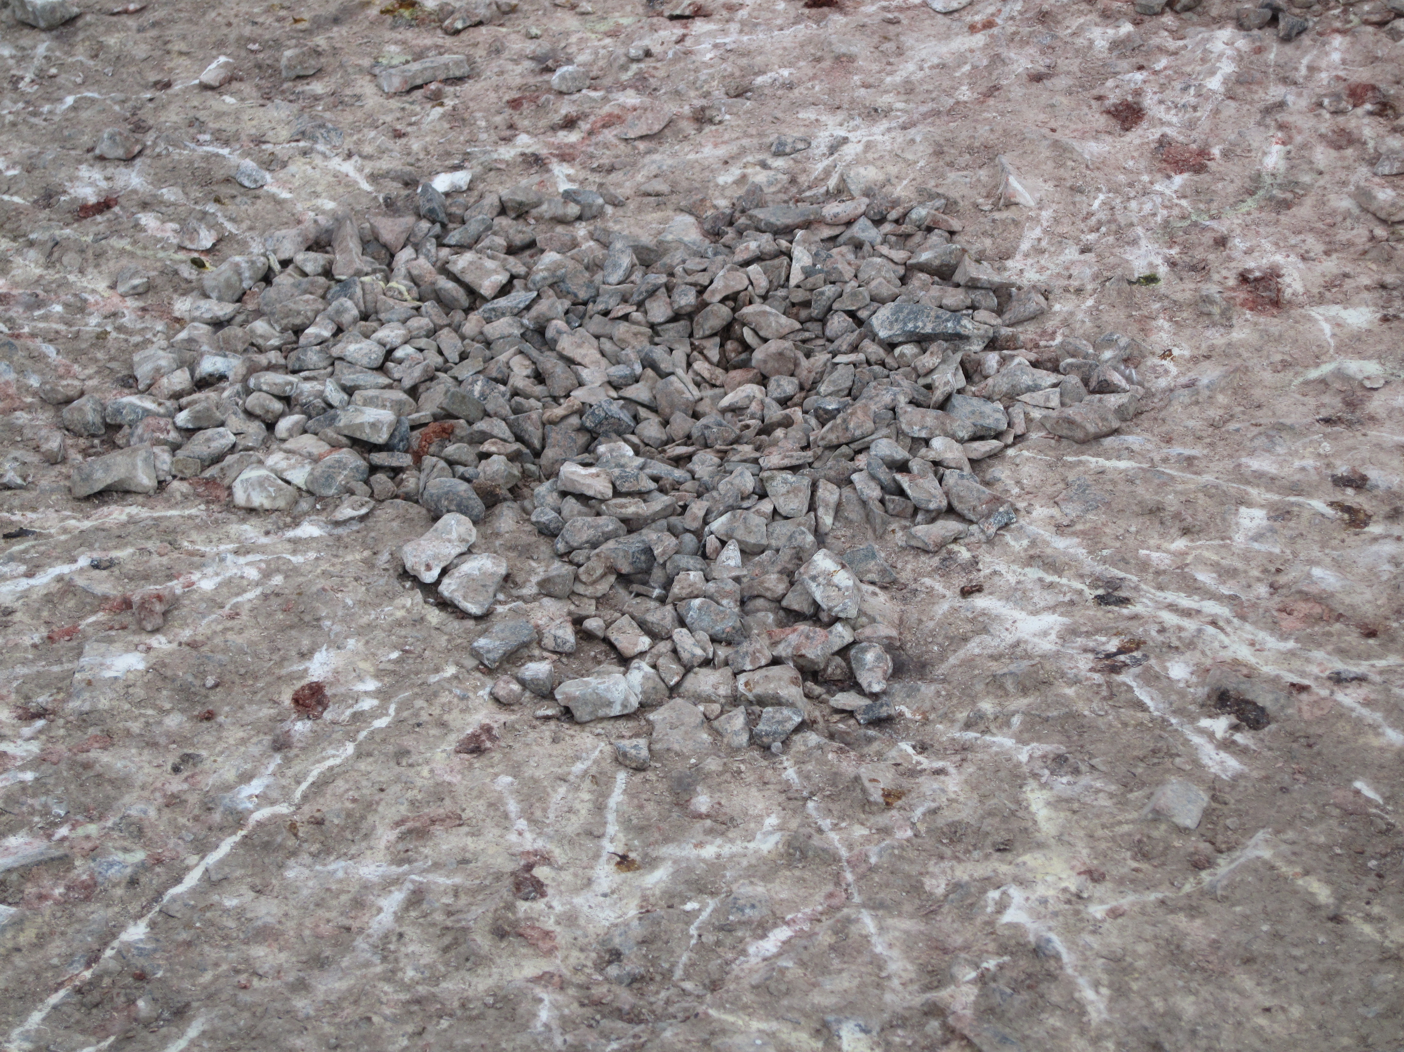
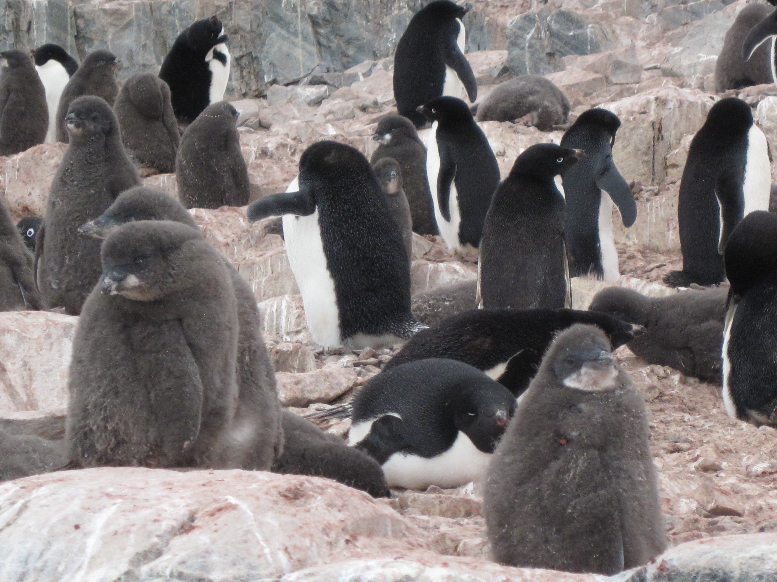
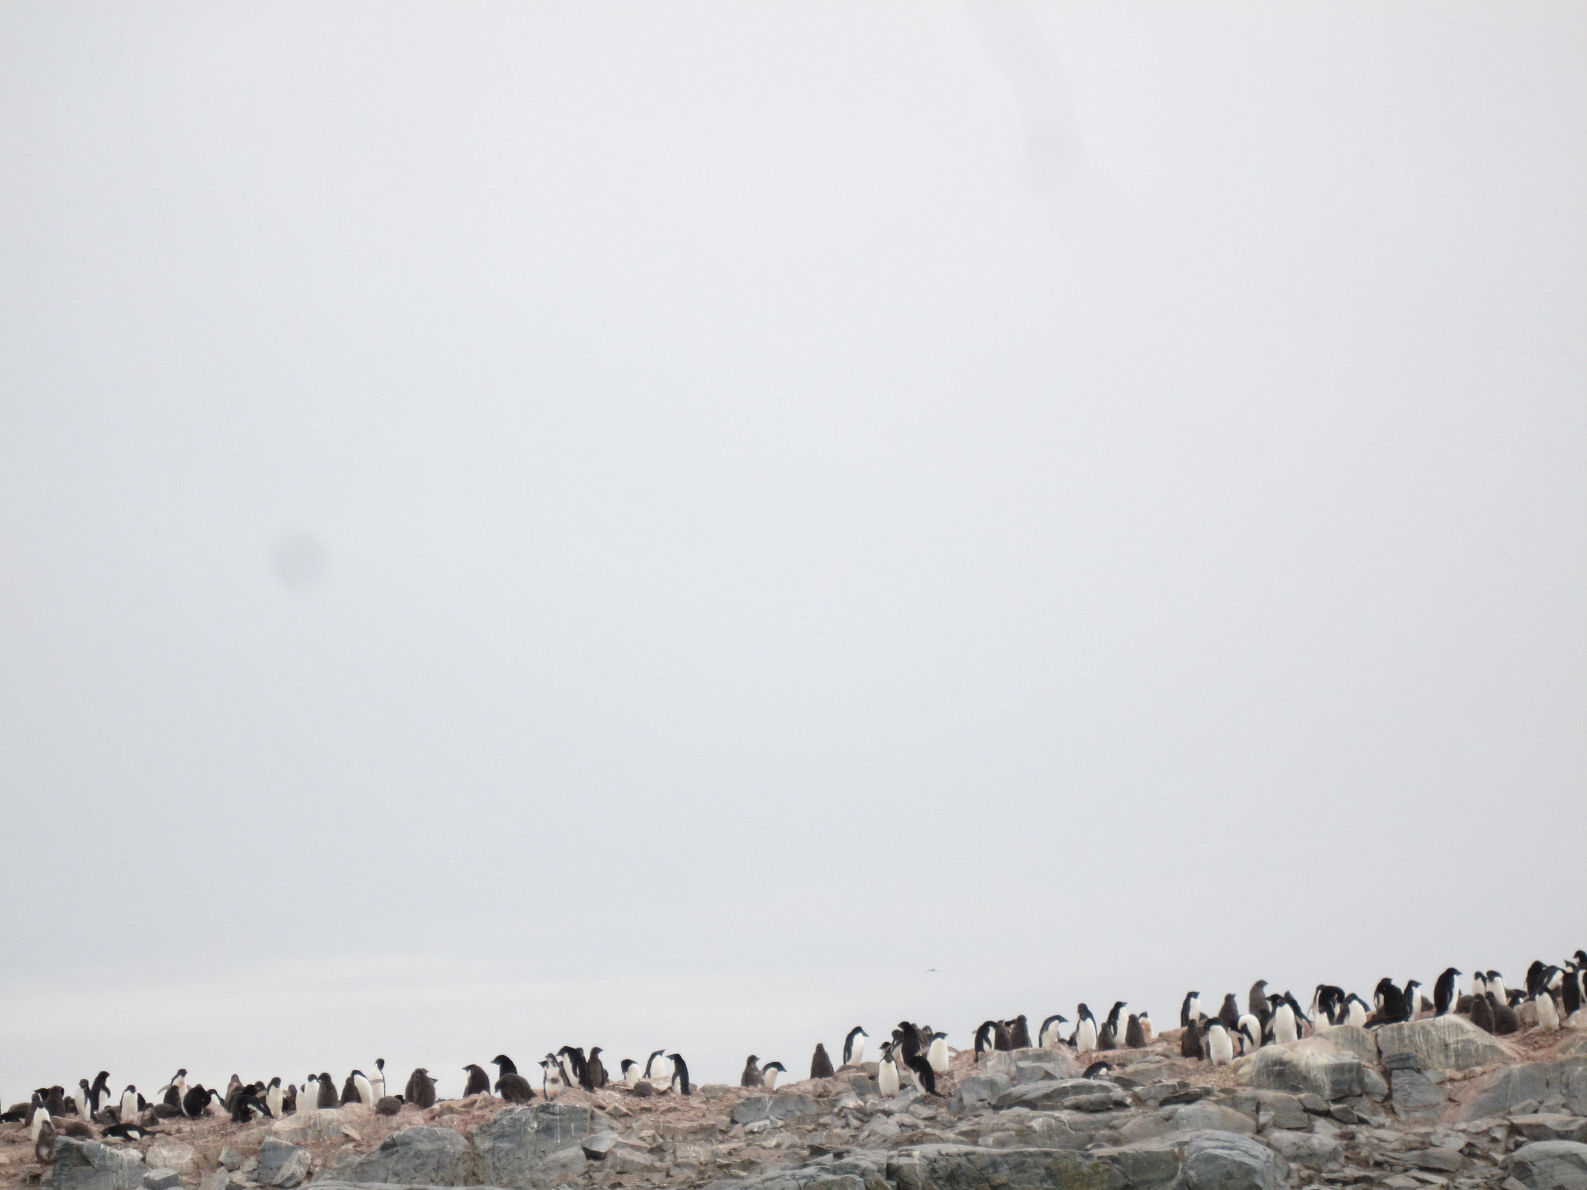
Adélie penguins form rookeries in fixed locations year after year. Rookeries are formed and breeding pairs raise their young. For their young the parents need a predictable food resource that can be ascertained in a less then a days swim.

Slide 6
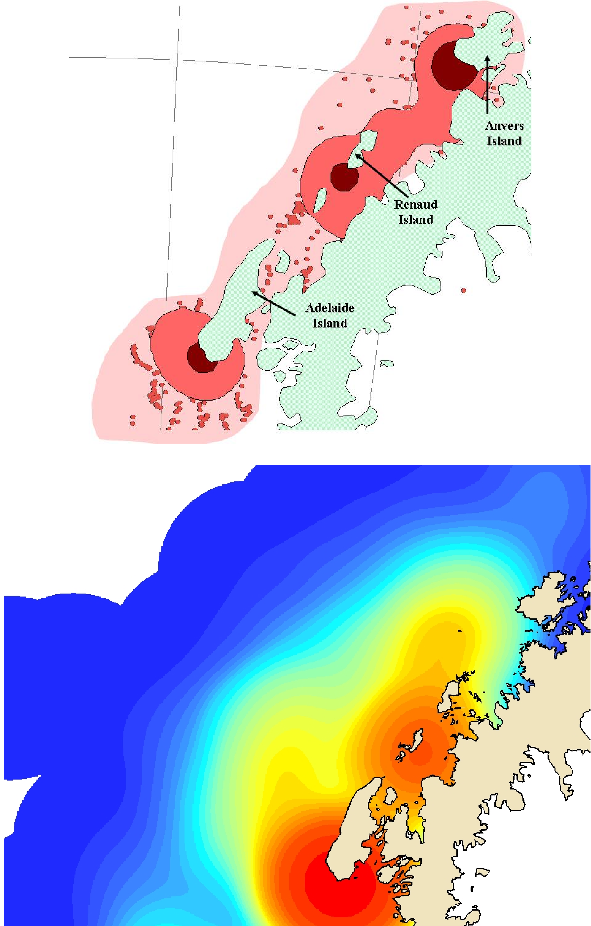
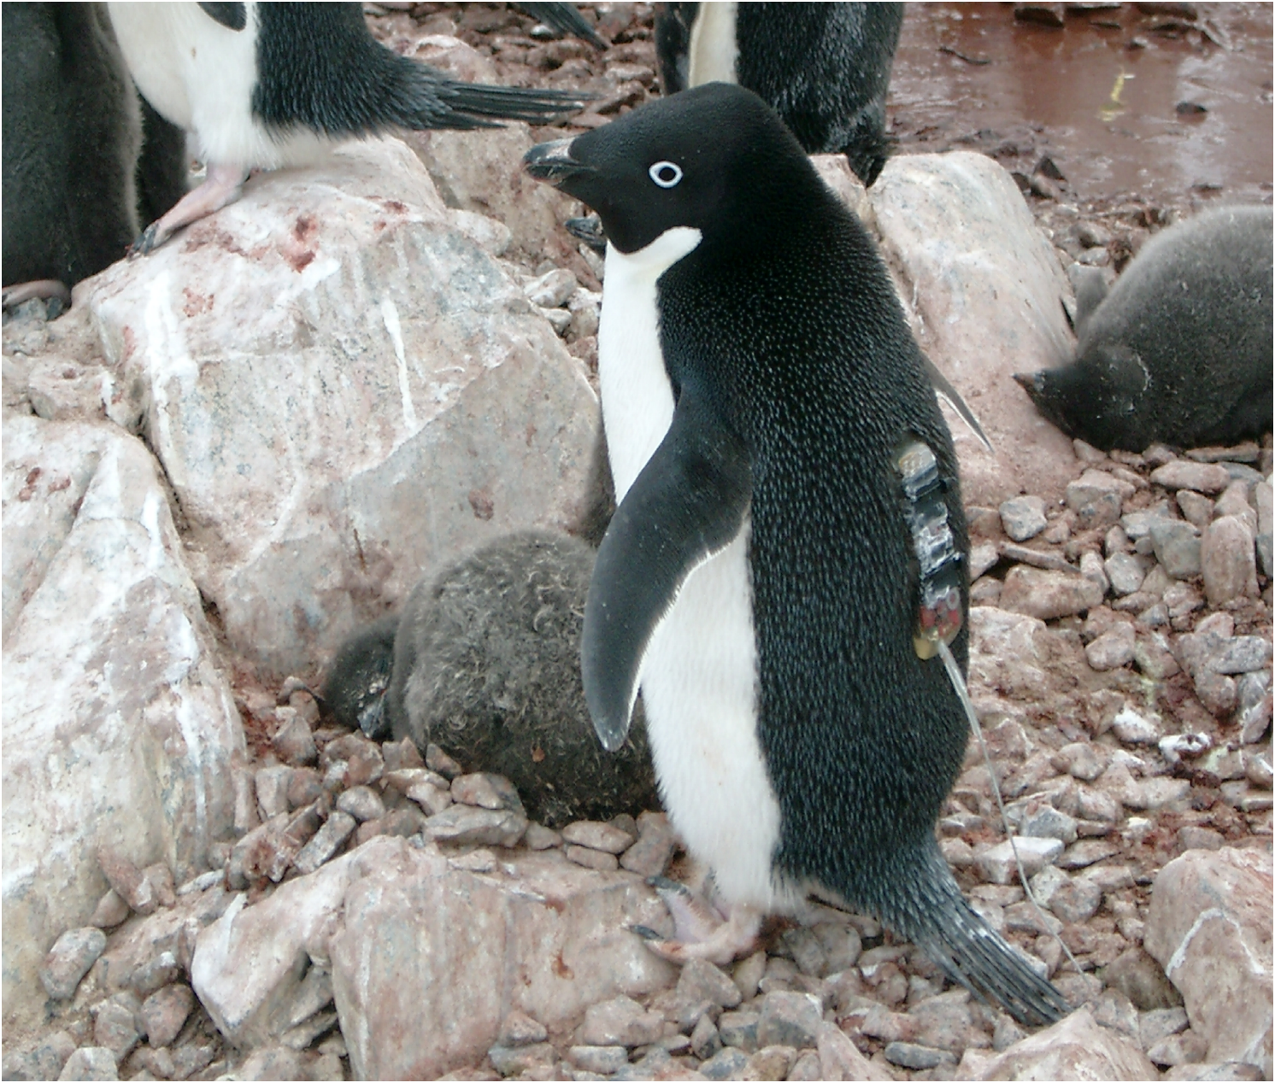
Summer
Foraging
Regions
What are the main foraging regions?
To determine that we take advantage of the ecology/evolution which has determined the prime locations to be. How?? glue stick…..
Winter
Foraging
Regions

Slide 7
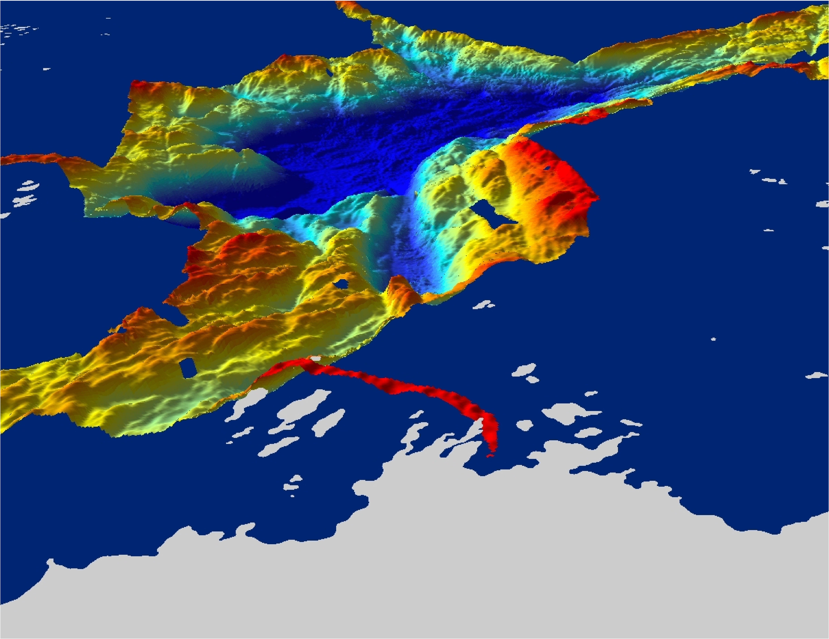
Anvers Island
Hot spots along the peninsula are associated with
deep undersea canyons located near suitable breeding areas,
which can be reached in a days foraging effort (~30 km).

Slide 8
Hypothesis 1: The location of the penguin colonies are linked to upwelling which transports UCDW water to coastal areas. The UCDW water is warm, leading to ice free conditions. These canyon zones should have relatively low ice & high predictable food.
Quantitatively describing the trends in these zones is critical as these systems are exhibiting large changes in the last few decades. Again as the penguins are at the higher trophic levels, they integrate over large space & time scales.

Slide 9
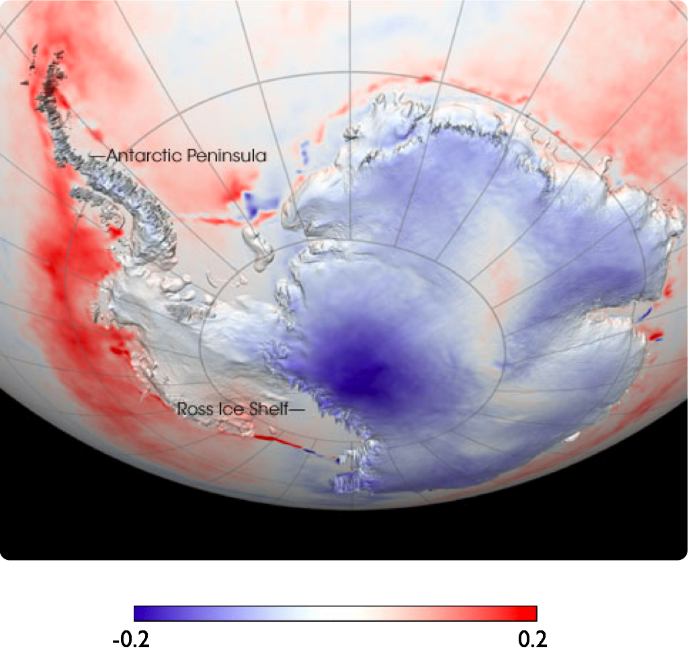
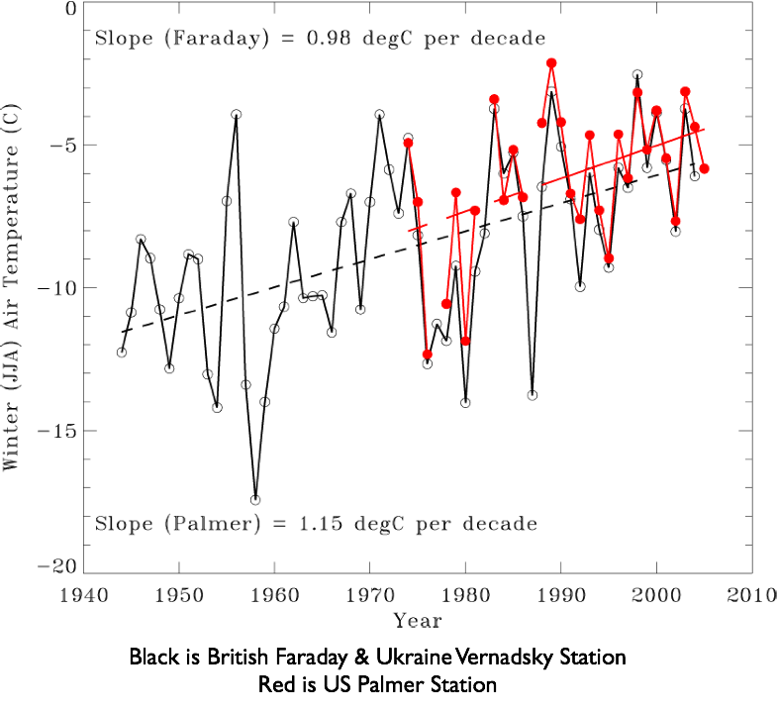
Temperature trends per year
-0.2
0.2

Slide 10
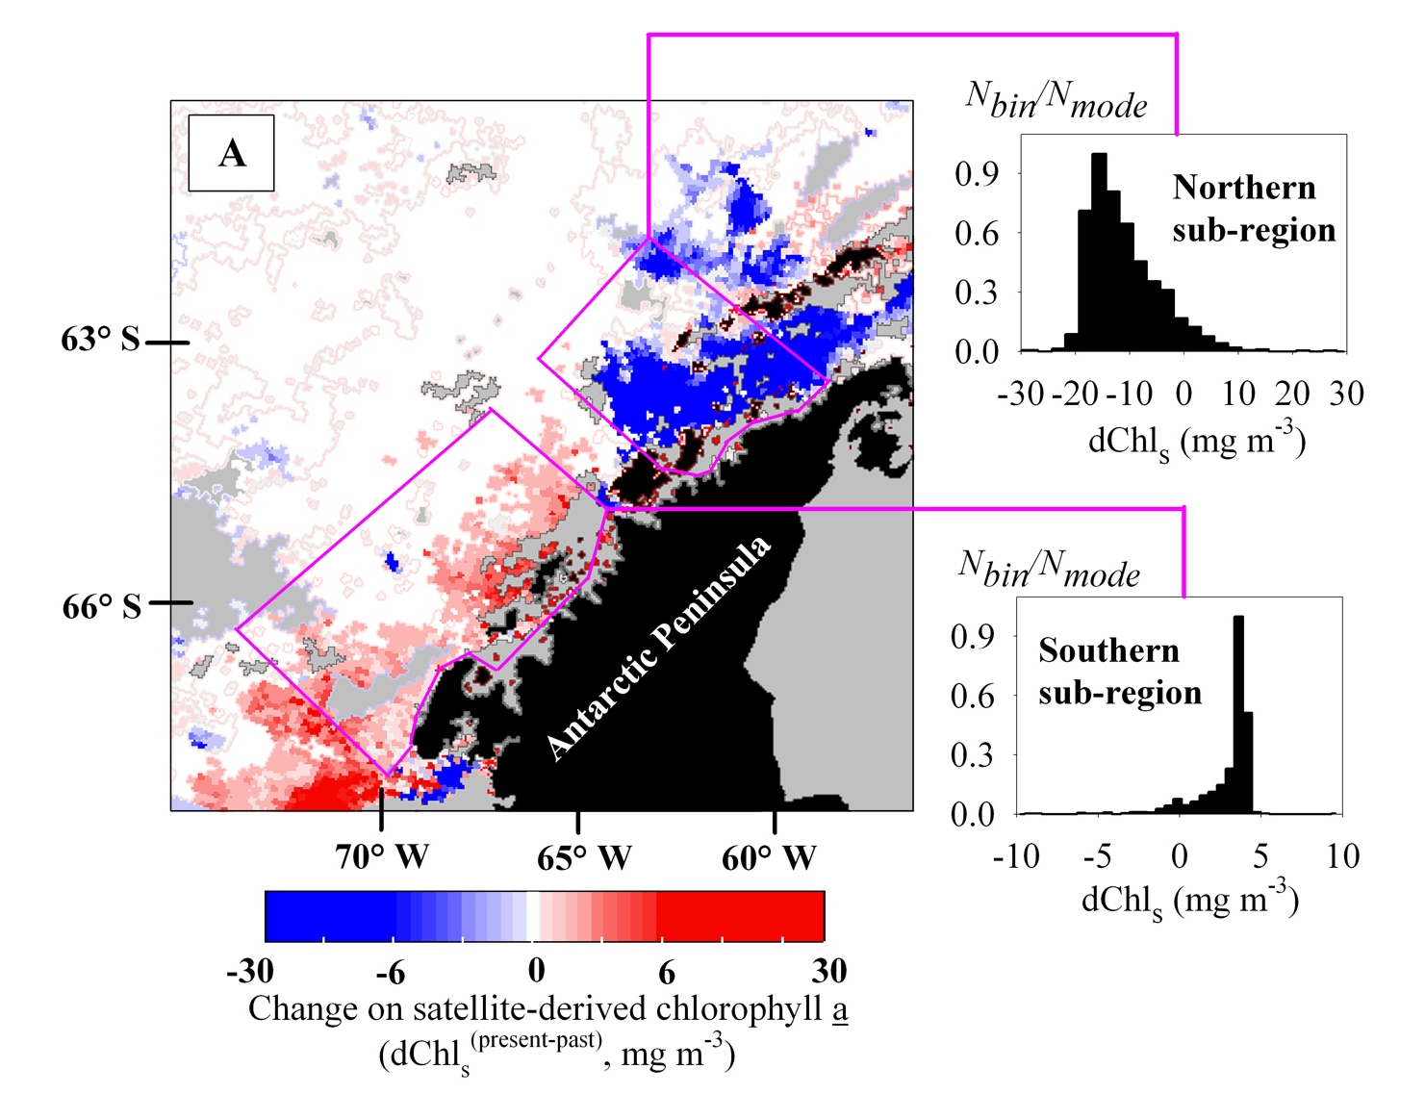
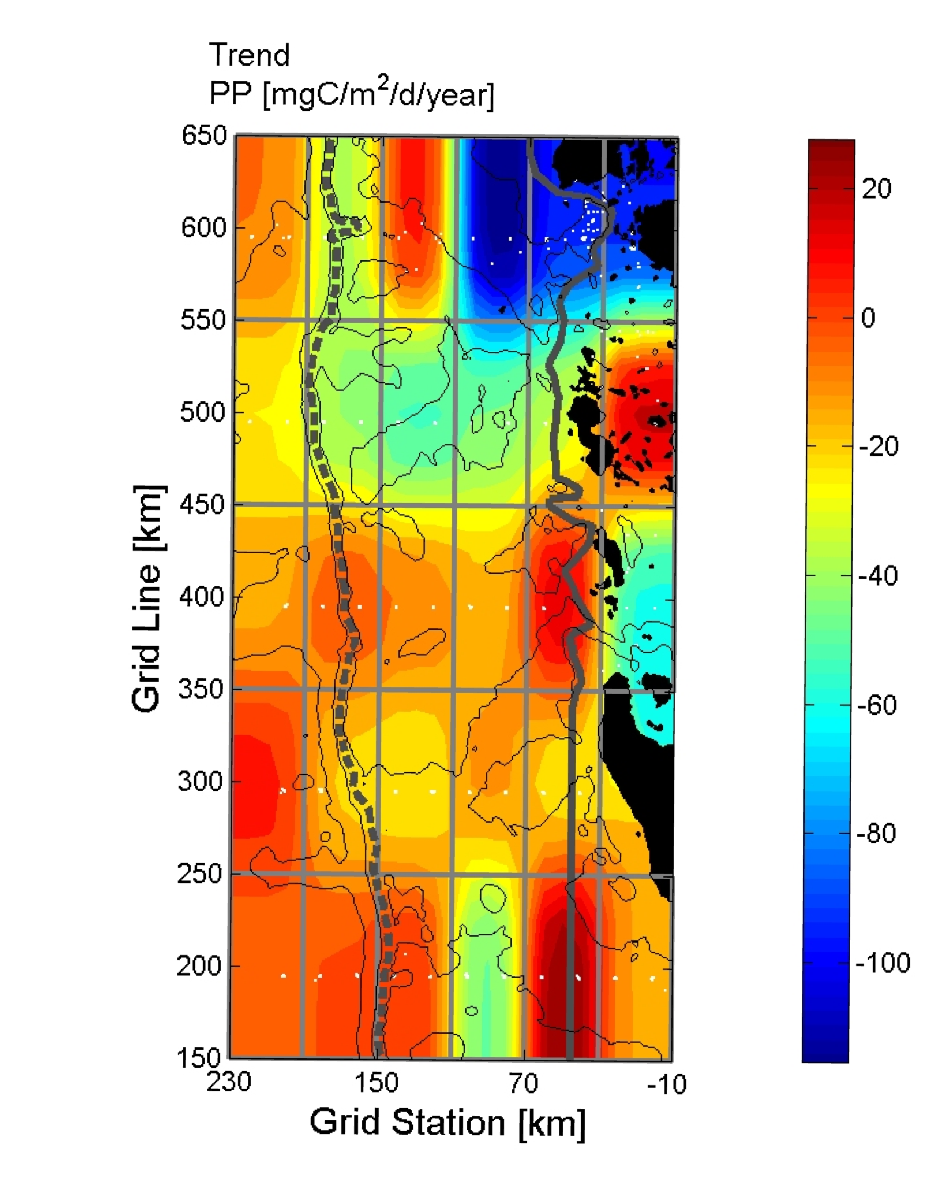
These changes have altered the base of the food chain
30-year seasonal change
~20-year January trend
Montes-Hugo et al. 2009
Vernet et al. 2008

Slide 11
From Loeb et al., 1997
100
10
6
Krill:Salp
Ice Index
1
4
0.1
0.01
2
0.001
80
82
84
86
88
90
92
94
96
100
Year
10
2
Krill:Salp
R
= 0.56
1
0.1
0.01
0.001
2
4
6
100
Ice Index
10
2
Krill:Salp
R
= 0.63
1
0.1
0.01
0.001
-4
-2
0
Mean Air Temperature (°C)

Slide 12
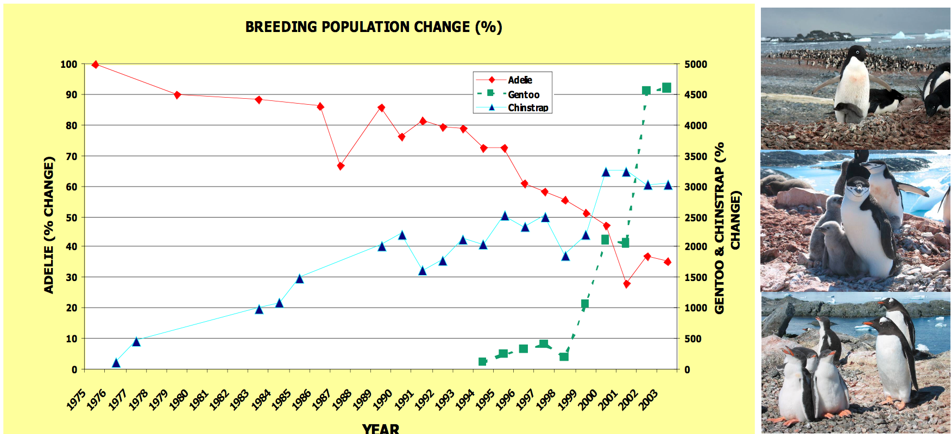

Slide 13
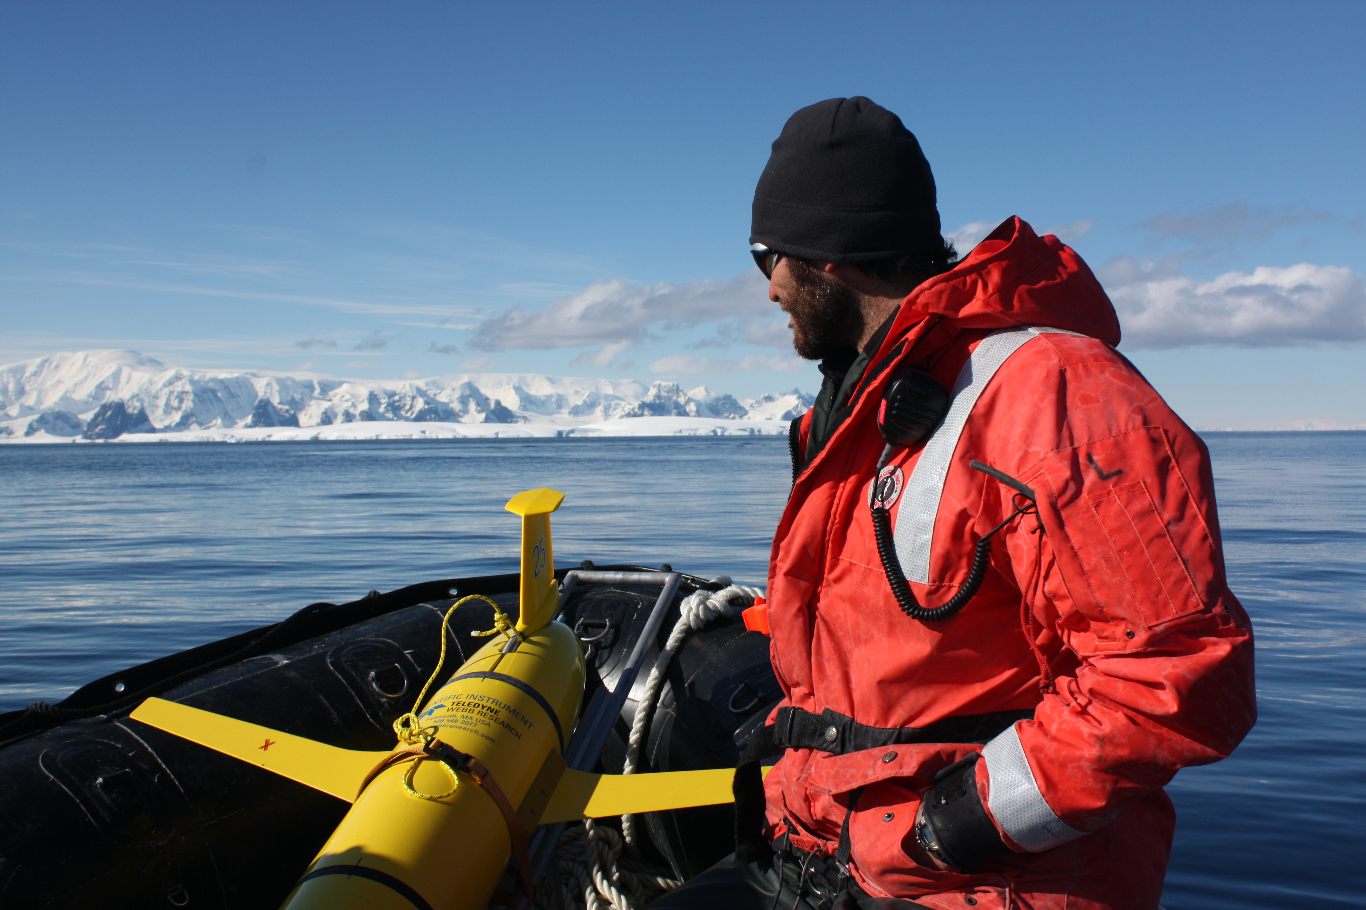

Slide 14
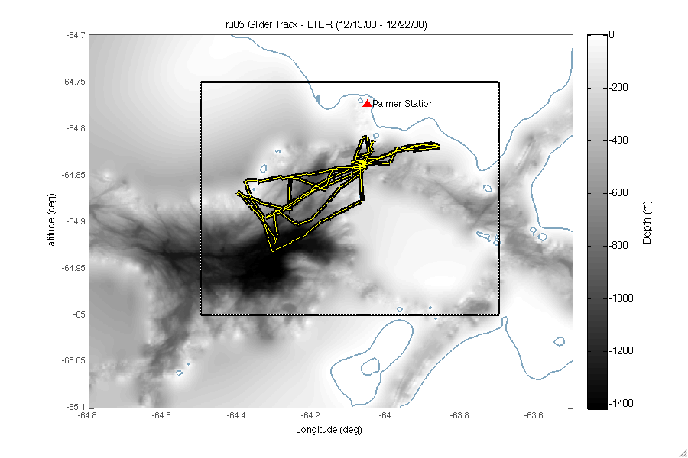

Slide 15
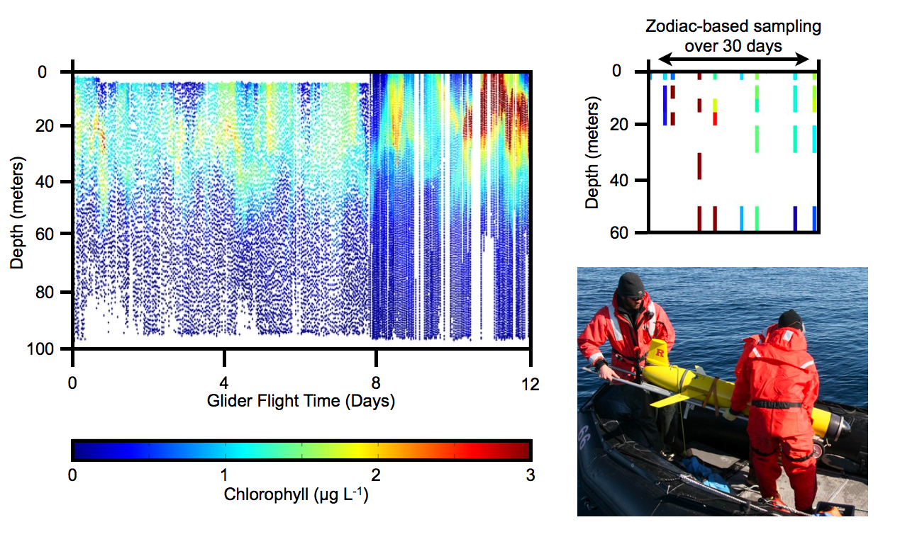

Slide 16
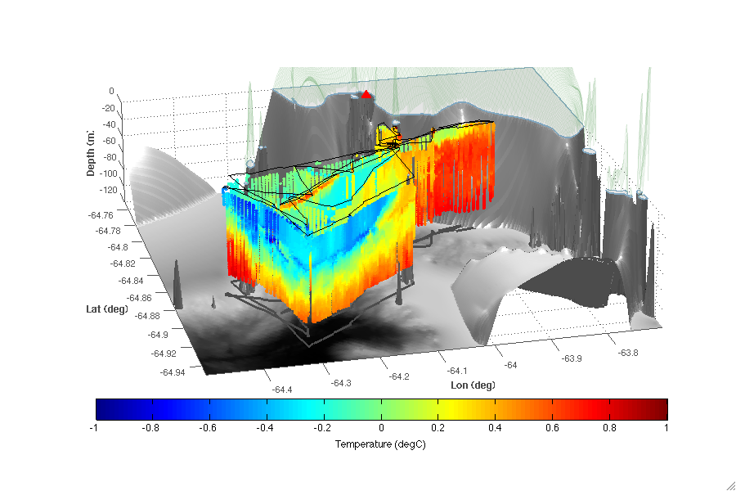

Slide 17
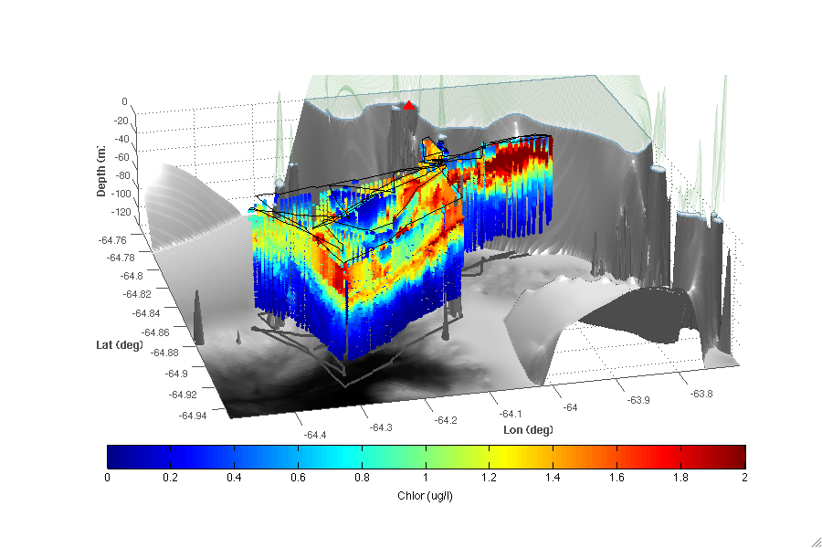

Slide 18
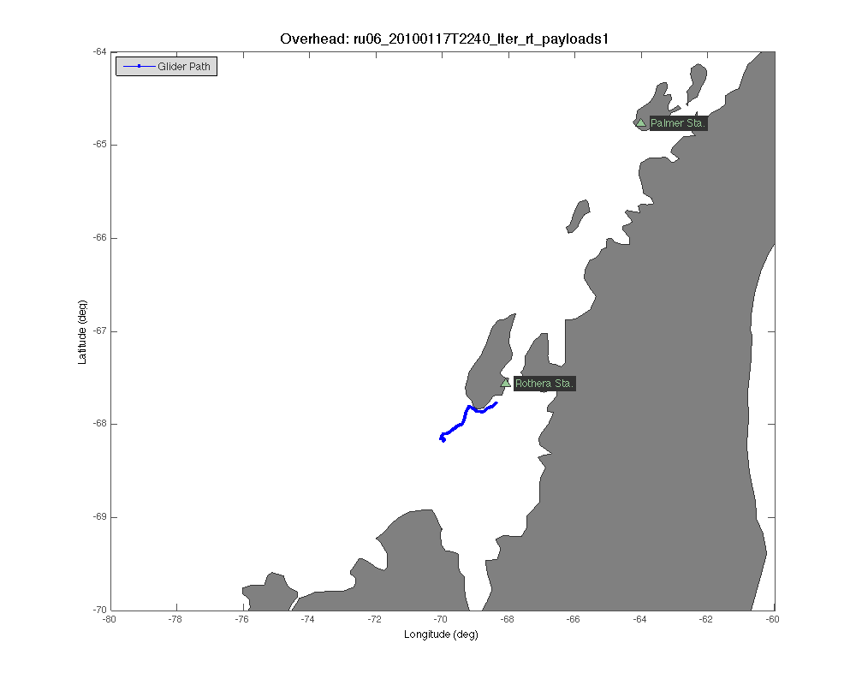
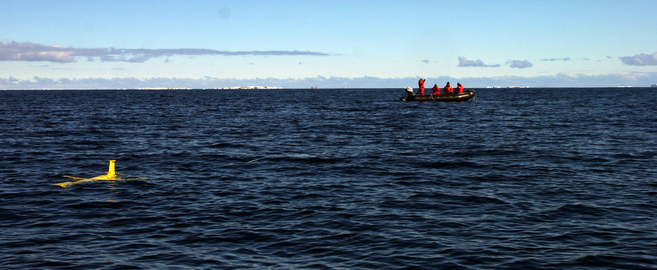

Slide 19
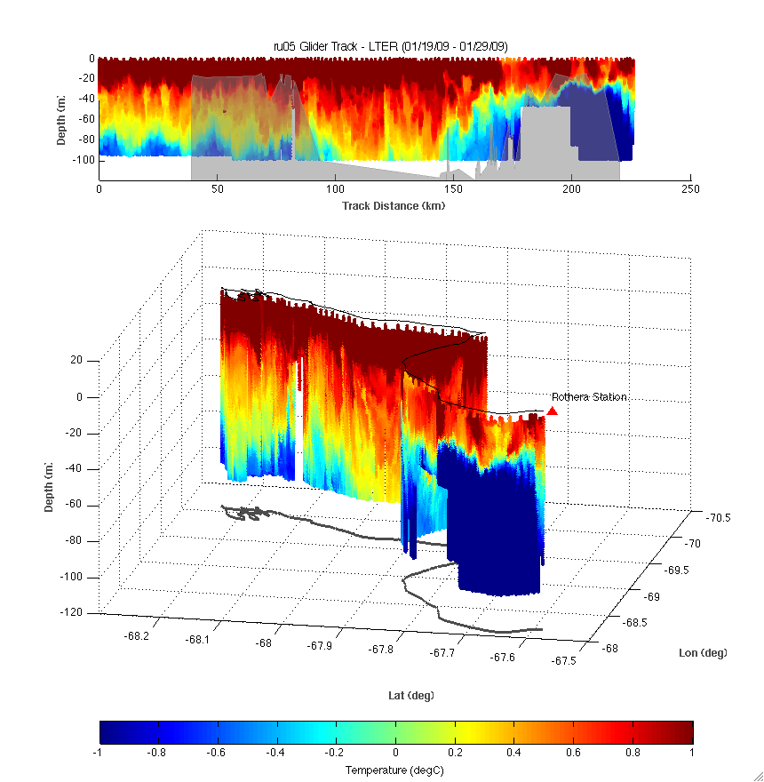

Slide 20
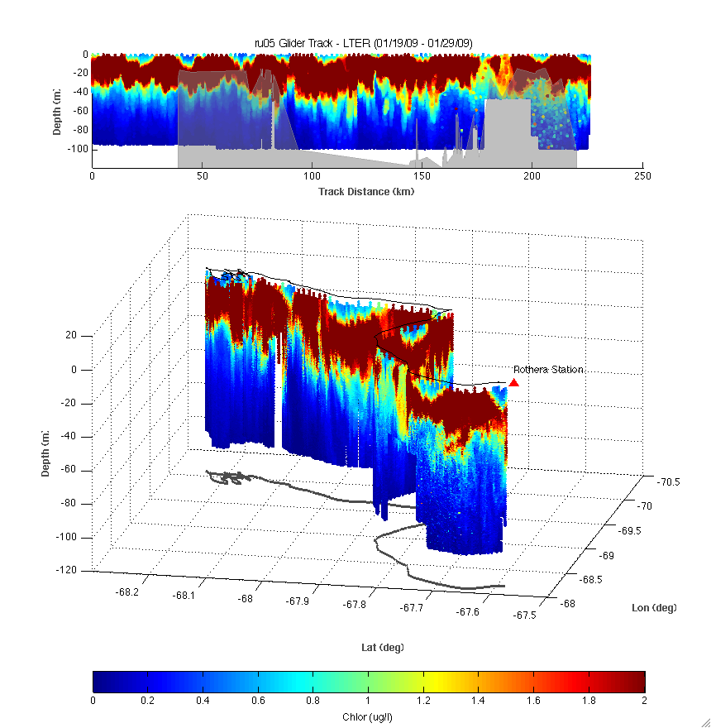

Slide 21
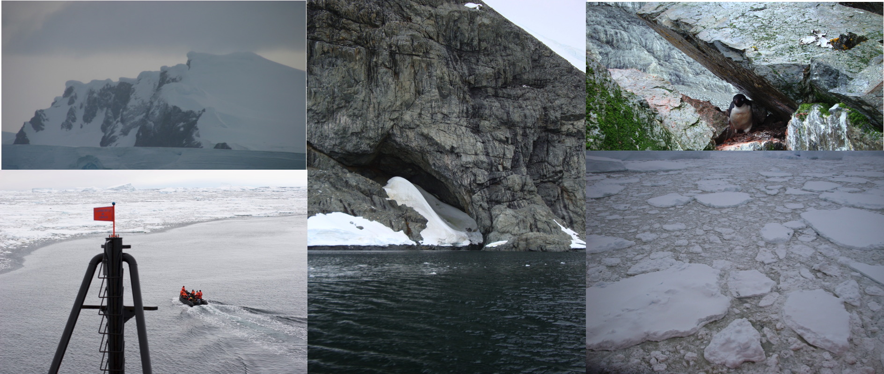
2009 discovery of the penguins at Charcot Island

Slide 22
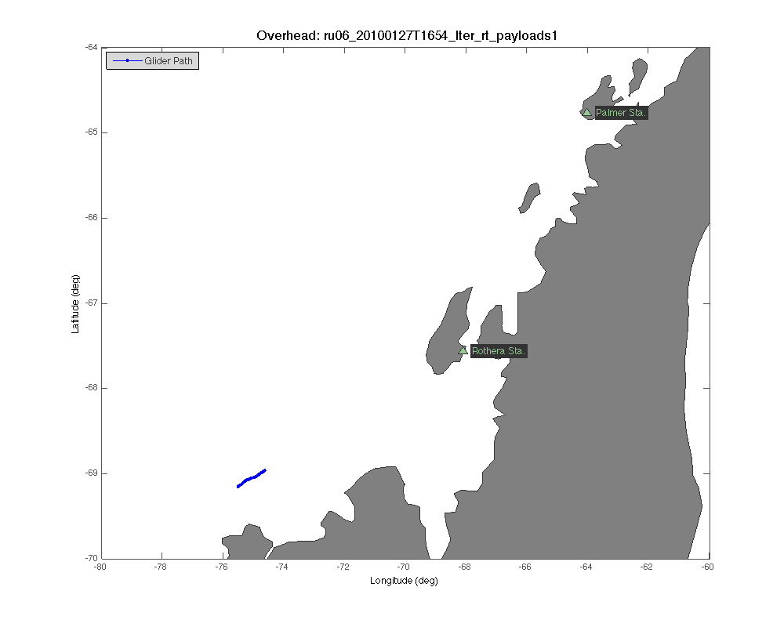

Slide 23
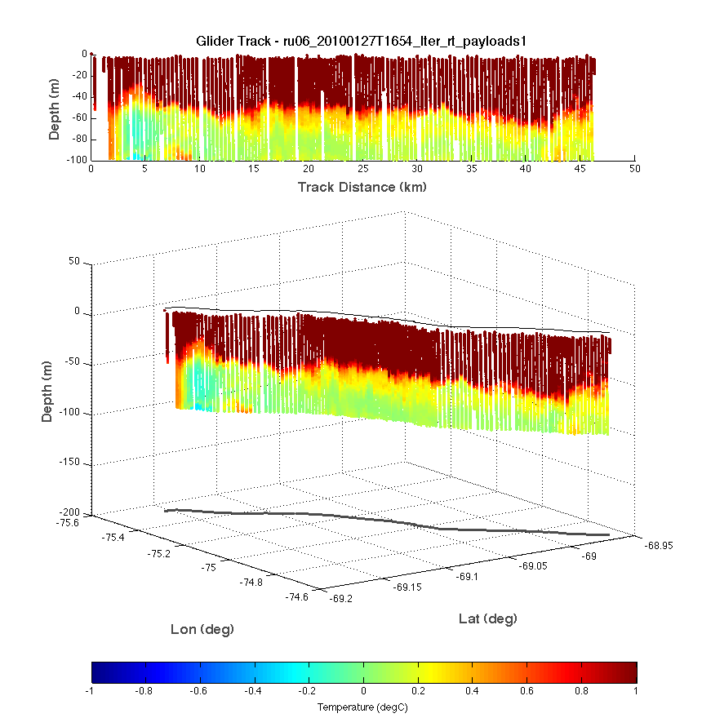

Slide 24
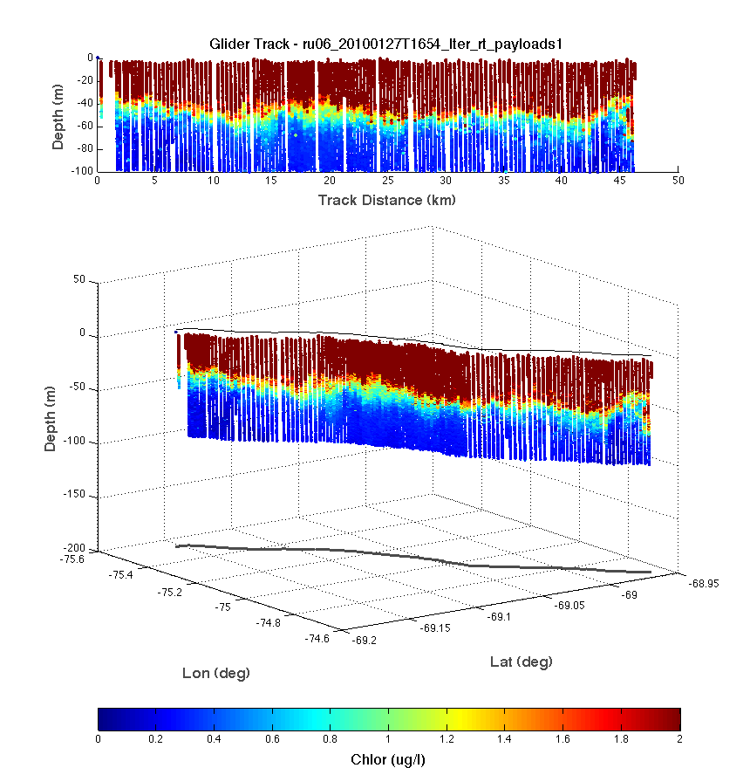

Slide 25
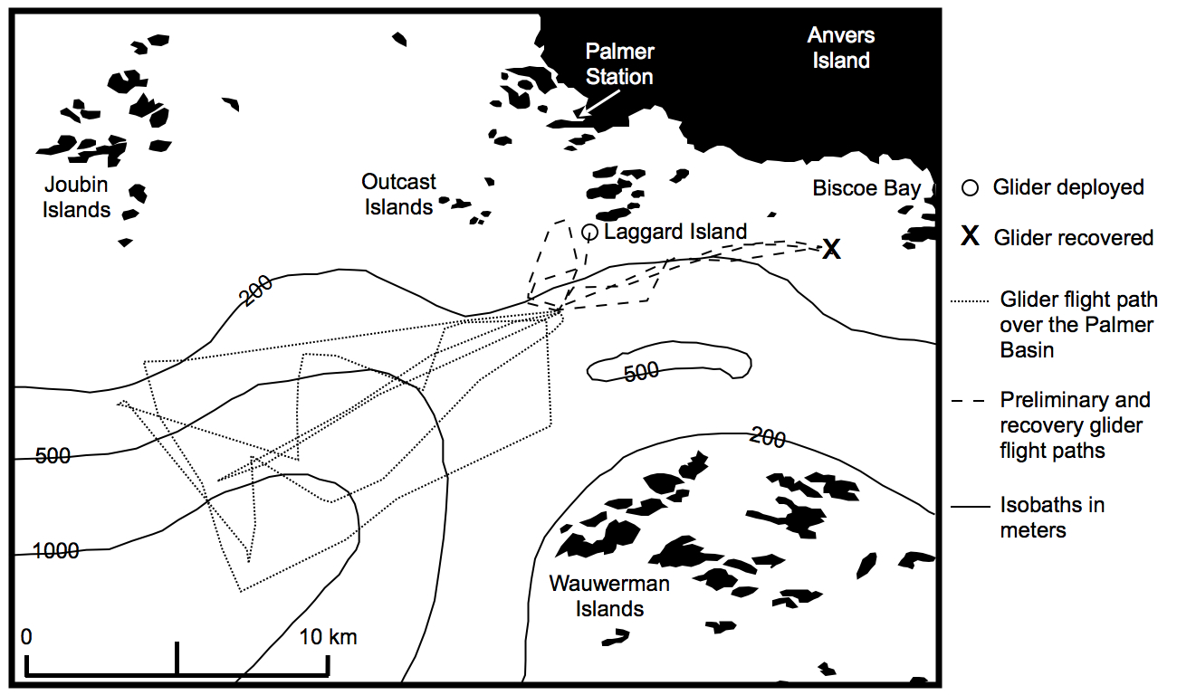

Slide 26
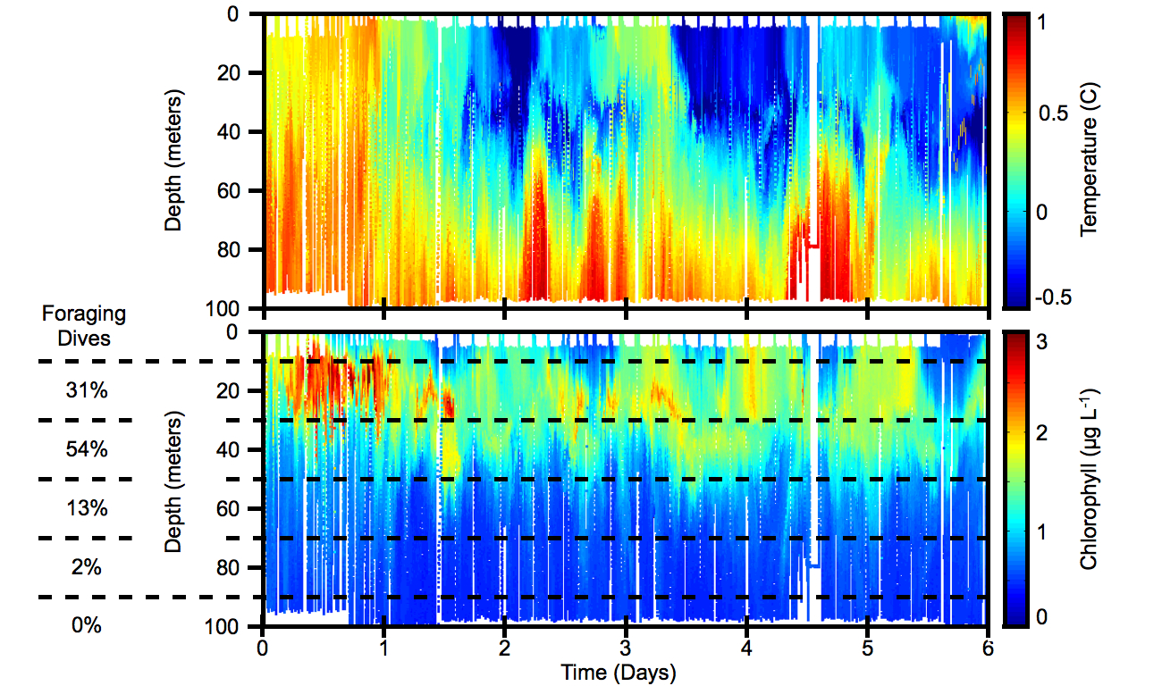

Slide 27
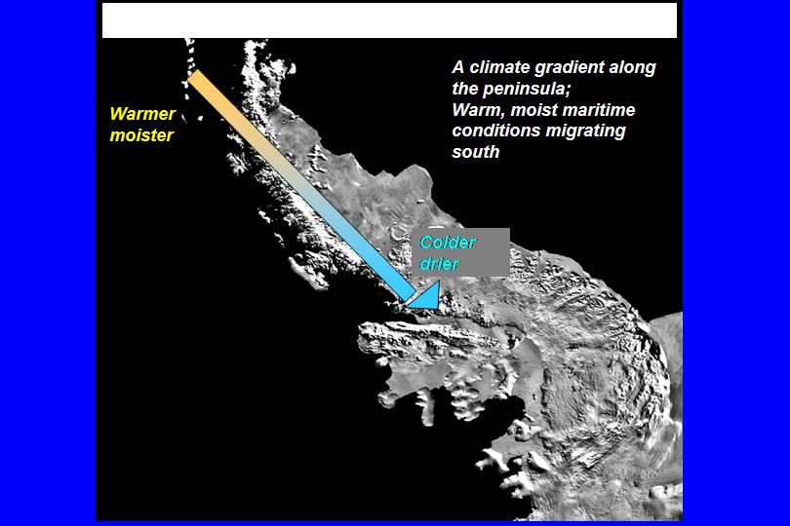
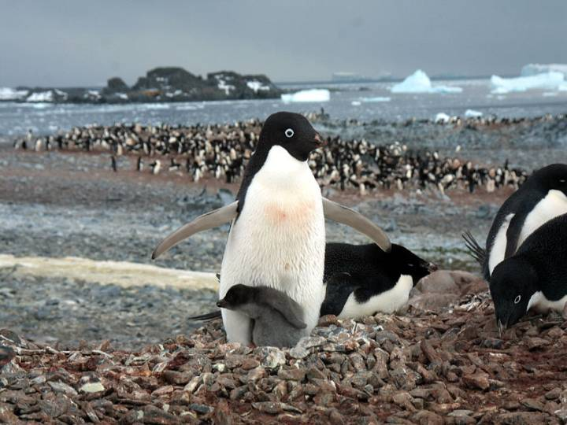
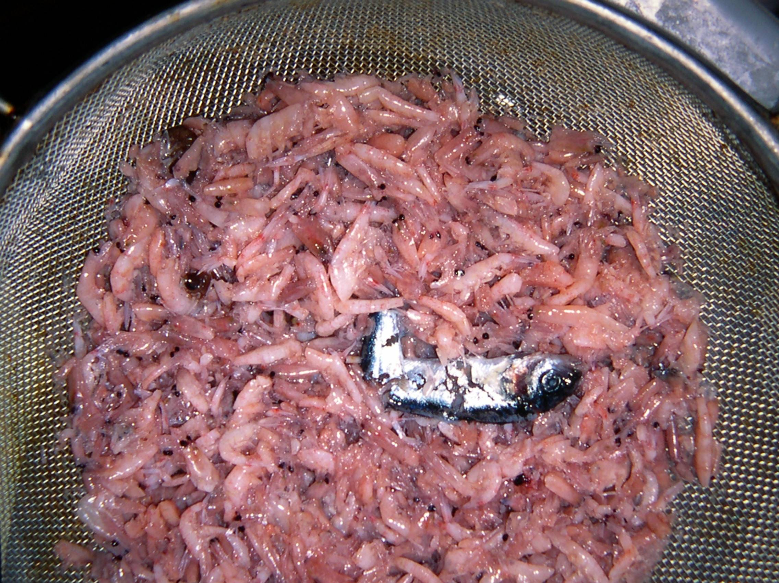
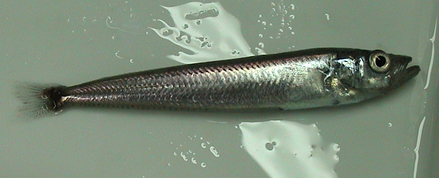
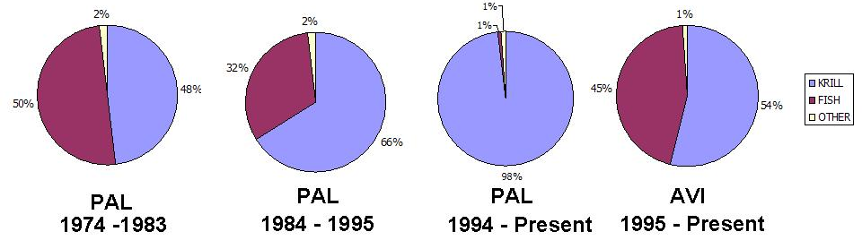
North to South Changes in Antarctic silverfish (Pleuragramma antarctica) Populations
ANVERS IS
1994-
present
ADELAIDE IS
1995-
present
Notes:
THE ANTARCTIC KRILL, EUPHAUSIA SUPERBA, AS YOU WILL LEARN LATER ON IN THESE TALKS, IS AN ICE-DEPENDENT SPECIES. LARVAE IN PARTICULAR CANNOT SURVIVE WINTER WITHOUT GRAZING ON THE ALGAE AND DIATOMS THAT GROW BENEATHE THE SEA ICE AT THIS TIME OF YEAR. RECENT EVIDENCE ALSO INDICATES THAT SILVERFISH REQUIRE SEA ICE FOR REPRODUCTION, IN THAT THE PLATELET ICE IN PARTICULAR SHELTERS EGGS AND LARVAE, AND FEEDS THEM IN MUCH THE SAME WAY LARVAL KRILL DEPEND ON SEA ICE. SO THIS IS QUITE AND INTERESTING AND SIGNIFICANT STORY WE HAVE DEVELOPED HERE, WHICH SPANS 3 DECADES. THERE ARE TWO OTHER ASPECTS TO THIS STORY, NAMELY WHAT HAS HAPPENED TO THISE ICE-DEPENDENT SPECIES IN THE FACE OF CLIMATE MIGRATION.

Slide 28
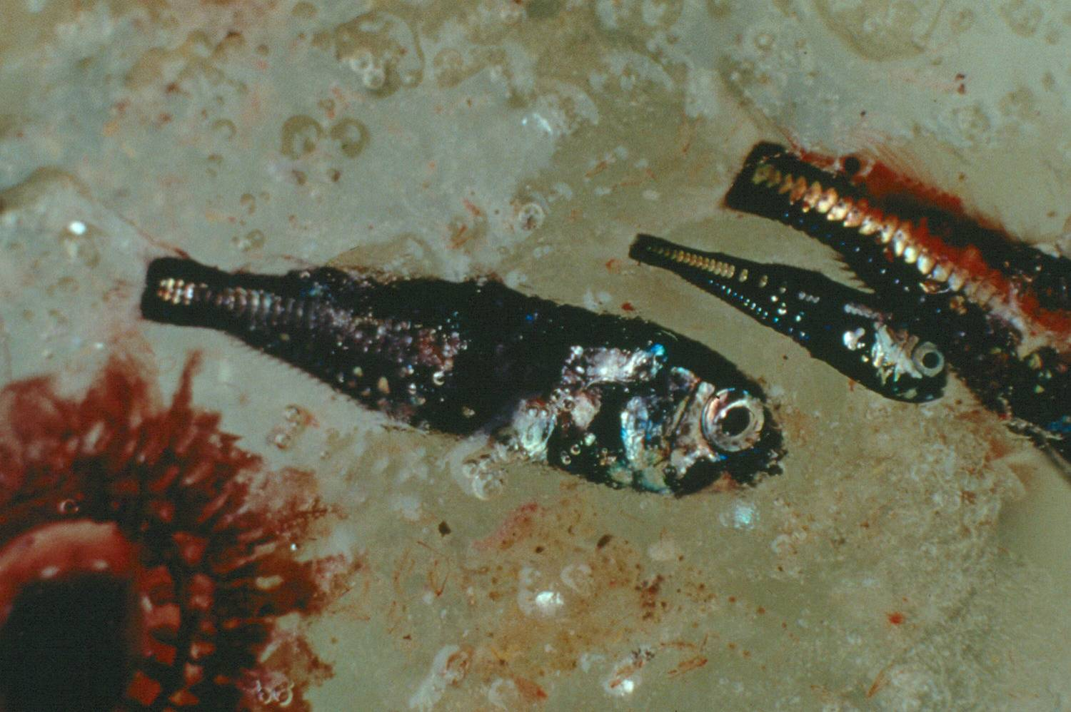
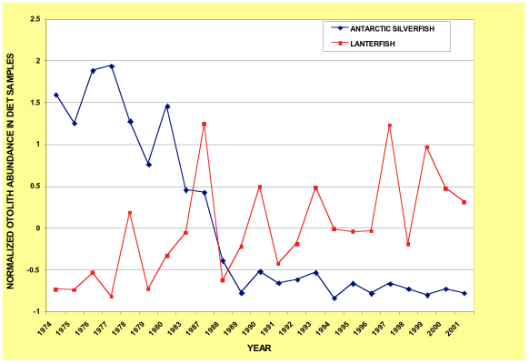
Silverfish
Lanternfish

Slide 29
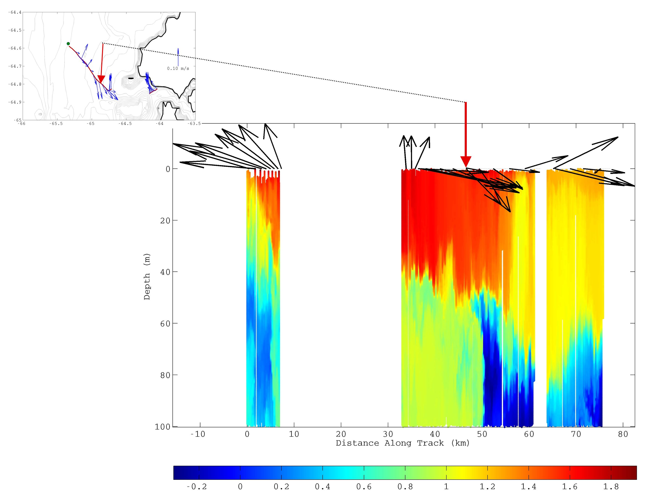
Warm water limits sea ice
which is critical to Silverfish
recruitment
Lanternfish
lack anti-freeze,
they need warmer
waters at depth

Slide 30
Where are we going?
Glider swarms: 1000 m glider to track UCDW in the deep waters of the canyon. Fv/Fm from glider to track health of the phytoplankton in the upwelling. ADCP glider to provide proxy for grazer community along with circulation
Utilize technology being developed by NSF OOI to make glider network smart. Coordinate the glider swarm using GAM models and real-time penguin radio-tag data. Give the keys of the car to penguins themselves.

