Slide 1
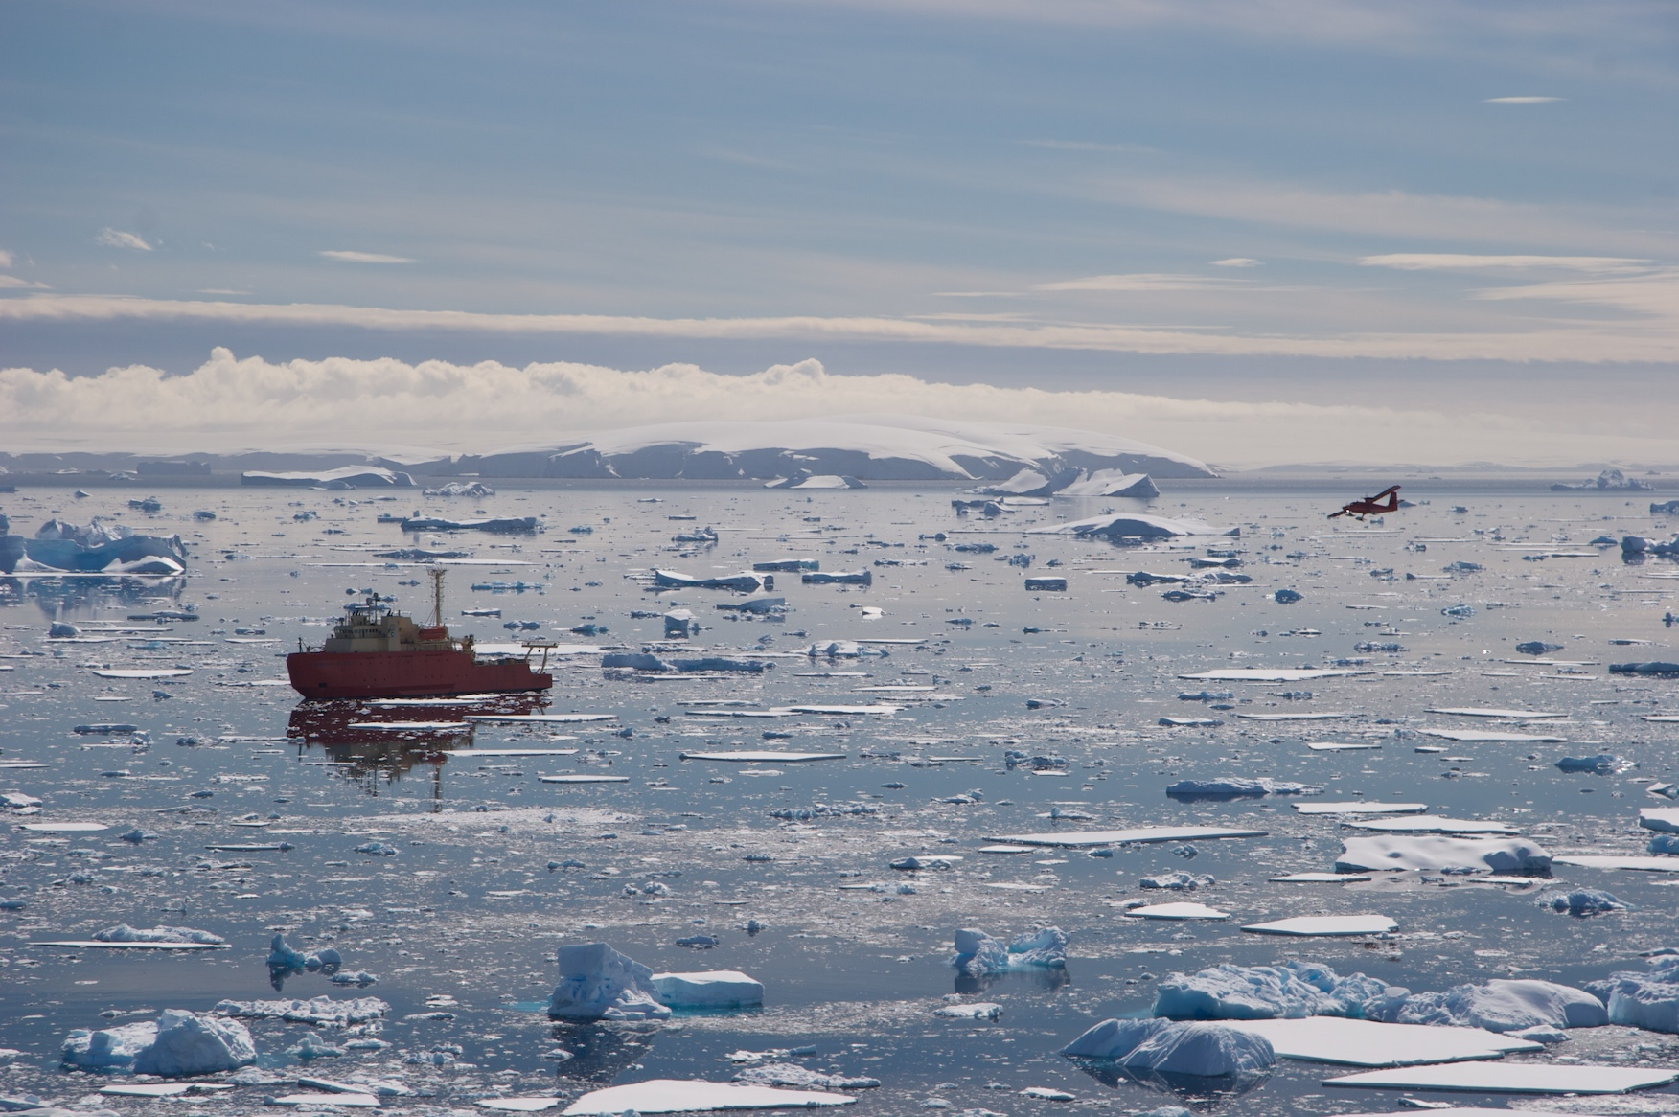
Satellite Driven Studies of Climate Mediated Changes in Antarctic Food Webs
Mathew Oliver, Andrew Irwin, Josh Kohut, Oscar Schofield, William Fraser
Also we acknowledge National Science Foundation’s Office of Polar Programs & LTER program, Gordon and Betty Moore Foundation

Slide 2
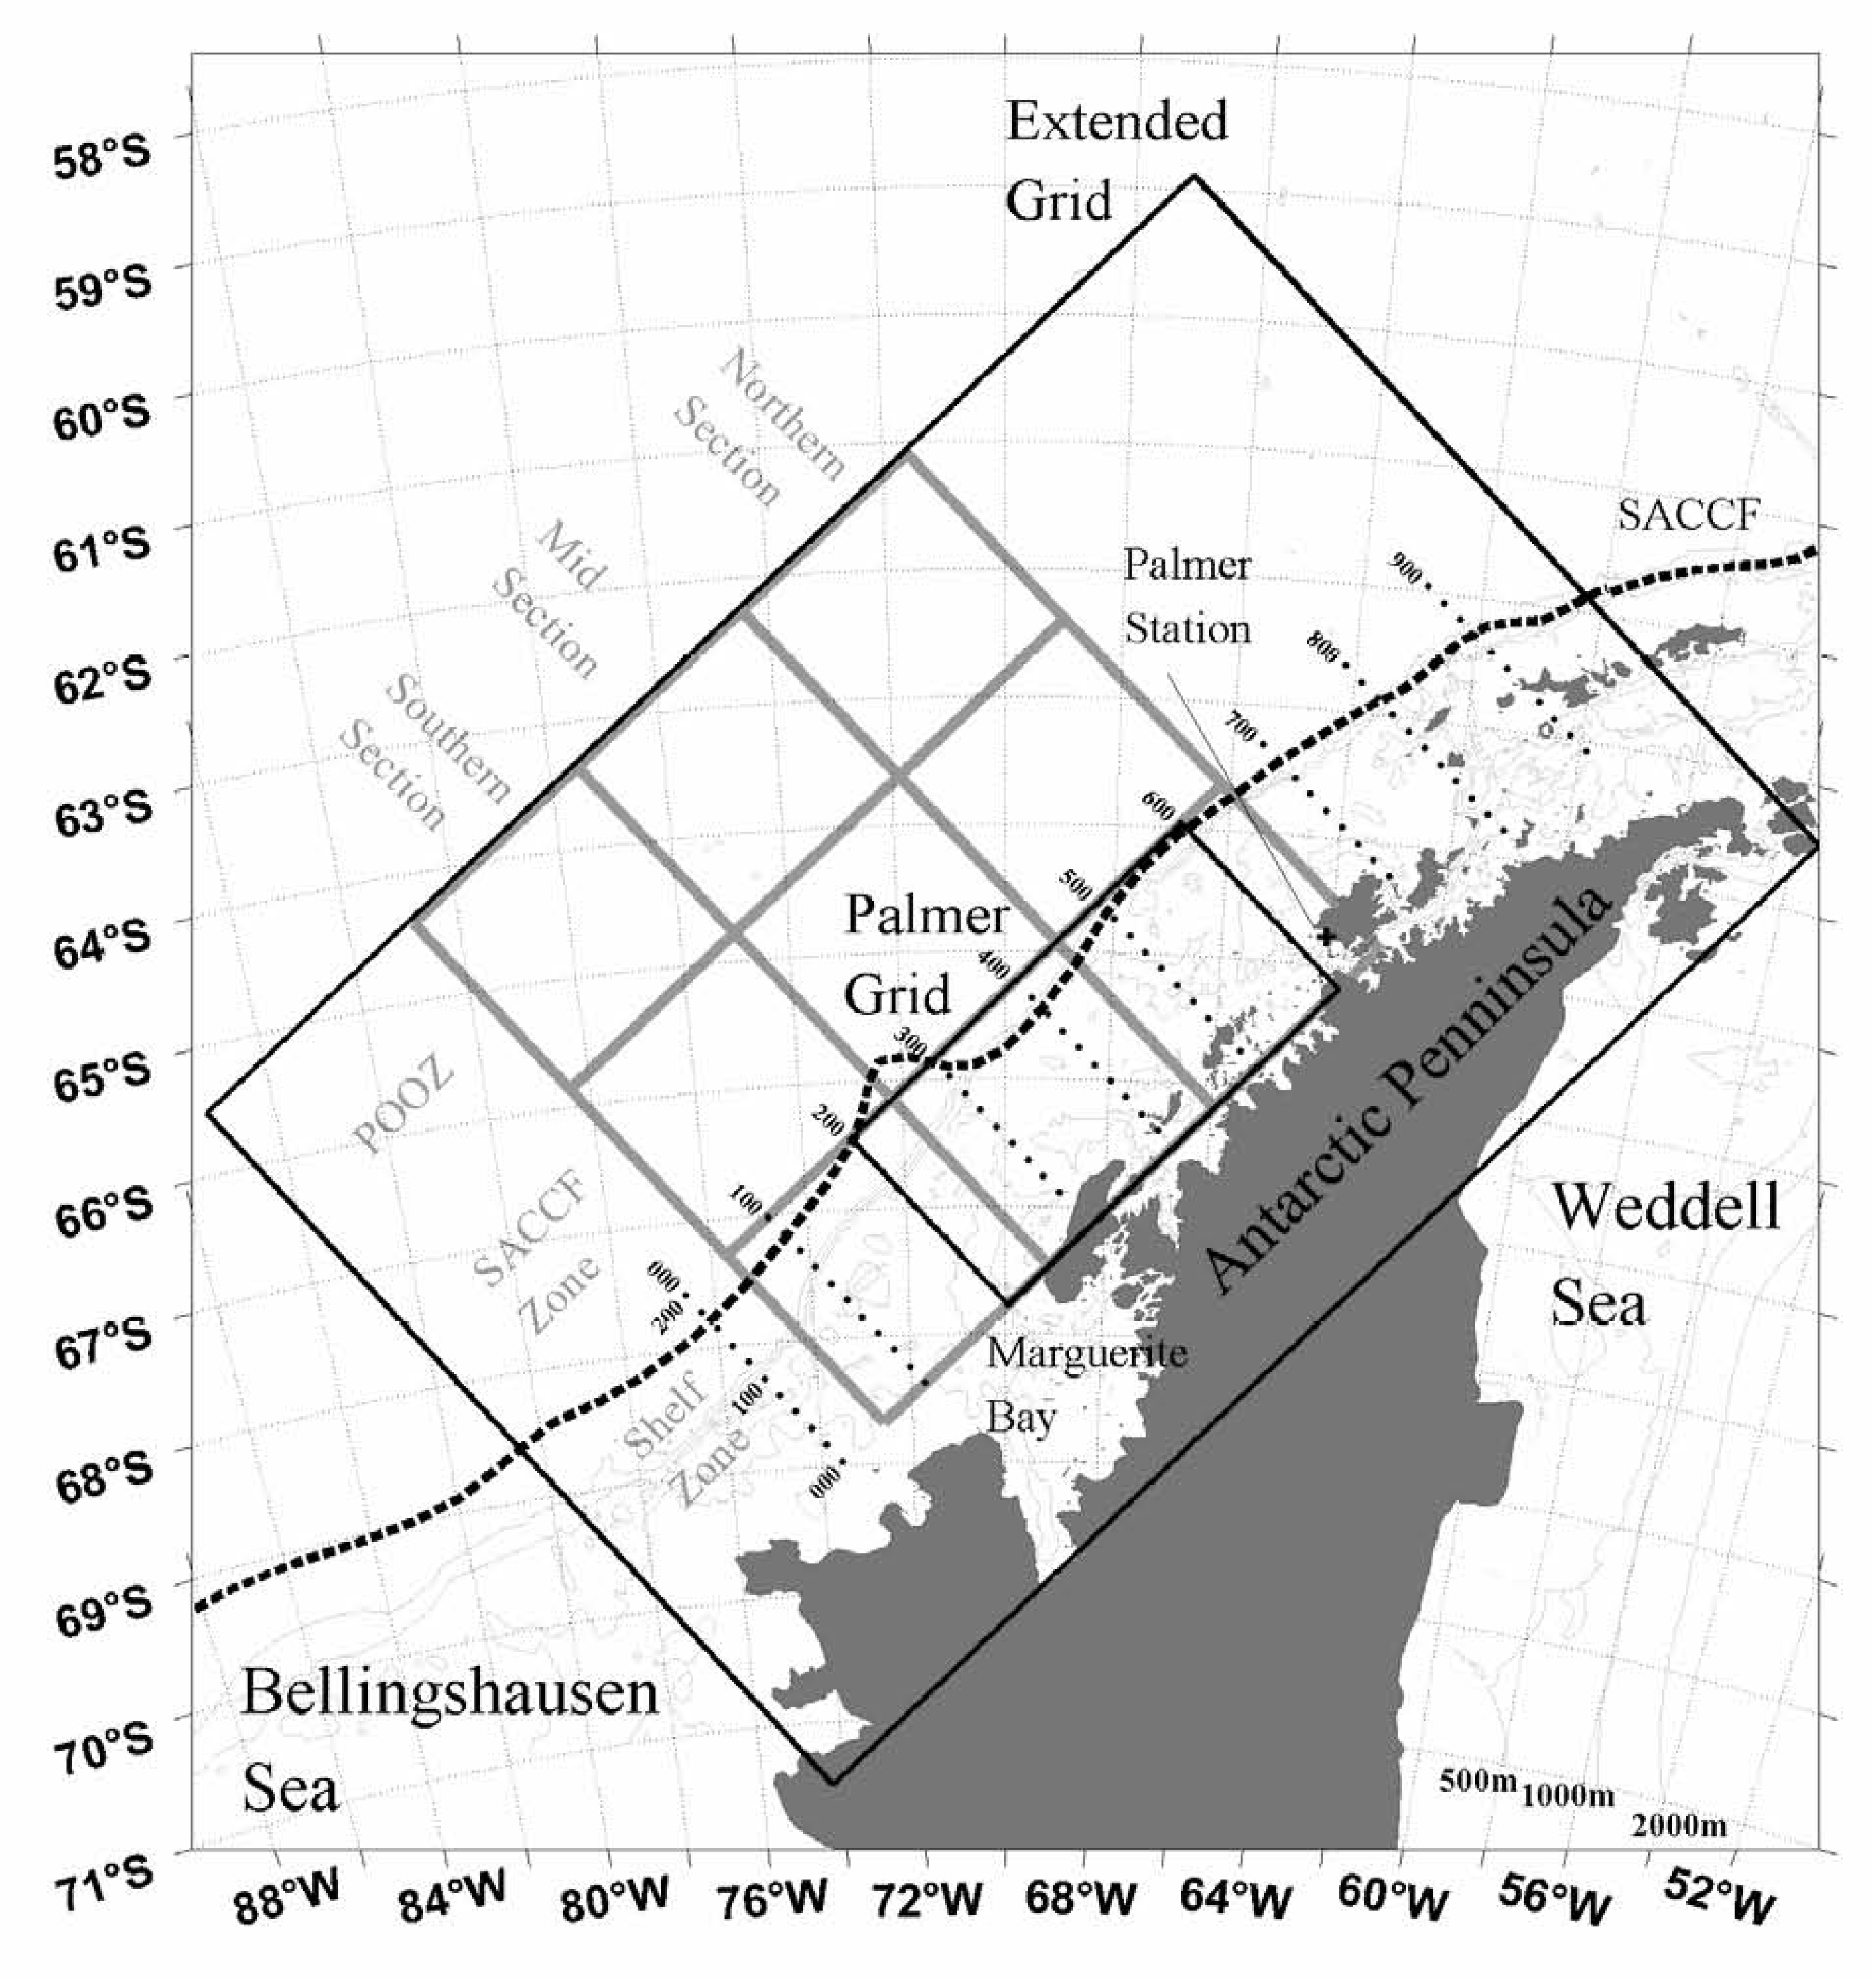

Slide 3
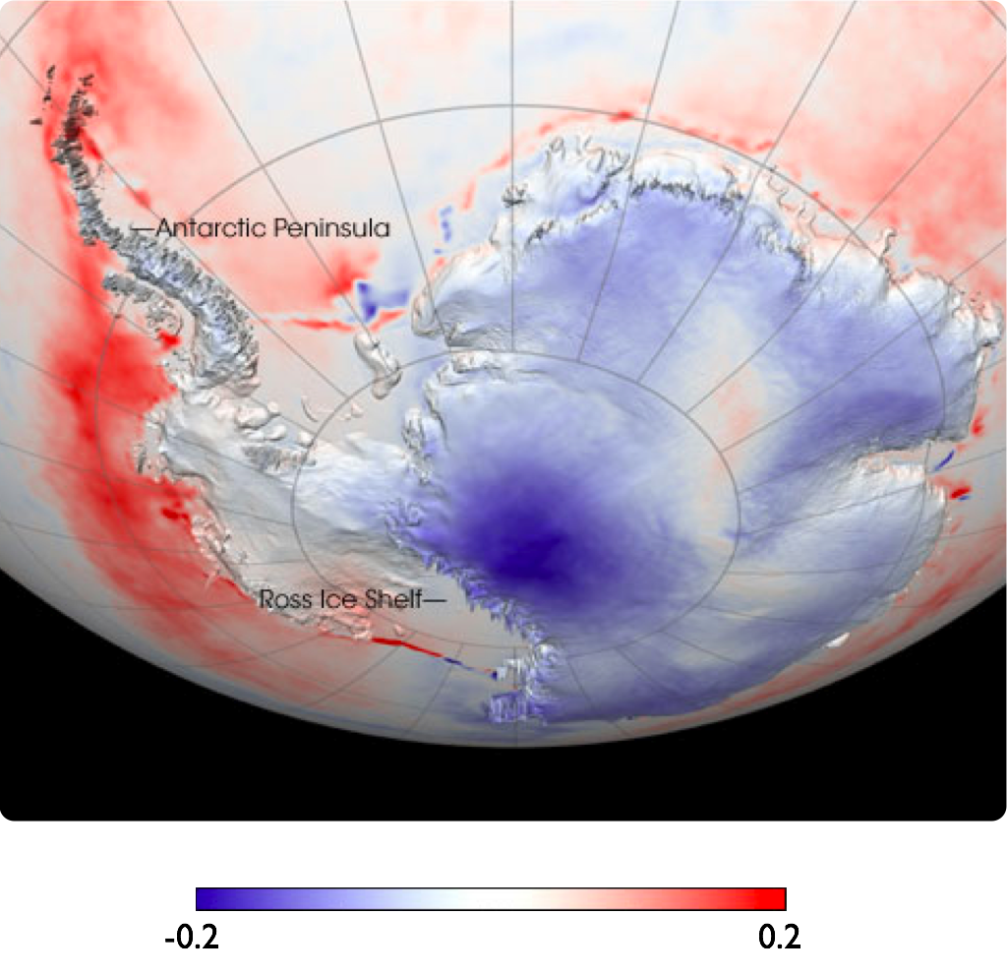
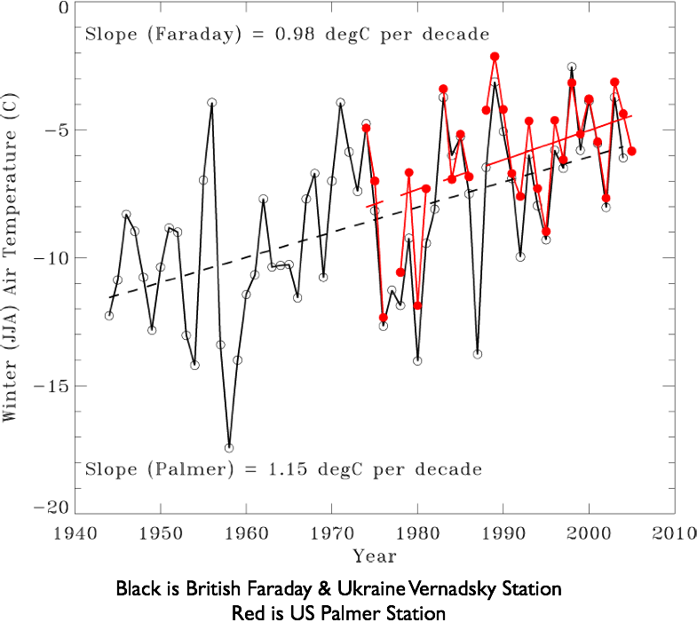
Temperature trends per year
-0.2
0.2

Slide 4
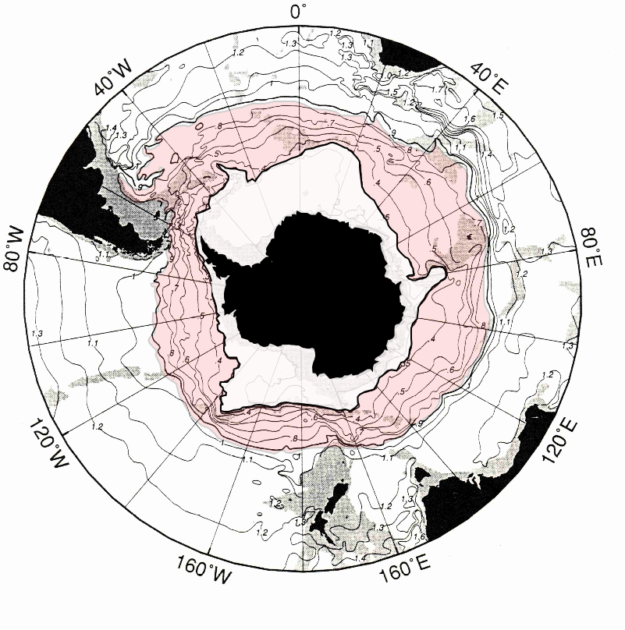
The West Antarctic Peninsula is the located close to the Antarctic Circumpolar Current compared to the rest of the continent. This current is the source of heat to this region as the warm is a balmy 4 degrees.

Slide 5
Winter air temperature
increases over the Peninsula
Sea ice duration drops
Sea ice season is almost 90 days shorter

Slide 6
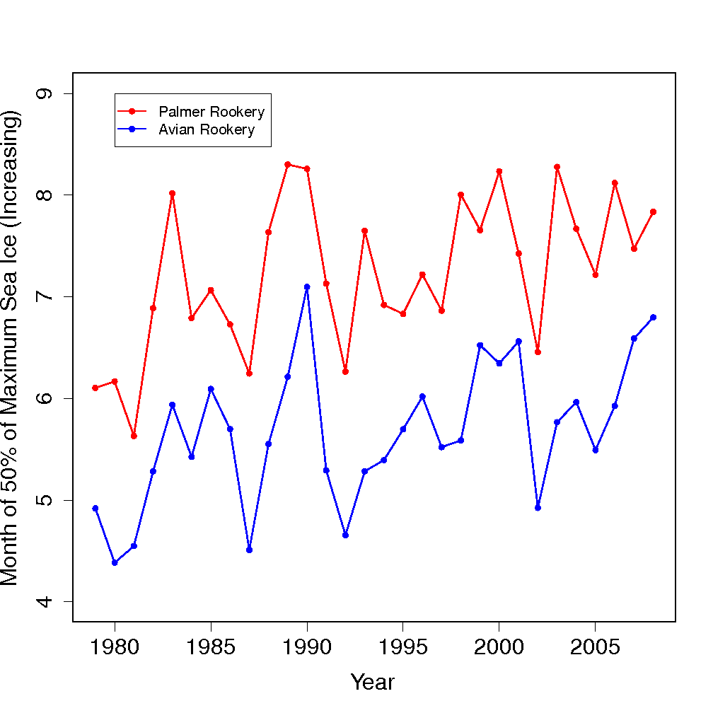
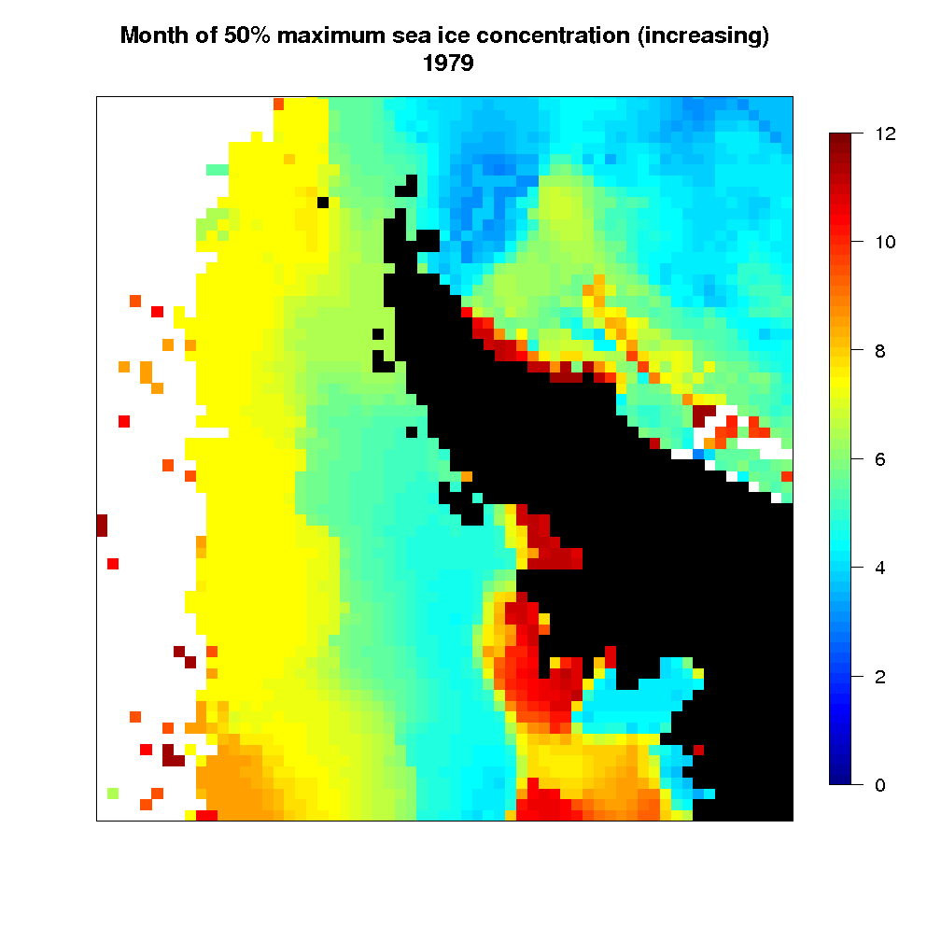
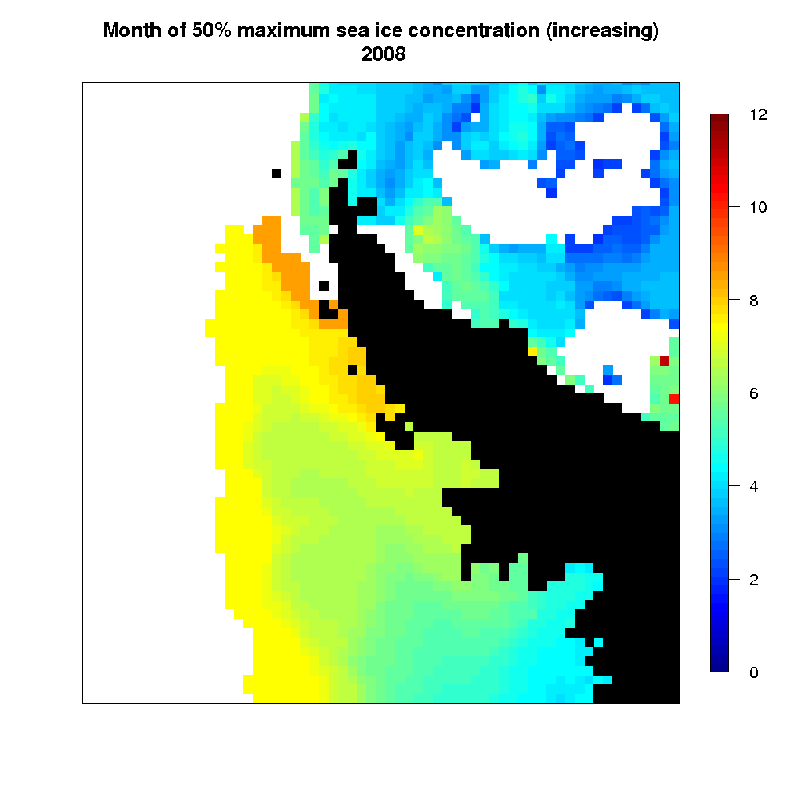
Peak sea ice timing is shifting

Slide 7
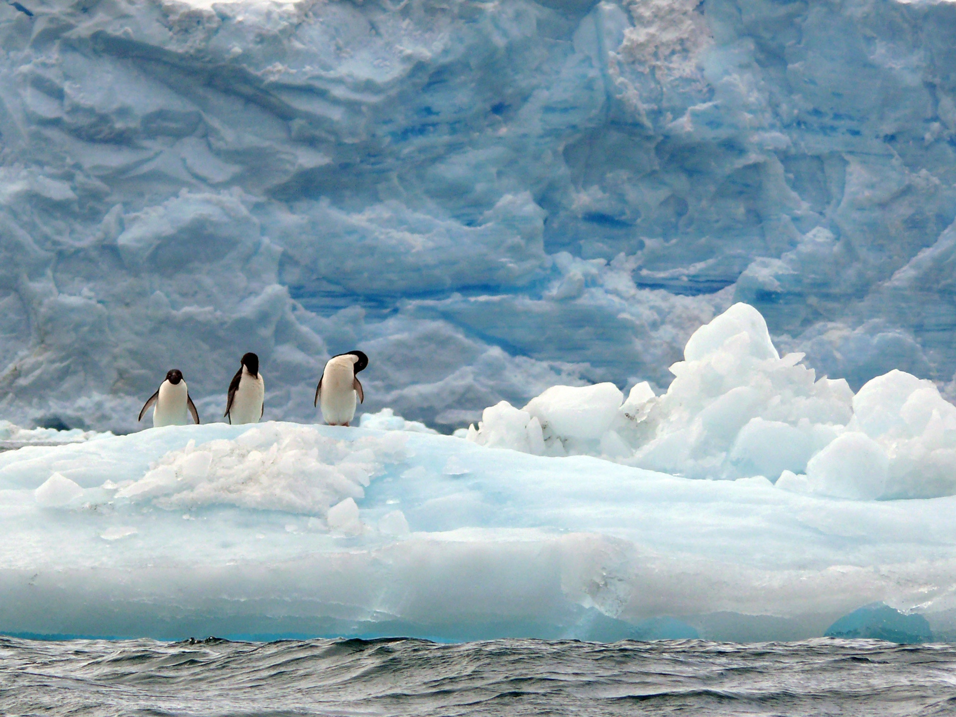
These ice changes are expected to have large impacts on
the ecosystem. Expectations are specific critters will be disproportionately impacted.
Adélie penguin
(Pygoscelis adeliae)

Slide 8
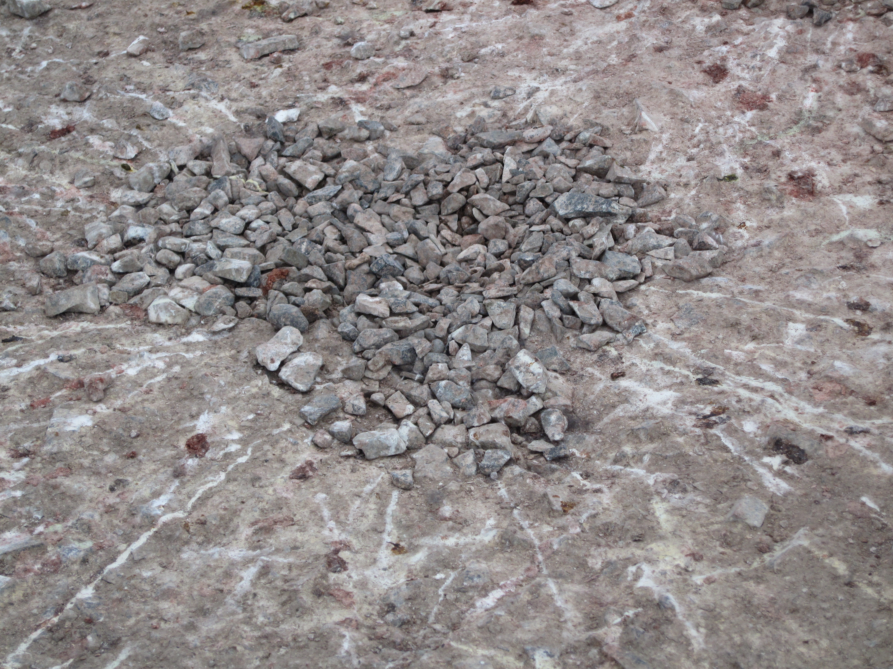
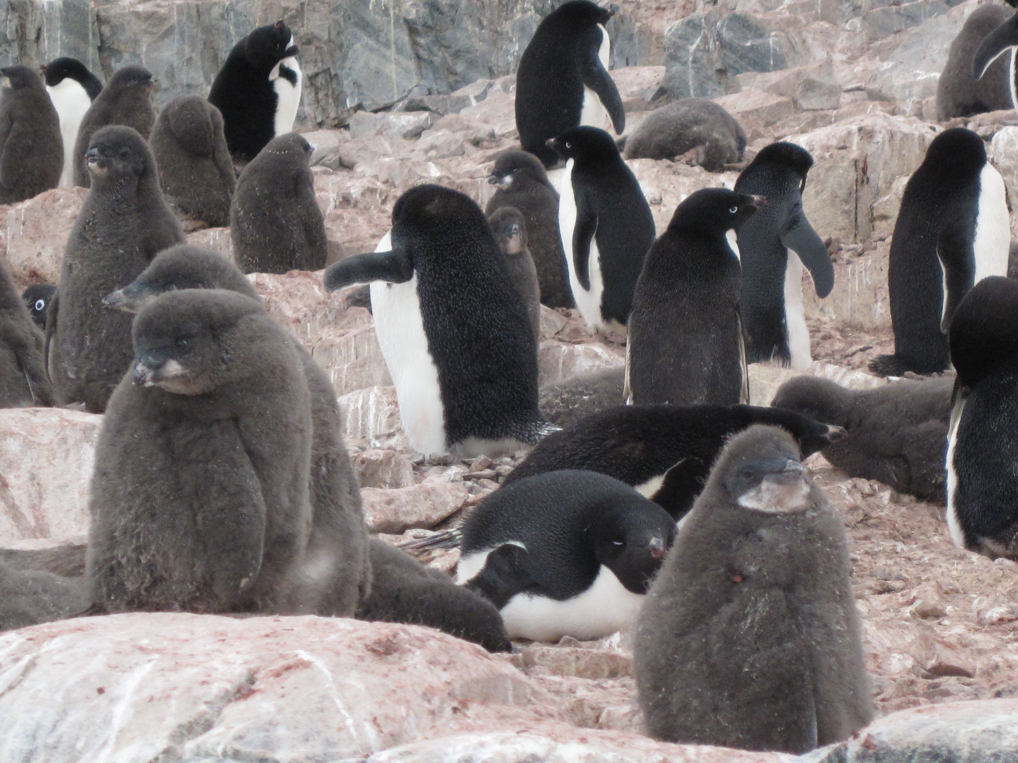
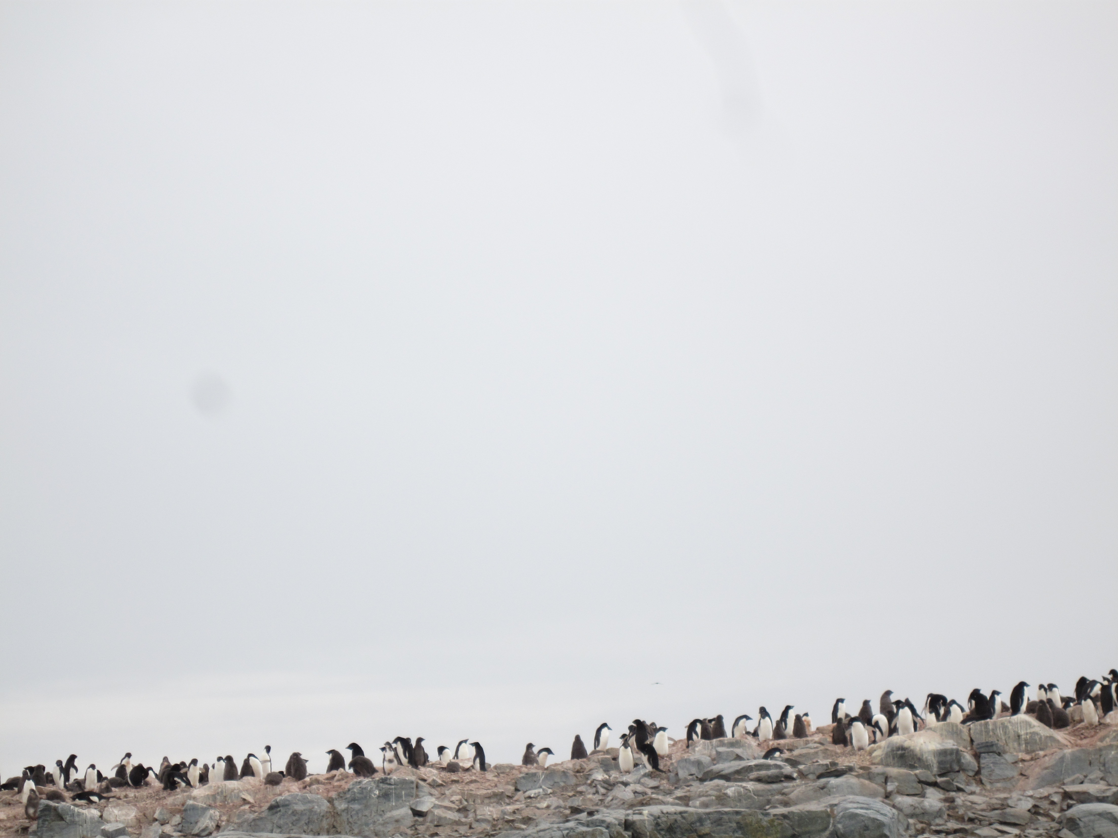
Adélie penguins form rookeries in fixed locations year after year. Rookeries are formed and breeding pairs raise their young. For their young the parents need a predictable food resource that can be ascertained in a less then a days swim.

Slide 9
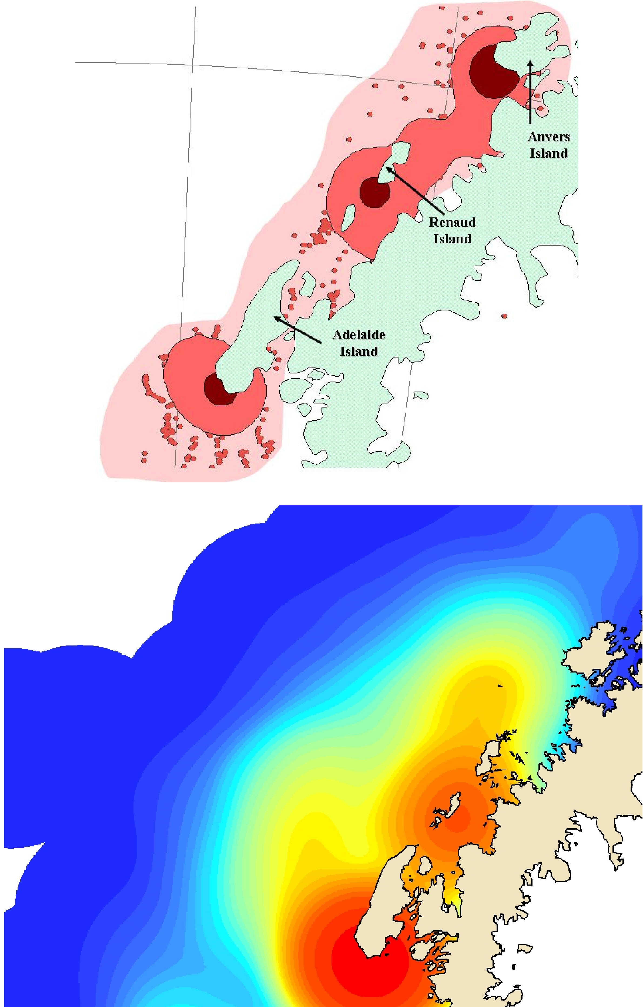
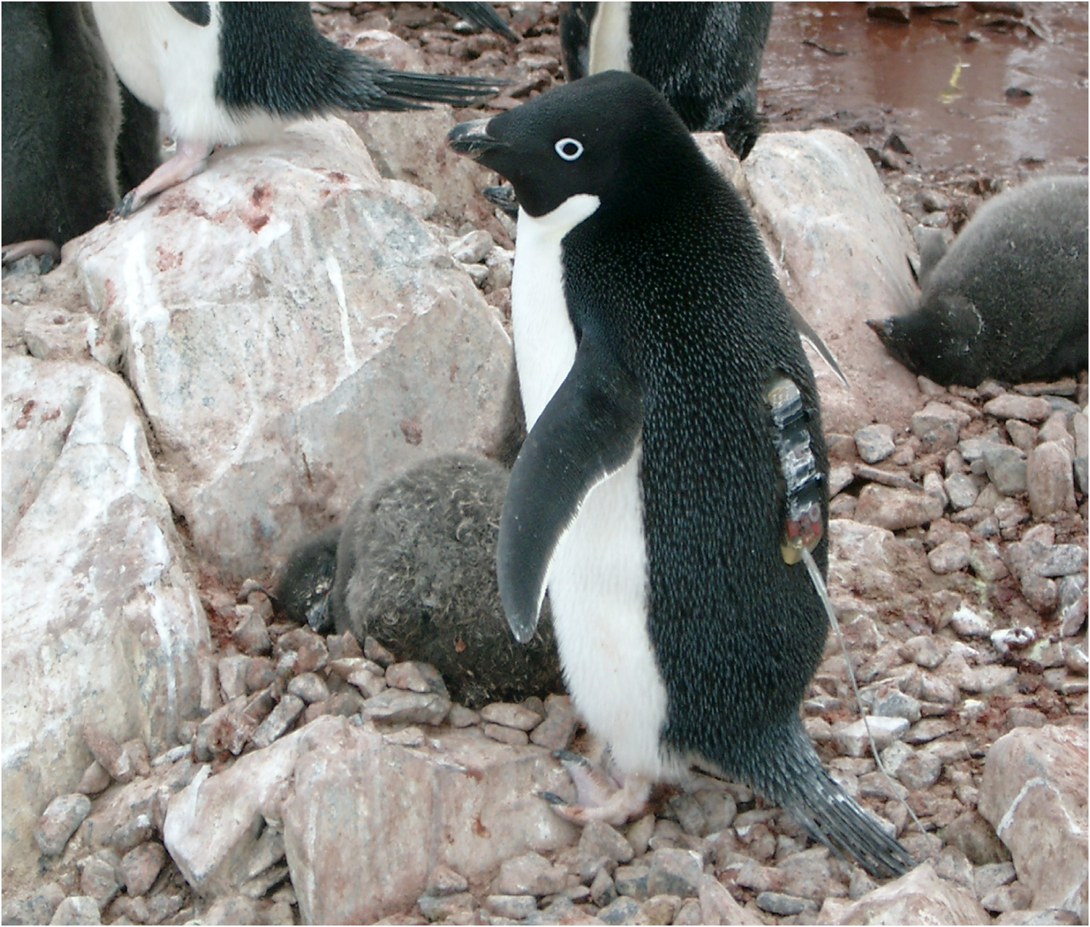
Summer
Foraging
Regions
What are the main foraging regions?
To determine that we take advantage of the ecology/evolution which has determined the prime locations to be. How?? glue stick…..
Winter
Foraging
Regions

Slide 10
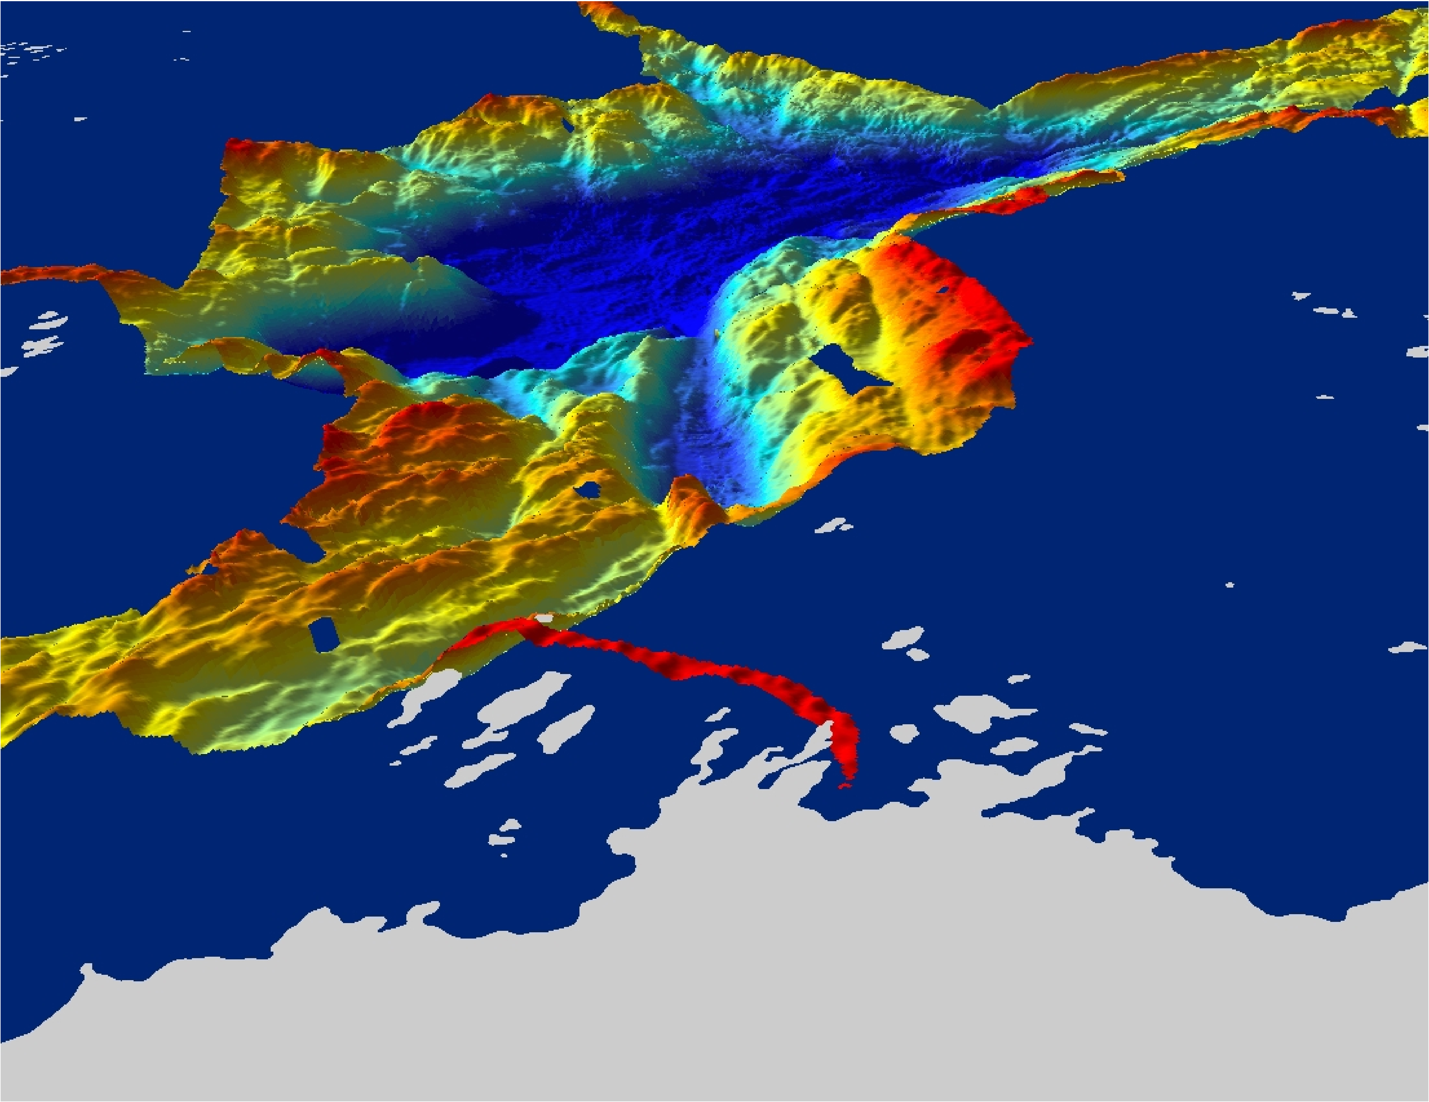
Anvers Island
Hot spots along the peninsula are associated with
deep undersea canyons located near suitable breeding areas,
which can be reached in a days foraging effort (~30 km).

Slide 11
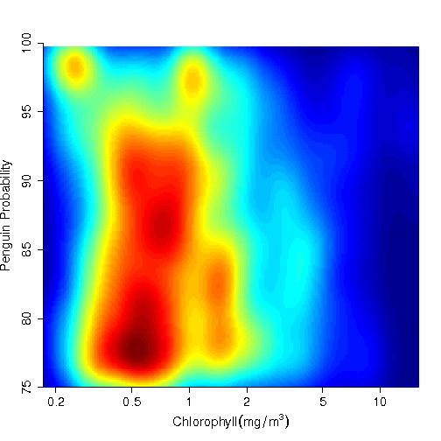
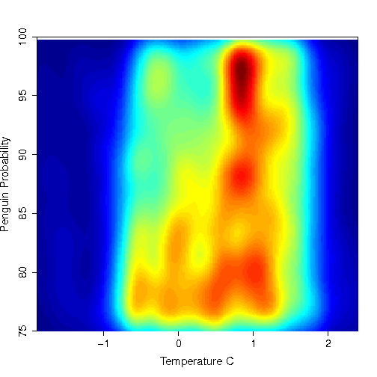
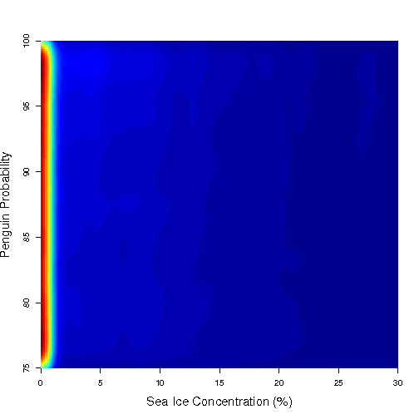

Slide 12
Changes have altered the base of the food chain
30-year seasonal change
~20-year January trend
Montes-Hugo et al. 2009
Vernet et al. 2008

Slide 13
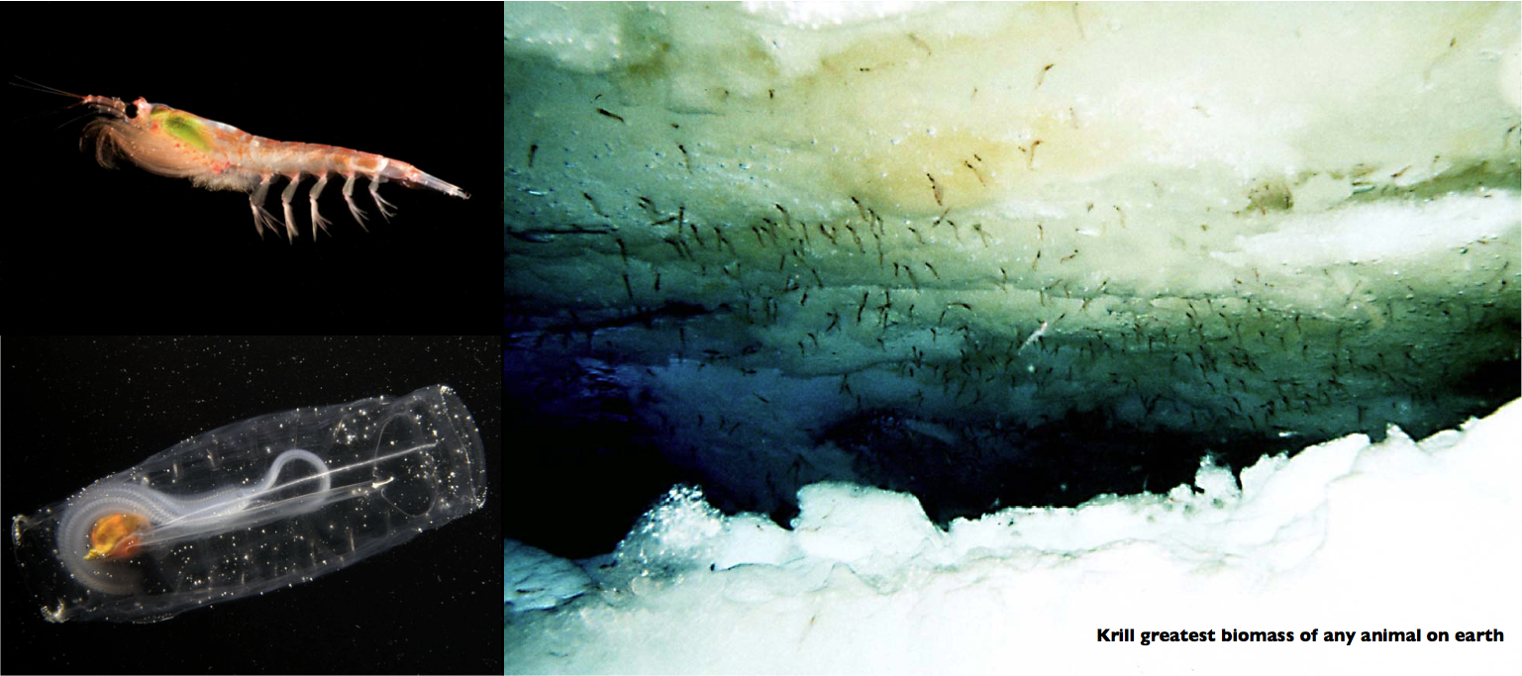
These changes have altered the base of the food chain

Slide 14
From Loeb et al., 1997
100
10
6
Krill:Salp
Ice Index
1
4
0.1
0.01
2
0.001
80
82
84
86
88
90
92
94
96
100
Year
10
2
Krill:Salp
R
= 0.56
1
0.1
0.01
0.001
2
4
6
100
Ice Index
10
2
Krill:Salp
R
= 0.63
1
0.1
0.01
0.001
-4
-2
0
Mean Air Temperature (°C)

Slide 15
Major changes seen in the upper trophic levels

Slide 16
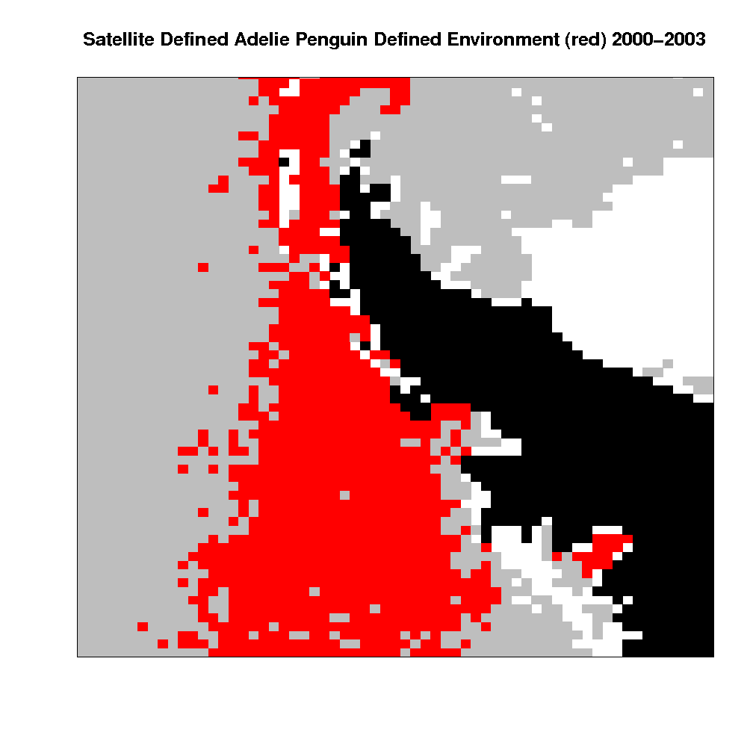
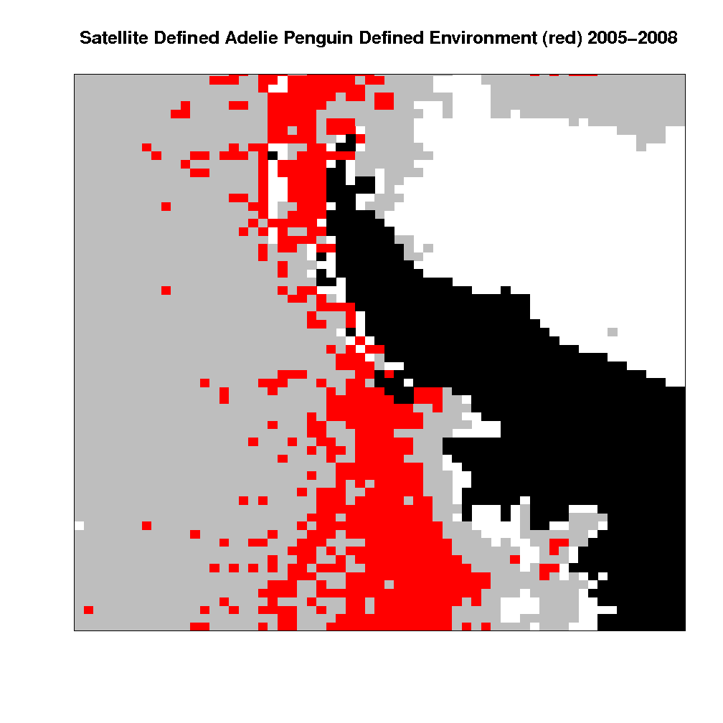
Penguin distributions have shifted

Slide 17
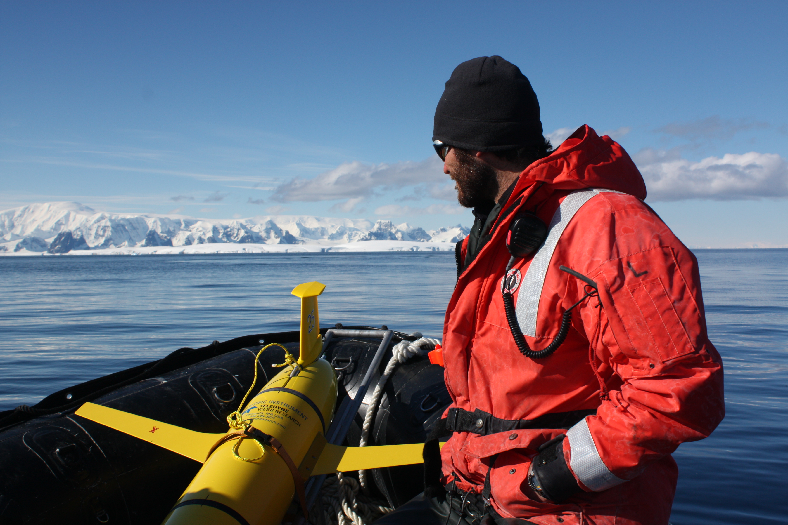

Slide 18
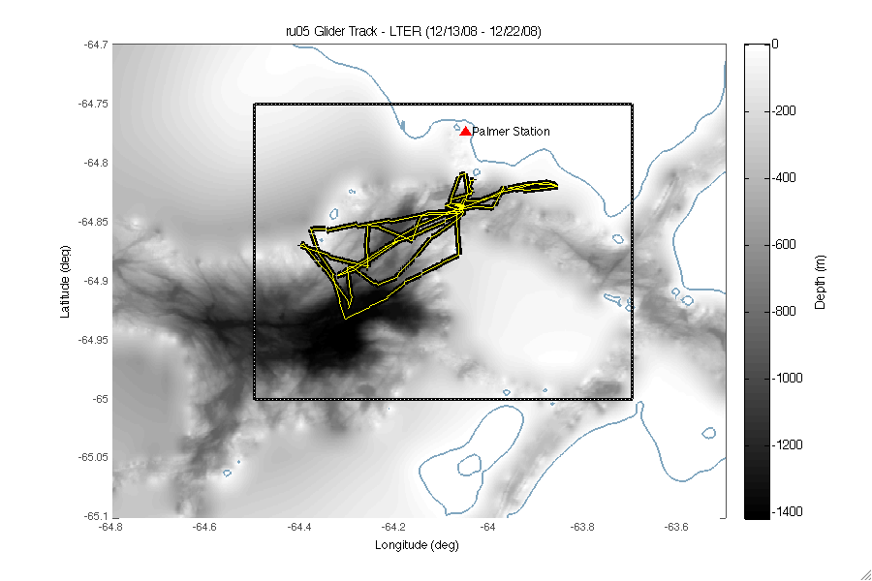

Slide 19
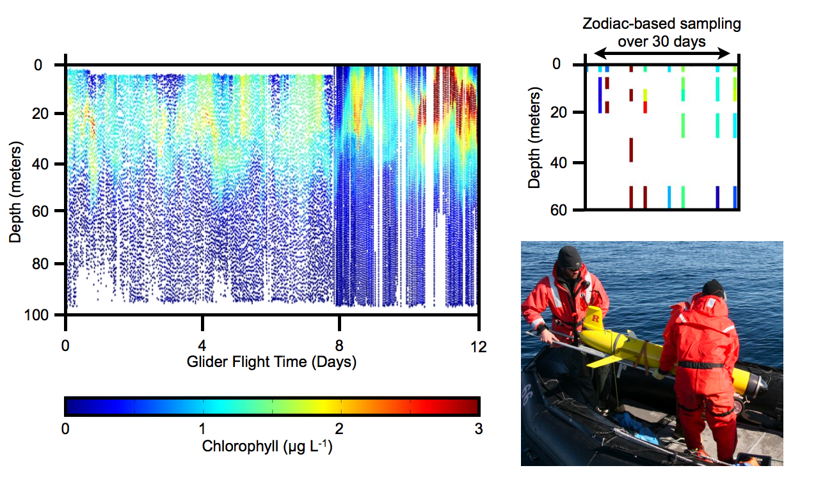

Slide 20
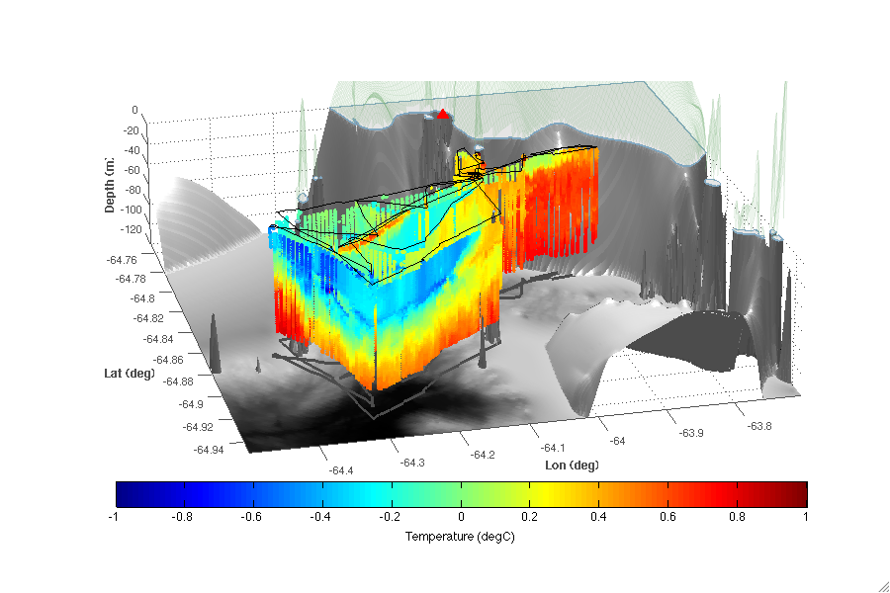

Slide 21
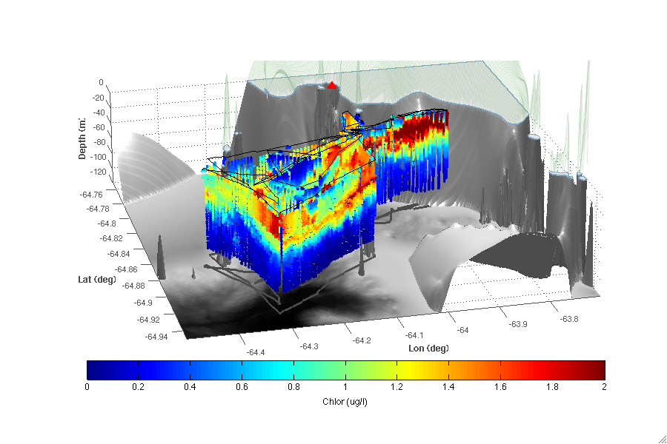

Slide 22
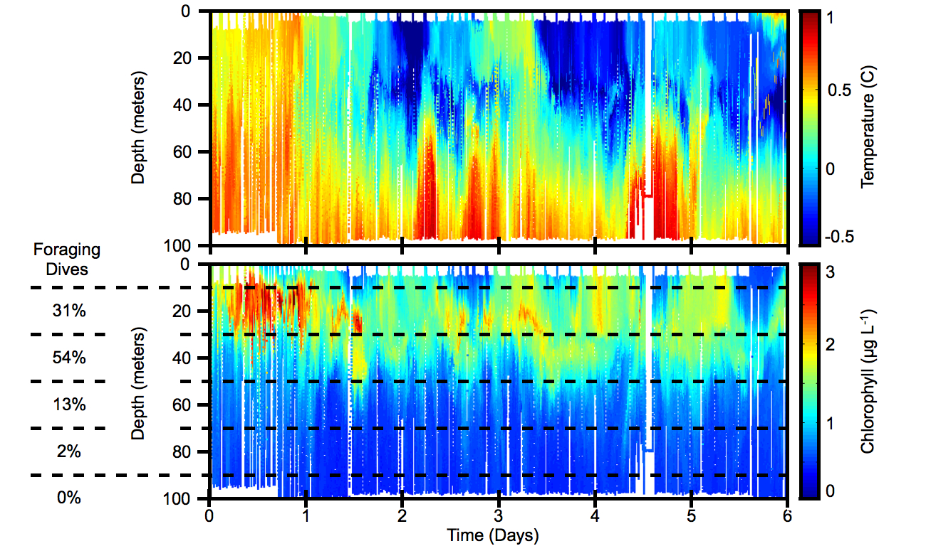

Slide 24
Conclusions
2011 is the major field season, with a glider fleet to be deployed in January 2011. The glider movements will be adjusted based on real-time data from radio-tagged penguin data.
Satellite derived water masses will be used to map the outer boundary sampling regimes
The glider fleet will be outfitted to measure:
-Phytoplankton biomass (fluorometry)
-Penguin “poop plumes” (Colored dissolved organic matter fluorescence)
-Particle load (backscatter)
-Phytoplankton physiology (Fv/Fm)
-Ecosystem metabolism (oxygen)
-Zooplankton load (acoustic backscatter)
Use real-time data to enable adaptive sampling.
Use penguin “water” to assess how the populations might be migrating to the south as permanent and annual sea ice decreases

Slide 25
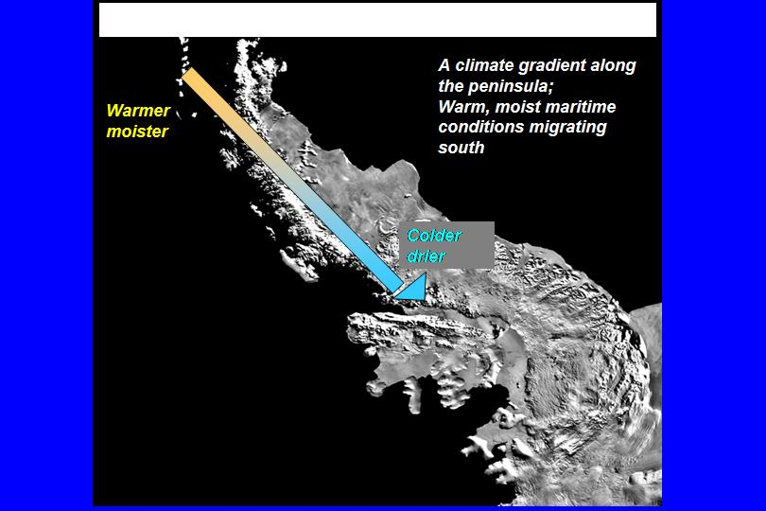
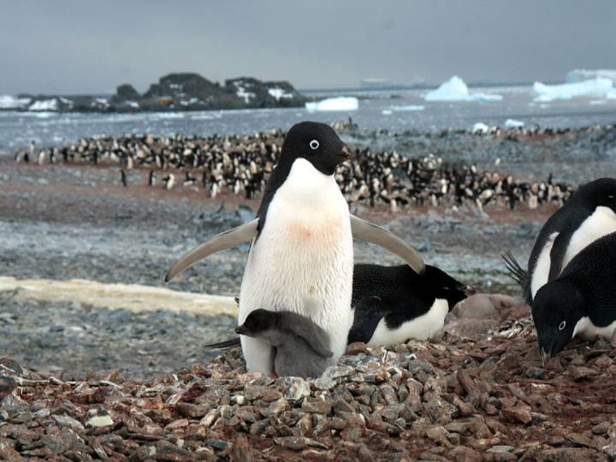
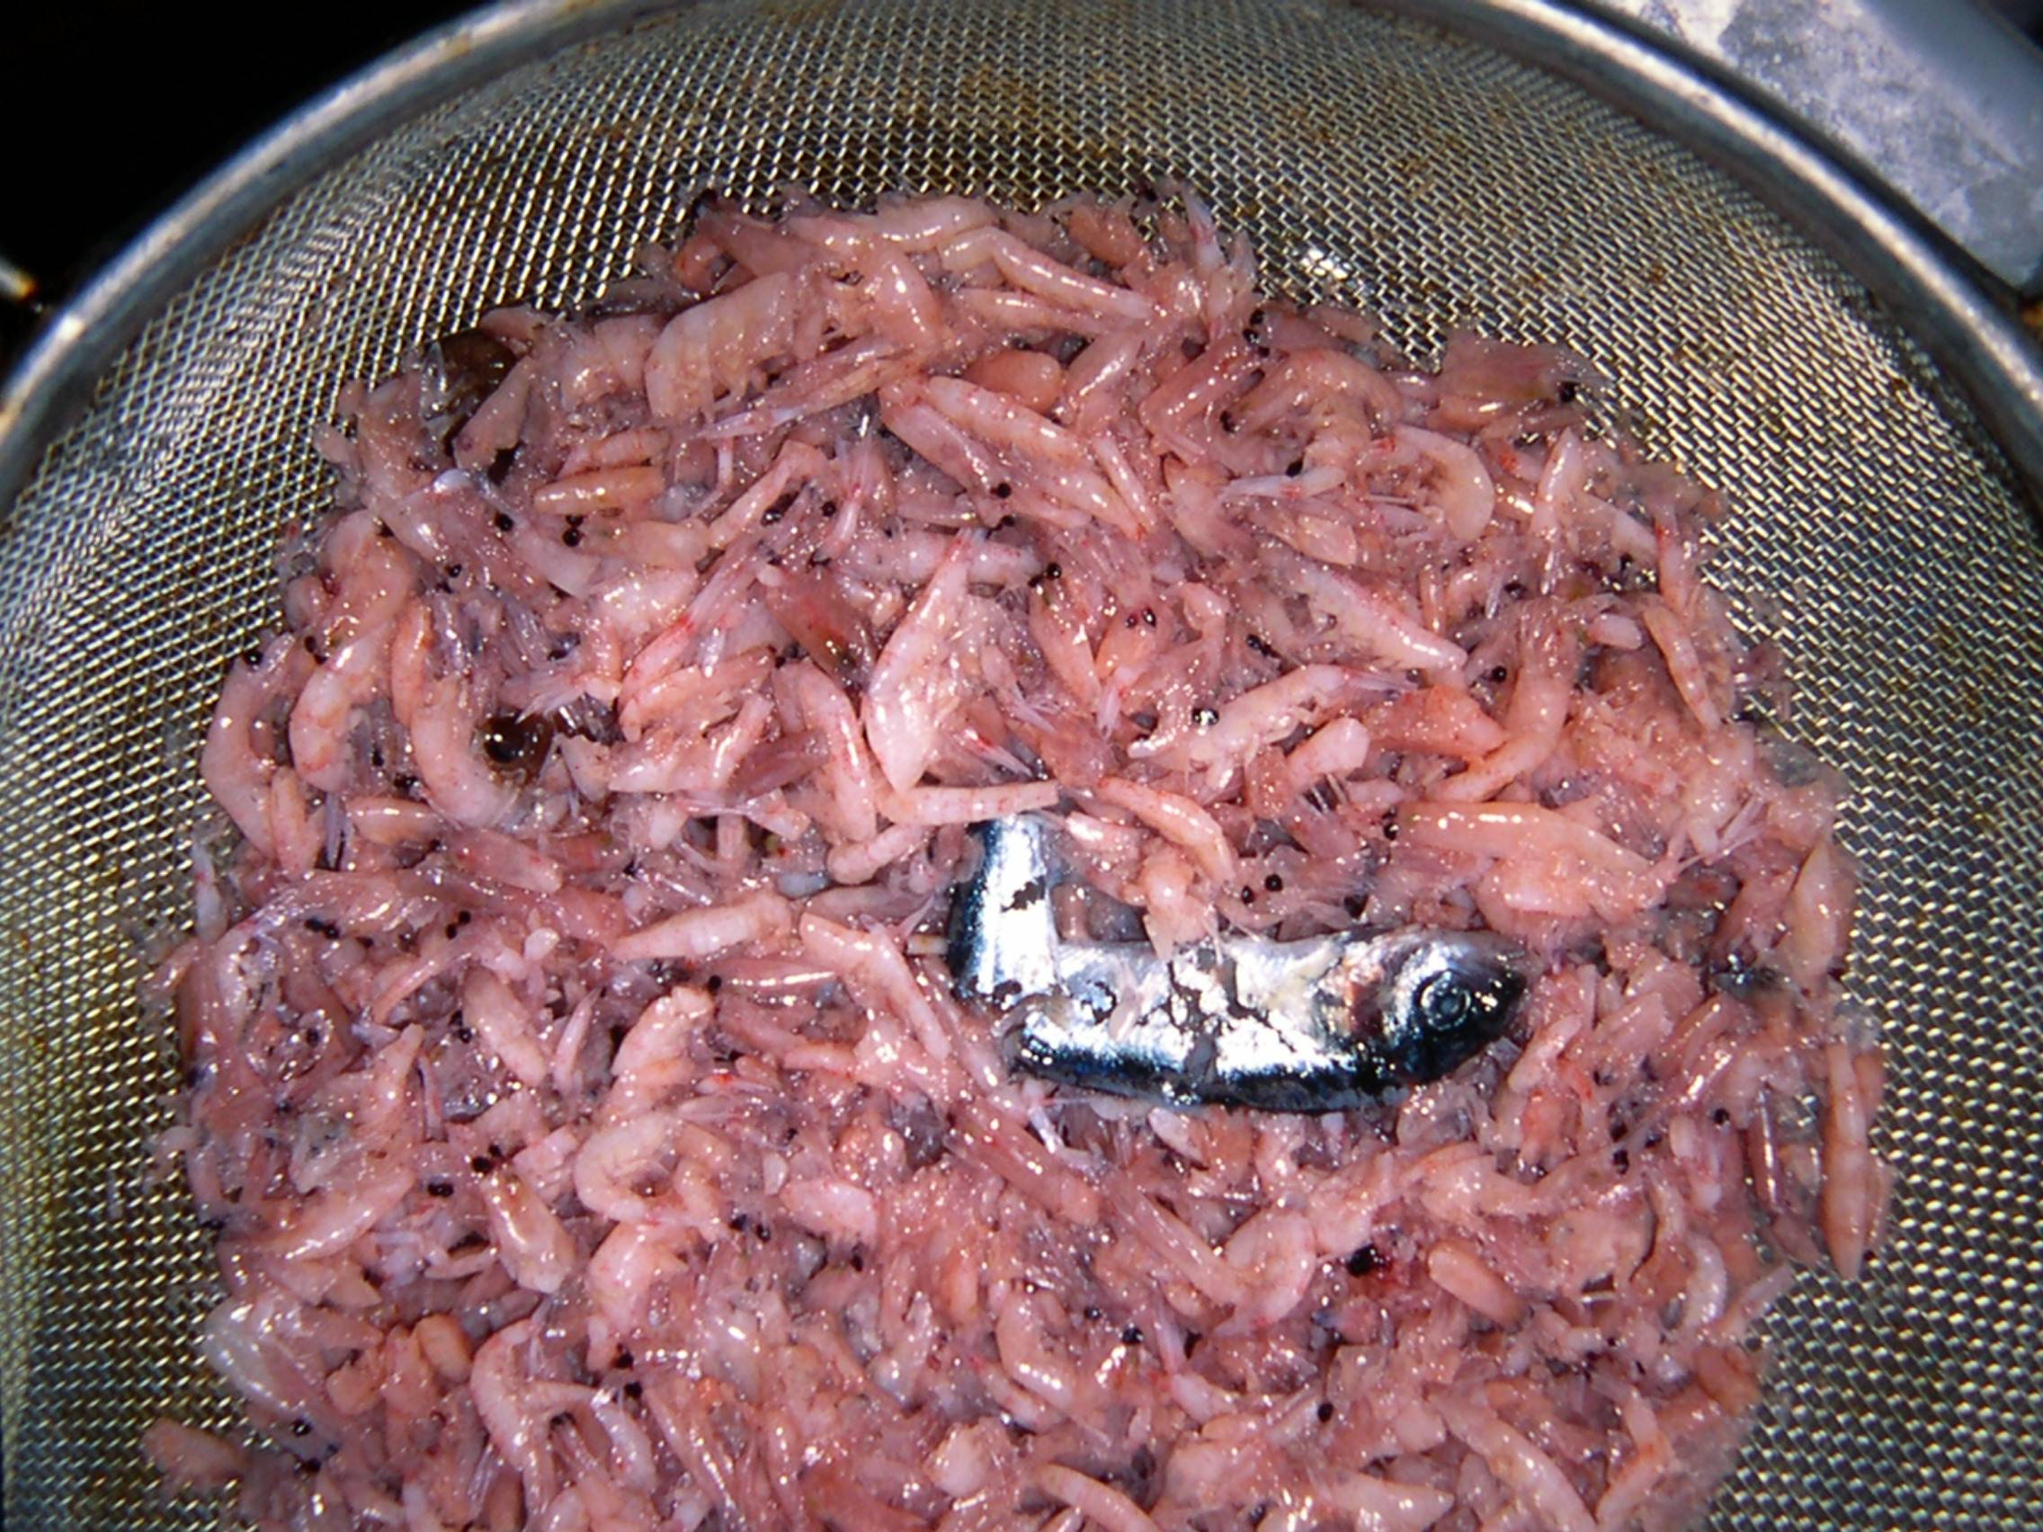
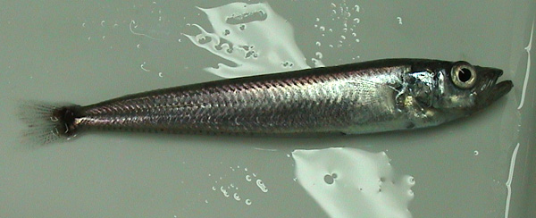
North to South Changes in Antarctic silverfish (Pleuragramma antarctica) Populations
ANVERS IS
1994-
present
ADELAIDE IS
1995-
present
Notes:
THE ANTARCTIC KRILL, EUPHAUSIA SUPERBA, AS YOU WILL LEARN LATER ON IN THESE TALKS, IS AN ICE-DEPENDENT SPECIES. LARVAE IN PARTICULAR CANNOT SURVIVE WINTER WITHOUT GRAZING ON THE ALGAE AND DIATOMS THAT GROW BENEATHE THE SEA ICE AT THIS TIME OF YEAR. RECENT EVIDENCE ALSO INDICATES THAT SILVERFISH REQUIRE SEA ICE FOR REPRODUCTION, IN THAT THE PLATELET ICE IN PARTICULAR SHELTERS EGGS AND LARVAE, AND FEEDS THEM IN MUCH THE SAME WAY LARVAL KRILL DEPEND ON SEA ICE. SO THIS IS QUITE AND INTERESTING AND SIGNIFICANT STORY WE HAVE DEVELOPED HERE, WHICH SPANS 3 DECADES. THERE ARE TWO OTHER ASPECTS TO THIS STORY, NAMELY WHAT HAS HAPPENED TO THISE ICE-DEPENDENT SPECIES IN THE FACE OF CLIMATE MIGRATION.

