Slide 1


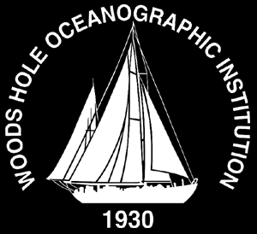





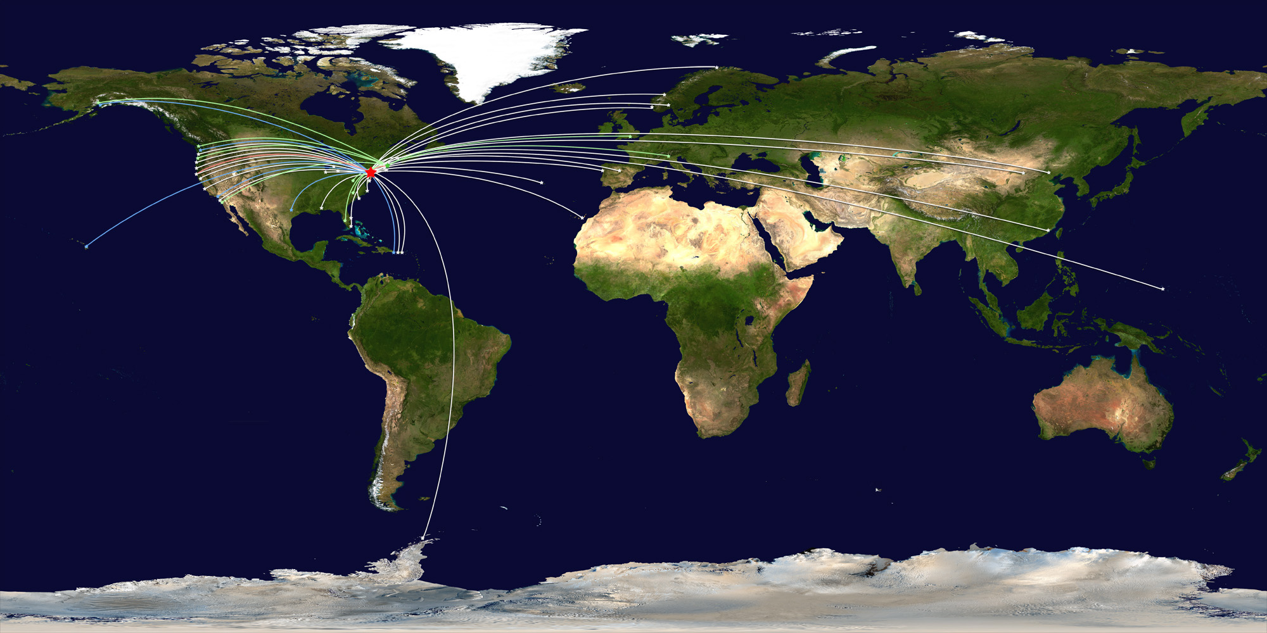






COSEE-Networked Ocean World (NOW)
Linking ocean scientists and educators in the virtual world
265 Members
100 Scientists
COSEE NOW is facilitating Ocean Observing partnerships to:
assess the knowledge & needs of Ocean Observing audiences
improve collaboration & coordination between scientists and educators
increase public awareness to improve society’s ocean literacy

Slide 2
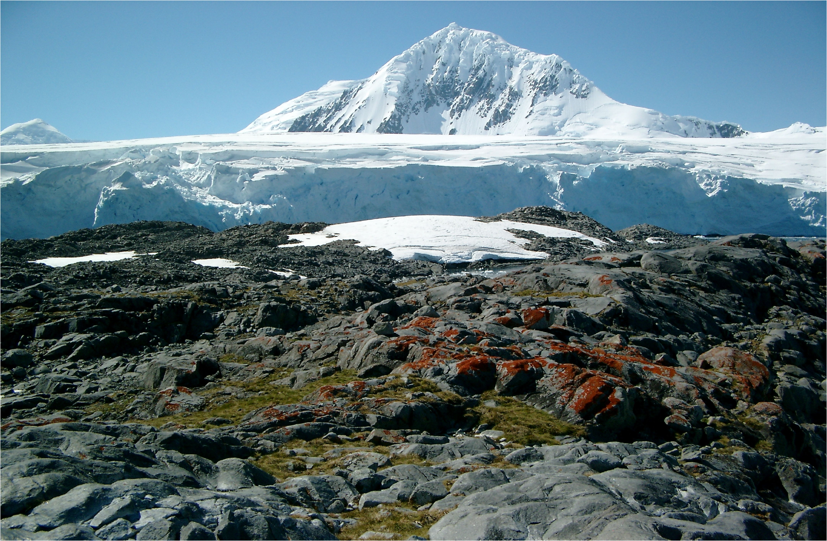
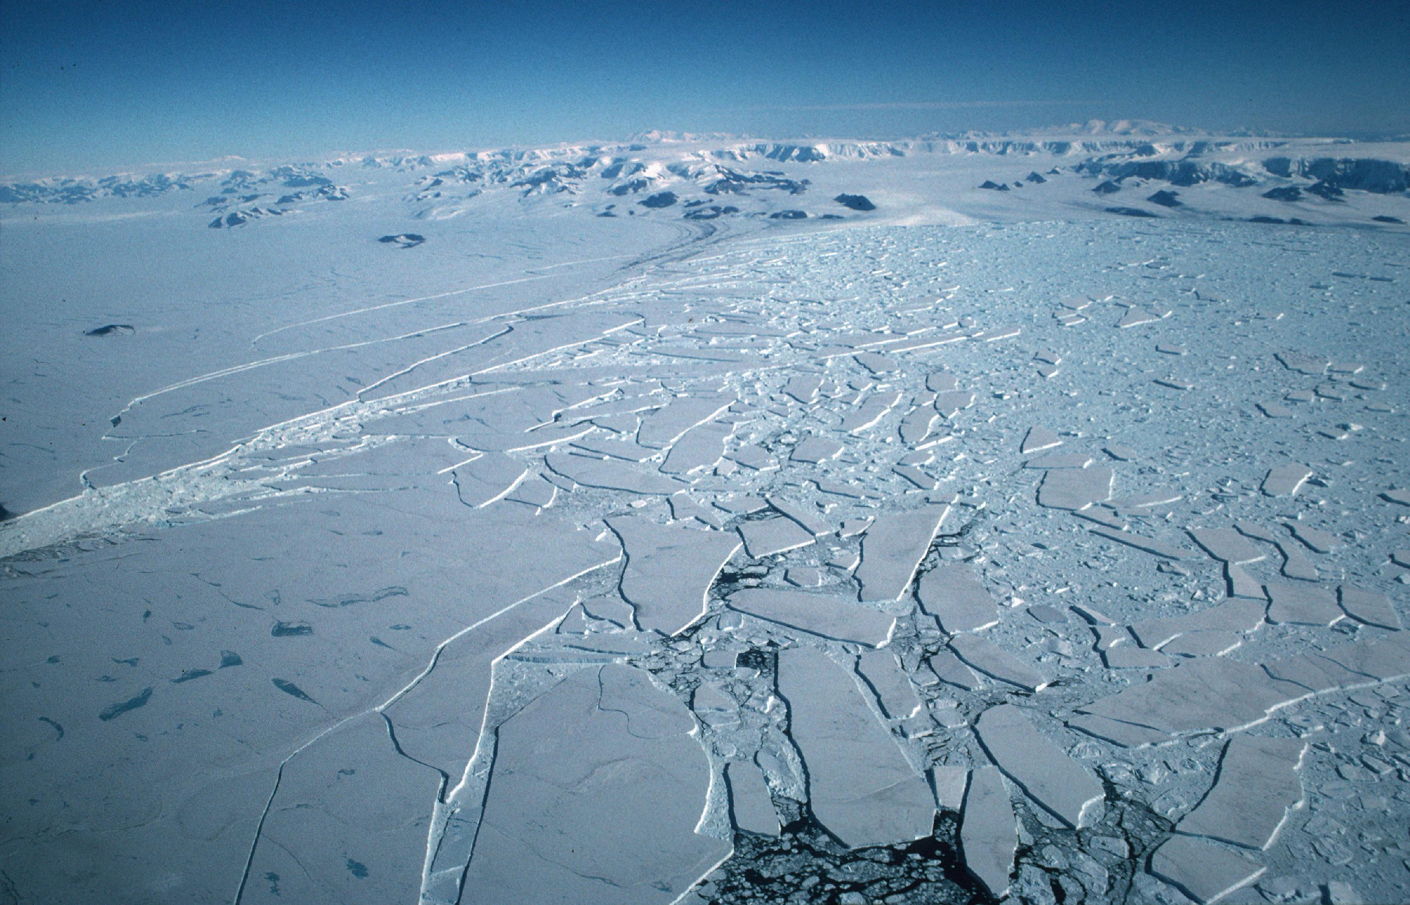
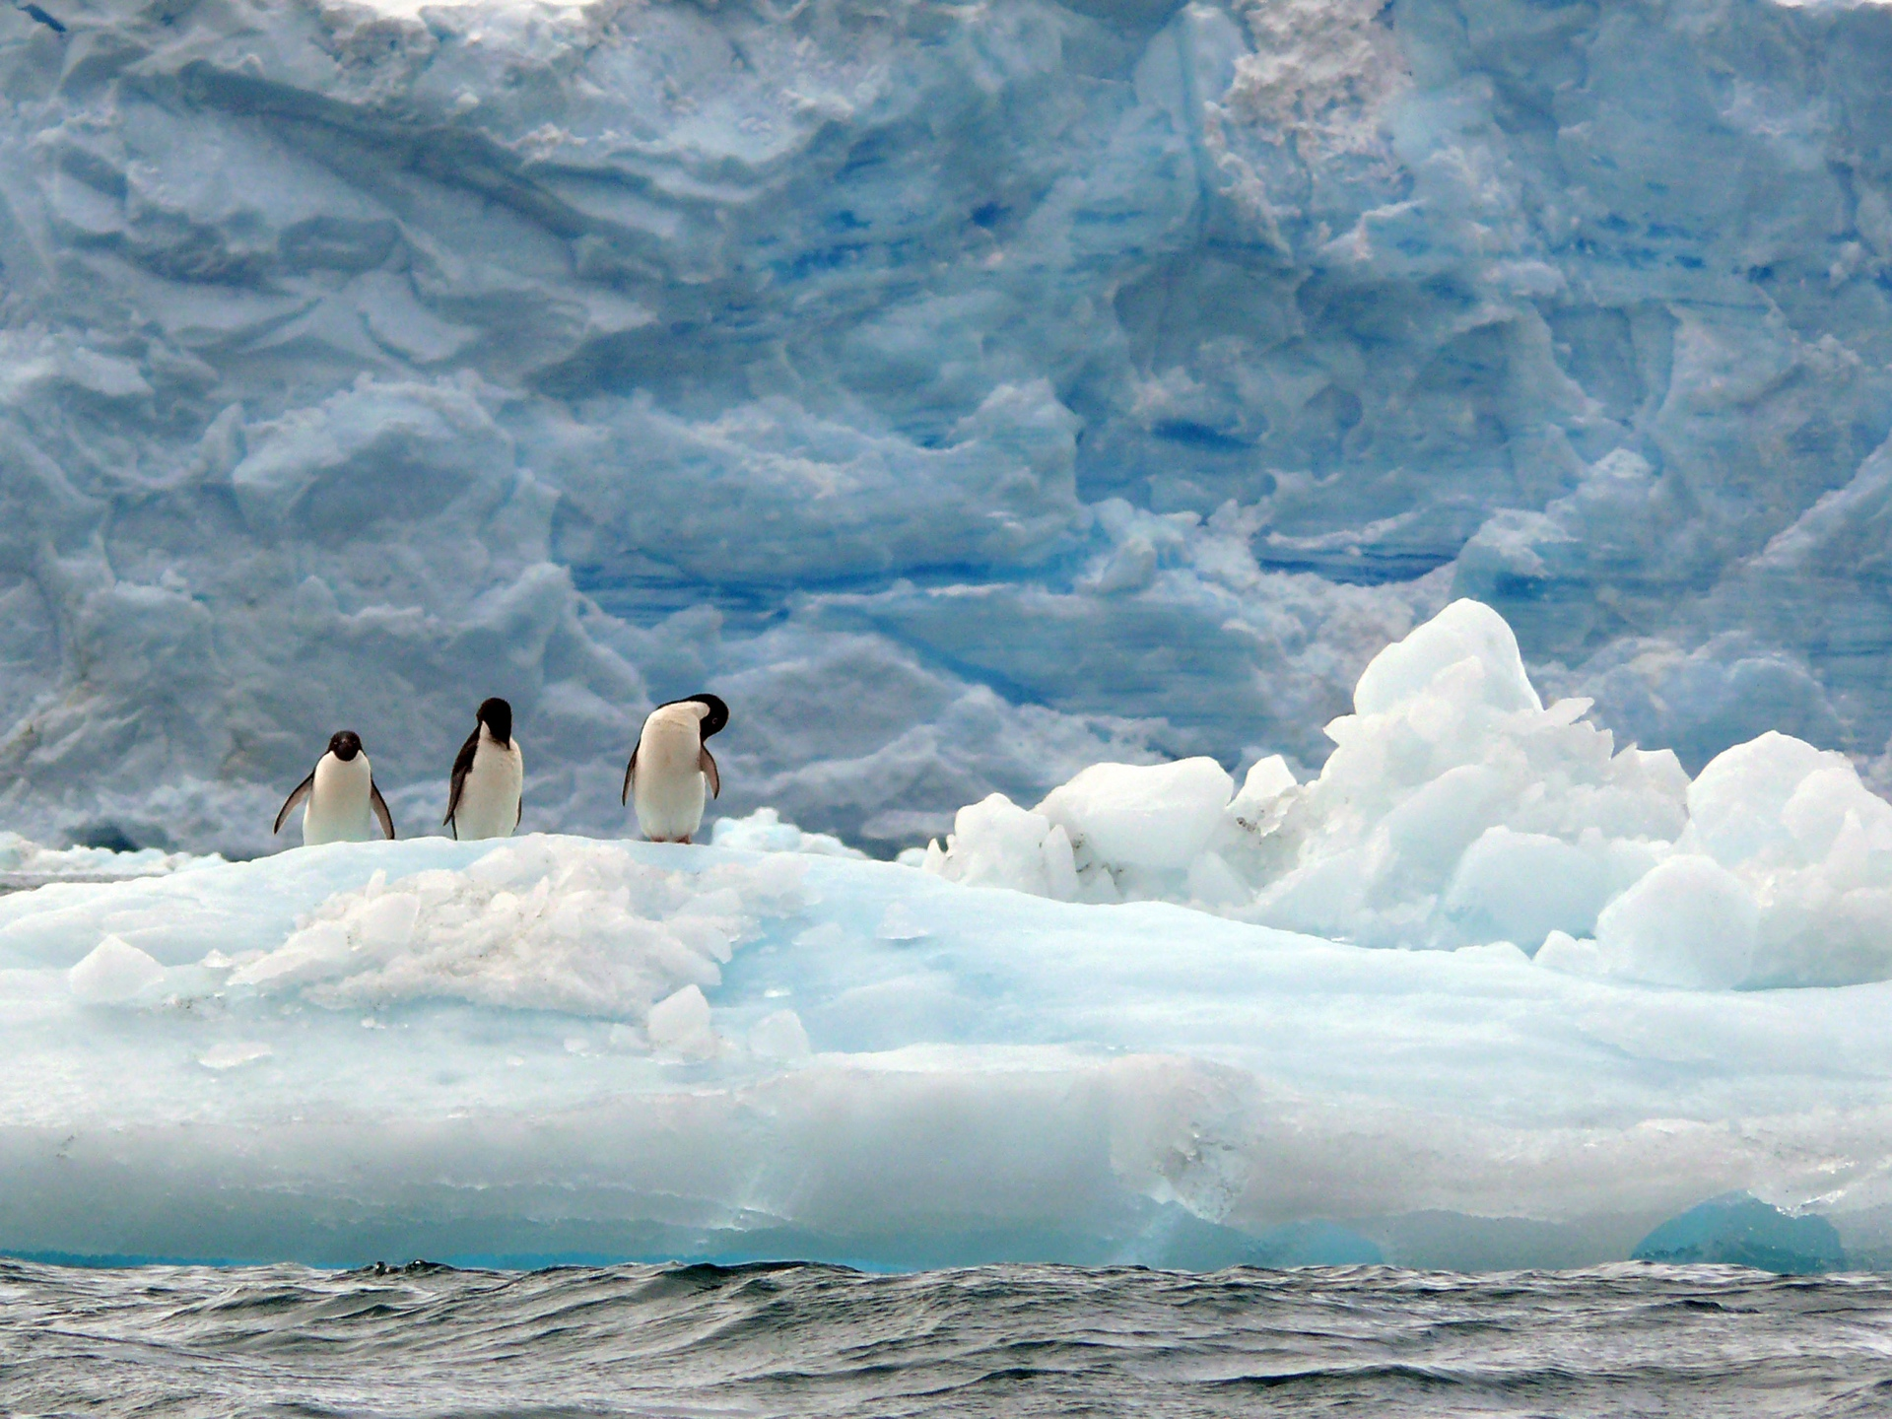
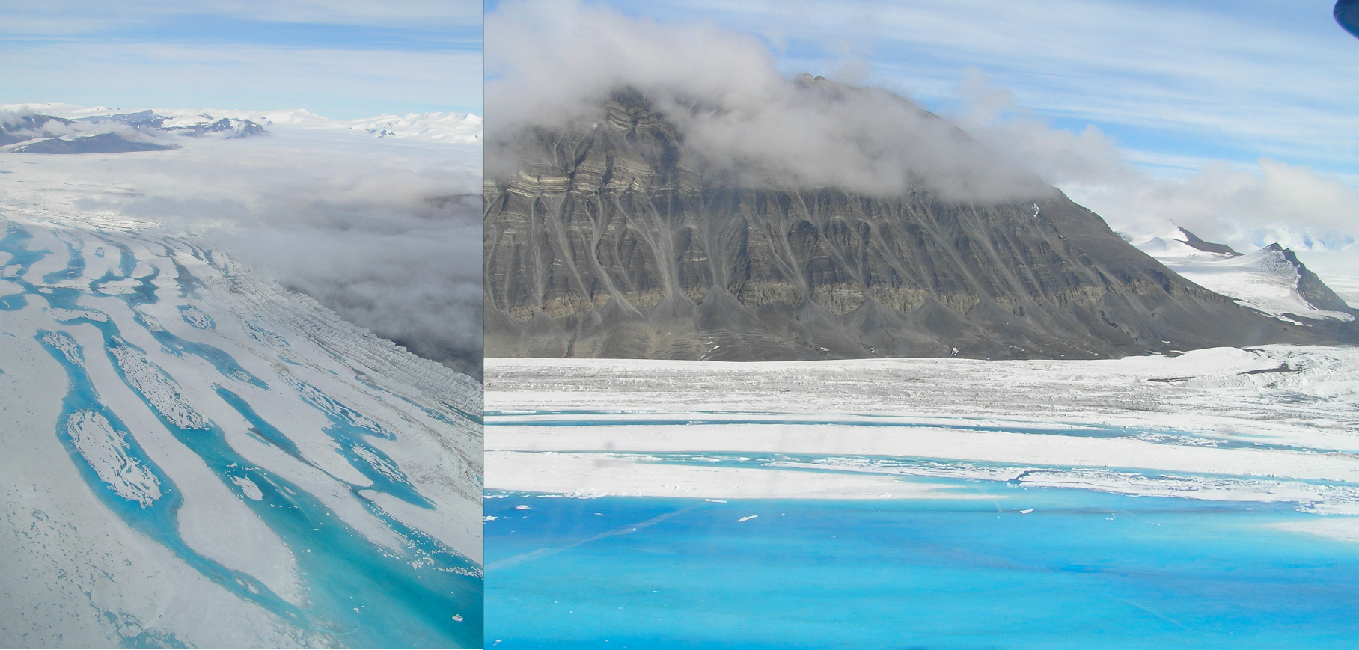
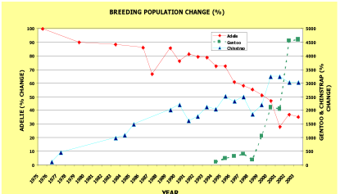
The world is changing. The ocean changes are dramatic and will alter Earth as we know it, the impact on future generations is not known.
By the time I finish my professional career…….
Larsen B ice shelf gone
Plants will be growing on the Antarctic peninsula
Thanks Bill Fraser
Adelie penguins at Palmer Station will
disappear
Thanks Andy Clarke
West Antarctic Ice sheet will
continue to melt
Thanks Andy Clarke
Thanks Bill Fraser

Slide 3
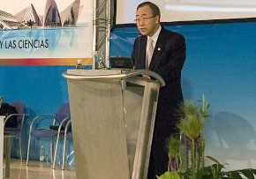
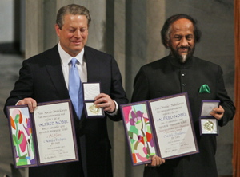
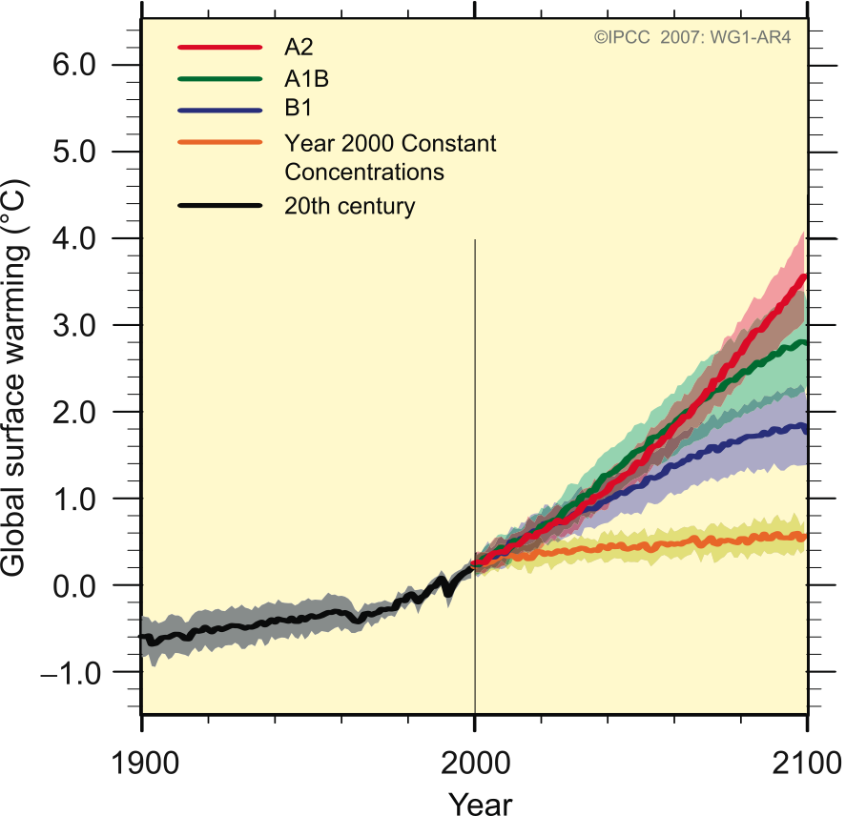
Motivation
U.N. Secretary General Ban Ki-moon:
“Slowing or even reversing the existing trends of global warming is the defining challenge of our ages”
Dr. R. K. Pachauri
Chairman, IPCC:
Knowledge
IPCC AR4 WG I
Figure SPM.5
How do we define what constitutes dangerous anthropogenic interference with the climate system?
2) How do we prepare the human race to face sea level rise & a world with new geographic features?
3) What changes in lifestyles, behavior patterns and management practices are needed, and by when?
Skills
Behavior

Slide 4
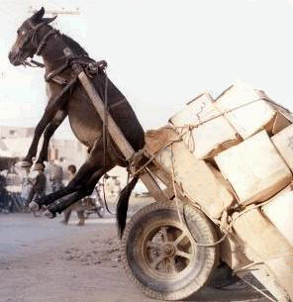
While I am FULLY excited & motivated to engage in education/outreach, I am limited by time and energy, as my responsibilities include:
Teaching undergraduates
Teaching graduates
Mentoring post-doctoral researchers
Mentor junior faculty
Writing manuscripts
Writing grants
Writing progress reports
Reporting findings at professional meetings
Foster science communication via seminars
Deal with increase in regulatory burden
Manage labs
Plan field expeditions
Produce Federal reports
Partake in community management
Talk to University donors
Work on Department committees
Work on University committees
Work on State committees
Work on Federal committees
Work on International committeesan
Informal census for three scientists yeild a required work week of 120 hours
In short I am overloaded just like my education and outreach brethren
NEED TO LOWER THE ACTIVATION ENERGY FOR ALL OF US TO COLLABORATE AND MAKE PROGRESS

Slide 5
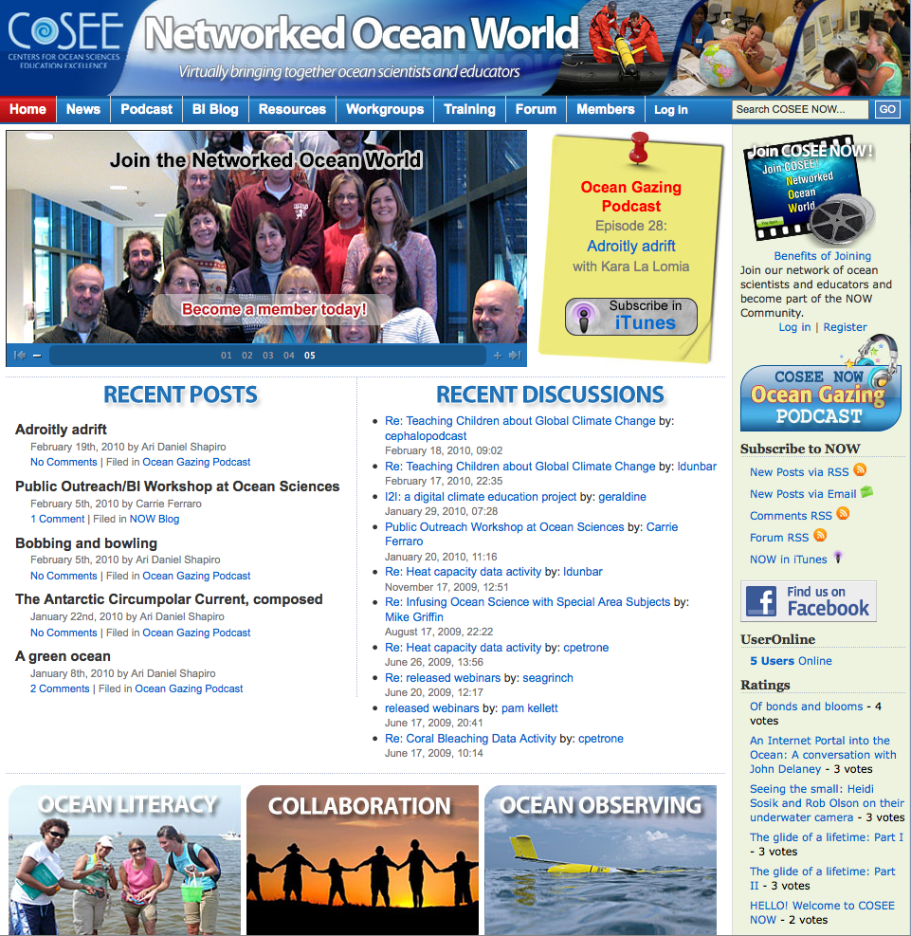
COSEE NOW provides the bridge to connect the professionals in science to the professionals in outreach to the professionals in education
My talk today will discuss how I view COSEE from my view as a scientist. Take home message, I need
these bridges to:
L get help in translation
L be provided a range of engagement possibilities that allow scientist to engage in the level they wish
L be provided a training ground to learn new modes to conduct the outreach
L become part of a community in which to toss ideas around

Slide 6
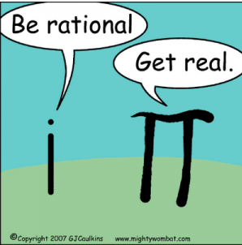
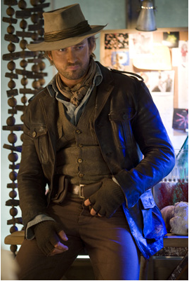
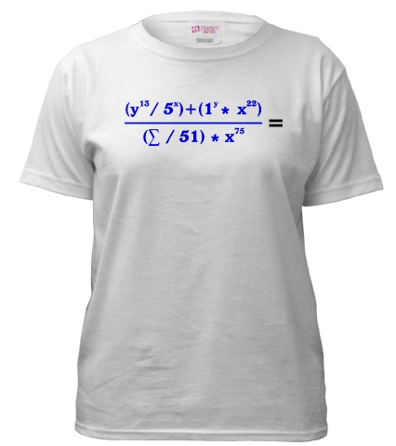
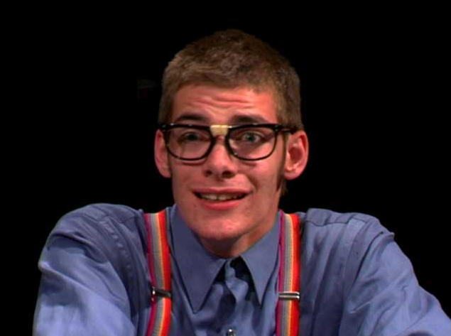
Why else do we need this? Scientists are dedicated and committed; however often are, at best, challenged to tell of their journey
Scientist humor has
selective appeal
Often we are unaware
of how others perceive us.
Their outreach does not
play well with wider
community
Right now I think I
am this to you
My entry to Rutgers
Comedy Night
Right now you are seeing this
My entry to NYC
fashion week

Slide 7
COSEE NOW facilitates engagement over a range
levels that fits the individual scientist’s needs and availibility, it provides a flexible buy-in plan:
Different
Science
Users
The Developer
The Raider
The Customer
The Adopter
The Pupil
Time :
Minutes
Days
Weeks
Months
Years
Resource:
Free
100s-
1000s
1000s-
10,000s
10,000s
100,000s
Degree of collaboration
None
Informal
Formal
Intense
Many &
Intense
Longevity
of
impact
Short
Career
Generational

Slide 8
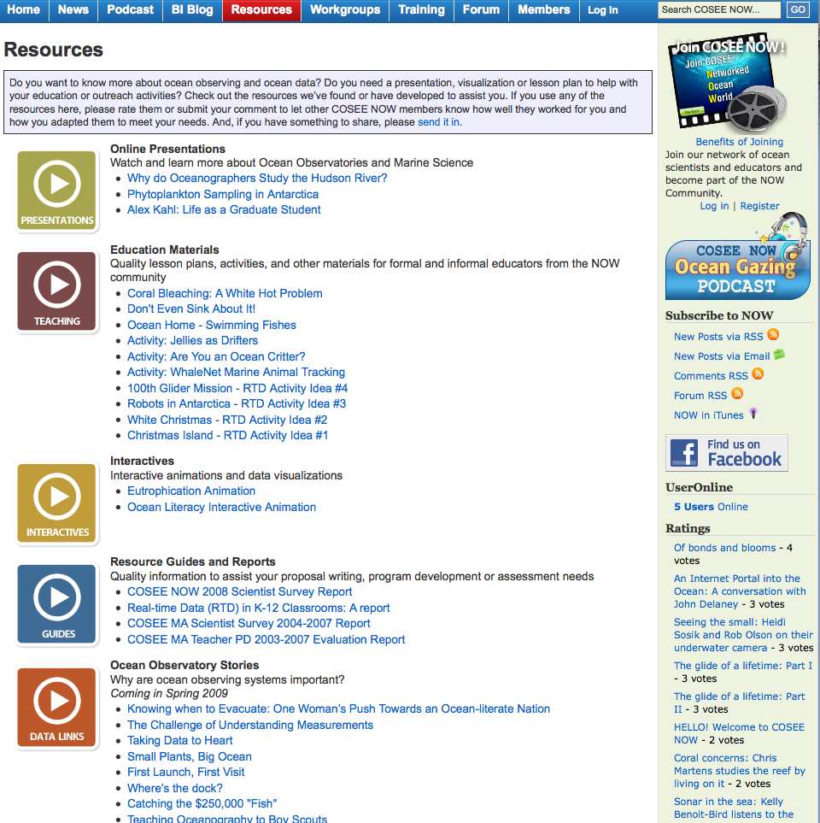
Level 1 Science User (The Raider): COSEE NOW provides online library of resources, I can use in lectures, classes, home work, etc.
Knowledge

Slide 9
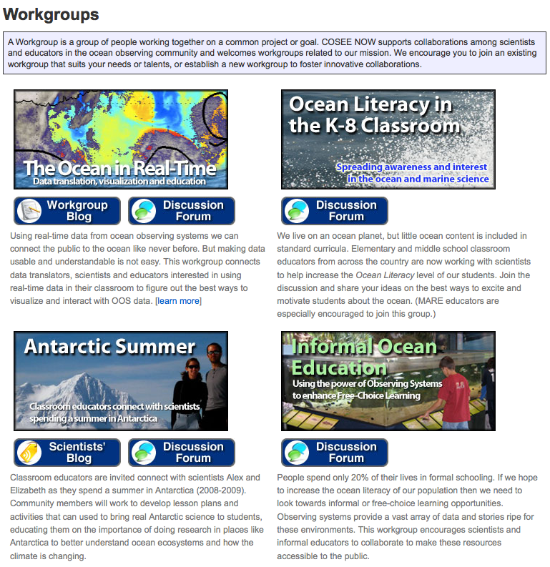
Knowledge

Slide 10
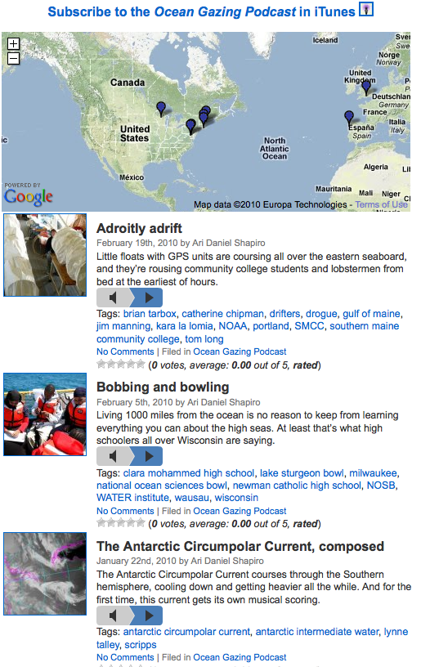
Level 2 Science User (The Customer): Scientists for relatively low amounts of resource can use COSEE NOW family to expand into new media & technologies that would be daunting without partnership
Knowledge

Slide 11
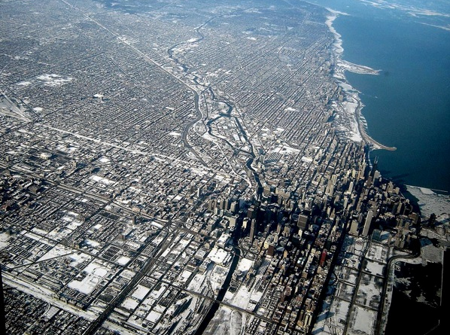
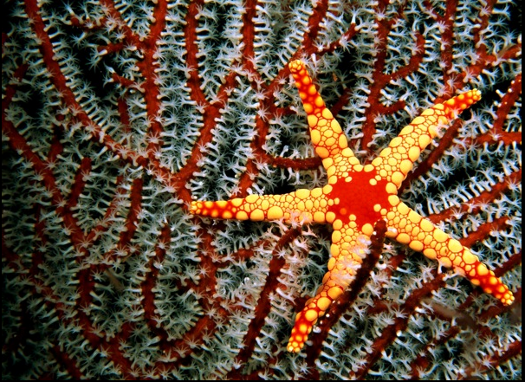
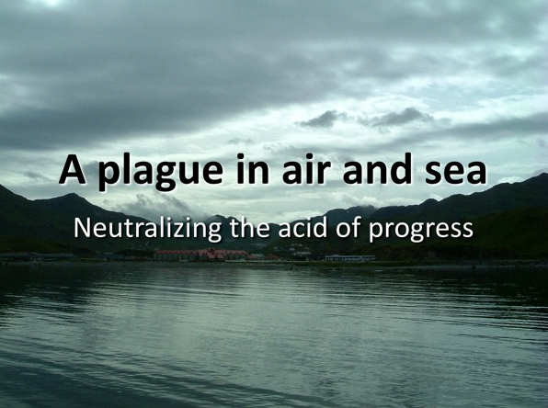
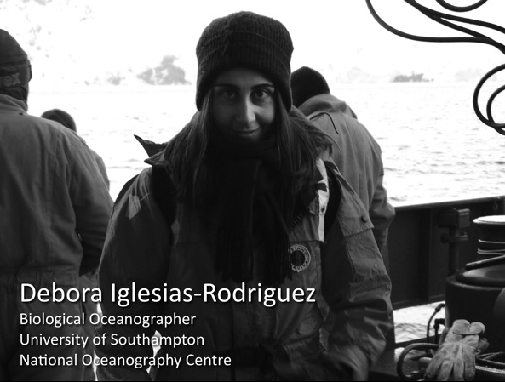
The engagement of the customer scientists might end at a podcast or expand up to audio slide show. COSEE NOW provides scientist an array to explore what is possible
Helping scientists to explain complex environmental problems in a digest-able manner
Knowledge

Slide 12
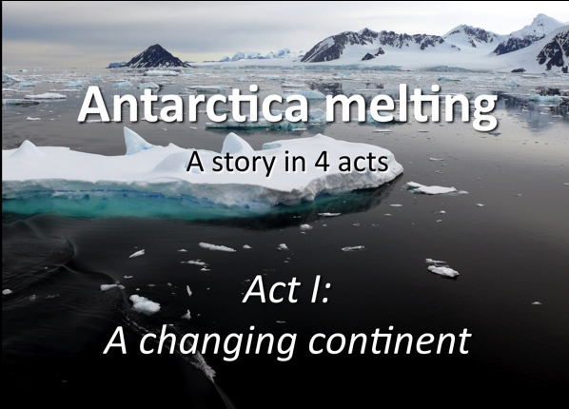
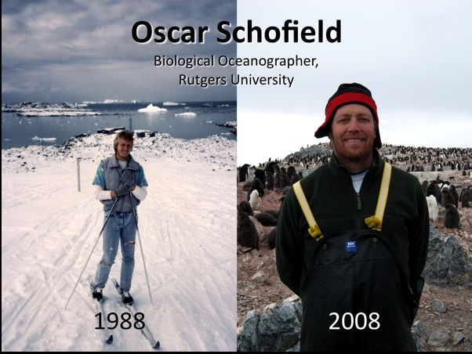
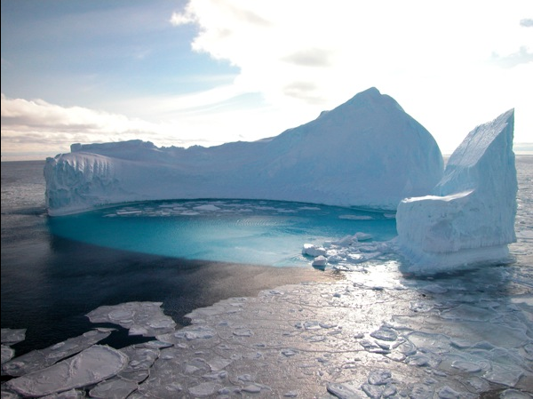
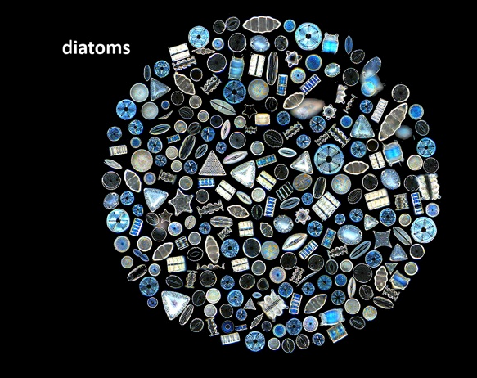
Products for scientists :Why do science, science stories told by scientists
4 part story of climate change & food webs: Walking in the forest in a changing Southern ocean
Knowledge

Slide 13
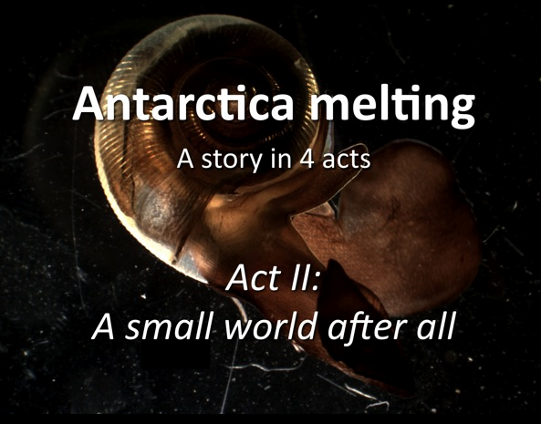
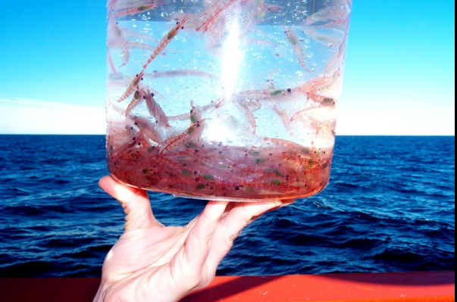
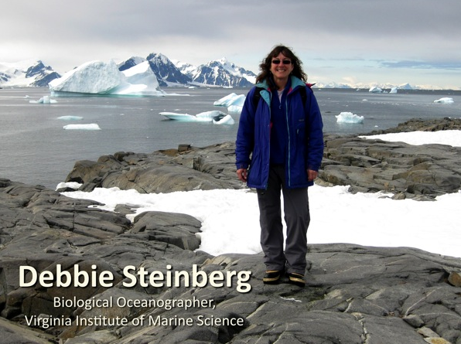
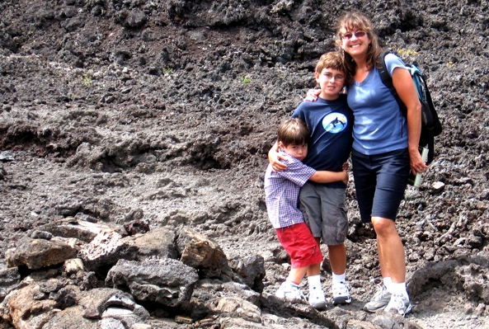
Products for scientists :Why do science, science stories told by scientists
4 part story of climate change & food webs: Zooplankton and why do we care?
Knowledge

Slide 14
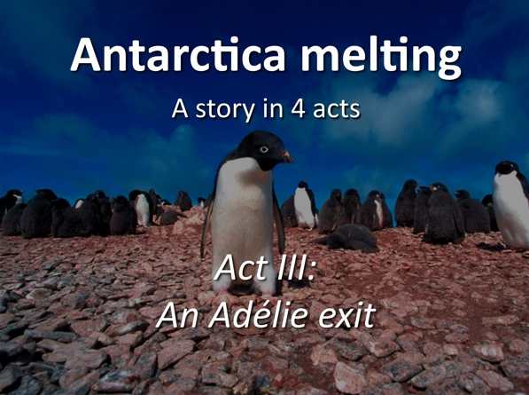
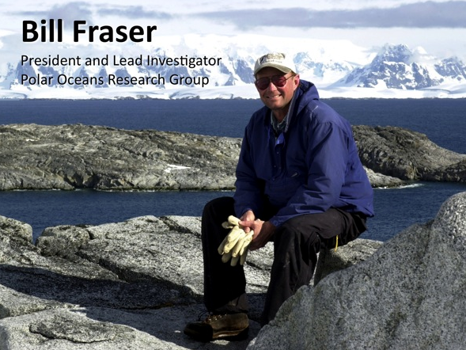
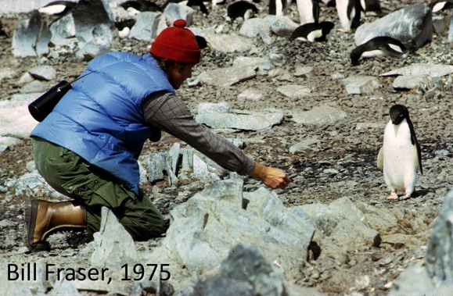
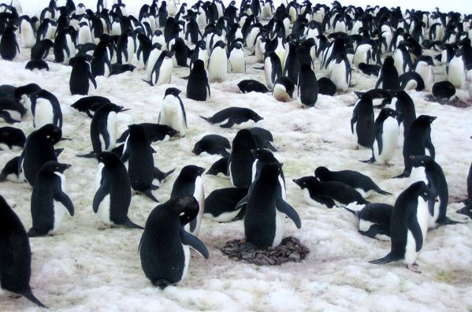
Products for scientists :Why do science, science stories told by scientists
4 part story of climate change & food webs: Penguins and watching the world change in one’s lifetime
Knowledge

Slide 15
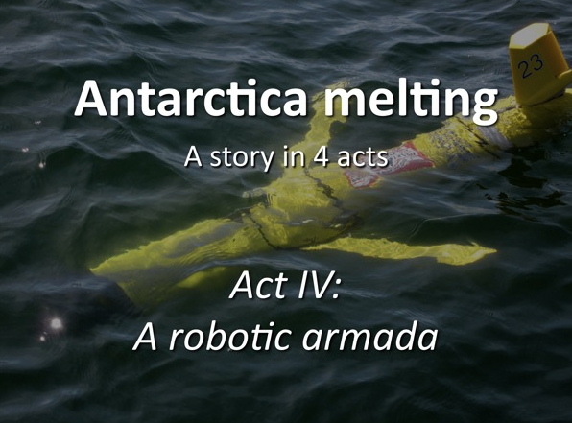
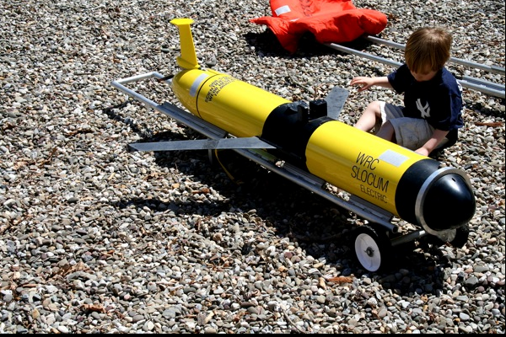
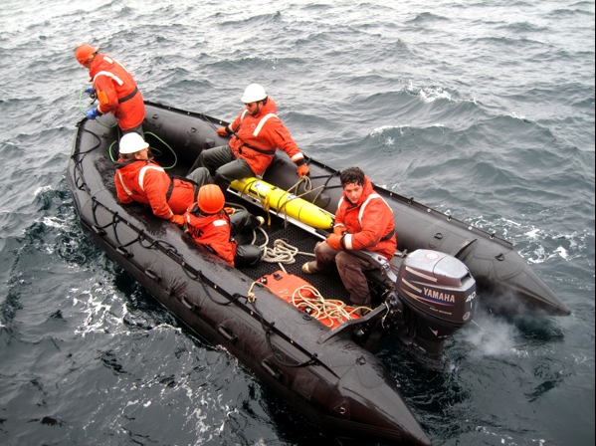
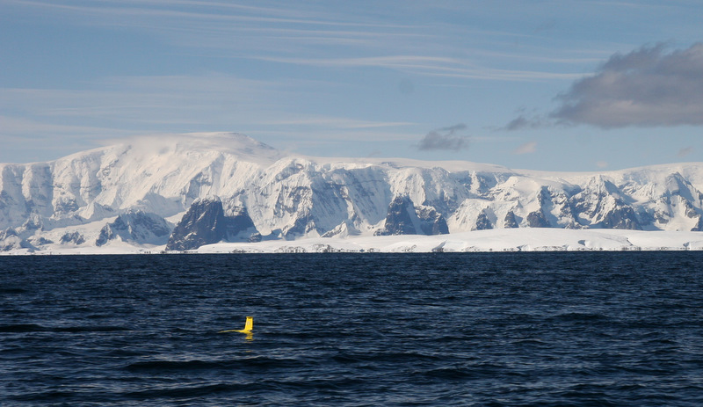
Products for scientists :Why do science, science stories told by scientists
4 part story of climate change & food webs: Technology and hopes to finding a new way to explore and solve problems
Knowledge

Slide 16
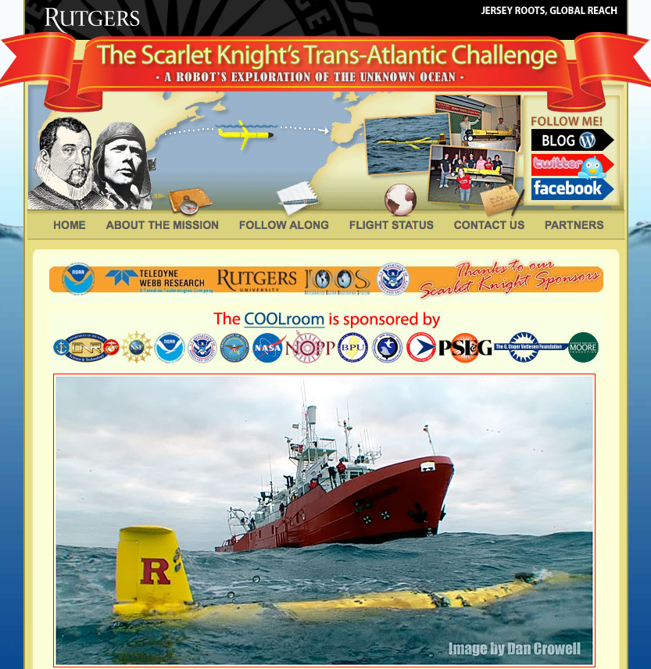
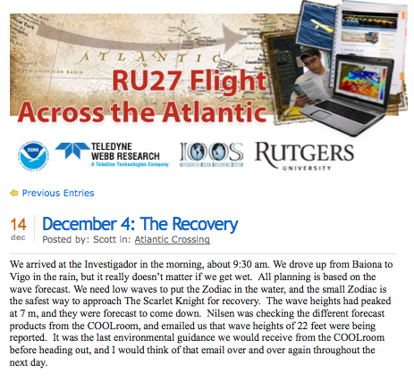
Level 3 Science User (The Adopter): The COSEE NOW menu provokes an idea that leads the scientist to develop new approaches in their own teaching practice
Skills

Slide 17

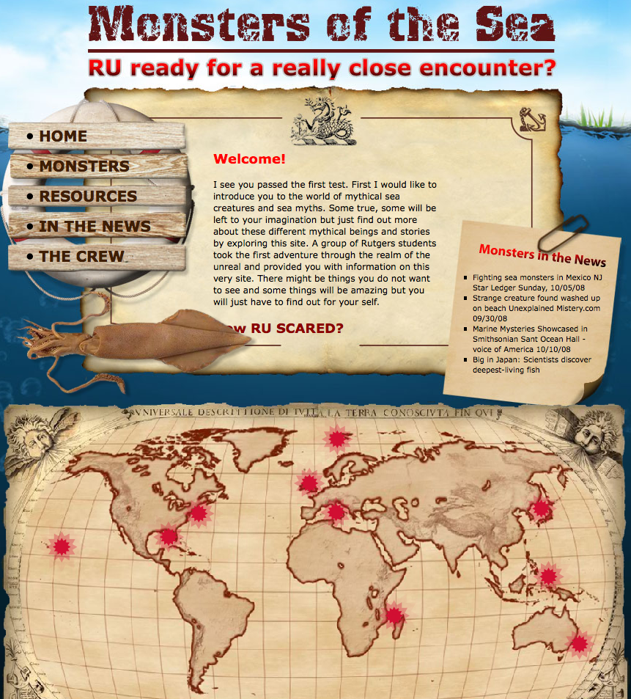
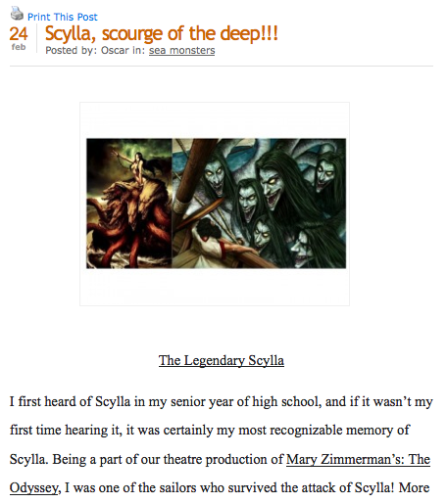
Level 3 Science User (The Adopter): The COSEE NOW menu provokes an idea that leads the scientist to develop new approaches in their own teaching practice
Skills

Slide 18
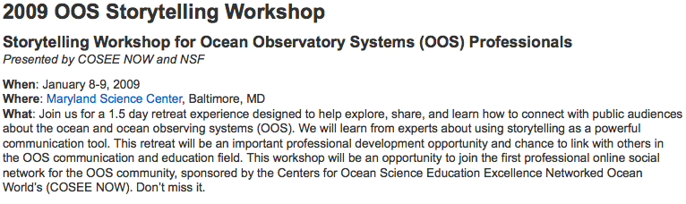
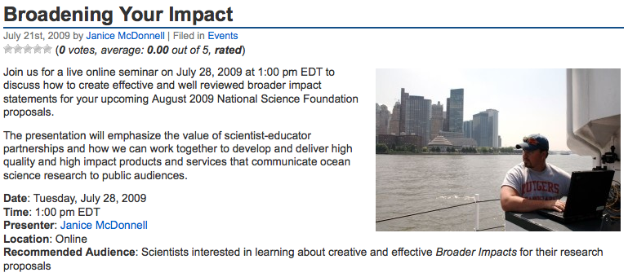
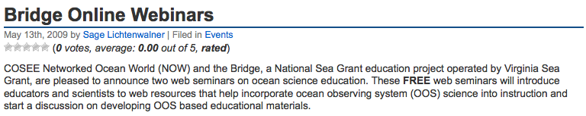
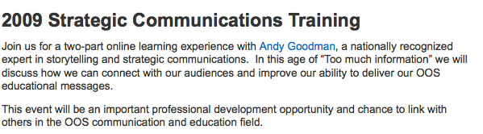
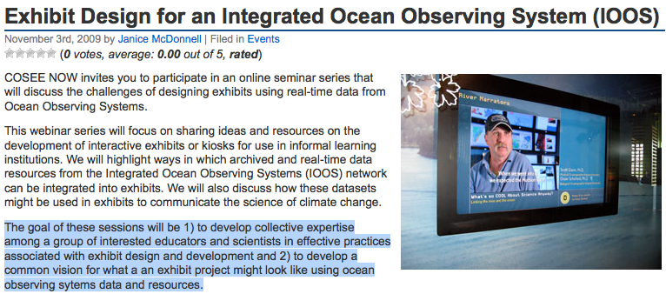
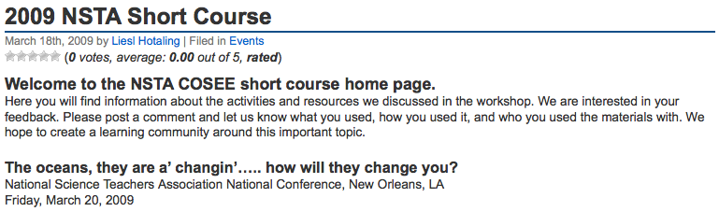
Level 4 Science User (The Active Student): The COSEE NOW community provides conduit for scientists who wish to improve and learn new skills to take part in ongoing training
Skills

Slide 19
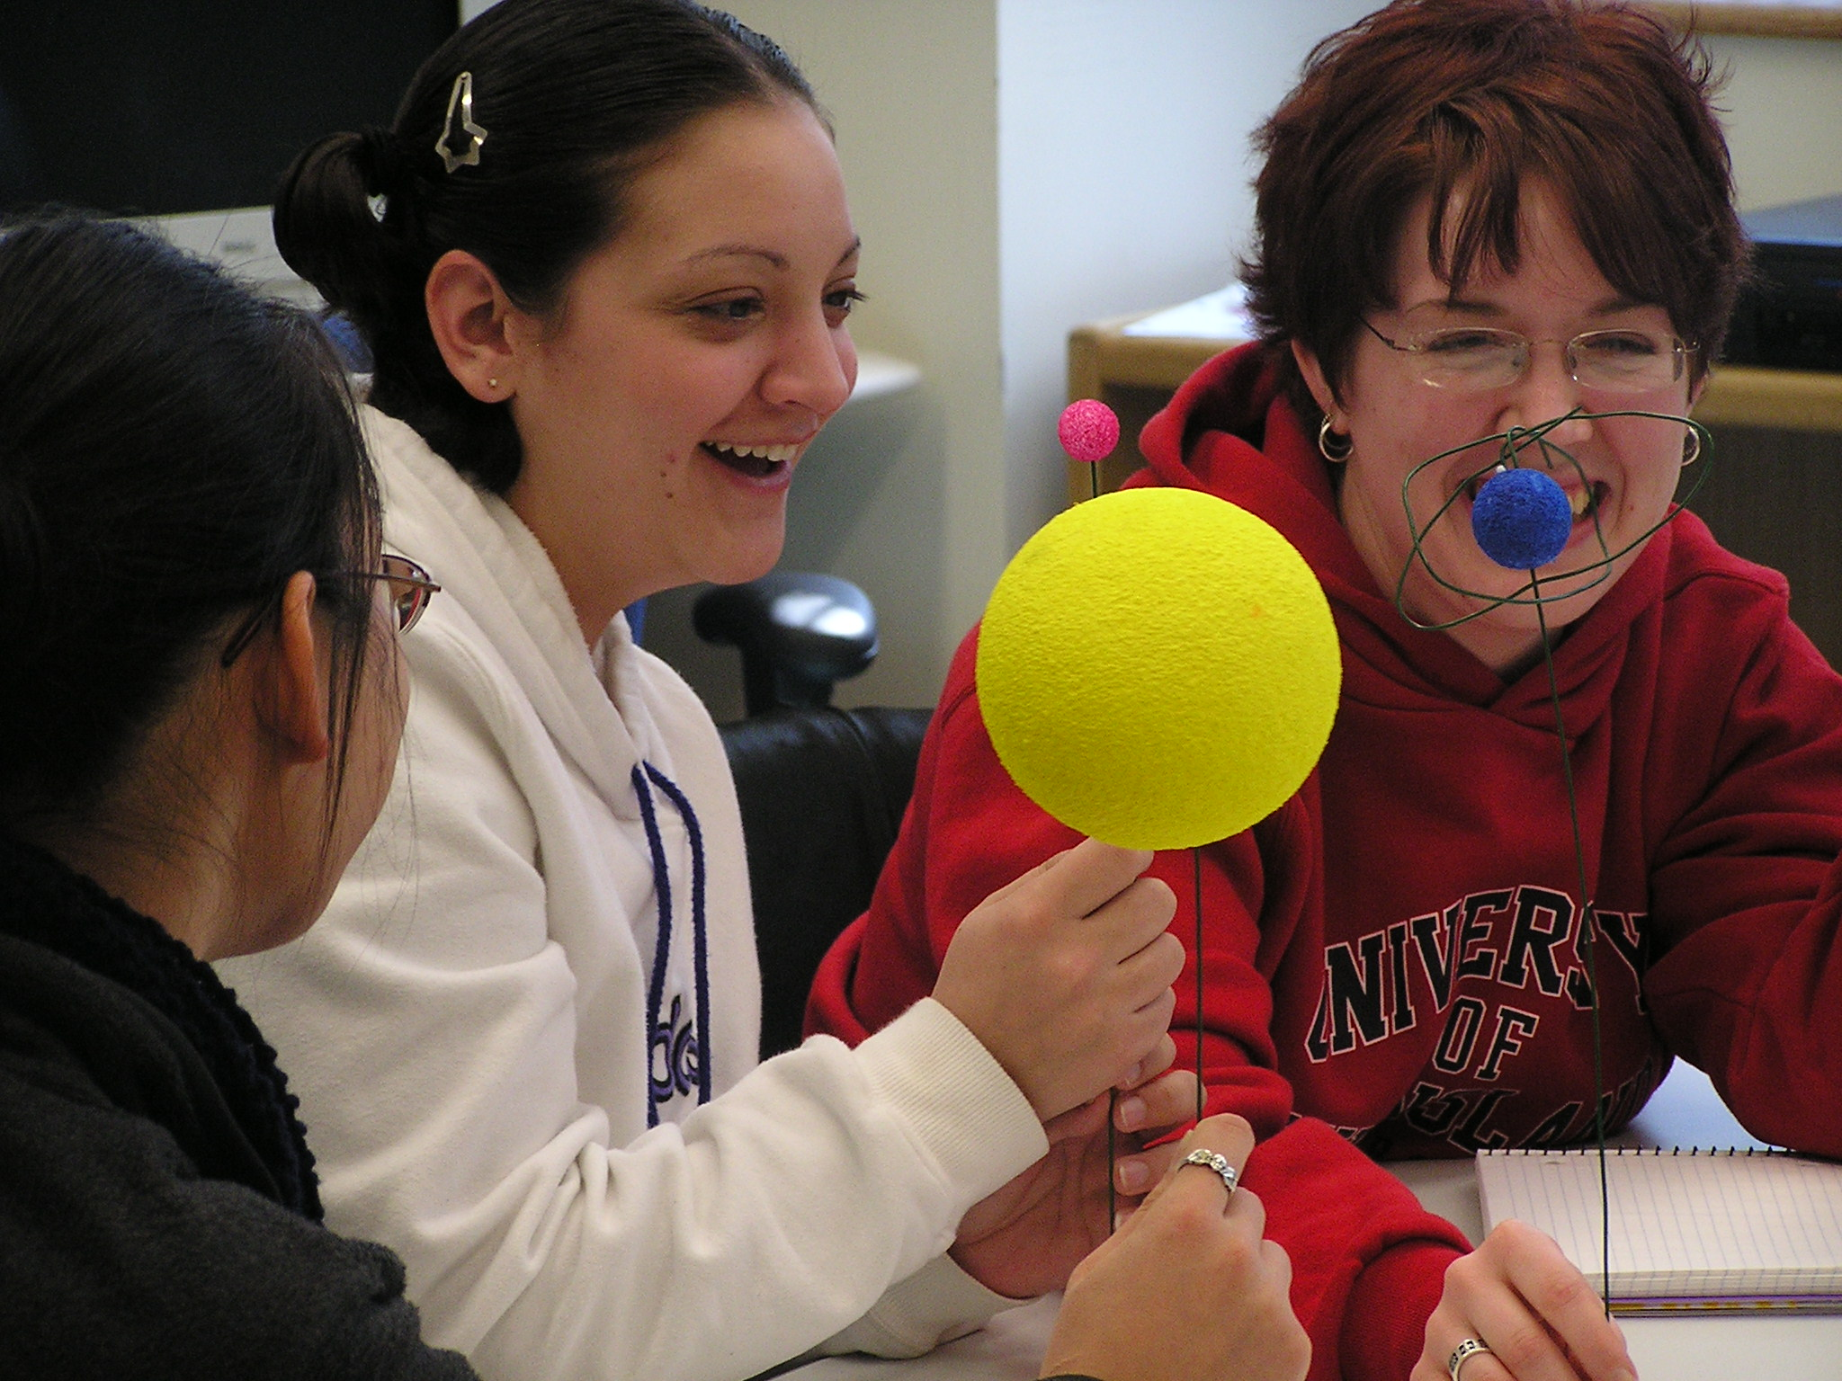

Level 5 Science User (The Developer): The COSEE NOW community provides the community in which joint efforts can lead to the development of new educational infrastructure
Building Curricula: Communication Ocean Sciences
Focuses in theoretical and practical aspects of how people learn.
Invitation
Reflection
Exploration
Application
Concept
Invention
Behavior

Slide 20




COSEE-MA
COSEE-NOW
COS
Programs
MARE
COSIA
Many new partnerships
Stronger COSEE partnerships
Student Achievement
Lone educator
Typical PD programs
Scientists on call
COS/COSIA/GSE Courses
Taking the Pulse Lecture Series
COOL Classroom v2
Impacts
Skills
Interest from GSE
Collaboration with LSC (informal)
High Student Interest
Proposal to NSF-EHR
Faculty Respect
Cultural shift in Science Community
Collaborative Ed/Research grants
Education School Course Opportunities
Undergraduate Opportunities
New Faculty & GA positions
New Facilities
Knowledge
Behavior

Slide 21
COSEE NOW provides the formal framework where the scientists can begin
to track impact through assessment. This means that the process is an iterative spiral development cycle. As the scientist iterates, they might morph their effort from a Raider all the way through to the Developer
Policy makers
Science literate public
K-16 teachers & students
Target
Audience
Needs
assessment
Develop
Demonstration
Project
Refine
Program
Pilot
Program
COSEE network
IOOS EPO & OOI OL
OOS scientific community
Evaluate
Program
Disseminate Program
& Publish Findings

Slide 22

Engaging the science community will happen one researcher at a time; traditional outreach modes will be locked into a linear model of engagement.
COSEE NOW is a force multiplier with tools that take advantage of modern social networking capabilities.
COSEE NOW lowers the barrier for scientists to engage at whatever level they are available. This is key, as the majority of scientists are willing, they are just overwhelmed and lost in where to begin.

Slide 23

Conclusions
There is a great need to develop better understanding of the oceans, as they changing as this will alter human society
Education and outreach is the central KEY area for the sustained engagement of society
Ocean Observing Systems and the associated virtual communities will be key to these systems realizing their synergistic potential
COSEE NOW will hopefully provide a tool to realize that potential.

