Slide 1
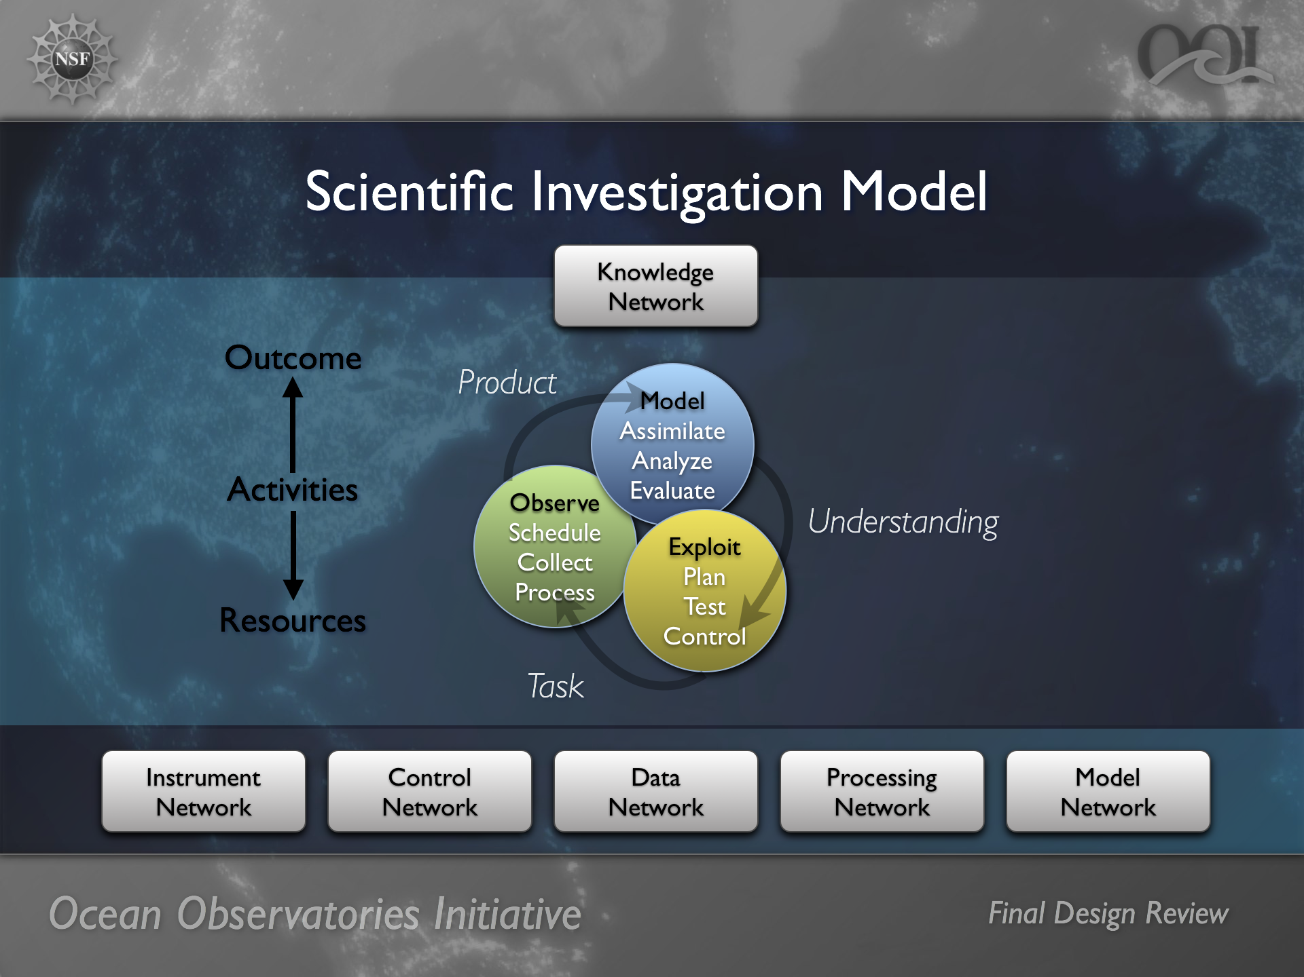

Slide 2
This will require a highly distributed set of capabilities that facilitates:
• End-to-end data preservation and access,
• End-to-end, human-to-machine and machine-to machine control of how data are collected and analyzed,
• Direct, closed loop interaction of models with the data acquisition process,
• Virtual collaborations created on demand to drive data-model coupling and share ocean observatory resources (e.g., instruments, networks, computing, storage and workflows),
• End-to-end preservation of the ocean observatory process and its outcomes, and
• Automation of the planning and prosecution of observational programs.

Slide 3
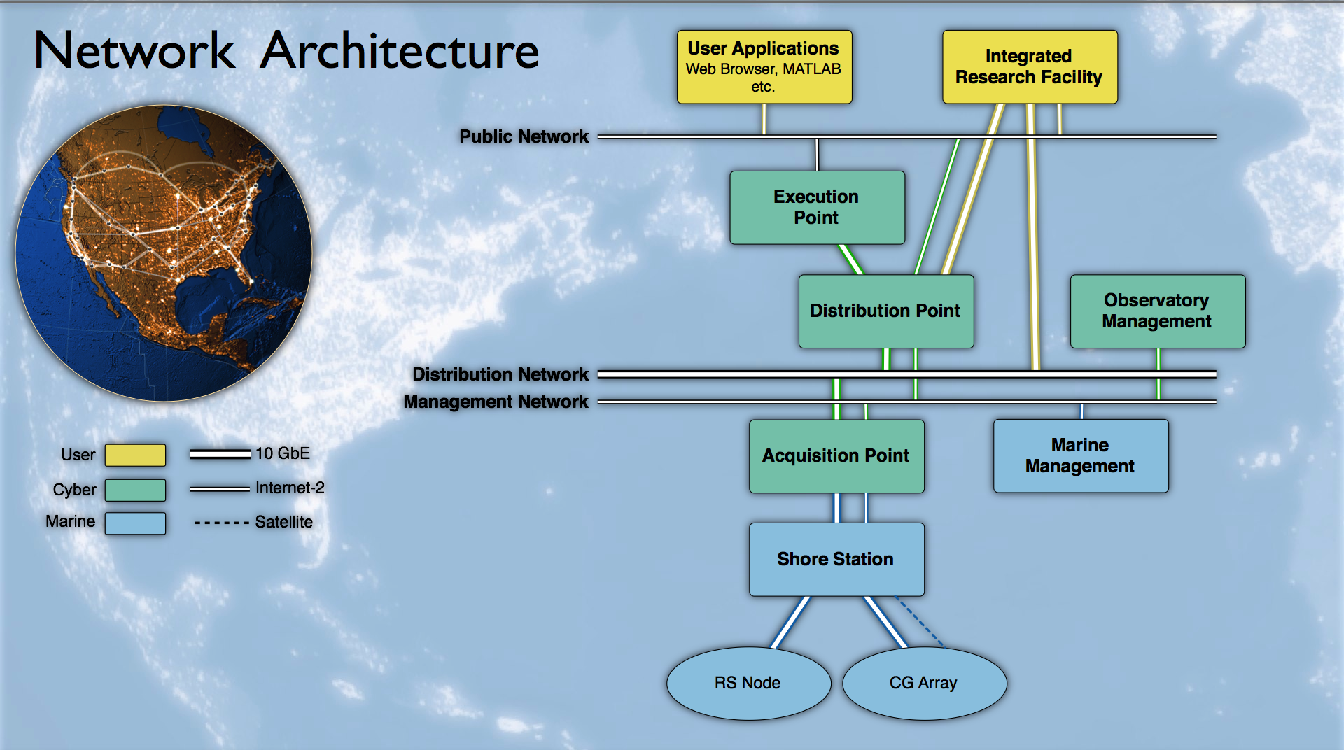
The CI integration strategy is based on messaging and service-orientation.
A high-performance message exchange provides a communication conduit with dynamic routing and interception capabilities for all interacting elements of the system-of-systems.
2) Service-orientation manages and maintain is applications in a heterogeneous distributed system. All functional capabilities and resources represent themselves as services with defined service access protocols based on message exchange. Services are independent of implementation technologies

Slide 4
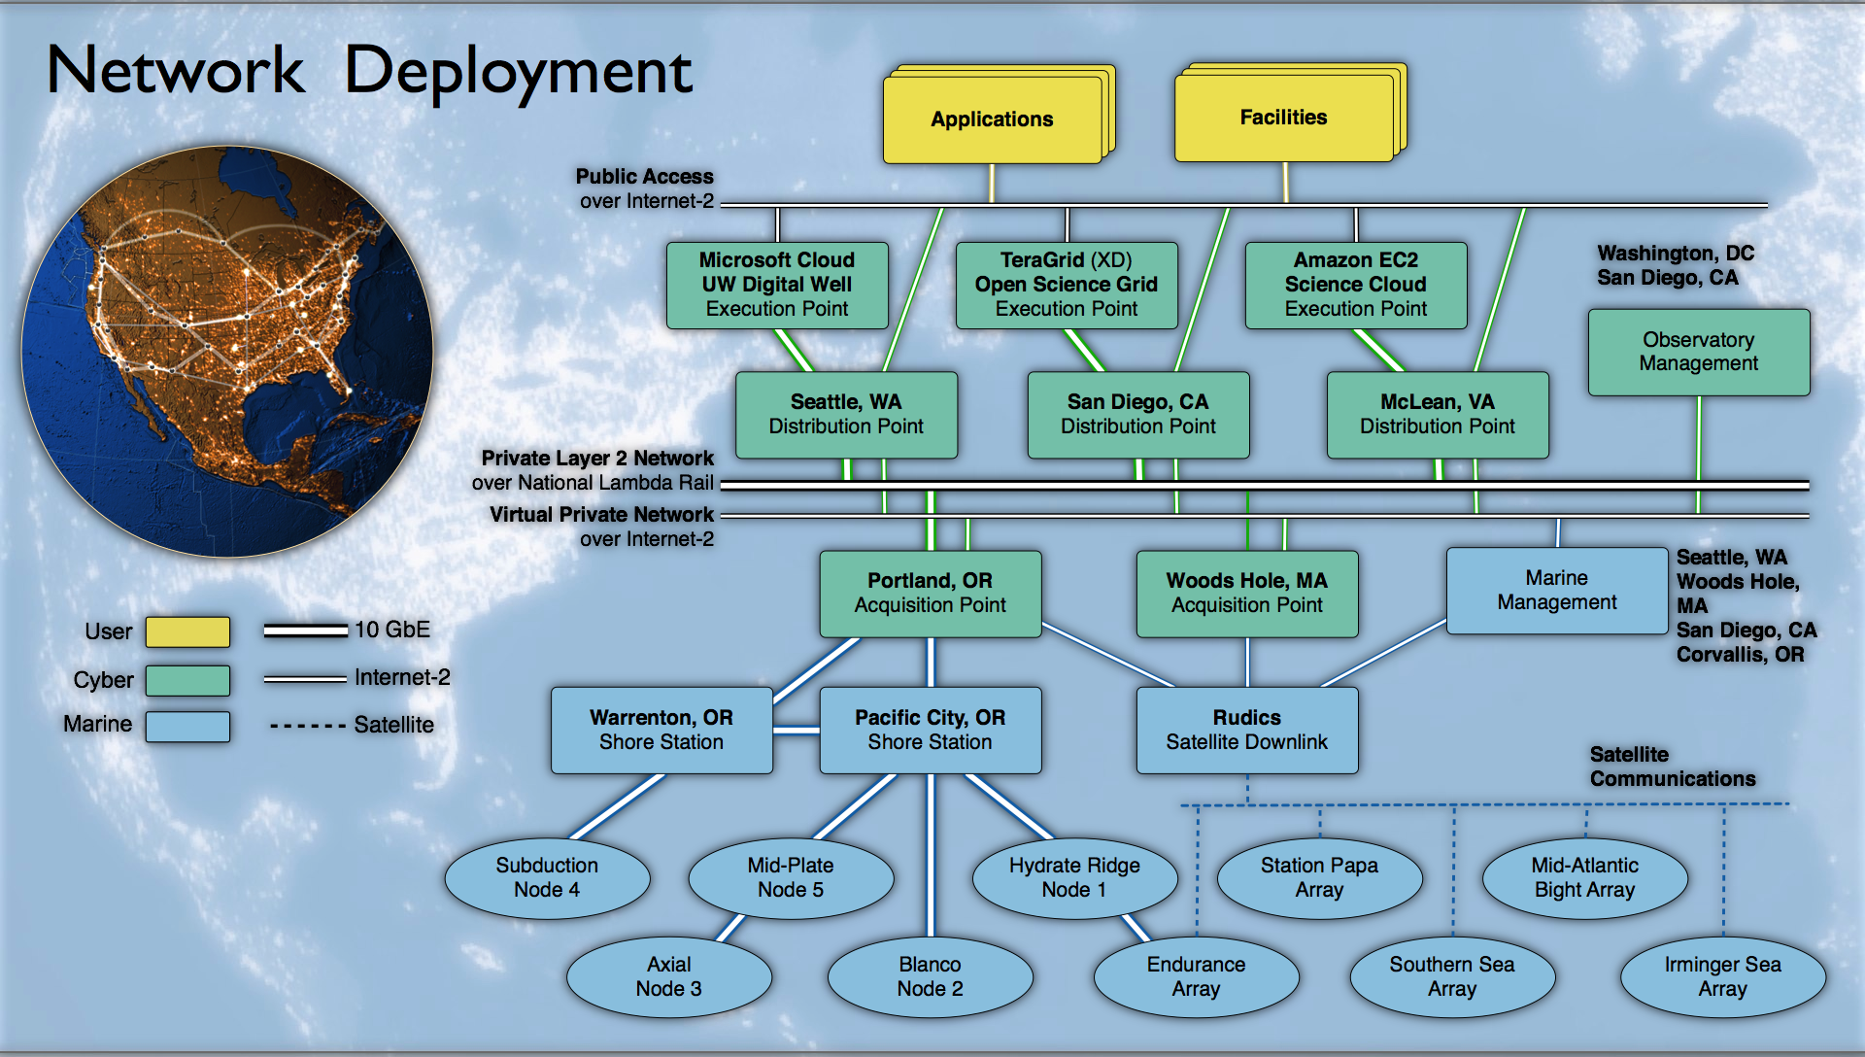

Slide 5
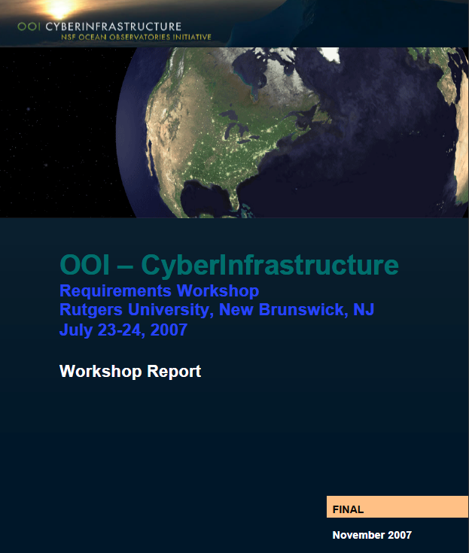
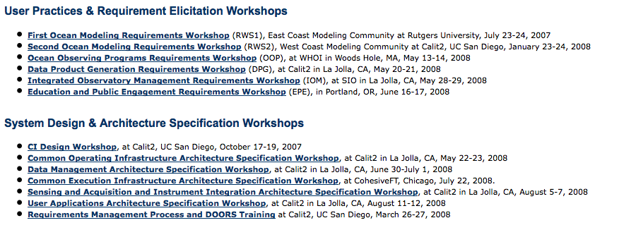
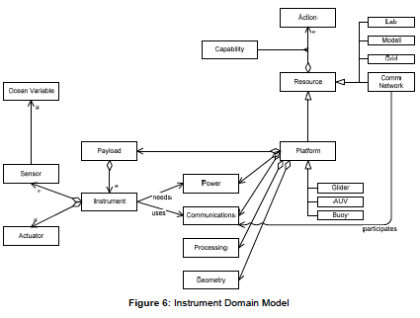
WHERE DID THE CYBER REQUIREMENTS COME FROM?
Close to 20 workshops spanning numerical modeling, infrastructure management, system architecture, through to education/outreach. These resulted in the system design. That was rigorously reviewed during PDR, CDR, and FDR. Involved well over 200 people from the ocean science, engineering and computer science communities

Slide 6
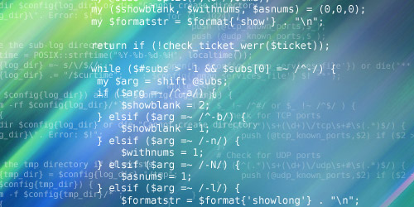
The CI Capability Container provides all essential infrastructure elements and selected deployment-specific application support. Capability containers can be deployed wherever CI-integrated resources are required across the observatory network, and can be adapted to available resources and their environment.
Translation: The software is a self contained package. It is capable of upgrades.
It can be deployed on instruments, to shore side facilities.

Slide 7
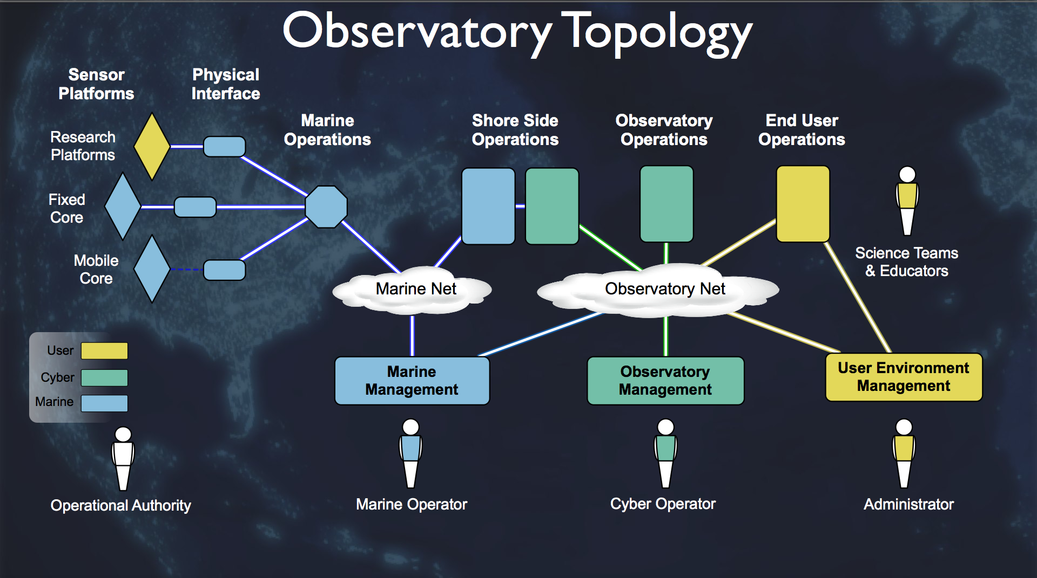
The CI Capability Container provides all essential infrastructure elements and selected deployment-specific application support. Capability containers can be deployed wherever CI-integrated resources are required across the observatory network, and can be adapted to available resources
and their environment.
How will CI help me?

Slide 8
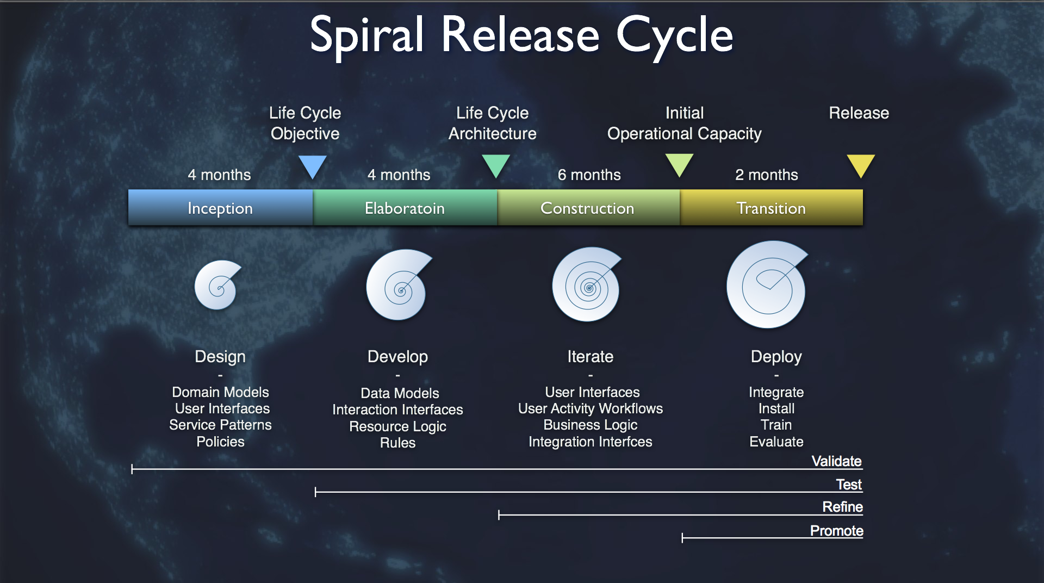

Slide 9
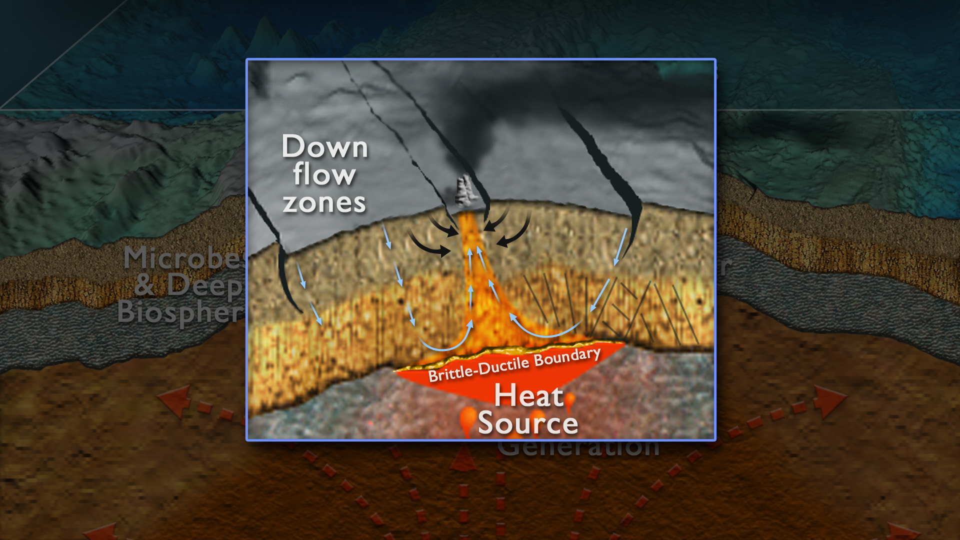
Many scientists form a distributed team to study earthquake modulation of seafloor biota. They use the cyber tools to form a social network to design experiments, explore data, and publish results

Slide 10
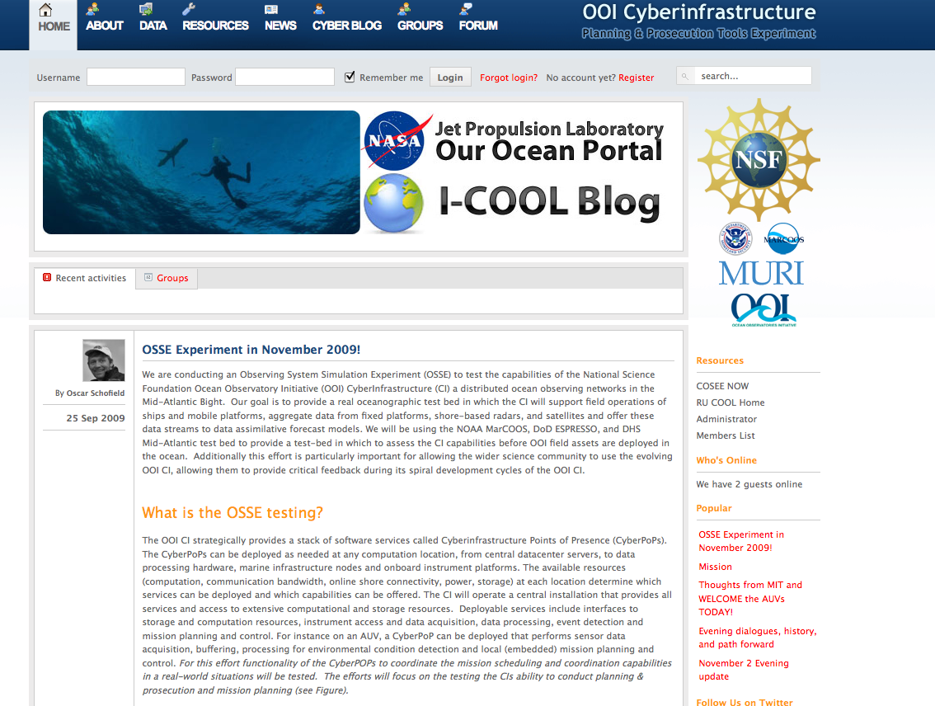

Slide 11
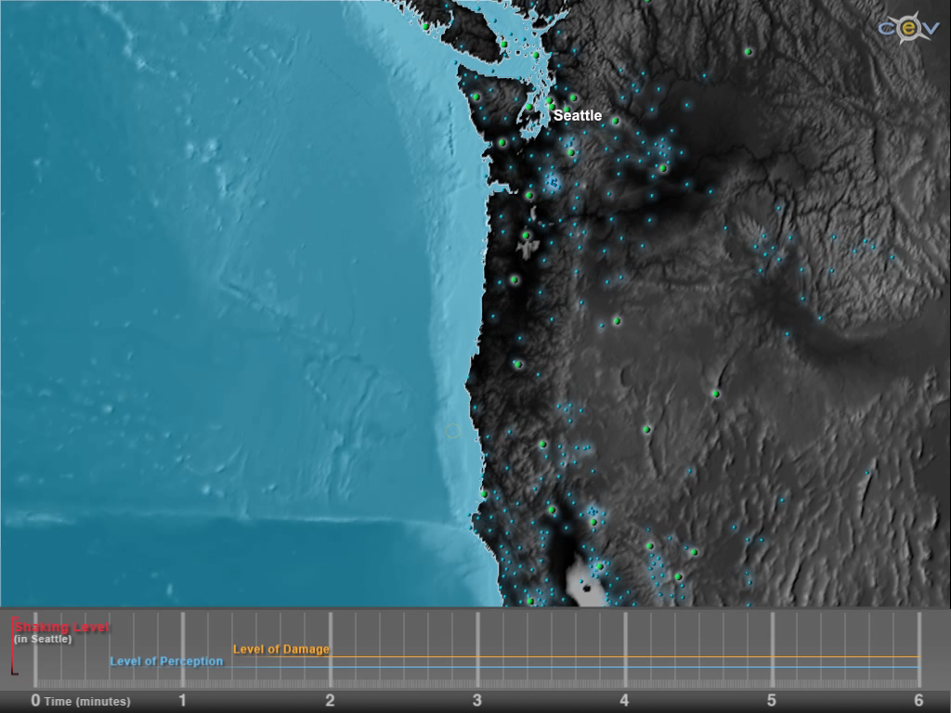
Example: There is an event. The events have been identified by the science user. The science user or science user group is then alerted.

Slide 12
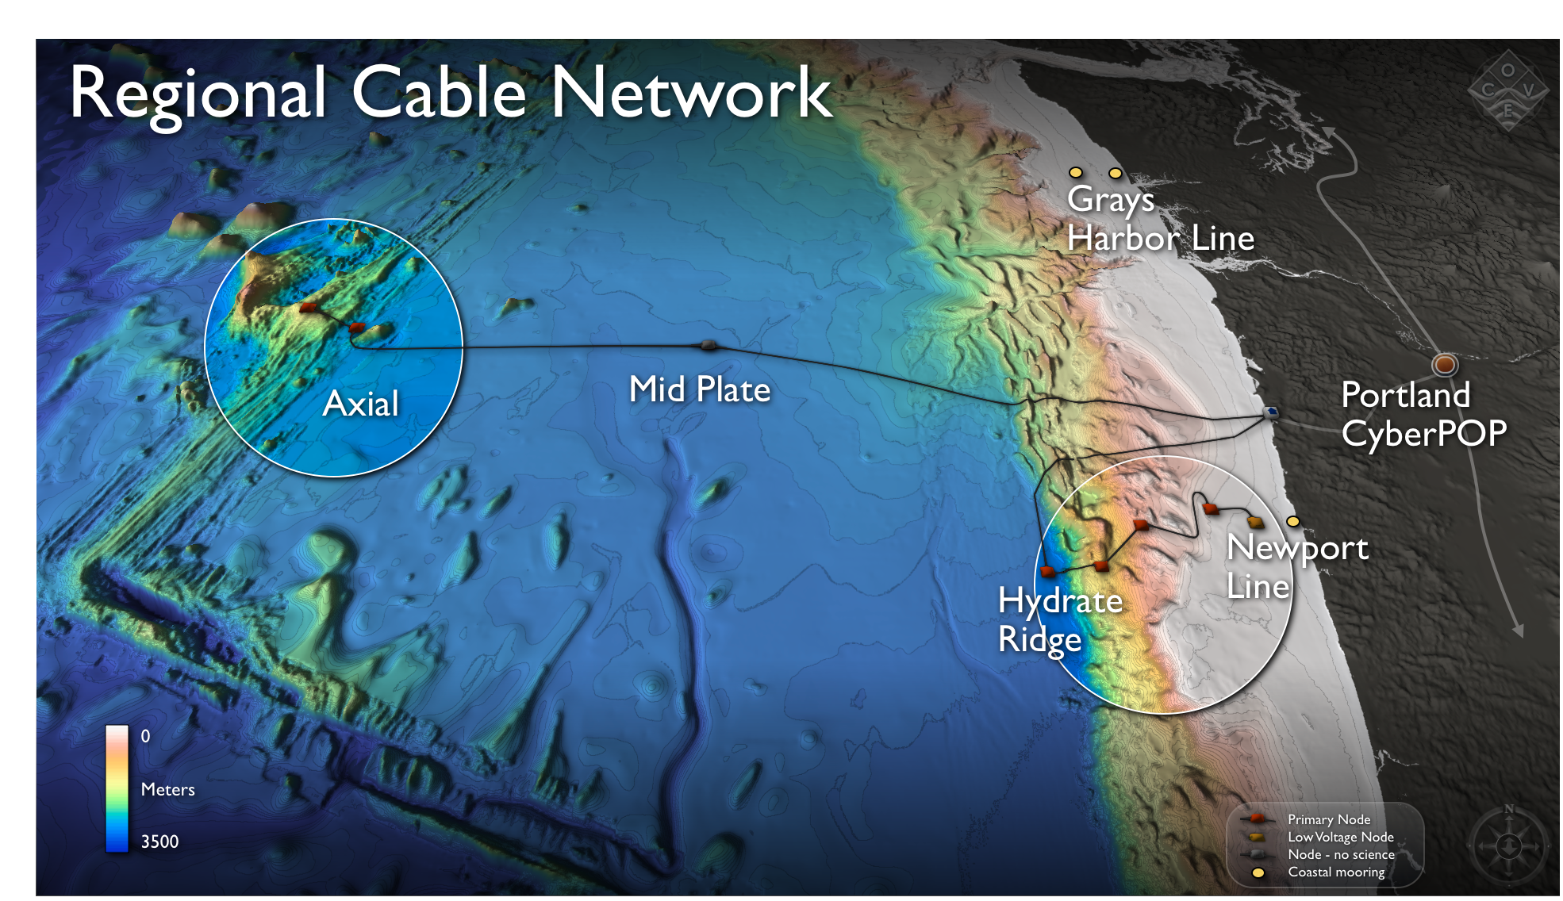
Working group has
programmed network to adaptively
detect and conduct experiments

Slide 13
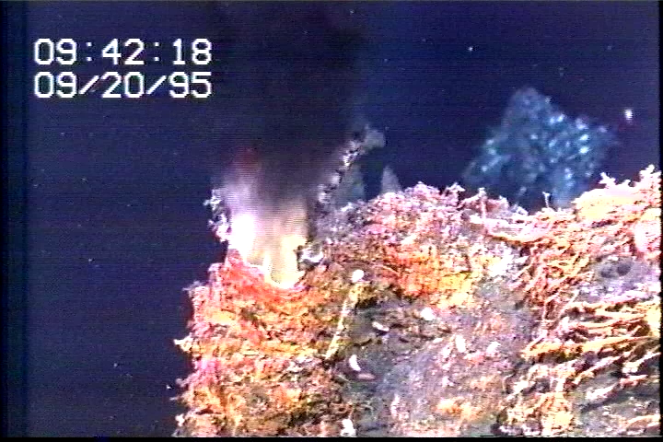

Slide 14

Scientist has subscribed to the vent working group.
The scientist is alerted to
an event occurring.
The
event alerts all scientists
in the working group to the event. They can interact and modify ongoing experiments.

Slide 15
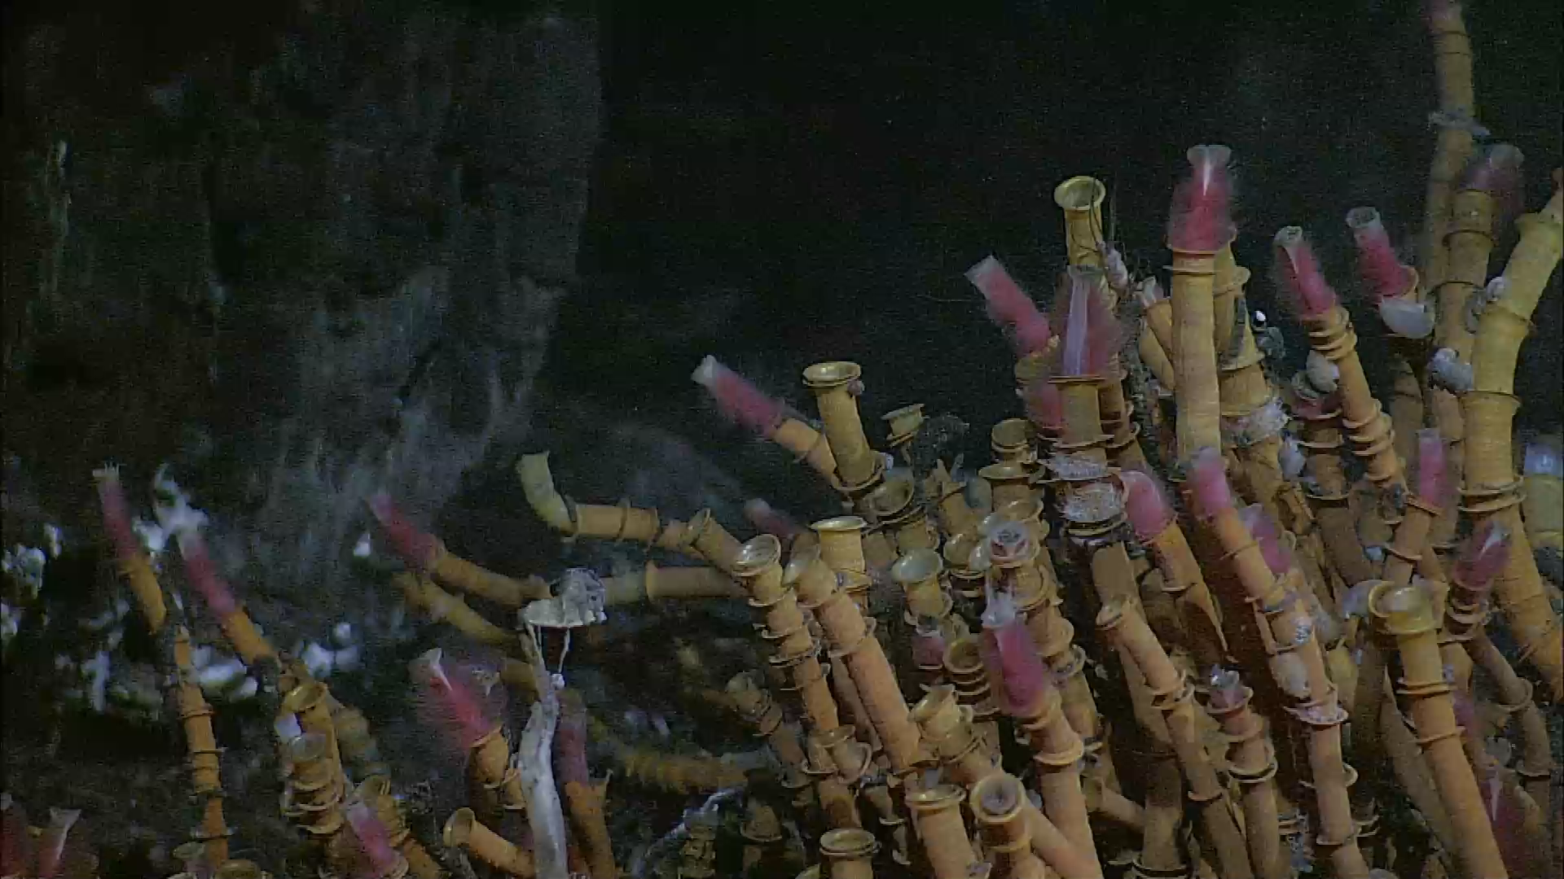
Scientist logs into
system to assess visually
status of the experiment

Slide 16
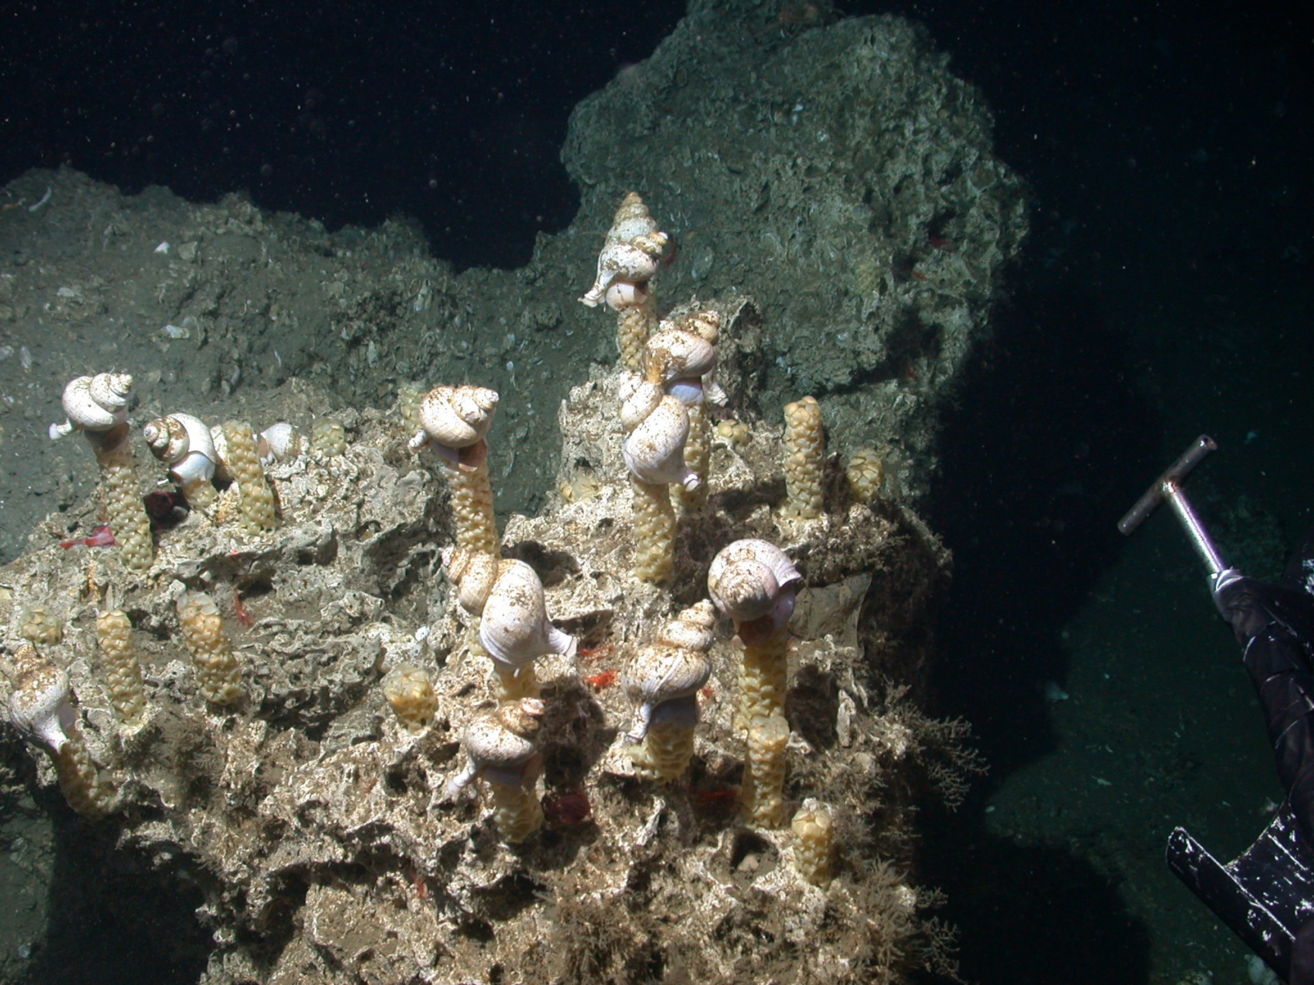
Another social group will be assessing how the
methane hydrate fields are impacted by the seismic event

Slide 17
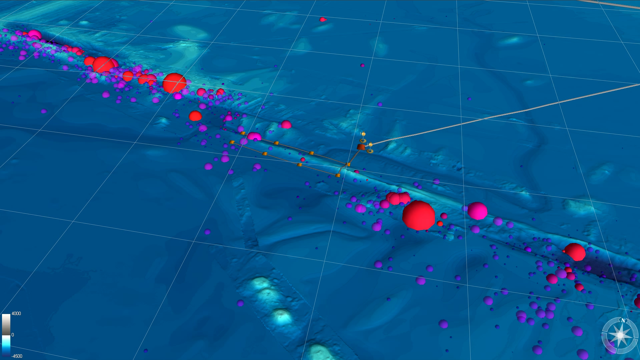
Mining the full data collected to put the processes in the historical data context

Slide 18
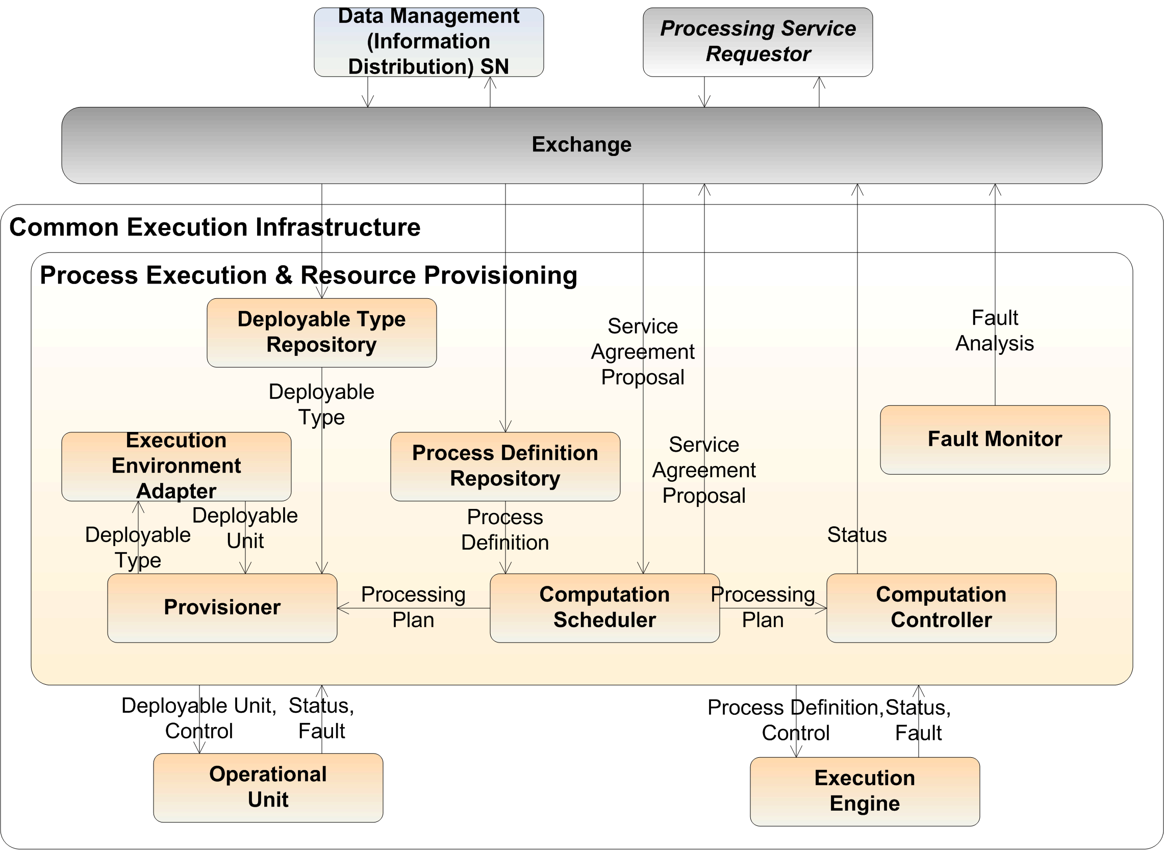
The Common Execution Infrastructure (CEI) provides for the virtualization of computing across the OOI, including execution resource provisioning, remote operational management and process execution.
-Supports software package functional decomposition and deployment, implementation and integration, as well as execution engines and an environment for specific user-requested purposes.
Fig. 10.

Slide 19
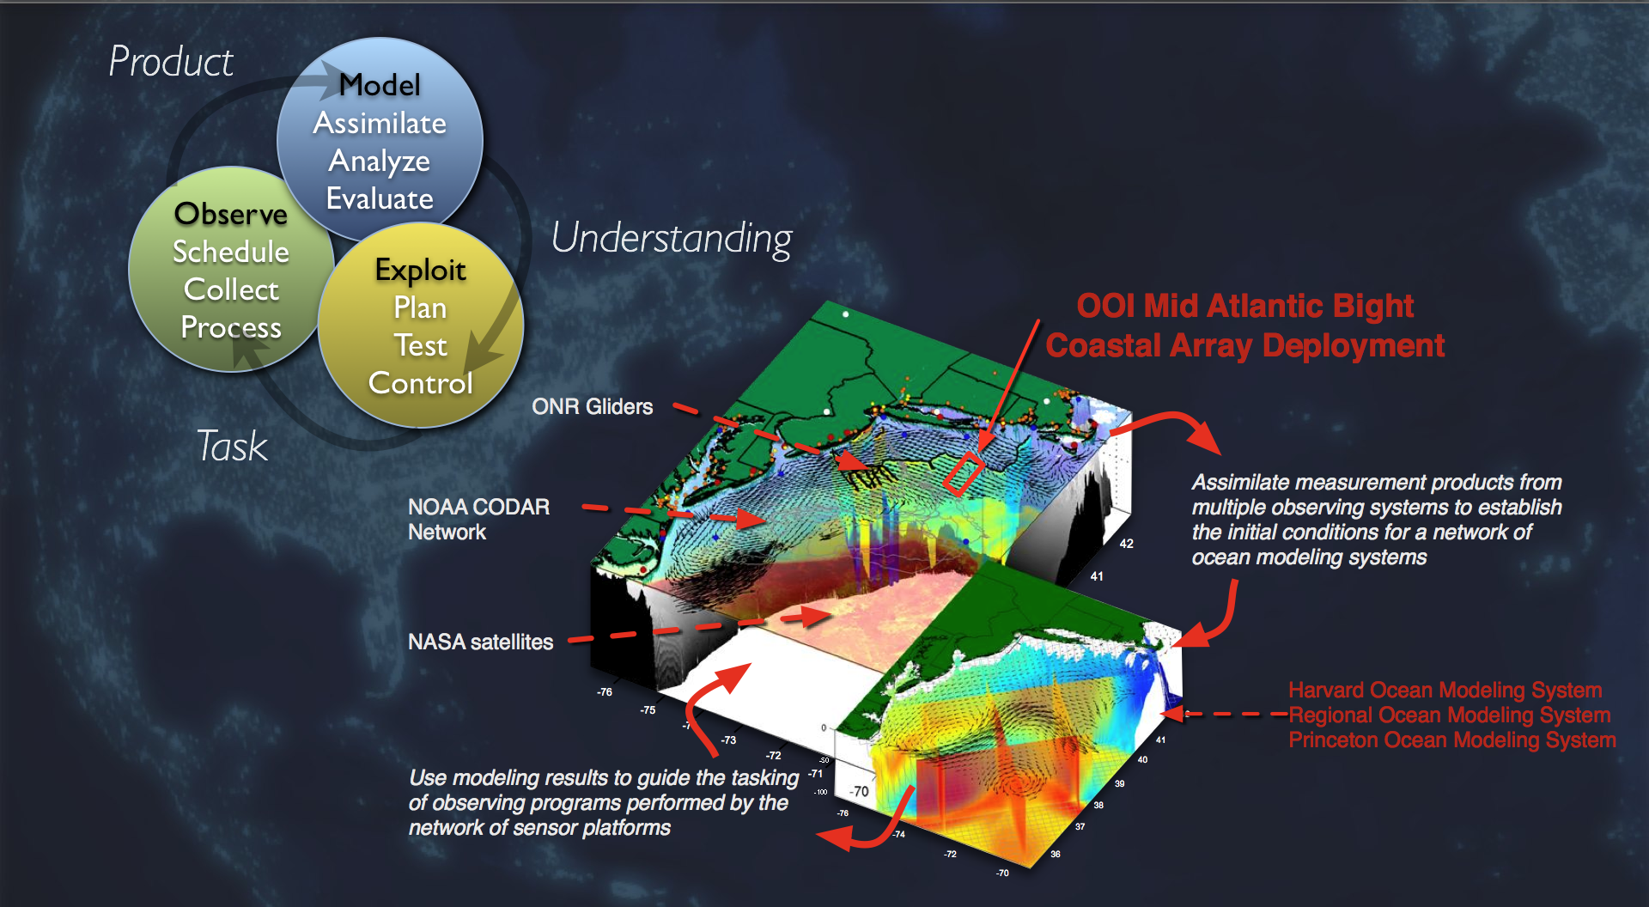
Building on real test-beds

Slide 20
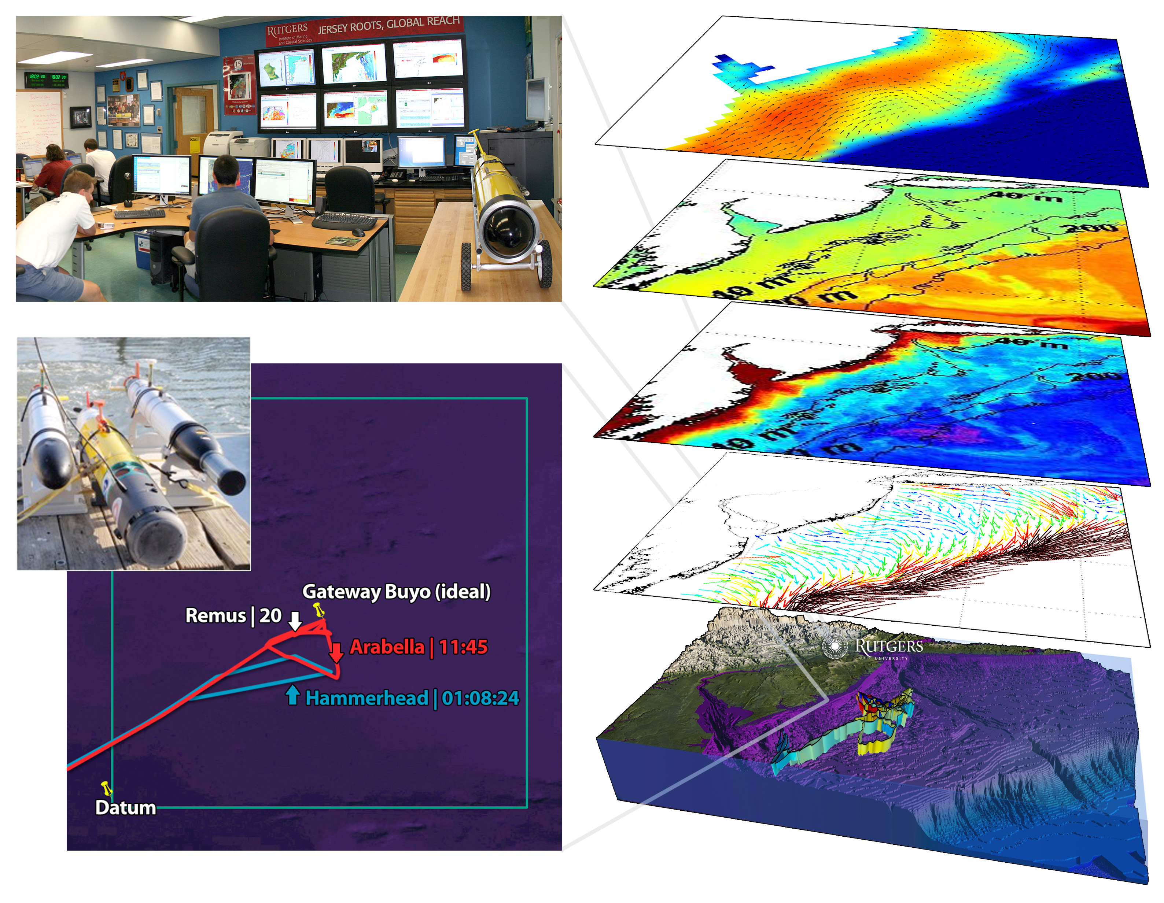

Slide 21
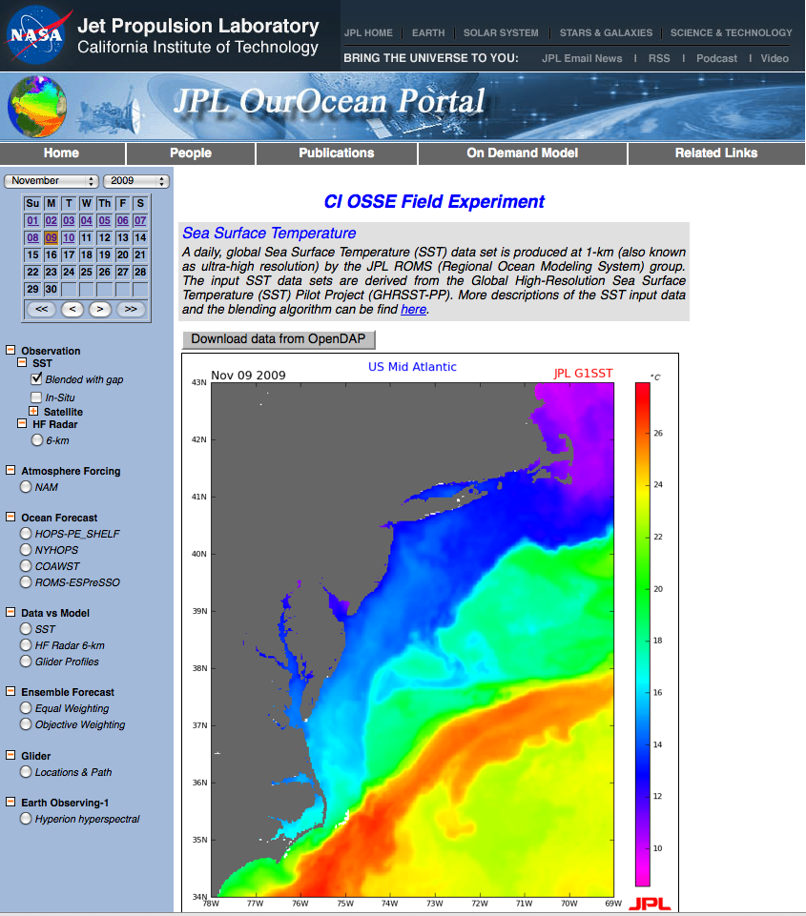

Slide 22
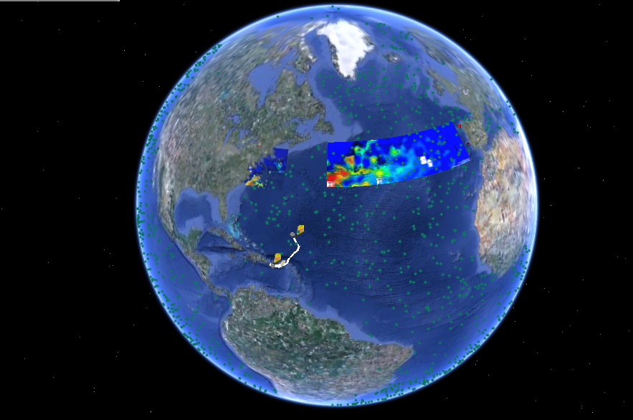
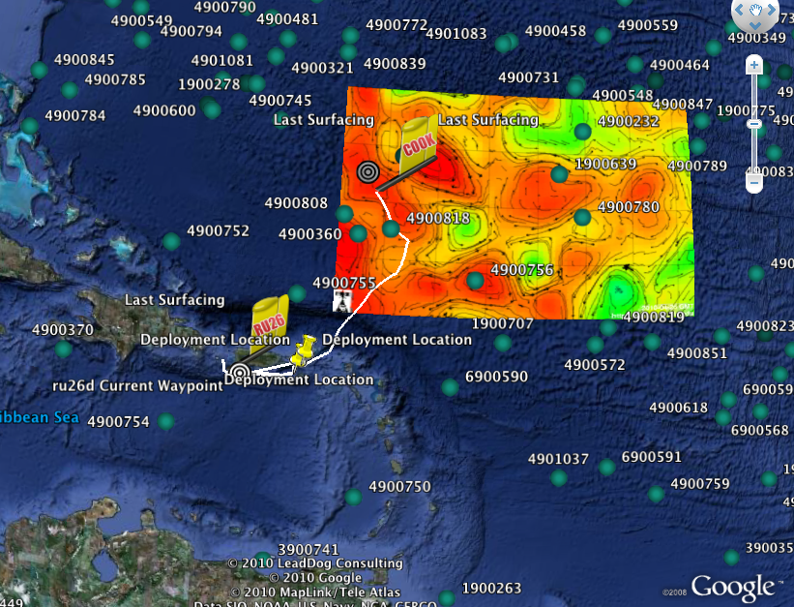
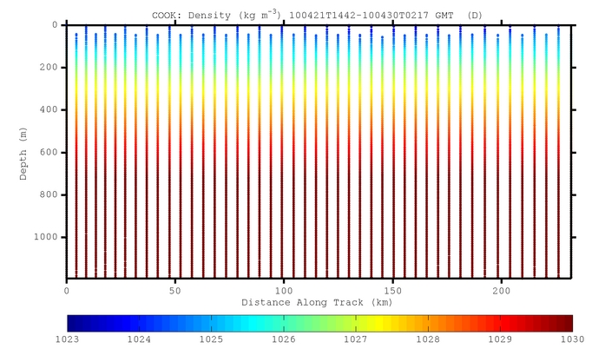
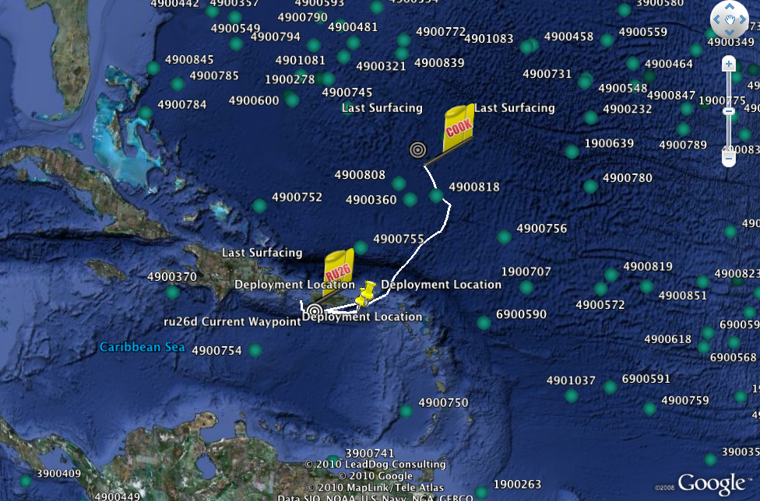
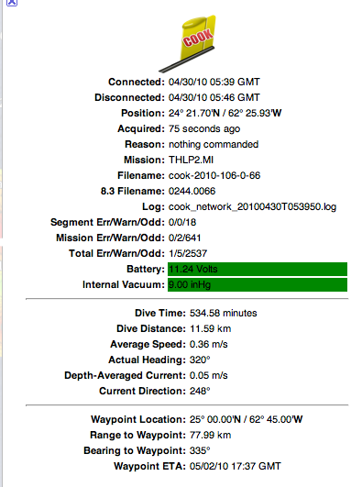
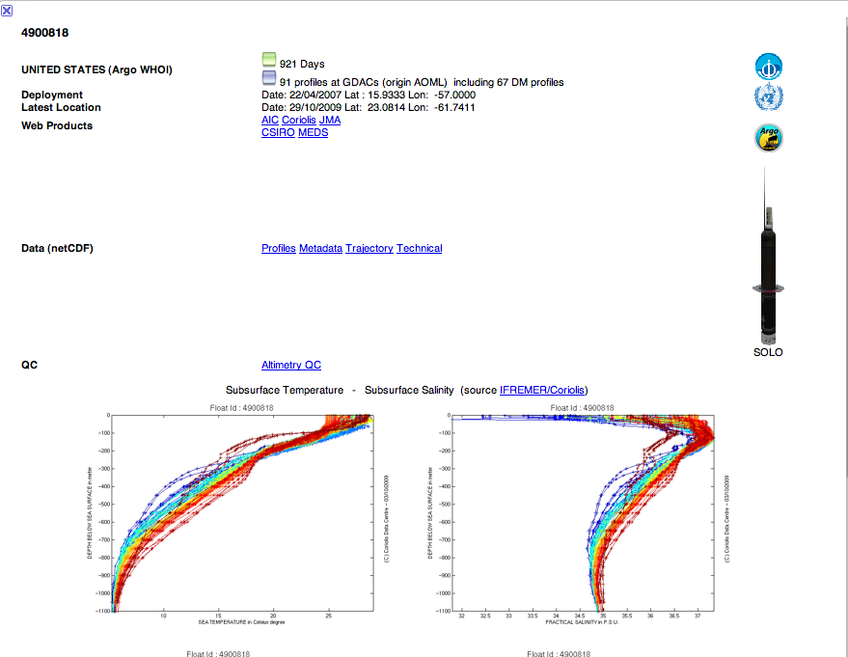
From the scientist perspective, tools for data aggregation beyond the OOI
From 6:43 this morning

Slide 23
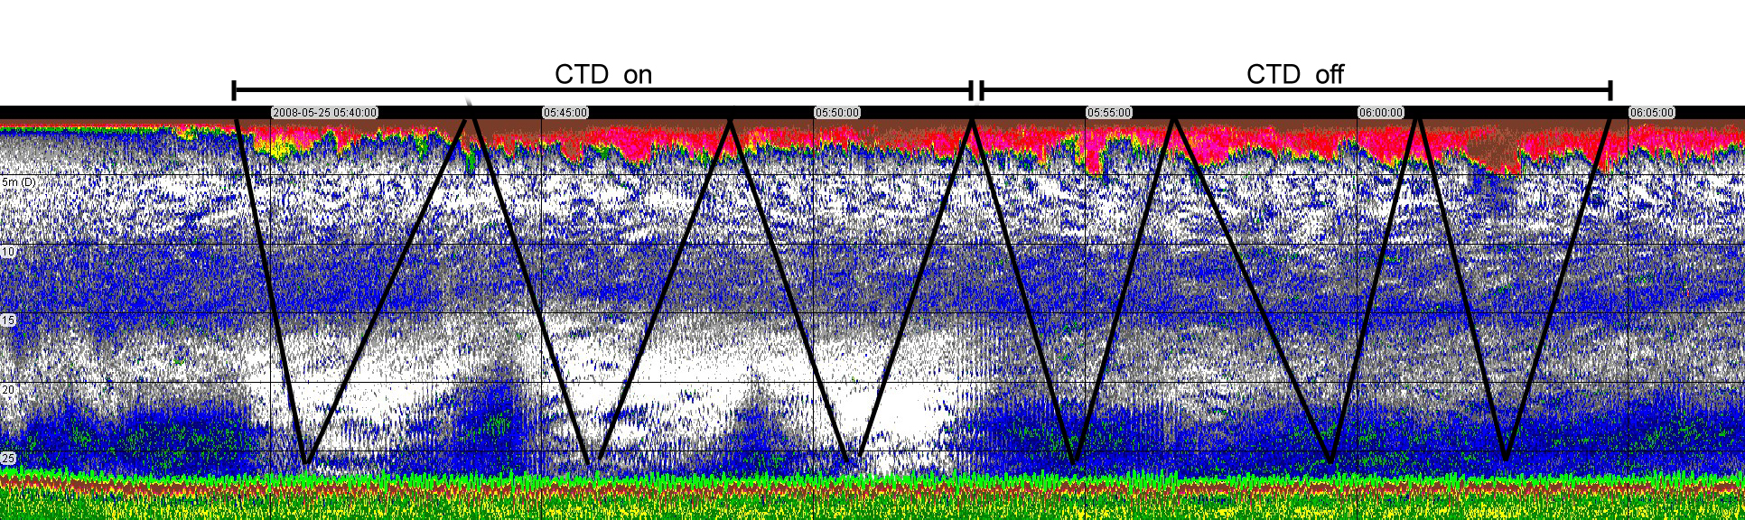
Basic functionality to allow for data visualization. The goal is to enable data mining and allow basic tools for analysis/synthesis to ultimately data to move from collection to publication.
Fluorometer on
Fluorometer off
AUV acoustics
AUV trajectory

Slide 24
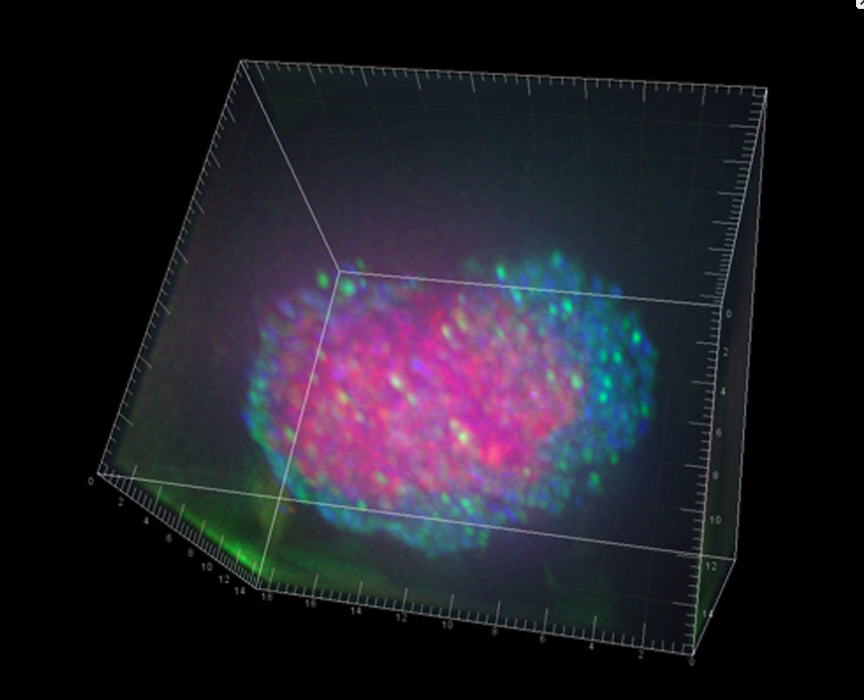

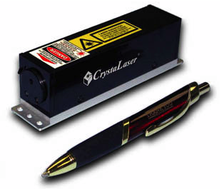


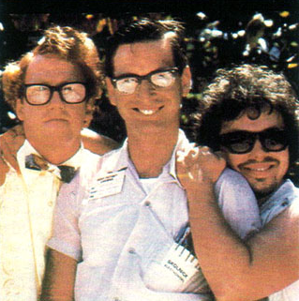
Data Provenance: Enabling a community shift
Young untenured scientist inspired writes an NSF proposal to miniaturize
His proposal seduces the panel, and he is funded first submittal
nanoSIMS: Shows the
Microbial consortia fix and
use nitrogen
Built
Dekas et al. 2009. Science
DEPLOYED

Slide 25
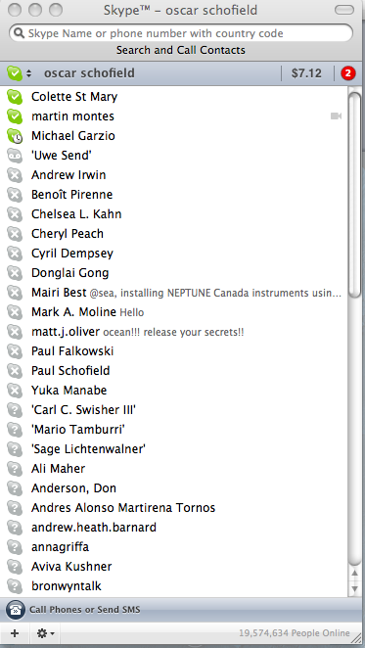
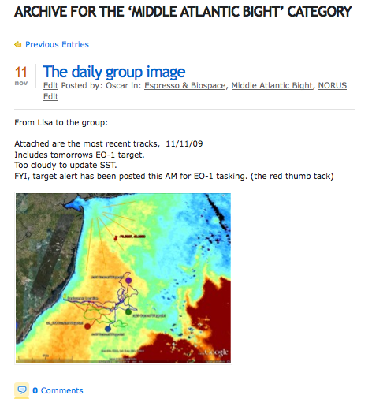
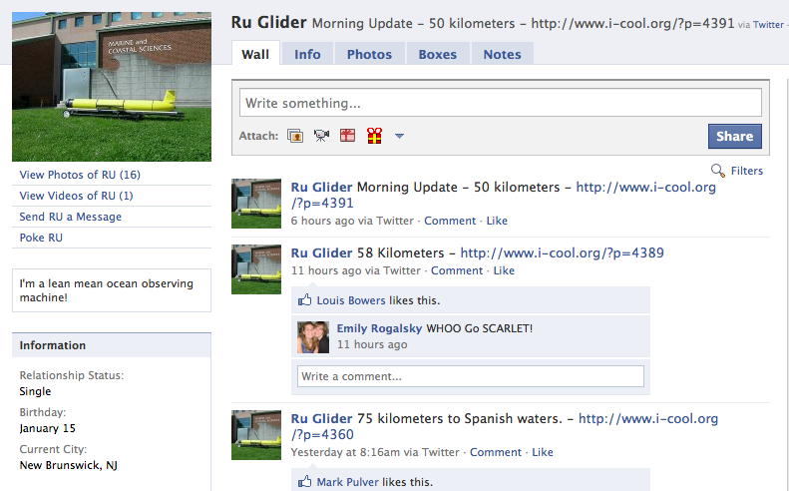
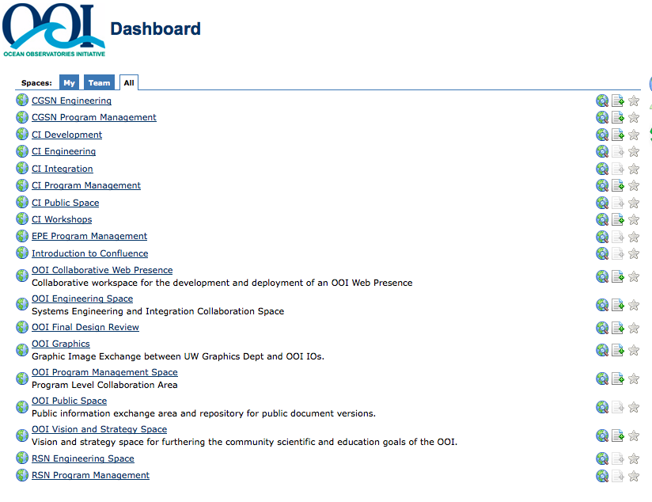
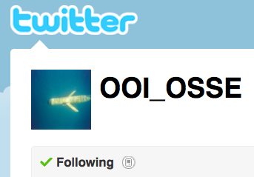
The science interactions enabled through social network tools

Slide 26
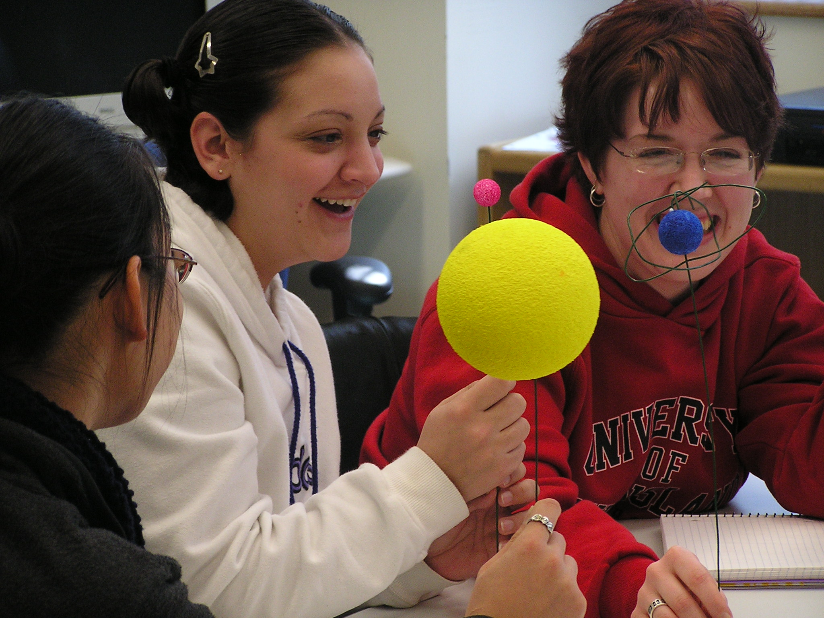
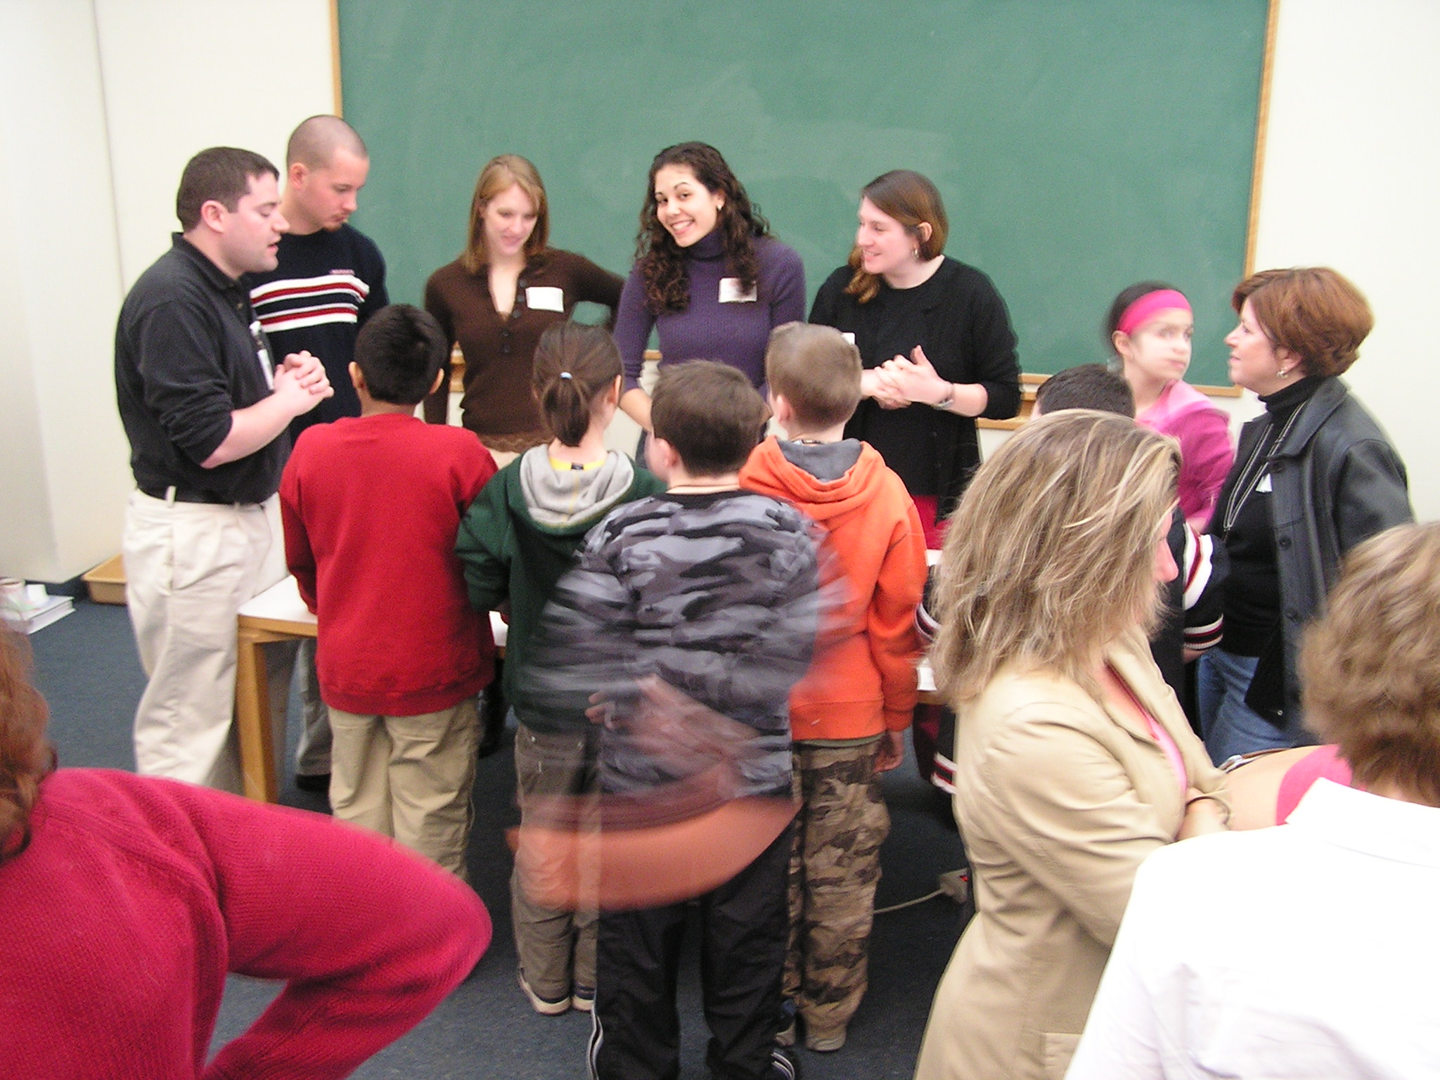
Support EPE IO community which provides the community in which joint efforts can lead to the development of new educational infrastructure
Building Curricula: Communication Ocean Sciences
Focuses in theoretical and practical aspects of how people learn.
Invitation
Reflection
Exploration
Application
Concept
Invention

Slide 27
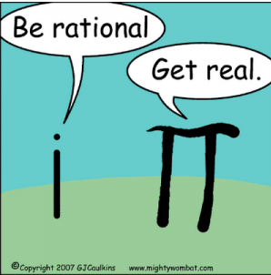
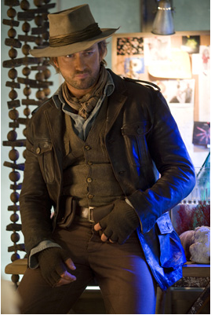
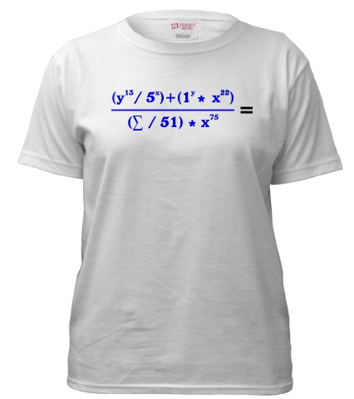

Why else do we need this? Scientists are dedicated and committed; however often are, at best, challenged to tell of their journey
Scientist humor has
selective appeal
Often we are unaware
of how others perceive us.
Their outreach does not
play well with wider
community
Right now I think I
am this to you
My entry to Rutgers
Comedy Night
Right now you are seeing this
My entry to NYC
fashion week

