Slide 1
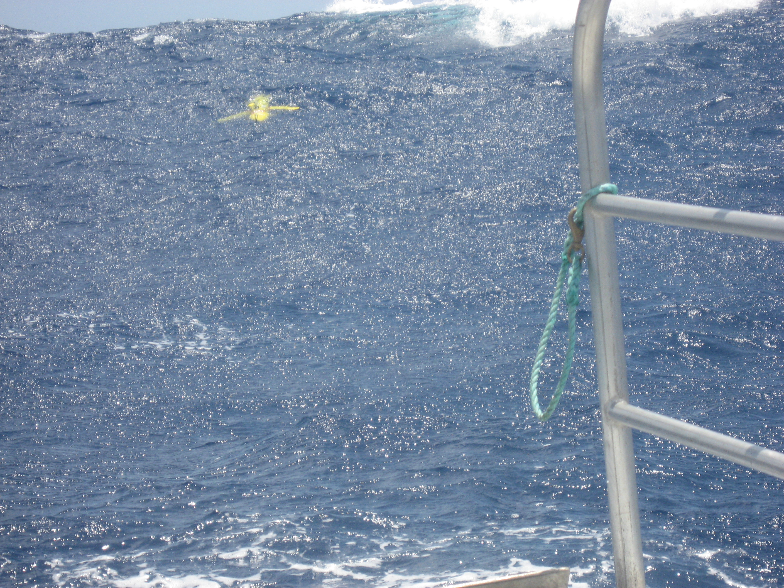




Observations of Storm Response and Sediment Transport on the
Middle Atlantic Bight Continental Shelf
Scott Glenn, Hugh Roarty, Josh Kohut, Travis Miles, John Kerfoot, Oscar Schofield (Rutgers University)
&
Wendell Brown (UMass), Larry Atkinson (ODU),
Bill Boicourt (UMaryland)

Slide 2
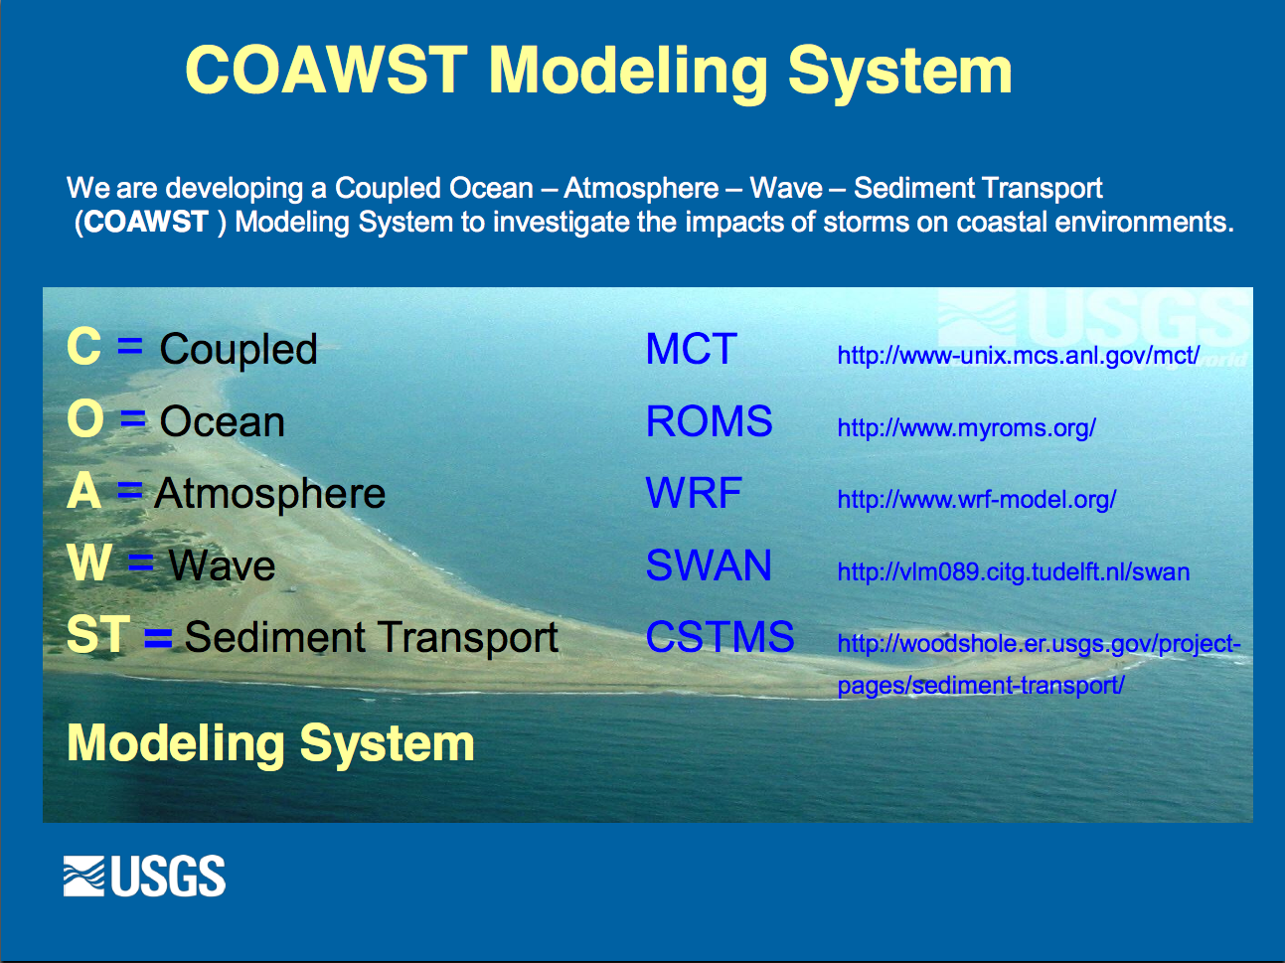
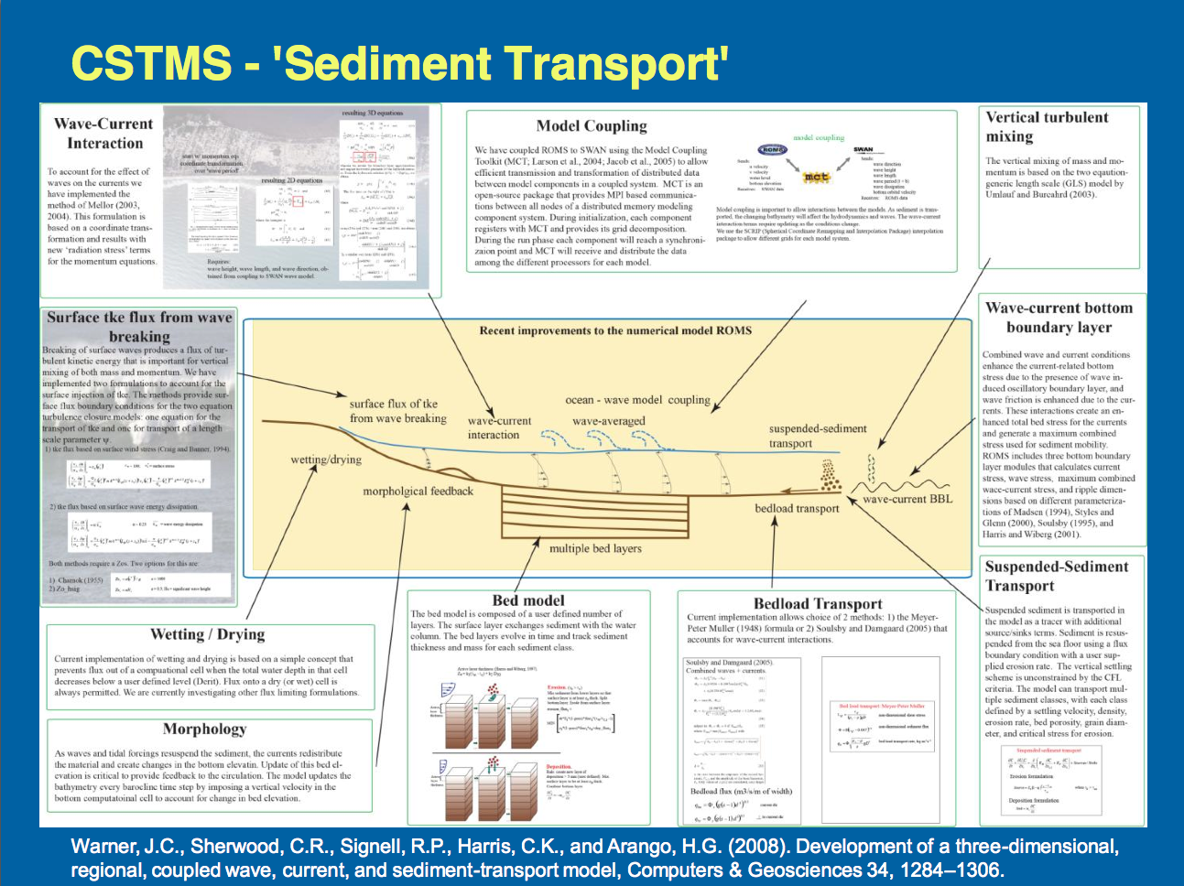
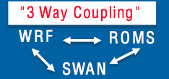
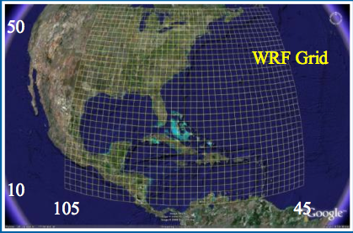
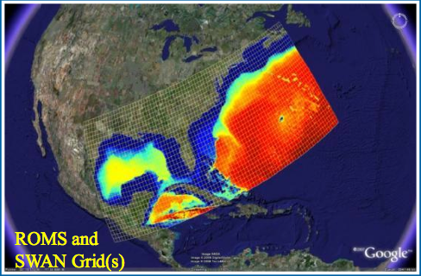
USGS/NCSU Coupled Ocean-Atmosphere-Wave-Sediment Transport (COAWST) Modeling System
uses the NOPP
Community Sediment Transport Modeling System (CSTMS) (cstms.org)
From John Warner, Jeff List, Rob Thieler, Brandy Armstrong, Ruoying He, Joseph Zambon, USGS & NCSU

Slide 3
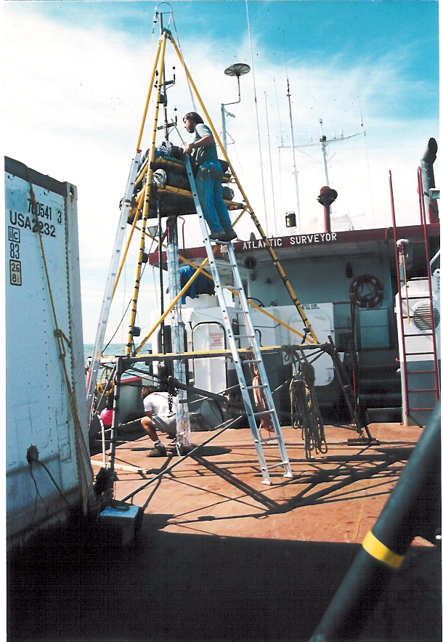
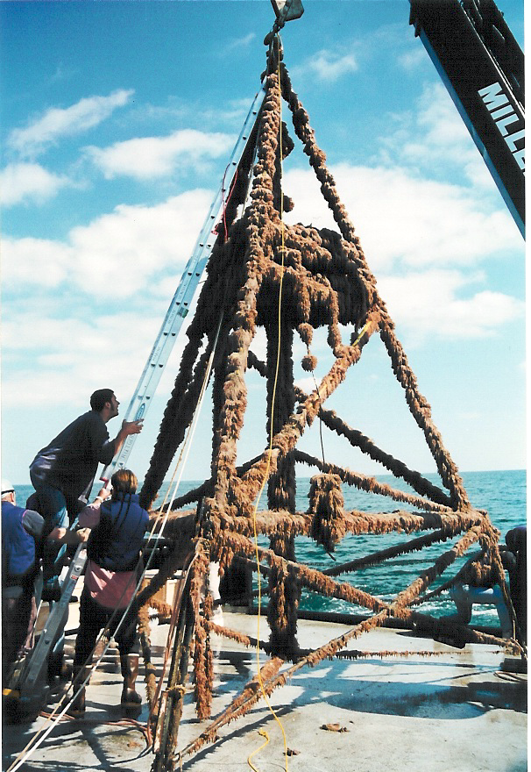
Observational Sediment Transport Studies – Traditional Approach
Benthic Acoustic Stress Sensor (BASS) Tripod
Before and After Summer Deployment at Longterm Ecosystem Observatory

Slide 4
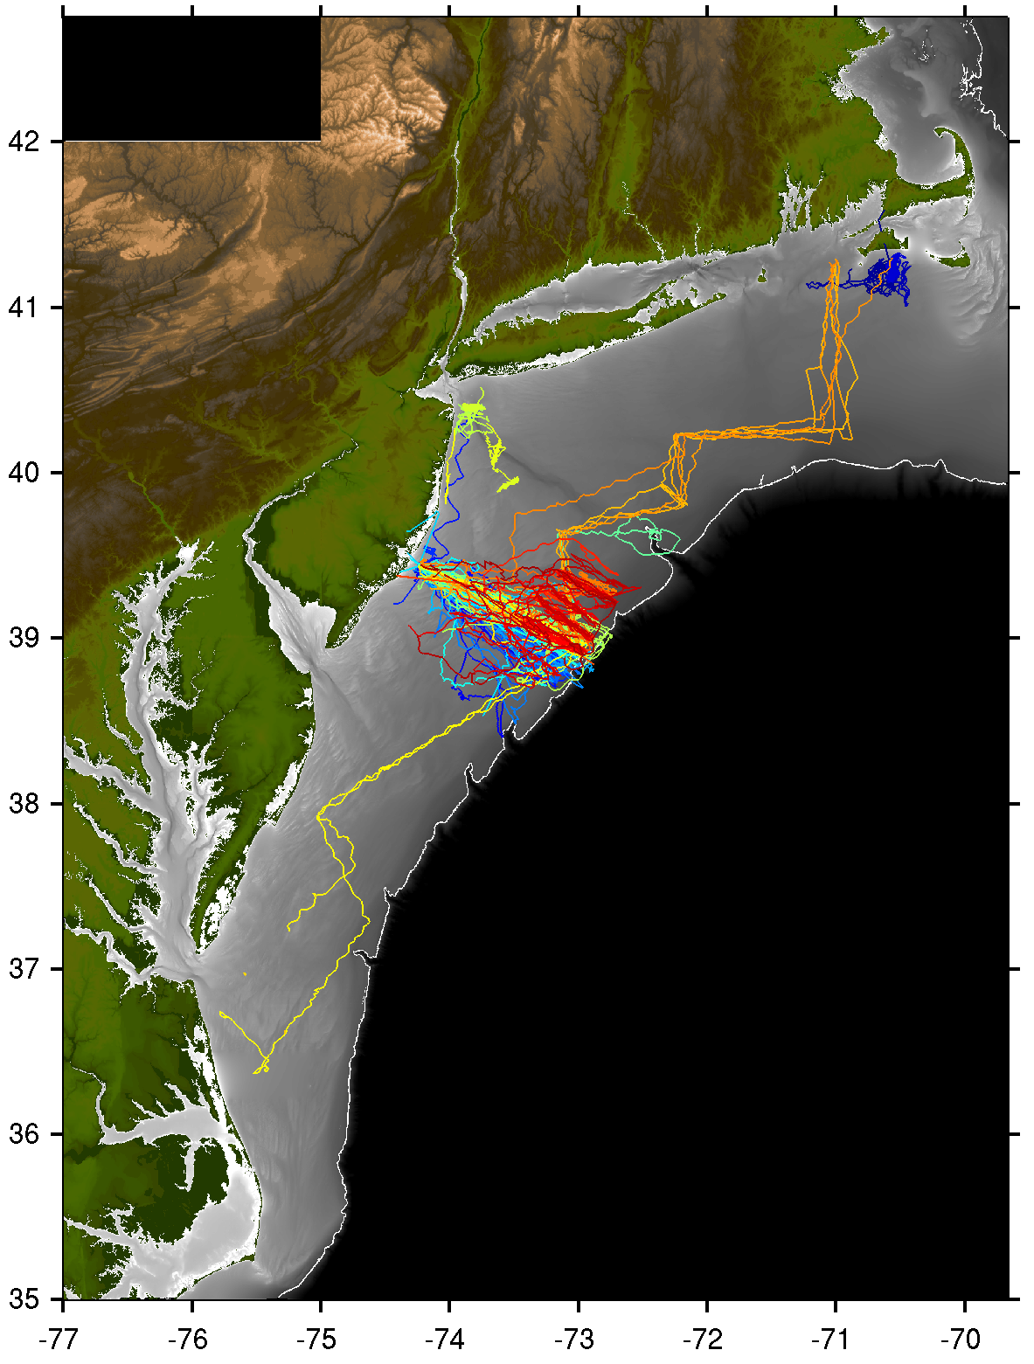

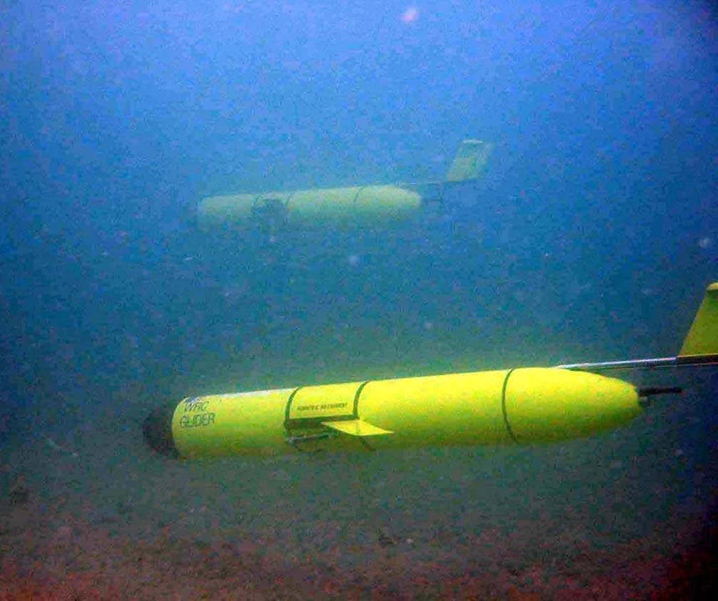
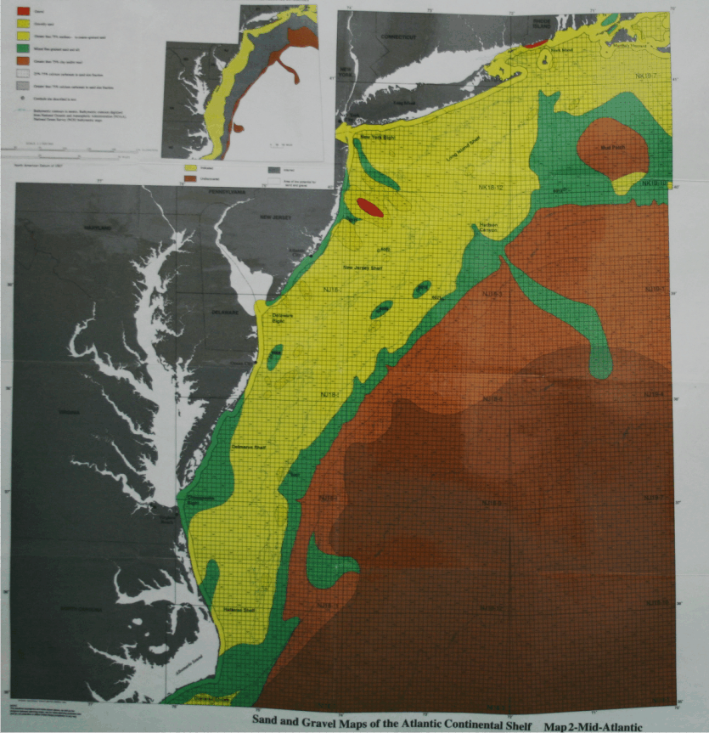
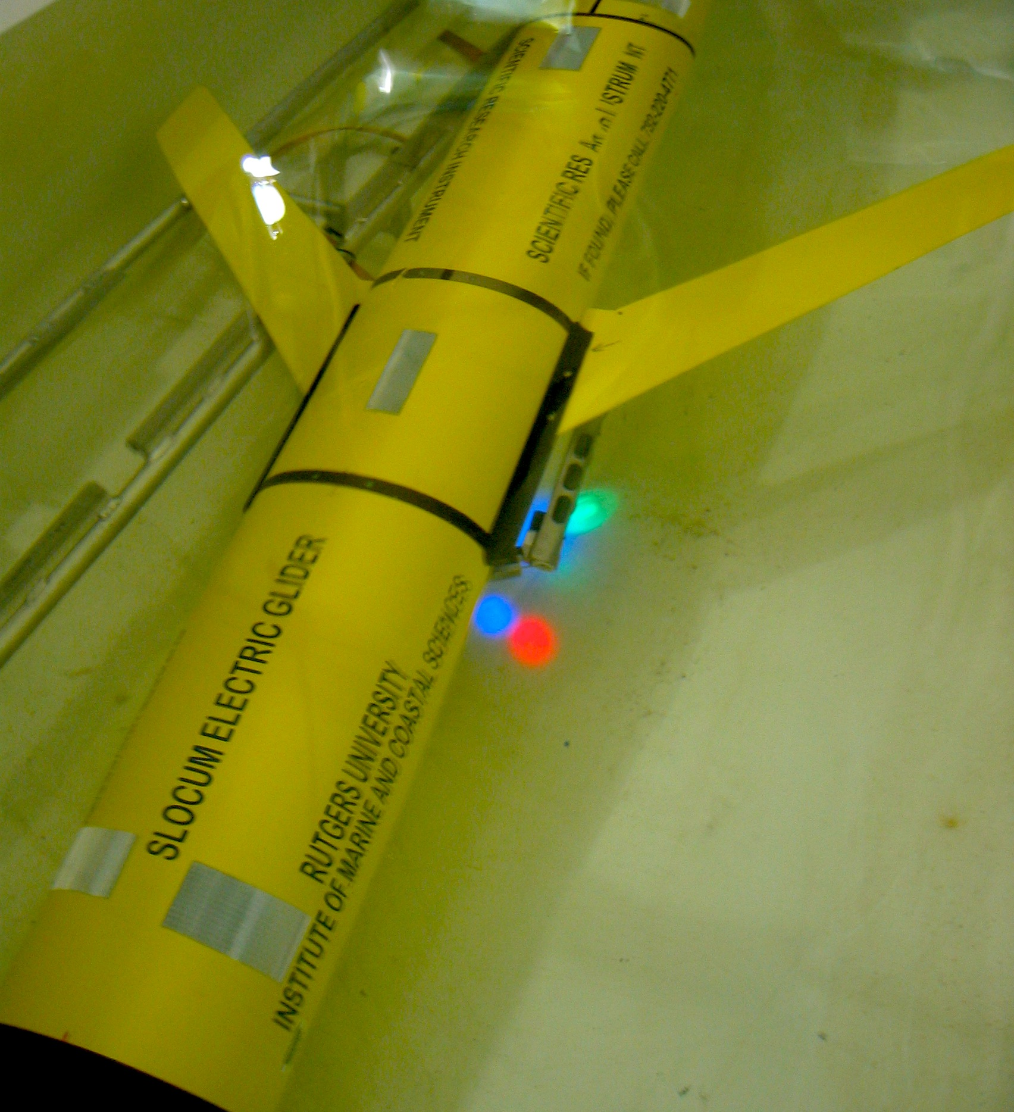
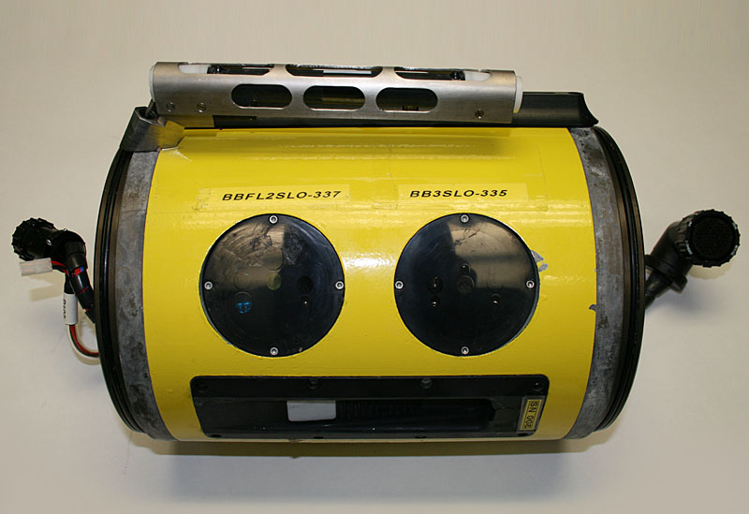
Storm-Induced Sediment Resuspension
Using Optical Sensors on Gliders
Science Questions:
What differences are observed in stratified versus unstratified seasons?
What processes influence the resuspension of sediment?
What are the implications for the redistribution of sediment in the MAB?
Focus Area:
Mid-shelf region of MAB
Relatively unexplored
Broad band of medium grain sands
Storm Track
Hurricane Tracks
Through New Jersey
Optical
Sensors

Slide 5
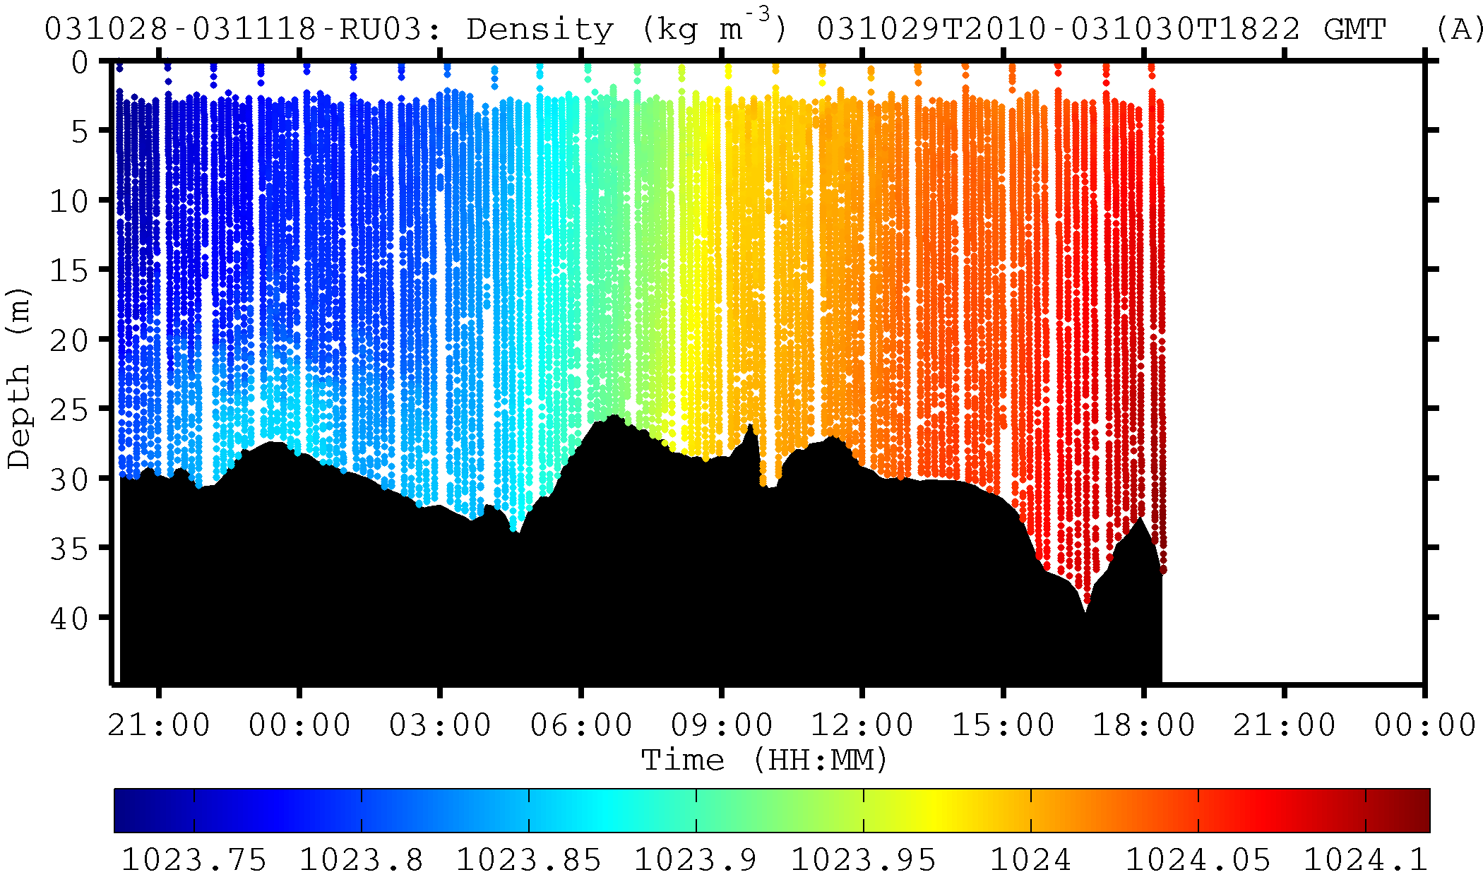
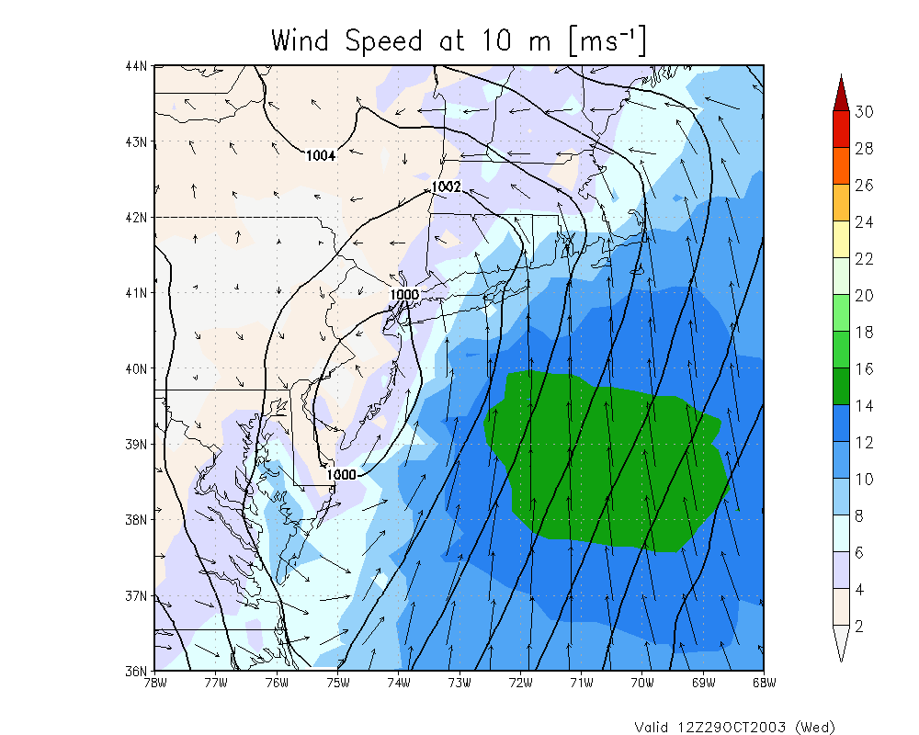
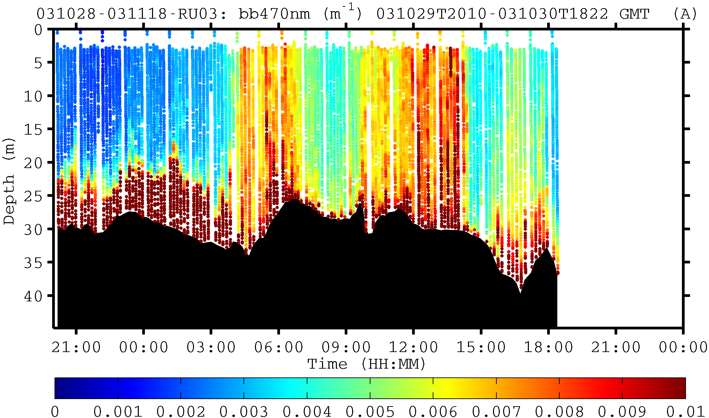
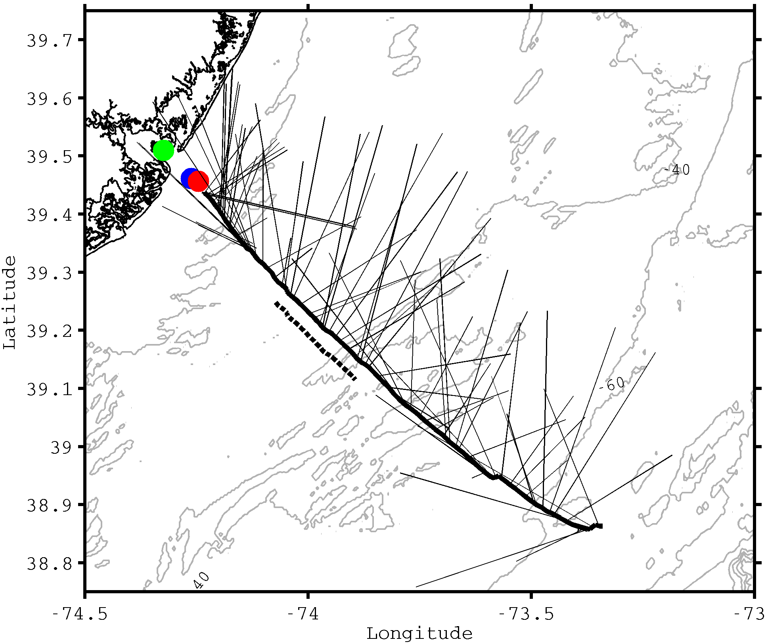
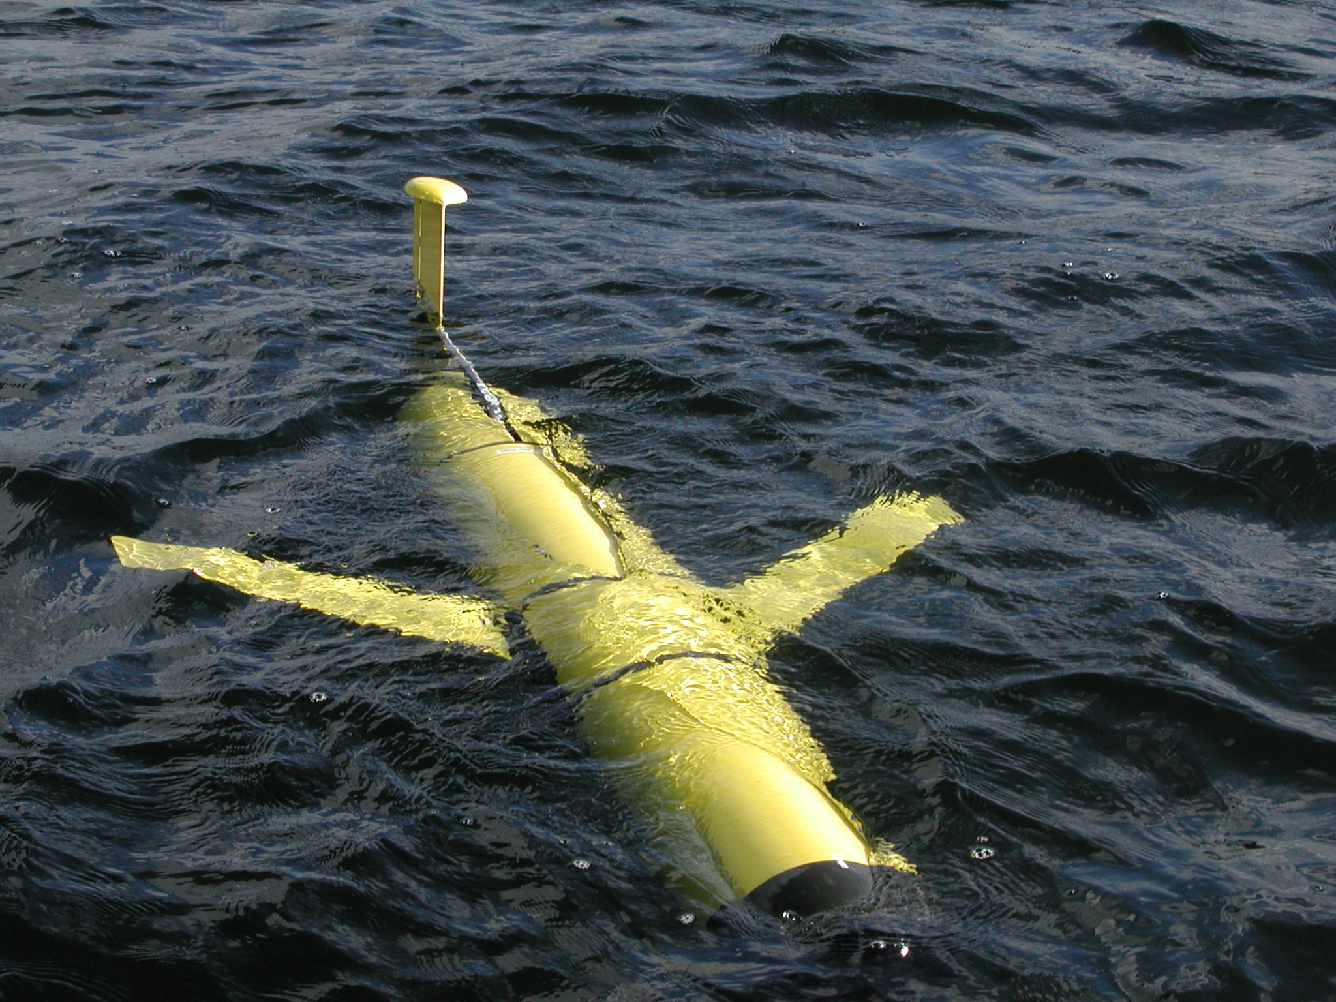
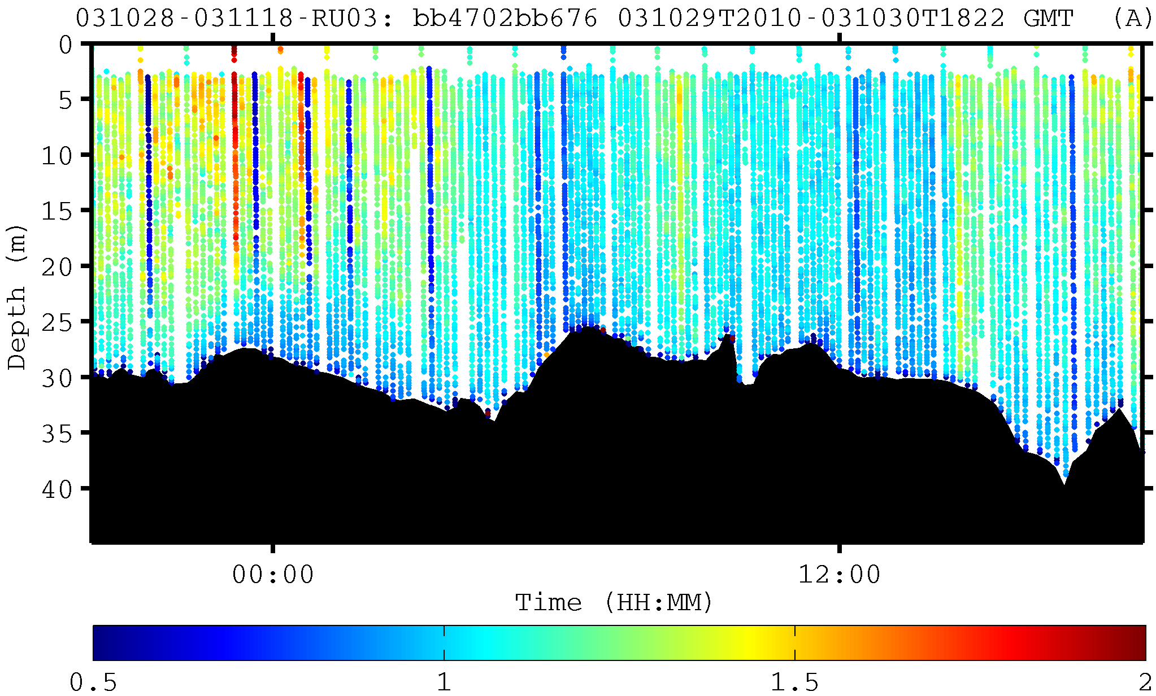
Tuckerton Endurance Line - October 2003 Fall Transition Storm
Density
Oct 29
Backscatter (470)
Oct 29
Oct 30
Backscatter Ratio (470/676)
Glider Track & Currents

Slide 6
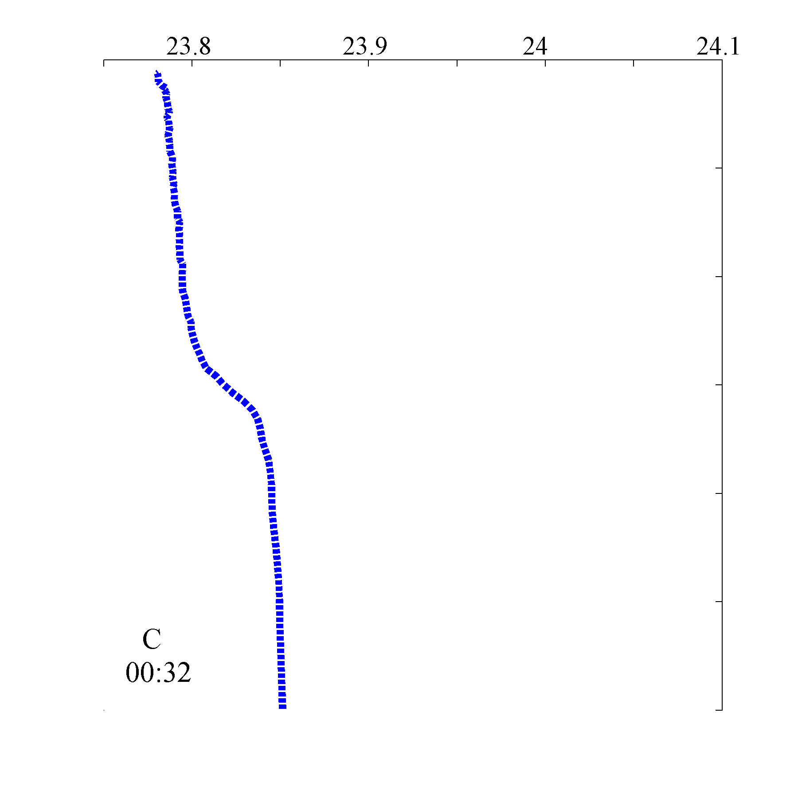
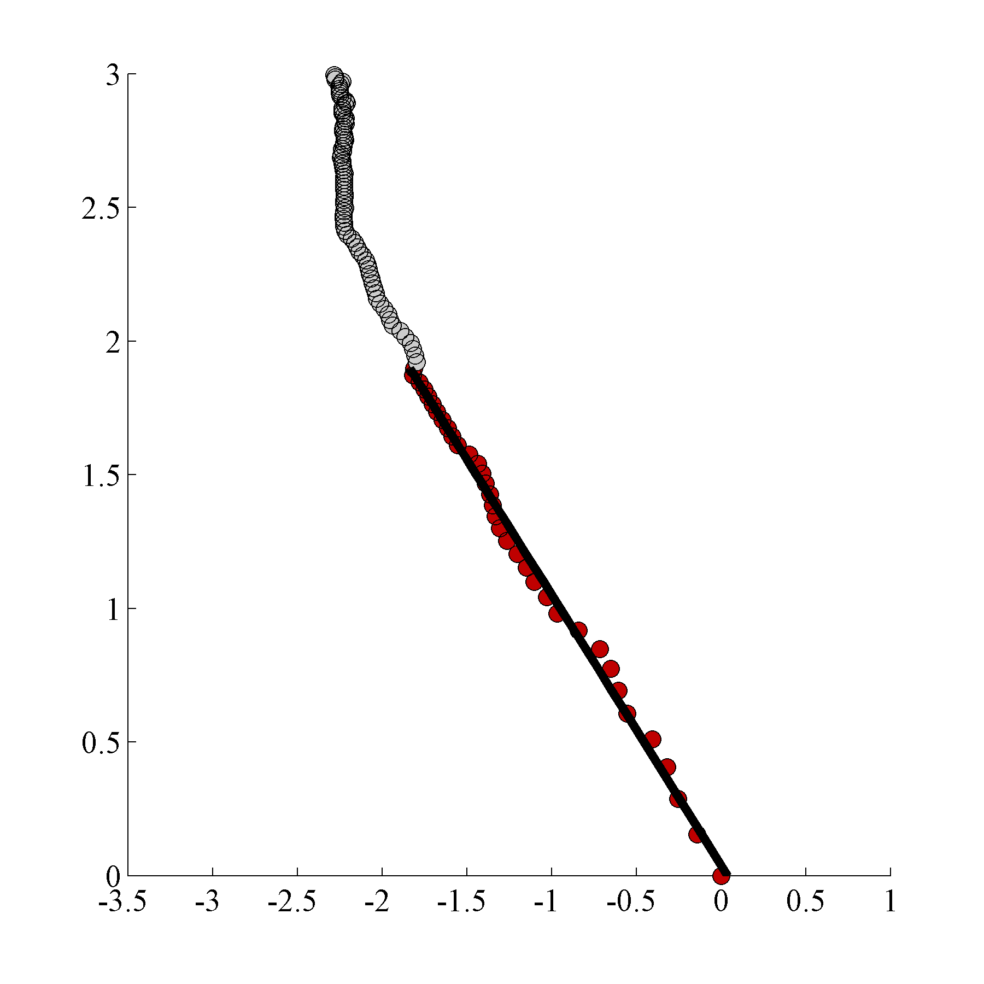
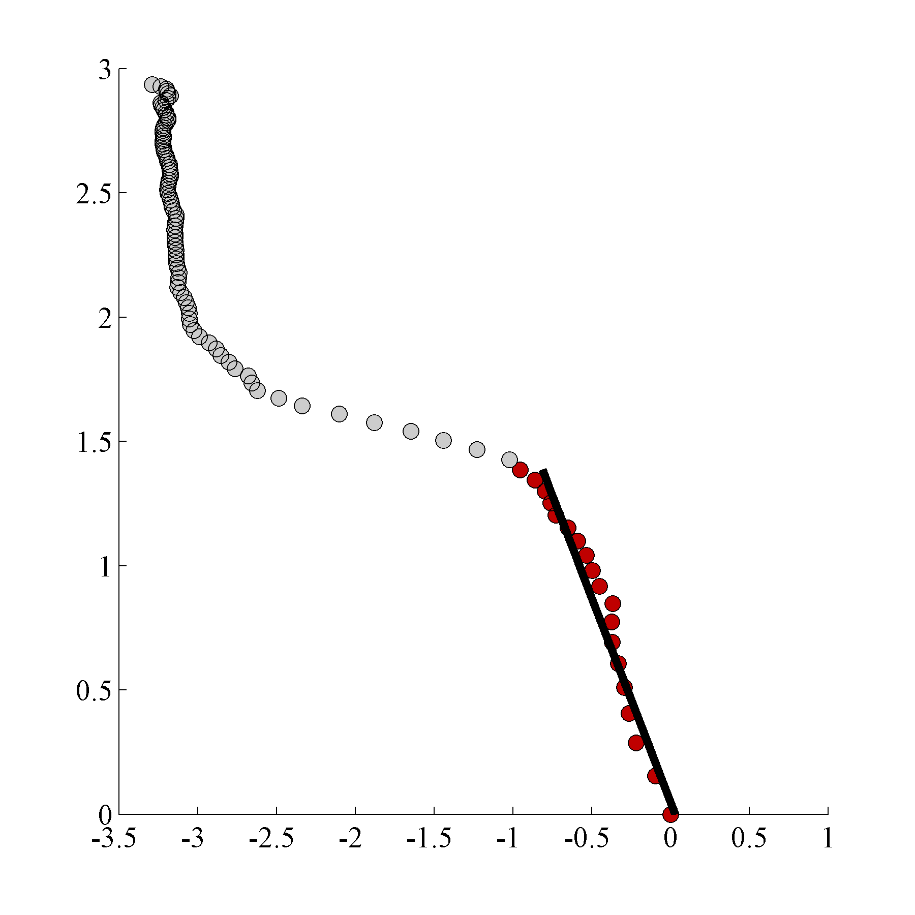
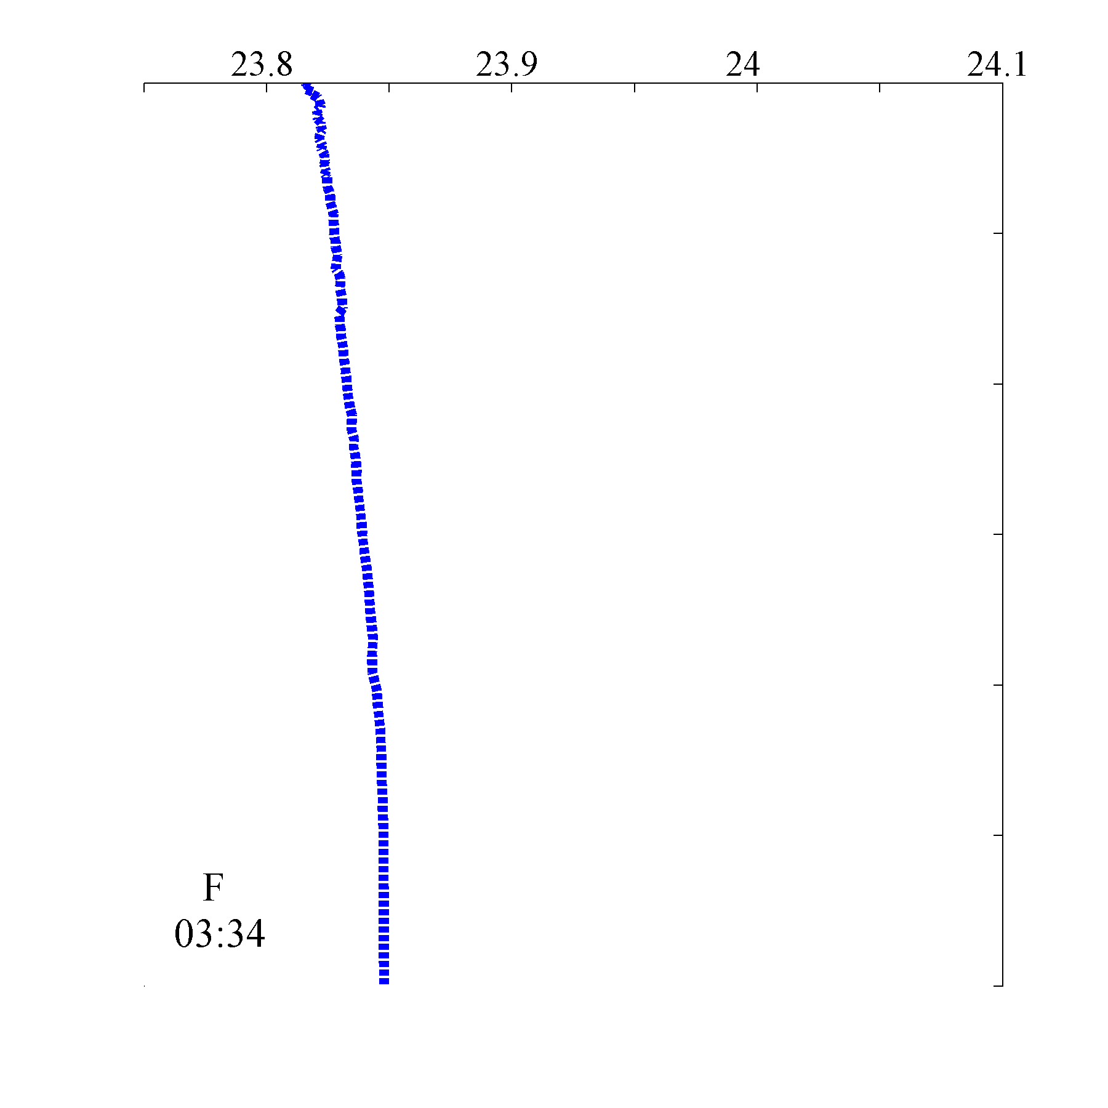
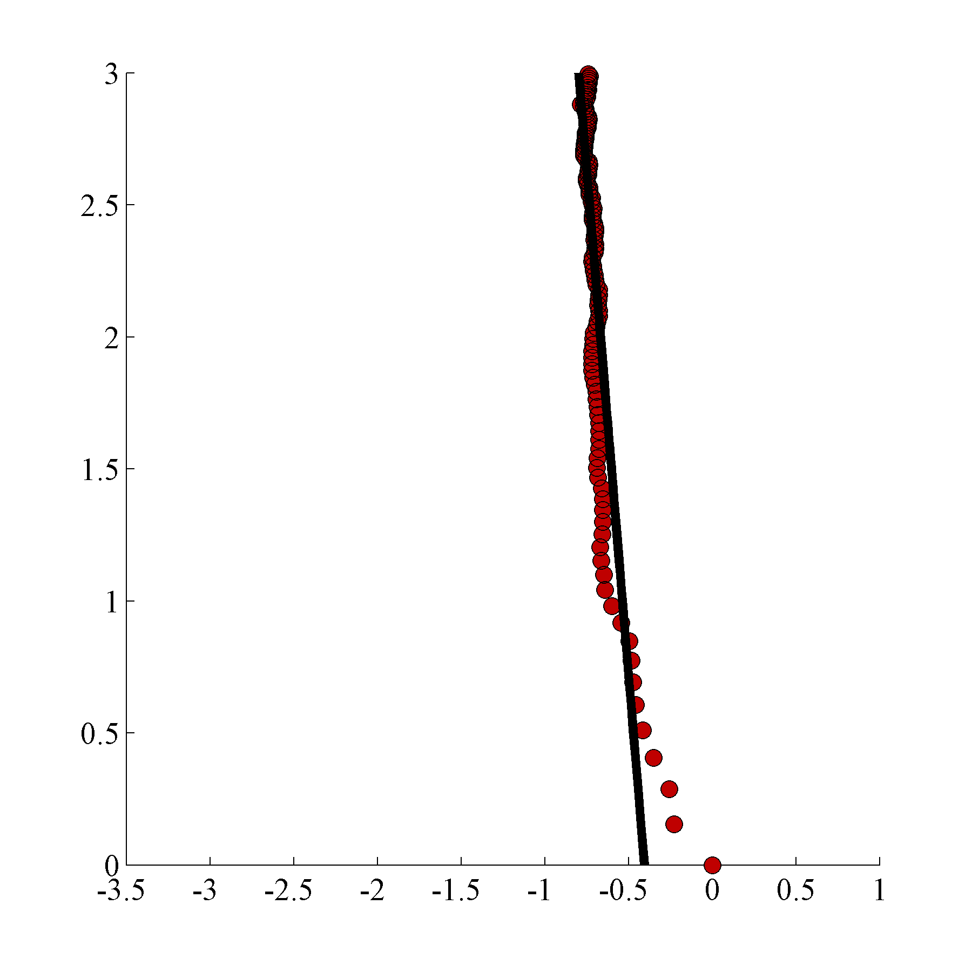
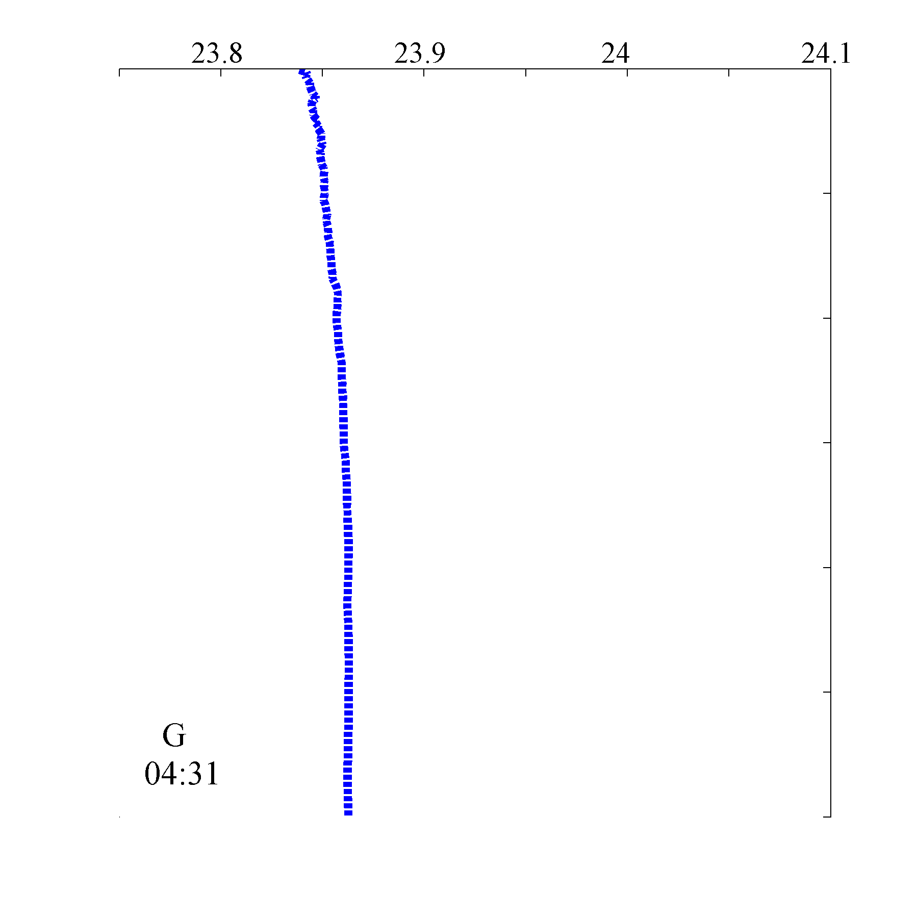
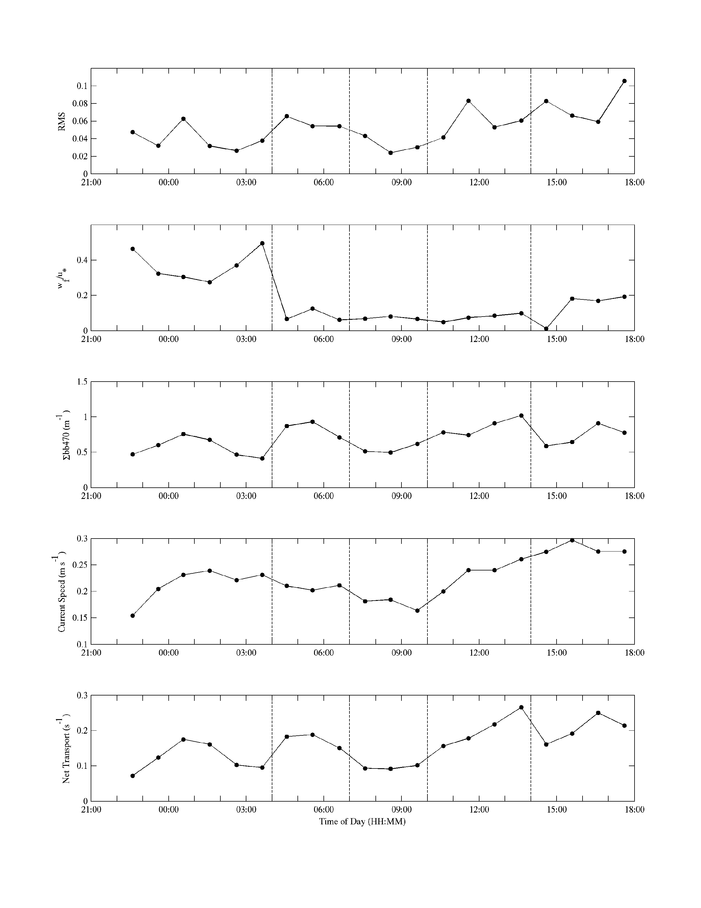
Tuckerton Endurance Line - October 2003 Fall Transition Storm
Fall Transition
BBL Growth
Rapid Increase in u*
as stratification is lost
Mixing throughout water column
1 2 3 4 5
RMS
Before Transition
After Transition
wf/u*
October 30, 2003

Slide 7
Tuckerton Endurance Line - October 2003 Fall Transition Storm
1 2 3 4 5
Total
Load
Current
Speed
Net
Trans-
port
October 30, 2003

Slide 8
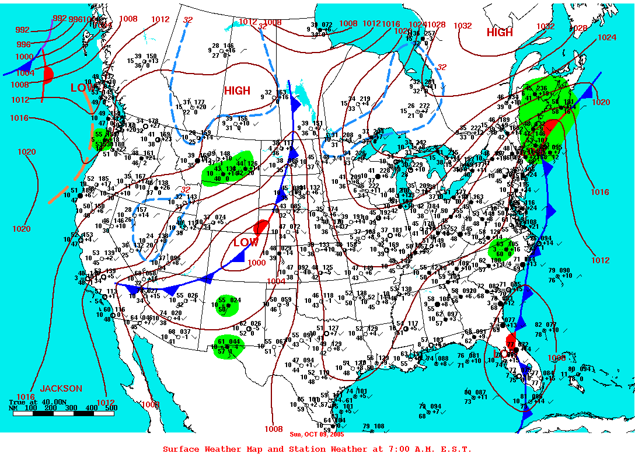
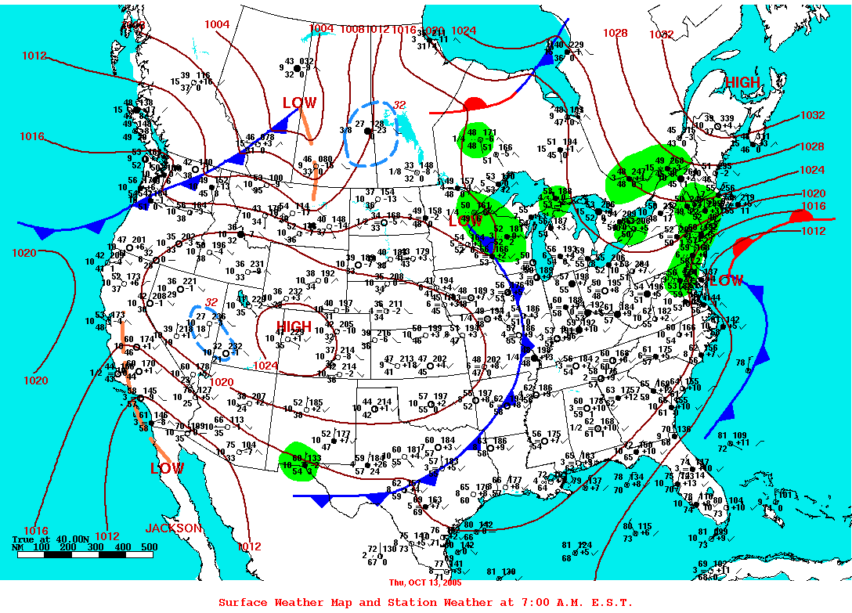
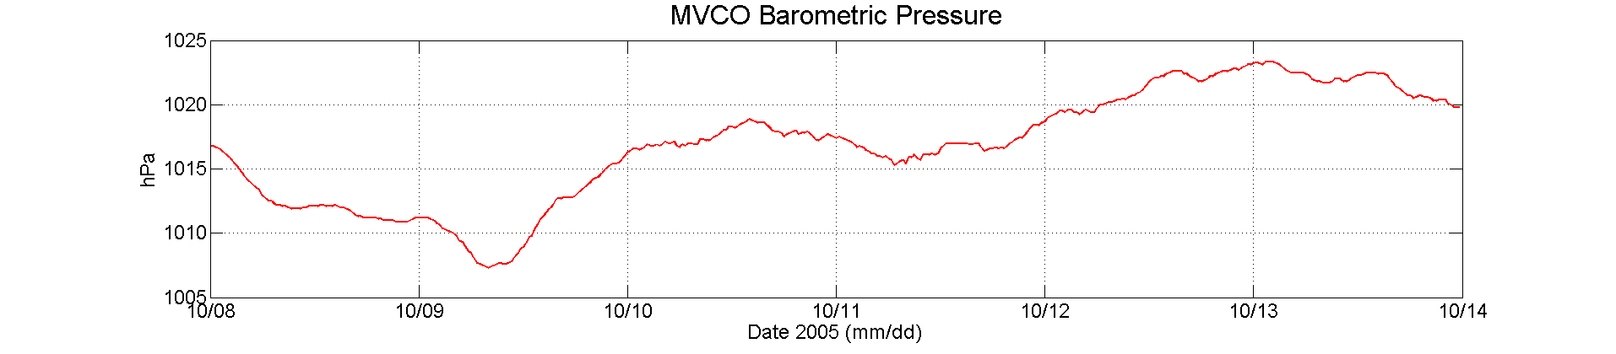
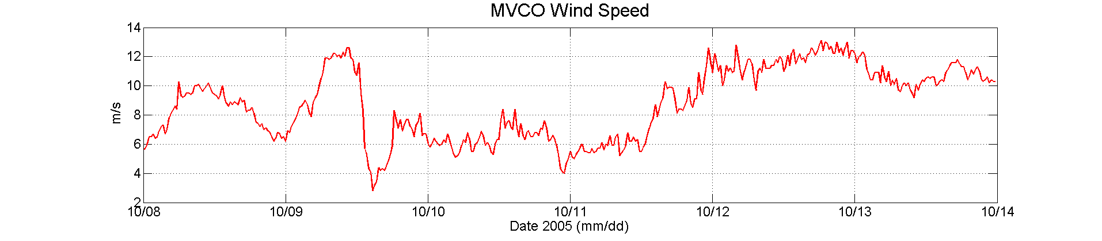
Martha’s Vineyard Coastal Observatory Storms – October 9 & 13, 2005
Storm 1
Storm 2

Slide 9
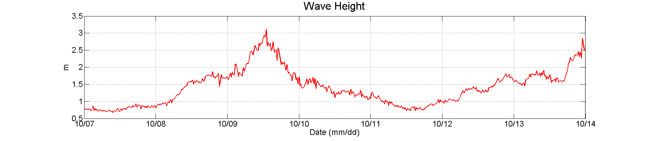
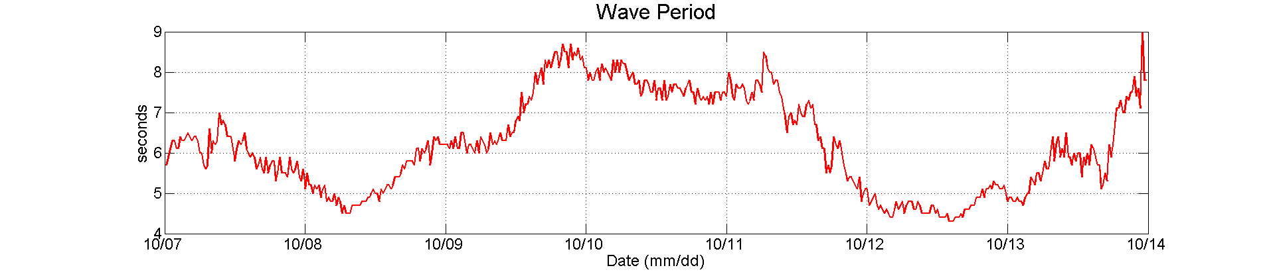
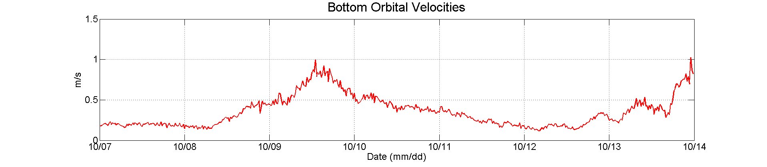
Martha’s Vineyard Coastal Observatory Storms – October 9 & 13, 2005
Storm 1
Storm 2

Slide 10
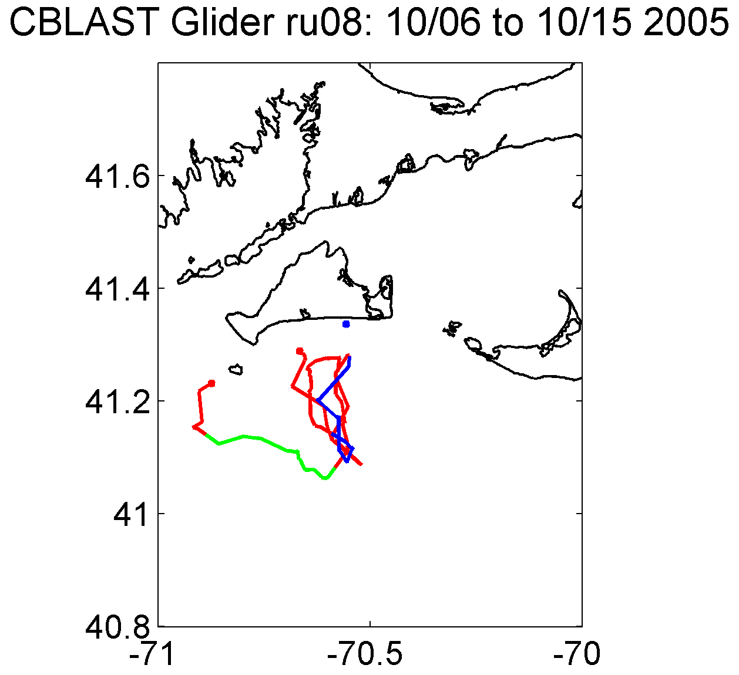
Martha’s Vineyard Coastal Observatory Storms – October 9 & 13, 2005
MVCO
Storm 1
Storm 2

Slide 11
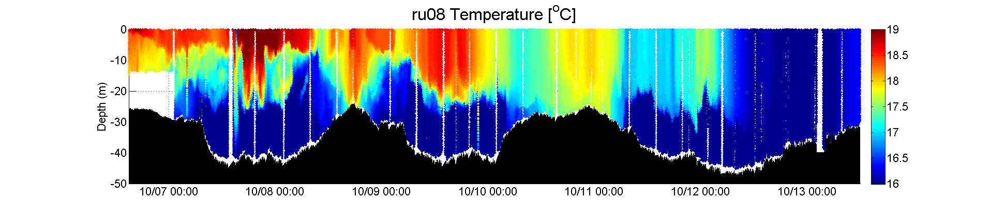
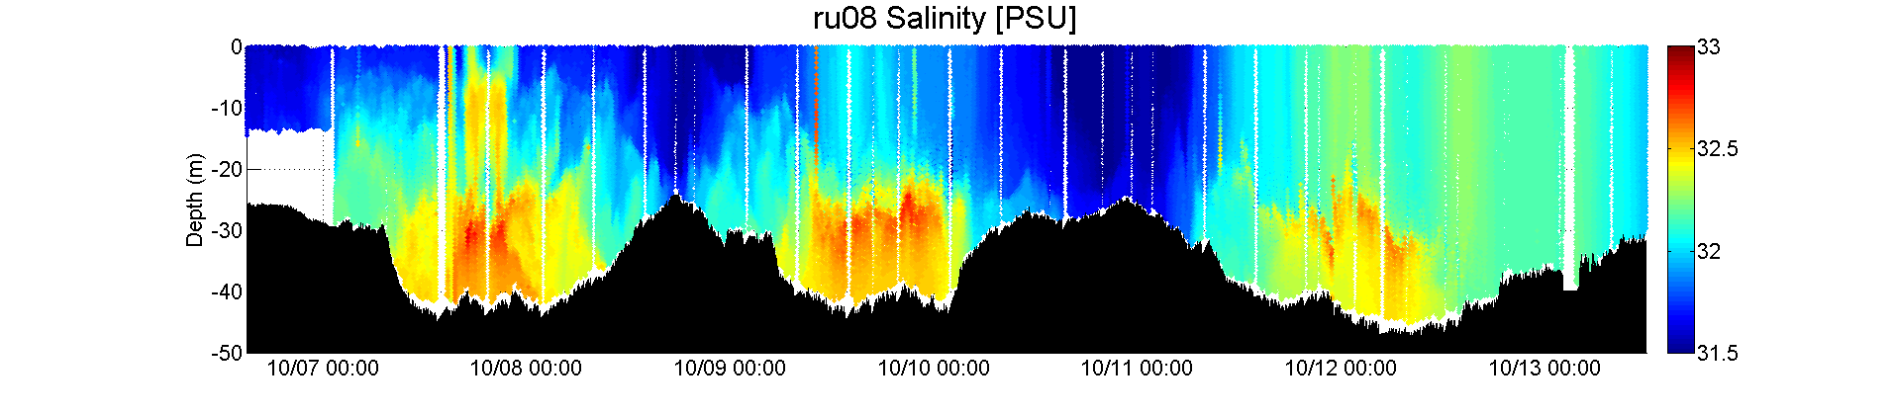
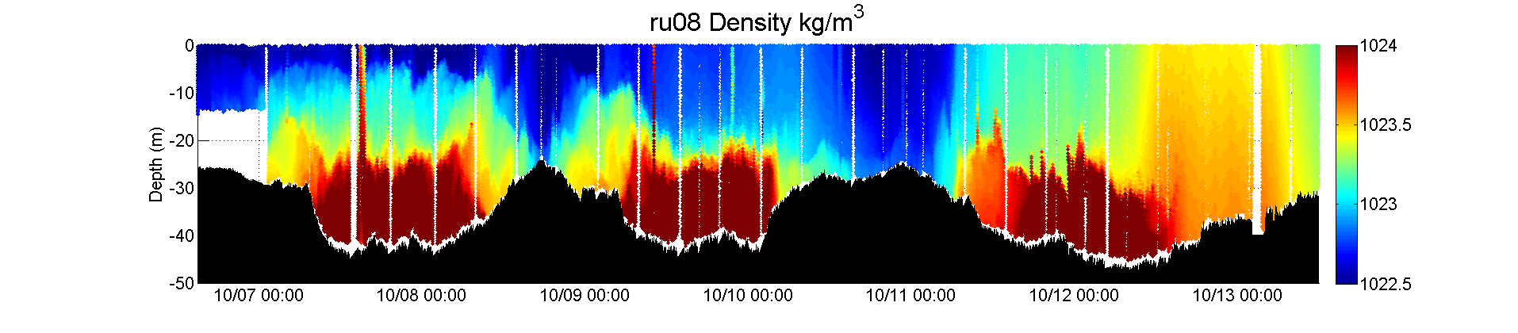
The glider showed a transition in the hydrography between the storms. During storm 1, system was stratified. This stratification was eroded by the second storm.
Storm 1
Storm 2

Slide 12
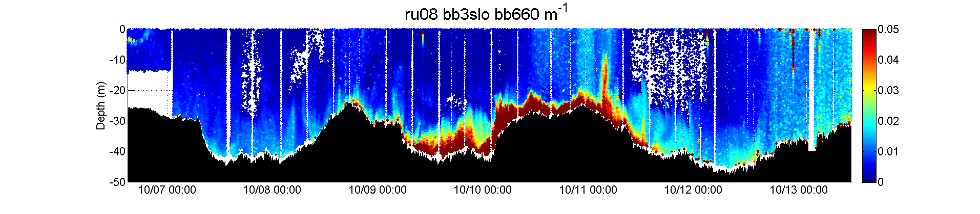
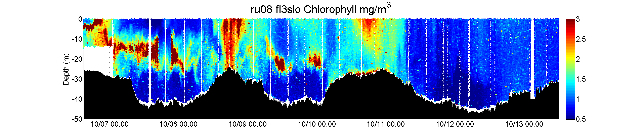
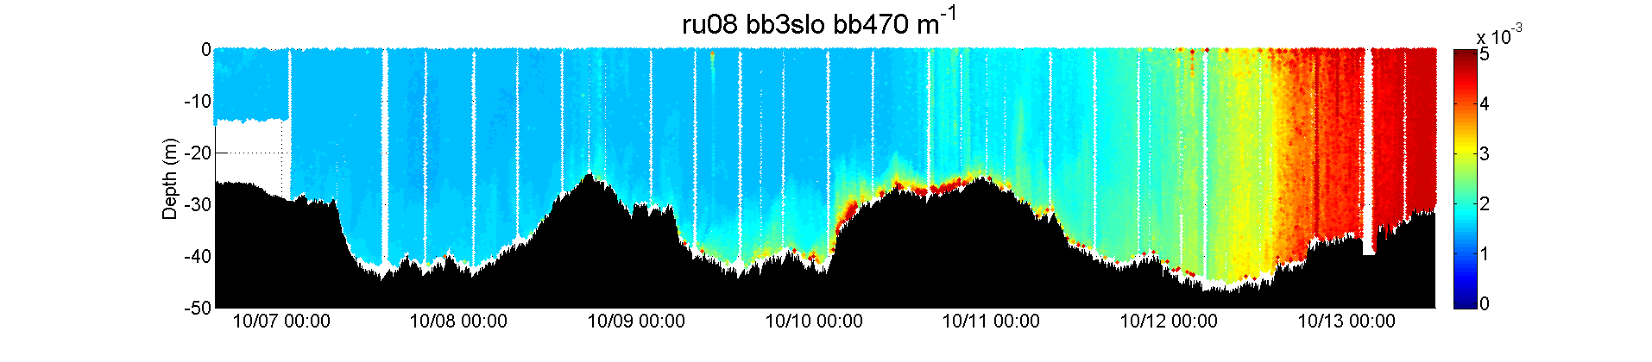
Storm 1, resuspension, none of the material penetrates through the weak stratification. Long period waves keep matter suspended.
Storm 2, resuspension, throughout the water column, during both storms chlorophyll is not a major constituent.

Slide 13
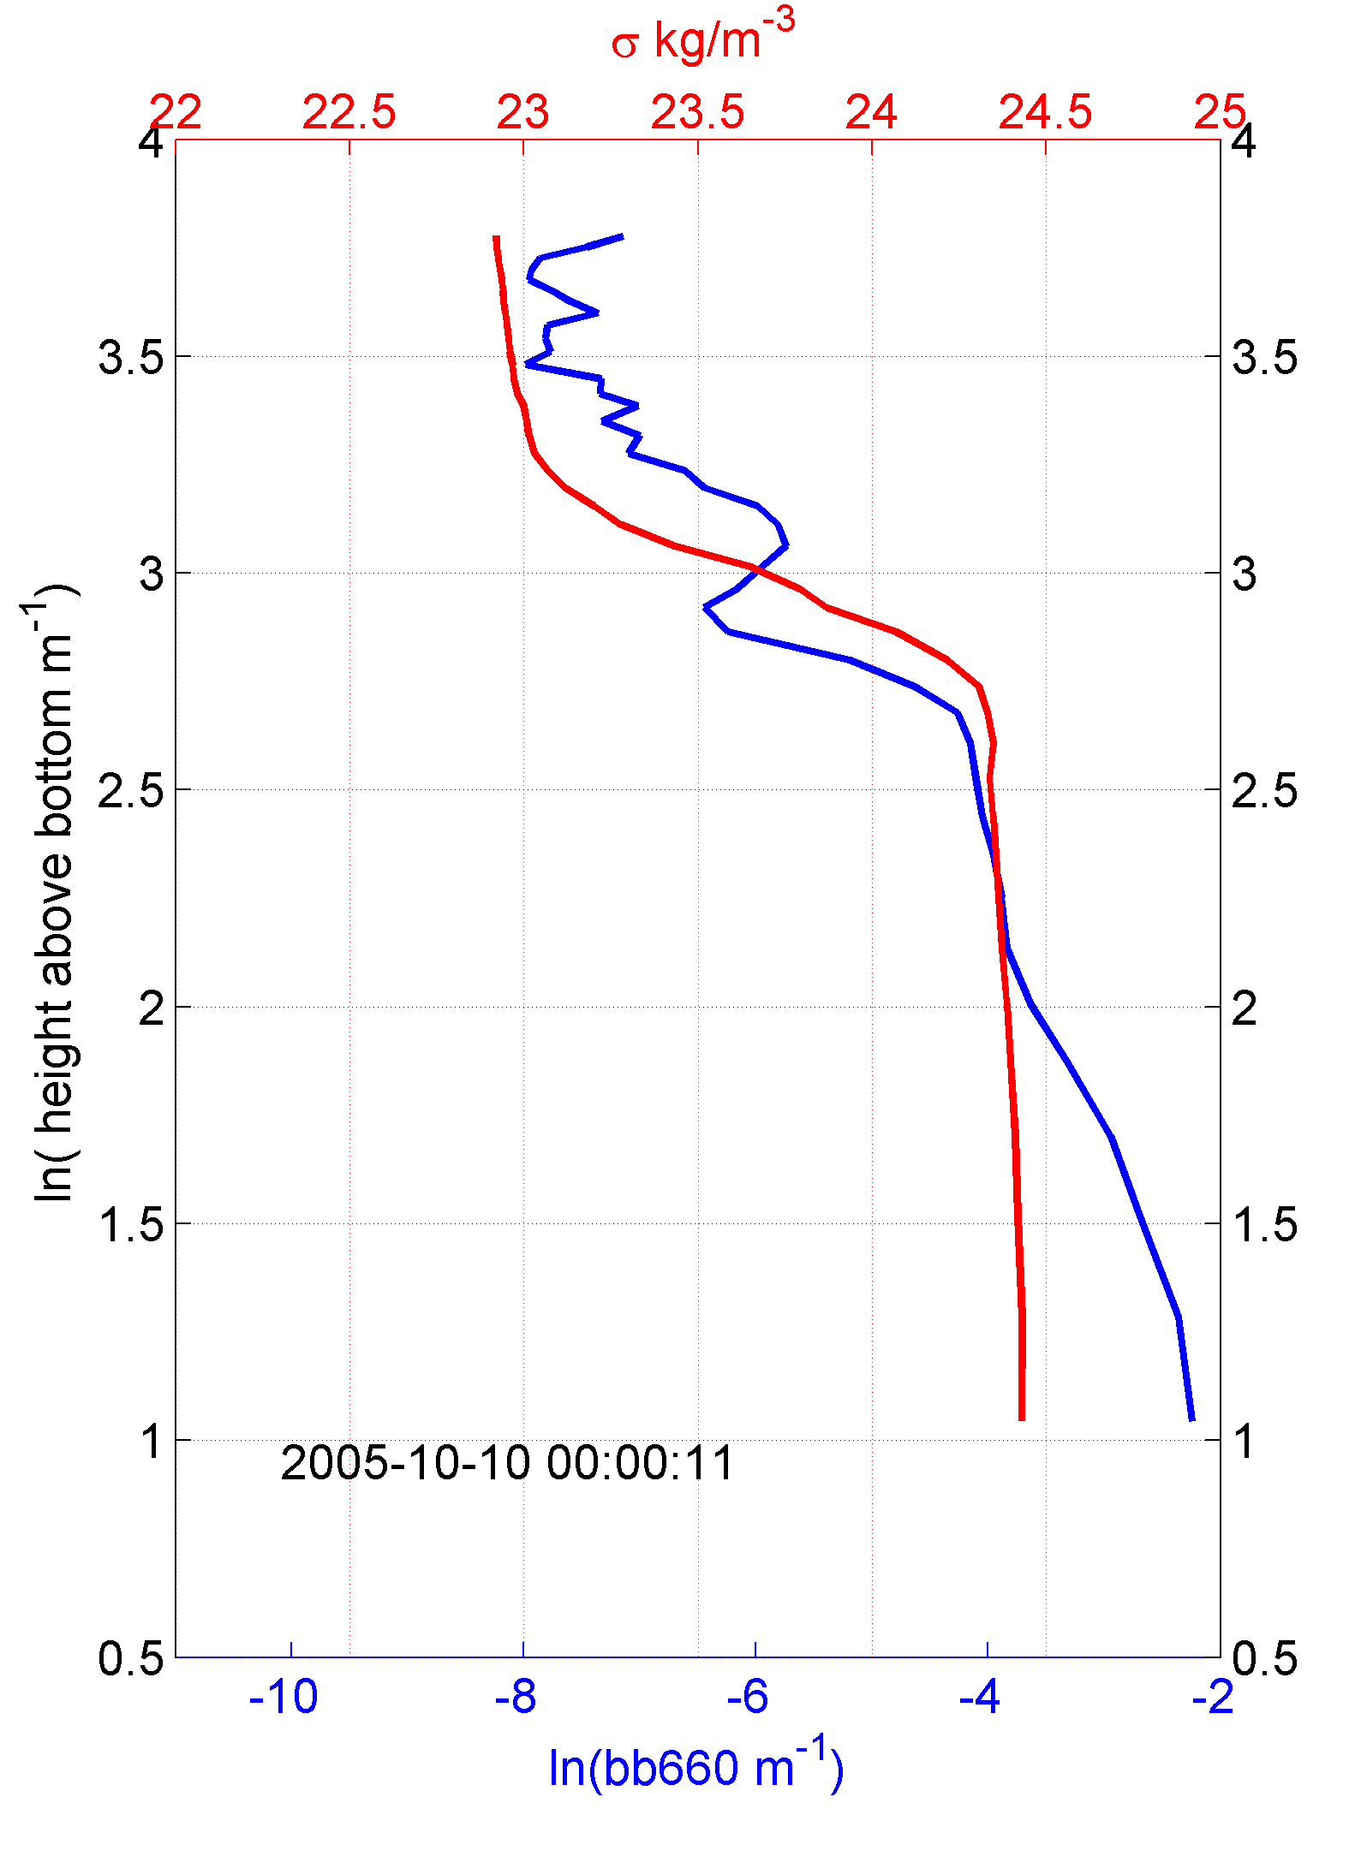
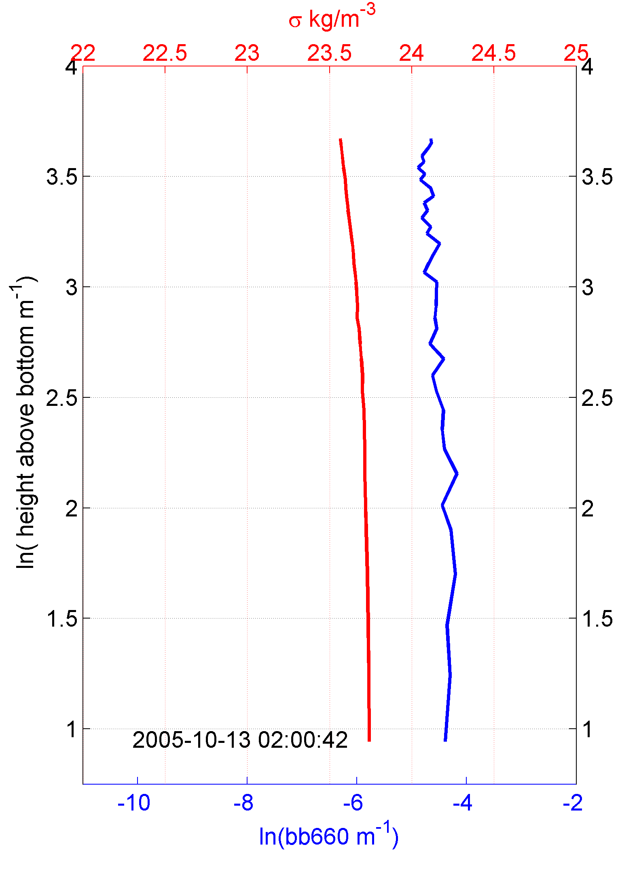
Martha’s Vineyard Coastal Observatory Storms – October 9 & 13, 2005

Slide 14
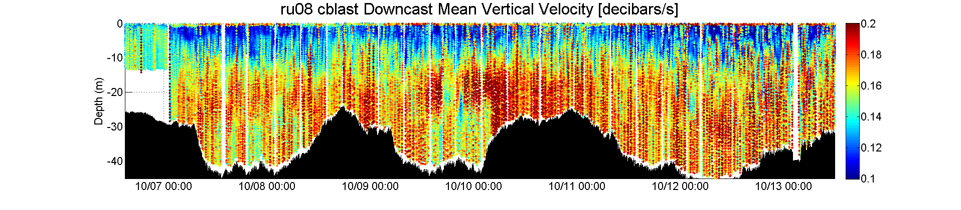
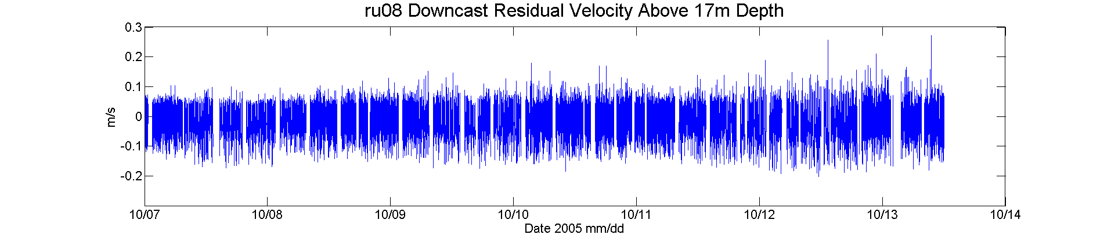
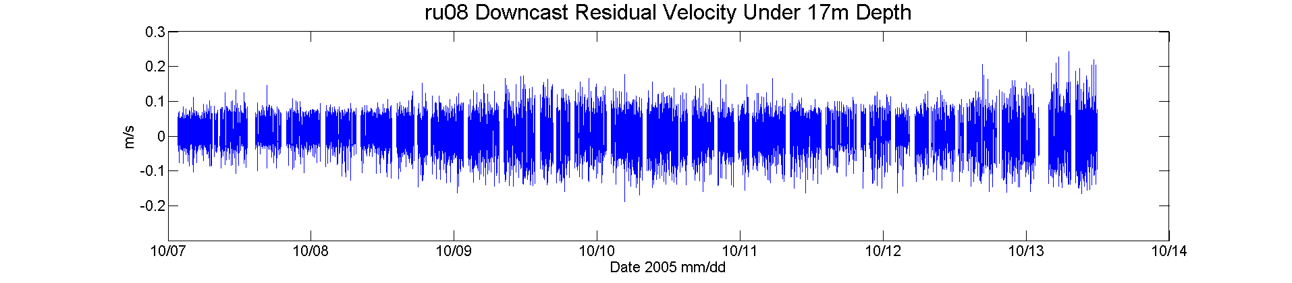
Martha’s Vineyard Coastal Observatory Storms – October 9 & 13, 2005

Slide 15
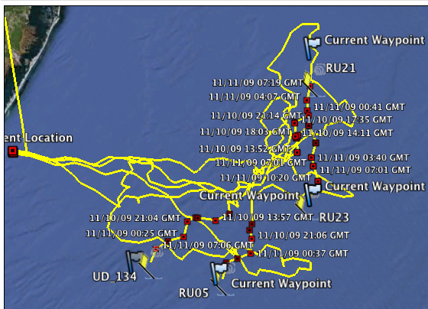
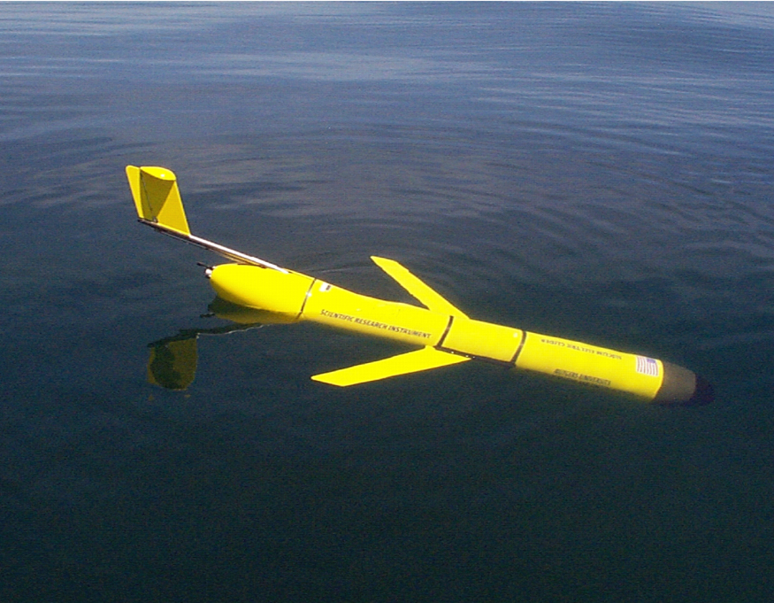
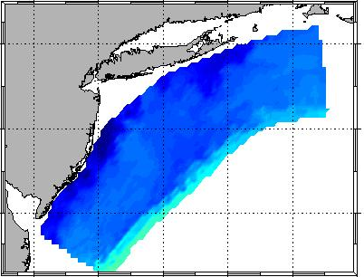
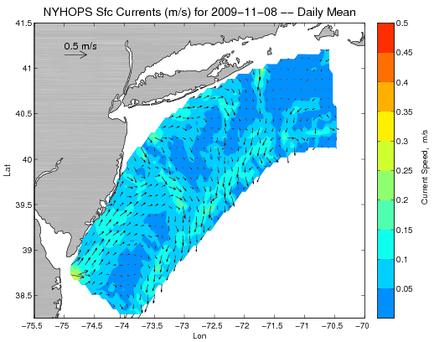
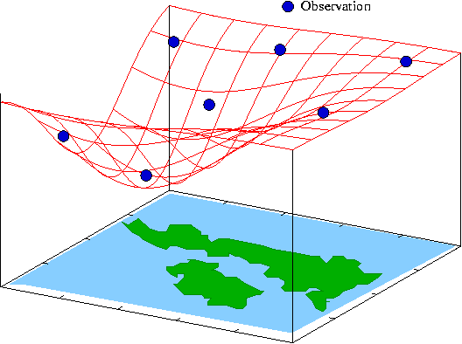

MURI, IOOS, ONR, OOI Observing System Simulation Experiment 2009
Design, Testing and Deploy
Observatory (simulated) data
Models
Sensor &
Platform
~3 km
~100 m
Virtual Ocean
Data Assimilation
Data
Analysis
Science Questions & Drivers
Data Synthesis: Nowcast & Data Impact

Slide 16


IDA Storm Nov 10 2009
MURI, IOOS, ONR, OOI Observing System Simulation Experiment 2009

Slide 17


IDA Storm Nov 11 2009
MURI, IOOS, ONR, OOI Observing System Simulation Experiment 2009

Slide 18


IDA Storm Nov 12 2009
MURI, IOOS, ONR, OOI Observing System Simulation Experiment 2009

Slide 19


IDA Storm Nov 13 2009
MURI, IOOS, ONR, OOI Observing System Simulation Experiment 2009

Slide 20


IDA Storm Nov 14 2009
MURI, IOOS, ONR, OOI Observing System Simulation Experiment 2009

Slide 21


IDA Storm Nov 15 2009
MURI, IOOS, ONR, OOI Observing System Simulation Experiment 2009

Slide 22




MURI, IOOS, ONR, OOI Observing System Simulation Experiment 2009
Storm
NOAA buoy

Slide 23



MURI, IOOS, ONR, OOI Observing System Simulation Experiment 2009

Slide 24



MURI, IOOS, ONR, OOI Observing System Simulation Experiment 2009
storms

Slide 25



MURI, IOOS, ONR, OOI Observing System Simulation Experiment 2009
chlorophyll contributes significantly to the resuspension signal

Slide 26



MURI, IOOS, ONR, OOI Observing System Simulation Experiment 2009

Slide 27





MURI, IOOS, ONR, OOI OSSE
Downcast mean vertical velocity
Downcast vertical velocity residual

Slide 28

Regional-Scale Conclusions
Gliders are Proven Storm Sampling Platforms
2) Existing Optical Sensors Produce Unique Sediment Transport Results – Regionally Distributed Fleets Possible Now – Spatial Patterns
3) New Sensors Will Further Enable New Storm Science
- Turbulent Closure & Mixing
torms

