Slide 1
Overview for September 25, 2025

Slide 2
NOAA RTOFS version of HyCOM

Slide 3
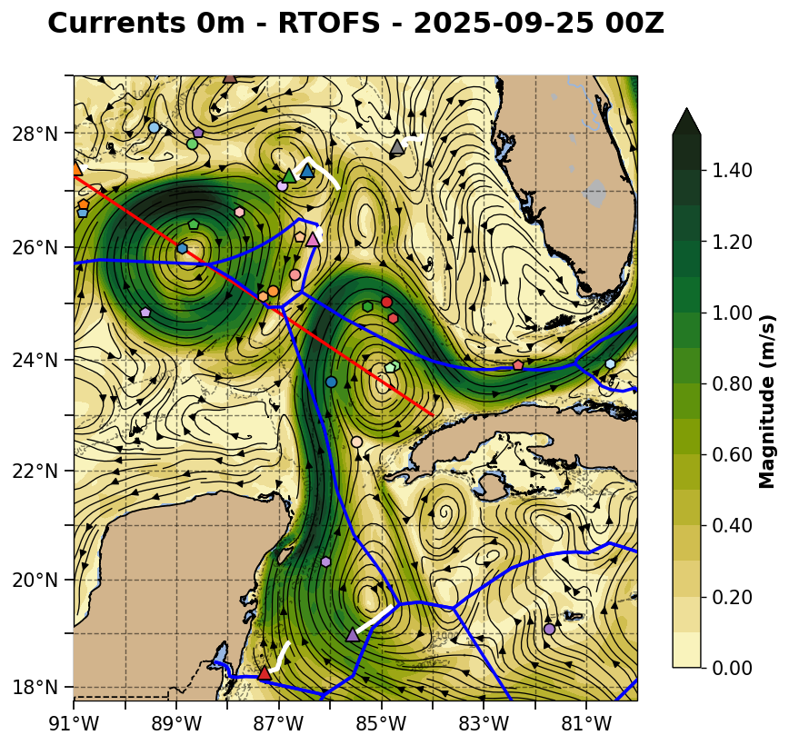
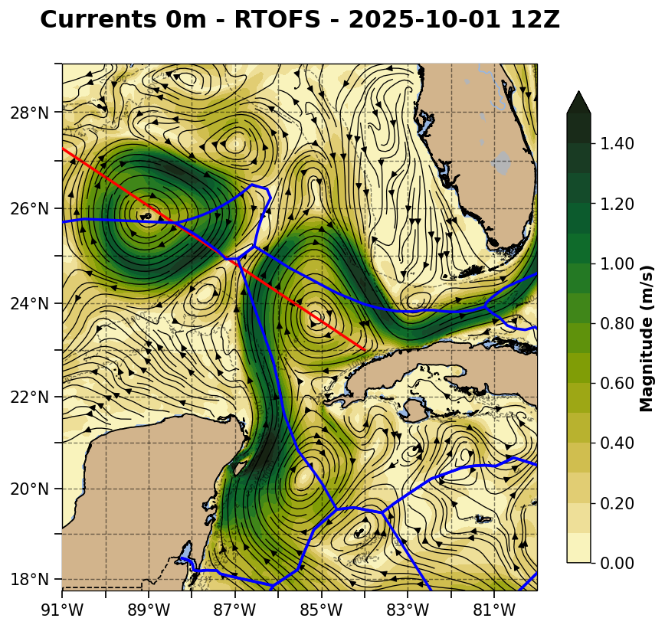

Slide 4
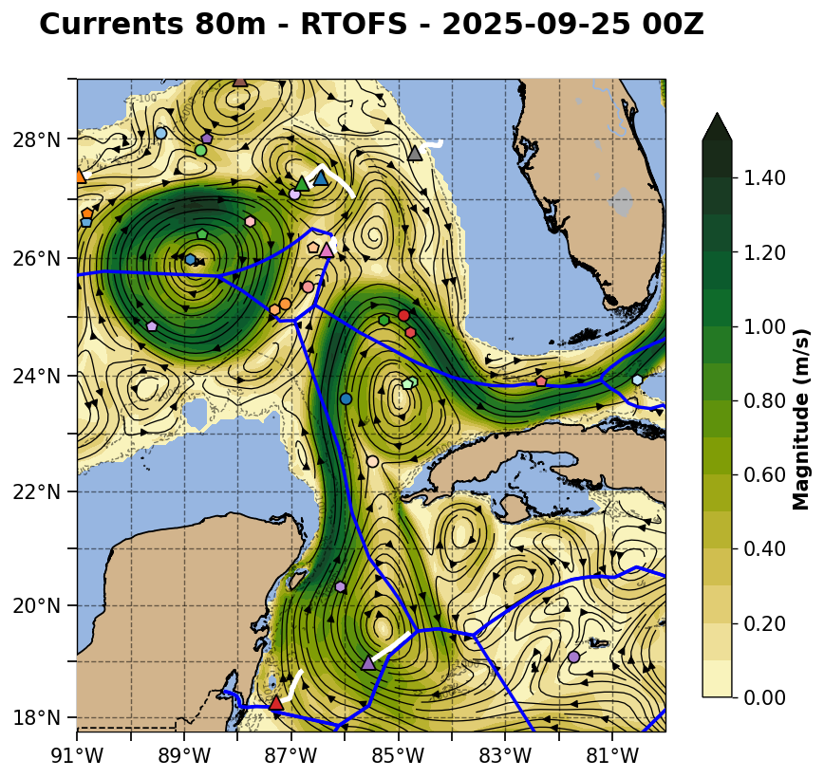
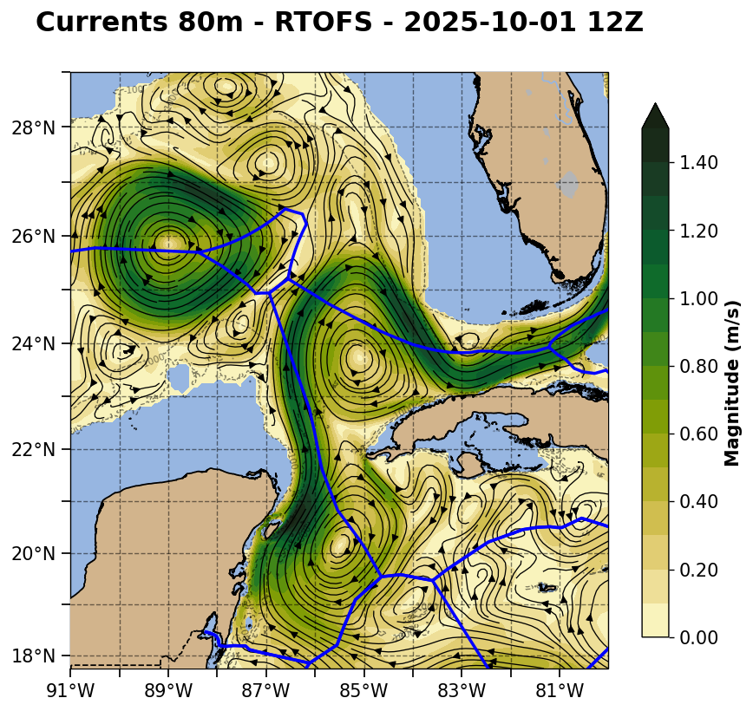

Slide 5
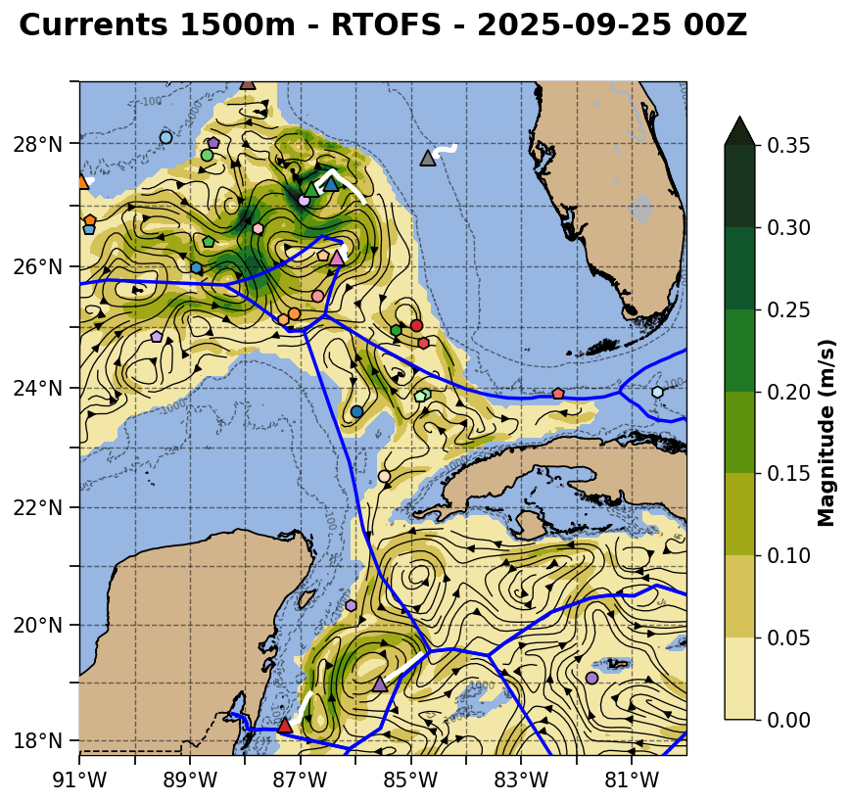


Slide 6
Navy ESPC version of HyCOM

Slide 7
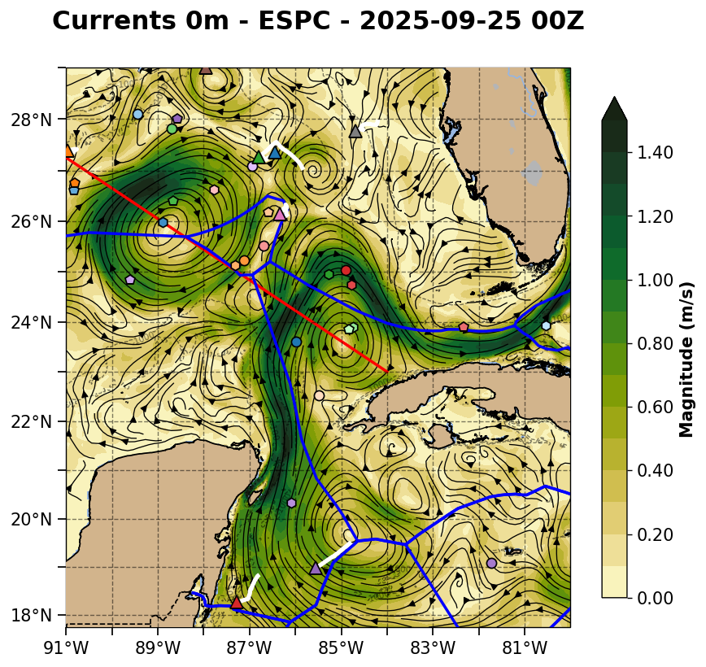
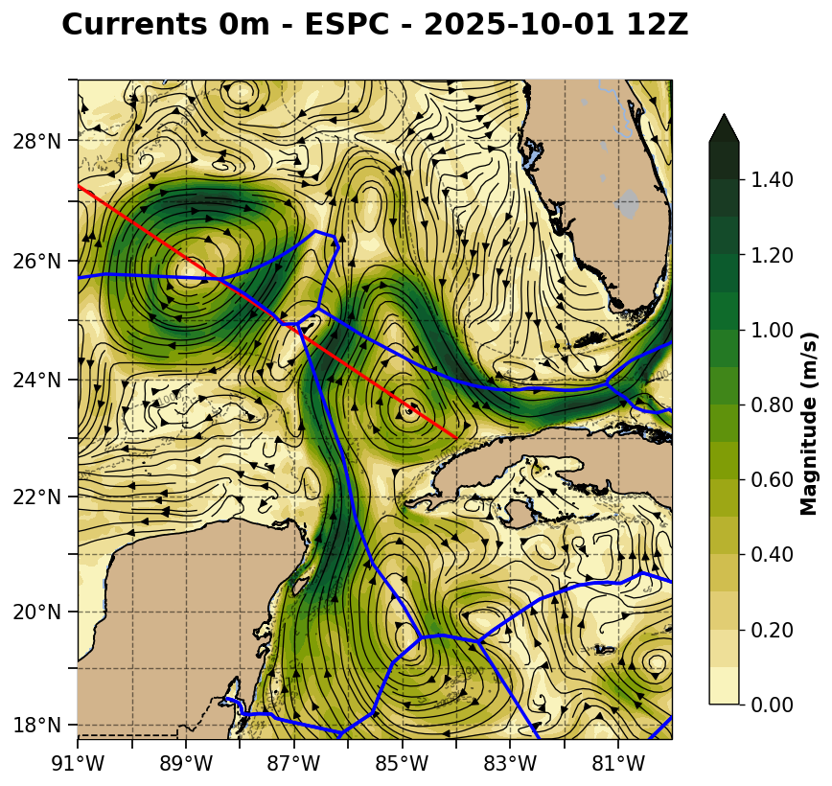

Slide 8
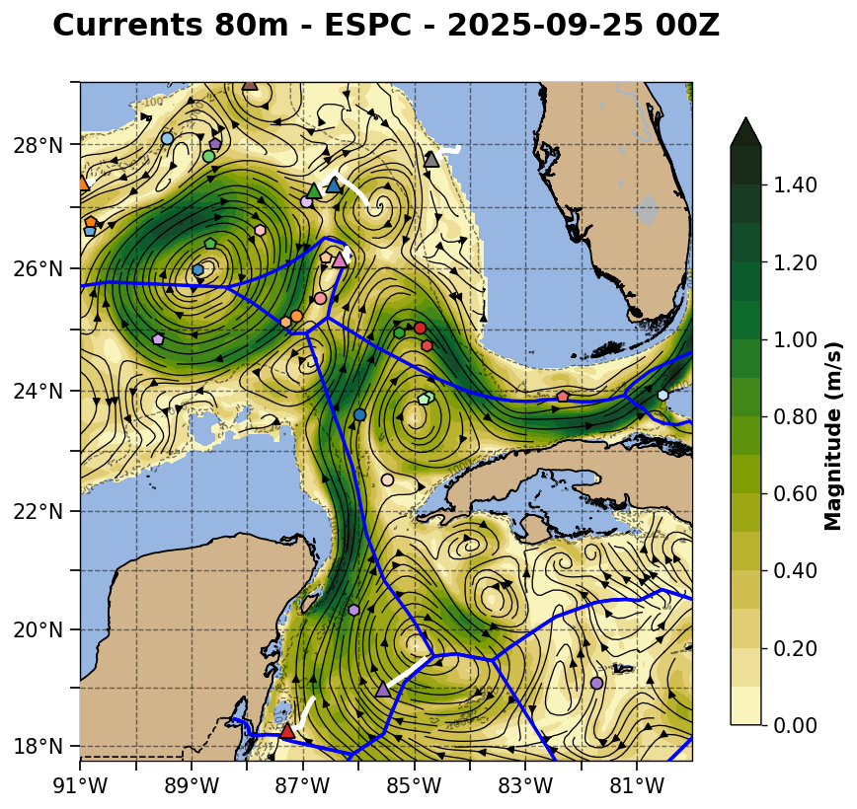
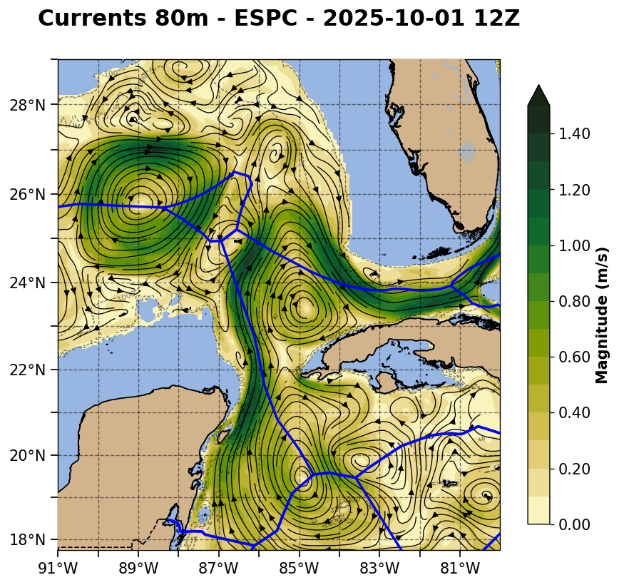

Slide 9
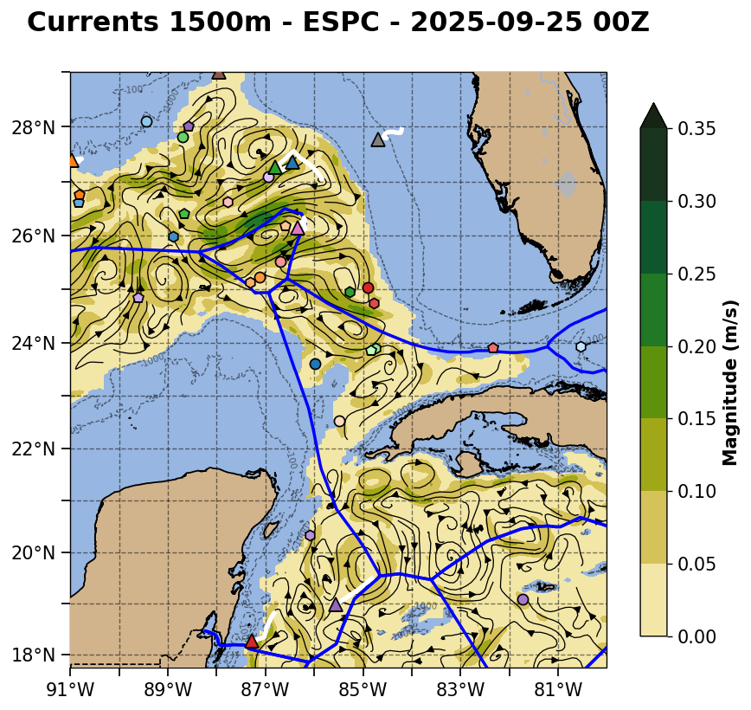
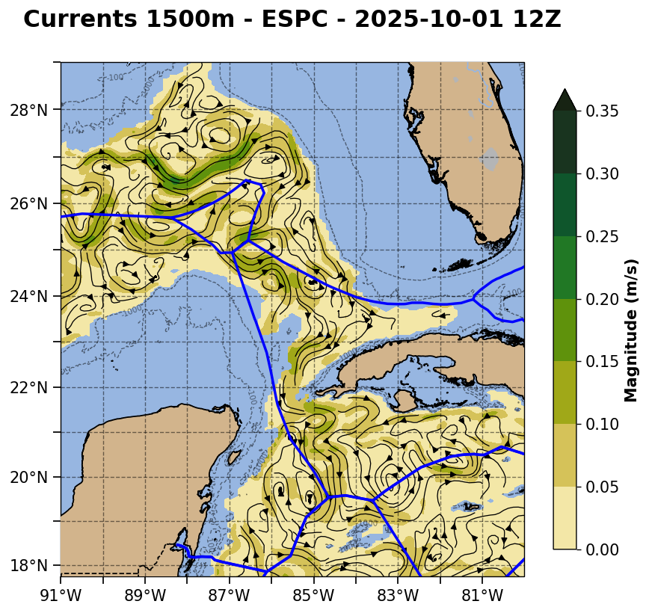

Slide 10
European CMEMS

Slide 11
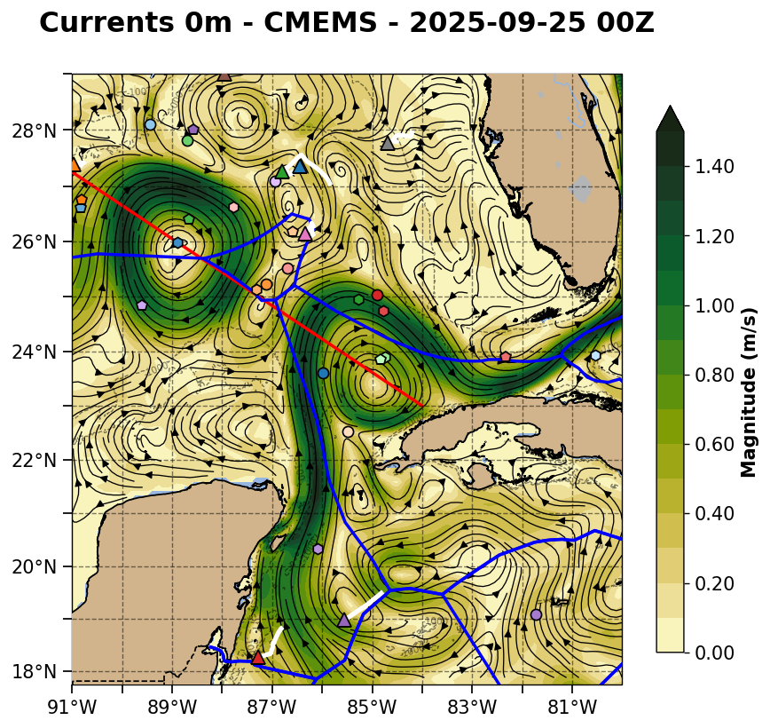
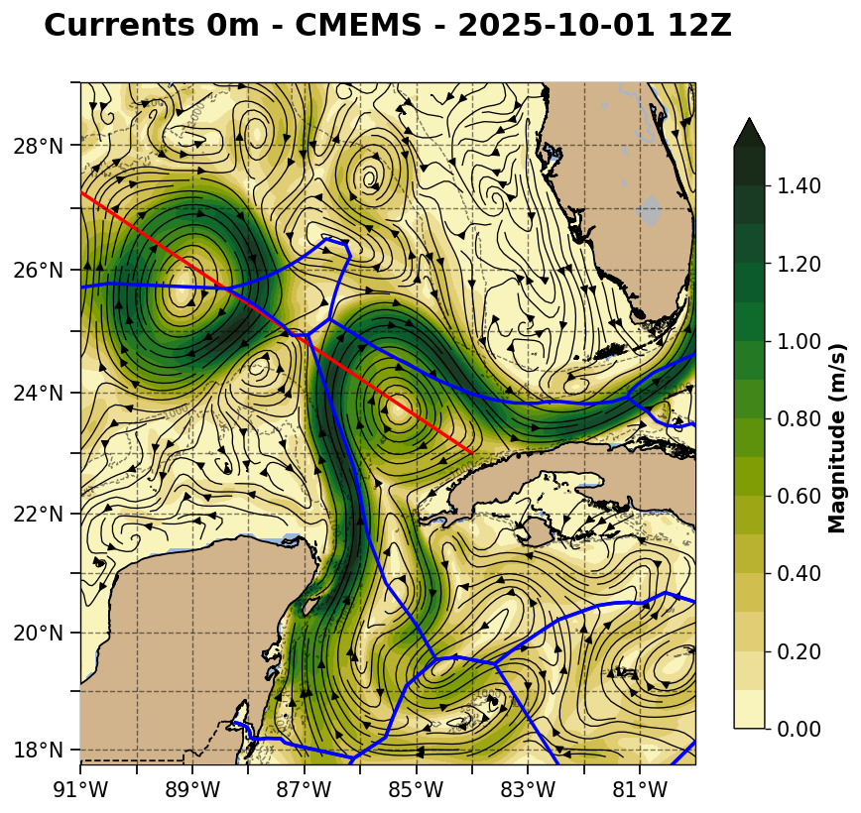

Slide 12
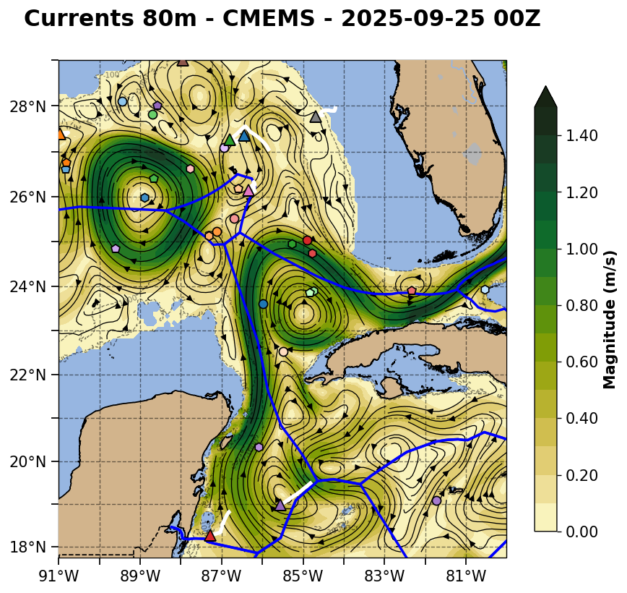
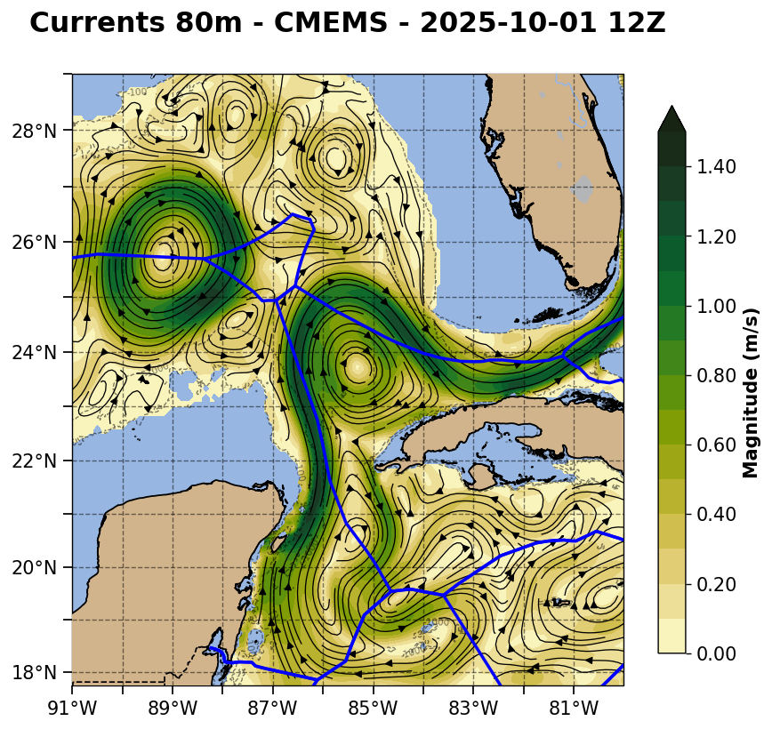

Slide 13
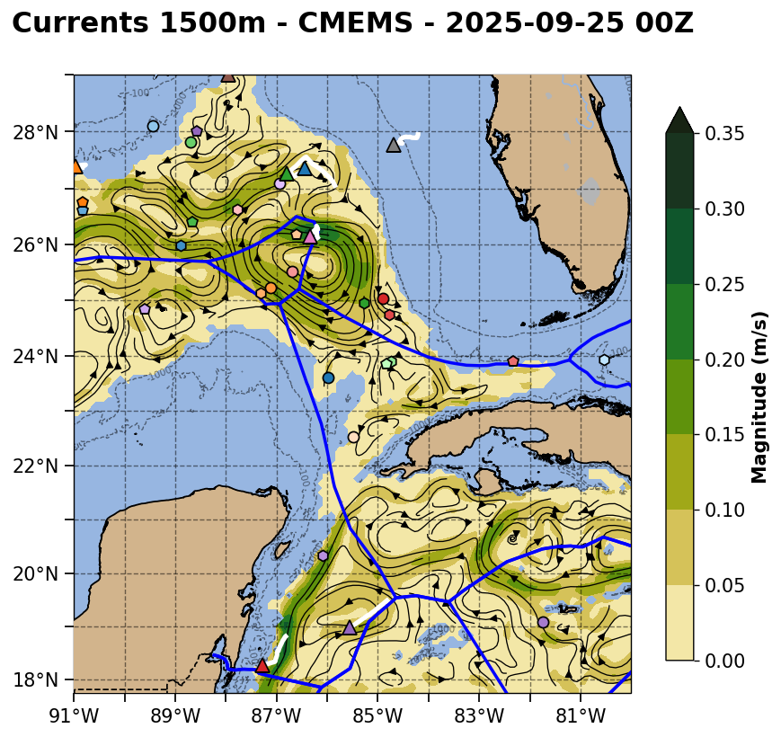
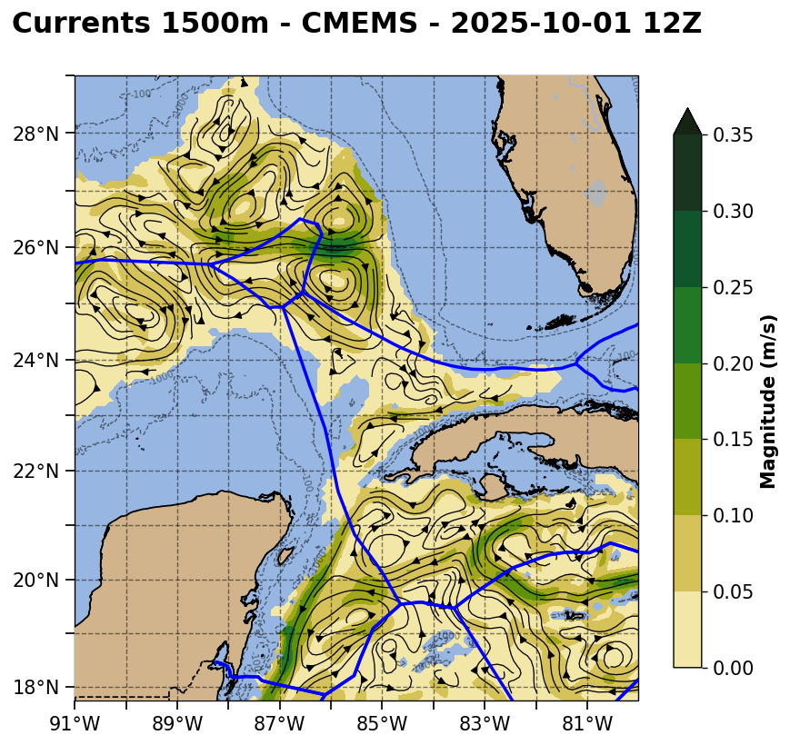

Slide 14
Current Speed Cross Sections through the pinch point and the eastern cyclonic eddy
ESPC -
RTOFS -
CMEMS -

Slide 15
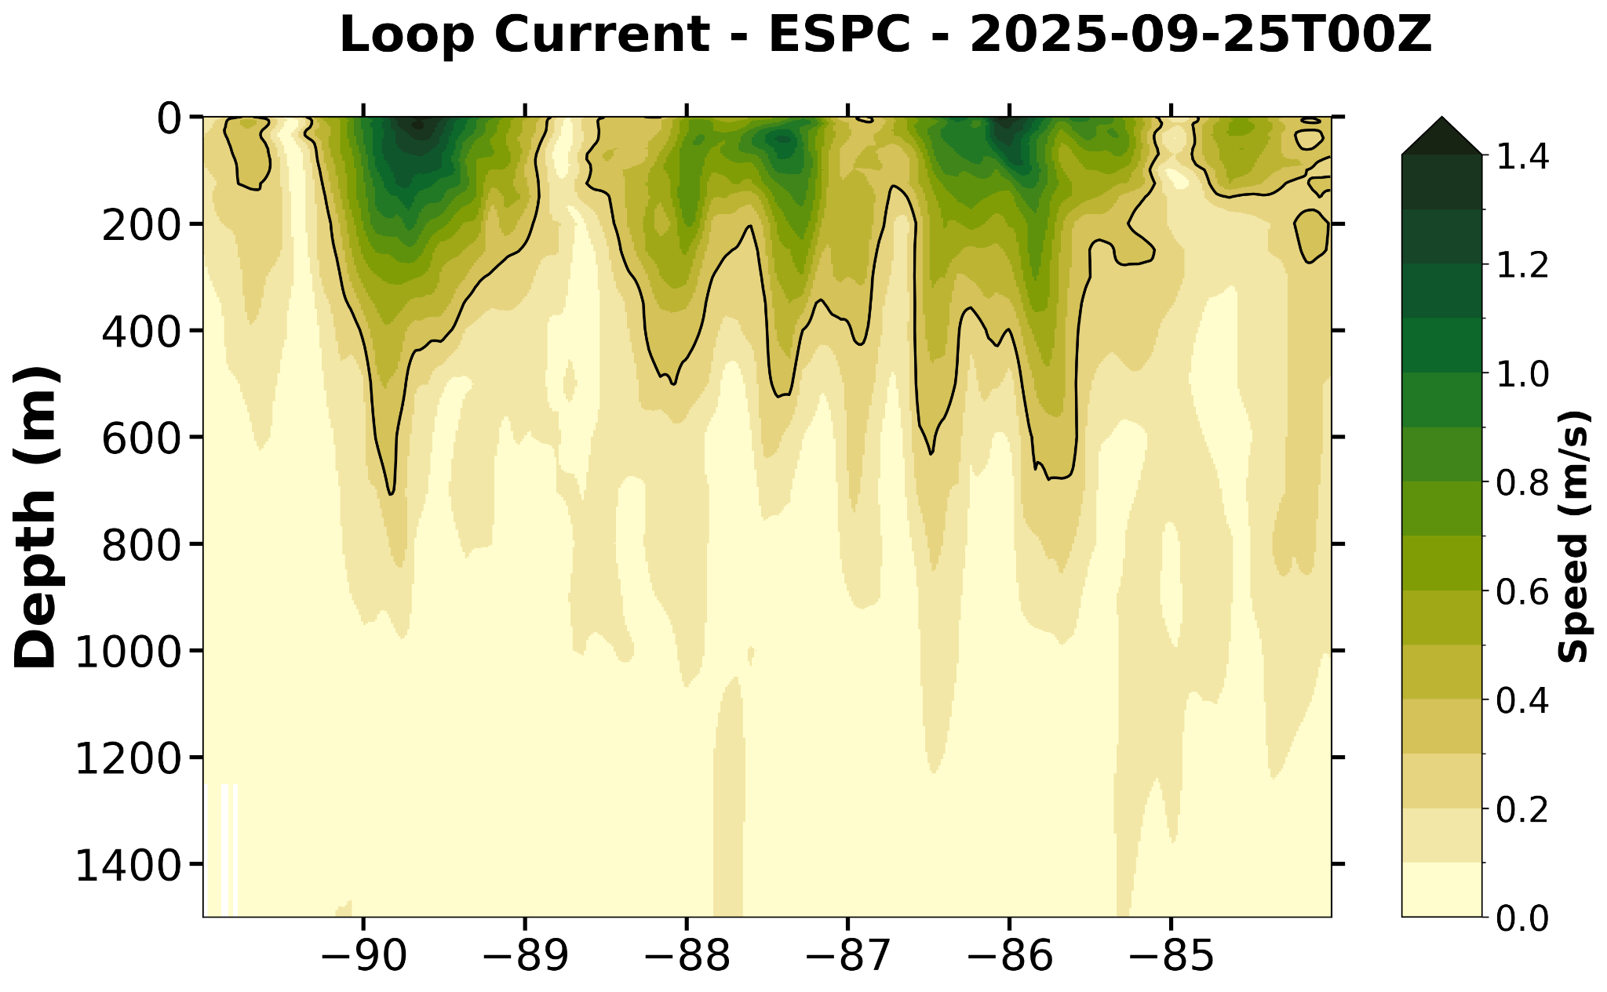
ESPC Not Available for this transect

Slide 16
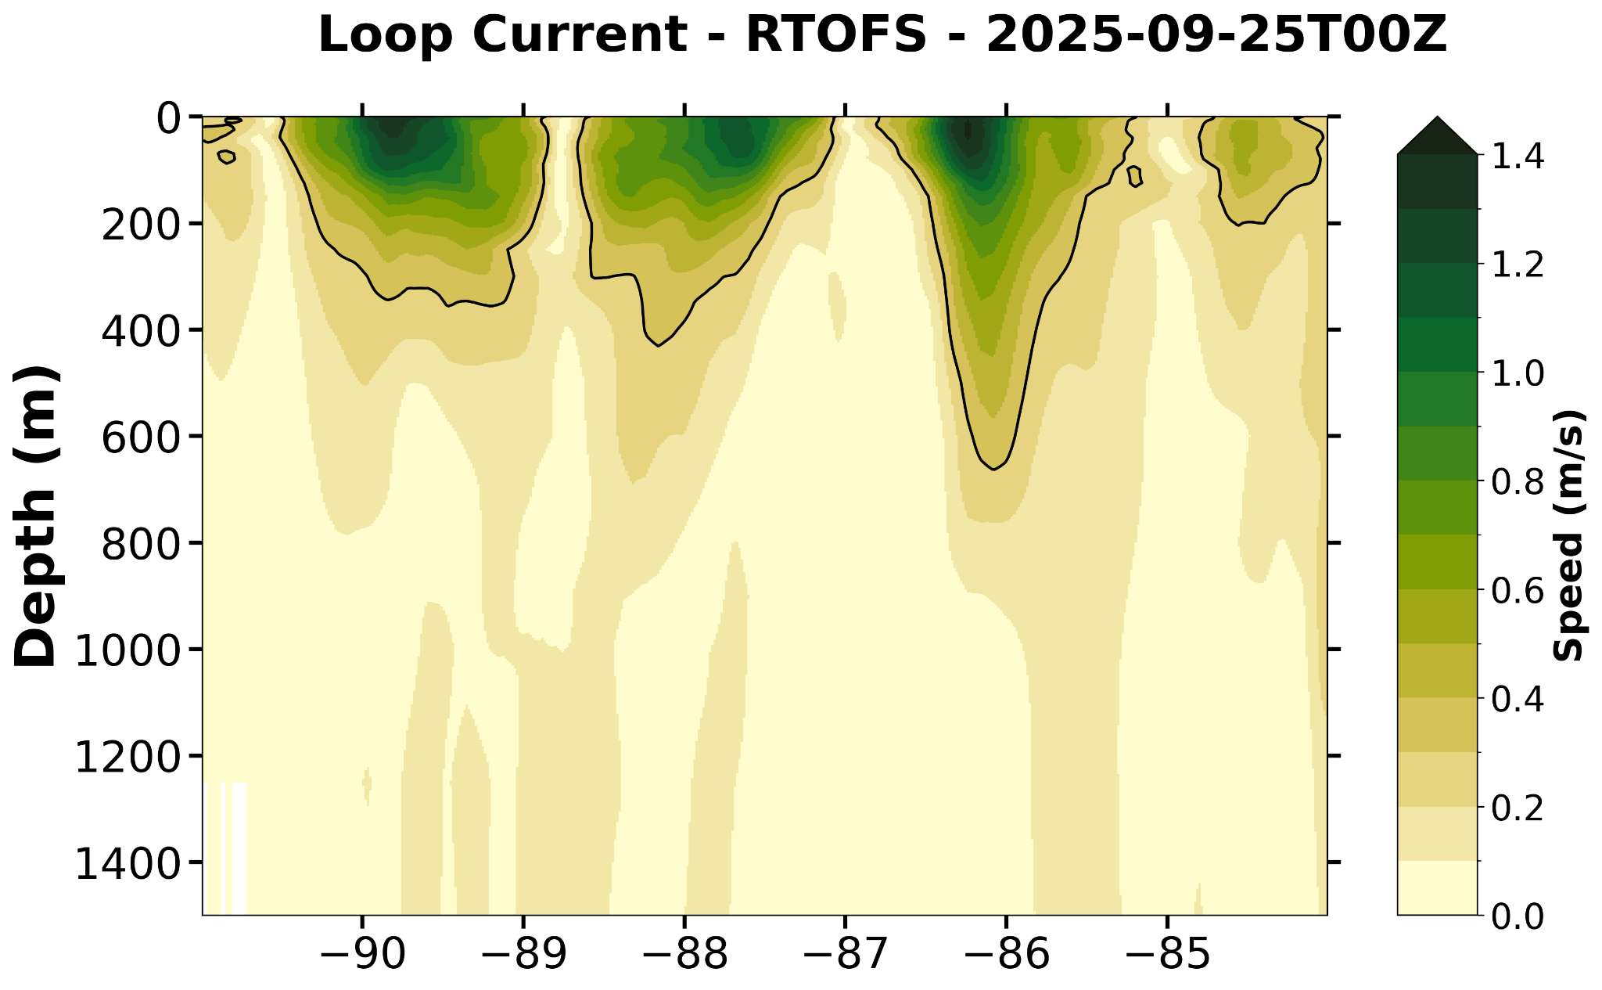

Slide 17
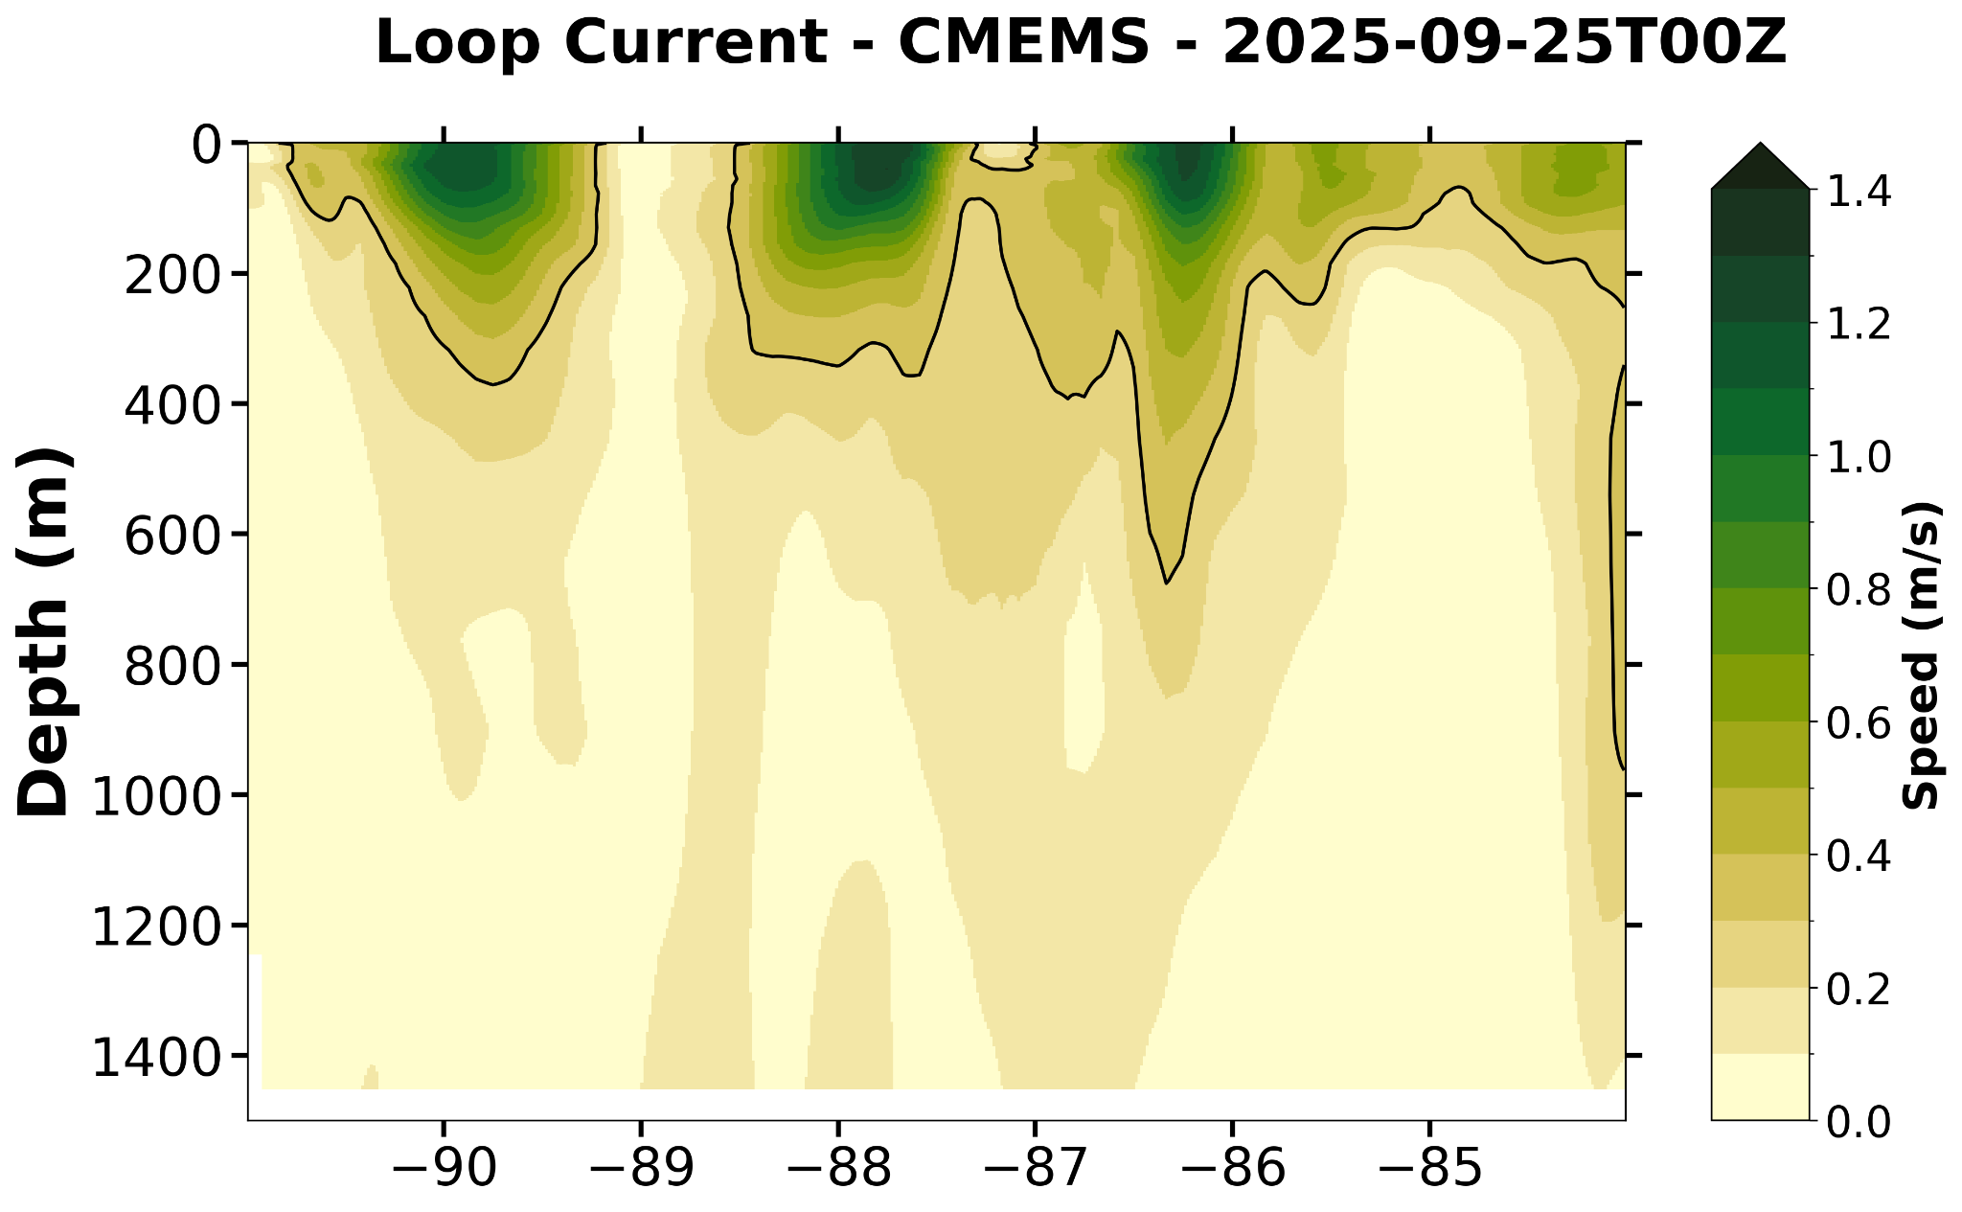

Slide 18
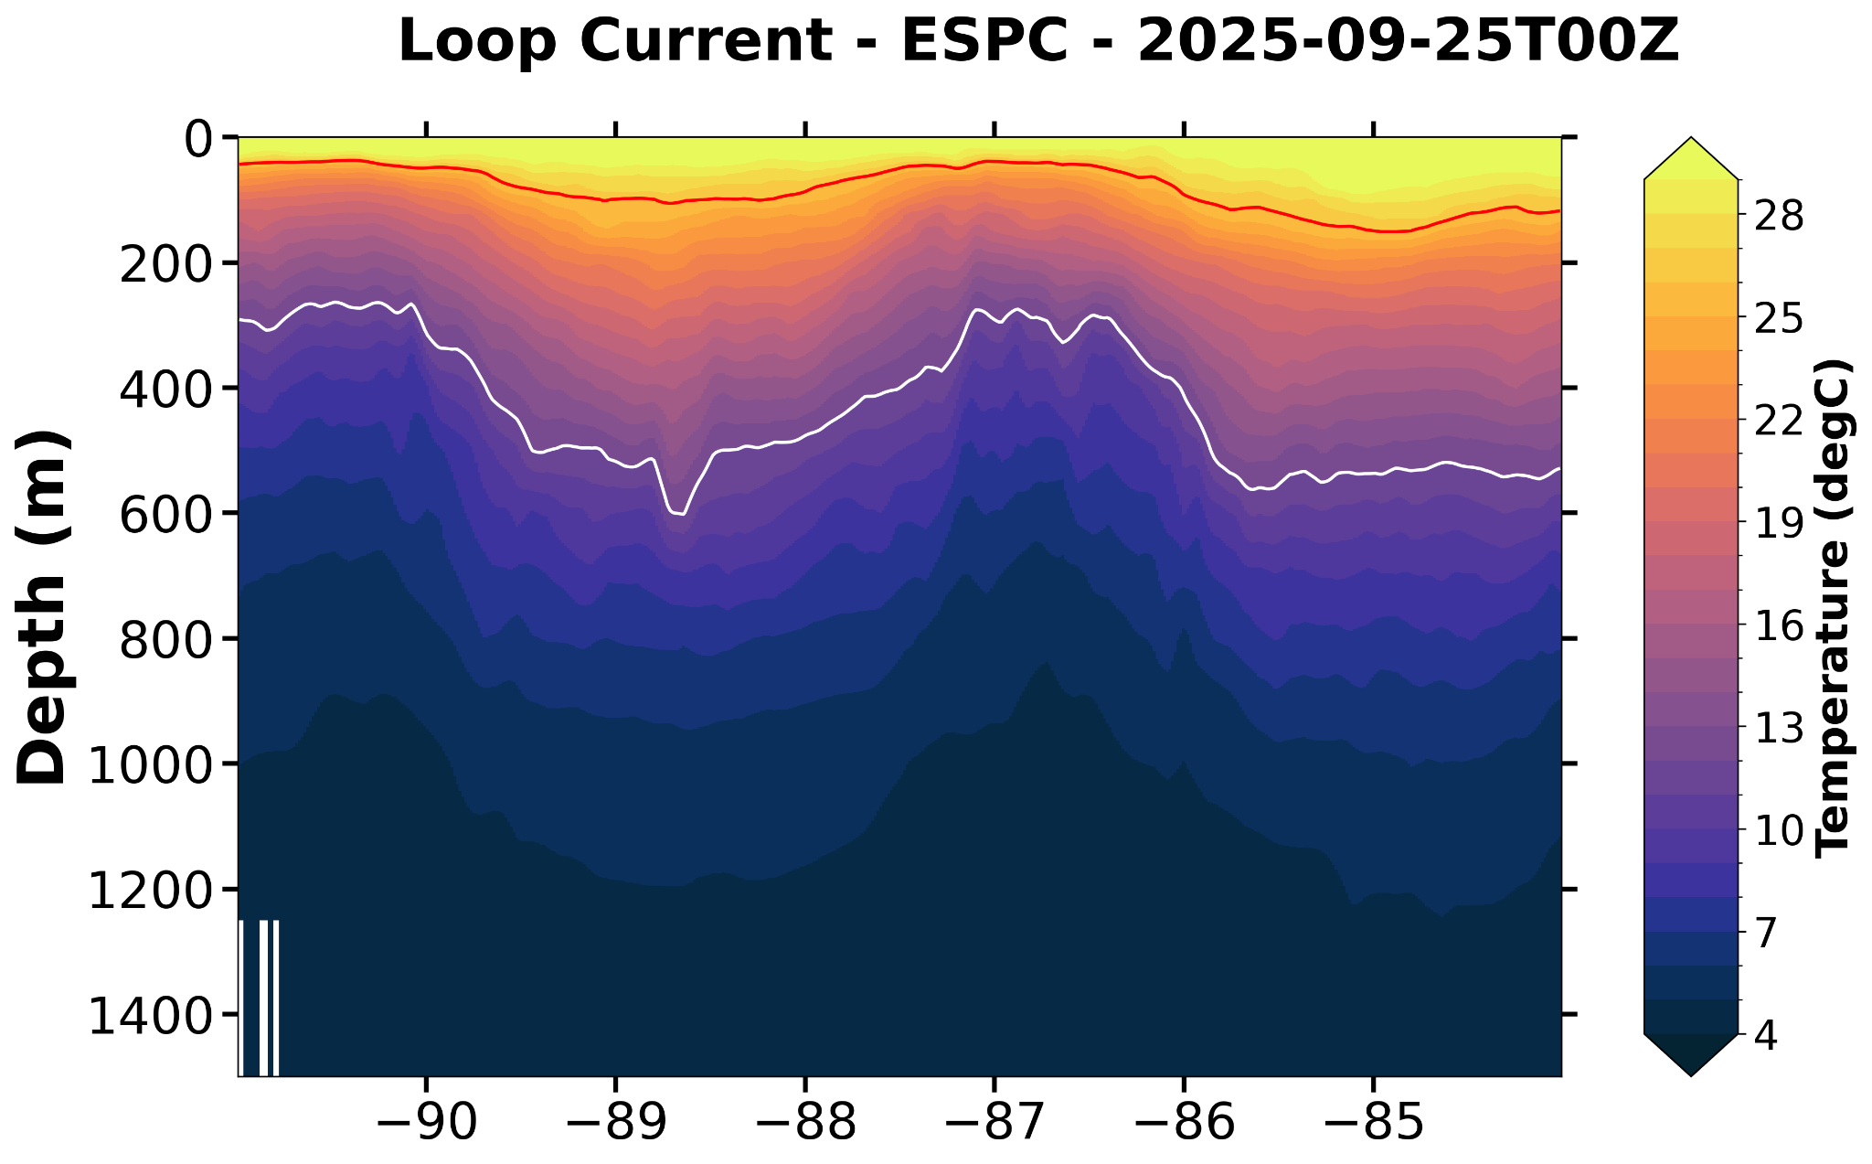
ESPC Not Available for this transect

Slide 19
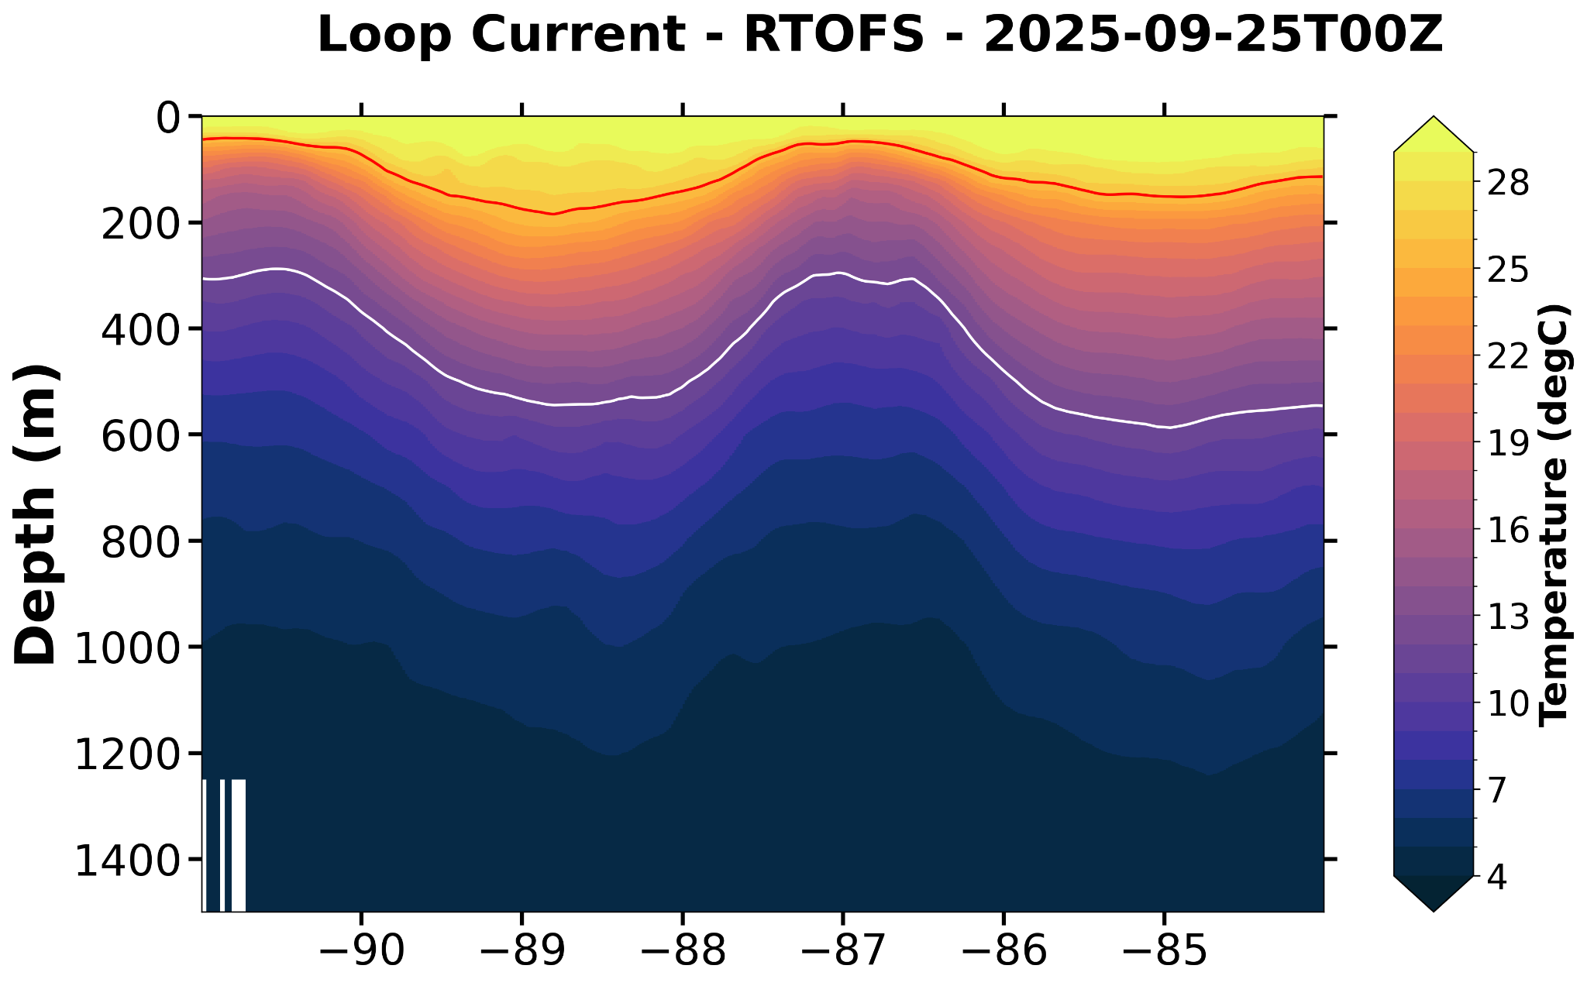

Slide 20
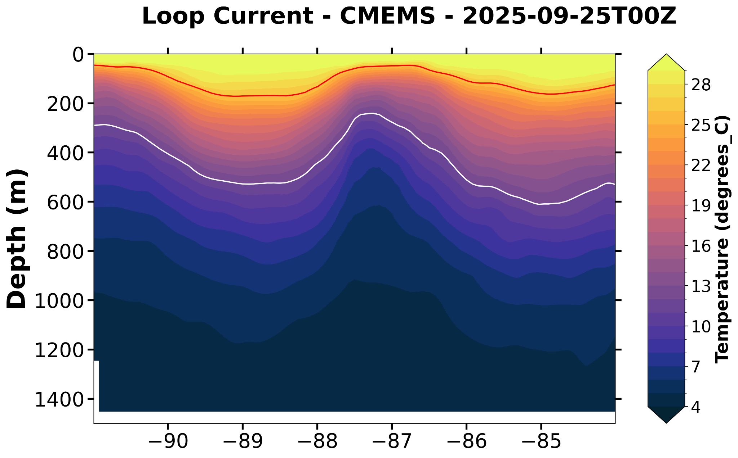

Slide 21
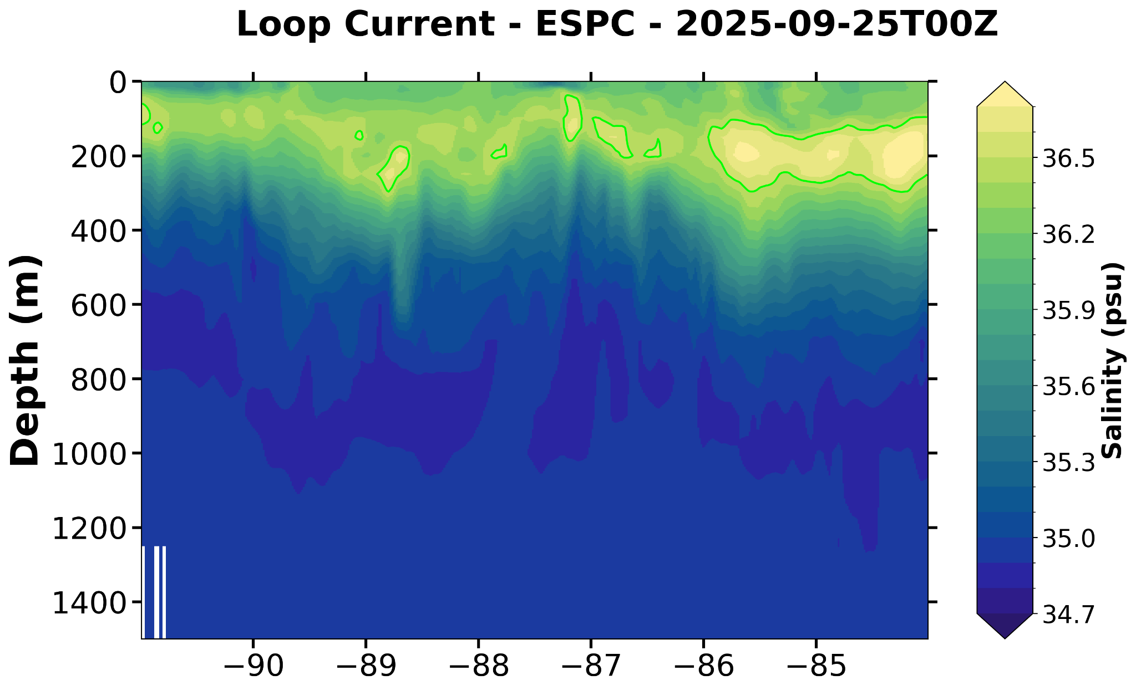
ESPC Not Available for this transect

Slide 22
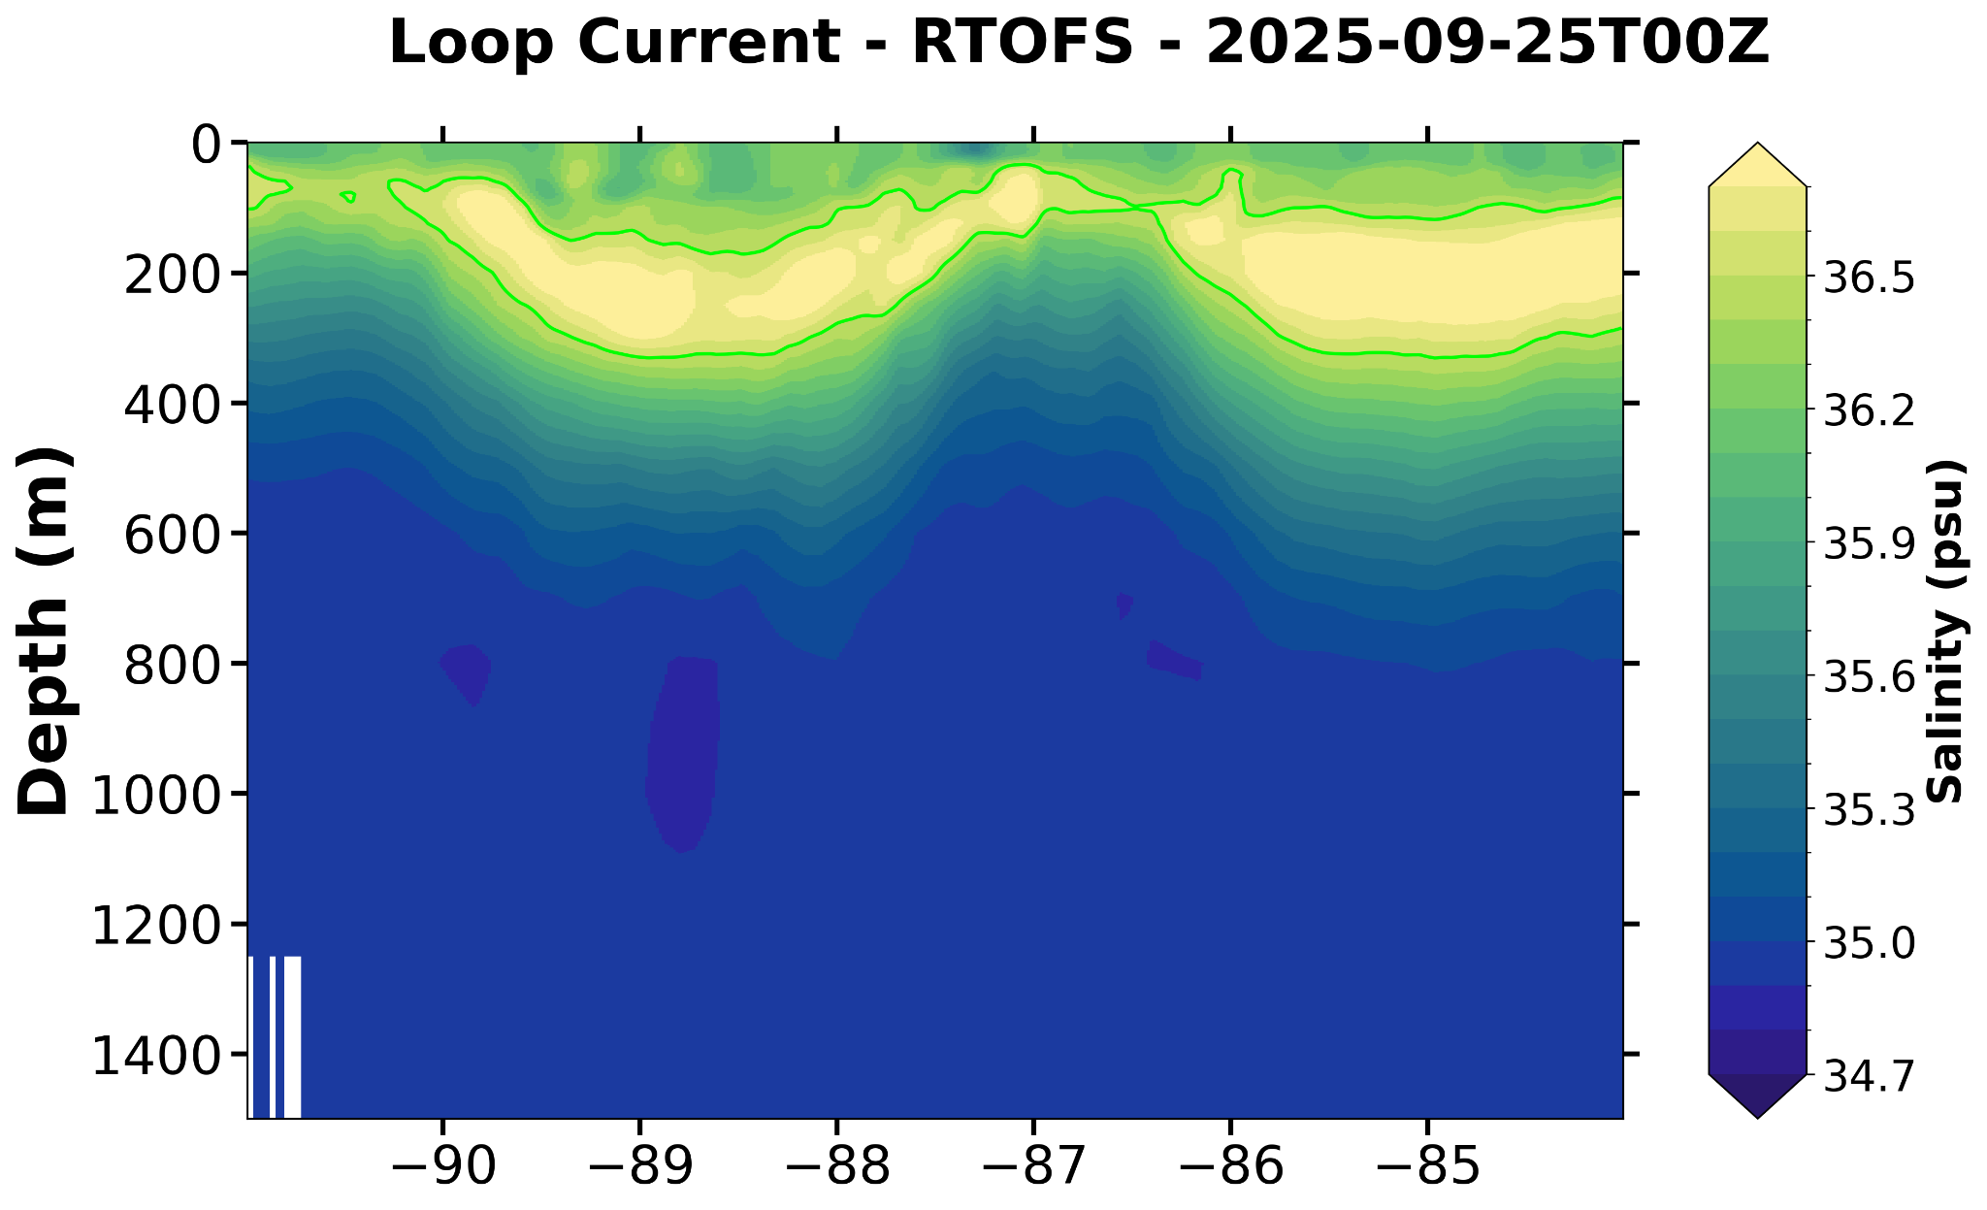

Slide 23
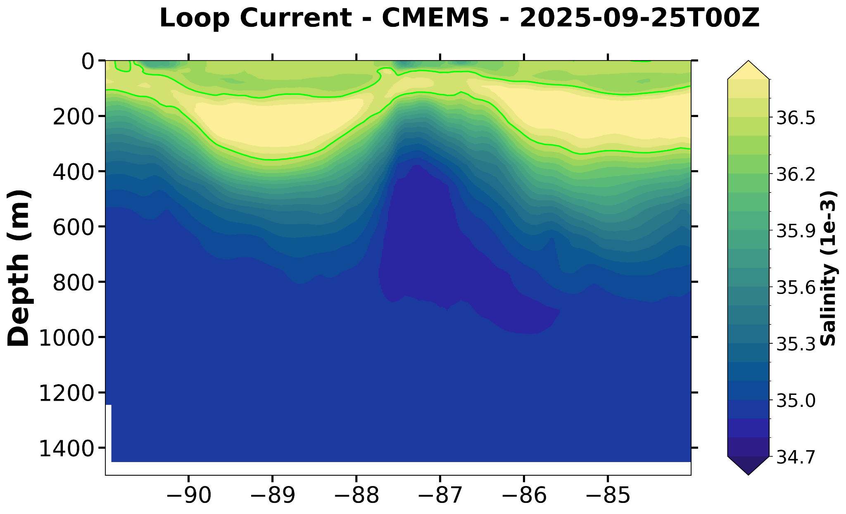

Slide 24
Current Speed Cross Sections
RTOFS - Teal Line in Slide 3

Slide 25
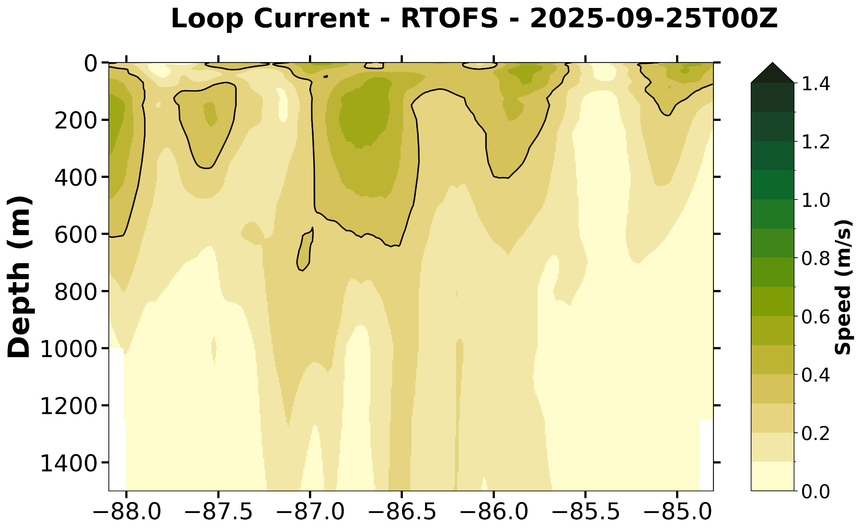
ESPC Not Available for this transect

Slide 26
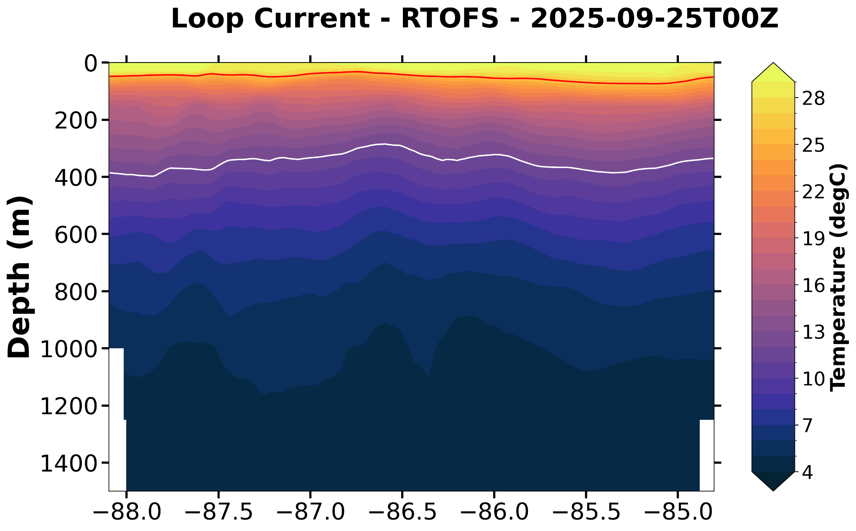
ESPC Not Available for this transect

Slide 27
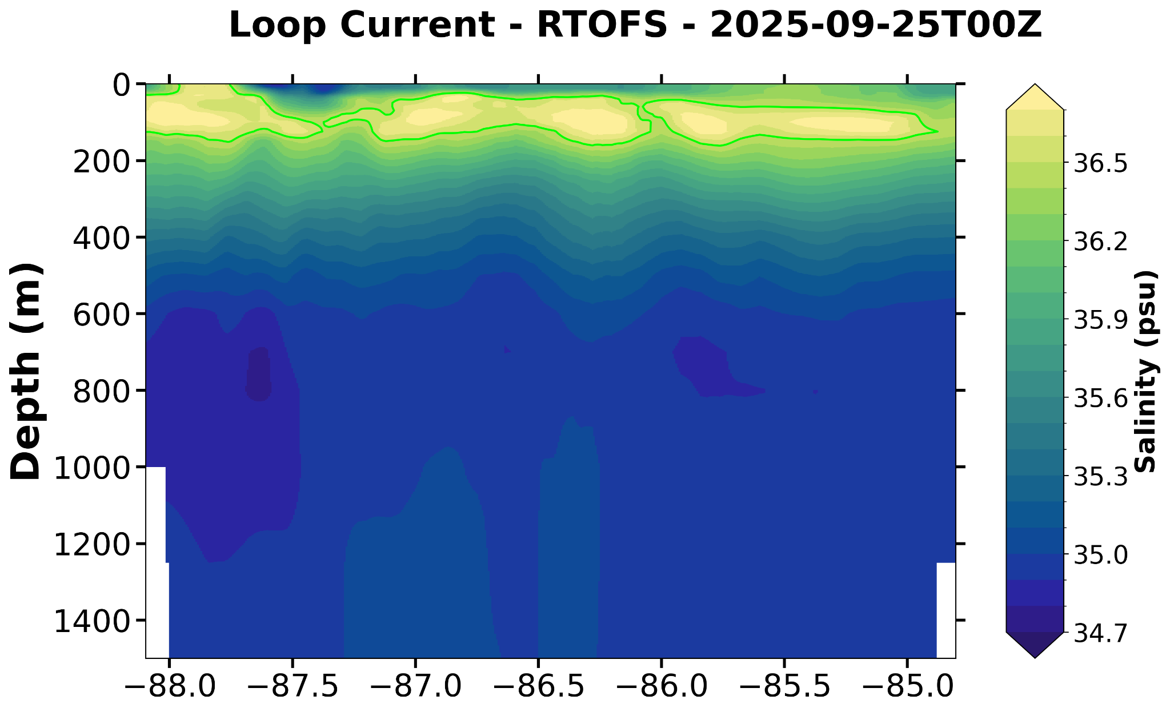
ESPC Not Available for this transect

Slide 28
Current Speed Cross Sections
ESPC - Blue Line in Slide 7

Slide 29
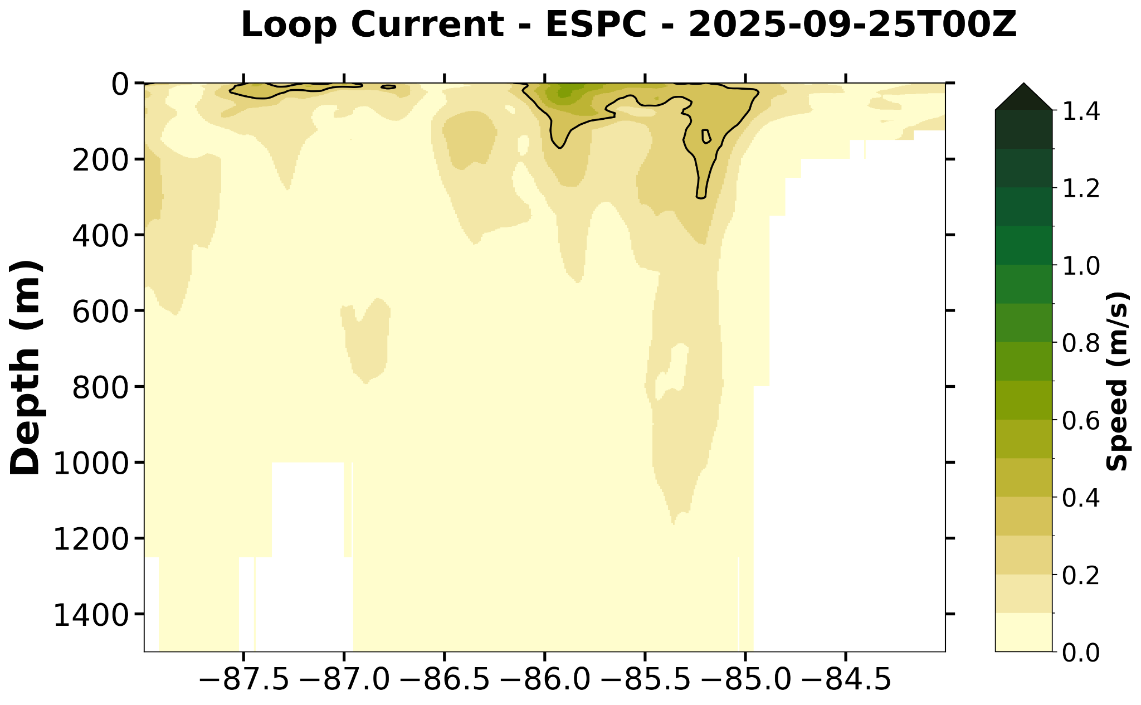
ESPC Not Available for this transect

Slide 30
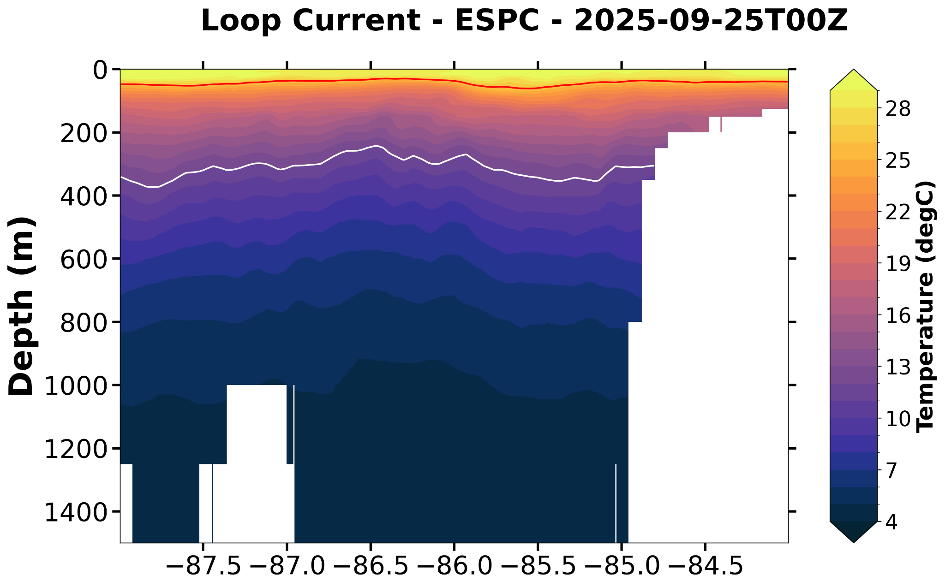
ESPC Not Available for this transect

Slide 31
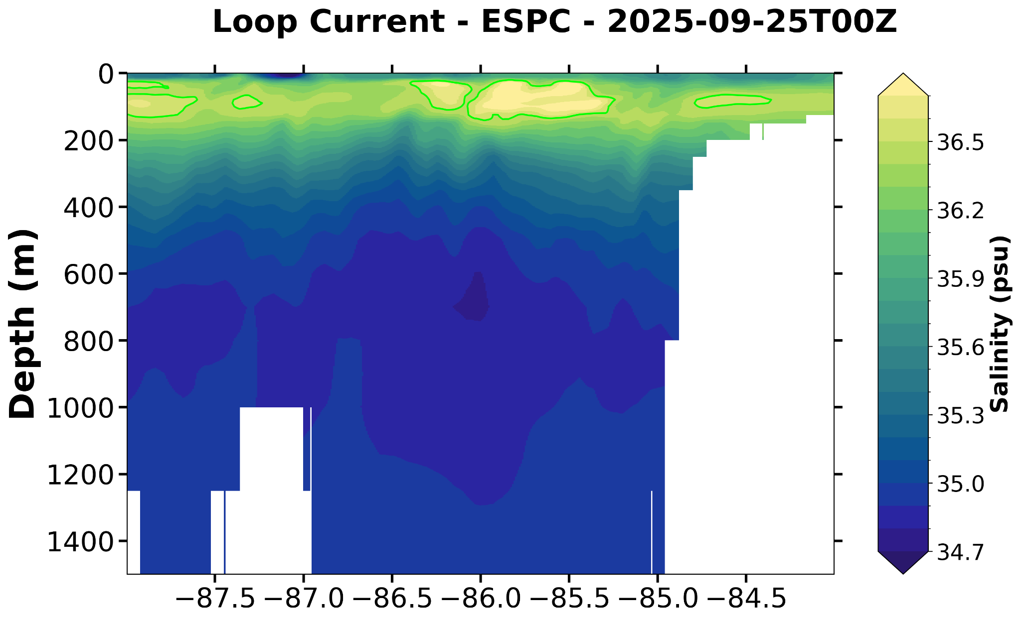
ESPC Not Available for this transect

Slide 32
Current Speed Cross Sections
CMEMS - Red Line in Slide 11

Slide 33
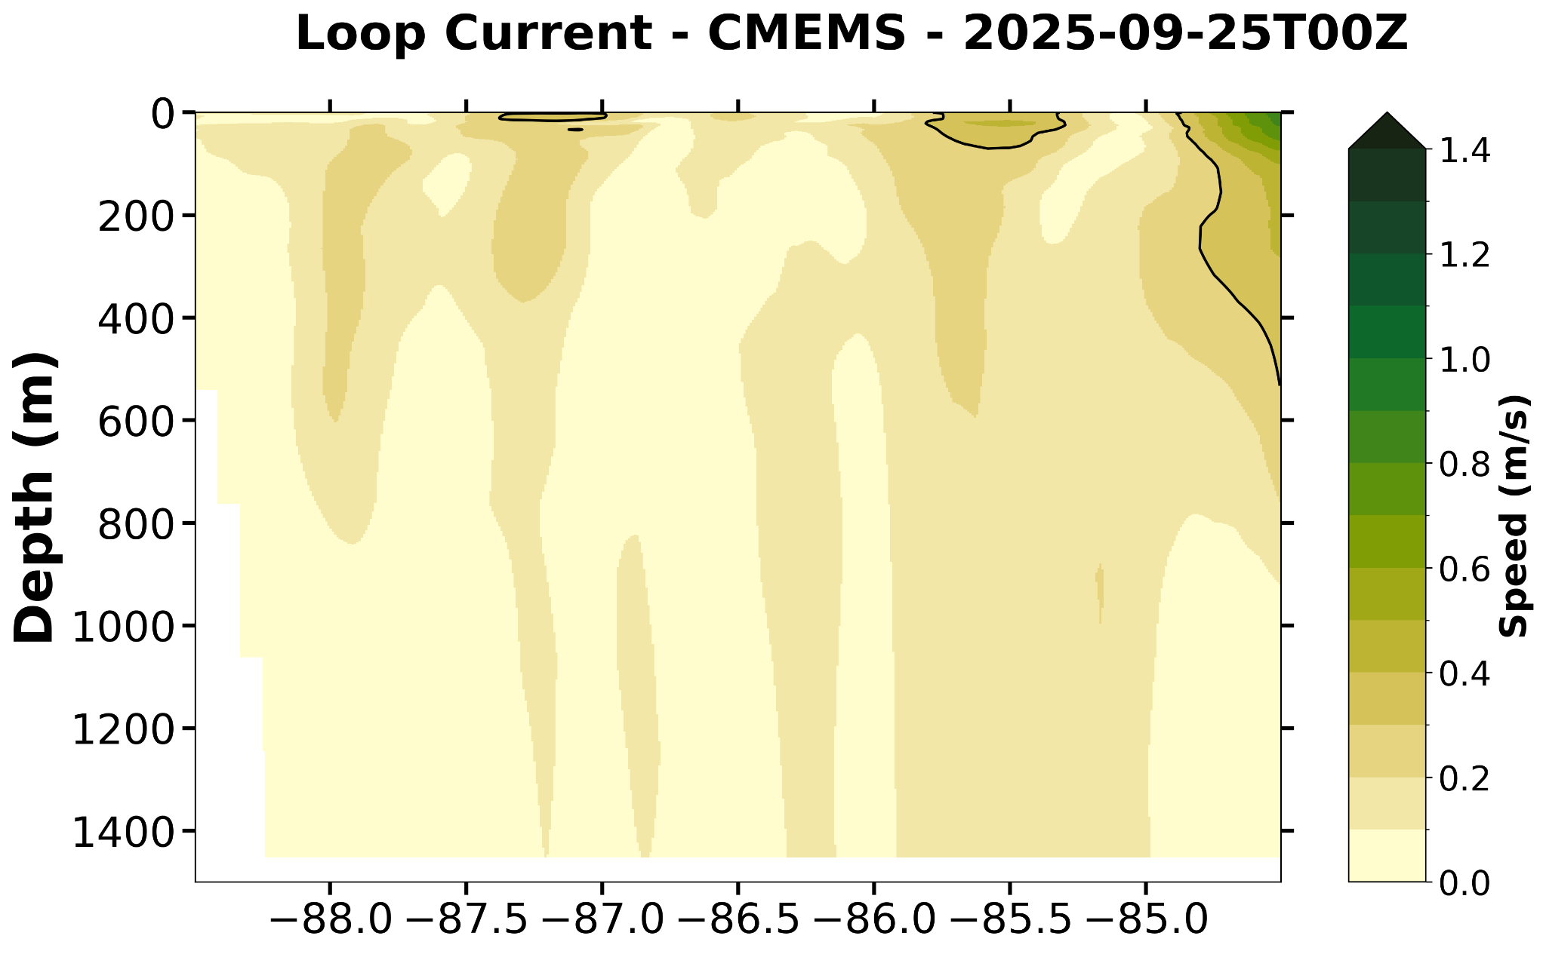
ESPC Not Available for this transect

Slide 34
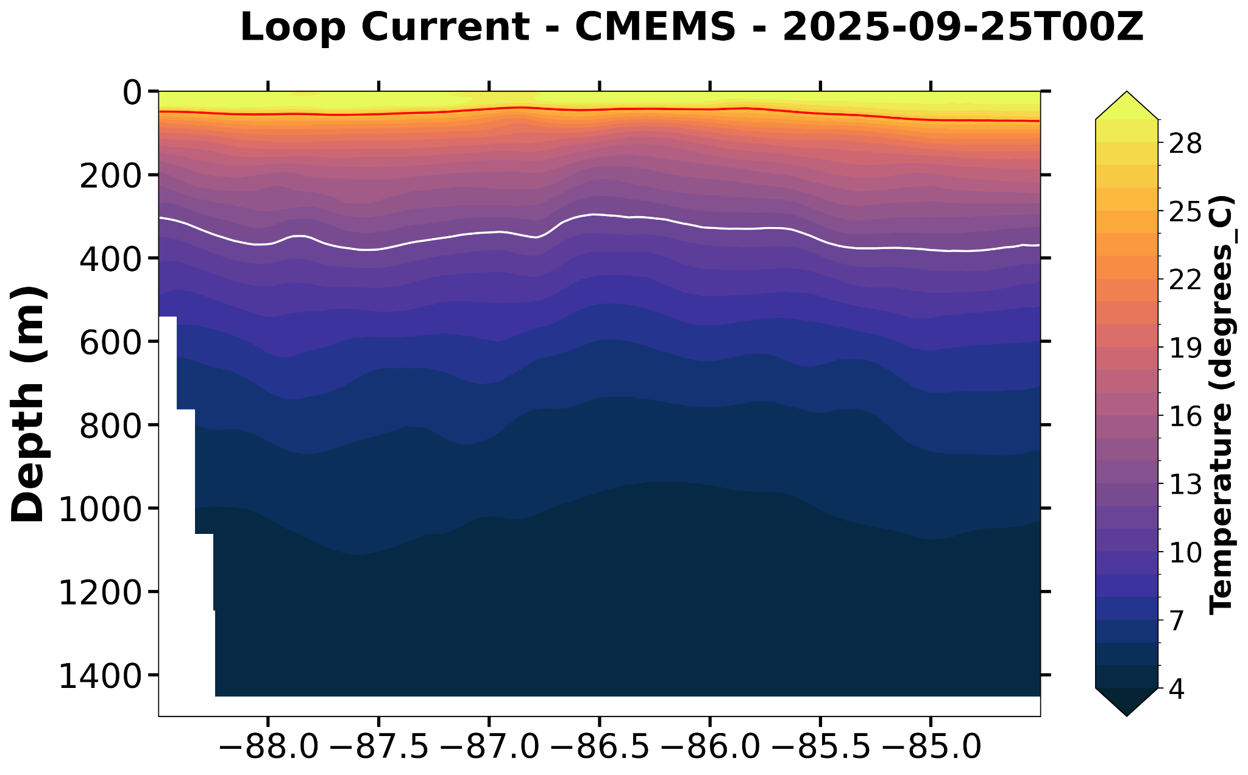
ESPC Not Available for this transect

Slide 35
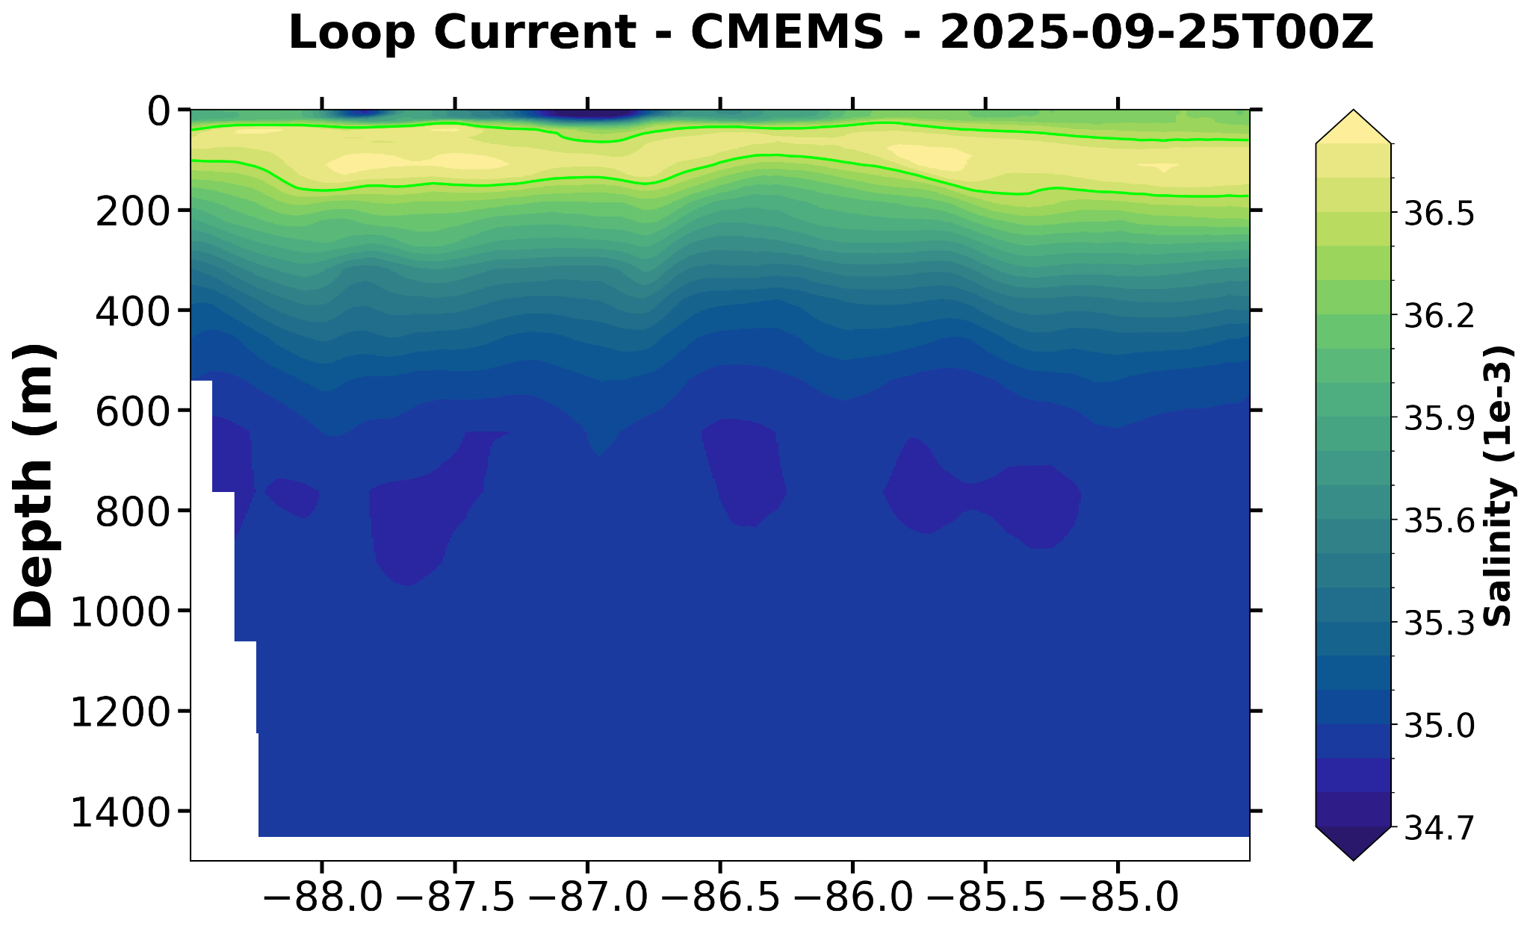
ESPC Not Available for this transect

