Slide 1
Overview for August 28, 2025

Slide 2
Navy ESPC version of HyCOM

Slide 3
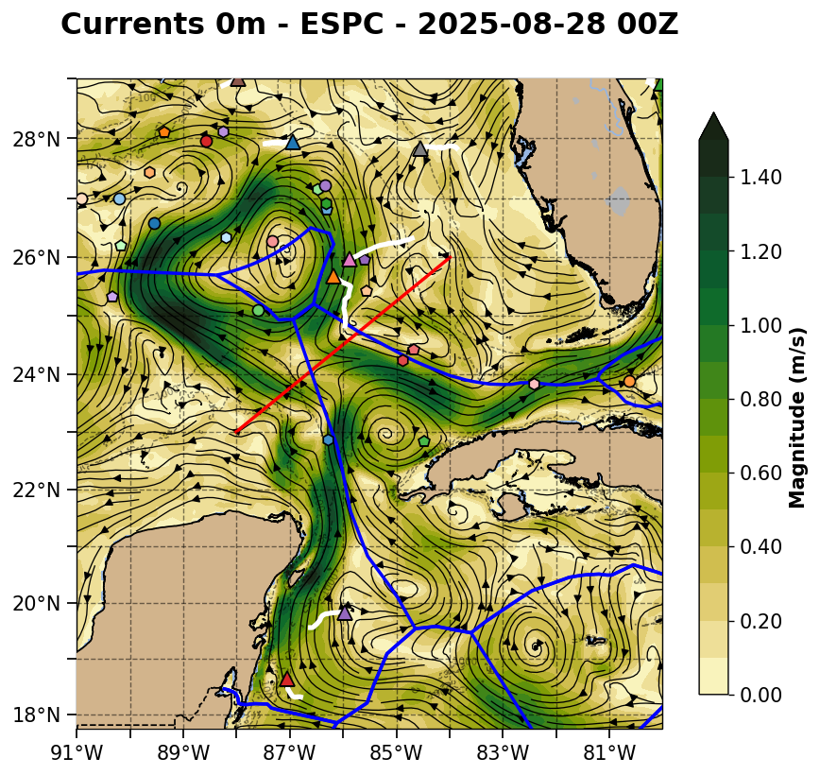
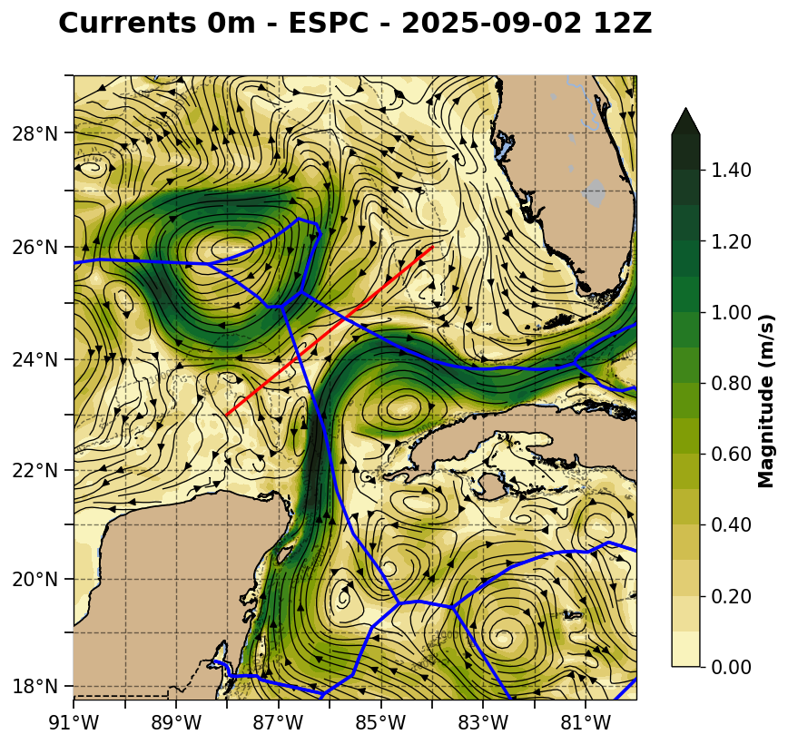

Slide 4
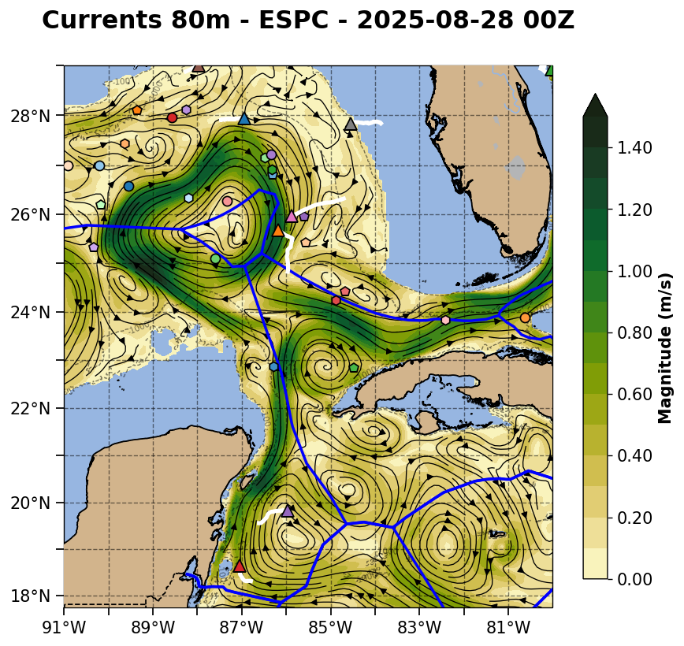
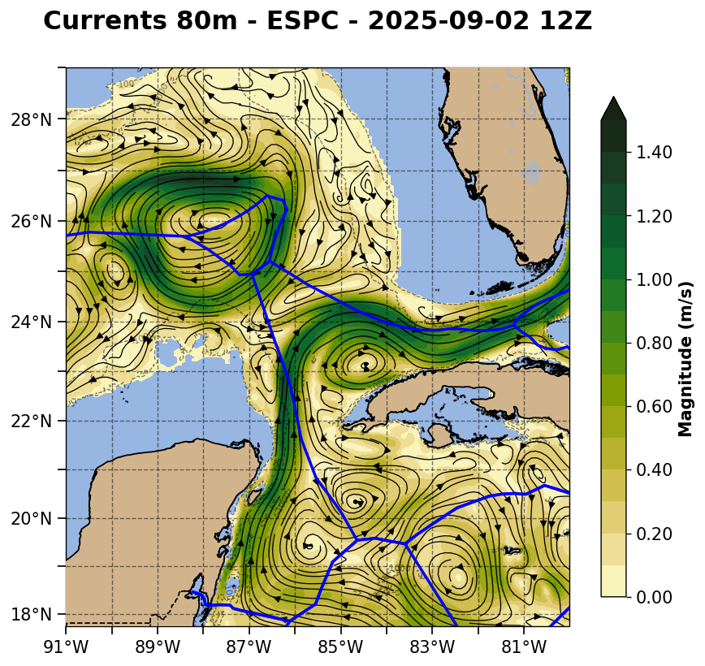

Slide 5
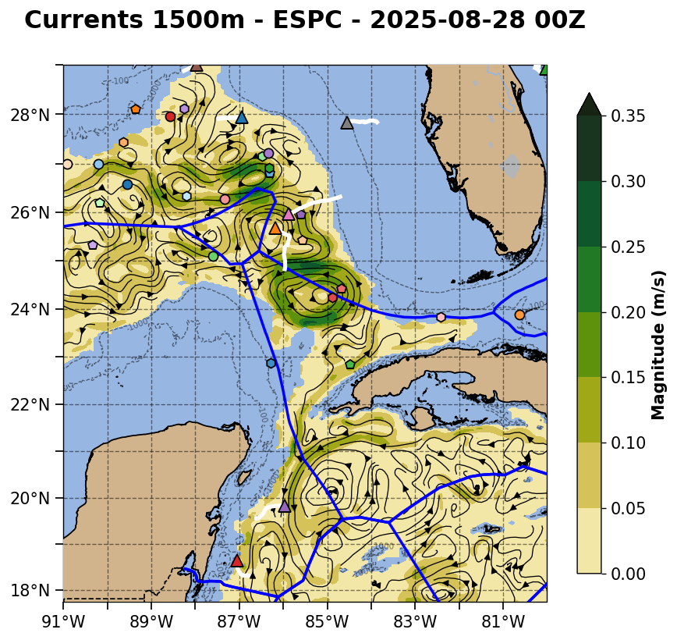
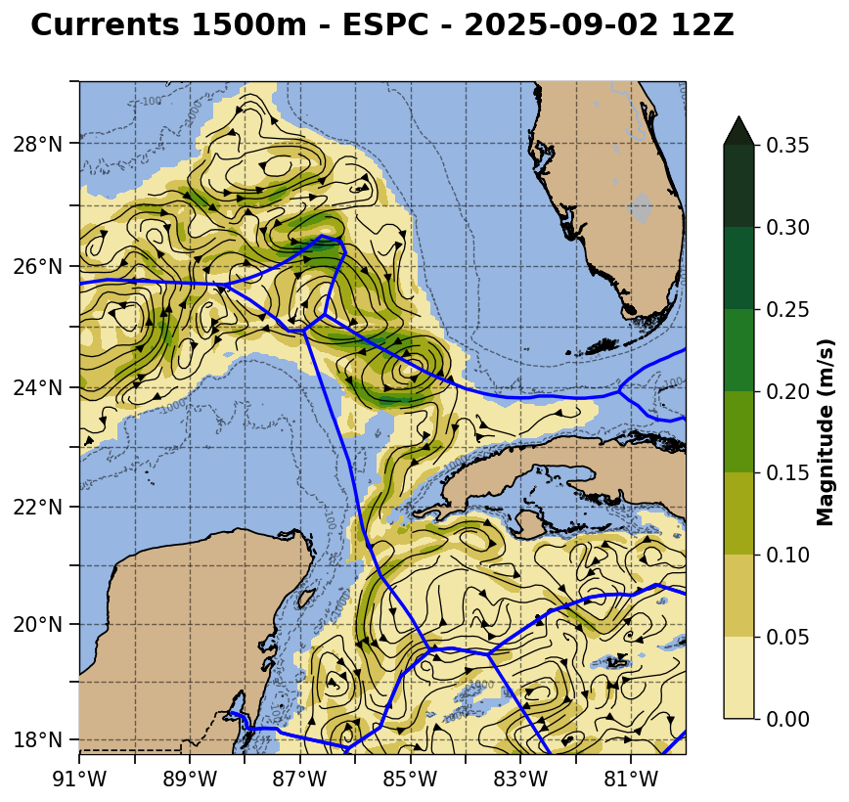

Slide 6
NOAA RTOFS version of HyCOM

Slide 7
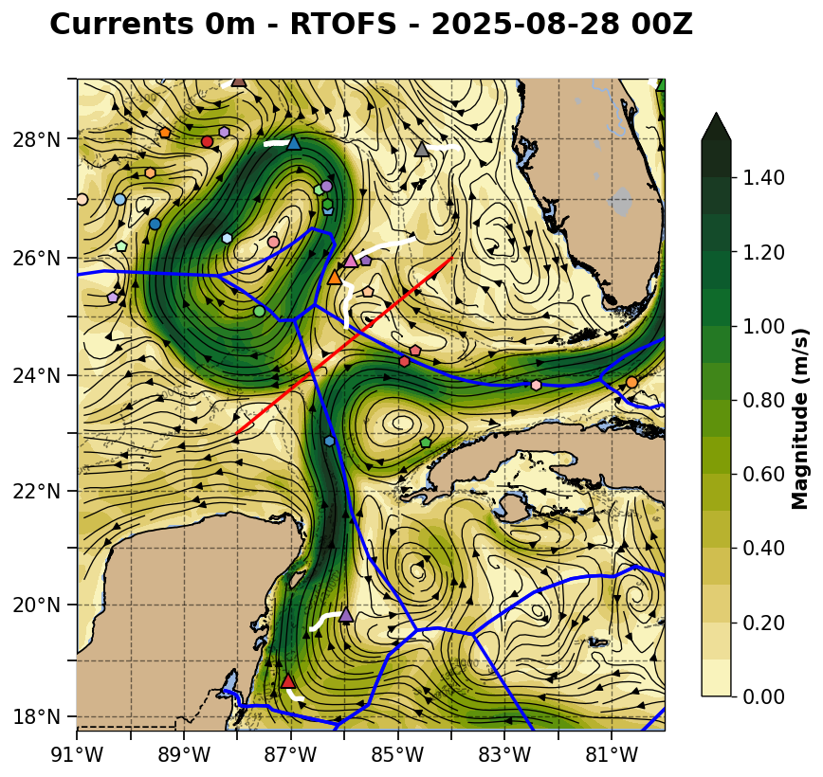
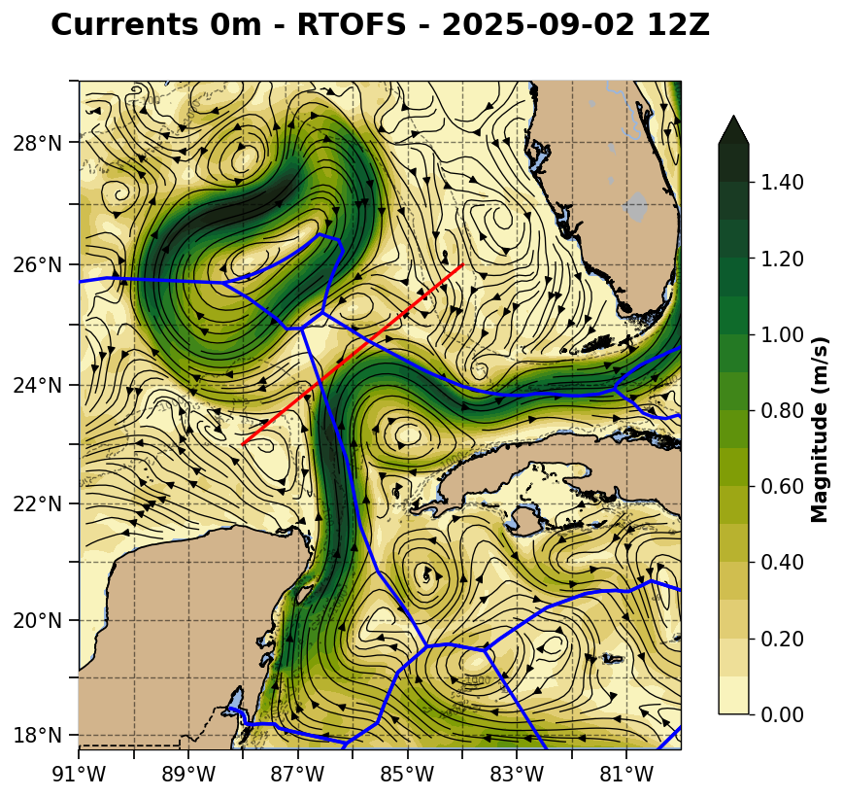

Slide 8
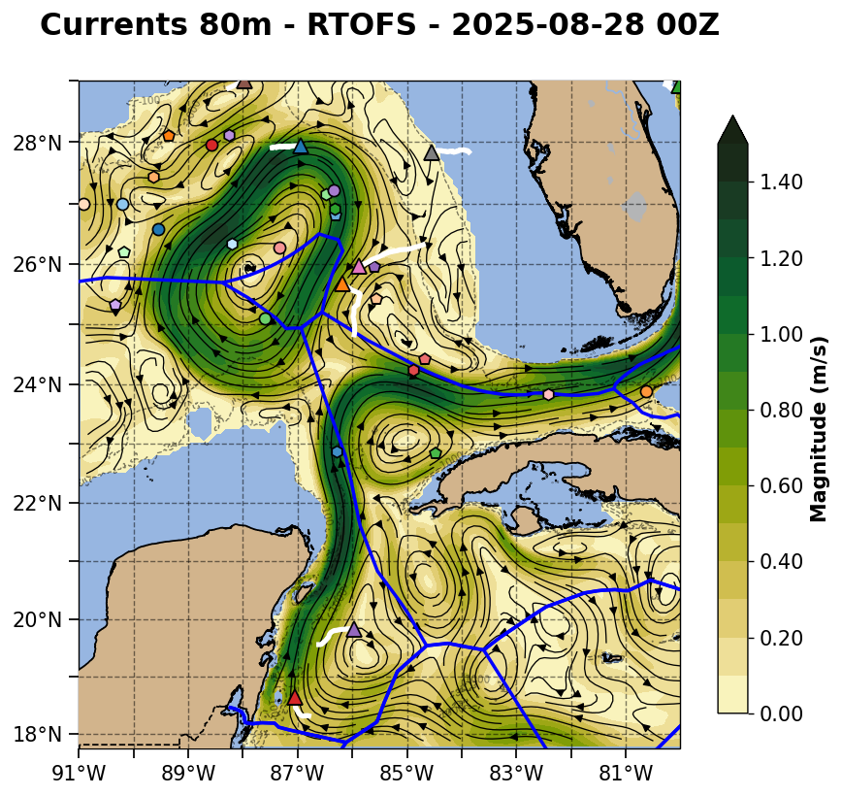
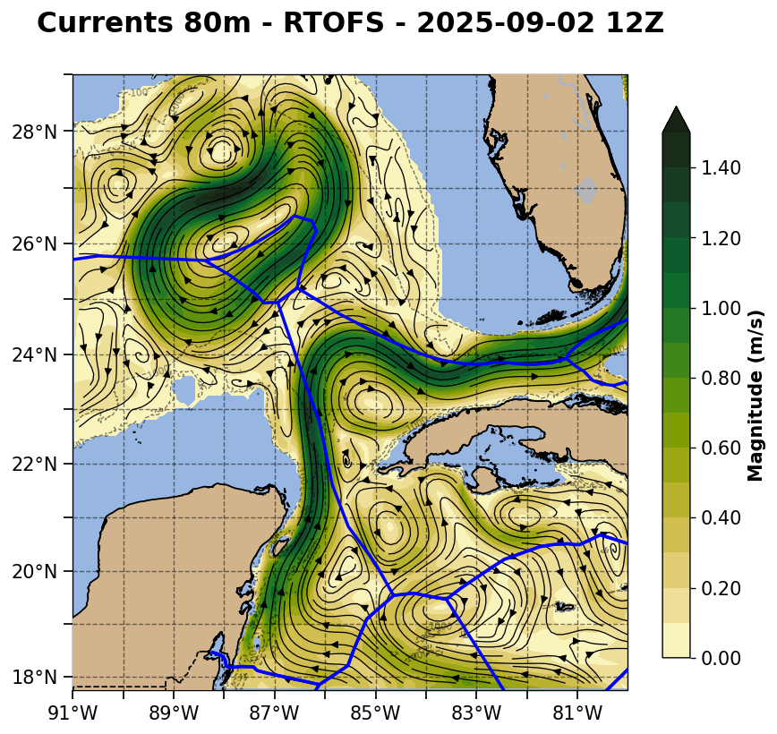

Slide 9
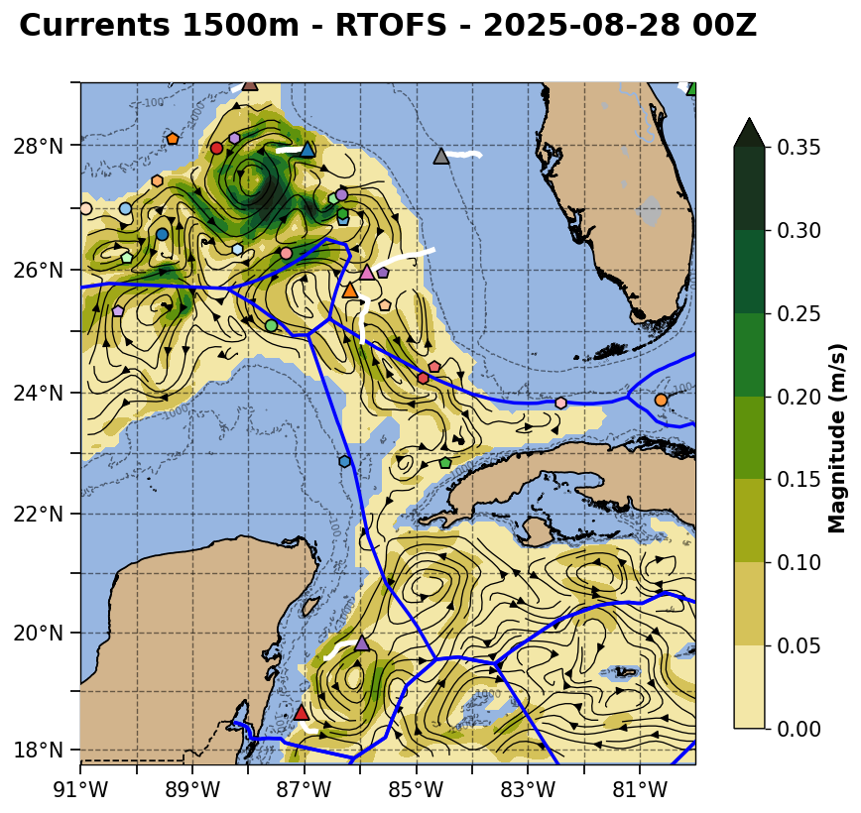
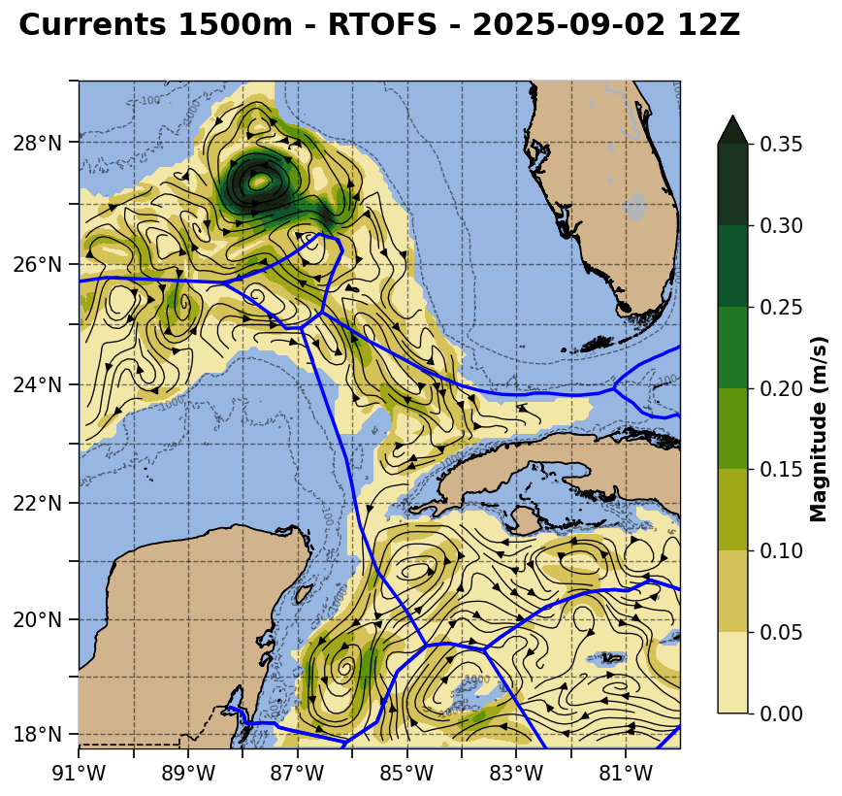

Slide 10
European CMEMS

Slide 11
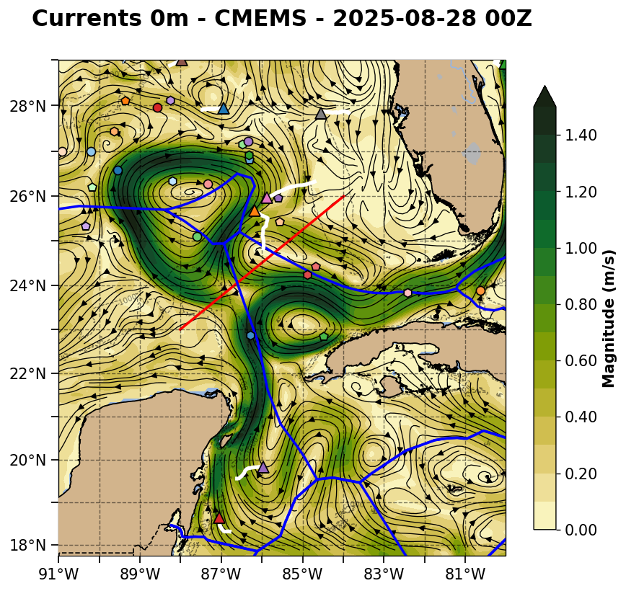
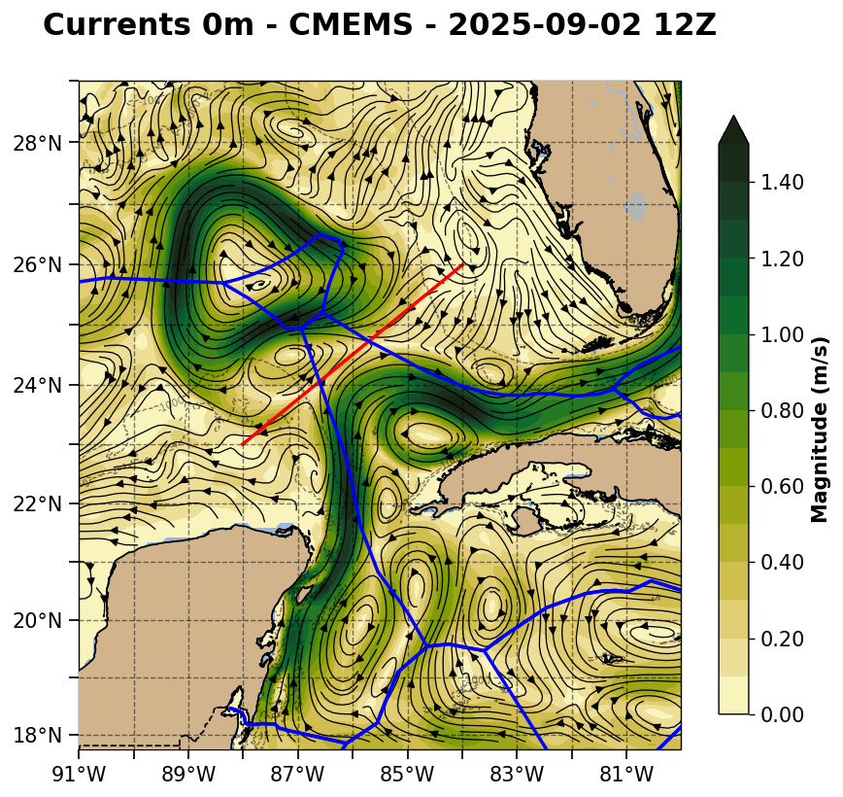

Slide 12
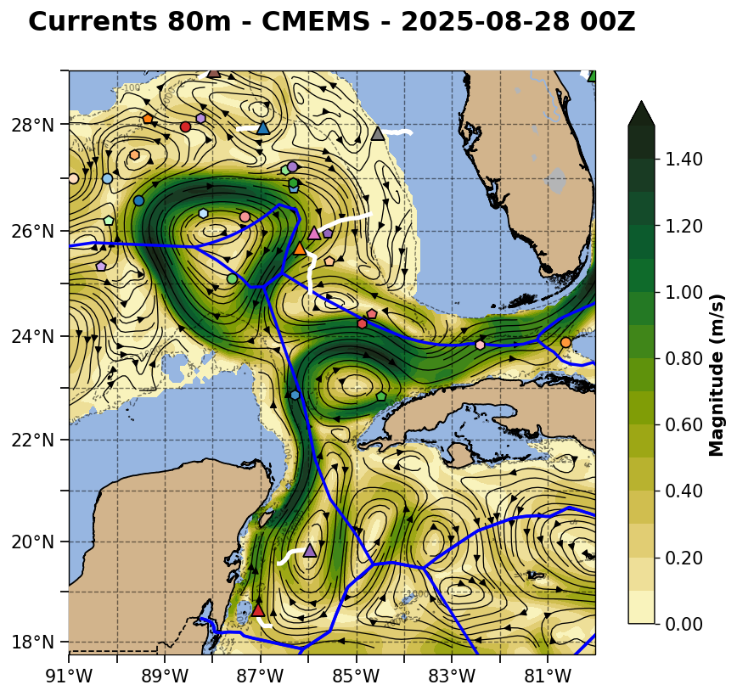
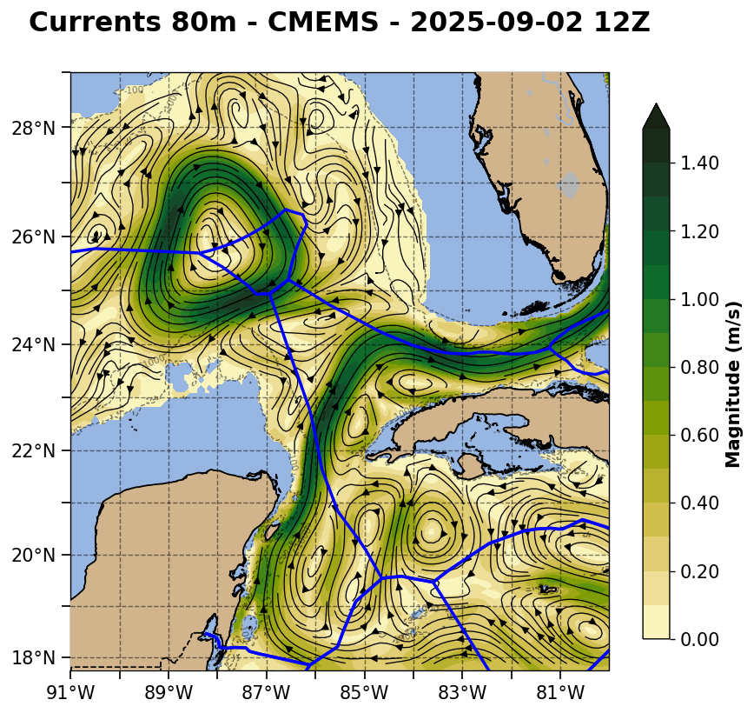

Slide 13
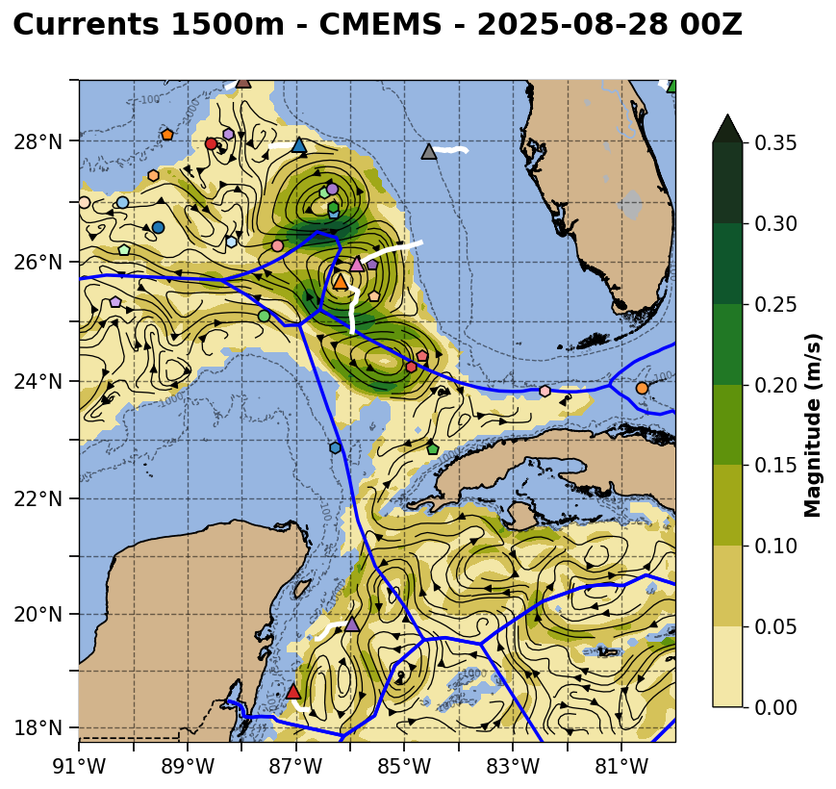
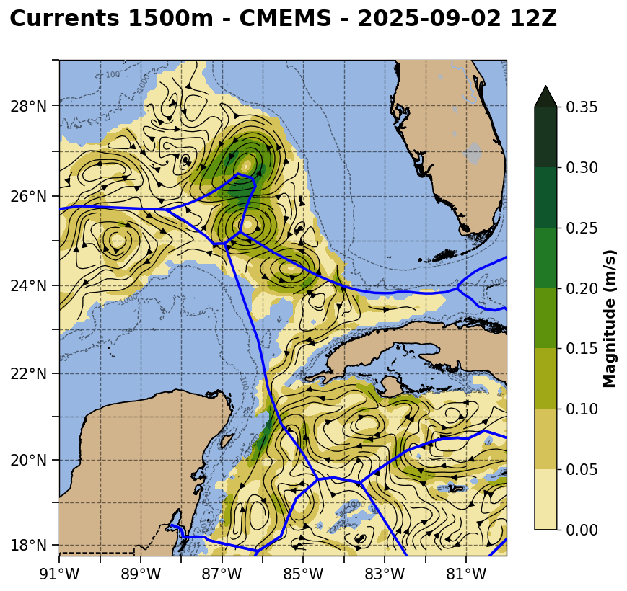

Slide 14
CNAPS version of ROMS

Slide 15
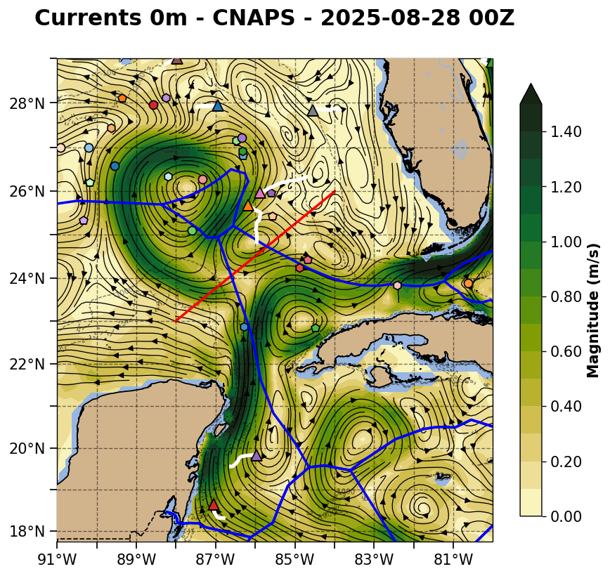
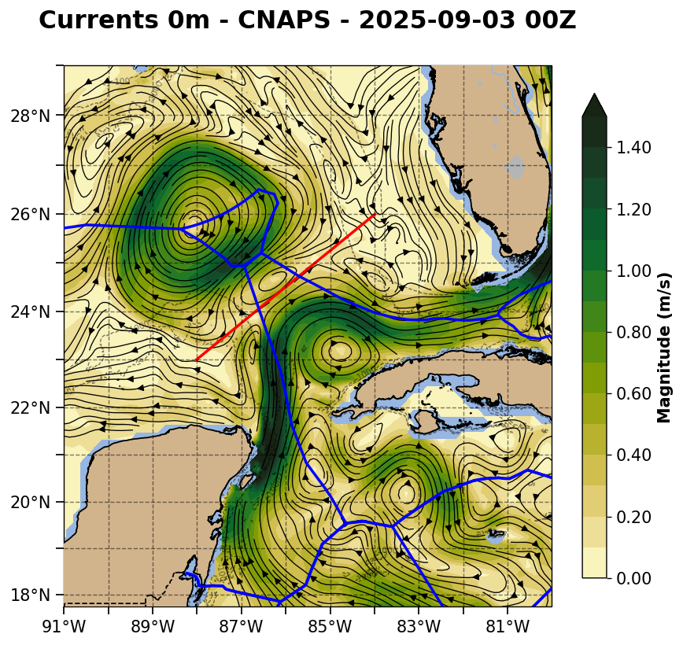

Slide 16
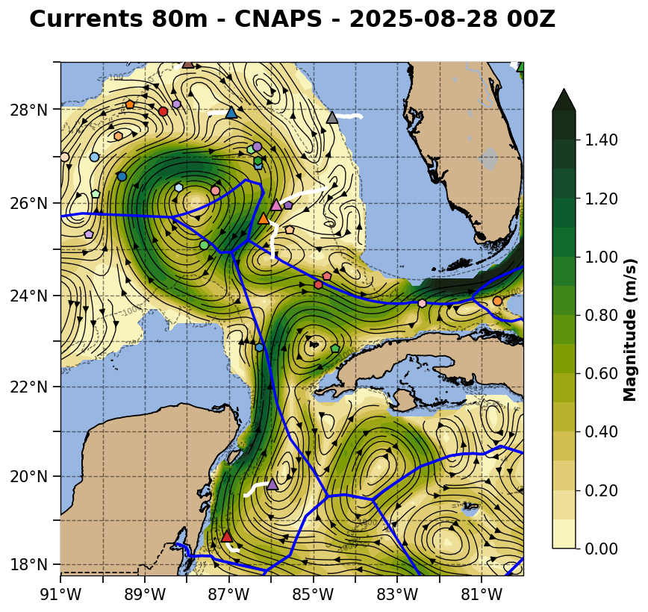
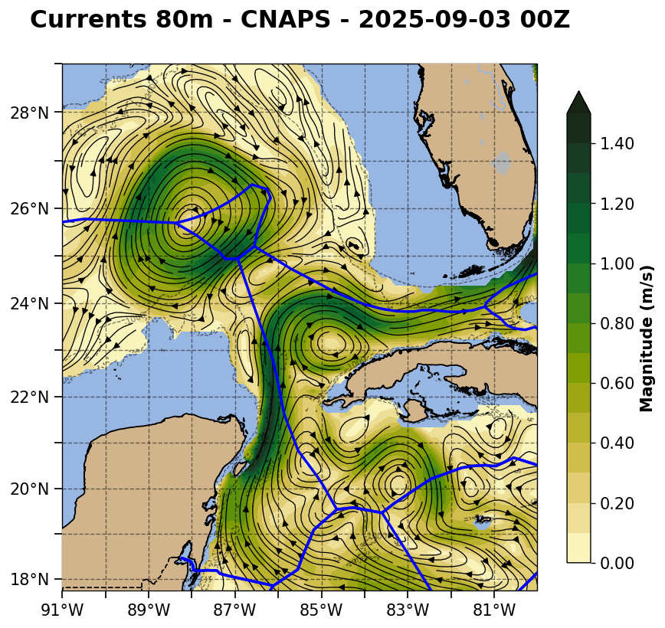

Slide 17
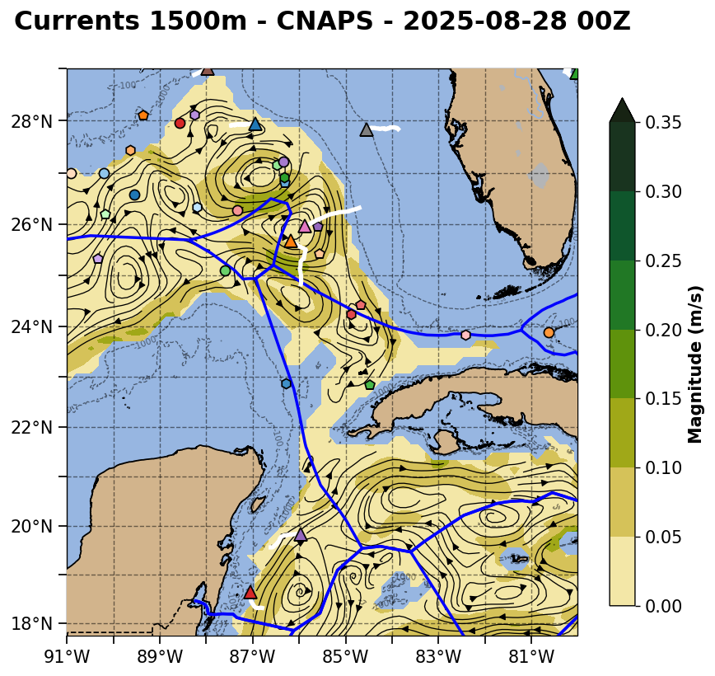
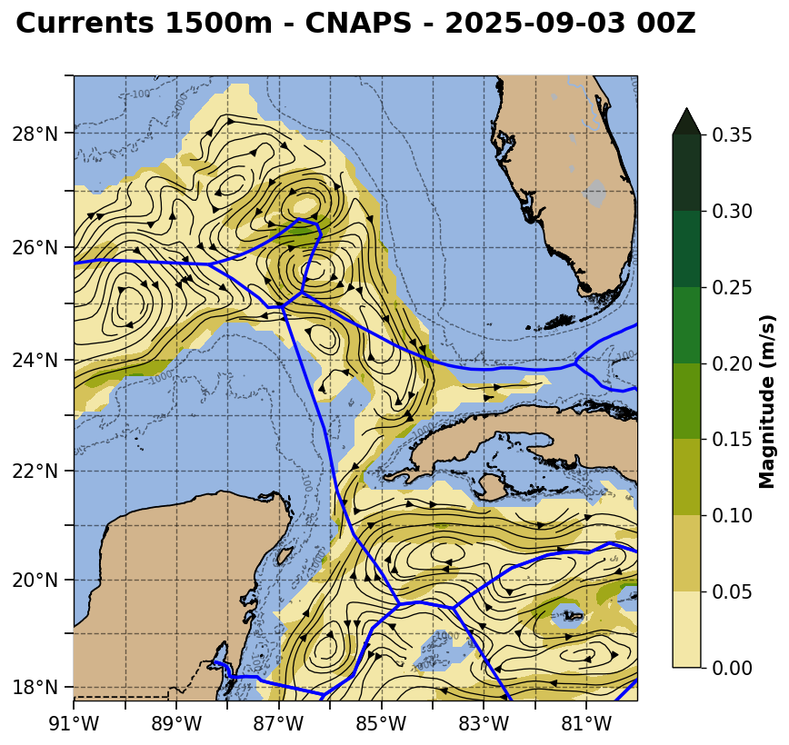

Slide 18
Current Speed Cross Sections through the pinch point and the eastern cyclonic eddy
ESPC - Strongest deep currents on the eastern side of the eastern cyclonic eddy, with deep currents extending deeper than the southward flowing Loop Current
RTOFS - Weakest deep currents on the east. Structure looks more like a meander than a cyclonic eddy
CMEMS - Deep currents in the cyclonic eddy look most like the southward flowing Loop Current in this nowcast. Currents speeds are in between the strong ESPC HyCOM and weak RTOFS HyCOM bookends.

Slide 19
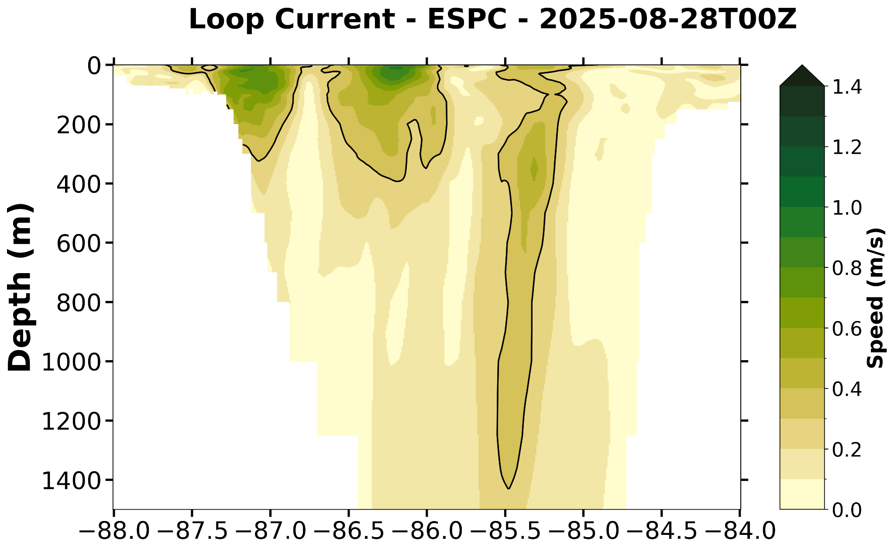
ESPC Not Available for this transect

Slide 20
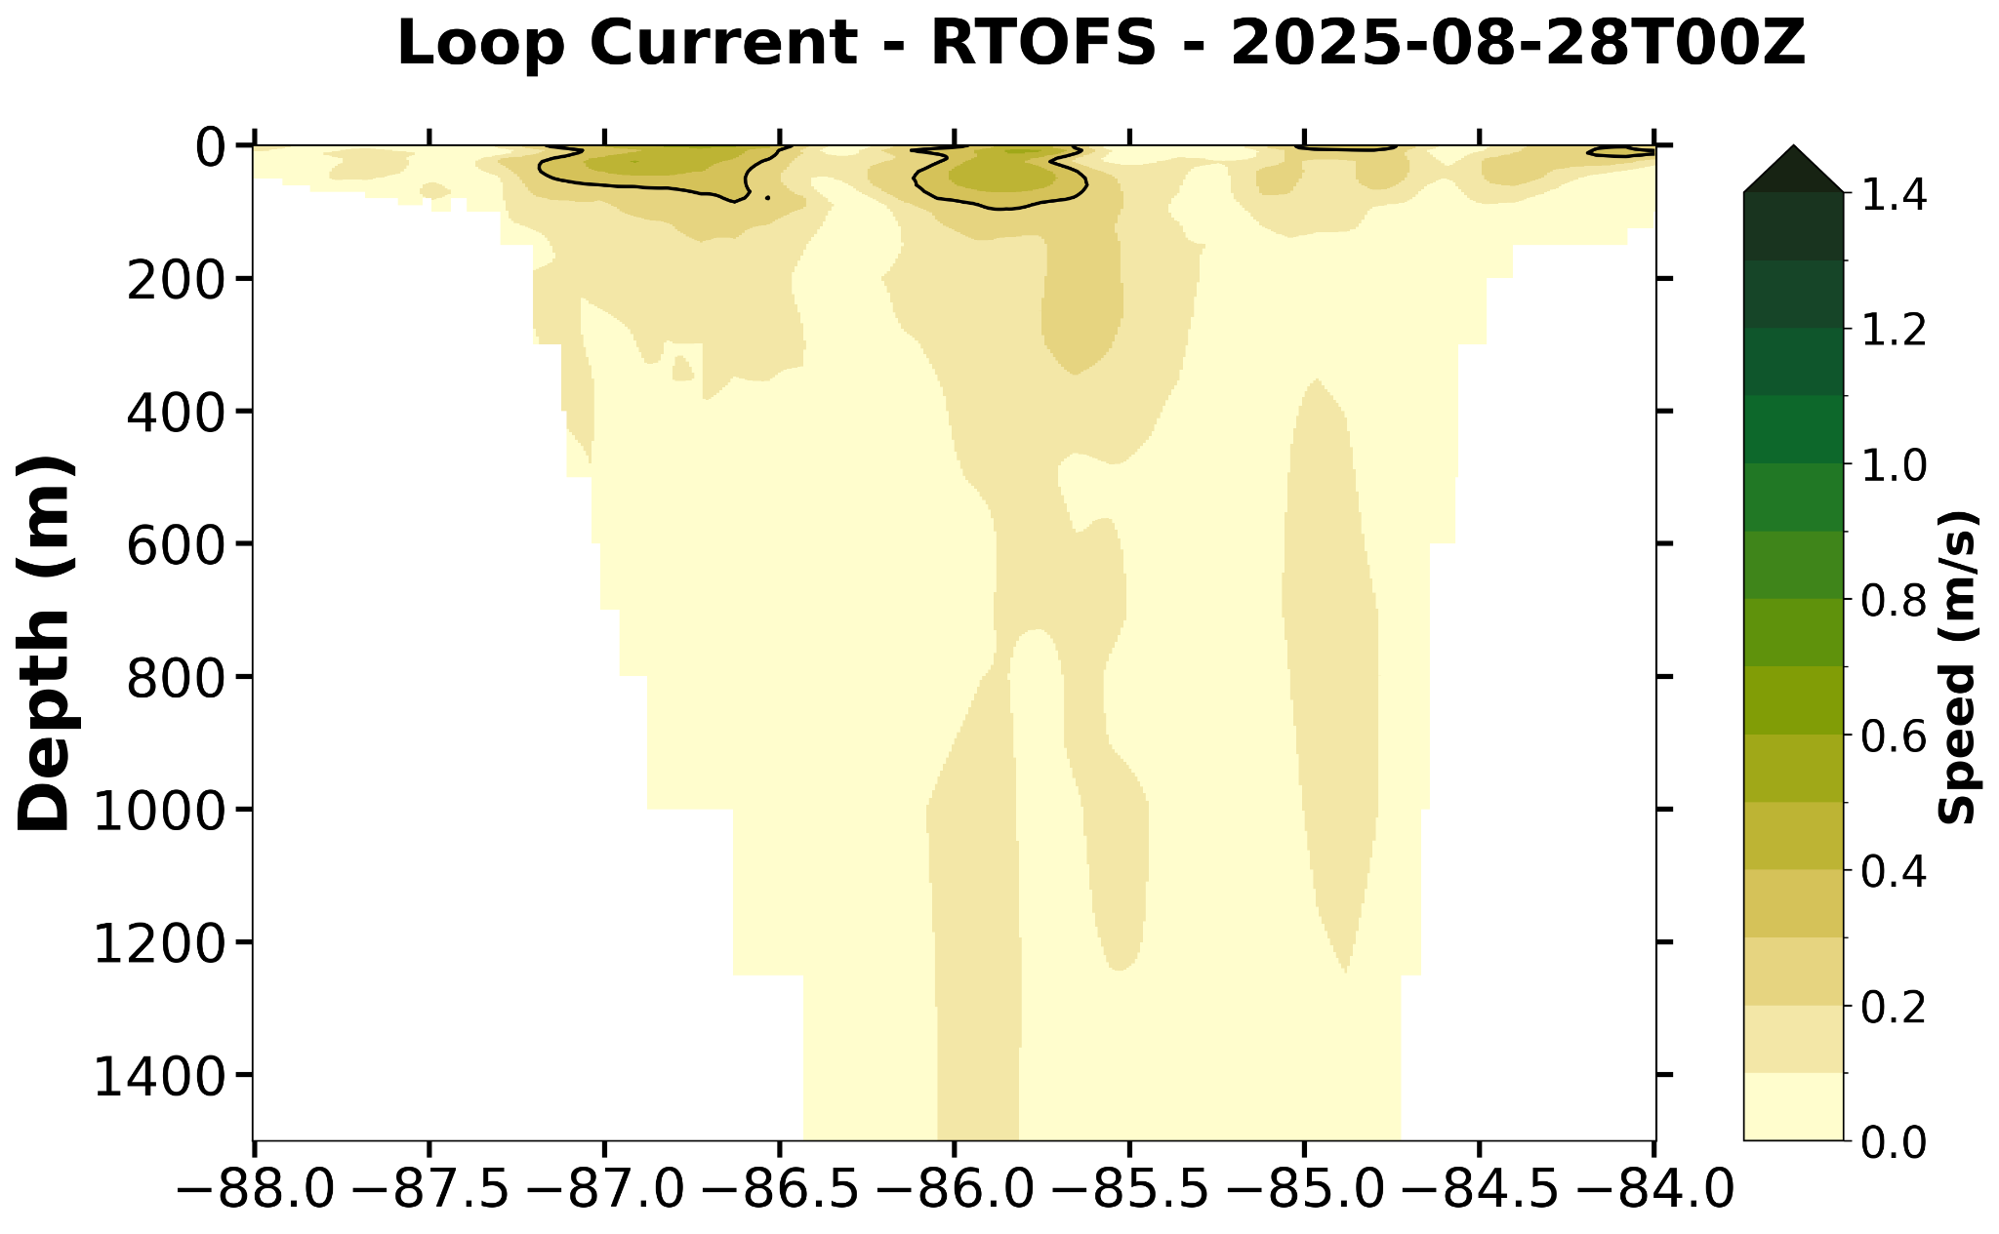

Slide 21
