Slide 1
Overview for August 21, 2025
All operational models are forecasting reformation of Eddy Feldman
Reformation faster in ESPC & CMEMS, and slower in RTOFS & CNAPS.
Difference is the location of the Cuban Anticyclone - more east in ESPC & CMEMS so the flow from Yucatan heads more east before heading around the Cuban Anticyclone; this cyclone is more west in RTOFS & CNAPS so there still is some connection of the Yucatan inflow with Eddy Feldman on the western side.

Slide 2
Navy ESPC version of HyCOM
Aug 21st nowcast 80 m currents more clearly show the cyclonic eddies on both western and eastern side of the Loop Current at the pinch point
Aug 27th forecast 0 m currents more clearly show the two cyclonic eddies approaching each other, more merged at 80 m to form a larger blocking eddy.
CE on the eastern side of the Loop is south of glider RU38 (compare with CNAPS where the large eastern eddy is north of RU38)
Yucatan anticyclone is much weaker, some may have moved north and merged with the Cuban Anticyclone.
1500 m currents have a strong cyclonic eddy under the eastern surface cyclonic eddy, and very weak cyclonic circulation under the northwest surface cyclonic eddy

Slide 3
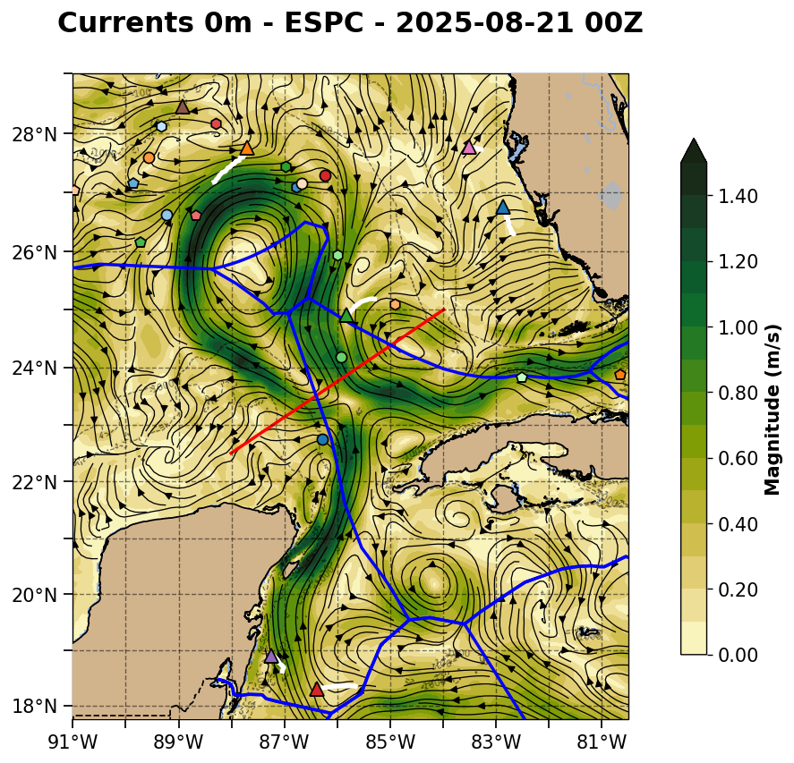
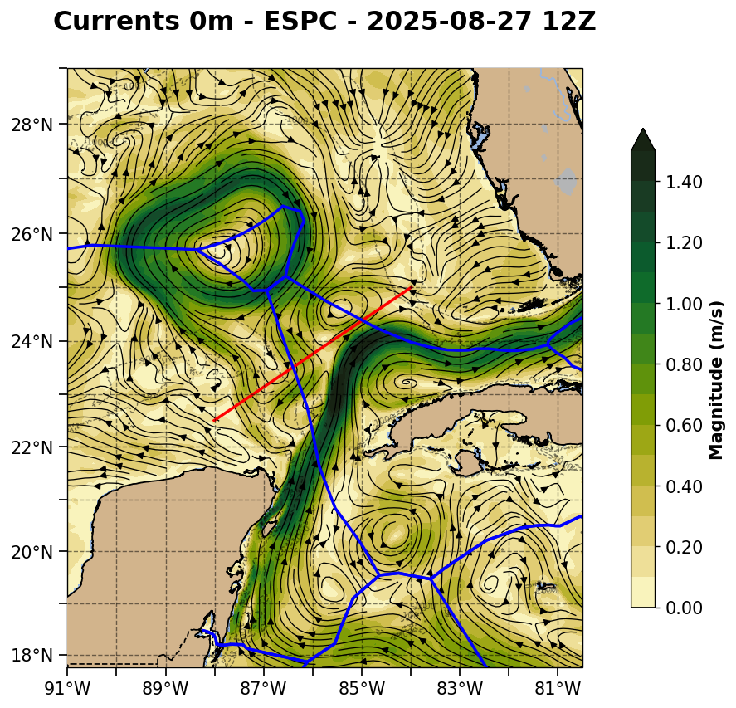

Slide 4
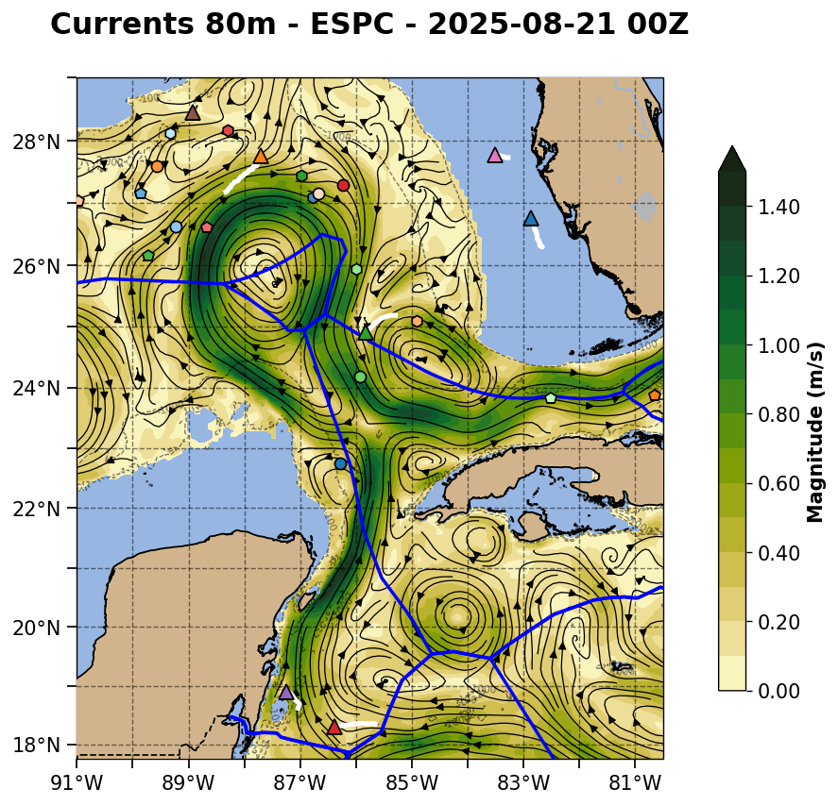
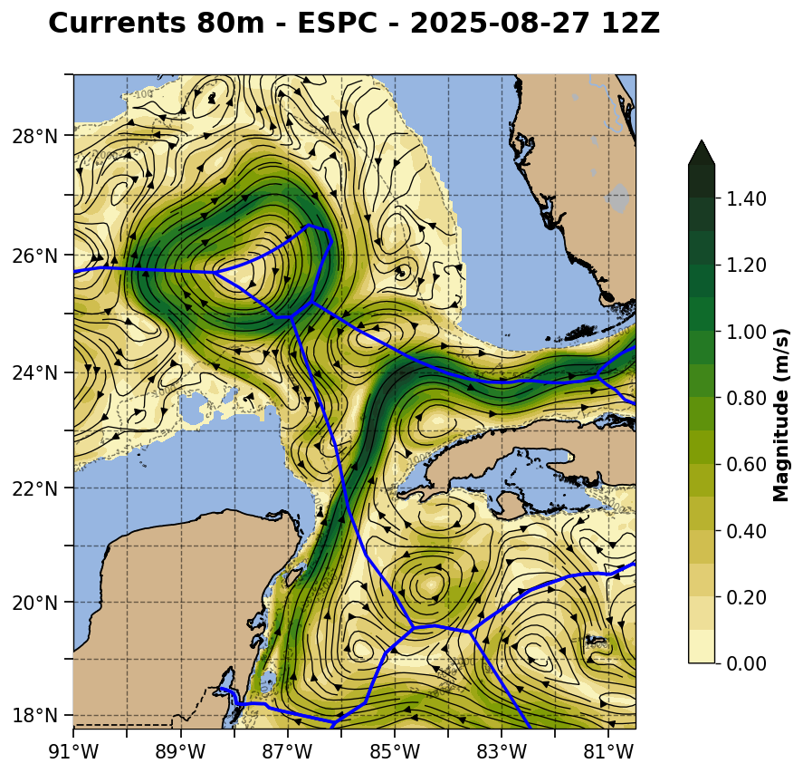

Slide 5
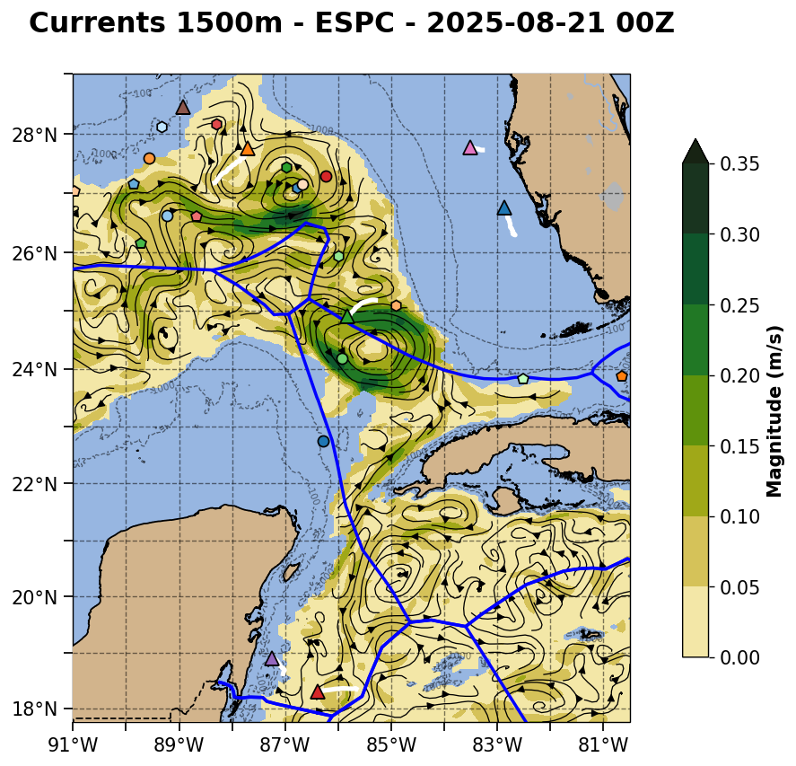
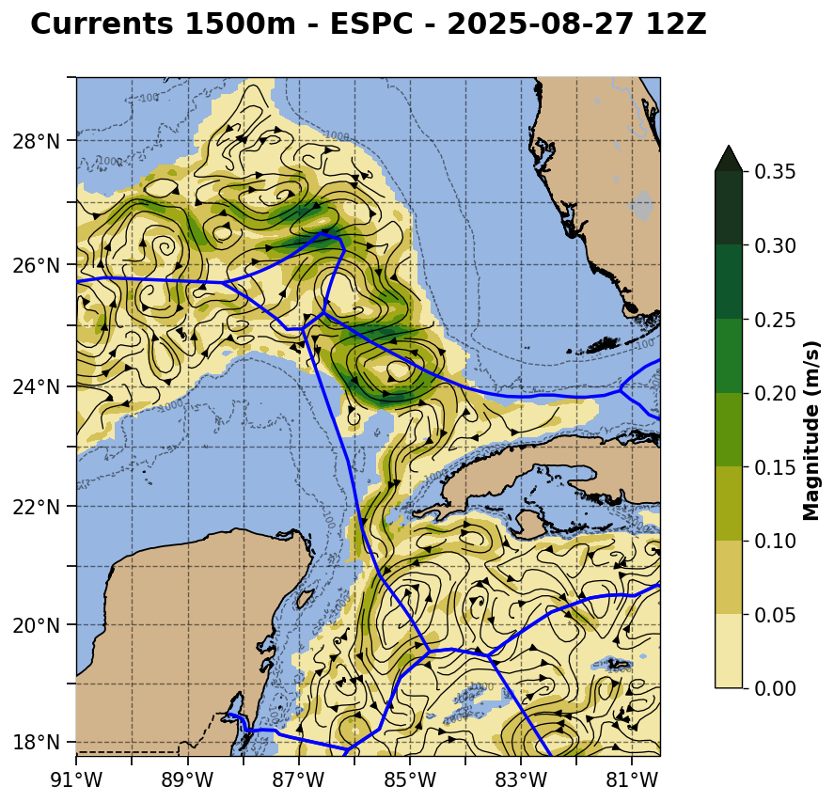
Forecast goes here

Slide 6
NOAA RTOFS version of HyCOM
Aug 21st nowcast looks more like Loop Current meanders on both western and eastern sides of the Loop Current at the pinch point
Aug 27th forecast 80 m currents have evolved into a pair of cyclonic eddies as the pinch point is closing.
Strong CE on the eastern side of the Loop in RTOFS is two weaker eddies in this nowcast (see 80 m currents), one to the south of RU38 as in ESPC and one to the north of RU38 as CNAPS.
Much stronger interactions between the Yucatan Anticyclone south of Cuba and the Cuban Anticylone north of Cuba.
1500 m currents have a week cyclonic eddy under the eastern surface cyclonic eddy, and a very strong cyclonic eddy on the northwest side of the Loop under the northwest cyclonic eddy. Opposite of ESPC.

Slide 7
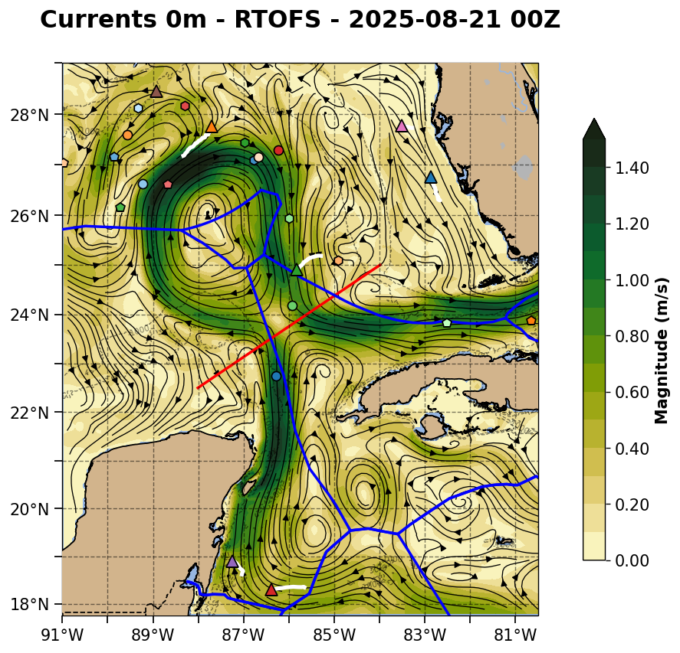
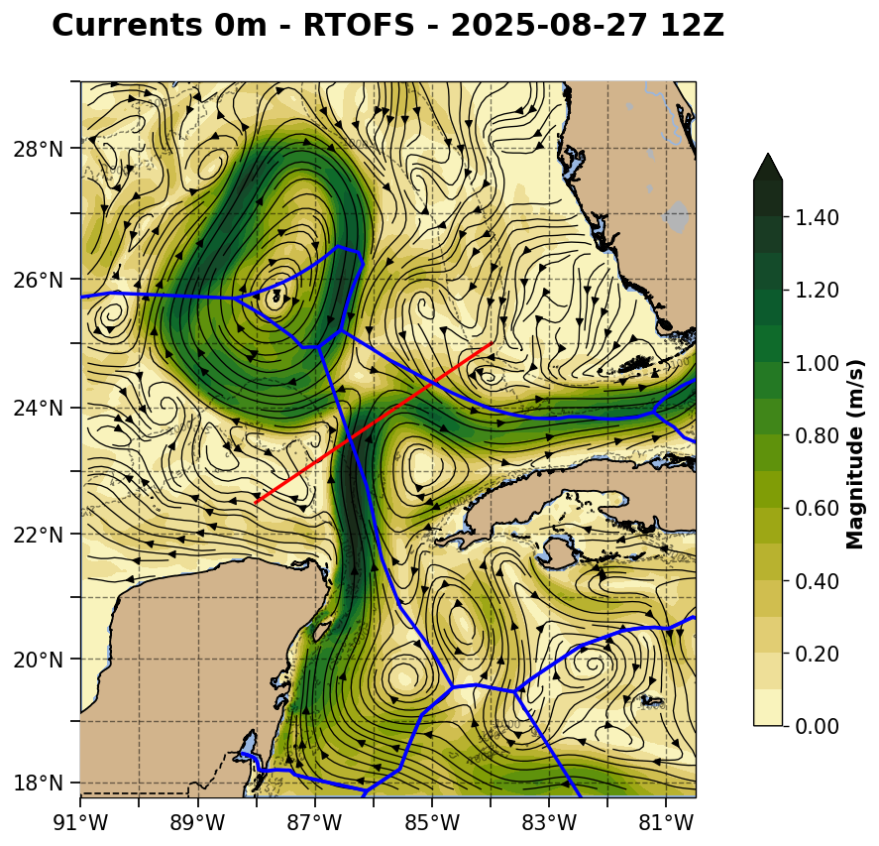

Slide 8
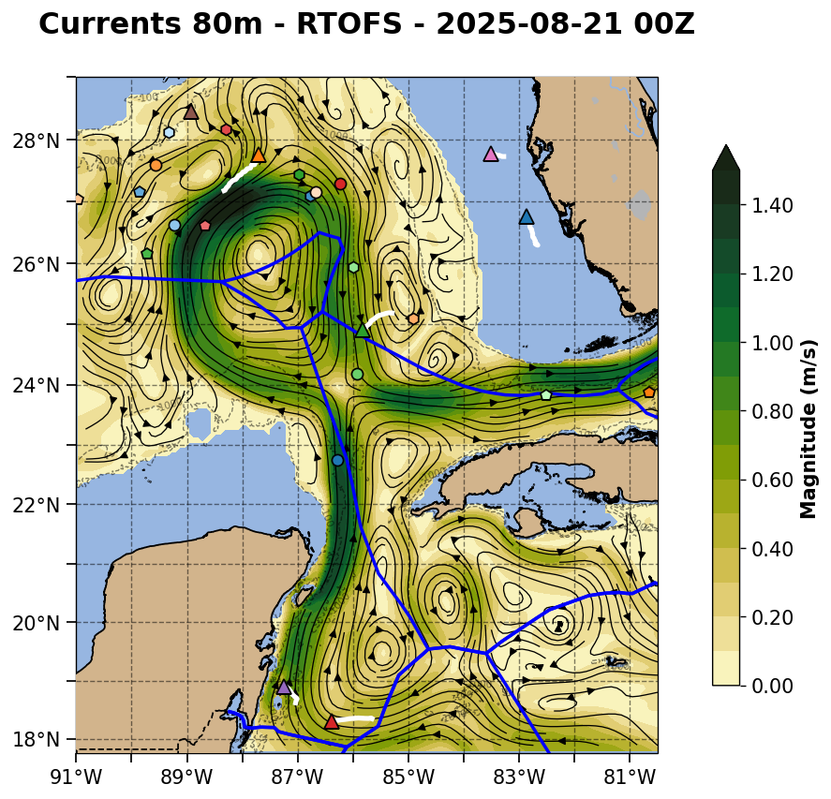
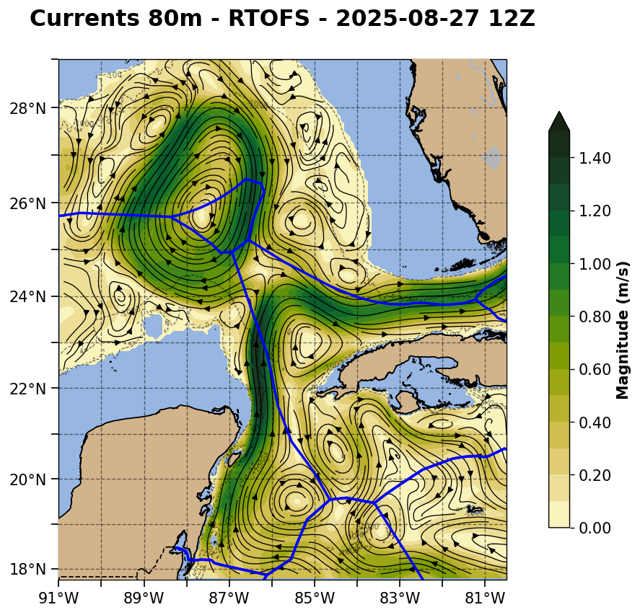

Slide 9
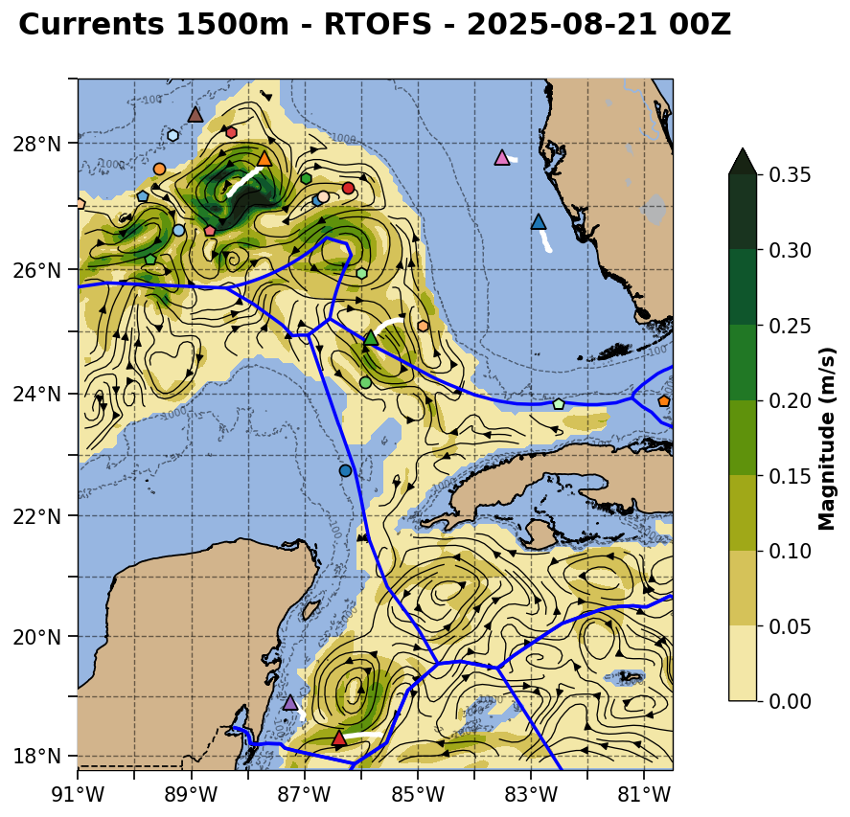
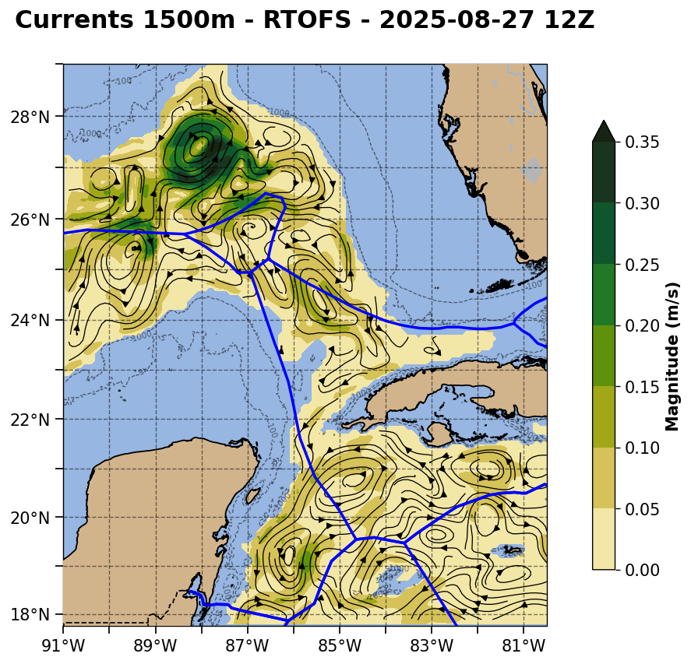

Slide 10
European CMEMS
Aug 21st nowcast has the strongest cyclonic eddies on both the western and eastern sides of the Loop Current at the pinch point
In the Aug 27th forecast, the eastern eddy grows into a blocking eddy and the western eddy remains intact to the south.
Strong CE on the eastern side of the Loop in CMEMS is south of RU38 as in ESPC.
Yucatan anticyclone remains strong and in a similar location as we have seen for weeks.
1500 m currents have a line of strong eddies on the eastern side of the Loop, with the two cyclonic eddies on the north and south, and the anticyclonic eddy in the middle. The southern cyclonic eddy is under the surface blocking eddy.

Slide 11
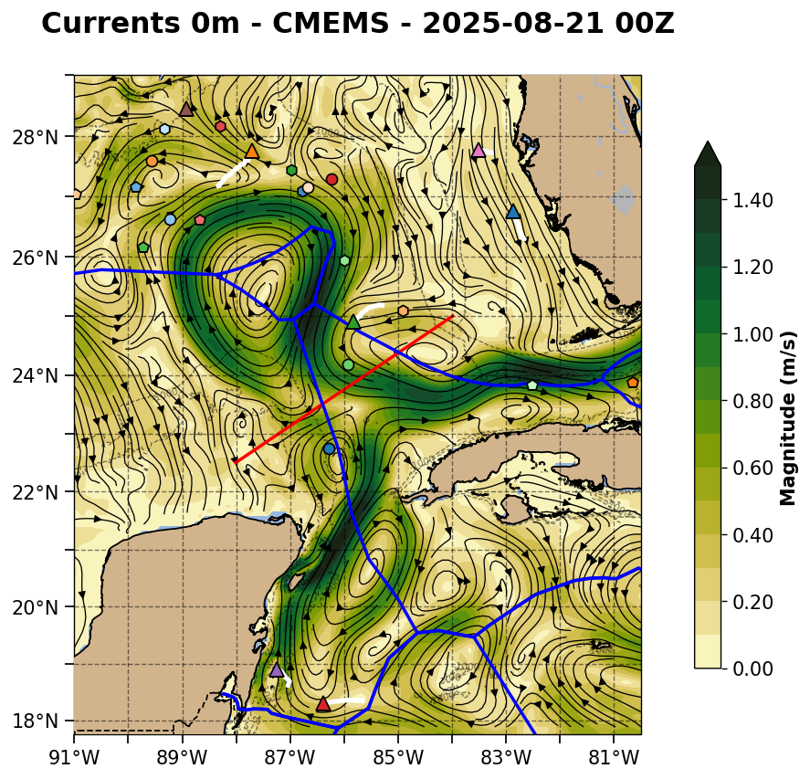
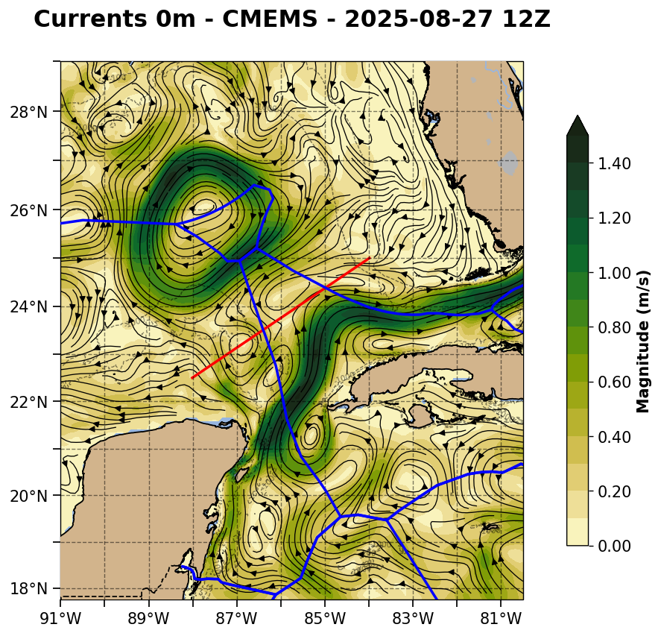

Slide 12
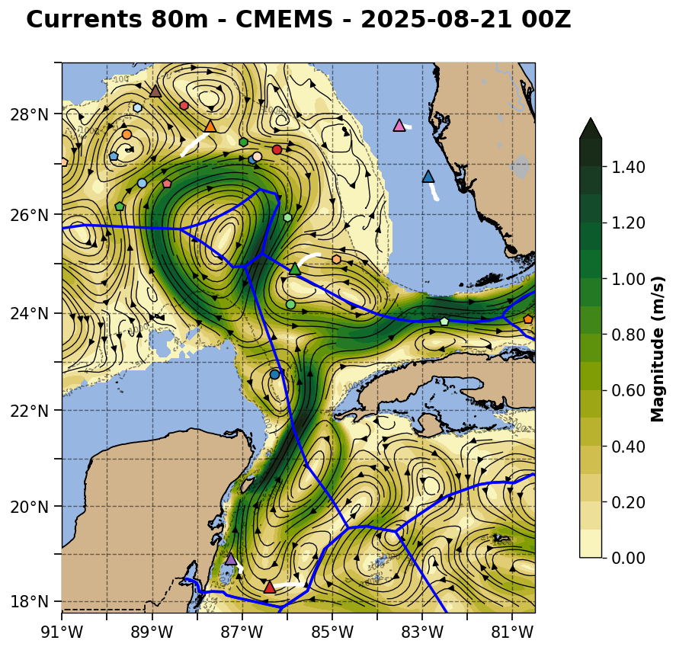
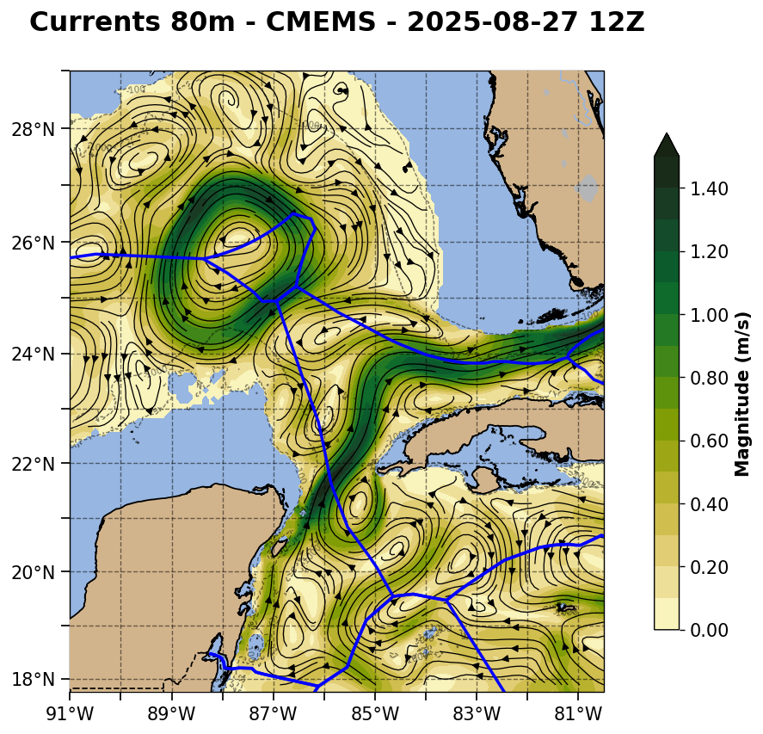

Slide 13
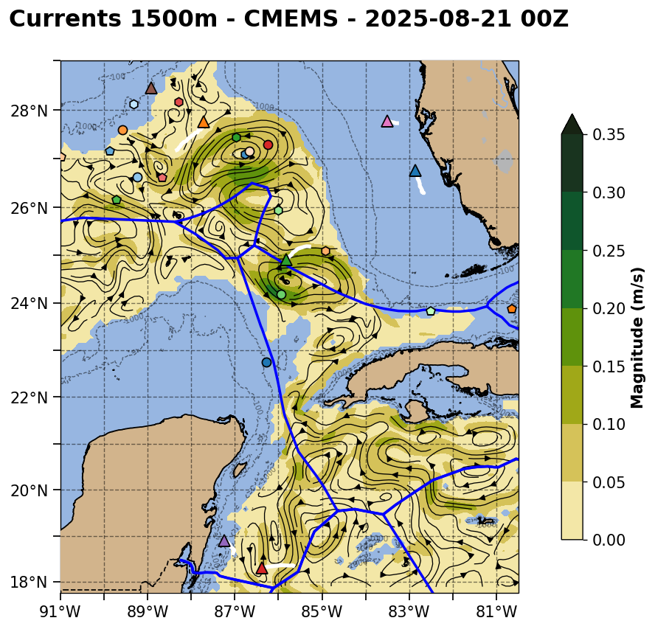
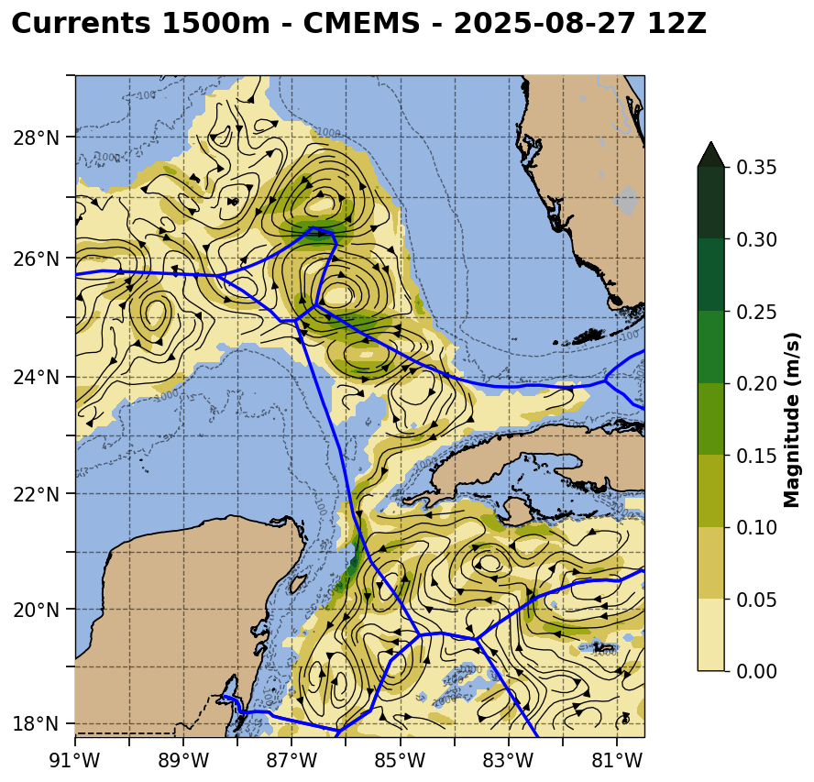
Forecast goes here

Slide 14
CNAPS version of ROMS
Aug 21st nowcast has cyclonic eddies on both the western and eastern sides of the Loop Current at the pinch point, but the eastern eddy is displaced farther north from the ESPC and CMEMS nowcasts
In the Aug 27th forecast, Eddy Feldman reformation is slower, with the western and eastern cyclonic eddies starting farther apart in the nowcast
Strong CE on the eastern side of the Loop in CMEMS is north of RU38. The cyclonic eddy on the northwest side with the Navy glider is well developed and influencing the northern side of Eddy Feldman
Both the Yucatan anticyclone (south of Cuba) and Cuban Anticyclone (north Cuba) remain strong and distinct on their respective sides of Cabo de San Antonio
1500 m currents are similar to CMEMS, with a line of strong eddies on the eastern side of the Loop, with the two cyclonic eddies on the north and south, and the anticyclonic eddy in the middle. The southern cyclonic eddy is under the surface blocking eddy.

Slide 15
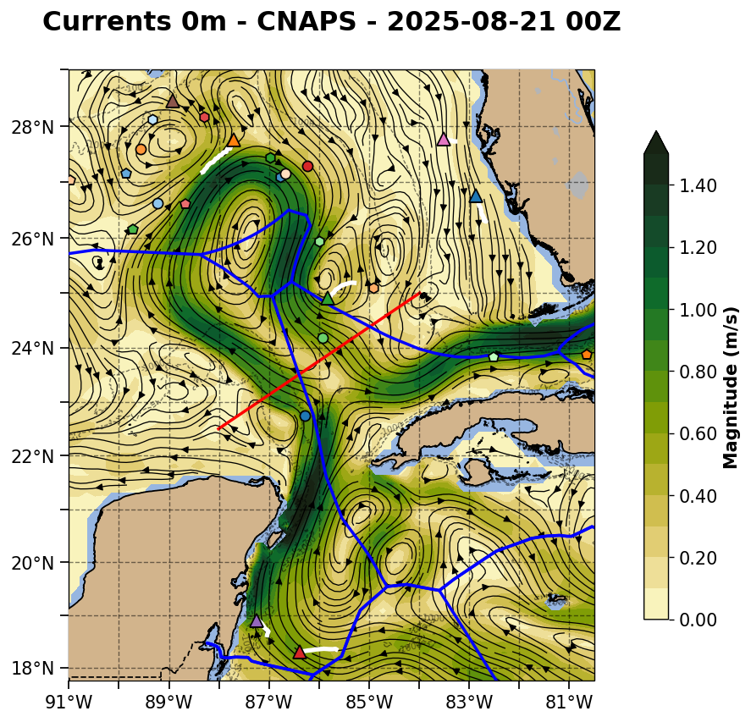
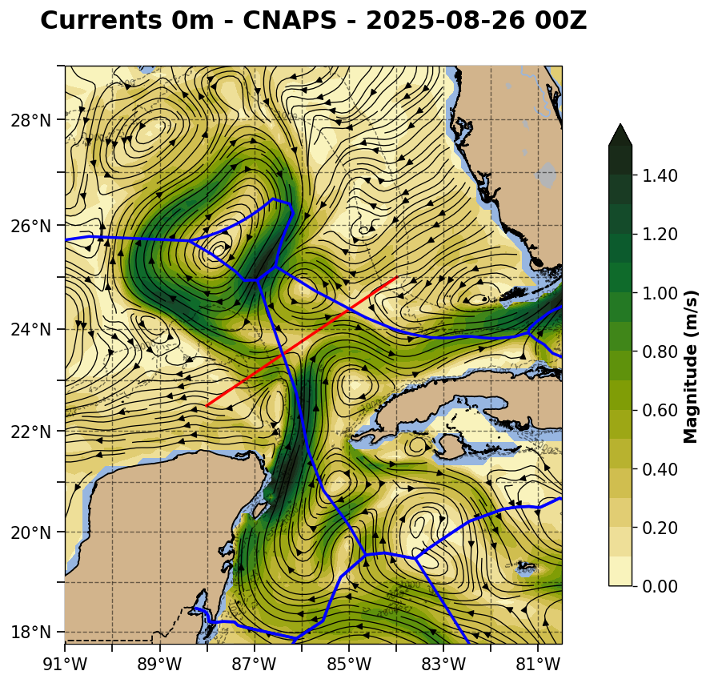

Slide 16
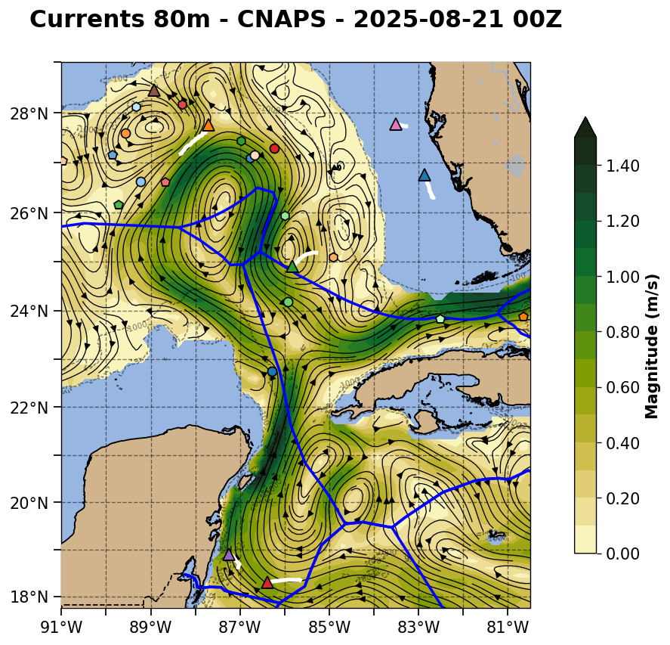
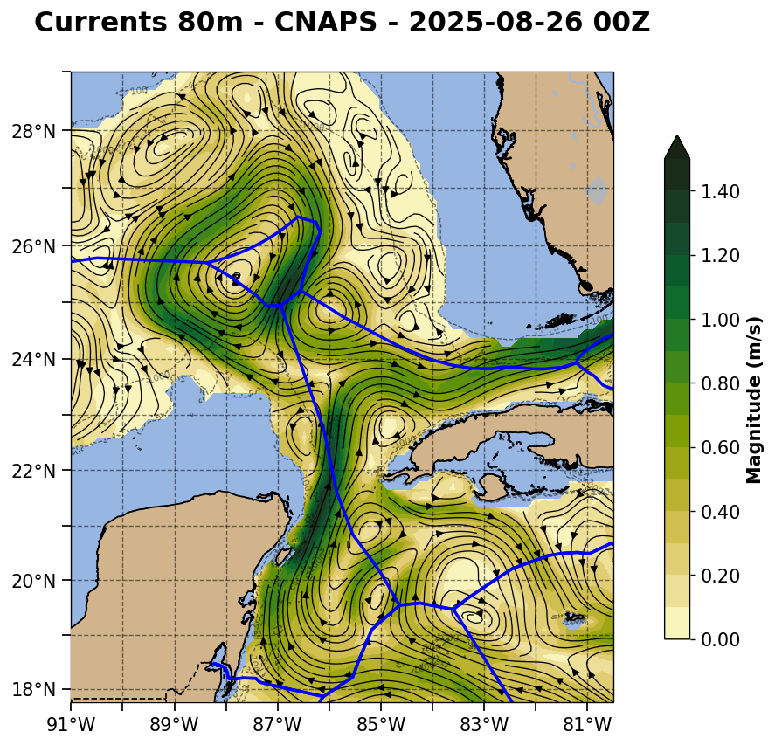

Slide 17
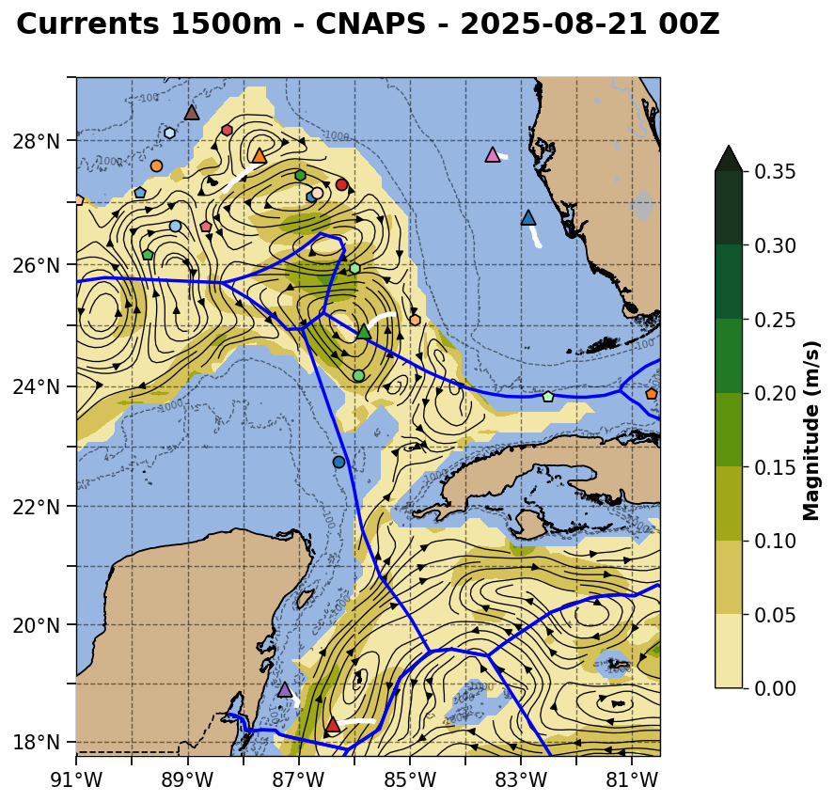
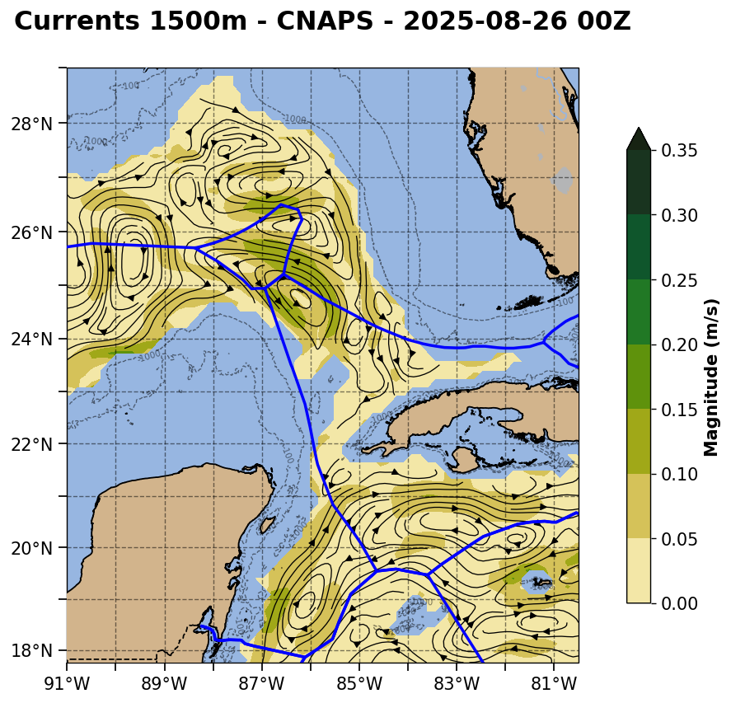
Forecast goes here

Slide 18
Current Speed Cross Sections through the pinch point and the eastern cyclonic eddy
ESPC - Strongest deep currents on the eastern side of the eastern cyclonic eddy, with deep currents extending deeper than the southward flowing Loop Current
RTOFS - Weakest deep currents on the east. Structure looks more like a meander than a cyclonic eddy
CMEMS - Deep currents in the cyclonic eddy look most like the southward flowing Loop Current in this nowcast. Currents speeds are in between the strong ESPC HyCOM and weak RTOFS HyCOM bookends.

Slide 19
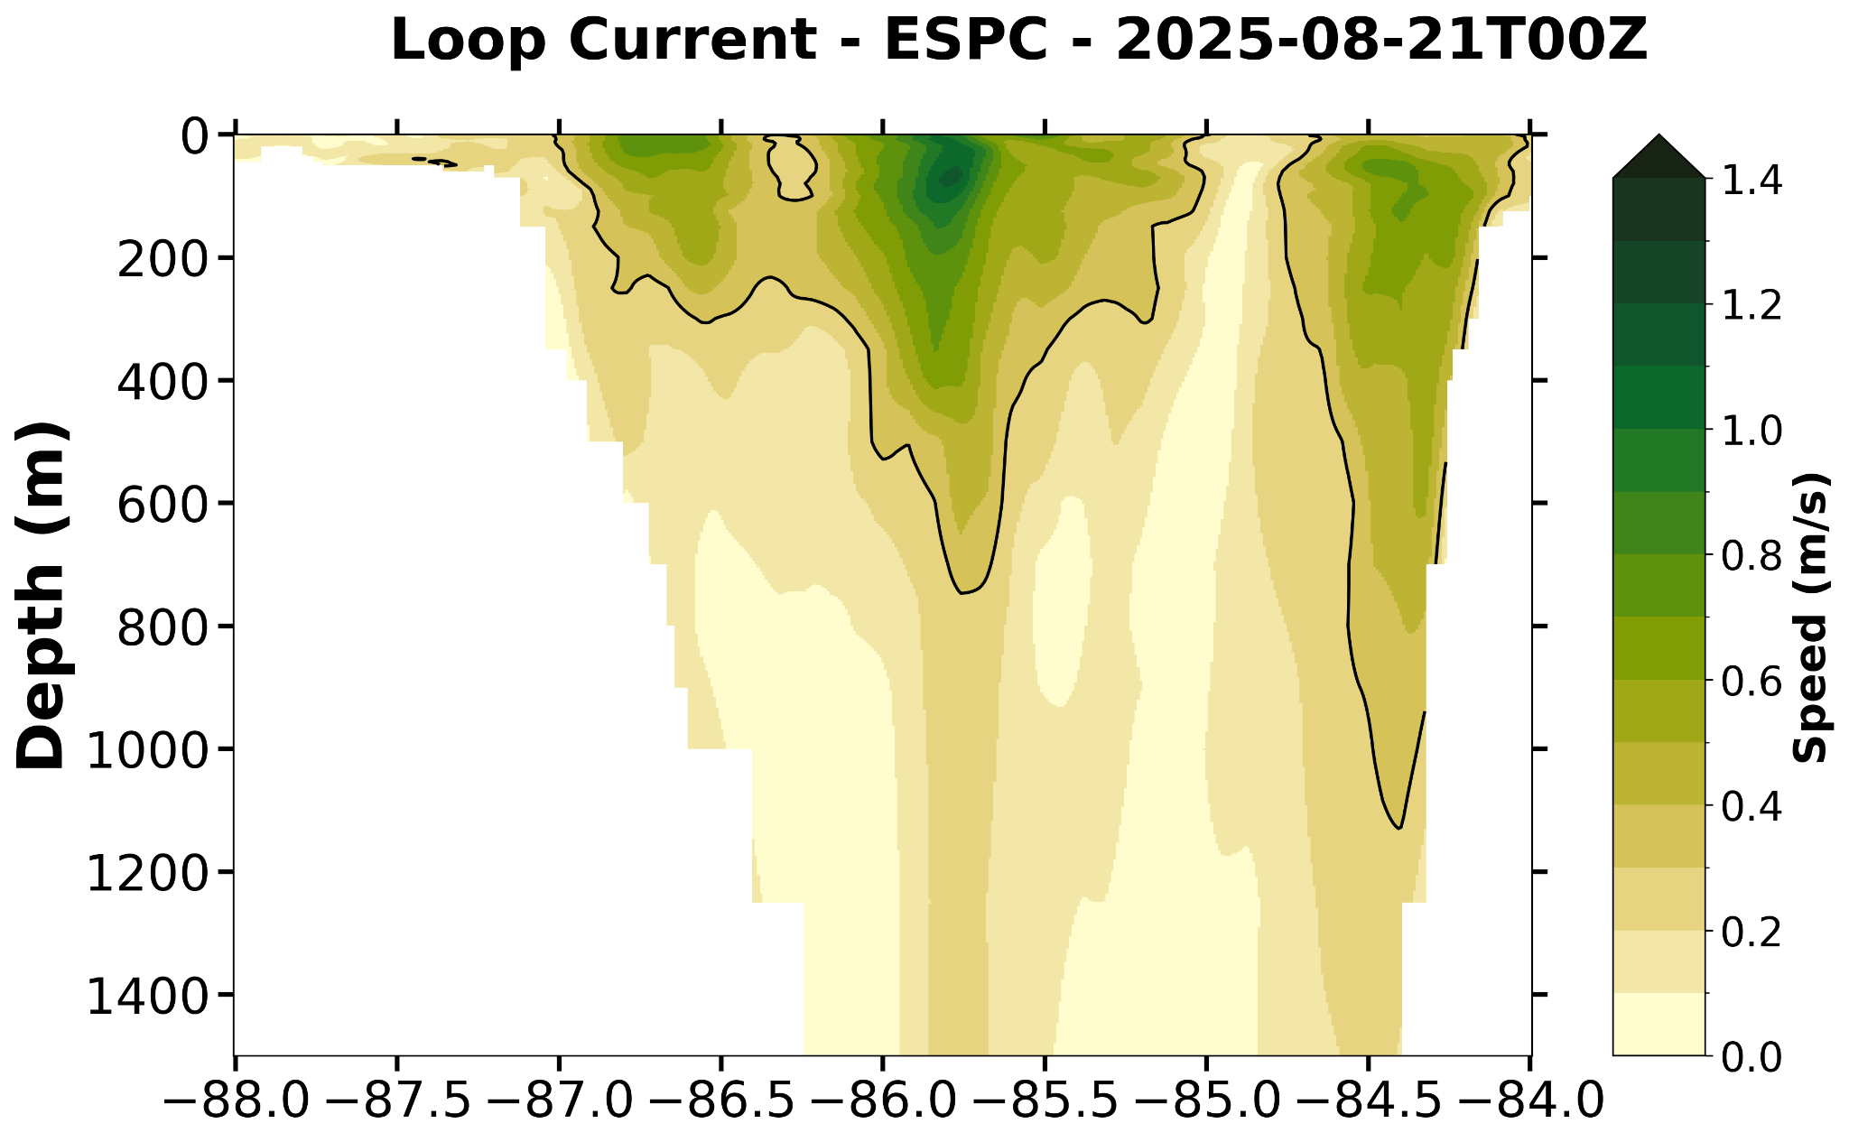
ESPC Not Available for this transect

Slide 20
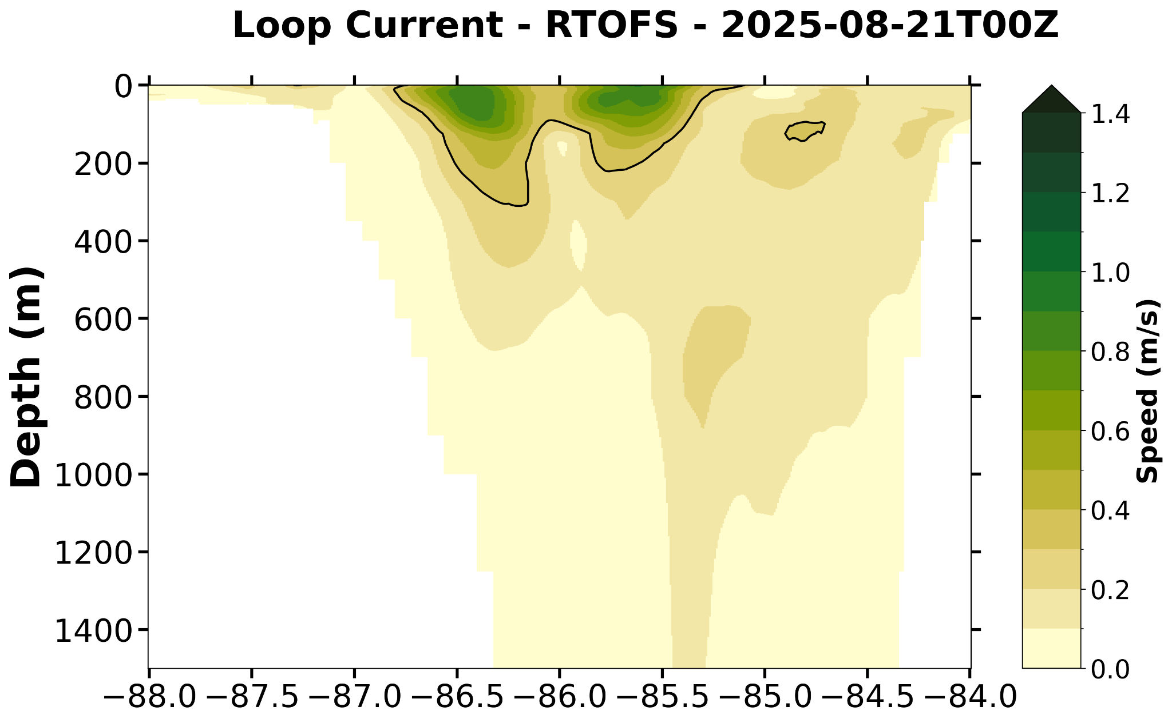

Slide 21
