Slide 1
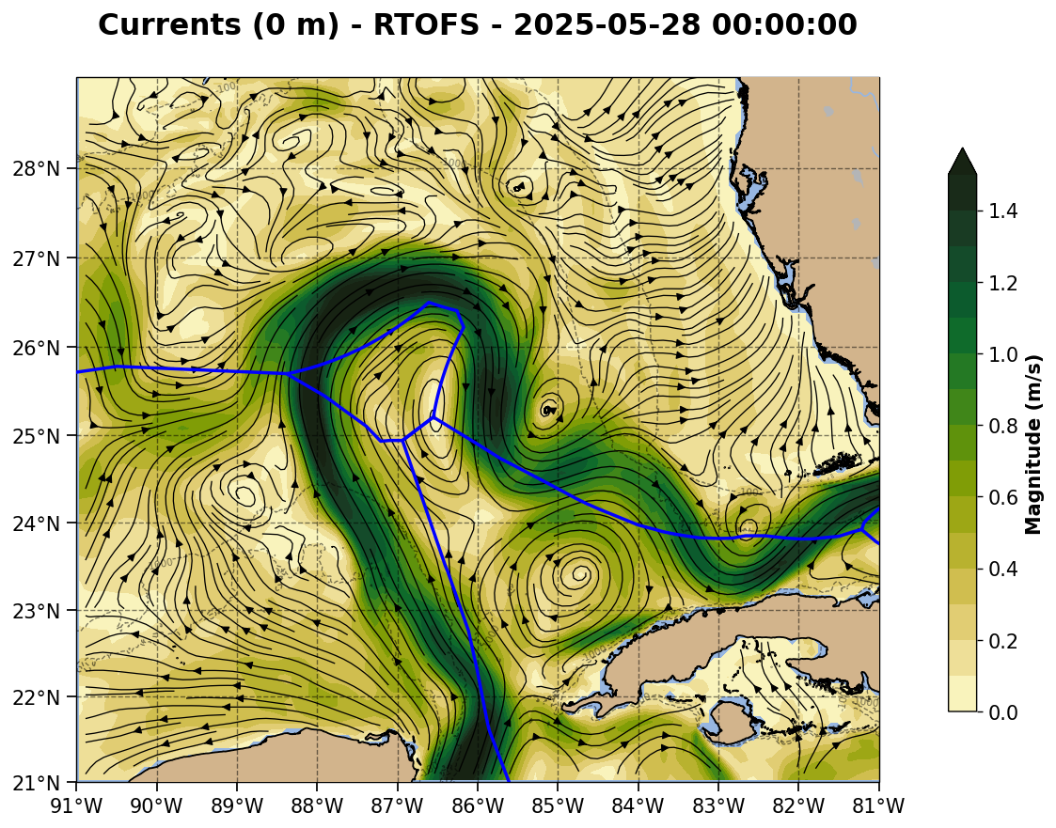
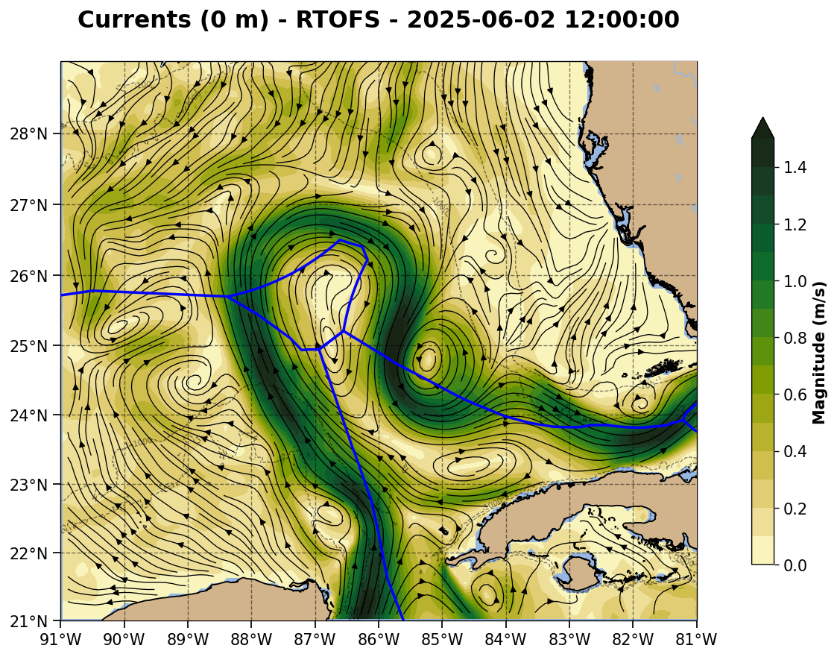

Slide 2
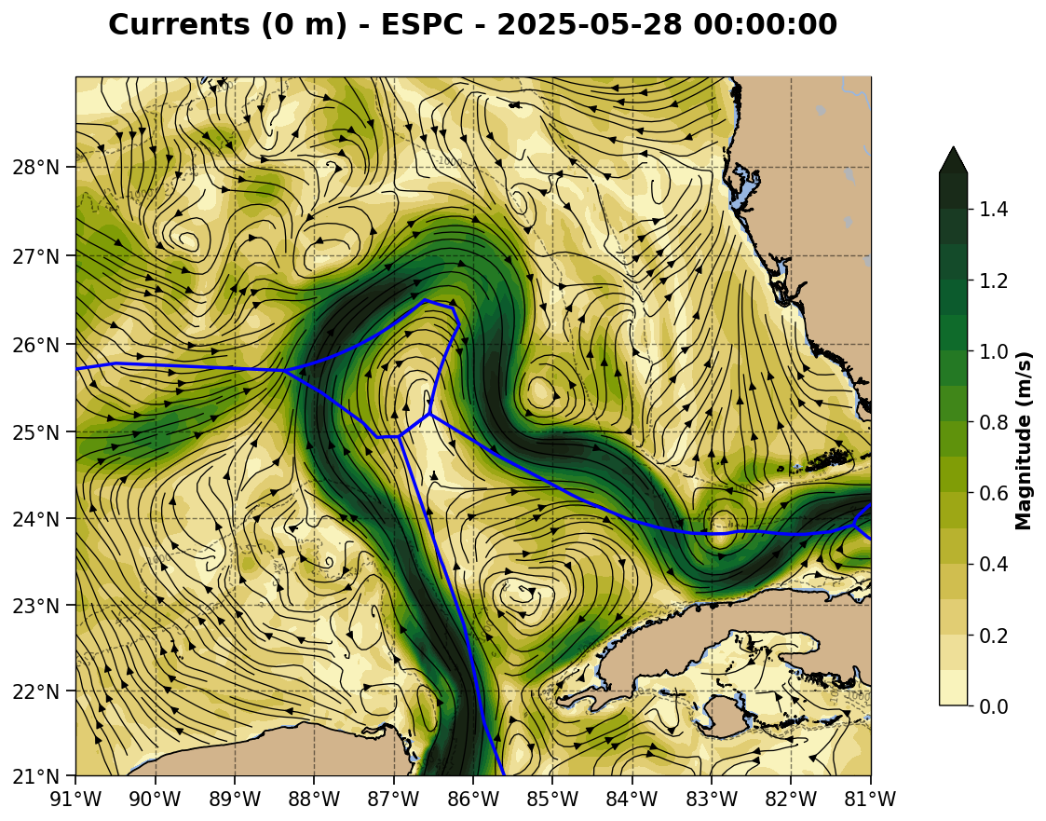
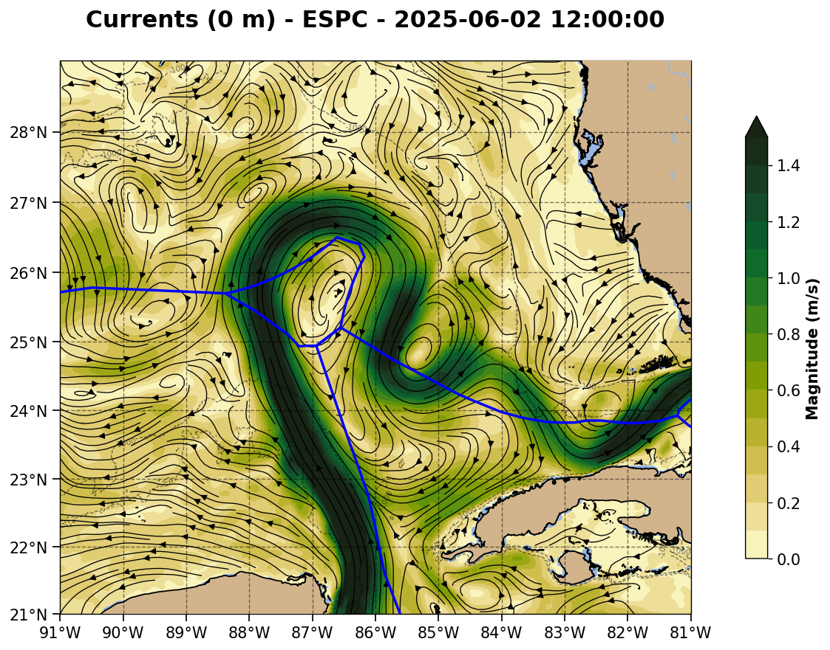

Slide 3
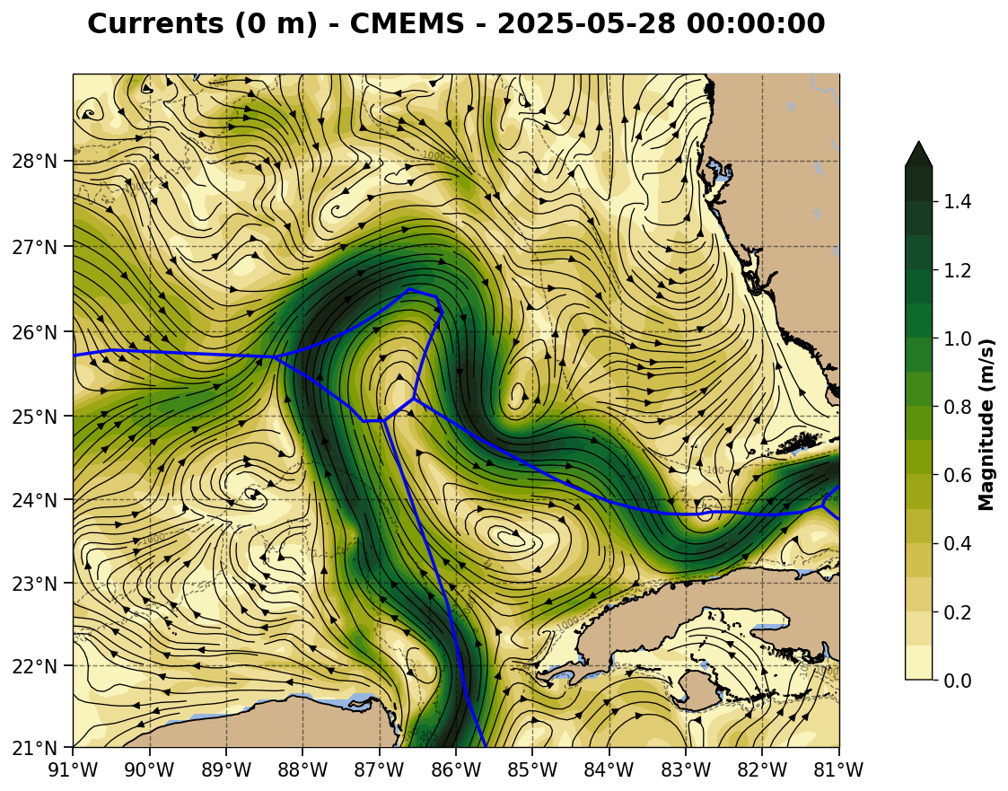
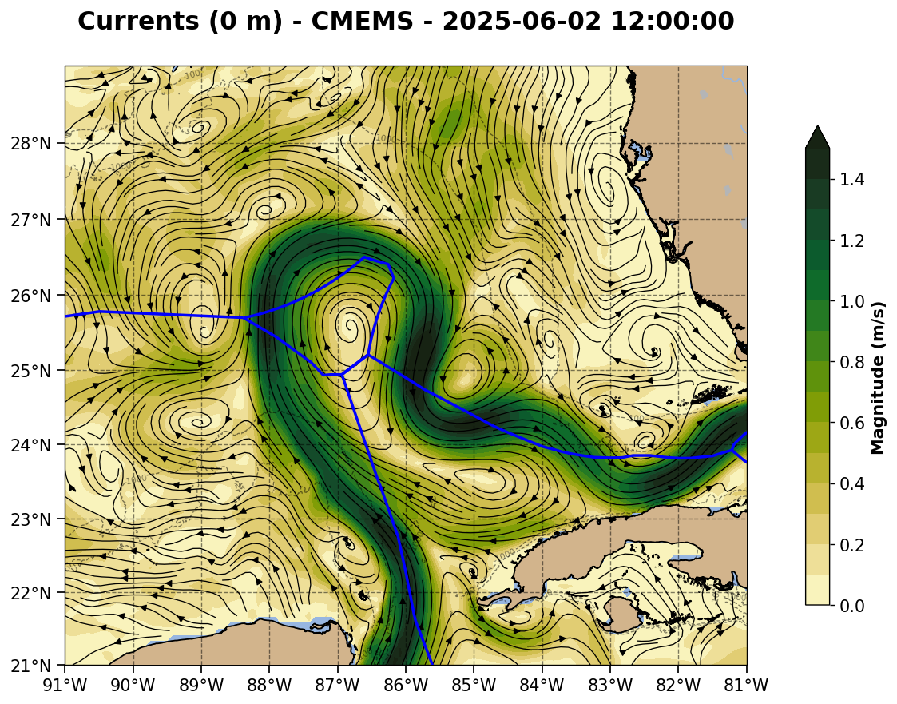

Slide 4
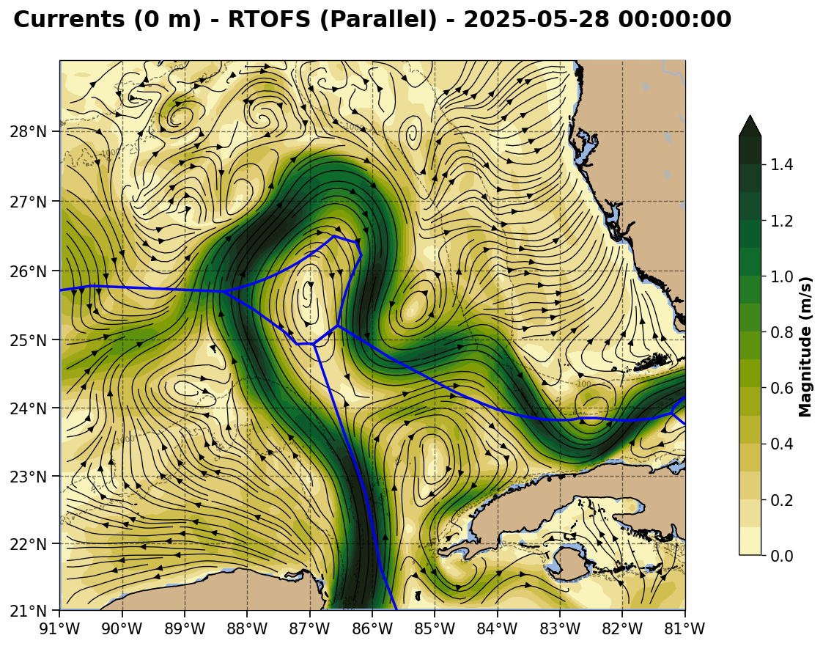

Slide 5
CNAPS Surface velocity maps

Slide 6
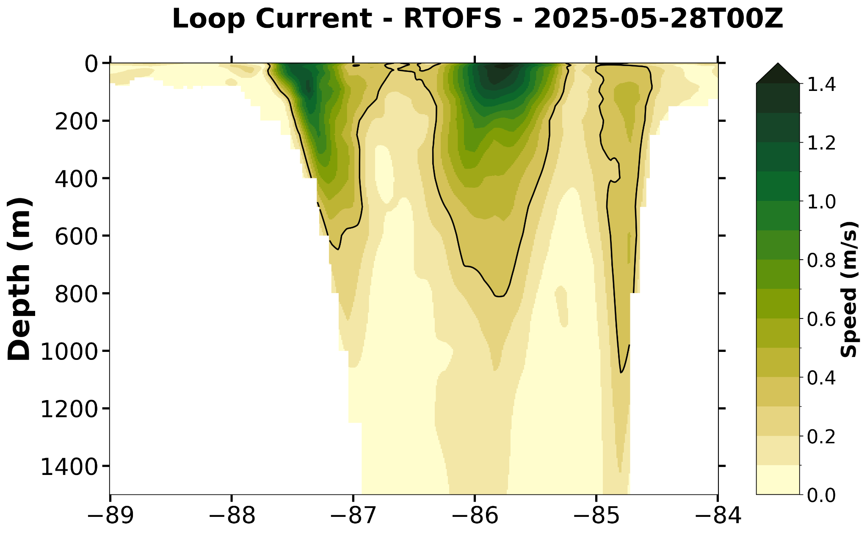

Slide 7
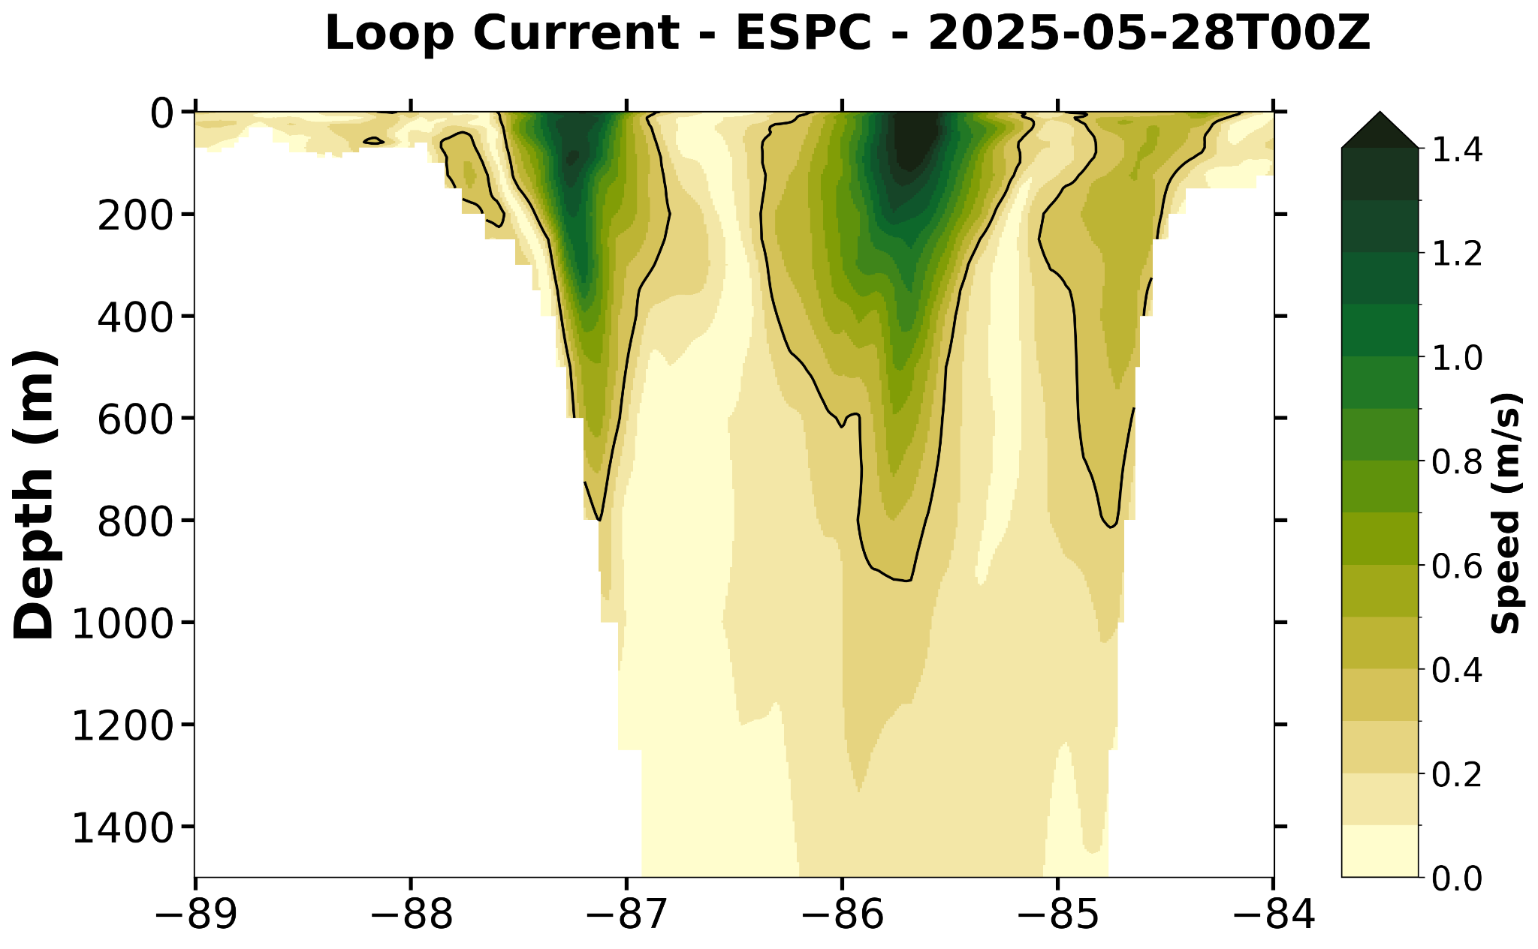

Slide 8
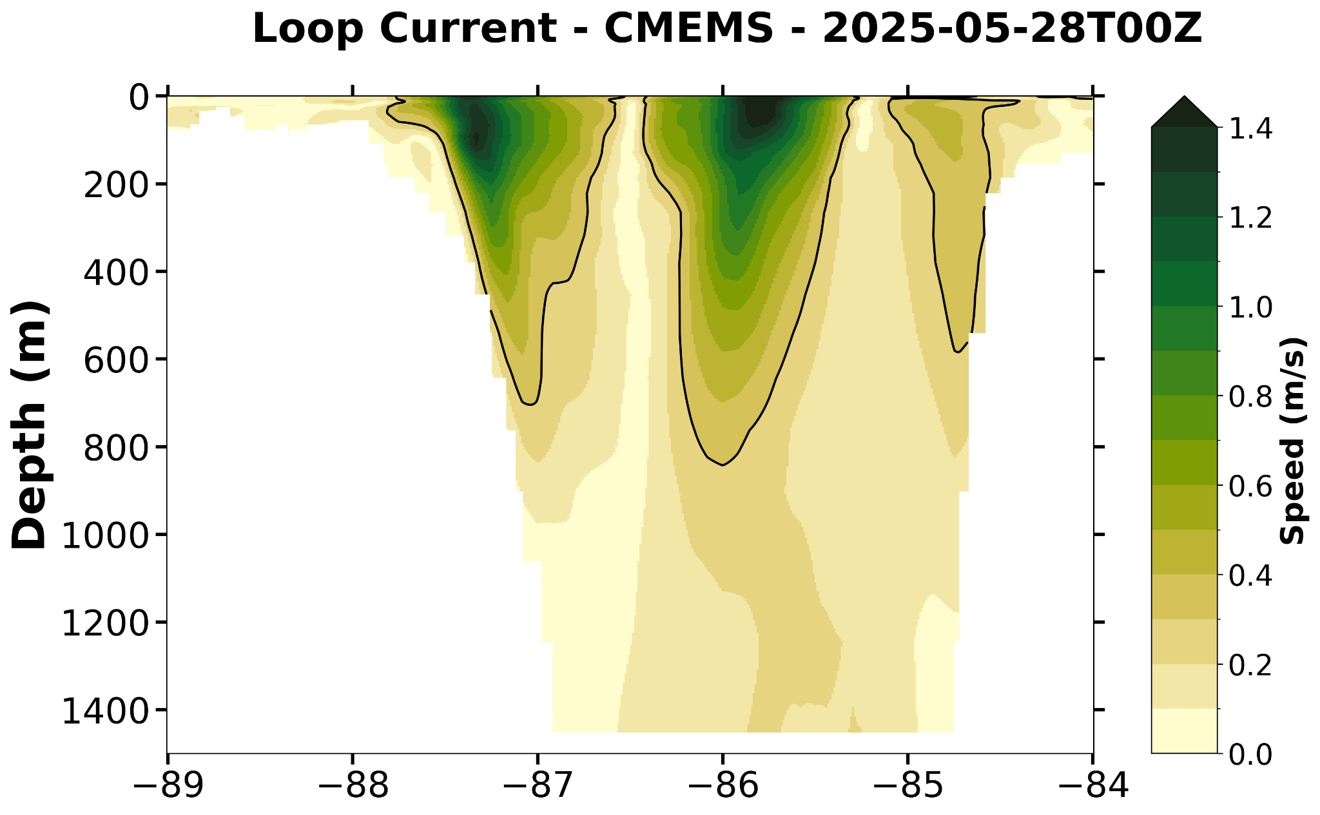

Slide 9
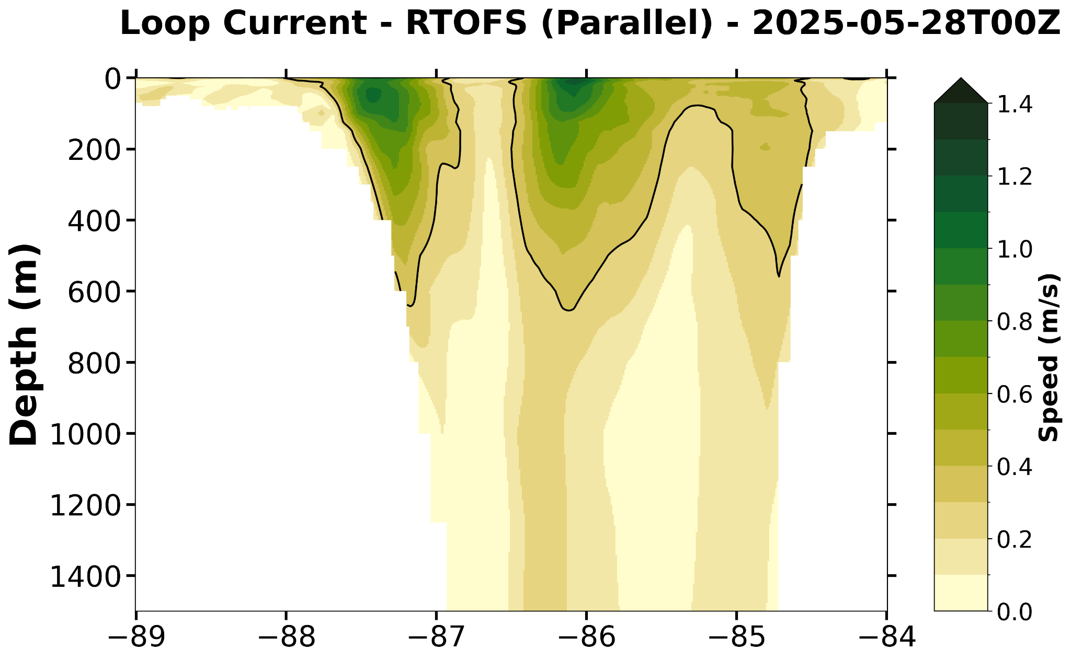

Slide 10
CNAPS velocity section

Slide 11
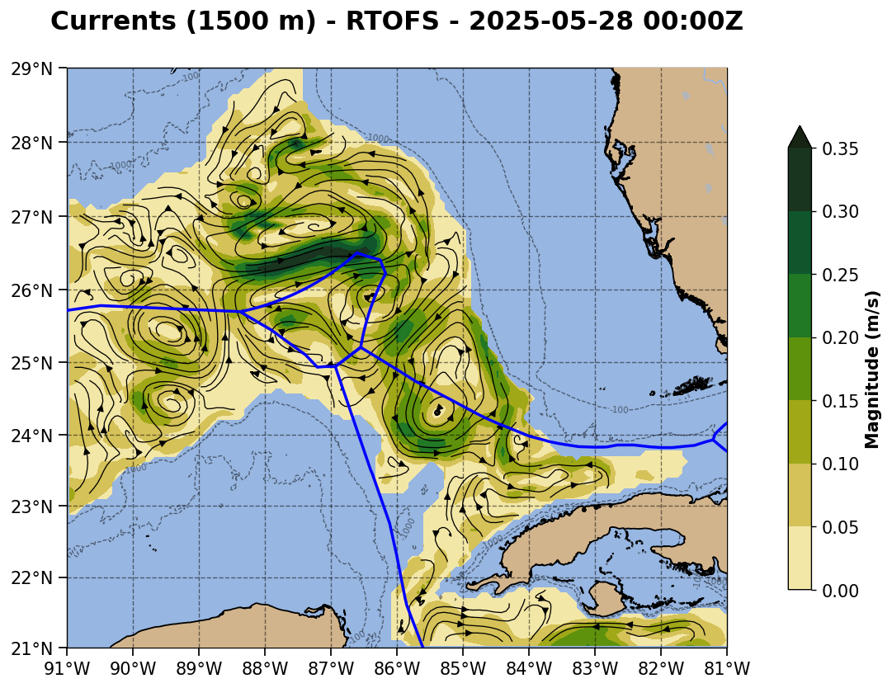
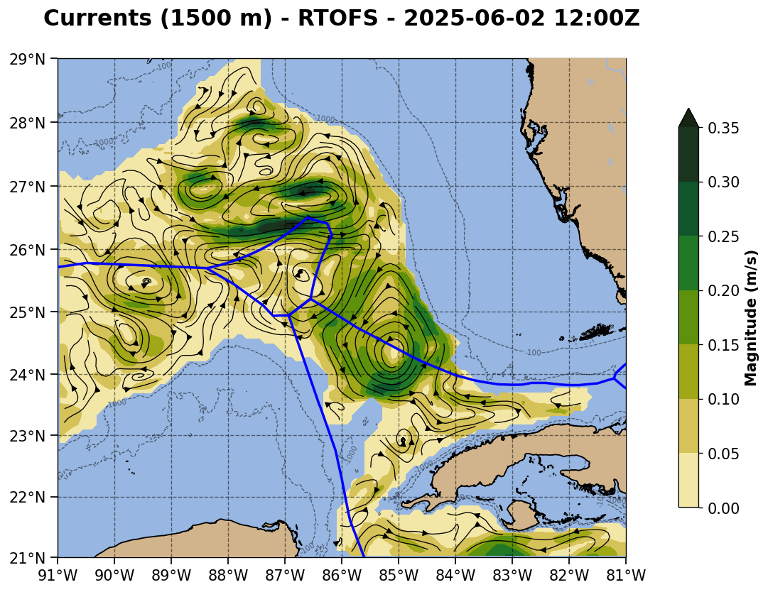

Slide 12
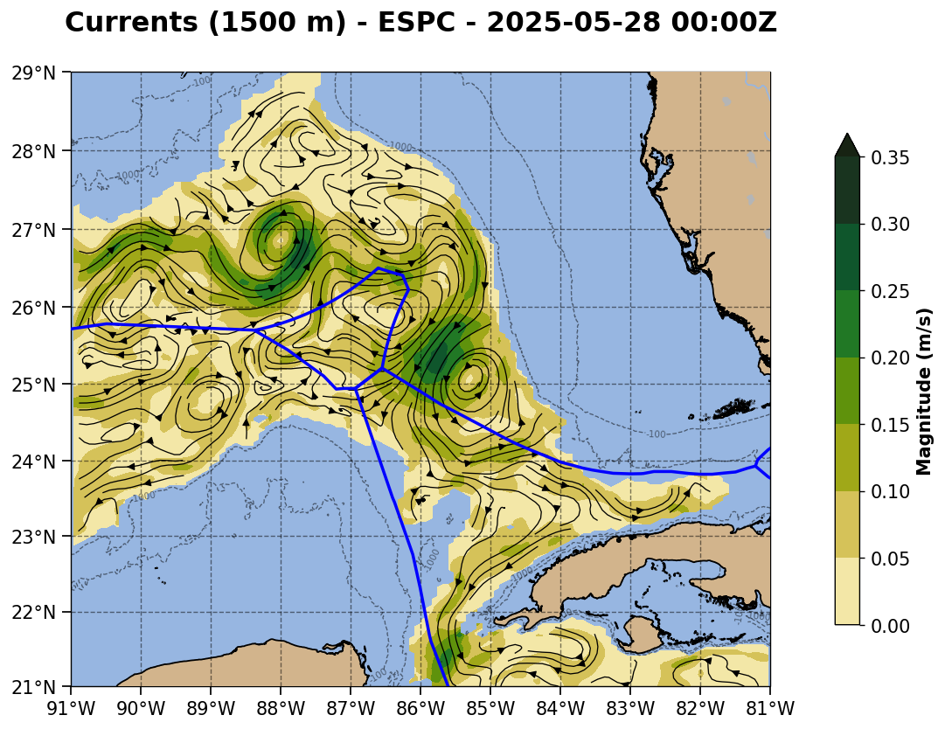
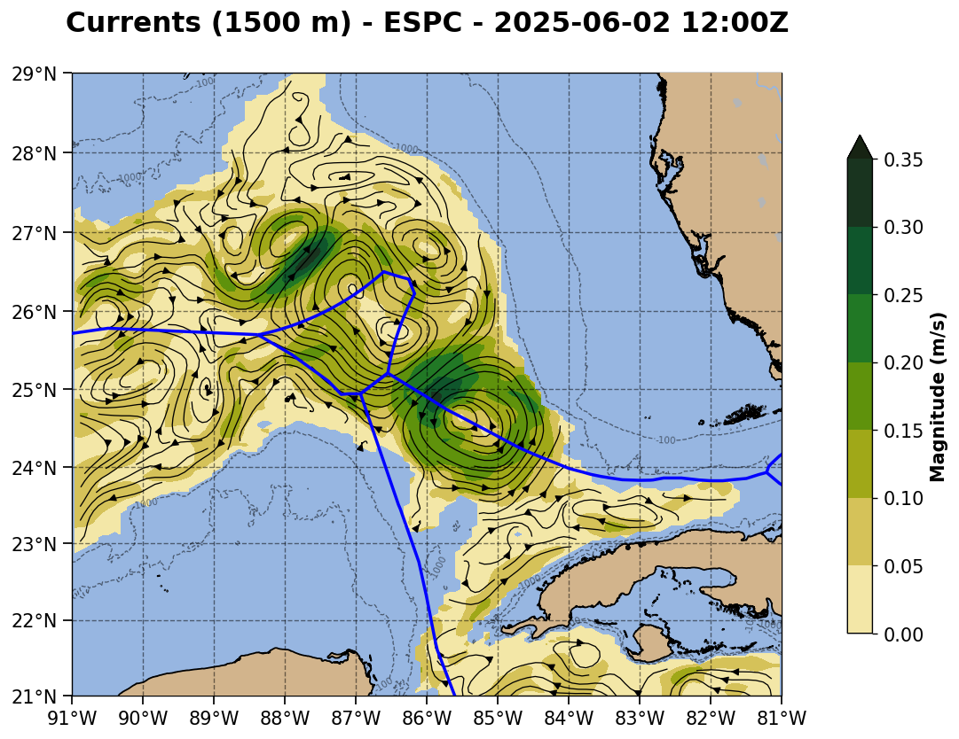
Forecast goes here

Slide 13
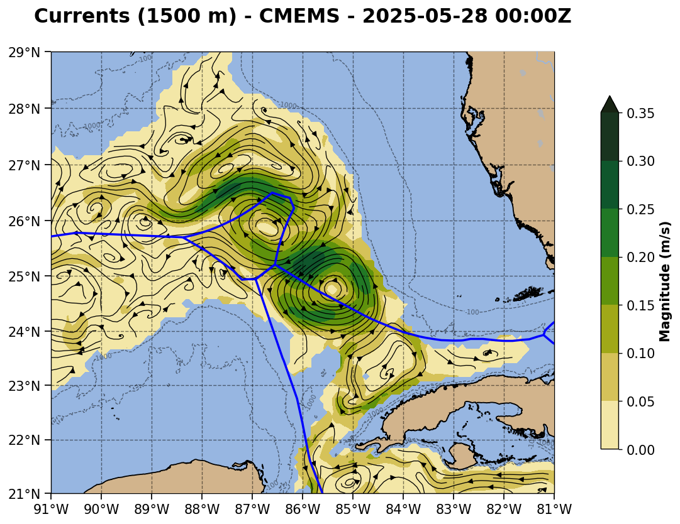
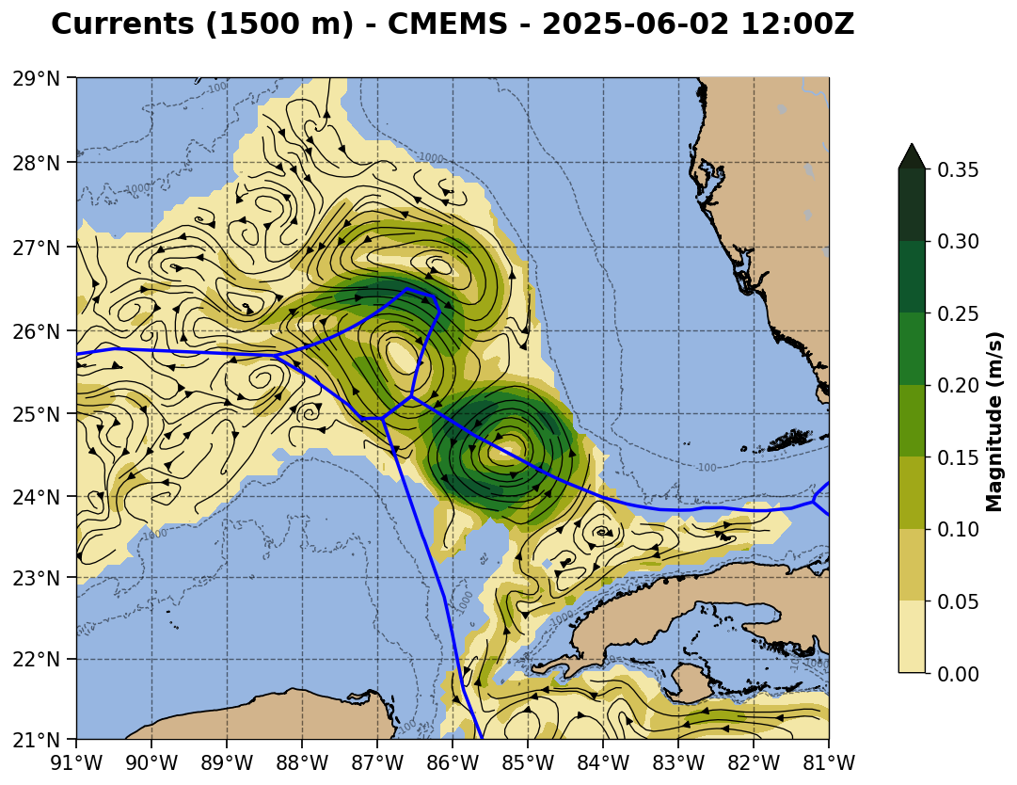
Forecast goes here

Slide 14
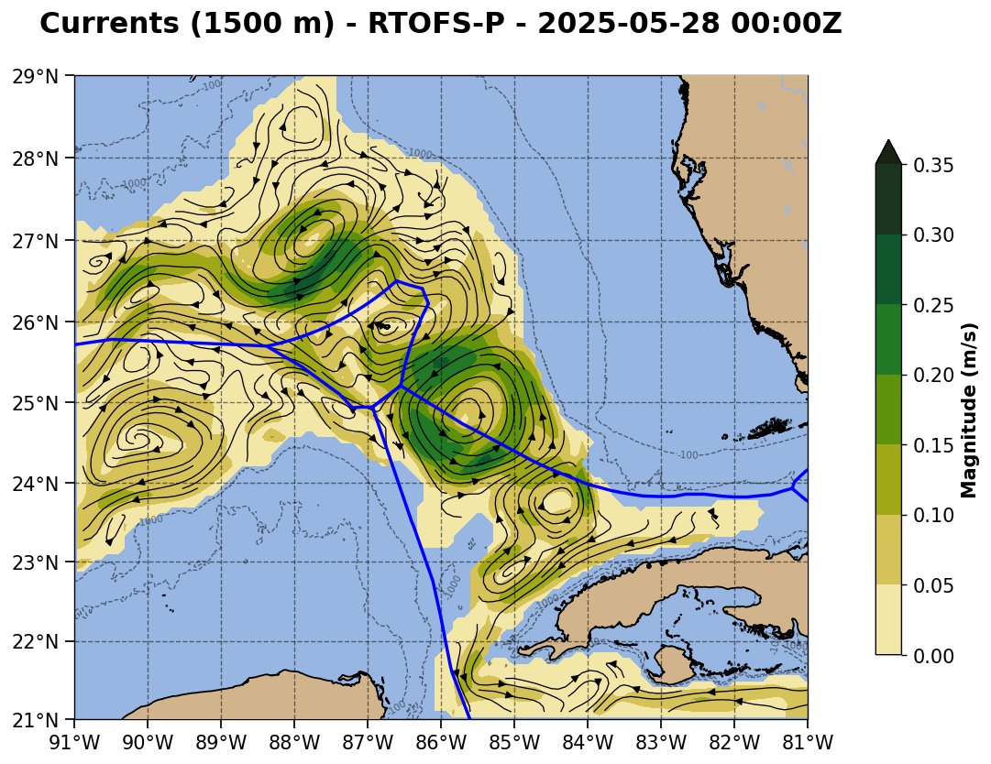

Slide 15
CNAPS 1500 m velocity maps

Slide 16
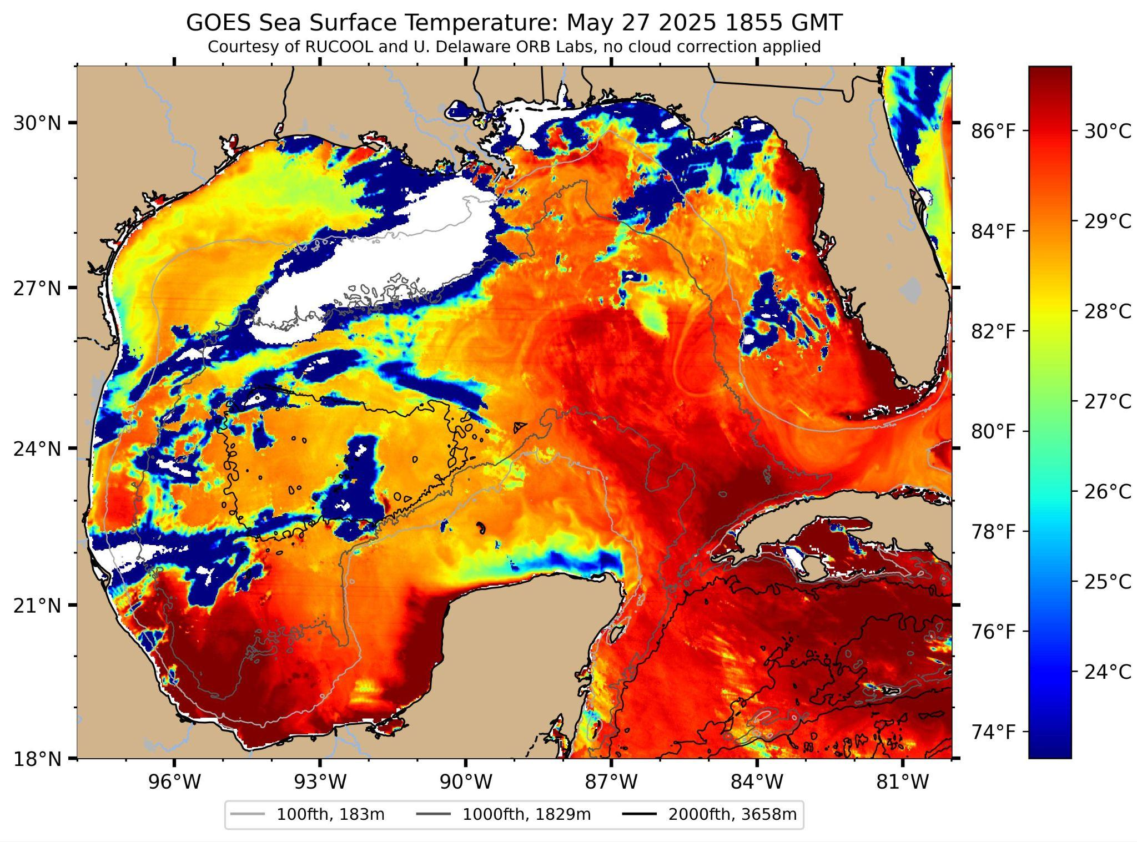
1855 GMT
Black lines added horizontally across 25N & 26 N, and vertically along 85W and 86W.
Eddy is within the white oval. Eddy is outlined by the persistent filament of cooler water wrapping around the Loop Current edge.
Center by eye is about 85.2W, 25.4N

Slide 17
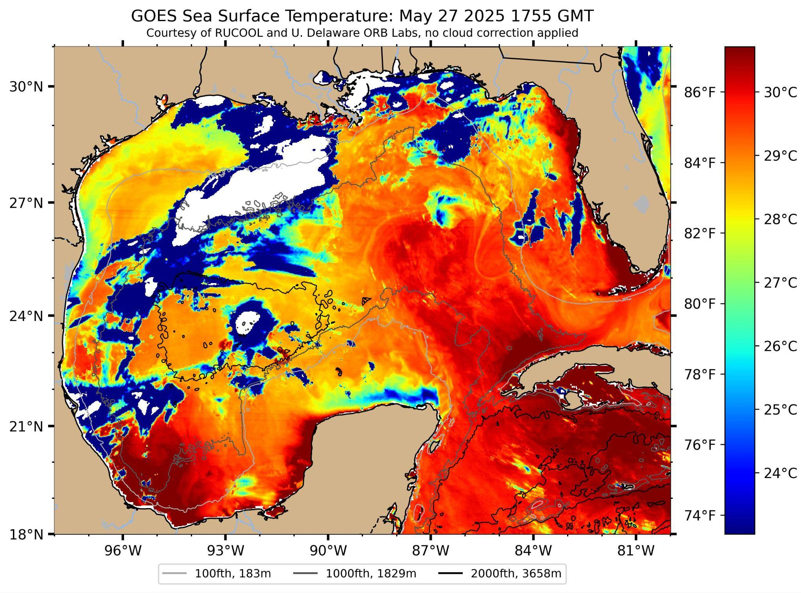
1855 GMT
Black lines added horizontally across 25N & 26 N, and vertically along 85W and 86W.
Eddy is within the white oval. Eddy is outlined by the persistent filament of cooler water wrapping around the Loop Current edge.
Center by eye is about 85.2W, 25.4N

Slide 18

Lon: -85.142428
Lat: 25.284099

Slide 19
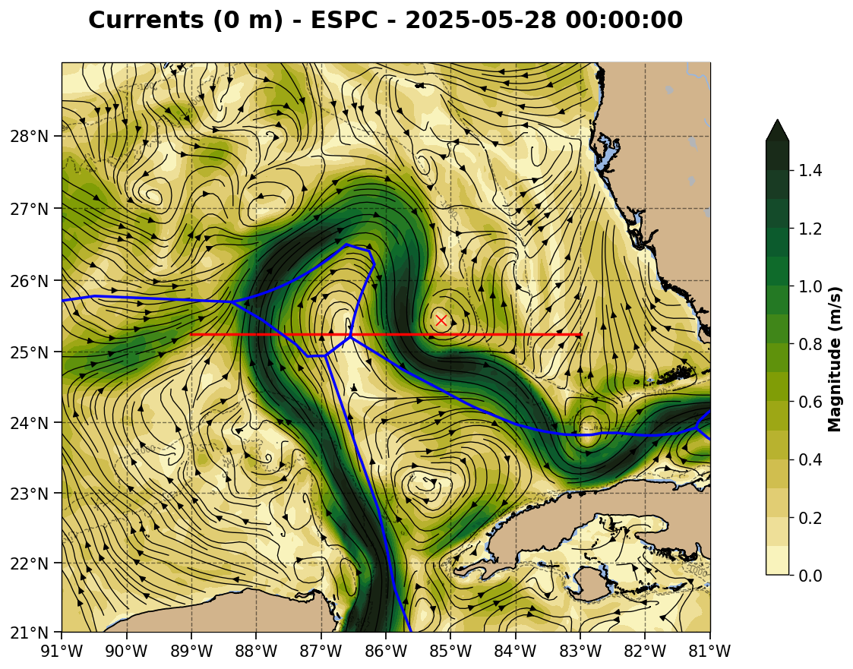
Lon: -85.142428
Lat: 25.443114

Slide 20

Lon: -85.210912
Lat: 25.242528

Slide 21
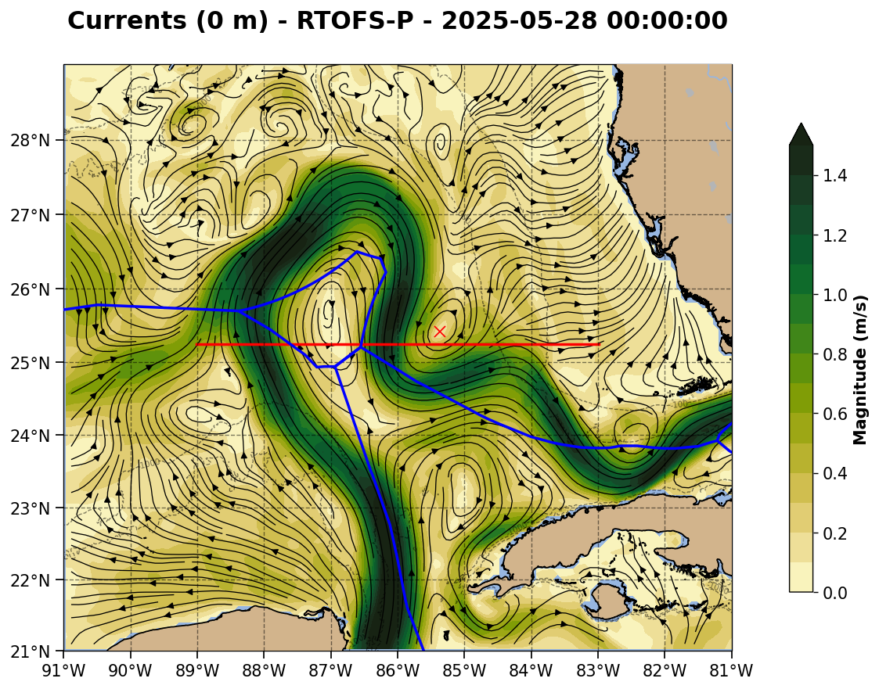
Lon: -85.363099
Lat: 25.415474

