Slide 3
Surface currents, nowcast and Forecast
8 slides

Slide 4
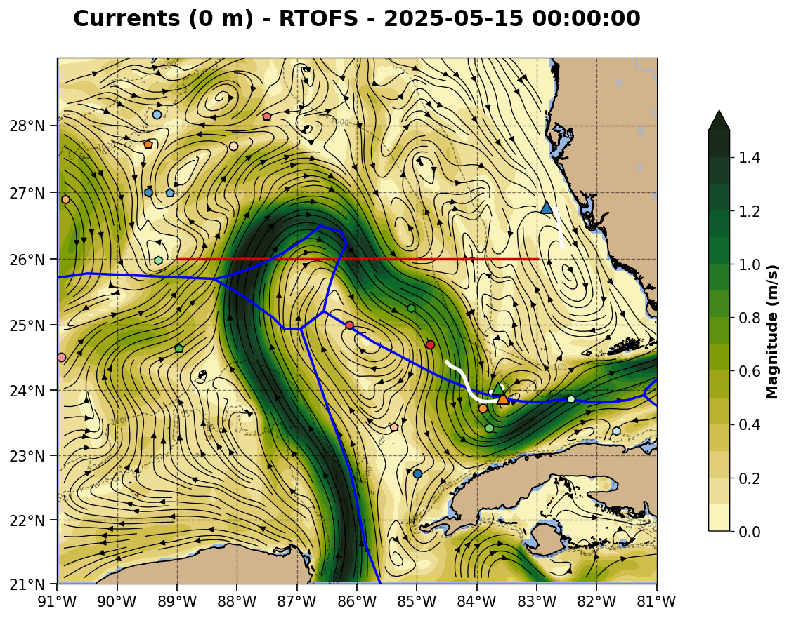

Slide 5
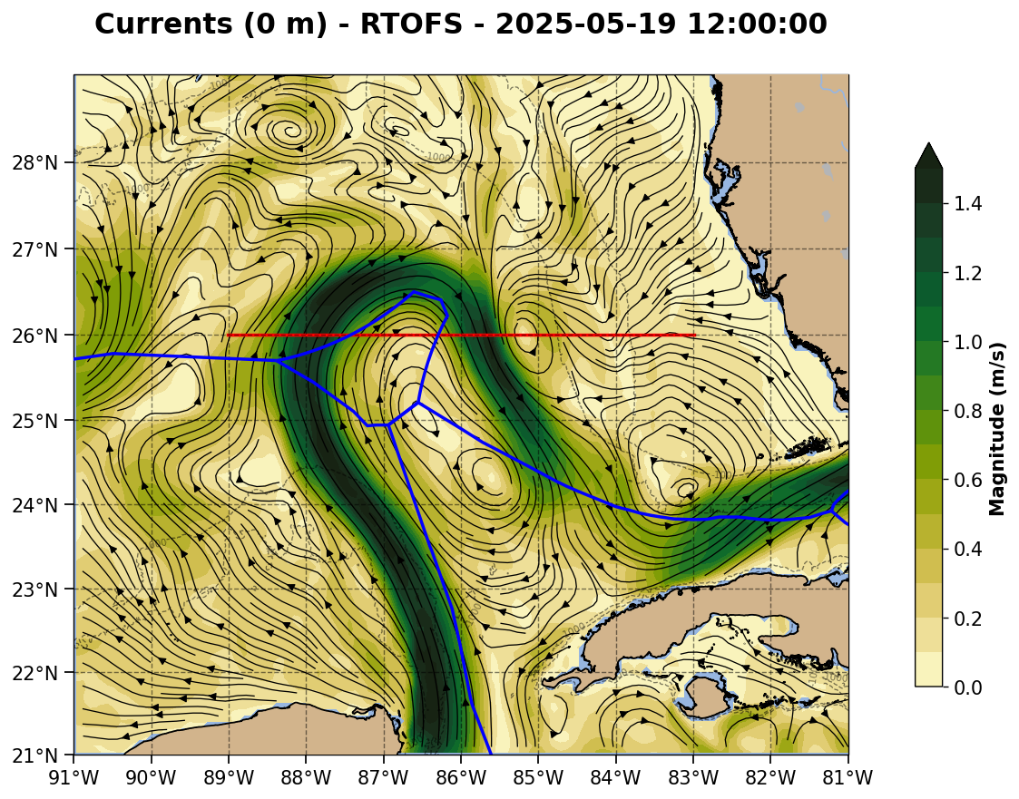

Slide 6
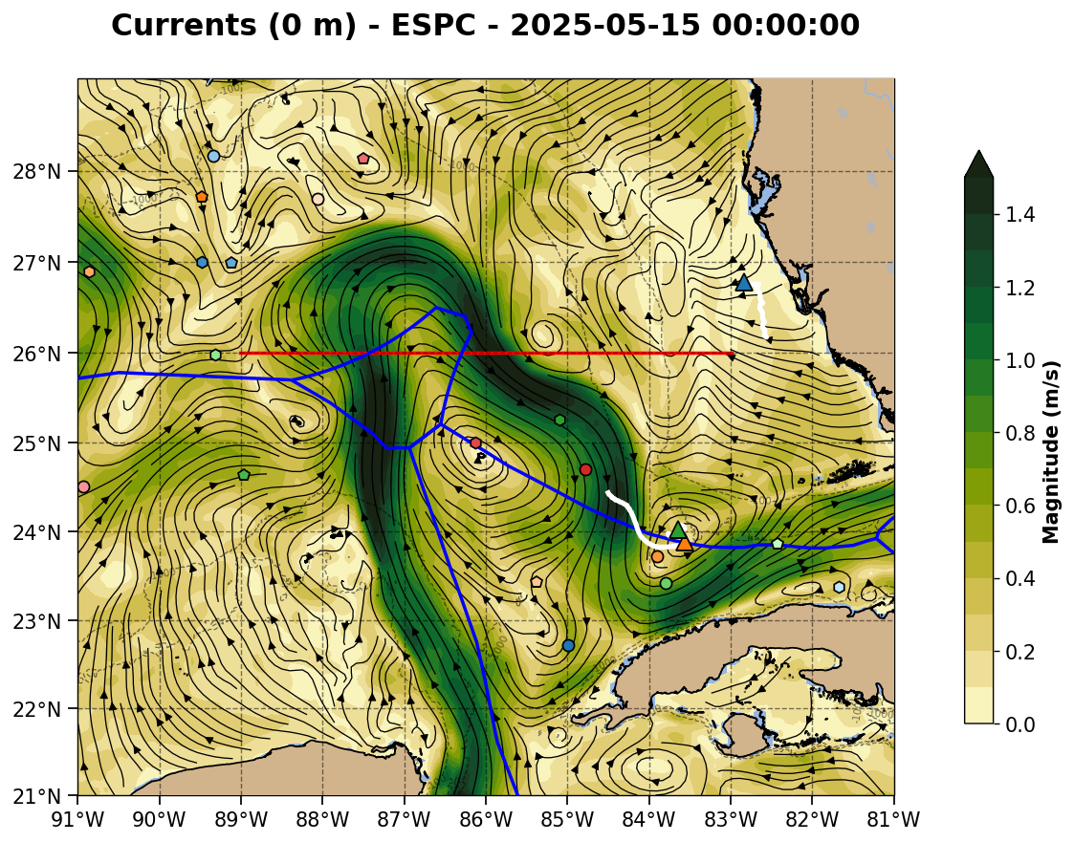

Slide 7
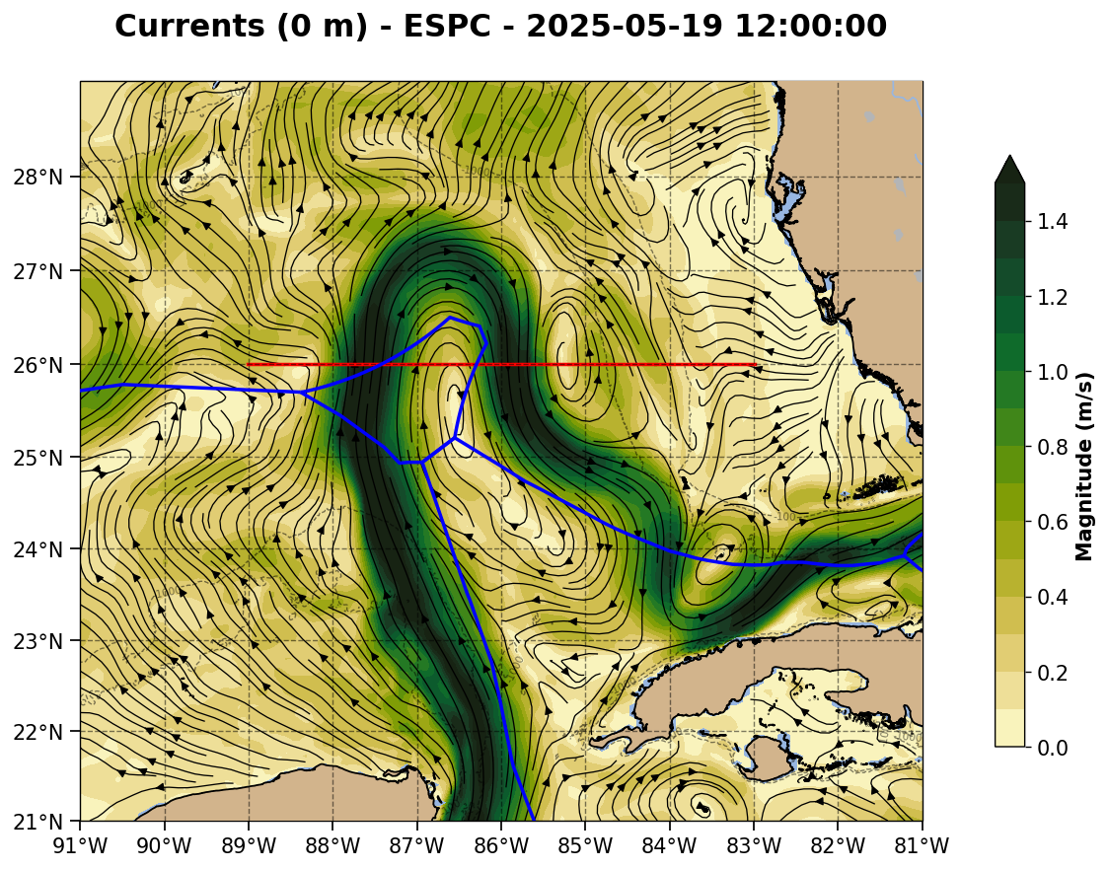

Slide 8
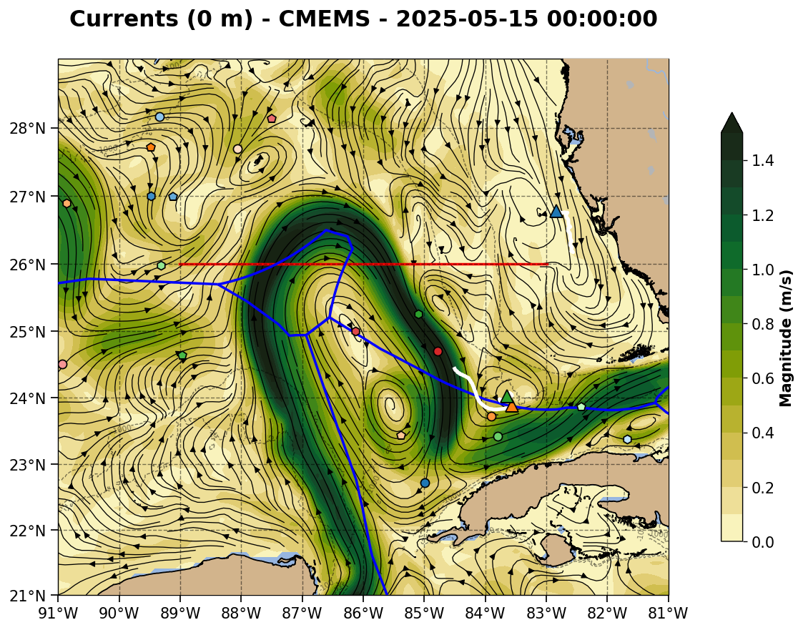

Slide 9
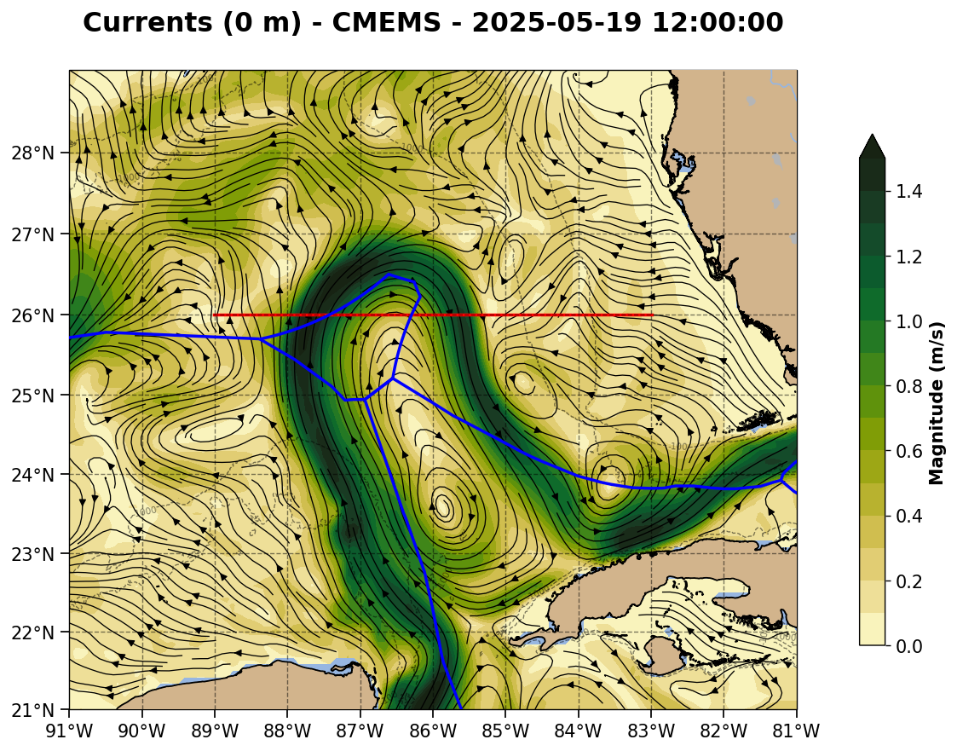

Slide 10
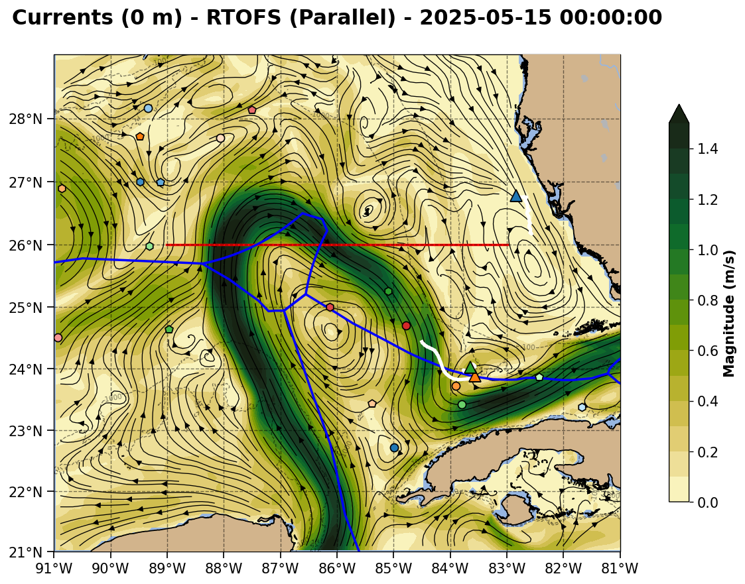

Slide 11
Parallel only goes to 24Z on the day of its run. Missing for this day.

Slide 12
1500 m currents, nowcast only
4 slides

Slide 13
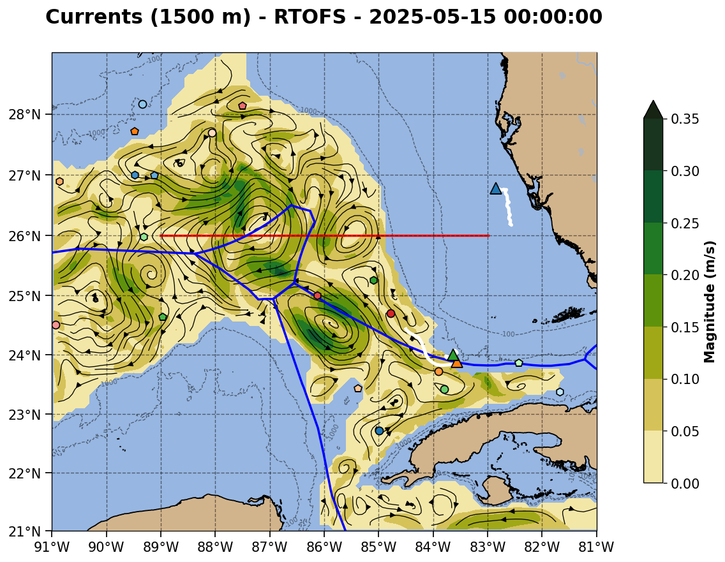

Slide 14
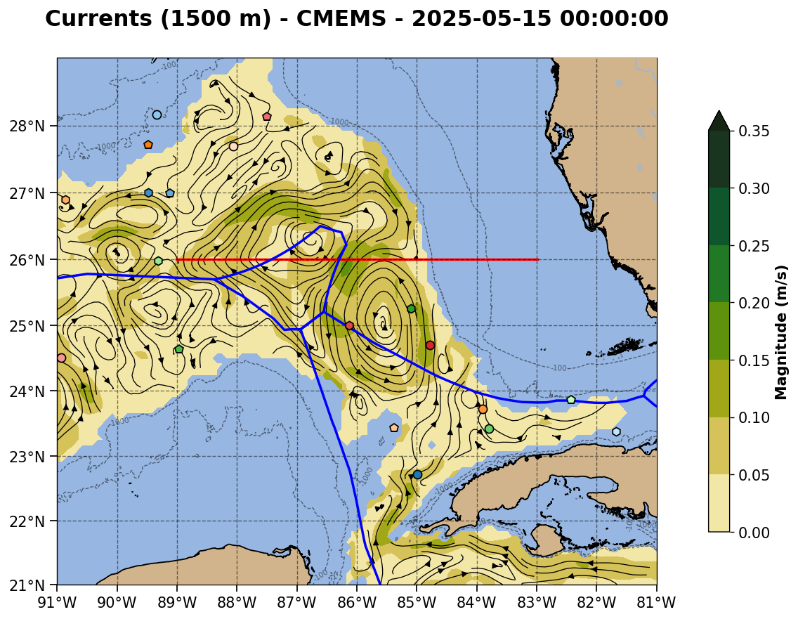

Slide 15
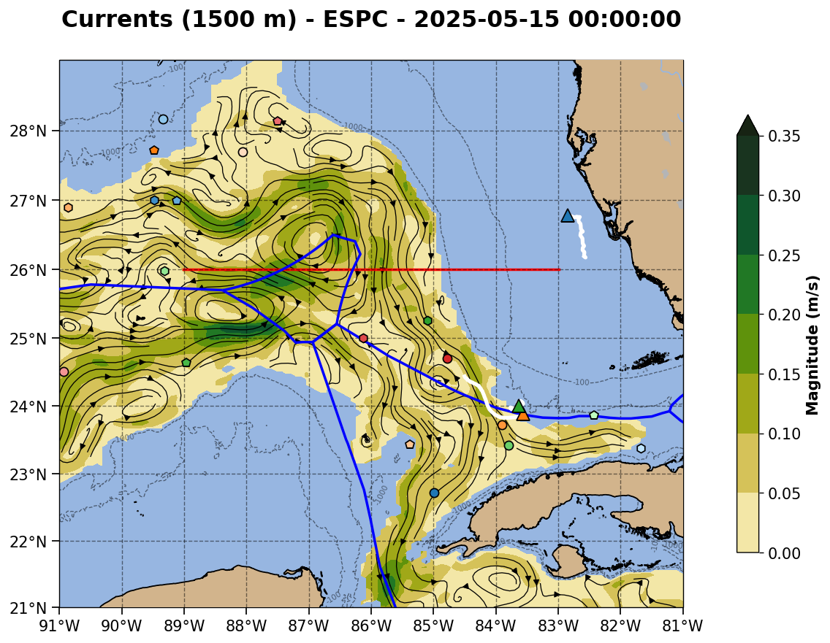

Slide 16
RTOFS parallel goes here when ready

Slide 17
Current speed sections on the gray diagonal line in surface current slides
4 slides

Slide 18
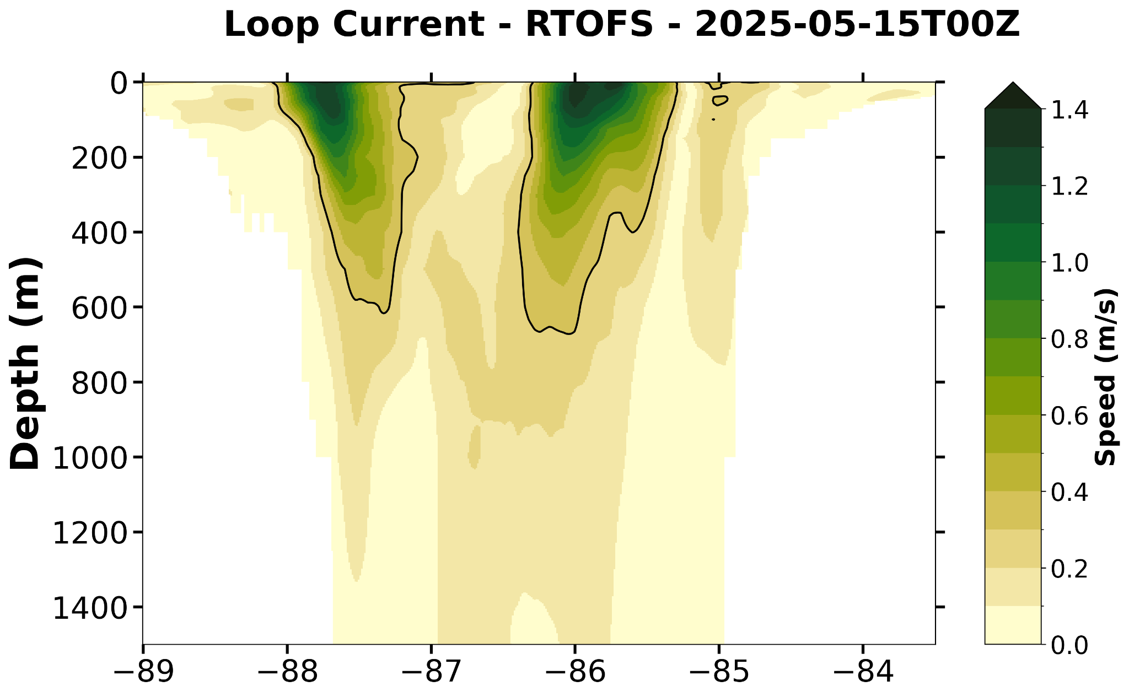

Slide 19
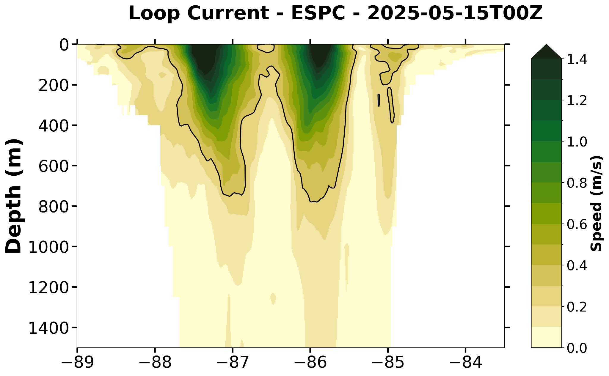

Slide 20
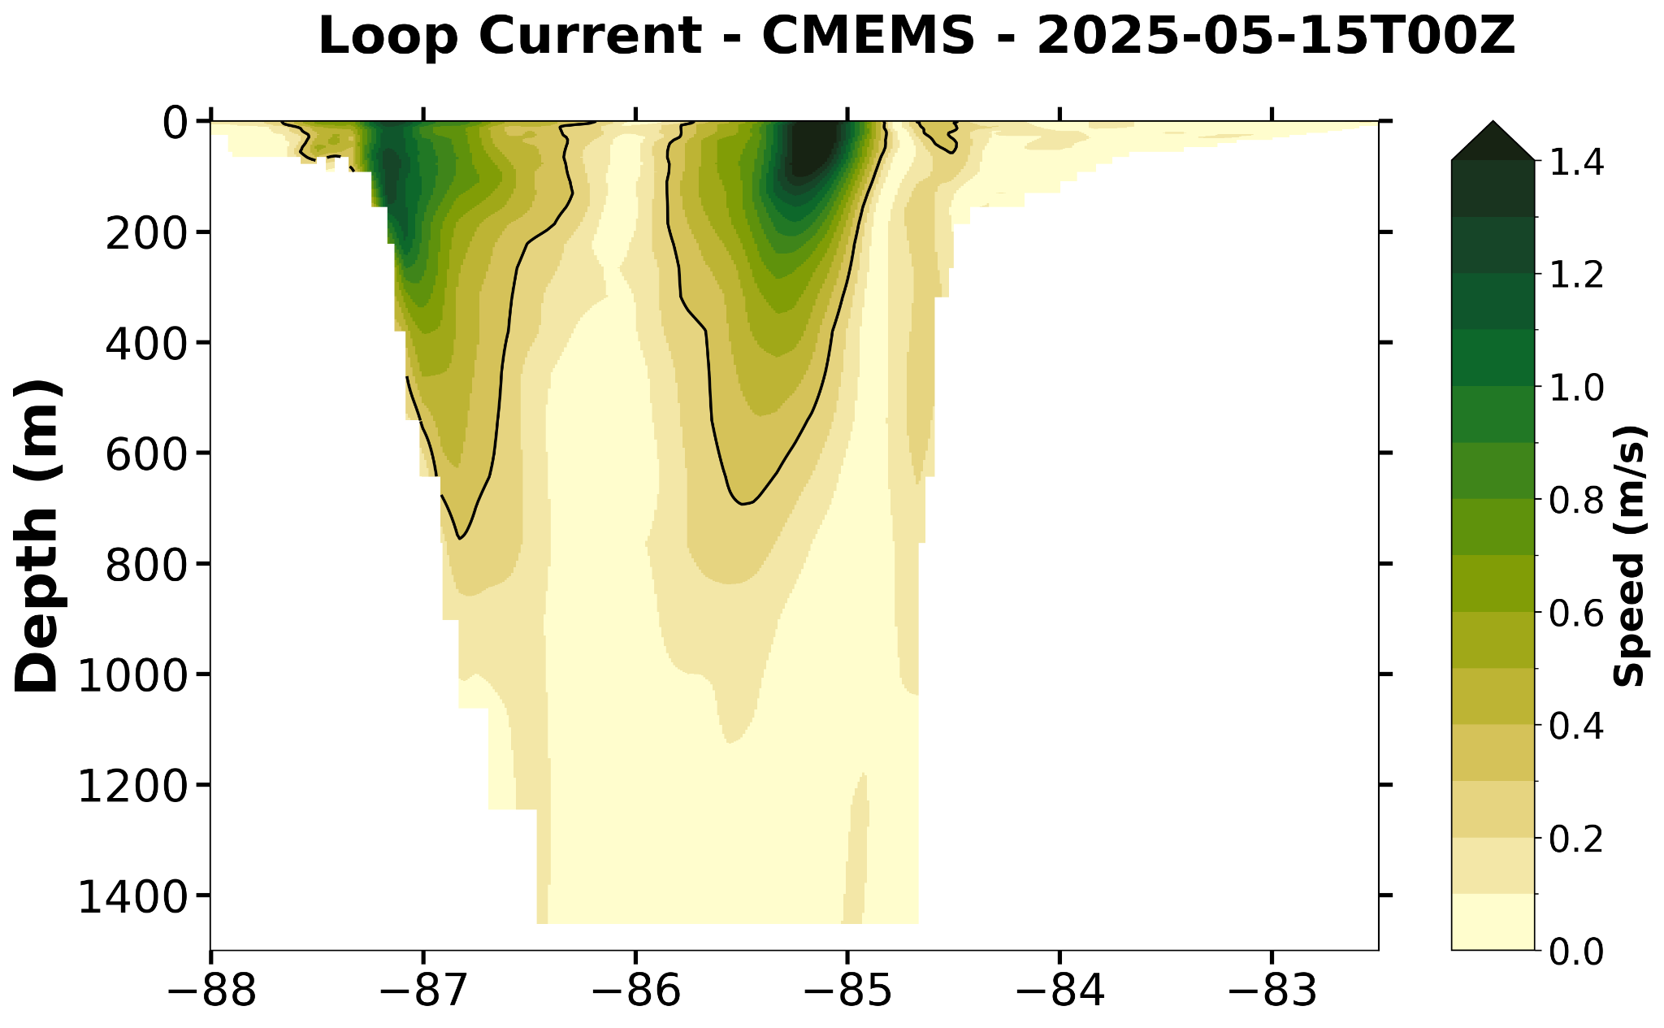

Slide 21
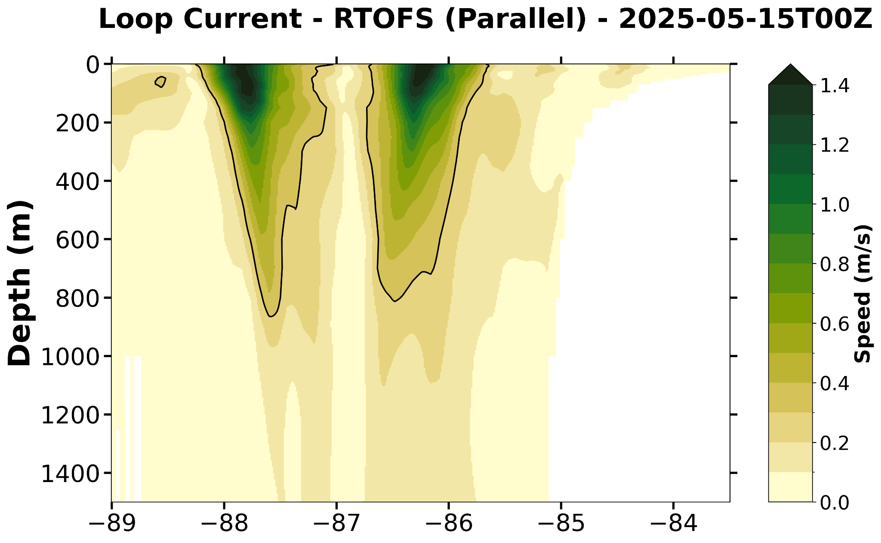

Slide 22
Current speed sections on the red east-west line in surface current slides
4 slides

Slide 23
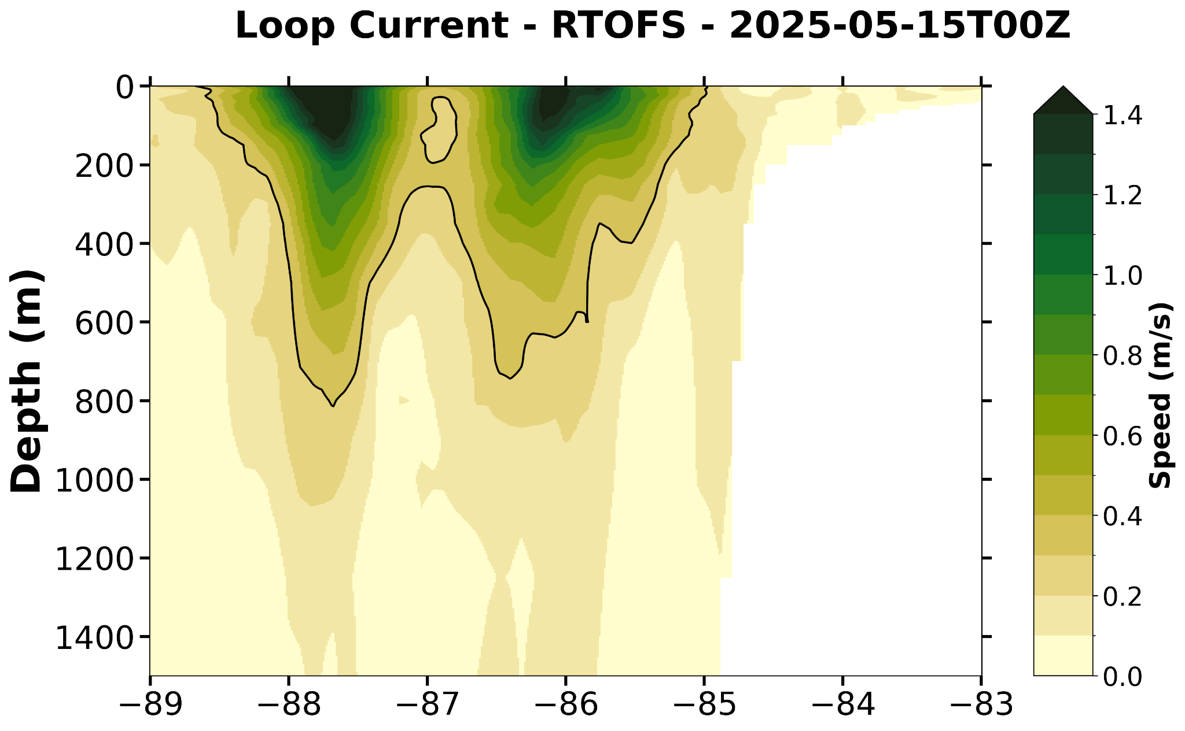

Slide 24
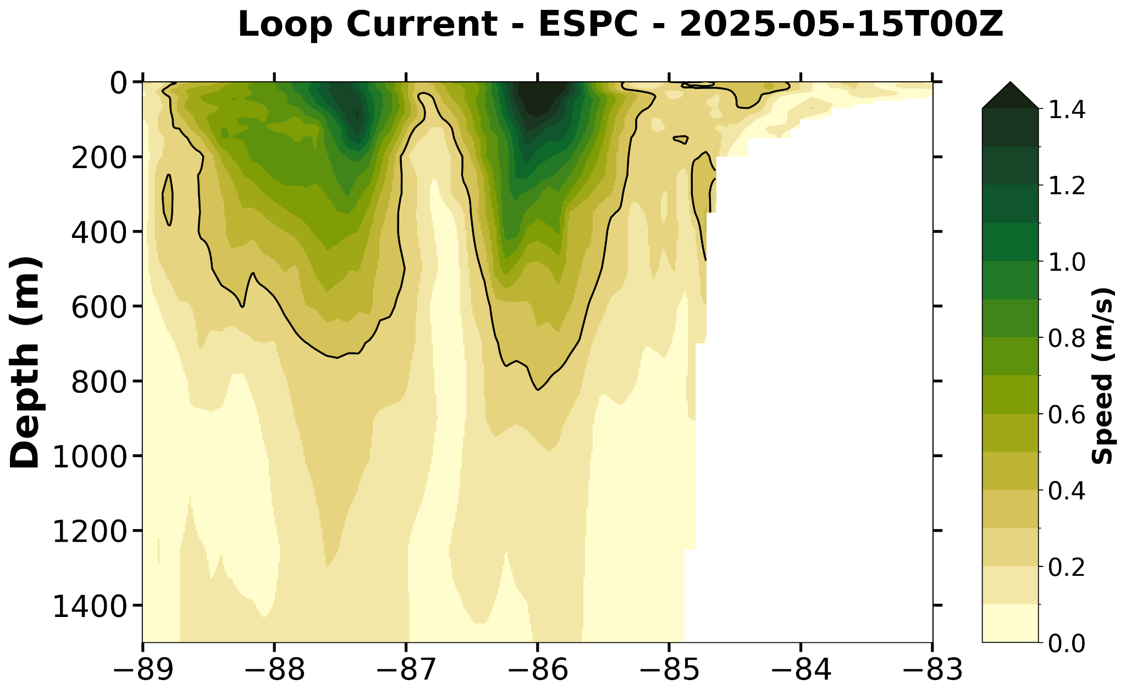

Slide 25
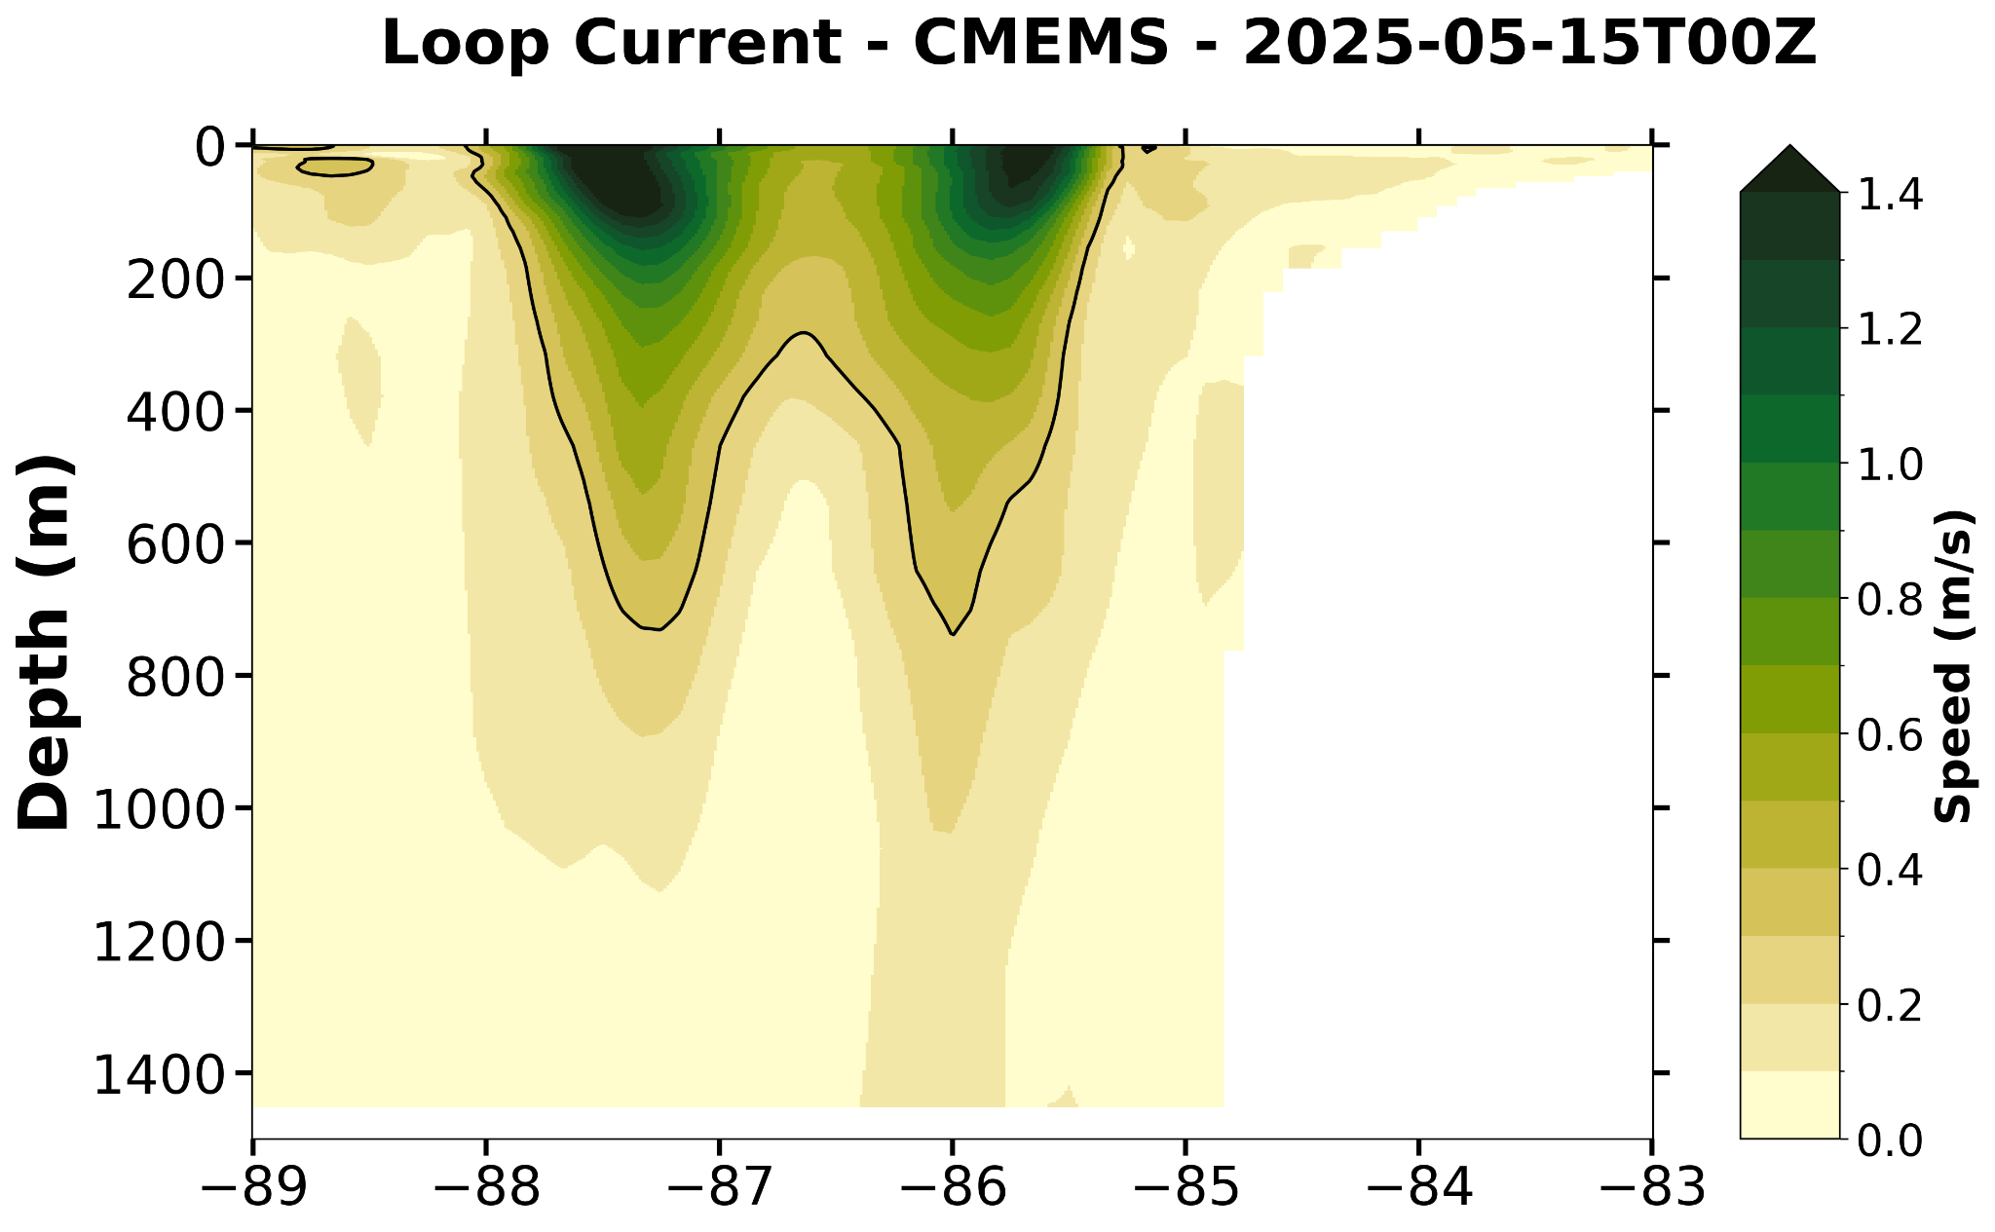

Slide 26
