Slide 1
Summary: 2025-05-8
Directory location - UGOS 2022-27 > GrASE > Operational Model Summaries (link)
Slides 2-5: Currents at the 1500 m park depth of the Argo Floats.
Slides 6-9: Southwest to northeast cross-section through the narrow neck of the LC, the center of the TCR, and weak northeast side of the TCR.
Slides 10-13: Northwest to southeast line through the center of the extended LC and the TCR.
Slides 13-?: Numerous model/data profile comparisons of potential interest

Slide 2
Currents at 1500m depth: 2025-05-8
Differing eddy structures at depth.
Slides 3: RTOFS has two eddies, a strong anticyclonic and a strong cyclonic eddy, under the extended Loop Current, one large anticyclonic eddy on the southern side of the Central Gulf.
Slides 4: CMEMS has a weak anticyclonic and a strong cyclonic eddy under the extended Loop. The large anticyclonic eddy in the central Gulf is not present.
Slides 5: ESPC has one very large but weak anticyclonic eddy under the extended Loop, a small cyclonic eddy under the narrow neck of the extended Loop, and a small anticyclonic eddy in the southern part of the Central Gulf,

Slide 3
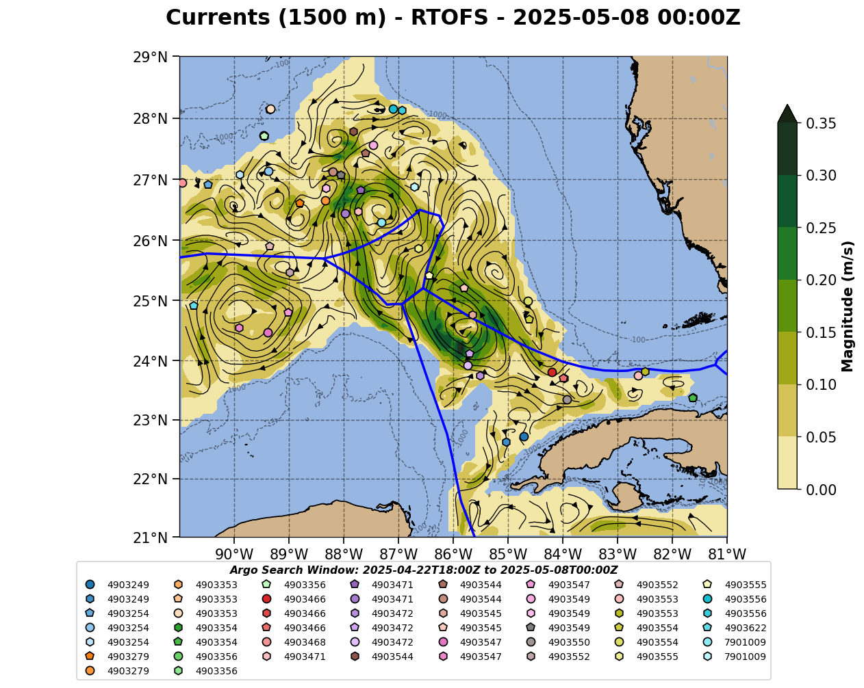
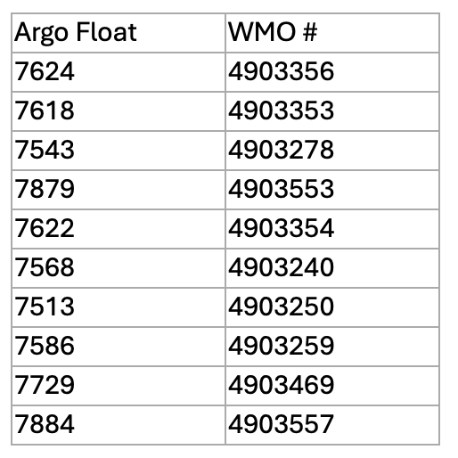
From Amy, Heather & Anna: Treat these Argo floats with caution for currents due to potential grounding. T&S profiles are good.
Tortugas Eddy Floats: 4903466, 4903550

Slide 4
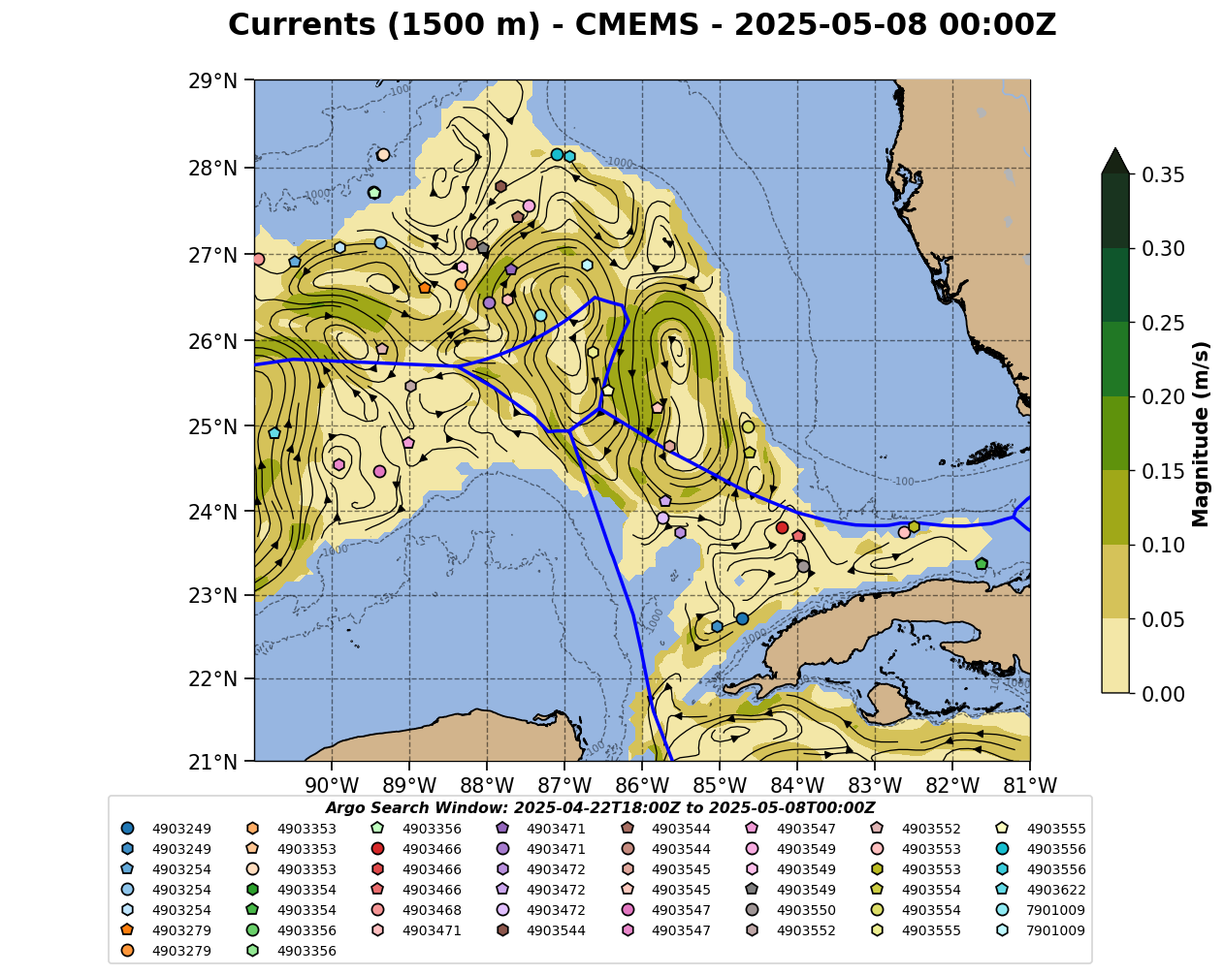
From Amy, Heather & Anna: Treat these Argo floats with caution for currents due to potential grounding. T&S profiles are good.
Tortugas Eddy Floats: 4903466, 4903550

Slide 5
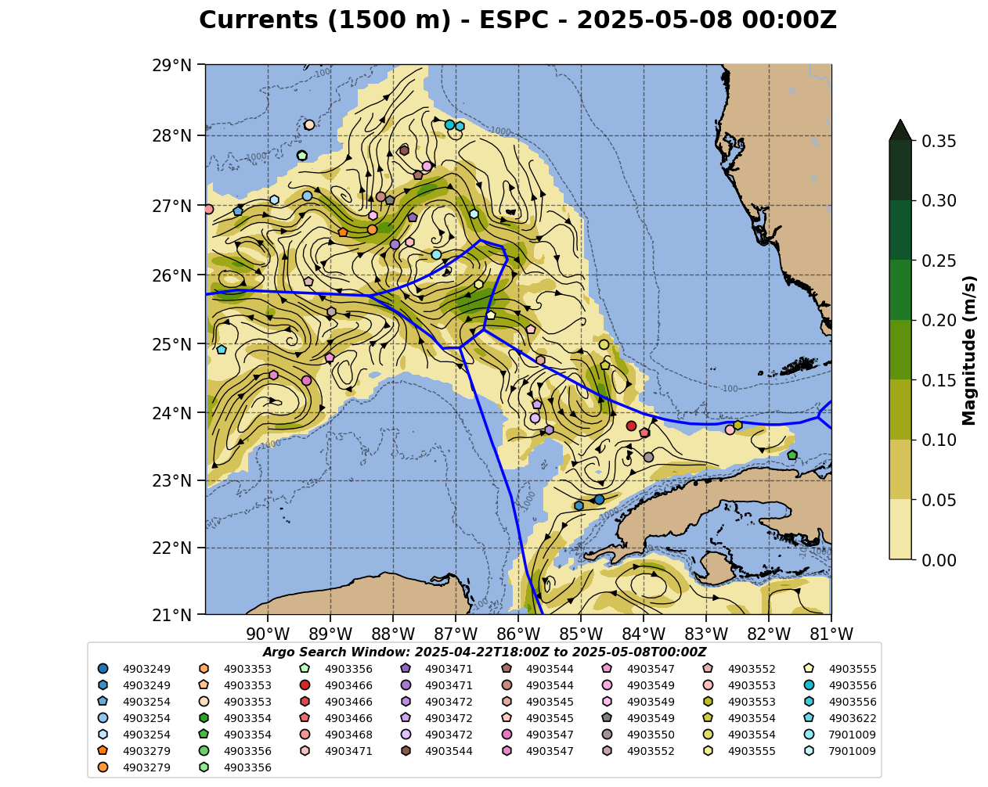
From Amy, Heather & Anna: Treat these Argo floats with caution for currents due to potential grounding. T&S profiles are good.
Tortugas Eddy Floats: 4903466, 4903550

Slide 6
East-West Section: 2025-05-01
Across the narrow neck of the extended Loop.
Slide 7: Navy ESPC - Most energetic in terms of surface evolution of the Loop. Small wavelength meanders grow on both the inflow and outflow and produce a second narrow neck farther north. Yucatan current inflow is strong in all models, but ESPC maximum velocity location does not change with depth. Salinity maximum is not responding the to the profile data. Outflow still has the strongest deep currents. Tortugas eddy is most like an eddy.
Slide 8: NOAA RTOFS - Loop Current inflow is strong and maximum velocity axis tilts inward with depth. Salinity max of Gulf outflow does respond to profile assimilation. Tortugas eddy is most like an elbow.
Slide 9: European CMEMS - The extended Loop has the least amount of small wavelength meanders and shows very little evolution. Loop Current inflow similar to RTOFS. Salinity max is present in both inflow and outflow. Tortugas eddy is more evident below 100 m.

Slide 7
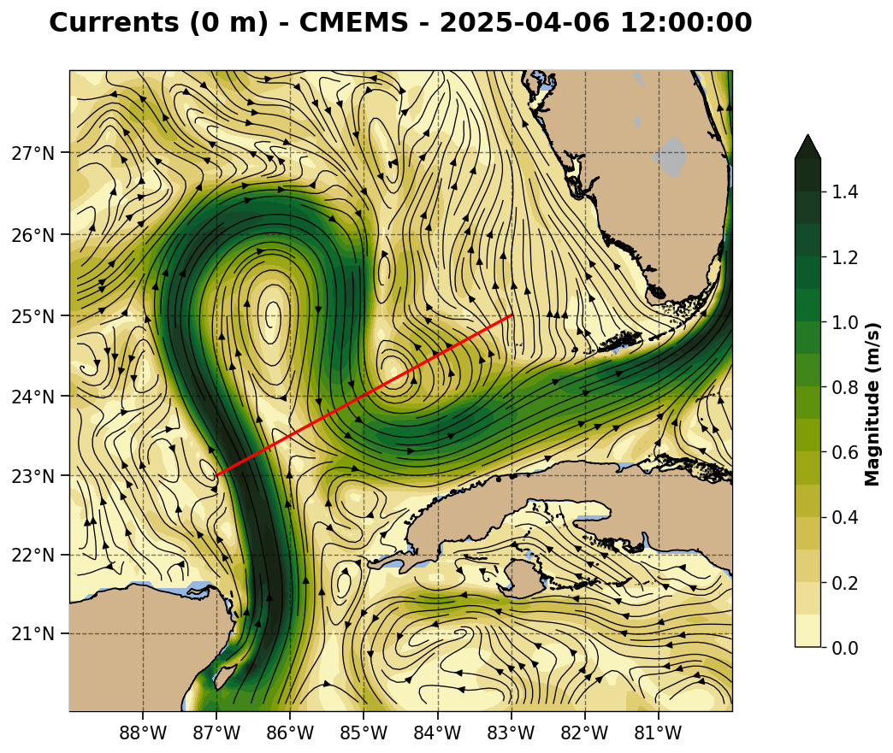
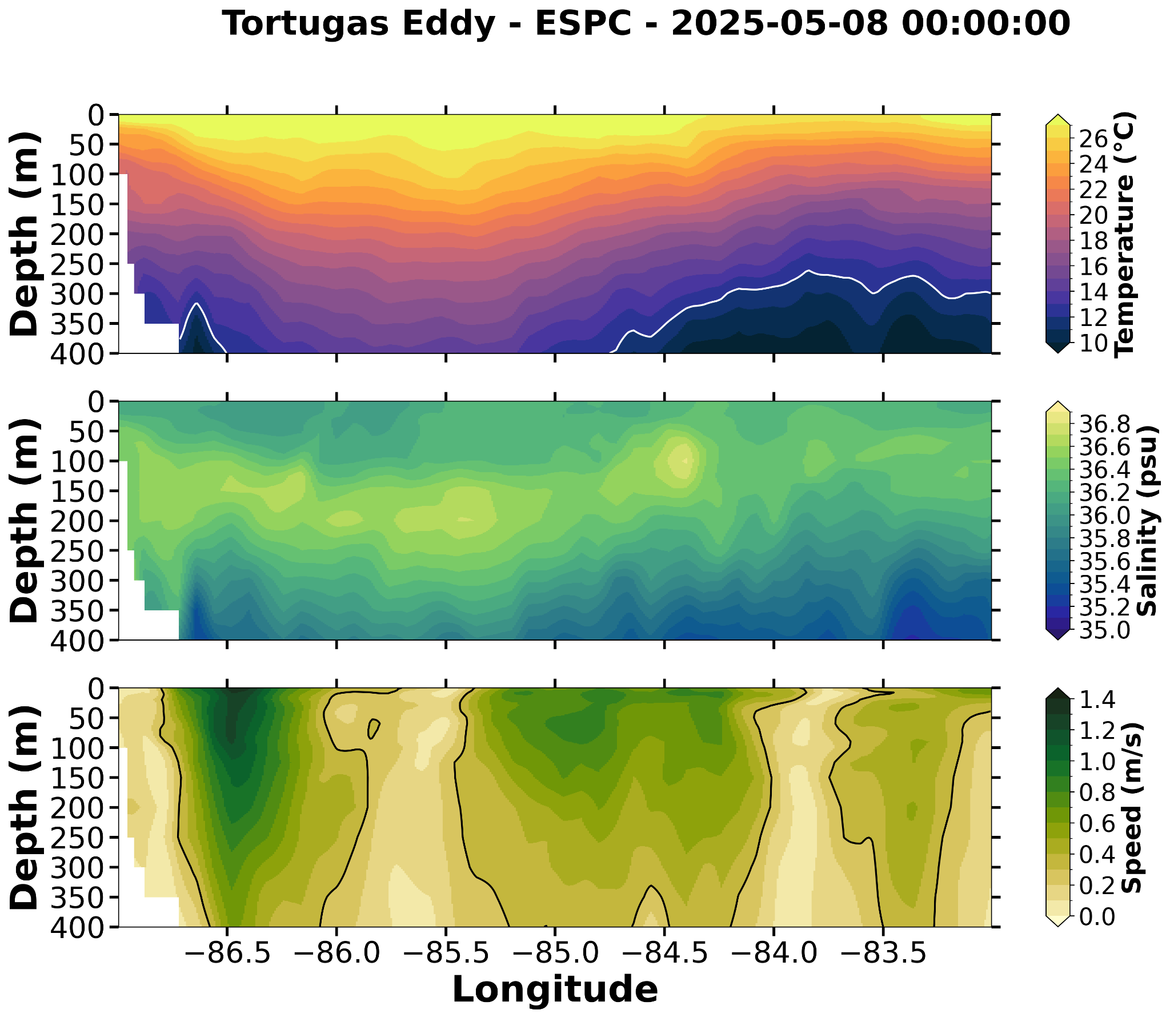
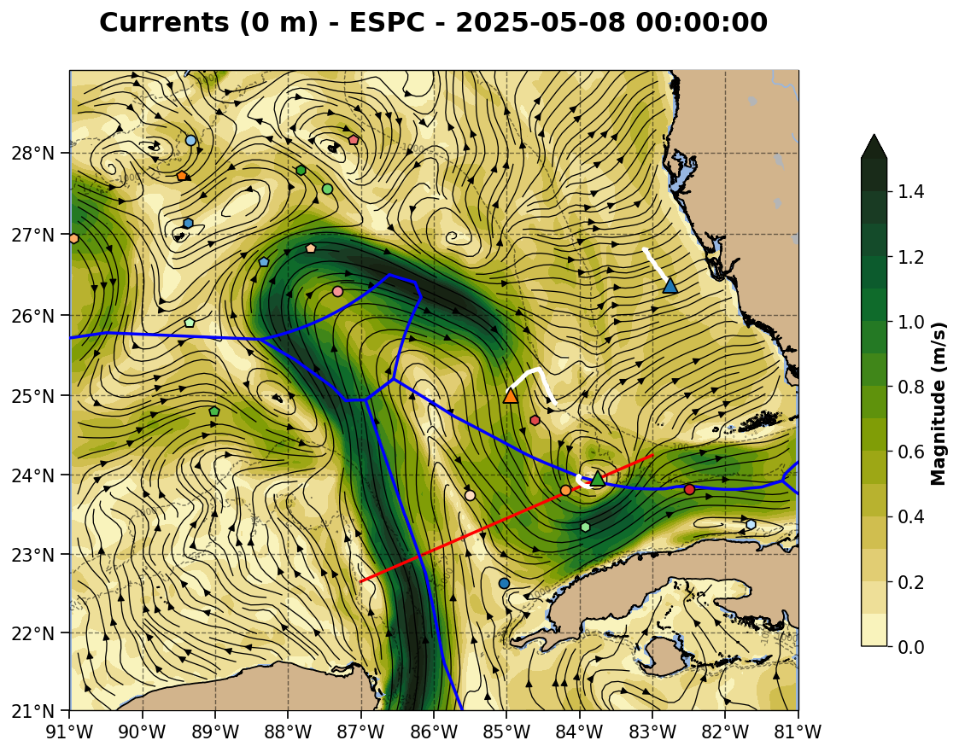
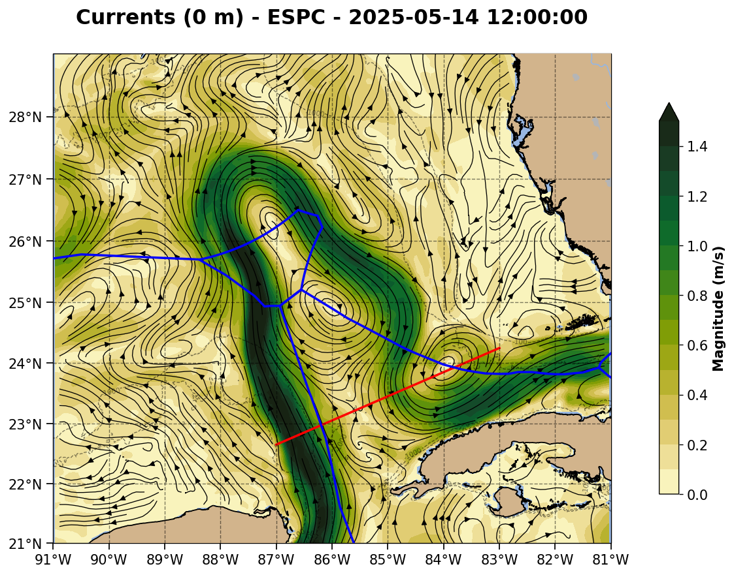

Slide 8
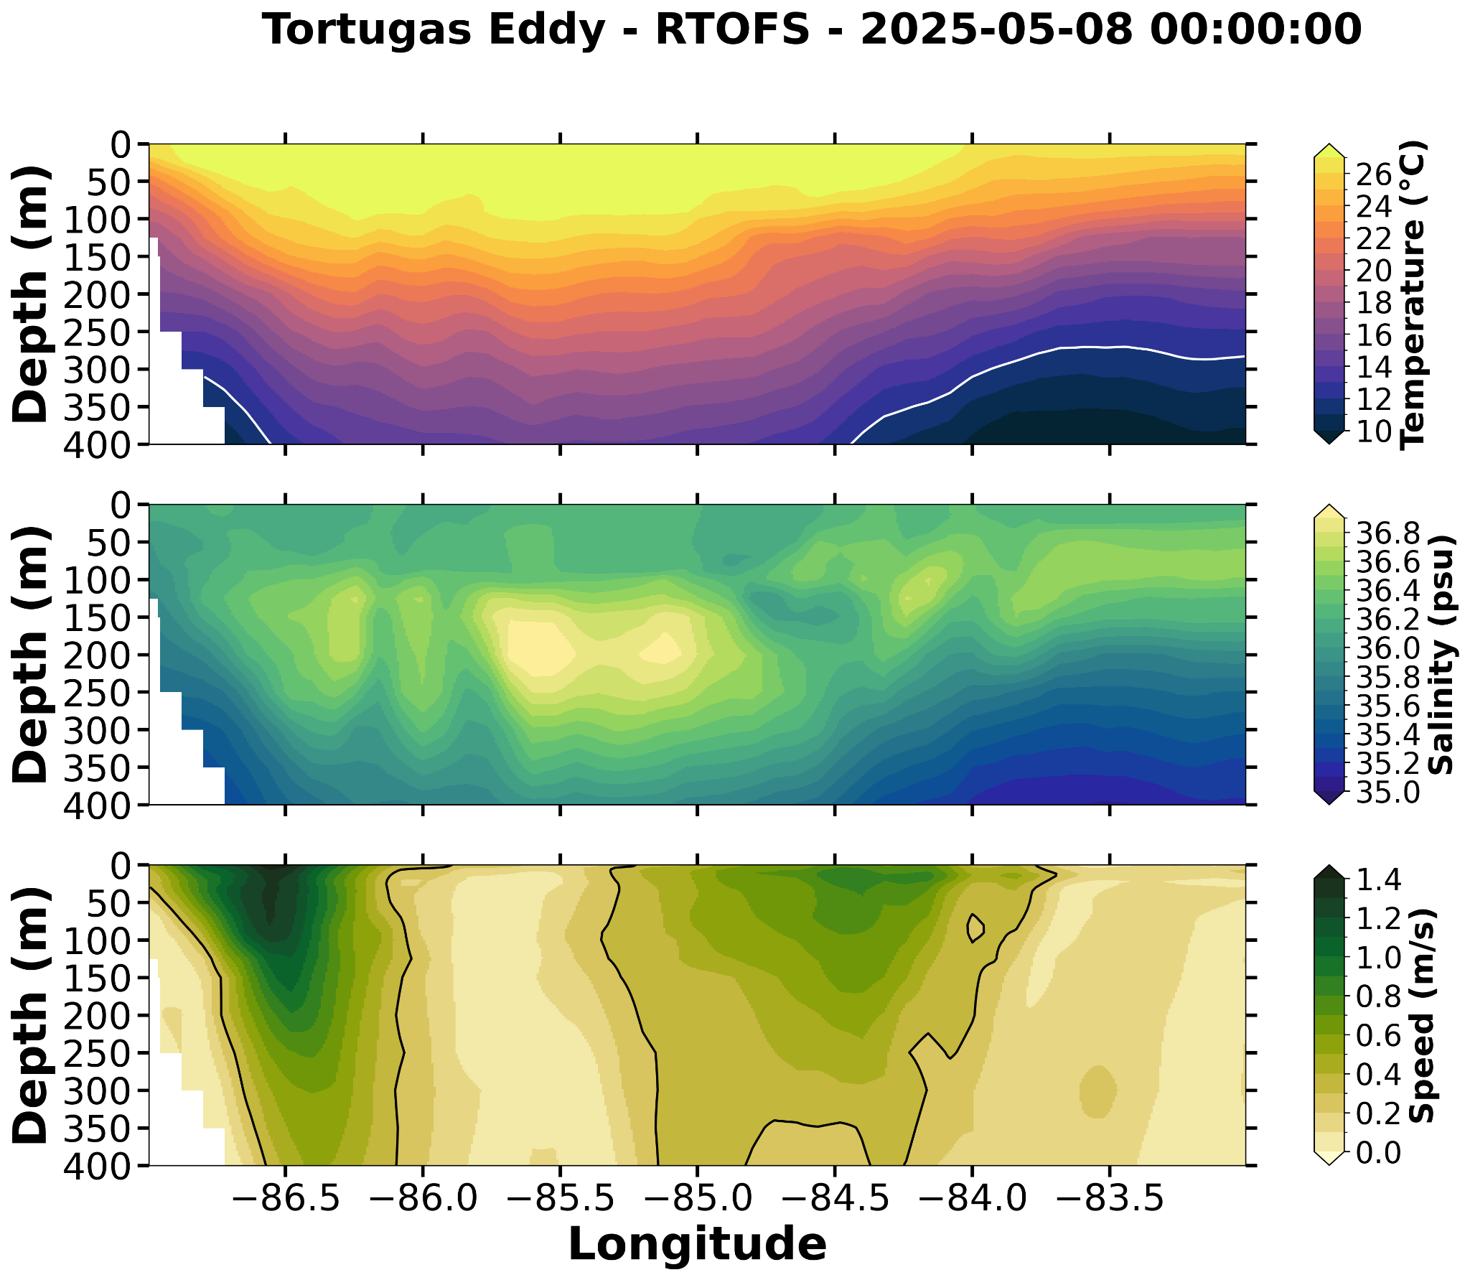
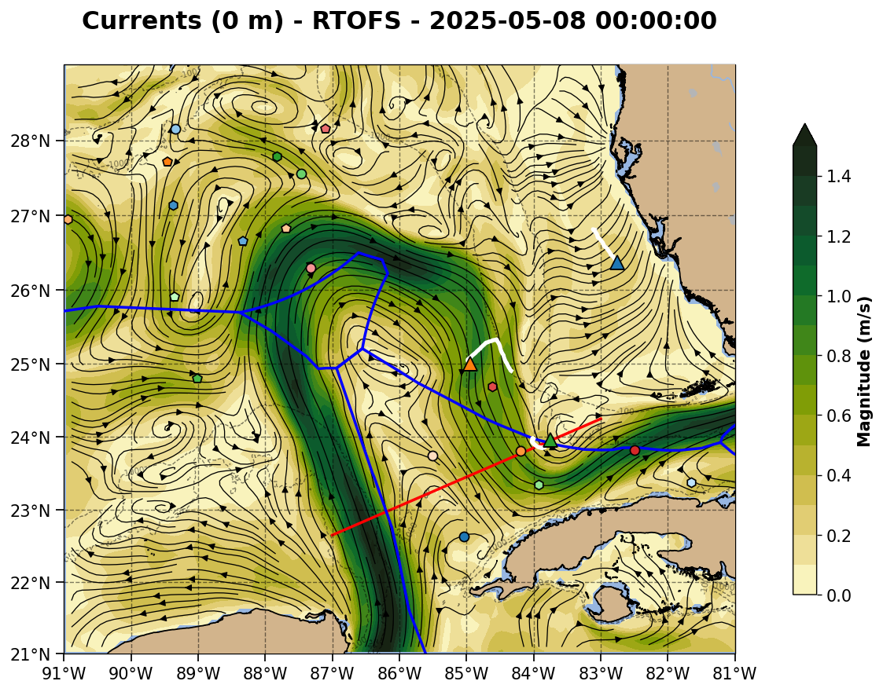
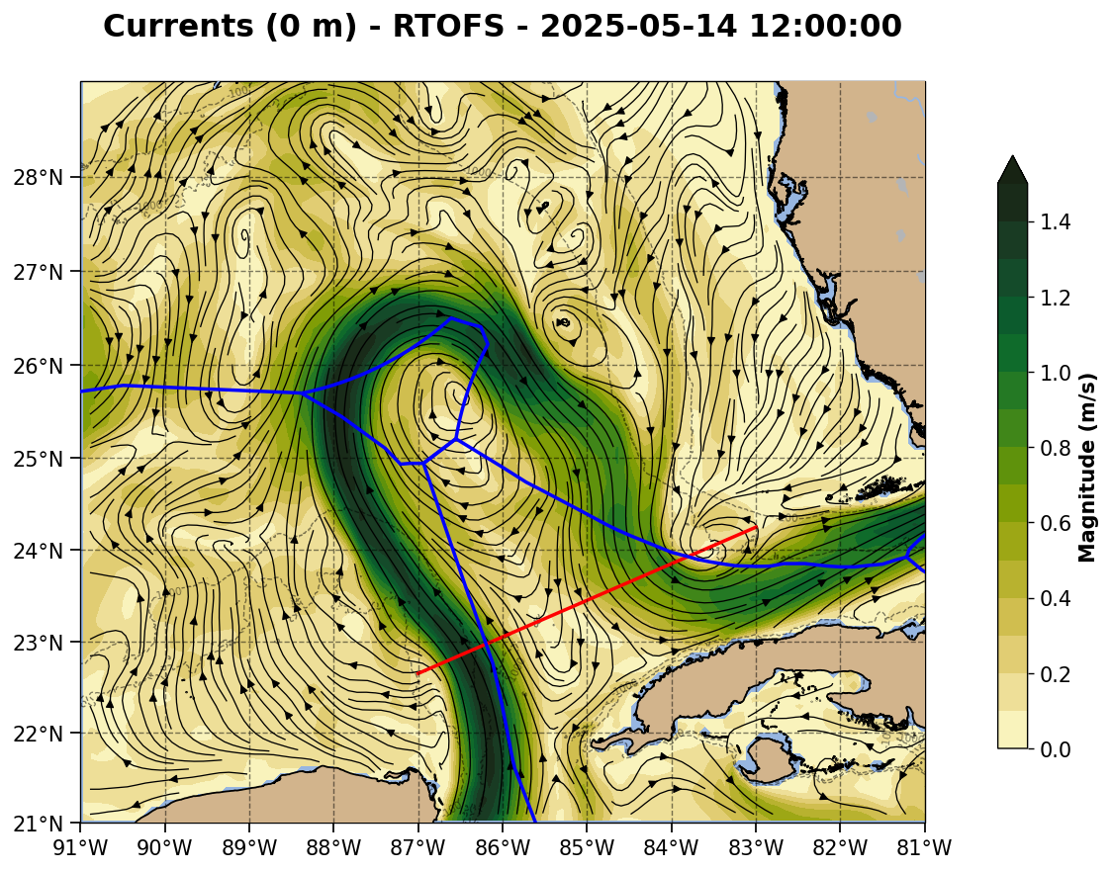

Slide 9
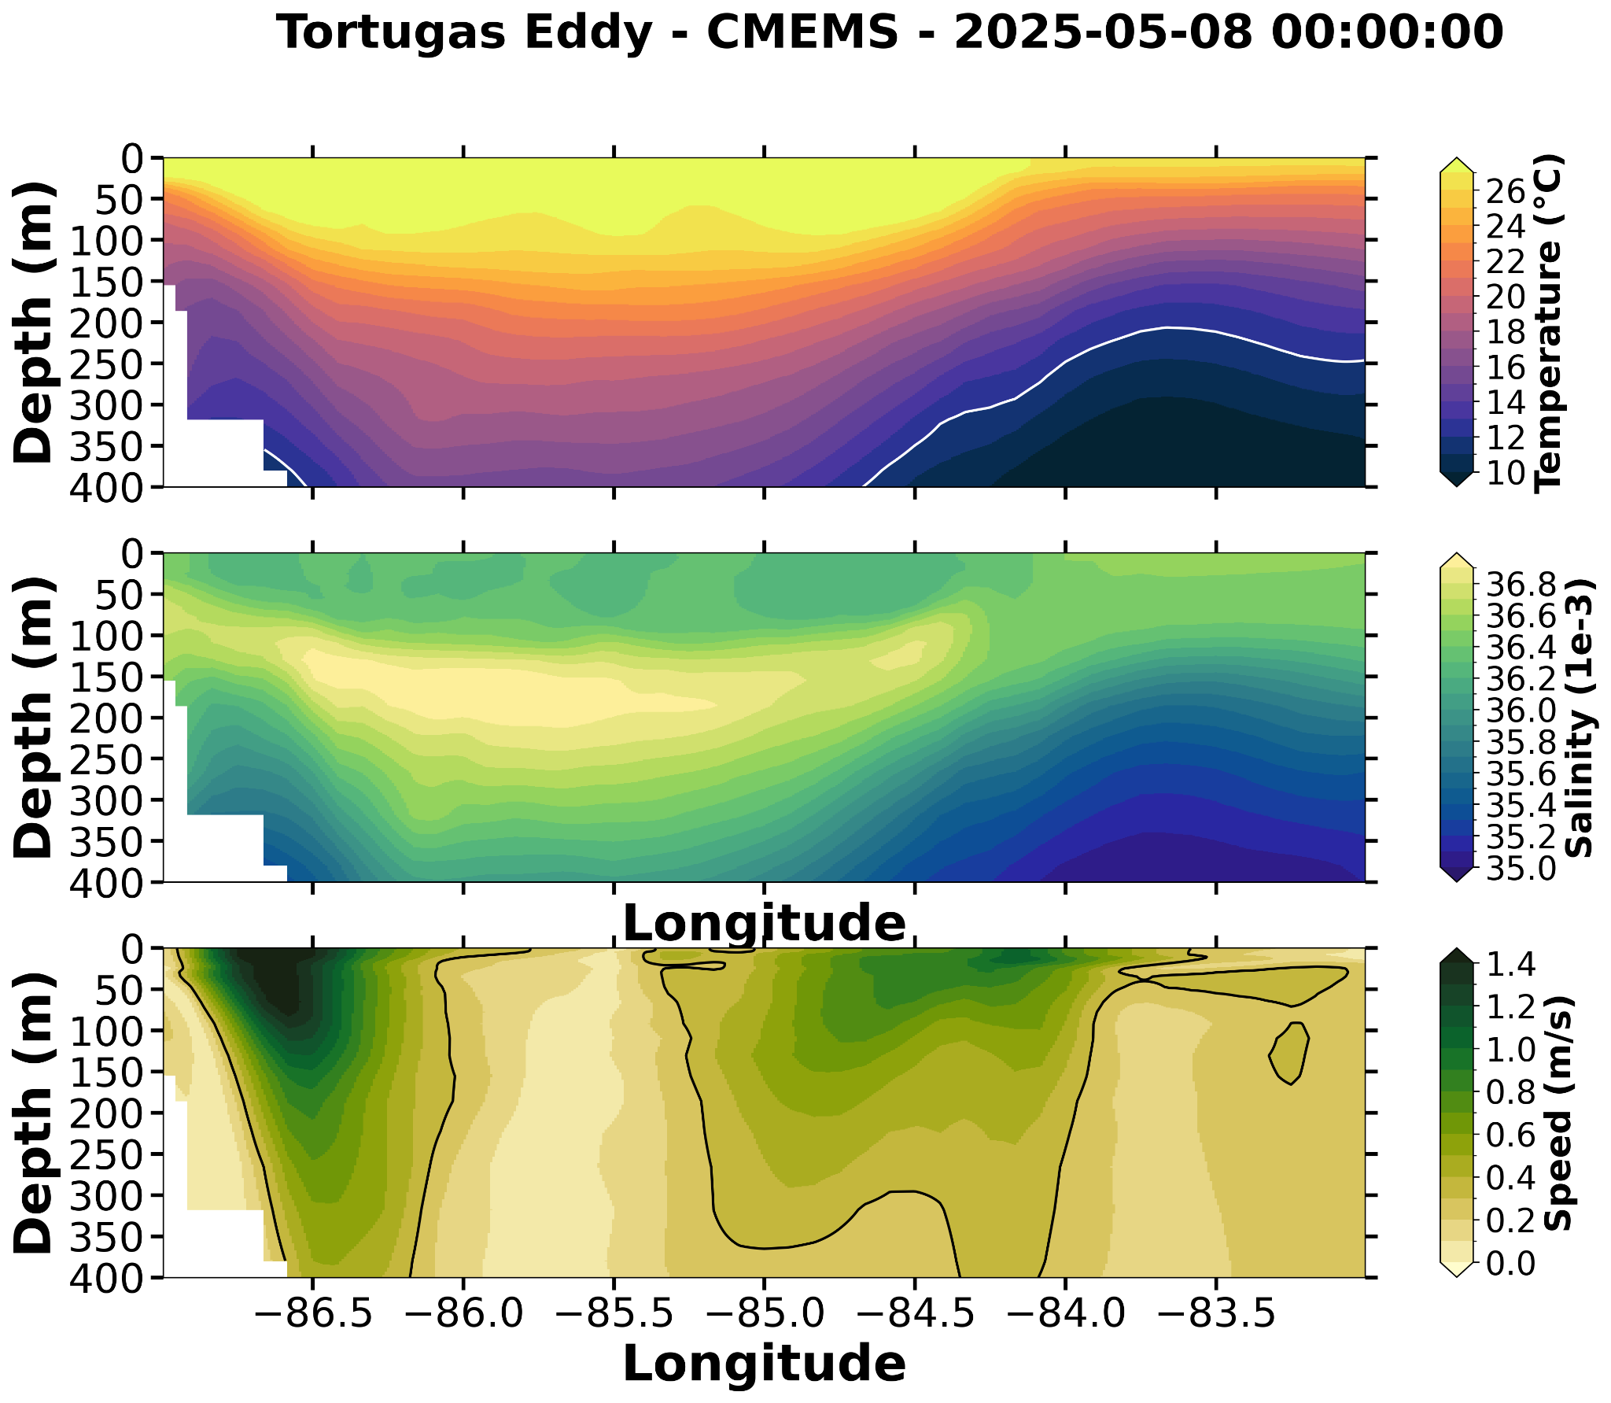
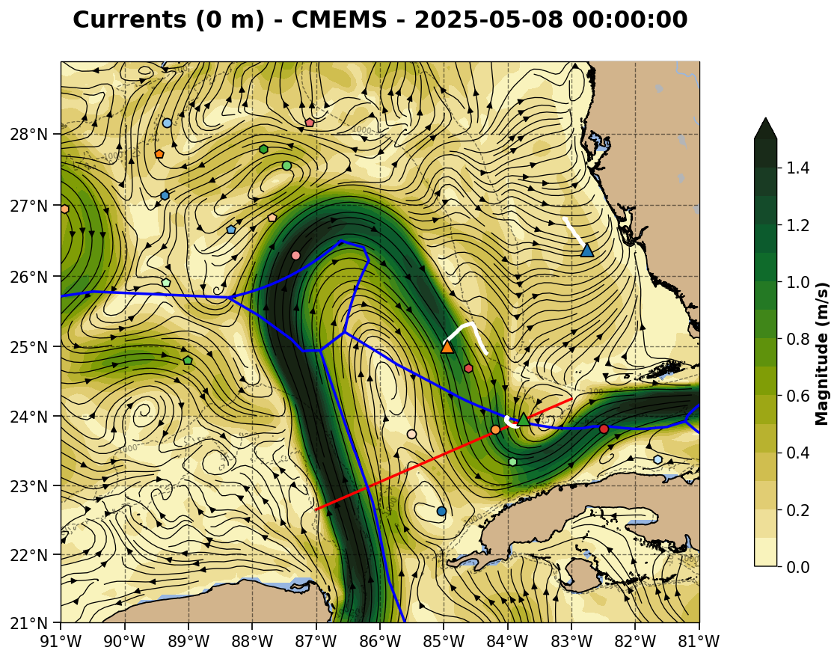
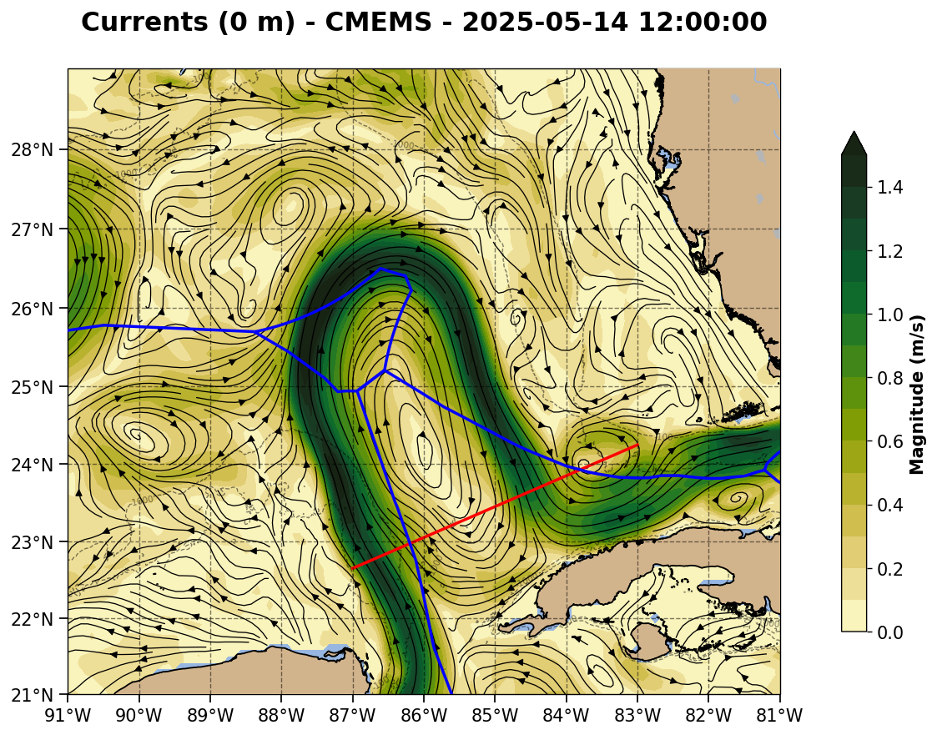

Slide 10
Northwest to Southeast Section: 2025-05-08
Red line is the northwest to southeast section.
Slide 11: Navy ESPC - Three LC crossings, all of which are broader than the other models but still strong.
Slide 12: NOAA RTOFS - Salinity max observed in multiple locations - thank you RTOFS-DA.
Slide 13: European CMEMS - The Loop Current is more narrow and stronger than the other models. Large area with the subsurface salinity maximum in all three Loop Current crossings.

Slide 11
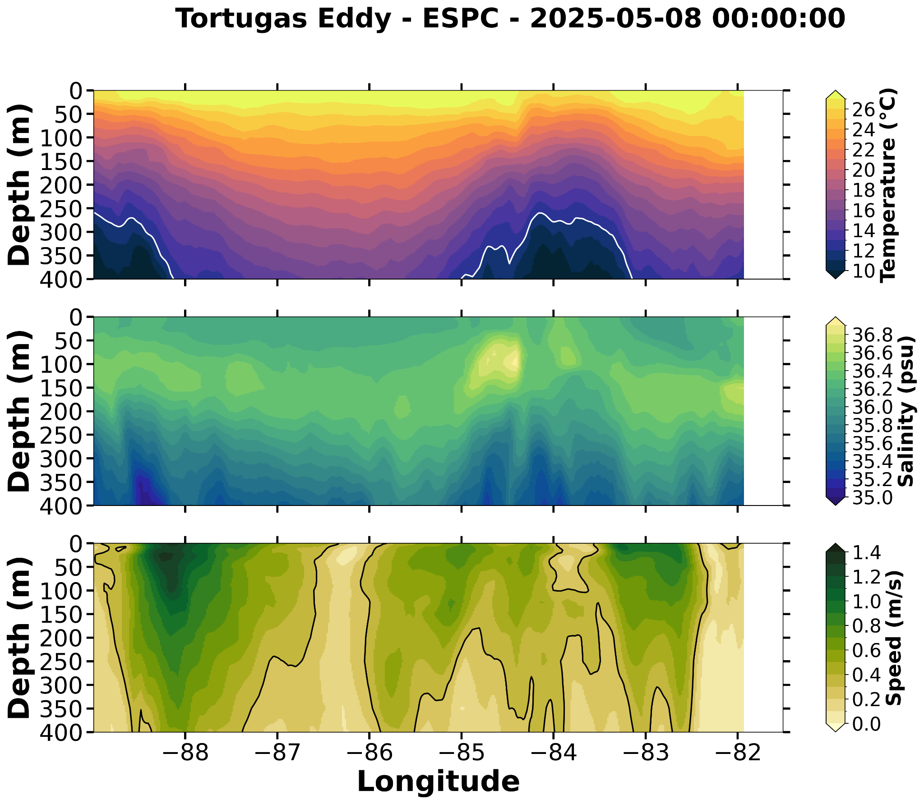
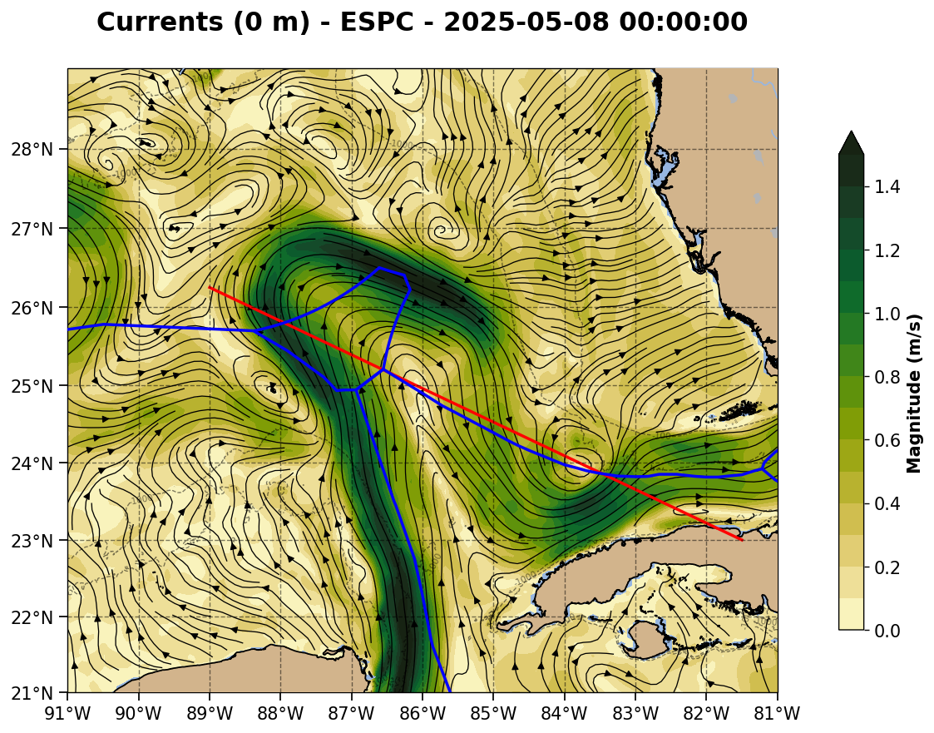
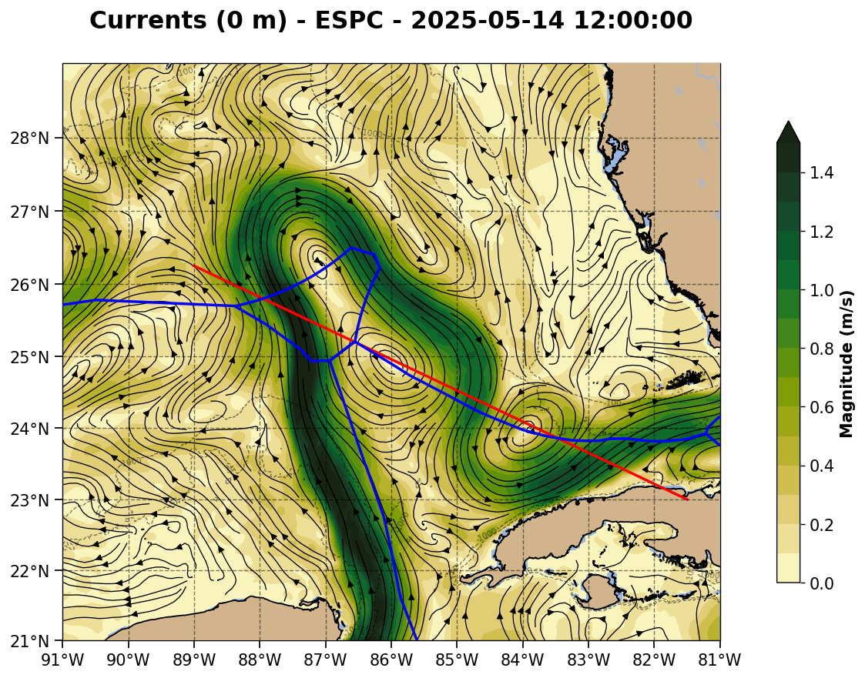

Slide 12
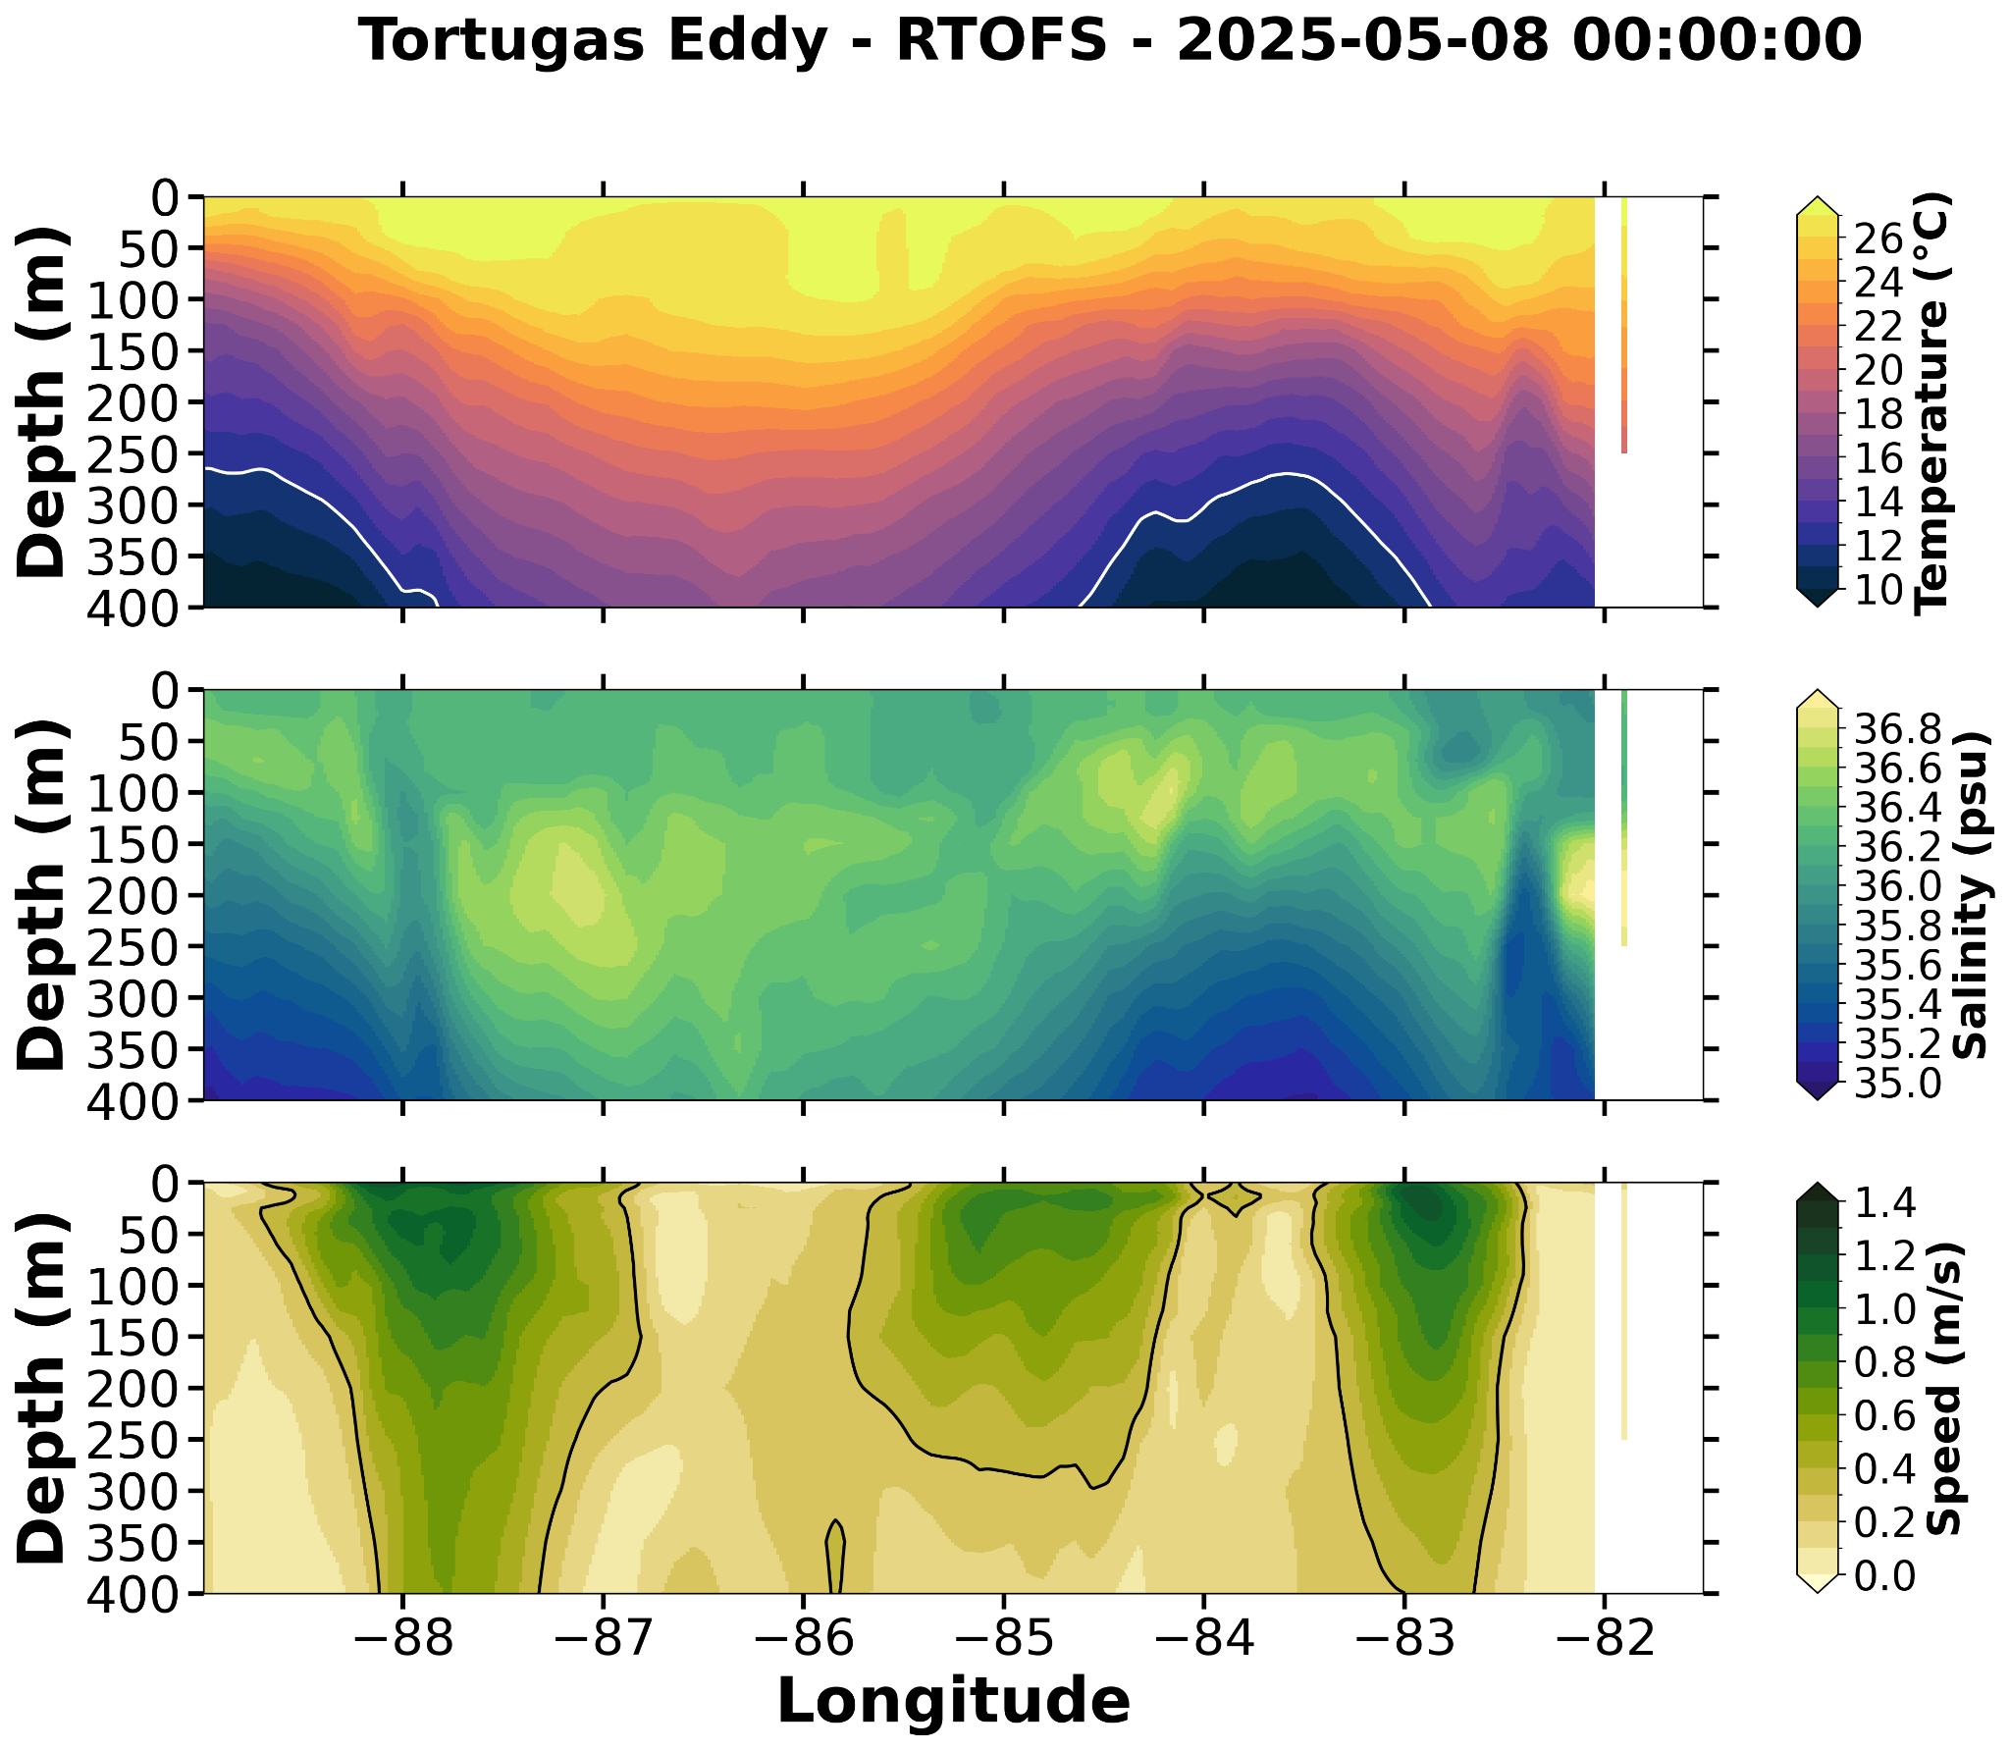



Slide 13
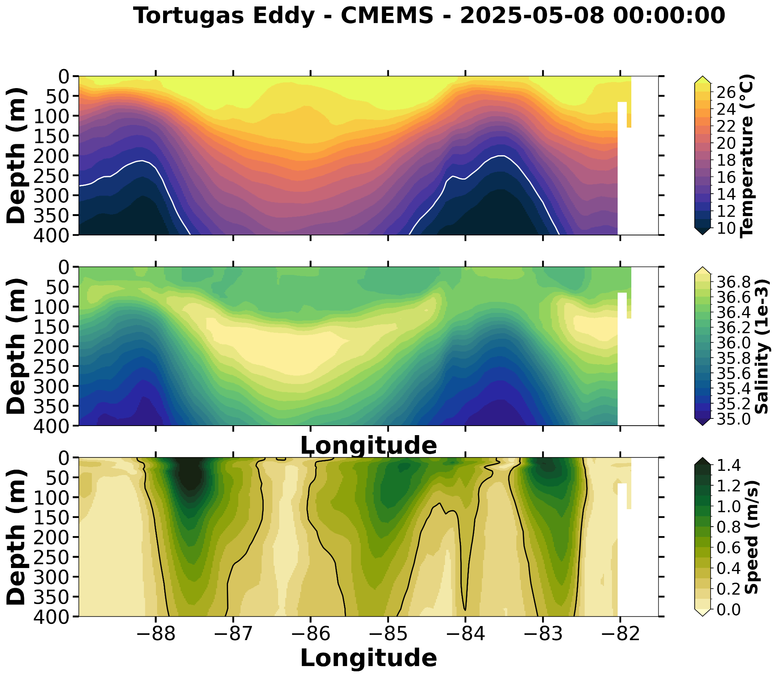
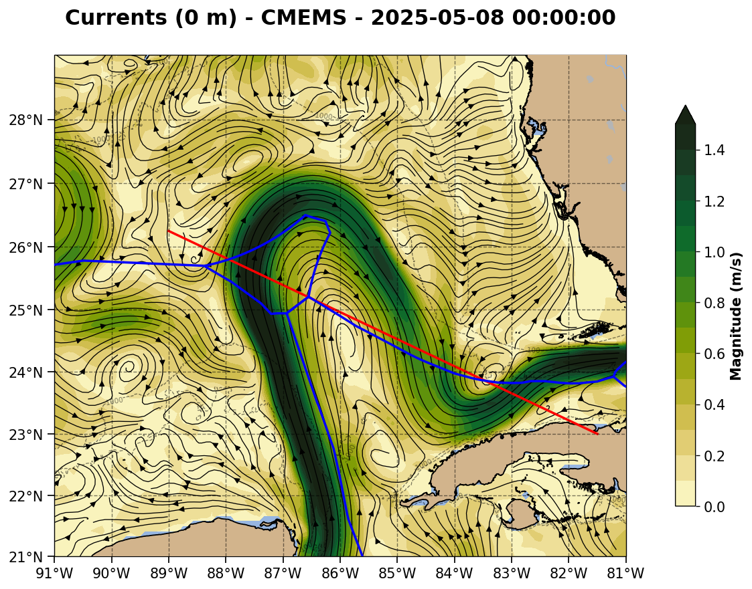


Slide 14
CICESE Gliders: 2025-05-08
Slide 15: Salinity map at 150 m for RTOFS & ESPC - before CICESE glider assimilation.
Slide 16: Profile comparison before assimilation - all models having difficulty.
Slide 17: Salinity map at 150 m for RTOFS & ESPC - after CICESE glider assimilation for about a week. Streaks of high salinity seen streaming into the Gulf.
Slide 18: Profile comparisons after a week of assimilation - all models in better agreement with assimilated glider profile that was not assimilated. US models do not match the performance of the European model.

Slide 15
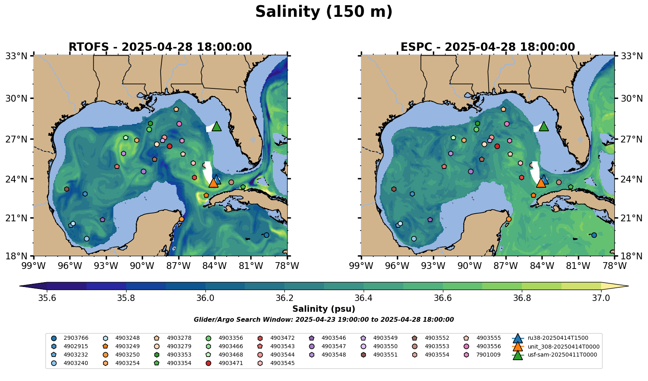

Slide 16
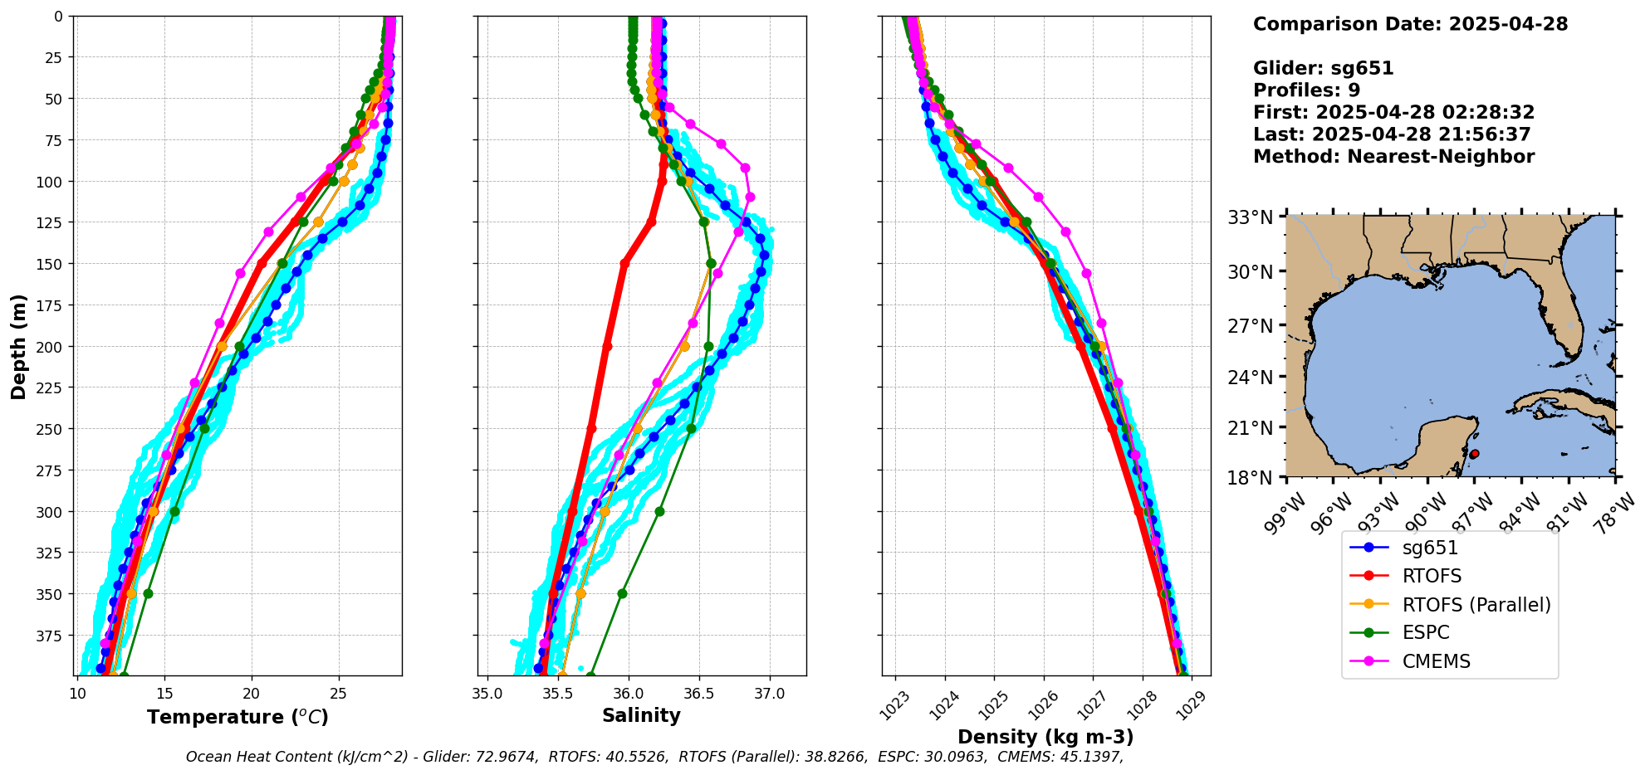
CICESE Glider/Model data comparison before any assimilation

Slide 17
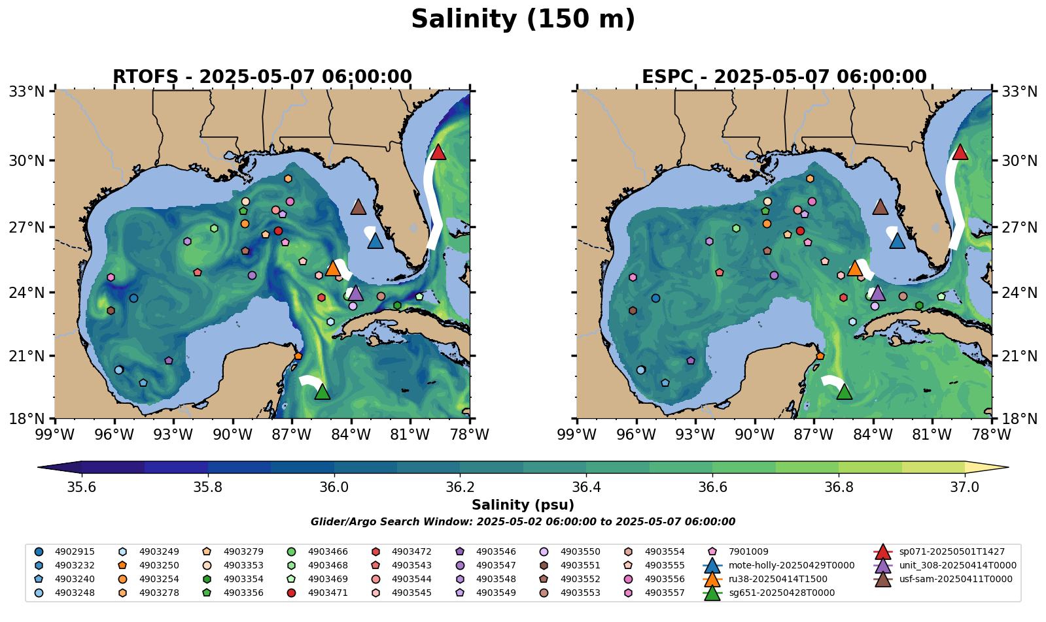

Slide 18
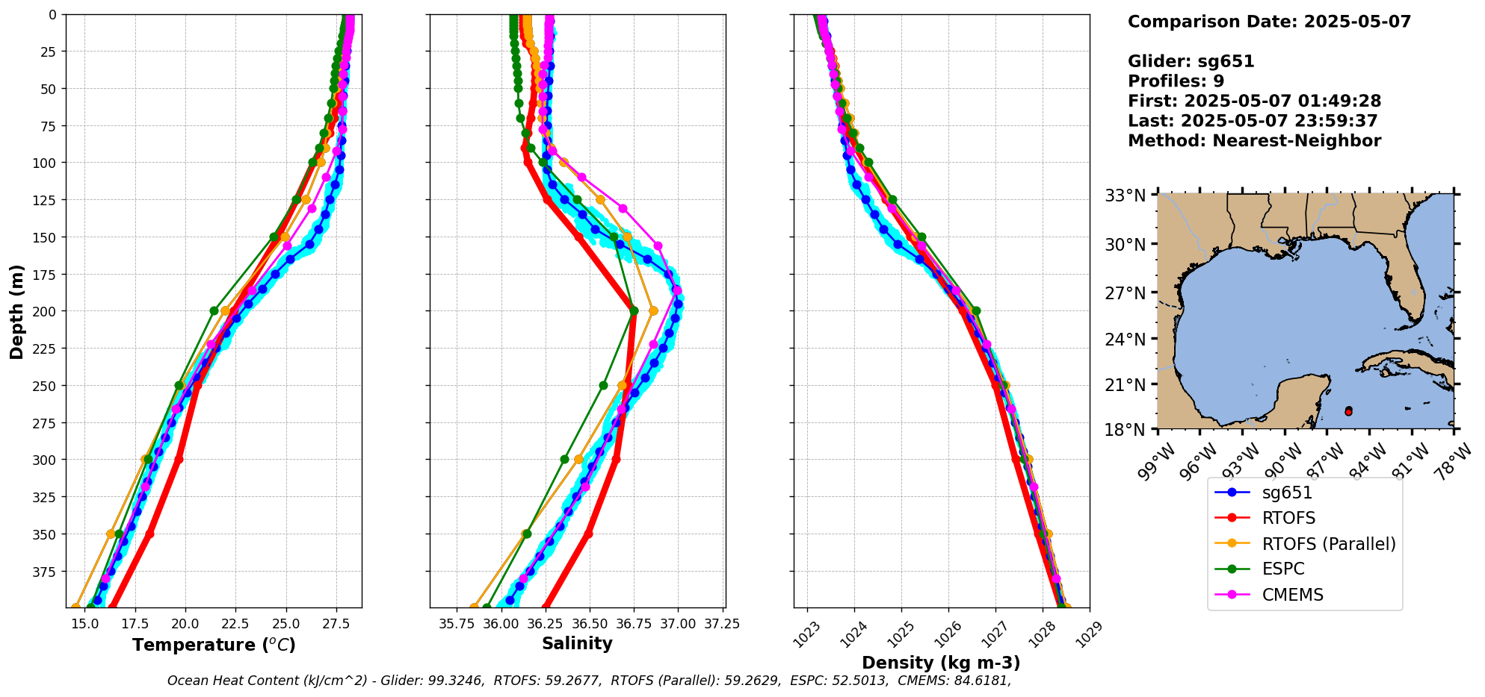
RU38 Glider/Model data comparison after 4/29 data was assimilated

