Slide 1
Summary: 2025-05-01
Operational model summary: European CMEMS site extremely slow on 4/30.
Slides 2-4: Currents at the 1500 m park depth of the Argo Floats. Amy, Heather & Anna check which floats are grounded. Together we are developing the visualization tools.
Slides 5-8: Southwest to northeast cross-section through the narrow neck of the LC, the center of the TCR, and weak northeast side of the TCR.
Slides 9-12: Northwest to southeast line through the center of the extended LC and the TCR.
Slides 13-26: Numerous model/data profile comparisons, starting with the Glider DAC map with CICESE glider now included, and ending with what Argo and gliders pass the EMC QC for DA.

Slide 2
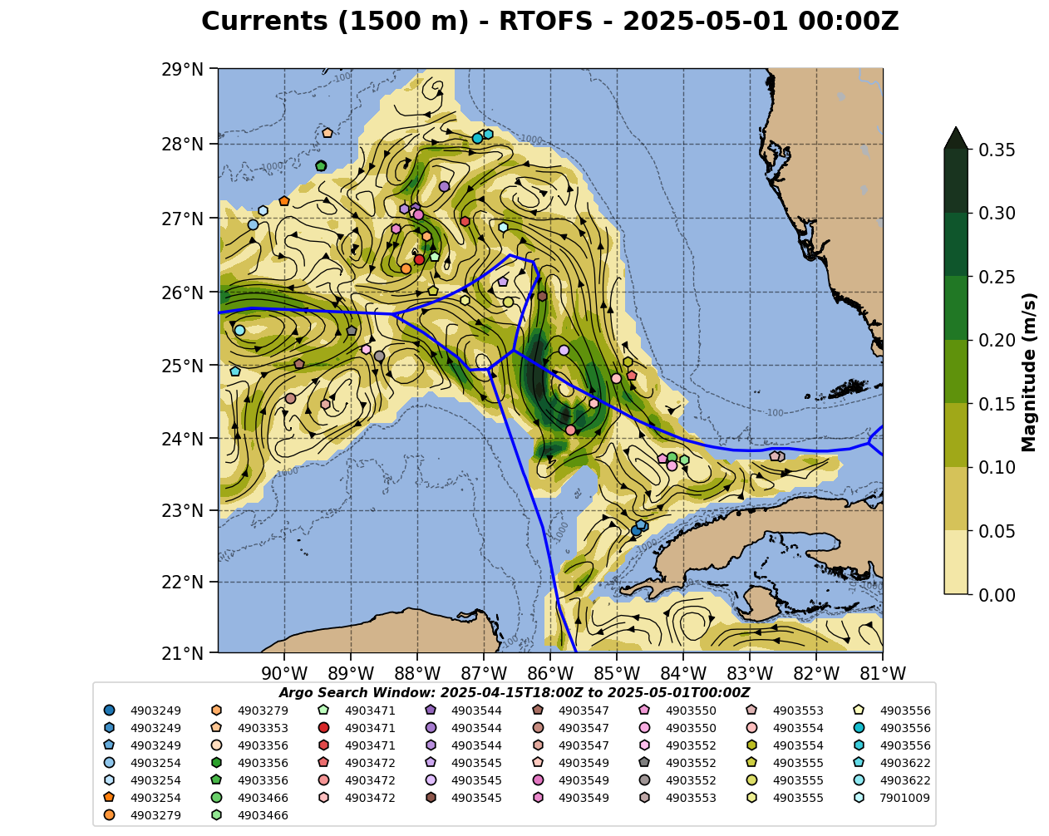
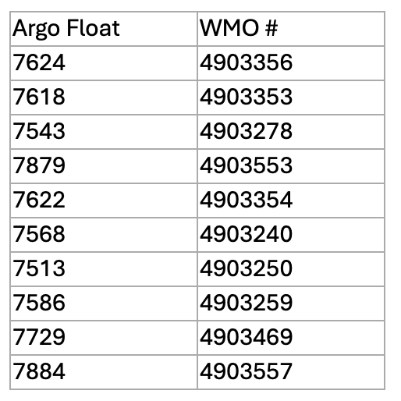
From Amy, Heather & Anna: Treat these Argo floats with caution for currents due to potential grounding. T&S profiles are good.
Tortugas Eddy Floats: 4903466, 4903550

Slide 3
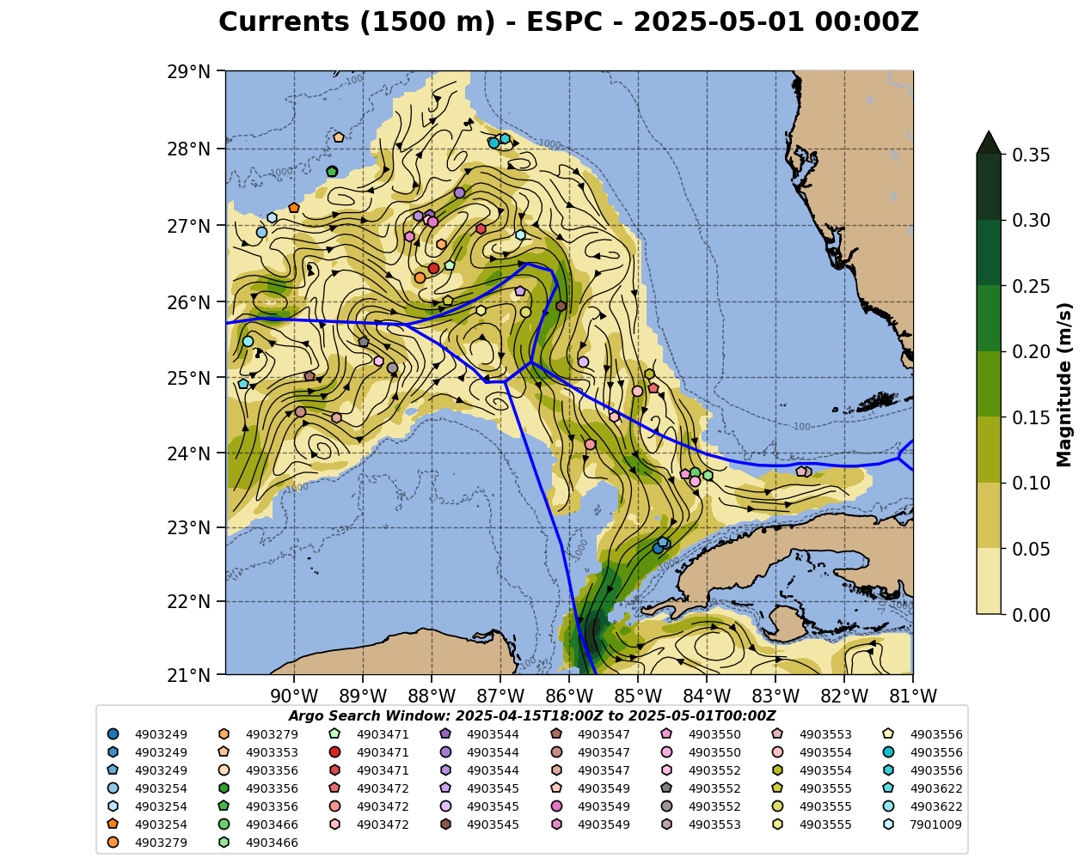
From Amy, Heather & Anna: Treat these Argo floats with caution for currents due to potential grounding. T&S profiles are good.
Tortugas Eddy Floats: 4903466, 4903550

Slide 4
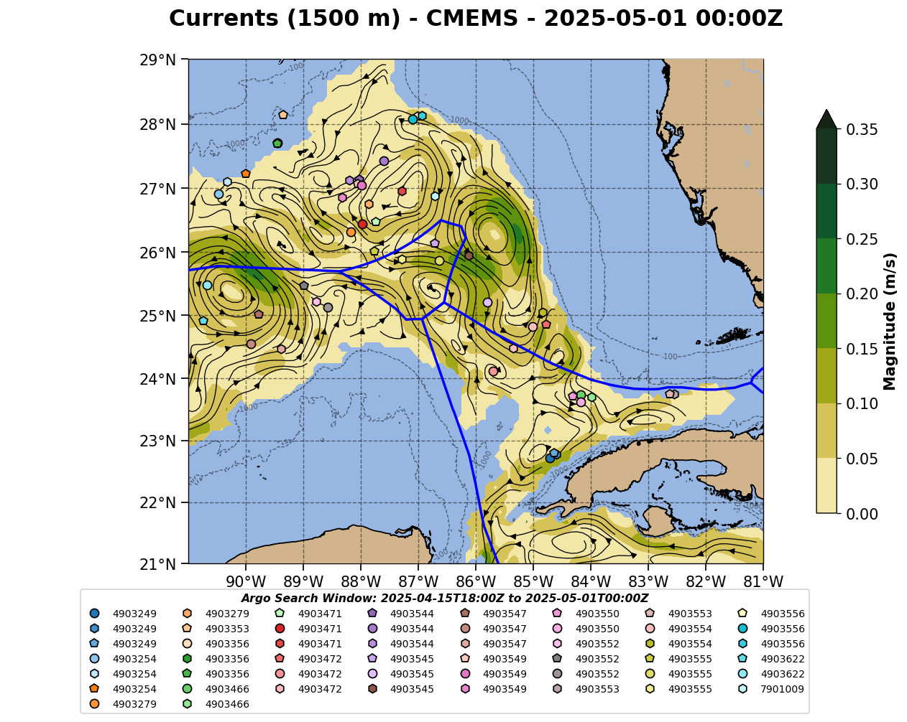
From Amy, Heather & Anna: Treat these Argo floats with caution for currents due to potential grounding. T&S profiles are good.
Tortugas Eddy Floats: 4903466, 4903550

Slide 5
Summary: 2025-05-01
Red line is the southwest to northeast section.
Slide 6: Navy ESPC - Yucatan current inflow is strong, narrow and deep, with the meander trough propagating downstream. Florida shelf side is much broader, with very weak currents on the northeast side of TCE. No sign of LCE formation
Slide 7: NOAA RTOFS - Loop Current is weaker and shallower than ESPC for both the Yucatan inflow and the West Florida Shelf. Stronger currents on northeast side of TCE.
Slide 8: European CMEMS or NOAA RTOFS Parallel

Slide 6
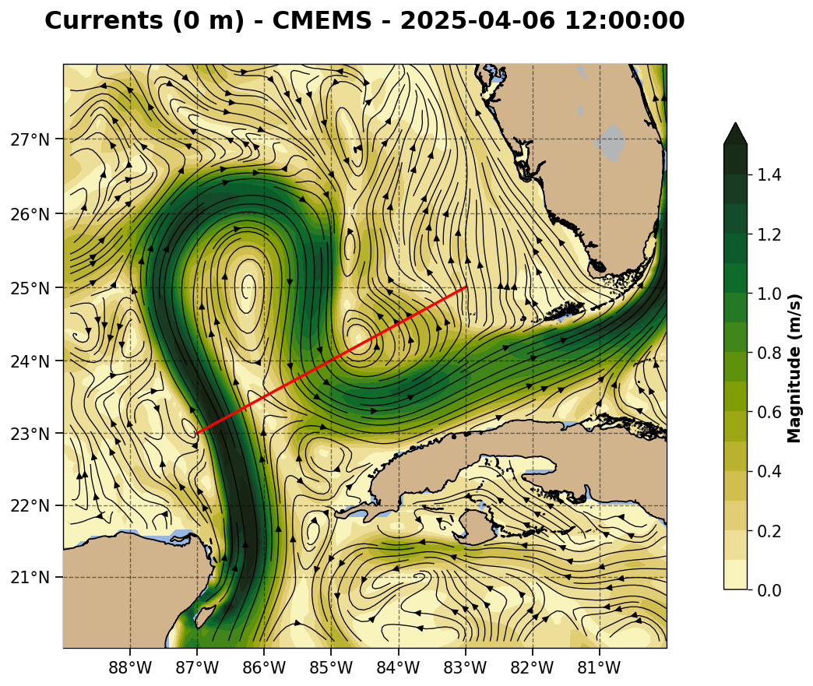
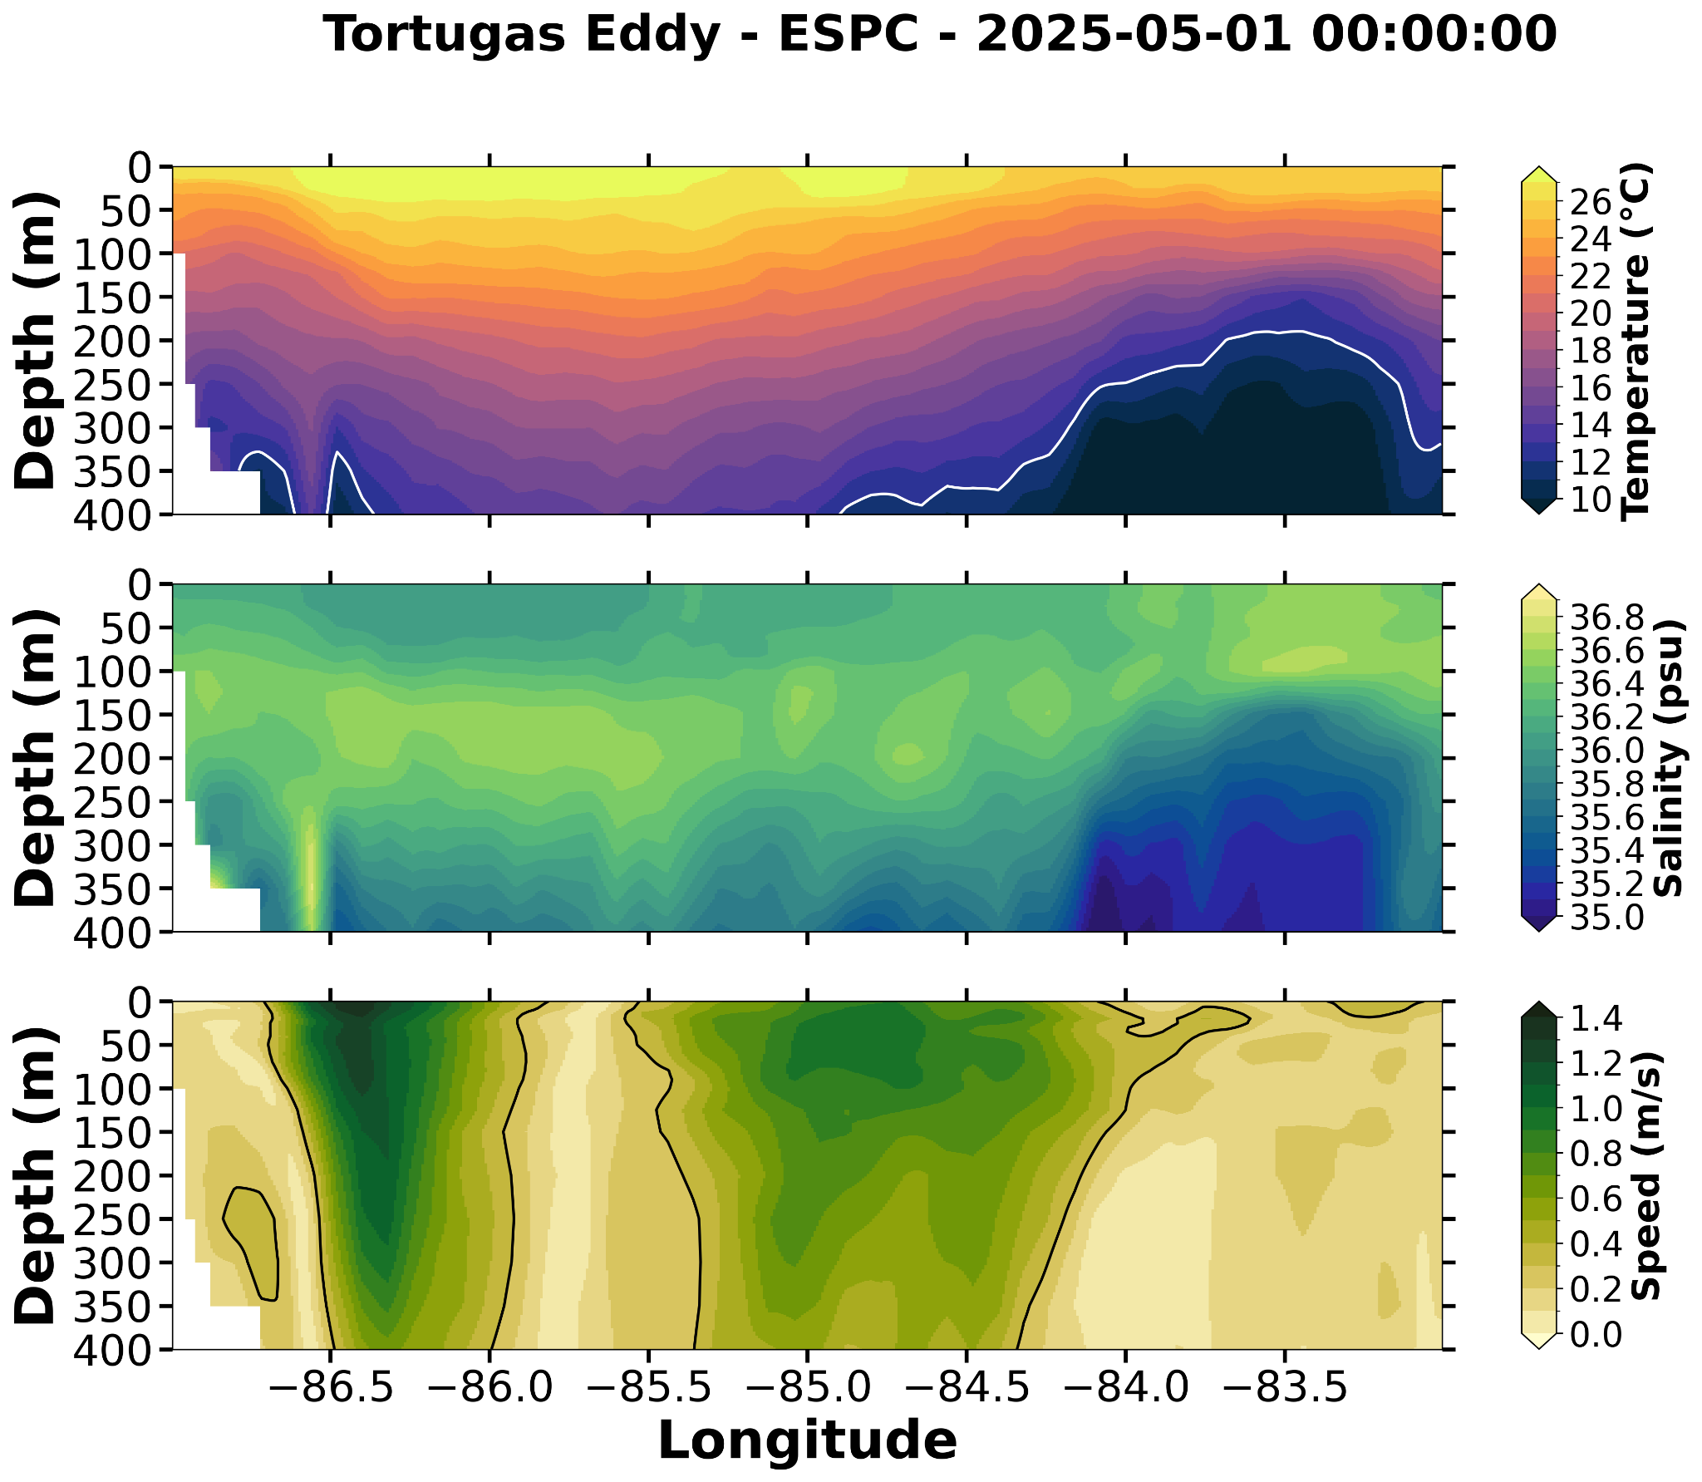
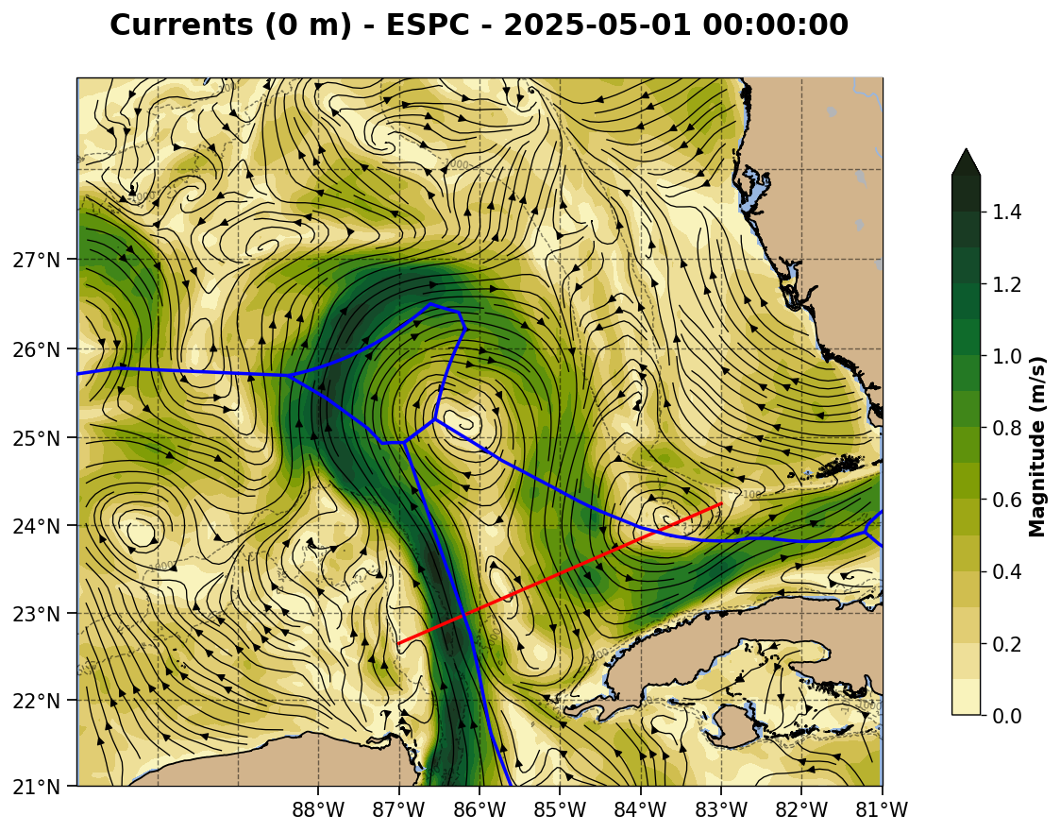
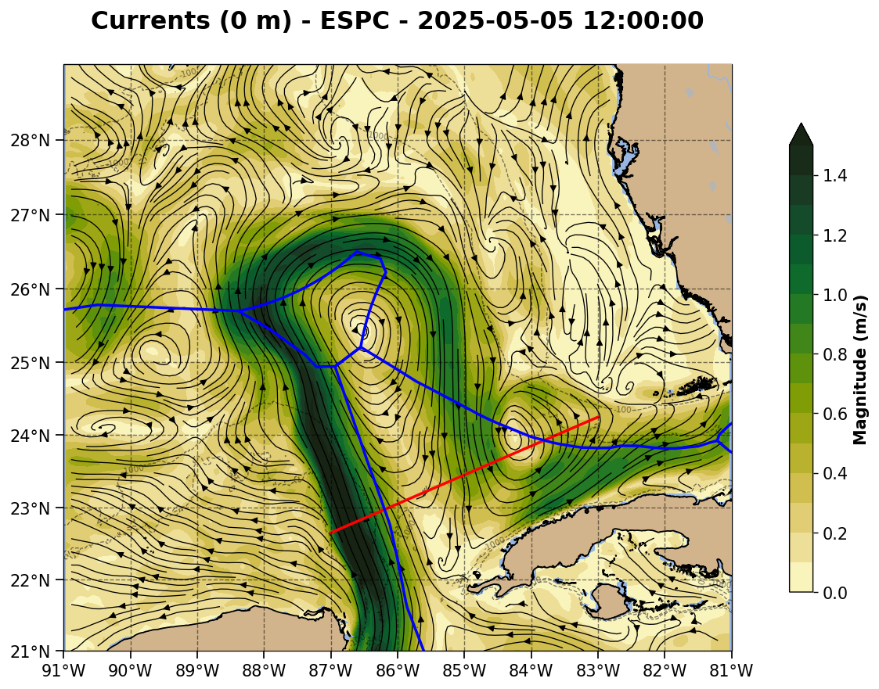

Slide 7
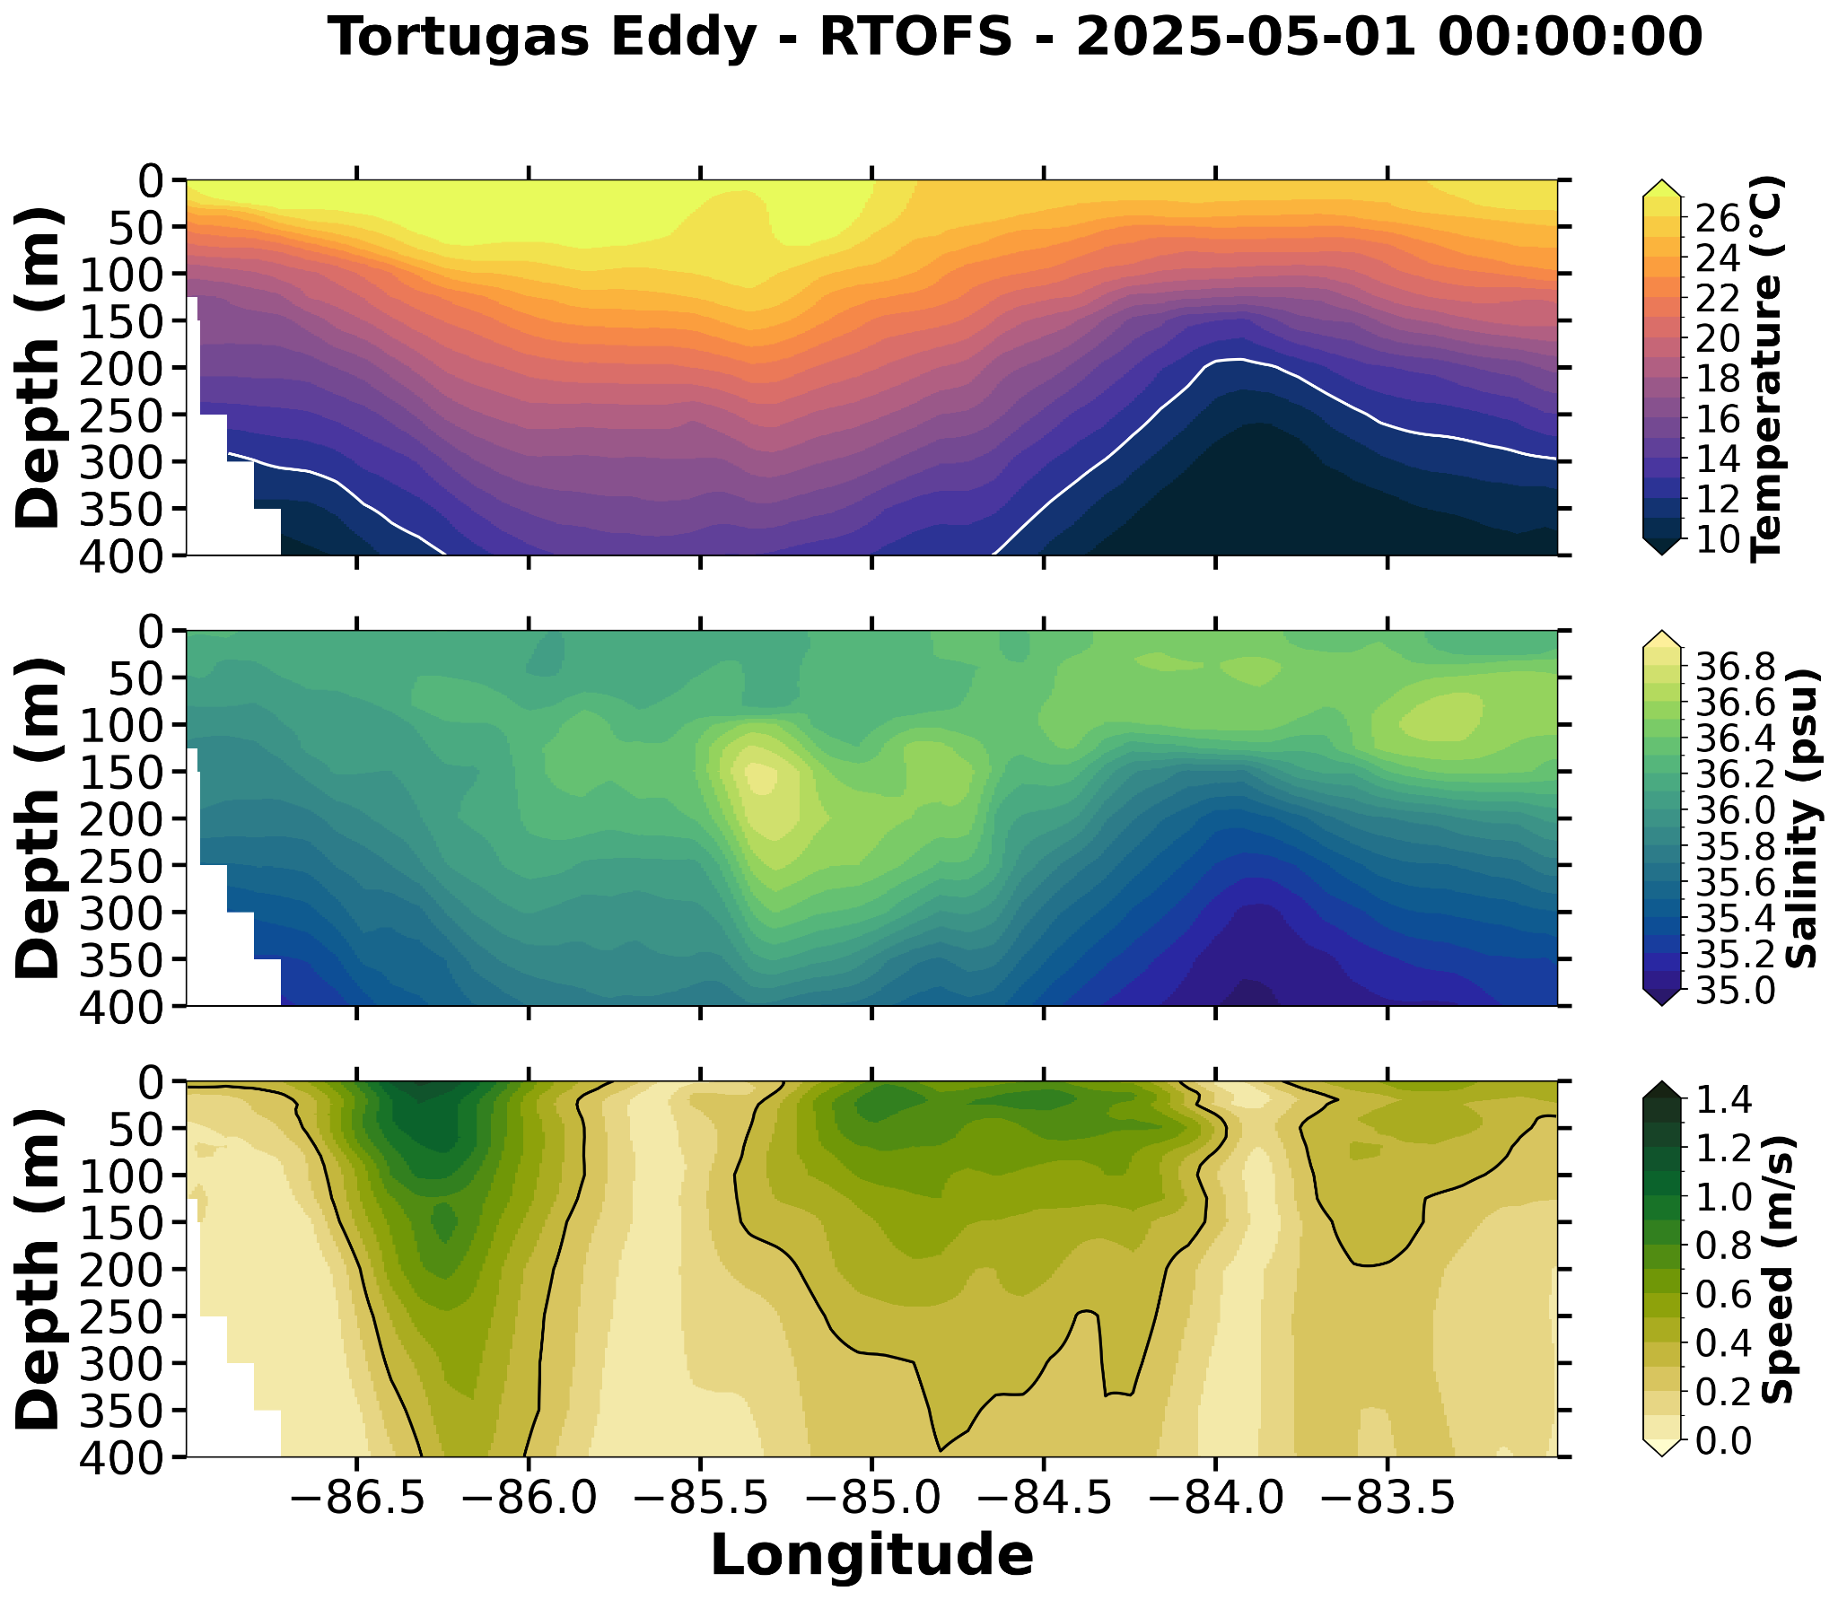
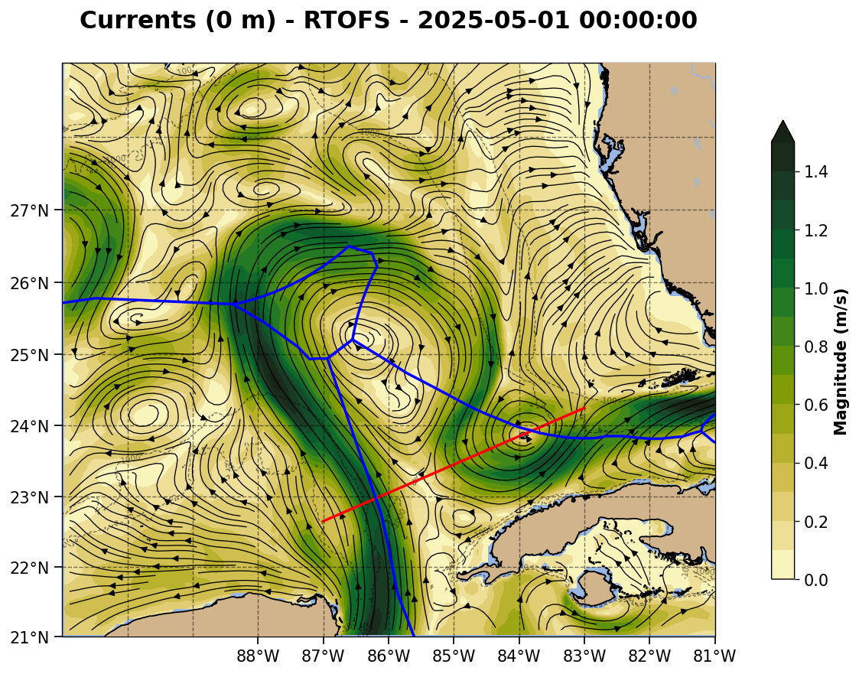
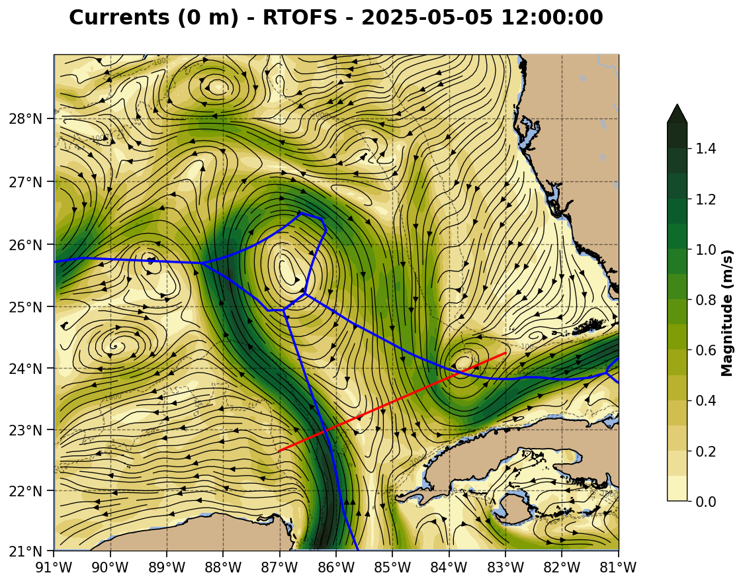

Slide 8
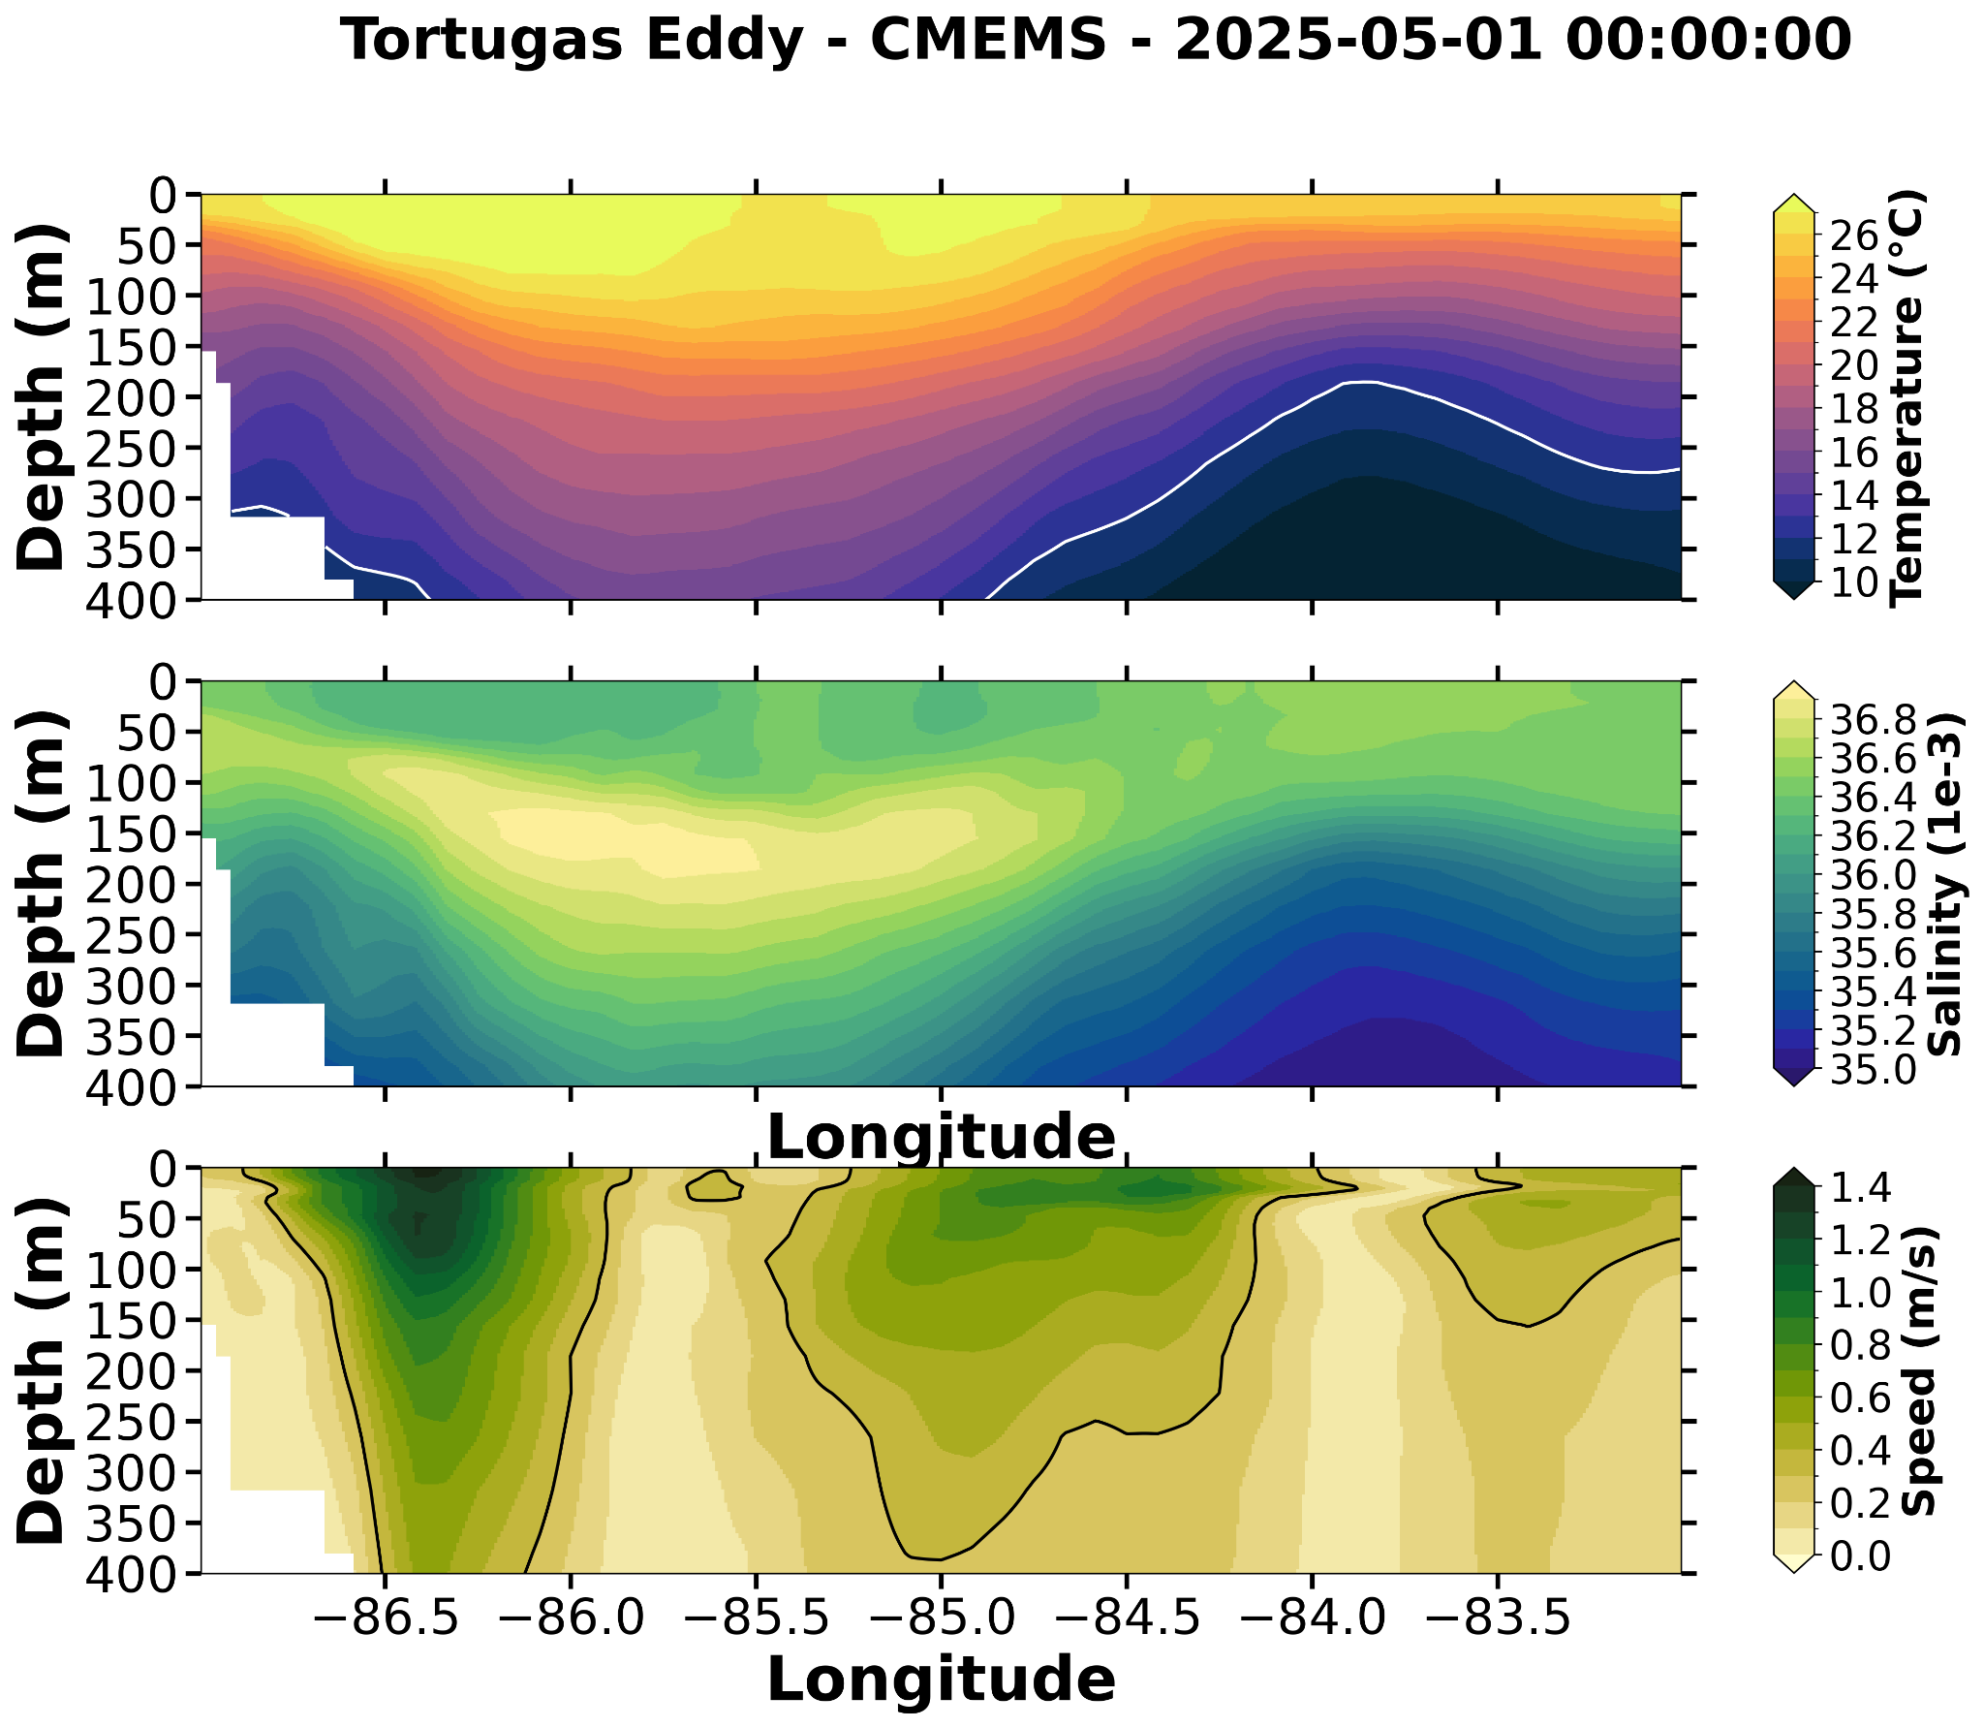
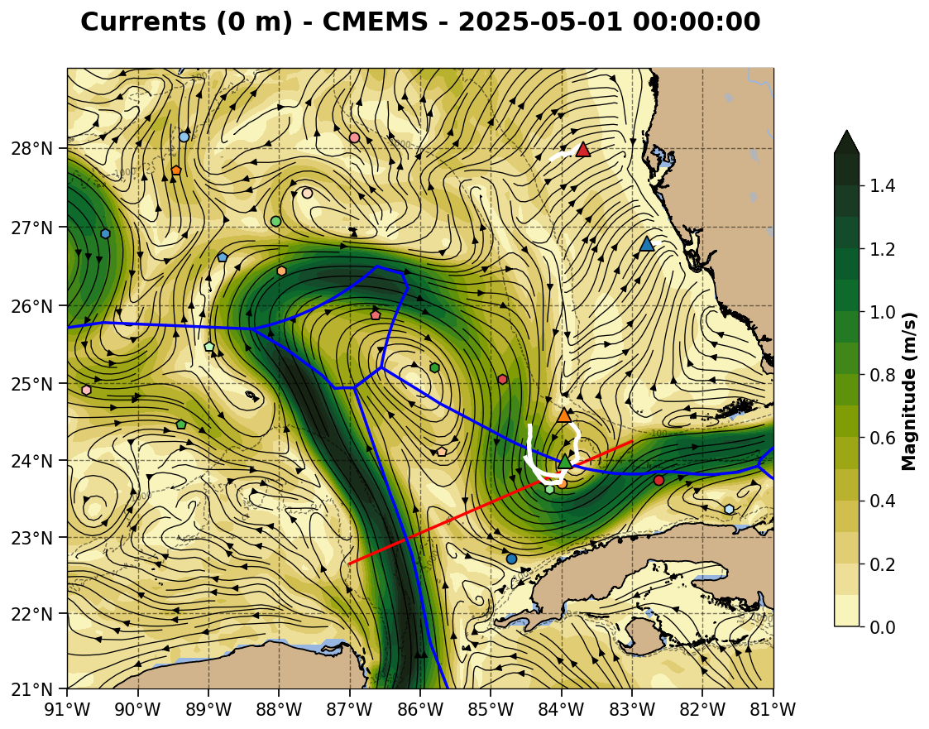
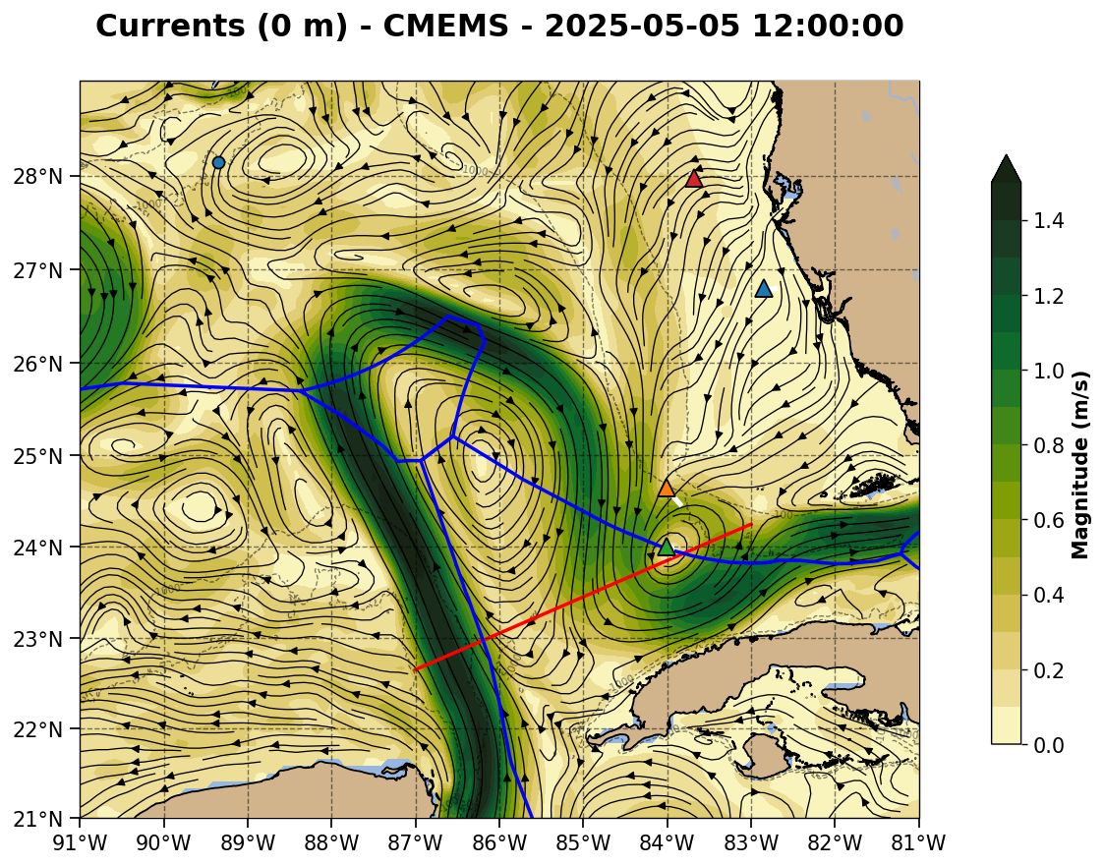

Slide 9
Summary: 2025-05-01
Red line is the northwest to southeast section.
Slide 10: Navy ESPC - Three LC crossings. Currents stronger and deeper than RTOFS.
Slide 11: NOAA RTOFS - Three LC crossings.
Slide 12: European CMEMS - Loop Current velocity structure is most similar in all three sections. Large area with the subsurface salinity maximum in all three Loop Current crossings.

Slide 10
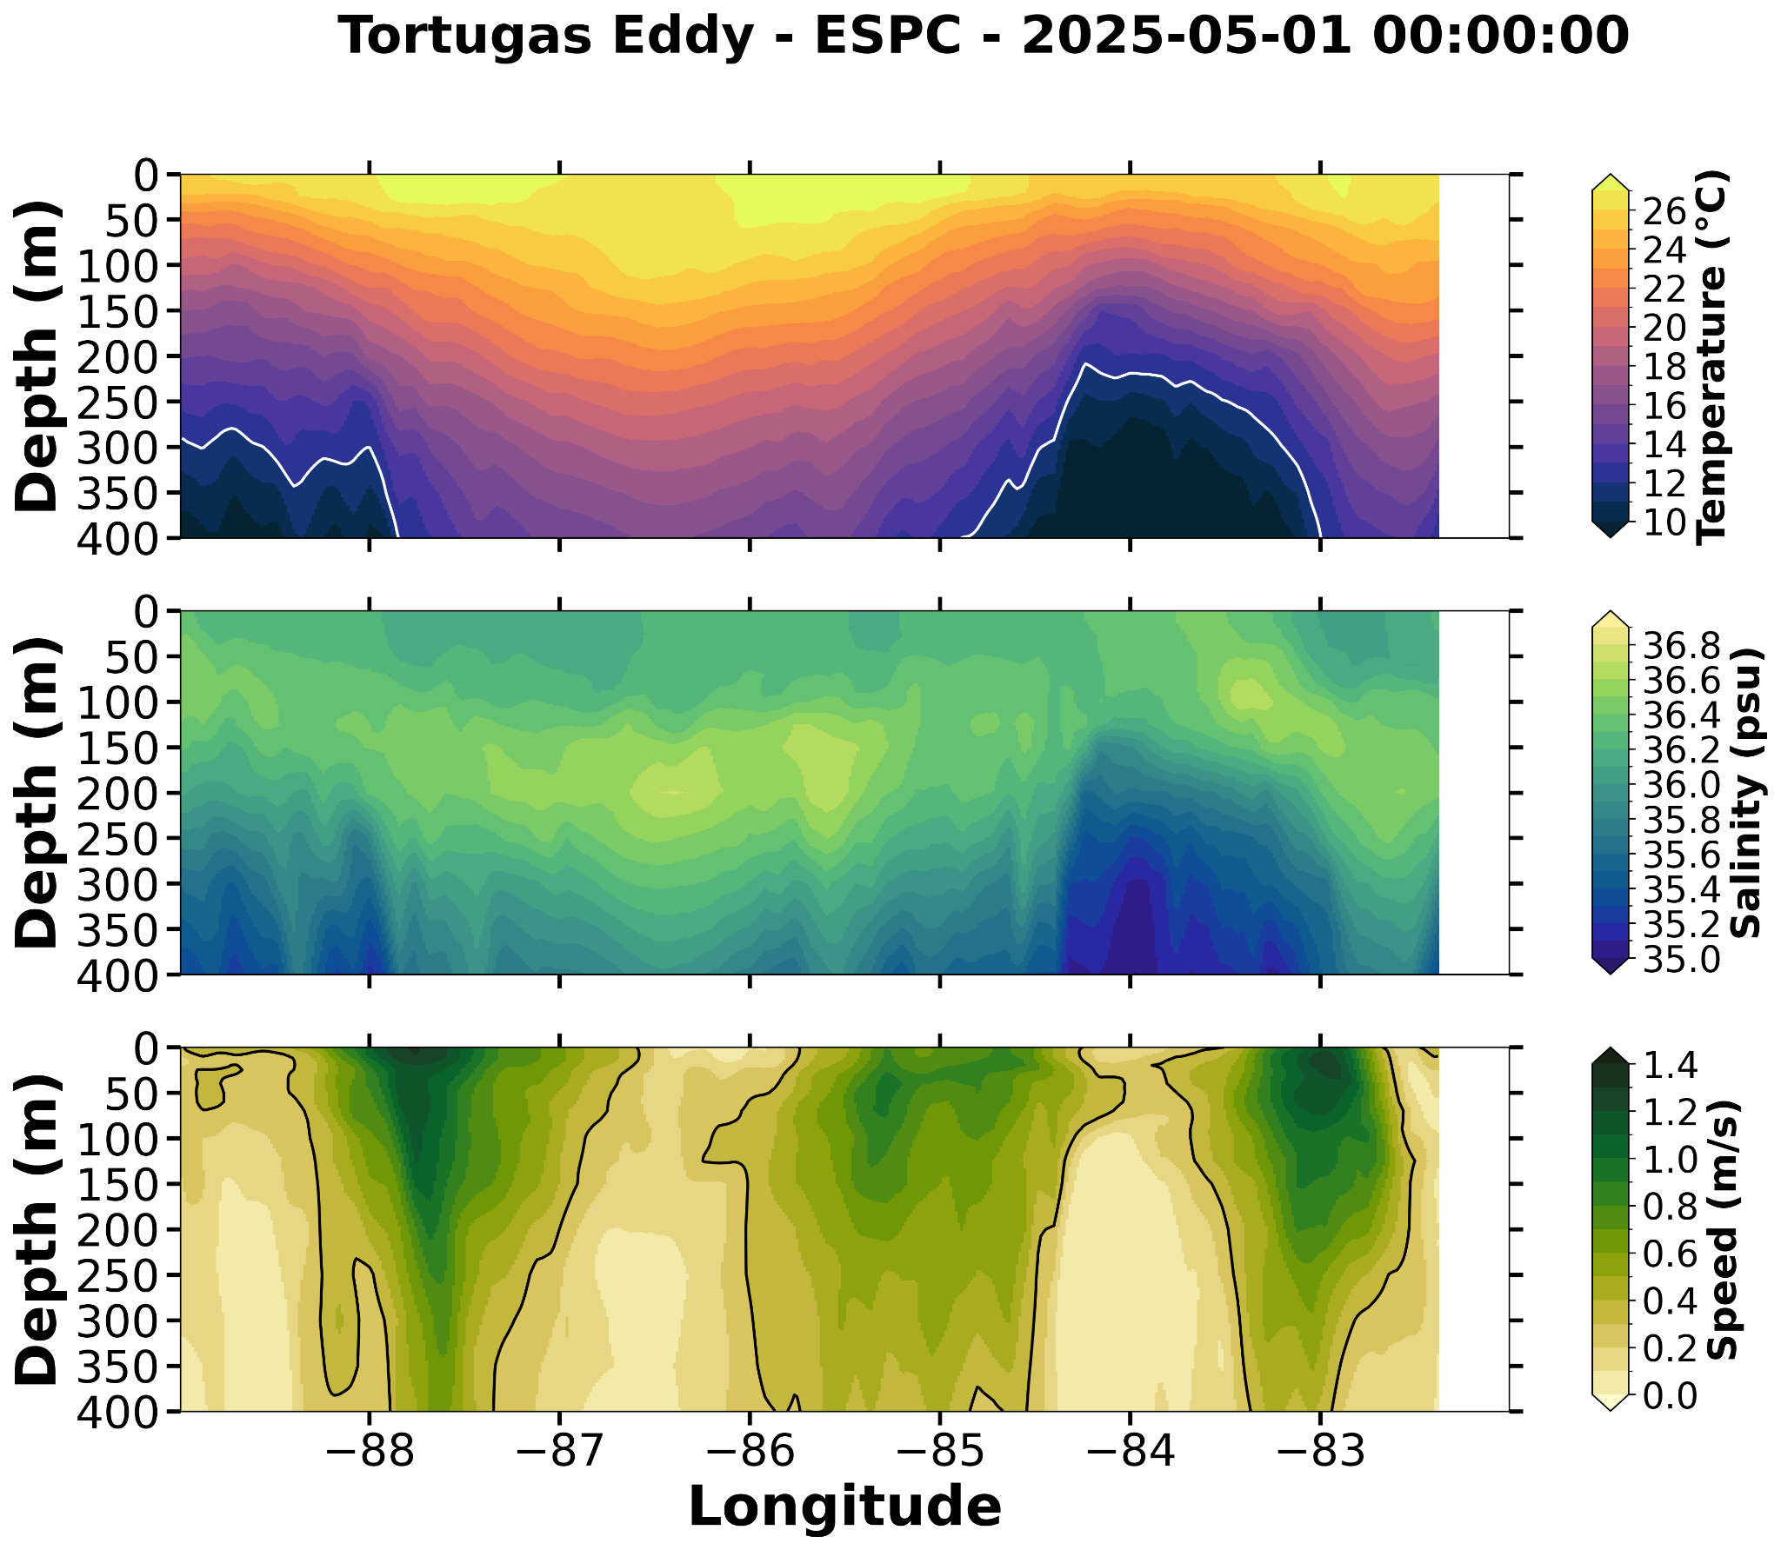
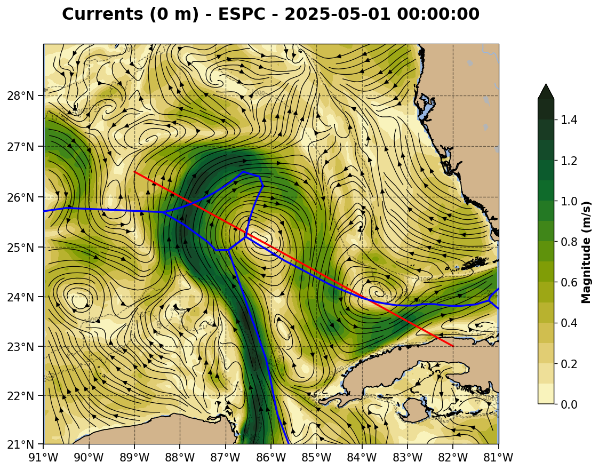
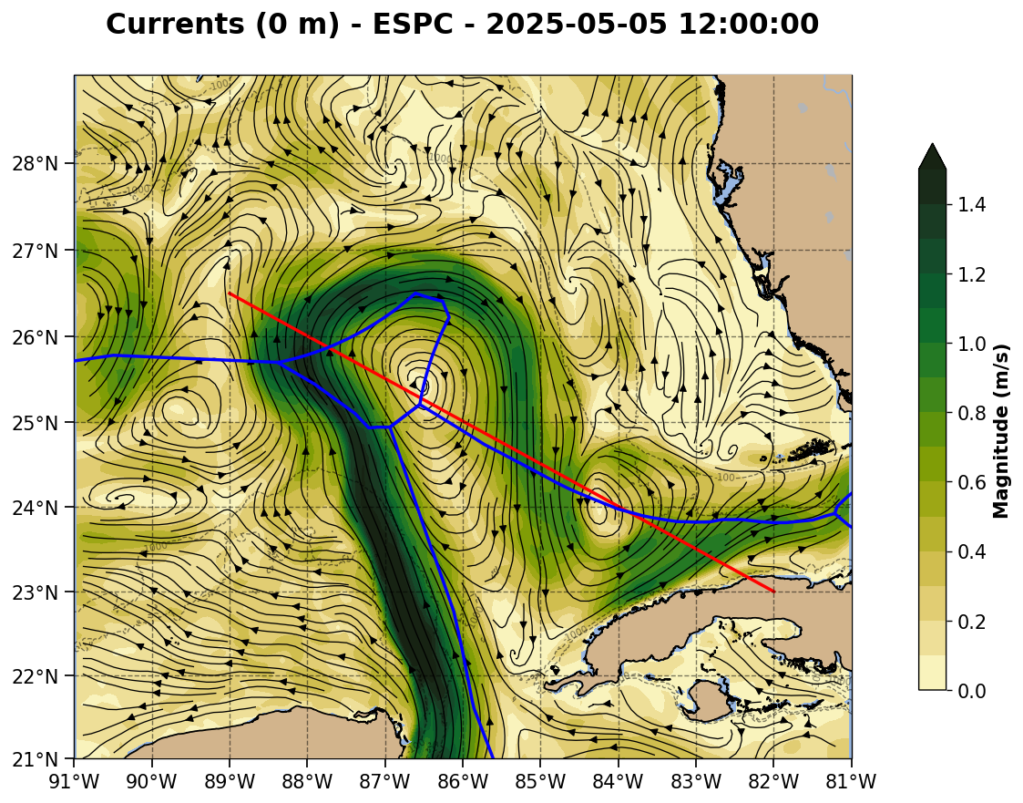

Slide 11
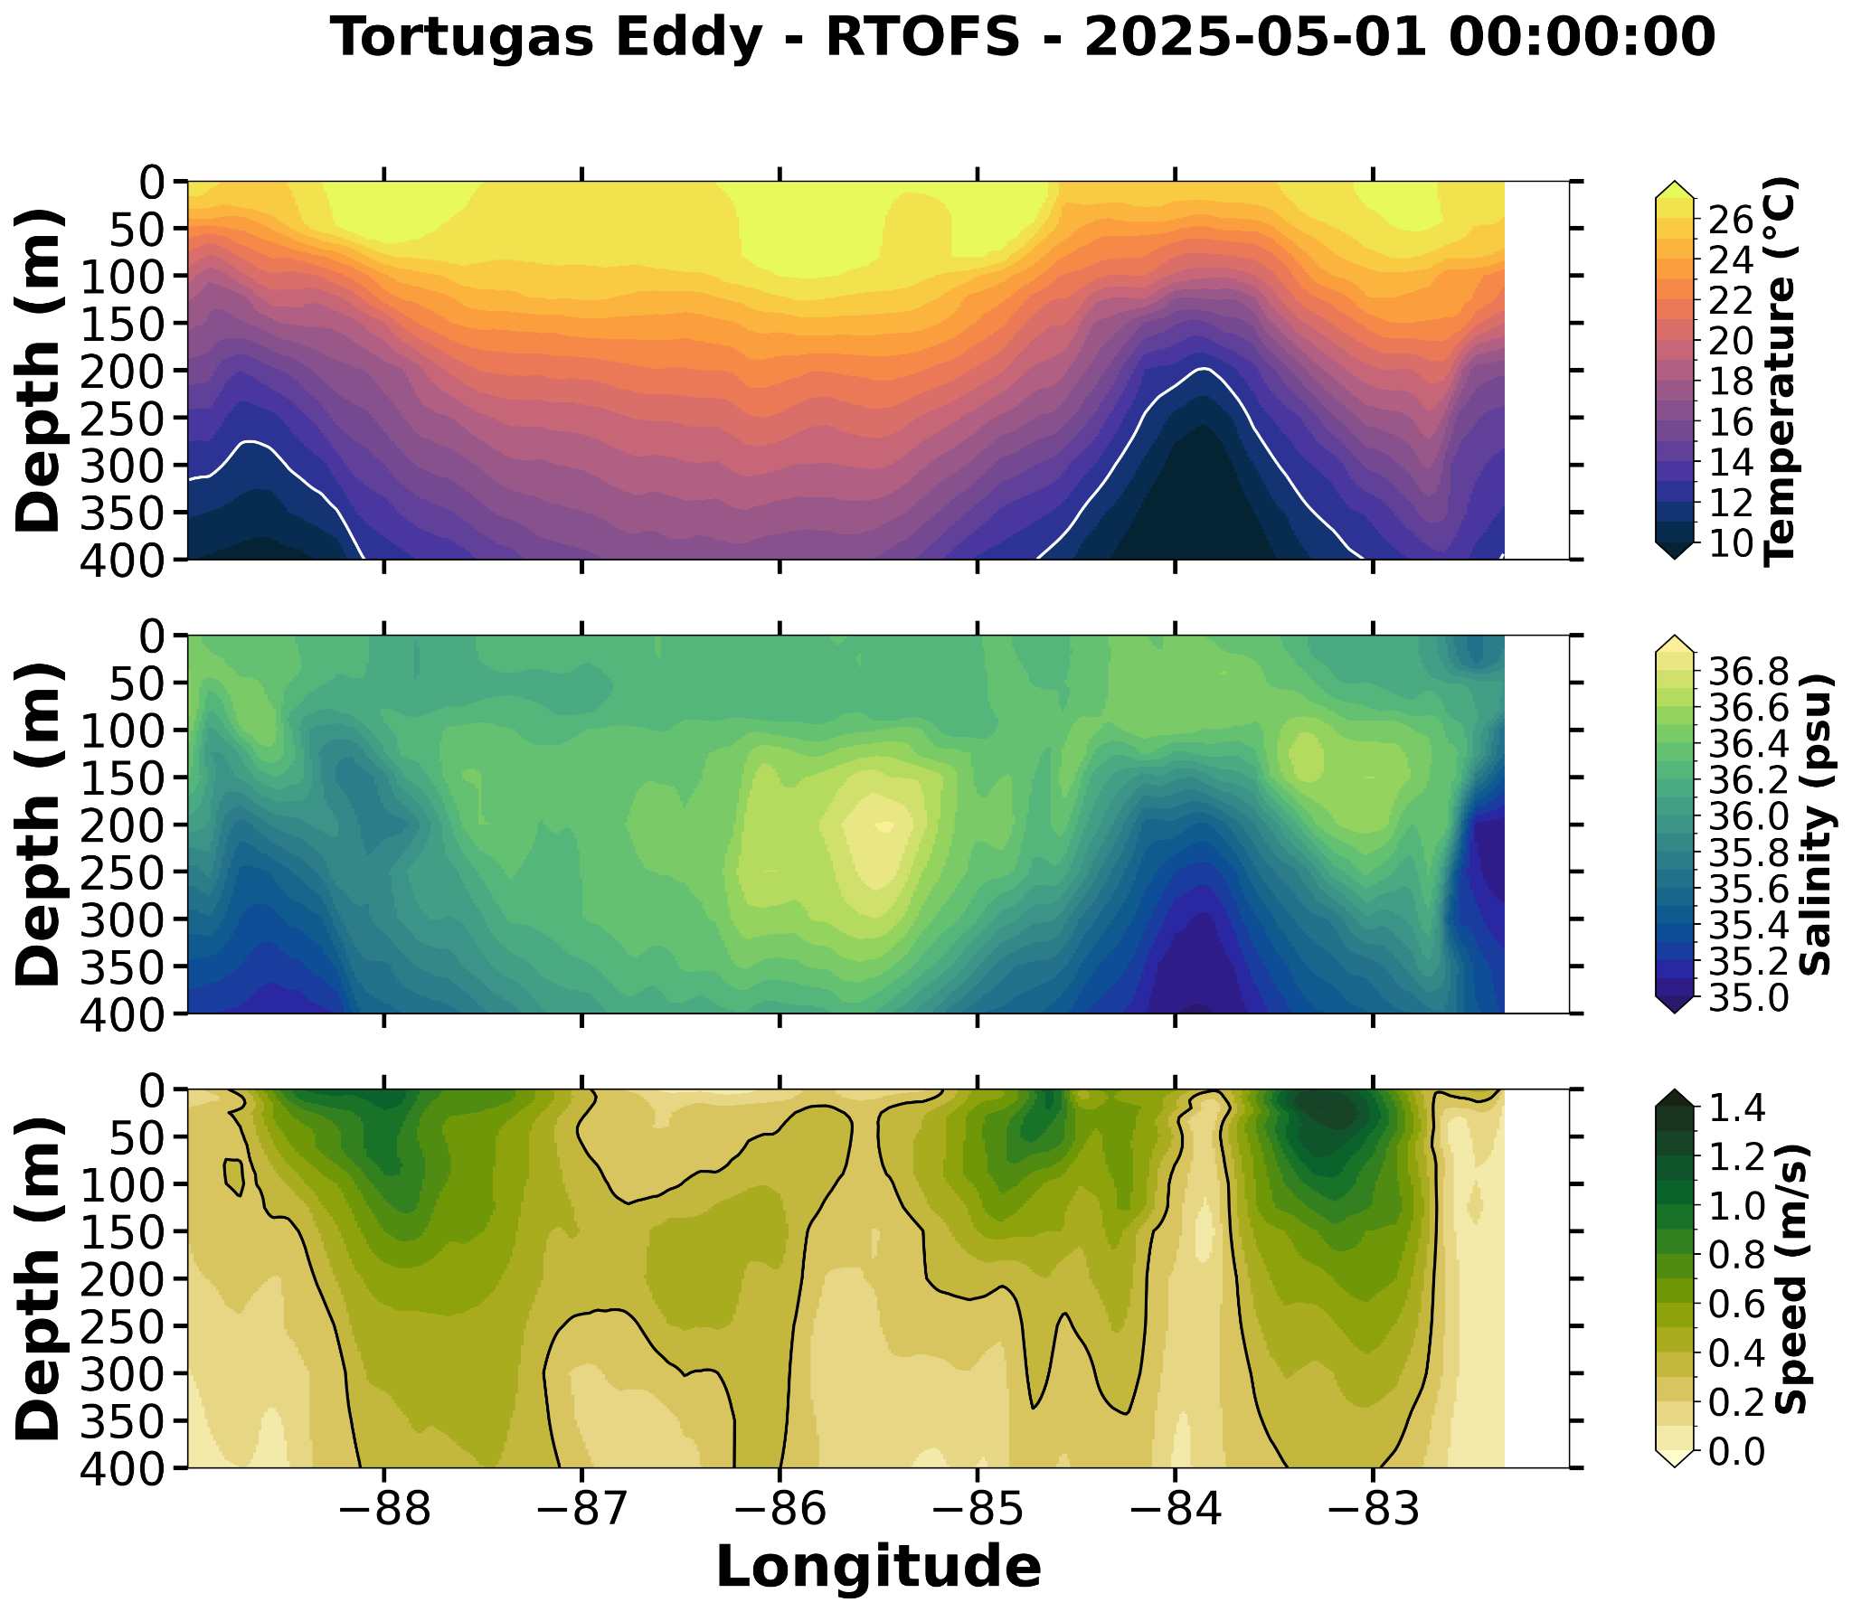
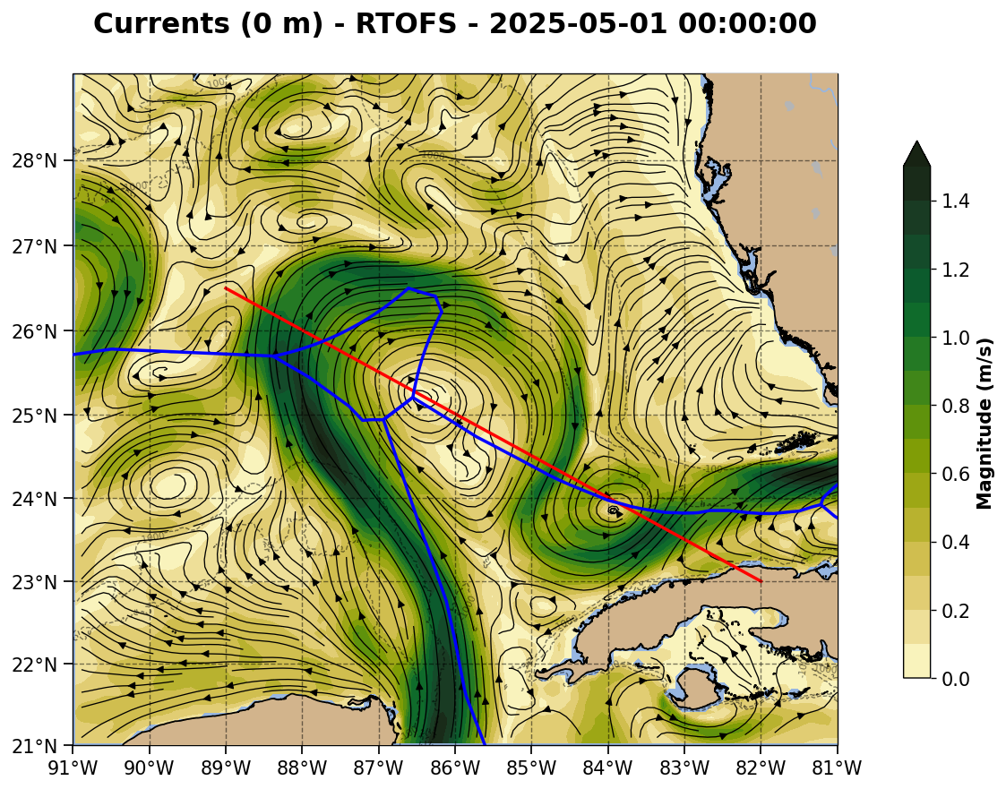
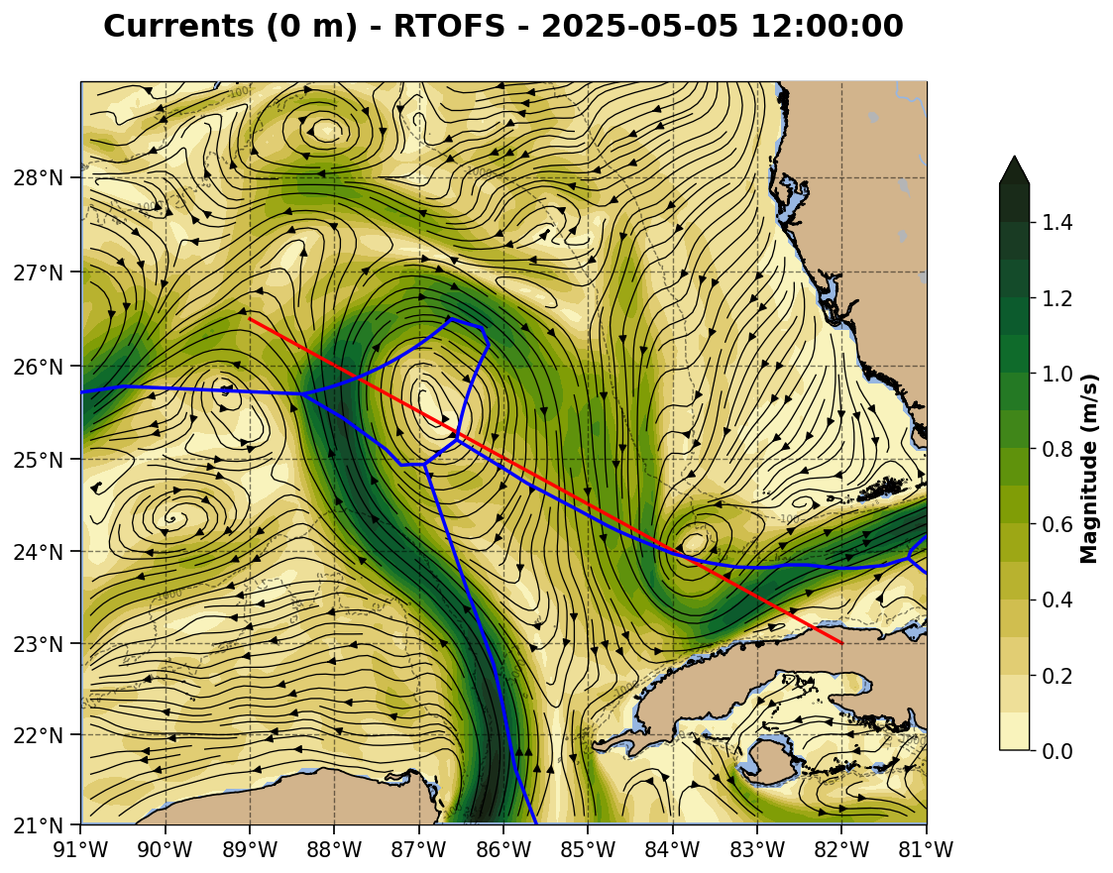

Slide 12
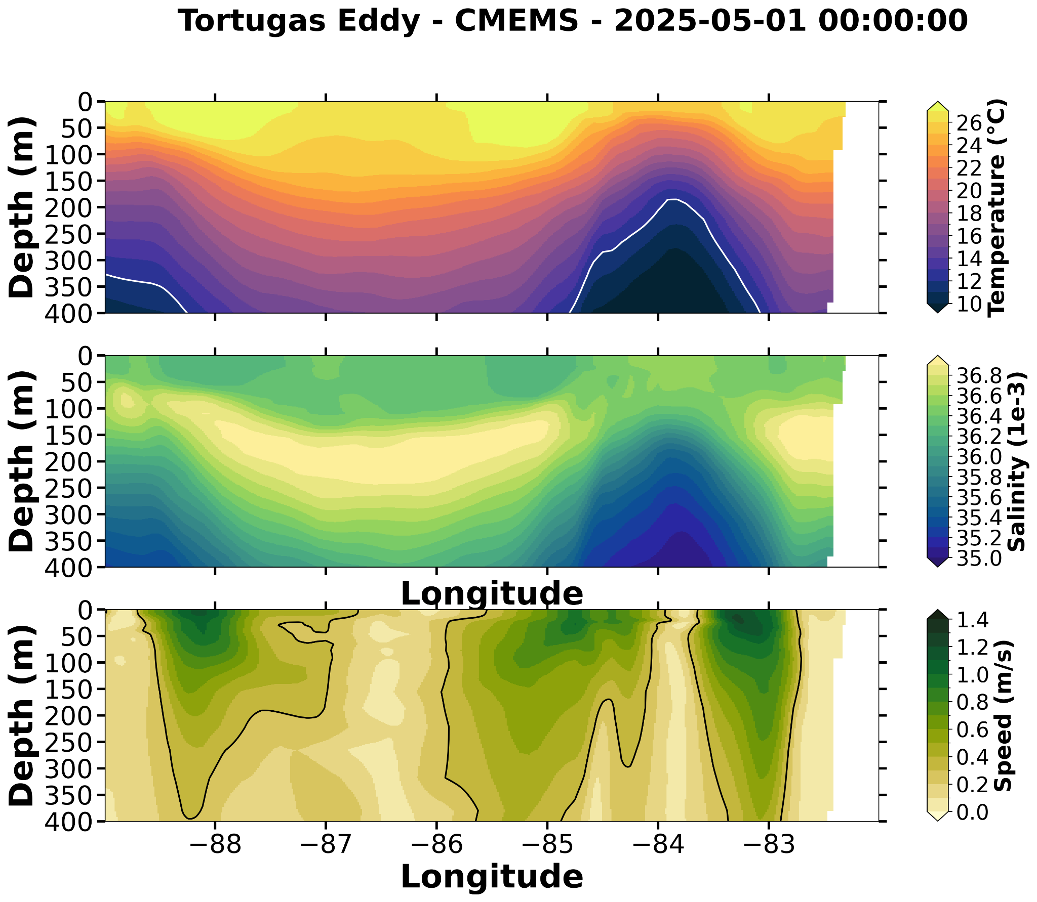
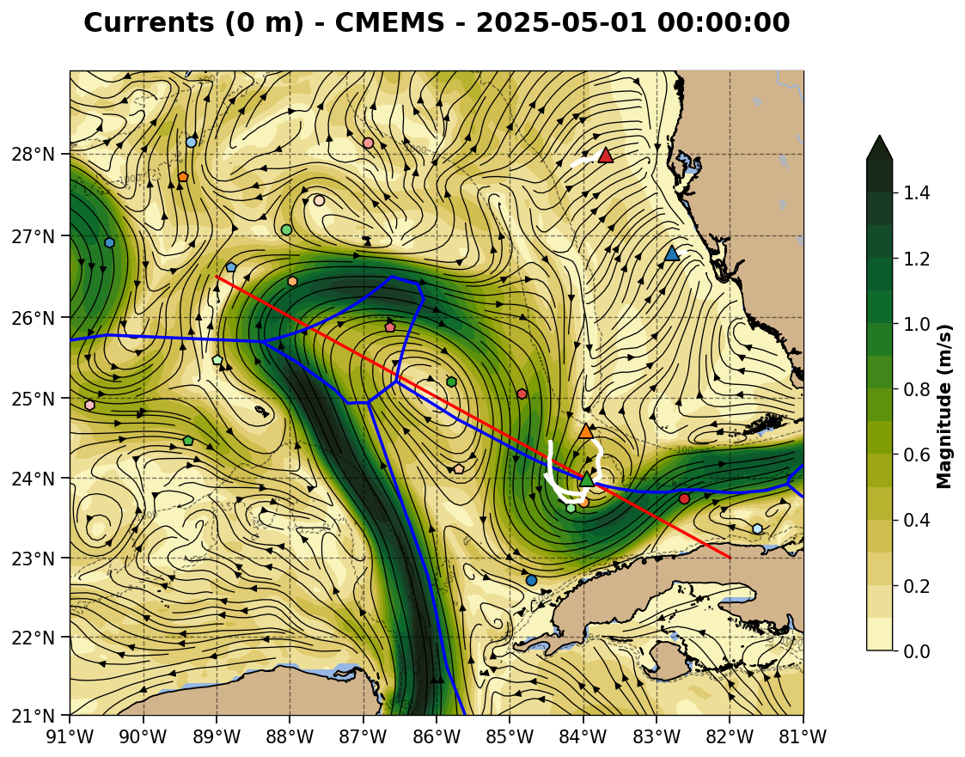
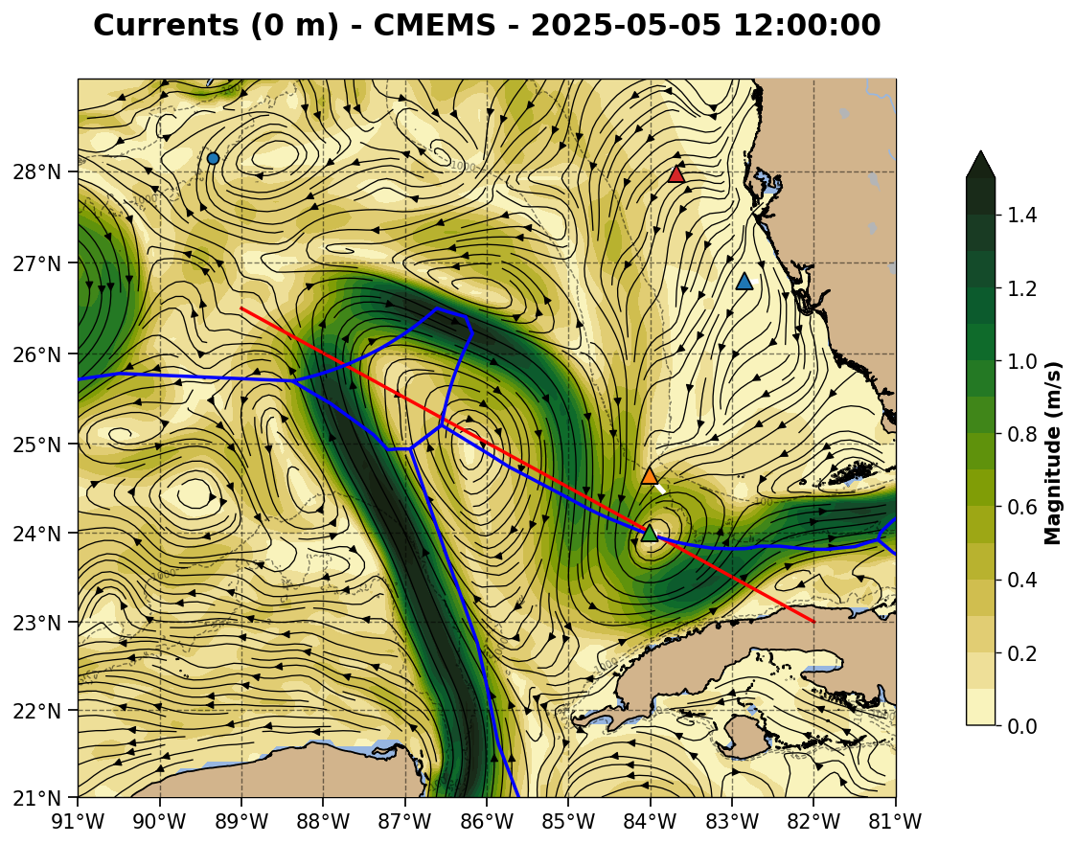

Slide 13
Summary: 2025-04-24

Slide 14
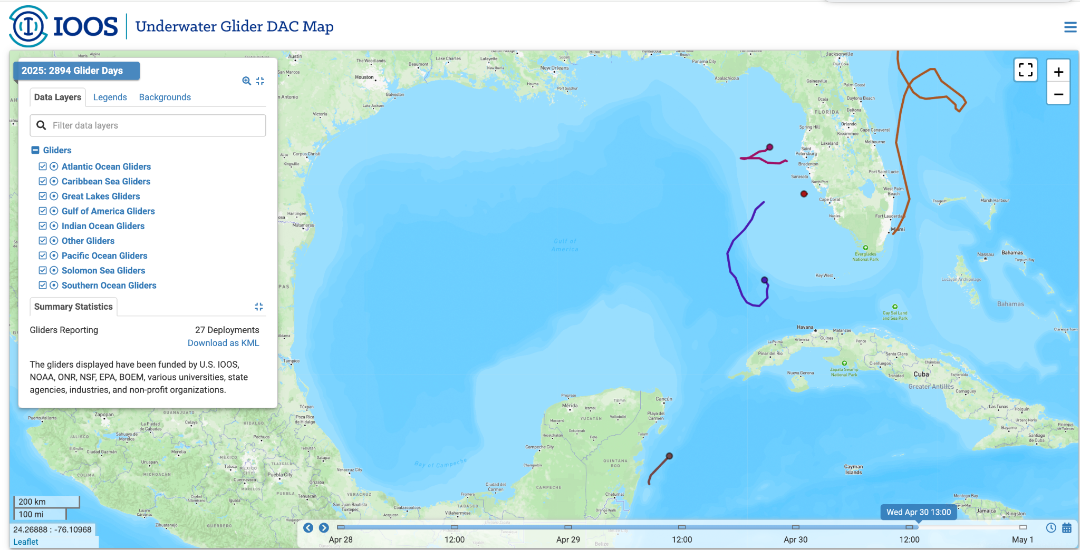
CICESE Glider is in the Glider DAC - downstream data flows initiated

Slide 15
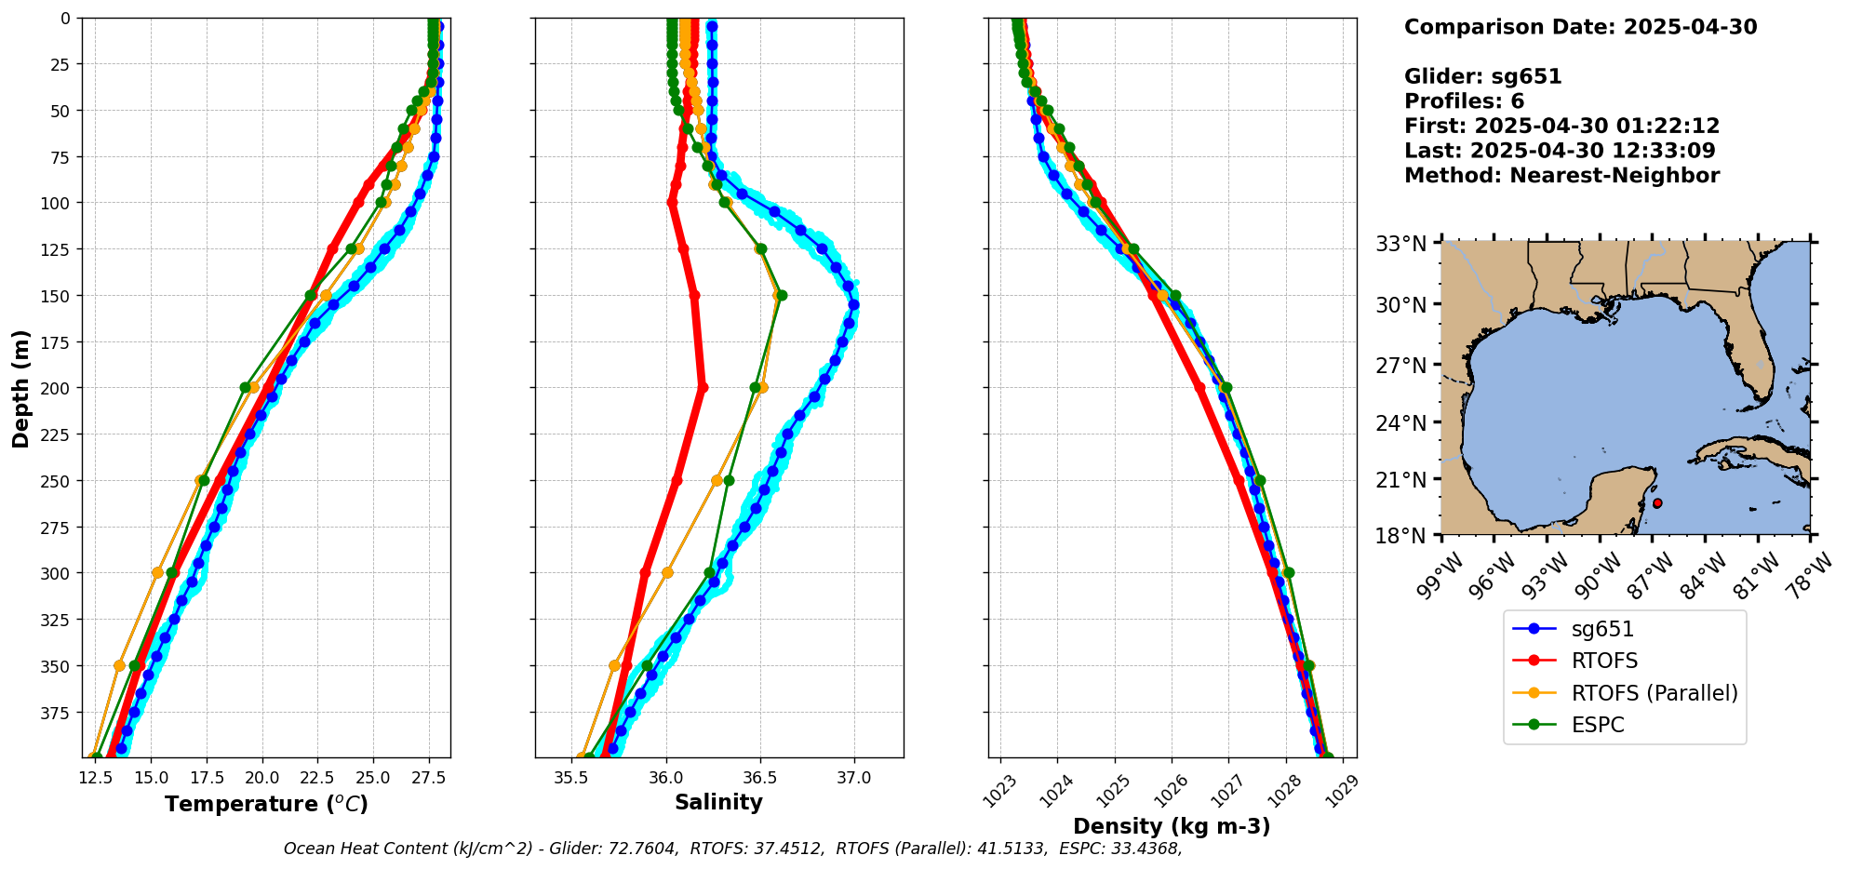
CICESE Glider/Model data comparison before any assimilation

Slide 16
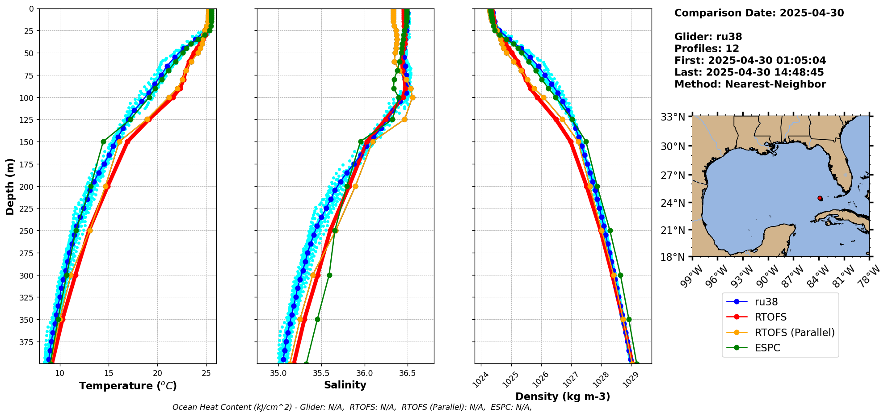
RU38 Glider/Model data comparison after 4/29 data was assimilated

Slide 17
Several Argo/model data profiles to follow from 2 Argo floats in the TCE and 2 Argo floats in the LC.

Slide 18
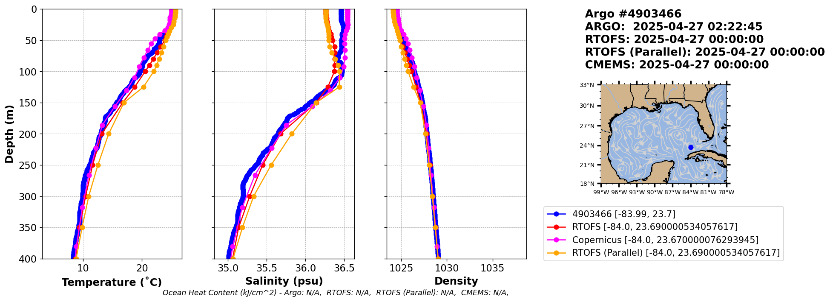

Slide 19
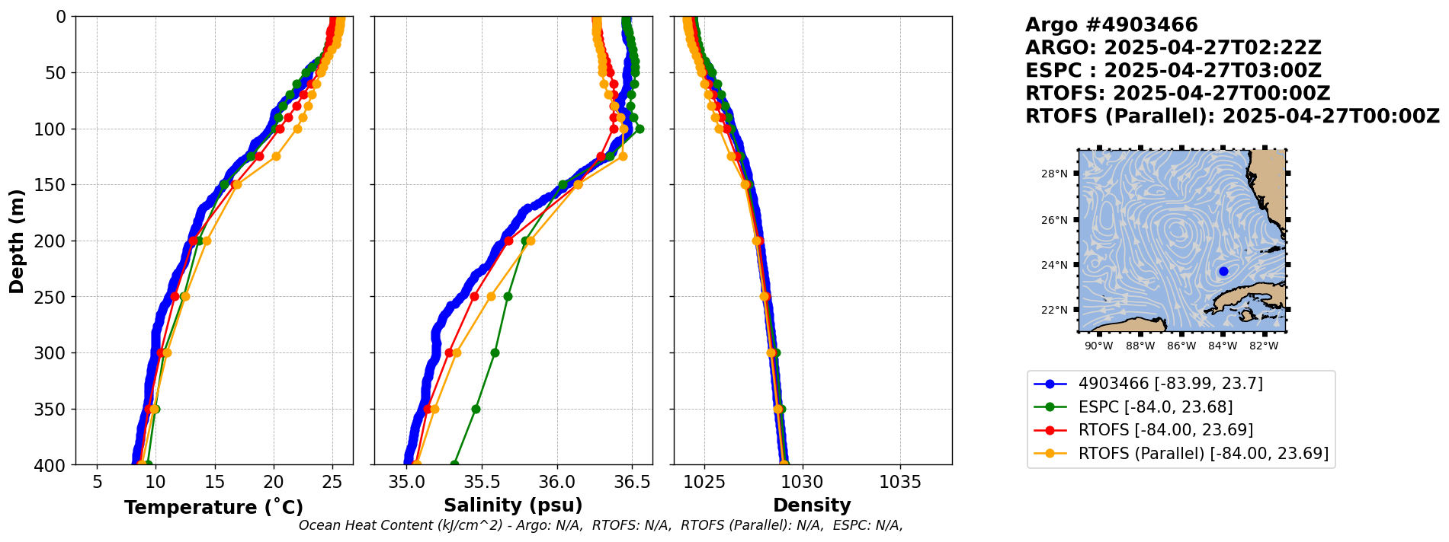

Slide 20
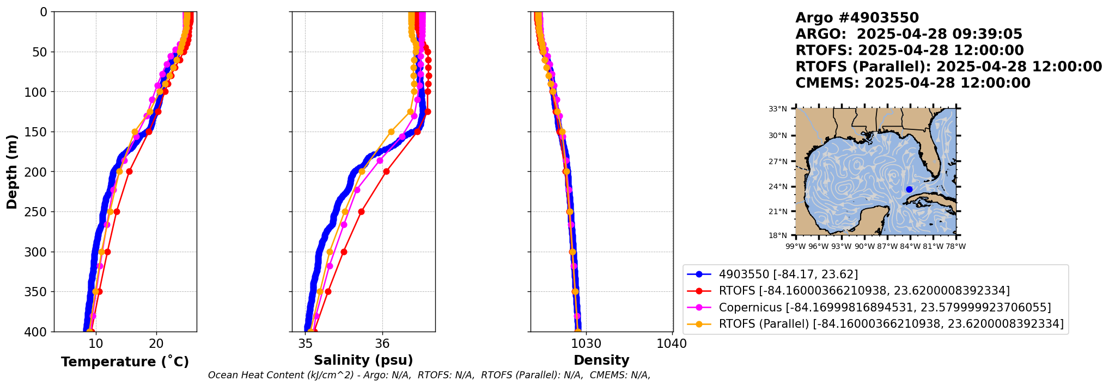

Slide 21


Slide 22
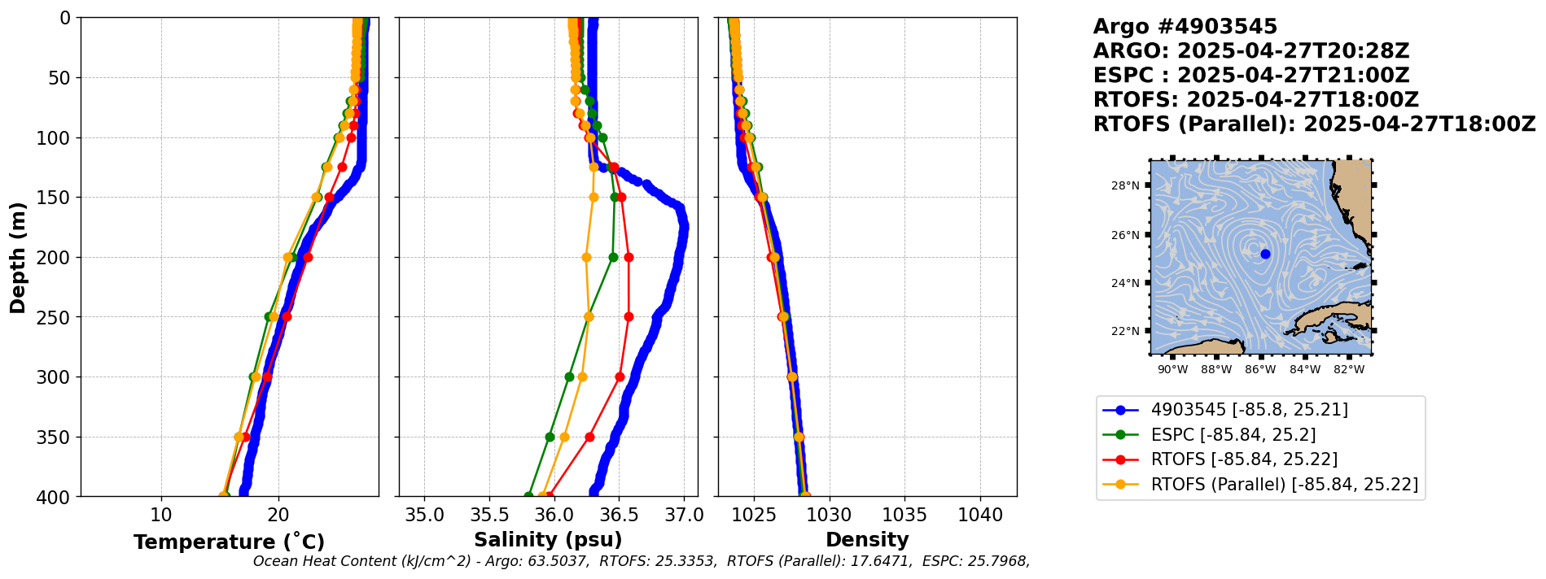

Slide 23
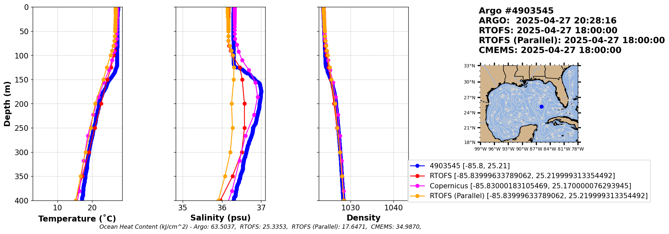

Slide 24
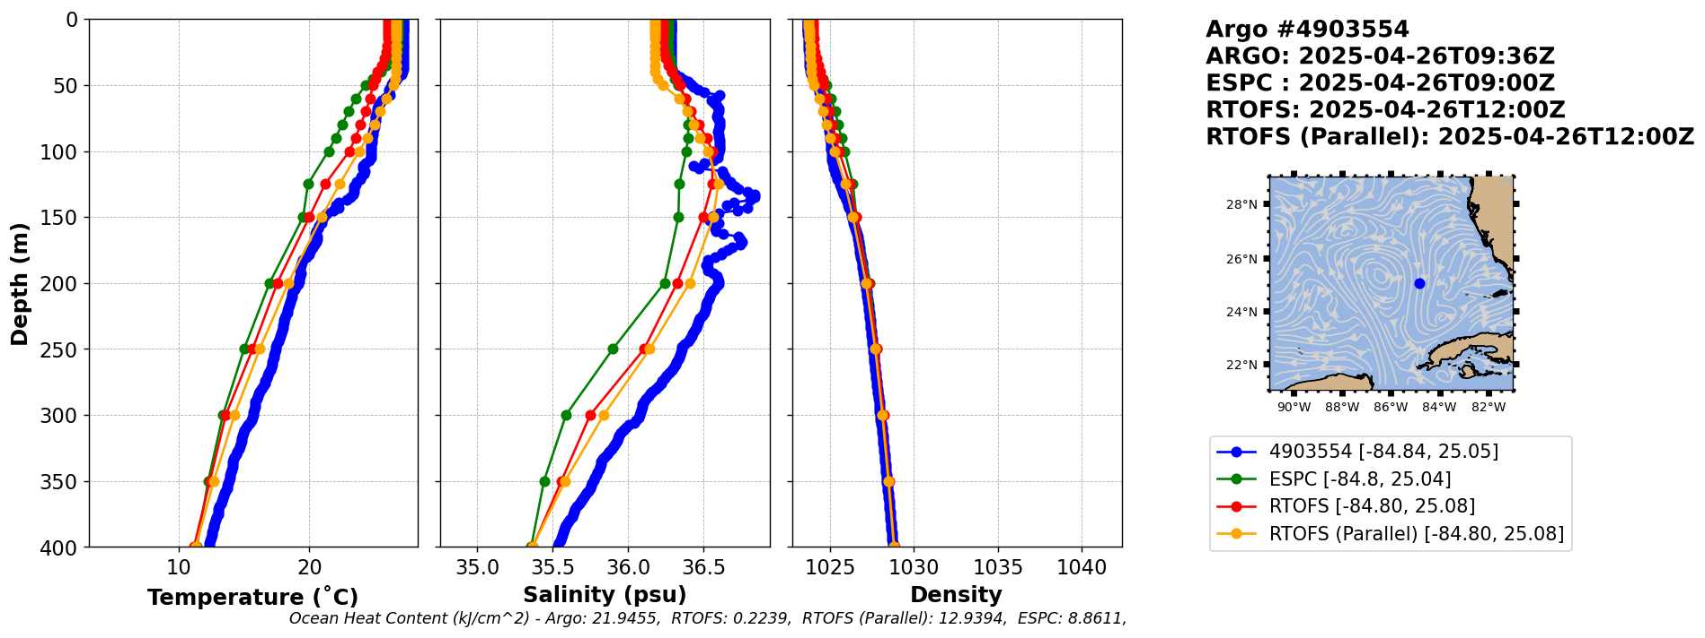

Slide 25
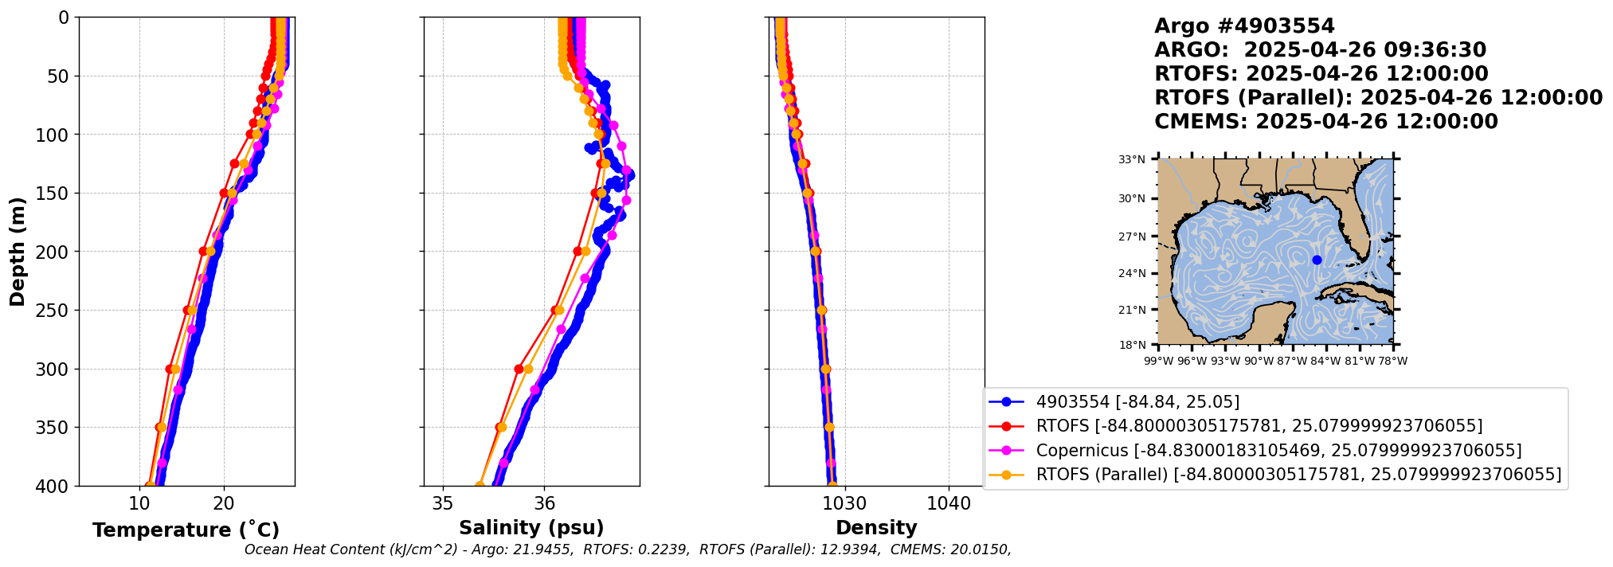

Slide 26
