Slide 1
Summary: 2025-04-24
Operational model summary: Today’s summary has three components:
Slides 2-5: Southwest to northeast cross-section through the Yucatan Current (YC), the narrow neck of the extended Loop Current (LC), and the Tortugas Cyclonic Eddy (TCE).
Slides 6-9: Northwest to southeast cross-section through the center of the extended Loop Current (LC), the Tortugas Cyclonic Eddy (TCE), and the Florida Current (FC) off Cuba.
Slides 10-15: Temperature, Salinity and Density profile comparisons between the two gliders and two Argo floats and the operational models, plus most recent EMC ROTFS DA QC.
Maps of surface currents include the red line showing the vertical cross section location and blue lines for the EEZs. The top map is a common hour near the start of each forecast, bottom map is the common hour at the end of the forecast.
Sections - Cross-section plots from the first common hour now include temperature, salinity and current speed. You will need to infer direction of the strong currents from the maps. Current speed of 0.3 m/s is highlighted by the black contour line.

Slide 2
Summary: 2025-04-24
Red line is the southwest to northeast section.
Slide 3: Navy ESPC - Yucatan current inflow is narrow and deep. High velocity currents in the LC-TCE interaction zone cover a broader area. Large area of low currents in the TCE. Maximum currents on eastern side of TCE are subsurface and lower speed.
Slide 4: NOAA RTOFS - Yucatan current inflow looks like the plots WHG has been showing us for the typical LC velocity structure, with the high velocity axis tilting to the inside with depth. Like ESPC, the LC-TCE interaction zone is broader. Eastern side of TCE is weaker and also has subsurface maximum.
Slide 5: European CMEMS - Yucatan inflow currents again look like the WHG average but much stronger and deeper than RTOFS. LC-TCE interaction zone is weaker and shallower than the inflow, opposite of RTOFS. All have the subsurface velocity max on the eastern side of TCE.

Slide 3
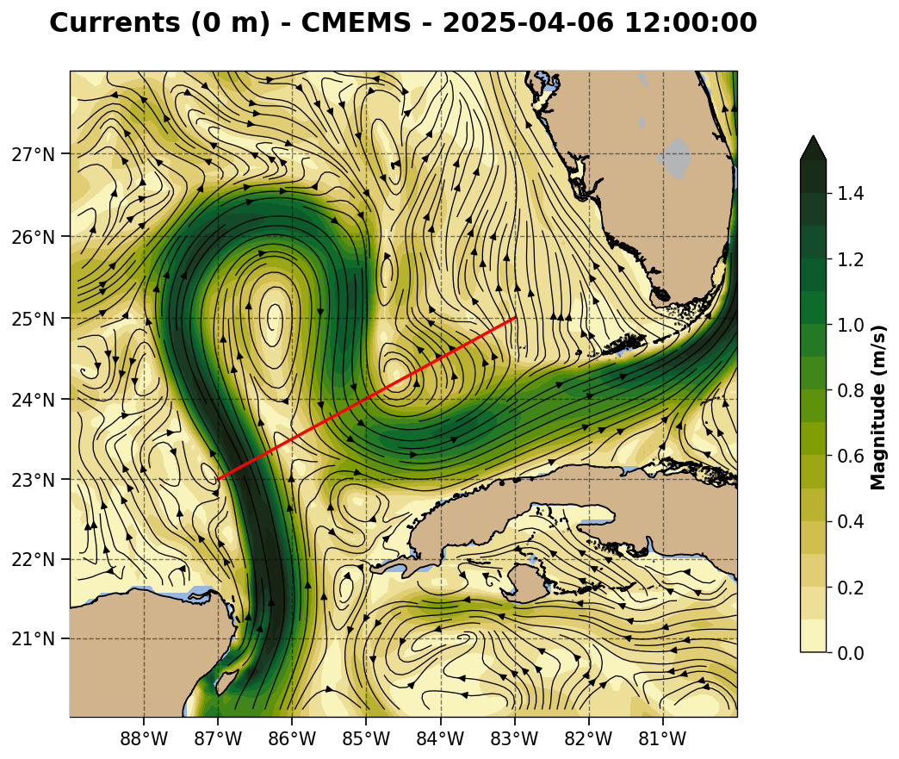
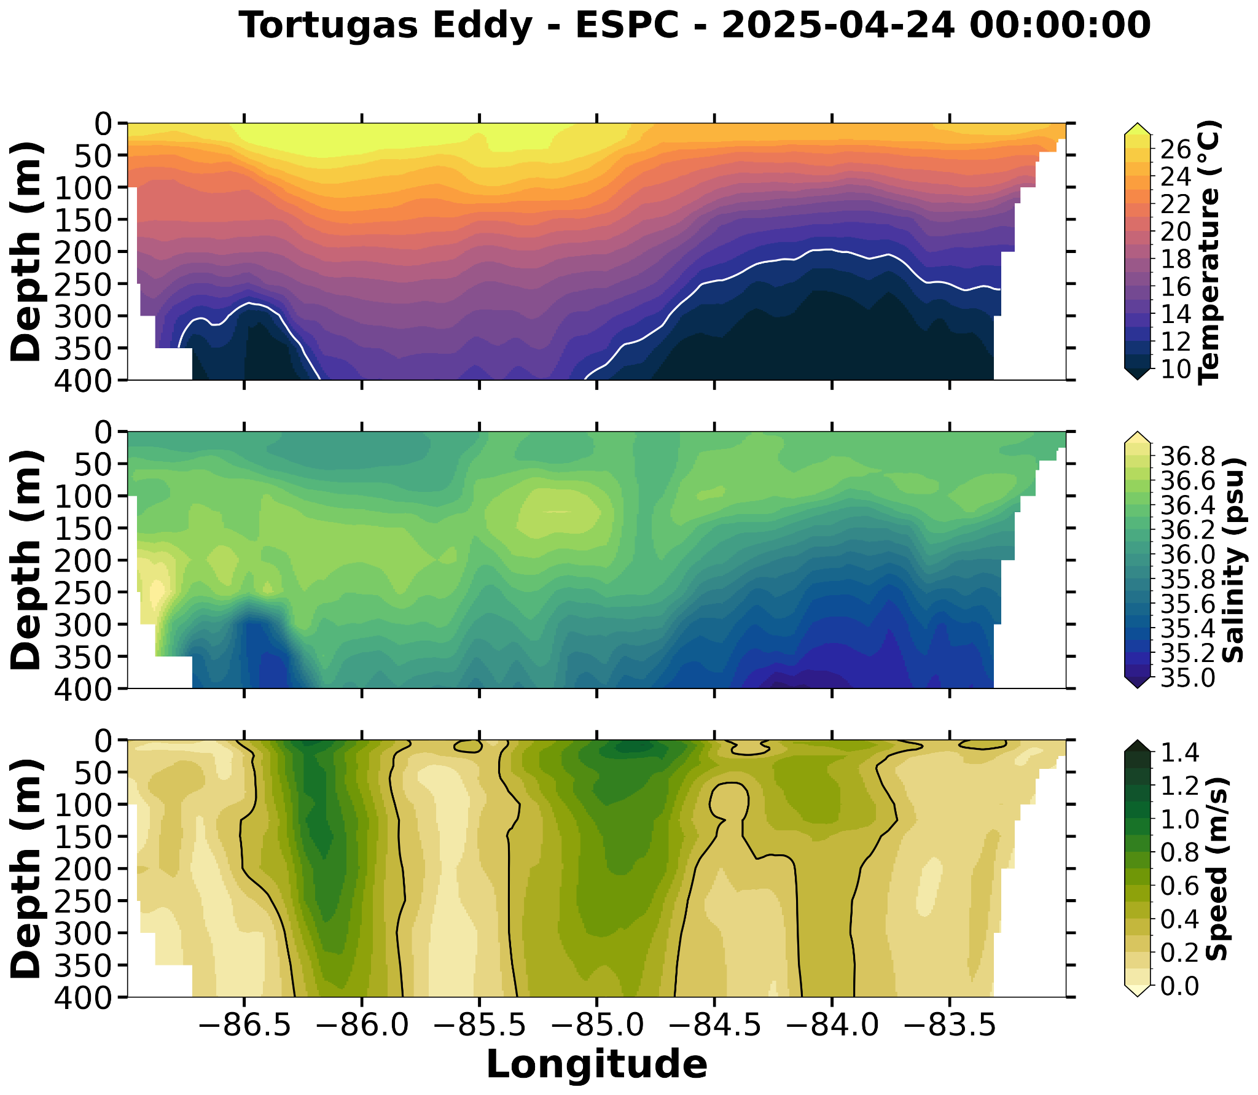
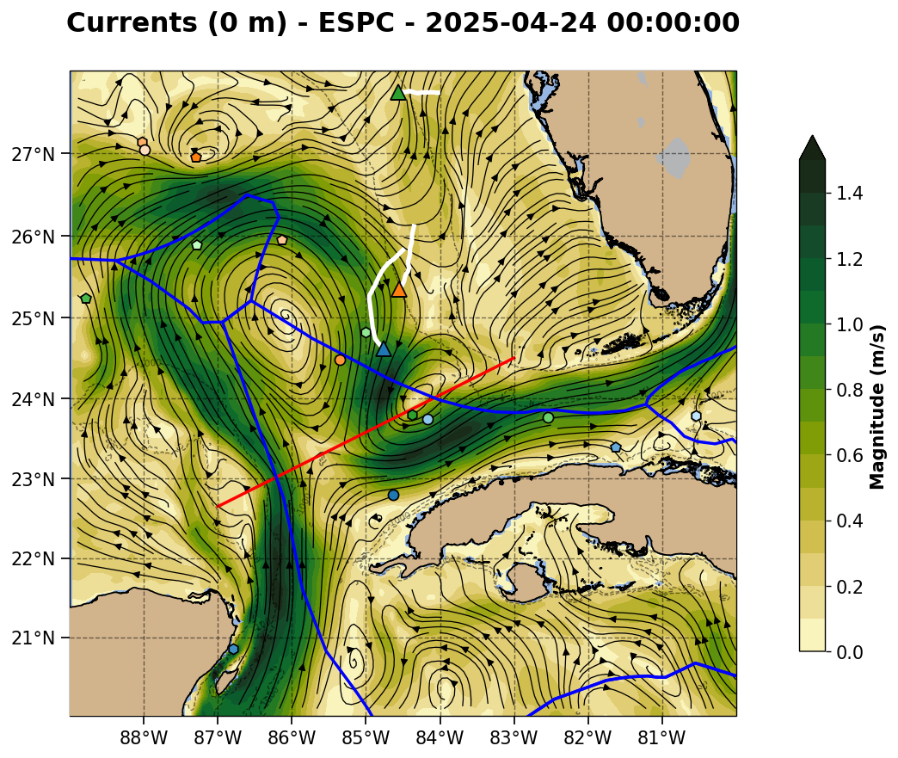
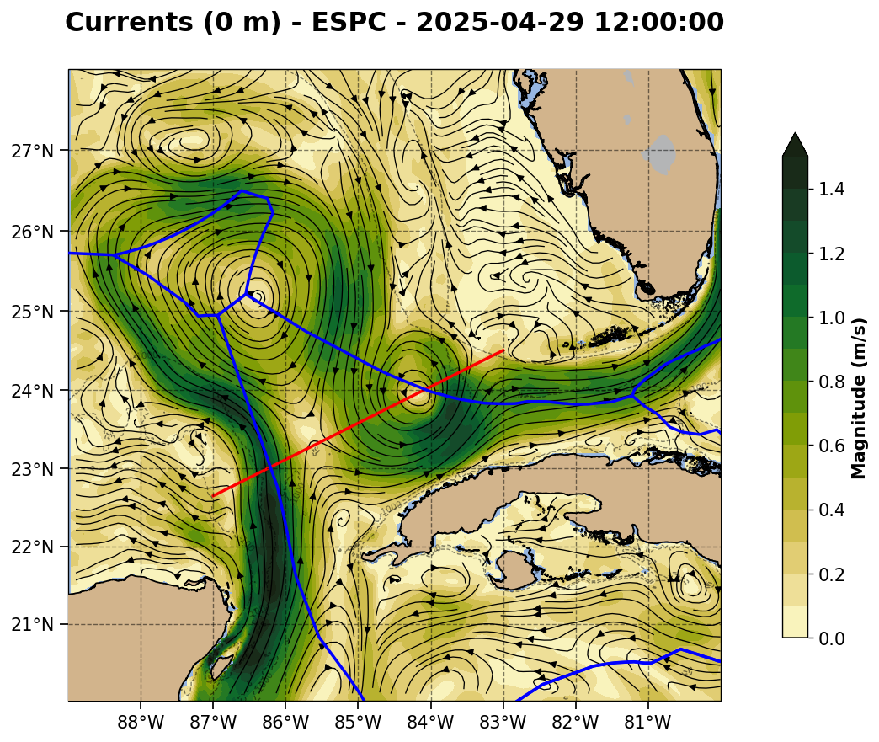

Slide 4
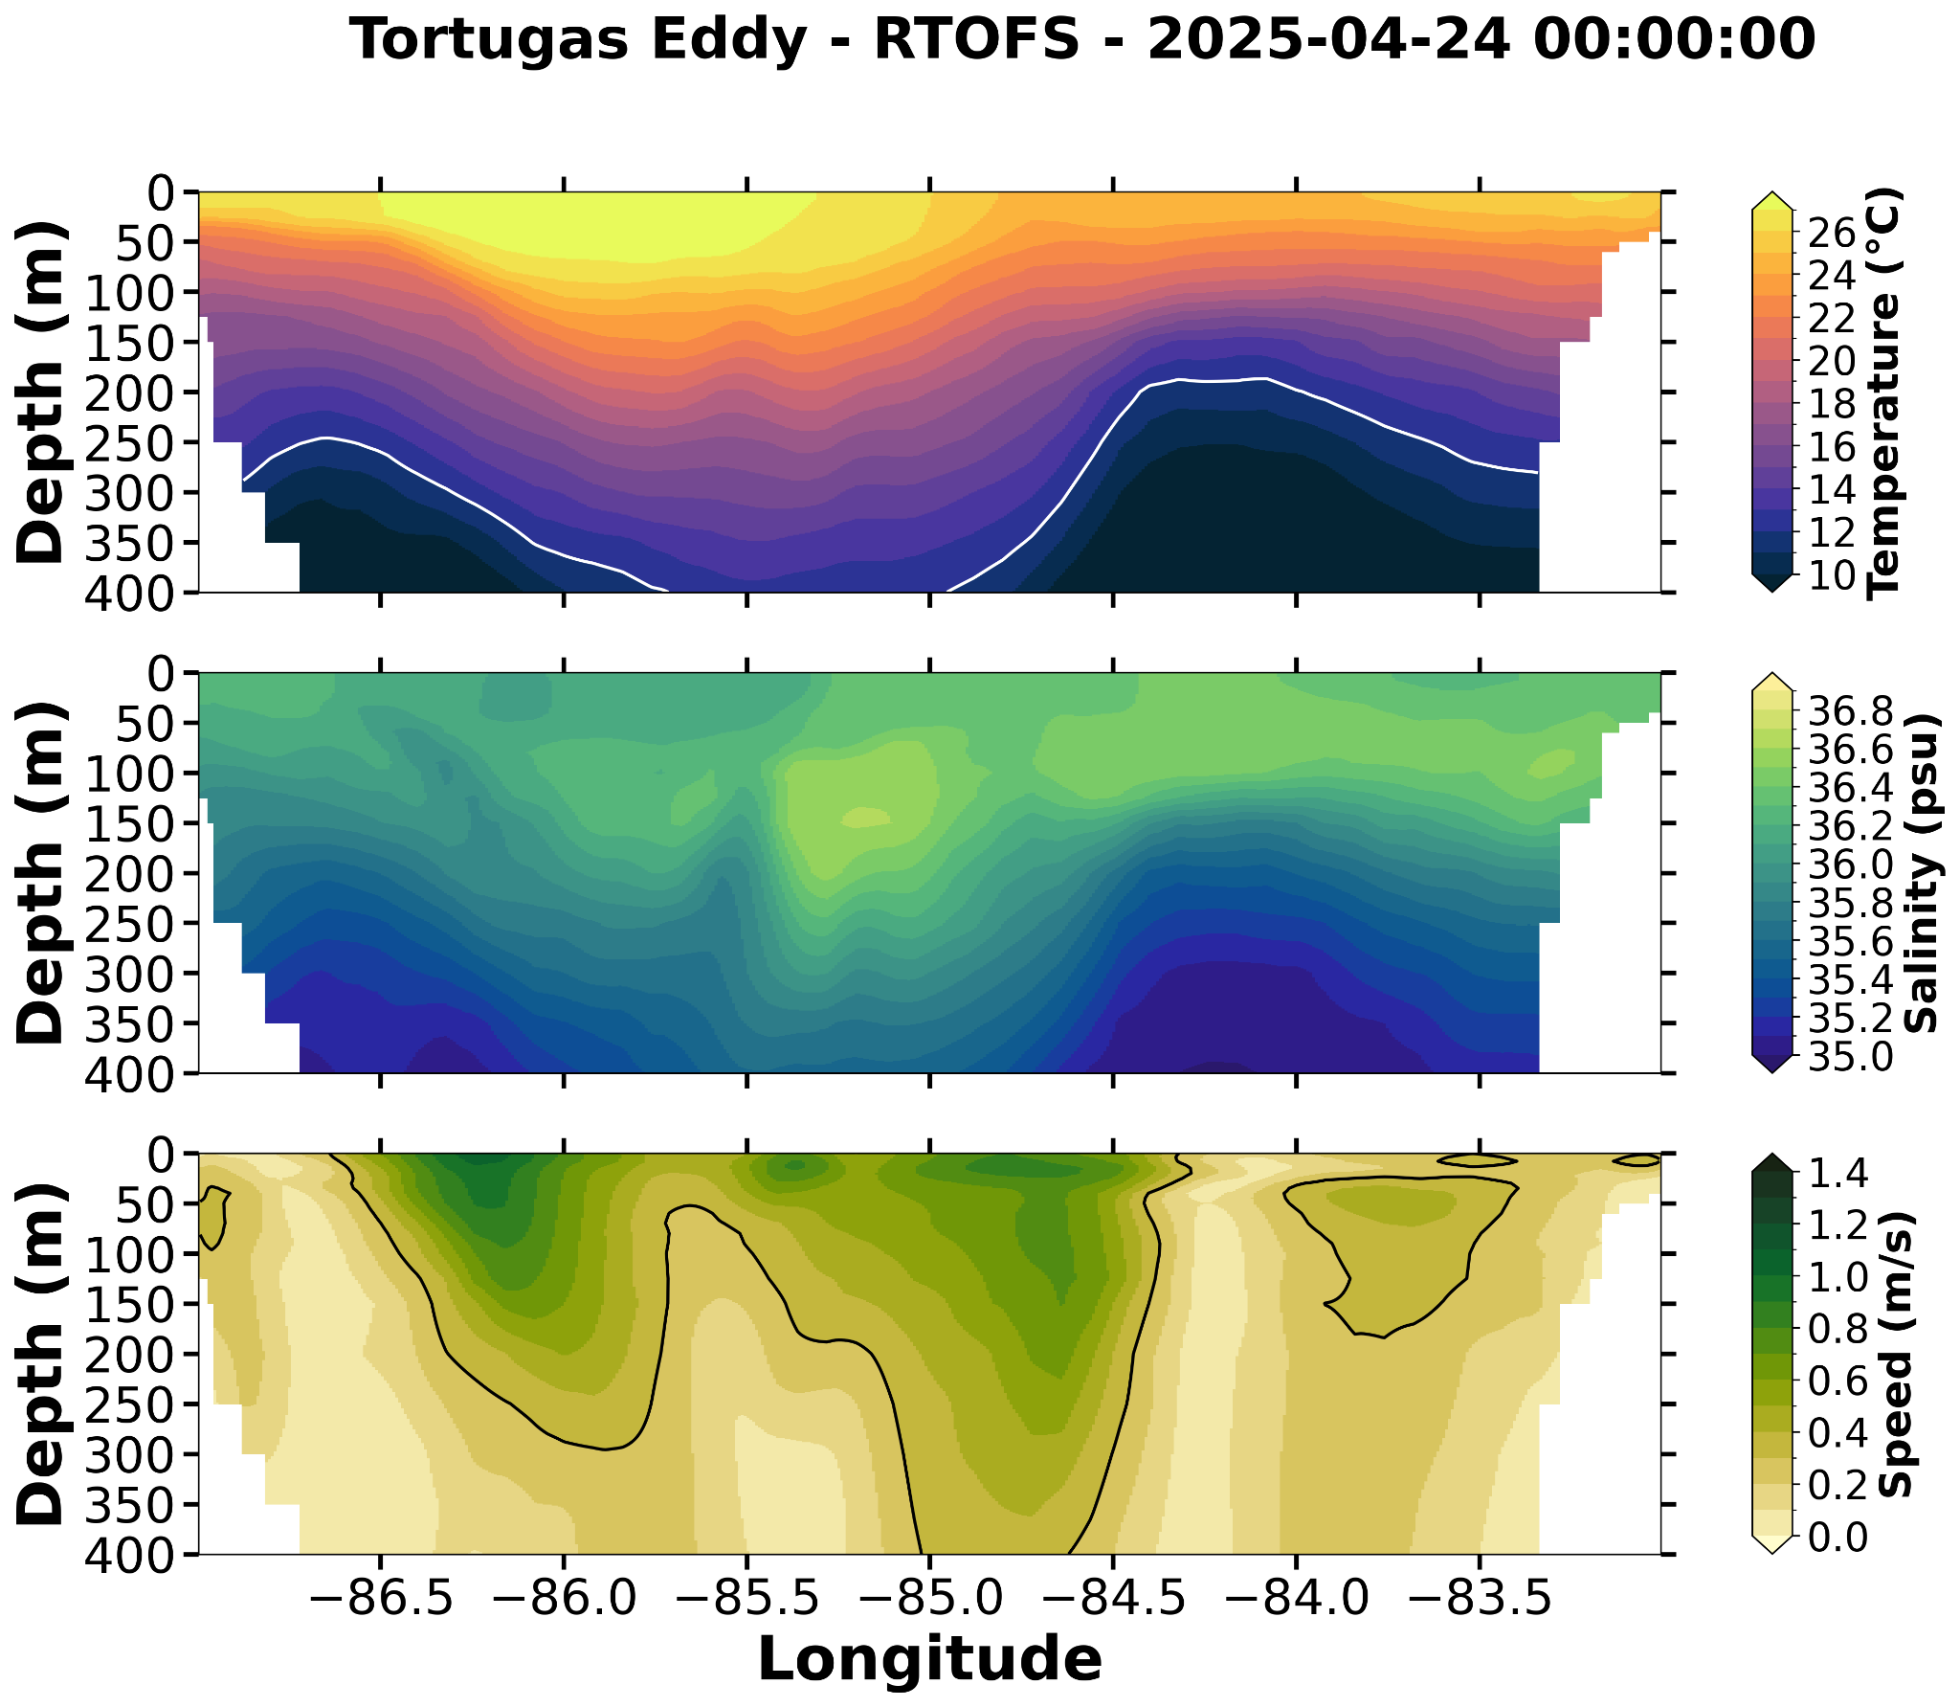
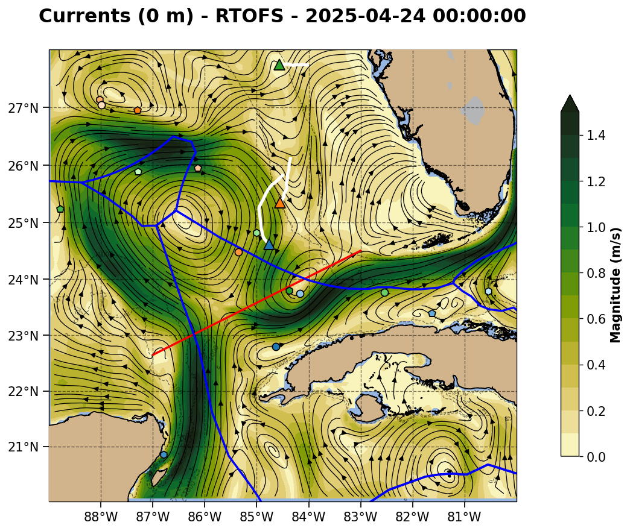
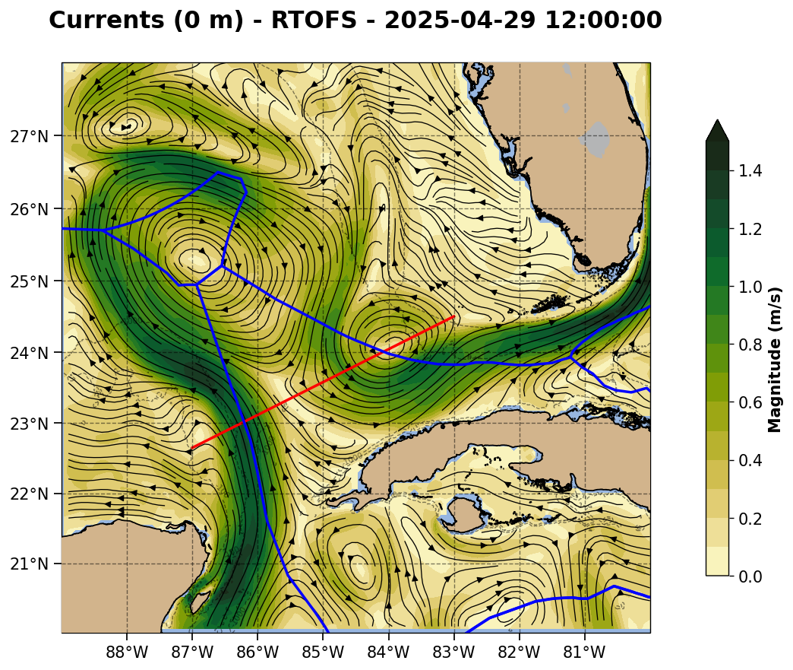

Slide 5
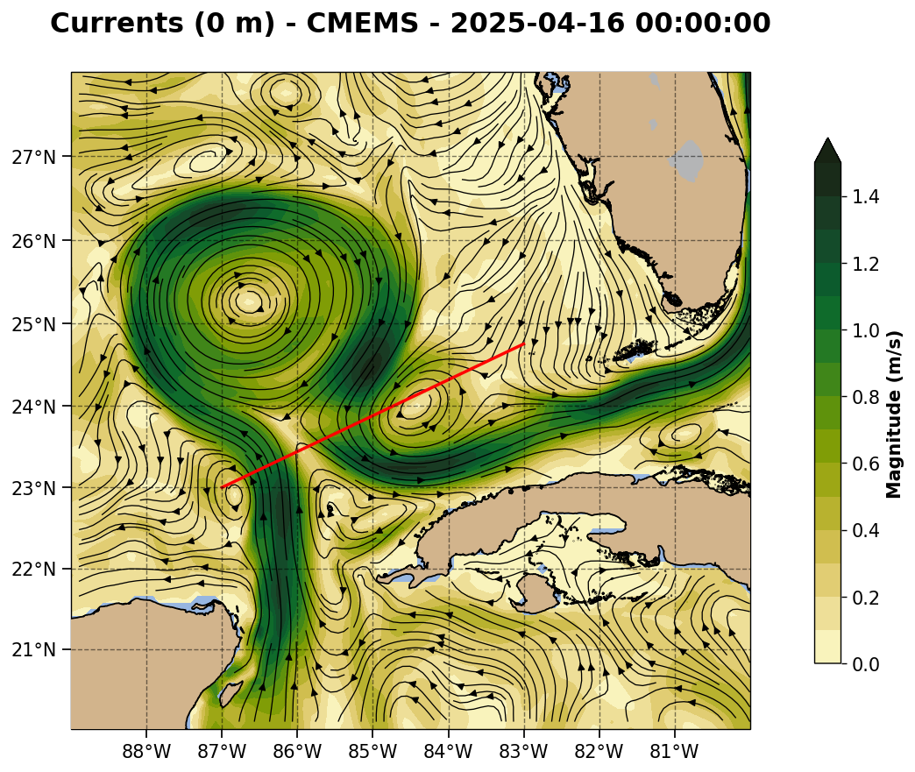
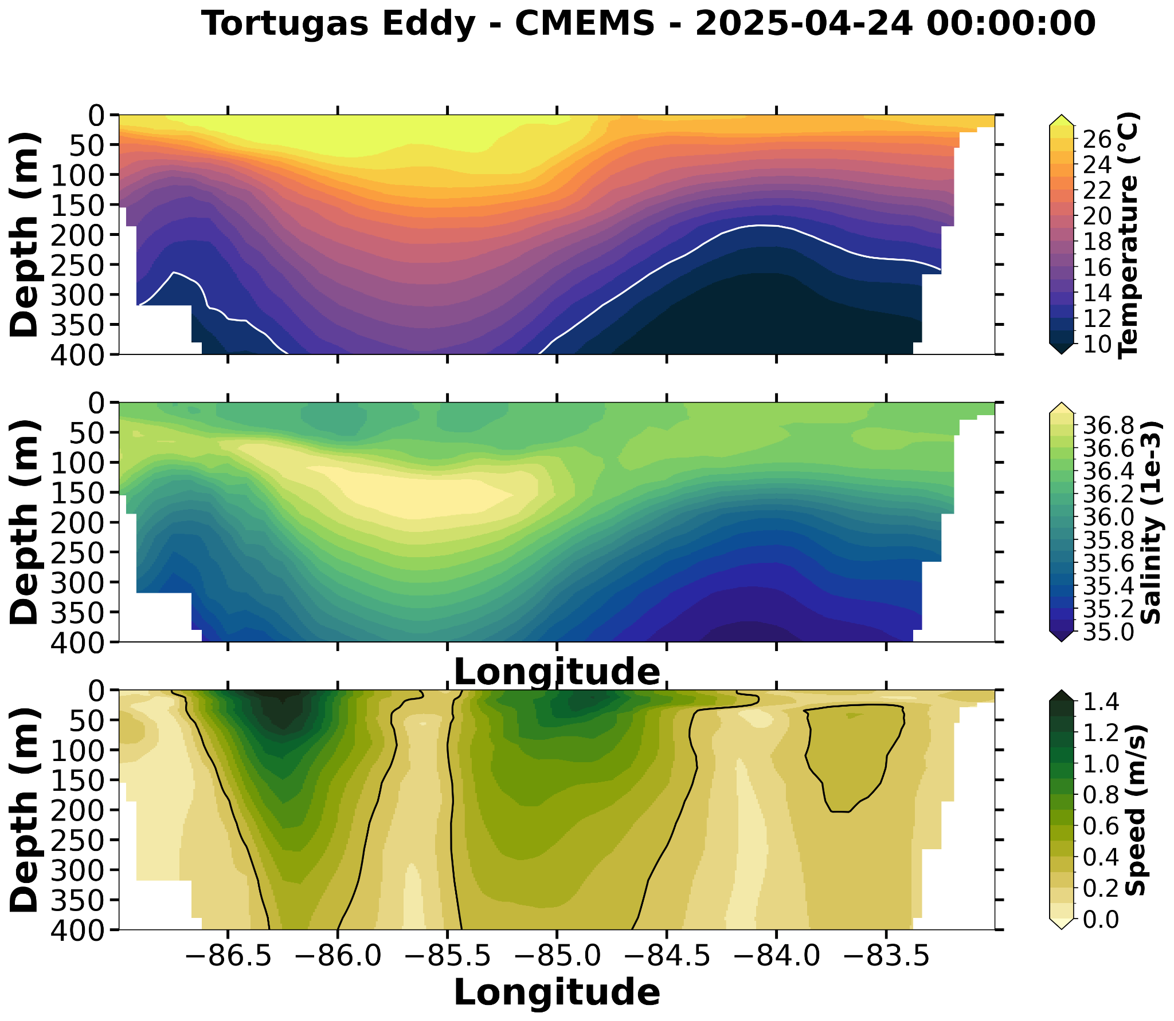
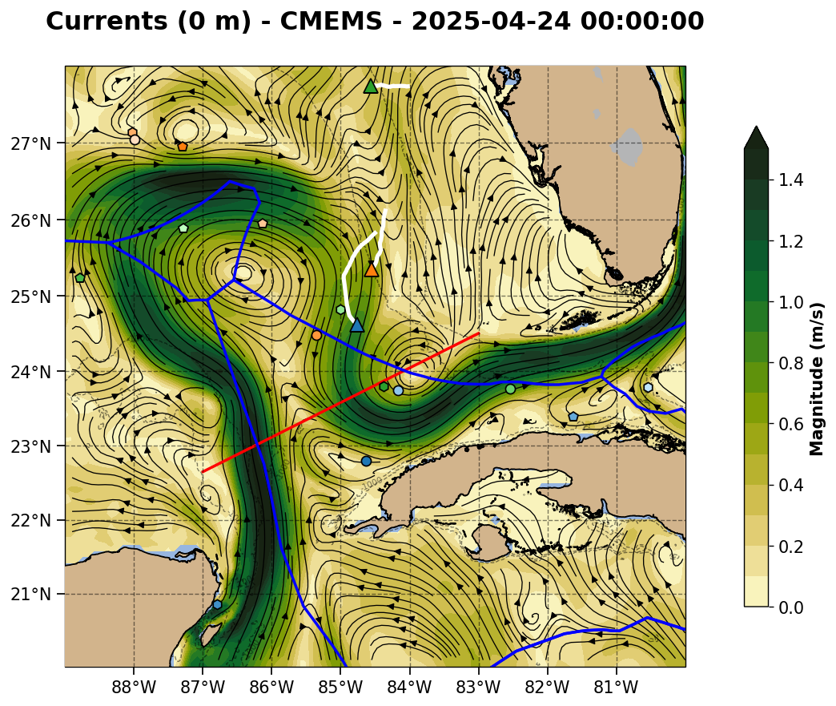
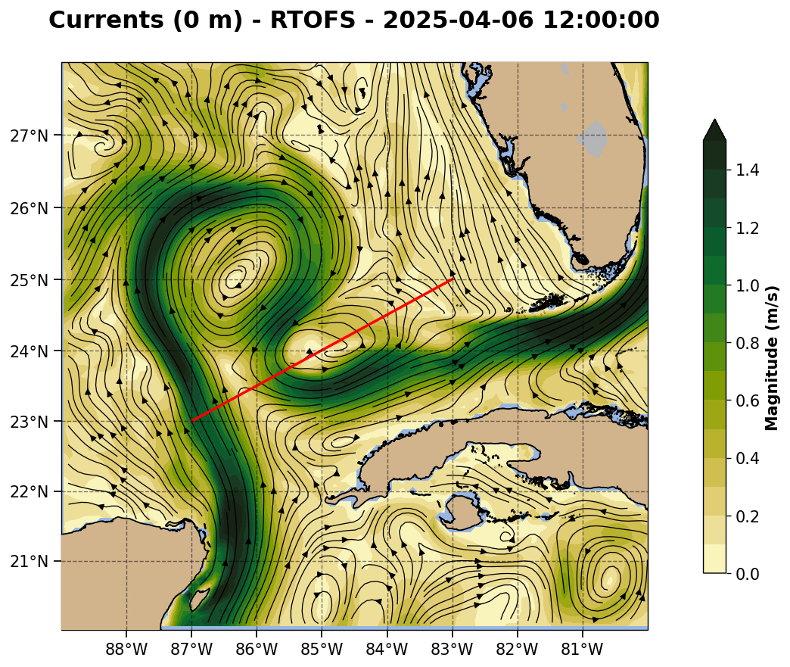
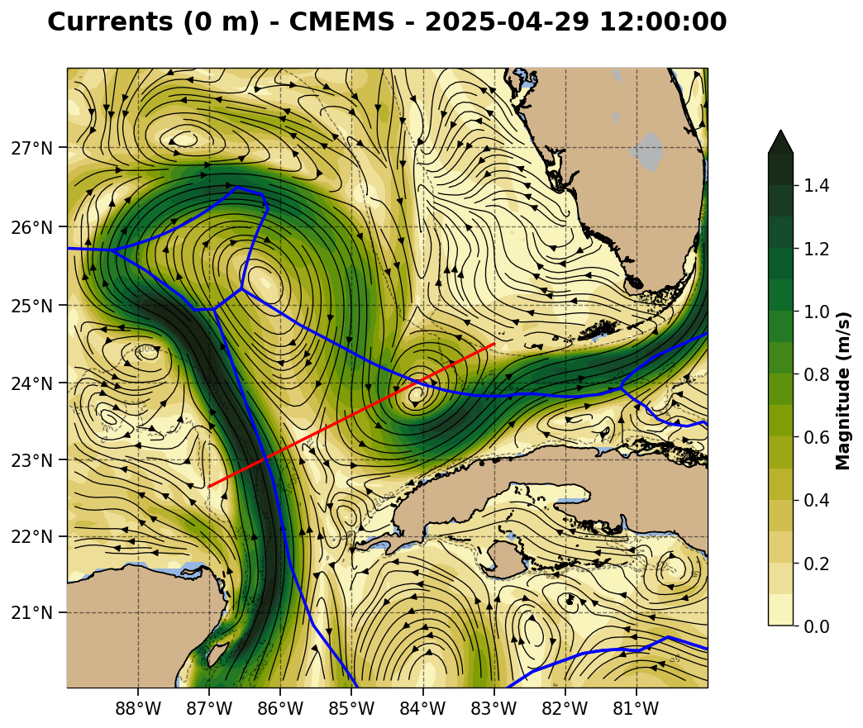

Slide 6
Summary: 2025-04-24
Red line is the northwest to southeast section. RU38 is approaching the red line and the edge of the Cuban EEZ.
Slide 7: Navy ESPC - LC northwest corner has a broad region of high surface velocity but a very narrow region of strong deep currents, with no vertical shift in the high velocity axis. LC-TCE interaction zone currents are the strongest and deepest of all the models.
Slide 8: NOAA RTOFS - LC northwest corner is shallower than ESPC. LC-TCE interaction zone has complex structure without the usual velocity signature. It does a high subsurface salinity maximum south of the gliders. FC-TCE interaction looks like a strong Florida Current with little tilt to the high velocity axis with depth.
Slide 9: European CMEMS - Loop Current velocity structure is most similar in all three sections. Large area with the subsurface salinity maximum in all three Loop Current crossings.

Slide 7
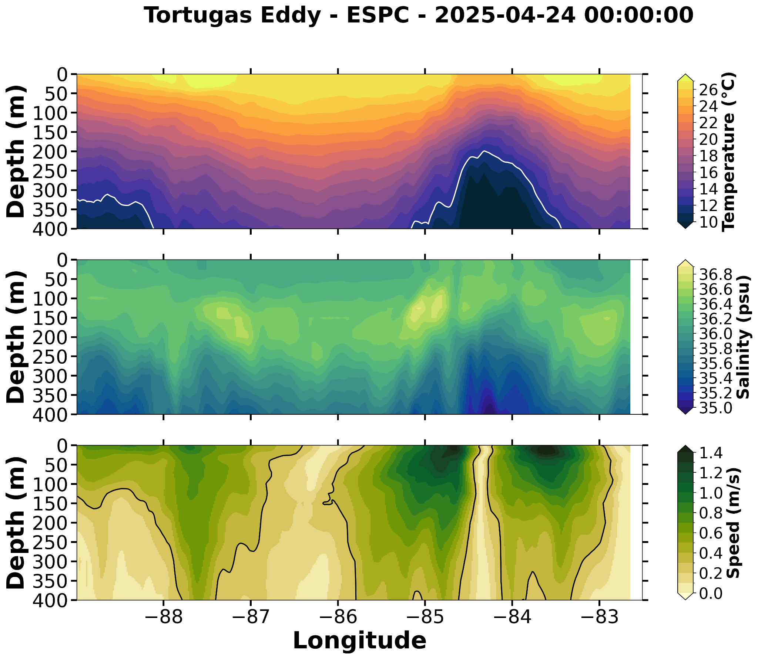
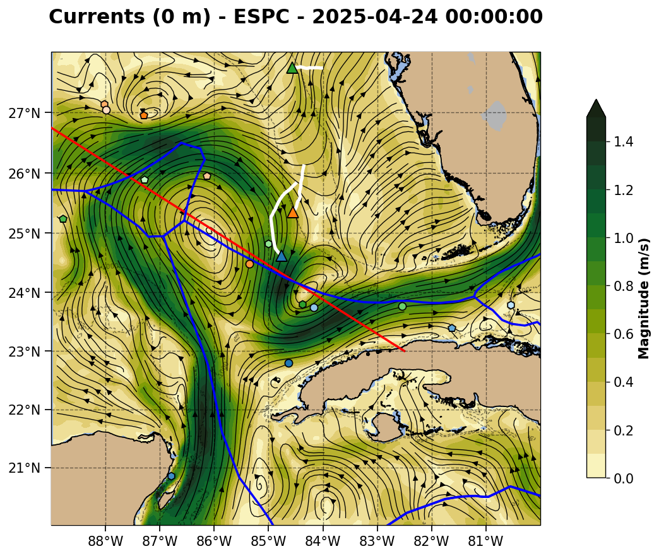
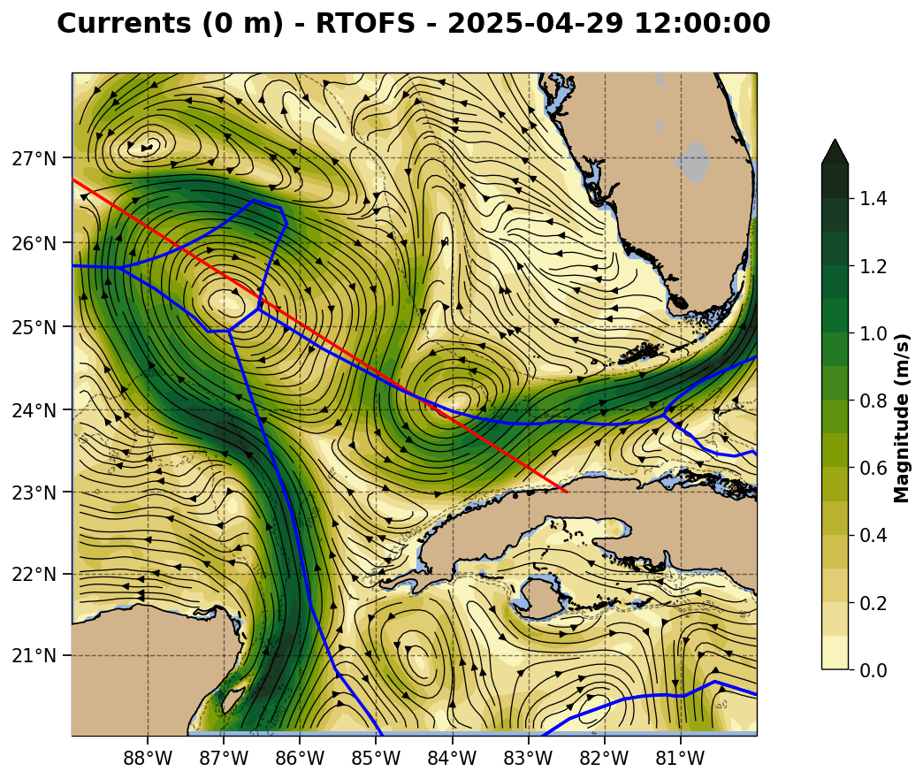

Slide 8
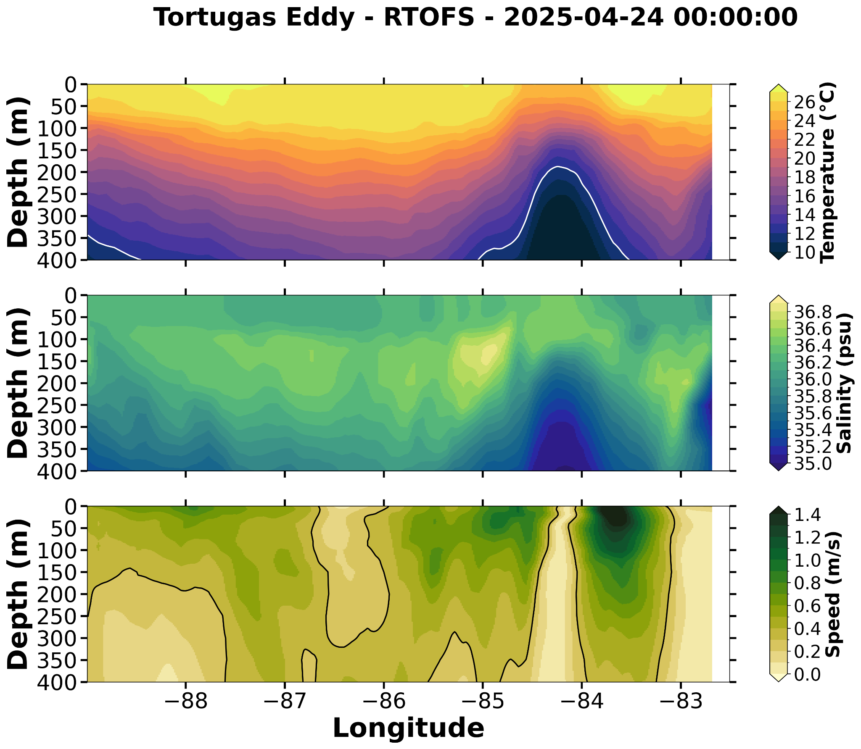


Slide 9
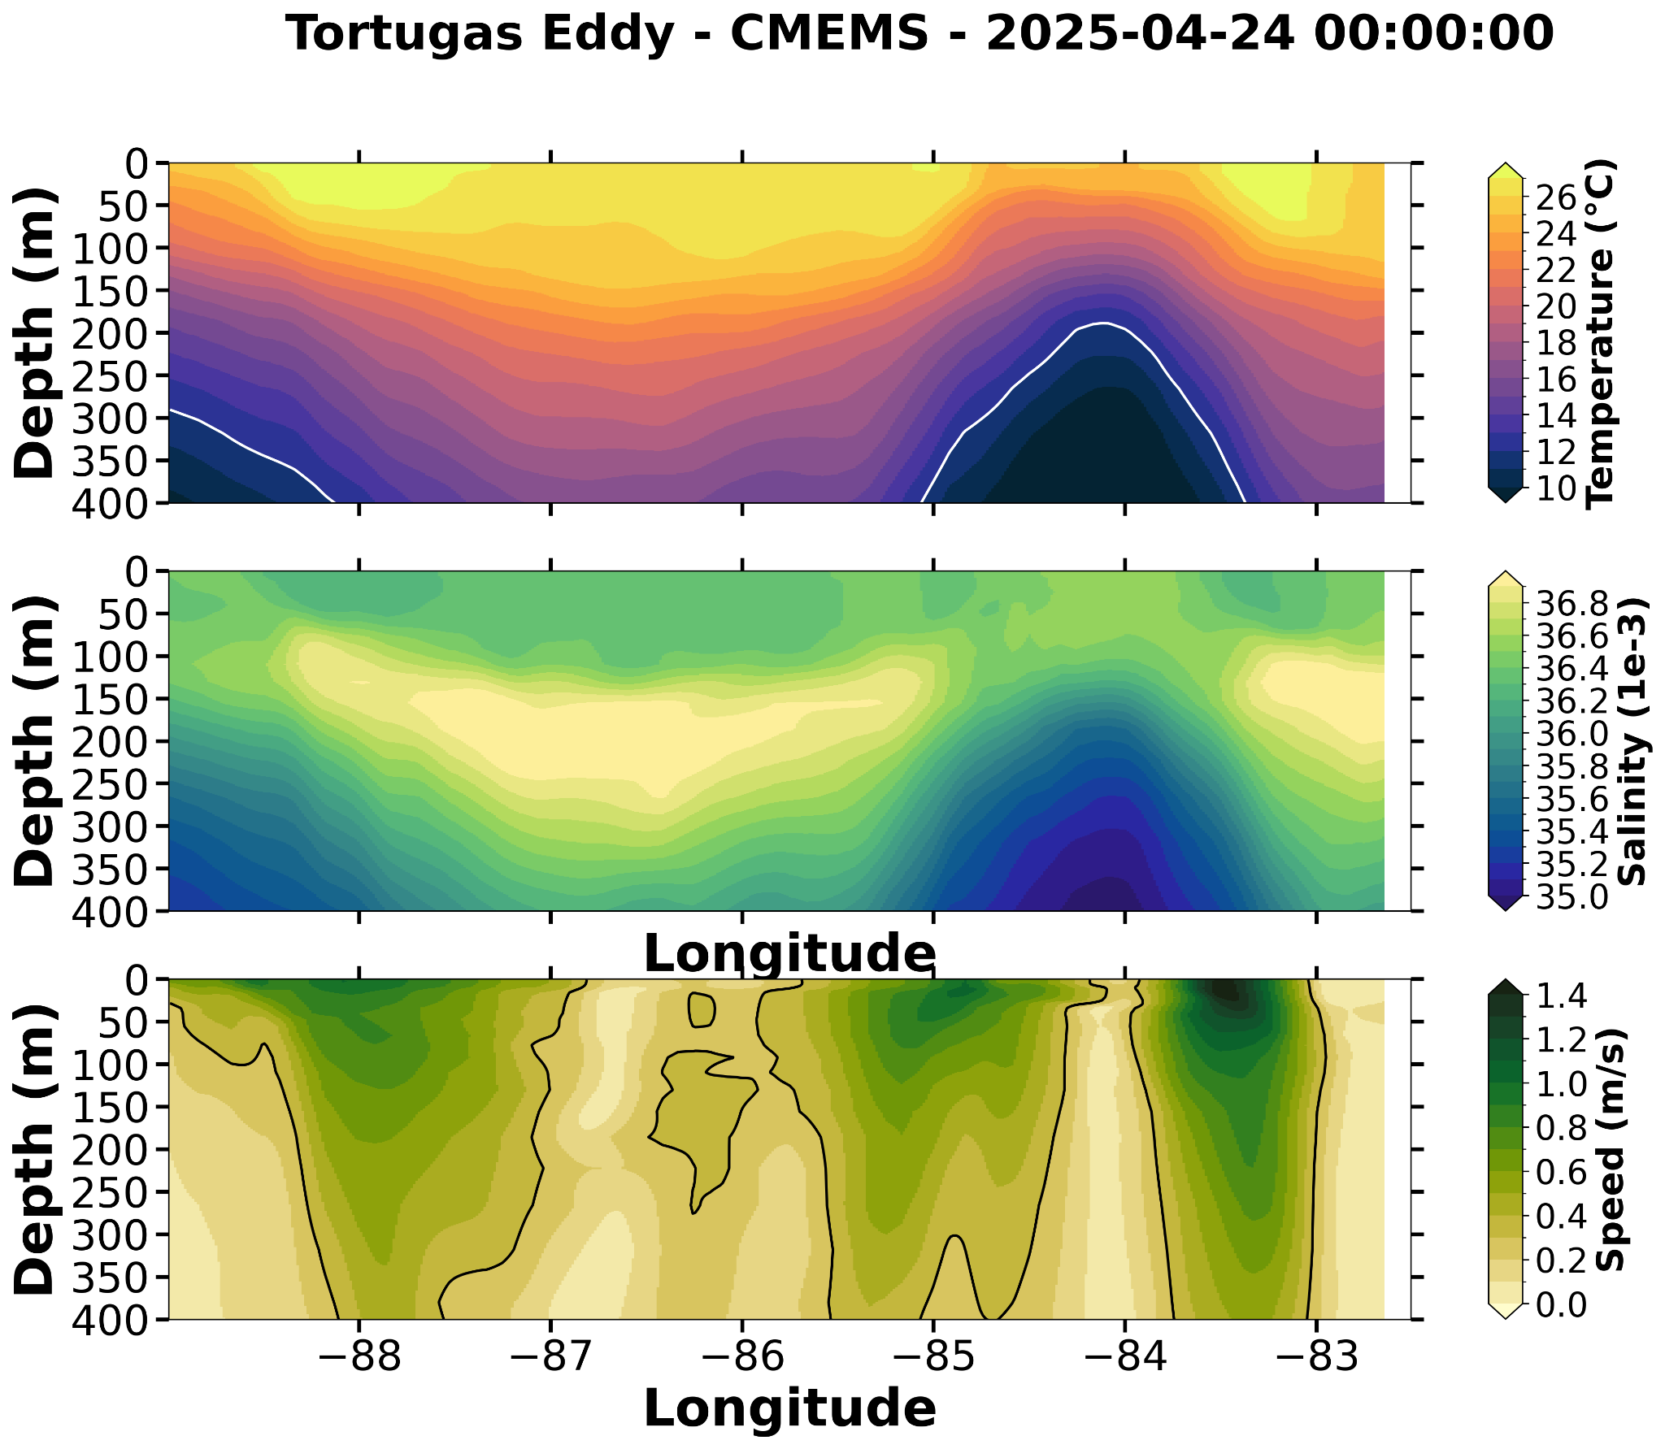



Slide 10
Summary: 2025-04-24
Here we compare the glider profile to the operational models.
Slide 11: RU38. April 24. RTOFS model (red) is the outlier. Below 100 m it is warmer and saltier than the other models and the data.
Slide 12: Howdy (Unit_308). April 23 comparison for Howdy goes to 400m. April 24 is only upper 100 m. On April 23, all models are comparing well with the Howdy data.
Slide 13: Argo float in the LC Extension. CMEMS Salinity profile is the model to beat. The subsurface salinity max is in the CMEMS and the data
Slide 14: Argo float in the Tortugas Cyclonic Eddy. All models cold and fresh.
Slide 15: EMC RTOFS DA QC. On April 21, the most recent data available for viewing, we see profiles of temperature and salinity from three gliders off West Florida and three Argo floats all being accepted for assimilation.

Slide 11
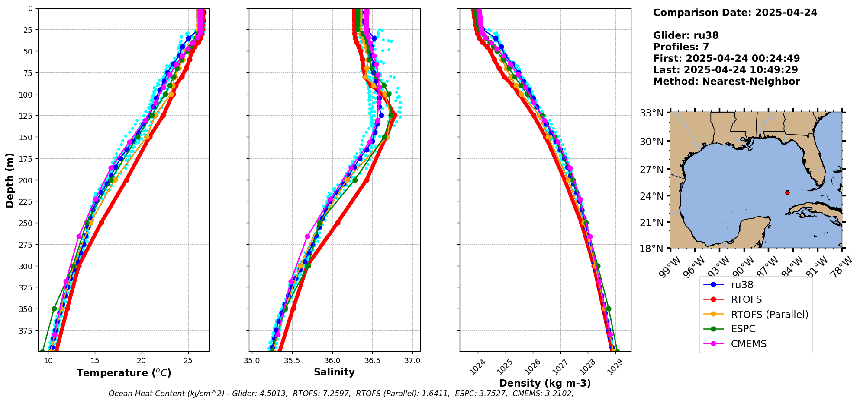

Slide 12
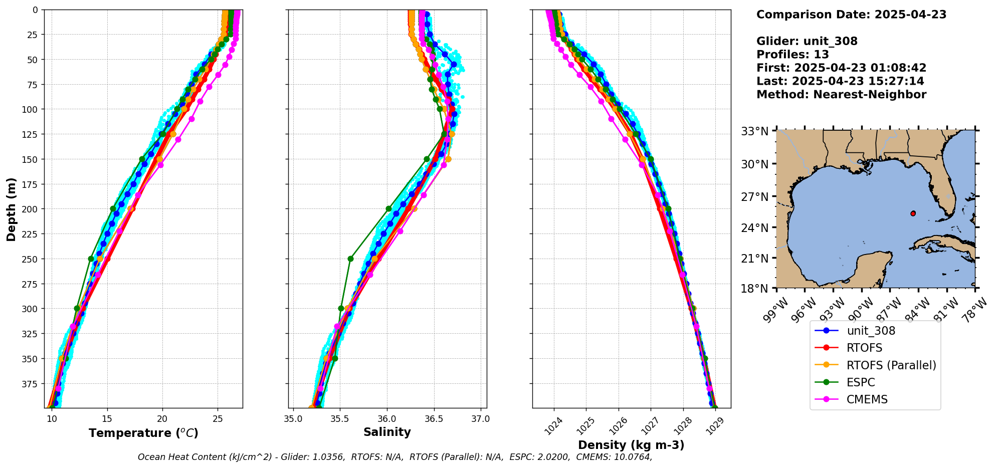

Slide 13
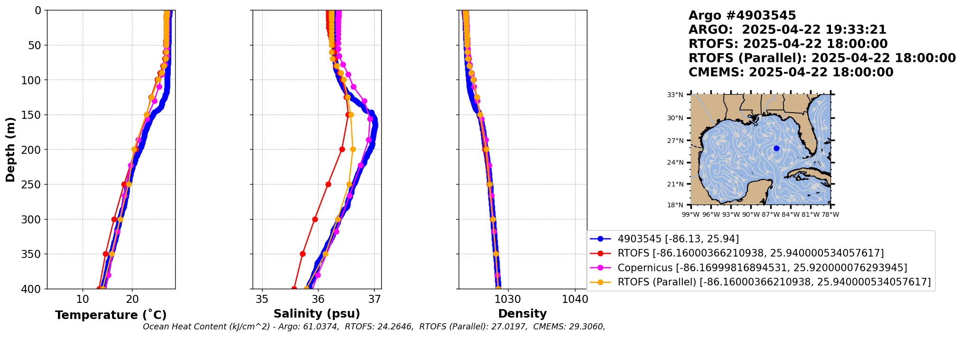

Slide 14
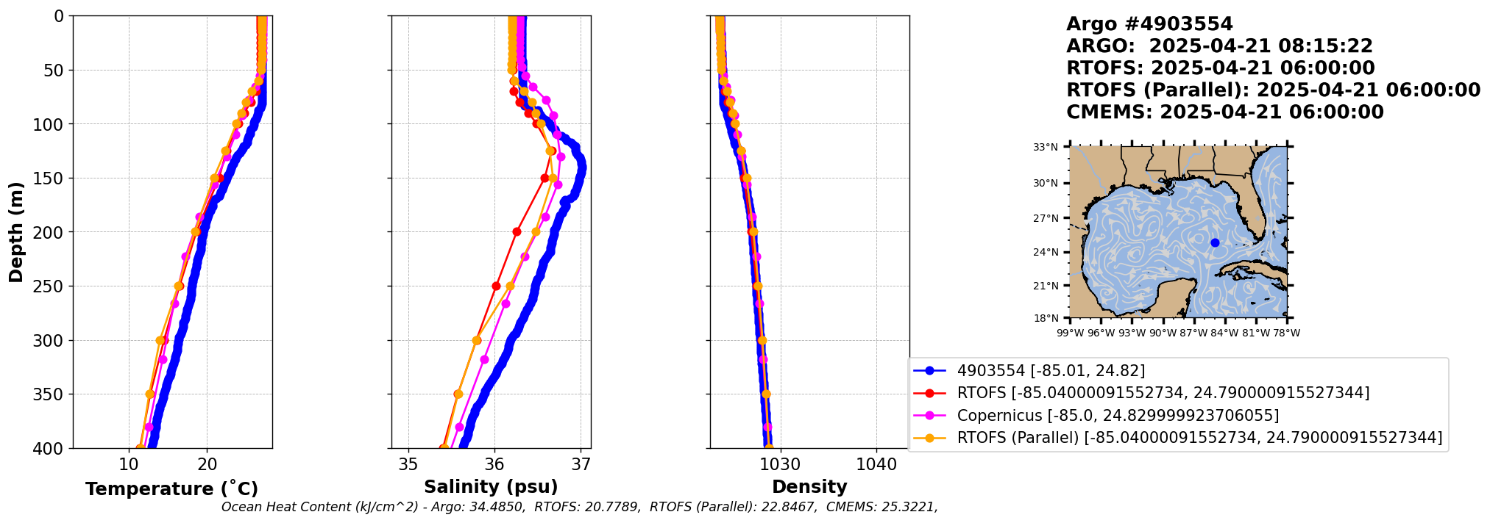

Slide 15
