Slide 1
Summary: 2025-04-21
Operational model summary: Today’s summary has three components:
Slides 2-6: Southwest to northeast cross-section through the Yucatan Current (YC), the narrow neck of the extended Loop Current (LC), and the Tortugas Cyclonic Eddy (TCE).
Slides 7-10: Northwest to southeast cross-section through the center of the extended Loop Current (LC), the Tortugas Cyclonic Eddy (TCE), and the Florida Current (FC) off Cuba.
Slides 11-13: Temperature, Salinity and Density profile comparisons between the two gliders and the operational models, plus most recent EMC ROTFS DA QC.
Maps of surface currents include the red line showing the vertical cross section location and blue lines for the EEZs. The top map is a common hour near the start of each forecast, bottom map is the common hour at the end of the forecast.
Sections - Cross-section plots from the first common hour now include temperature, salinity and current speed. You will need to infer direction of the strong currents from the maps. Current speed of 0.3 m/s is highlighted by the black contour line.

Slide 2
Summary: 2025-04-21
Red line is the southwest to northeast section.
Slide 3: Navy ESPC - Yucatan current inflow is narrow and deep. High velocity currents in the LC-TCE interaction zone cover a much broader area. Large area of low currents in the TCE. Maximum currents on eastern side of TCE are subsurface.
Slide 4: NOAA RTOFS - Yucatan current inflow looks like the plots WHG has been showing us for the typical LC velocity structure, with the high velocity axis tilting to the inside with depth. Currents are stronger and deeper in the LC-TCE interaction zone than the inflow. Eastern side of TCE also has subsurface maximum.
Slide 5: European CMEMS - Yucatan inflow currents again look like the WHG average but much stronger and deeper than RTOFS. LC-TCE interaction zone is weaker and shallower than the inflow, opposite of RTOFS. All have the subsurface velocity max on the eastern side of TCE.

Slide 3
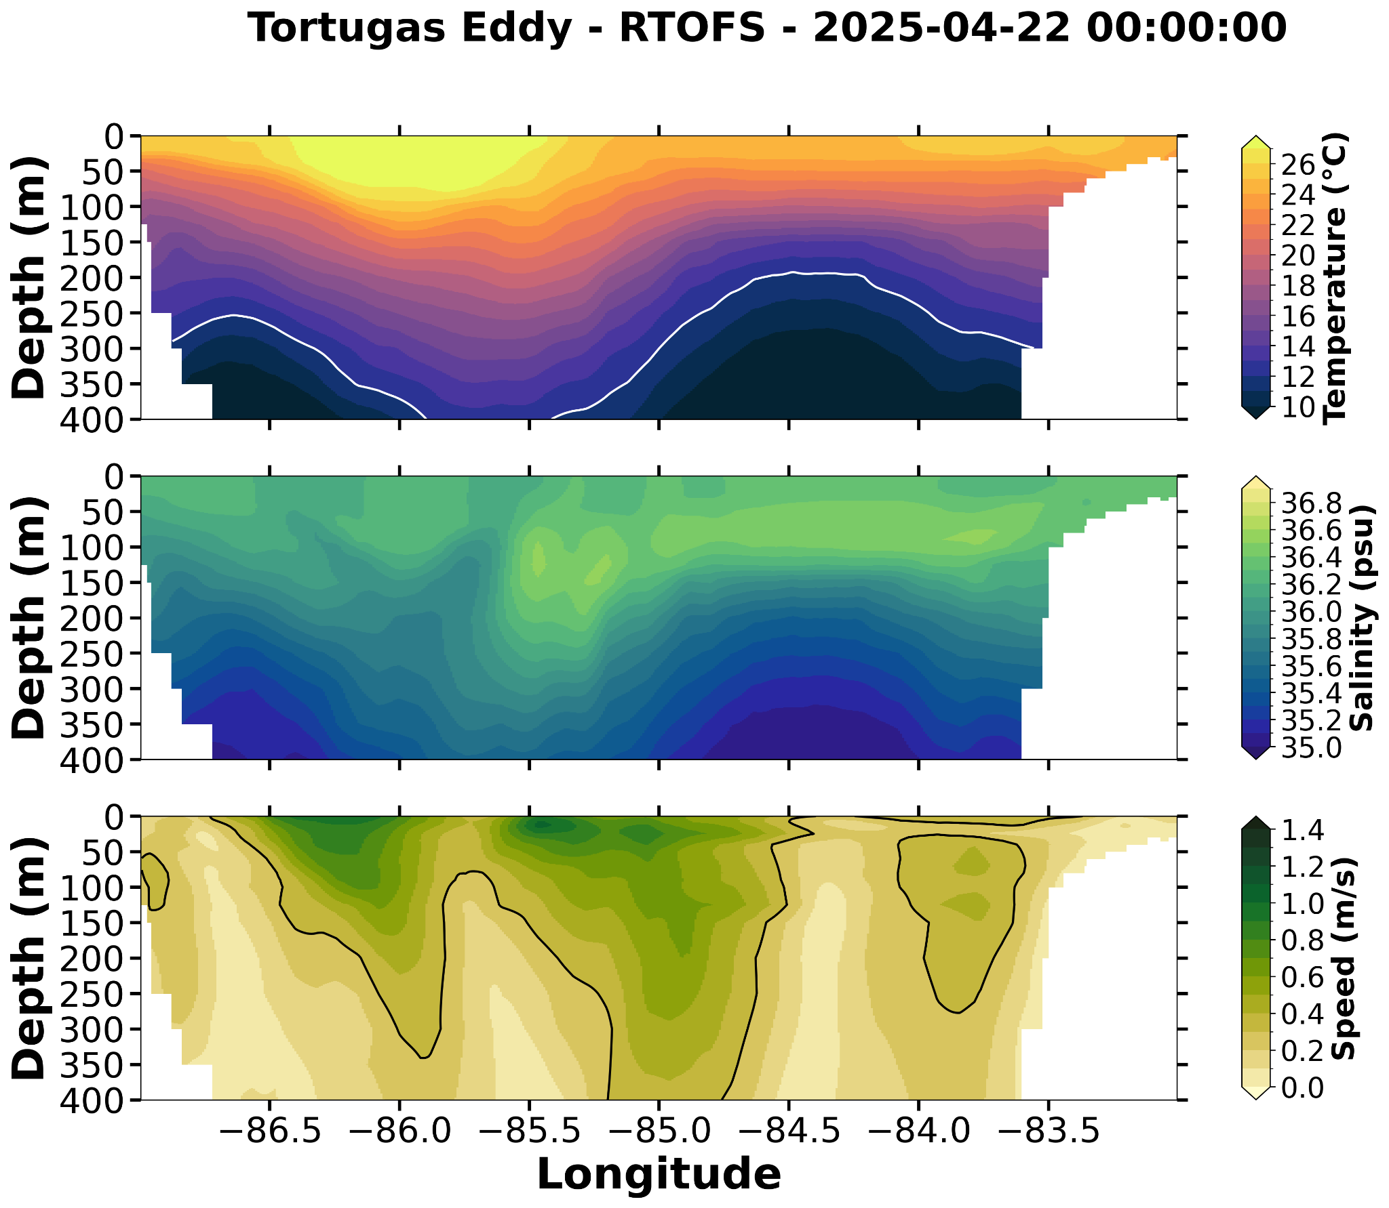
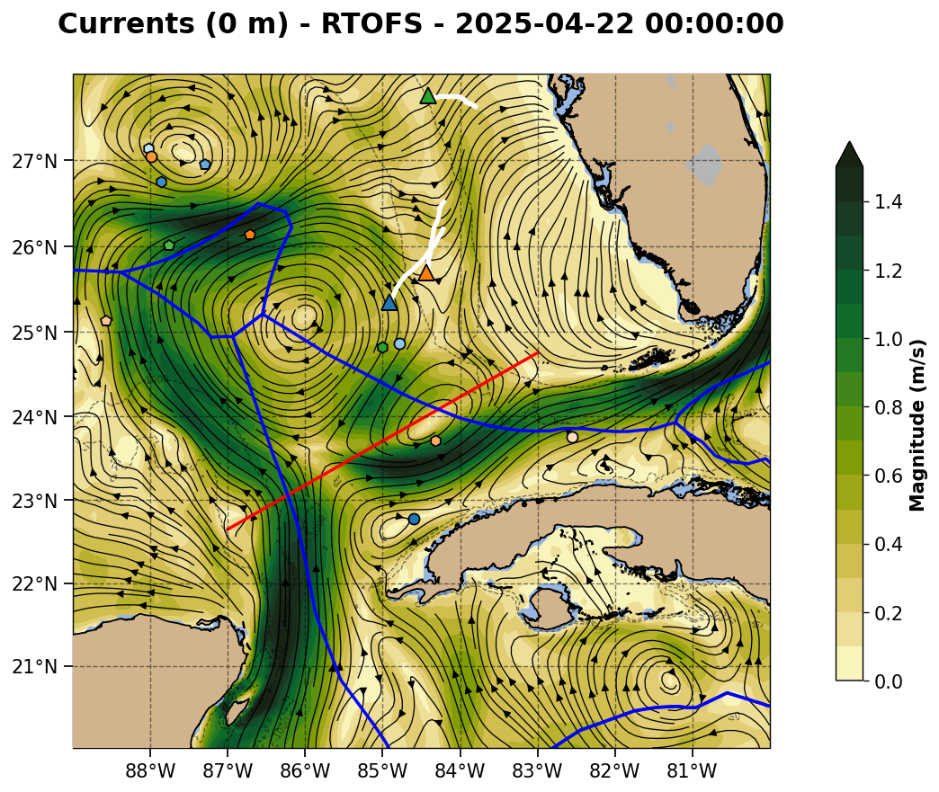
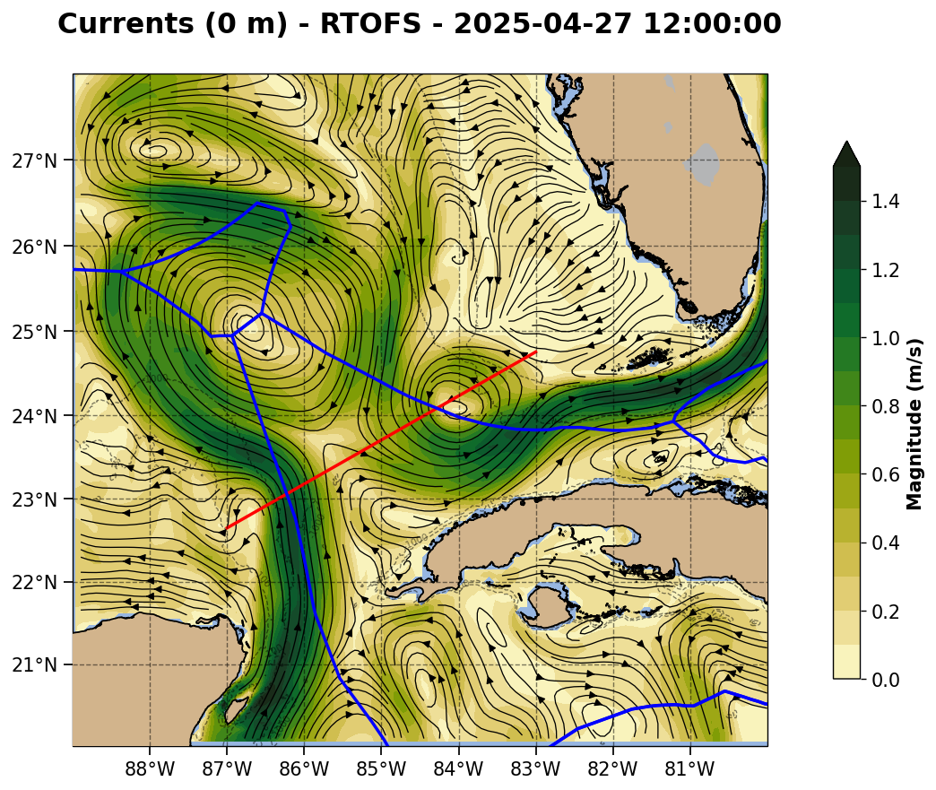

Slide 4
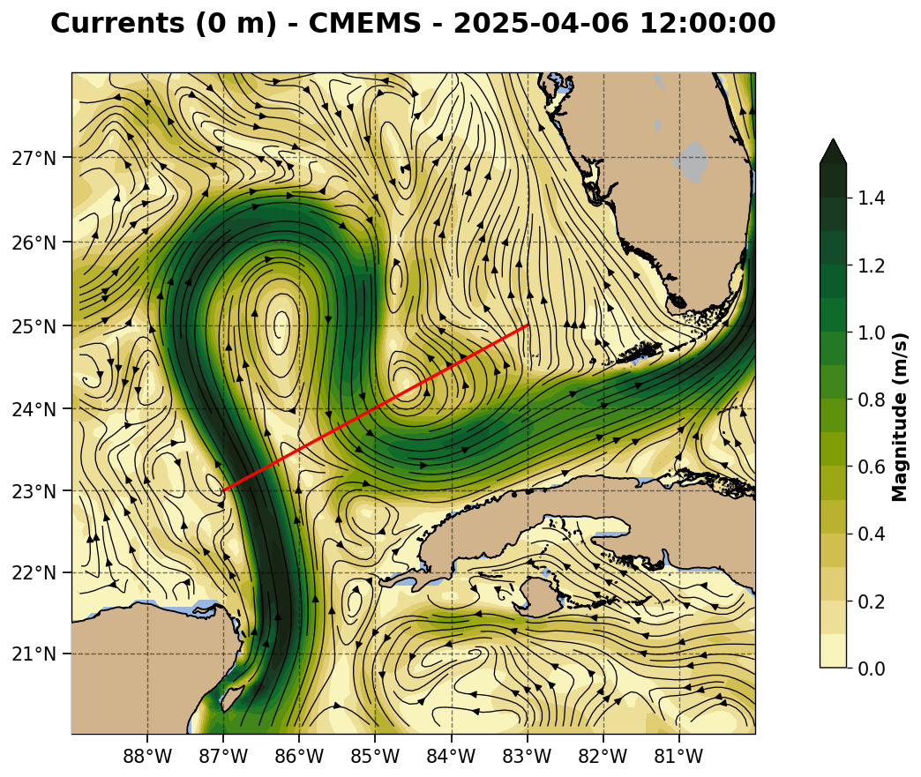
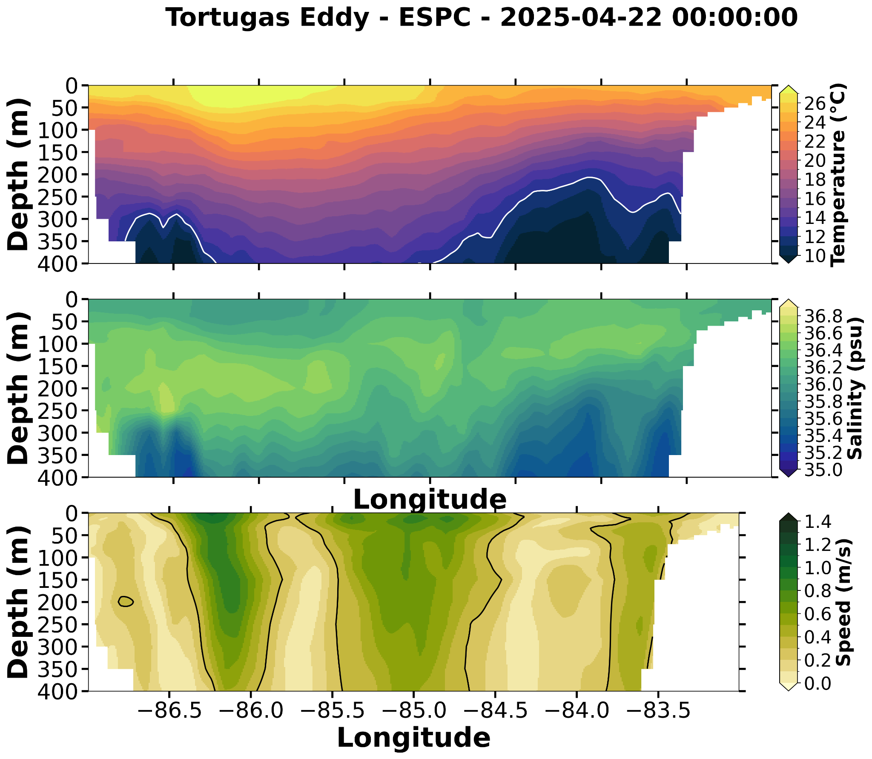
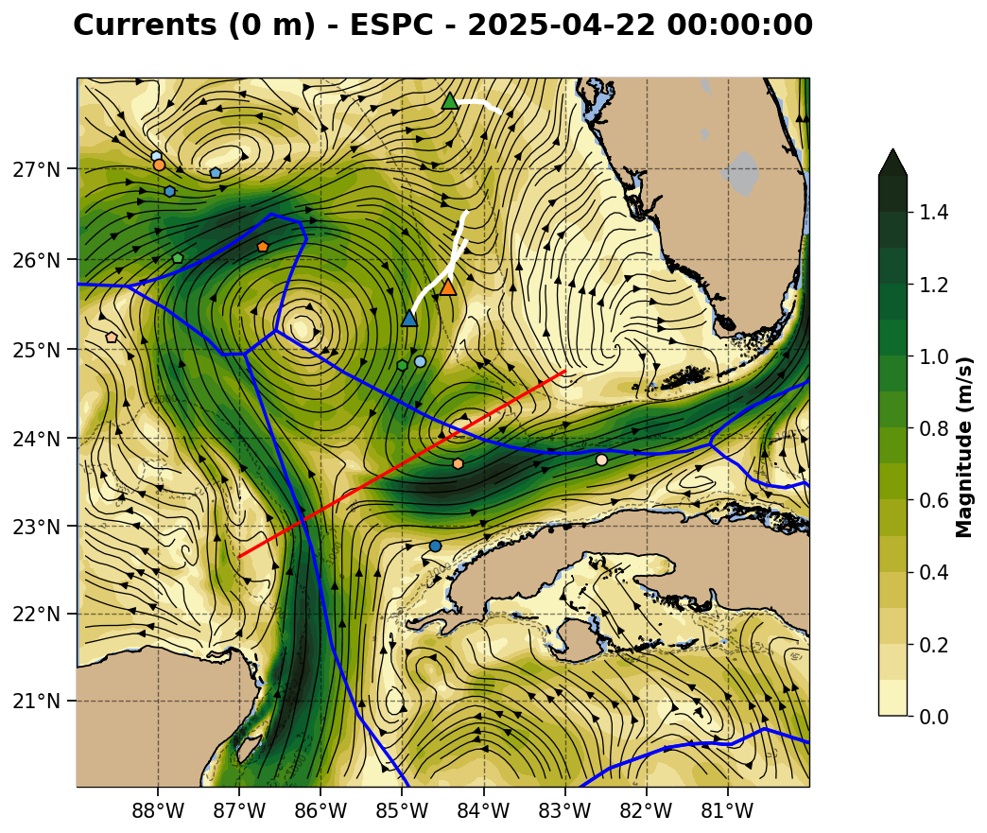
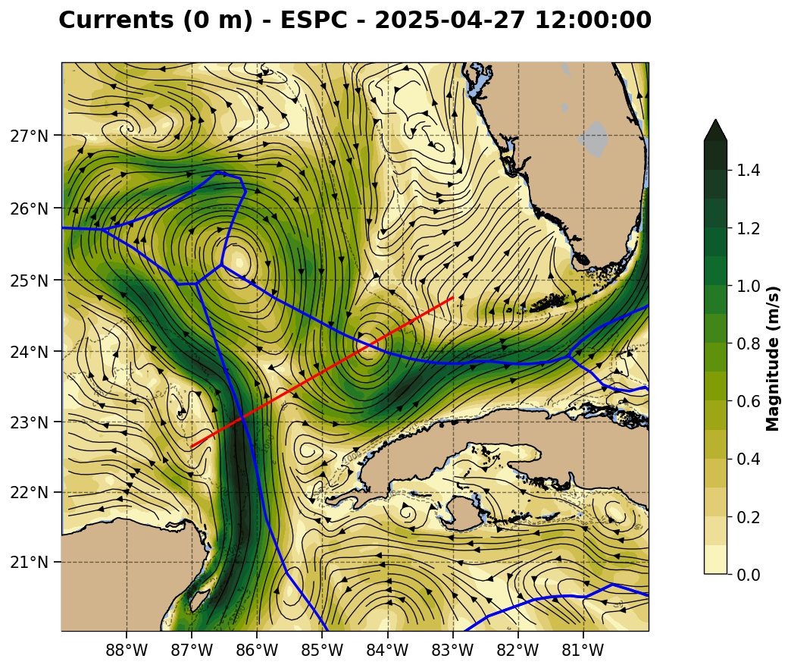

Slide 5
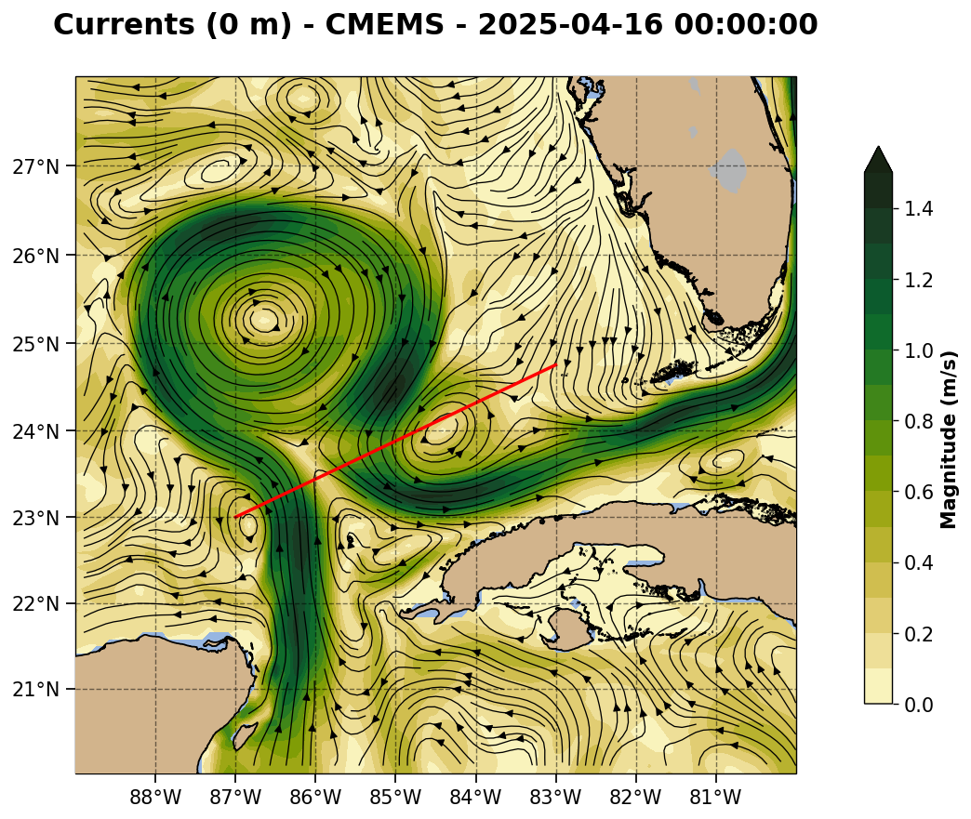
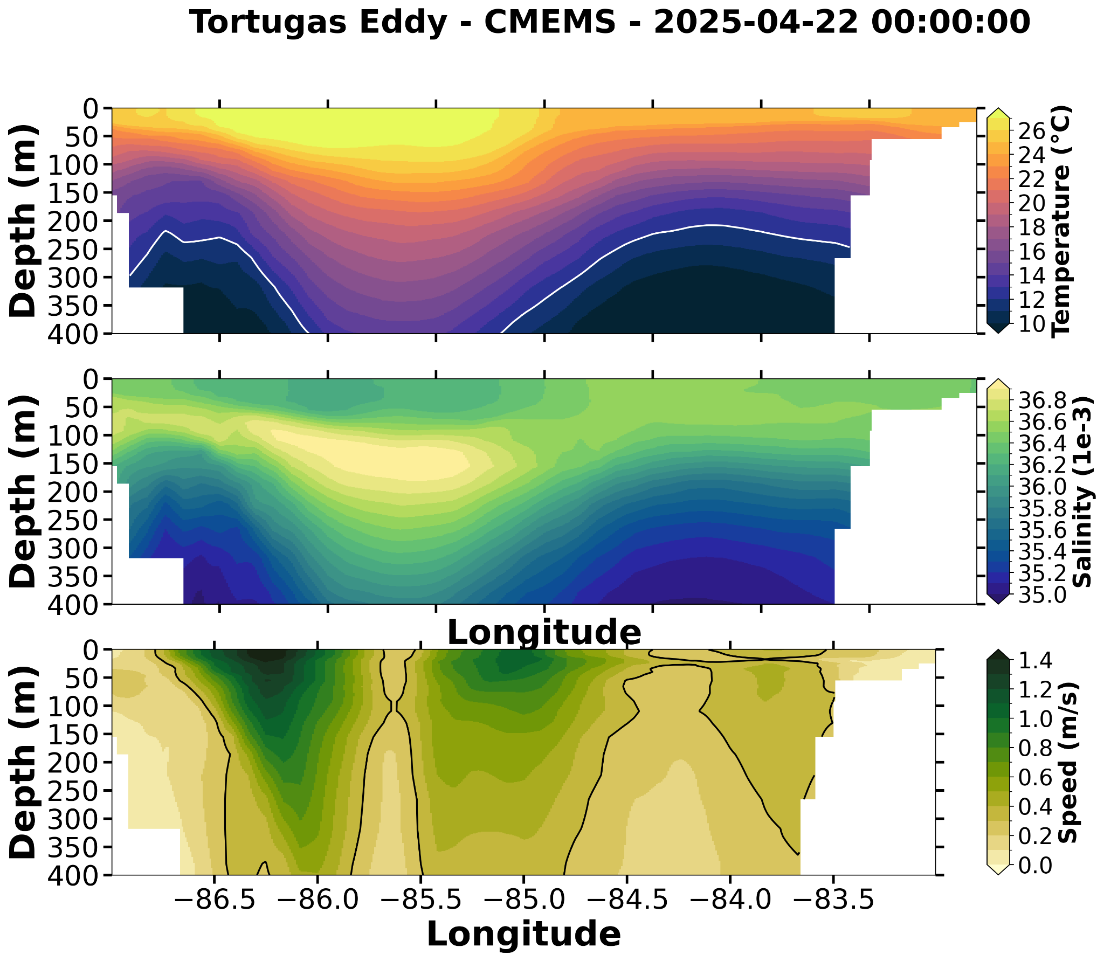
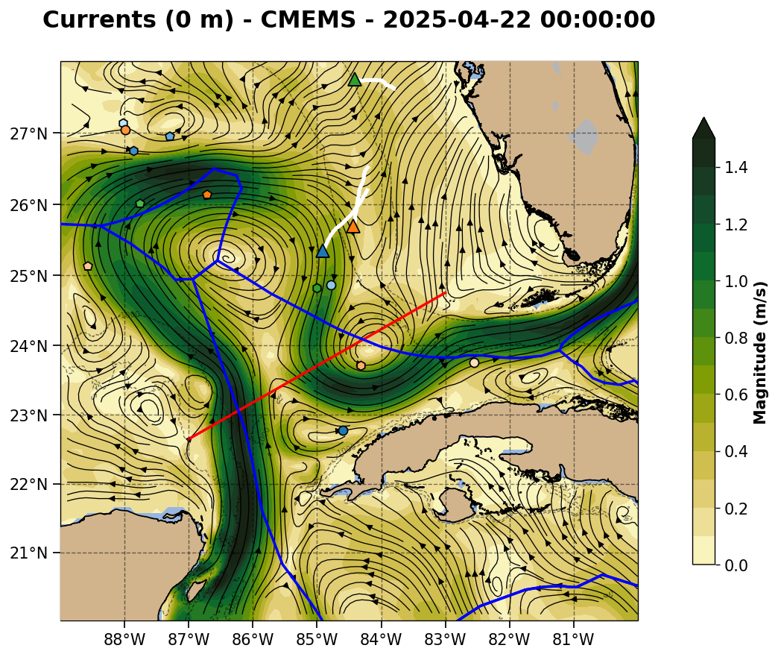
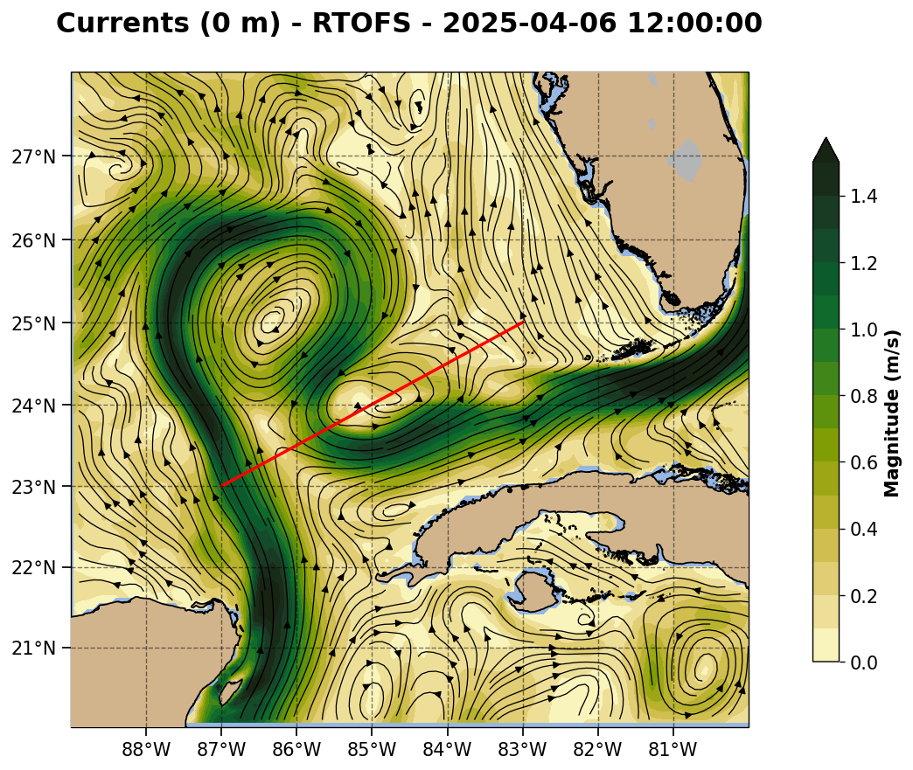
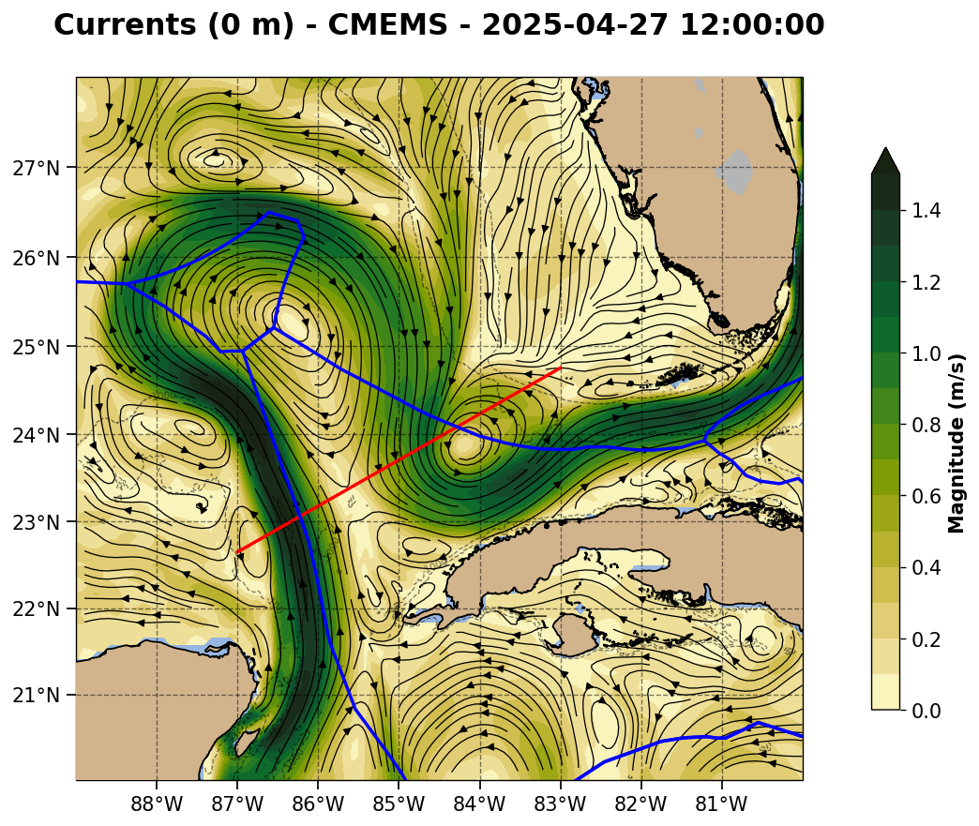

Slide 6
Summary: 2025-04-21
Red line is the northwest to southeast section.
Slide 7: Navy ESPC - LC northwest corner has a broad region of high surface velocity but a very narrow region of strong deep currents, with no vertical shift in the high velocity axis. LC-TCE interaction zone currents are wide and weaker, with two subsurface peaks. FC-LCE interaction zone currents are strong, single peaked, with no tilt with depth.
Slide 8: NOAA RTOFS - LC northwest corner is shallower than ESPC, symmetrical in the east-west. LC-TCE interaction zone has complex structure without the usual velocity signature. FC-TCE interaction looks like a strong Florida Current. Here we do see that tilt in the velocity structure with depth, with the deeper strong currents closer to Cuba.
Slide 9: European CMEMS - Still processing

Slide 7
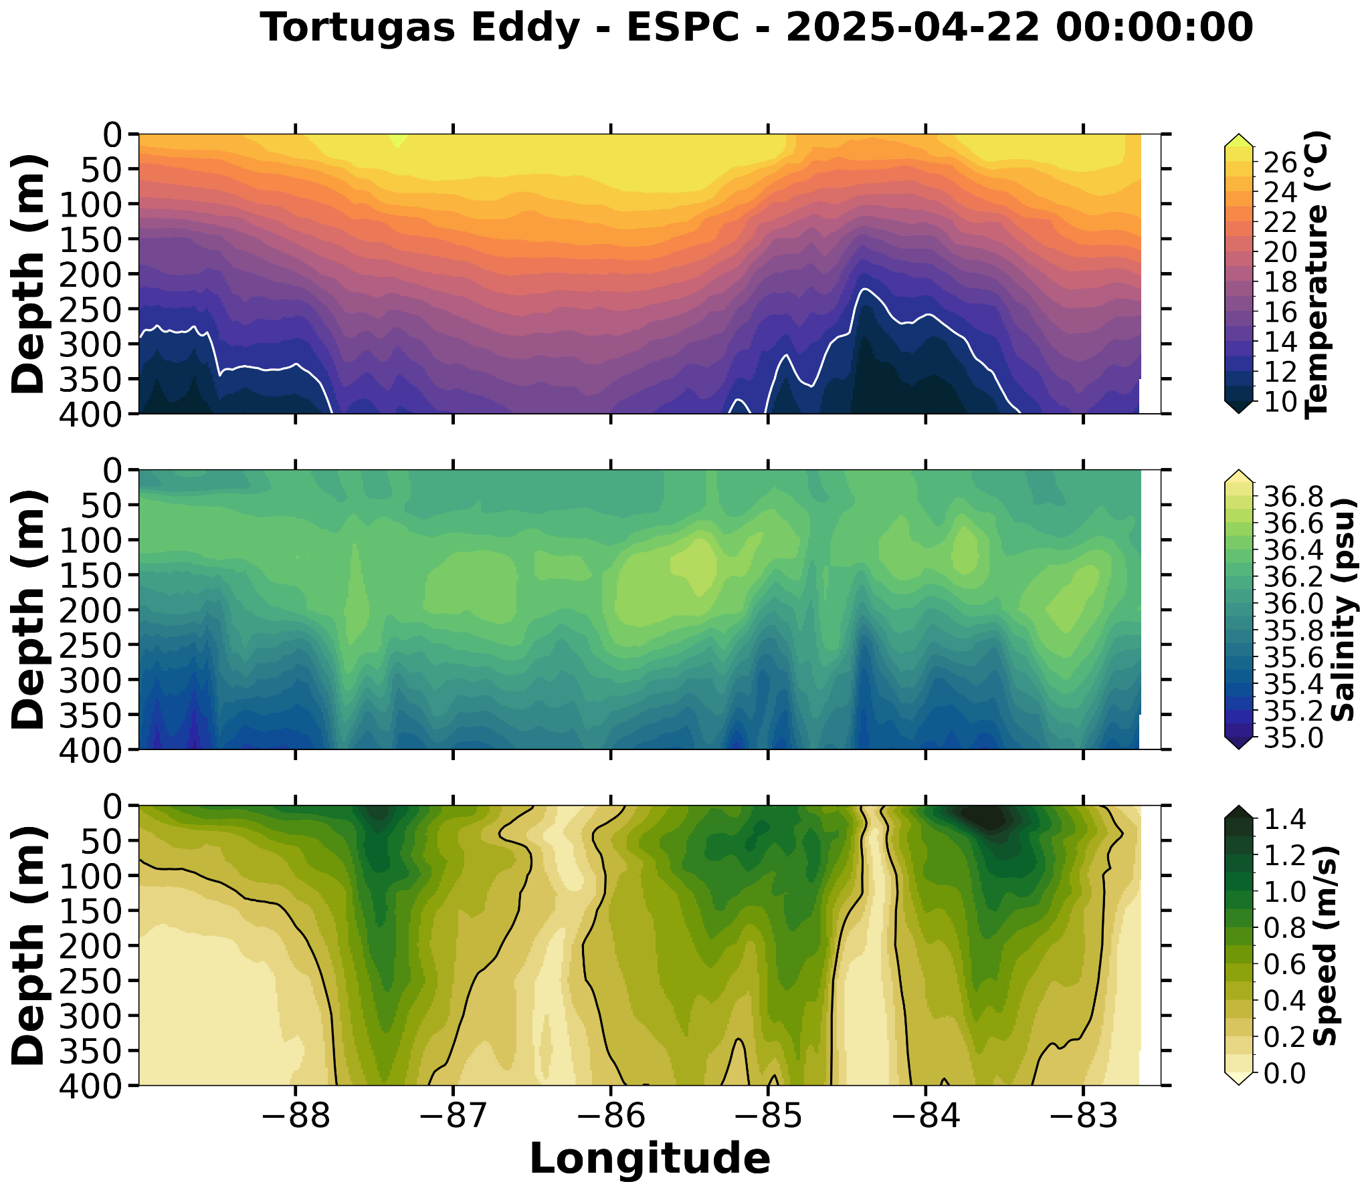


Slide 8
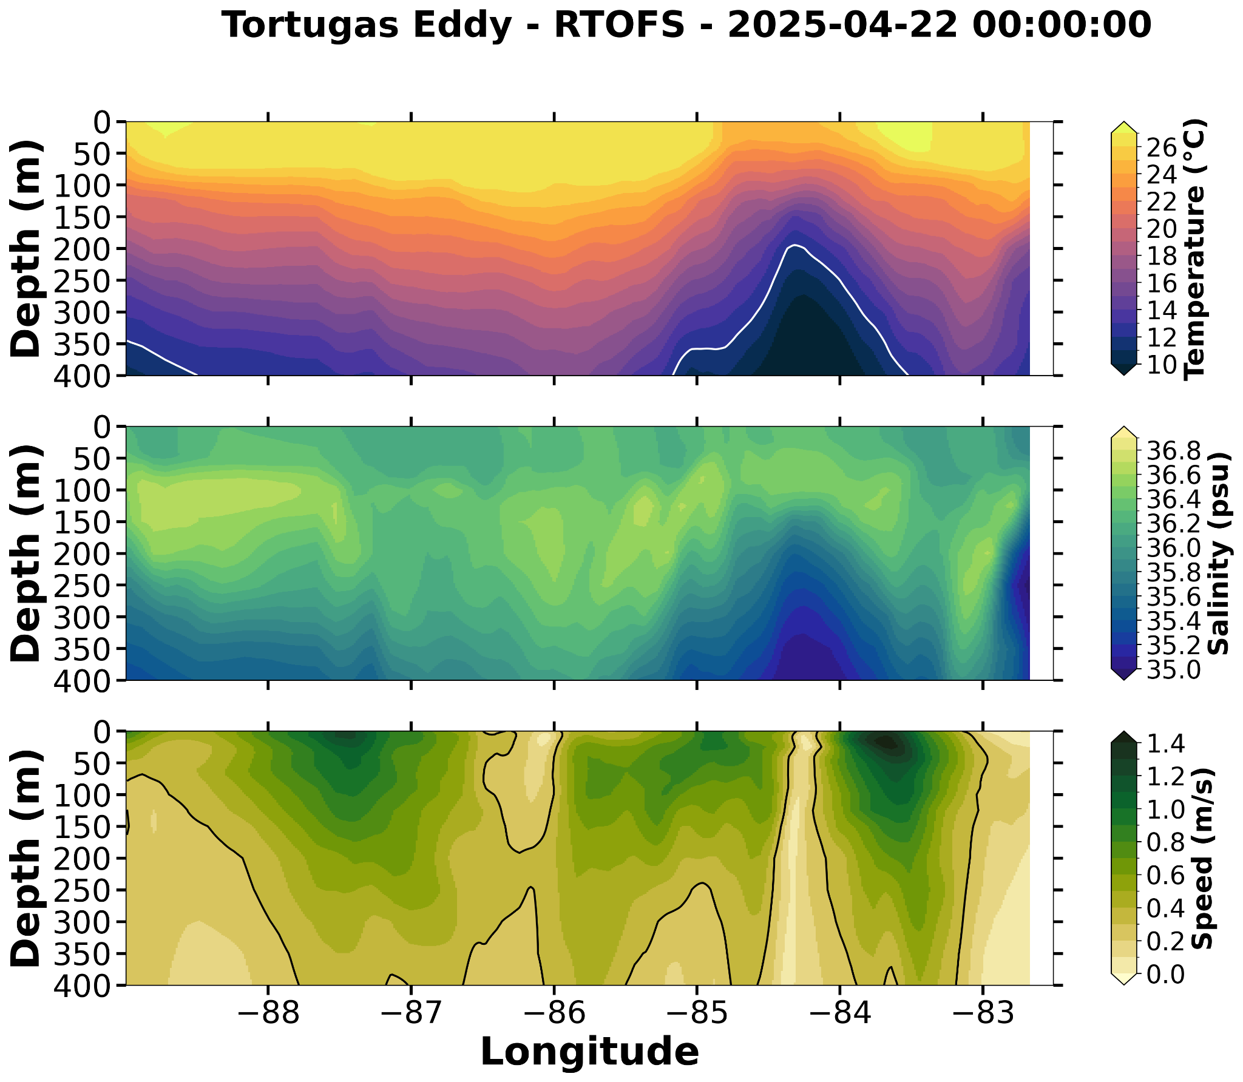
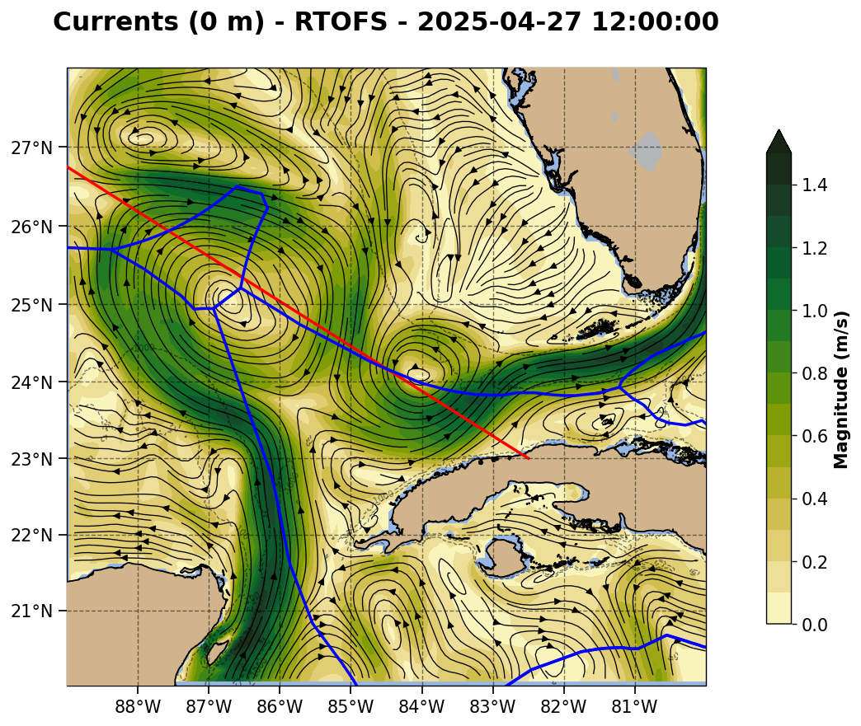

Slide 9
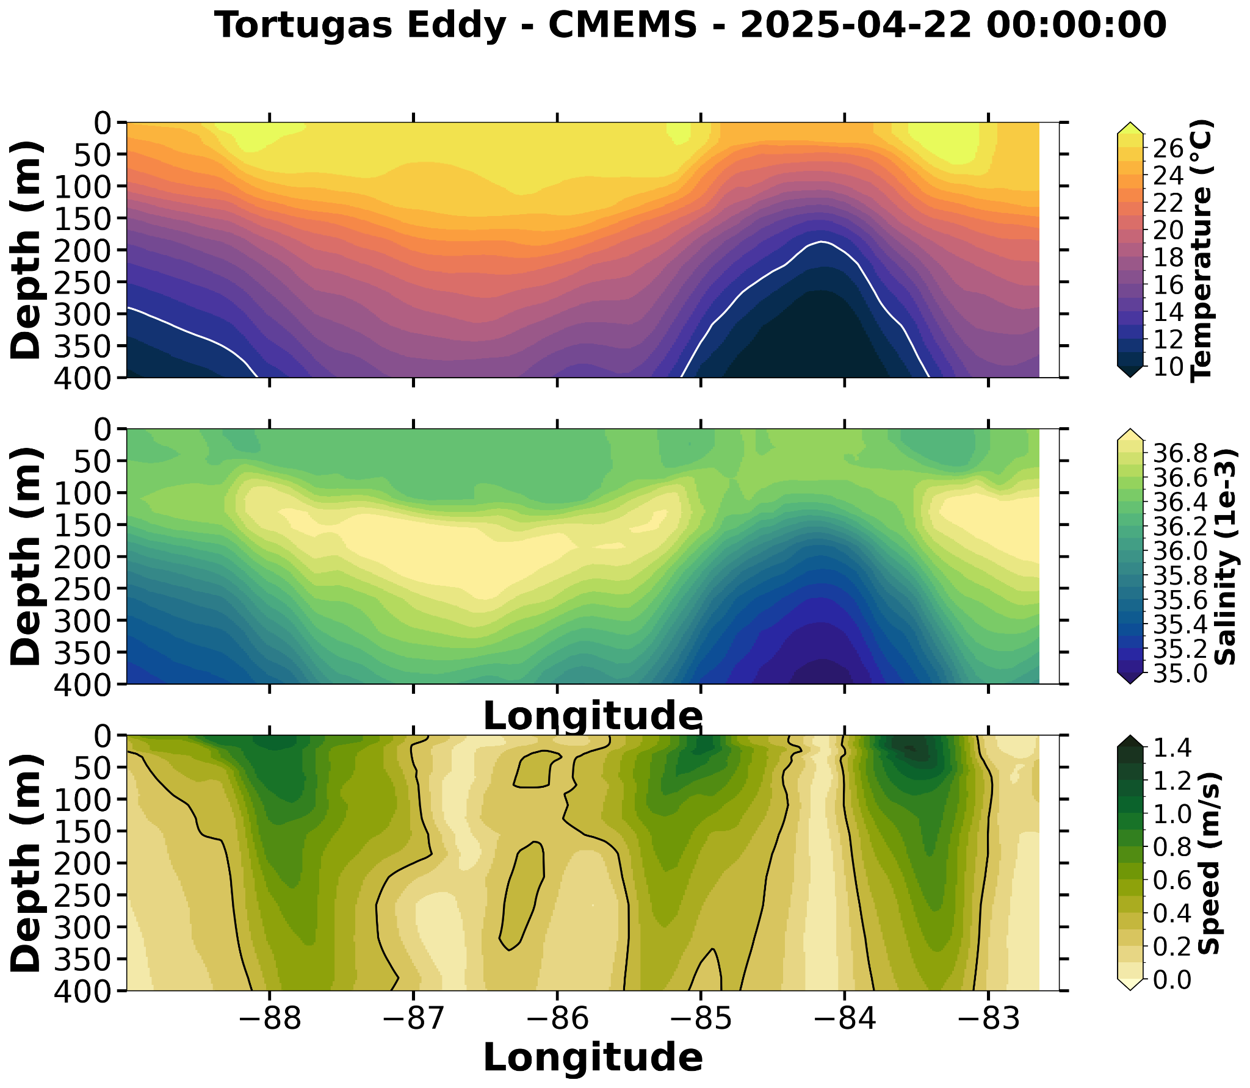
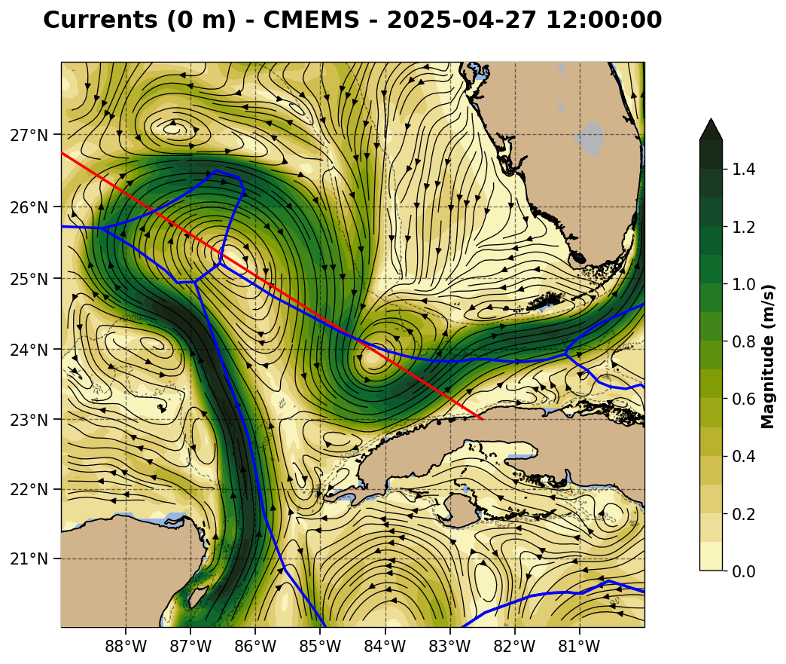

Slide 10
Summary: 2025-04-21
Here we compare the glider profile to the operational models.
Slide 11: RU38. RU38 is in deepwater cycling cycling from the surface to 1000 m, with the plot zoomed into the upper 400 m. All the models are in good agreement on the temperature profile, but all are about a degree colder than the glider. Salinity profiles illustrate how the European CMEMS is consistently better at representing the subsurface salinity maximum of the SubTropical UnderWater than all of the U.S. models, including the new experimental Parallel version of RTOFs.
Slide 12: Howdy (Unit_308). Howdy is on the outer West Florida Shelf in water depths of about 200 m. In this location, compared to European CMEMS, all the U.S. models are in better agreement with the glider for temperature and salinity.
Slide 13: EMC RTOFS DA QC. On April 18, the most recent data available for viewing, we see profiles from three gliders off West Florida being accepted for assimilation: USF’s Sam to the north, TAMU’s Howdy close by in the middle, and RU38 to the south.

Slide 11
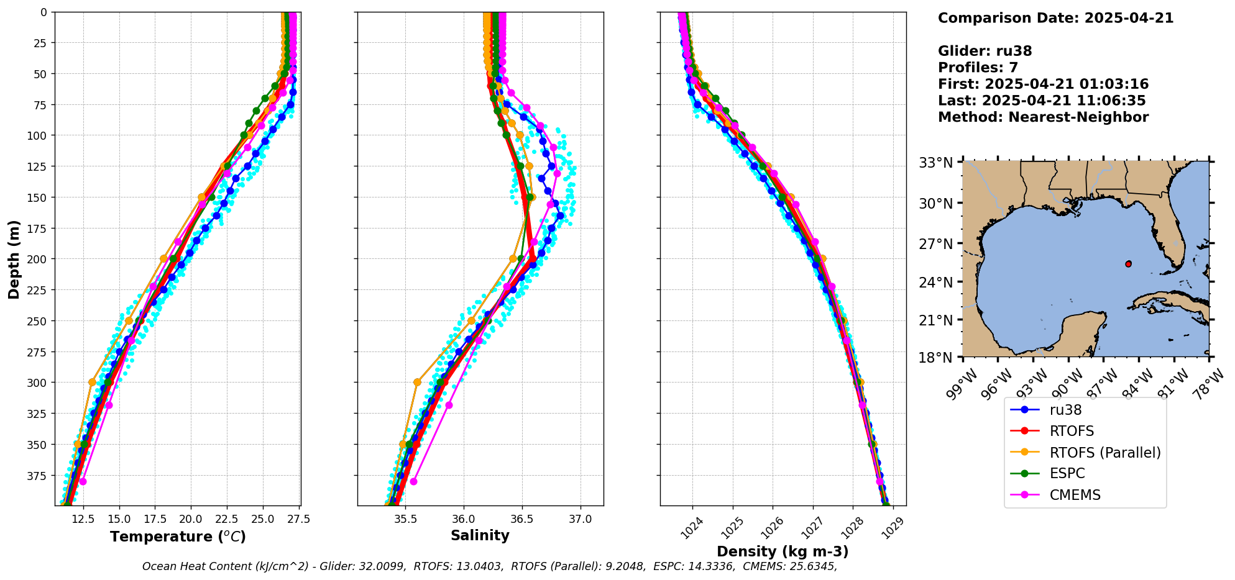

Slide 12
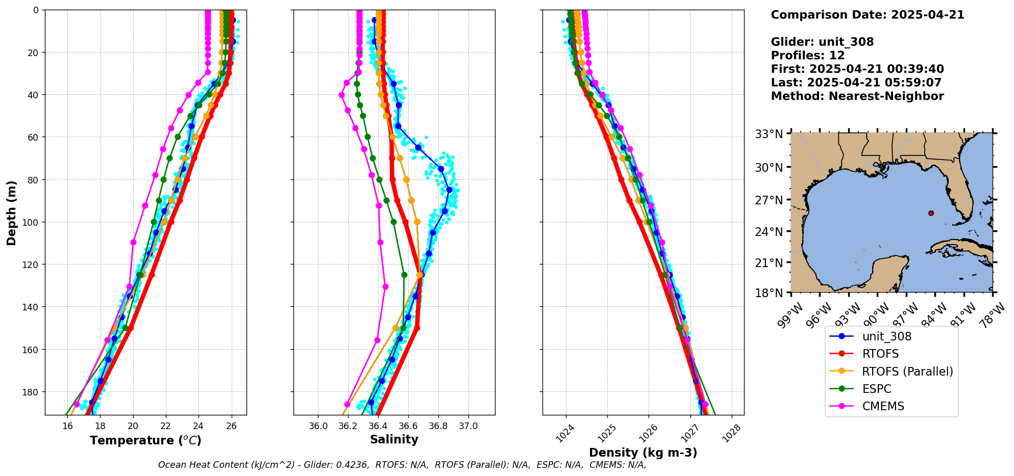

Slide 13
