Slide 1
Summary: 2025-04-17
Top right map is the earliest common time (April 17, 00Z) near the start of each model run; bottom right map is the latest common time near the end of each model run (April 23, 12Z).
Map format expanded to include EEZ lines in blue, 100 m & 1000 m isobaths as thin black dashed lines purposely left faint, and location of T & S sections we plot on the left as the red line. Glider location at the time of the map is shown as triangles, with Rutgers as orange and TAMU as green.
Slide 2: Navy ESPC - Tortugas Cyclonic Eddy (CE) is forecast to become more circular and stronger, Yucatan Escarpment CE forecast to weaken, large Loop Current Eddy (LCE) forecast to move more towards reattachment. Half the Loop Current flows along Cuba, half around the LCE.
Slide 3: NOAA RTOFS - Yucatan CE and Tortugas CE look strongest in this model. Large LCE is also forecast to move closer to reattachment and the Yucatan CE weakens. Tortugas CE remains strong. LC similar to ESPC, half along Cuba, half around the LCE.
Slide 4: European CMEMS - No Yucatan CE in CMEMS. Loop Current remains in extended mode, fully flowing north from Yucatan and around the extended Loop Current. Tortugas CE still strong.

Slide 2
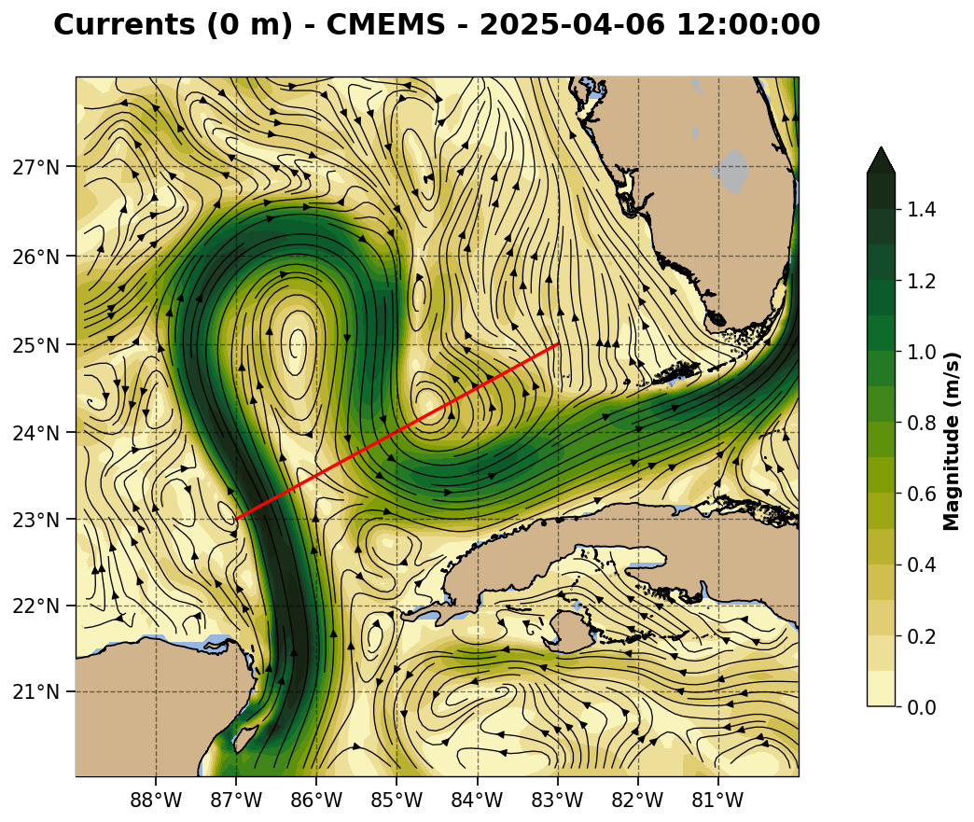
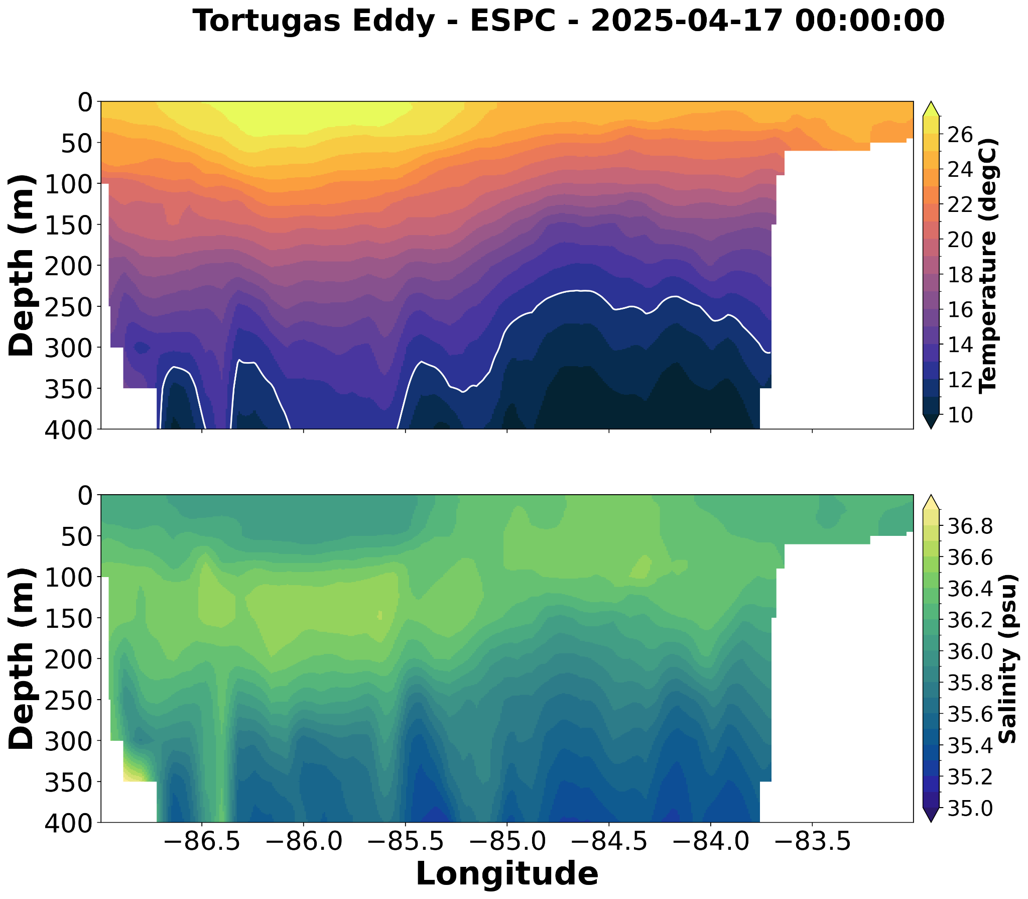
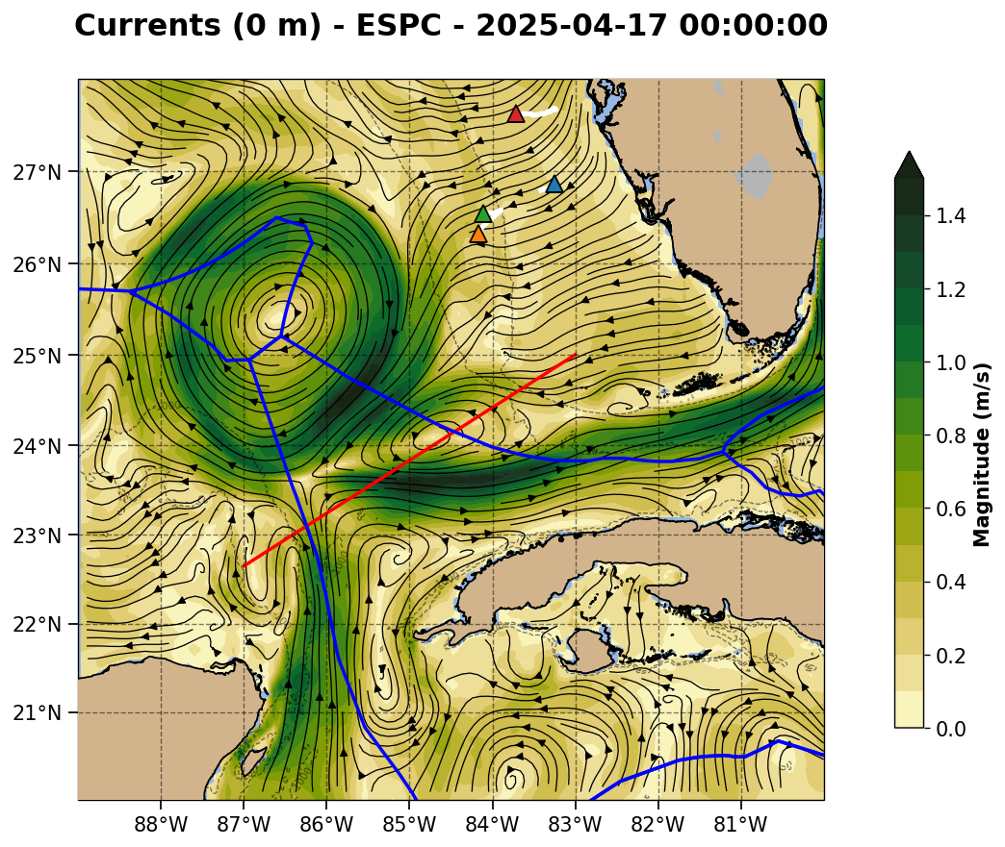
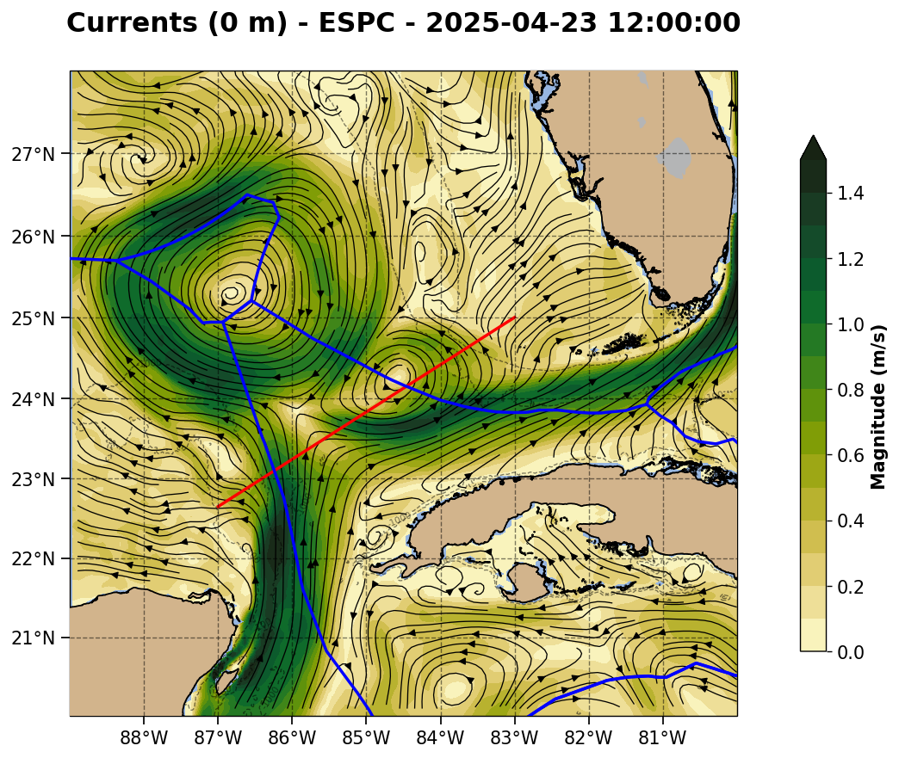

Slide 3
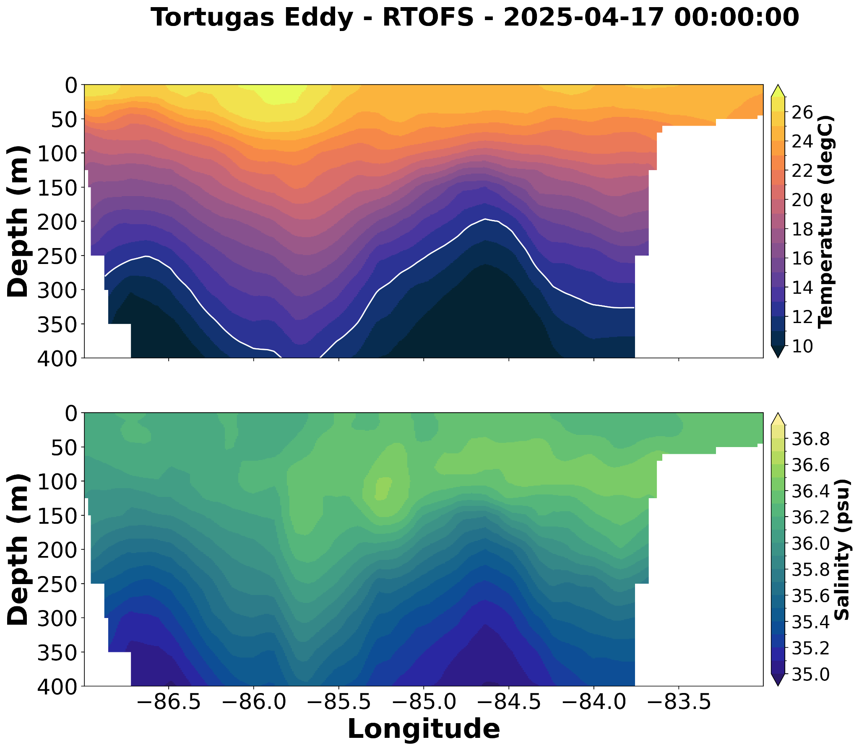
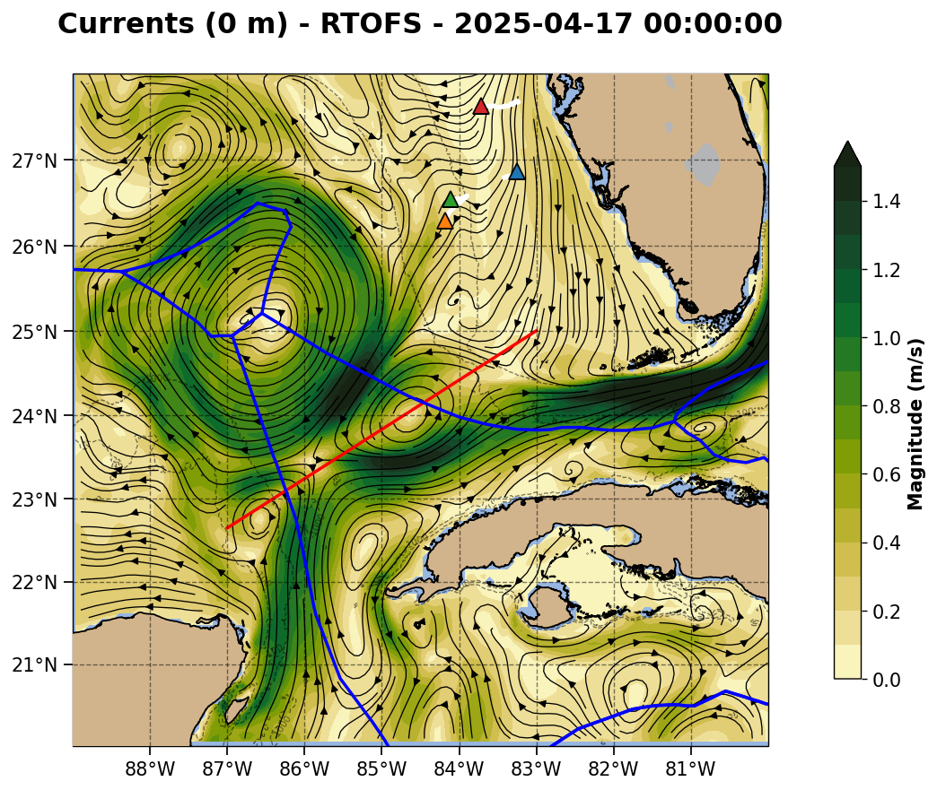
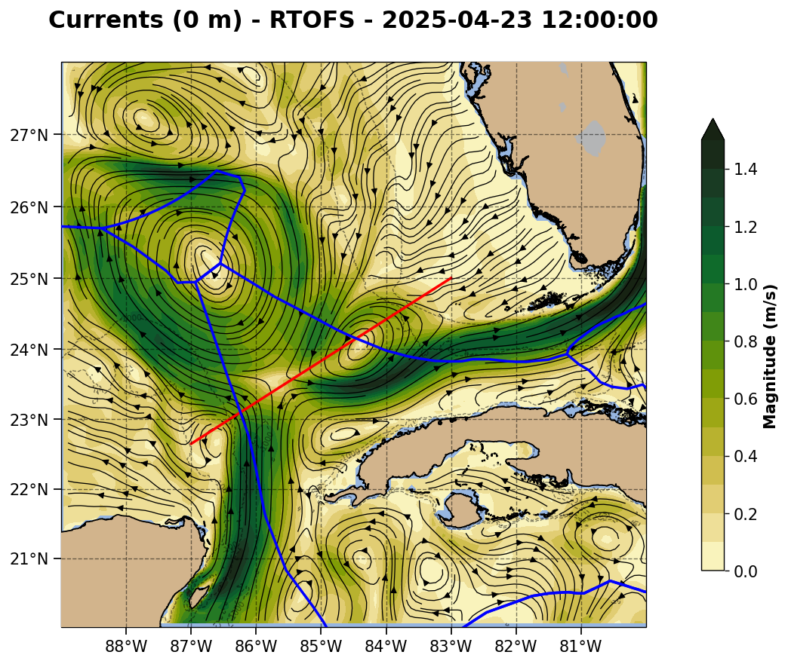

Slide 4
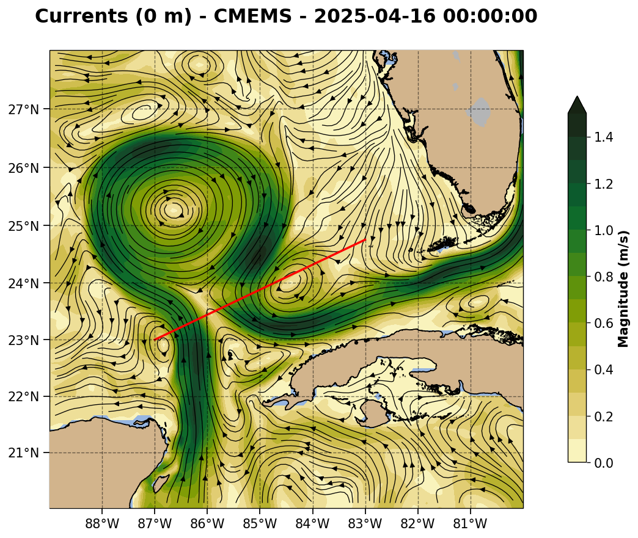
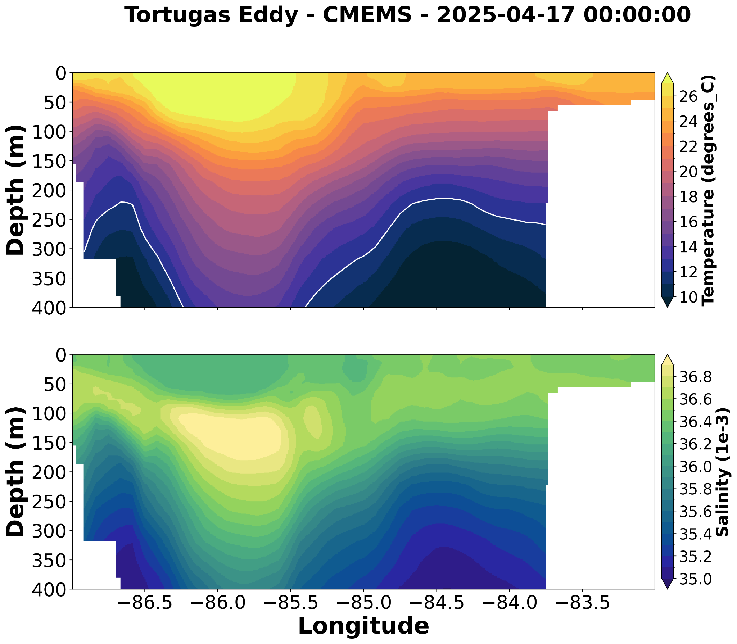
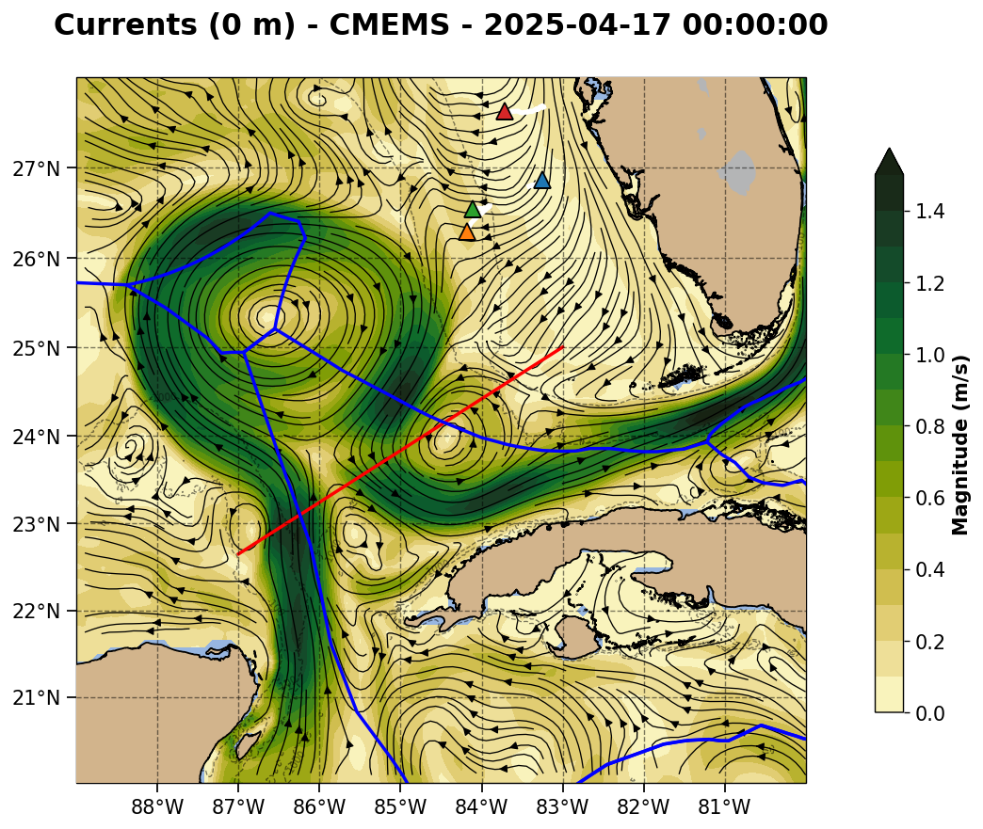
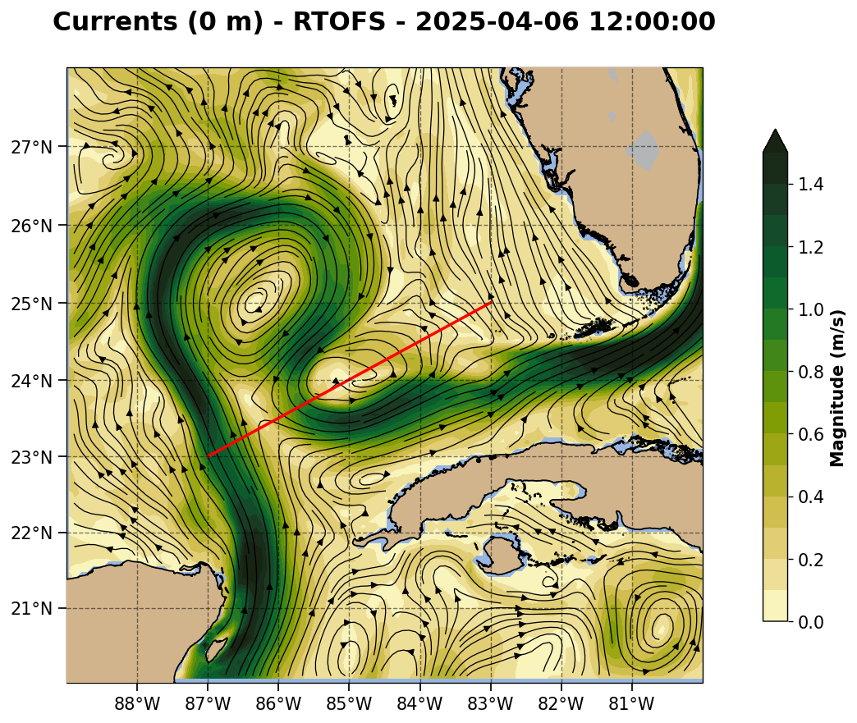
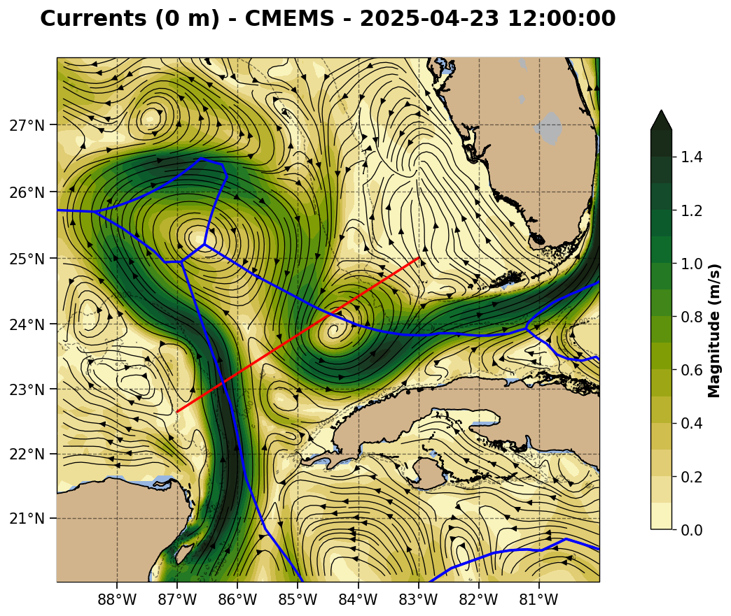

Slide 5
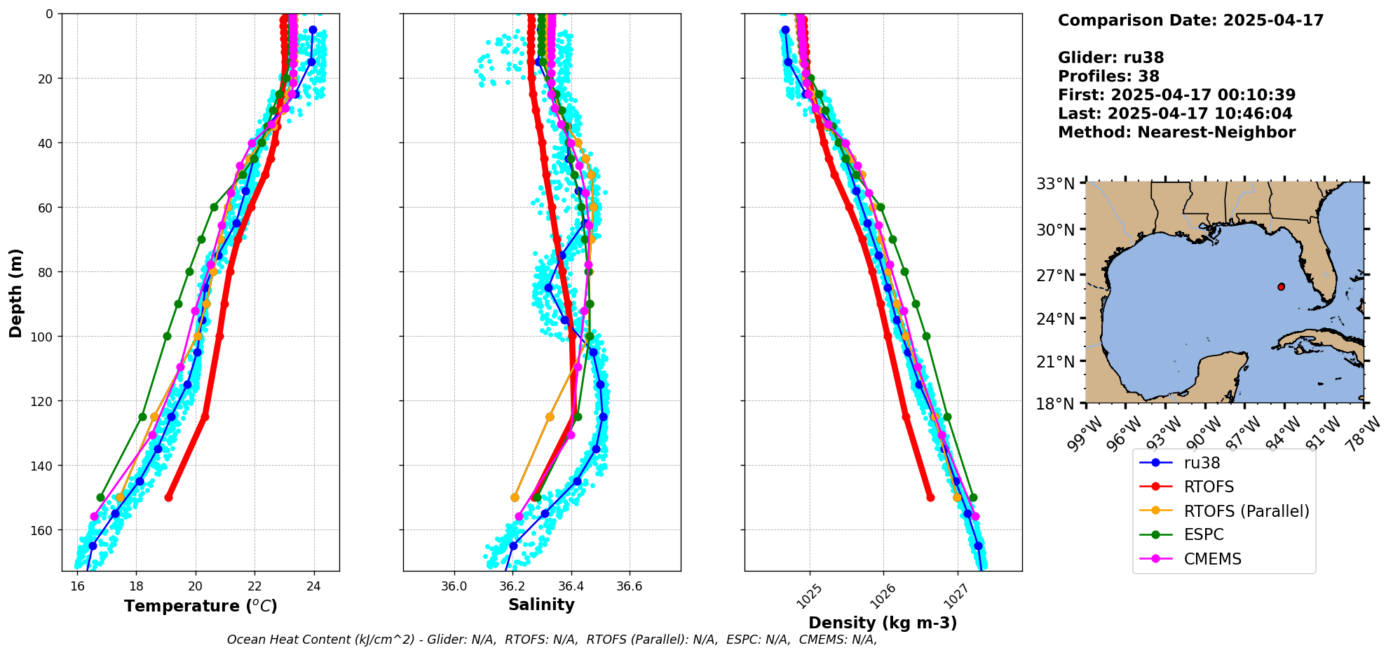

Slide 6
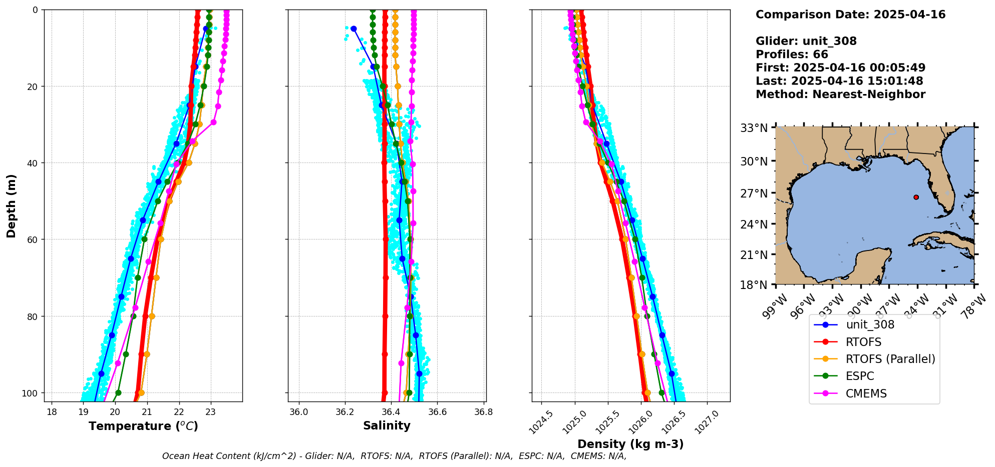

Slide 7
