Slide 1
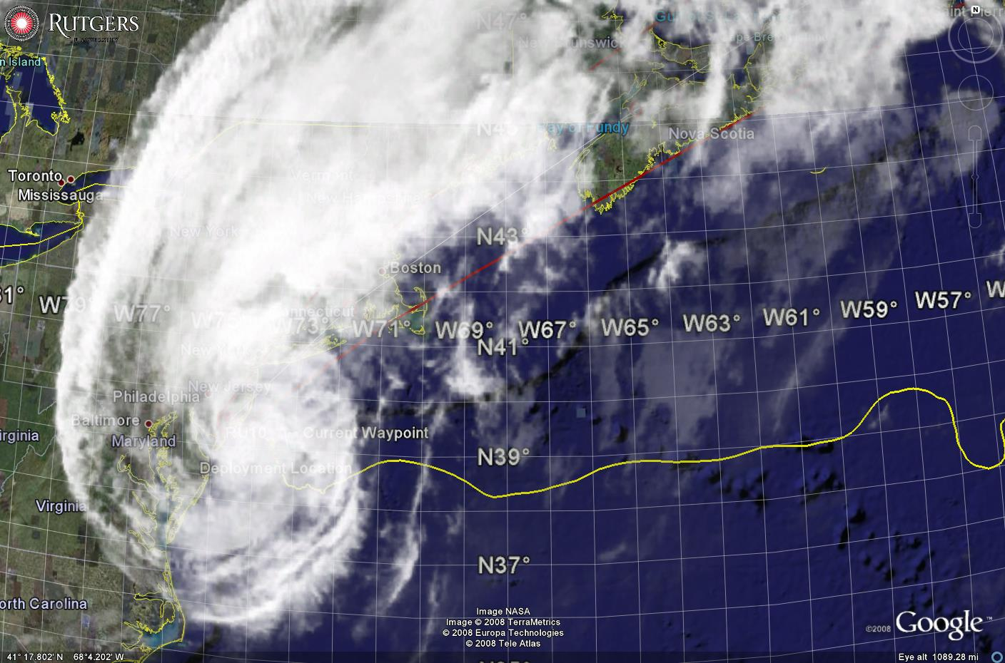
Sediment Transport in Hurricane Sandy:
Glider Observations and Regional Ocean Modeling
Travis Miles, Scott Glenn, Oscar Schofield, Josh Kohut and Greg Seroka
Rutgers University
7th EGO Conference,
National Oceanography Centre,
Southampton, UK
September 27th, 2016
Notes:
Sediment – Pollutants, benthic habitat, coastal change, interpret historical sediment record for climate studies

Slide 2
Key Storm Glider Reference List
Glenn, Jones, Twardowski, Bowers, Kerfoot, Kohut, Webb, Schofield, 2008. Glider observations of sediment resuspension in a Middle Atlantic Bight fall transition storm. Limnology and Oceanography 53(5, Part 2): 2180-2196.
Miles, Glenn, Schofield, 2013. Temporal and spatial variability in fall storm induced sediment resuspension on the Mid-Atlantic Bight. Continental Shelf Research 63, Supplement: S36-S49.
Miles, Seroka, Kohut, Glenn, 2015. Glider observations and modeling sediment transport in Hurricane Sandy. JGR Oceans, DOI: 10.1002/2014JC010474
Glenn, Miles, Seroka, Xu, Forney, Yu, Roarty, Schofield, Kohut, 2016. Stratified coastal ocean interactions with tropical storms, Nature Communications, DOI:10.1038/ncomms10887.
Seroka, Miles, Xu, Kohut, Schofield & Glenn, 2016. Hurricane Irene Sensitivity to Stratified Coastal Ocean Cooling, Monthly Weather Review, in press.
Seroka, Rutgers Ph.D. Thesis Chapter 3, 2016. To be submitted to JGR Oceans Special Issue on Tropical Cyclones.
Sea-Bottom Interface
Air-Sea Interface

Slide 3
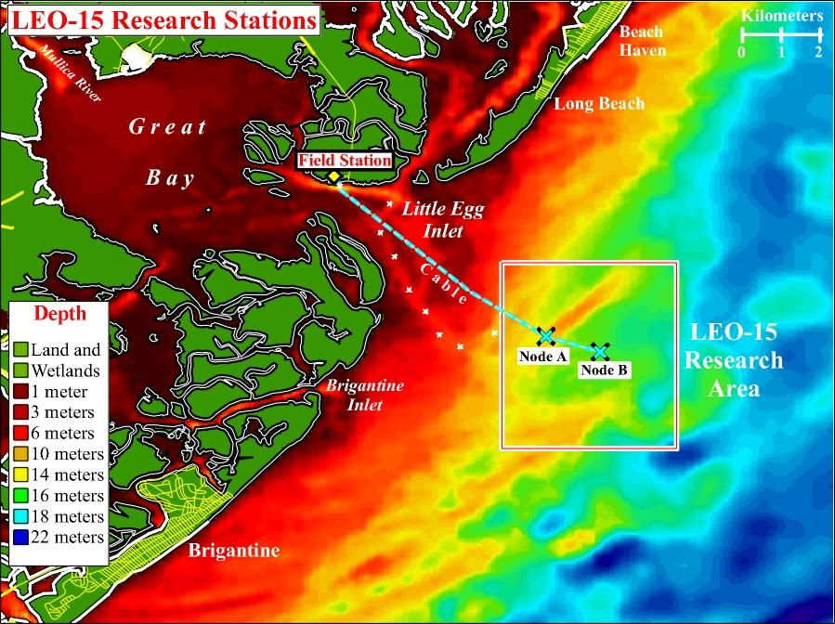
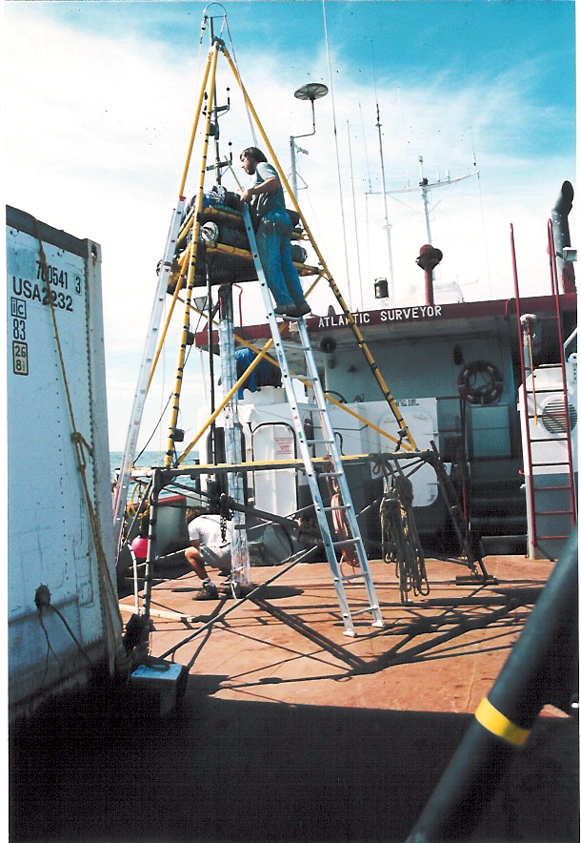
Sediment Transport Studies at LEO Site –early 1990’s
Benthic Acoustic Stress Sensor (BASS) Tripod
Notes:
BASS sensor, ADCPS, Optical instruments, LISSTs
Very good at resolving wave bottom boundary layer
Provides high temporal resolution at a single location
Instrumental in developing one-dimenisional bottom boundary layer models coupled to Regional Ocean Modeling System
New technologies needed for regional model validation

Slide 4
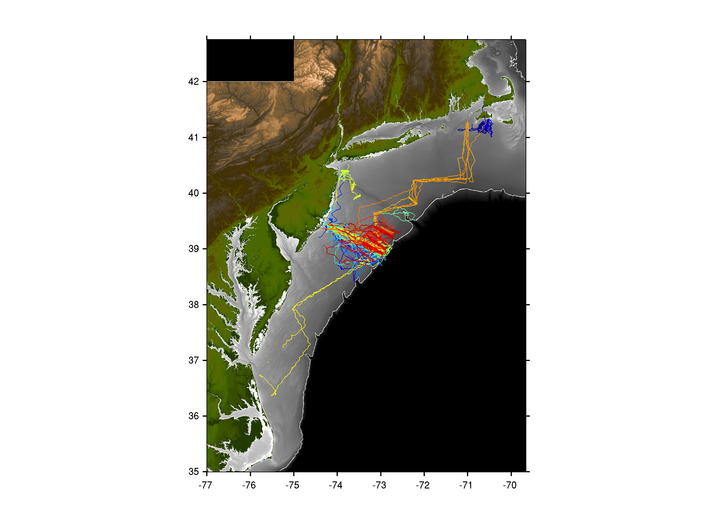

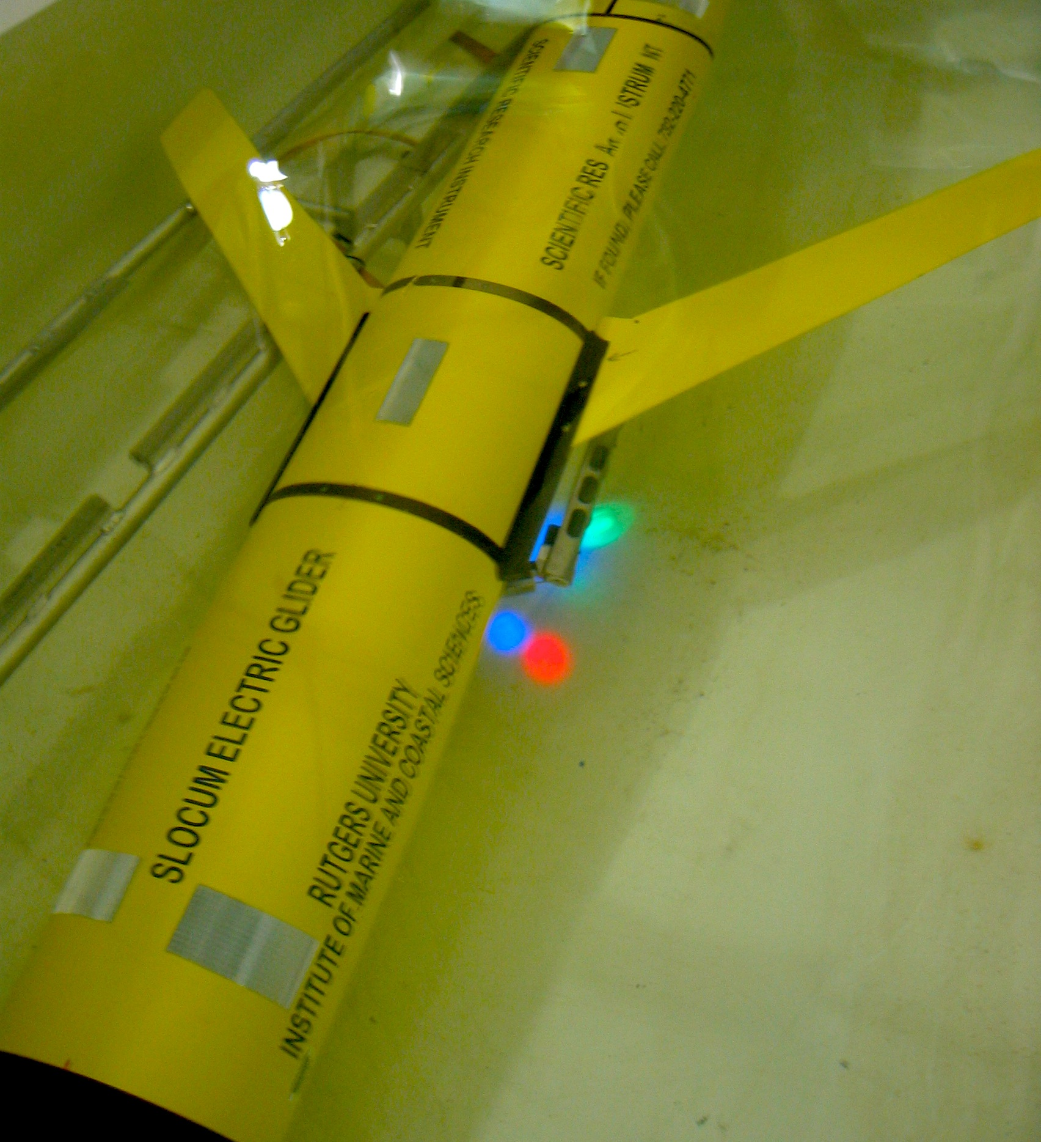
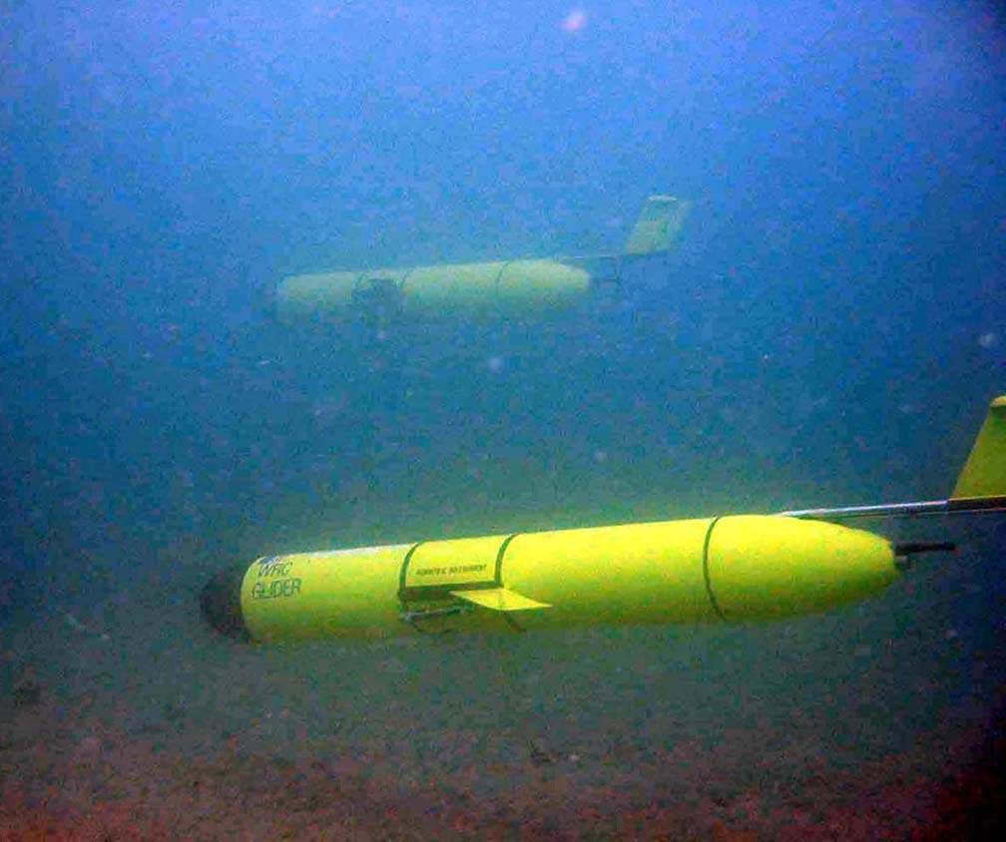
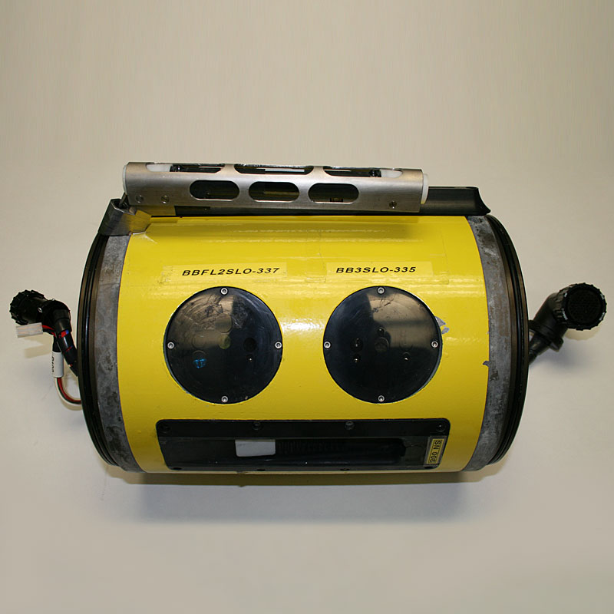
Glider Observations of Sediment Resuspension in a Middle Atlantic Bight Fall Transition Storm (Glenn et al., 2008)
Temperature
Optical
Sensors
Notes:
One of the first studies to demonstrate this capability in gliders was Glenn et al. 2008
- Here you see a Teledyne-Webb Slocum glider equipped with a Wetlabs BB3 Optical Backscatter sesnosr

Slide 5
Notes:
Two storms were sampled and presented in this study during unstratified and stratified conditions
Here you see Temperature and optical backscatter during a fall transition storm on the left
The water column is vertically well mixed and you can see full water column sediment resuspension from the bed to the surface at nearly 40 meters depth
A deployment on a similar line in Summer of 2004 shows the highly stratified continental shelf, and sediment resuspended, but limited by the stable thermocline (likely not visible from satellite etc.)

Slide 6
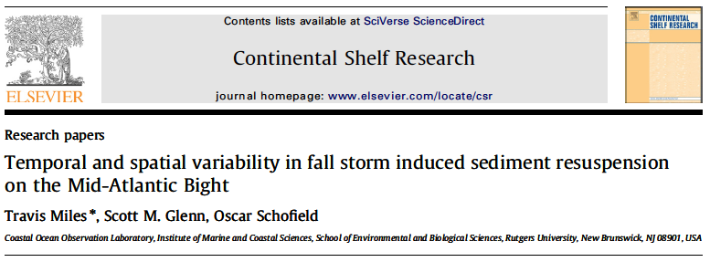
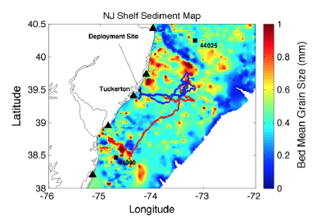
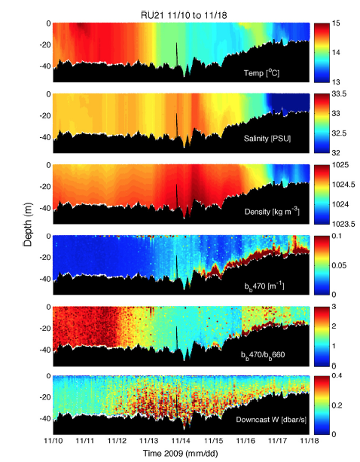
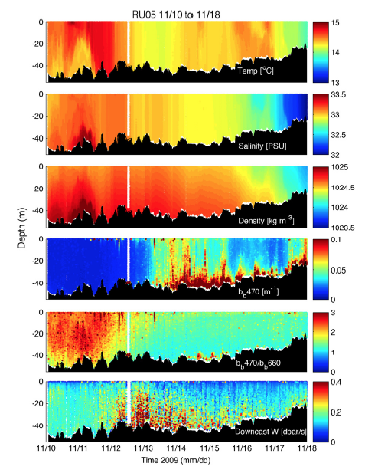
Notes:
In 2009 during the first few months of my PhD we opportunistically had 4 gliders deployed on the NJ shelf for an OSSE experiment, when a hurriacane that transitioned into an extra-tropical cyclone came through the region
Two of these G1 Slocum gliders had optical backscatter pucks and we used them to investigate spatial variability in shelf-wide sediment resuspension
They showed differences of about an order-of-magnitude largely due to order 10 km > differences in sediment meant grain size

Slide 7
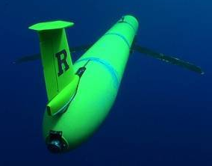
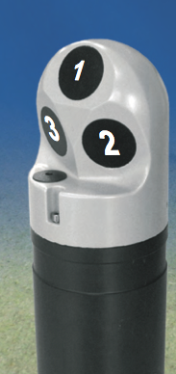
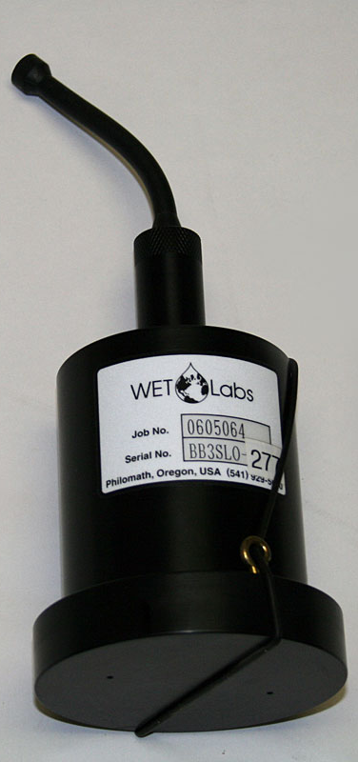
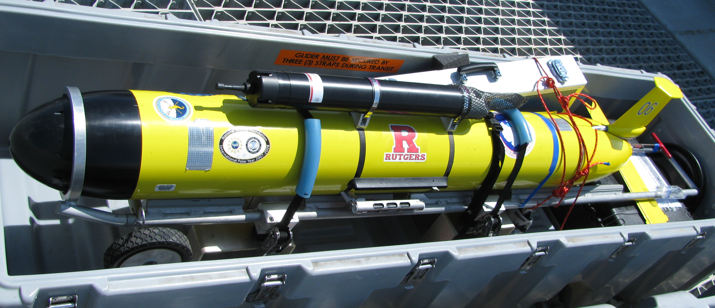
RU23: Shallow G1 Slocum Glider 100 meter pump:
Conductivity Temperature
and Depth (CTD) (Seabird)
Optical Backscatter: Wet Labs Eco-puck BB3 (470, 532, 660 nm) – Smaller particles
Acoustic Backscatter/Currents: Nortek Aquadopp Current Profiler (2 MHz head, 1 meter bins, internally logging, 30 days) – medium sands
Storm Glider v1
Notes:
After these two studies we wanted to design a glider deployment specifically to compare with a realistic ROMS run with sediment parameters
Added a Nortek Aquadopp Current Profiler to be able to estimate transport
Also add acoustic backscatter measurements in order to target both smaller grain size particles (with optics) and larger grain sizes with acoustics.
Glider we put together was the first version of a ‘storm glider’

Slide 8
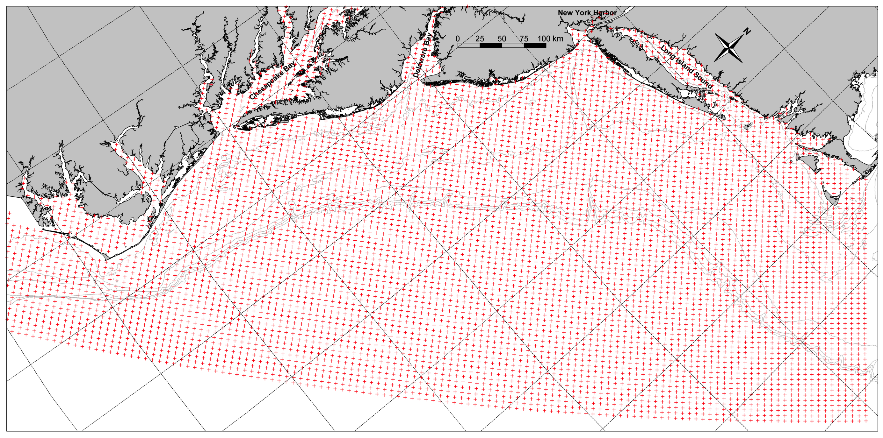
Rutgers ROMS ver. 645 on the ESPreSSO domain
  Detailed at : http://www.myroms.org/espresso/
    Cape Hatteras to Cape Cod
    36 Vertical Levels, 5 km resolution, output hourly
    Tides at boundary from ADCIRC
    HYCOM-NCODA Boundary Conditions
    NCEP North American Mesoscale (NAM) 12km – 3 hourly Wind forcing
  (Cahill et al., 2008, Haidvogel et al., 2008, Hoffman et al., 2008, Zhang et al., 2009a,b, Wilkin and Hunter, 2013)
Notes:
Don’t get hung up!

Slide 9
Rutgers ROMS ver. 645 on the ESPreSSO domain
  Detailed at : http://www.myroms.org/espresso/
    Cape Hatteras to Cape Cod
    36 Vertical Levels, 5 km resolution, output hourly
    Tides at boundary from ADCIRC
    HYCOM-NCODA Boundary Conditions
    NCEP North American Mesoscale (NAM) 12km – 3 hourly Wind forcing
  Replaced NAM with Weather Research Forecast Model 6 km – hourly
  Coupled Bottom Boundary Layer (SSW_BBL) included in ROMS checkout
  Wave Height, Wave Period, and Wave Direction from NOAA NCEP Wavewatch III 3-hourly (http://polar.ncep.noaa.gov/waves/)
  Idealized Sediment from the Community Sediment Transport Model
    Version Included in ROMS Trunk
    Two Non-Cohesive size-classes 0.1 mm and 0.4 mm
      Fall Velocities 5.7 mm/s and 52 mm/s, 0.14 and 0.23 Critical Shear Stress ,respectively
    Spatially uniform for entire Domain
  (Warner et al., 2008, Madsen 1994, Styles and Glenn 2000, Wiberg and Harris 1994, Harris and Wiberg 2001)
Notes:
Don’t get hung up!

Slide 10
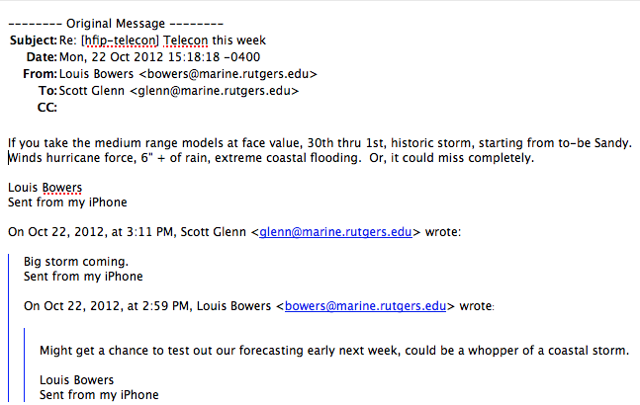
First Warning for Hurricane Sandy:
Monday, Oct 22, 1-week prior to landfall

Slide 11
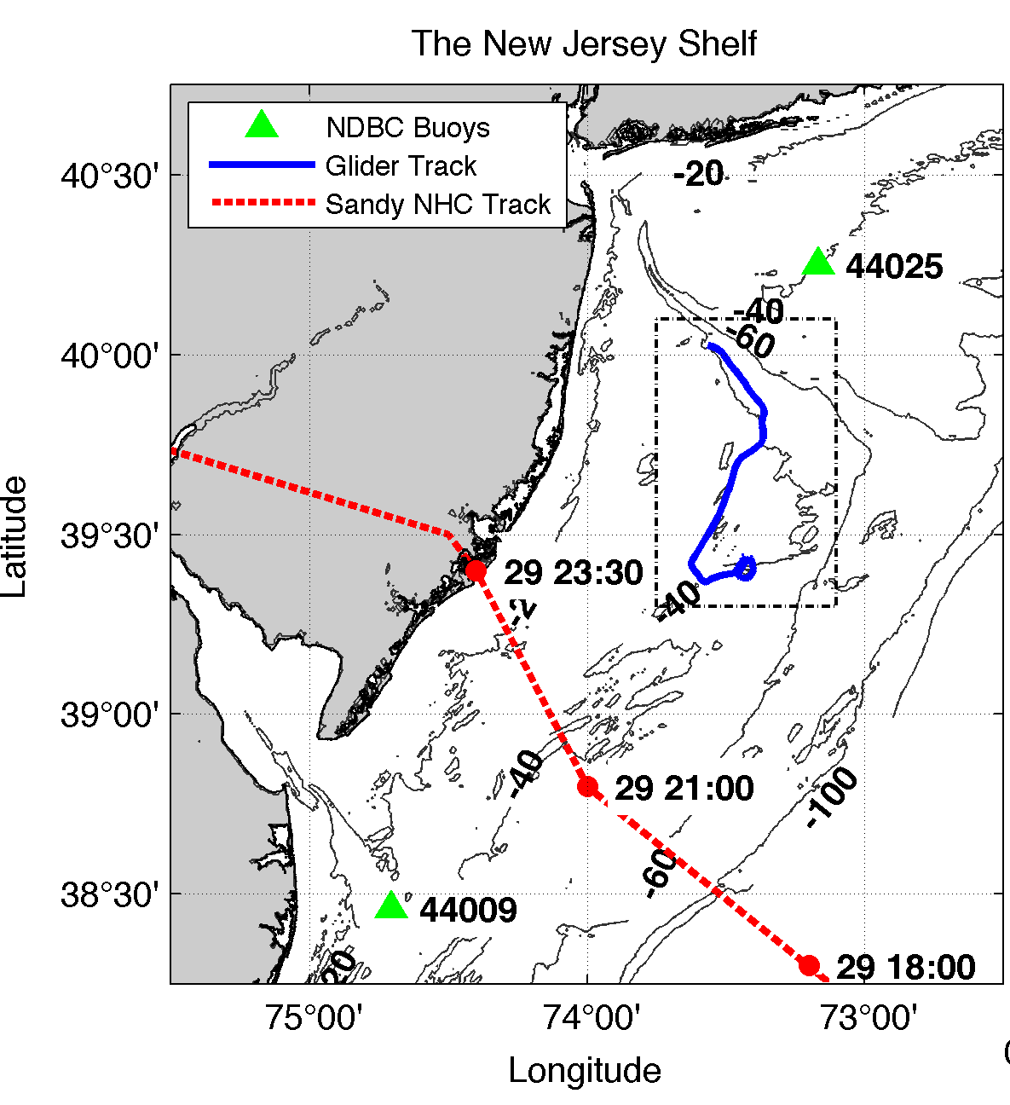
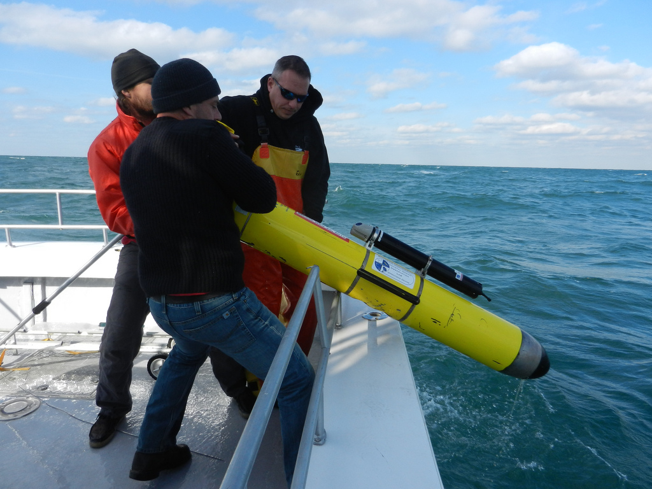
RU23 Deployed on October 25th
Transited southeast along 40 meter isobath (southern flank of Hudson Shelf Valley)
During storm advected southwestward.
Within ~100 km of storm center NE quadrant (strongest winds/waves).
Notes:
Describe piloting strategy

Slide 12
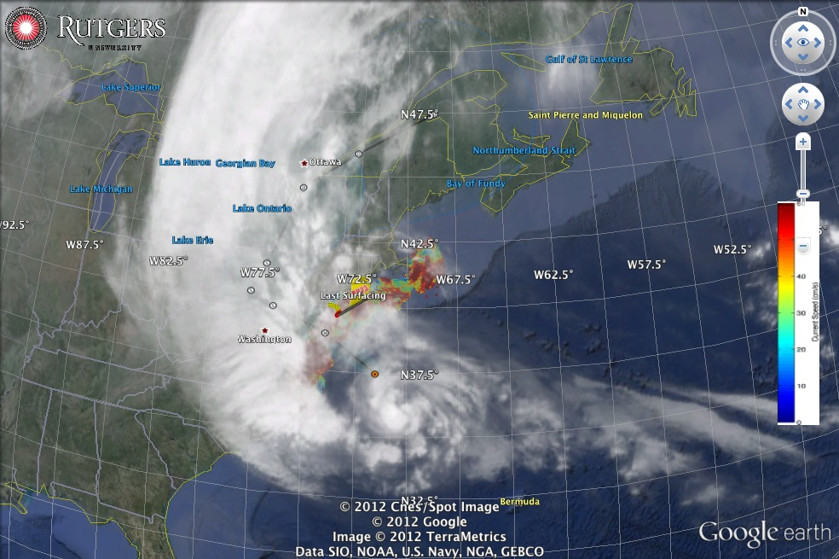
Hurricane Sandy
October 29, 2012
NOAA/NHC Damage:
#2 with >$60 Billion.
Minimum pressure – 948 mb
Storm surge over –14 ft. in NYC

Slide 13
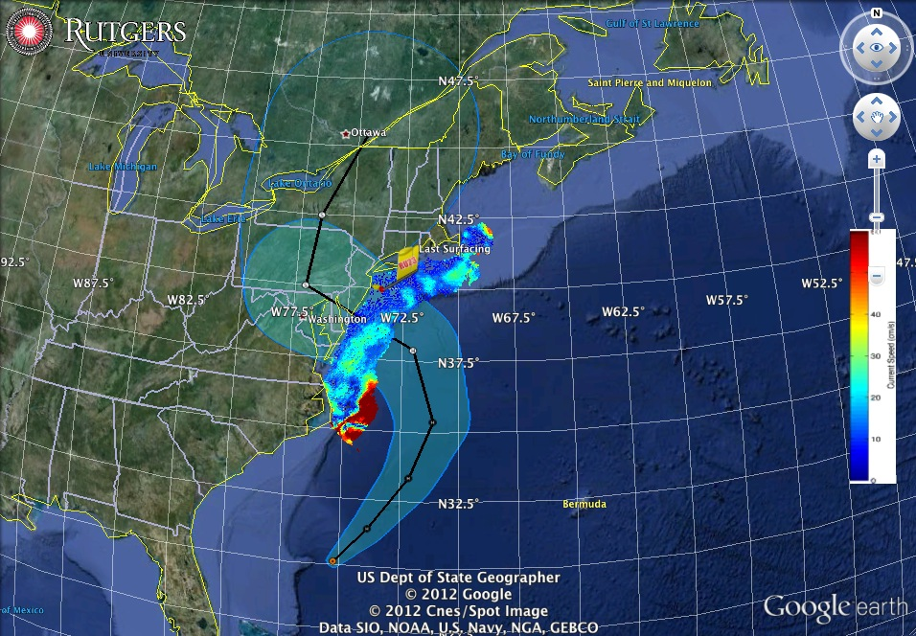
Superstorm Sandy: 2 Days Before Landfall

Slide 14
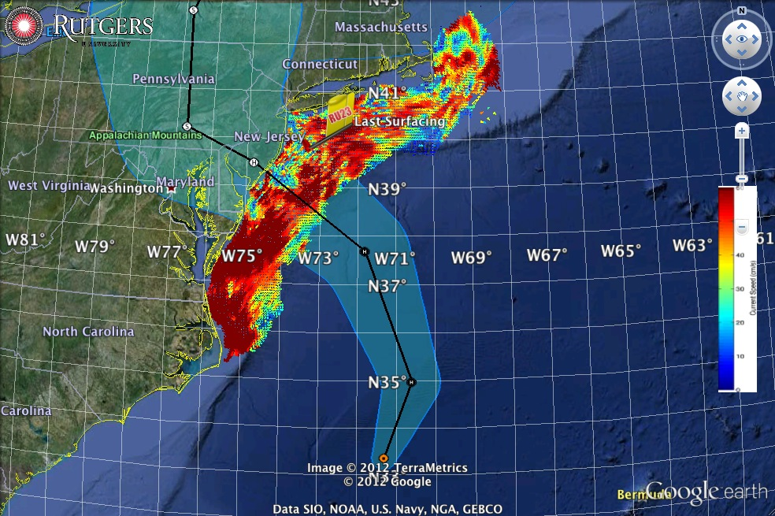
Superstorm Sandy: 1 Day Before Landfall

Slide 15
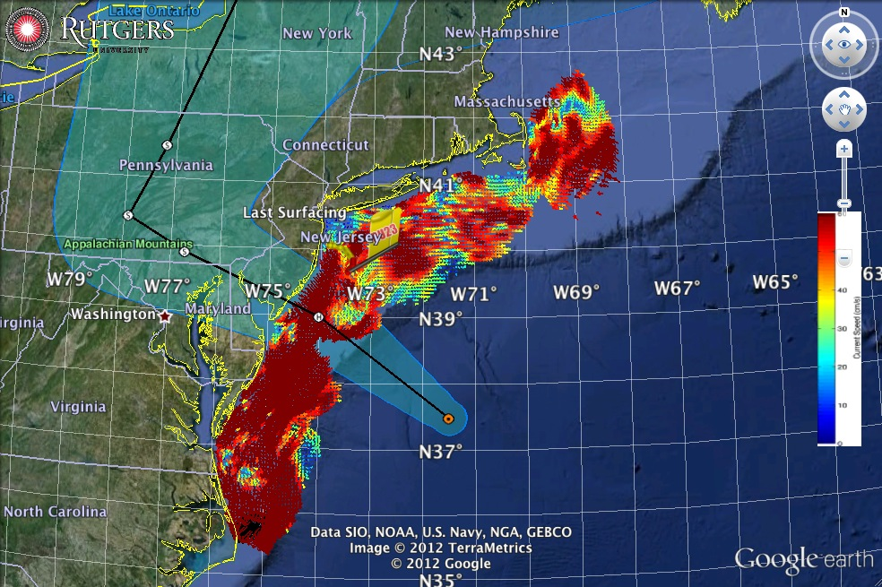
Superstorm Sandy: Morning Before Landfall

Slide 16
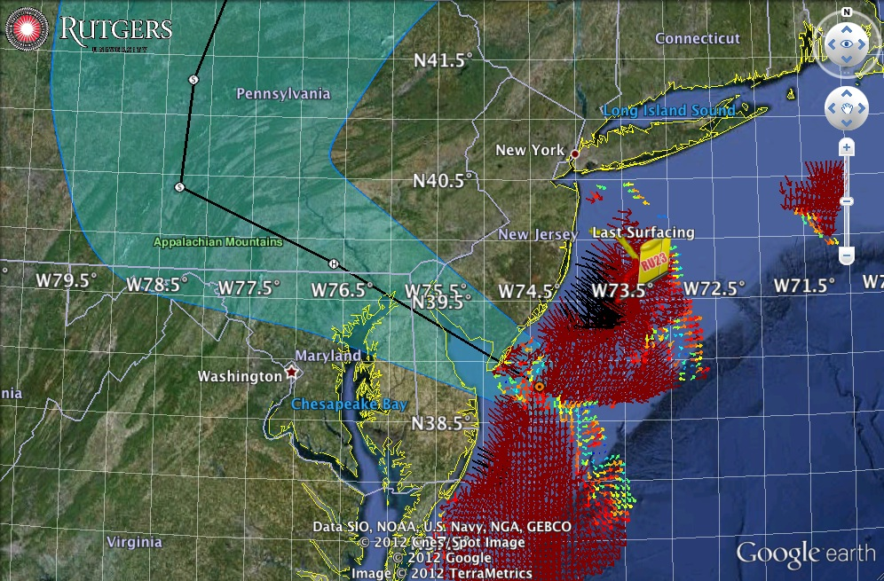
Superstorm Sandy: Landfall (20:00 Local)

Slide 17
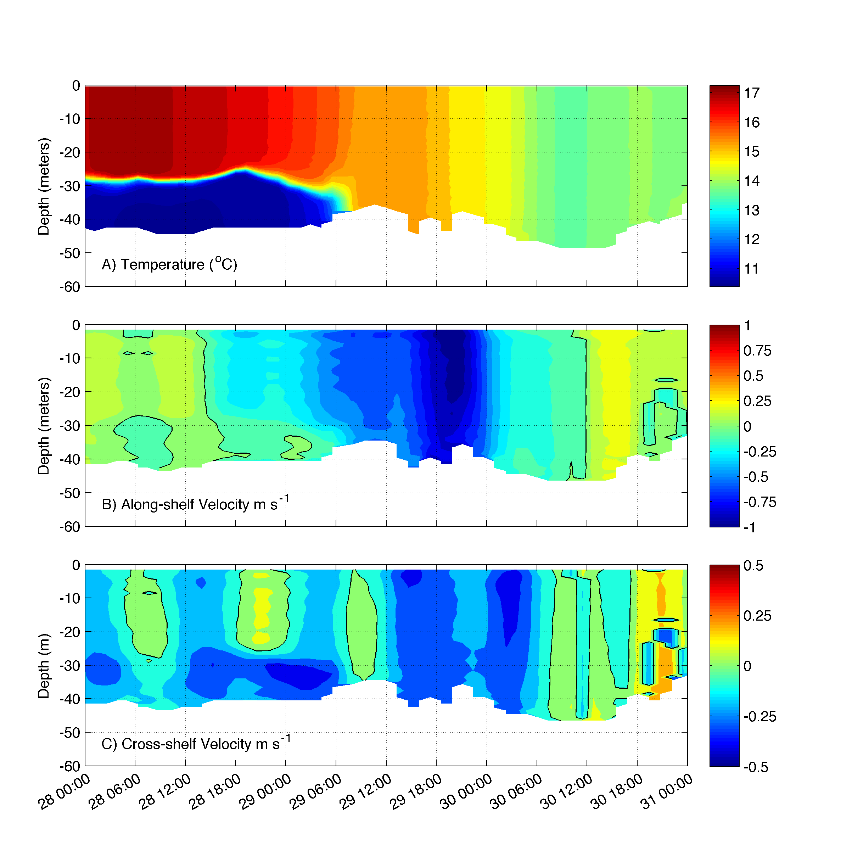
Temperature, transitions from 2-layer to well-mixed on the 29th at 06:00 GMT 18 hrs before landfall
Strong one-layer flow just prior to landfall > 1 m/s
Weak Two-layer flow while stratified: Onshore surface, offshore bottom ~0.3 m/s
Shear least-squares method: Visbeck et al. (2002) and Todd et al. (2011)
Notes:
Need to update this with New Results

Slide 18
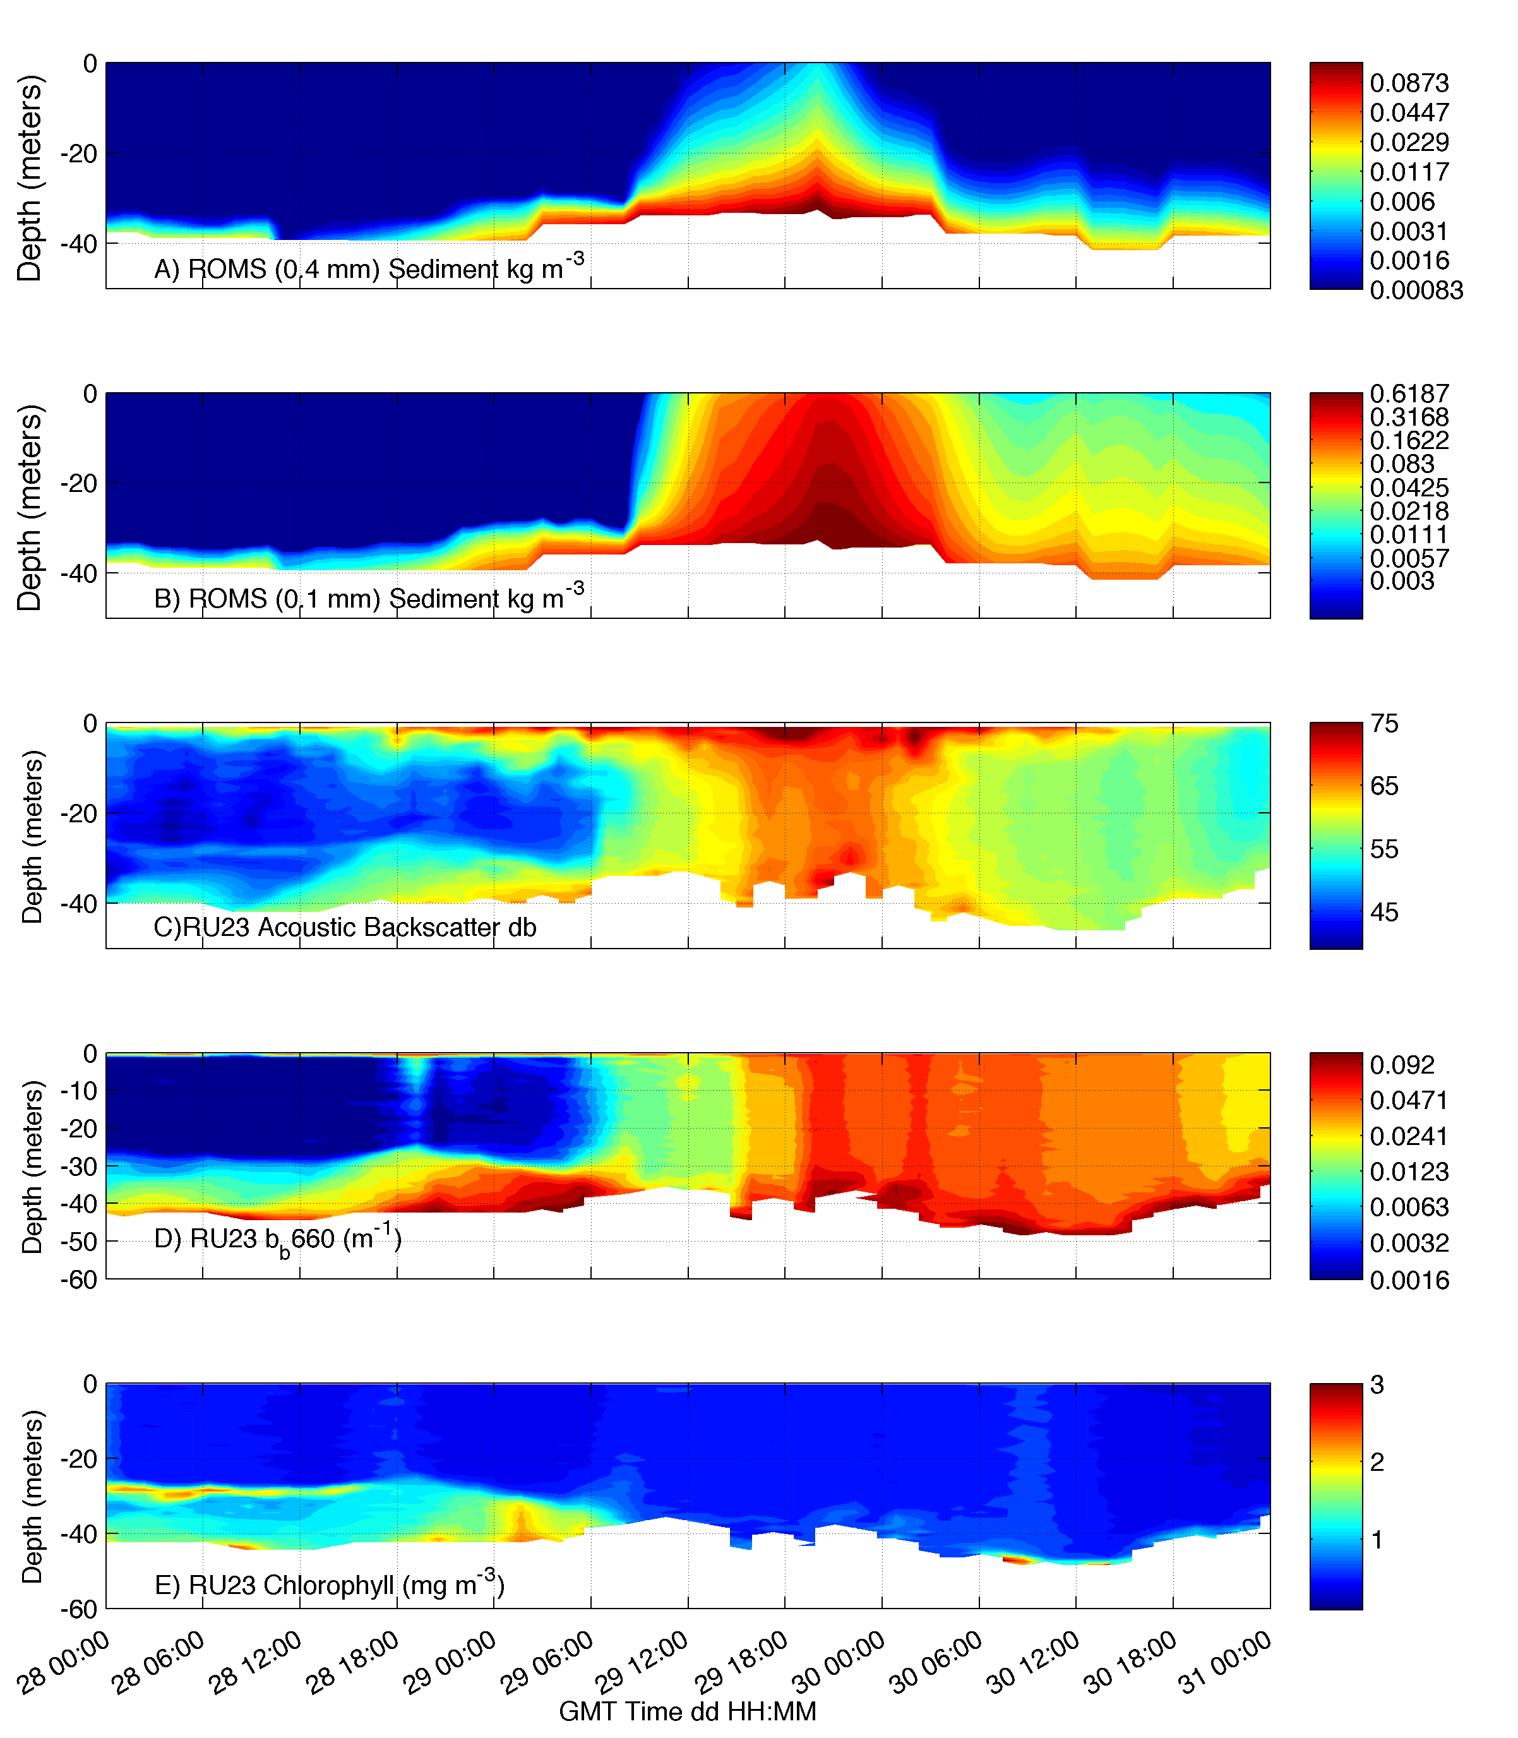
ROMS 0.4 mm sediment
concentration
ROMS 0.1 mm sediment
concentration
Acoustic Backscatter
db
Optical Backscatter
1/m
Chlorophyll Concentration
mg m⁻³

Slide 19
ROMS 0.4 mm sediment
concentration
ROMS 0.1 mm sediment
concentration
Acoustic Backscatter
db
Optical Backscatter
1/m
Chlorophyll Concentration
mg m⁻³

Slide 20
ROMS 0.4 mm sediment
concentration
ROMS 0.1 mm sediment
concentration
Acoustic Backscatter
db
Optical Backscatter
1/m
Chlorophyll Concentration
mg m⁻³
Notes:
Surface signal is likely bubbles (upward looking system)

Slide 21
ROMS 0.4 mm sediment
concentration
ROMS 0.1 mm sediment
concentration
Acoustic Backscatter
db
Optical Backscatter
1/m
Chlorophyll Concentration
mg m⁻³
Notes:
Need to work on calibration of acoustics for sediment

Slide 22
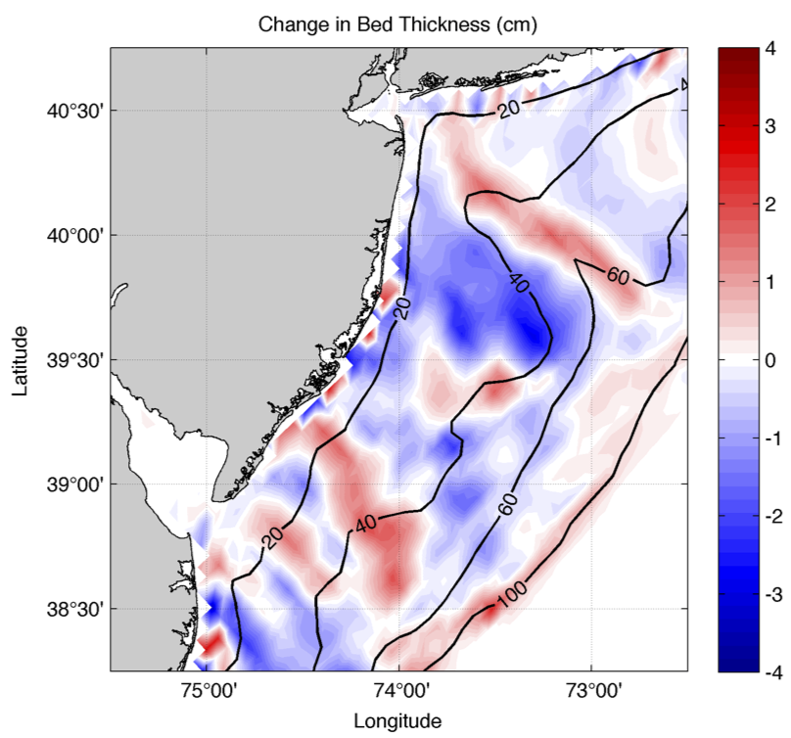

Slide 23
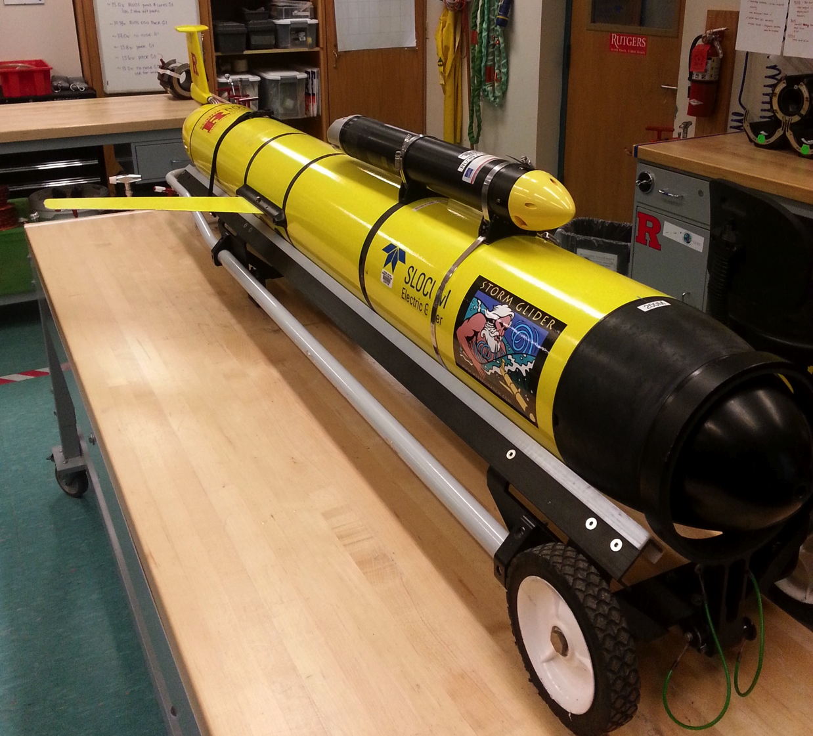



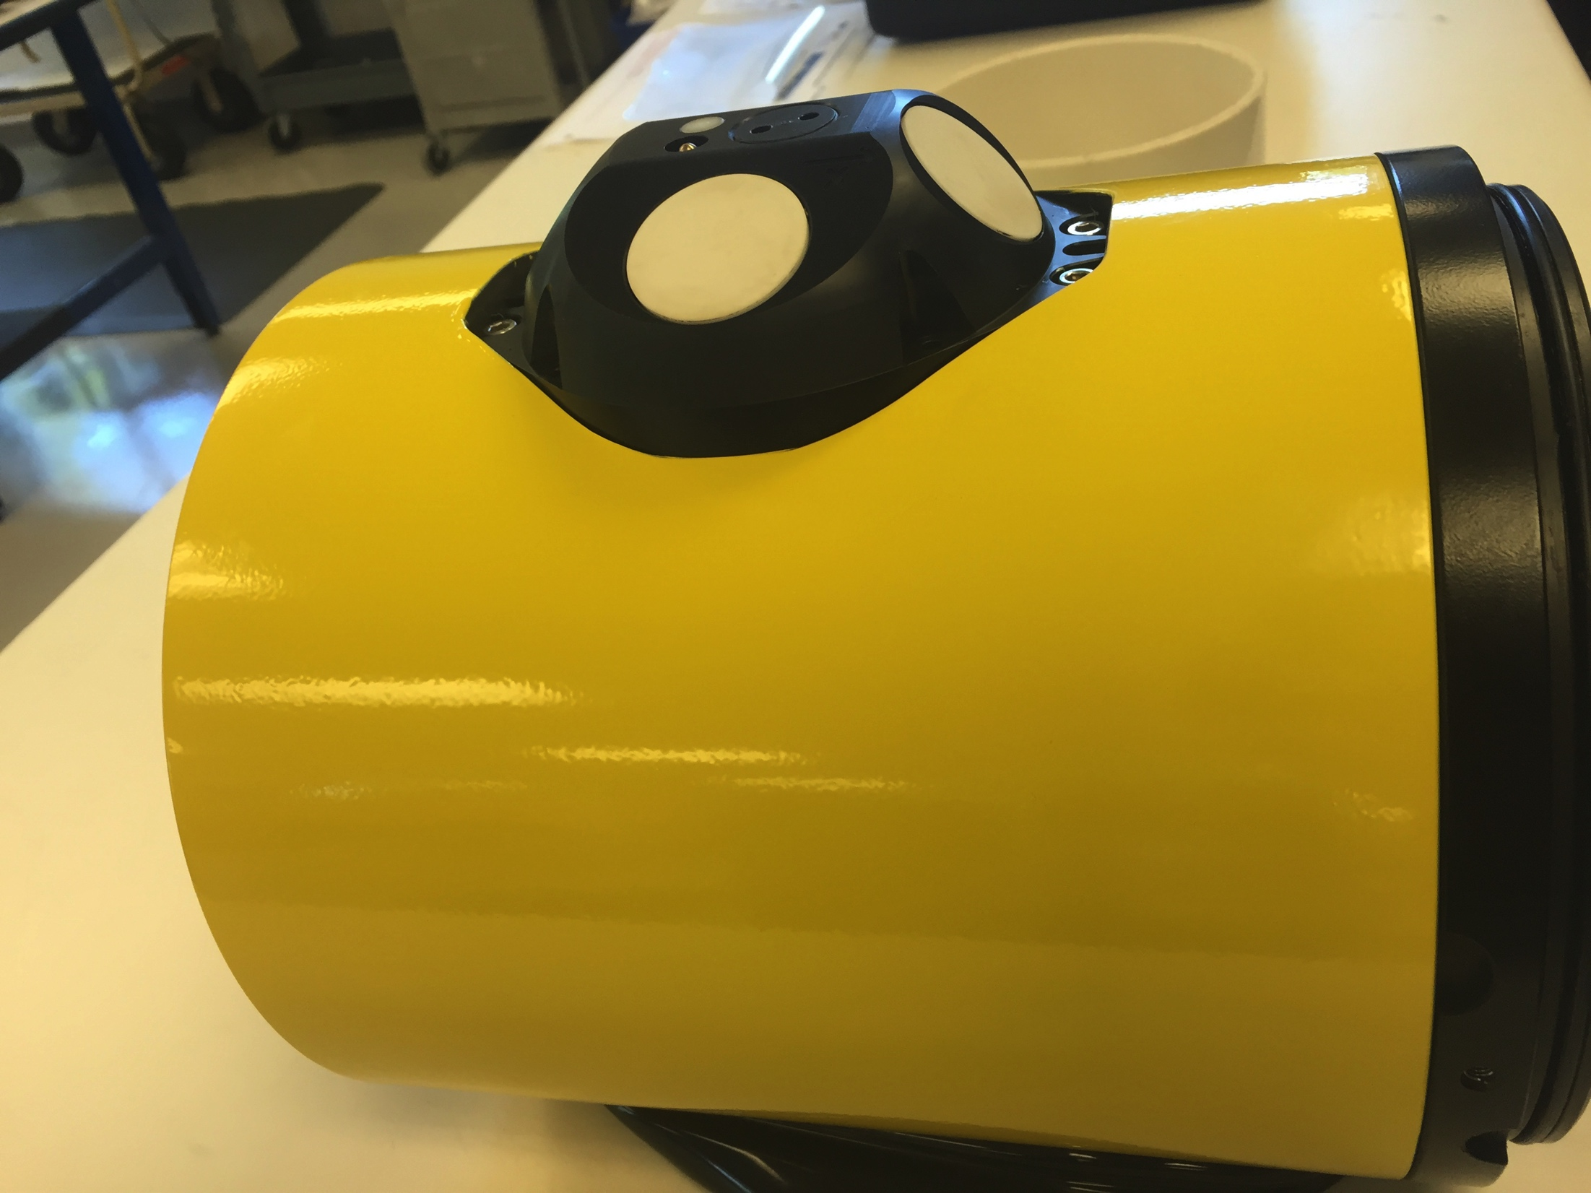


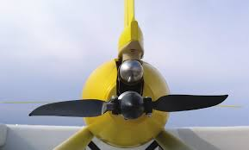
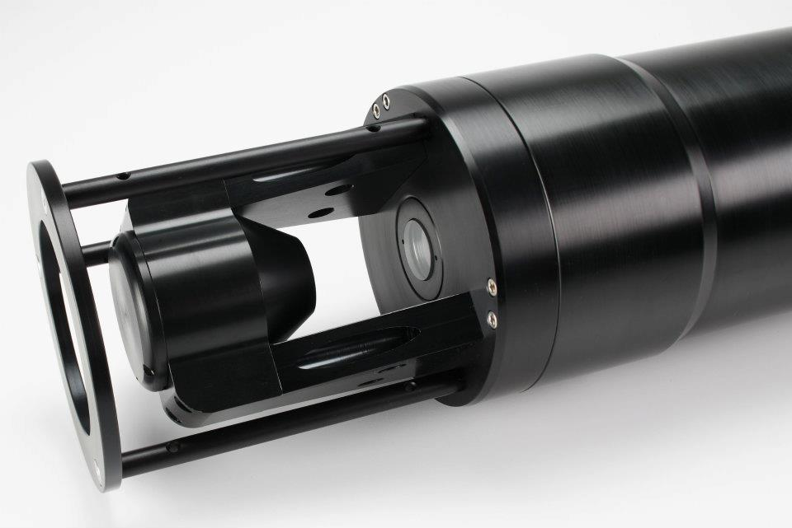
Storm Glider Development
Storm Glider (v1)
Seabird Conductivity Temperature Depth (CTD), Wetlabs ECOpuck, Aandera Optode, Nortek Aquadopp, Accelerometer.
Storm Glider (v2)
Integrated Nortek AD2CP, development integrated LISST-200X, thruster G2.
Notes:
Need ONR and GoMRI

Slide 24
Summary/Conclusions
Model and glider show full water-column sediment resuspension as Sandy made landfall.
ROMS reasonably captures the timing and direction of sediment transport.
Gliders may be essential tools to supplement traditional sampling methods for 3D model validation, particularly in large data-limited storm events.
New sensors and calibration techniques are critical for quantitative calibration of regional sediment sampling.

Slide 25


Storm Glider Development
Storm Glider (v1)
Seabird Conductivity Temperature Depth (CTD), Wetlabs ECOpuck, Aandera Optode, Nortek Aquadopp, Accelerometer.
Thank you!
Questions?
Storm Glider (v2)
Integrated Nortek AD2CP, development integrated LISST-200X, thruster G2.
Notes:
Need ONR and GoMRI

Slide 26
Nortek Aquadopp Current Profiler:
2 MHz Custom glider head – Upward looking (doesn’t block Optics)
- Instrument pitch reads 0 at glider pitch of 26.5º
10 Meter profile length
- 1 meter bins
- 0.2 meter blanking distance
3 beams – collected in Beam coordinates and transformed to East-North-Up during post-processing
Lithium batteries allows for ~30 day deployment, non-integrated internally logging.

Slide 27
Nortek Aquadopp Current Profiler:
Acoustic Backscatter:
2 MHz head ~0.25 mm sediment
Lohrman, 2001

Slide 28
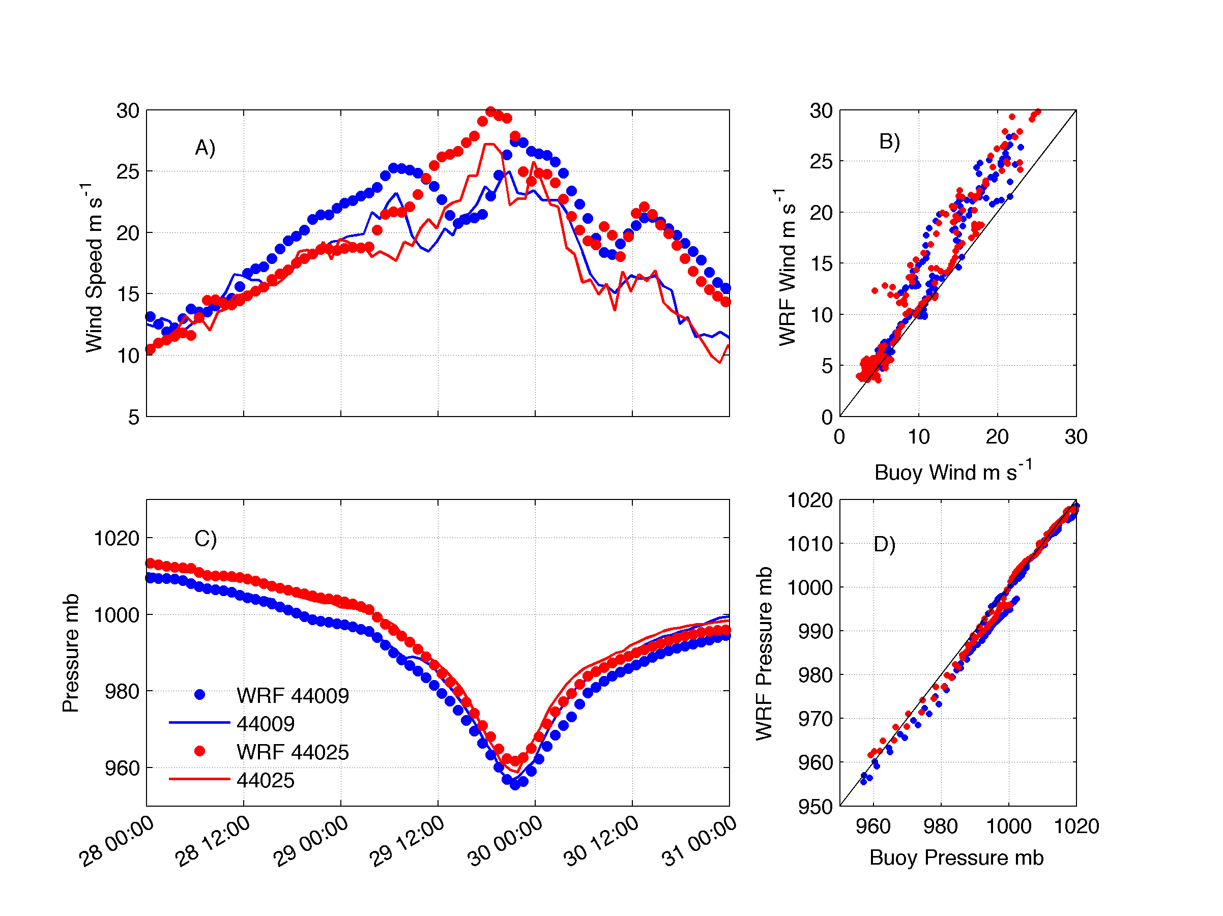

Slide 29
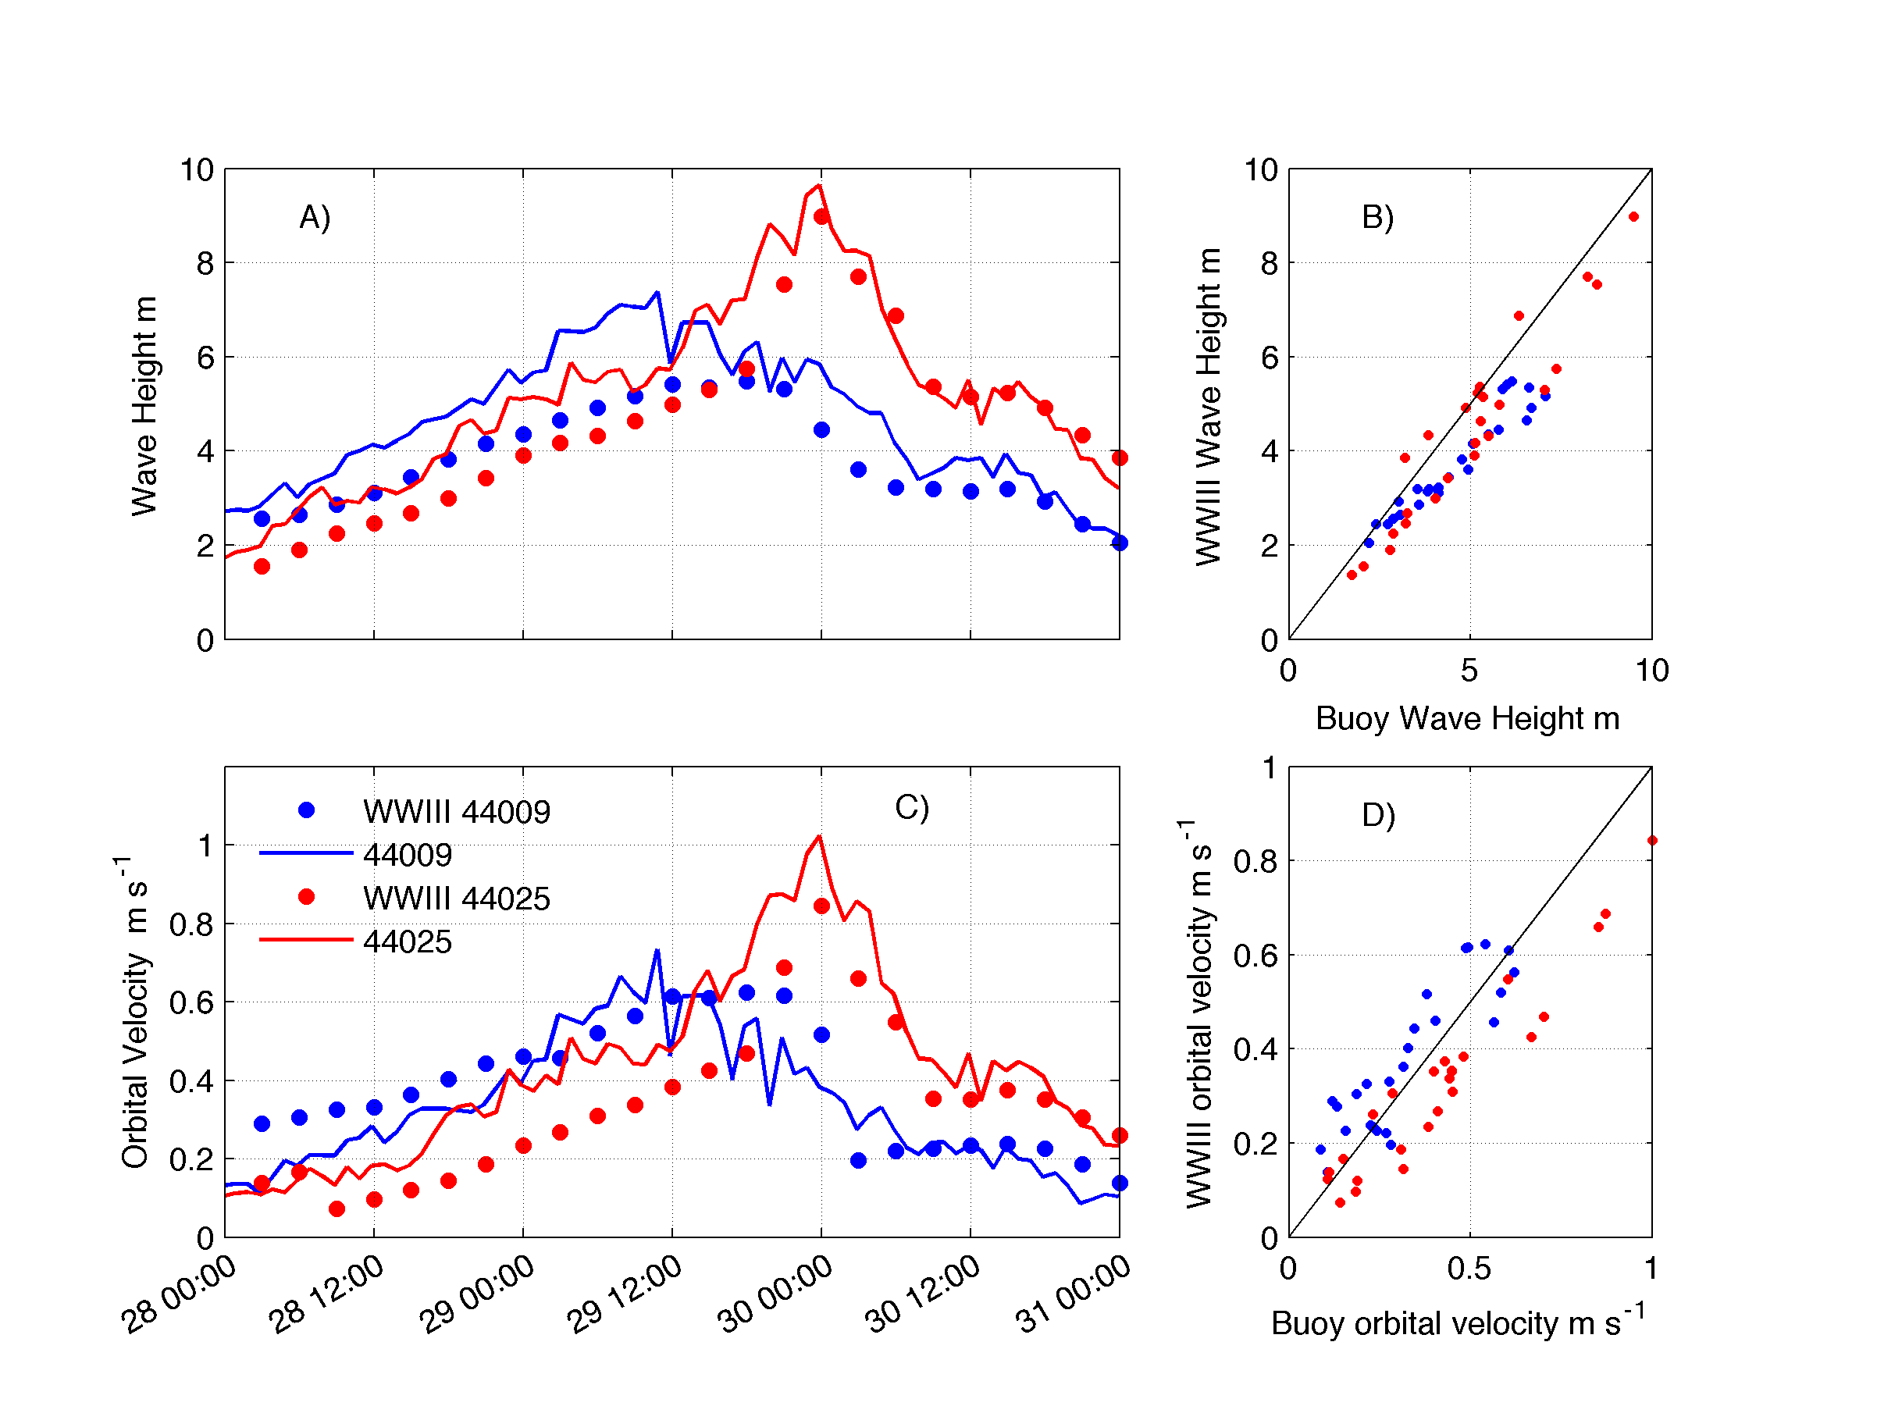
Wave Model performs well

Slide 30
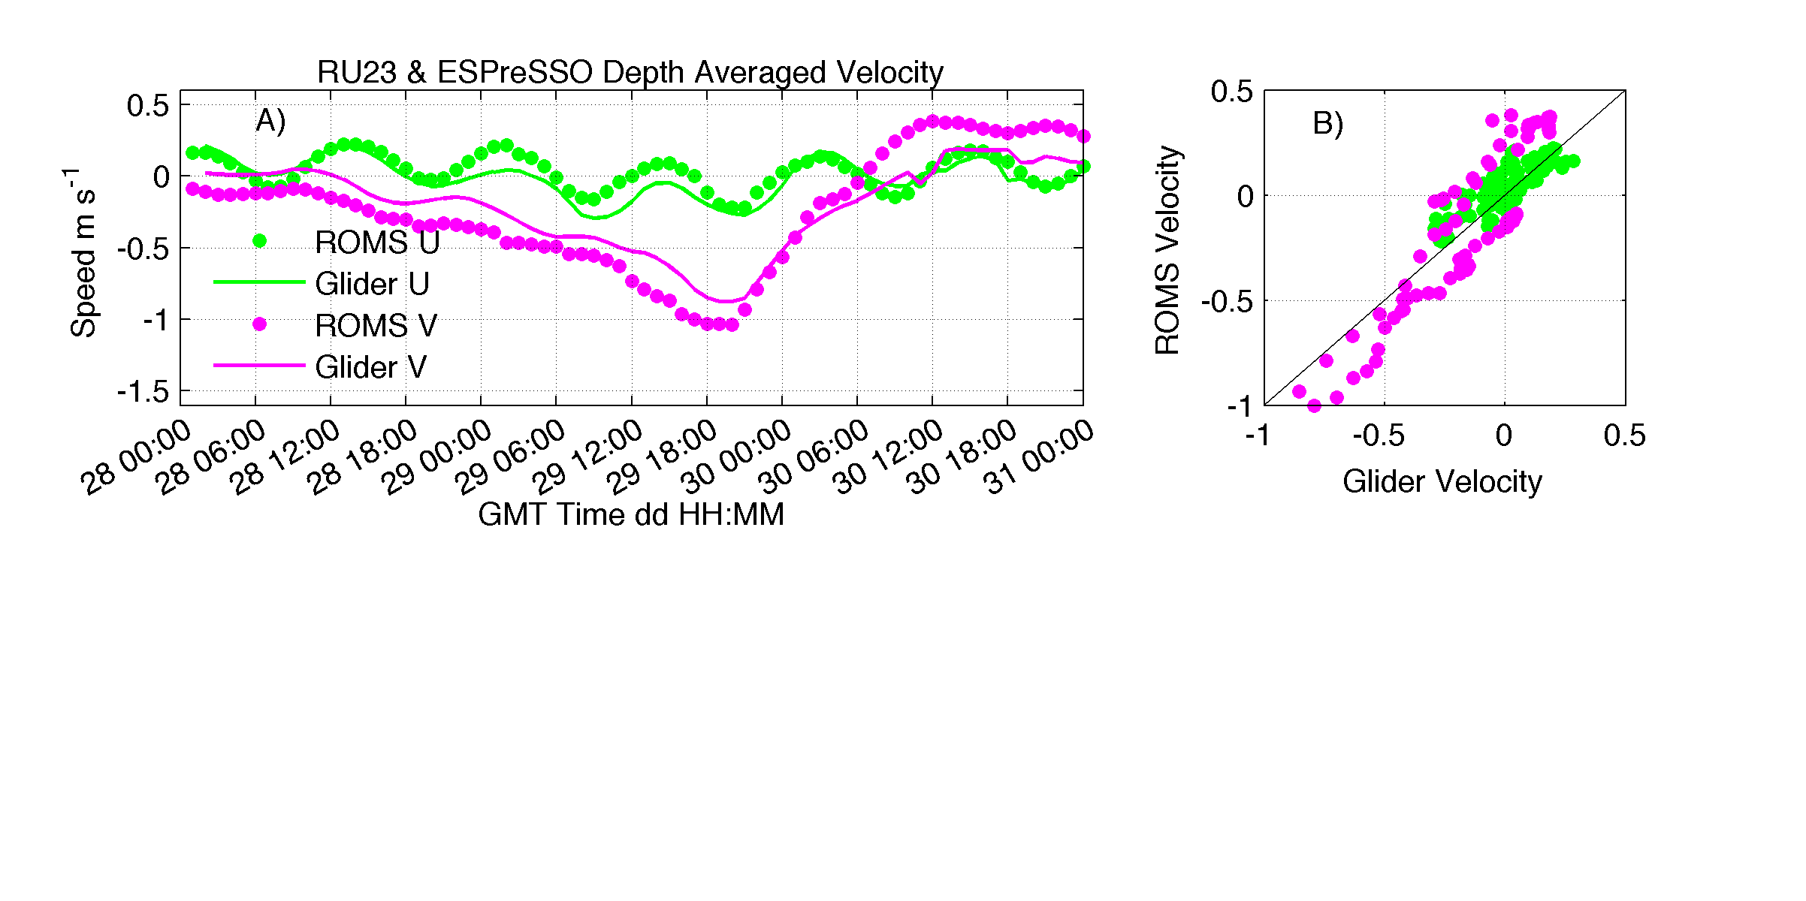

Slide 31
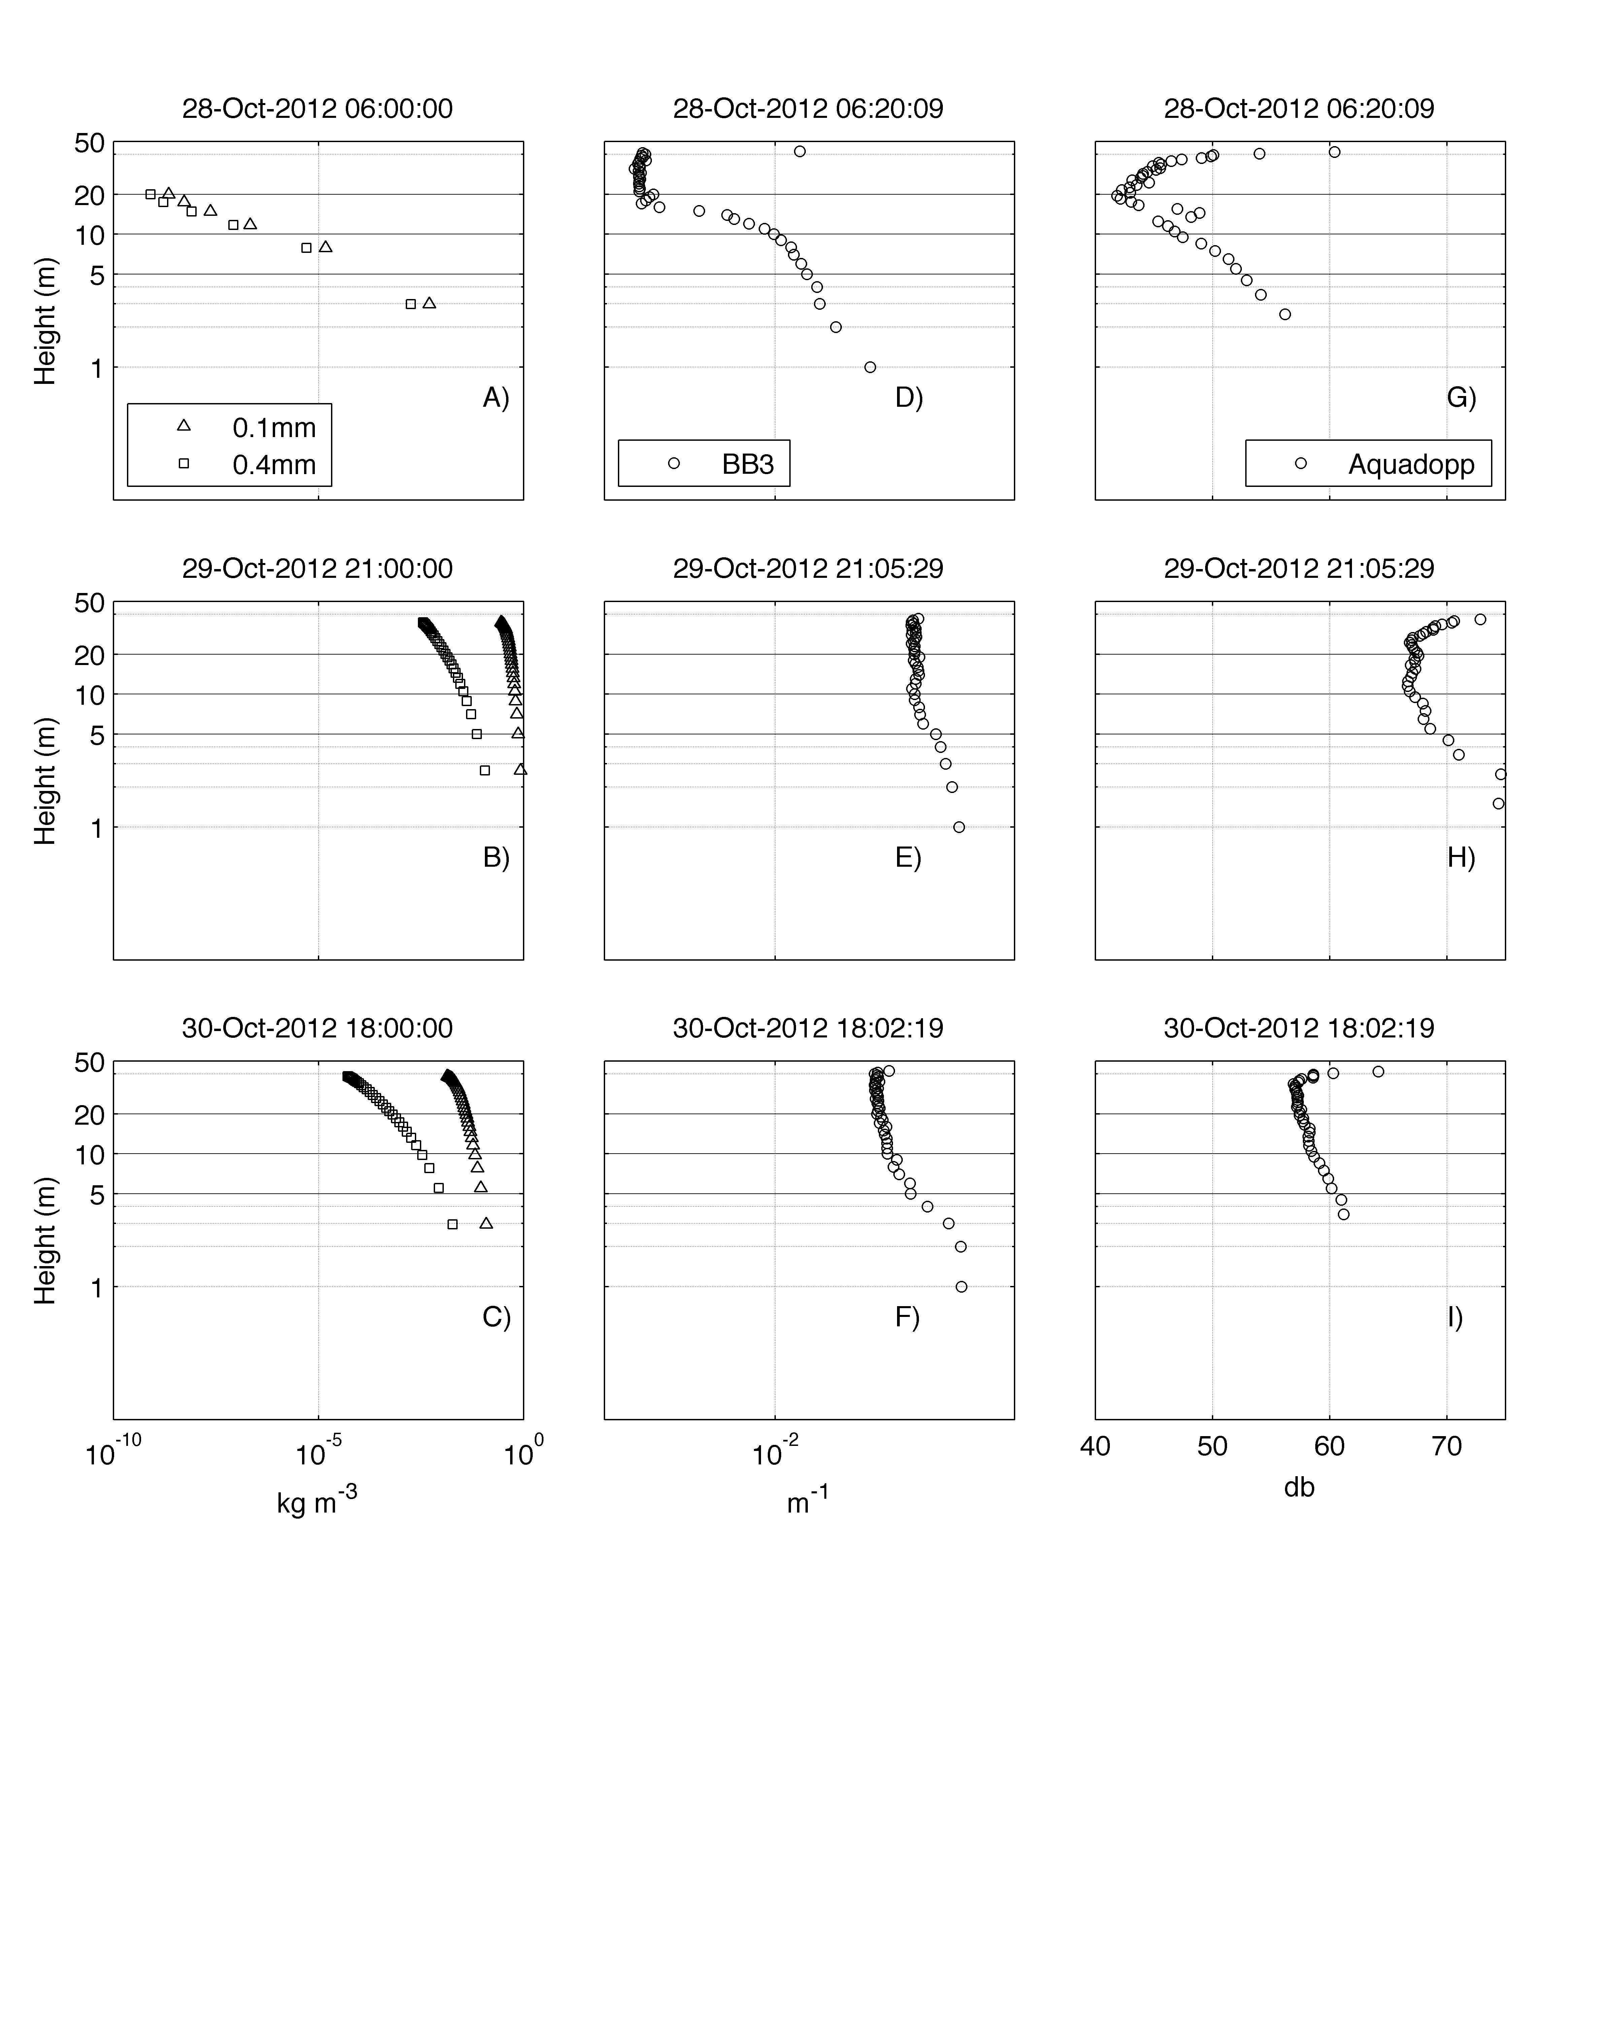
Model
Optics
Acoustics
Pre- storm
Peak- storm
Post- storm

Slide 32
Questions for this study
Can gliders be used to validate regional coupled sediment resuspension and transport
Can we deploy a glider in rapid-response to a forecasted tropical cyclone?
What sensor advancements are needed to obtain quantitative suspended sediment concentrations?
Notes:
Original plan as of October 20th 2012: Deploy glider and transit across the shelf waiting for a storm…

Slide 33
Future/Ongoing Work
Model sensitivities
Coupled atmospheric and wave model
Calibrate optical sensors w/ in-situ sediment necessary to make quantitative comparisons.
New technologies:
  Wave Sensors – U. of Maine w/ Neal Pettigrew
  Downward looking integrated current profiler
  Glider integrated LISST: Breaking up into grain sizes
CINAR TEMPESTS project
  4 Planned deployments next 2 years
    2 Nor’easters & 2 Hurricanes
    First deployment March 2014

Slide 34
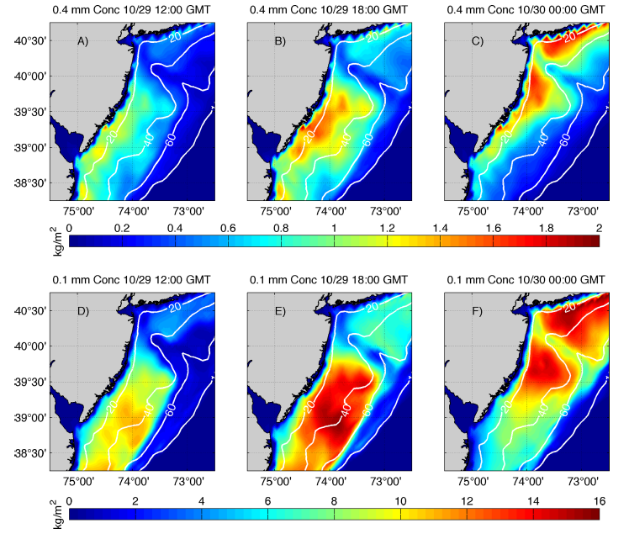
0.4 mm suspended concentration
0.1 mm suspended concentration
Notes:
Full shelf-wide figure

Slide 35
0.4 mm suspended concentration
0.1 mm suspended concentration
Notes:
Full shelf-wide figure

Slide 36
Regional Ocean Modeling System (ROMS) and Coupled Ocean Atmosphere Wave Sediment Transport (COAWST) model
Primary validation is post storm surveys and limited point measurements.
Need for new technologies for regional in situ observations
Notes:
These one-dimensional bottom boundary layer models have been coupled to three-dimensional bottom boundary layer models
Specifically ROMS and the Coupled Ocean, Atmosphere, Wave, and Sediment Transport model (COAWST)
Primary validation is post storm surveys/and limited point measurements
Need for new technologies for regional in situ observations in storm events

Slide 37
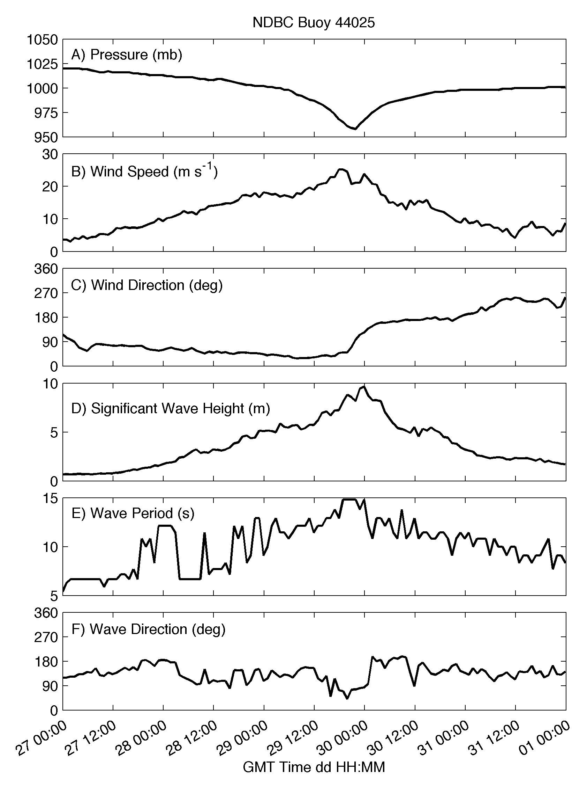
Notes:
Identify what’s on the map and describe Piloting strategy

Slide 38
Along-shore

Slide 39
Along-shore
Onshore
Notes:
Include 44009 comparisons? Not helpful

