Slide 1

Small Vessel Detection with UHF Radar in the Hudson River
Lenny Llauger
Shankar Nilakantan
Danielle Holden
Angelica Sogor
Dakota Goldinger
Omar Lopez
July 29 th,2010

Slide 2
Outline
Introduction
Background
Hypothesis
Methodology
Discussion and Analysis
Conclusions and Recommendations

Slide 3
Introduction
NY/NJ Port is third busiest in the US and first on the East Coast
Threat of small vessels
  Can harbor terrorists
  Can be used as a weapon
  Threat to cruise ships

Slide 4
Continued..
Small vessels could be a threat because they often go undetected by technology and humans due to:
  Small size
  Low speed
  No AIS requirement

Slide 5
Small vessel and other threats can:
  Impede the flow of cargo in and out of the port, affecting the economy of not just the tri-state area, but also other states where the cargo had its final destination
  Produce toxic chemical and biological effects, which can cause harm to human, plant, and animal life in the Hudson and on land

Slide 6
Current Research:
  Uses an Ultra High Frequency Radar system, the RiverSonde
  Aim to validate measurements of along shore and cross shore currents
  Determine if the UHF radar can detect small vessels

Slide 7
Measurement of currents also done with:
  Airborne optical system
  Jet ski-based near shore bathymetric survey system
  Acoustics (Echo sounders)
  Satellites

Slide 8
Small vessel detection has previously been done with:
  Passive millimeter wave (mmW) imagers
    Currently used for Anti-Terrorism / Force Protection and navigation tasks for U.S. Navy
    Also used by U.S. Coast Guard

Slide 9
If the RiverSonde is able to detect and provide a tracking input for small vessels, the Port Authority of NY/NJ and the Coast Guard may be better able to detect the intentions (friend or foe) of small vessels, based on factors like the vessel’s velocity and movements to and away from the radar, which will increase the security of the port

Slide 10
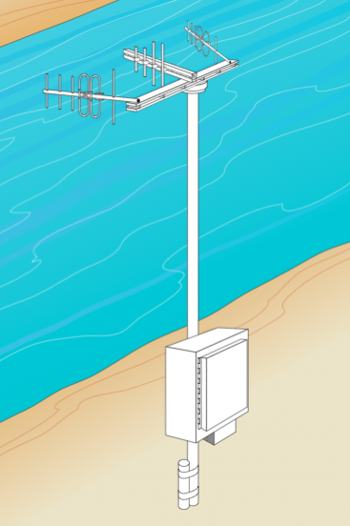
Background
RiverSonde
  Ultra High Frequency (UHF)
  Transmits vertically polarized electromagnetic energy
    Frequency :420 - 450 MHz
    Wavelength: approximately 60 centimeters
  Shore based remote sensing
    Streamflow measurement system
  All weather capable

Slide 11
RiverSonde works on the Doppler-Shift Principle
  Traveling towards radar: increase in frequency; positive Doppler
  Traveling away from radar: decrease in frequency; negative Doppler

Slide 12
Doppler Spectrogram
  Current/vessel detection:
    Intensity, frequency, Doppler bins, range cells
  Noisy Background: Bragg waves, stationary objects, and noise floor
  Effect of other devices with same frequency

Slide 13
Wave scattering
  Only those with exactly half of the wavelength of the transmitted wave and traveling in a radial path will be returned to the source
  Returned signal can be used for mapping surface currents
  Transmitted signal reflects off conductive material, such as metal on ships

Slide 14
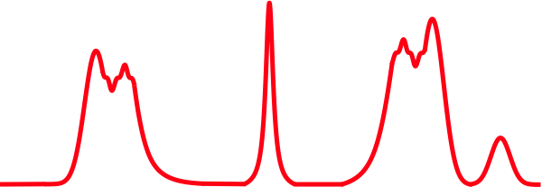
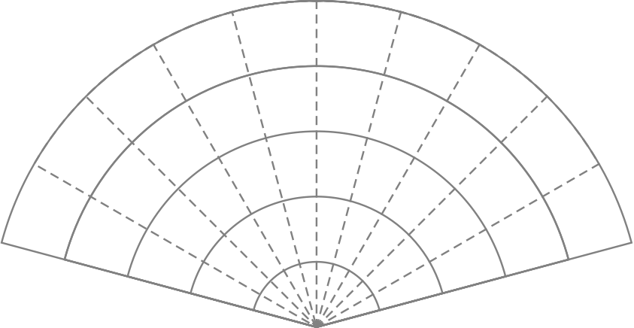

Echo Strength (dBm)
-fB
0
+fB
Doppler Frequency (Hz)
5
4
3
2
1

Slide 15
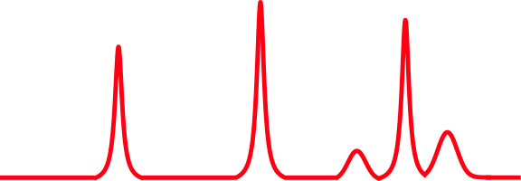
DOPPLER SPECTRUM
Doppler Frequency(RED shift)
Actual Frequency
Doppler Frequency(BLUE shift)
f2
fo
f1

Slide 16
DOPPLER SPREAD
Boat moving away from the radar
Boat moving towards the radar
v → radial velocity of boat
c → velocity of light
f → frequency of antenna (435 Mhz)
f f (1-2v/c)
f f (1+2v/c)

Slide 17
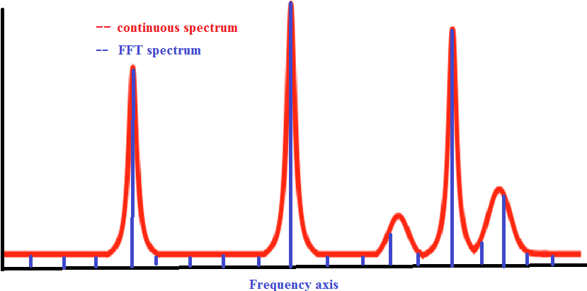
Fast Fourier Transform

Slide 18
SWEEP RATE
Corresponds to the maximum Doppler shift that RiverSonde can measure
Maximum Doppler shift
Doppler shift relates to the velocity of the boat as
fd(max) = Sweep Rate/2
fd= 2fv/c

Slide 19
Sweep Rate and Velocity
Current measurements
SWEEP RATE(Hz) | MAXIMUM DOPPLER SHIFT(Hz) | MAXIMUM RADIAL VELOCITY(knots)
16 | 8 | 5
32 | 16 | 10
64 | 32 | 20
Vessel Detection

Slide 20
FAST FOURIER TRANSFORM
N →Number of FFT points
fs →Sweep rate in Hertz
Tfft →FFT time length
fs/N = 1/Tfft
Computational Resolution = fs/N
Physical Resolution = 1/Tfft

Slide 21
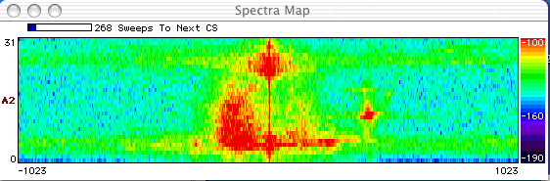
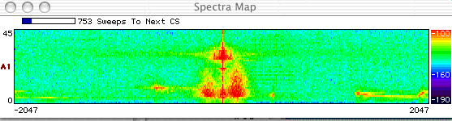
2048 FFT points and 32 hz Sweep rate
4096 FFT points and 64 hz Sweep rate

Slide 22
Changing Parameters
Higher sweep rate → Higher velocity that could be measured
To maintain same physical resolution, FFT point length should be increased correspondingly
SWEEP RATE(Hz) | FFT POINTS
16 | 1024
32 | 2048
64 | 4096

Slide 23
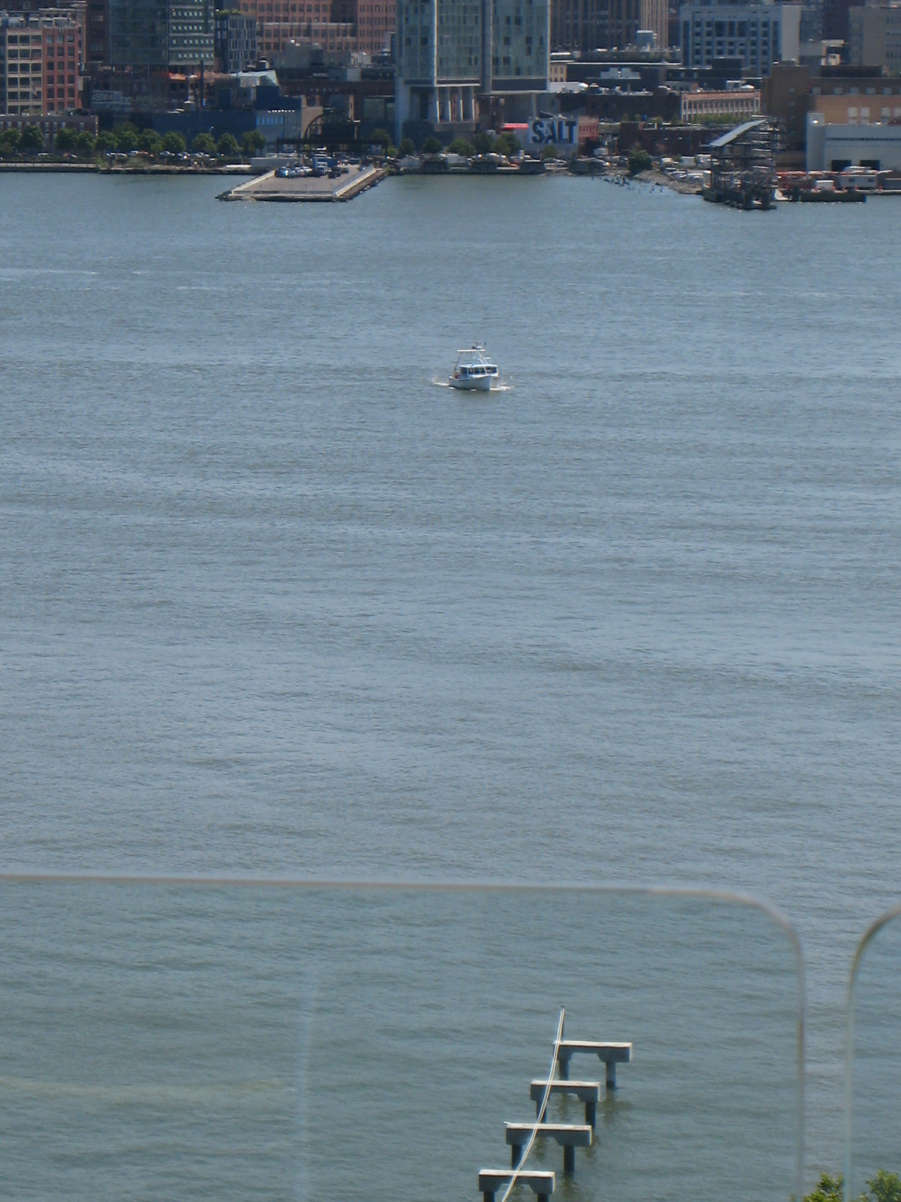

Slide 24
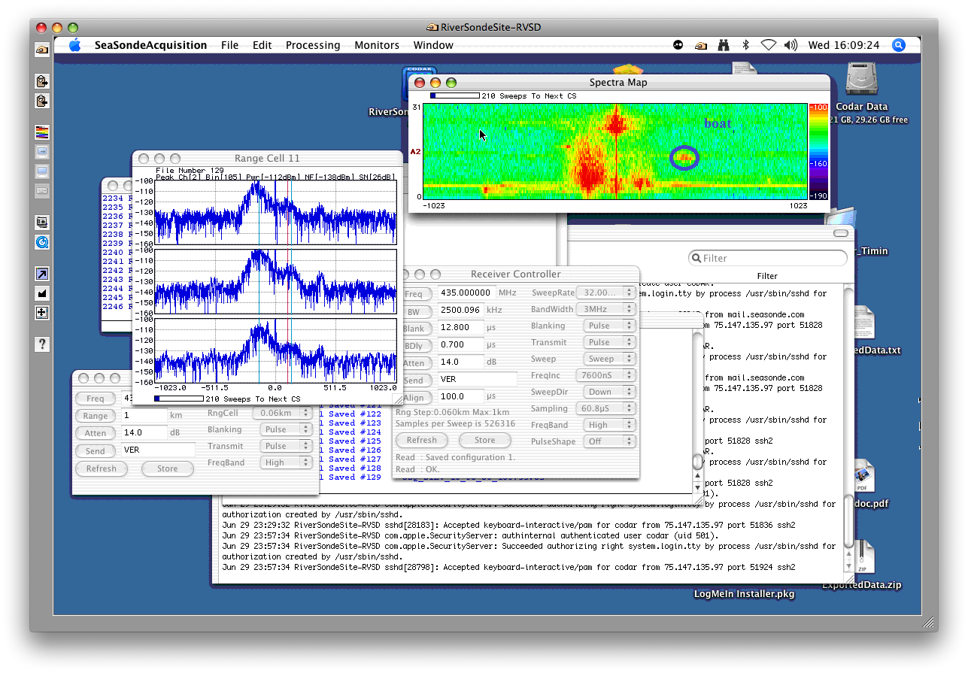

Slide 25
Interpreting the spectrum
Bin number = 384
1024 bins correspond to 11 knots
The 384th bin corresponds to approximately
( 384*11 ) / 1024 = 4.1 knots

Slide 26
Hypothesis
The hypothesis for the study is that the RiverSonde is capable of identifying small vessels in the Hudson River
Small vessel movement will be reflected on the RiverSonde such that the radial vector field will be disrupted on a small time scale
Time series measurements will also display anomalies in surface velocity

Slide 27
METHODOLOGY
Overview
Research Objectives
Radar Installation
Data Process and Collection
Experiments

Slide 28
Objectives
Develop a technology that detect small boat threats along USA coasts.
How?
-Ensure RiverSonde is working properly
-Detect and track boats with the RiverSonde spectra.
-Determine how small is too small to detect.

Slide 29
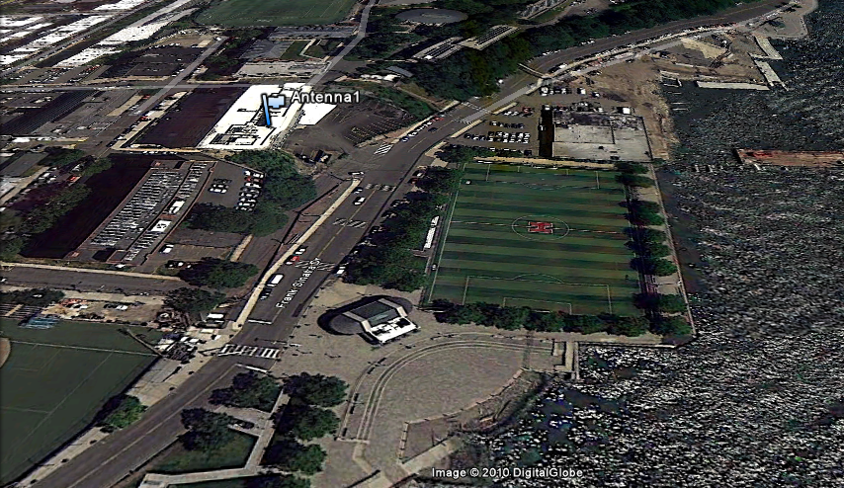
Radar Installation
HF RADAR was installed on the patio on the 6th floor of the Babbio Center at Stevens Institute of Technology.
40 m
140 m

Slide 30
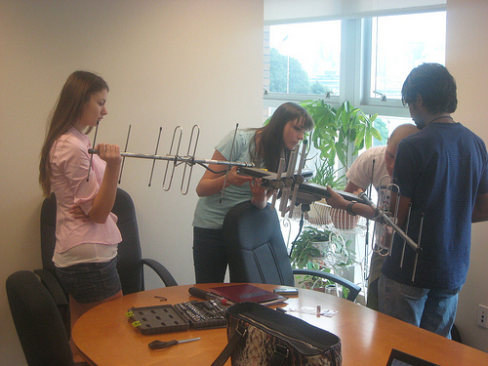
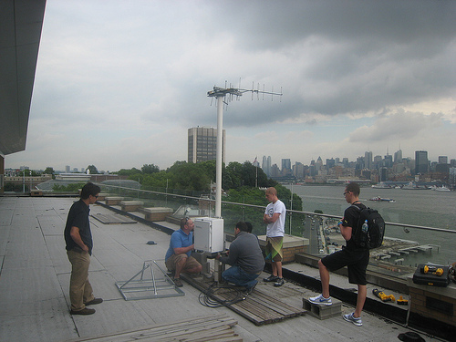
We did the job!
Installing the antenna

Slide 31
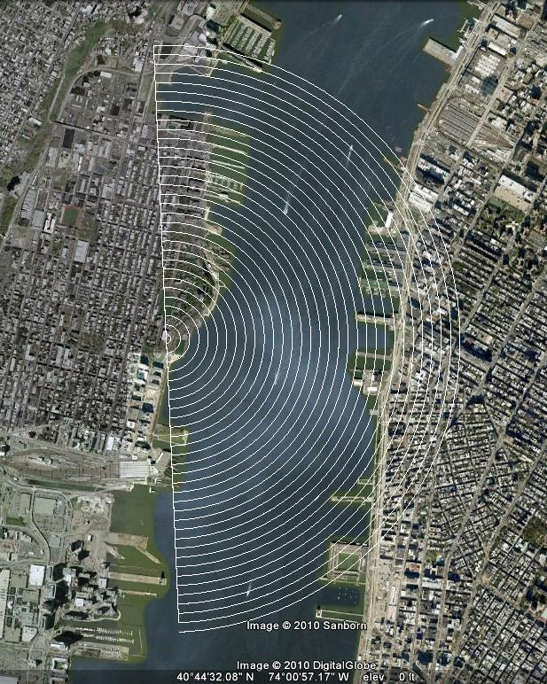
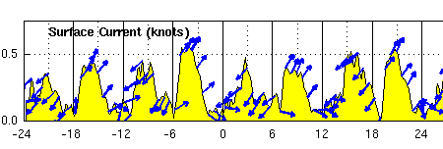
Calibration and Validation
Surface current velocity compare data with NYHOPS model.
Extend the range through the river.

Slide 32
Data Process and Collection
  Process:
  Take images from boats and match they time with the spectra images.
  Collection:
  What was done during the boat experiments?
    Collecting Spectra Images.
    Tracking our boat and other boats.
    Documenting other boats with pictures.
    GPS tracking.
    AIS (Automatic Identification System) tracking.

Slide 33
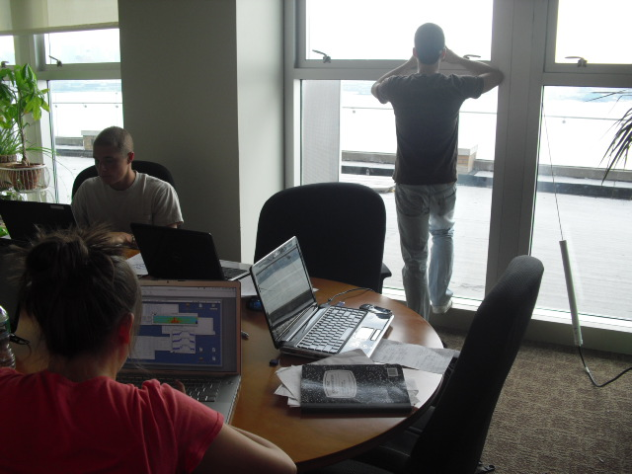
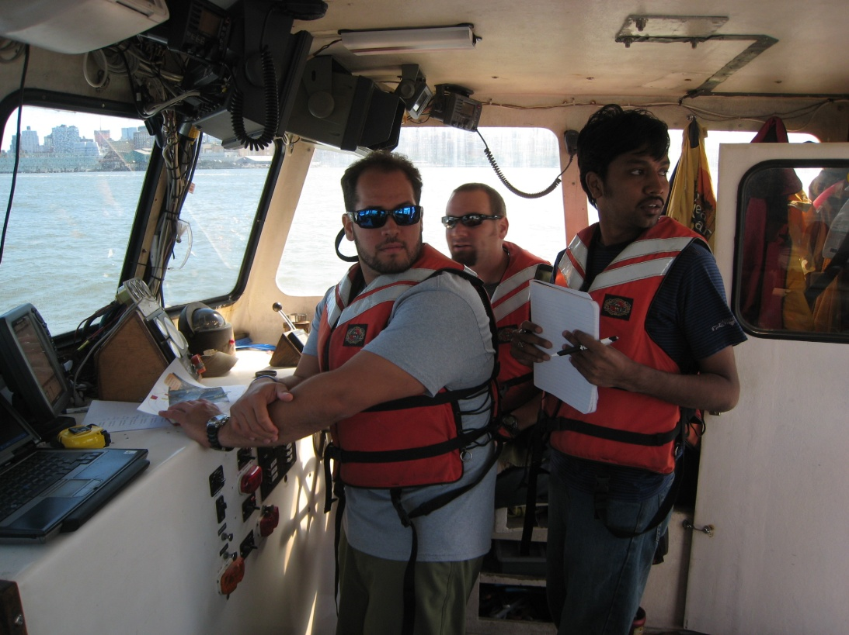
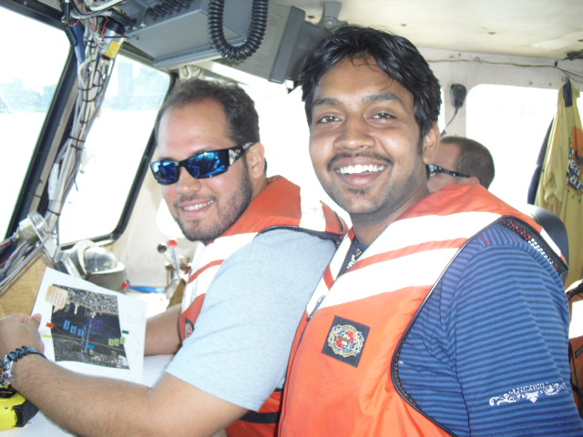
GPS Collection
Following the boat path using waypoints in the GPS.
Our Command Center

Slide 34
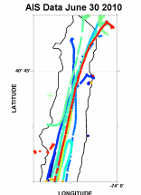
AIS Collection
Here is a zoom of the harbor highlighting the location of the RiverSonde as the
* Each color represents a different vessel

Slide 35
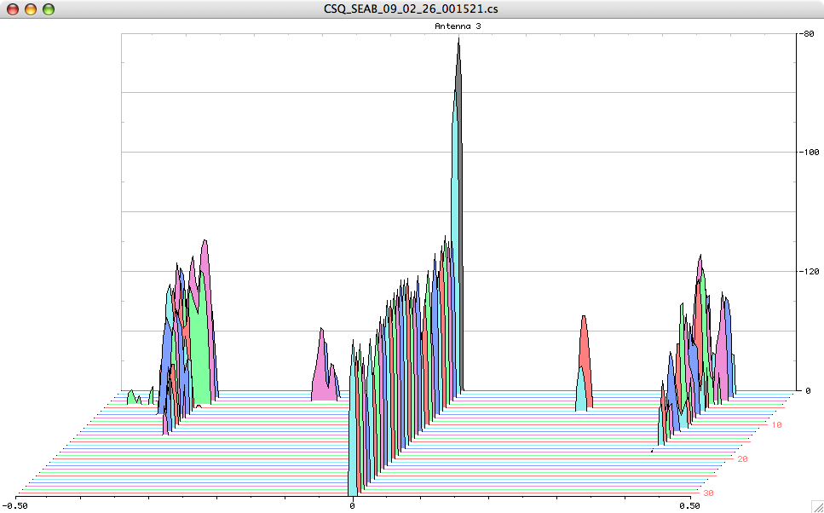
Spectra Map for the SeaSonde in 3D
Boat Signal

Slide 36
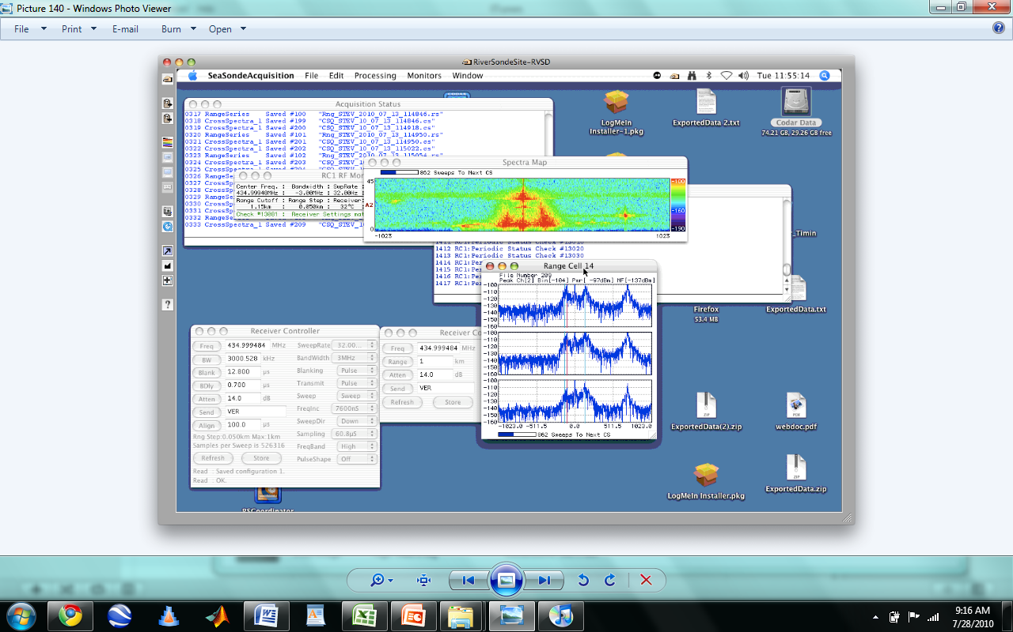
Looking at boats in the spectra images
Boat
Boat Signal
Noise

Slide 37
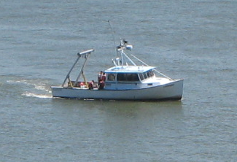
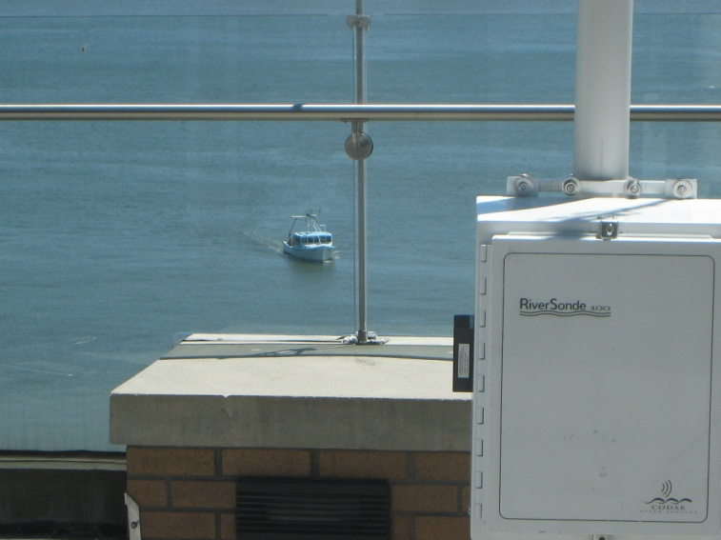
Experiments
Three days of experiments using a boat provide from the University.
- Planning
- Implementation
- Hot wash
Savitsky Boat

Slide 38
Experiments
1st Boat Experiment on June 30, 2010
- Focus:
How the Savitsky boat looks in the spectra image when it is moving. Work along Acoustics Team in the boat
2nd Second Experiment on July 13
- Focus:
Navigate the boat towards and away from the antenna. Taking notes from other boats
3rd Third Experiment on July 15
- Focus:
Observing small vessels

Slide 39
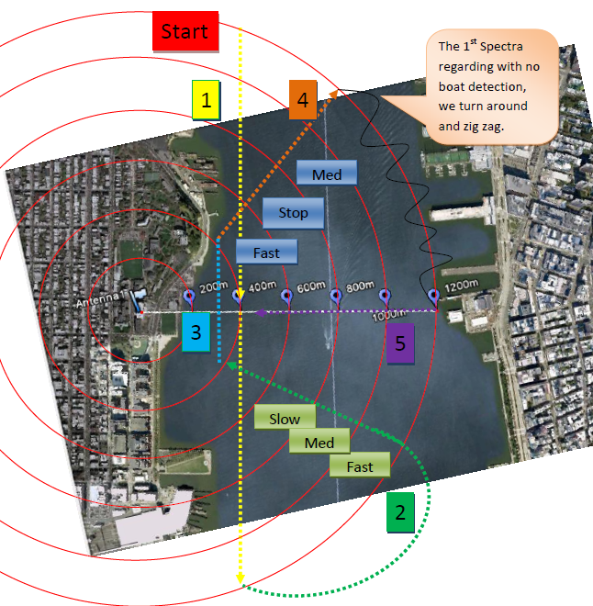
Boat Path Experiment #1
Parameters for experiment #1 am
Track | Vel. (Knot) | BW (MHz) | Bins | Cells (m)
1 | 4 | 2.5 | 2048 | 60
2 | 4 | 2.5 | 2048 | 60
3 | 4 | 2.5 | 2048 | 60
4 | 4 | 2.5 | 2048 | 60
5 | 4 | 2.5 | 2048 | 60
Parameters for experiment #1 pm
Track | Vel. (Knot) | BW (MHz) | Bins | Cells (m)
1 | 7 | 2.5 | 1024 | 60
2 | 7 | 2.5 | 1024 | 60
3 | 6 | 1.5 | 2048 | 100
4 | 7 | 1.5 | 2048 | 100
5 | 7 | 1.5 | 2048 | 100

Slide 40
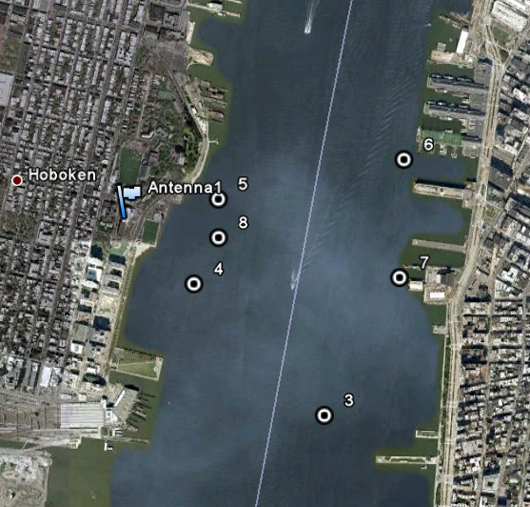
Boat Path Experiment #2
Start
Track #1 @4 Knot
Track #4 @8 Knot
Finish
Parameters for experiment #2
Track | Vel. (Knot) | BW (MHz) | Bins | Cells (m)
1 | 4 | 2.5 | 2048 | 60
2 | 4 | 2.5 | 2048 | 60
3 | 6 | 2.5 | 2048 | 60
4 | 8 | 2.5 | 2048 | 60
Track #3 @6 Knot
Track #2 @4 Knot

Slide 41
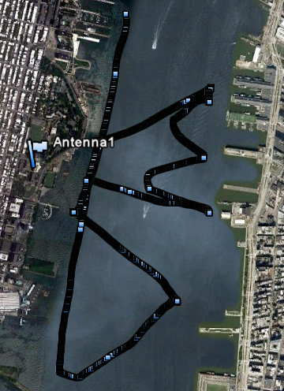
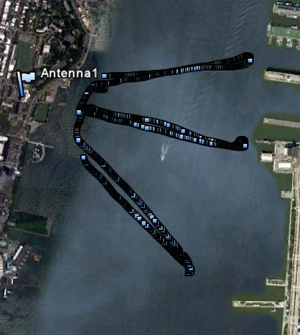
GPS Tracking
Path for 1st experiment
Path for 2nd experiment

Slide 42
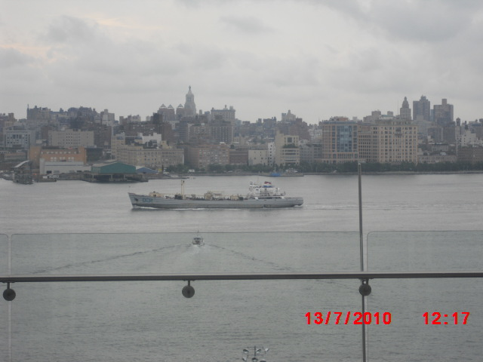
Tracking other boats
On which track did we see the boat?
Estimating boat size
Noting types and names of surrounding vessels
Was the boat between the Savitsky and the radar?
Direction of boat
Miscellaneous notes

Slide 43
Results

Slide 44
First step

Slide 45
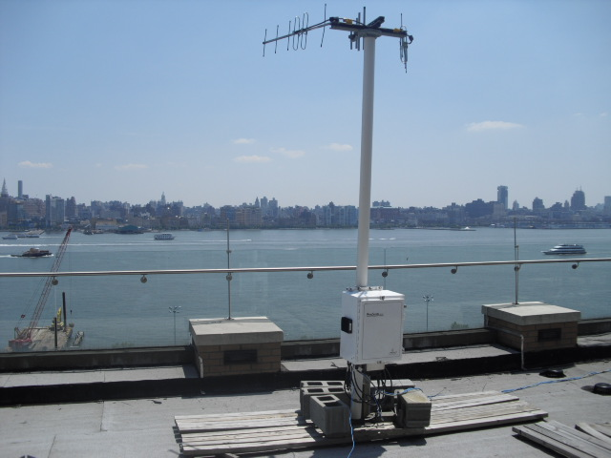
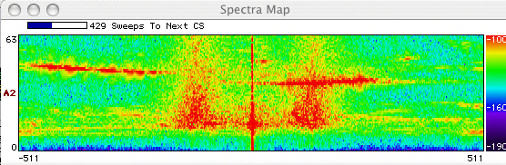
Random ship detection

Slide 46
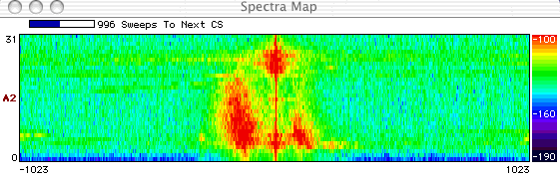
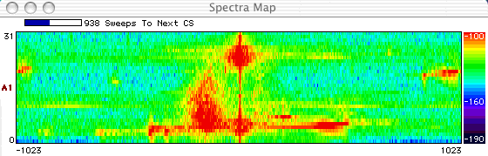
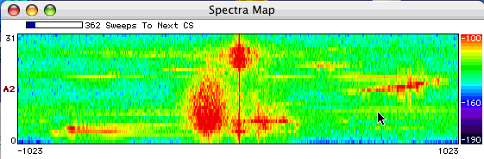



Patterns in spectra
Clear spectra map: No boats
ANY boat traveling down river:
Travels from right to left in spectra map
Appears closer as it nears 0 doppler and in further range cells and it is further away

Slide 47
Tracking Savitsky
Spectra map shows direction away and towards.
Range cell graphs identify whish antenna is tracking the boats radial speed more precisely.
The antenna with most intensity tells you relative area of boat. LEFT, RIGHT, or FRONT

Slide 48
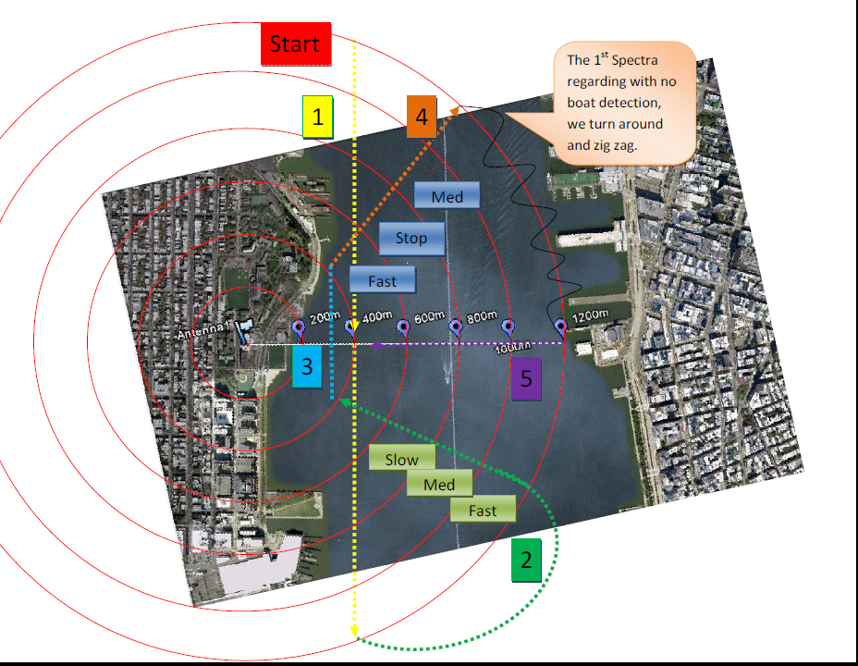

Slide 49
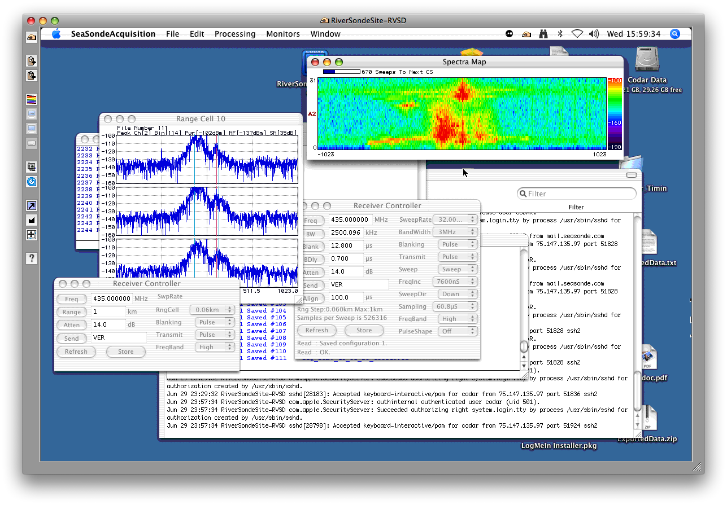



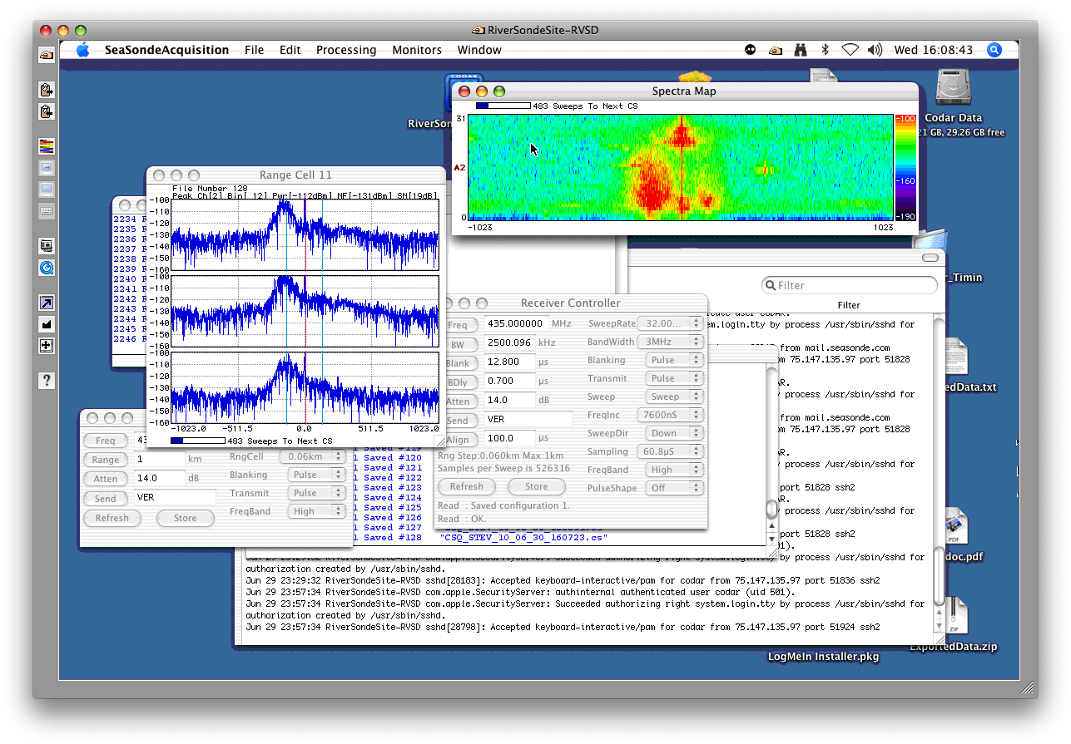



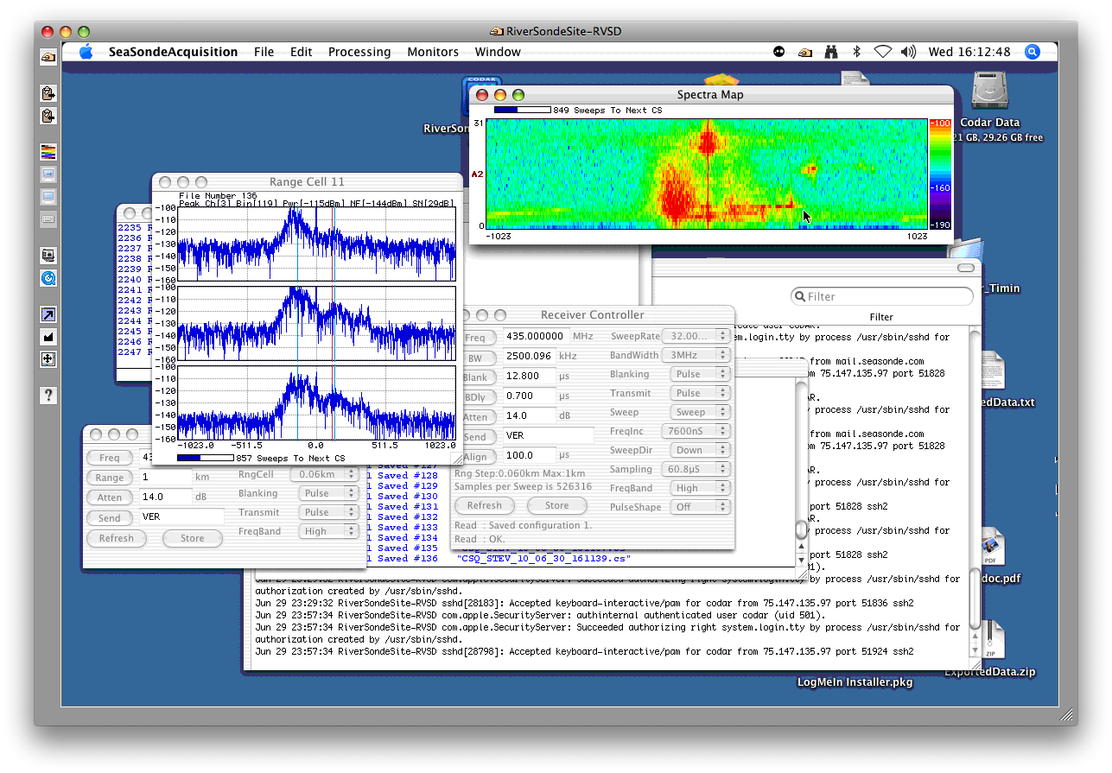
Boat Detection , Positive Radial Velocity on track 2.

Slide 51
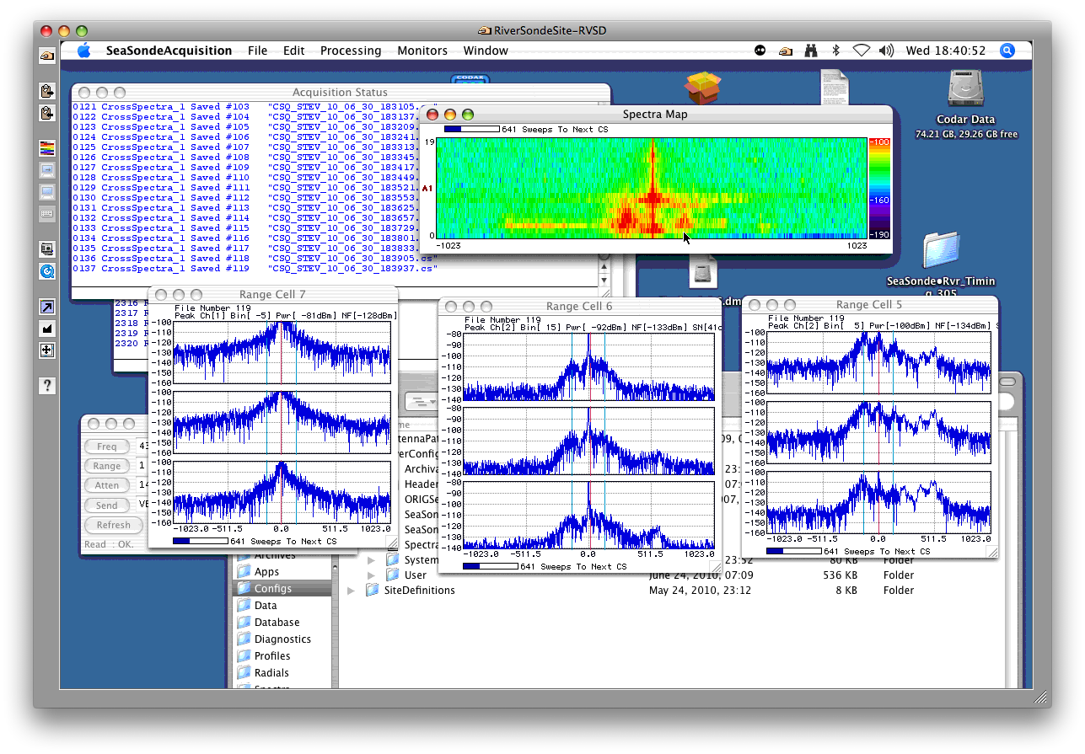

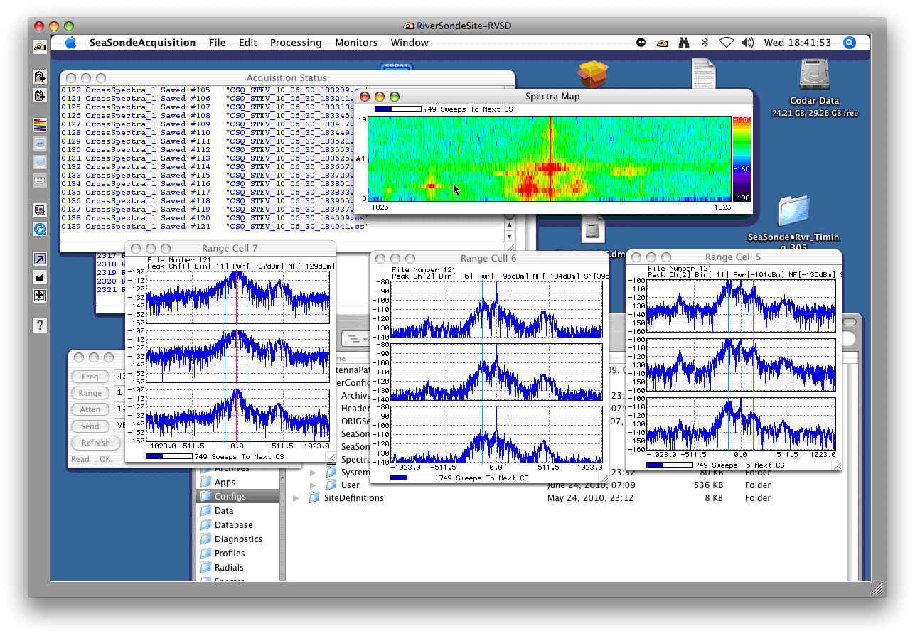

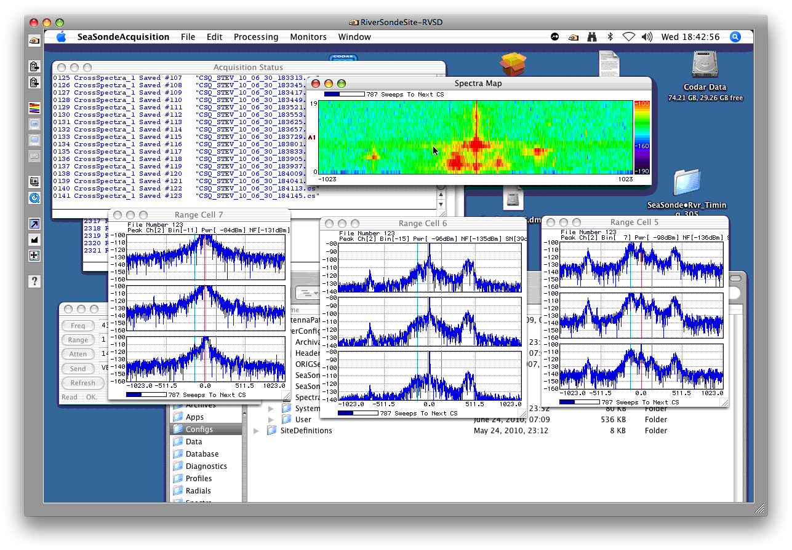


Radial velocity on track 4
RANGE CELL SIZE
200m

Slide 52
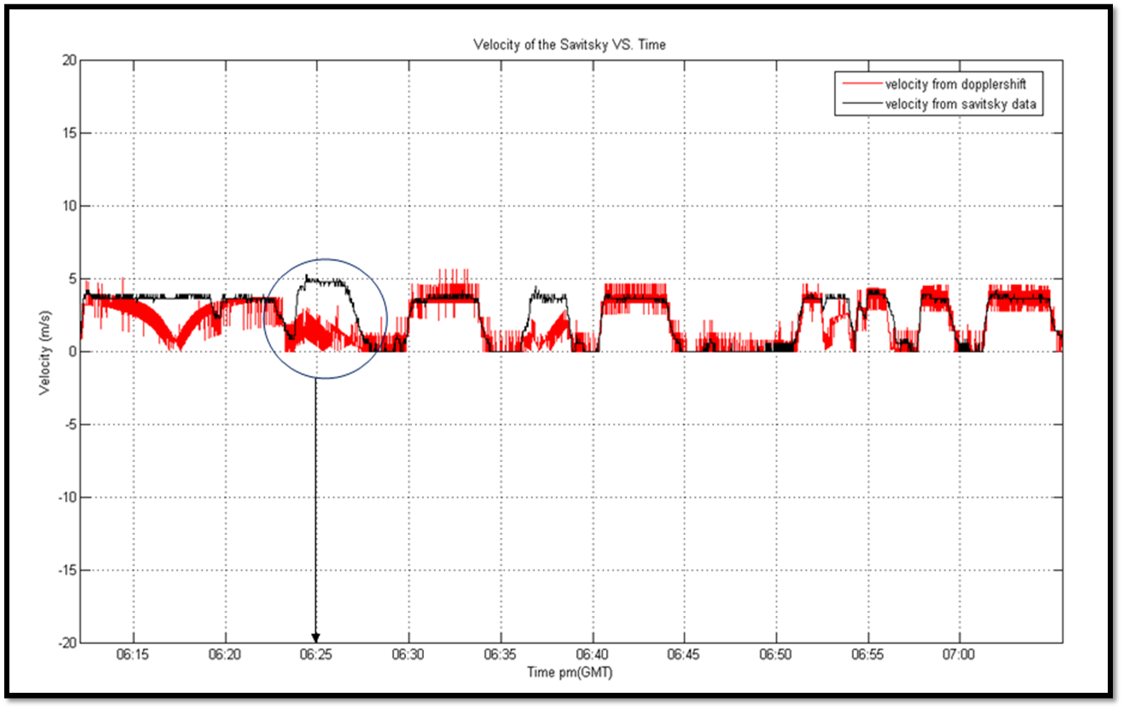
GPS Plots from 1st experiments
The velocity of Doppler shift does not correlate with Savitsky data in some cases because of the direction the boat was traveling

Slide 53
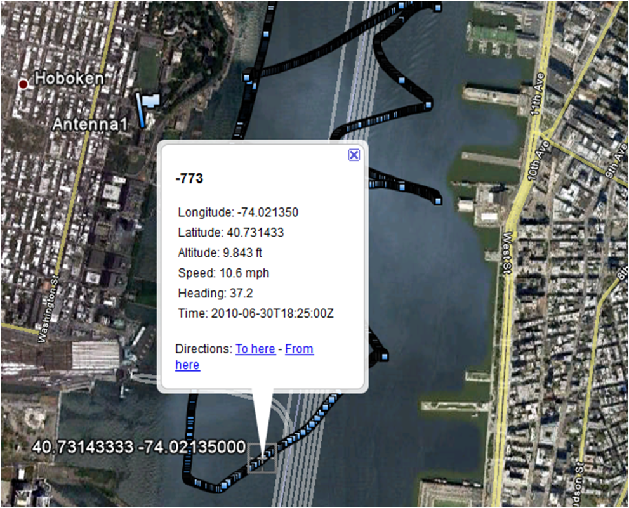
Plots from 1st experiments
Here is shown were the boat was when the Doppler velocity did not correlate.

Slide 54
New Boat Path Experiment #2
Path home
Track #4 @8 Knot
Finish
Start
Track #3 @6 Knot
Track #2 @4 Knot

Slide 55
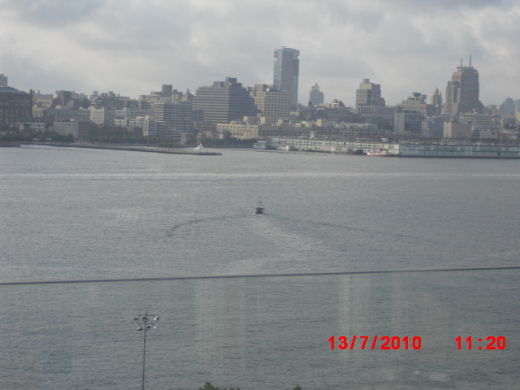

Slide 56
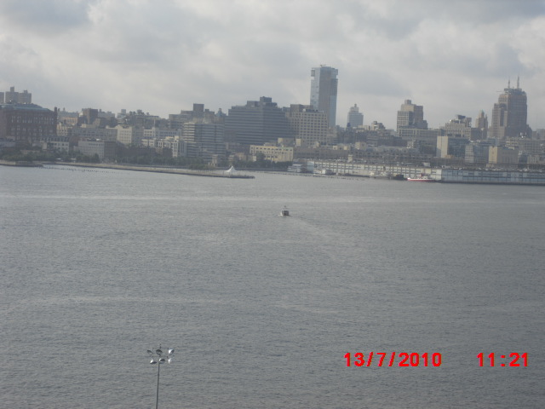

Slide 57
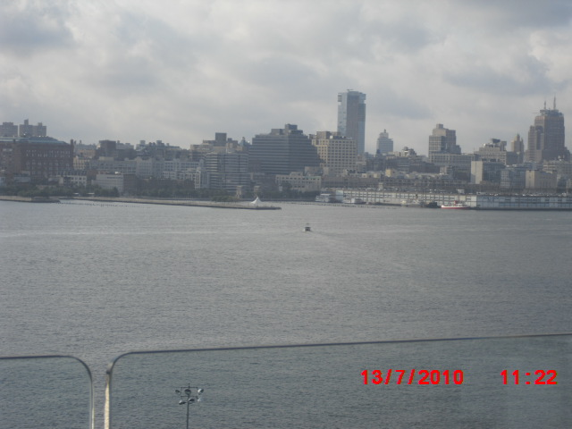

Slide 58
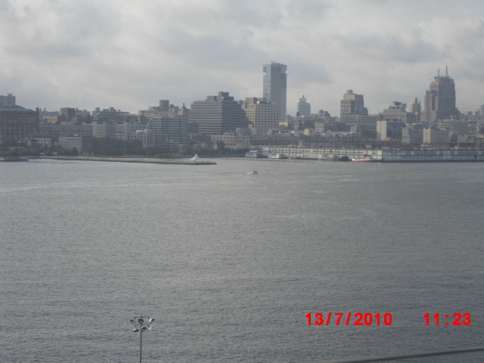

Slide 59
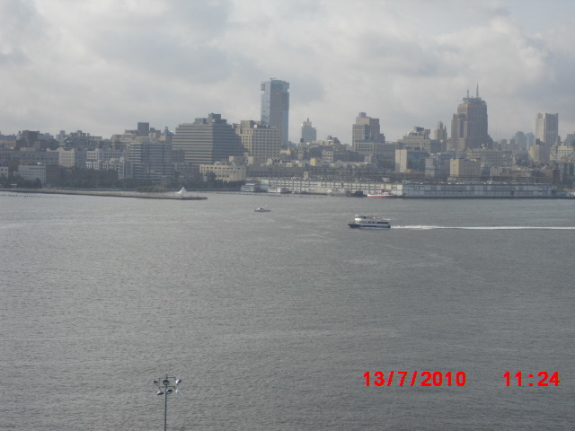

Slide 60
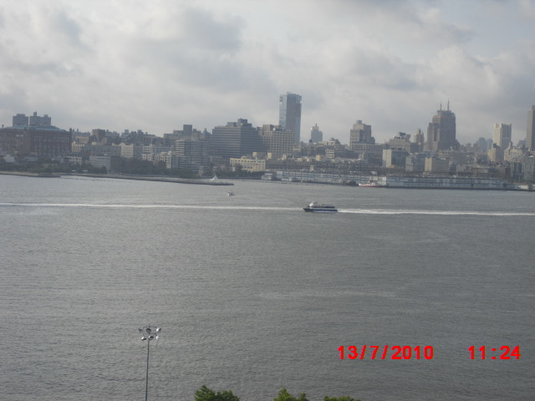

Slide 61
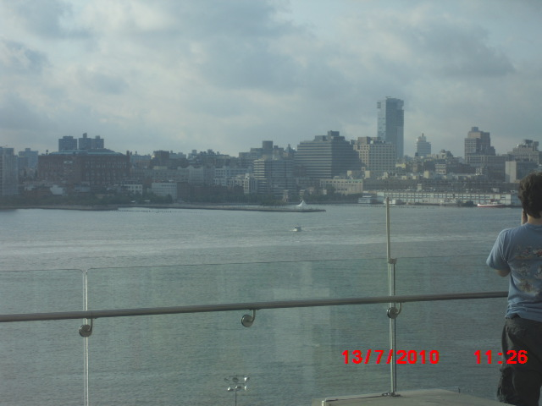

Slide 62
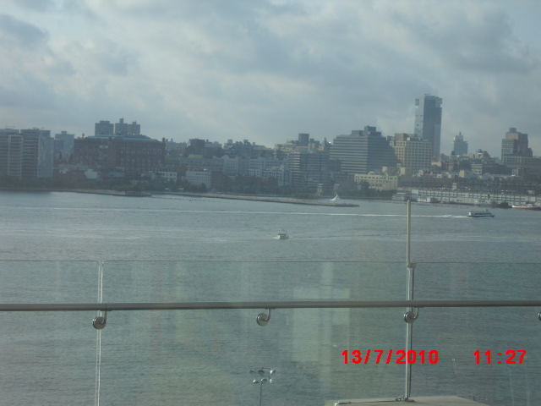

Slide 63
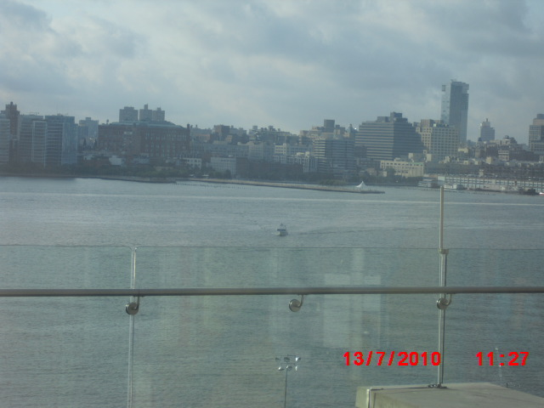

Slide 64


Slide 65






















Track 2 , Antenna 3

Slide 66
New Boat Path Experiment #2
Path home
Track #4 @8 Knot
Finish
Start
Track #3 @6 Knot
Track #2 @4 Knot

Slide 67

Track 3, antenna 2
Boat travels away with same pattern as track 2. Now with different direction and speed.

Slide 68


Slide 69


Slide 70


Slide 71


Slide 72



Slide 73


Slide 74


Slide 75


Slide 76


Slide 77


Slide 78


Slide 79


Slide 80


Slide 81
Track 4, antenna 1
The pattern was the same as the other tracks.
Intensity changes from antenna 2 and 3 , too antenna 1

Slide 82

Savitsky Travels Away!

Slide 84

Savitsky Travels Back Towards Antenna!

Slide 86
Final Track “along shore path”
Path home
Track #4 @8 Knot
Finnish
Start
Track #3 @6 Knot
Track #2 @4 Knot

Slide 87


Slide 88


Slide 89


Slide 90


Slide 91


Slide 92


Slide 93




Savitsky Leaving “Moving Along Shore”

Slide 94

Plots from 2nd experiments
This is the plot of Velocity VS. Time from Savitsky’s GPS boat path on July 13, 2010

Slide 95
Plots from 2nd experiments
Path for boat experiment on July 13, 2010

Slide 96


Third experiment: Small boat observations July 15, 2010
Parameters set to observe small boats:
Bandwidth: 3MHz
# Doppler bins: 2048
# Range Cells: 45

Slide 97


10:51 GMT
Small sport fishing boat (~25 feet)
Moving away from RiverSonde
Movement appears on spectra

Slide 98


11:11 GMT
Small sailboat (~25 ft length, 50 ft tall)
Moving towards RiverSonde; drifting
Moderate intensity: yellow

Slide 99
11:15 GMT
Sailboat drifting; can be seen in zero Doppler

Slide 100



11:21 GMT
Speed boat is traveling at 8 knots towards RiverSonde. Is about 25 feet long, 15 feet tall

Slide 101


11:30 GMT
Sail boat is covered by fast moving ferry
~30 ft length, ~50 ft tall
Very slow moving; has weak signal

Slide 102


11:51 GMT
Sail boat is drifting and can be
seen in zero Doppler

Slide 103


12:24 GMT
Two small boats; RiverSonde
Detected two boats as one

Slide 104


12:42 GMT
Sailboat movement appears on spectra

Slide 105


13:51 GMT
Fishing boat movement away from RiverSonde appears on spectra

Slide 106
Conclusions from July 15
The main factor in detecting small vessels is not just size
Must consider boat movement and materials on the boat
Boats with a larger surface area appear more intense on spectra because RiverSonde receives more signal wave feedback

Slide 107
CONCLUSION
  RiverSonde can be used effectively in the following areas
  - Vessel Detection
  - Surface current measurements
  Current measurements compared well with the NYHOPS model
  Could be a valuable tool in search and rescue operation

Slide 108
VESSEL DETECTION
RiverSonde could detect boats of size ~ 15 feet high
Test Boat, Savitsky, was tracked at different paths and different velocities
Unidentified vessels were also tracked at different directions and velocities
Exact bearing could not be extracted at the moment

Slide 109

VESSEL DETECTION
Radial velocity of boat determined using Spectrogram

Slide 110
HOW SMALL IS TOO SMALL
THEORETICAL
Any conductor at a height of λ/4 can reflect considerable amount of signal back to the radar
λ – Signal Wavelength(60 cm)
Smallest boat height = 15 cm (?)

Slide 111
LIMITATIONS
Spatial resolution
Boats travelling close together at the same velocity at adjacent range cells might be too difficult to differentiate
Resolving large array of boats in the spectrogram was difficult
One RiverSonde system not sufficient to locate the position of boat in river

Slide 112
Building for the future
Building a network of radars to track and monitor the movement of the ships and triangulate position in the Hudson river.
Developing a dual use capability system for both vessel and current detection
Cognitive methods(like Spectrum Sensing techniques) to vary system parameters with environmental conditions

Slide 113
OUR SINCERE THANKS
CODAR Ocean Sensors Ltd.
Jeremy Turner, Research Engineer, Stevens Institute of Technology
All faculty mentors and DHS

Slide 114
THANK YOU FOR YOUR PATIENCE!!

