Slide 1
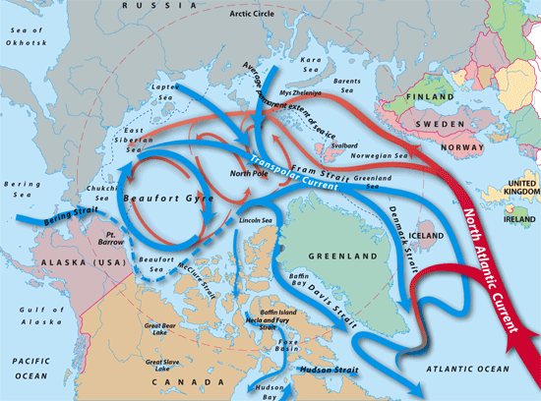
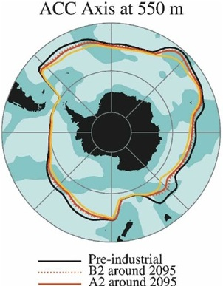
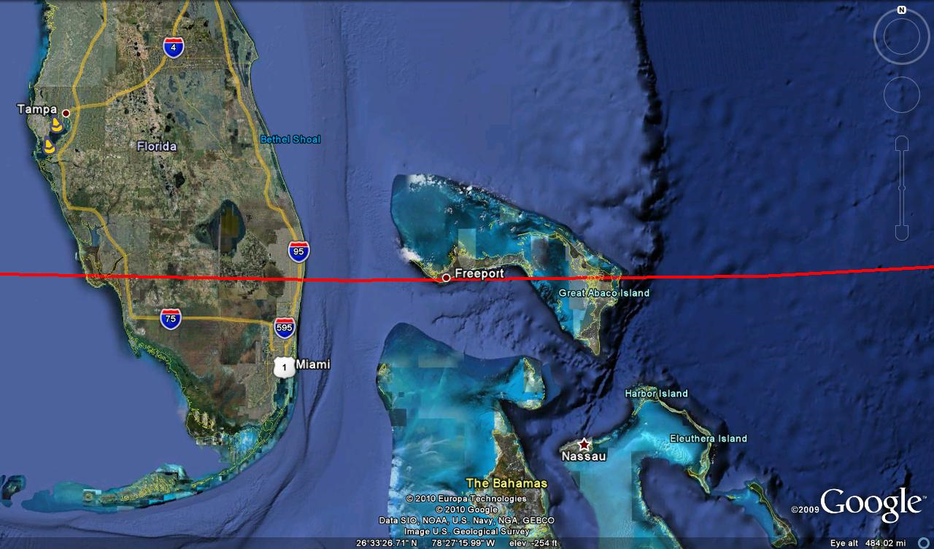
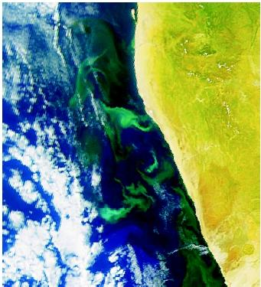
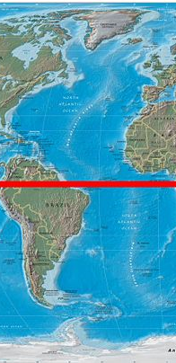
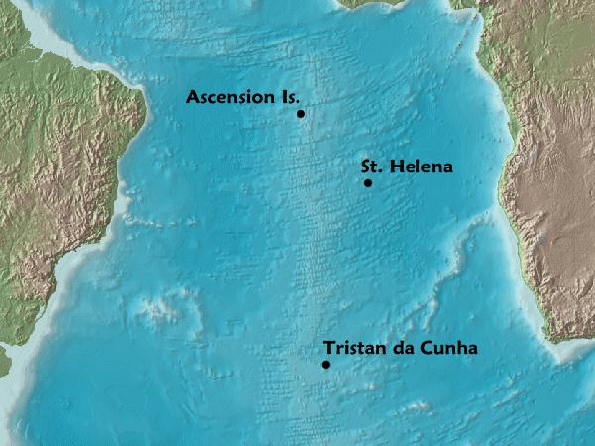
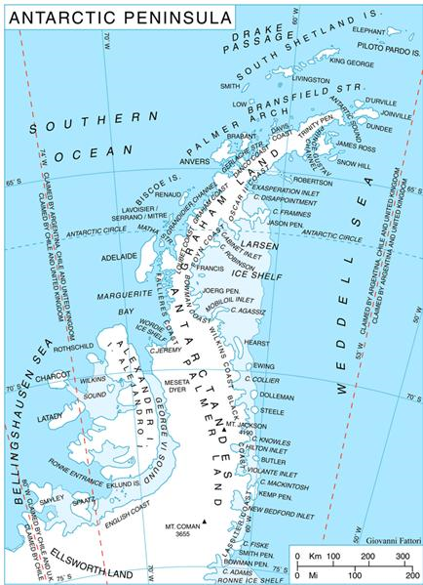
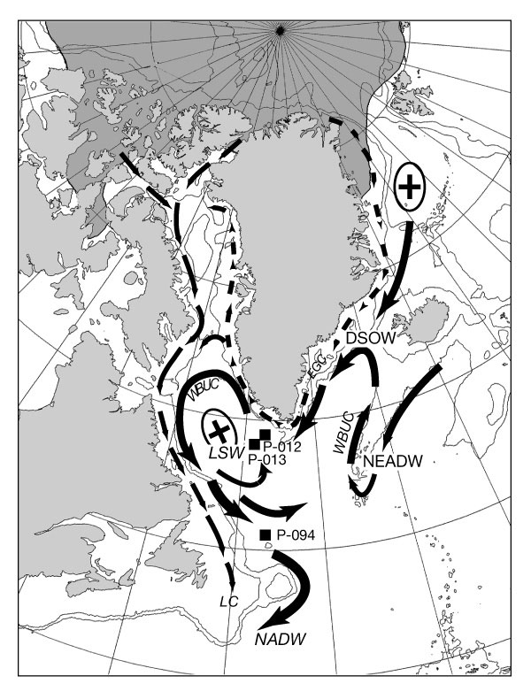
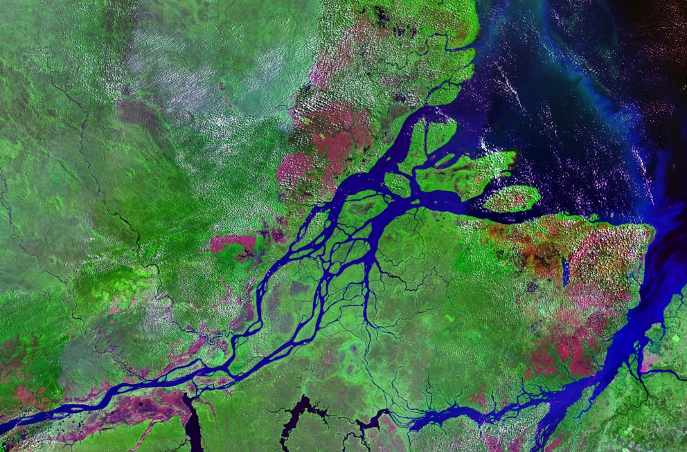
Atlantic Ocean Basin Facts
Antarctic Circumpolar Current
The Antarctic Circumpolar Current (ACC), a continuous current encircling Antarctica, is the dominant ocean circulation feature of the Southern Hemisphere and is largely responsible for vital ocean-air interaction and regulation.
Formed after the opening of Drake’s Passage and was first discovered by Edmund Halley
A change in the water temperature of the Antarctic Circumpolar Current is causing a change in the ice cycles, disrupting feeding and growth seasons for marine life such as phytoplankton, krill, and penguins.
Arctic
Rich in natural resources
Man’s last true frontier explored by Fridjt of Nansen and Wally Herbert
Climate change has significantly affected the environmental region of the Arctic
26.5N
Runs through Florida, the Bahamas, and Northern Africa
Florida and the Bahamas were accidentally discovered by Ponce de León in the search for new territories and the mythical fountain of youth
Rely on tourism and fisheries for economic stability
Africa
Home to 2 major upwelling zones
African Partnership Station was started in 2006
Increased piracy around Benguela and the Gulf of Guinea
Equator
The French Academy of Sciences discovered in 1735 that the circumference of the Earth was greatest around the Equator
In this region the North Equatorial, South Equatorial and Equatorial Under- Current can be found
Major exports of Libreville , in Africa and Belém, in South America include: aluminum, iron, nuts, pineapples, cassava, jute, and hardwoods
South Atlantic Gyre
Located between South American and Africa in the Southern Hemisphere
Three main islands: Tristan Da Cunha, Saint Helena, Ascension Island
Part of Ferdinand Magellan’s circumnavigation and HMS Challenger voyage
Antarctic Peninsula
Warming at a rate of 2 or 3 times faster than the global average
Warming is effecting the entire ecosystem including the plants, penguins, phytoplankton, and krill
Palmer Station, named after Nathaniel B. Palmer and located on Anvers Island, is the only US station north of the Arctic Circle
Antarctic Treaty, signed by 12 countries on December 1, 1959 supports scientific research and protects Antarctica’s eco-zone
North Atlantic – Greenland Sea/Irminger Current
Home to 2 major downwelling sites
Hosts world’s richest fishing resources
Recent wartime history proved Greenland to be of strategic importance
Amazon River/Orinoco Outflow
Contain tar oil, iron, gold, copper, nickel, manganese, tin, and diamonds
Orinoco and Amazon River release more than 7.5 billion cubic feet of freshwater into the ocean per second
There is a record held for longest riding of the wave surfing, 33 minutes.

