Slide 1
What can COSEE NOW do to help you achieve broader impacts with your research?
Brought to you by:
“The people who always bring kids into the building”
Janice McDonnell
Sage Lichtenwalner
Carrie Ferraro
September 20, 2010

Slide 2
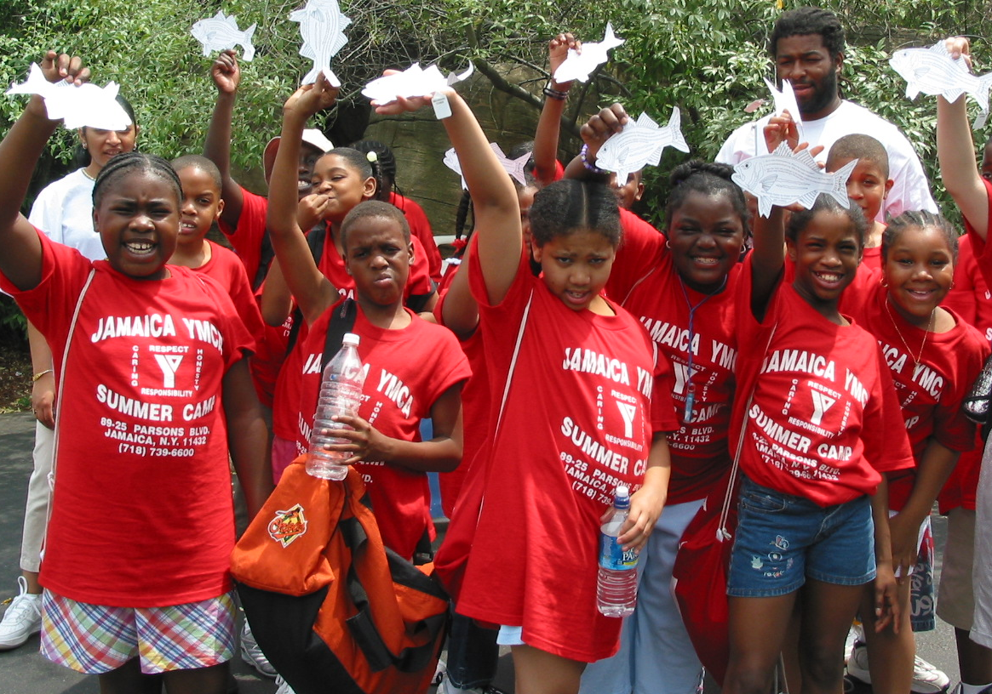
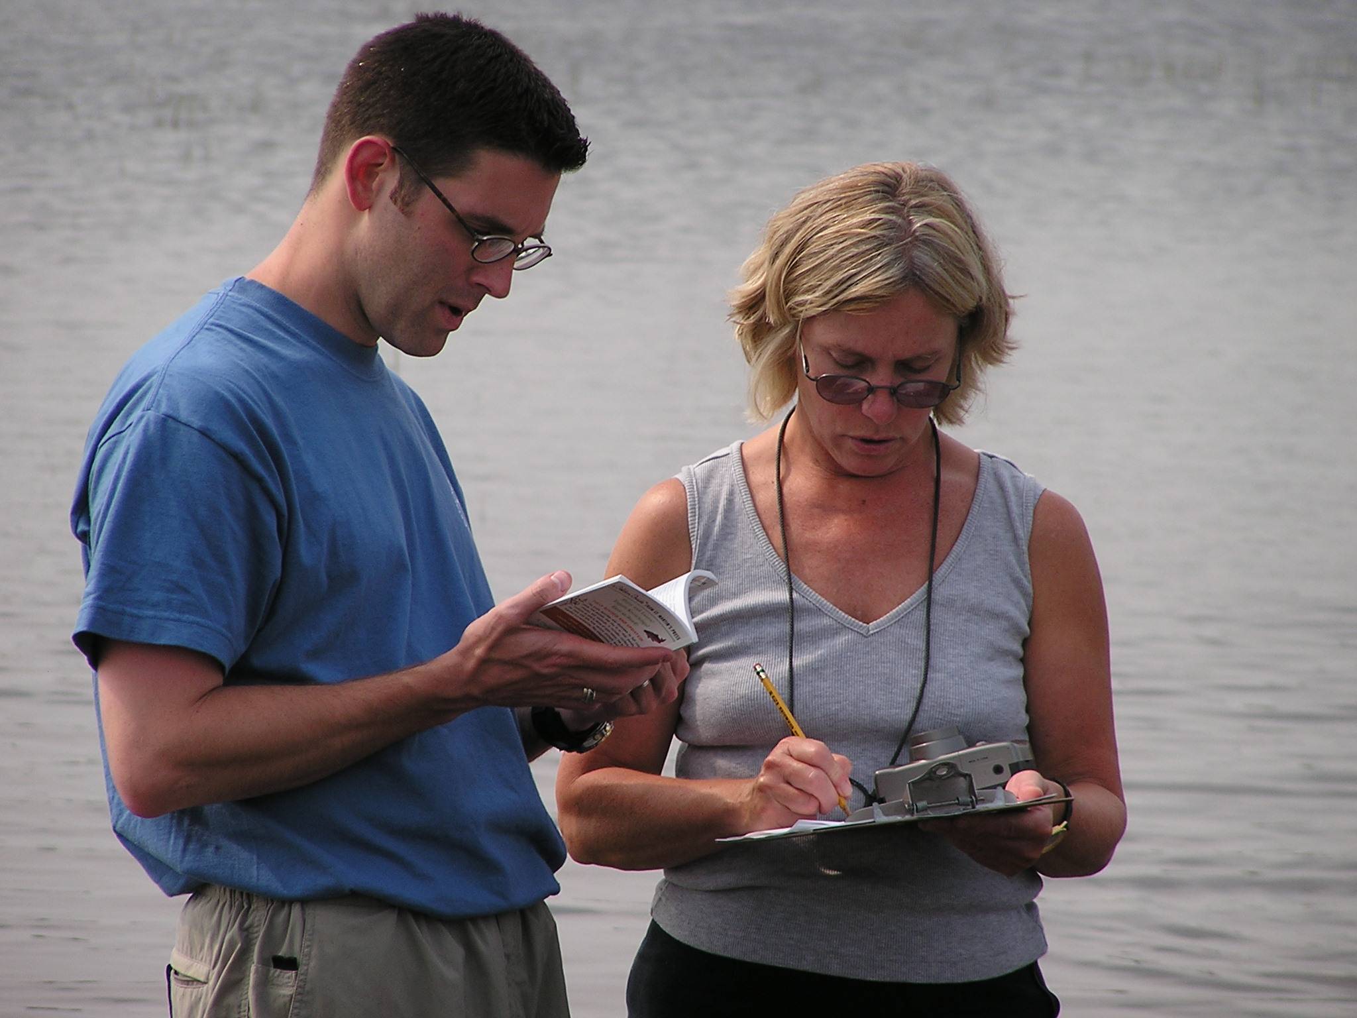
Talk Outline
Intro to Broader Impacts
COSEE: Who we are and how can we help
How to fulfill Criterion II?
Examples

Slide 3


What is Criterion II or Broader Impacts?
Since 1997, NSF attempted to diversify and enrich science research and education in the USA through the Broader Impacts Criterion (BIC), also known as “Criterion Two” or the “Second Criterion”

Slide 4

BI Criterion
• Advance discovery and understanding
• Broaden the participation of underrepresented groups
• Enhance the infrastructure for research and education
• Disseminated broadly
• Benefit society
Notes:
How well does the activity advance discovery and understanding while promoting teaching, training and learning?
• How well does the proposed activity broaden the participation of underrepresented groups (e.g., gender, ethnicity, disability, geographic, etc.)?
• To what extent will it enhance the infrastructure for research and education, such as facilities, instrumentation, networks and partnerships?
• Will the results be disseminated broadly to enhance scientific and technological understanding?
• What may be the benefits of the proposed activity to society?

Slide 5
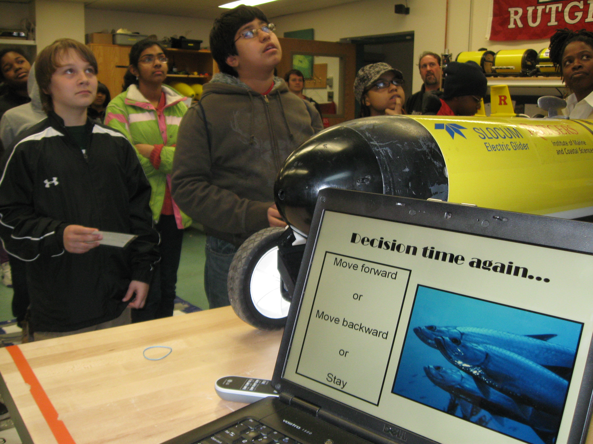
Education & Public Outreach are not the only options for Criterion II:
technology transfer
science policy
developing instrumentation that will benefit your research community
broadening participation in STEM fields
establishing user facilities
Notes:
We can also help you with these?

Slide 6
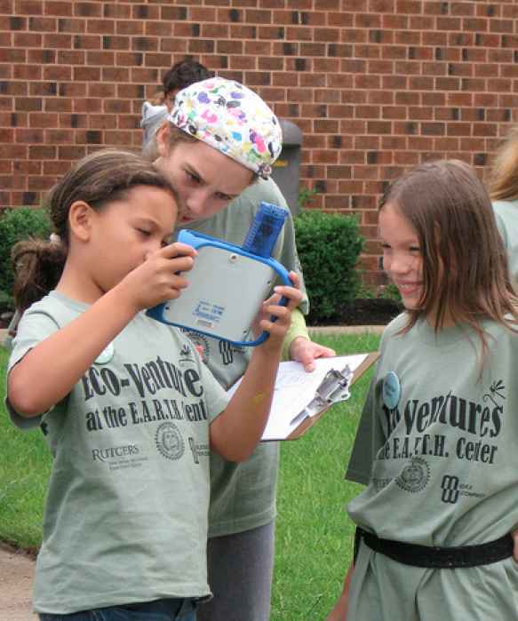
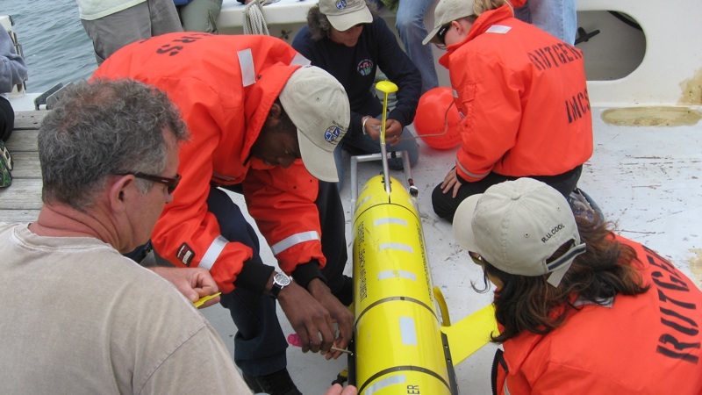
The Importance of Broader Impacts
The 30,000 foot view:
Improve public decision making
Enhance the capability of future generations to develop and use new scientific information and technology
Addressing future workforce issues, including recruiting & retaining higher level graduate students
Notes:
Literate citizens are more capable to understand the options and impacts of their choices
It is not enough to just provide information, you must provide motivation (exciting projects can do this while boring facts cannot)
Proxmire was famous for issuing his Golden Fleece Awards, which identified what he considered wasteful government spending, between 1975 and 1988. While they often resulted in basic research projects being taken out of context,the first was awarded in 1975 to the National Science Foundation, for funding an $84,000 study on why people fall in love. Other Golden Fleece awards over the years were "awarded" to the Justice Department for conducting a study on why prisoners wanted to get out of jail, the National Institute of Mental Health to study a Peruvian brothel ("The researchers said they made repeated visits in the interests of accuracy," reported the New York Times), and the Federal Aviation Administration, for studying "the physical measurements of 432 airline stewardesses, paying special attention to the 'length of the buttocks.'"^{[1]} Proxmire was successful in stopping numerous science and academic projects which were, in his opinion, of dubious value.

Slide 7



The Importance of Broader Impacts
On the ground:
Agencies require Criterion II
Give you an “edge” and improve funding potential
Convince “the people” that your project is worth the investment
(Proxmire’s Golden Fleece Awards)
Notes:
Literate citizens are more capable to understand the options and impacts of their choices
It is not enough to just provide information, you must provide motivation (exciting projects can do this while boring facts cannot)
Proxmire was famous for issuing his Golden Fleece Awards, which identified what he considered wasteful government spending, between 1975 and 1988. While they often resulted in basic research projects being taken out of context,the first was awarded in 1975 to the National Science Foundation, for funding an $84,000 study on why people fall in love. Other Golden Fleece awards over the years were "awarded" to the Justice Department for conducting a study on why prisoners wanted to get out of jail, the National Institute of Mental Health to study a Peruvian brothel ("The researchers said they made repeated visits in the interests of accuracy," reported the New York Times), and the Federal Aviation Administration, for studying "the physical measurements of 432 airline stewardesses, paying special attention to the 'length of the buttocks.'"^{[1]} Proxmire was successful in stopping numerous science and academic projects which were, in his opinion, of dubious value.

Slide 8


Scientist’s Concerns about Criterion II
It is unclear what is required
It will take too much time & money

Slide 9

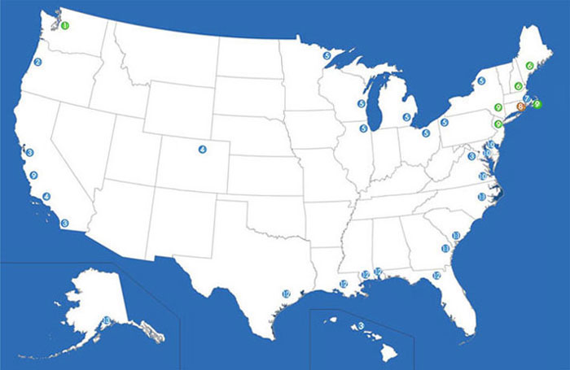
Centers for Ocean Sciences Education Excellence (COSEE)
Mission: To spark and nurture collaborations among research scientists and educators to advance ocean discovery and make known the vital role of the ocean in our lives.

Slide 10
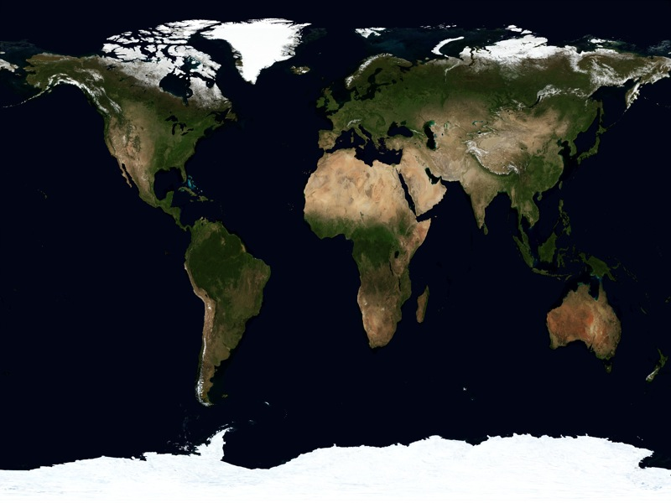

COSEE - Networked Ocean World (NOW)
Lead Institutions
Rutgers
WHOI
Liberty Science Center
VIMS
University of South Florida
Monterey Peninsula College
Word Craft
and a Global Distributed Group of Partner Scientists
COSEE NOW is focused on:
l assessing the knowledge & needs of Ocean Observing Systems (OOS) audiences
l improve collaboration & coordination between scientists and educators
l increase public awareness of OOS in order to improve society’s ocean literacy

Slide 11

Scientists
COSEENOW.net
Educators
Notes:
Our work is focused on developing collaborative relationships among scientists and informal educators to address public education on topics such as climate change. COSEE NOW is using online webinars, blogs, and chats to share ideas, build skills, and foster the collaborative development of educational products for informal and formal learning institutions, like science centers and schools.

Slide 12

Leveraging & Partnerships
Find a science educator/professional to advise and help execute your project.
“Effective partnerships result when ideas are shared, each partner’s expertise is respected, and both scientist and educator work toward the common goal of delivering high-quality products and services to the intended audience”.

Slide 13
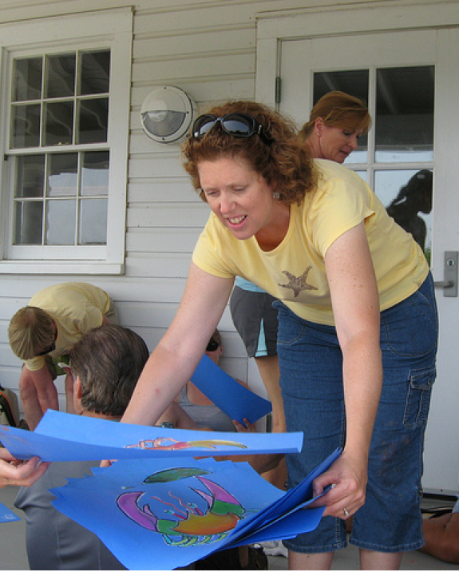
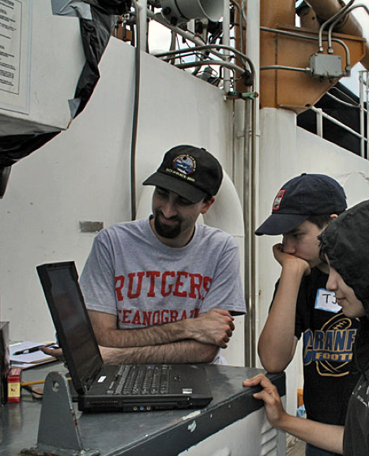
Interdisciplinary Team
Education specialist with a background in biological oceanography
Data visualization and technology specialist with a background in physical oceanography
GPO alum working on science content and curriculum design

Slide 14

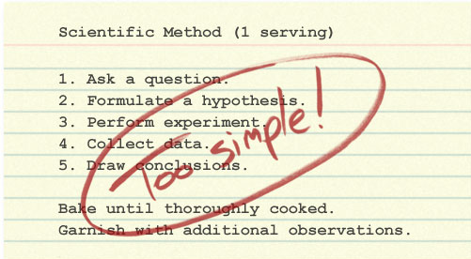
What can we cook up for you?

Slide 15


Logic Models

Slide 16
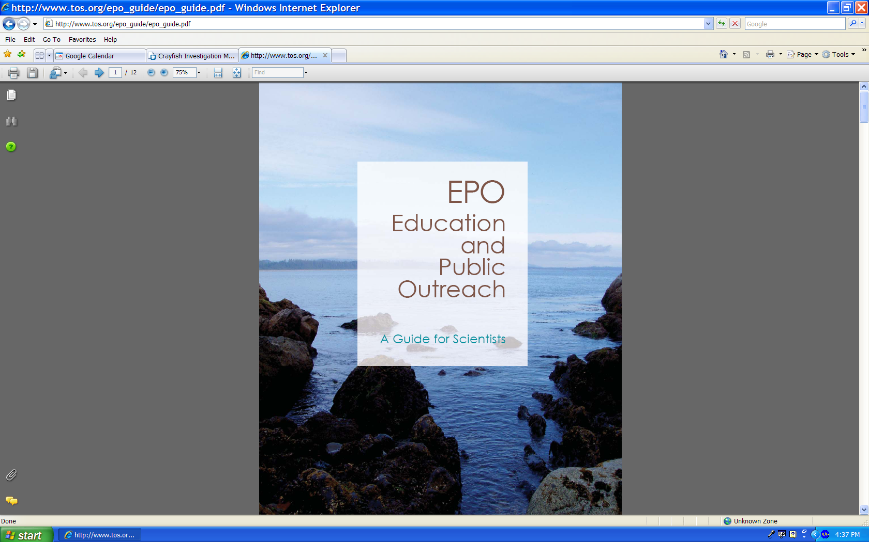
COSEE NOW Support with NSF Criterion II
Our recommendations for success:
1. Open with core objective (who and why)
2. Link to major “educational player/partner” already involved in your aforementioned “who and why”
3. Relate to educational literature – how are you contributing to education needs of your target audience?
4. Close with evaluation plan – how will you know you are successful.
5. Please have a budget for your proposed work.

Slide 17

1. Open with Core Objective: Who is involved and Why
Ocean literacy is an understanding of the oceans influence on you and your influence on the ocean.

Slide 18
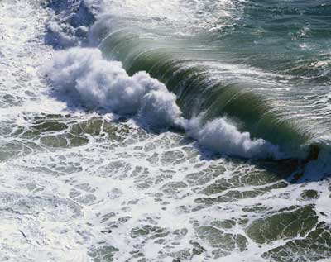
An ocean-literate person can communicate about the oceans in a meaningful way

Slide 19
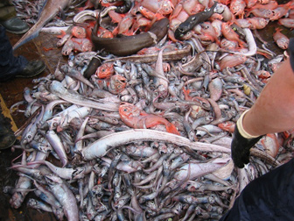
…is able to make informed and responsible decisions regarding the oceans and its resources.

Slide 20
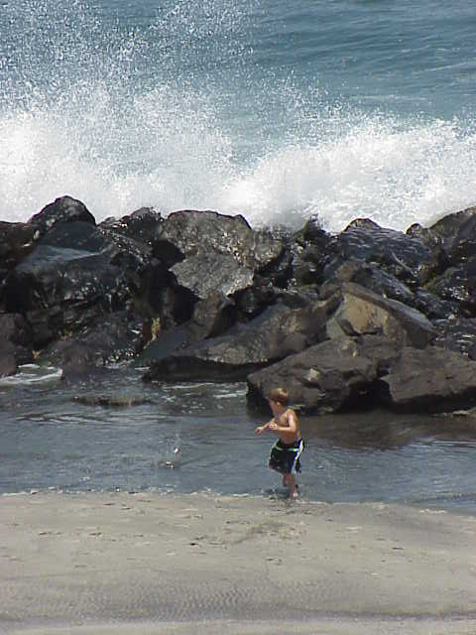
Essential Principles
1. Earth has one big ocean with many features.
2. The ocean and life in the ocean shape the features of Earth.
3. The ocean is a major influence on weather and climate.
4. The ocean makes Earth habitable.
5. The ocean supports a great diversity of life and ecosystems.
6. The ocean and humans are inextricably linked.
7. The ocean is largely unexplored.

Slide 21
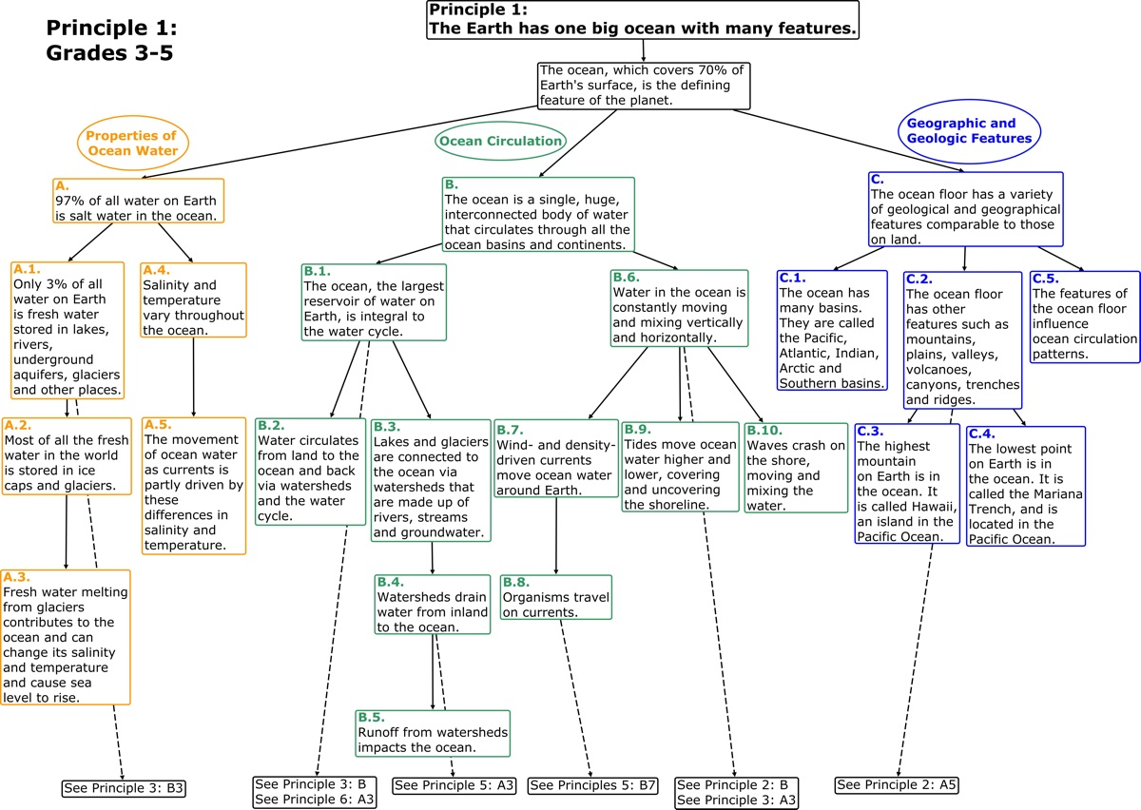

Slide 22
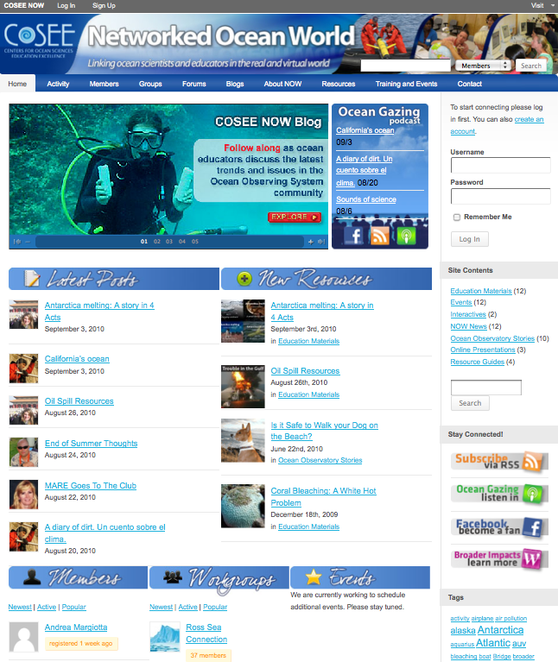
2. Link to a major educational partner

Slide 23
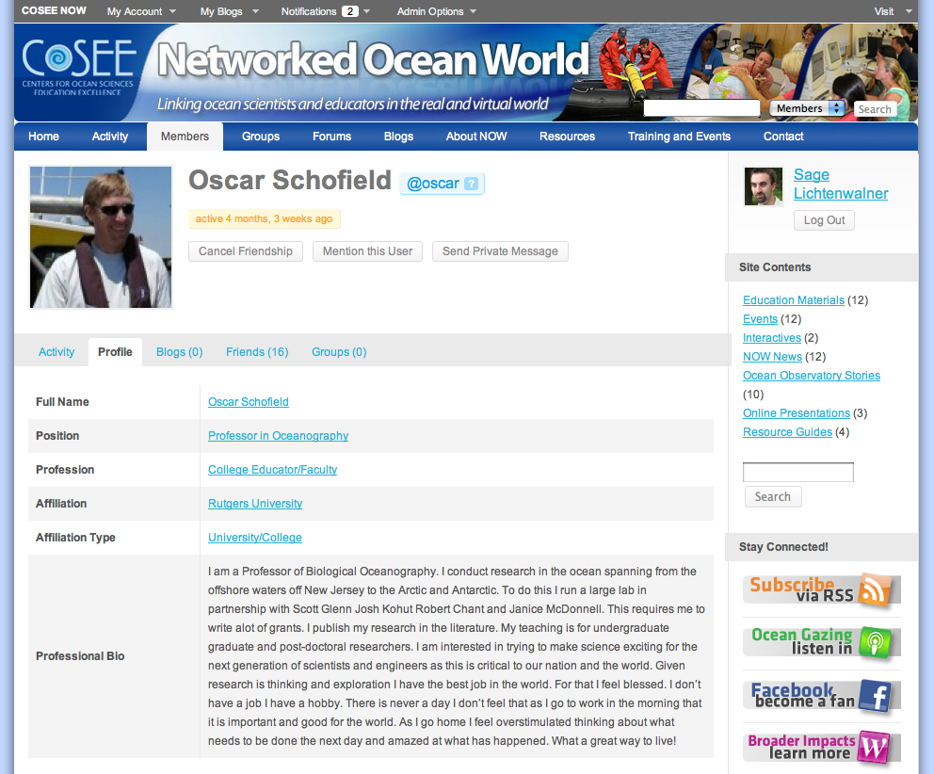
Build a Profile and Get Connected
Friend Tools
Search member profiles
Send private messages
Status updates & link sharing

Slide 24
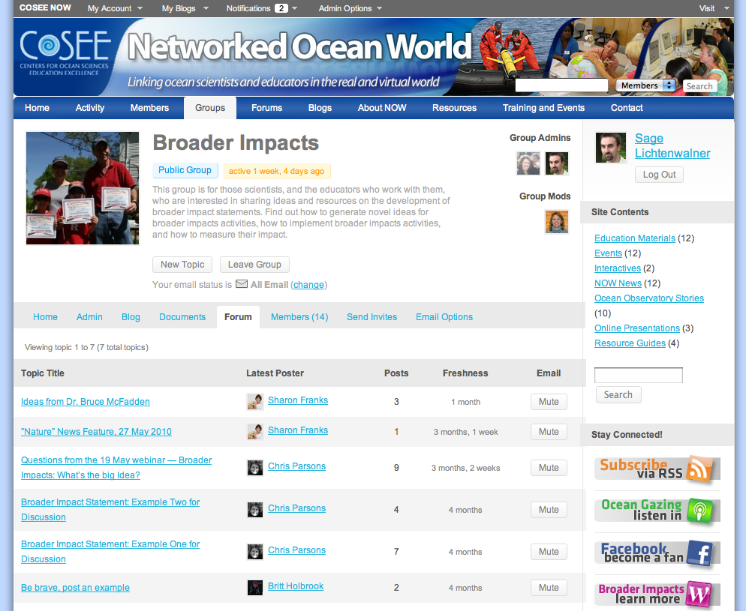
Collaborative Community Workgroups
Create your own groups to fit your needs
Workgroup Features
Find colleagues with similar interests
Partake in collaborative discussions (forums)
Host a community blog
Send broadcast messages
Document Library

Slide 25
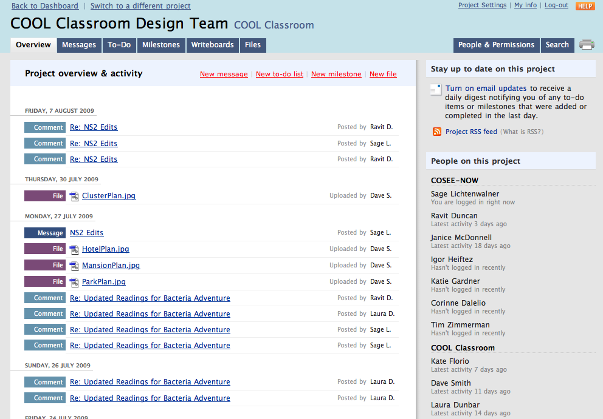
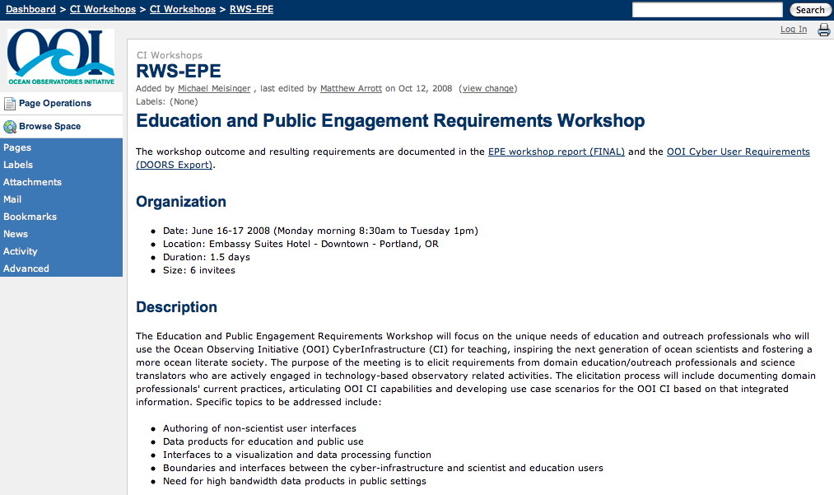
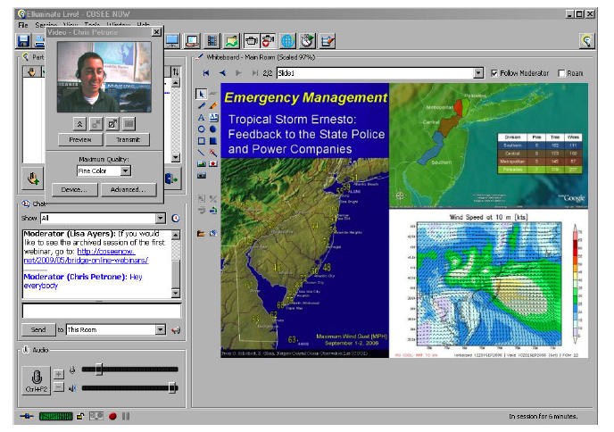
Additional Collaboration Tools
Project Management
Collaborative Editing (Wikis)
Virtual Meetings

Slide 26
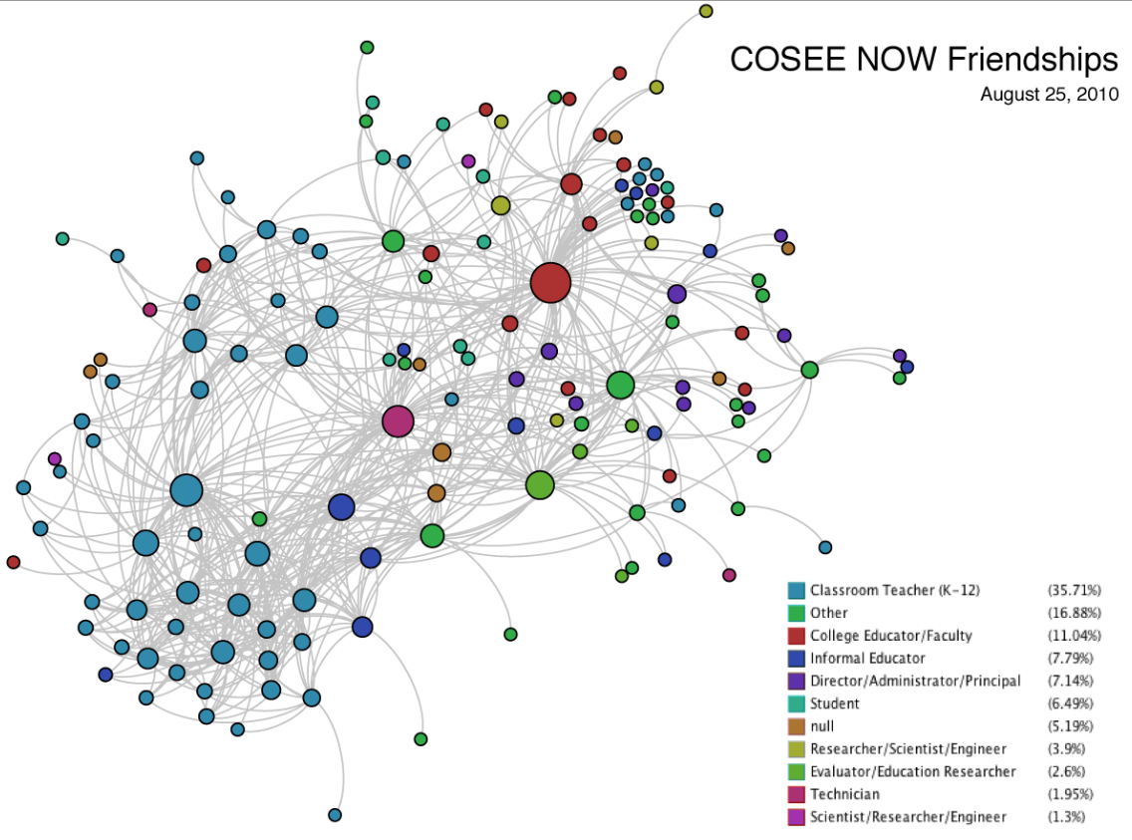

Slide 27
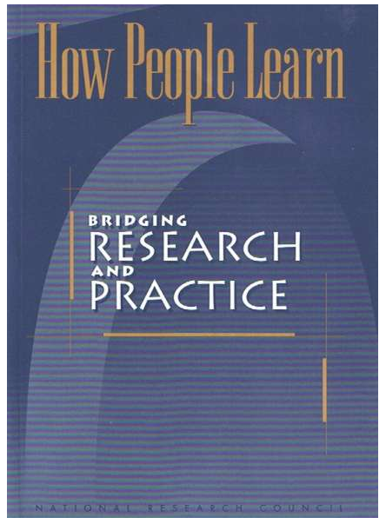
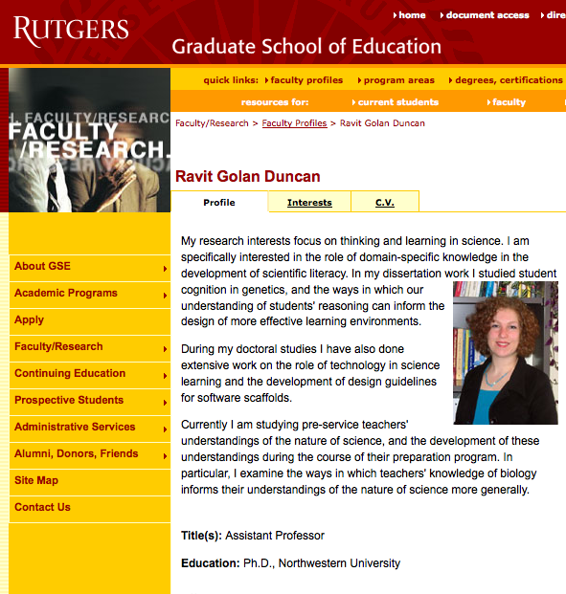

3. Relate to educational literature

Slide 28
4. Close with evaluation plan – how will you know you are successful?
Choose BI
Summative
Eval
Front-end
Eval
Do BI Project
Plan BI Project
(incl.
Evaluation)
Design/Develop
BI Project
Formative
Eval
Formative
Eval

Slide 29
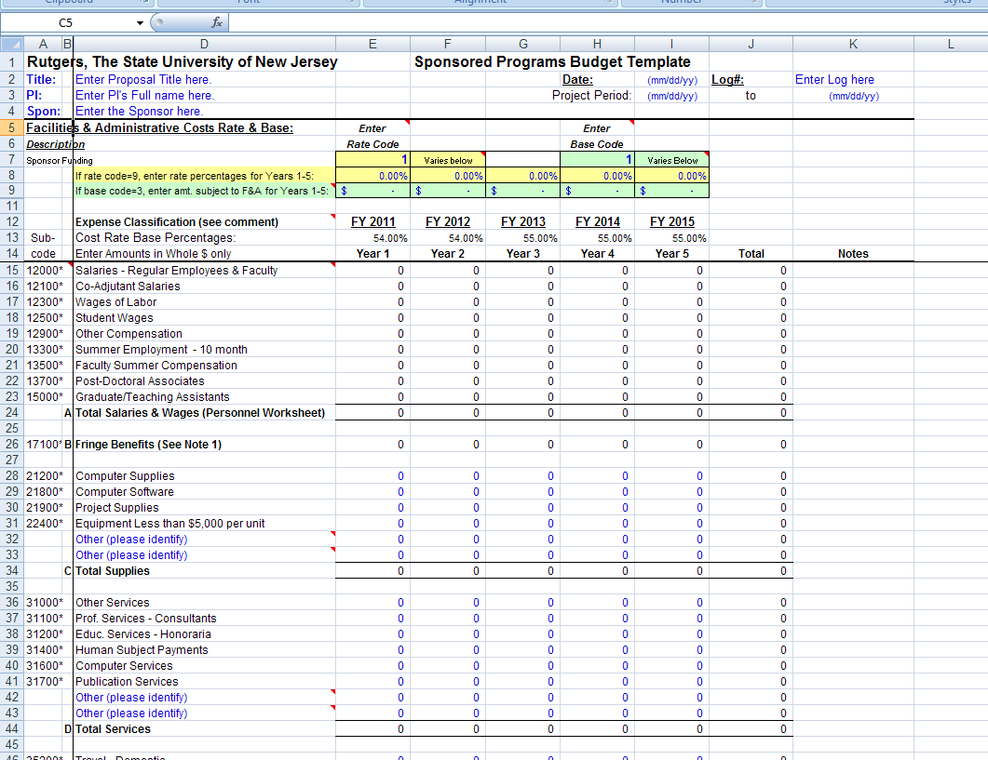

5. Have a budget for your proposed work.

Slide 30
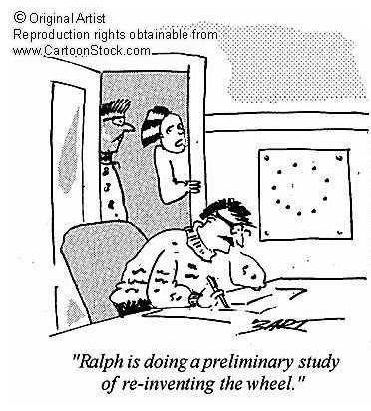
Don’t reinvent the wheel -- leverage existing infrastructure and relationships

Slide 31
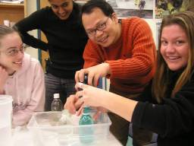
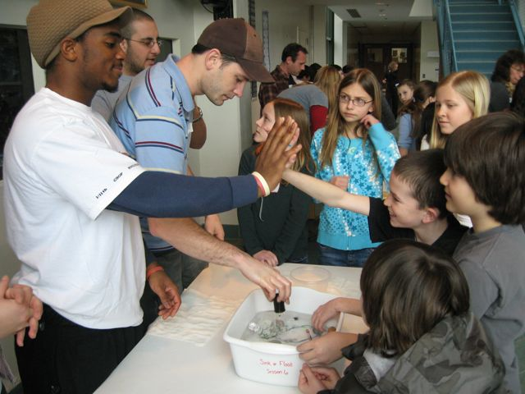
Serving as a science specialist
Mentor a student for a science fair project.
Host an educator or student in your lab, on a cruise, or in the field.
Serve on an EPO-oriented advisory or review panel.
Be a scientist-in-residence at a school, science center, museum, or aquarium

Slide 32

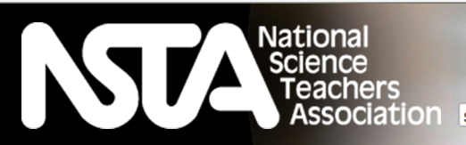


Connect with National Education Programs

Slide 33


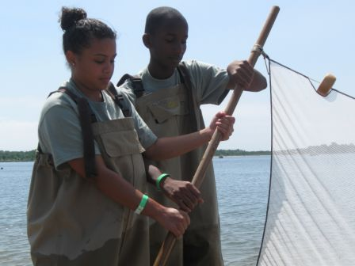
Work with programs that broaden participation of underrepresented groups

Slide 34

Public Lectures at Liberty Science Center

Slide 35
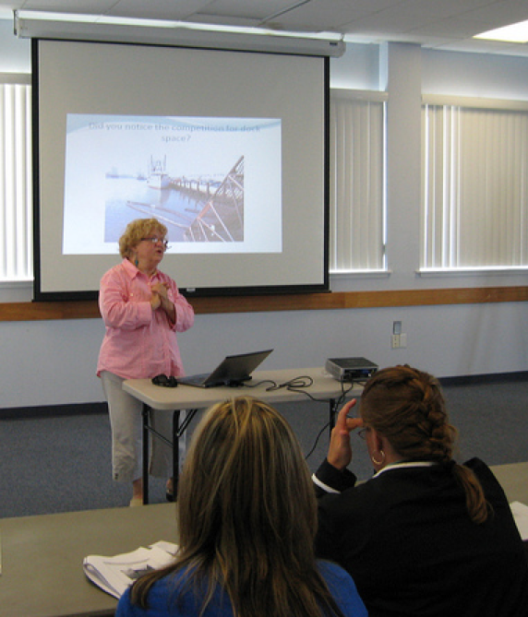
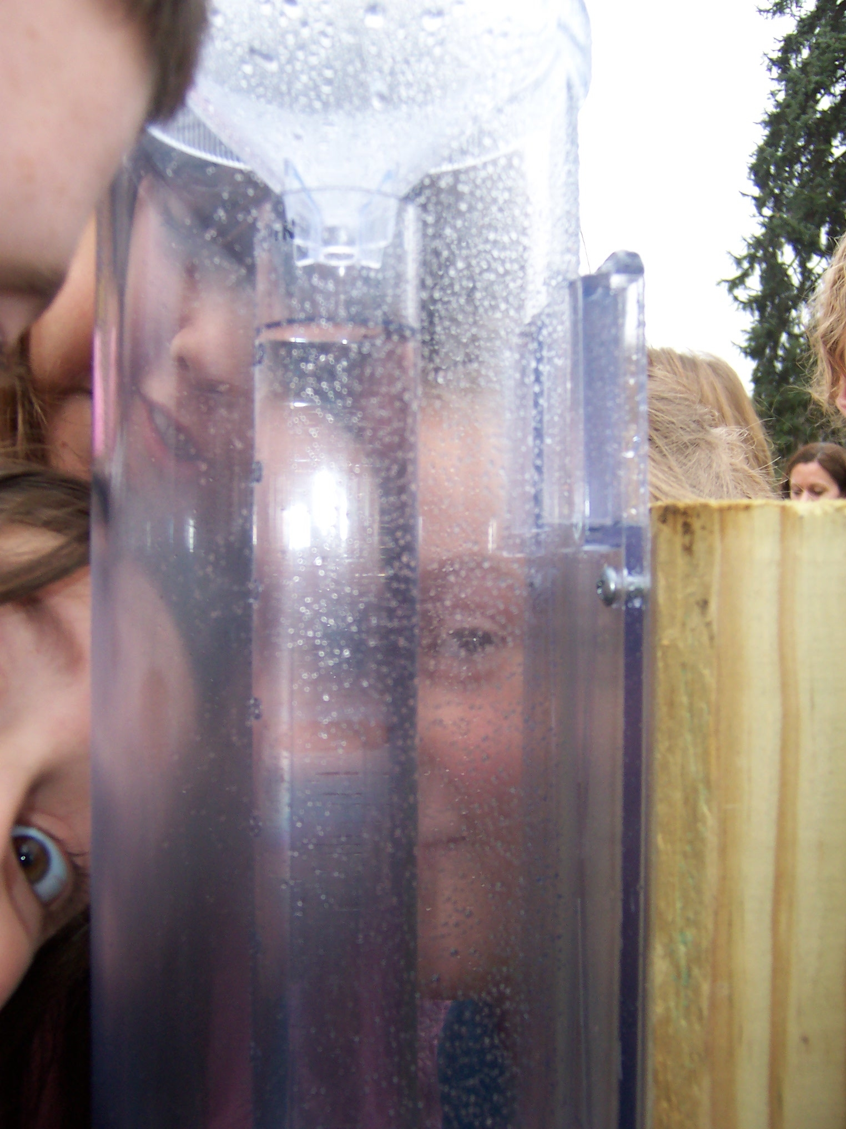
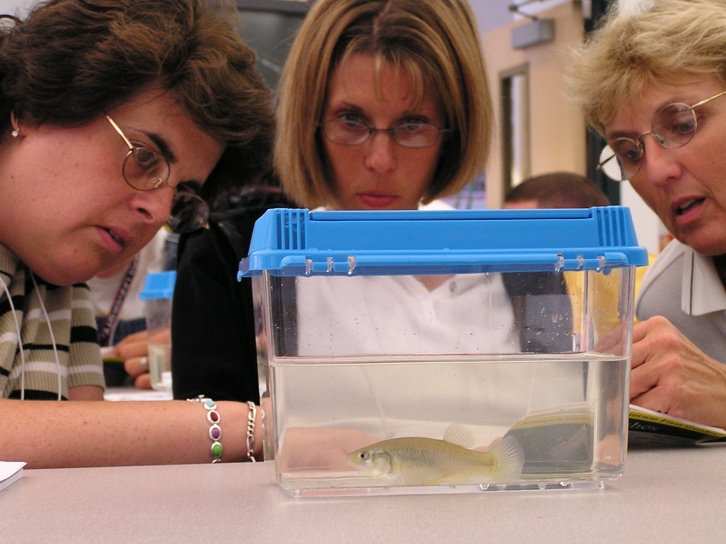
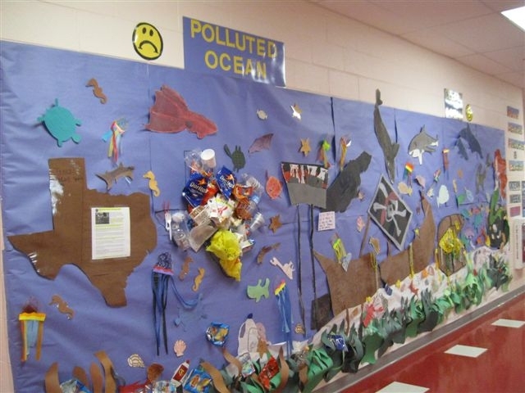
MARE: Marine Activities, Resources & Education

Slide 36

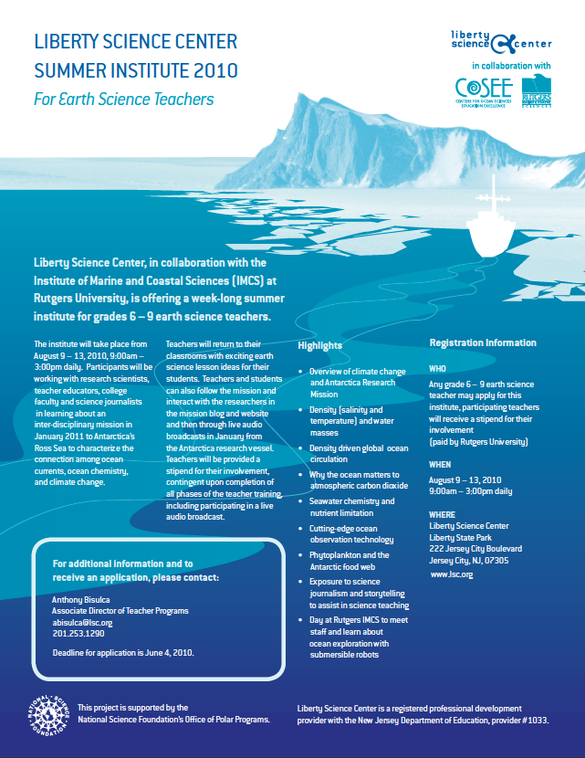
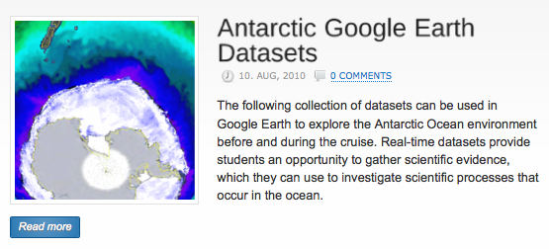
Professional Development/Webinars

Slide 37
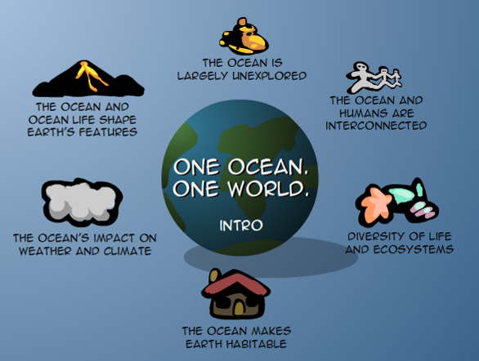
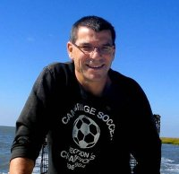
Develop an EPO product.
Be a content expert on a curriculum-development team.
Create visualizations tailored for classroom or educational program use.

Slide 38
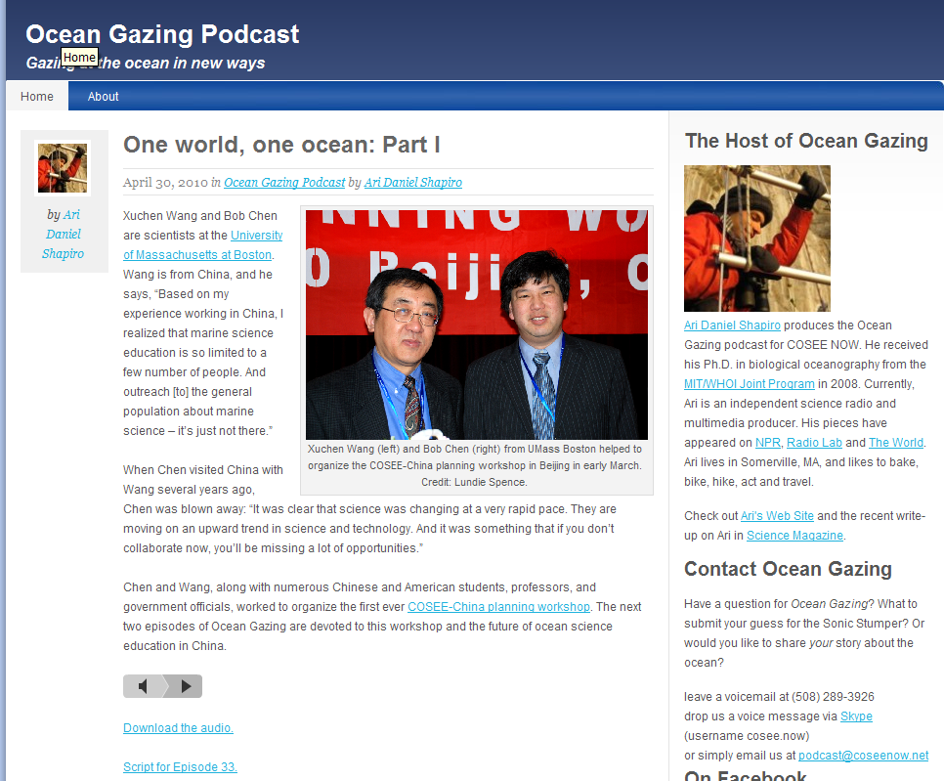
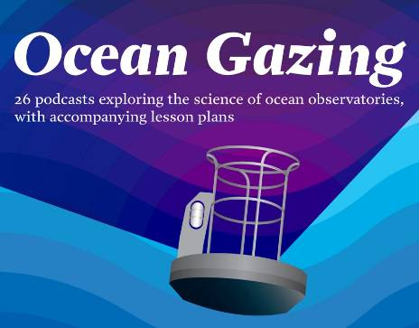
Podcasts
Notes:
Out there and can be found via the website (www.oceangazing.org), Facebook page, iTunes presence, and links from other university and research group websites to advertise, promote and post the podcast materials.
Used by schools competing in ocean science academic bowls
Over 200 downloads per episode

Slide 39
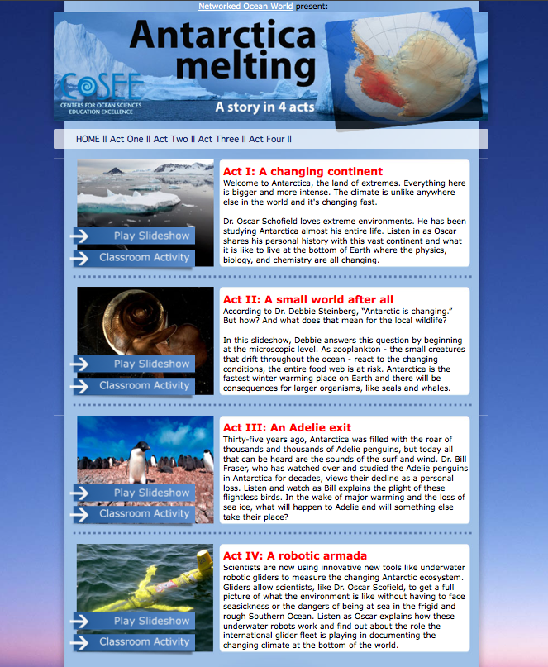
Website
Resources
Notes:
Can also be used in this format
Play example

Slide 40
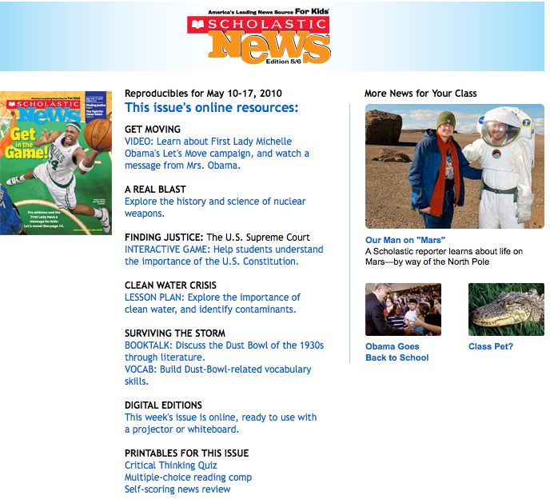
Journals and Popular Media
Get published in a different type of journal

Slide 41
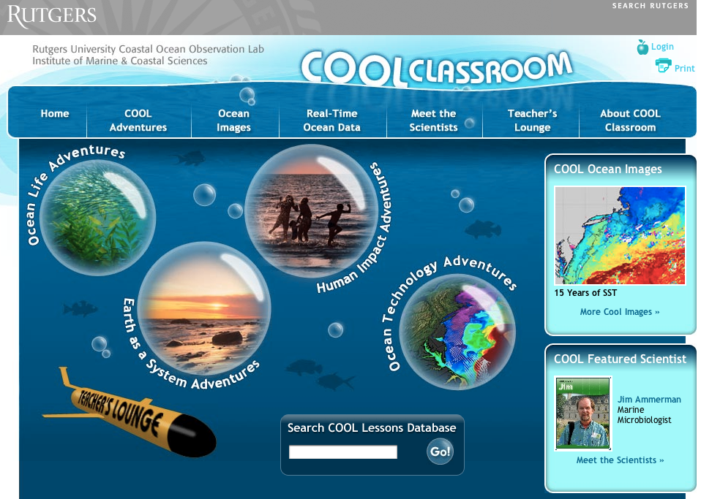

Slide 42
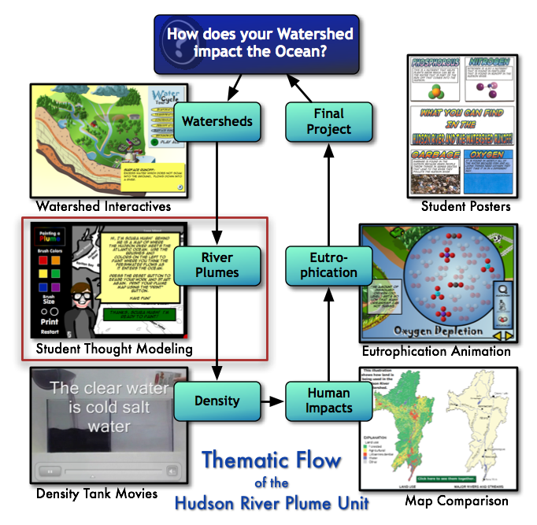

Slide 43
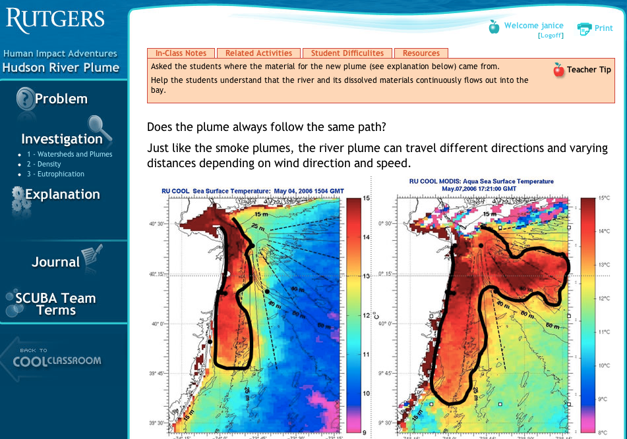

Slide 44
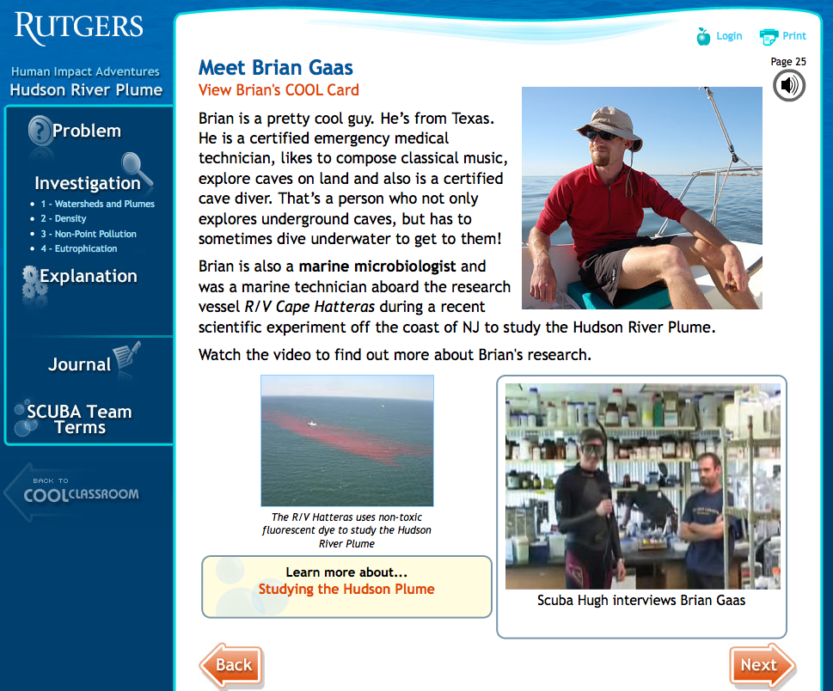

Slide 45







We have friends who can also help: COSEE NOW (Networked Ocean World)

Slide 46
Questions?

Slide 47
Thank you!

Slide 48
Why did NSF institute the broader impacts merit review requirement?
a) To make researchers’ lives more difficult.
b) To help the NSF justify to Congress how their money is
used.
c) To make researchers aware that they have responsibilities
beyond producing Science and Nature papers.
d) To provide a fast, easy, check-off list that will streamline
proposal review.
e) Broader Impacts are important to the overall survival of
the research enterprise
The Broader Impacts ‘Cosmo Quiz’ by Diandra L. Leslie-Pelecky

Slide 49
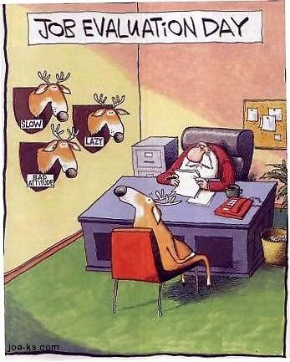
What is Evaluation?
Copyright joe-ks
http://www.joe-ks.com/archives_dec2003/SantaJobEvaluation.htm

