Slide 1
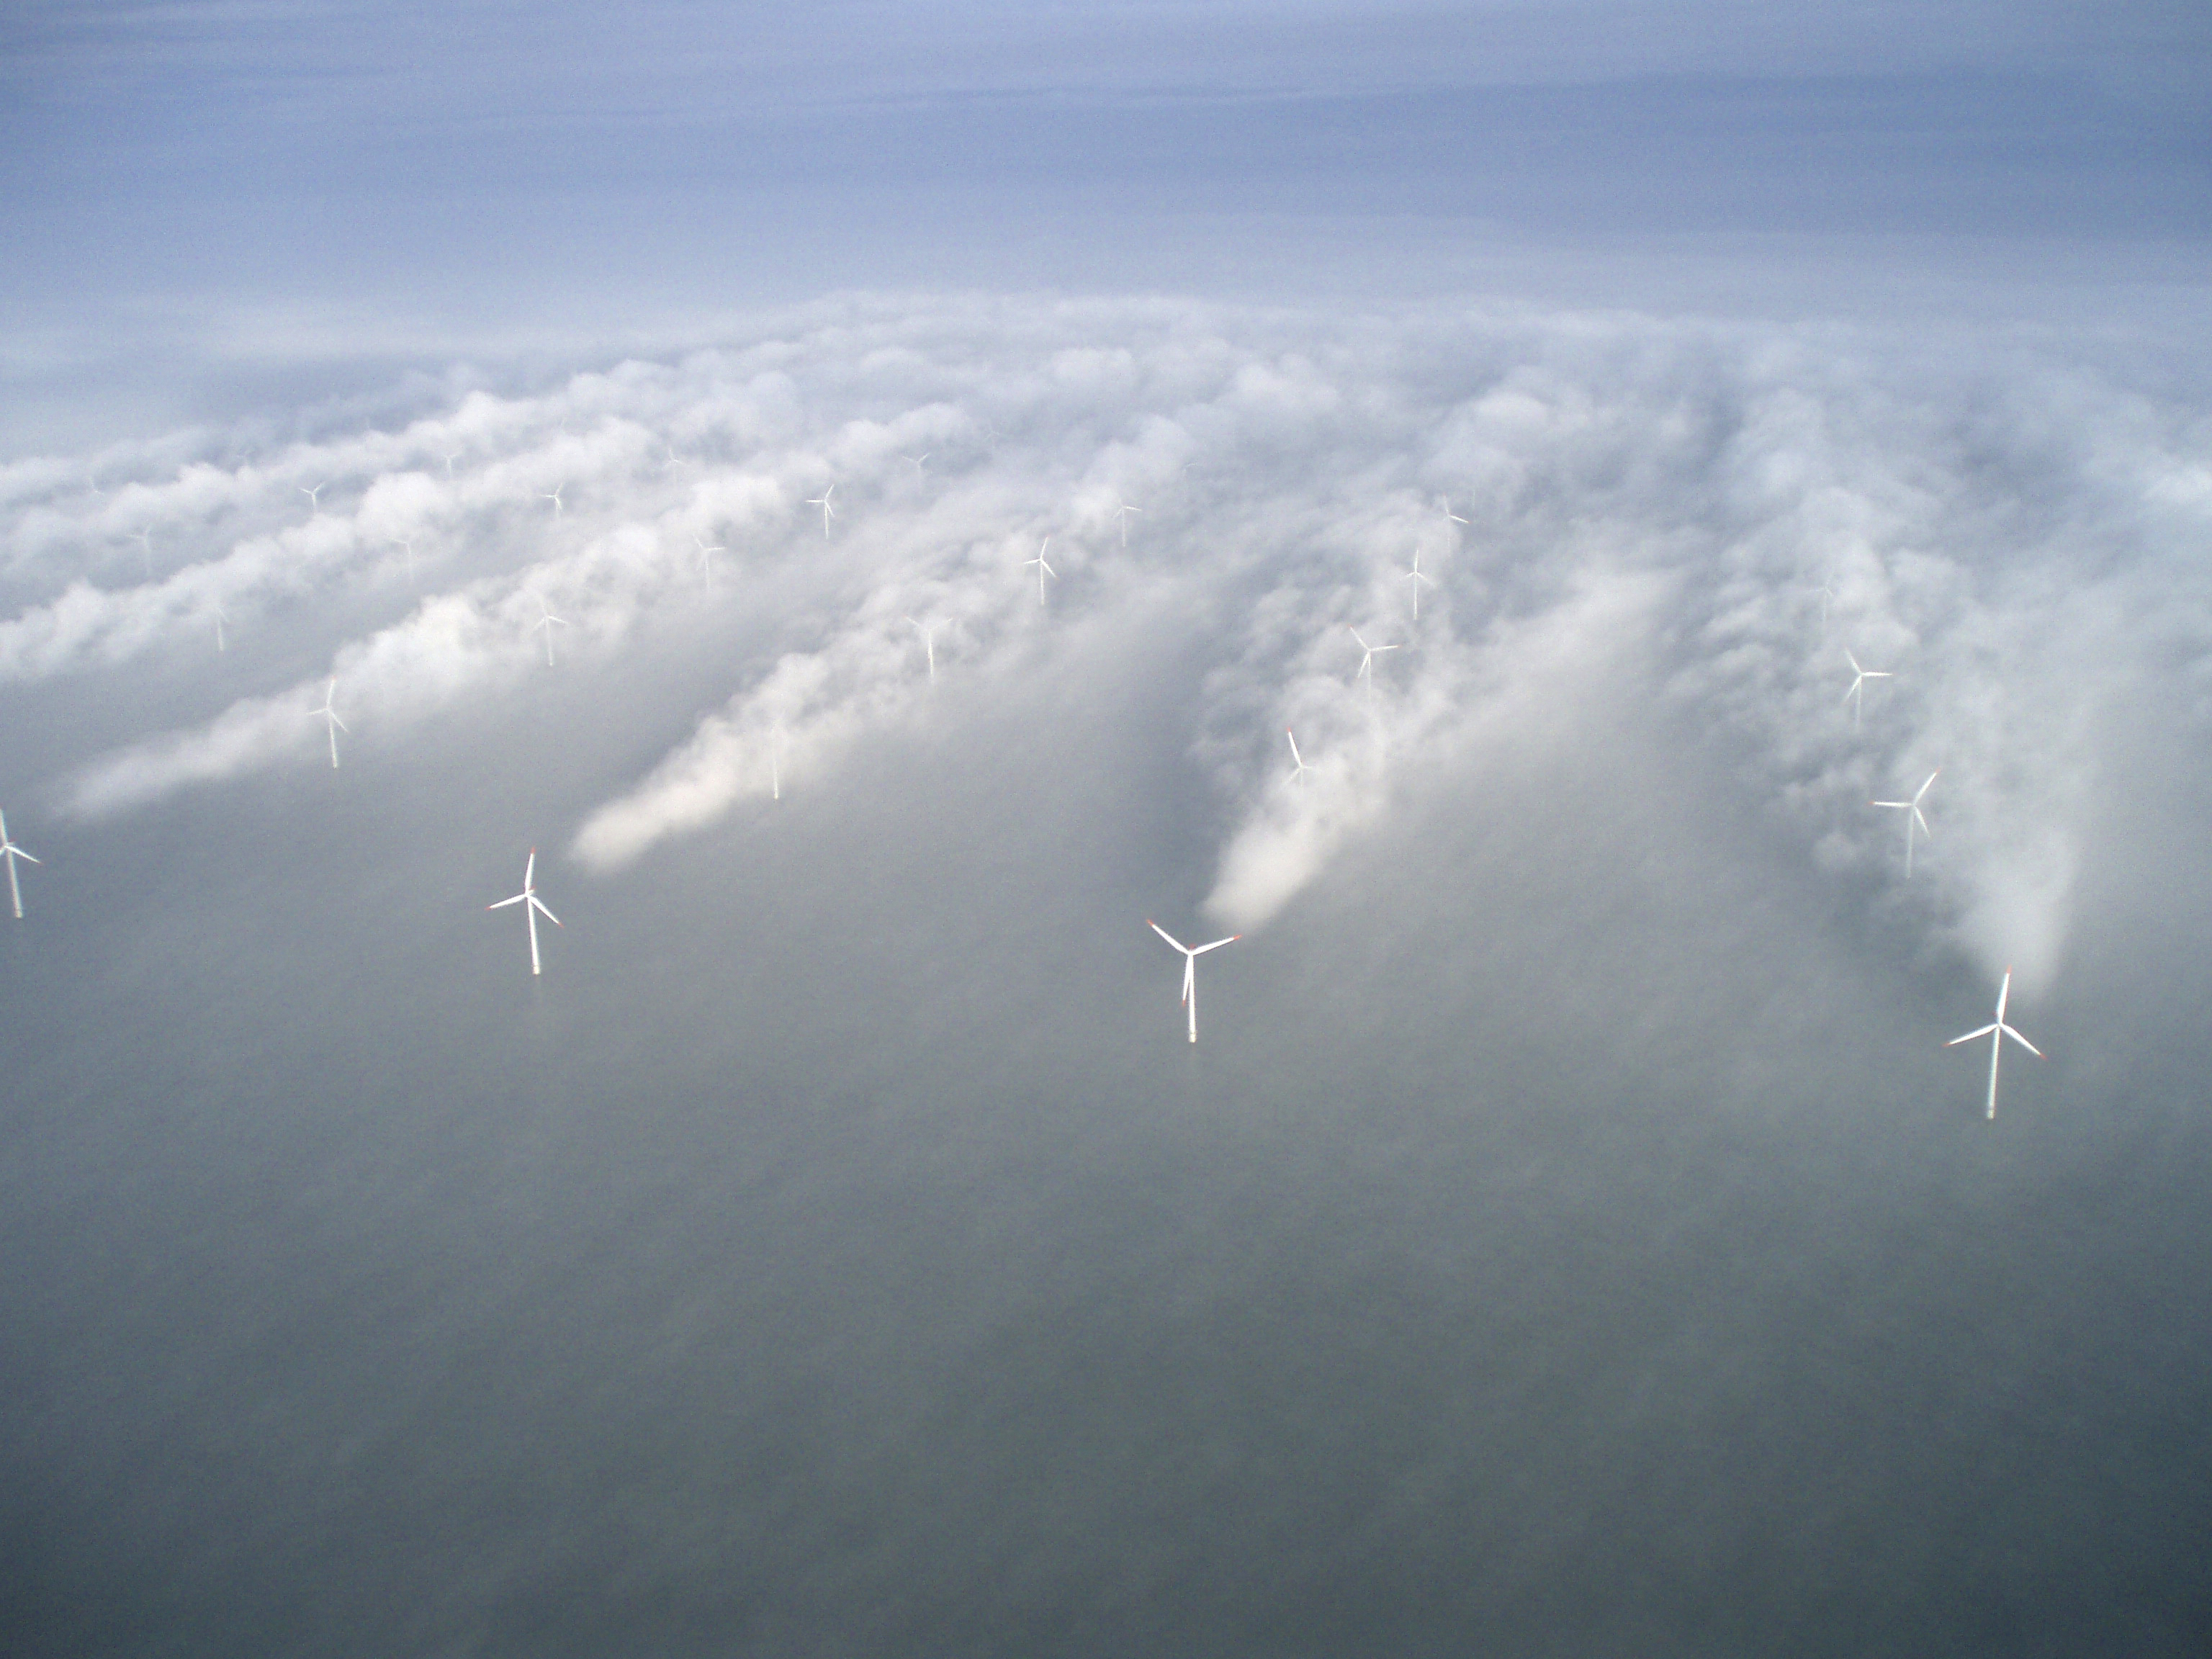



Exploring Offshore Wind Energy:
Why is it important and what is being done at Rutgers?
Greg Seroka
NJ Governor’s School: Energy and
Sustainability Course
July 10, 2012

Slide 2
Renewable Energy, Non-fuels
Obama: 20% renewable by 2030
Diversified energy solution critical for success
Renewable energy sources (non-fuel):
  Hydropower
  Geothermal
  Solar (variable)
  Wind (variable)
Compare to coal, oil, natural gas, and nuclear
Notes:
-not only renewable, but clean (green) energy solutions (lessen emissions, better for environment and for climate change)

Slide 3
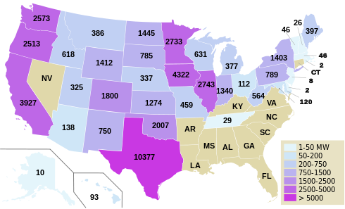
Installed U.S. Wind Capacity
(as of end 2011)
Notes:
-All “on-land” wind farms
-Two existing NJ facilities: Jersey Atlantic Wind Farm in Atlantic City (first coastal wind farm in US, 2005, five turbines)
Bayonne Municipal Utilities Authority (south of NYC, operational in late June 2012, one turbine)

Slide 4
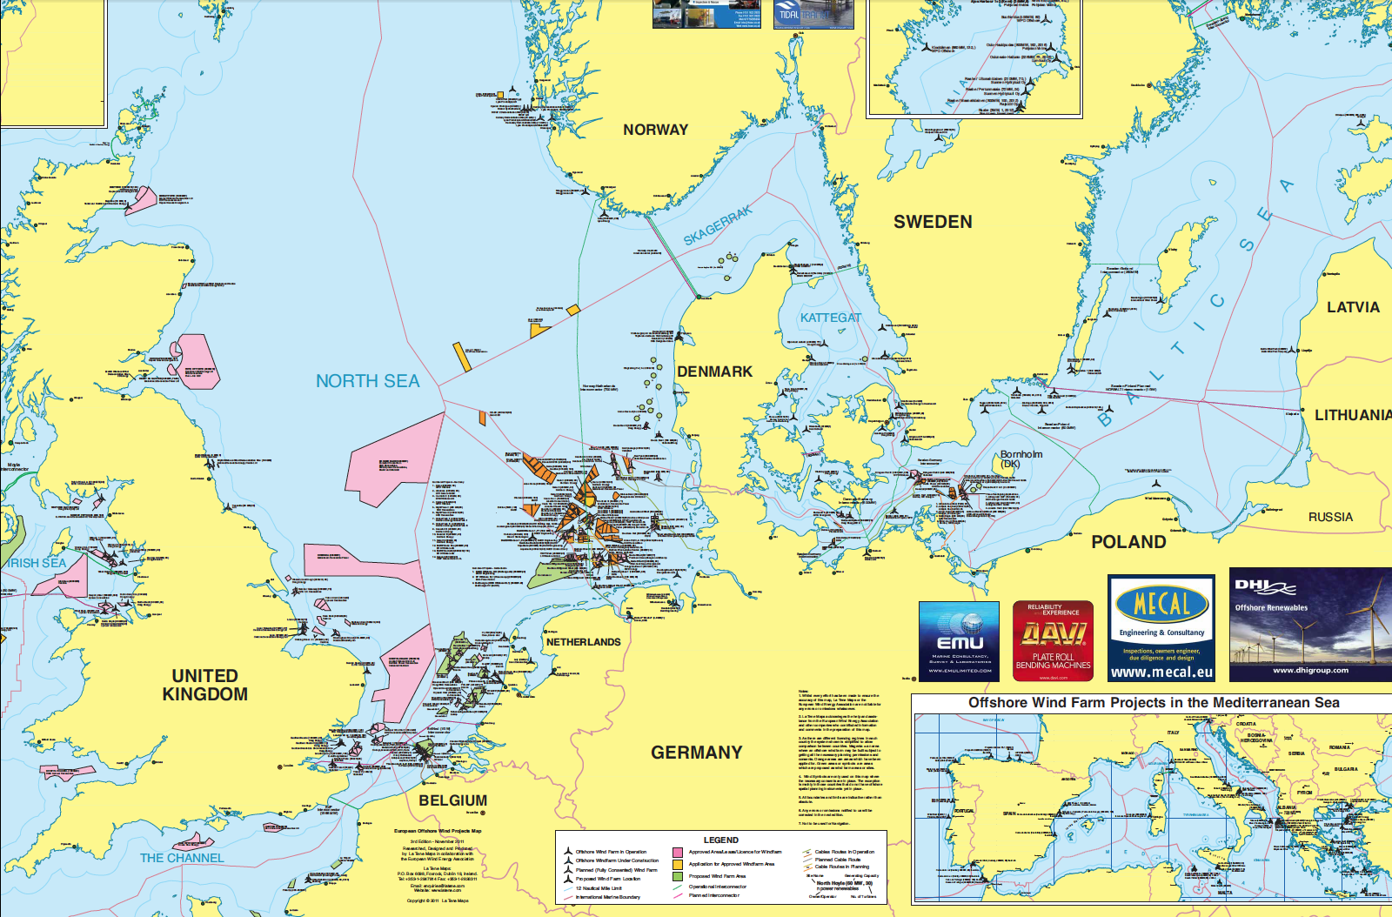
Current US Status and Future Needs
To achieve 20% renewable by 2030, expansion is obvious and needed (currently, 14.6%)
Northern Europe has over 50 offshore wind farms, while U.S. has ZERO
Notes:
Currently over 50 offshore wind farms in northern Europe… zero in US

Slide 5
Why will offshore wind be an area of growth for US?
More wind power potential offshore than onshore
Notes:
-less friction, more wind, more consistent wind

Slide 6
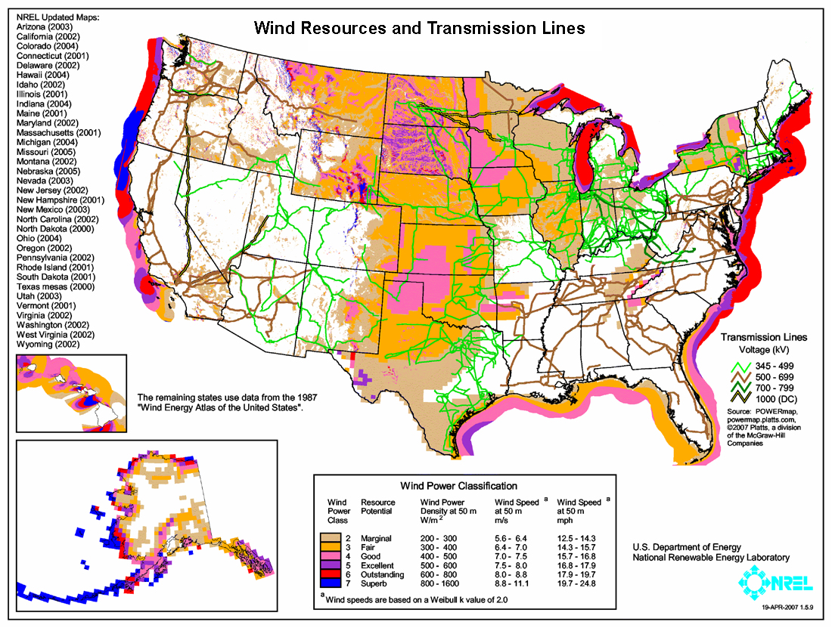
U.S. Wind Resource Potential
Notes:
-less friction, more wind, more consistent wind

Slide 7
Why will offshore wind be an area of growth for US?
More wind power potential offshore than onshore
Closer to population centers (coastal cities)
  Less transmission needed
US energy security
Growth esp. along East Coast because:
  Proximity to I95 corridor
  Shallow waters
Notes:
-closer to population centers- compare to Midwest- less transmission of power needed b/c of less distance
-East coast particularly likely for offshore wind growth due to close proximity to I95 corridor and shallow waters (floating turbines, which are still in research phase, would be needed in deeper West Coast waters)

Slide 8
National Renewable Energy Lab (NREL)
Map of Transformation of the Electric Sector:
  http://rpm.nrel.gov/refhighre/expansion/expansion.html
Notes:
-current proposed offshore wind projects in US: Cape Wind (MA), Block Island (RI), New Jersey* (e.g. Fishermen’s state waters, OffshoreMW, enXco, GSOE federal waters)

Slide 9
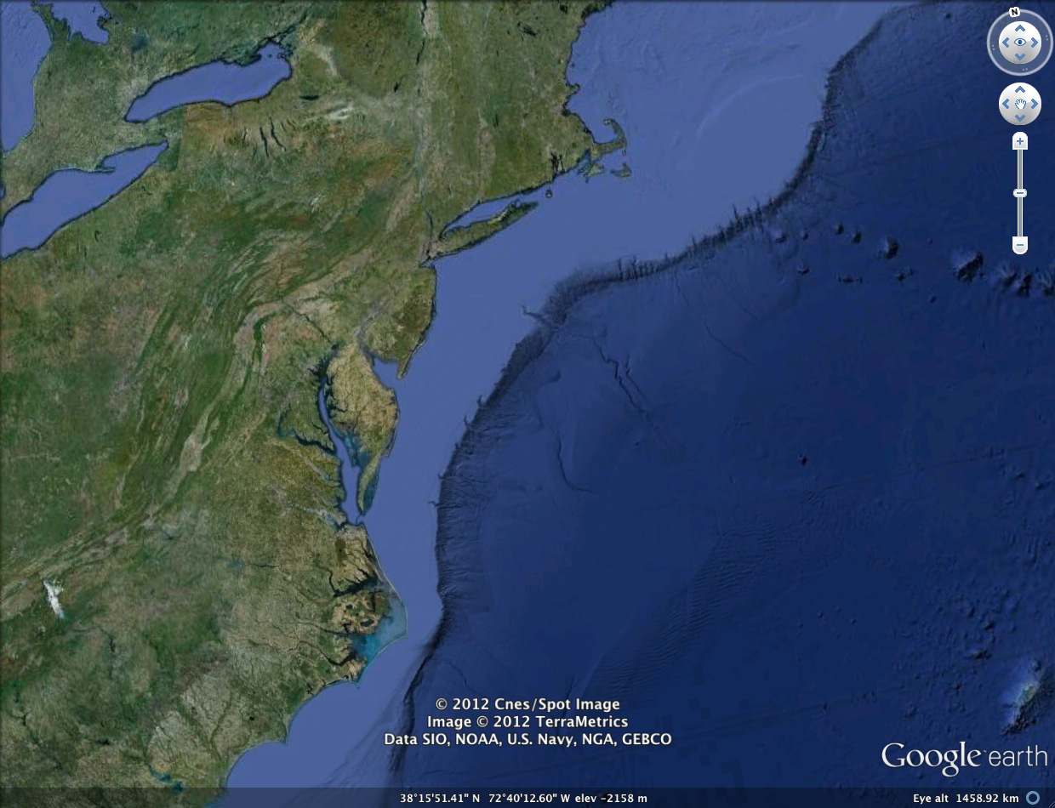
Why New Jersey?
State government support
  Offshore Wind Economic Development Act (2010), ORECS
Continental shelf (shallow waters)
Good wind resource
Notes:
-New Jersey* (e.g. Fishermen’s state waters, OffshoreMW, enXco, GSOE federal waters)
-state government support: Offshore Wind Economic Development Act (2010, signed by Gov. Chris Christie): up to $100 million in ratepayer-funded subsidies for offshore wind development connected to New Jersey’s grid
-ORECS: subsidies only awarded after projects meet cost/benefit criteria and produce and deliver renewable energy
-Many experts consider New Jersey’s offshore wind program to be the most well-conceived state policy initiative in the nation
-however, as stated before, wind (and solar) power is a variable renewable energy source- need to understand when, where, how often variability occurs (characterize, quantify major sources of variability, e.g. sea breeze occurring during peak energy demand season)

Slide 10
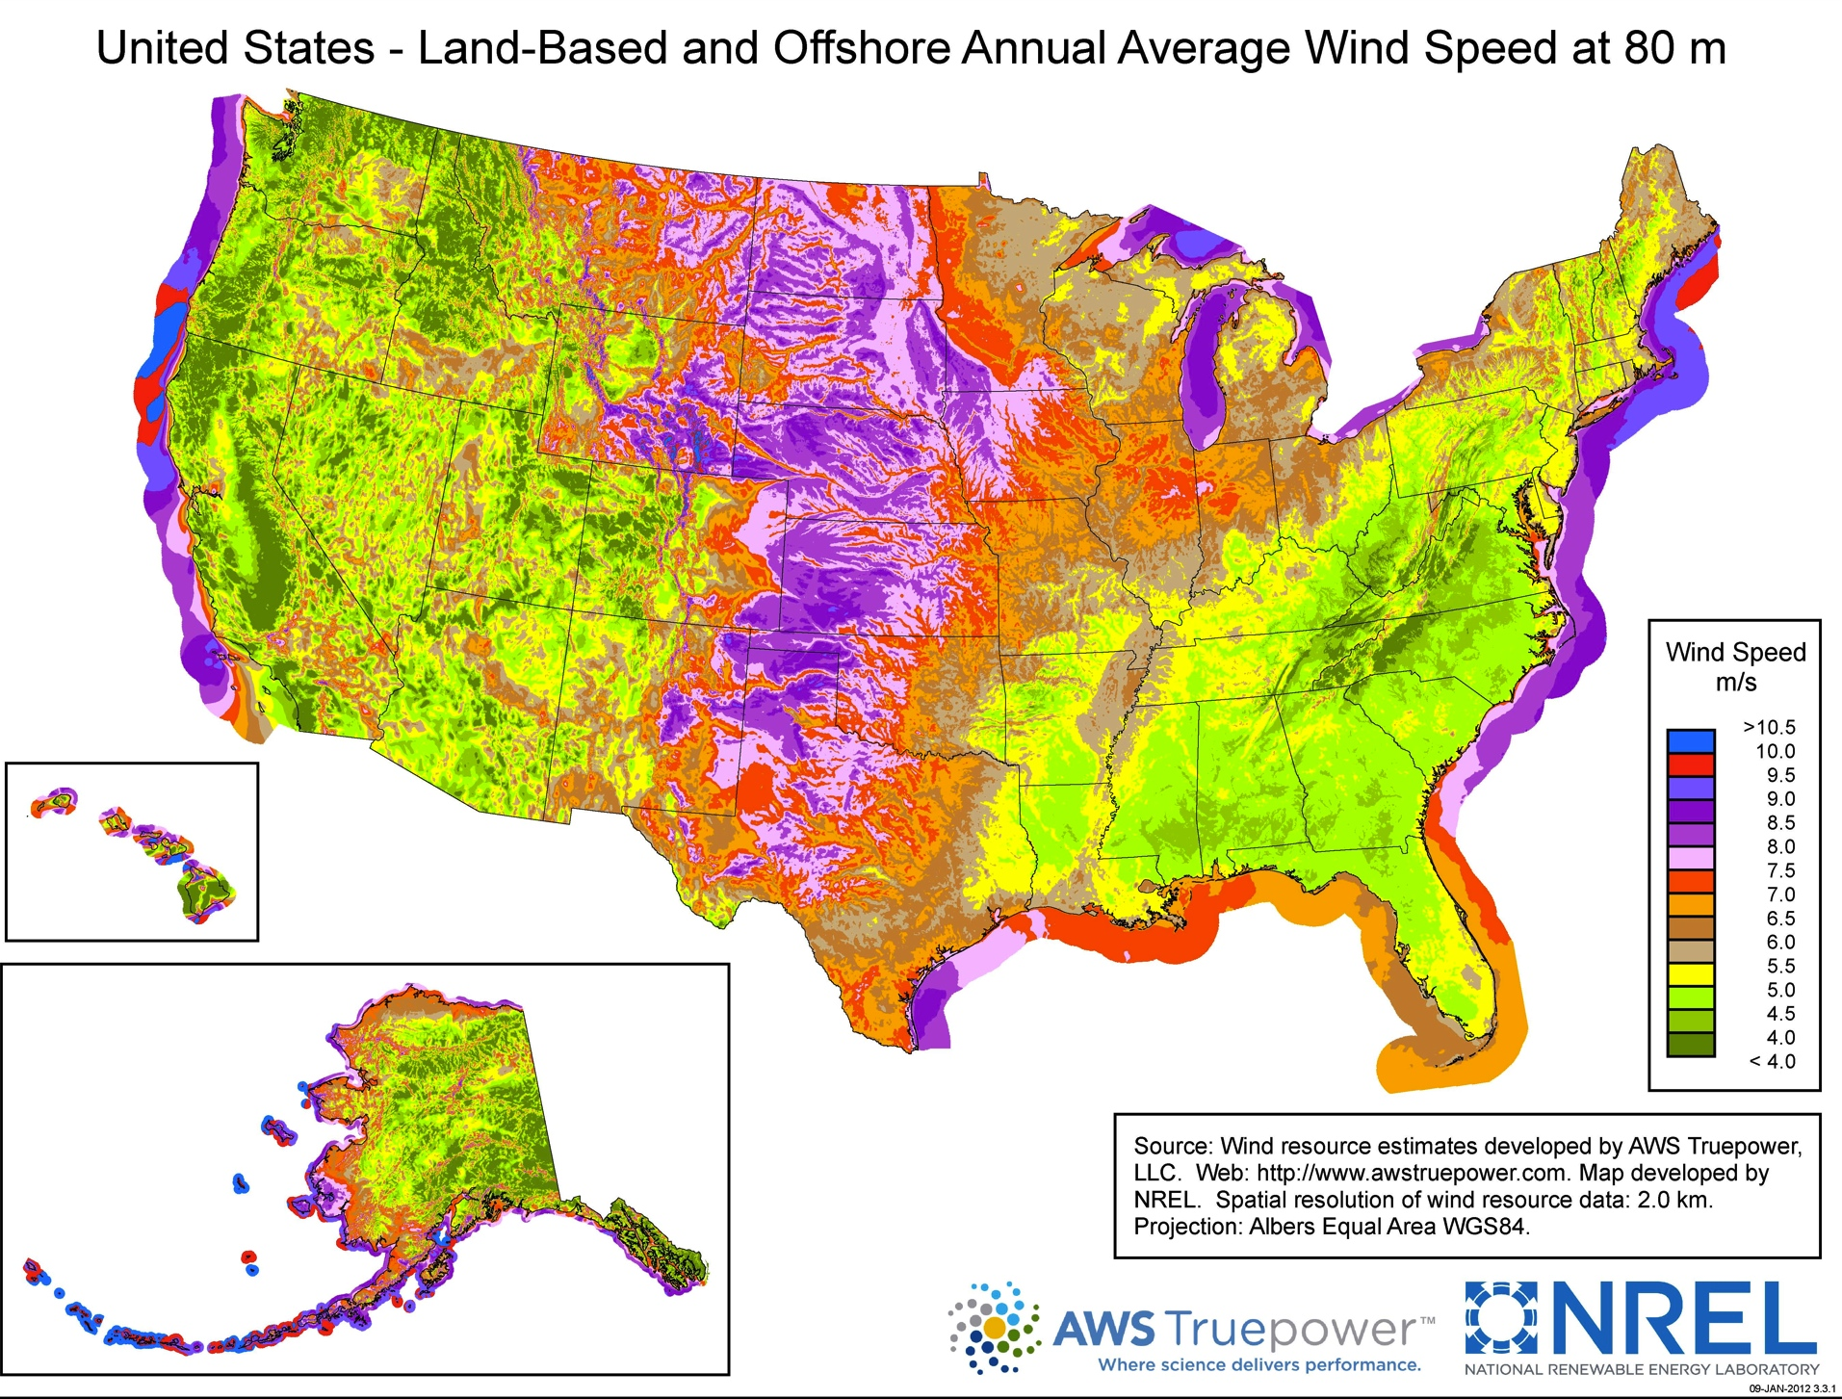
Notes:
-annual average! Smooths out any temporal variation!
-however, as stated before, wind (and solar) power is a variable renewable energy source- need to understand when, where, how often variability occurs (characterize, quantify major sources of variability, e.g. sea breeze occurring during peak energy demand season)

Slide 11
Wind Variability
Wind (and solar) are variable renewable energy (VRE) sources
  Non-fuel, no storing (still in research phase)
Critical to understand, characterize, and quantify major sources of variability
Scarce oceanic observations limit efforts toward this goal

Slide 12
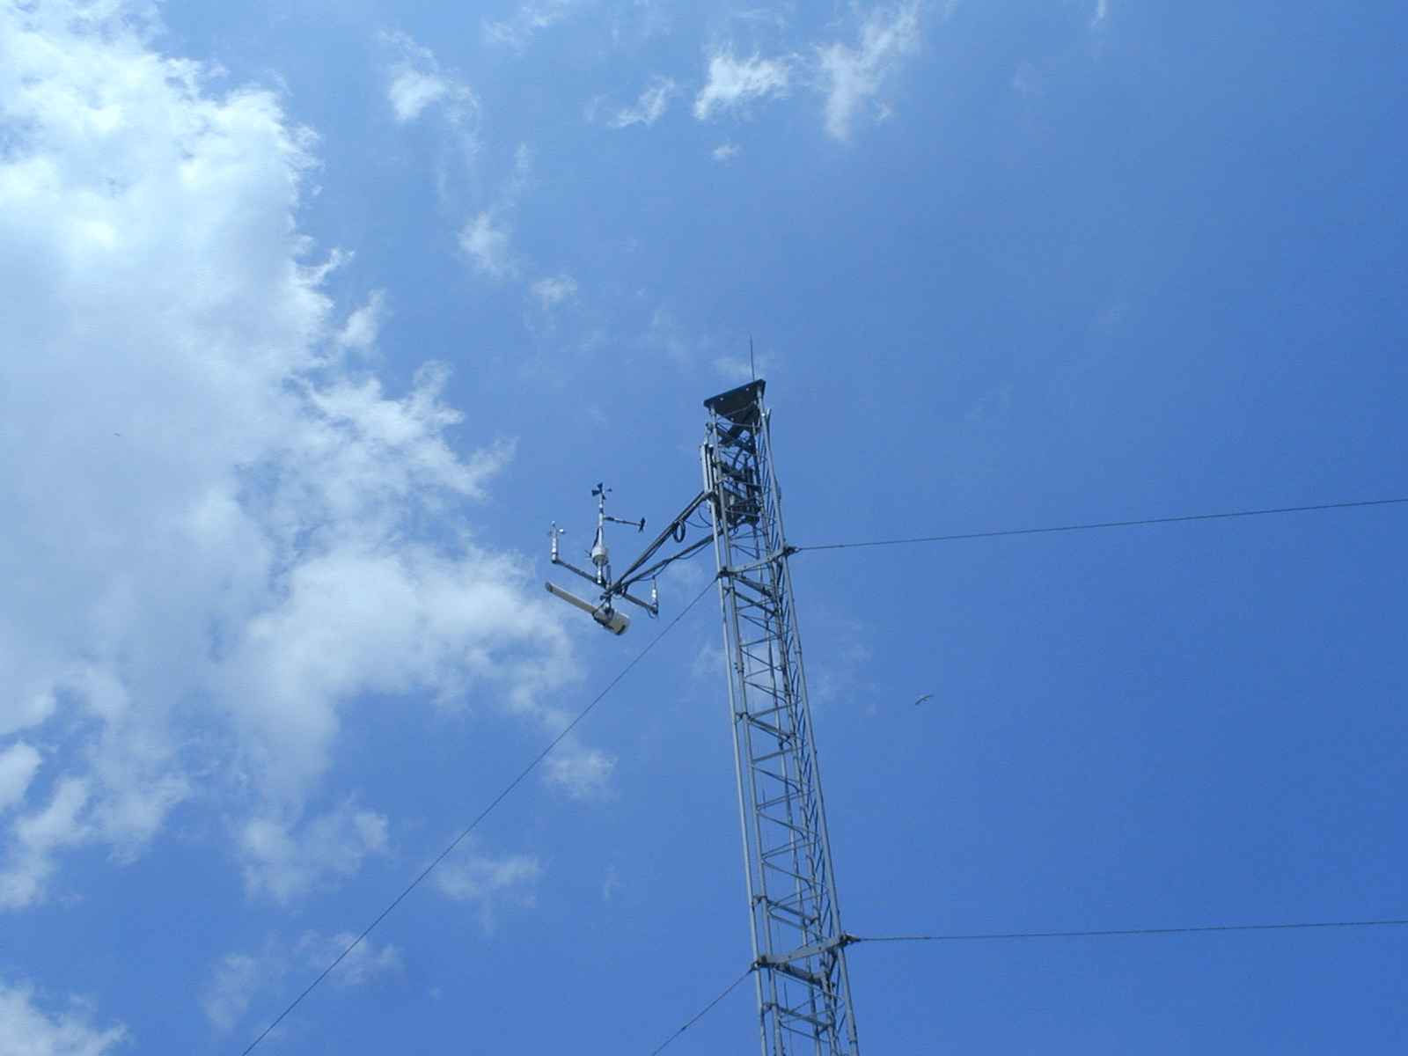
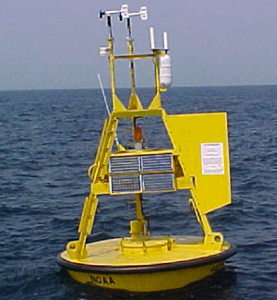
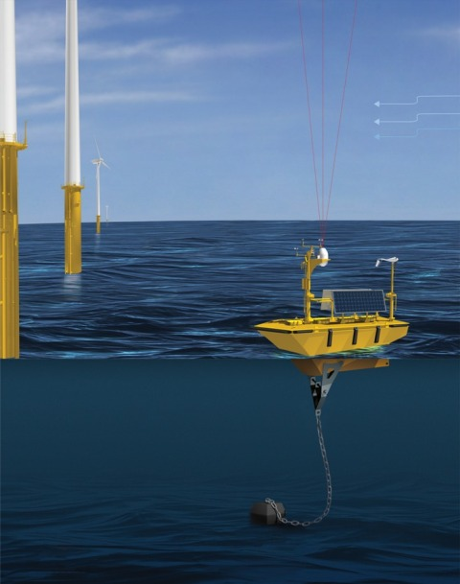
Coastal/Offshore Monitoring
Meteorological Tower
Meteorological Buoy
Offshore vertical LIDAR
Coastal/Offshore Scanning LIDAR
Infrared Satellite
Coastal Radar (CODAR)
Notes:
-offshore met towers very expensive (multi-million dollar projects!)
-first two cannot provide full spatial, temporal variability in wind
-LIDARs can (esp. scanning LIDAR) but expensive and limited in range
-satellite cannot monitor winds directly, especially at a sufficient resolution
-CODAR cannot monitor winds directly, especially at wind turbine height

Slide 13

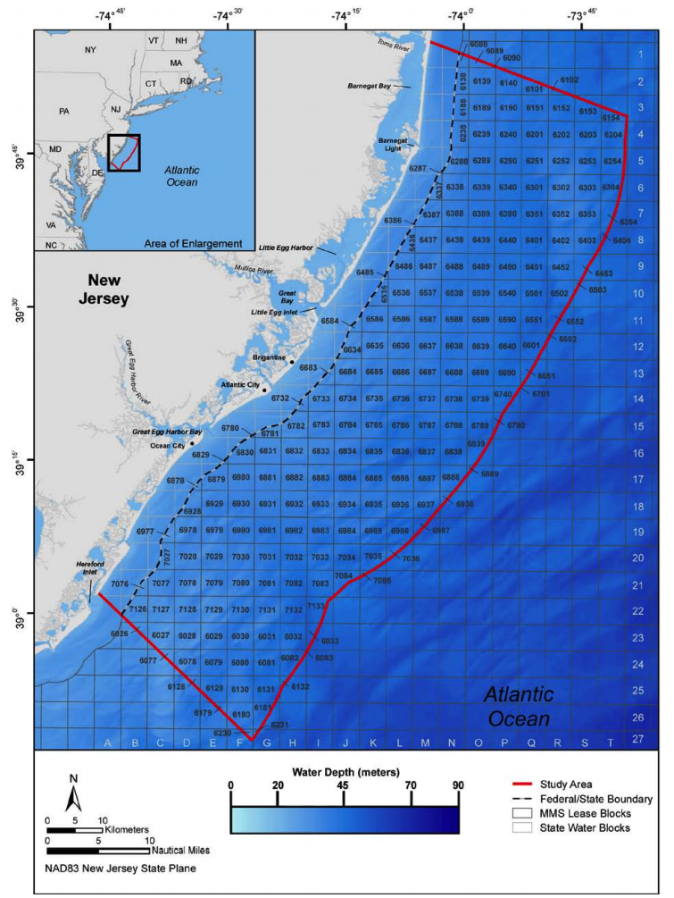
Ecological baseline studies of offshore wind power already performed (shown to left)
  Avian species
  Fisheries
  Marine Mammals
  Sea turtles
This project is the state’s physical baseline study

Slide 14
NJ Board of Public Utilities (NJBPU): a current RUCOOL project
NJBPU asked RUCOOL to evaluate wind resource as a sort of “consultant”
Use modeling to achieve these goals, complement ecological baseline study
Notes:
-developers have own consultants with which we will compare our wind resource assessments→ if any disagreements, will come together and talk
-modeling: take in observations, analyses; use equations of motion (physics) which then provide predictions of what the atmosphere will be in the future
-not only resolve what will happen in the future (temporally) but will resolve spatially at high resolutions across NJ offshore domain in question

Slide 15



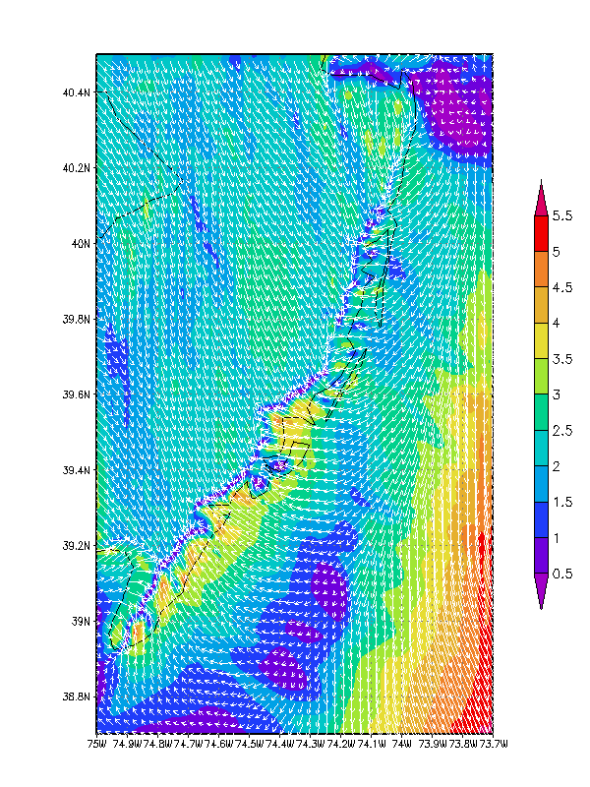
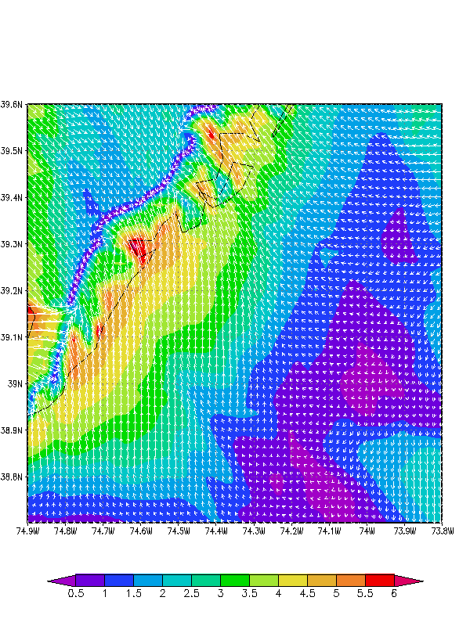
State of New Jersey
New Jersey Board of Public Utilities (NJBPU)
An Advanced Atmosphere/Ocean Assessment Program:
Reducing the Risks Associated with Offshore Wind Energy Development
As Defined by The NJ Energy Master Plan and
The NJ Offshore Wind Energy Economic Development Act
Principal Investigators: Dr. Scott Glenn and Dr. Rich Dunk, CCM
Team Members: Dr. Josh Kohut, Dr. Hugh Roarty, Louis Bowers, Greg Seroka,
John Kerfoot, Laura Palamara, Mike Crowley, Ethan Handel, Colin Evans
New Ocean Data
Hi-Res Weather Model
Spatial Validation Data
Wind Power Statistics
Notes:
-Demonstrate variability of the offshore wind resource for designated study area by using high resolution nested atmospheric WRF model
-Validate modeling efforts with existing data as well as with developer’s coastal/offshore data (scanning LIDAR, axis LIDAR, three 60m coastal met towers)
-NJ sea breeze has large impact on wind resource during peak energy demand season
-Sea surface temperature is a critical input variable to the atmospheric model for producing accurate wind resource assessments; RUCOOL has developed a unique technique for declouding satellite imagery to ensure that coastal upwelling and storm mixing processes can be resolved
-CODAR is a unique monitoring system for detecting surface currents and the associated spatial wind variability within the study area; wave data and spatial variability of the waves from CODAR can also be used to determine surface roughness features which is an input to the atmospheric model
-This work can be used as a basis for a representative forecasting/predicting program

Slide 16
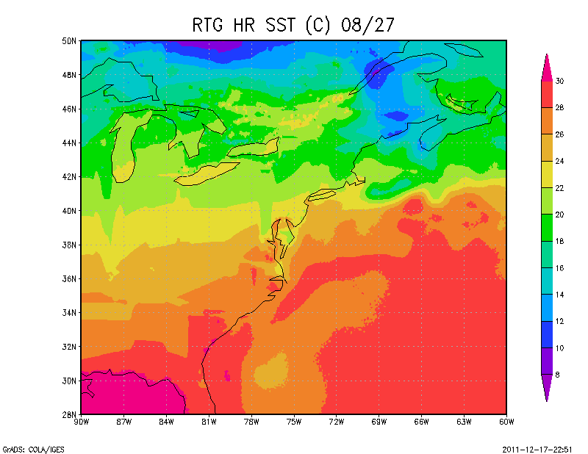
New Rutgers Satellite Product
Existing NOAA Product
New Rutgers Product
Notes:
-SST key input variable into atmospheric model, SST a primary driver in offshore winds

Slide 17
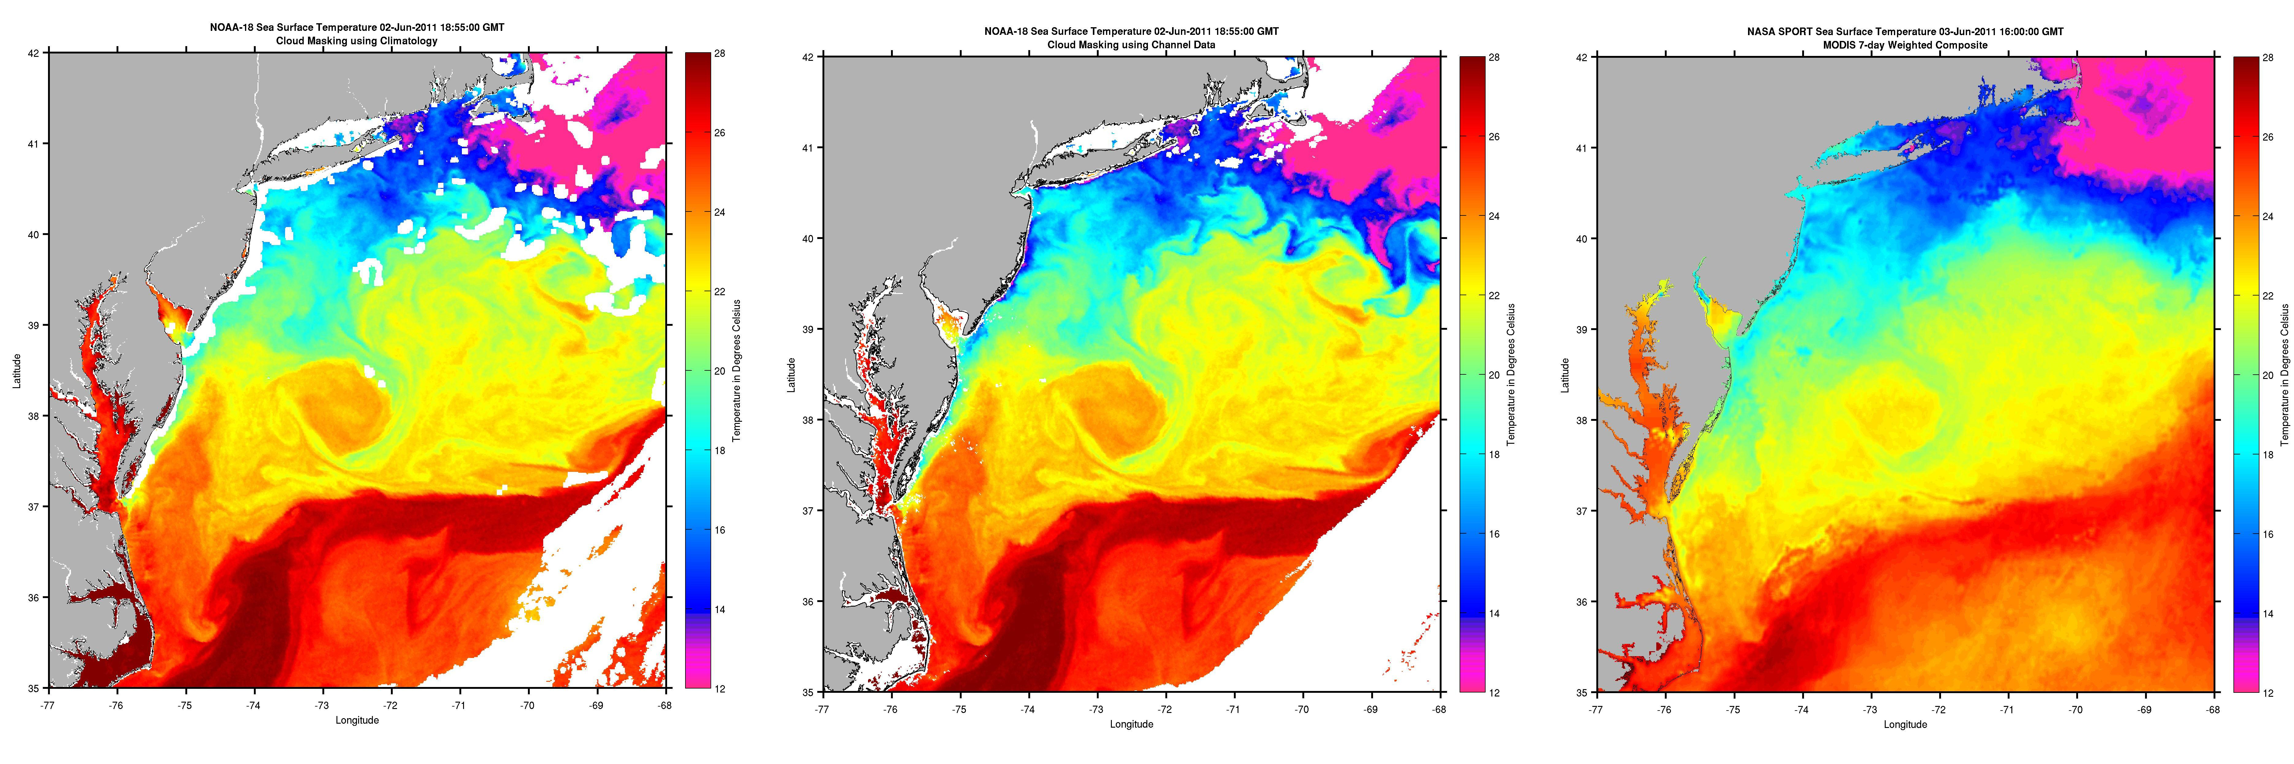
We can now resolve upwelling using satellites…
Cloud Masking (old method)
*Cloud Masking*
(new method, unique to Rutgers)
MODIS 7-day
(old method)

Slide 18
…and SST for hurricane simulations:
e.g. Hurricane Irene
SPoRT + RTG
RU declouded
product
Difference

Slide 19
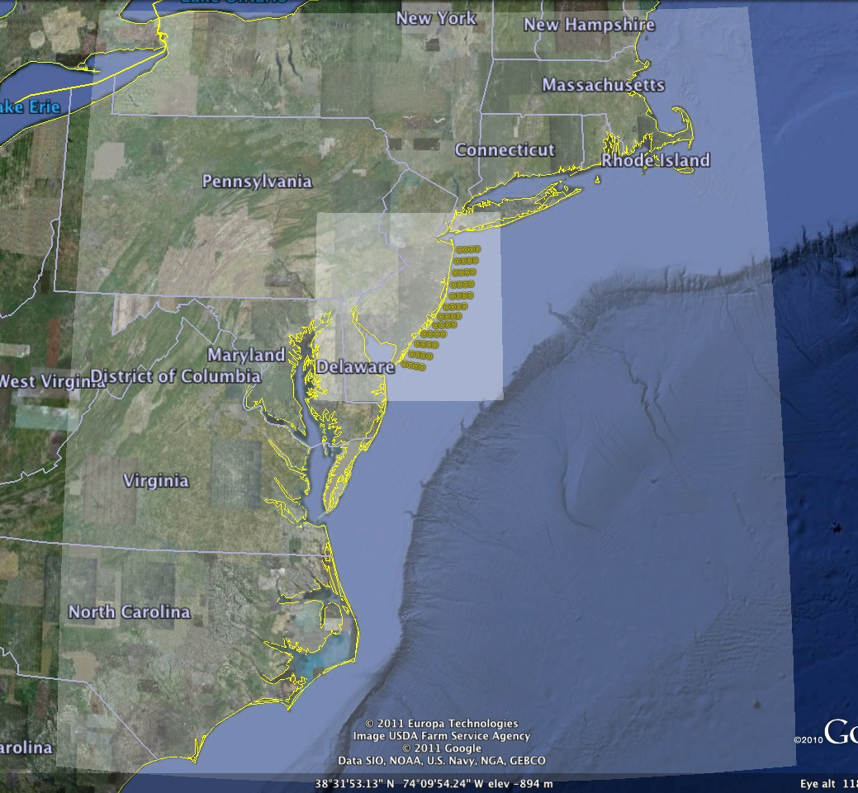
RU-WRF domains
3 km horizontal resolution over NY Bight
0.75 km horizontal resolution over study area
By comparison, North American Mesoscale (NAM) Model from NOAA is 12 km horizontal resolution
Model is being run in real-time, for precise comparison to onsite met towers
0.75 km
  Data is currently being extracted from the model at a selected array of grid points within the study domain producing several “Virtual” Meteorological Towers.
3 km
Notes:
-modeling: take in observations, analyses; use equations of motion (physics) which then provide predictions of what the atmosphere will be in the future
-not only resolve what will happen in the future (temporally) but will resolve spatially at high resolutions across NJ offshore domain in question

Slide 20
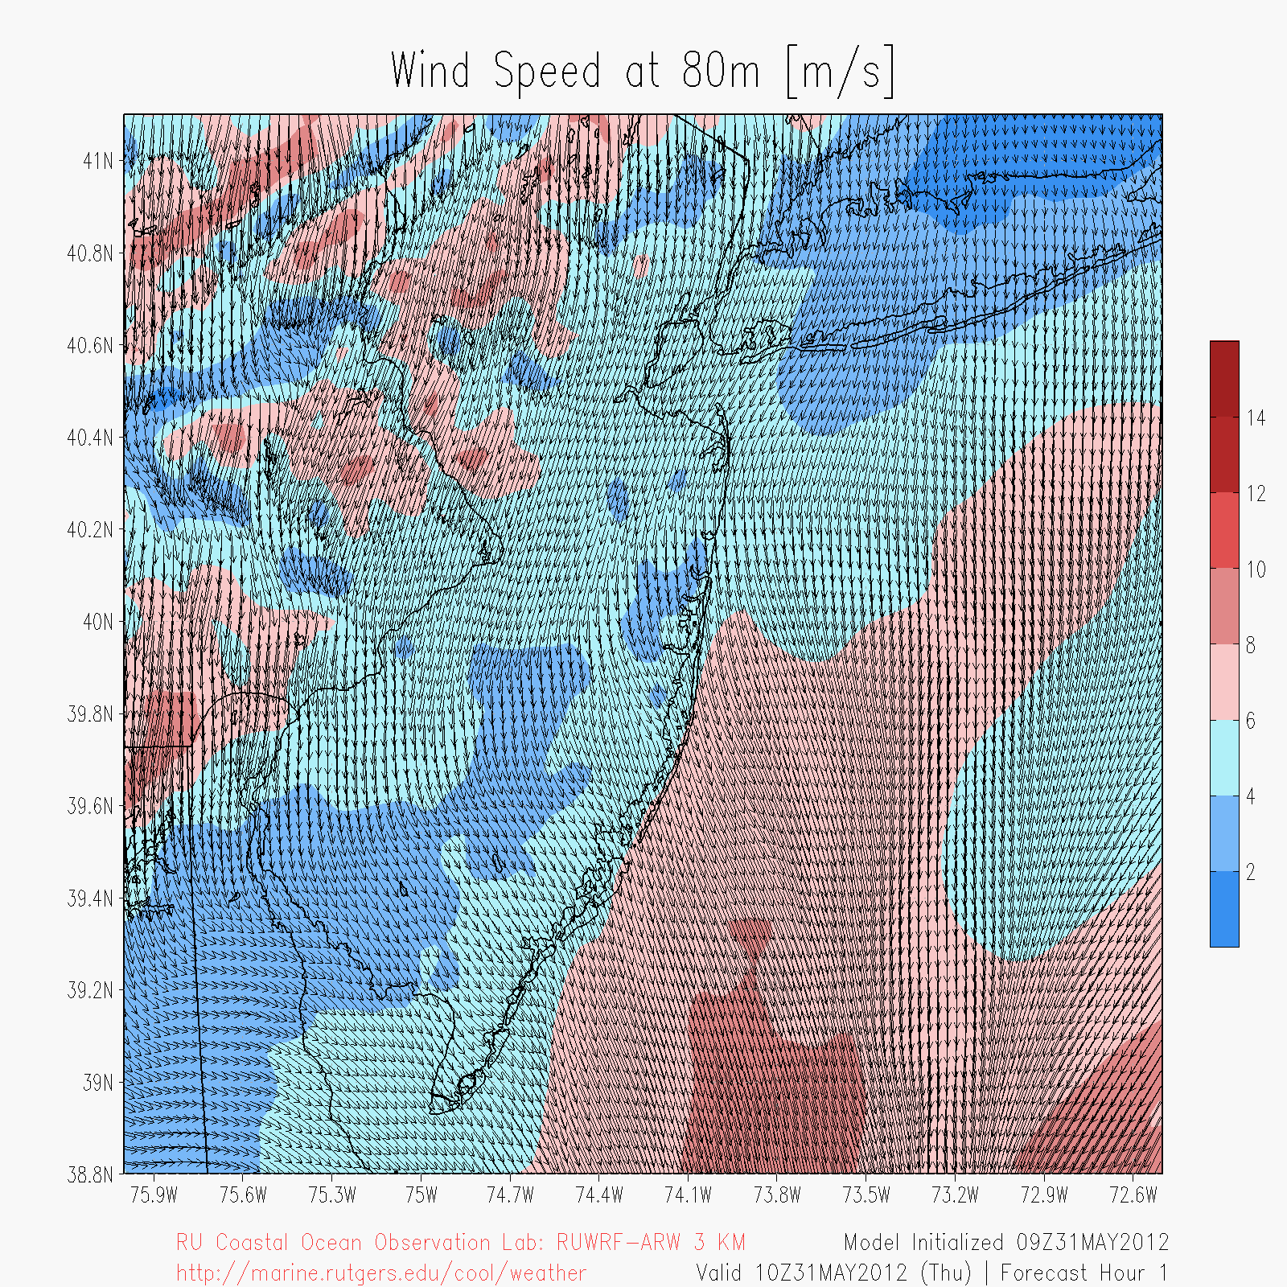
Sea breeze animation:
RU-WRF 3km run with RUSST
Notes:
-Sea breeze is a major source of variability in the wind resource, especially during the summer when energy demand is at its peak
-RUCOOL specializes in the NJ sea breeze system

Slide 21
RU-WRF domains
3 km horizontal resolution over NY Bight
0.75 km horizontal resolution over study area
By comparison, North American Mesoscale (NAM) Model from NOAA is 12 km horizontal resolution
Model is being run in real-time, for precise comparison to onsite met towers
0.75 km
  Data is currently being extracted from the model at a selected array of grid points within the study domain producing several “Virtual” Meteorological Towers.
3 km

Slide 22
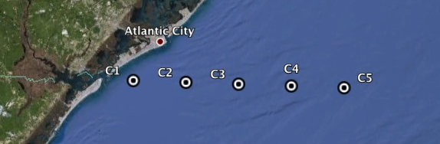
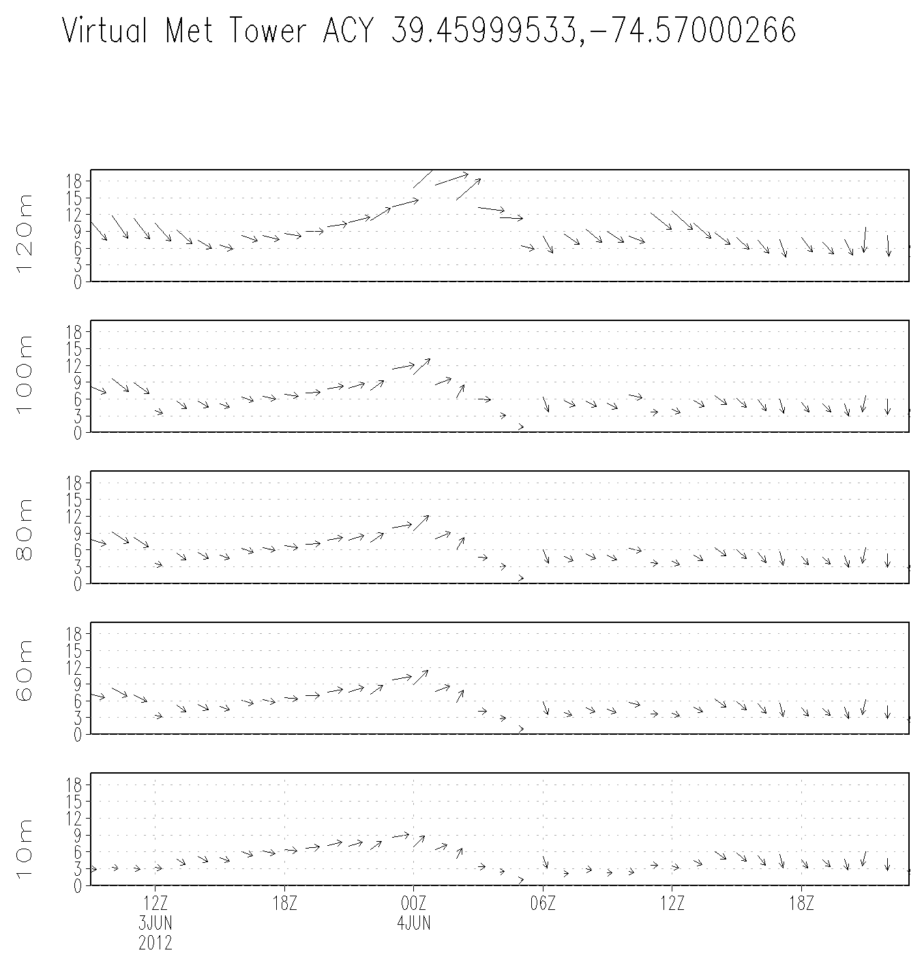
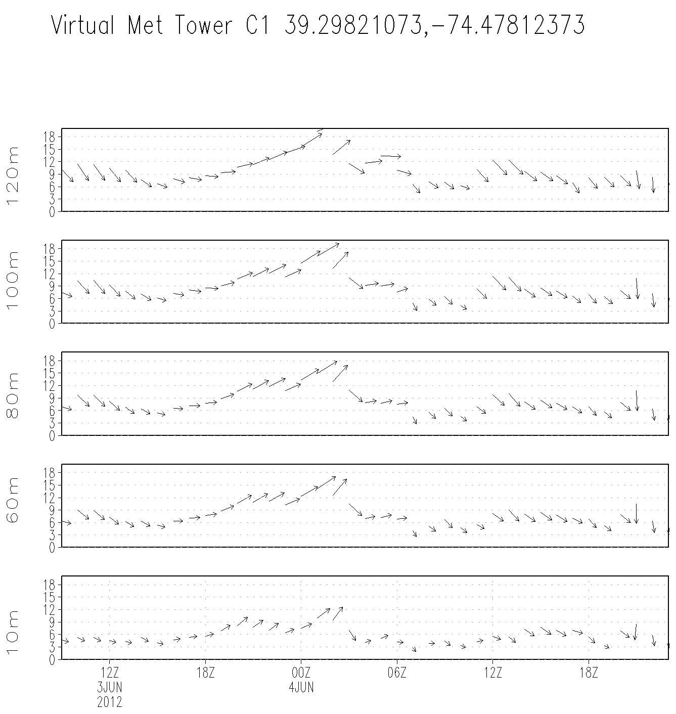
Virtual Met Tower Examples
Onshore (KACY)
Offshore
Notes:
-Peak in wind speed at around 00Z on June 4 is higher offshore than onshore, from surface up to 100m; at 120m, wind speed is comparable offshore to onshore (less frictional drag)
-virtual met towers can be used as “virtual” sources of measurement to temporally and spatially resolve wind resource and variability within across the NJ offshore domain

Slide 23
Model Validation
Meteorological Tower
Meteorological Buoy
Offshore vertical LIDAR
Coastal/Offshore Scanning LIDAR
Infrared Satellite
Coastal Radar (CODAR)
Notes:
-model validation: we produce forecasts/diagnoses--- how do we know they’re accurate?
- monitoring systems (OSW developers’, existing buoys, met towers) – vertical validation
- Scanning LIDAR, CODAR – spatial validation

Slide 24
Model Validation
Offshore vertical LIDAR
Coastal/Offshore Scanning LIDAR
Notes:
-vertical LIDAR: vertical validation
-scanning LIDAR: both vertical and spatial* validation

Slide 25
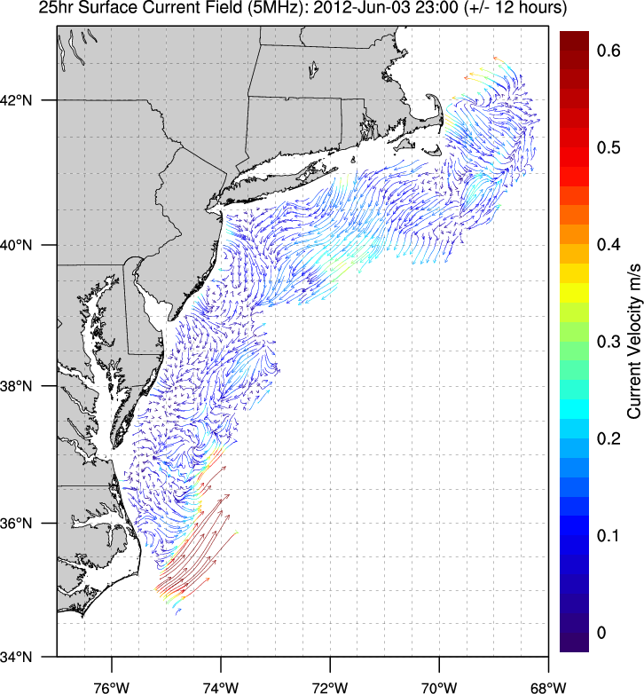
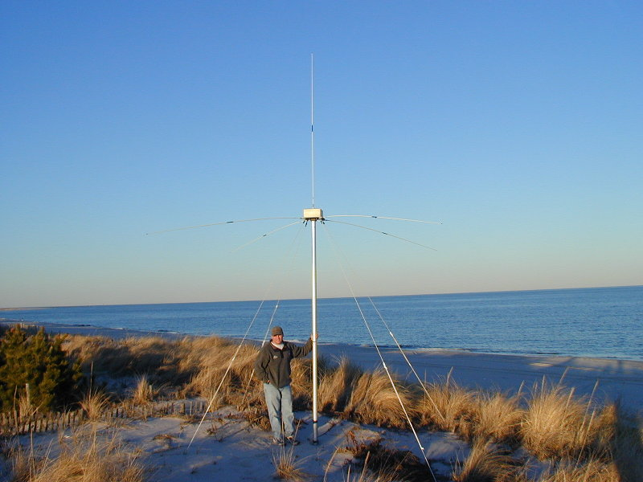
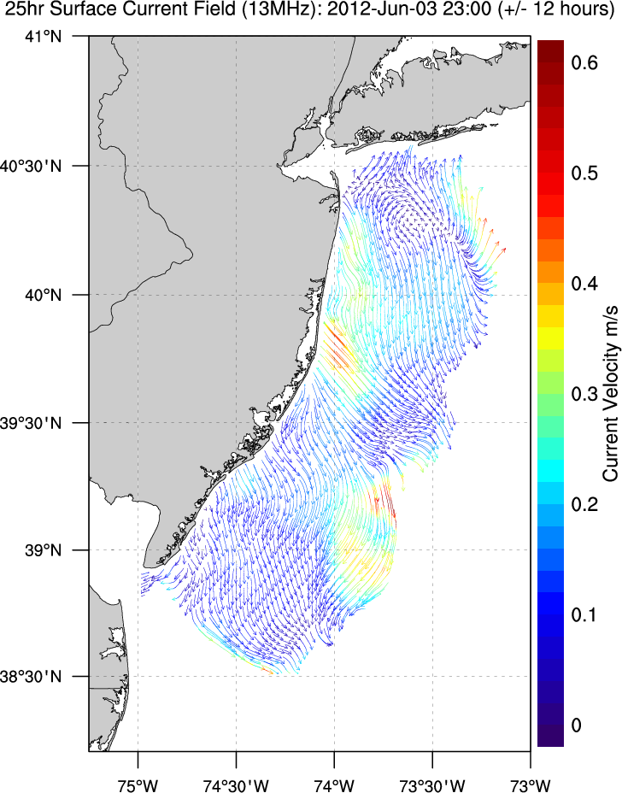
Enhanced High Resolution Coverage
13 MHz CODAR
Surface Ocean Currents
Notes:
-CODAR: spatial validation
-existing CODAR antennas across coastal NJ, Long Island (part of 5 MHz coarse current detecting system)
-BPU project installed 4 new, enhanced antennas along NJ coast (13 MHz) to provide high resolution coverage of the current and wave field

Slide 26
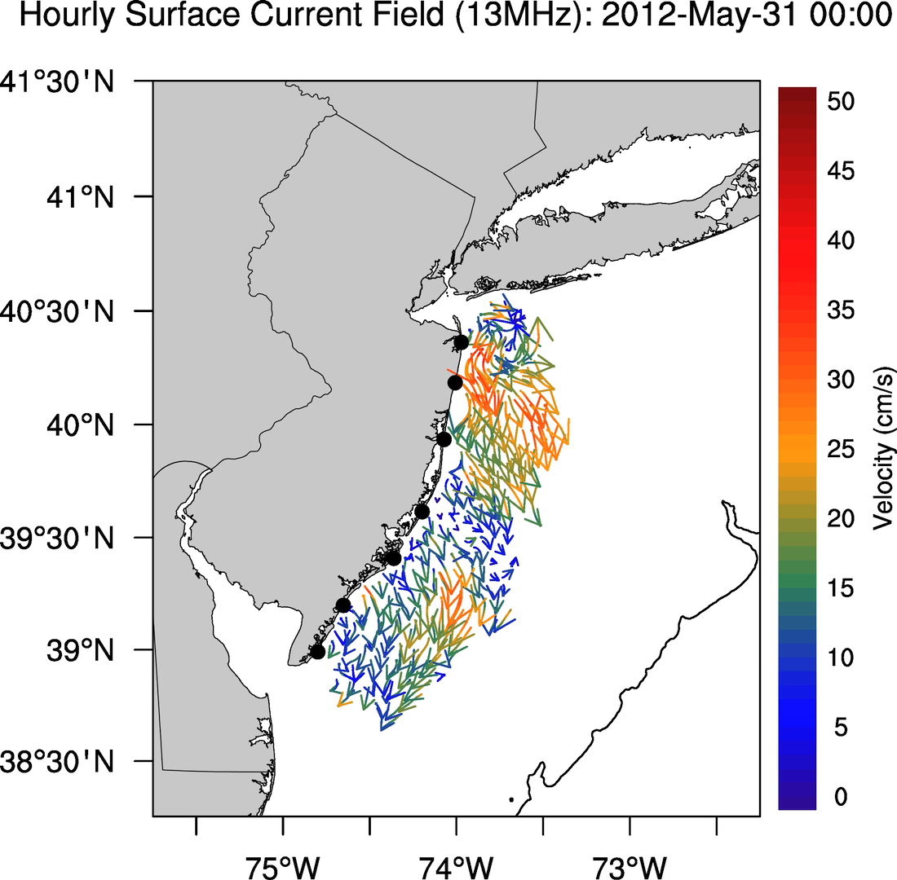
CODAR seabreeze animation

Slide 27
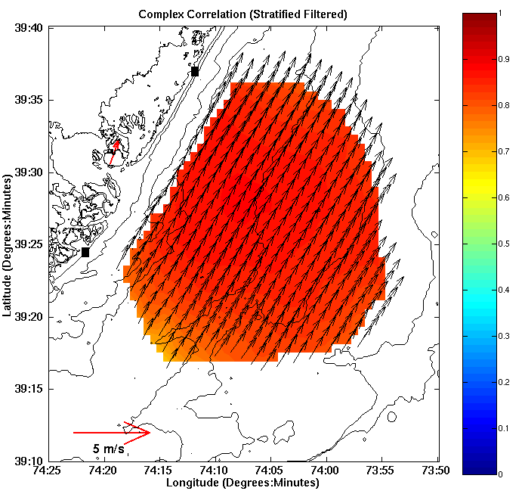
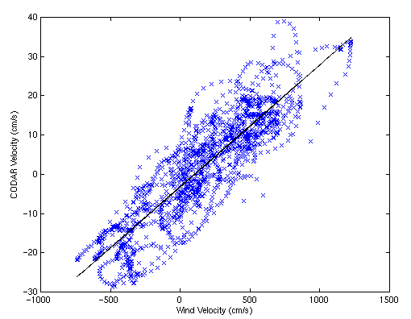
HF Radar Derived Linear Wind Model
Current Transient [U'] (cm/s)
Wind Transient [W'] (cm/s)
Rotate wind vectors according to complex correlation
Calculate the slope and intercept of best fit line
U'_{c}(x,y,t) = slope(x,y)*W'(t)
Notes:
-get winds from currents (surface winds closely correlated to surface currents)- can provide spatial variation in wind field and help spatially validate the model results

Slide 28
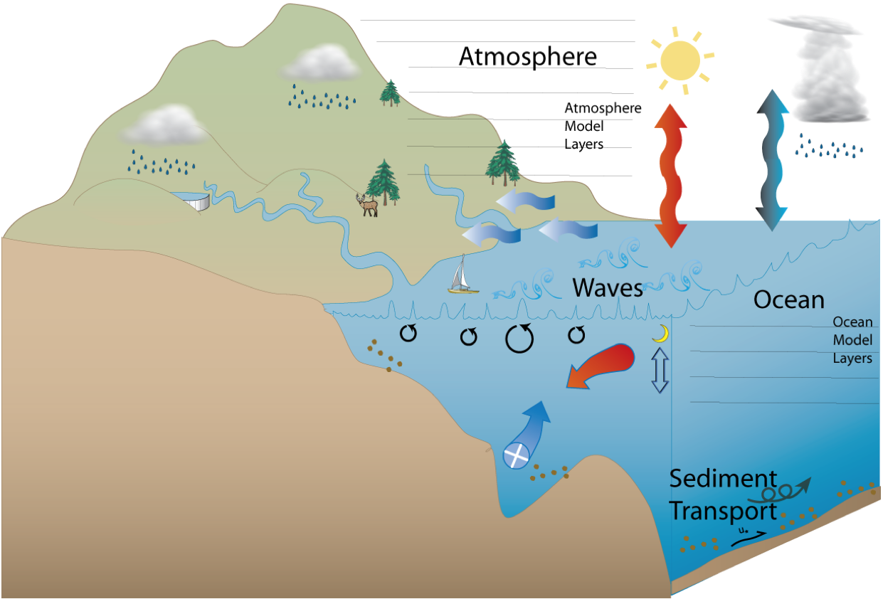
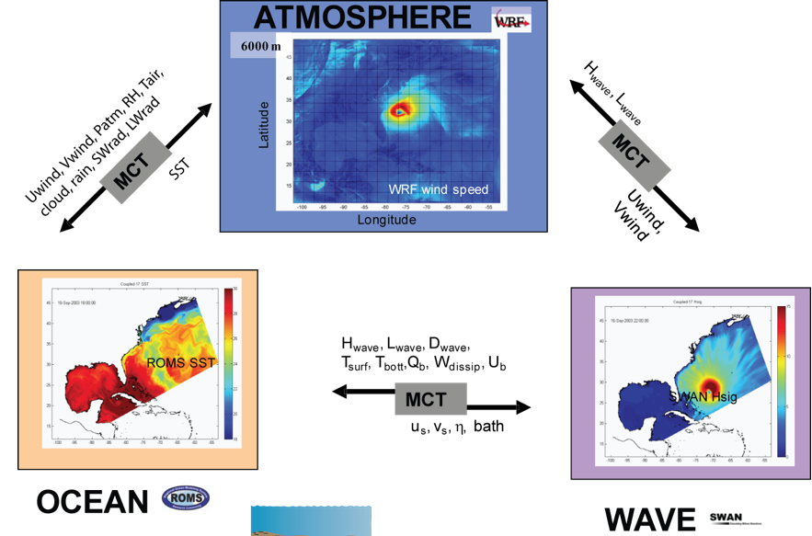
Atmosphere-Ocean-Wave Coupling

Slide 29
Future Possibilities
This work can be used as a basis for a representative forecasting/predicting program
Show economic viability of offshore wind
Most efficient integration into grid
Day ahead bidding of energy by utilities
Construction, operation, maintenance
Notes:
-Provide wind forecasts which can be used to predict variability in wind and optimize integration of electricity into the existing grid

Slide 30
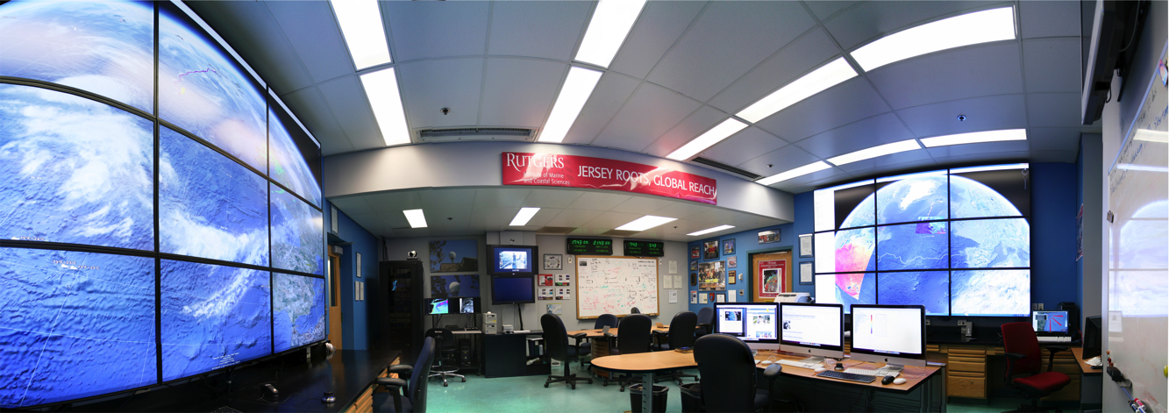
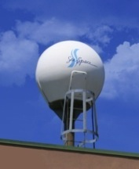
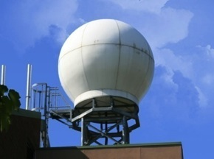
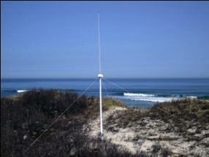
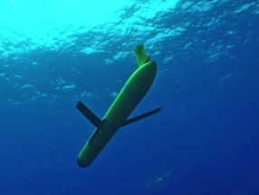
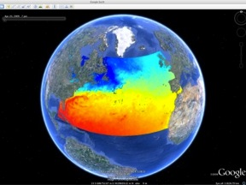
Rutgers University - Coastal Ocean Observation Lab
Operations, Research & Education Center
Vessels -
Satellite
Satellite
CODAR
Ships/ Vessels
Glider
REMUS
Data Vis.
Modeling
Security
Leadership
Education
Satellite Data Acquisition Stations
CODAR Network
Glider Fleet
3-D Forecasts

