Slide 1
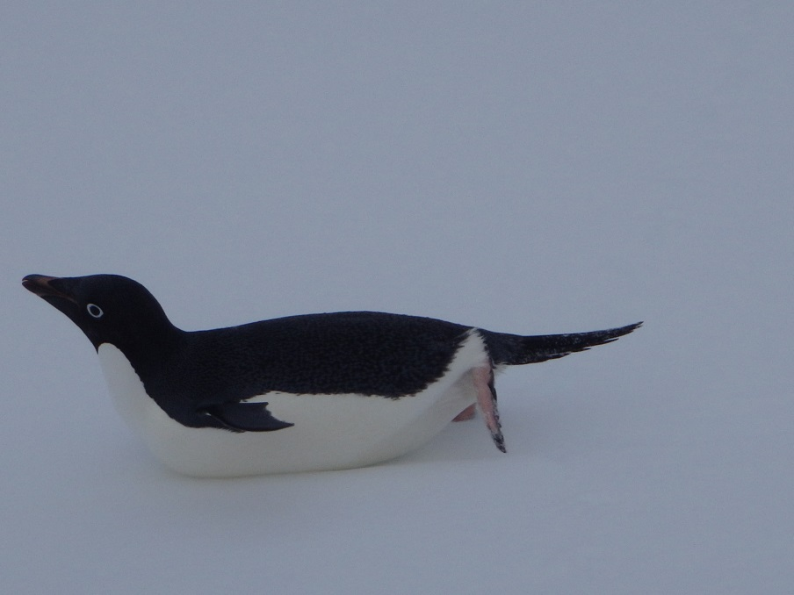
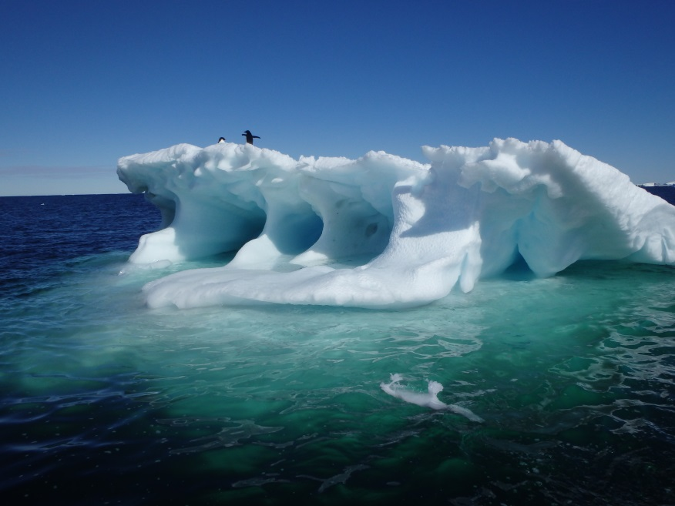
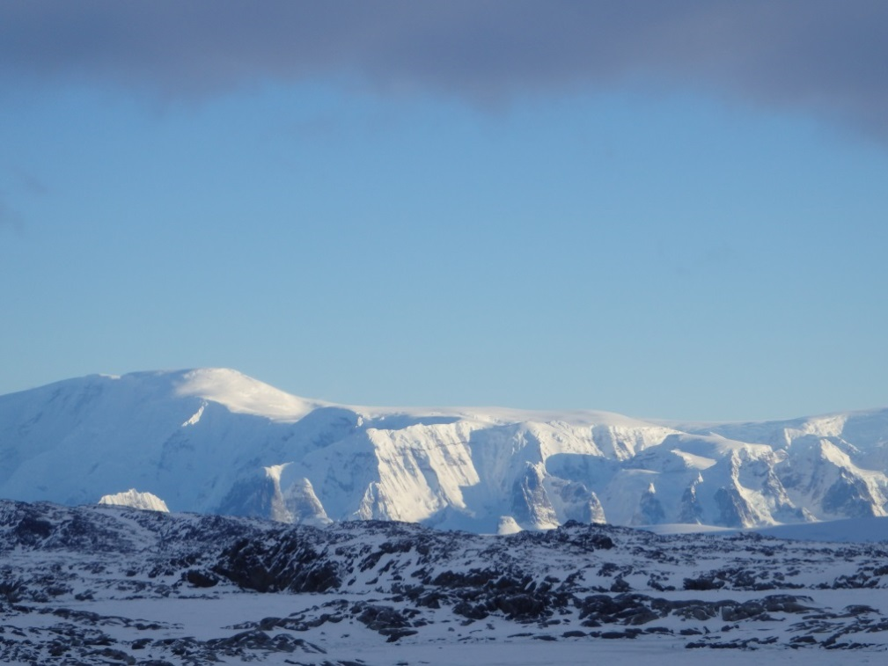
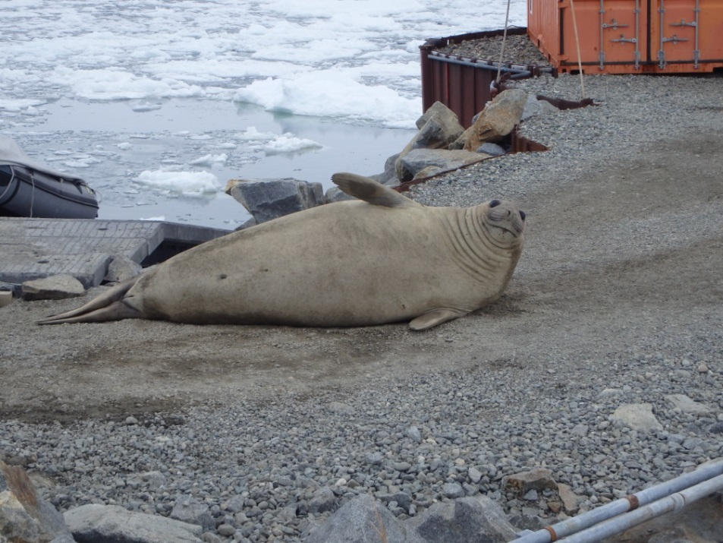
MY TIME AT PALMER STATION

Slide 2
I am a Junior at Rutgers University, double majoring in Geology and Marine sciences.

Slide 3
Palmer Station, Antarctica
The smallest of the three United States Antarctic bases.
Constructed in the late sixties.
It has the capacity to support about 45 people, both scientists and support staff.

Slide 4
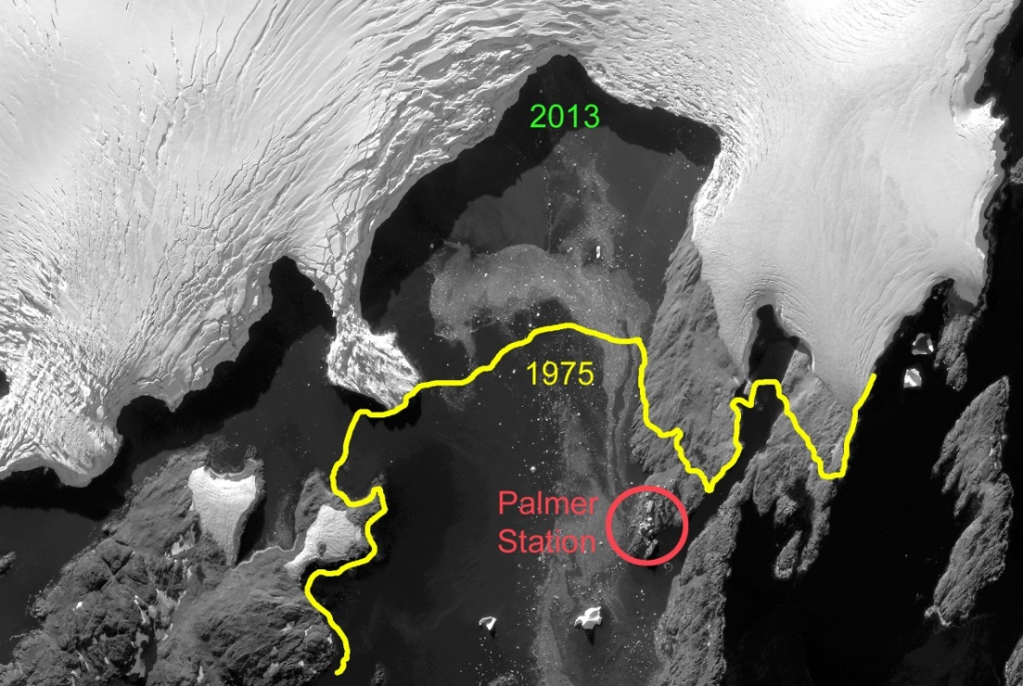
WHY ARE WE WORKING AT PALMER?
The Long Term Ecological Research program (LTER) employs scientists to study specific sites all over the world that are experiencing dramatic environmental changes. To the right shows the sampling grid, with Anvers Island (Palmer Station) located above the 600.200 line.
The Western Antarctic Peninsula (WAP) is currently experiencing a very drastic warming trend. To the left is a satellite image demonstrating this warming right in our own backyard.
satellite image edited by: Glenn Grant

Slide 5
As part of LTER, sites B and E (seen below) are sampled bi-weekly during the summer season, tracking the health and size of the phytoplankton population.
Our data is tied in with other groups in the program, such as penguin and krill researchers, to provide a more complete picture of the ecosystem.

Slide 6
WHAT DO I DO?
In the picture below, I am guiding one of the instruments, the “Cage”, into the water. The Cage is a conglomeration of an AC9 and bio-optics puck
Above is a picture of my lab mate and I getting our zodiac “Bruiser” prepped to go out on the water to sample sites B and E.

Slide 7
After collecting sea water, it is brought back to our lab to filter out phytoplankton and run them through a fluorometer, which helps us determine the health of the sample.
On the table are two Slocum Gliders. RU01, on the right, is outfitted with a double payload to aid in Chlorophyll data collection.

Slide 8
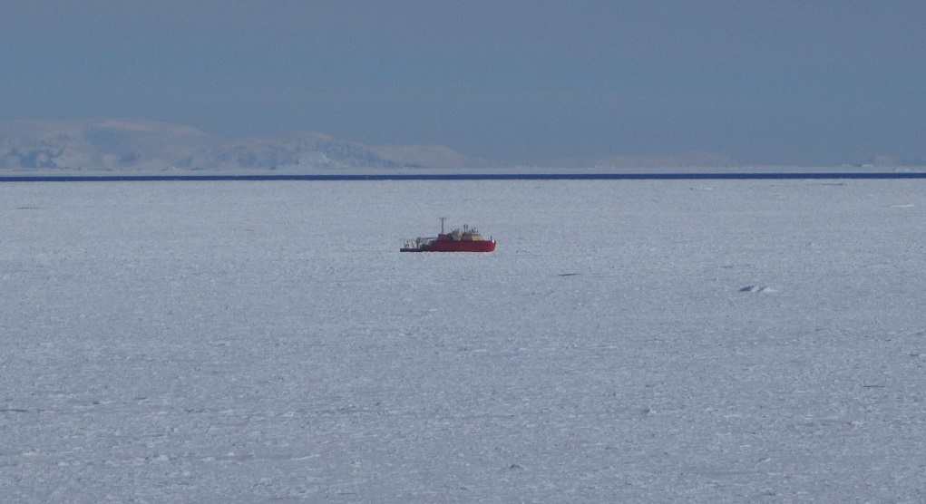
However, Sea Ice Delayed The Start To Season
Below is an ice image from the Naval Ice Center (NIC) taken on Halloween.
Above shows a heavy sea ice day looking off of the Palmer pier.
To the left is a photo of the Laurence M. Gould, our resupply vessel, pushing its way through the ice to get to station.

Slide 9
TWO MONTHS LATER
There was just enough open water to get close to one of the sampling sites, seen below.
photo below by: Joanne Feldman
Above is an Ice image taken by the NIC for Christmas day showing most of the ice blowing out from around station.

Slide 10
Questions?

