Slide 1
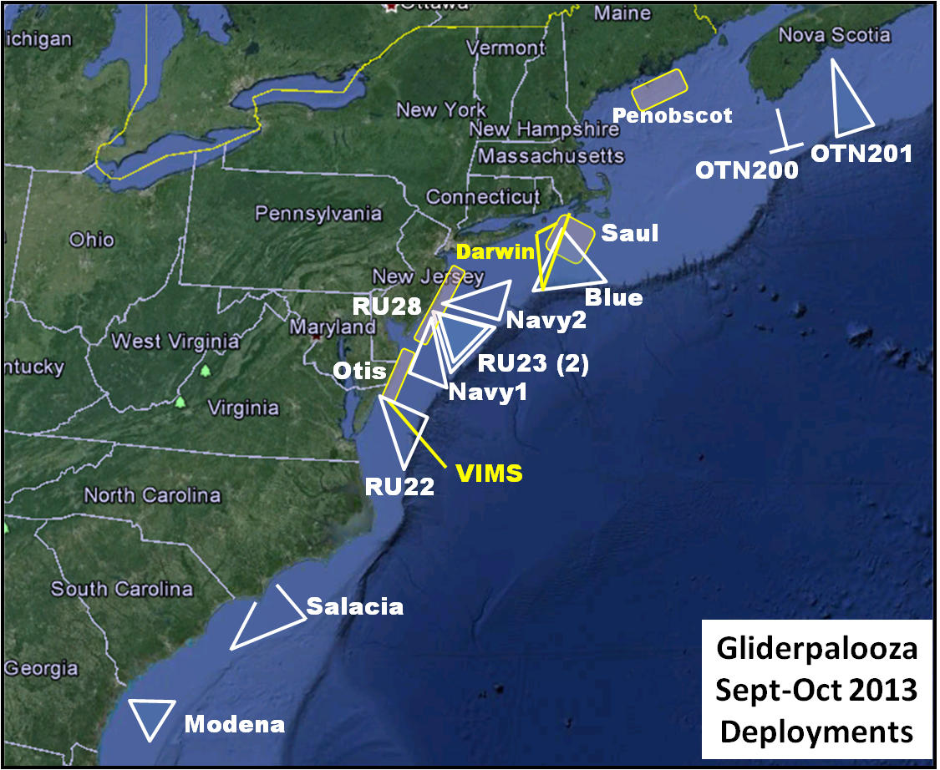
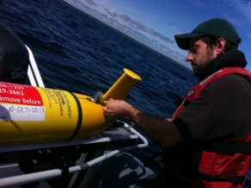
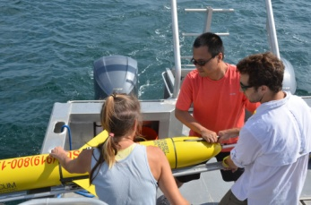
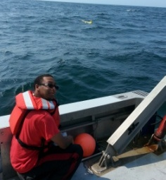
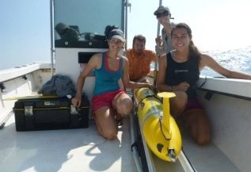
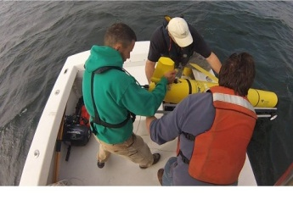
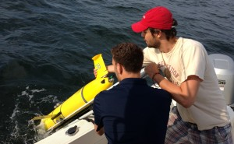
Gliderpalooza 2013: So much more than gliders
Oscar Schofield
Professor Bio-Optical Oceanography
Rutgers University

Slide 2
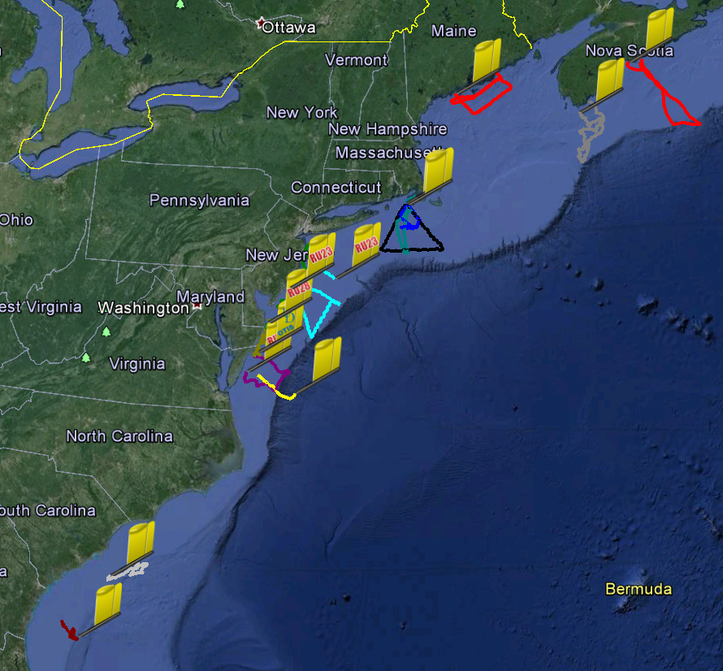
Gliderpalooza Partners & Funders
 | Group | Glider | Deploy | Funding
1 | Dalhousie | OTN200 (2) | 10-Sep | OTN
2 |  | OTN201 | 16-Sep | OTN
3 | UMaine | Penobscot (2) | 10-Sep | Maine
4 | WHOI | Saul | 10-Sep | ONR
5 | UMass | Blue | 6-Sep | MARACOOS/IOOS
6 | Rutgers | RU28 | 12-Sep | NJDEP
7 | UMaryland | RU22 | 22-Sep | MARACOOS/IOOS
8 | Rutgers | RU23 (2) | 10-Sep | MARACOOS/IOOS
9 | UDelaware | Otis | 12-Sep | Private
10 | VIMS | Stewart | 10-Oct | VIMS
11 | NC State | Salacia | 17-Sep | NASA
12 | Skidaway | Modena | 10-Sep | Skidaway/SECOORA/IOOS
13 | T. Webb | Darwin | 11-Sep | Self
14 | Navy | Navy1 | 10-Oct | Navy
Deployments
A true grass-roots effort: 14 gliders, 14 partners, 3 months, 17 deployments

Slide 3
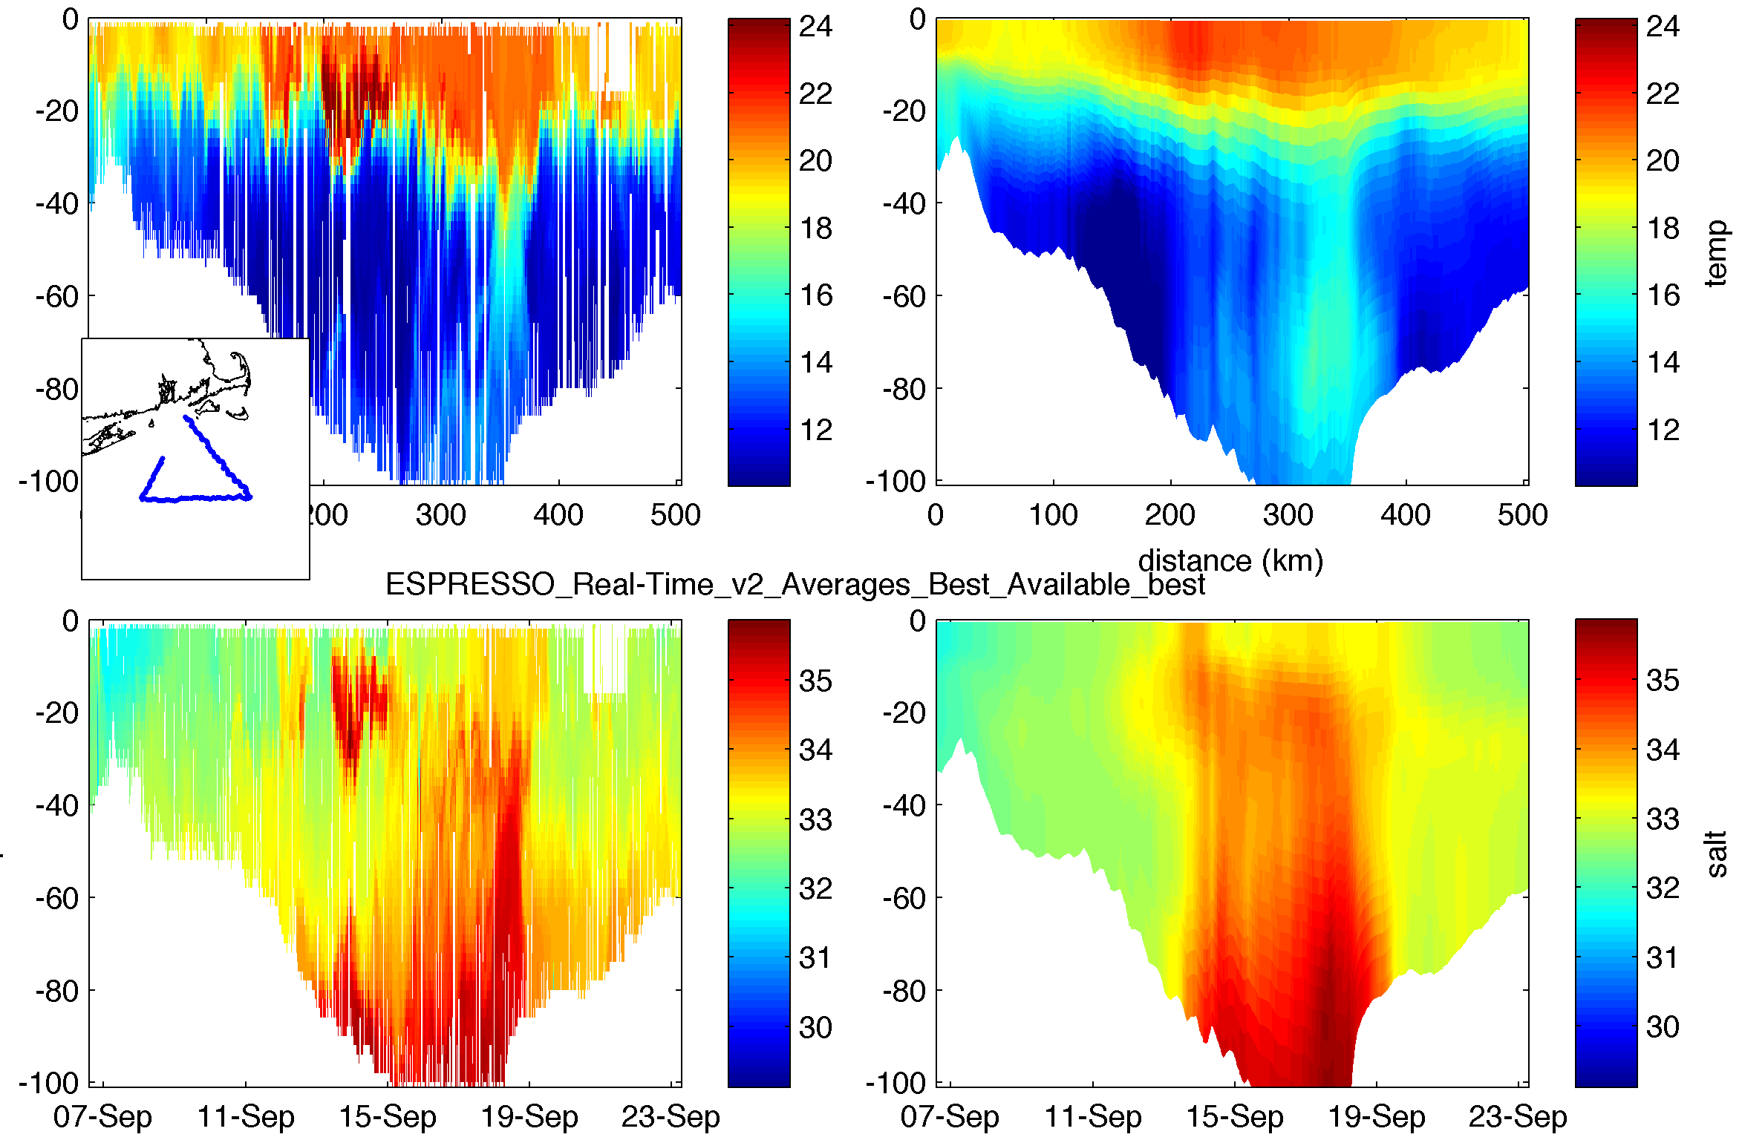
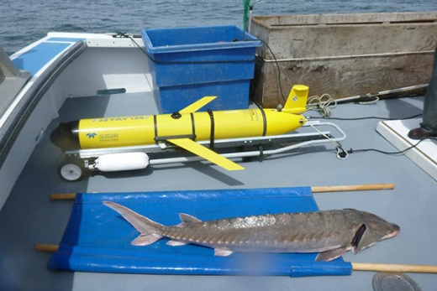
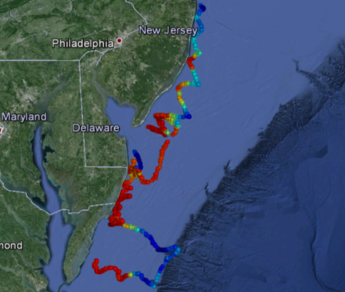
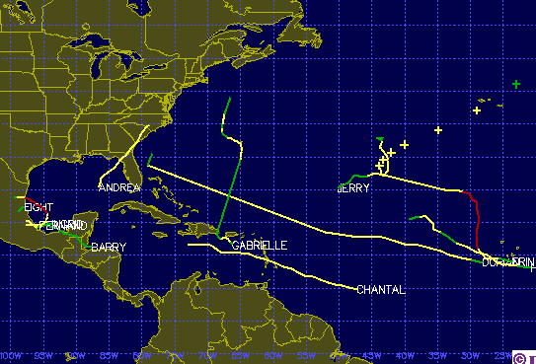
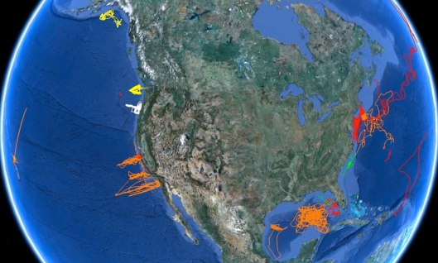
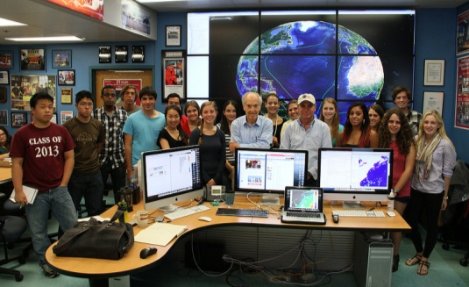
Gliderpalooza 2013: Science and Technical Goals
Provide a unique data set to modelers
Provide standardized dataset a over ecological scales and information on fish/mammal migrations
Provide a 3-D snapshot of the MAB cold pool
Provide an extensive distributed network through the peak period of fall storms, demonstrating "surge" capacity
Demonstration of a national glider network
Proof of data flow through IOOS to NDBC via DMAC
Engage undergraduates in ocean observing efforts.
2013 Tropical Storms
Bottom Temps
National Network
Education

Slide 4
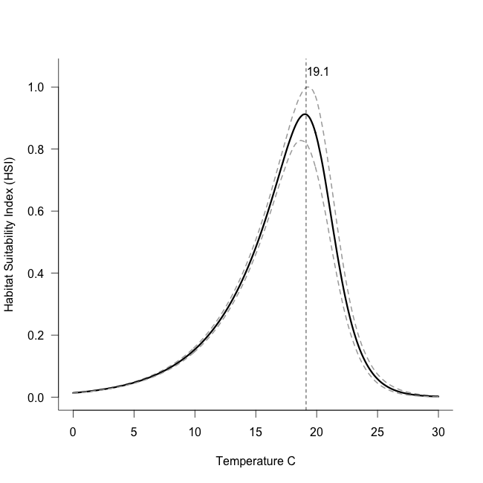
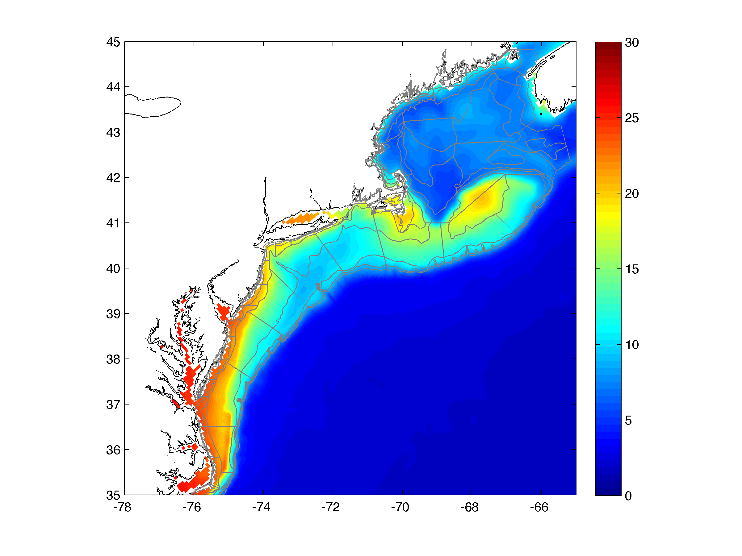
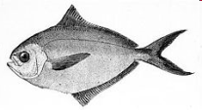
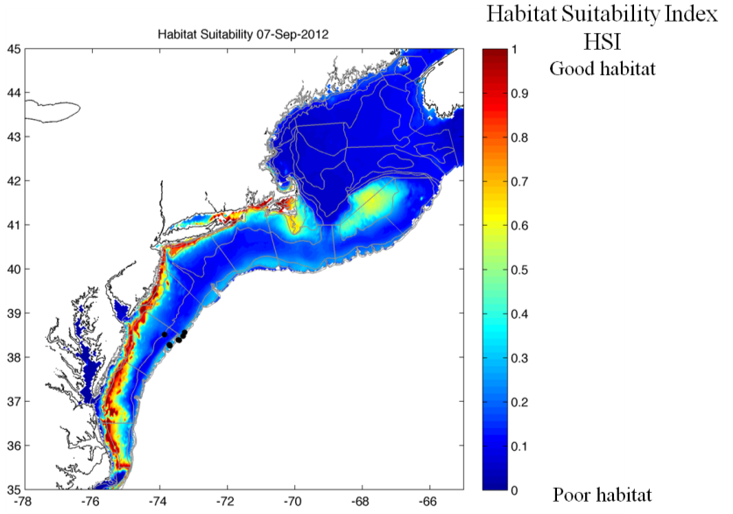
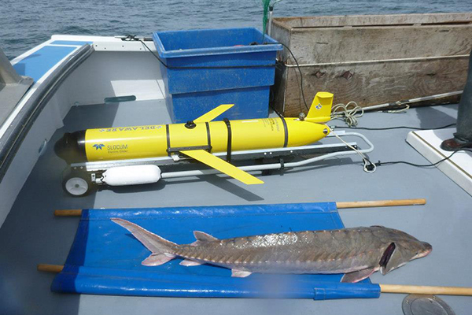
Goal 2: Ecological Scales & Fish/Mammal Migrations
Niche model: nonlinear extension of Boltzmann-Arrhenius equation
(mechanistic basis in enzyme kinetics)
Water temp
hindcast from
Ocean model
Fish habitat forecast/hindcasts
Vemco receivers deployed on 9 of 16 gliders
Key Species: Right Whales, tiger sharks, Atlantic sturgeon, Atlantic Salmon
Data will be organized by OTN in Nov-Dec
+
Estimate of habitat distribution in NW Atlantic
=
Thermal habitat dynamics & NEFSC Survey

Slide 5
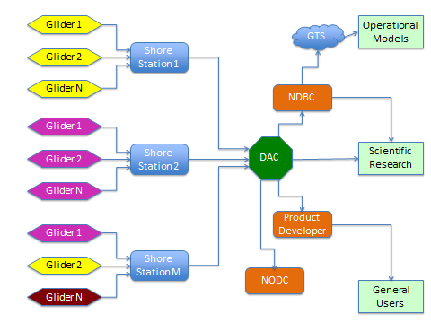
Goal 6: Data Flow from IOOS to NDBC to GTS: Demonstration of National Glider Plan
Data flow through to NDBC as defined in the upcoming National Glider Network Plan
Operators to shore station to DAC to world
Successful transfer to GTS through NDBC!
National Network

