Slide 1
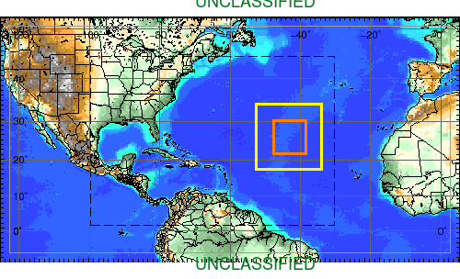
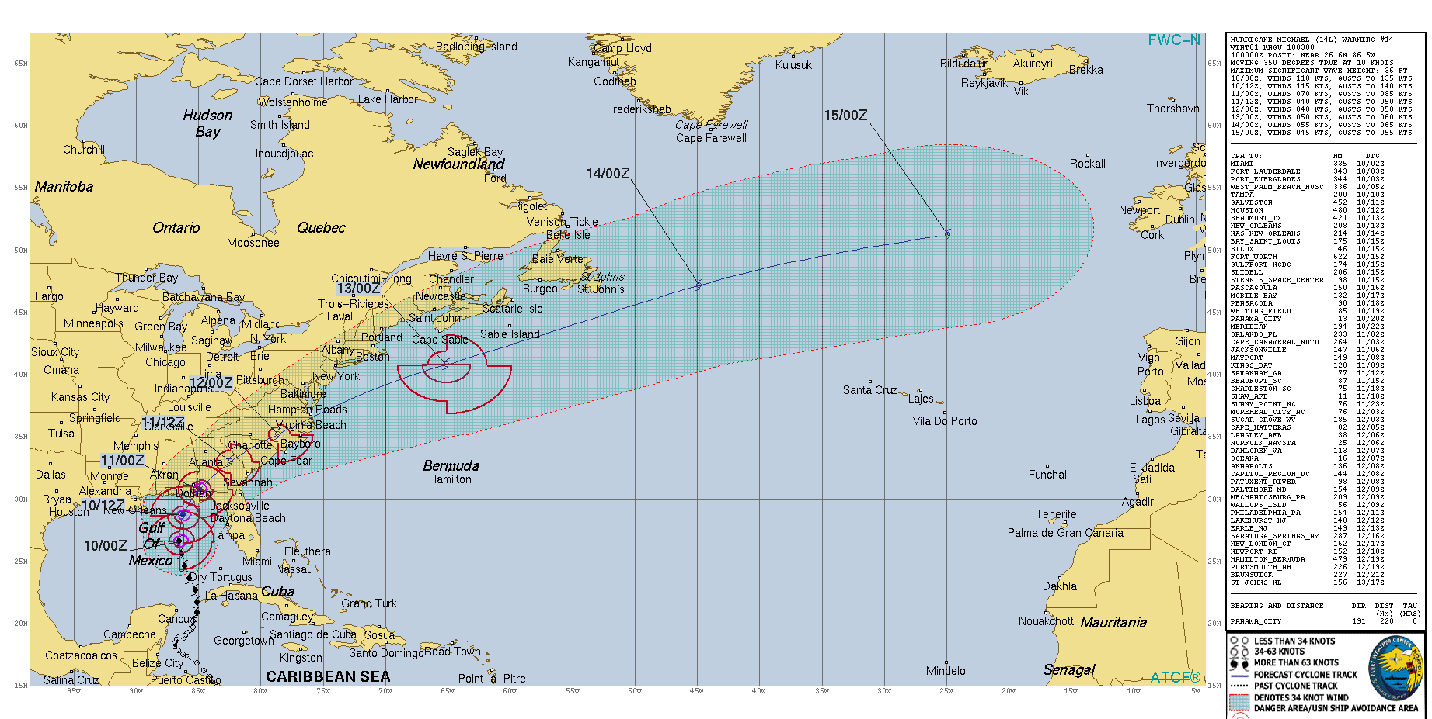
COAMPS-TC Forecast of Hurricane Michael
Sue Chen, NRL Monterey
EPAC
2017 coupled COAMPS-TC Model Configuration
Atmosphere: 36x12x4 km, 40 levels
Inner nest 2&3 automatically follow TC (moving nests)
Ocean (NCOM): 7.5 km, 40 layers with 24 Z levels, 5 m upper layer
Coupled interval – 10 min
12 h ocean update cycle with NCODA
GFS & HYCOM LBC
Two sets of experiments
Assimilate all ocean observations
As in 1 but exclude the gliders
ATL
JTWC Forecast of Hurricane Michael (2018100912)

Slide 2
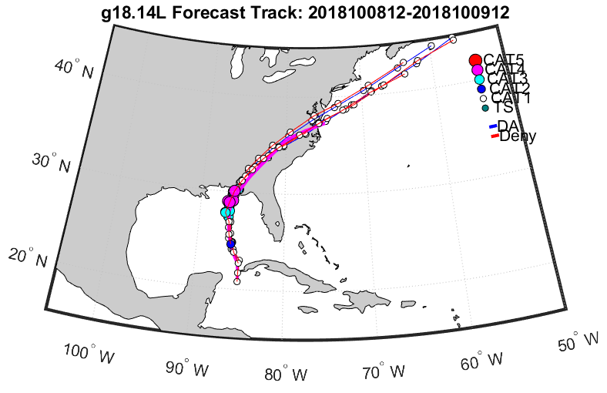
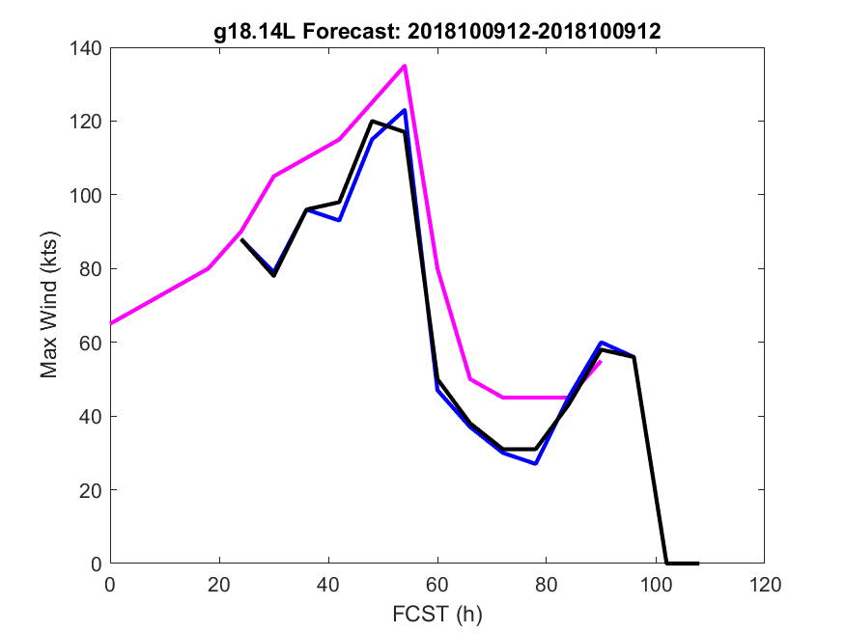
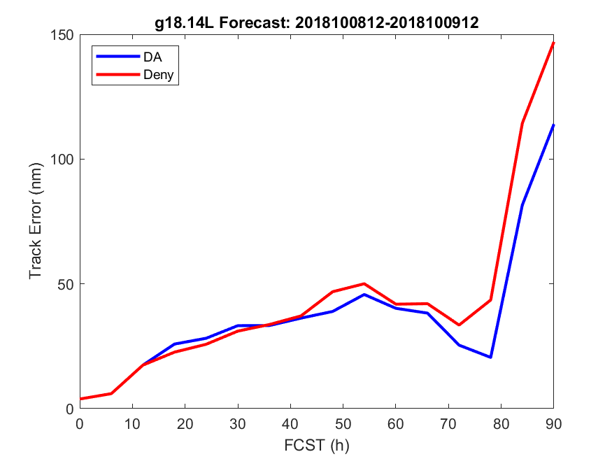
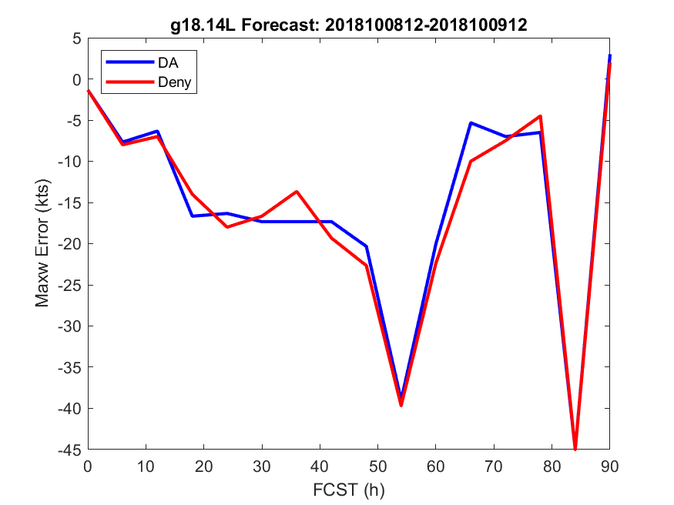
COAMPS-TC Forecast of Hurricane Michael
Sue Chen, NRL Monterey
Observation
2018100912 forecast
DA, with gliders
DA, without gliders
Assimilating the gliders improved the Hurricane Michael’s track forecast
COAMPS-TC forecast intensity was weaker than the real-time best track

