Slide 1
OM31A-06
Real Time Ocean-Sea Ice Coupled Three Dimensional Variational Global Data Assimilation at National Centers for Environmental Prediction
Zulema D Garraffo¹, James A Cummings¹, Hae-Cheol Kim¹, Shastri Paturi¹, Yan Hao¹, Todd D Spindler¹, Dan Iredell¹, Ilya Rivin² and Avichal Mehra³
Scientific lead: James A. Cummings
IMSG at NOAA/NWS/NCEP/EMC, (2) NOAA/NOS/CO-OPS, (3) NOAA/NWS/NCEP/EMC
United States

Slide 2
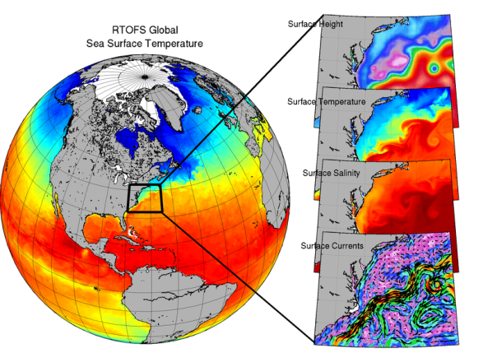
Global RTOFS and RTOFS-DA
RTOFS: Real-Time Ocean Forecast System
HYCOM+CICE forecast models
Configuration: 1/12° HYCOM-CICE, 41 layer, tri-polar grid
GDAS/GFS forcing
No tides
Users include: EMC (waves, hurricanes), NHC, OPC, NOS, U.S. Coast Guard, AOML/HRD
RTOFS-DA: RTOFS Data Assimilation
Multivariate, multi-scale 3DVAR
Flexible and unified end-to-end system:
data quality control → variational analysis → diagnostics
Analysis performed directly on HYCOM tri-polar grid layers using 24-hr update cycle

Slide 3
Data Flow through RTOFS-DA System
Obs
Ocean Data QC:
Fully automated, executed in real-time
3DVAR:
Multivariate analysis of temperature, salinity, velocity, sea ice coverage
Hourly FGAT for ICE, SST, SSS
HYCOM:
Coupled to CICE model
3-hr incremental analysis update (IAU)
SST:
METOP, NPP, JPSS, GOES, Ship, Buoy, Himawari
SSS:
SMAP, SMOS
Profile Temp/Salt: XBT, CTD, Argo Floats, Buoys, Gliders, ALAMO, Animal-borne sensors, Saildrone
Altimeter SSH:
Jason, CryoSat, Altika, Sentinel
Sea Ice:
SSMI/S, AMSR, VIIRS
Velocity:
HF Radar, ADCP, Drifters
Biology:
Ocean Color Chlorophyll
QC w/ condition flags
Ocean Data
QC
Innovations
3DVAR
Increments
HYCOM
Adaptive Sampling Data Impacts
Forecast Fields Prediction Errors
First Guess
Sensors
Assimilation
Forecast Model

Slide 4
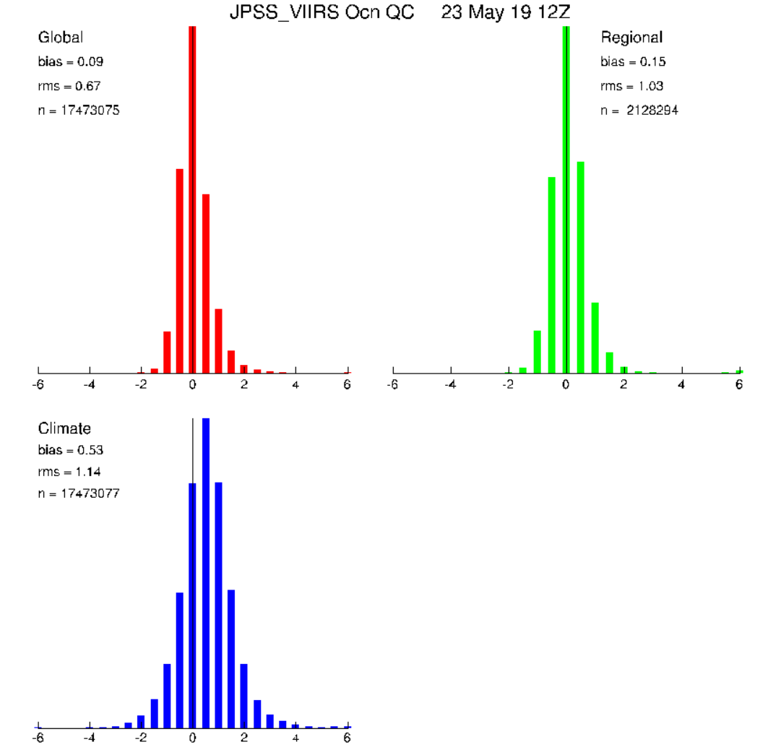
Ocean Data Quality Control: Stages and Outcomes
Stage 1 – sensibility checks
land/sea boundaries, location (speed) test, exact/near duplicate, future observation time test
Stage 2 – error checks:
instrumentations failure modes, vertical gradients, static stability
cross validation, background fields (climate, forecast)
Stage 3 – consistency checks:
reject if global 3DVAR solution is not converging at observation location
innovation error checks performed during the variational minimization
QC outcomes: likelihood observation contains an error plus condition flags
All QC tests performed before a QC decision is made: accept, reject, correct
Decision making algorithm is used to resolve multiple background field checks
climate, cross validation analysis, forecast
QC outcomes and flags used to select valid observations for the analysis
Anomaly histograms of JPSS-VIIRS SST vs. various SST backgrounds
Climate Global Regional
Notes:
1

Slide 5
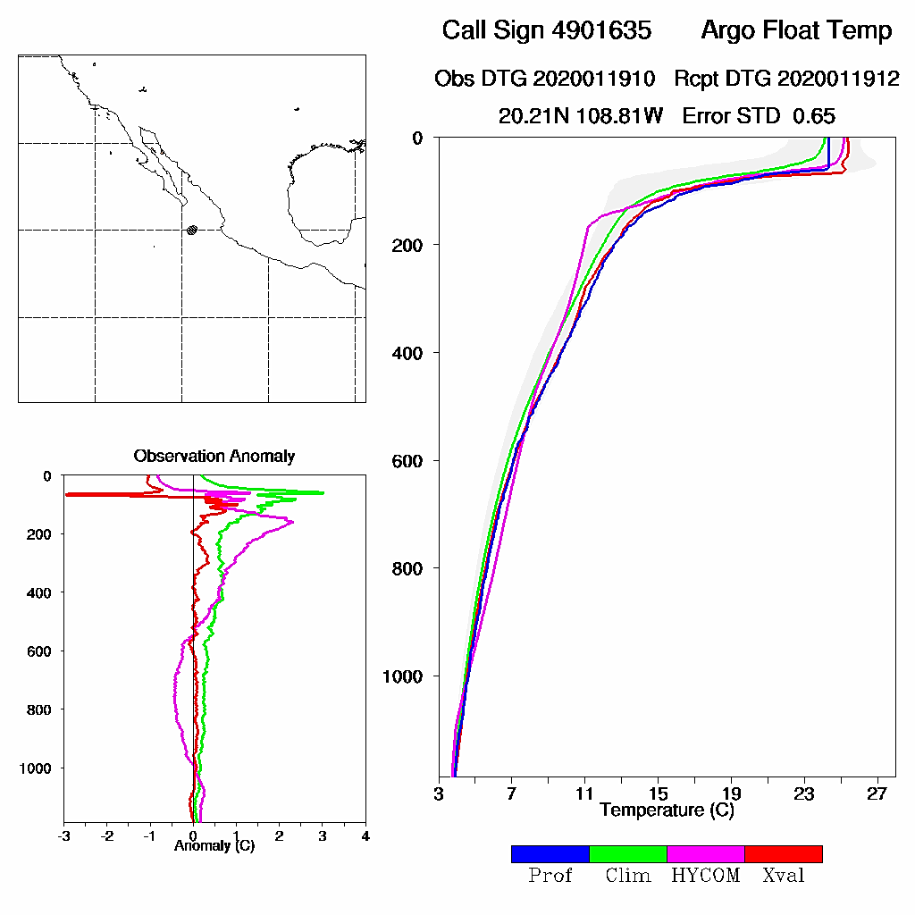
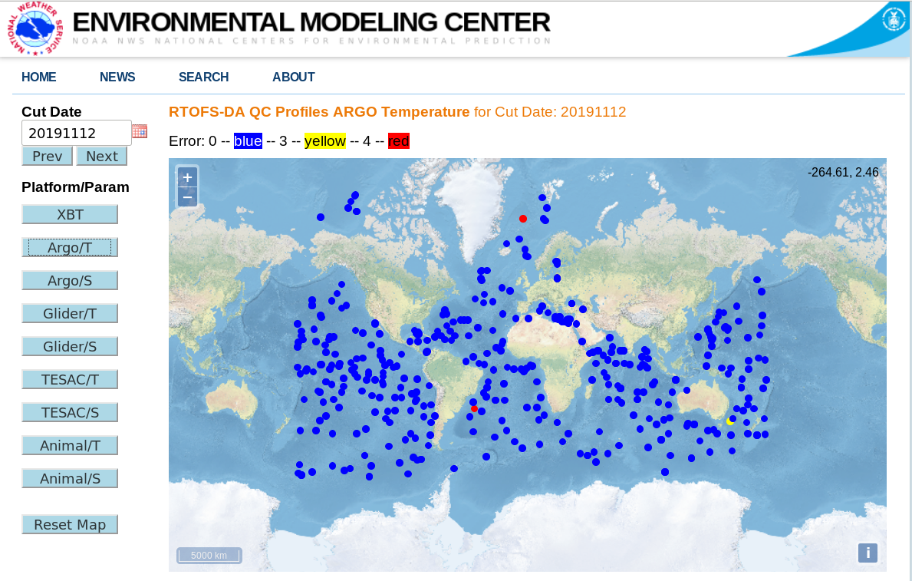
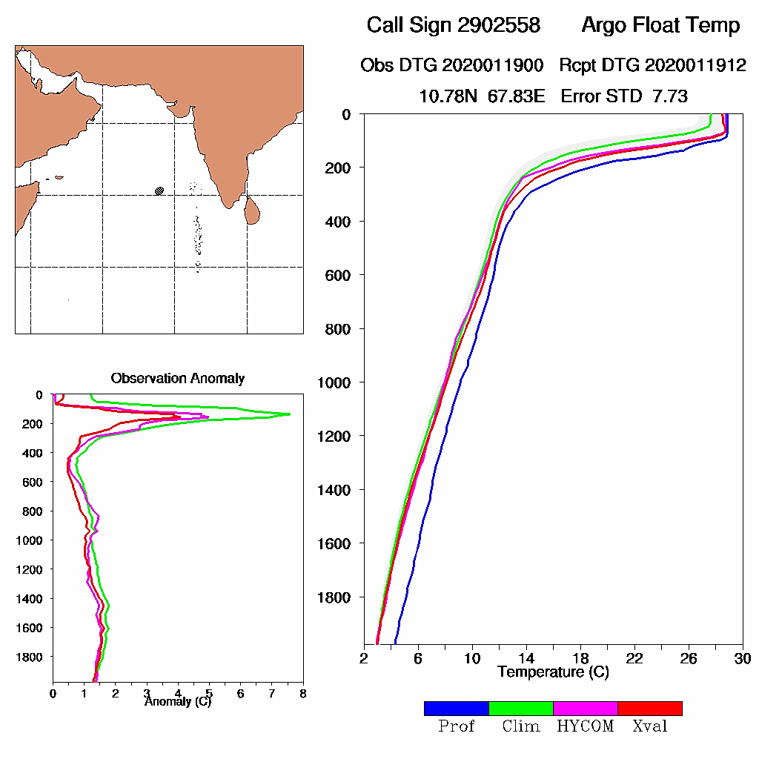
RTOFS-DA: Profile QC
Profile QC outcomes available on the web in real-time
accepted (blue), rejected (red), marginal (yellow)
Shows background fields and anomalies used to make QC decision (climate, cross validation, model forecast)
accepted:
error < 3
https://polar.ncep.noaa.gov/develop/RTOFS-DA/
login: rtofseval passwd: eval2007
rejected:
error > 4

Slide 6
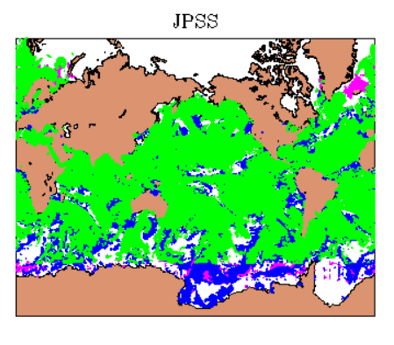
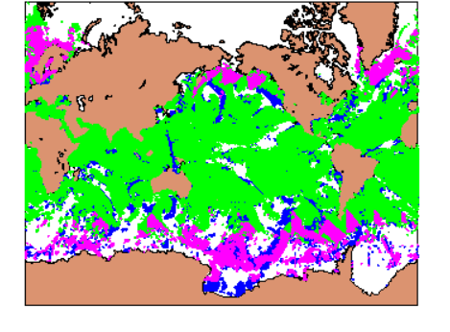
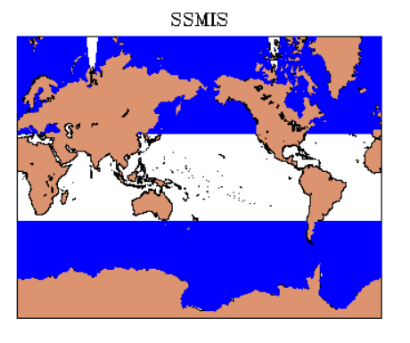
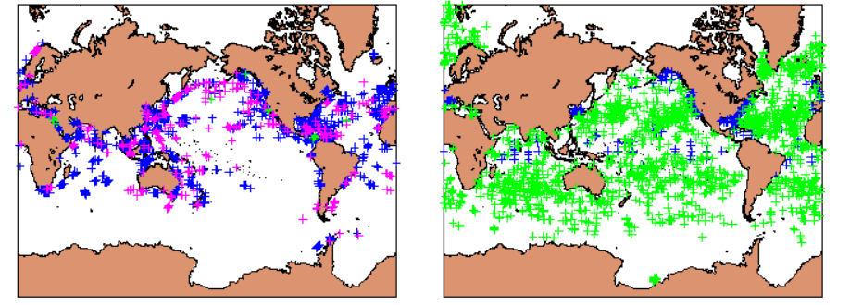
RTOFS-DA Ocean Observing
Systems: 22 Jan 2020
Satellite and In situ SST
Sea Ice Coverage
JPSS-VIIRS METOP-A
SSMI/S
# ICE obs: 1,015,298
# SST obs: 83,038,928
Sfc SHIP Fixed/Drifting Buoy

Slide 7
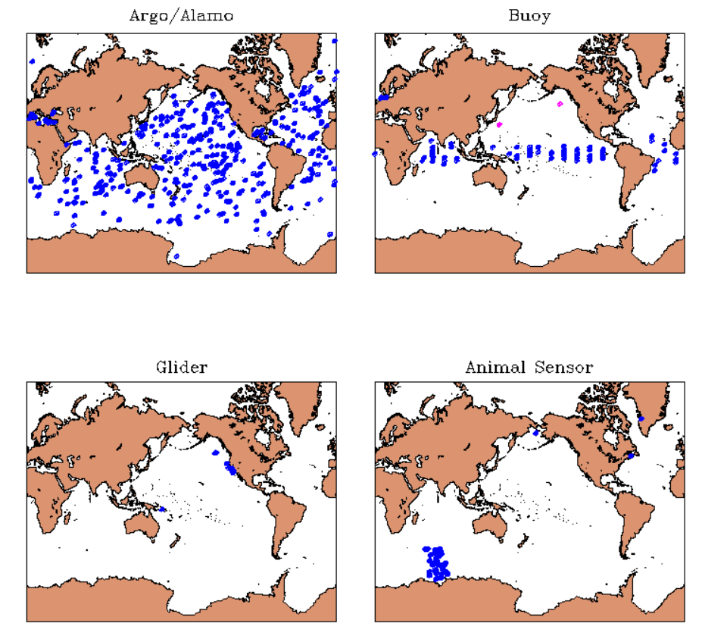
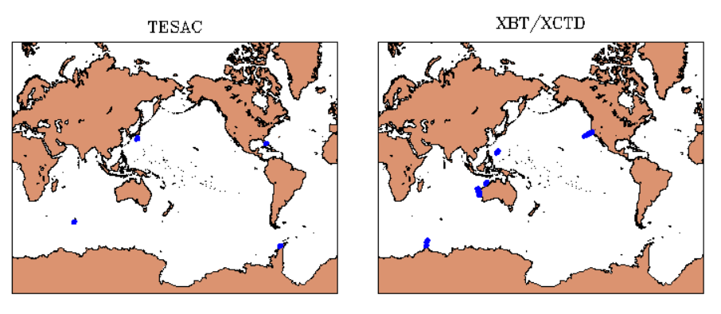
RTOFS-DA Ocean Observing Systems: 22 Jan 2020
Profile Observations
Argo Fixed Buoy TESAC
Glider Animal Sensor XBT/XCTD
# profiles: 831 # profile T,S obs: 218,506

Slide 8
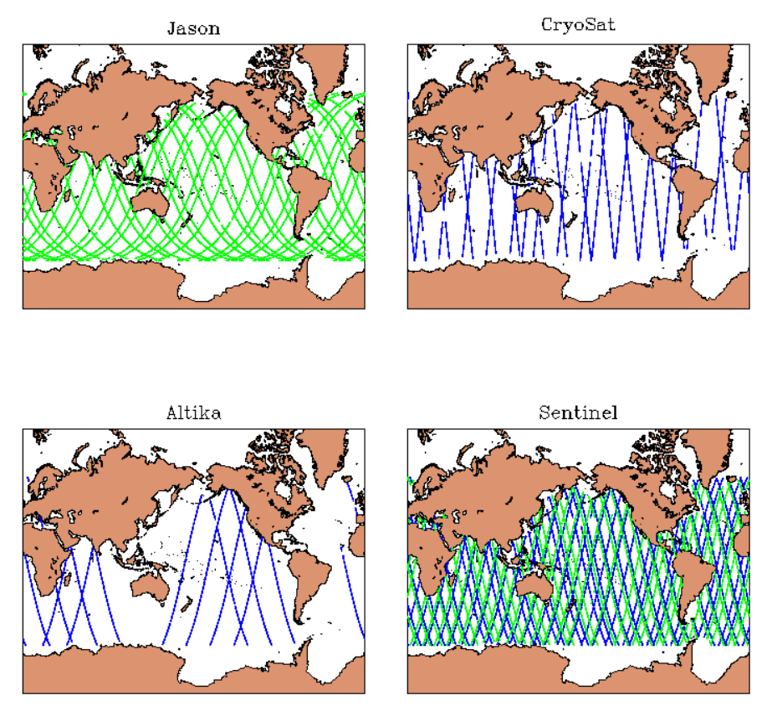
RTOFS-DA Ocean Observing Systems: 22 Jan 2020
Altimeter SSH
Jason-3 CryoSat-2
# SSH obs: 345,702
Altika Sentinel-3A,3B

Slide 9
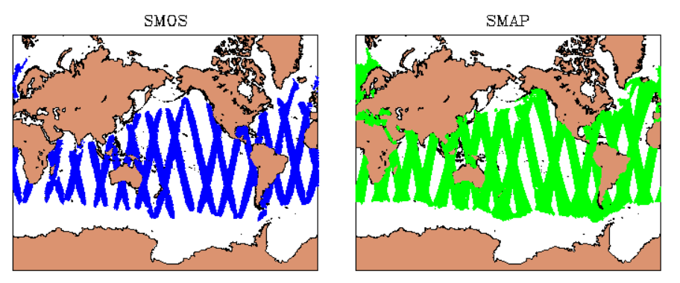
RTOFS-DA Ocean Observing Systems: 22 Jan 2020
Satellite Sea Surface Salinity
JPSS-VIIRS METOP-A
SMOS SMAP
# SSS obs: 863,496

Slide 10
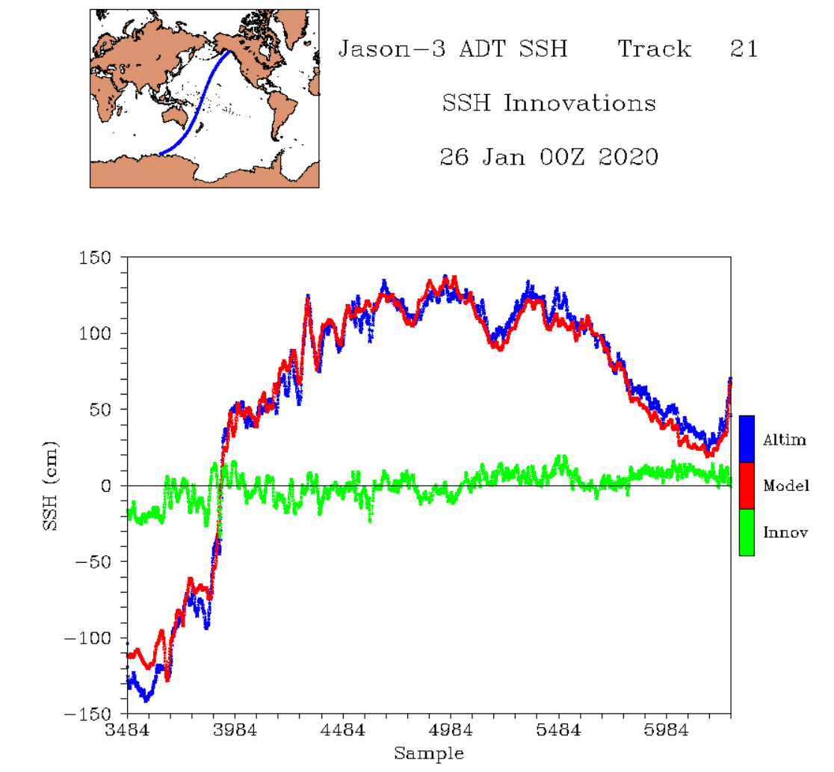
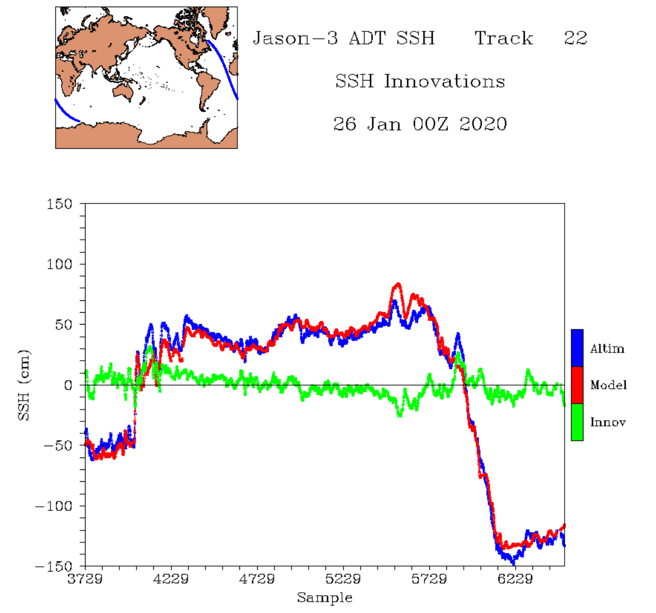
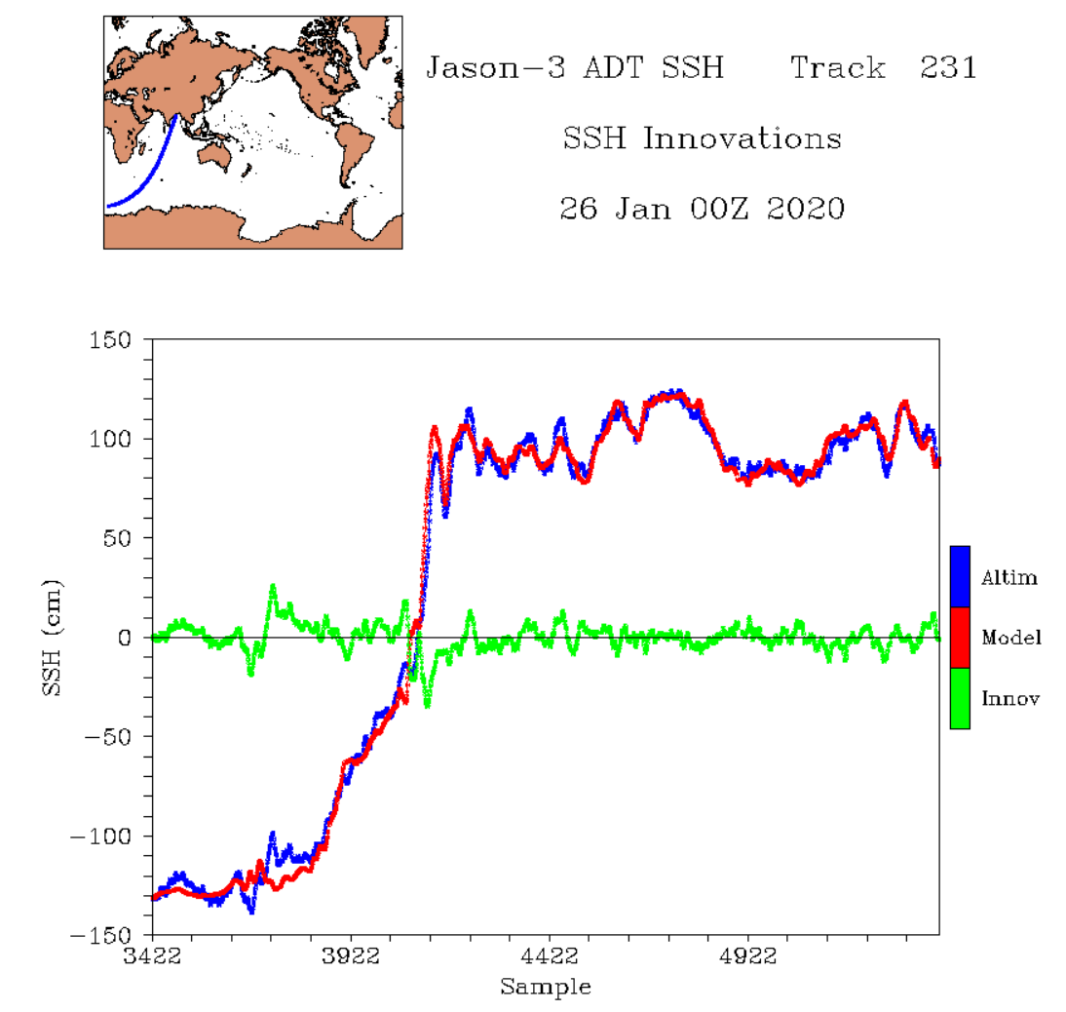
Altimeter Absolute Dynamic Topography (ADT) Assimilation
Pacific
Atlantic
Altimeter tracks of ADT, HYCOM ADT, and ADT-HYCOM innovations in 3 ocean basins
Good agreement between ADT observations and HYCOM 24-hr ADT forecasts
HYCOM ADT bias corrected along altimeter tracks: corrections nearly constant (~50 cm) for all tracks and for all satellites
Indian

Slide 11
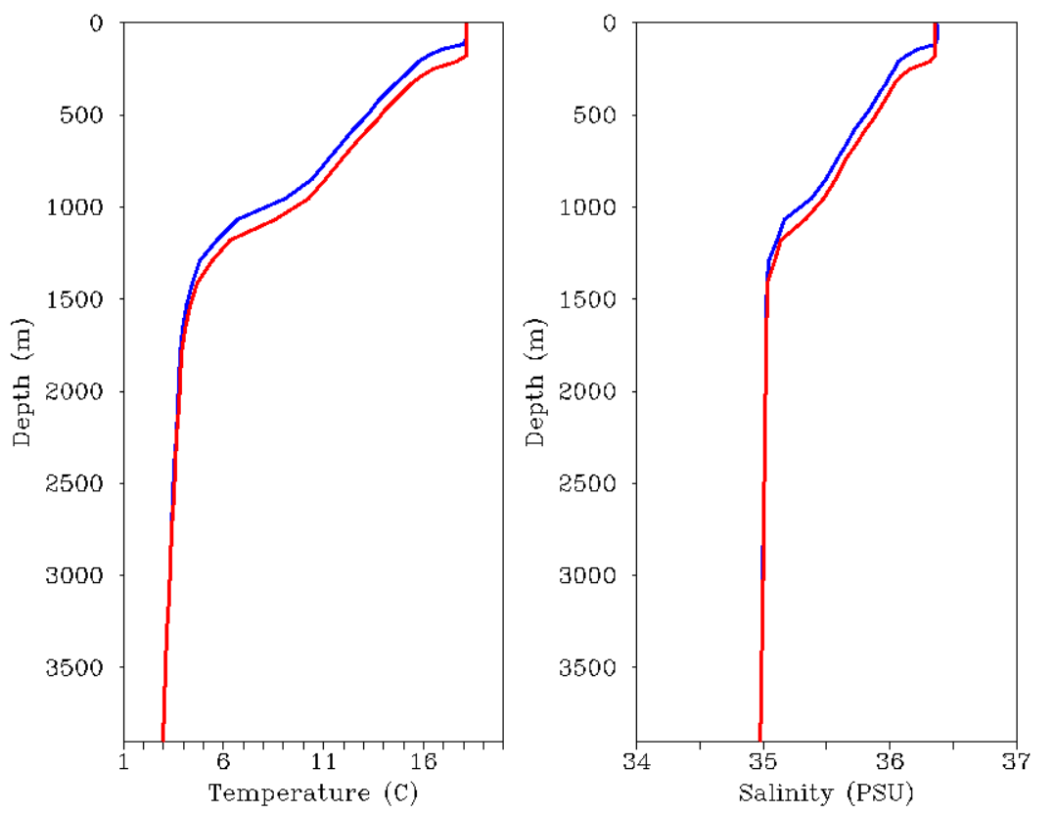
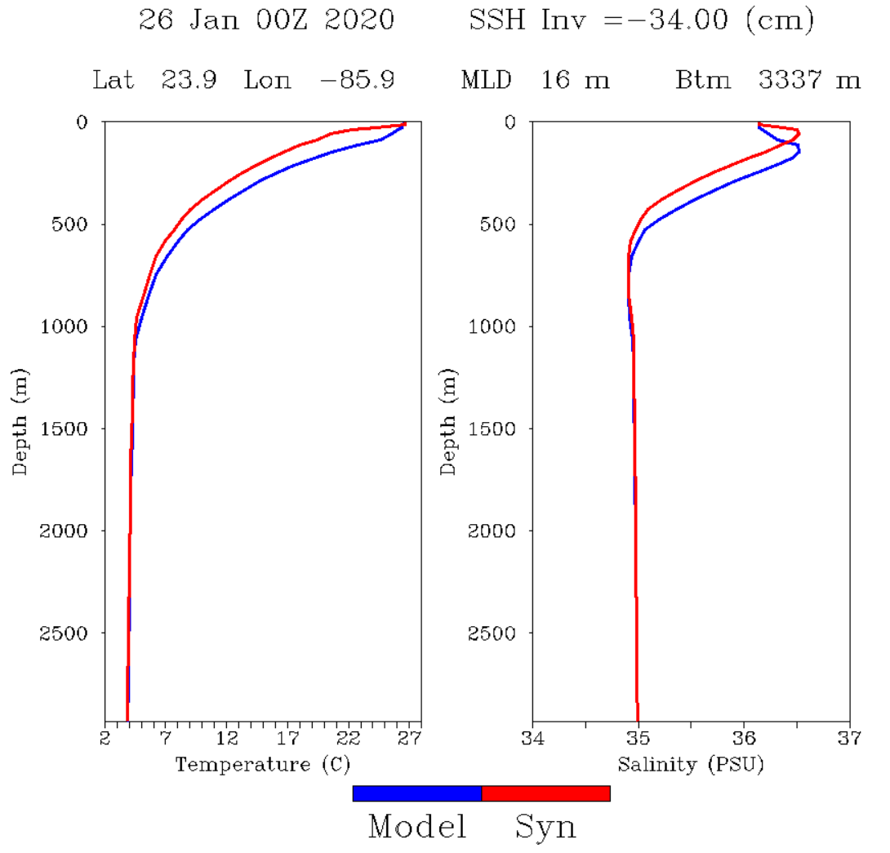
Altimeter Absolute Dynamic Topography (ADT) Assimilation
δADT=+16 cm
δADT=-34 cm
Forecast Corrected
Assimilation corrects forecast model layers to be consistent with δADT
  - layers are lowered when δADT > 0; layers are raised when δADT < 0
Solution conserves model TS relationships and is constrained by SST, SSS, MLD

Slide 12
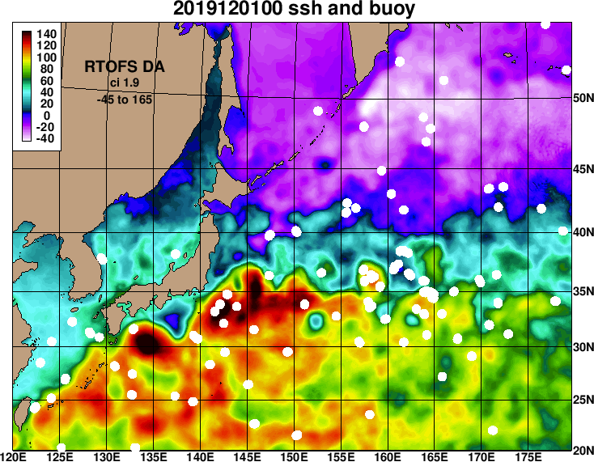
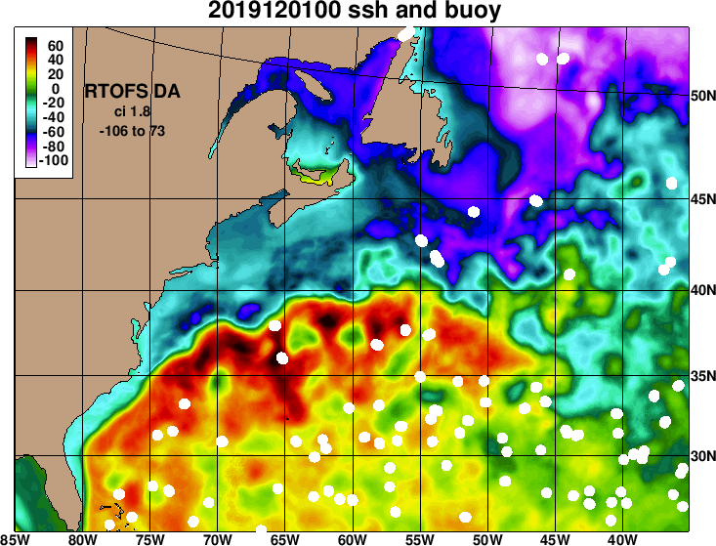
Kuroshio Extension Gulf Stream
Drifting buoy tracks vs. HYCOM model SSH forecasts (12 hour intervals)
Shows skill of HYCOM circulation patterns from altimeter ADT assimilation

Slide 13
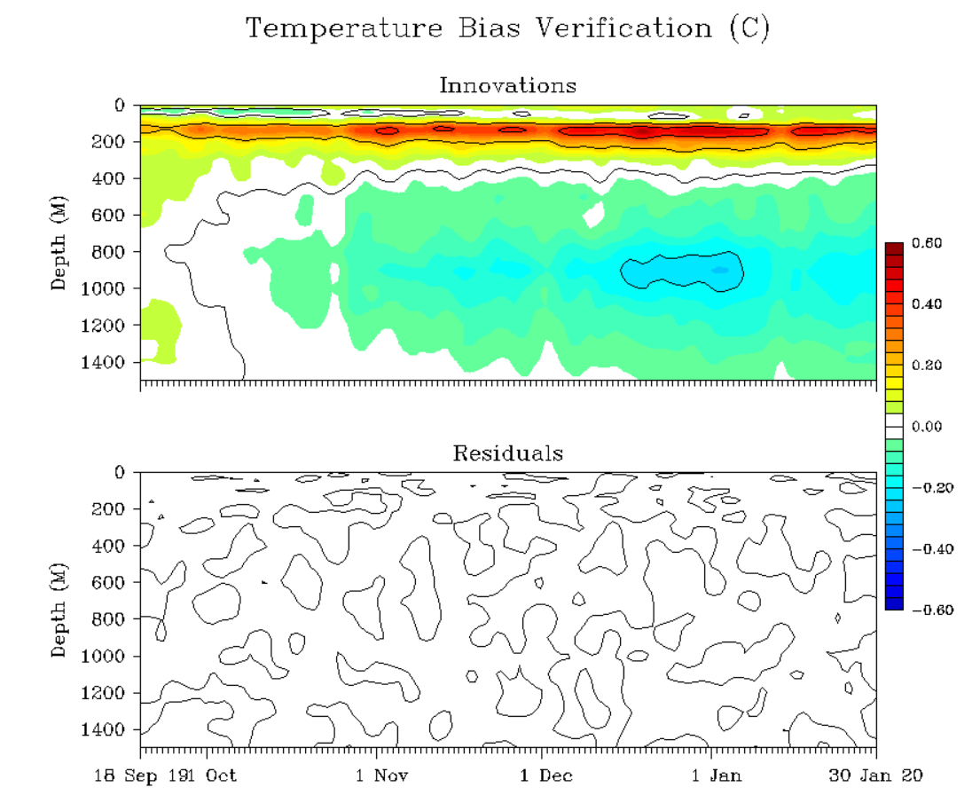
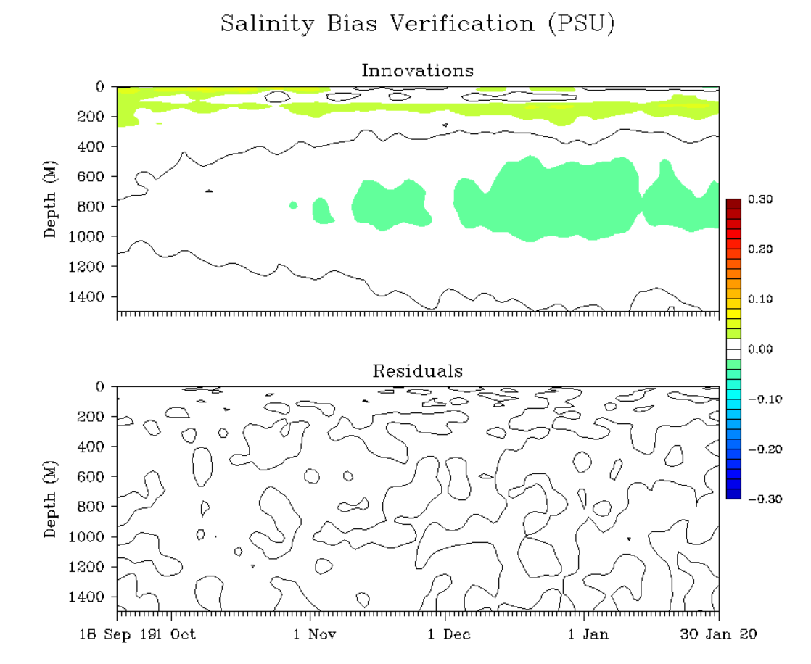
Global Analysis Verification: 18 Sep 2019 to 30 Jan 2020
Temperature Bias Salinity Bias
OmF
OmA
HYCOM mean bias errors (OmF) greatest at top of seasonal thermocline (~150 m; 0.4°C, 0.1 PSU)
Secondary maximum in mean bias errors at permanent thermocline depths (~800 m)
OmA residuals are essentially zero: RTOFS-DA 3DVAR effectively analyzes the observations

Slide 14
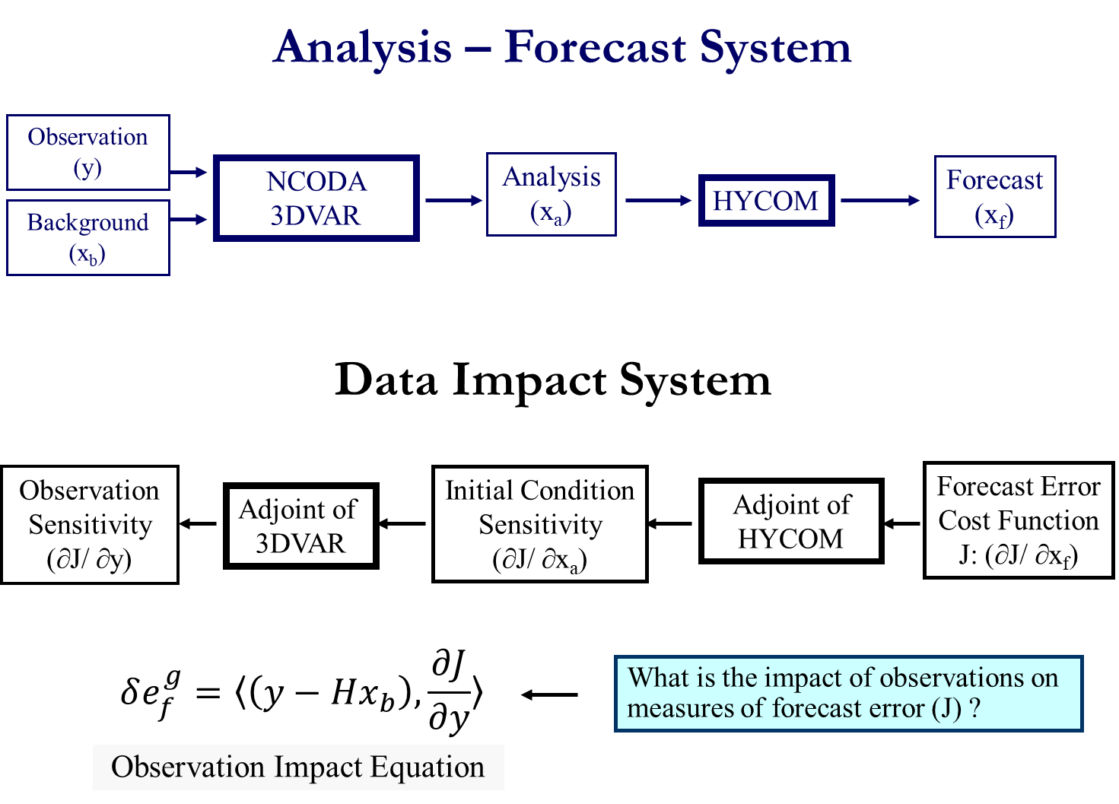
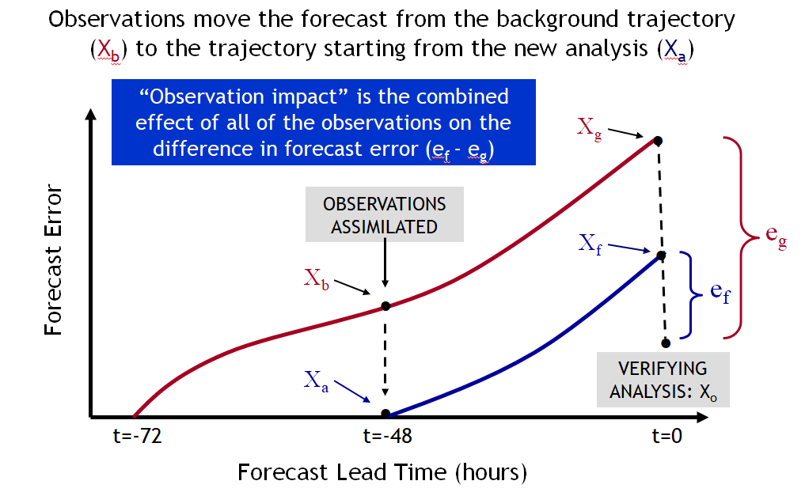
New Capabilities: Observation Data Impact System
Adjoint of ROTFS-DA provides impacts of observations on reducing HYCOM 48 hr forecast errors
Data impacts routinely calculated every assimilation cycle
Multiple Uses of Data Impact System
Application | Innovations | Cost Function | Purpose
Observation Impact | Real observations (all known) | Forecast error (known) | Evaluate impacts of observations on forecast error
Observing System Design | Real and simulated observations (known, unknown) | Forecast error or model variable (known) | Develop more optimal configurations of observing systems
Targeted Observing | Simulated observations (all unknown) | Proxy for forecast error (unknown) | Impact of adding observations at some future time

Slide 15
RTOFS-DA: Operational Transition
Operational status expected August, 2020:
  daily analysis at 00Z plus 8 day forecasts, fields available to the public
  data impact products available to the public
  support for GODAE Ocean Predict task teams: DA-TT, OSEVal-TT, IV-TT
Continuing support:
  new ocean observing systems:
    SST: GOES-17, Himawari-9, METOP-C, Sentinel SLSTR
    ICE coverage, thickness, surface temperature: CryoSat-2, SMOS, VIIRS
    Velocity: HF Radar, ADCP, Drifting Buoys
    Altimeter SSH: SWOT
  new analysis variables:
    ocean color (chlorophyll): JPSS-VIIRS, Sentinel-OLCI, GCOM-C
Model/system updates:
  move to MOM-6/HYCOM merged forecast model
  integrate with JCSDA/JEDI system components

Slide 16
RTOFS-DA: Downstream users at NCEP
Hurricanes: ocean initialization for coupled hurricane systems
AI21A-07: H-S Kim et al., Wave-Hurricane-Ocean coupling
CP53D-03: H-S Kim et al., Oceanic response to Hurricane Dorian
Waves: wave-current interactions
NWPS (Nearshore Wave Prediction System)
  https://polar.ncep.noaa.gov/nwps/
  GFS: future implementation FV3/WWIII:
    Ocean Currents from RTOFS-DA

Slide 17
Questions?

Slide 18
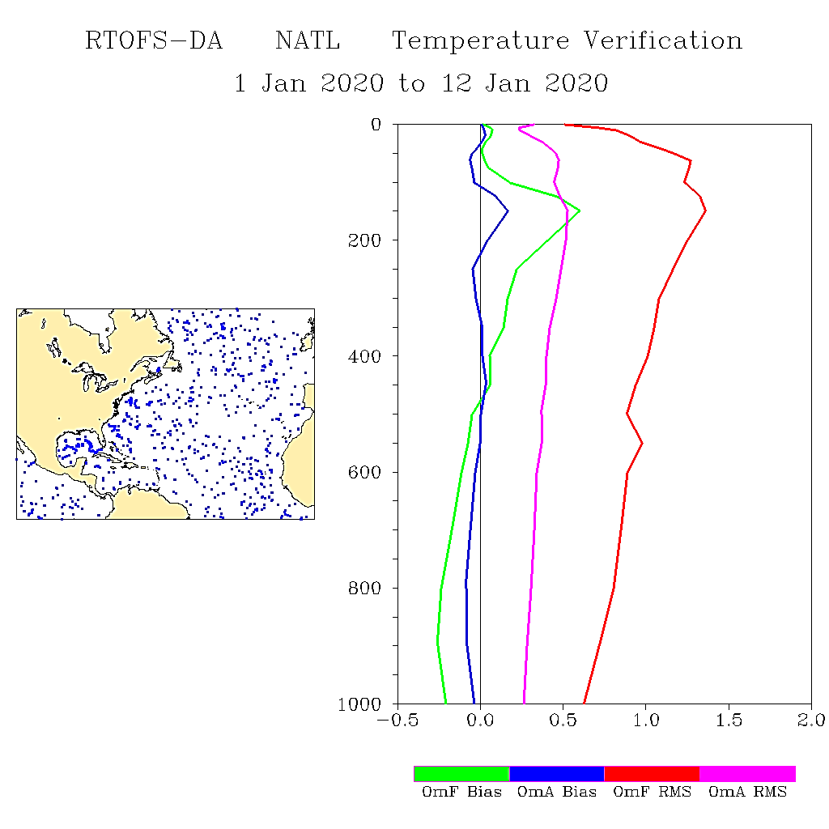
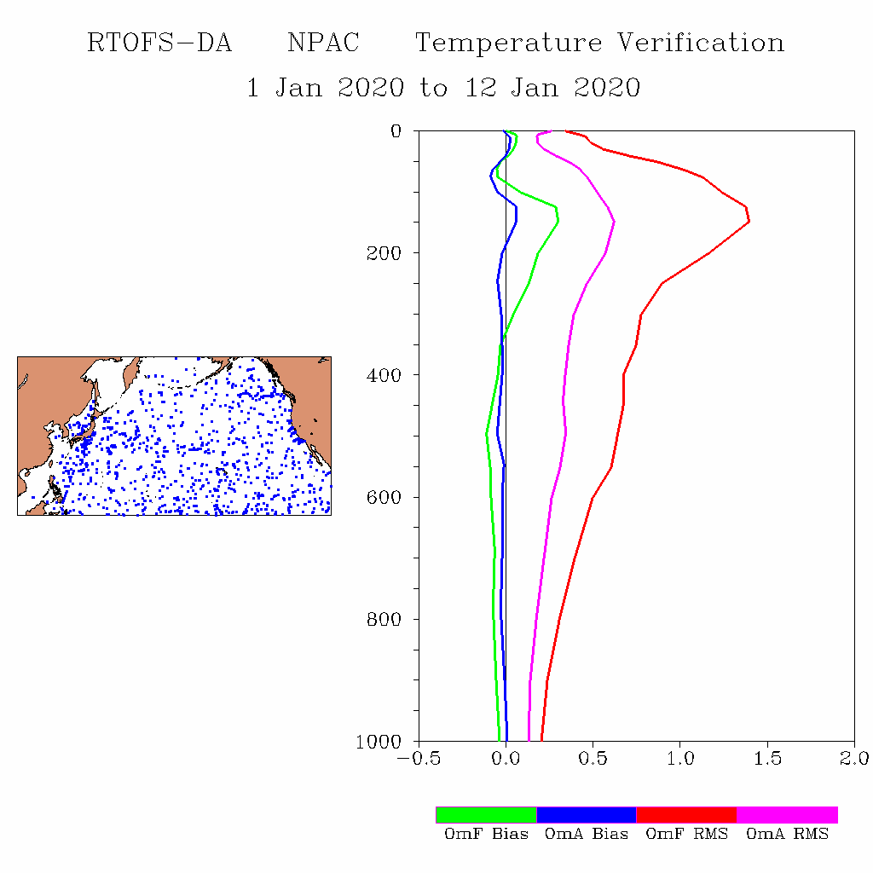
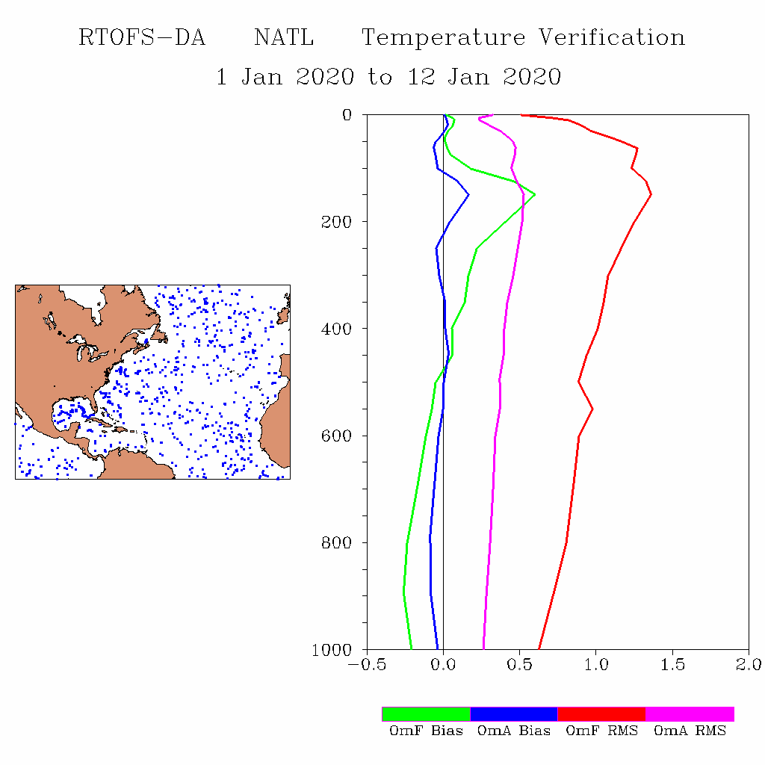
RTOFS-DA Temperature Verification: 1-12 Jan 2020
NATL
NPAC

Slide 19
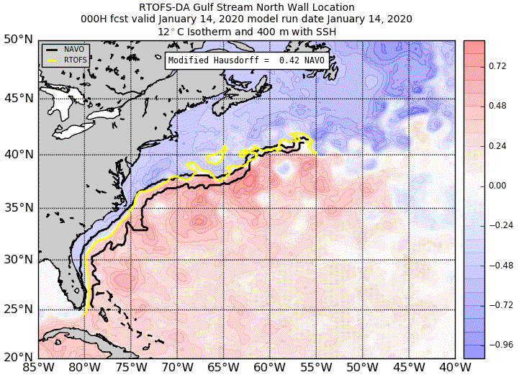
RTOFS-DA verification: Gulf Stream front
https://polar.ncep.noaa.gov/develop/RTOFS-DA/
Login: rtofseval passwd: eval2007

