Slide 1
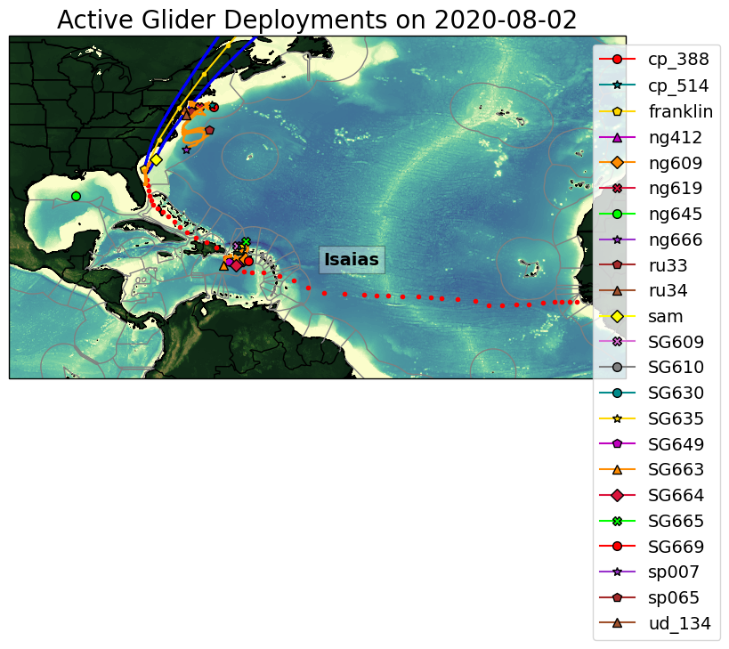
Storm Isaias passed through the hurricane glider array in the Caribbean and SAB. The effects of Isaias were also clearly seen in the data collected in the MAB, even though the storm had already made landfall near NC/SC.

Slide 2
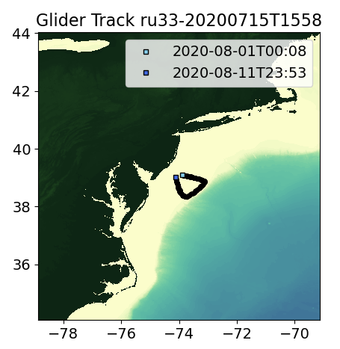
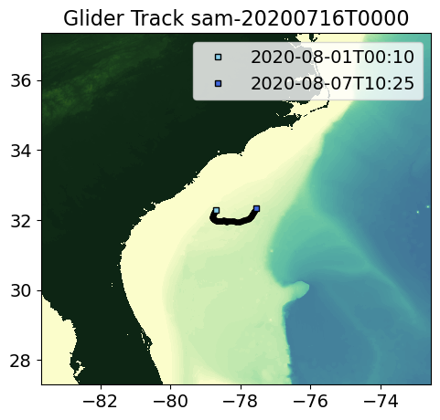
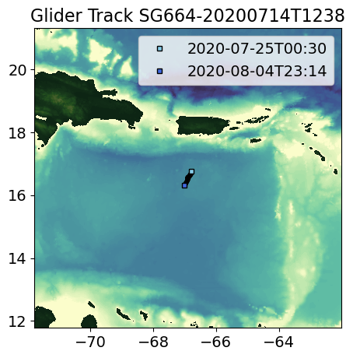
Regions of Interest
MAB
SAB
Caribbean

Slide 3
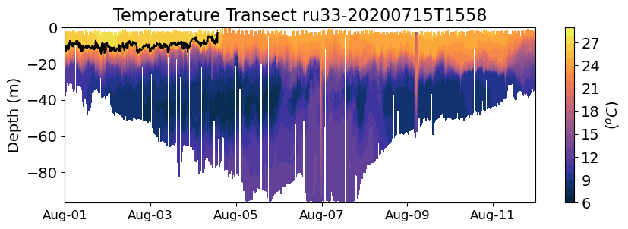
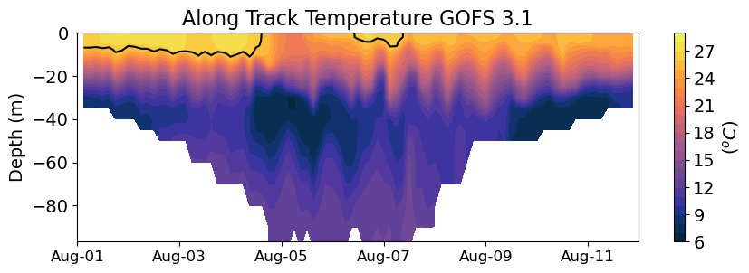
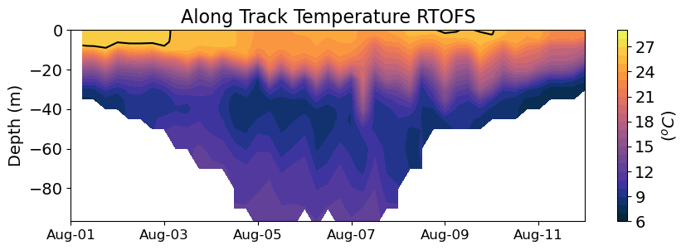
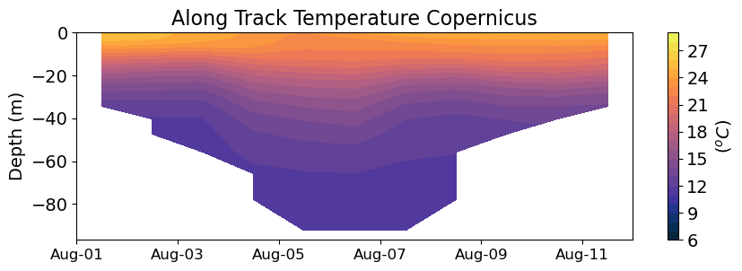
MAB
Isaias
Observations
Analysis
Glider RU33 showed cooling of about 3 degrees in the surface mixed layer after the passage of Isaias. GOFS and RTOFS captured this cooling
Forecast
Forecast

Slide 4
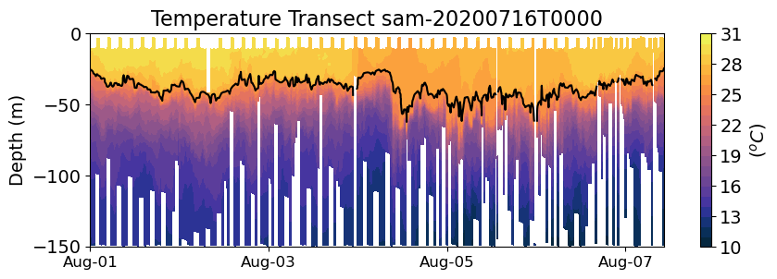
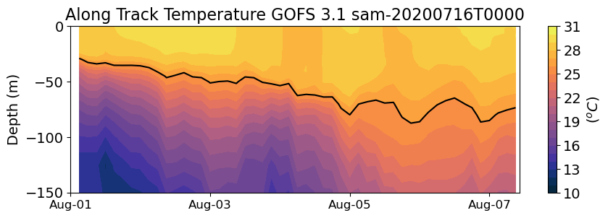
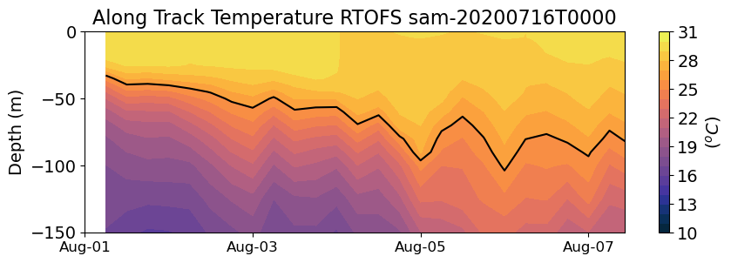
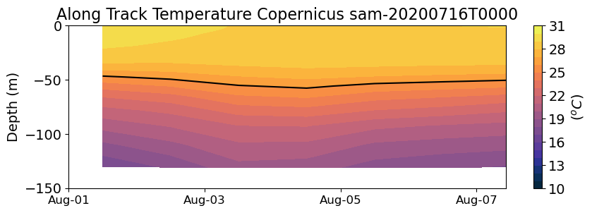
SAB
Isaias
Observations
Analysis
Glider SAM also showed cooling of 2 degrees in the surface mixed layer after the passage of Isaias. GOFS captured this cooling. RTOFS also had a drop in the mixed layer temperature but less intense.
Forecast
Forecast

Slide 5
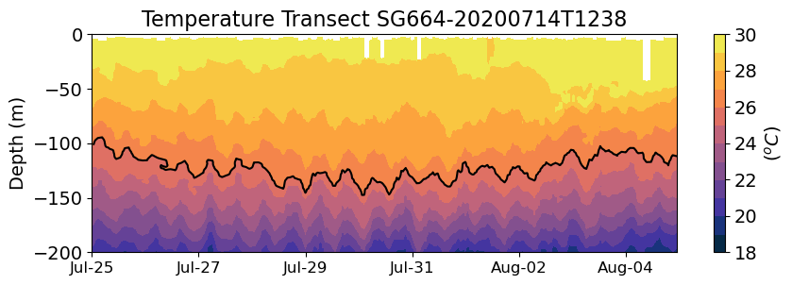
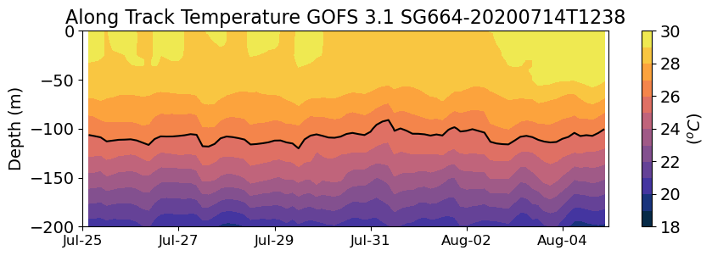
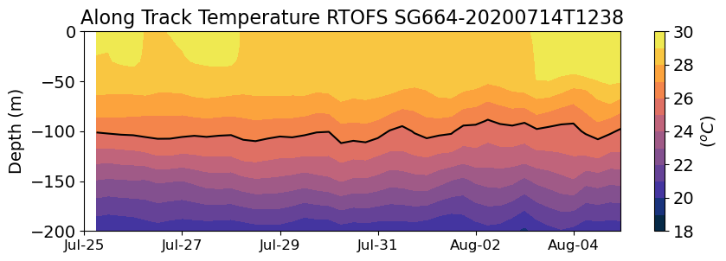
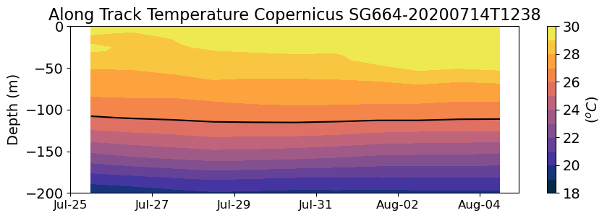
Caribbean
Isaias
Observations
Analysis
Glider SG664 showed no evident change in the temperature of the mixed layer after Isaias.
Forecast
Forecast

Slide 6
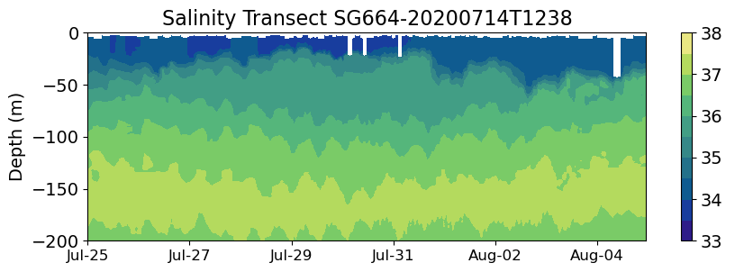
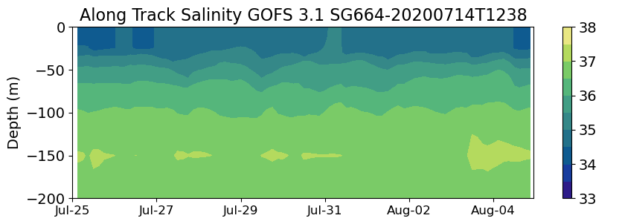
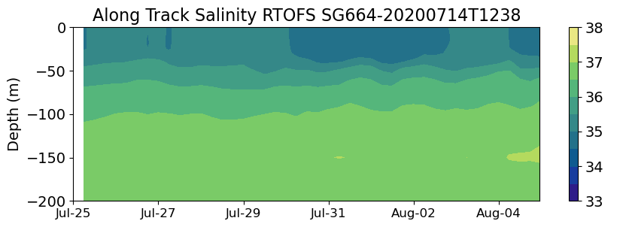
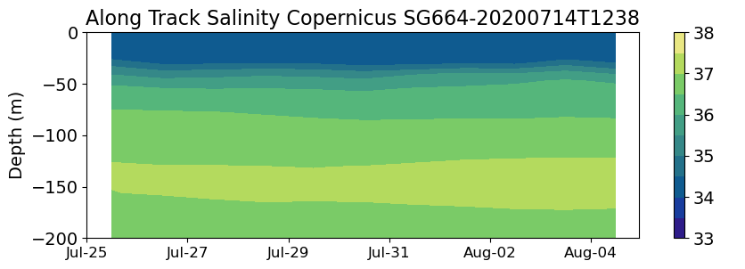
Caribbean
Isaias
Observations
Analysis
Glider SG664 was within the region of fresh water influence and showed a barrier layer. We will investigate if the barrier layer prevented the vertical mixing within the mixed layer.
Forecast
Forecast

Slide 7
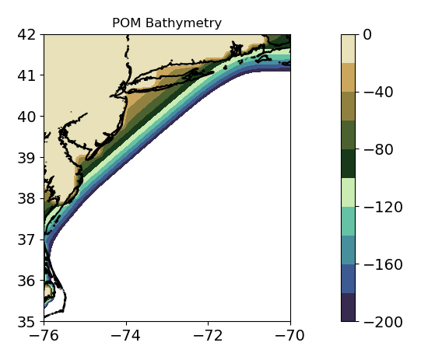
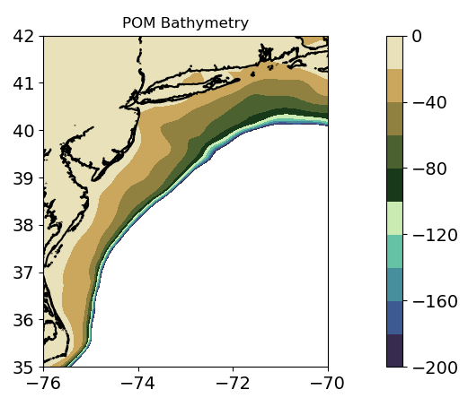
HWRF-POM Bathymetry IC Climatology vs IC RTOFS
Big improvements in the shelf bathymetry for all regions
IC Clim.
IC RTOFS

Slide 8
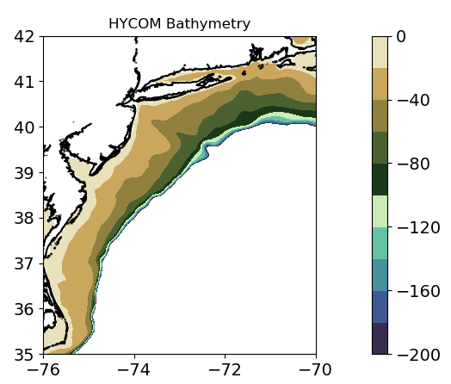
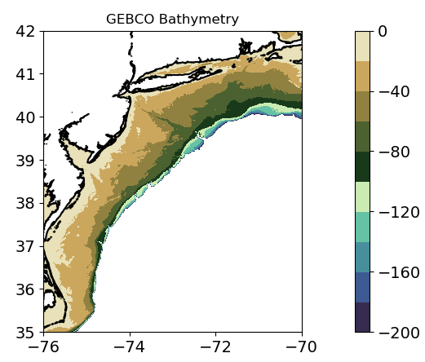
MAB
IC Clim.
IC RTOFS

Slide 9
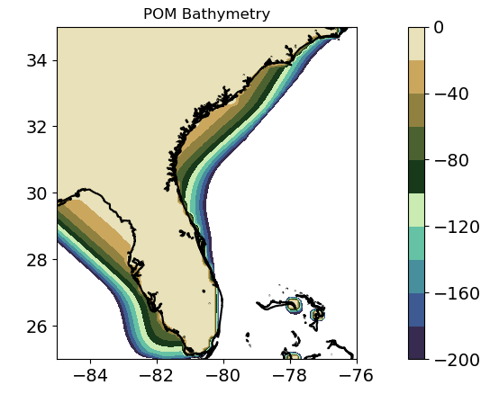
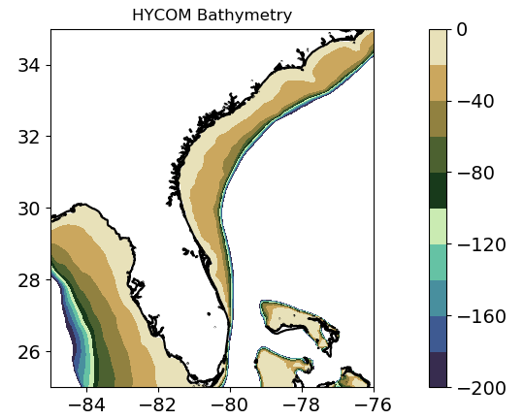
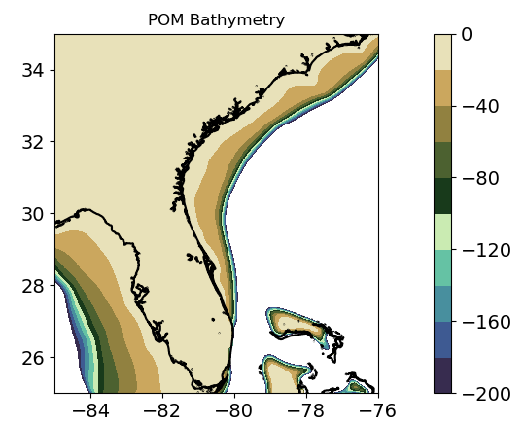
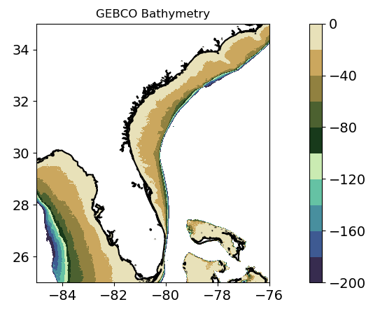
SAB
IC Clim.
IC RTOFS

Slide 10
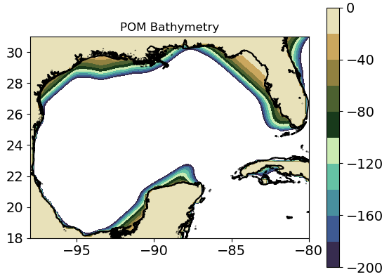
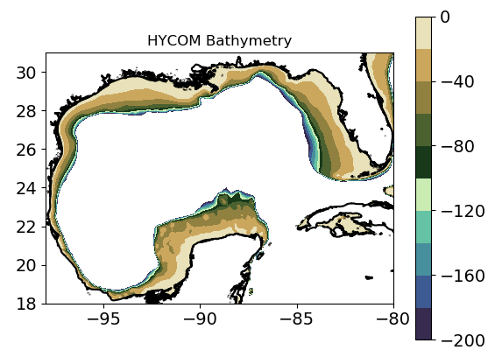
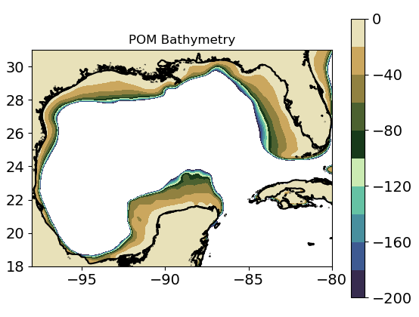
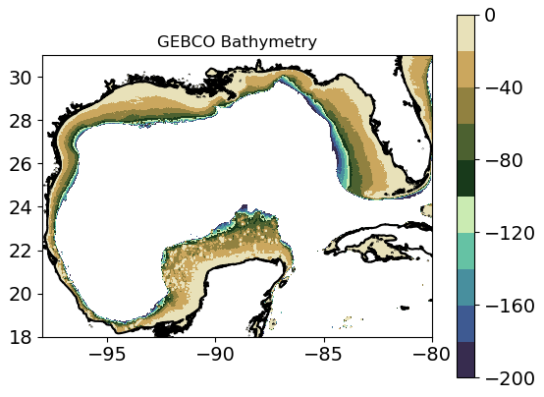
Gomex
IC Clim.
IC RTOFS

Slide 11
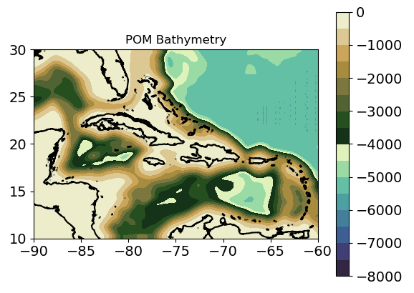
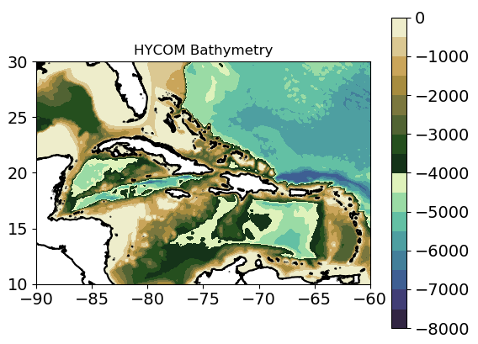
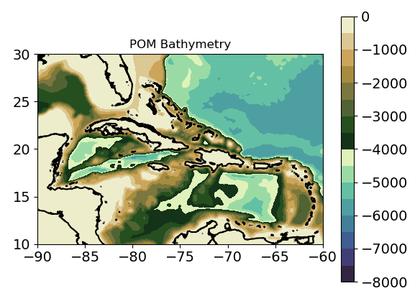
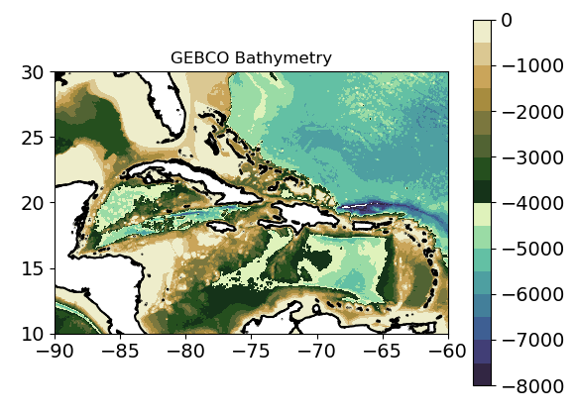
Caribbean
IC Clim.
IC RTOFS

Slide 12
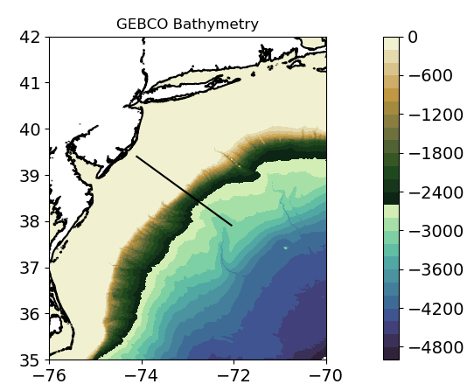
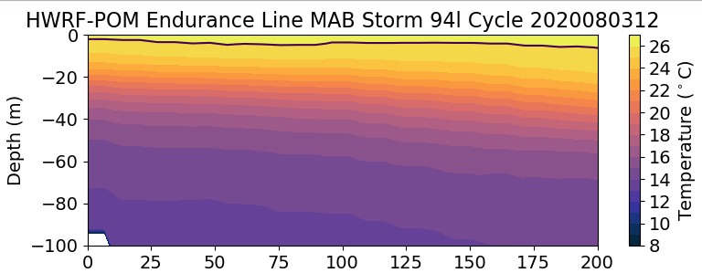
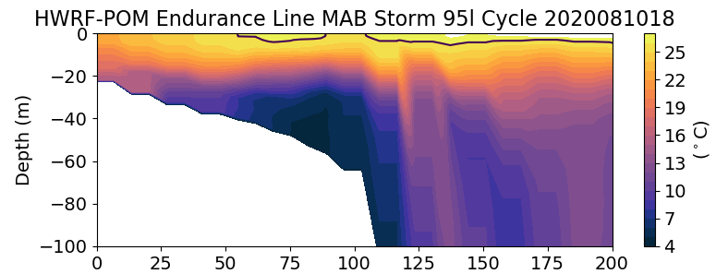
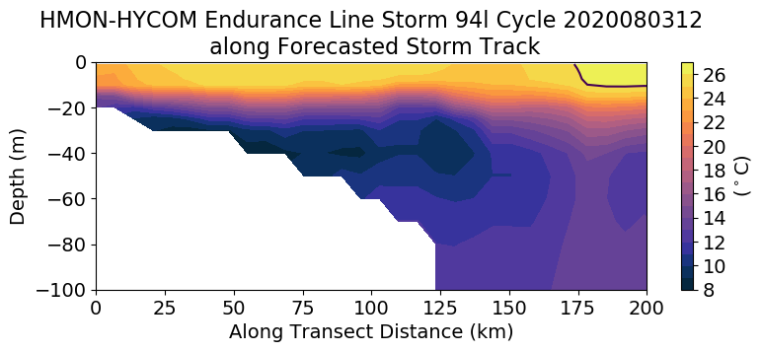
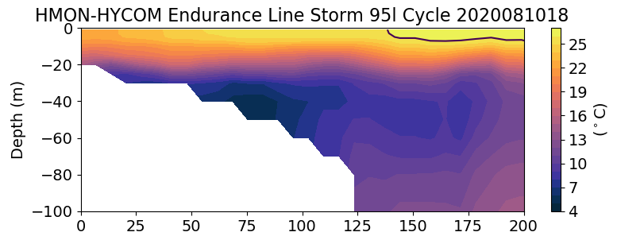
MAB
New HWRF-MPIPOM has a cold pool
IC Clim.
IC RTOFS

Slide 13
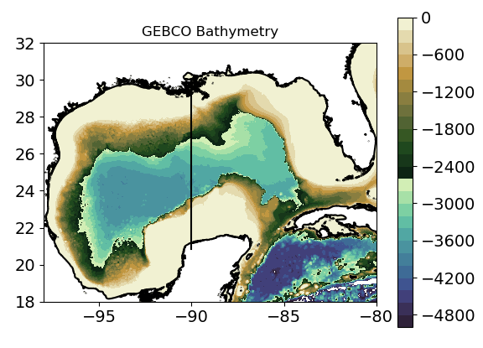
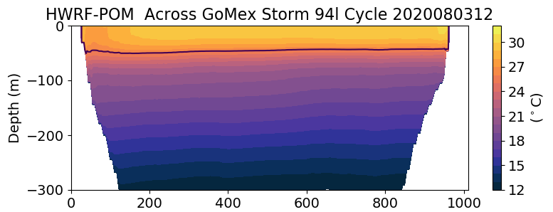
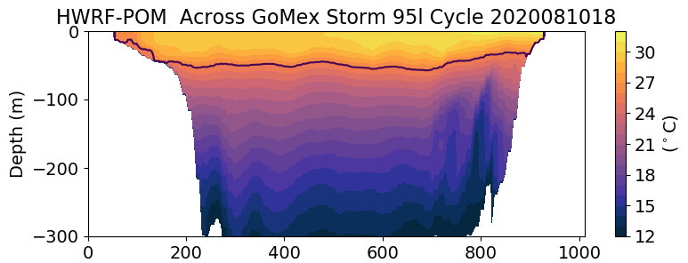
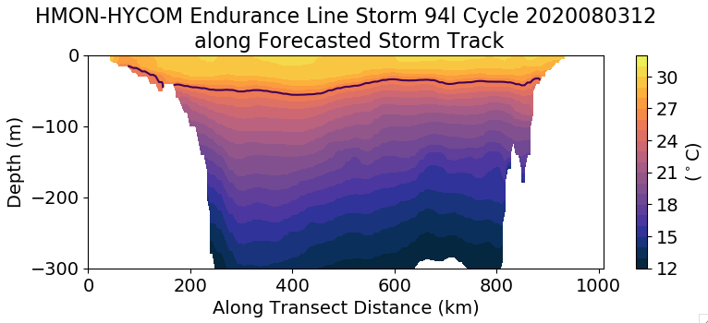
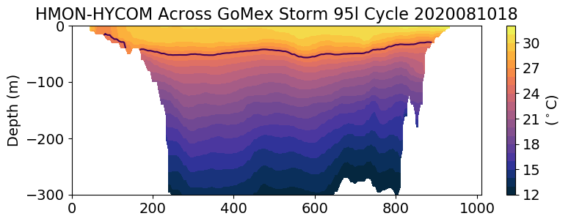
GoMex
The Yucatan and Louisiana shelf are much better represented in
HWRF-MPIPOM
IC Clim.
IC RTOFS

Slide 14
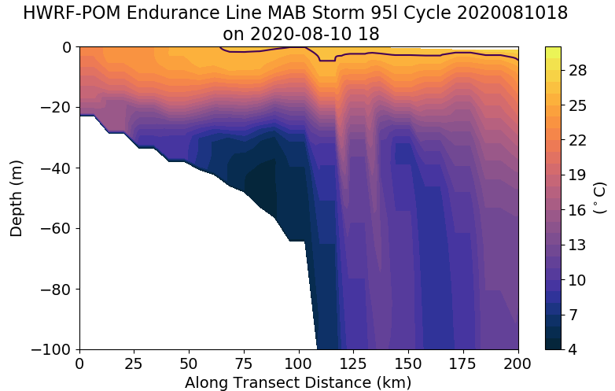
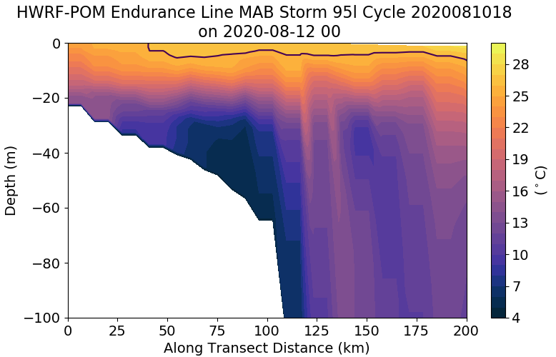
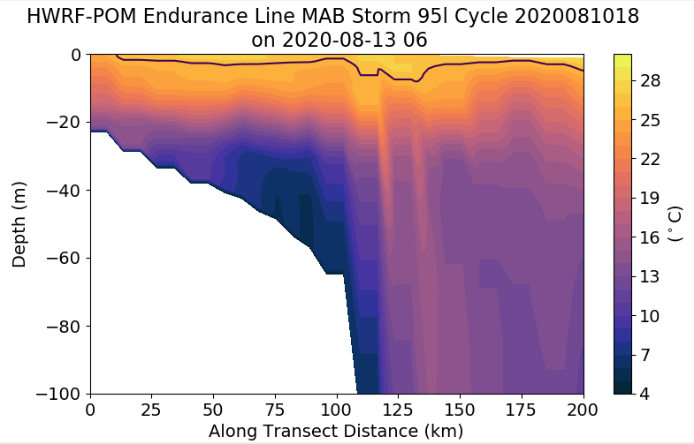
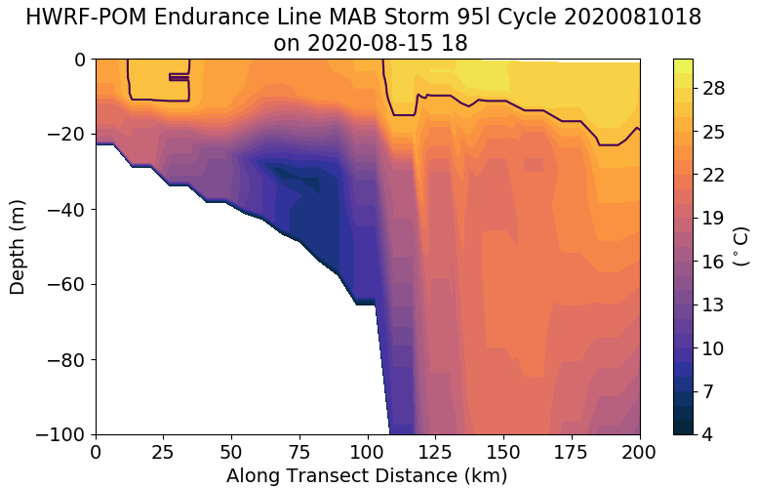
HWRF-MPIPOM has some jumps in the temperature field that persist through the forecasting cycle

