Slide 1
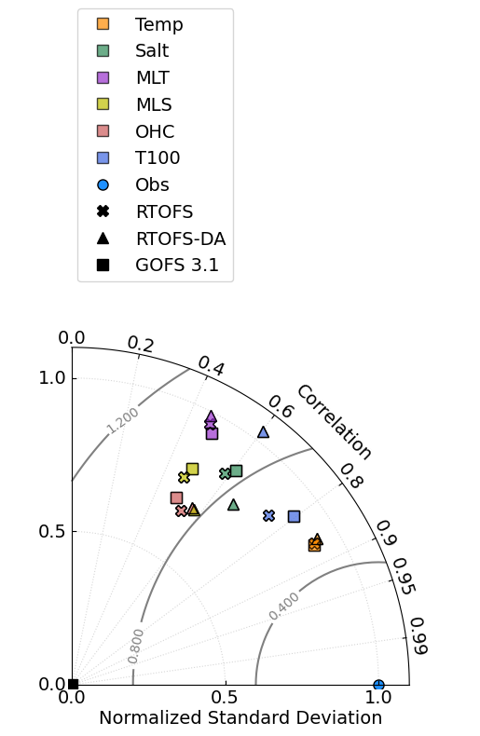
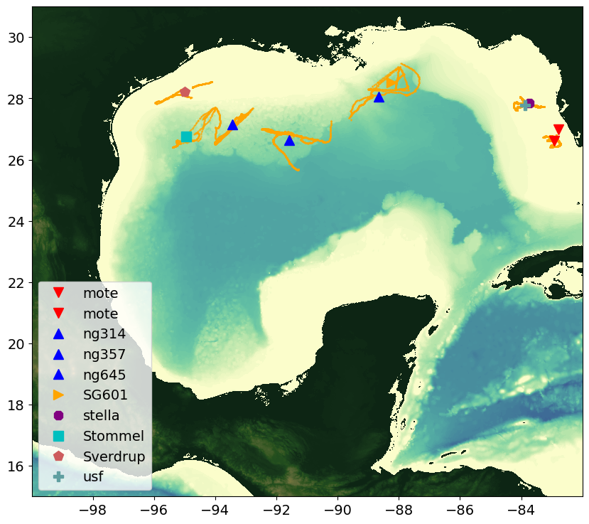
﻿date_ini = '2020/06/19/06'
date_end = '2020/10/25/06'
MLT
MLS
T100
OHC
Salt
Temp

Slide 2
﻿Gomex
 |  | Bias
 | N | Temp(ºC) | Salt
RTOFS | 86190 | -0.96 | -0.11
RTOFSDA | 83927 | -0.53 | 0.08
GOFS | 172669 | -0.95 | -0.08
 |  | Bias
 | N | MLT(ºC) | MLS
RTOFS | 3832 | -0.34 | -0.31
RTOFSDA | 3754 | -0.18 | -0.03
GOFS | 7658 | -0.26 | -0.22
 |  | Bias
 | N | OHC(KJ/cm²)
RTOFS | 3811 | -7.9
RTOFSDA | 3728 | -4.1
GOFS | 7618 | -9.6
 |  | Bias
 | N | T100(ºC)
RTOFS | 1155 | -0.92
RTOFSDA | 1130 | -0.57
GOFS | 2295 | -0.97

Slide 3
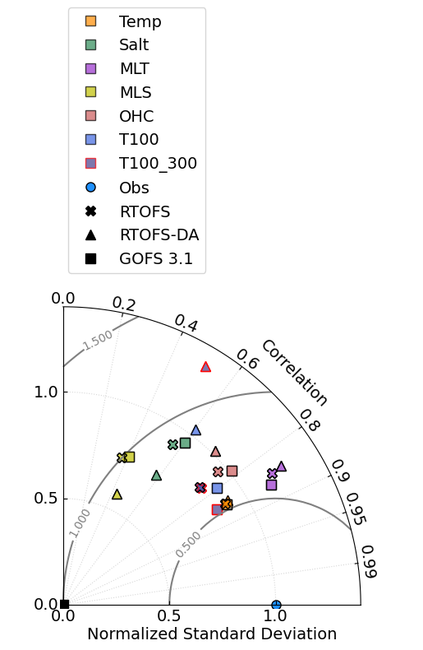
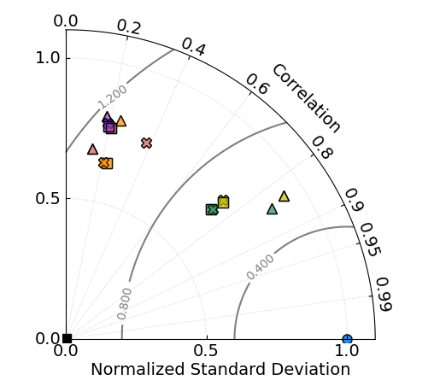
Deep Gliders
Shelf Gliders
T100_300
MLT
OHC
T100
MLS
OHC
MLS
MLT
Temp
Salt
Temp
Salt

Slide 4
﻿Gomex Deep
﻿Gomex Shelf
 |  | Bias
 | N | T100_300(ºC) | T100(ºC)
RTOFS | 1575 | -0.65 | -0.92
RTOFSDA | 1529 | 0.56 | -0.57
GOFS | 3153 | -0.68 | -0.97
 |  | Bias
 | N | Temp(ºC)
RTOFS | 23791 | -1.1
RTOFSDA | 23207 | -0.75
GOFS | 47558 | -1.0
 |  | Bias
 | N
RTOFS
RTOFSDA
GOFS
 |  | Bias
 | N
RTOFS
RTOFSDA
GOFS

Slide 5
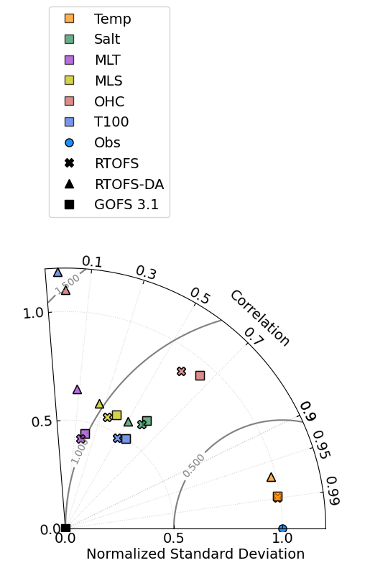
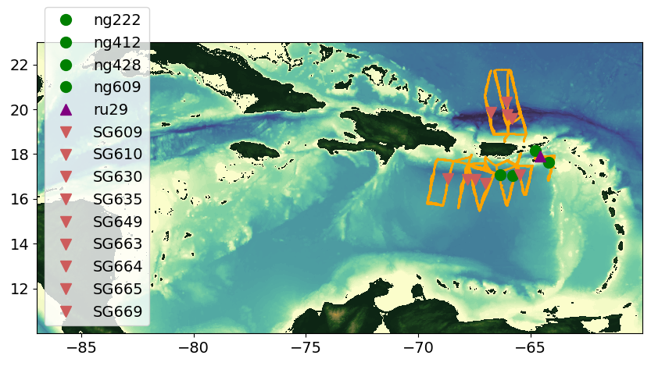
﻿date_ini = '2020/06/19/06'
date_end = '2020/10/25/06'
OHC
T100
MLS
MLT
Salt
Temp

Slide 6
﻿Caribbean
 |  | Bias
 | N | Temp(ºC) | Salt
RTOFS | 194389 | 0.011 | 0.33
RTOFSDA | 189359 | 0.88 | 0.41
GOFS | 388533 | -0.035 | 0.34
 |  | Bias
 | N | MLT(ºC) | MLS
RTOFS | 7001 | -0.013 | 0.17
RTOFSDA | 6845 | 0.19 | 0.20
GOFS | 13977 | -0.042 | 0.22
 |  | Bias
 | N | OHC(KJ/cm²)
RTOFS | 6490 | 3.0
RTOFSDA | 6327 | 29.1
GOFS | 12956 | 0.13
 |  | Bias
 | N | T100(ºC)
RTOFS | 4070 | -0.39
RTOFSDA | 3965 | 0.55
GOFS | 8170 | -0.46

Slide 7
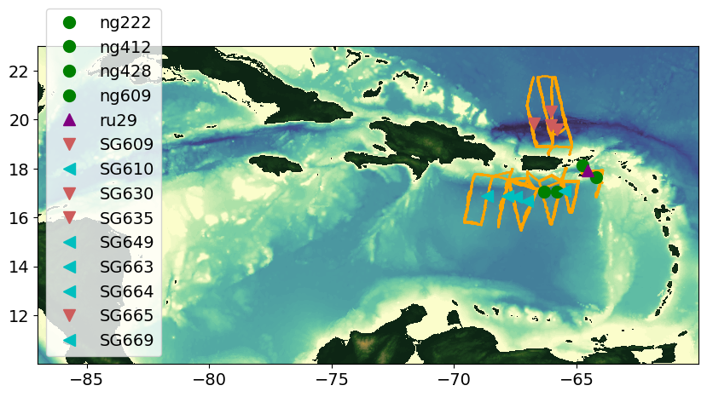
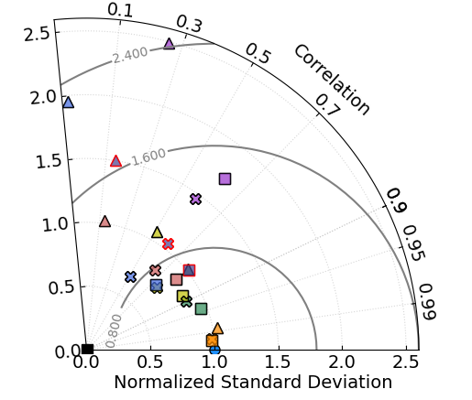
Caribbean Gliders
North Atlantic Gliders
T100_300
T100
MLT
T100
OHC
MLT
Salt
OHC
MLT
T100_300
MLS
Salt
Temp
MLS
Temp

Slide 8
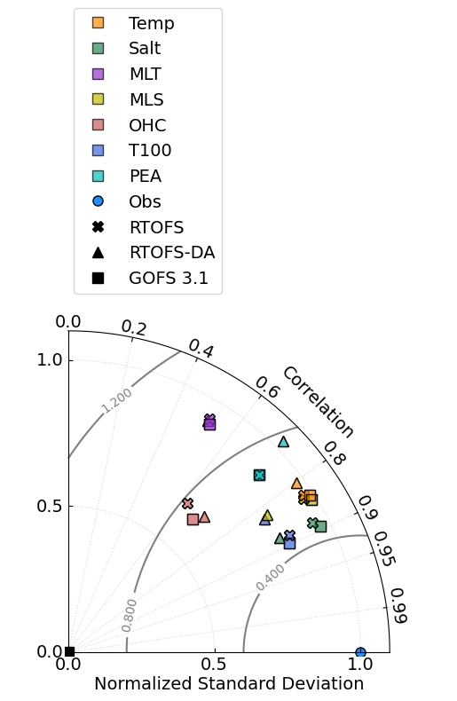
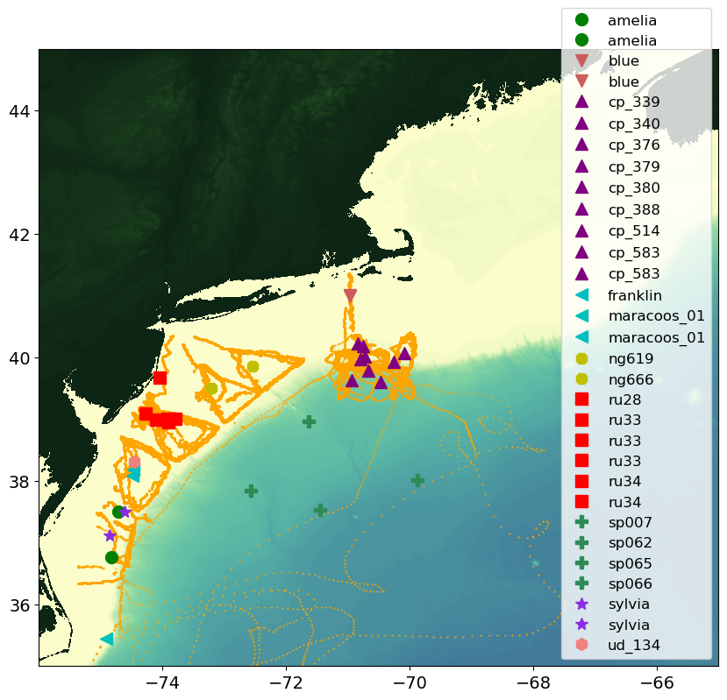
﻿date_ini = '2020/06/19/06'
date_end = '2020/10/25/06'
MLT
PEA
OHC
Temp
MLS
T100
Salt

Slide 9
﻿MAB
 |  | Bias
 | N | Temp(ºC) | Salt
RTOFS | 249828 | -0.33 | -0.07
RTOFSDA | 243525 | -0.86 | -0.35
GOFS | 499323 | -0.46 | -0.08
 |  | Bias
 | N | MLT(ºC) | MLS
RTOFS | 12806 | -0.38 | -0.15
RTOFSDA | 12511 | -0.62 | -0.56
GOFS | 25575 | -0.64 | -0.12
 |  | Bias
 | N | OHC(KJ/cm²)
RTOFS | 959 | 15.5
RTOFSDA | 1020 | 13.4
GOFS | 2200 | 14.4
 |  | Bias
 | N | T100(ºC)
RTOFS | 3203 | -1.8
RTOFSDA | 3135 | -2.7
GOFS | 6400 | -2.1

Slide 10
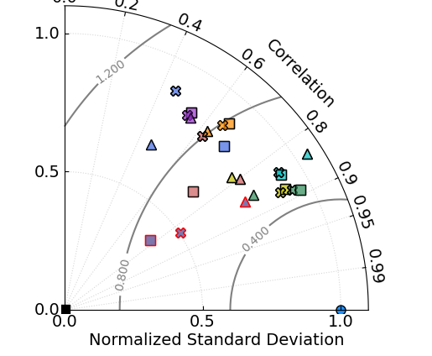
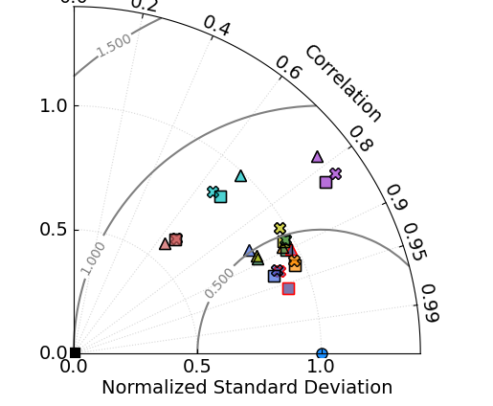
CP Gliders
T100_300
MLS
PEA
MLT
T100
Salt
Temp
OHC
Shelf Gliders
SP Gliders
MLT
Temp
T100
PEA
MLT
PEA
MLS
OHC
OHC
MLS
Salt
Salt
Temp
T100_300
T100
T100_300

Slide 11
﻿MAB Shelf
 |  | Bias
 | N | OHC(KJ/cm²)
RTOFS
RTOFSDA
GOFS
 |  | Bias
 | N | Temp(ºC) | Salt
RTOFS | 84915 | -0.73
RTOFSDA | 82798 | -1.27
GOFS | 169632 | -0.84
 |  | Bias
 | N | MLT(ºC) | MLS
RTOFS
RTOFSDA
GOFS
 |  | Bias
 | N | T100(ºC)
RTOFS | 241 | -2.05
RTOFSDA | 239 | -3.65
GOFS | 467 | -2.39
 |  | Bias
 | N | T100_300(ºC)
RTOFS | 612 | 4.55
RTOFSDA | 612 | 4.44
GOFS | 1217 | 4.56

Slide 12
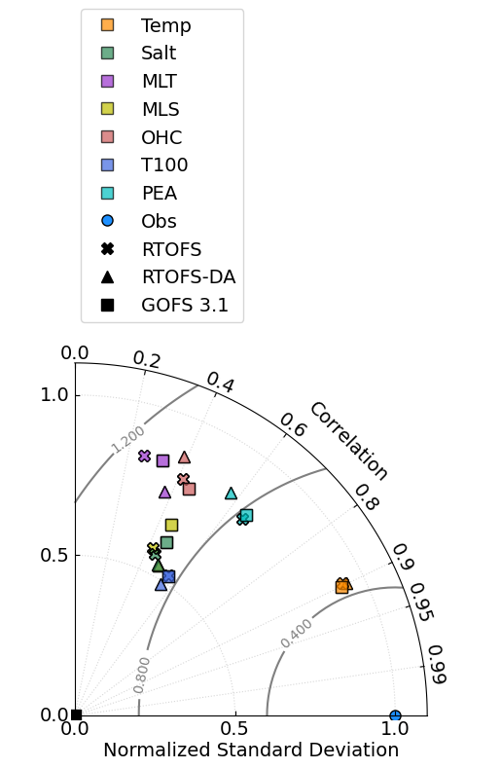
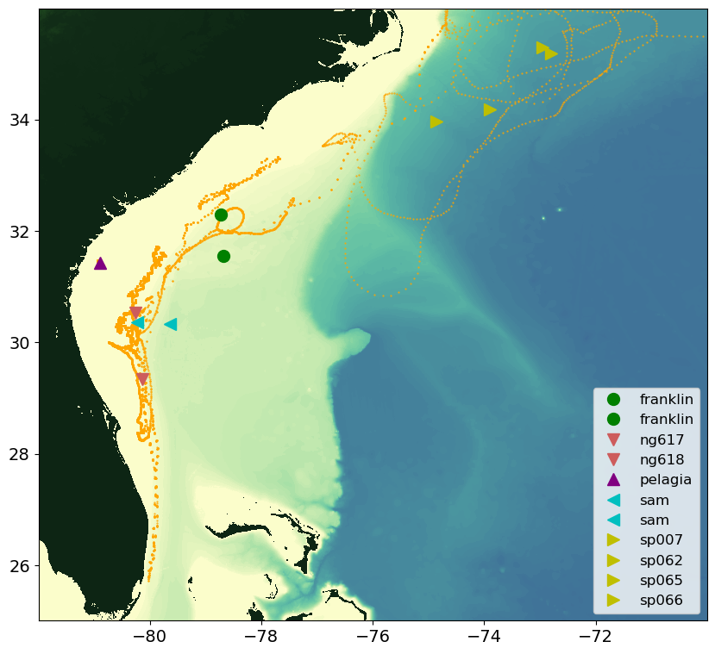
﻿date_ini = '2020/06/19/06'
date_end = '2020/10/25/06'
OHC
MLT
PEA
MLS
Salt
Temp
T100

Slide 13
﻿SAB
 |  | Bias
 | N | Temp(ºC) | Salt
RTOFS | 108434 | -0.17 | -0.22
RTOFSDA | 105676 | -0.26 | -0.21
GOFS | 216675 | -0.31 | -0.23
 |  | Bias
 | N | MLT(ºC) | MLS
RTOFS | 4270 | 0.14 | -0.29
RTOFSDA | 4150 | 0.061 | -0.25
GOFS | 8541 | 0.077 | -0.28
 |  | Bias
 | N | OHC(KJ/cm²)
RTOFS | 3576 | 2.6
RTOFSDA | 3536 | 1.8
GOFS | 7243 | 2.1
 |  | Bias
 | N | T100(ºC)
RTOFS | 3117 | -2.6
RTOFSDA | 3041 | -2.8
GOFS | 6274 | -2.6

Slide 14
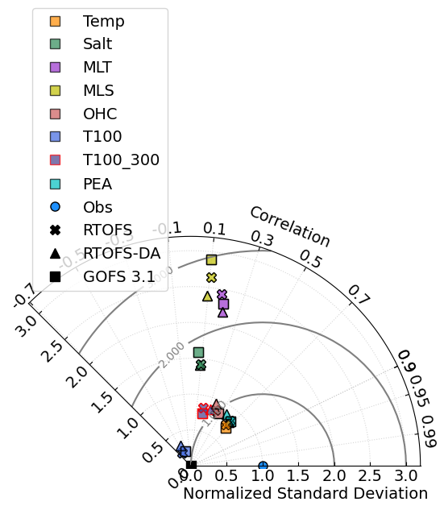
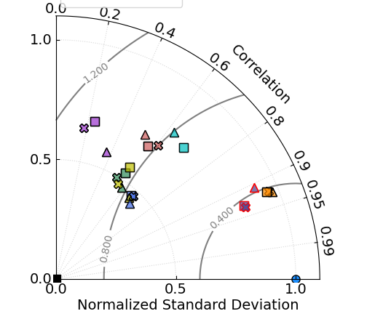
Shelf Gliders
SP Gliders
MLS
MLT
MLT
PEA
Salt
OHC
Salt
MLS
Temp
T100_300
PEA
T100
T100
T100_300
Temp

