Slide 1
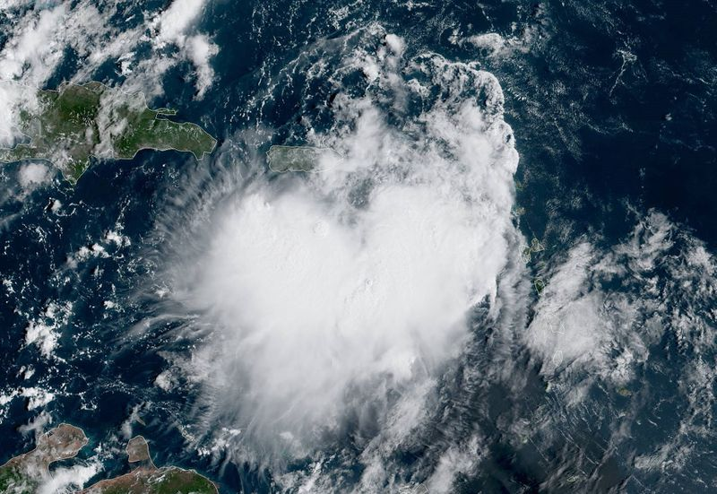
Tropical Storm Karen
Tropical Storm Karen
National Hurricane Center

Slide 2
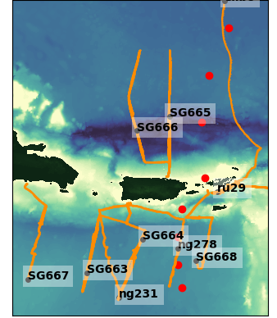
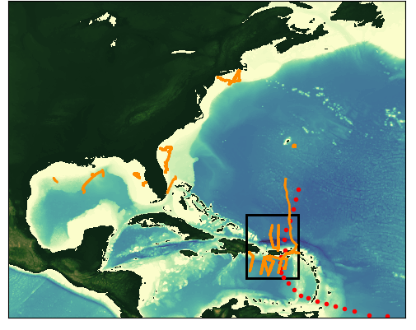
Tropical Storm Karen
Tropical Storm Karen
Gliders Deployed Sep 20th to Sep 27th 2019
Dorian
8/24 – 7/07
Karen
Sep 20 – Sep 27
Notes:
During tropical storm Karen there were 10 gliders deployed in the Caribbean

Slide 3
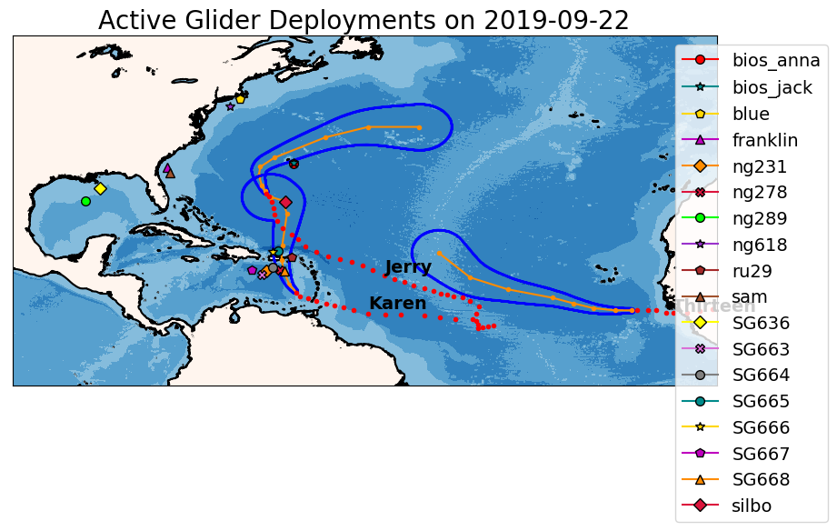

Slide 4
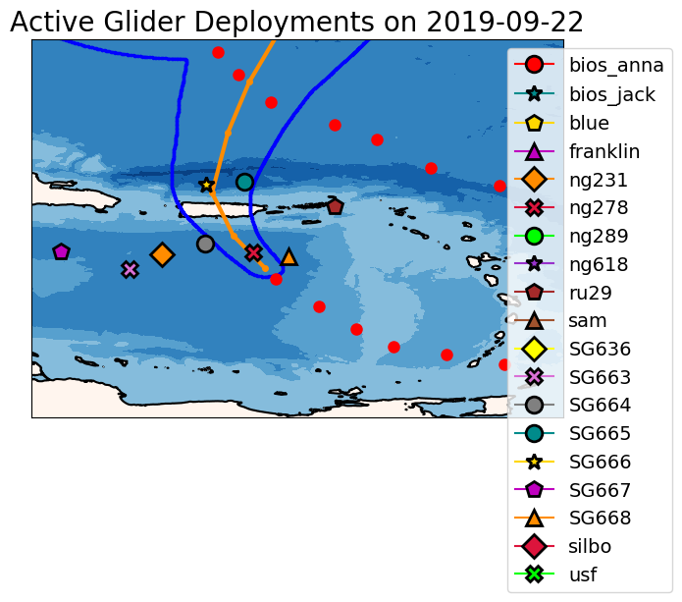

Slide 5
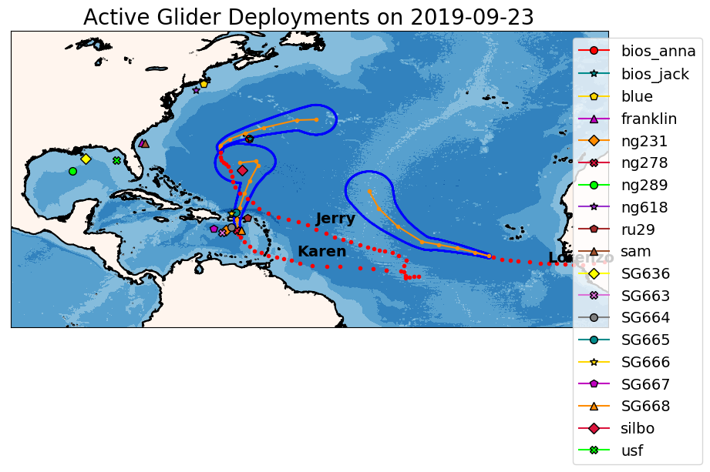

Slide 6
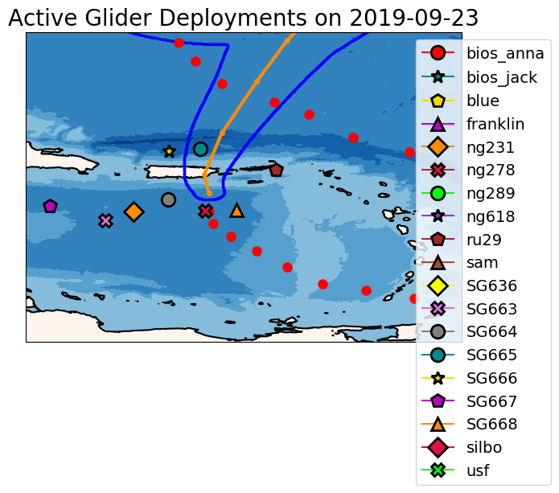

Slide 7


Slide 8


Slide 9
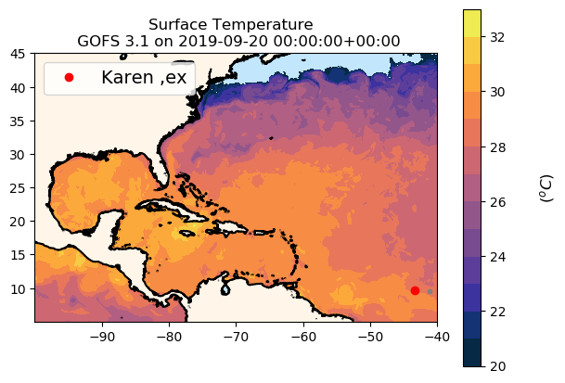



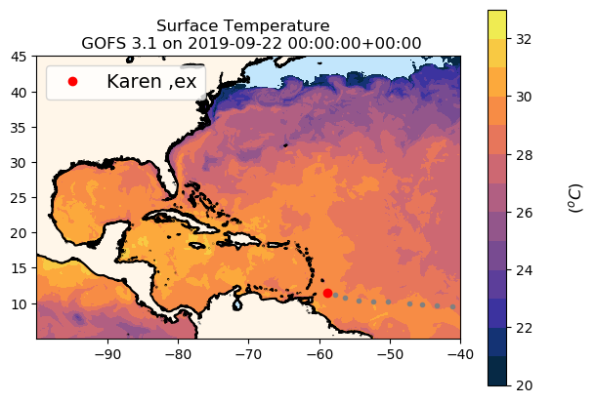
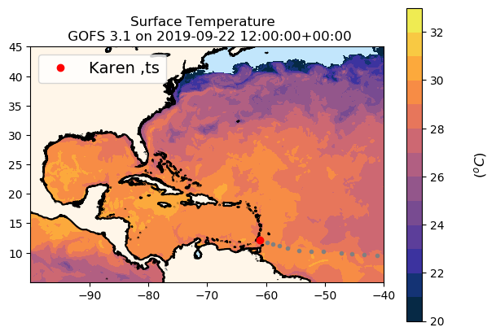



GOFS 3.1 Surface Temperature During TS Karen
Cooling

Slide 10
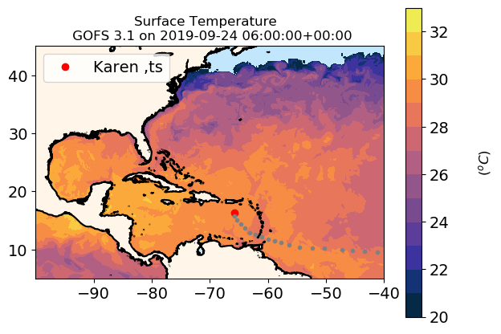



GOFS 3.1 Surface Temperature During TS Karen

Slide 11
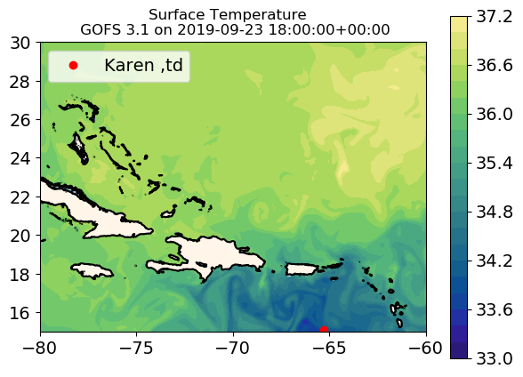

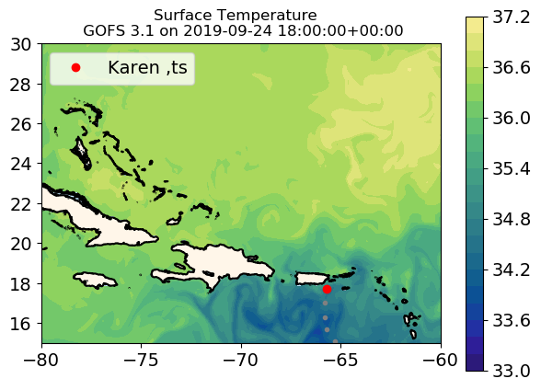
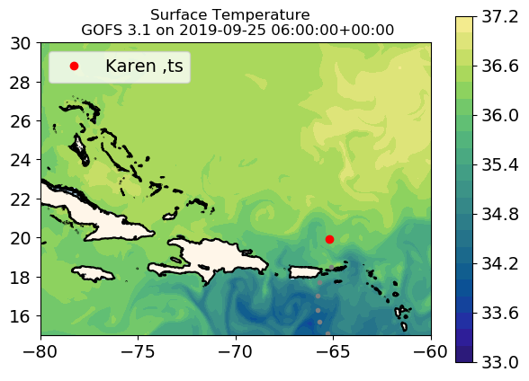
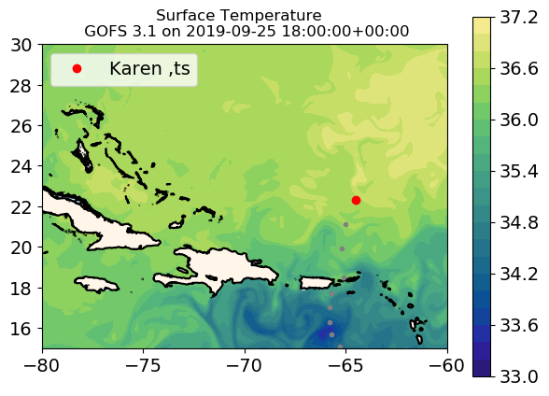

GOFS 3.1 Surface Salinity During TS Karen
GOFS 3.1 Response to Hurricane Dorian

Slide 12
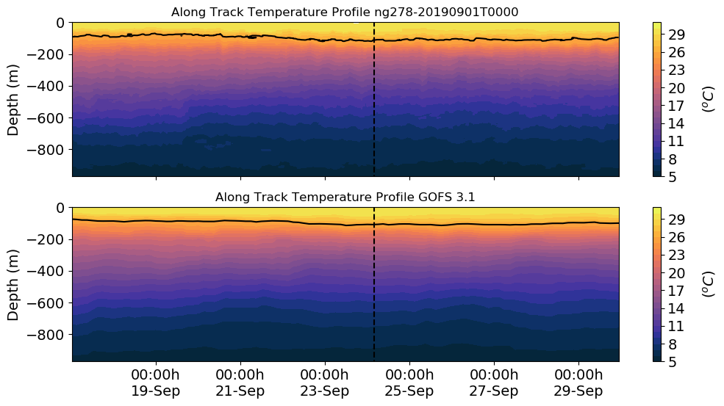
ng278

Slide 13
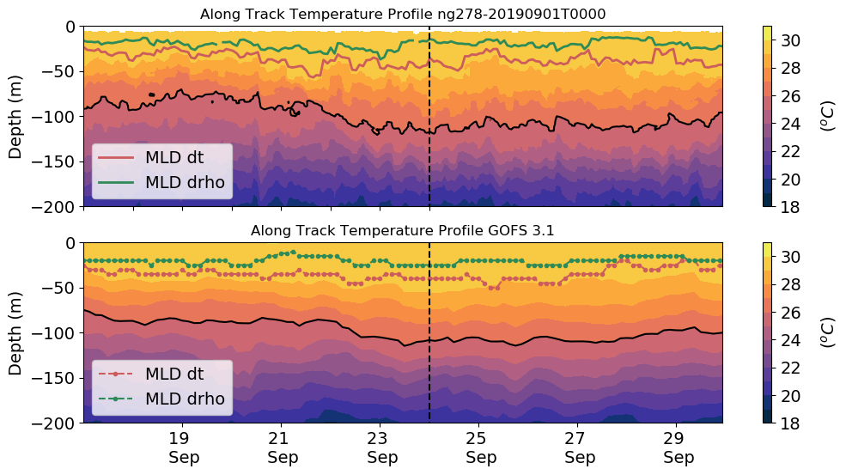
ng278 Mixed layer depth
Karen
26º
26º

Slide 14
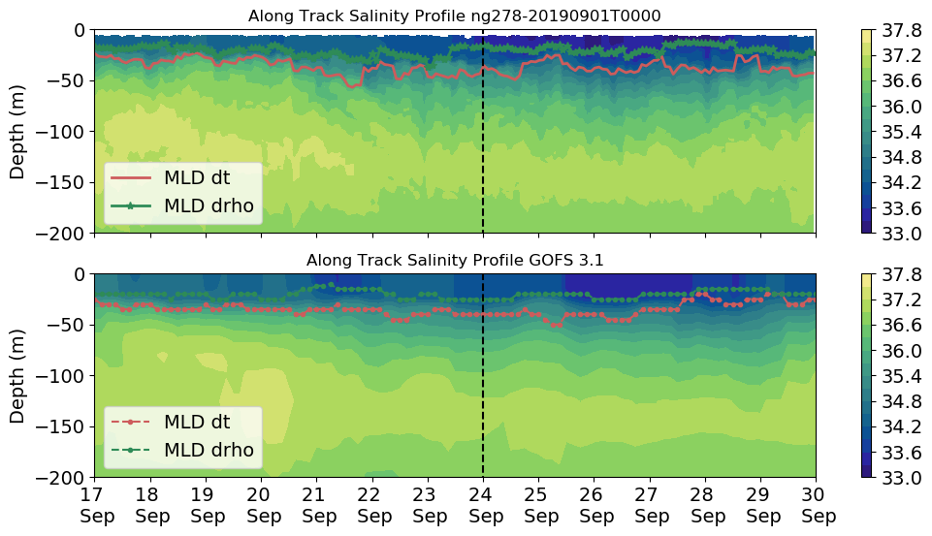
ng278 Mixed layer depth
Karen
Very fresh layer.
Precipitation?

Slide 15
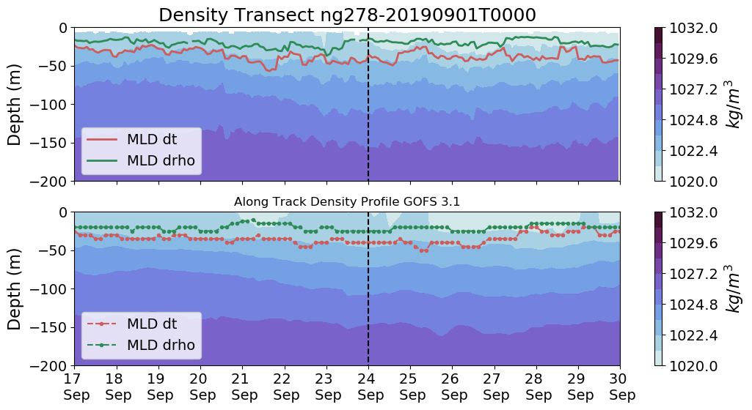
ng278 Mixed layer depth
Karen

Slide 16
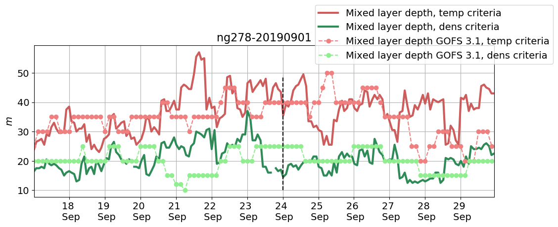
ng278 Mixed layer depth
Karen

Slide 17
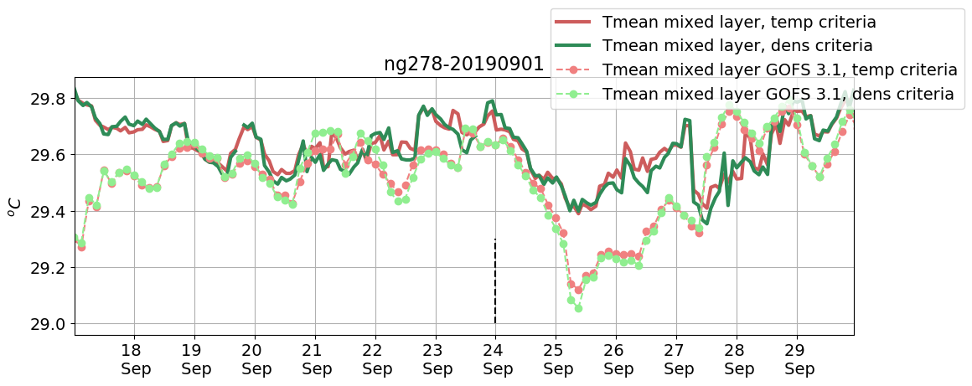
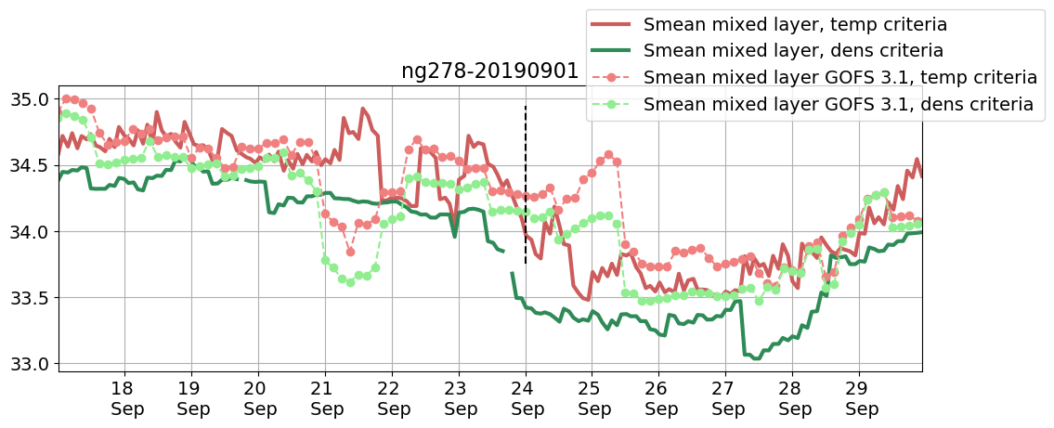
ng278 Mean temperature and Salinity
within the mixed layer
Karen
0.4 ºC
Cold bias in GOFS 3.1 during Karen
0.6

Slide 18
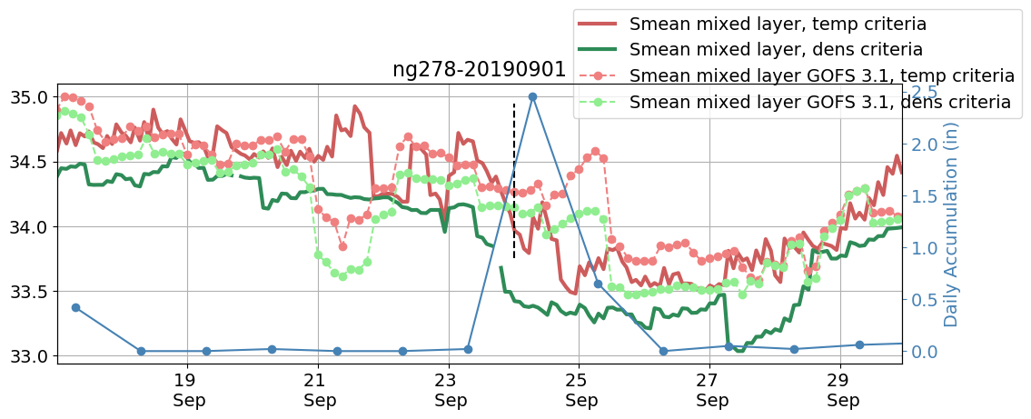
ng278 Salinity within the mixed layer
Freshening due to low salinity south of Puerto Rico or precipitations?
Glider Salinity drops 2 days before GOFS 3.1 salinity does. Part of the drop in salinity is because
the glider is moving into an area of lower salinity but there is definitely a correlation between
The drop in salinity and precipitation.
0.6
Karen

Slide 19
GOFS 3.1 Surface Salinity During TS Karen
GOFS 3.1 Response to Hurricane Dorian

Slide 20
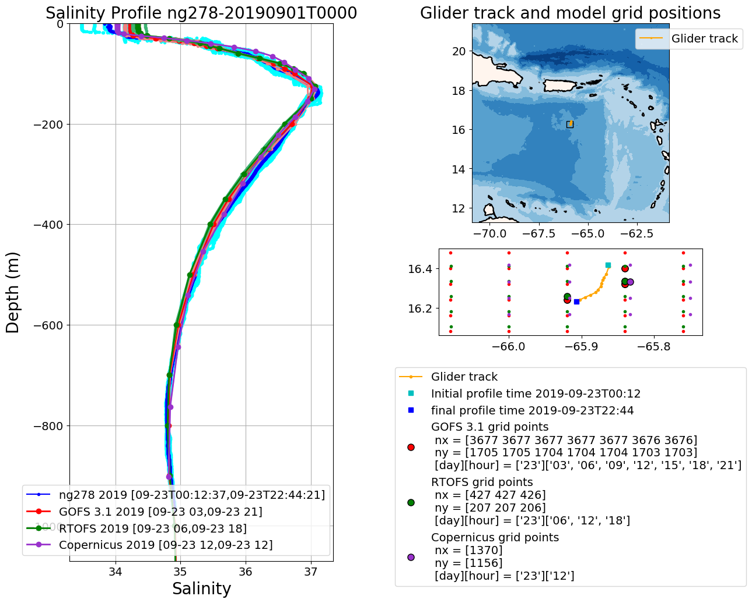
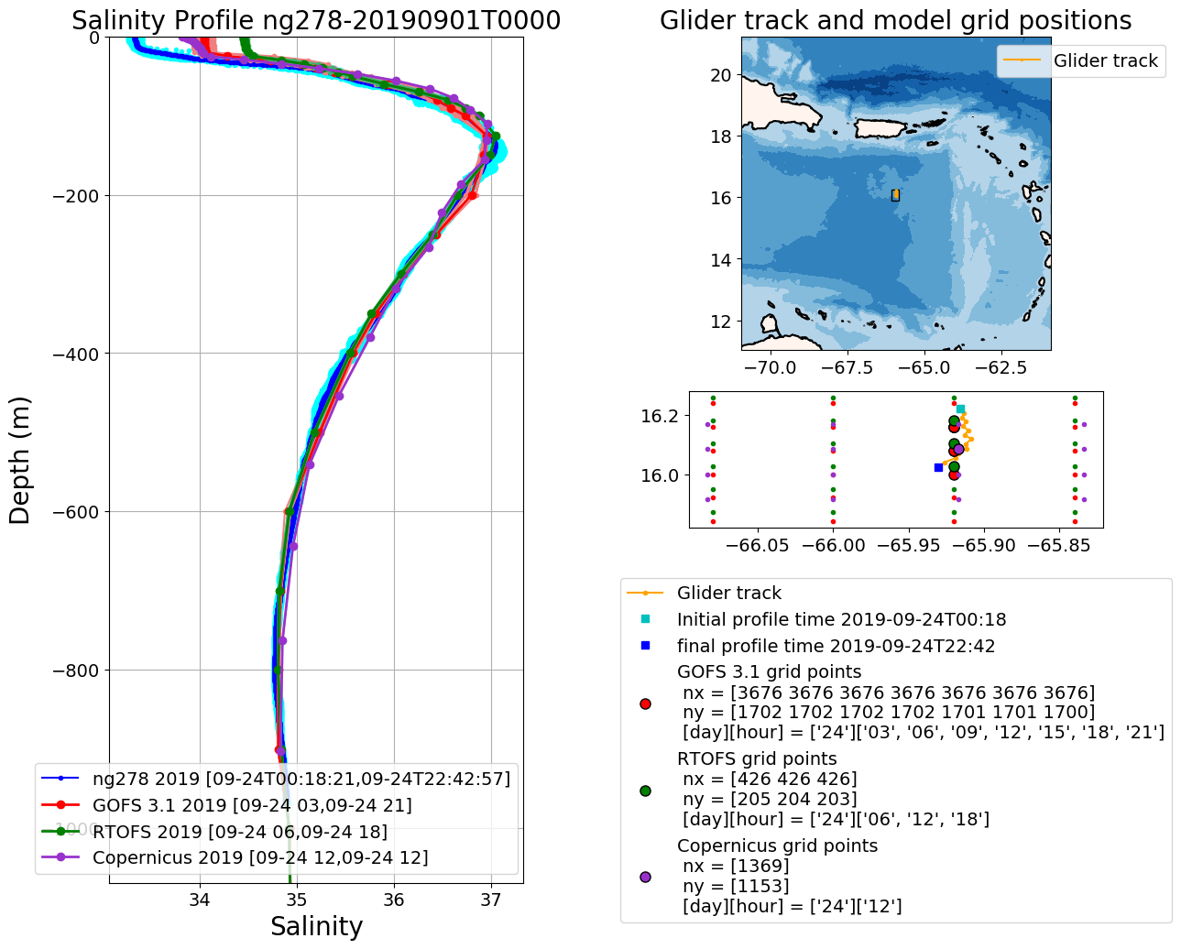
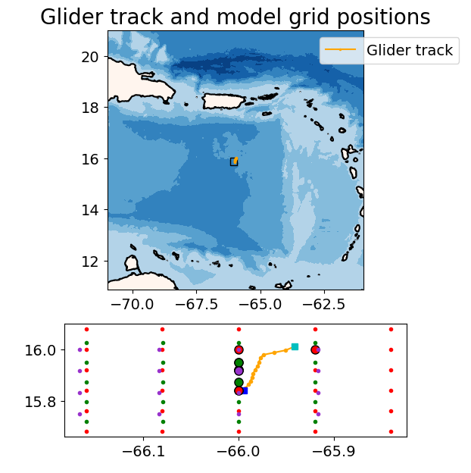
Ng278 moving south towards area of lower salinity
Sep 23
Sep 24
Sep 24

Slide 21
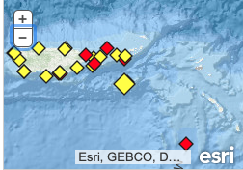
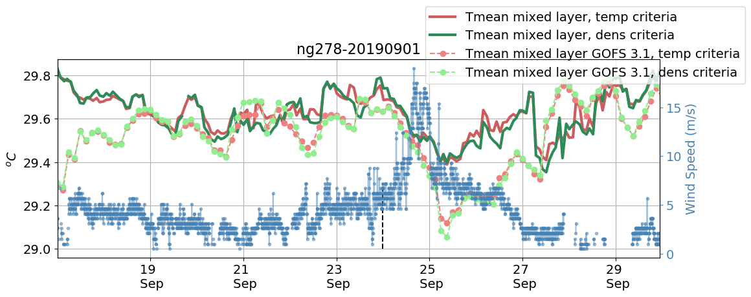
Wind Speed
Wind Speed
NNOS LTBV3

Slide 22
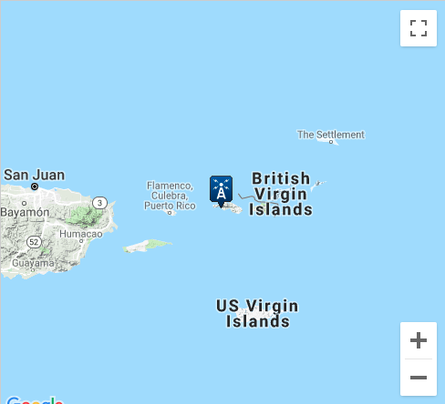
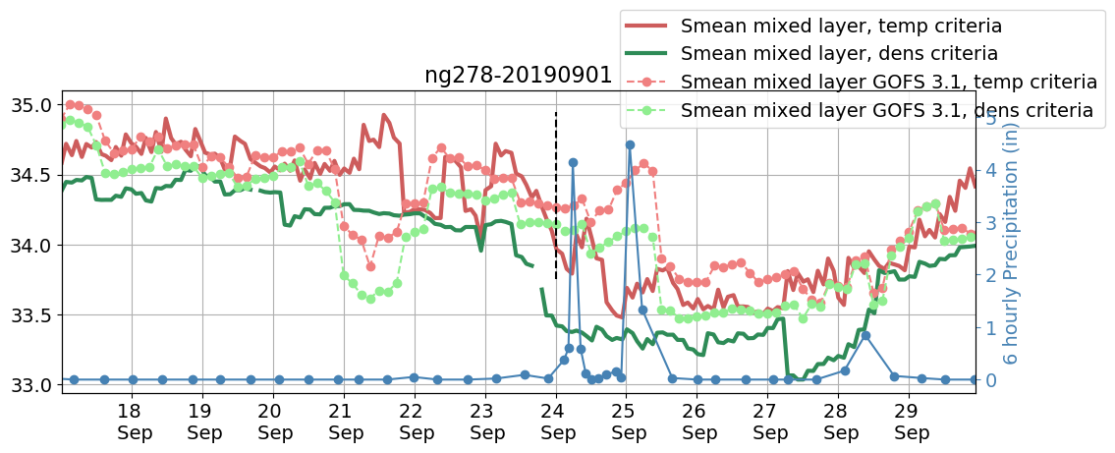
Precipitation
Precipitation
https://www.ncdc.noaa.gov/cdo-web/datasets/LCD/stations/WBAN:11640/detail
WBAN:11640

Slide 23
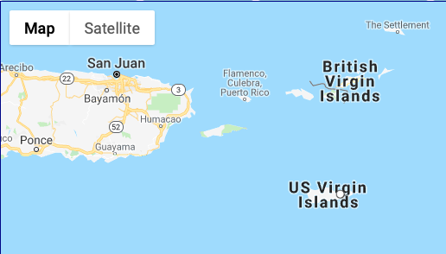
Precipitation
Precipitation
http://data.cocorahs.org/cocorahs/maps/?country=usa&amp;state=vi
VI-SC-8

Slide 24
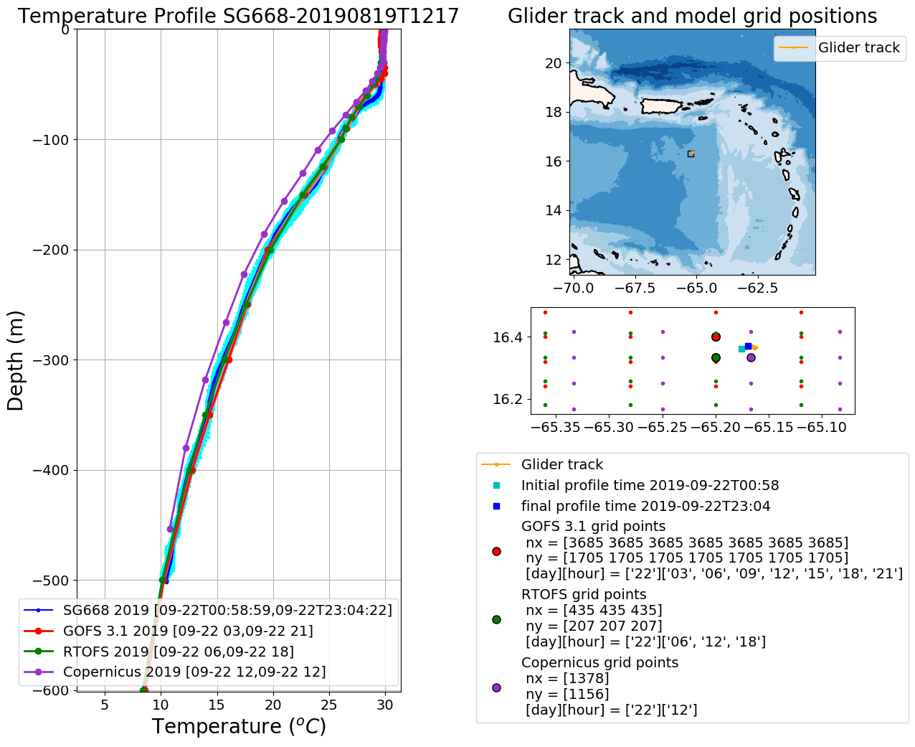
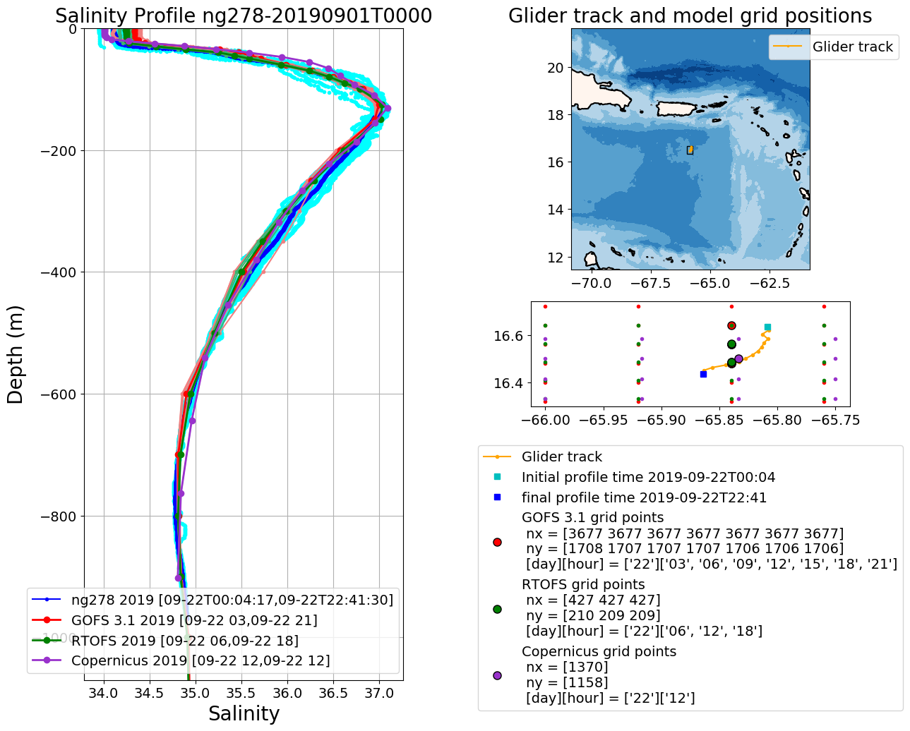
ng278/Model Comparisons
Sep 22/2019

Slide 25
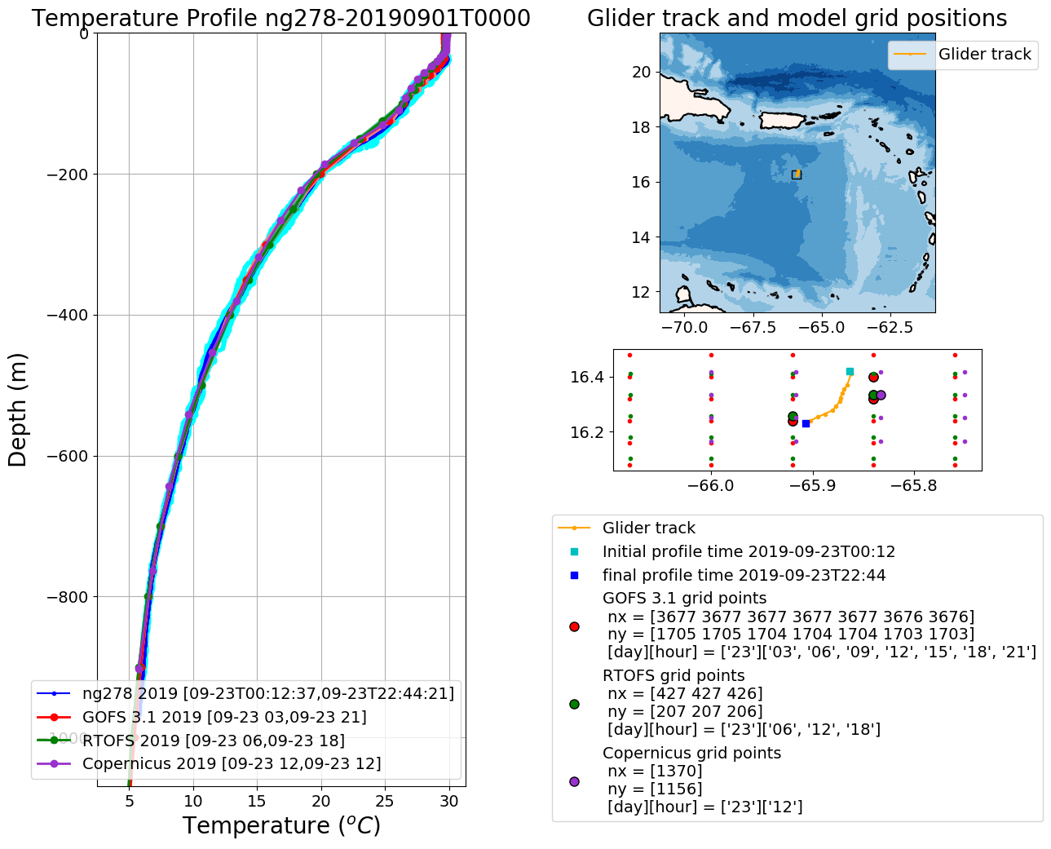
ng278/Model Comparisons
Sep 23/2019
ç
Very fresh layer.
Must be precipitation!

Slide 26
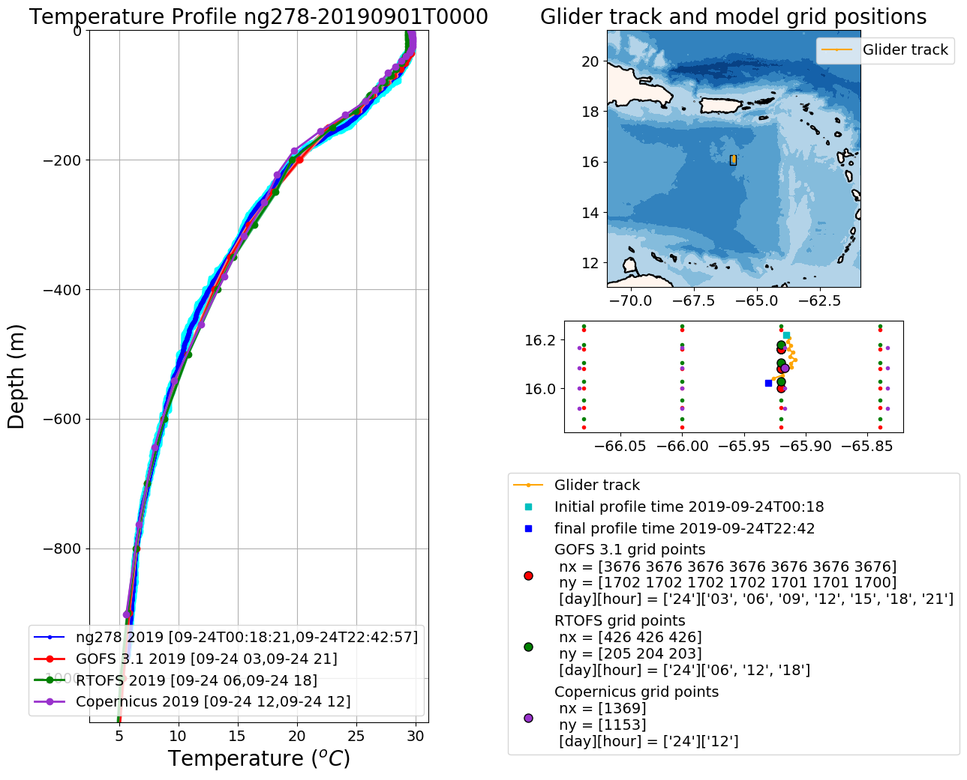
ng278/Model Comparisons
Sep 24/2019
ç
Very fresh layer.
Must be precipitation!
Very fresh layer.
Must be precipitation!

Slide 27
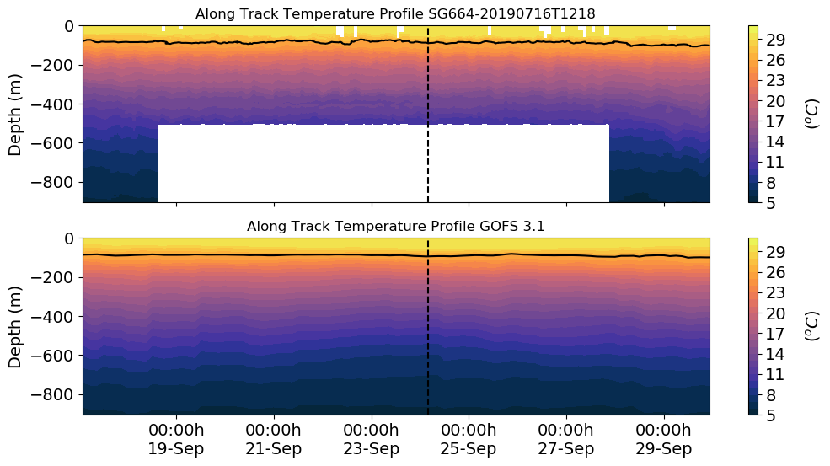
SG664

Slide 28
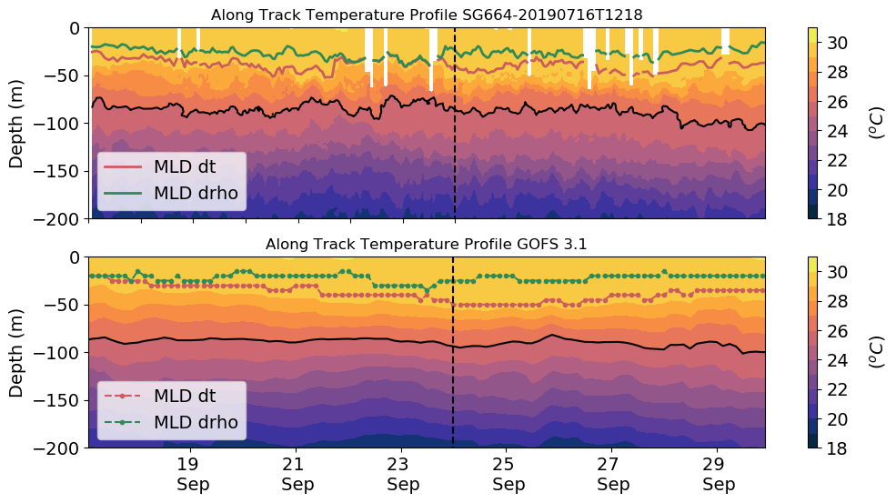
SG664 Mixed layer depth
Karen
26º
26º

Slide 29
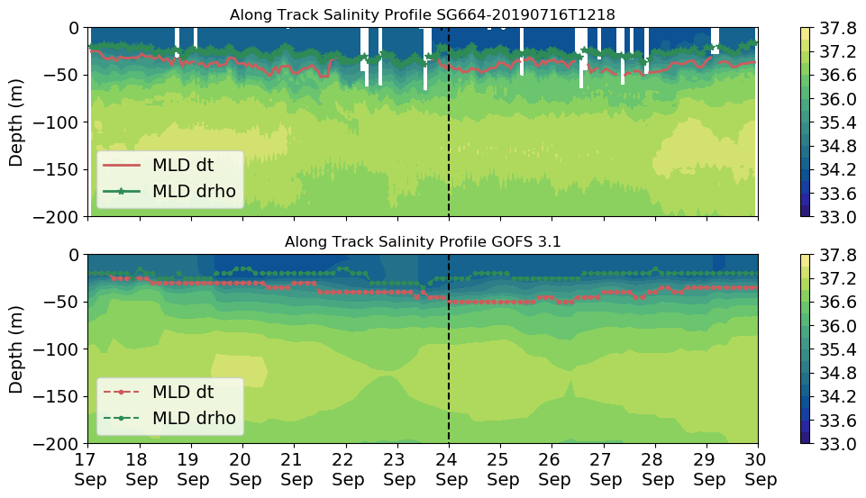
SG664 Mixed layer depth
Karen

Slide 30
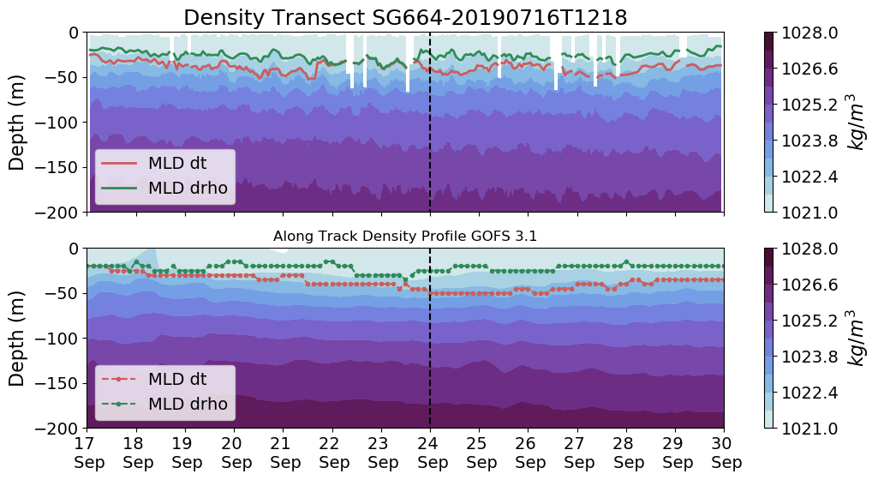
SG664 Mixed layer depth
Karen

Slide 31
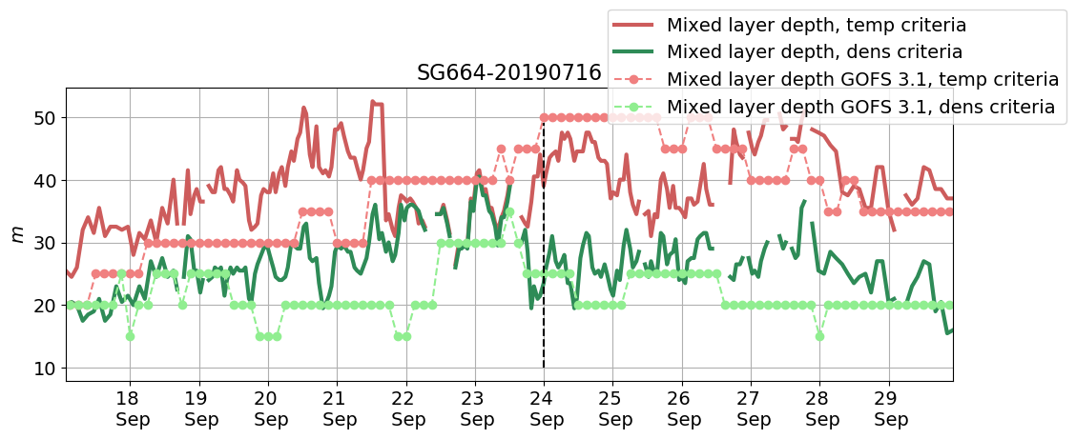
SG664 Mixed layer depth
Karen

Slide 32
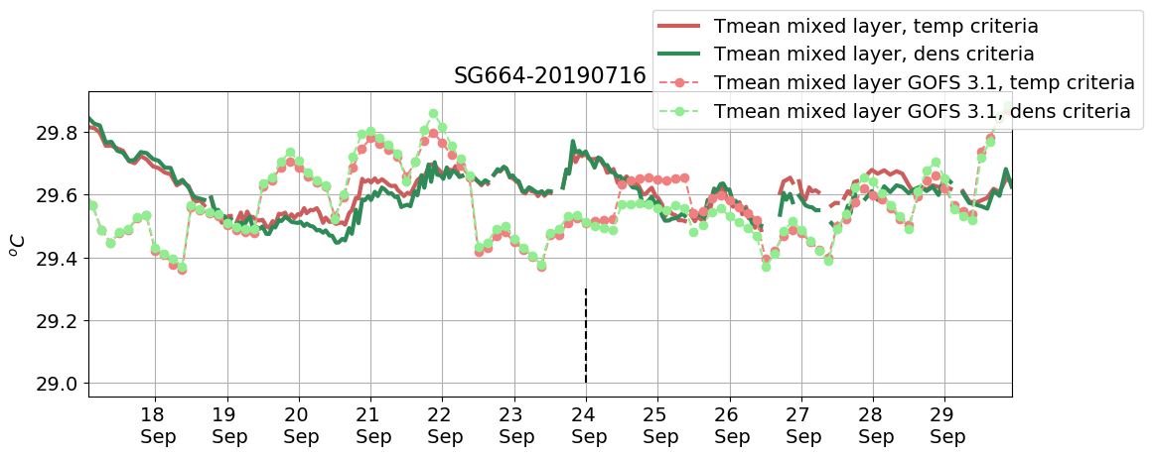
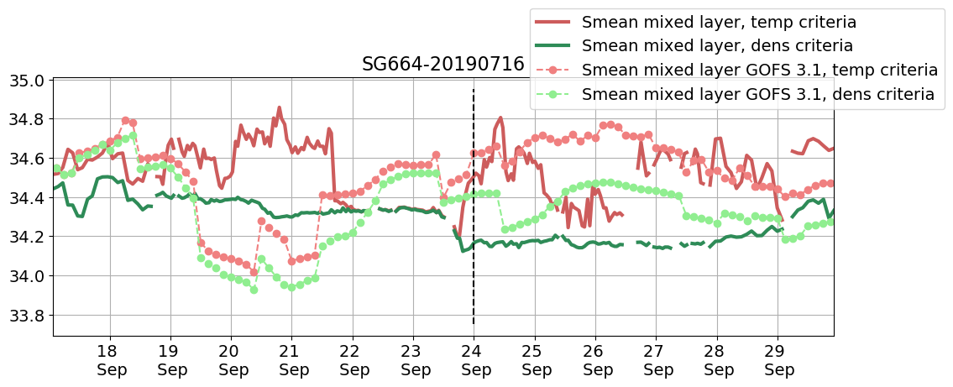
SG664 Mean temperature and Salinity
within the mixed layer
Karen
Cold bias in GOFS 3.1 during Karen

Slide 33
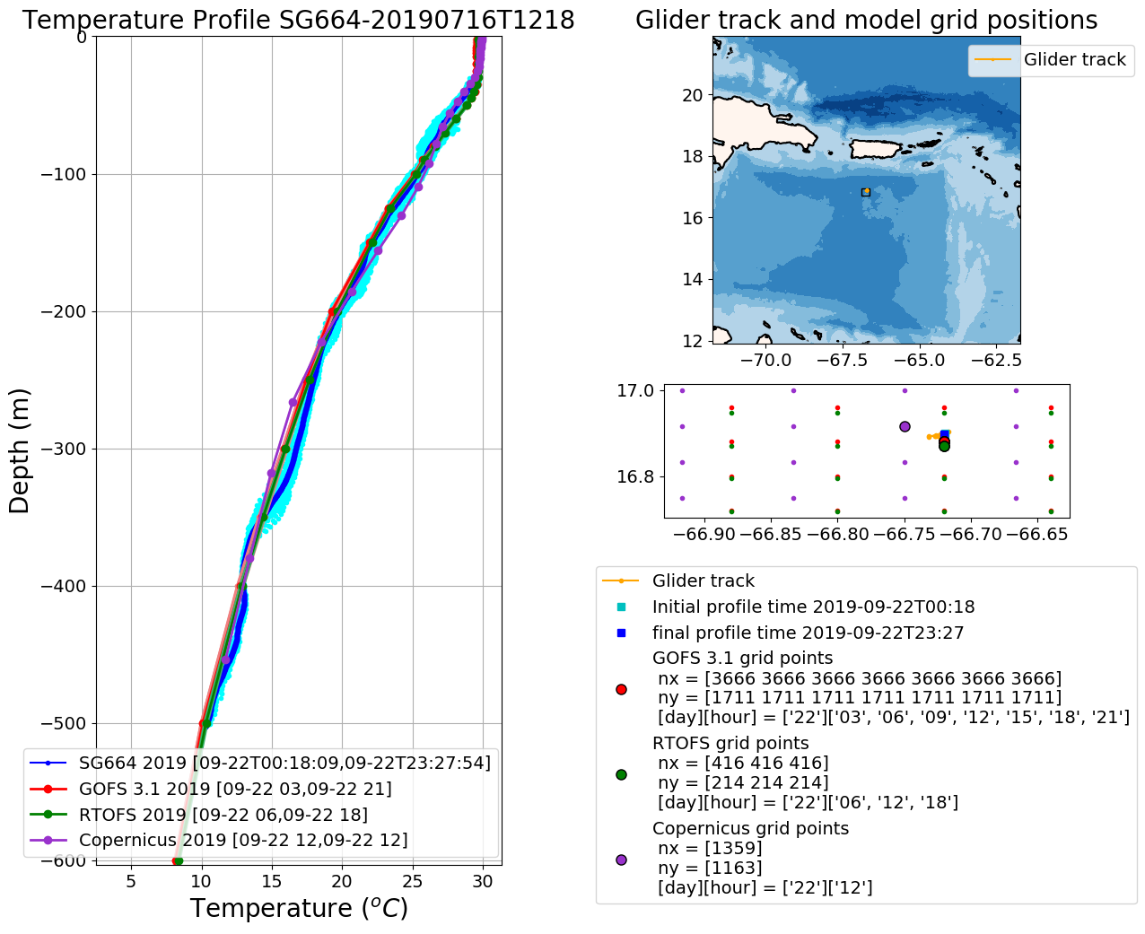
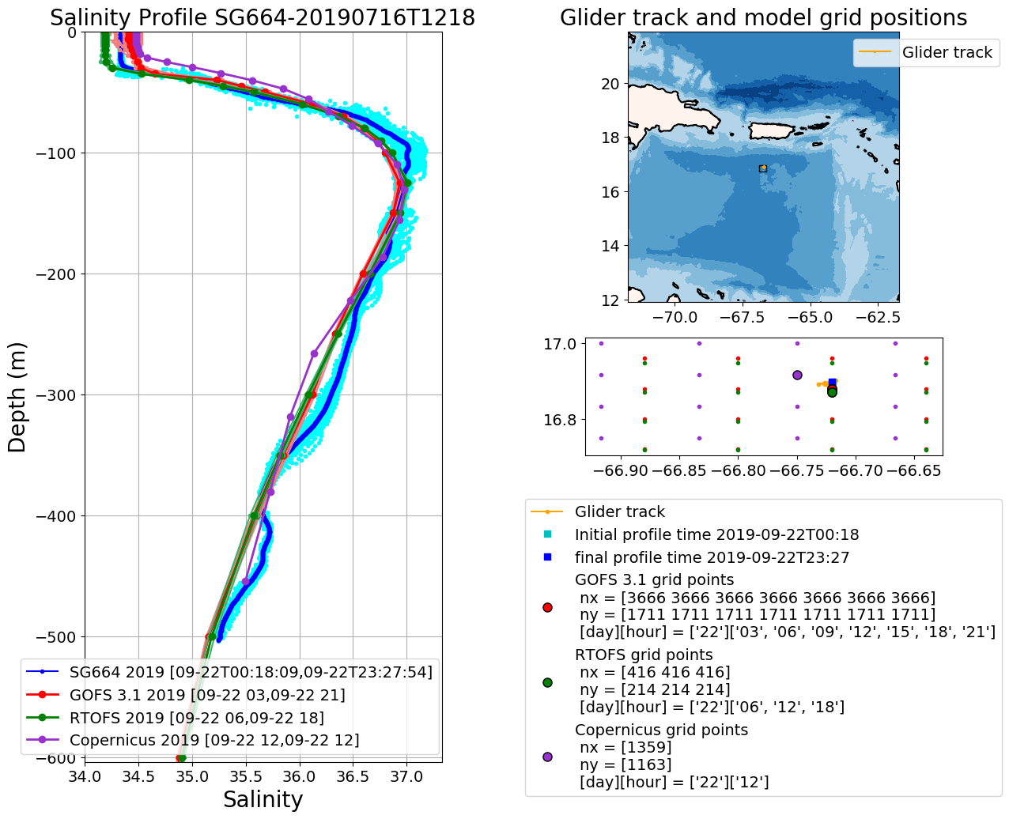
SG664/Model Comparisons
Sep 23/2019

Slide 34
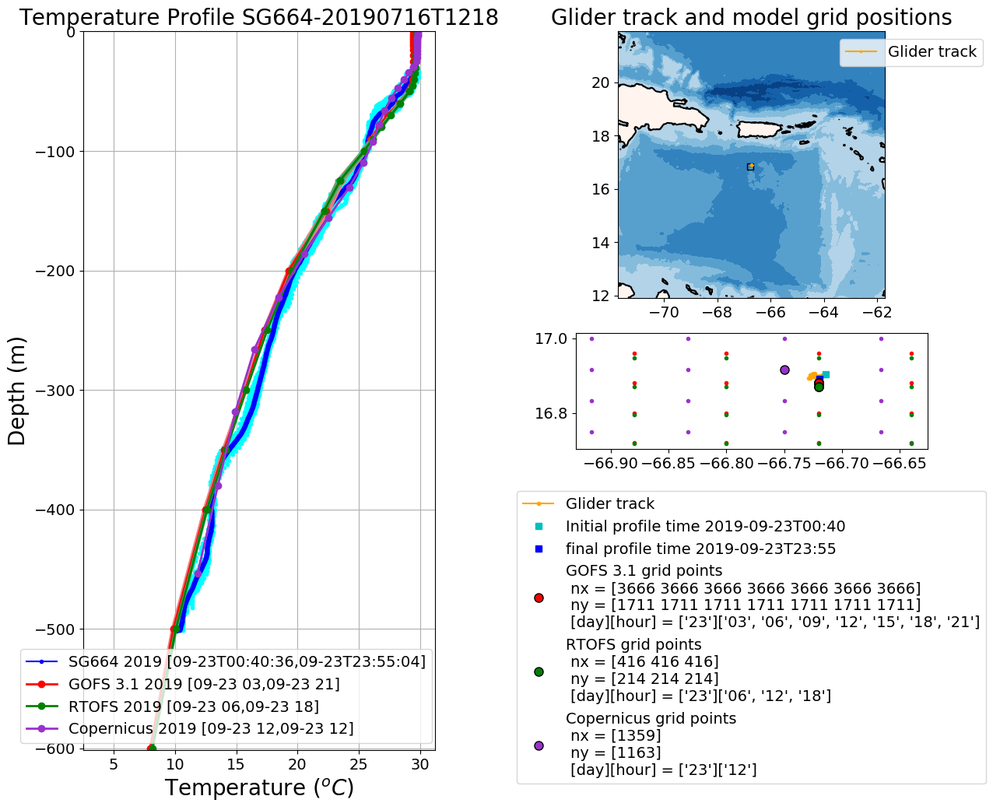
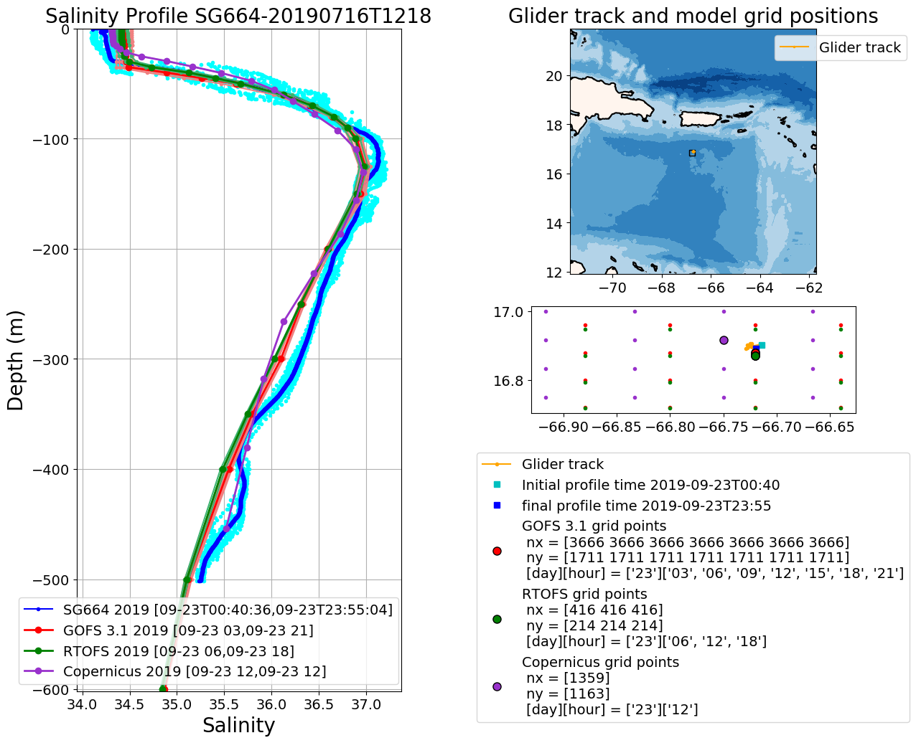
SG664/Model Comparisons
Sep 23/2019
A little bit
Of freshening

Slide 35
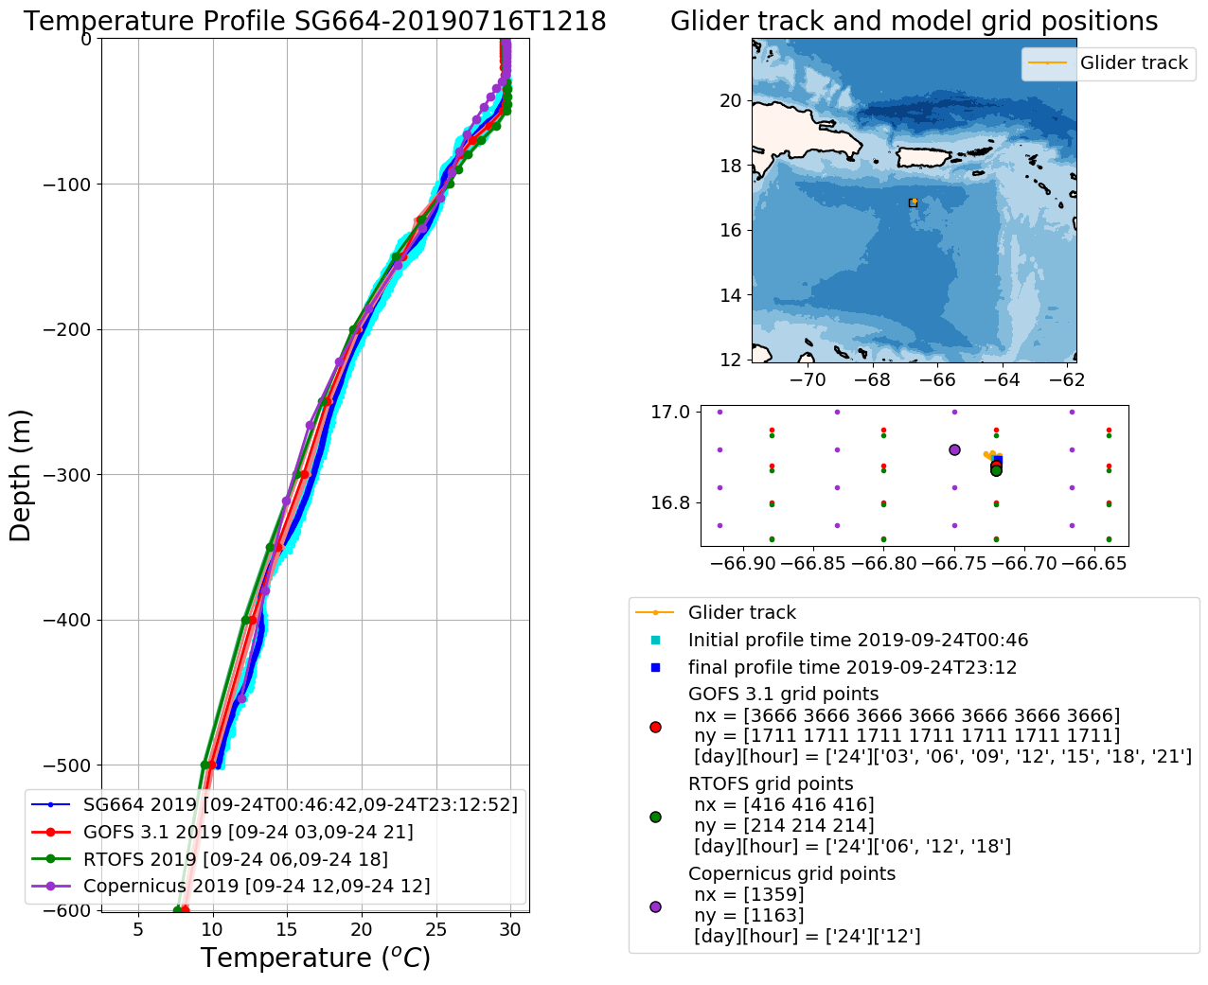
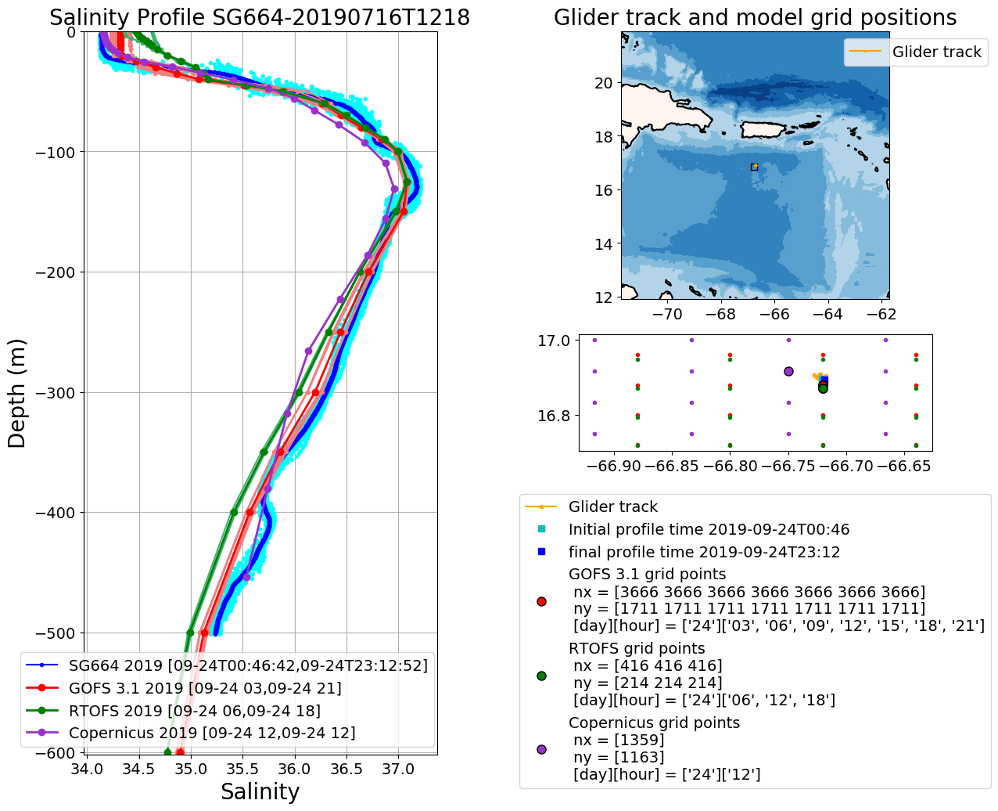
SG664/Model Comparisons
Sep 24/2019
A little bit
Of freshening

Slide 36
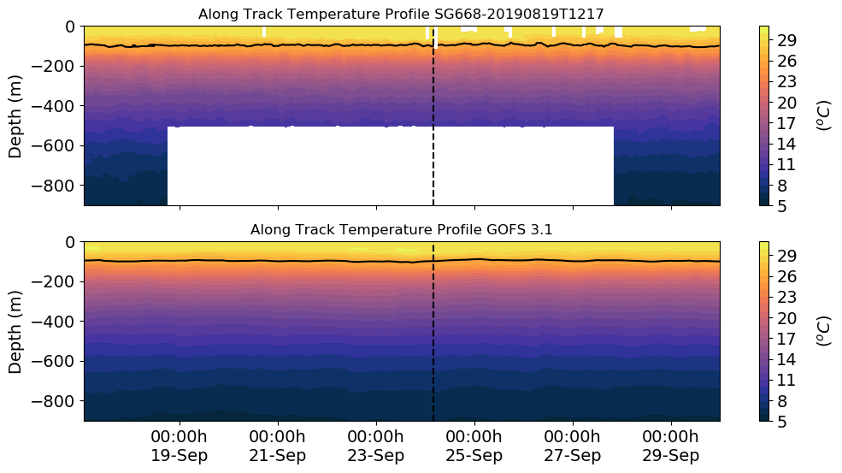
SG668

Slide 37
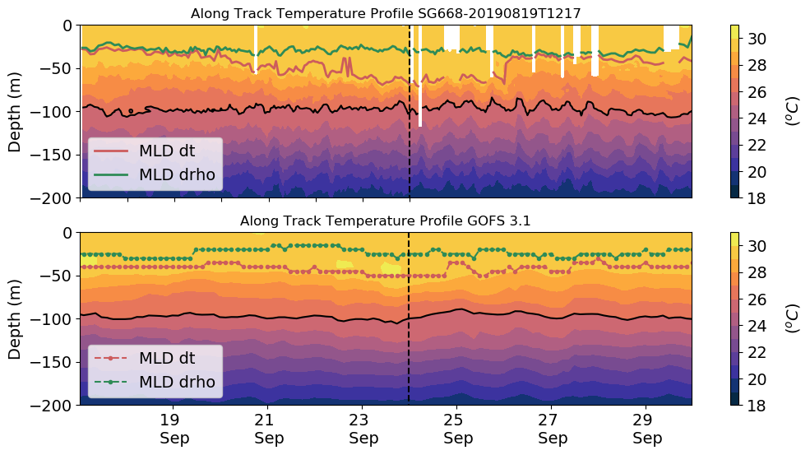
SG668 Mixed layer depth
Karen
26º
26º

Slide 38

SG668 Mixed layer depth
Karen

Slide 39

SG668 Mixed layer depth
Karen

Slide 40

SG668 Mixed layer depth
Karen

Slide 41


SG668 Mean temperature and Salinity
within the mixed layer
Karen

Slide 42

SG668/Model Comparisons
Sep 22/2019

Slide 43


SG668/Model Comparisons
Sep 23/2019

Slide 44


SG668/Model Comparisons
Sep 24/2019

Slide 45

RU29

Slide 46

RU29 Mixed Layer Depth

Slide 47



Slide 48

RU29
Mean temperature within the mixed layer

Slide 49


RU29/Model Comparisons
Sep 22/2019

Slide 50


RU29/Model Comparisons
Sep 23/2019

Slide 51


RU29/Model Comparisons
Sep 24/2019

