Slide 1
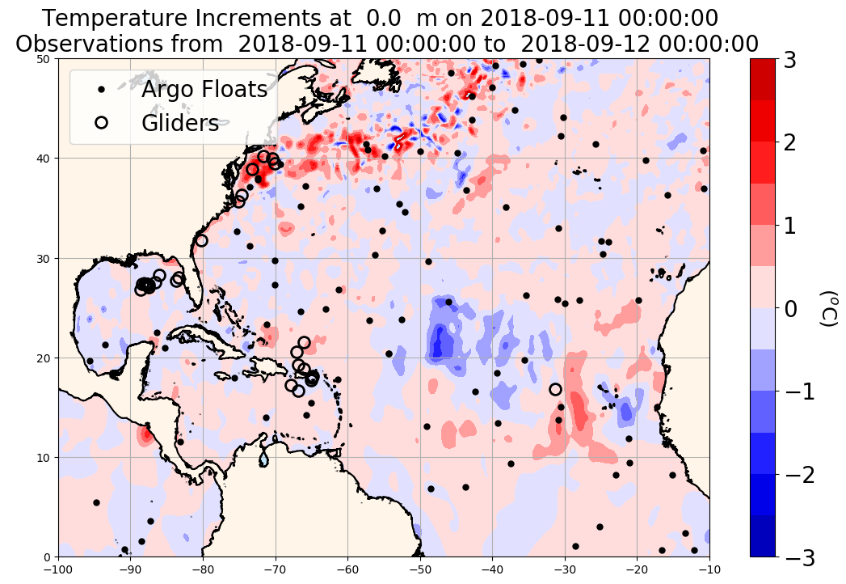
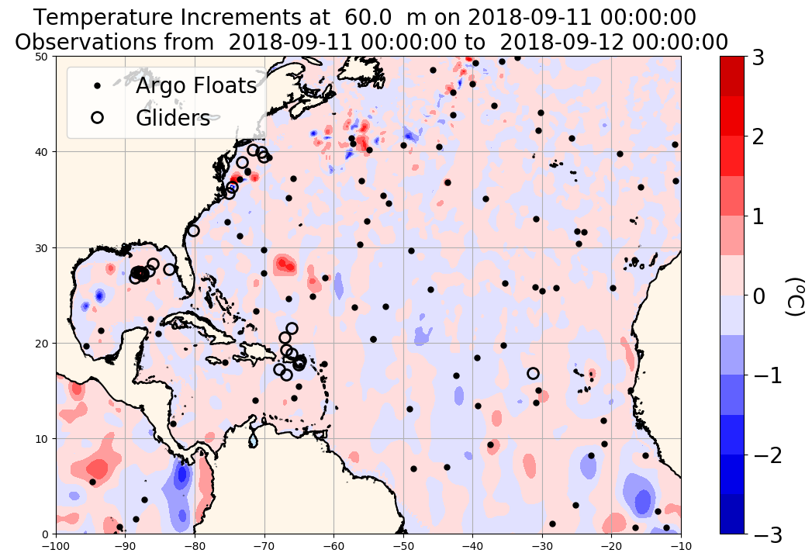
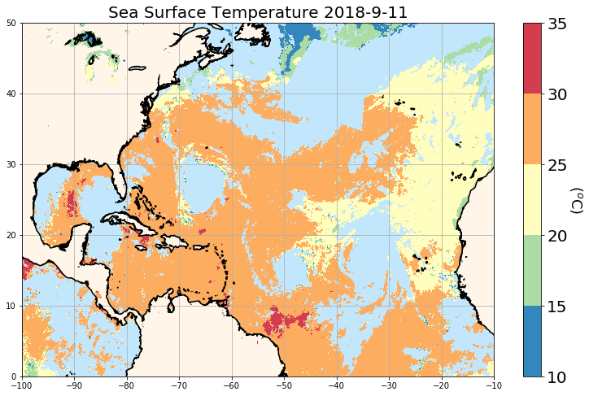
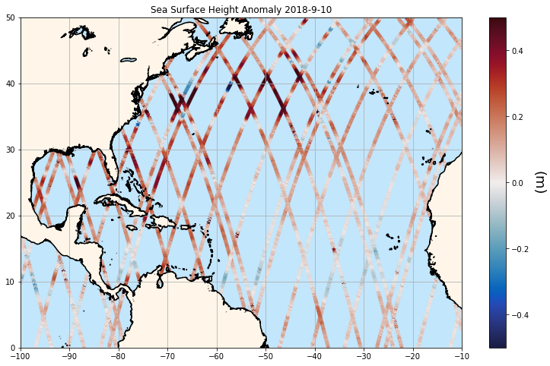
Overlap altimeter passes
AVHRR by OSI SAF
(Ocean and Sea Ice Satellite Application Facility)
https://podaac.jpl.nasa.gov/dataset/OSTM_L2_OST_OGDR_GPS
Ocean Surface Topography Mission/Jason-2 (OSTM)
Notes:
Top figures: Black dots: position of Argo floats profiles on 2018-09-11
Open black circles: mean position of glider tracks on … (need to double check)
Temperature increments from NCODA (provided by Pat Hogan) on 2018-09-11 at 0 m (top left figure) and at 60 m (top right figure)
Bottom left: SST from AVHRR on 2018-09-11
Bottom right: SSH anomaly from Jason-2 from 2018-09-06 to 2018-09-11

Slide 2
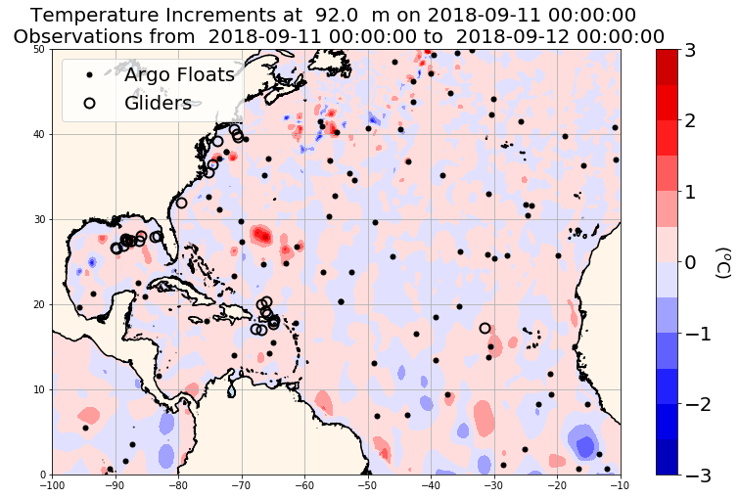
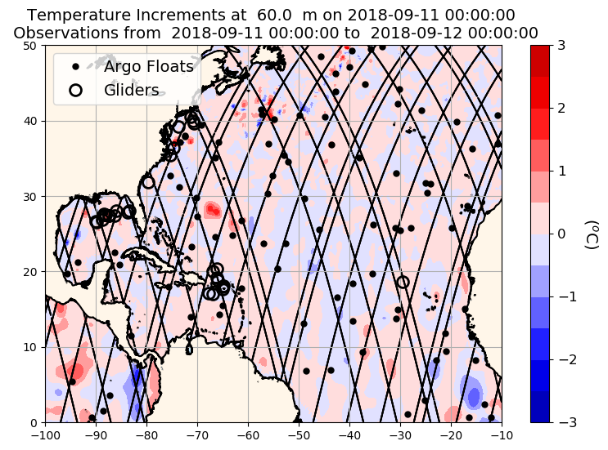
Notes:
All figures: Black dots: position of Argo floats profiles on 2018-09-11
Open black circles: mean position of glider tracks on … (need to double check)
Top figures: Temperature increments from NCODA (provided by Pat Hogan) on 2018-09-11 at 60 m (top left figure) and at 92 m (top right figure)
Lower left: Temperature increments at 60 m and Jason-2 tracks (black lines) from 2018-09-06 to 2018-09-11
Lower right: Temperature increments at 60 m
Black lines: Jason-2 tracks on 2018-09-11
White lines: Jason-2 tracks from 2018-09-06-2018-09-10

Slide 3
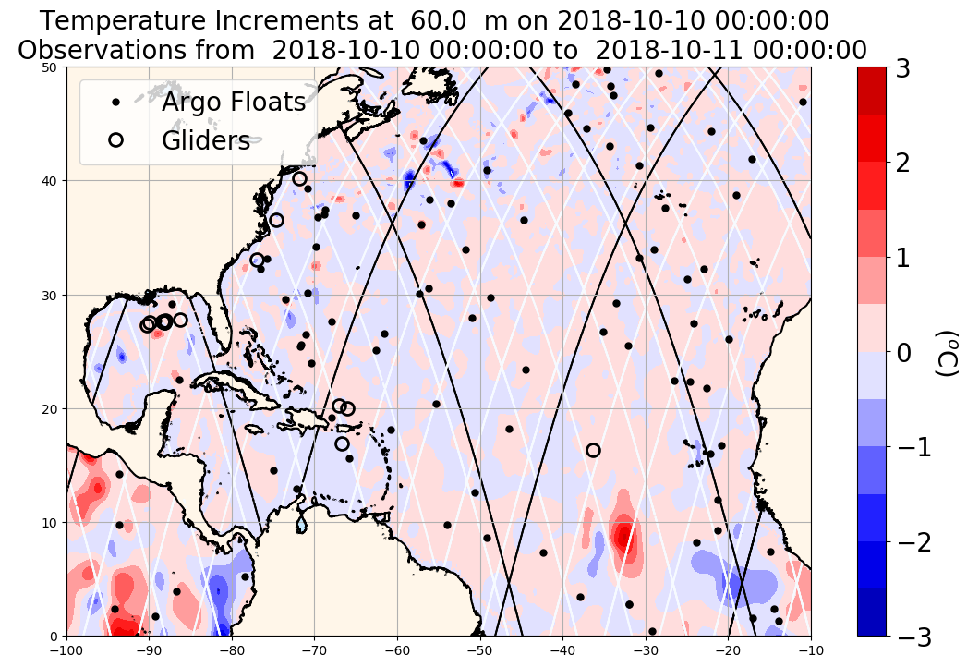
Notes:
Black dots: position of Argo floats profiles on 2018-09-11
Open black circles: mean position of glider tracks on 2018-09-11 (almost 100% sure)
Temperature increments from NCODA (provided by Pat Hogan) on 2018-09-11 at 60 m
Black lines: Jason-2 tracks on 2018-09-11
White lines: Jason-2 tracks from 2018-09-06-2018-09-10

