Slide 1
Glider Data vs Operational Models During Michael

Slide 2
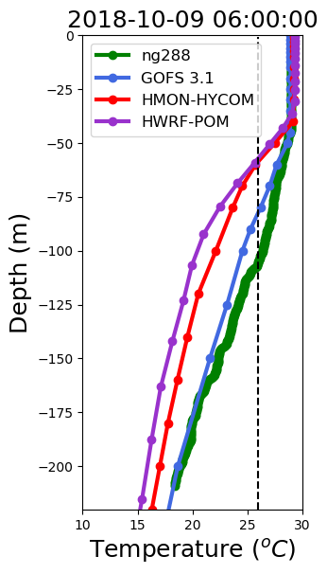
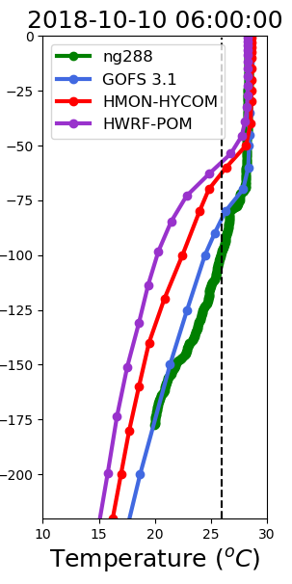
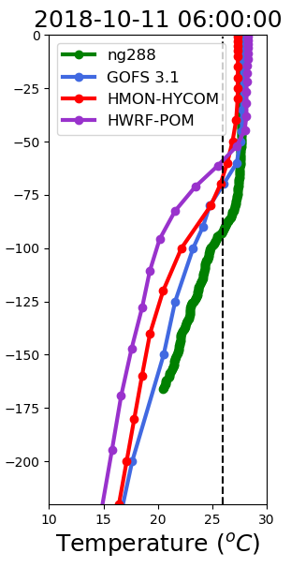
Vertical Profiles of Temperature
1 day before
During Michael
1 day after
Deepening
of mixed layer
Mixed layer
remains deep

Slide 3
Glider Data vs Experimental Forecast Hurricane Models

Slide 4
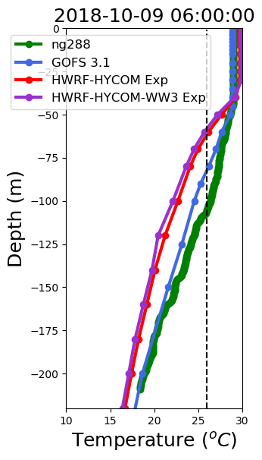
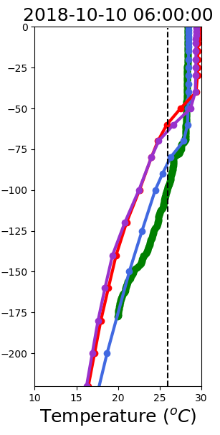
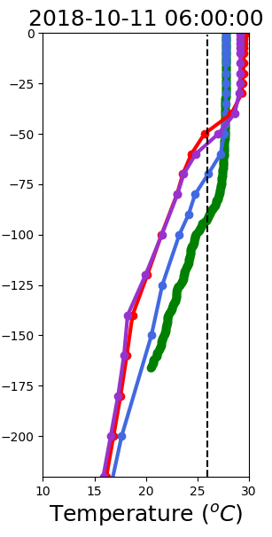
Vertical Profiles of Temperature
1 day before
During Michael
1 day after
Warmer SST
Warmer SST
Deepening
of mixed layer
Mixed layer
remains deep

Slide 5
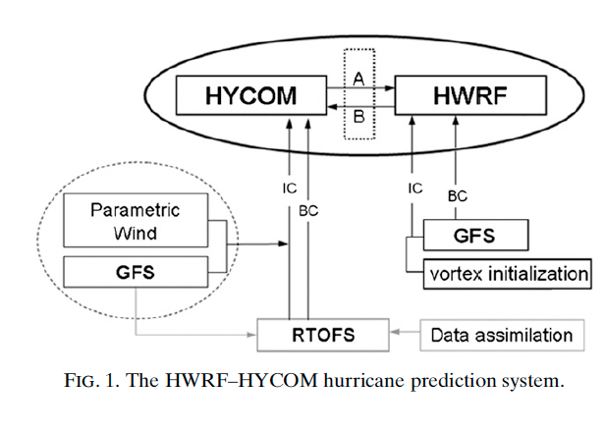
New Experimental HWRF-HYCOM System
X
FV3
Kim et al. 2014

Slide 6
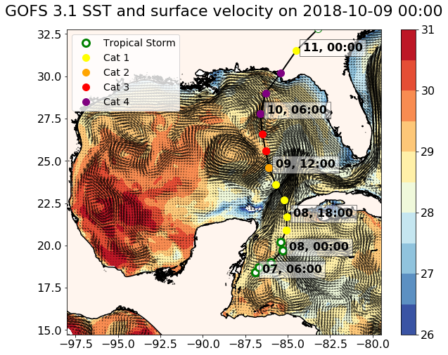
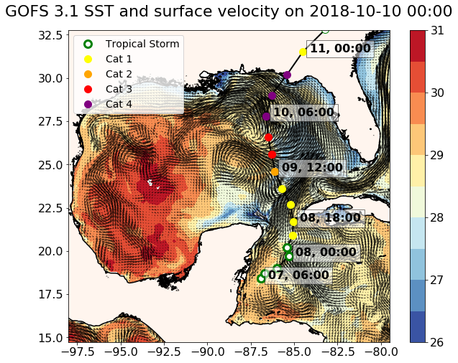
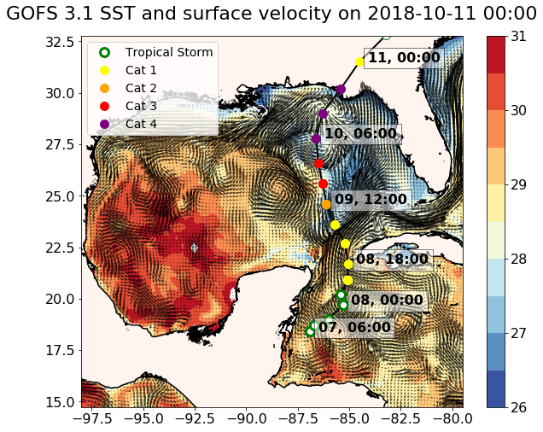
Surface Fields from GOFS 3.1 During Michael
2018-10-09 0h
Entering GoM
2018-10-10 0h
Middle GoM
2018-10-11 0h
After Land Fall

Slide 7
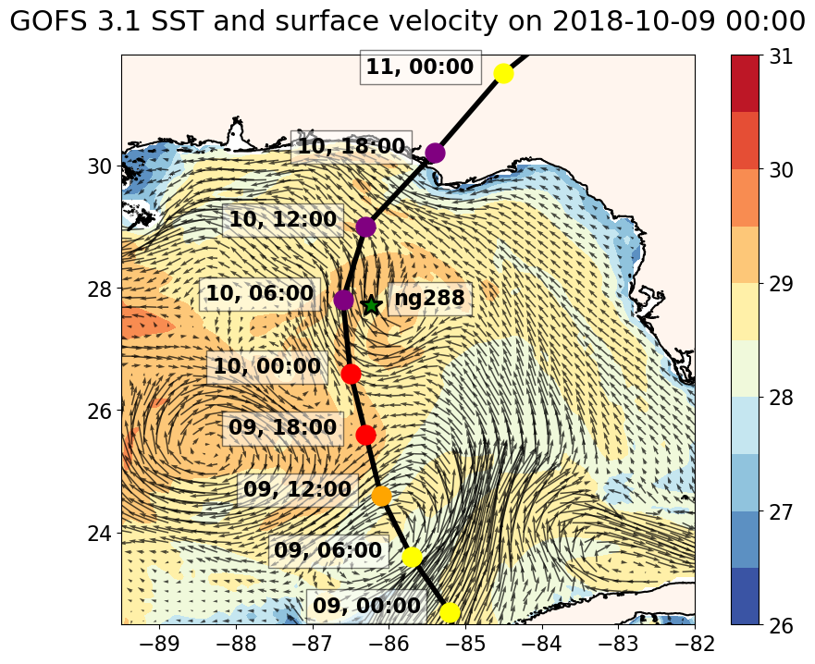
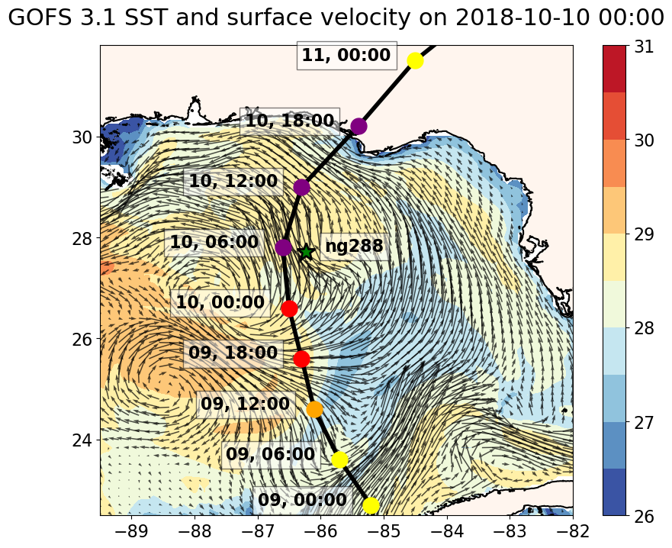
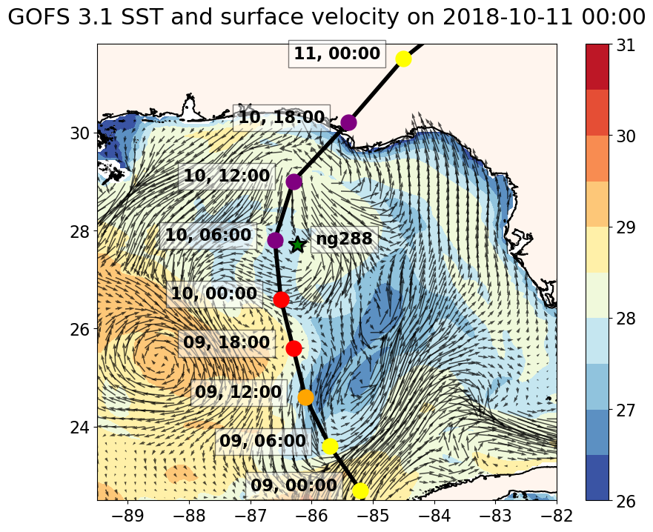
Surface Fields from GOFS 3.1 During Michael
2018-10-09 0h
Entering GoM
2018-10-10 0h
Middle GoM
2018-10-11 0h
After Land Fall

Slide 8
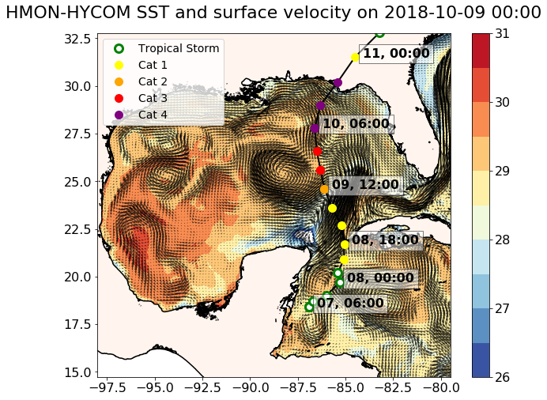
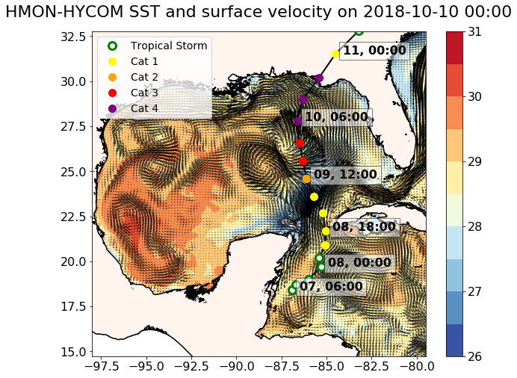
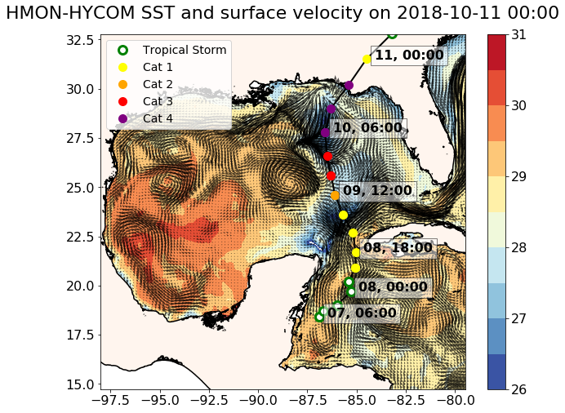
Surface Fields from HMON-HYCOM During Michael
2018-10-09 0h
Entering GoM
2018-10-10 0h
Middle GoM
2018-10-11 0h
After Land Fall

Slide 9
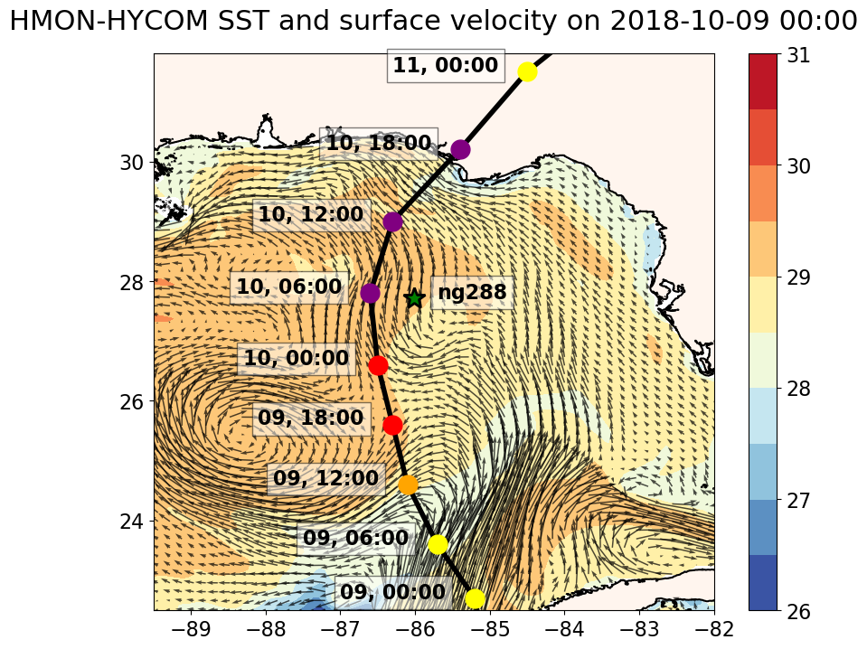
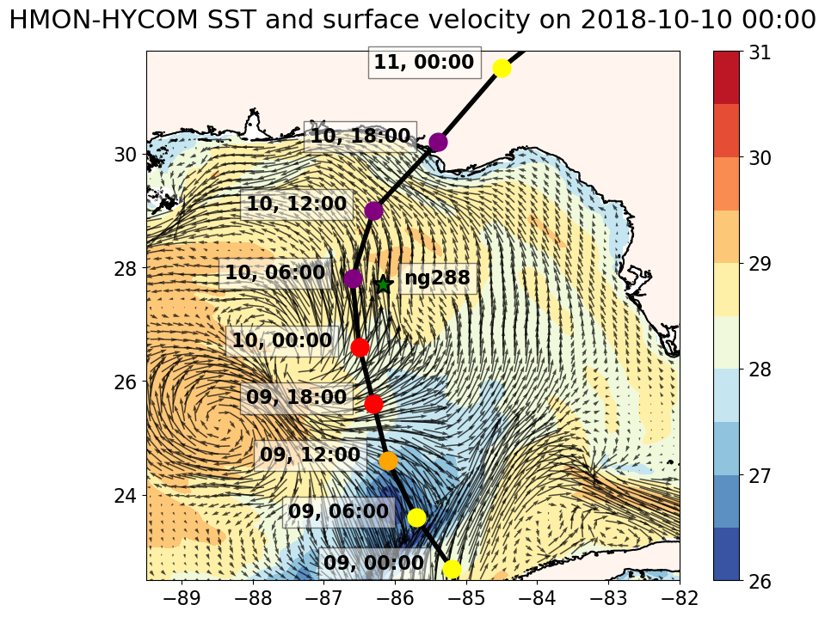
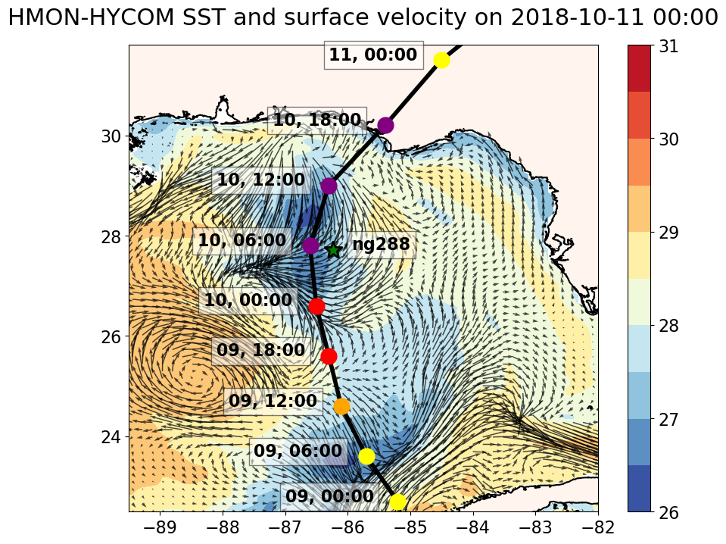
Surface Fields from HMON-HYCOM During Michael
2018-10-09 0h
Entering GoM
2018-10-10 0h
Middle GoM
2018-10-11 0h
After Land Fall

Slide 10
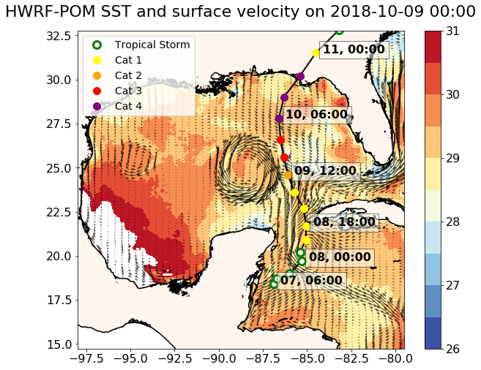
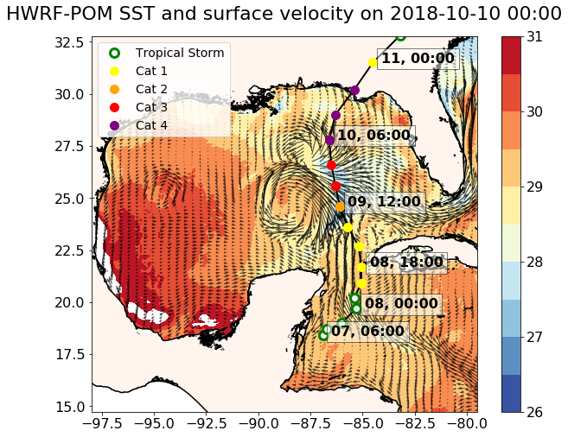
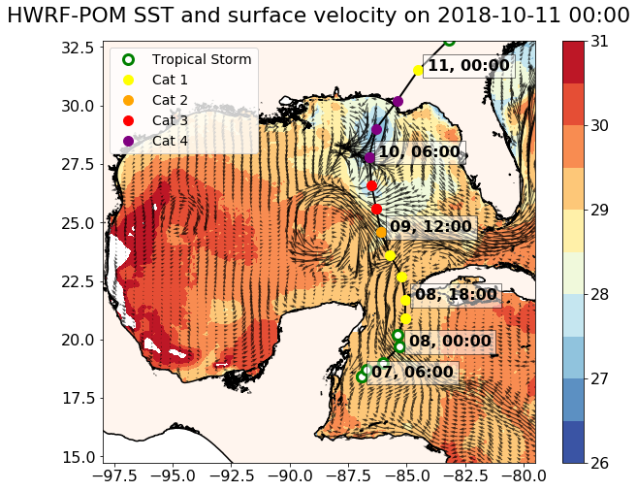
Surface Fields from HWRF-POM During Michael
2018-10-09 0h
Entering GoM
2018-10-10 0h
Middle GoM
2018-10-11 0h
After Land Fall

Slide 11
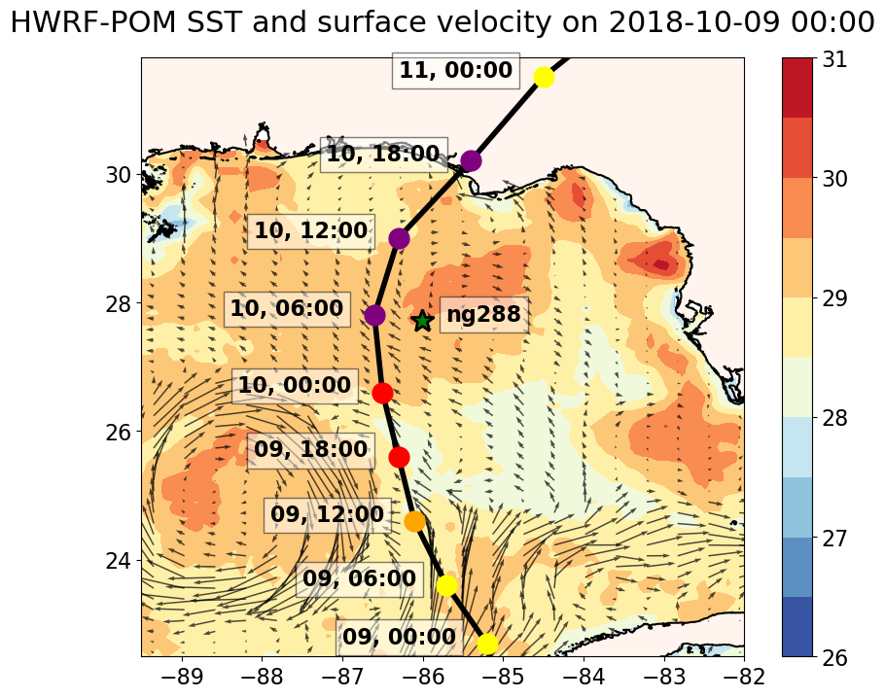
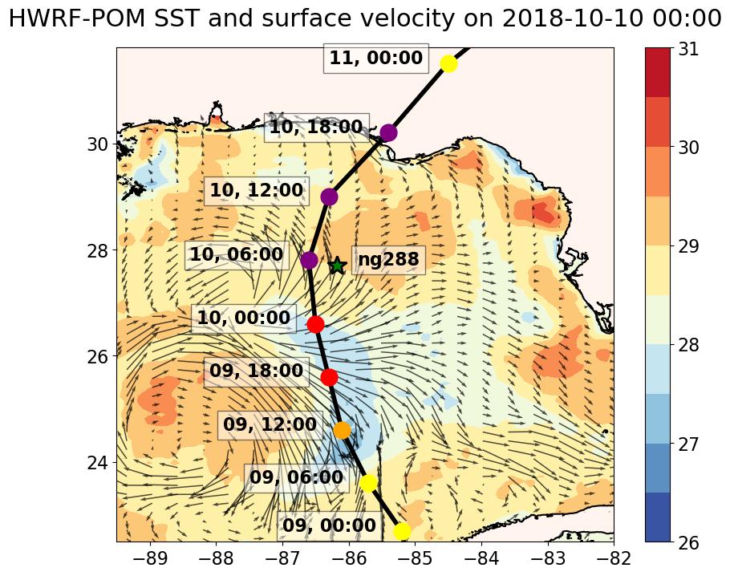
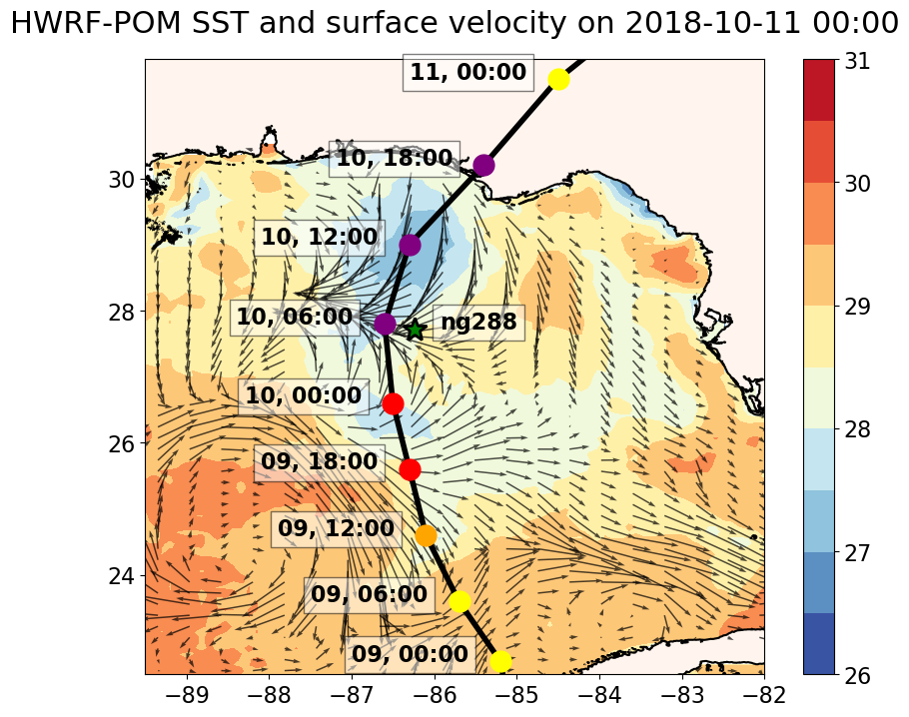
Surface Fields from HWRF-POM During Michael
2018-10-09 0h
Entering GoM
2018-10-10 0h
Middle GoM
2018-10-11 0h
After Land Fall

Slide 12
Surface Fields from on 2018-10-09 During Michael
GOFS 3.1
HMON-HYCOM
HWRF-POM

Slide 13
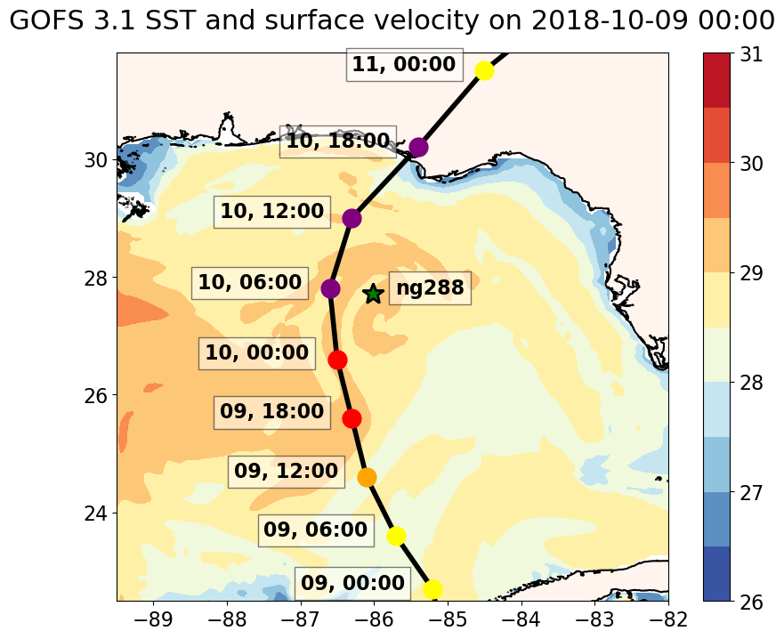
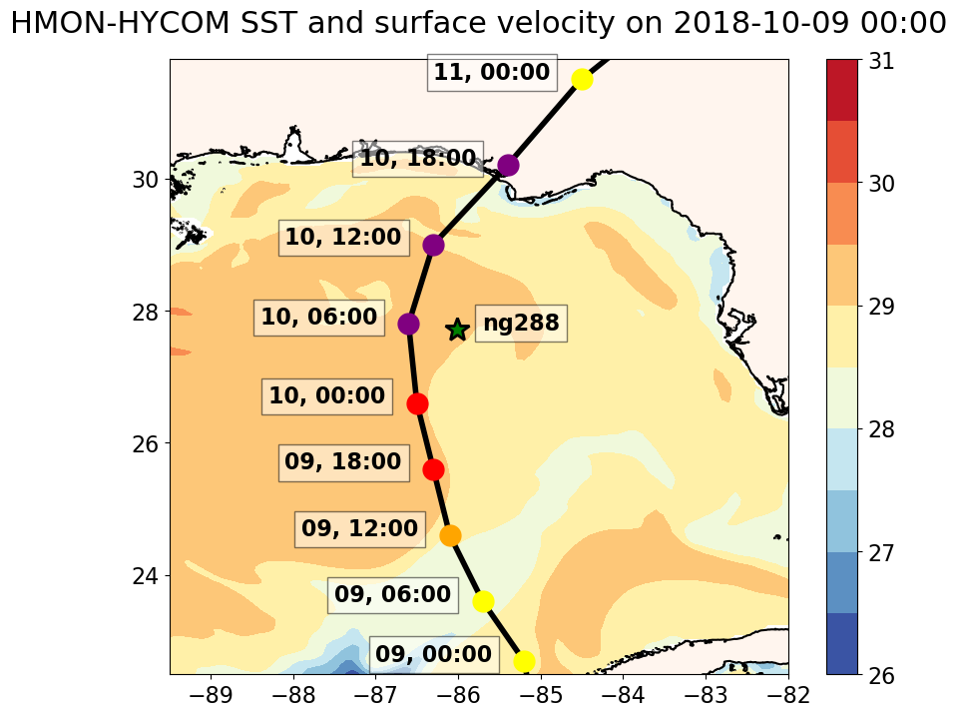
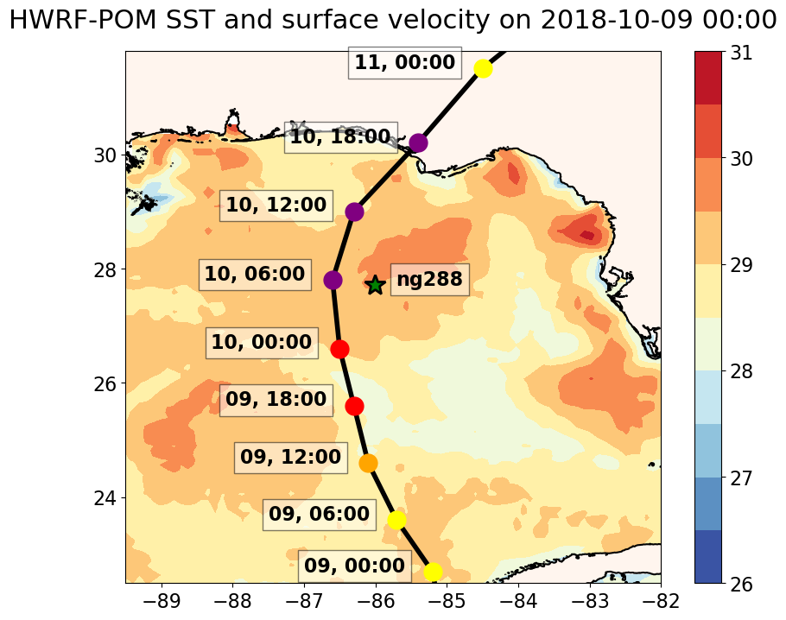
Surface Fields from on 2018-10-09 During Michael
GOFS 3.1
HMON-HYCOM
HWRF-POM

Slide 14
Surface Fields from on 2018-10-10 During Michael
GOFS 3.1
HMON-HYCOM
HWRF-POM

Slide 15
Surface Fields from on 2018-10-11 During Michael
GOFS 3.1
HMON-HYCOM
HWRF-POM

Slide 16
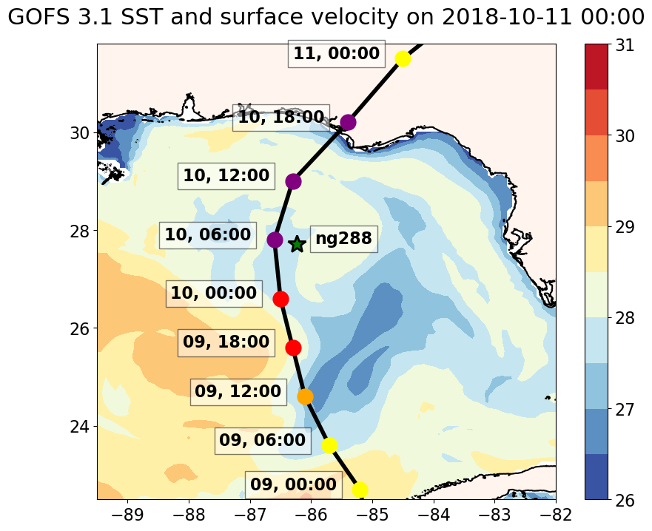
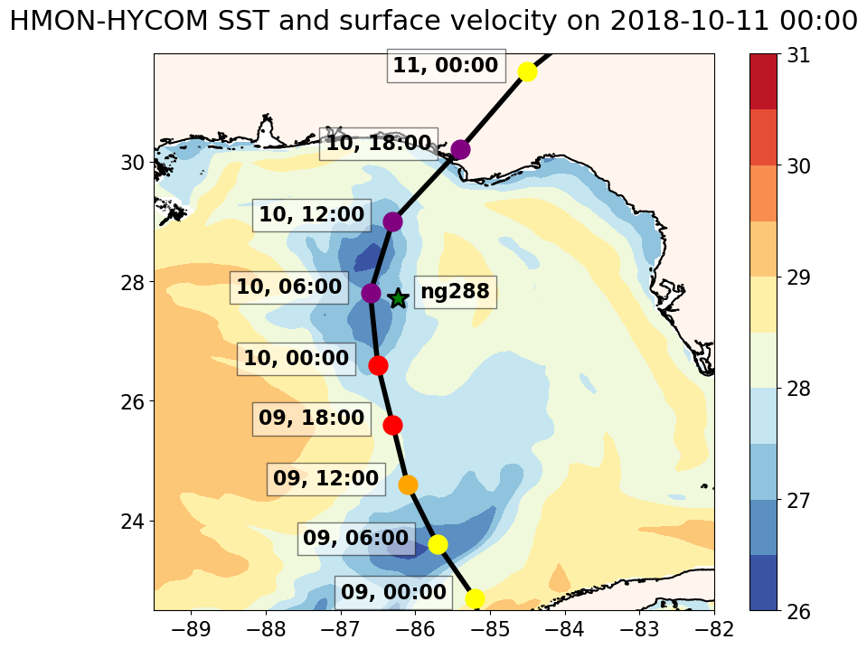
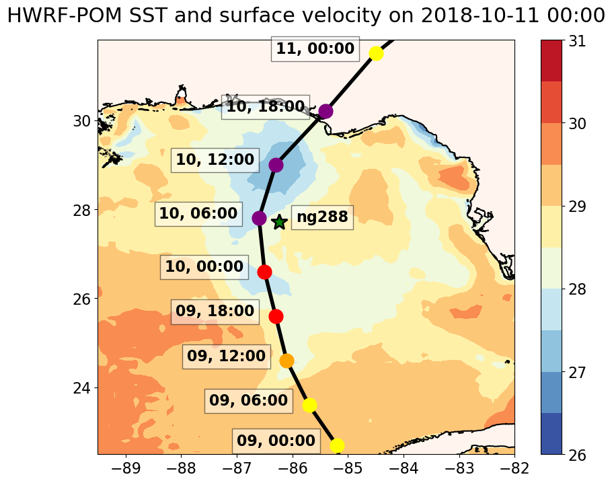
Surface Fields from on 2018-10-11 During Michael
GOFS 3.1
HMON-HYCOM
HWRF-POM

Slide 17
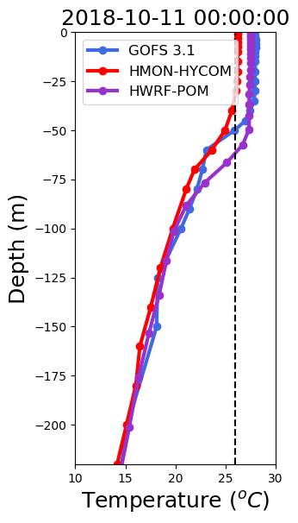
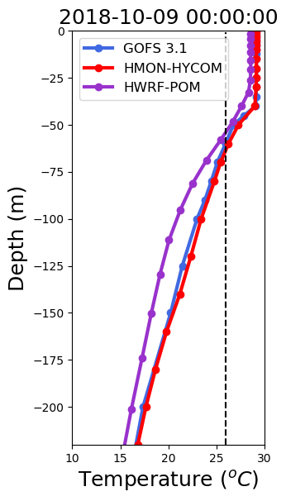
At (-86.58,28.40)
At (-86.3,25.6)

Slide 18
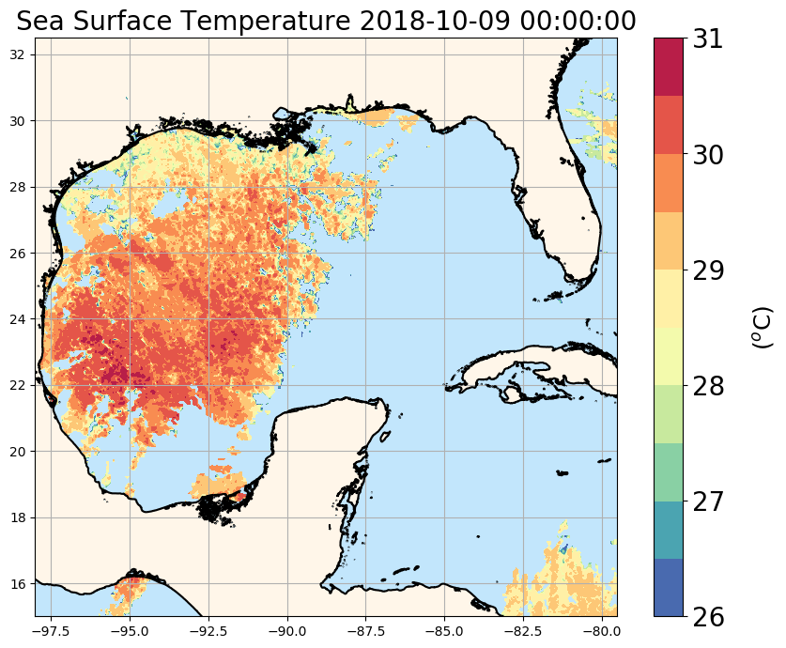
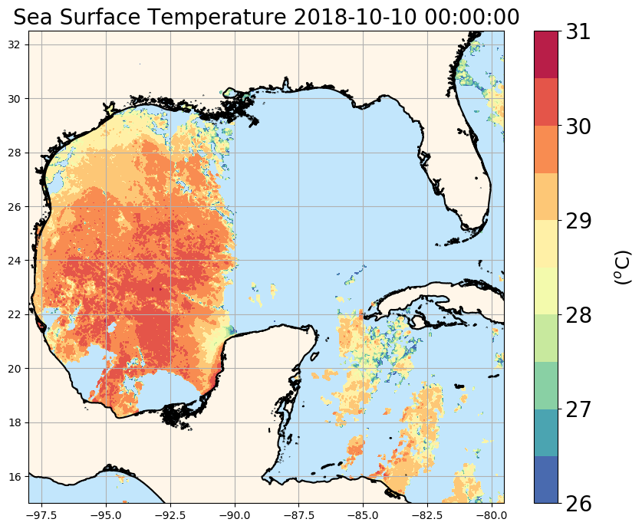
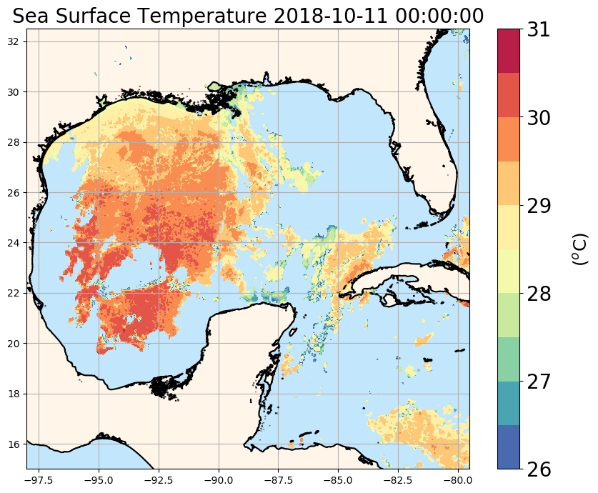
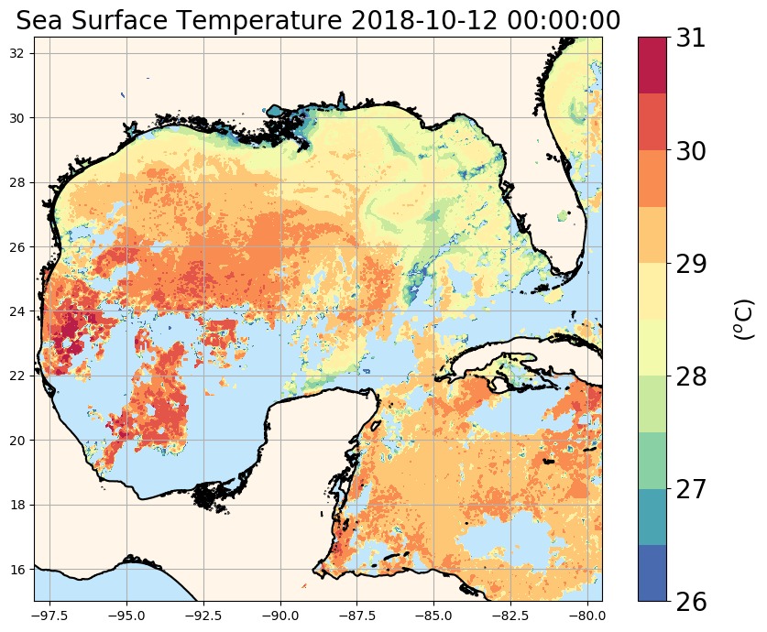
SST from AVHRR
﻿

Slide 19
Passage of Michael

Slide 20
Passage of Michael

