Slide 1
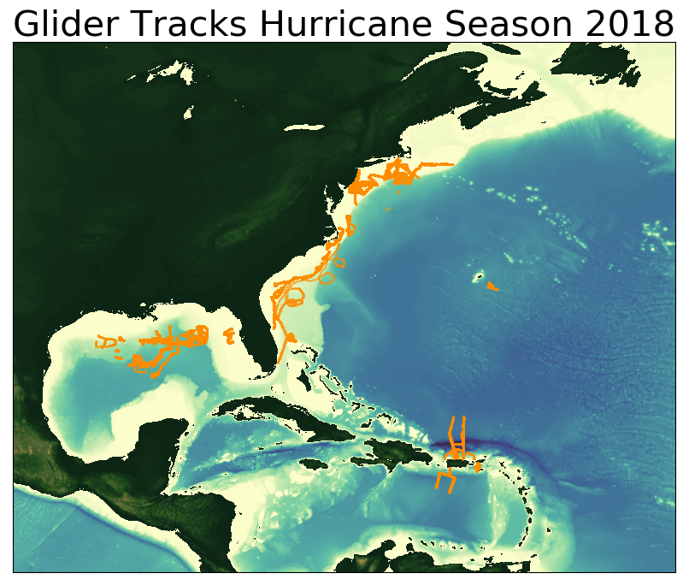
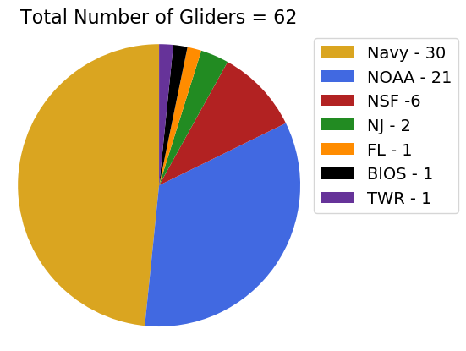

Slide 2
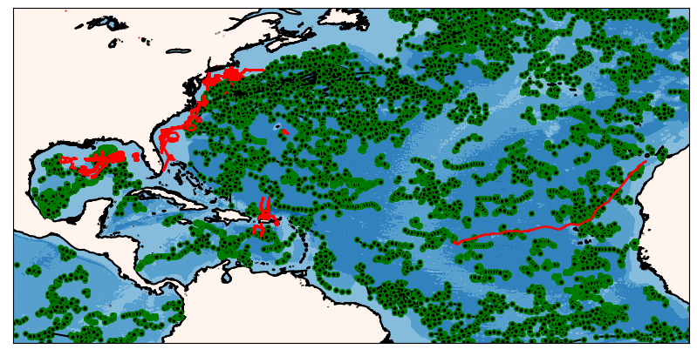
ARGO Floats
During the 2018 Hurricane Season
Total number of glider profiles = 123335
Total number of Argo profiles = 17264

Slide 3
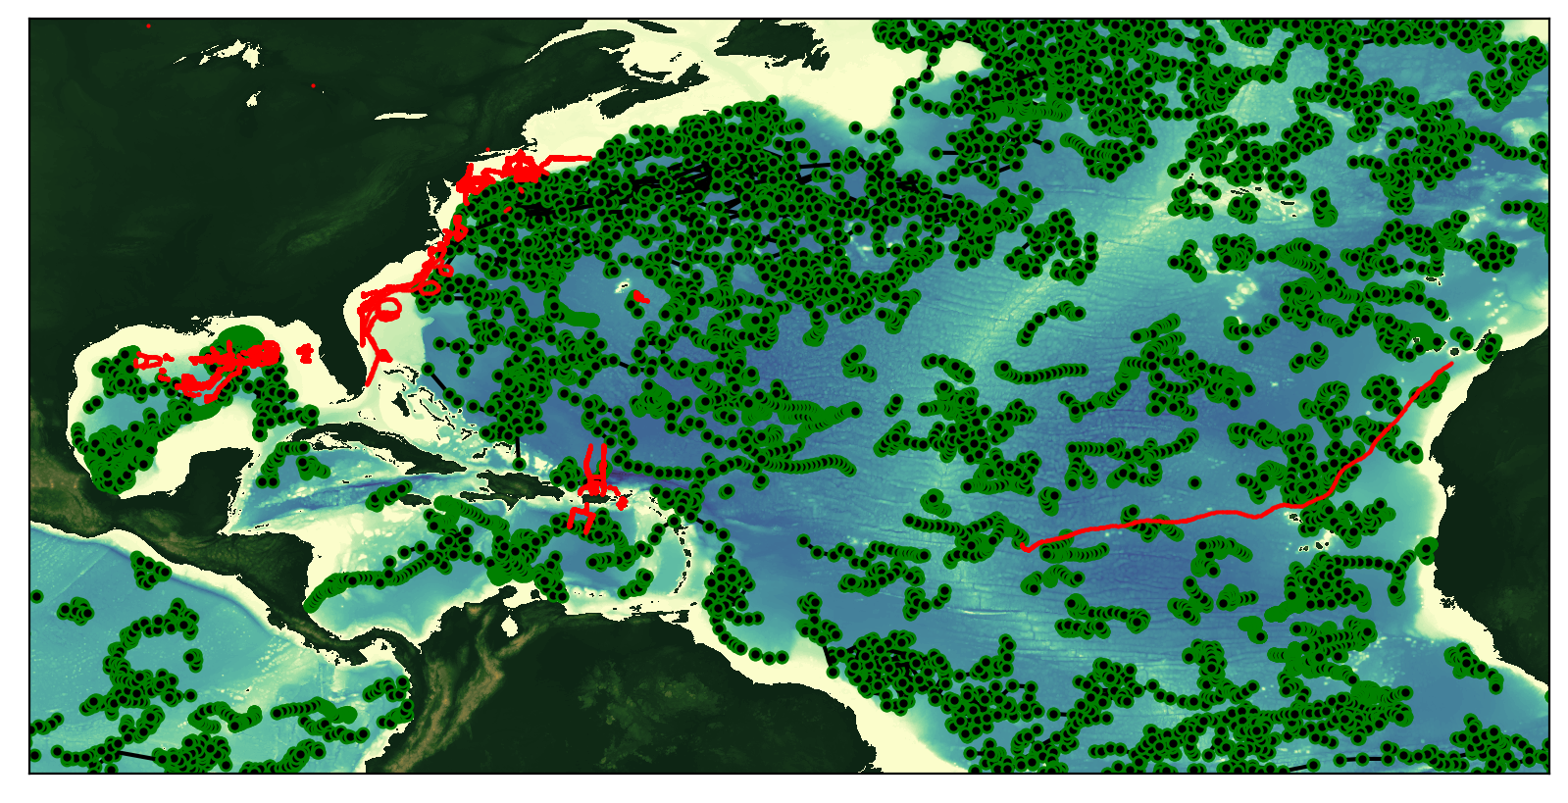
ARGO Floats
During the 2018 Hurricane Season
Total number of glider profiles = 123335
Total number of Argo profiles = 17264

Slide 4
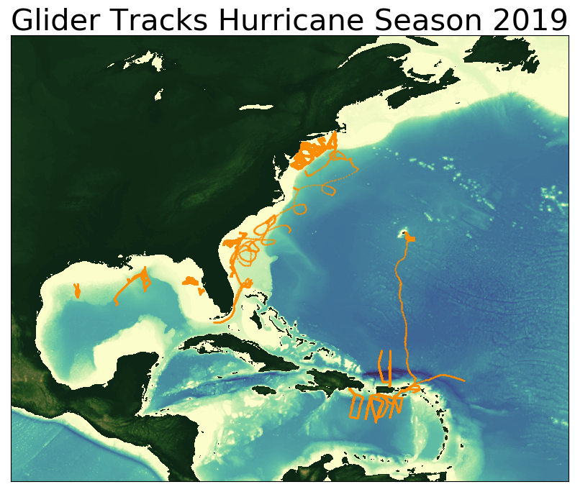
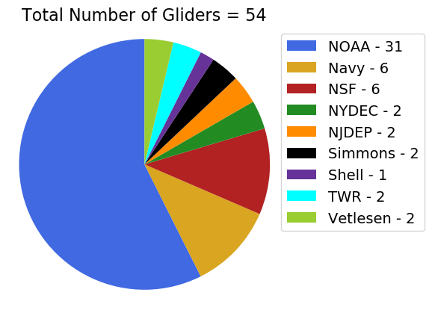

Slide 5
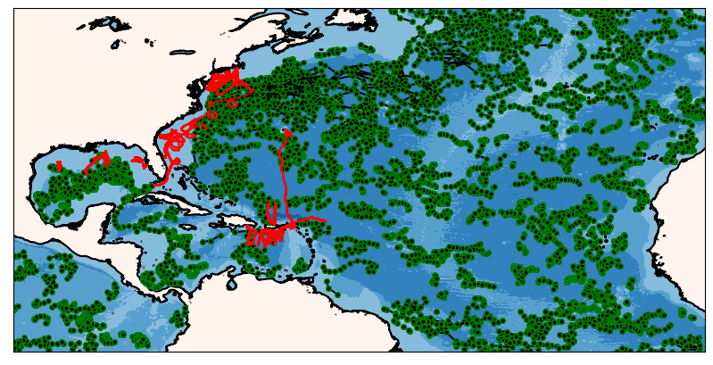
ARGO Floats
During the 2019 Hurricane Season
Total number of glider profiles = 103511
Total number of Argo profiles = 13164

Slide 6
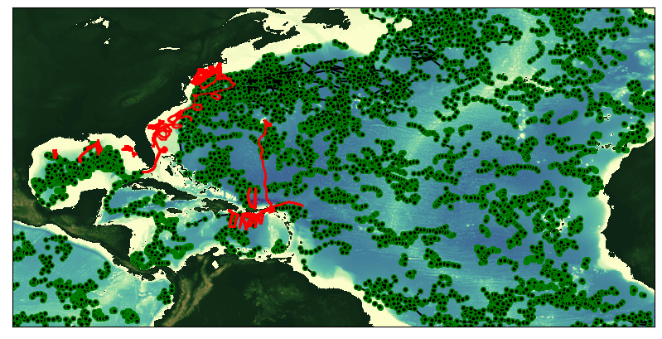
ARGO Floats
During the 2019 Hurricane Season
Total number of glider profiles = 103511
Total number of Argo profiles = 13164

