Slide 1
2020

Slide 2
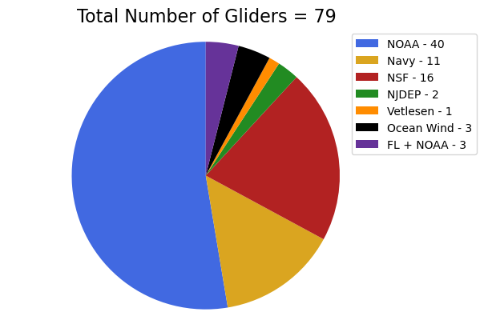
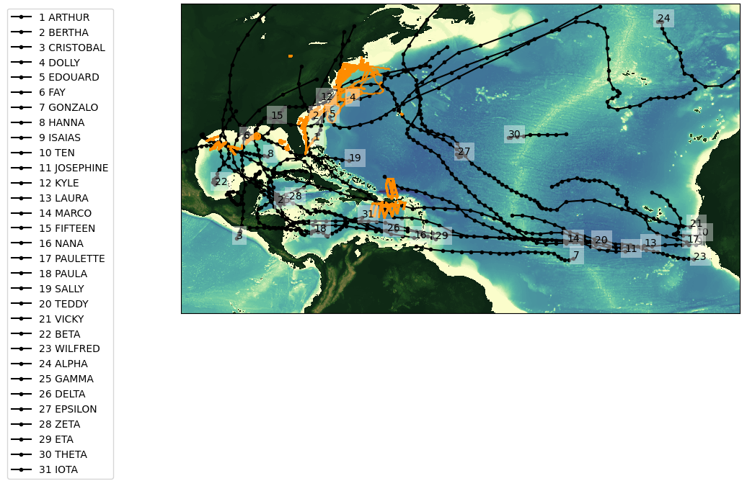
2020 Glider Picket line and Hurricane Tracks
Total number of gliders deployments = 79
Total number of glider profiles = 183377

Slide 3
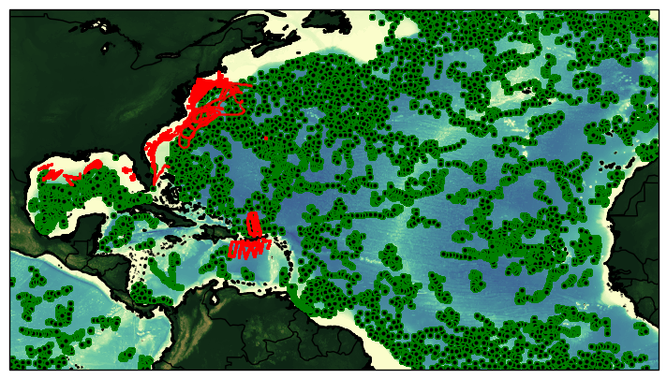
Glider Tracks and ARGO Floats
During the 2020 Hurricane Season
Total number of glider profiles = 183377
Total number of Argo profiles = 9025

Slide 4
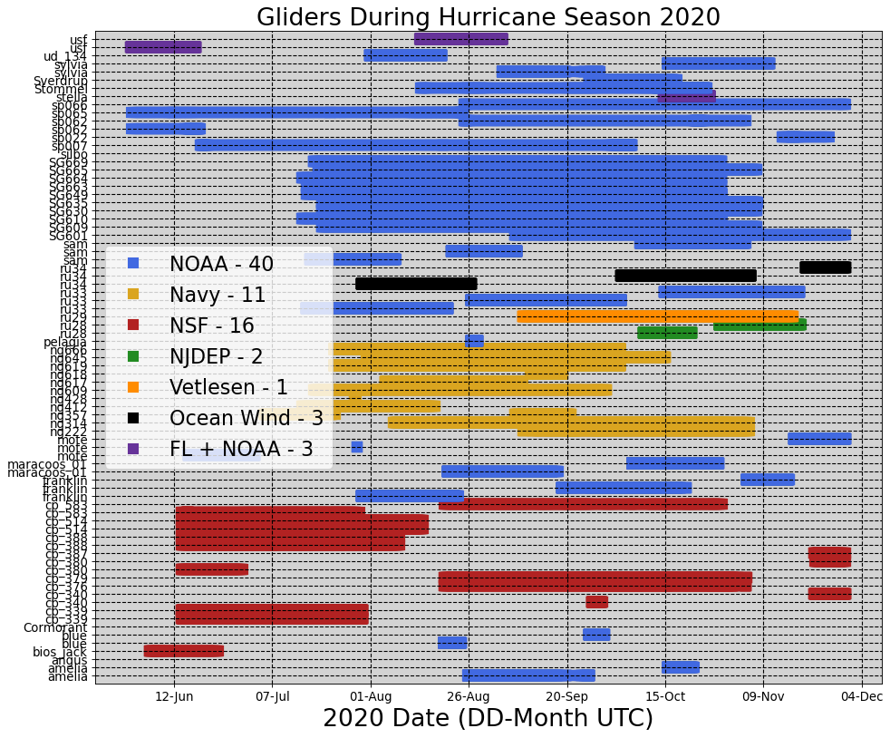

Slide 5
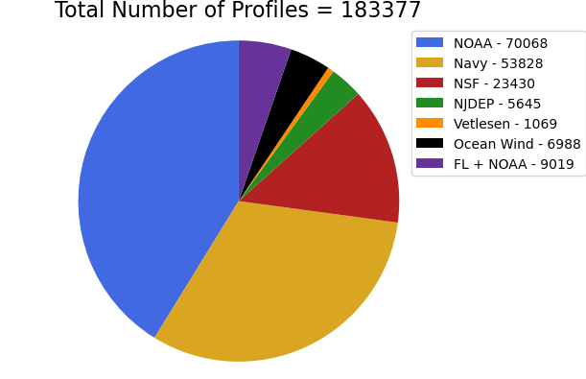
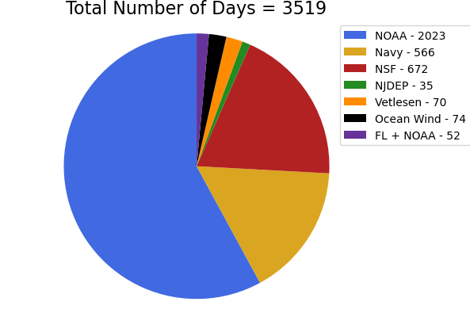
Total number of deployments = 79

Slide 6
2019

Slide 7
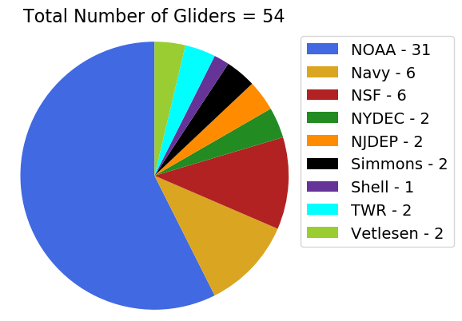
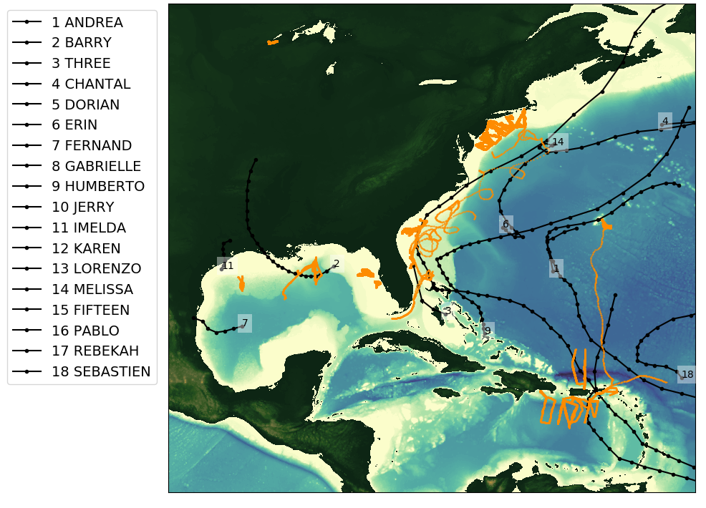
2019 Glider Picket line and Hurricane Tracks
Total number of glider deployments = 54 (~half volunteer)
Total number of glider profiles = 103511

Slide 8
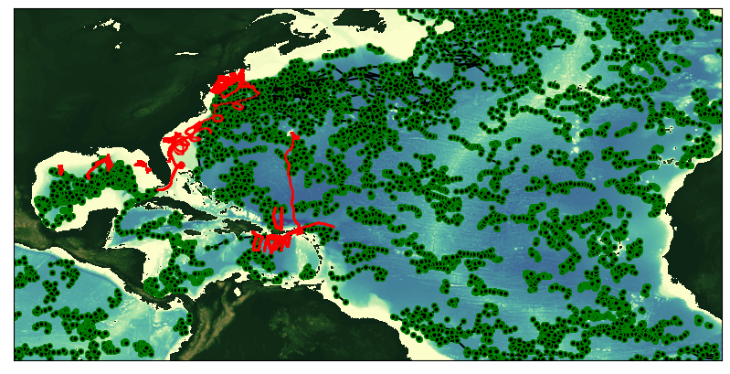
Glider Tracks and ARGO Floats
During the 2019 Hurricane Season
Total number of glider profiles = 103511
Total number of Argo profiles = 13164

Slide 9
2018

Slide 10
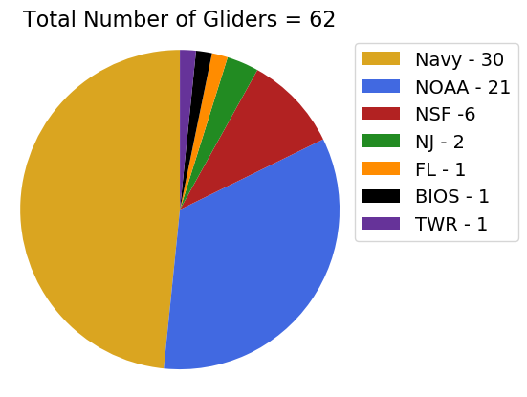
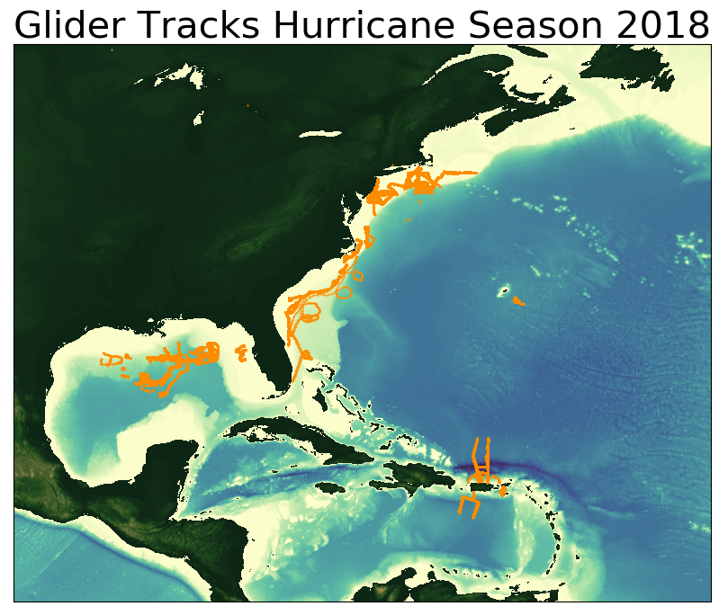
2018 Glider Picket line
Total number of gliders deployments = 62
Total number of glider profiles = 123335

Slide 11
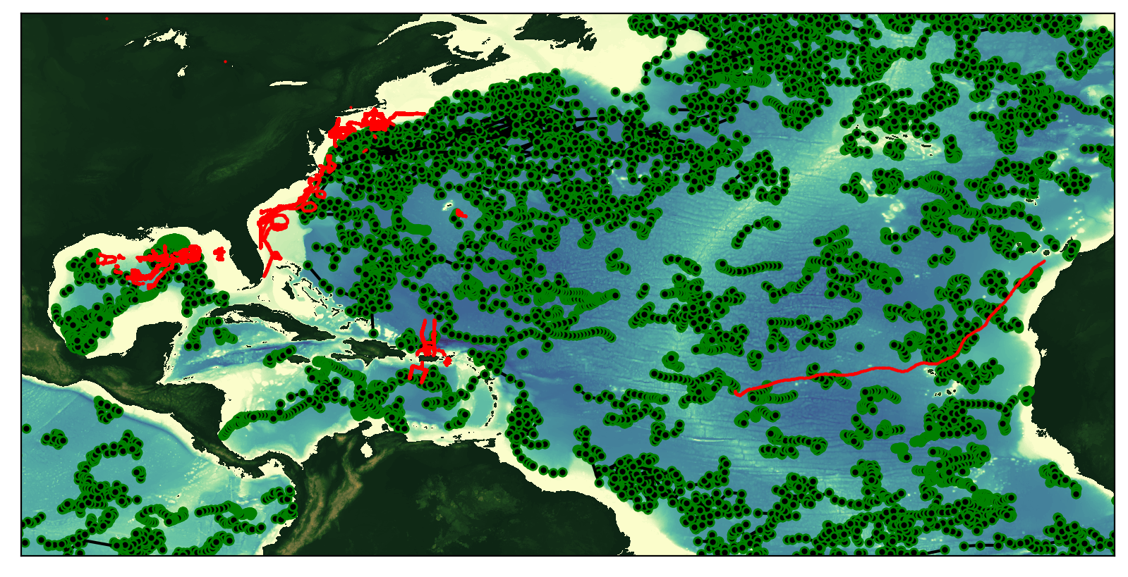
Glider Tracks and ARGO Floats
During the 2018 Hurricane Season
Total number of glider profiles = 123335
Total number of Argo profiles = 17264

