Slide 1
http://data.oceansmap.com/eds_thredds/dodsC/EDS/HYCOM_GLOBAL_NAVY/hycomglobalnavy_2020092200.nc
distribution_statement: Approved for public release; distribution unlimited.
institution: Fleet Numerical Meteorology and Oceanography Center
source: HYCOM archive file; GOFS 3.1 GLBy0.08 expt_93.0
history: created on 20200921
field_type: instantaneous
Conventions: NAVO_netcdf_v1.0
analysis_tau: 036 hours since analysis, analysis_time_origin = 2020-09-20 12:00:00
contact: FNMOC, CDO
generating_model: GOFS 3.1, Global HYCOM with OSU tides
operational_status: operational
model_type: x-curvilinear lon, y-curvilinear lat, hybrid z
input_data_source: FNMOC NAVGEM, Satellite SSH, SST, in situ
message: UNCLASSIFIED
reference: https://portal.fnmoc.navy.mil/
comment: ...
time_origin: 2020-09-21 00:00:00
Unlimited_Dimension: time
My interpretation of this information is that this file is a forecast with initial conditions taken from the GOFS3.1/NCODA analysis

Slide 2
https://tds.hycom.org/thredds/dodsC/GLBy0.08/expt_93.0/uv3z
classification_level: UNCLASSIFIED
distribution_statement: Approved for public release. Distribution unlimited.
downgrade_date: not applicable
classification_authority: not applicable
institution: Fleet Numerical Meteorology and Oceanography Center
source: HYCOM archive file
history: archv2ncdf3z
field_type: instantaneous
Conventions: CF-1.6 NAVO_netcdf_v1.1

Slide 3
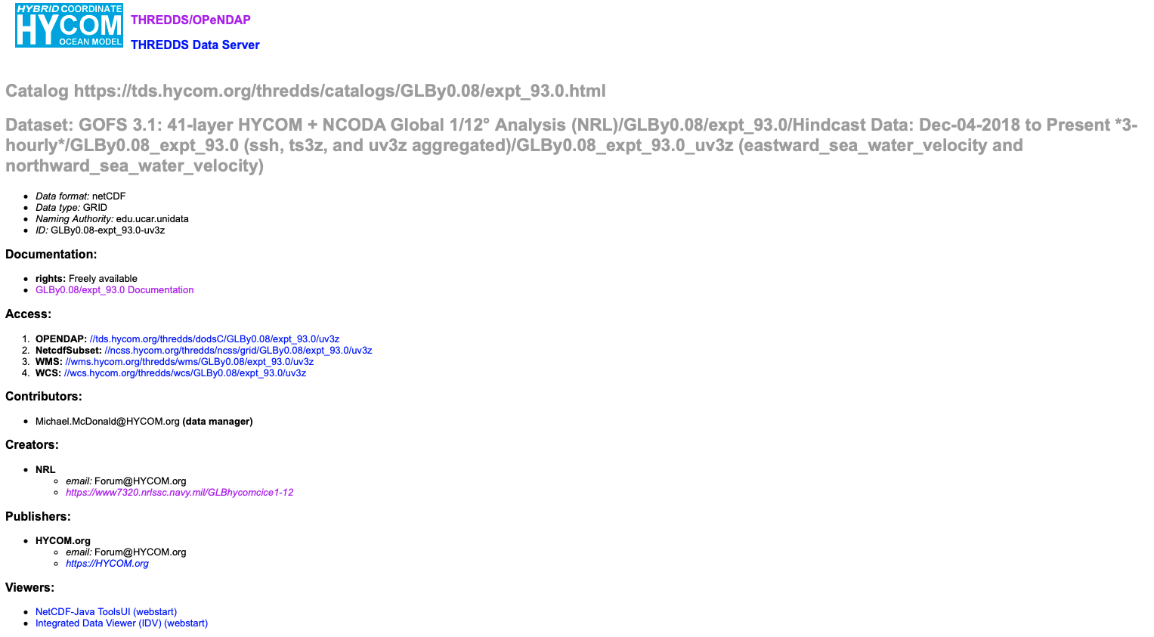
https://tds.hycom.org/thredds/dodsC/GLBy0.08/expt_93.0/uv3z
I understand that this output is the aggregation of all the GOFS3.1/NCODA analysis. It is not clear to me how they stitch the time series, but I believe they consider this as the best time series

Slide 4
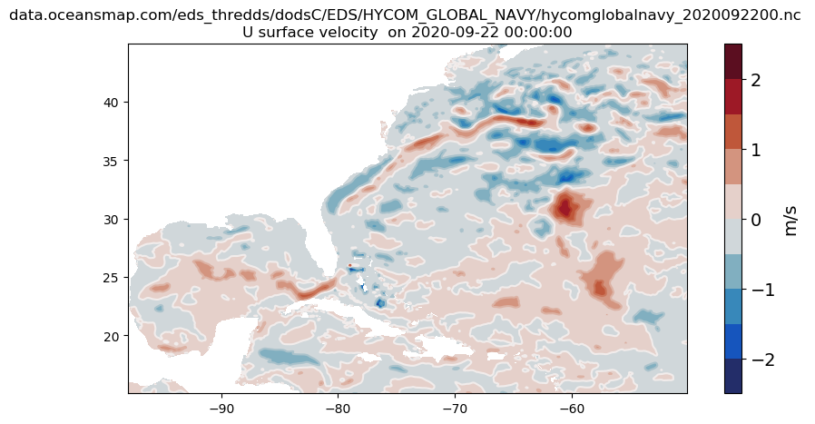
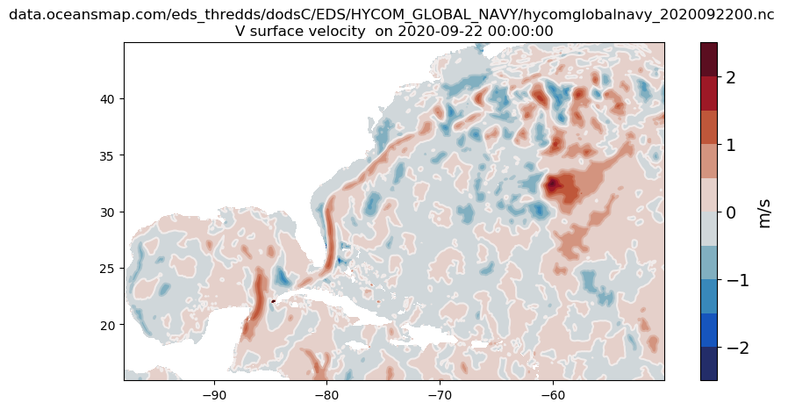
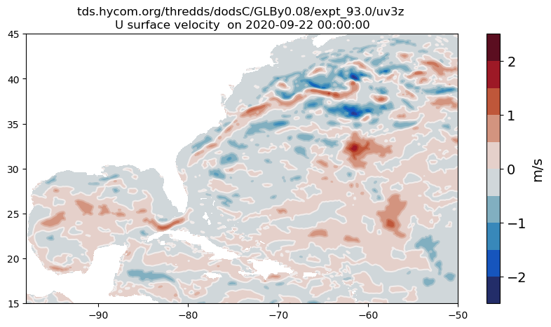
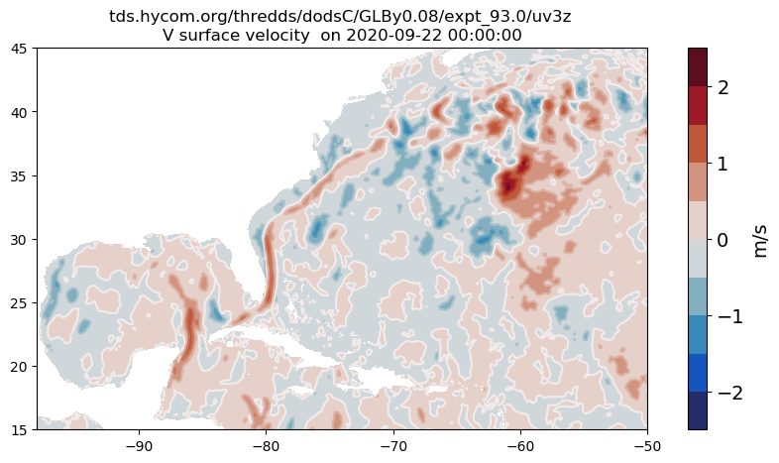
The velocities are similar but not the same

Slide 5
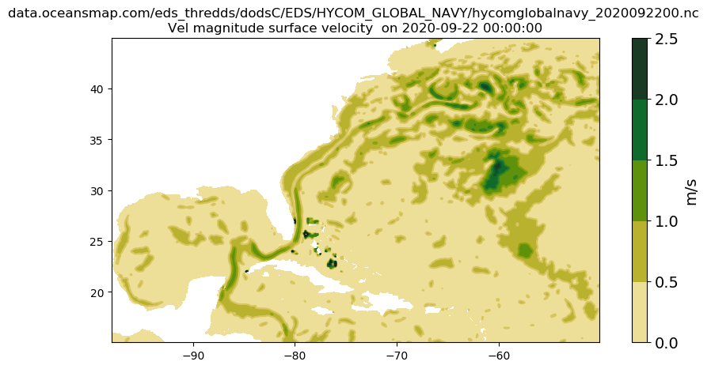
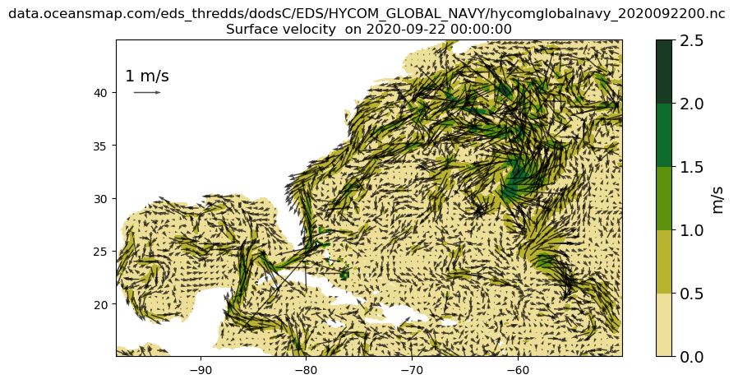
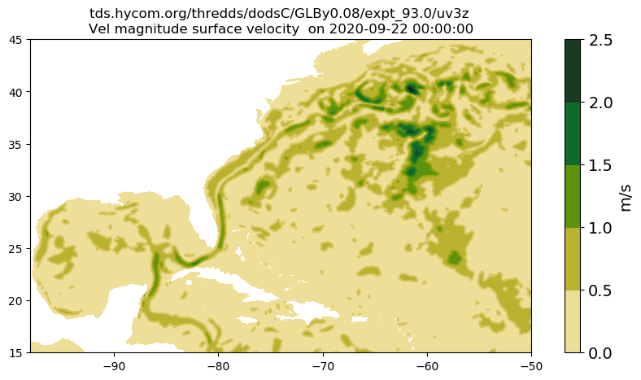
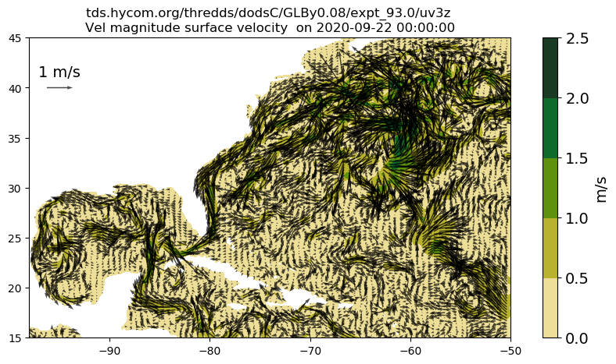
Velocity Magnitude
Latitudinal spacing is twice as higher in the HYCOM aggregation
Delta Lat_oceanmap is 0.08 degrees
Delta Lat_HYCOM is 0.04 degrees
Delta Lat_oceanmap is 0.08 degrees
Delta Lon_HYCOM is 0.08 degrees

Slide 6
