Slide 1
Hurricane Michael
Observations vs Operational models
Maria Aristizabal
Travis Miles
Scott Glen
Hyun-Sook Kim
Avichal Mehra
Pat Hogan

Slide 2
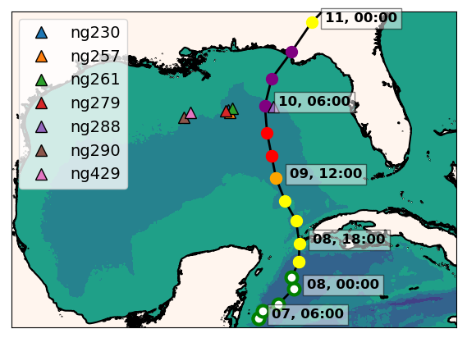
ng288
Seven Navy gliders reporting to the glider DAC
in the GoM during hurricane Michael
Ng288 was at 36 km from the eye
of hurricane Michael
Notes:
During the passage of hurricane Michael, there were 7 Navy gliders in the Gulf of Mexico. One of them ng288 was 36 km away of the hurricane eye.

Slide 3
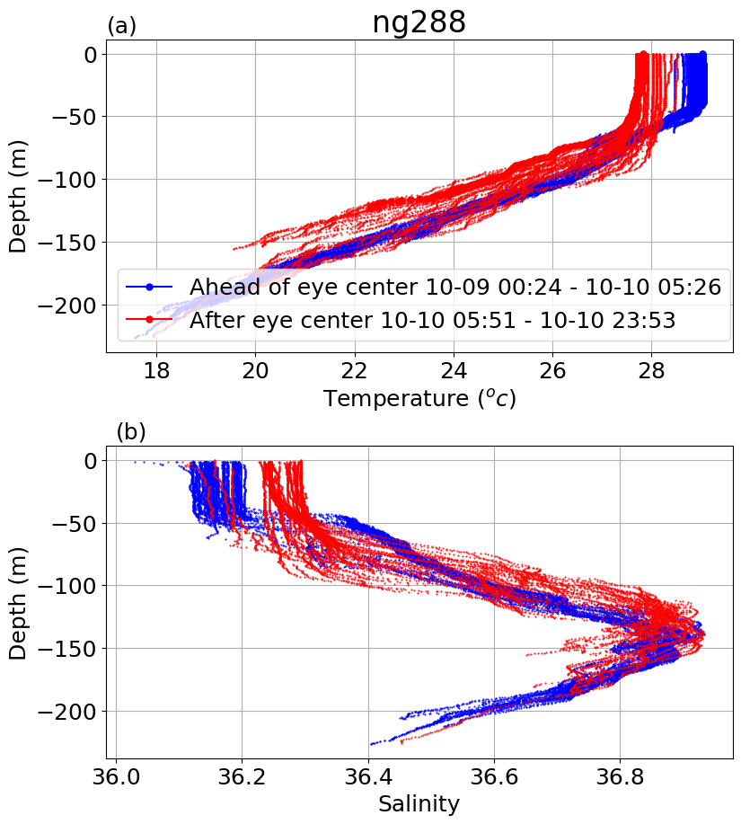
Mixed layer depth deepens about 30 meters
after the passage of Michael

Slide 4
Hurricane Michael
Increments
Insertion Window
Increments
Insertion Window
Increments
Insertion Window
The assimilation of glider data days ahead of Michael corrected
the position of the thermocline
Notes:
This is the temperature transect from ng288 and we also have the temperature transect form the GOFS 3.1 following ng288 glider track. When we look back 5 days before the passage of Michael, we observe that in GOFS 3.1 after every increment insertion window, the thermocline is pulled down to match the depth of the thermocline from the glider data until it settles down at the right depth. This highlights the importance of having a continuous glider presence so when a storm strikes, the model ocean has a most realistic vertical stratification.

Slide 5
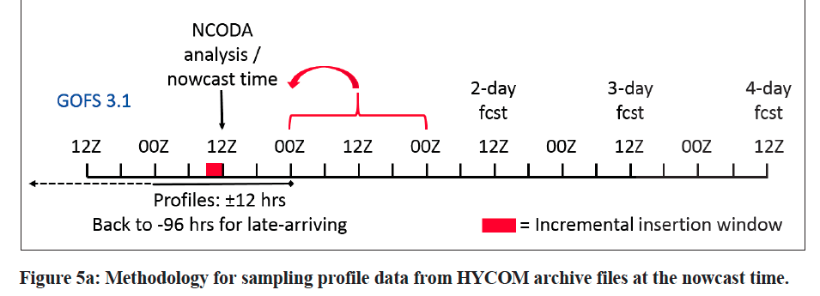
Metzger,E.J,Helber,R.W.,Hogan,P.J.,Posey,Thoppil,P.G.,Townsend, T.L., Wallcraft, A.J., Smedstad, O.M., Franklin, D.S., Zamudio-Lopez, L., Phelps, M.W, ”Global Ocean Forecasting System 3.1, validation test”, Naval Research Laboratoty. 2017, NRL/MR/7320—17-9722.

Slide 6
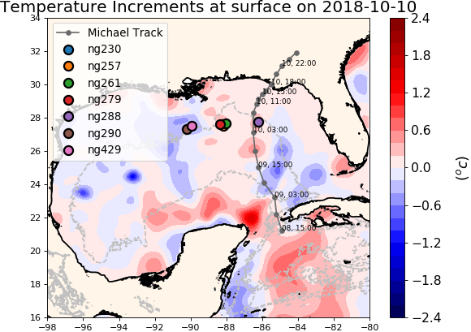
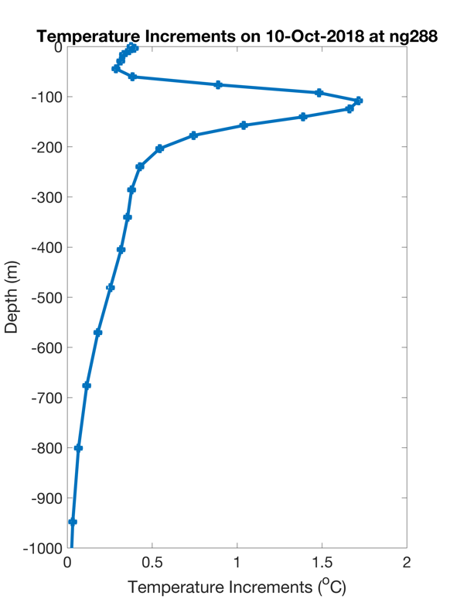
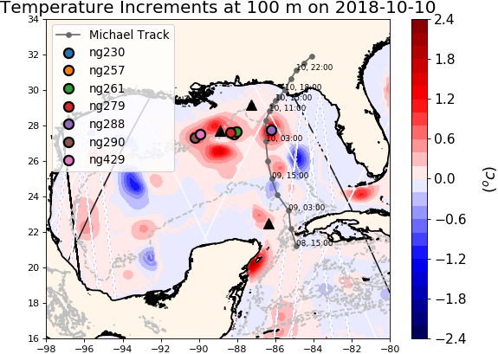
NCODA Temperature Increments
Argo
Jason 2
CryoSat
Notes:
The data from these gliders was assimilated by the navy operational ocean model GOFS. These figures show the temperature increments that are calculated by NCODA, the data assimilation system within GOFS. In the data assimilation jargon, the increments is the change made to the model when compared to the previous assimilation cycle. At the surface the temperature increments have a moderate value but most of the correction happens at depth around the locations of the gliders.

Slide 7
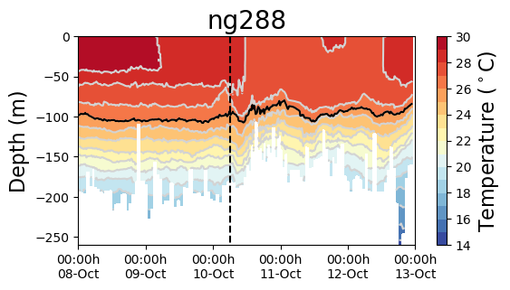
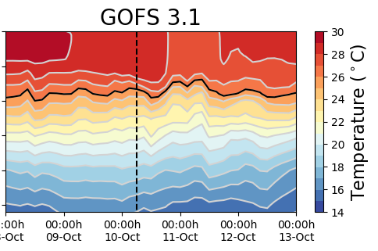
Hurricane Michael
Increments
Insertion Window
Increments
Insertion Window
The modeled SST increased after the passage of Michael: the ocean response is faster than the 1-day
assimilation cycle
Notes:
We also see how the top 100 meters is being homogenized around the time of the eye passage next to the glider. There is an uplifting of the thermocline and this signal propagates as an inertial wave. To the right we have the same transect for GOFS 3.1. The bottom figure shows a temperature time series for the glider and GOFS. The grey rectangles show the time window when the temperature increments are inserted into the ocean model. Before the passage of Michael, the model is following the observations, but right after the eye passage the SST decreases more rapidly in the observations, however after the insertion window the model temperature jumps abruptly. We think that the reason for that is that in the current NCODA setup, the assimilation cycle is one day. But the ocean is responding much more rapidly to the passage of the hurricane and therefore the 1 day cycle is inadequate to capture the rapid ocean response.

Slide 8
Glider Data vs Operational Models: Michael
Notes:
We also had access to the ocean models underneath the NOAA hurricane forecasting models in the North Atlantic thanks to our collaborator at NCEP. Both, the HMON/HYCOM model and the HWRF/POM have a thermocline that is 50 meters shallower than the observations. So clearly the effects of the data assimilation in GOFS 3.1 did not make through the ocean model underneath the hurricane model. This is an aspect that we will investigate with our partners at NCEP.

Slide 9
Glider Data vs Operational Models: Michael
The ocean under the operational hurricane models have a thermocline that is too shallow. POM does not completely capture the magnitude and timing of cooling and subsequent mixing

