Slide 1
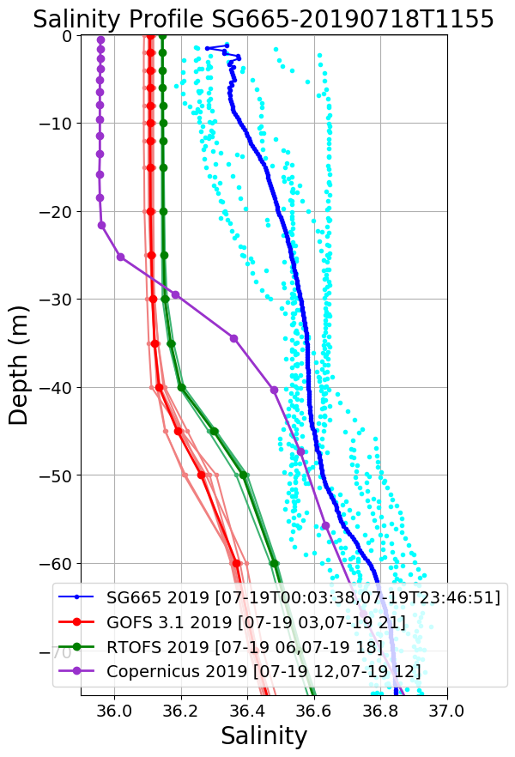
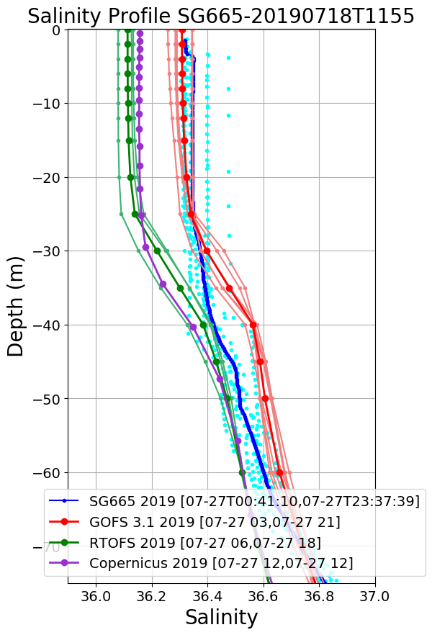
Jul 19
Jul 27

Slide 2
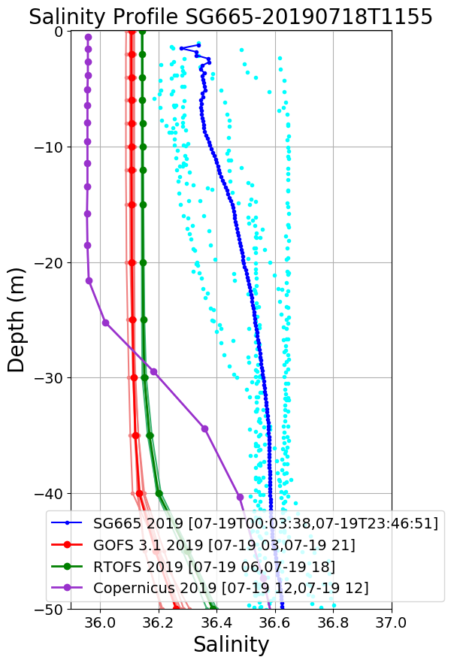
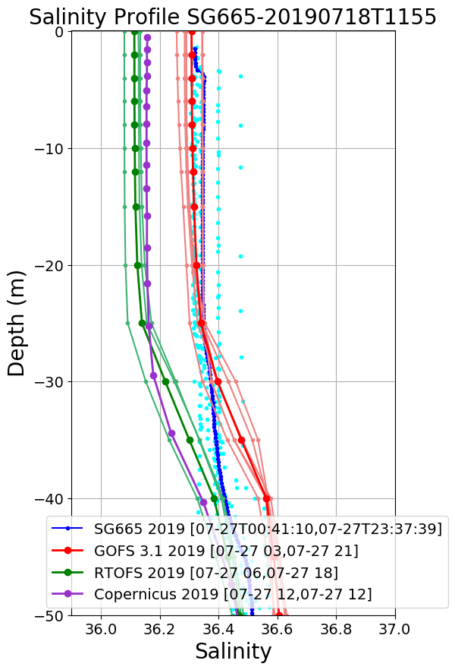
Jul 19
Jul 27

Slide 3
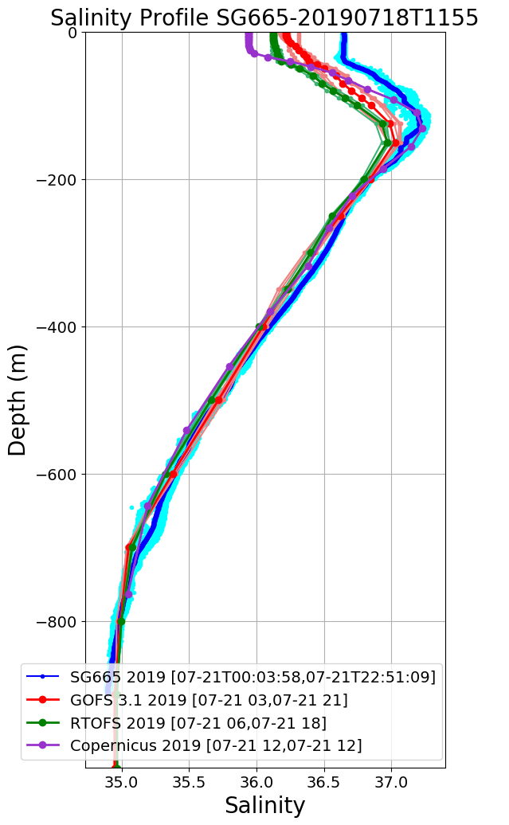
SG665 Salinity at Deployment
Large Salinity offset surface to 160 m
Jul 19
Jul 20
Jul 21
Jul 22
Salinity Progressively Improves over 1 week period
Jul 23
Jul 24
Jul 25
Jul 27

Slide 4
SG665 Salinity at Deployment
Jul 19
Jul 27

