Slide 1
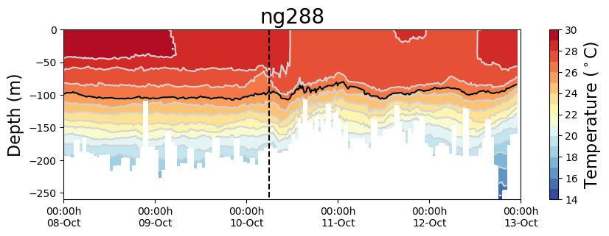
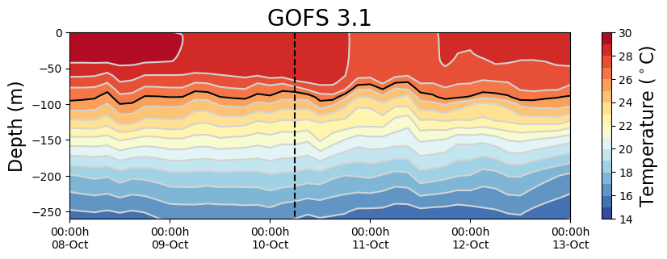
GOFS 3.1/NCODA vs ng288 during Hurricane Michael
/NCODA

Slide 2
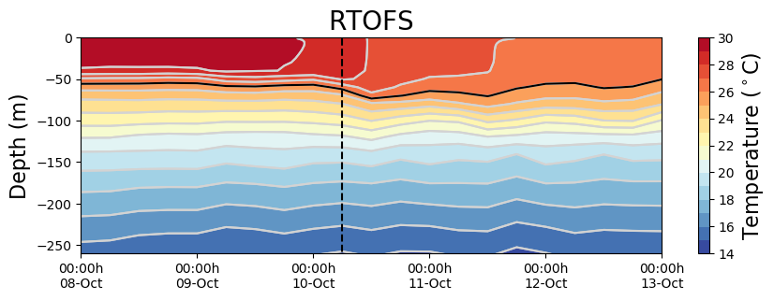
HMON-RTOFS vs ng288 during Hurricane Michael
HMON-

Slide 3
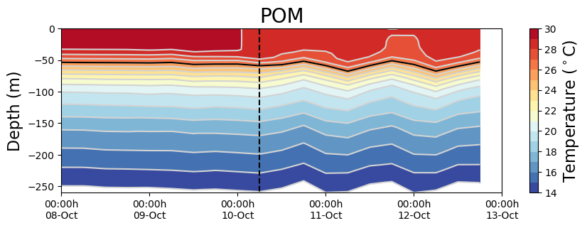
HWRF-POM vs ng288 during Hurricane Michael
HWRF-

Slide 4
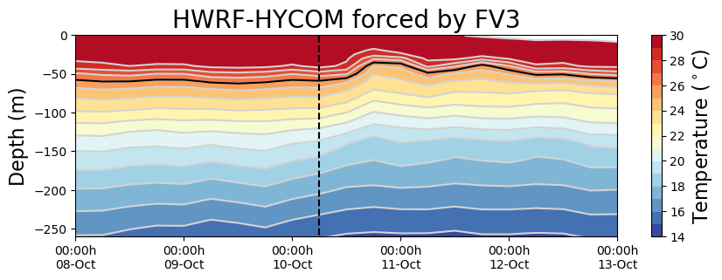
HWRF-HYCOM vs ng288 during Hurricane Michael

Slide 5
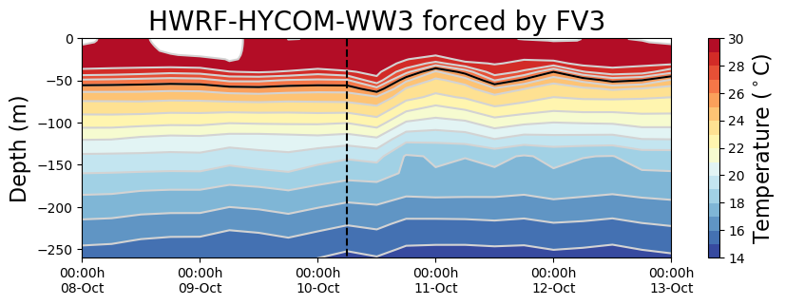
HWRF-HYCOM-WW3 vs ng288 during Hurricane Michael

